Slide 1
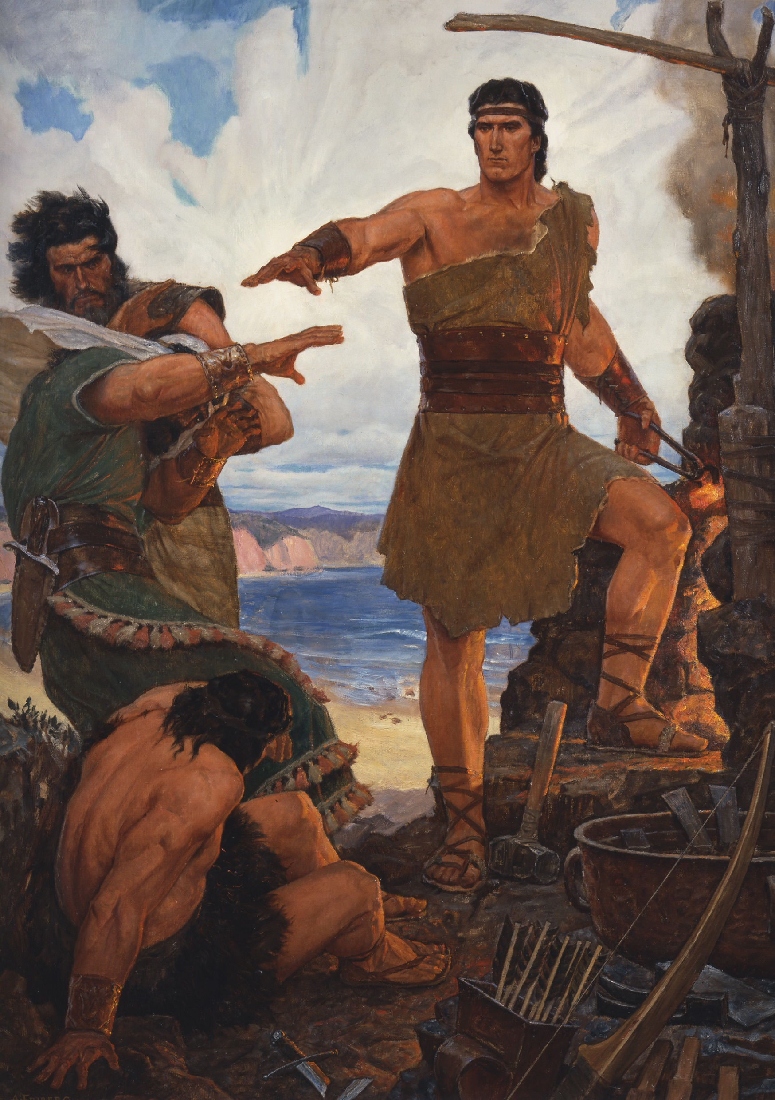
Consistent Witnesses
“For the fulness of mine intent is that I may persuade men to come unto the God of Abraham, and the God of Isaac, and the God of Jacob, and be saved”
1 Nephi 6:4

Slide 2
Consistent Witnesses
“That I might more fully persuade them to believe in the Lord their Redeemer I did read unto them that which was written by the prophet Isaiah”
1 Nephi 19:23

Slide 3
Consistent Witnesses
“And the words which I have written…speaketh of Jesus, and persuadeth them to believe in him”
2 Nephi 33:4

Slide 4
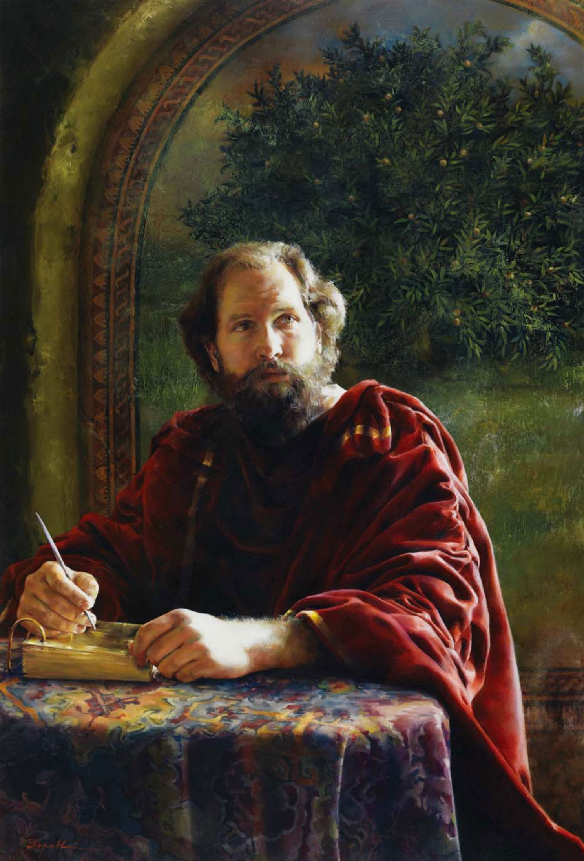
Consistent Witnesses
“[Nephi] gave me, Jacob, a commandment that I should write upon these plates a few of the things which I considered to be most precious…We labored diligently among our people, that we might persuade them to come unto Christ”
Jacob 1:2, 7

Slide 5
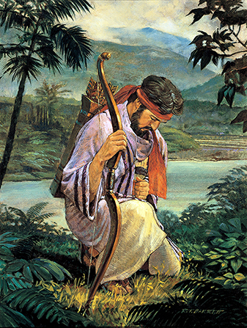
Consistent Witnesses
“My soul hungered; and I kneeled down before my Maker, and I cried unto him in mighty prayer and supplication for mine own soul; and all the day long did I cry unto him; yea, and when the night came I did still raise my voice high that it reached the heavens”
Enos 1:4

Slide 6
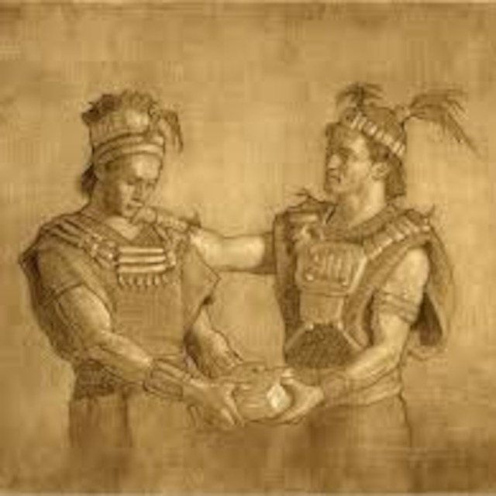
Consistent Witnesses
The prophets in Jarom’s day focused on “persuading [the people] to look forward unto the Messiah, and believe in him to come as though he already was.”
Jarom 1:11

Slide 7
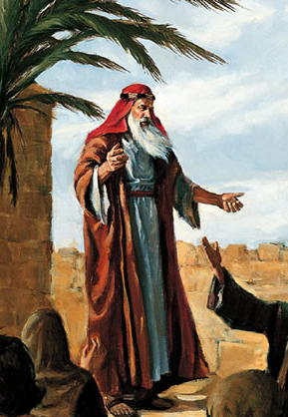
Consistent Witnesses
And now, my beloved brethren, I would that ye should come unto Christ, who is the Holy One of Israel…and offer your whole souls as an offering unto him.”
Omni 1:26

Slide 8
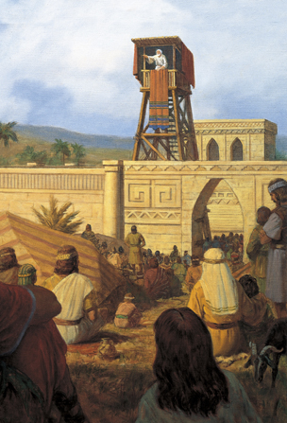
Consistent Witnesses
“There shall be no other name given nor any other way nor means whereby salvation can come unto the children of men, only in and through the name of Christ, the Lord Omnipotent.”
Mosiah 3:17

Slide 9
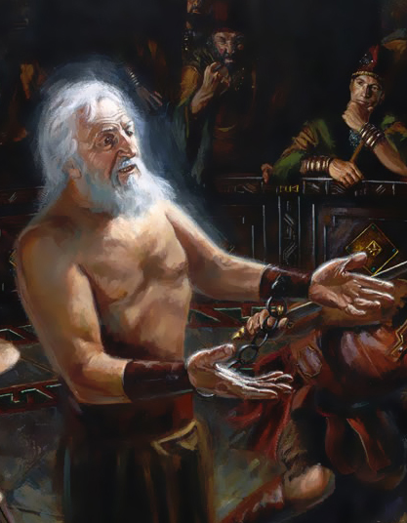
Consistent Witnesses
Christ…is the light and the life of the world; yea, a light that is endless, that can never be darkened; yea, and also a life which is endless, that there can be no more death.
Mosiah 16:8-9

Slide 10
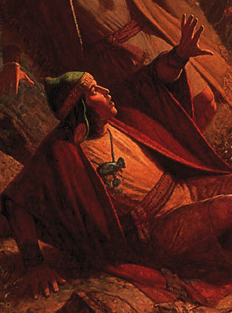
Consistent Witnesses
“All nations, kindreds, tongues and people, must be born again; yea, born of God, changed from their carnal and fallen state, to a state of righteousness, being redeemed of God, becoming his sons and daughters”
Mosiah 27:25

Slide 11
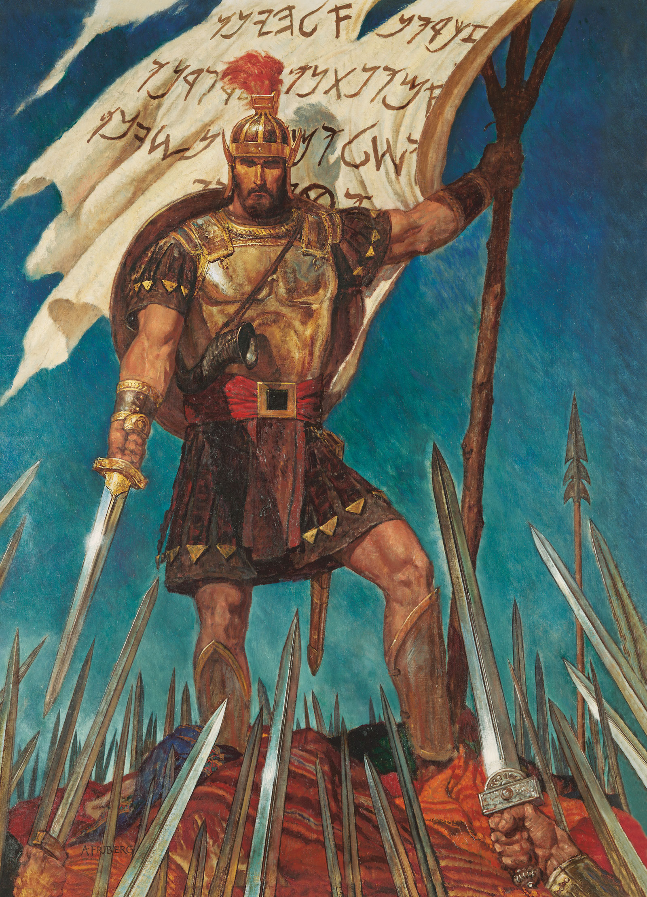
Consistent Witnesses
“This is done unto us because of our religion and our faith in Christ. And now ye see that ye cannot destroy this our faith.”
Alma 44:3

Slide 12
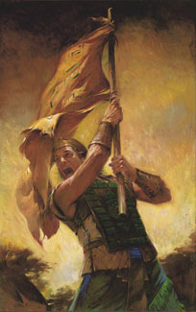
Consistent Witnesses
And now, my sons, remember, remember that it is upon the rock of our Redeemer, who is Christ, the Son of God, that ye must build your foundation.”
Helaman 5:12

Slide 13
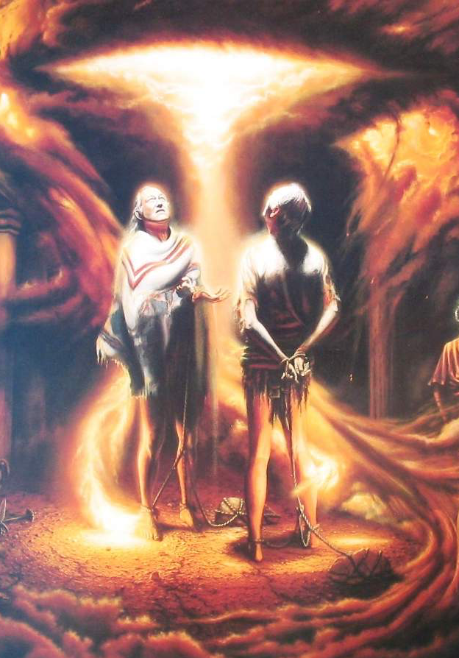
Consistent Witnesses
“Nephi also testified of these things, and also almost all of our fathers, even down to this time; yea, they have testified of the coming of Christ, and have looked forward, and have rejoiced in his day which is to come.”
Helaman 8:22

Slide 14
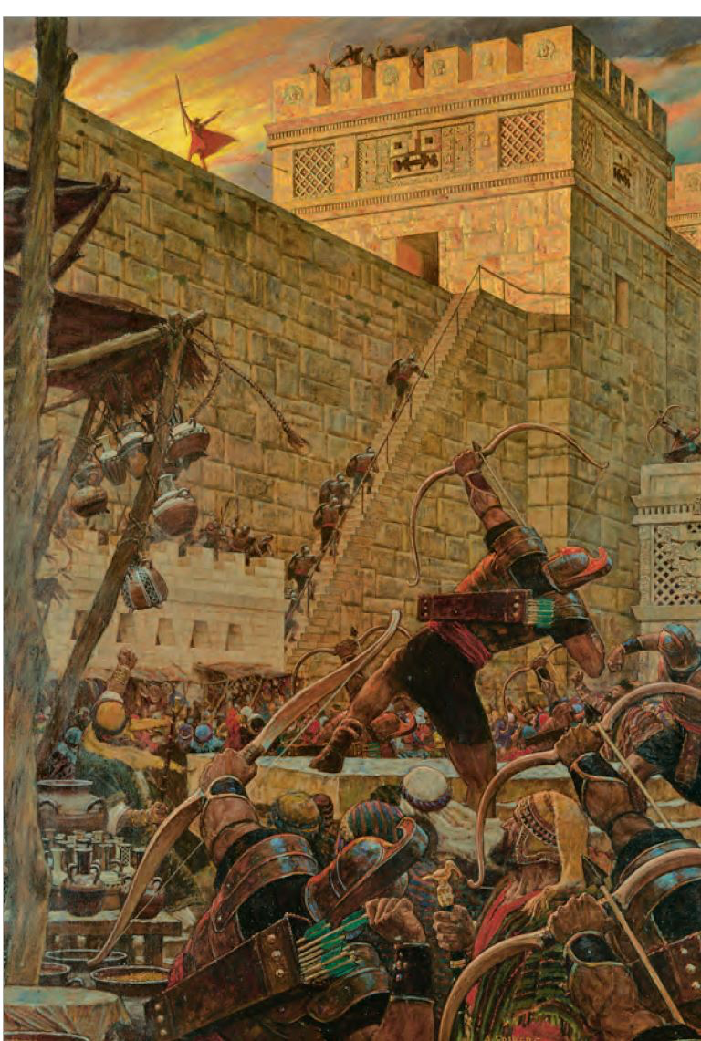
Consistent Witnesses
“The resurrection of Christ redeemeth mankind, yea, even all mankind, and bringeth them back into the presence of the Lord.”
Helaman 14:17

Slide 15
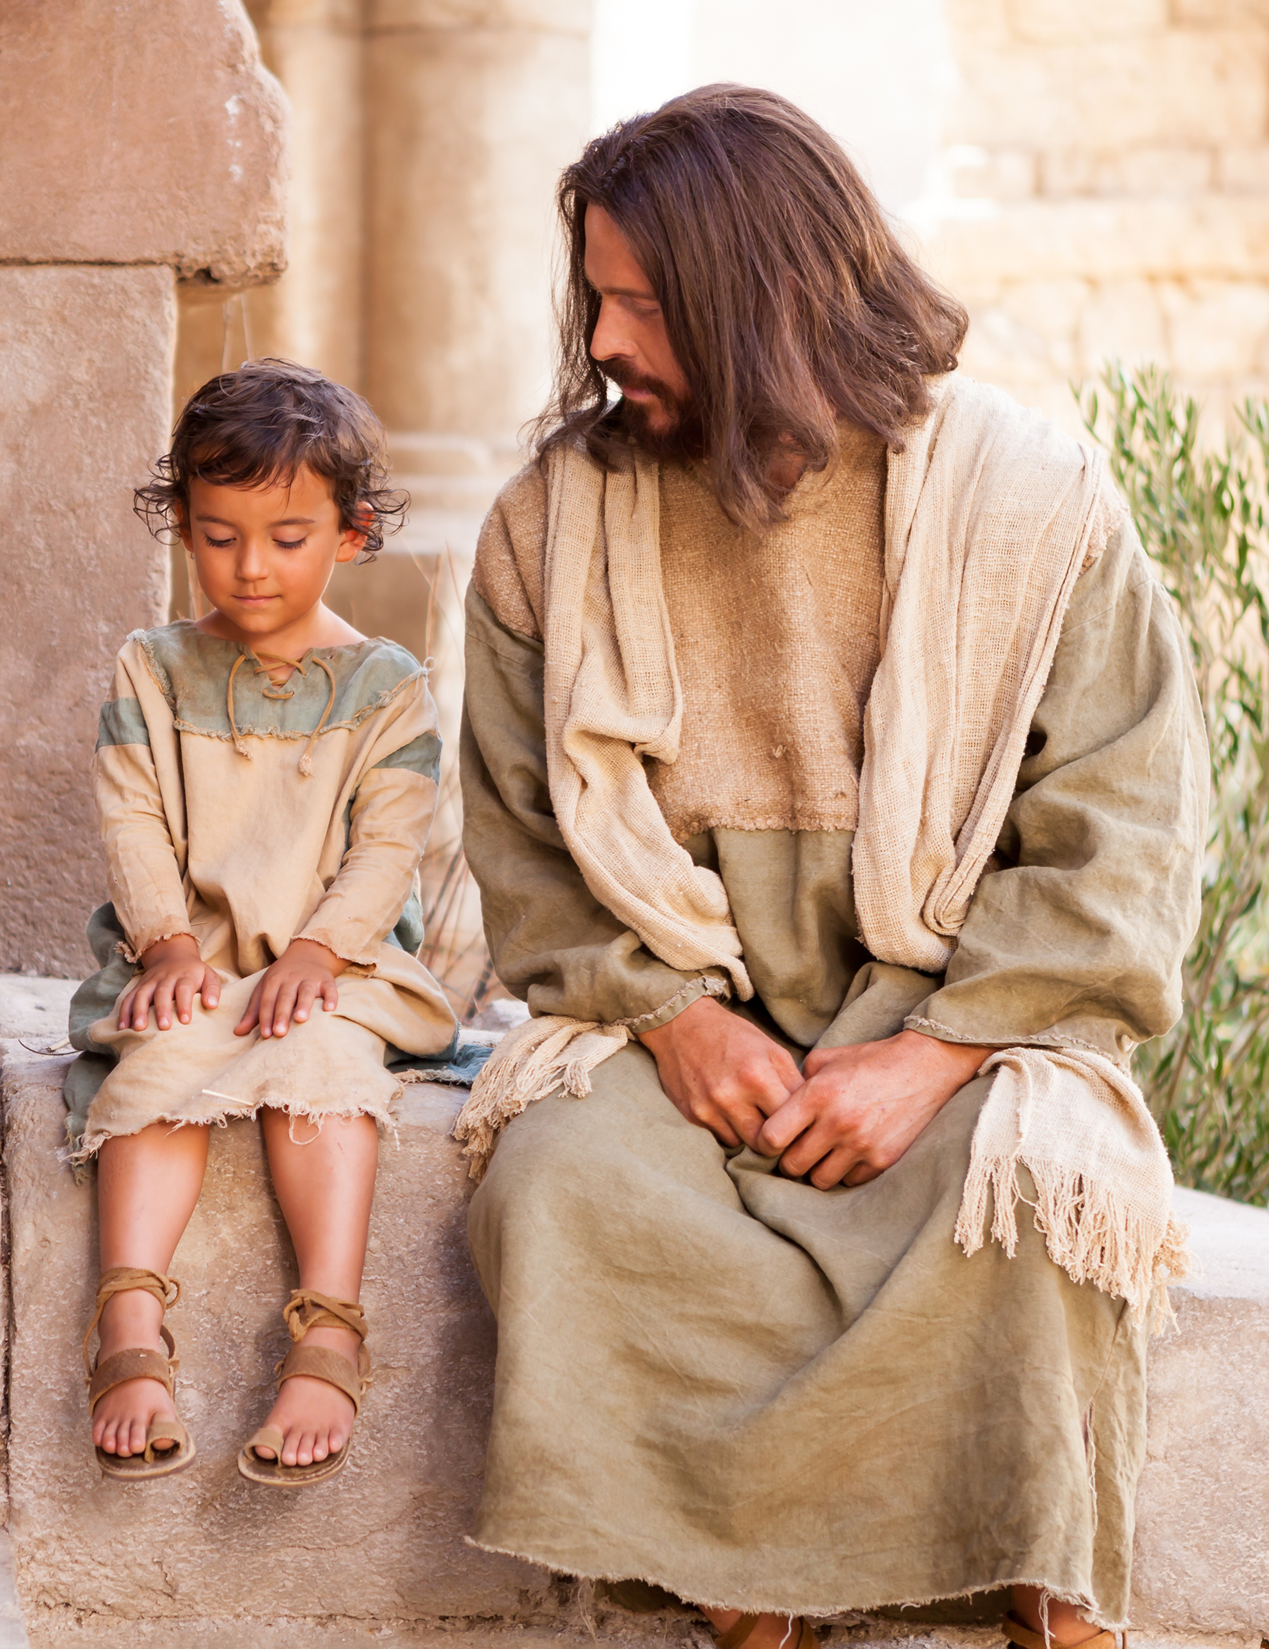
Consistent Witnesses
“Arise and come forth unto me, that ye may thrust your hands into my side, and also that ye may feel the prints of the nails in my hands and in my feet, that ye may know that I am the God of Israel.”
3 Nephi 11:14

Slide 16
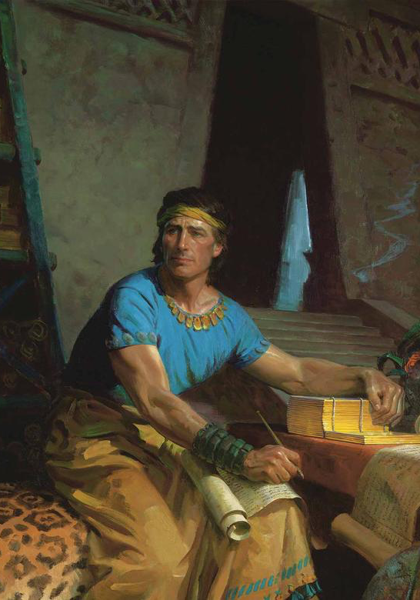
Consistent Witnesses
“I write unto you…that ye may believe the gospel of Jesus Christ…And I would that I could persuade all ye ends of the earth to repent and prepare to stand before the judgment-seat of Christ.”
Mormon 3:20–22

Slide 17
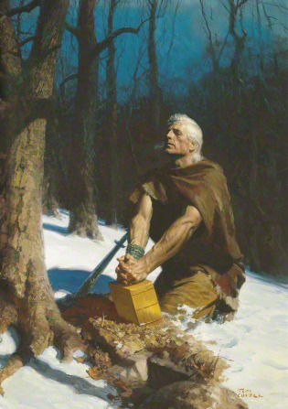
Consistent Witnesses
“Yea, come unto Christ, and be perfected in him.”
Moroni 10:32

