Slide 1
If you had to choose one of the following six paintings to hang in your home, which would you choose?

Slide 2
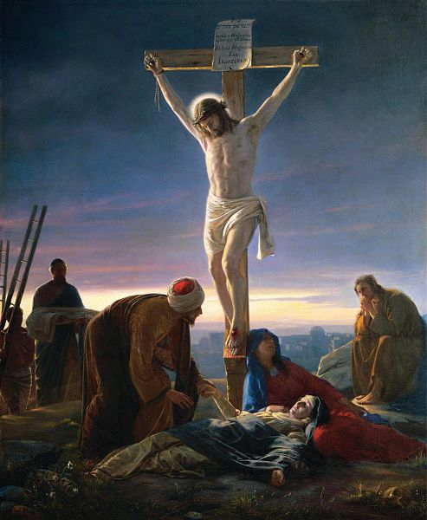
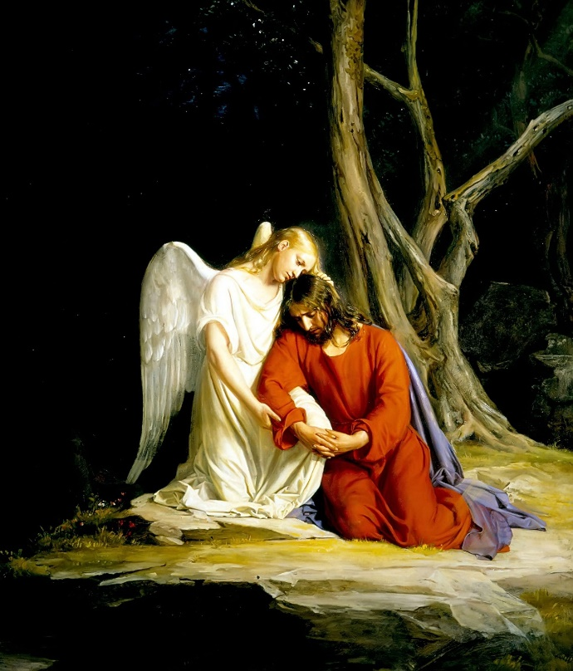
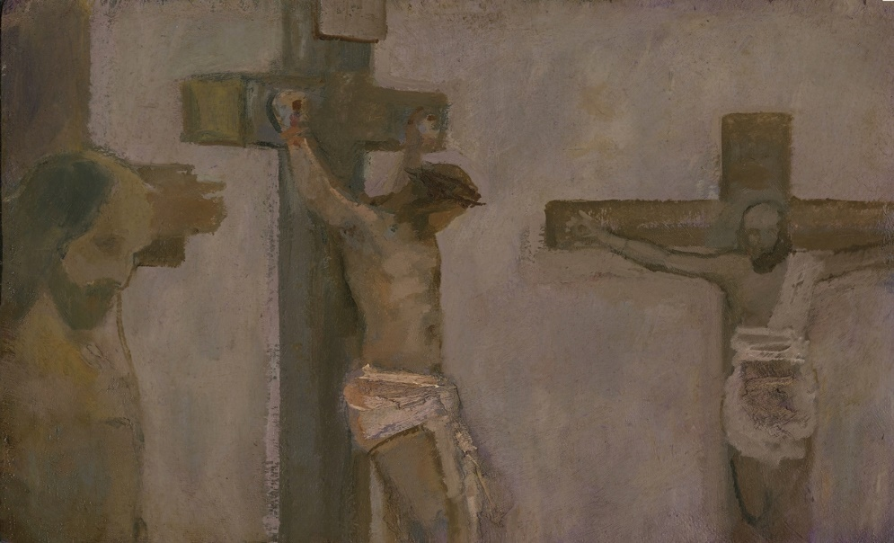
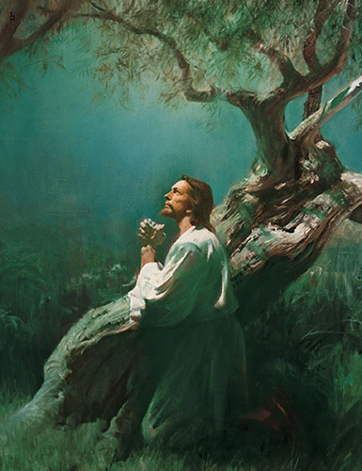
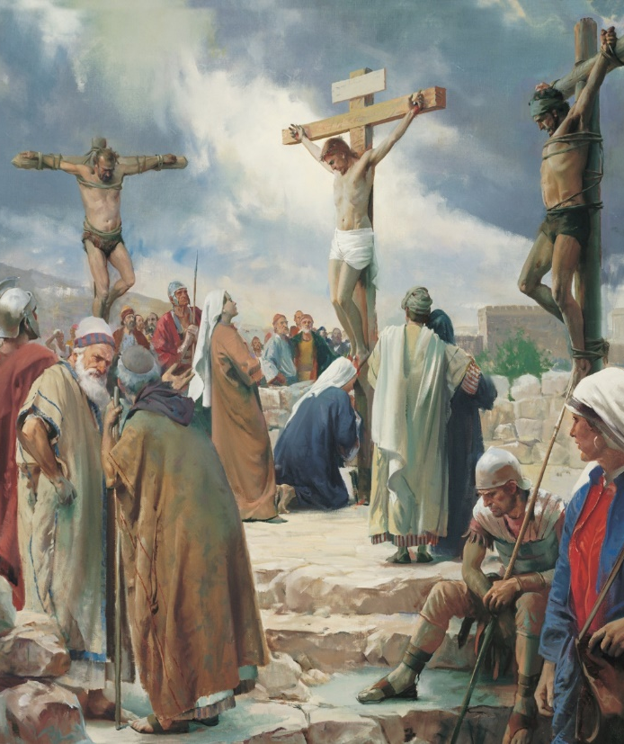
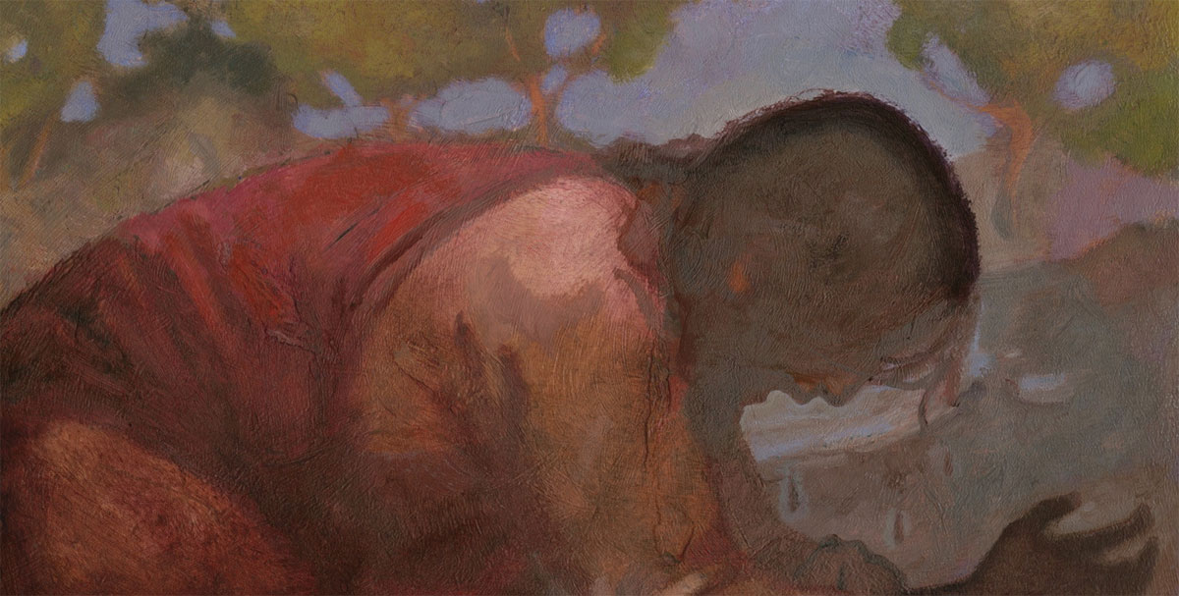
4
3
5
1
2
6

Slide 3
“Greater love hath no man than this, that a man lay down his life for his friends” (John 15:13)

Slide 4
“God commendeth his love toward us, in that, while we were yet sinners, Christ died for us” (Romans 5:8)

Slide 5
“May Christ lift thee up, and may his sufferings and death . . . rest in your mind forever” (Moroni 9:25)

Slide 6
“We would to God that we could persuade all men [to] . . . believe in Christ, and view his death, and suffer his cross” (Jacob 1:8)

Slide 7
“Look unto me in every thought; doubt not, fear not.” (Doctrine and Covenants 6:36)

Slide 8
“Behold [meaning “fix your eyes upon”], the wounds which pierced my side, and also the prints of the nails in my hands and feet” (Doctrine and Covenants 6:37)

Slide 9
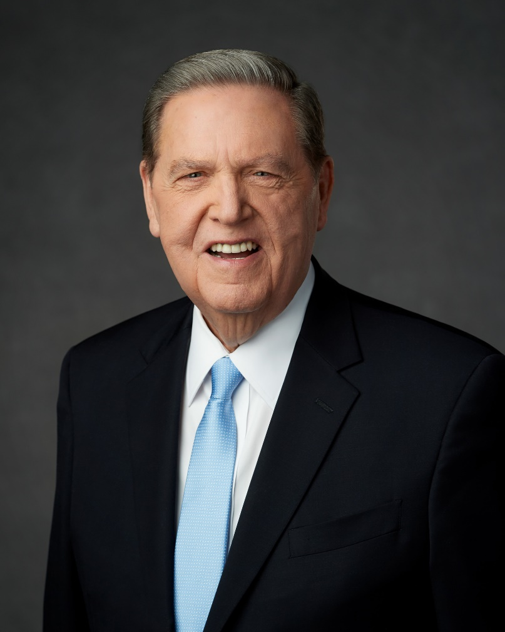
However dim our days may seem, they have been a lot darker for the Savior of the world. As a reminder of those days, Jesus has chosen, even in a resurrected, otherwise perfected body, to retain for the benefit of His disciples the wounds in His hands and in His feet and in His side—signs, if you will, that painful things happen to the pure and the perfect;
Elder Jeffrey R. Holland, “Teaching, Preaching, Healing,” Ensign, January 2003, p. 42.

Slide 10
Signs, if you will, that pain in this world is not evidence that God doesn’t love you. . . . It is the wounded Christ who is the Captain of our souls, he who yet bears the scars of our forgiveness . . . .These wounds are the principal way we are to recognize Him when he comes.
Elder Jeffrey R. Holland, “Teaching, Preaching, Healing,” Ensign, January 2003, p. 42.

