Slide 1
The Beatitudes
“Blessed are the…”
Blessed, happy = beatus (Latin)
James Tissot

Slide 2
Matthew 5:3–12
“Blessed are the poor in spirit: for theirs is the kingdom of heaven. Blessed are they that mourn: for they shall be comforted. Blessed are the meek: for they shall inherit the earth. Blessed are they which do hunger and thirst after righteousness: for they shall be filled. Blessed are the merciful: for they shall obtain mercy. Blessed are the pure in heart: for they shall see God. Blessed are the peacemakers: for they shall be called the children of God. Blessed are they which are persecuted for righteousness’ sake: for theirs is the kingdom of heaven. Blessed are ye, when men shall revile you, and persecute you, and shall say all manner of evil against you falsely, for my sake. Rejoice, and be exceeding glad: for great is your reward in heaven: for so persecuted they the prophets which were before you”

Slide 3
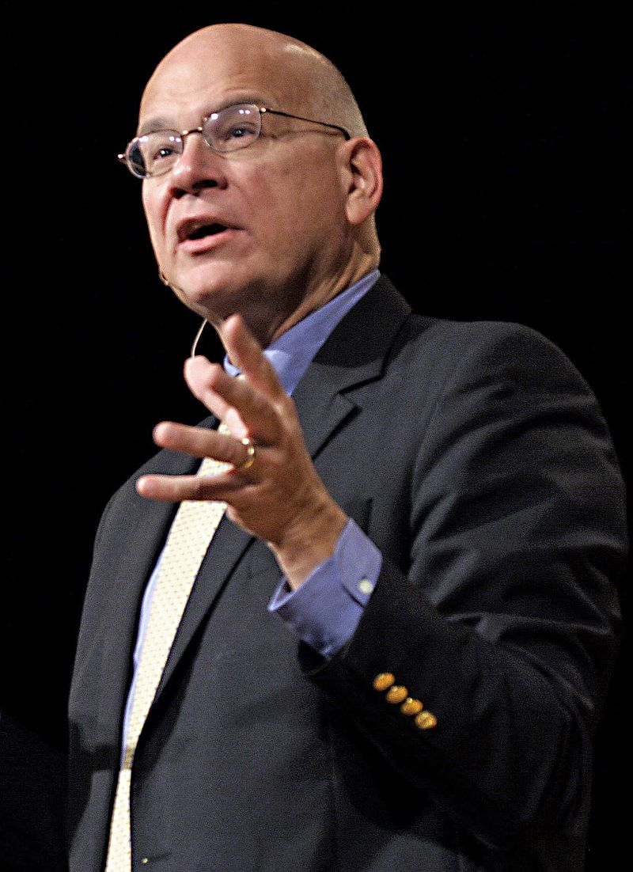
“You might look at those beatitudes, those descriptors and those rewards, and realize that they also describe Jesus himself. And when we think of that we see how what he did gives us what each beatitude promises. Why can you and I be as rich as kings? Because he became spiritually and utterly poor. Why can you and I be comforted? Only because he mourned; because he wept inconsolably and died in the dark.
Frank Licorice
Timothy Keller,
Preaching,
89–90
Notes:
https://en.wikipedia.org/wiki/Tim_Keller_(pastor)#/media/File:Timothy_Keller.jpg

Slide 4
“Why are you and I inheriting the earth? Because he became meek; because he was like a lamb before his shearers. Because he was stripped of everything—they even cast lots for his garment. Why can you and I be filled and satisfied? Because on the cross he said, “I thirst.” Why are you and I obtaining mercy? Because he got none: not from Pilate, not from the crowd, not even from his Father.
Frank Licorice
Timothy Keller,
Preaching,
89–90
Notes:
https://en.wikipedia.org/wiki/Tim_Keller_(pastor)#/media/File:Timothy_Keller.jpg

Slide 5
“Why will you and I be able to someday see God? Because he was pure. Do you know what the word “pure” means? It means to be single-minded, absolutely undivided, laser focused. So why is it that someday we will see God? Because Jesus Christ set his face like a flint to go up to Jerusalem and die for us (Luke 9:51). You and I can see God because, on the cross, Jesus could not.
Frank Licorice
Timothy Keller,
Preaching,
89–90
Notes:
https://en.wikipedia.org/wiki/Tim_Keller_(pastor)#/media/File:Timothy_Keller.jpg

Slide 6
“When you see Jesus Christ being poor in spirit for you, that helps you become poor in spirit before God and say, “I need your grace.” And once you get it and you are filled, then you are merciful, you become a peacemaker, you find God in prayer and wait someday for the beatific vision, to see God as he is (1 John 3:1–3). The beatitudes, like nearly everything else in Scripture, point us to Jesus far more than we think.”
Frank Licorice
Timothy Keller,
Preaching,
89–90
Notes:
https://en.wikipedia.org/wiki/Tim_Keller_(pastor)#/media/File:Timothy_Keller.jpg

Slide 7
Gospel of Christ
Law of Moses
Christ Raises
The Standard
Marie-Lan Nguyen
Notes:
https://commons.wikimedia.org/wiki/File:Women_high_jump_French_Athletics_Championships_2013_t150931.jpg

Slide 8
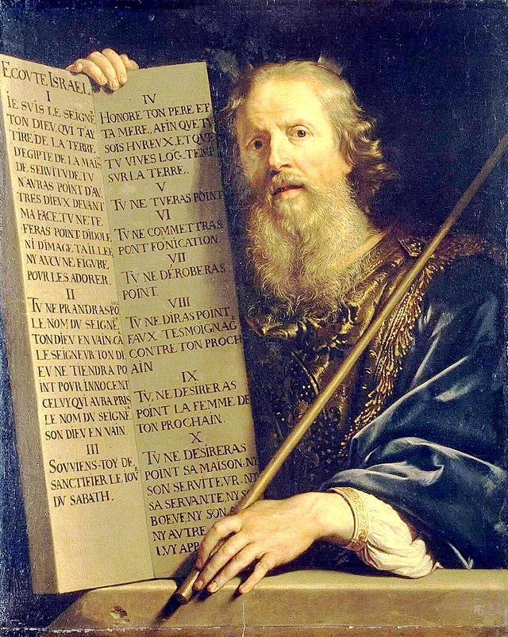
Philippe de Champaigne
“It has been said by them of old time, Thou shalt not kill, and whosoever shall kill shall be in danger of the judgment of God.”
Matthew 5:21 (alluding to Exodus 20:13)
Notes:
https://commons.wikimedia.org/wiki/File:Philippe_de_Champaigne_-_Moses_with_the_Ten_Commandments_-_WGA04717.jpg
https://www.churchofjesuschrist.org/media/image/christ-teaching-the-people-31eb3e7?lang=eng&collectionId=3cbf78e787498a07417814a31656063f9227b4c6
JST also changes “the judgment” to “his judgment” likely referring to God’s based on the previous verse.

Slide 9
Harry Anderson
“But I say unto you, that whosoever is angry with his brother without a cause shall be in danger of the judgment.”
KJV Matthew 5:22
Philippe de Champaigne
“It has been said by them of old time, Thou shalt not kill, and whosoever shall kill shall be in danger of the judgment of God.”
Matthew 5:21 (alluding to Exodus 20:13)
Notes:
https://commons.wikimedia.org/wiki/File:Philippe_de_Champaigne_-_Moses_with_the_Ten_Commandments_-_WGA04717.jpg
https://www.churchofjesuschrist.org/media/image/christ-teaching-the-people-31eb3e7?lang=eng&collectionId=3cbf78e787498a07417814a31656063f9227b4c6
JST also changes “the judgment” to “his judgment” likely referring to God’s based on the previous verse.

Slide 10
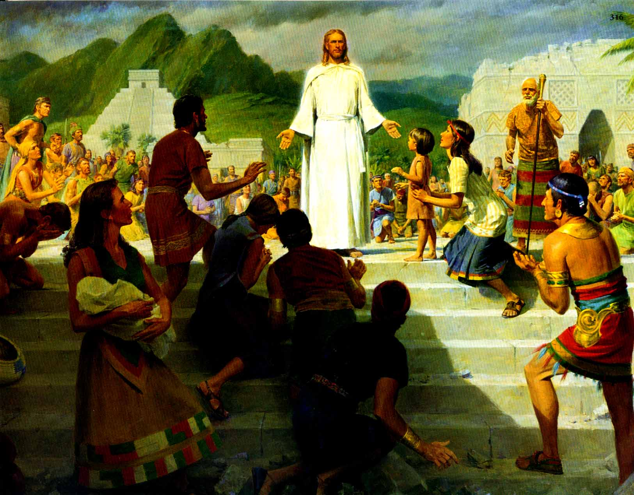
“Whosoever is angry with his brother shall be in danger of his judgment.”
(3 Nephi 12:22)
Anger
“He that hath the spirit of contention is not of me, but is of the devil.”
(3 Nephi 11:29)
John Scott
Notes:
https://www.churchofjesuschrist.org/media/image/jesus-nephites-8ddd1aa?lang=eng&collectionId=3cbf78e787498a07417814a31656063f9227b4c6

Slide 11
Philippe de Champaigne
“Ye have heard that it was said by them of old time, Thou shalt not commit adultery.”
Matthew 5:27 (alluding to Ex. 20:14)
Notes:
https://commons.wikimedia.org/wiki/File:Philippe_de_Champaigne_-_Moses_with_the_Ten_Commandments_-_WGA04717.jpg
https://www.churchofjesuschrist.org/media/image/christ-teaching-the-people-31eb3e7?lang=eng&collectionId=3cbf78e787498a07417814a31656063f9227b4c6

Slide 12
Harry Anderson
“But I say unto you, that whosoever looks on a woman, to lust after her, has committed adultery already in his heart.”
Matthew 5:28
Philippe de Champaigne
“Ye have heard that it was said by them of old time, Thou shalt not commit adultery.”
Matthew 5:27 (alluding to Ex. 20:14)
Notes:
https://commons.wikimedia.org/wiki/File:Philippe_de_Champaigne_-_Moses_with_the_Ten_Commandments_-_WGA04717.jpg
https://www.churchofjesuschrist.org/media/image/christ-teaching-the-people-31eb3e7?lang=eng&collectionId=3cbf78e787498a07417814a31656063f9227b4c6

Slide 13
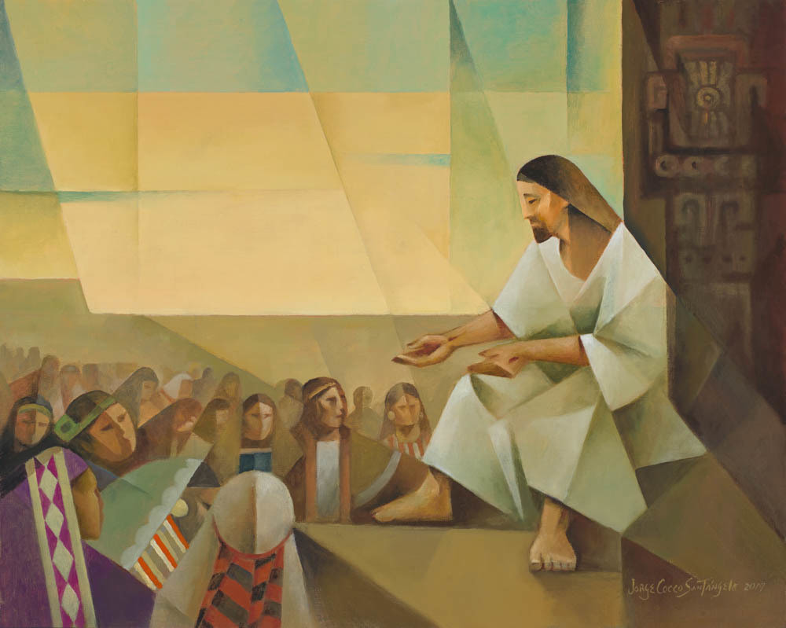
“Whosoever looketh on a woman, to lust after her, hath committed adultery already in his heart. Behold, I give unto you a commandment, that ye suffer none of these things to enter into your heart; For it is better that ye should deny yourselves of these things, wherein ye will take up your cross, than that ye should be cast into hell.”
Jorge Cocco
3 Nephi 12:28–30
Notes:
https://www.churchofjesuschrist.org/media/image/jesus-nephites-8ddd1aa?lang=eng&collectionId=3cbf78e787498a07417814a31656063f9227b4c6

Slide 14
Don’t think about a cat playing ukulele

Slide 15
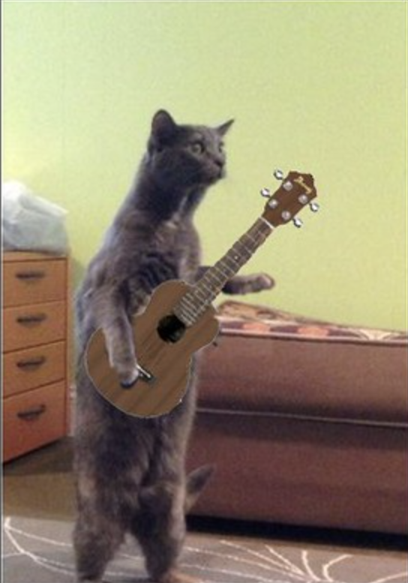
Don’t think about a cat playing ukulele
FolsomNatural
Notes:
https://www.flickr.com/photos/87249144@N08/33367945125/in/photostream/

Slide 16
Don’t think about a cat playing ukulele
Sometimes when we try to stop thinking about something, it’s hard!
There are many approaches to reduce lustful thoughts, (filters, getting advice from trusted friends/family/counselors/church leaders, continual practicing, etc.).

Slide 17
“The light of the body is the eye: if therefore thine eye be single to the glory of God, thy whole body shall be full of light.”
(Matthew 6:22, JST, see also Doctrine and Covenants 88:67)
“Look unto me in every thought.” (Doctrine and Covenants 6:36)
Del Parson

Slide 18
Philippe de Champaigne
“Ye have heard that it has been said, Thou shalt love thy neighbor and hate thine enemy.”
Matthew 5:43

Slide 19
Harry Anderson
“But behold I say unto you, Love your enemies, bless them that curse you, do good to them that hate you, and pray for them which despitefully use you and persecute you.”
Matthew 5:44
Philippe de Champaigne
“Ye have heard that it has been said, Thou shalt love thy neighbor and hate thine enemy.”
Matthew 5:43

Slide 20
Matthew 5:45–48
“Love your enemies…That ye may be the children of your Father which is in heaven: for he maketh his sun to rise on the evil and on the good, and sendeth rain on the just and on the unjust. For if ye love them which love you, what reward have ye? do not even the publicans the same? And if ye salute your brethren only, what do ye more than others? do not even the publicans so? Be ye therefore perfect, even as your Father which is in heaven is perfect.”

Slide 21
Matthew 5:45–48
“Love your enemies…That ye may be the children of your Father which is in heaven: for he maketh his sun to rise on the evil and on the good, and sendeth rain on the just and on the unjust. For if ye love them which love you, what reward have ye? do not even the publicans the same? And if ye salute your brethren only, what do ye more than others? do not even the publicans so? Be ye therefore perfect, even as your Father which is in heaven is perfect.”

