Slide 1
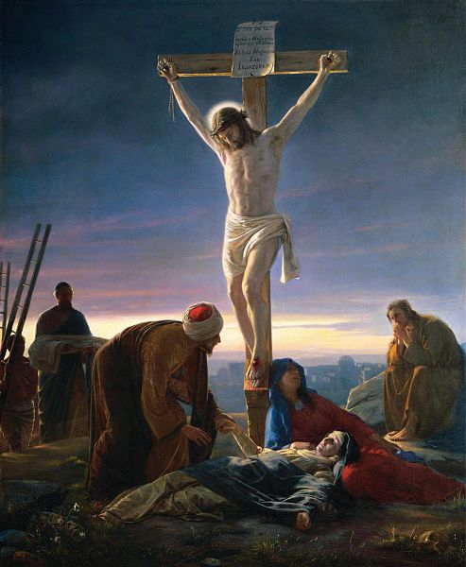
Welcome to Class! Before We Start…
Enjoy this music: “The Proof of your Love”
Midterm #1 starts tomorrow. Today’s class will be on the midterm.
Research Paper Draft #1 due in eight days!

Slide 2
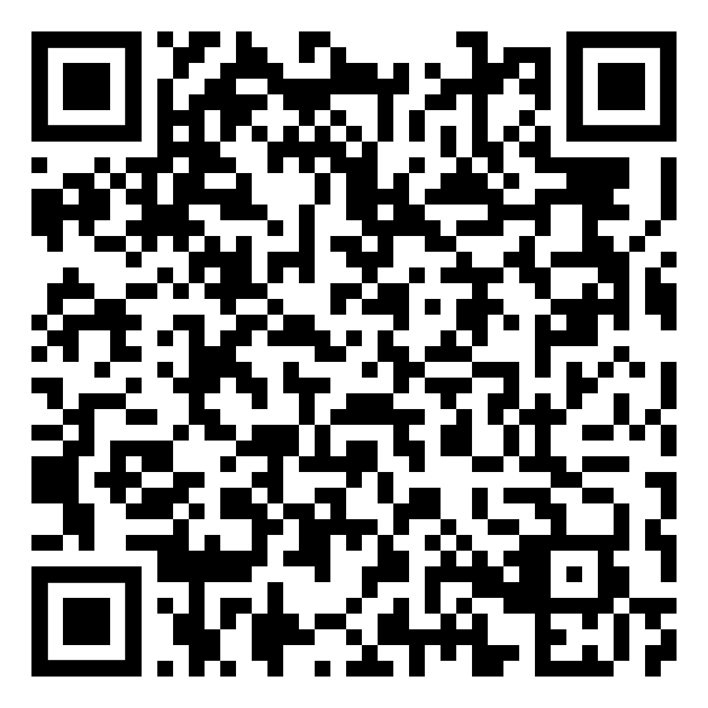
Gospel Portraits of Jesus Christ
The following are the learning outcomes for this lesson:
Feel the Holy Ghost
Identify and act on at least one specific thing you will do in your life as a result of our discussion today.
Be able to answer the questions from today’s class period (see QR code)

Slide 3
A Brief Overview of the Four Gospels

Slide 4
Matthew, Mark, & Luke =
The Synoptic Gospels
(“The Synoptics”)
Synoptic = “see together”
Matthew, Mark, & Luke have the same basic stories and sequence.

Slide 5
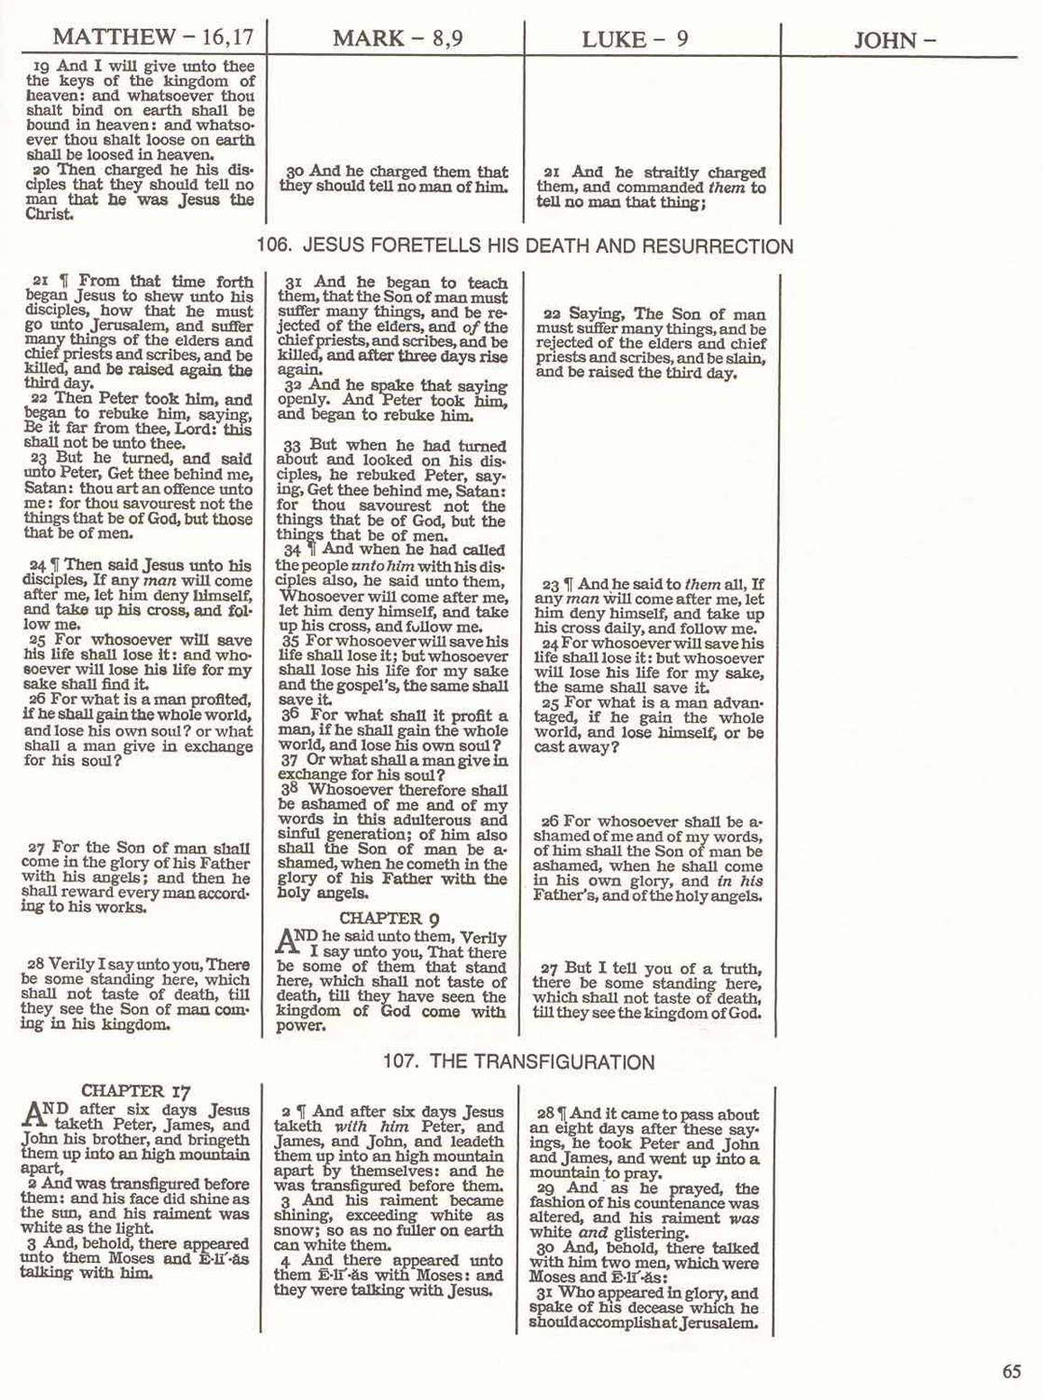
Matt, Mark, & Luke have many common stories, often word-for-word the same (thus, probably from a common written source).

Slide 6
If two research papers were word-for-word identical in some sections, what would be the natural conclusion?
It is very likely that there is a literary relationship between the Synoptic Gospels.

Slide 7
“For as much as many have taken in hand to set forth in order a declaration of those things which are most surely believed among us… It seemed good to me also… to write unto thee in order, most excellent Theophilus, That thou might know the certainty of those things, wherein thou hast been instructed.” (Luke 1:1-4)
*“Many have taken in hand” = I know many other written Gospels
*“To write in order” = I will write an orderly account (better than the others)
*The Lord did not simply give Luke a revelation—Luke used written sources.

Slide 8
John is Different, Unique
Gospel Unique Common
Mark 7% 93%
Matthew 42% 58%
Luke 59% 41%
John 92% 8%
Notes:
The majority view of modern scholars is that Mark was the first gospel to be composed and that Matthew (who includes some 600 of Mark's 661 verses) and Luke both drew upon it as a major source for their works.^{[19][20]} The author of Matthew did not, however, simply copy Mark, but used it as a base, emphasising Jesus' place in the Jewish tradition and including other details not covered in Mark.^{[21]} An additional 220 (approximately) verses, shared by Matthew and Luke but not found in Mark, from a second source, a hypothetical collection of sayings to which scholars give the name "Quelle" ("source" in the German language), or the Q source.^{[22]}

Slide 9
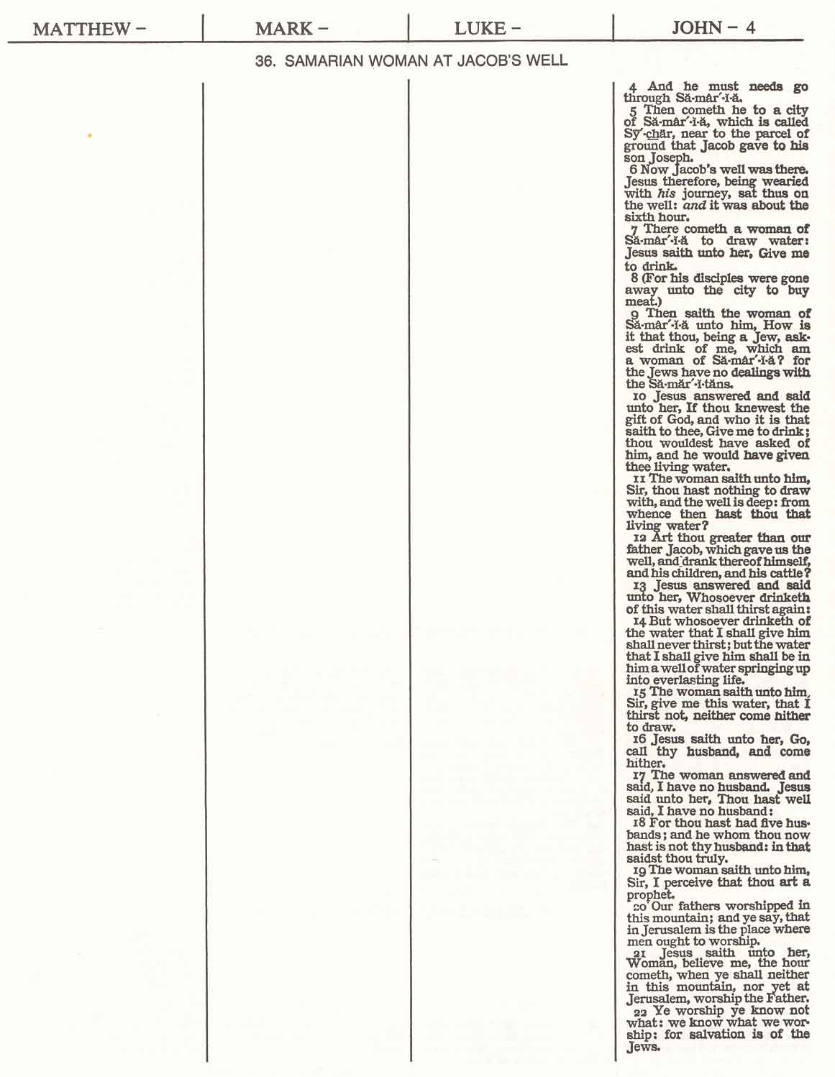
John very often has material that is not in any other Gospel.

Slide 10
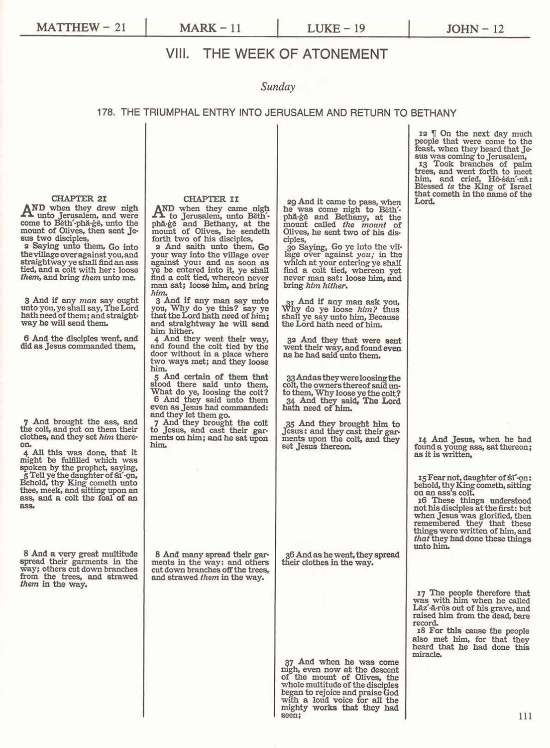
Even when all four Gospels have the same story, John often has different information.

Slide 11
So How Should We Read the Gospels?

Slide 12
Reading the Gospels as a “Harmony”
A “harmony” is an artificial blending of the four gospels into one story.
PRO: Perhaps easier to read as one clear narrative
Notes:
We will read as a “harmony” as we study the birth of Jesus Christ

Slide 13
Downside to Harmony
There is a significant con to reading in a Harmony.

Slide 14
Downside to Harmony
Notes:
“If we had four mosaics giving different representations of the same scene, it would not occur to us to say, “These mosaics are so beautiful that I do not want to lose any of them; I shall demolish them and use the enormous pile of stones to make a single mosaic that combines all four of them.” Trying to combine the pieces would be an outrageous affront to the artists. Because the four Gospels are different from each other, we must study each one for itself, without demolishing it and using the debris to reconstruct a life of Jesus by making the four Gospels into one Gospel.” (Richard Neitzel Holzapfel, “The Passion of Jesus Christ,” in The Lord of the Gospels, ed. Bruce A. Van Orden and Brent L. Top (Salt Lake City: Deseret Book, 1991), 79.)

Slide 15
Reading the Gospels Sequentially
PRO: Focuses on the audience, message, narrative, and structure of each individual Gospel
CON: Can be repetitive (some accounts are very similar).

Slide 16
Reading the Gospels in a Synopsis
PRO: Comparing the Gospels in a synopsis, or in parallel helps you examine what each does differently and gain new insights.
CON: Can be harder to match up accounts side by side passages and do a careful reading.
Notes:
As to the con – but it’s worth it! You’ll be looking at a synopsis study of Christ’s baptism and later this semester we’ll have a paper that helps you study in this way.

Slide 17
Check Yourself
Compare and contrast reading the New Testament Gospels in an harmony, sequentially, or in a synopsis.
Which have you primarily done thus far in your life?
Notes:
Emphasize that there is no WRONG WAY. We can benefit from each of these approaches at different times in our lives. We will primarily focus on sequential reading, but explore the other two as well.

Slide 18
How Was Your Synopsis Experience?
What did you learn from your baptism synopsis study?
Any questions about the Synopsis paper?
Option #1: The Roman Trial of Jesus Christ: Mark 15:1-20, Matthew 27:1-31, Luke 23:1-25, John 18:28-John 19:15.
Option #2: The Crucifixion: Mark 15:20-41, Matthew 27:31-56, Luke 23:26-49, John 19:16-37
How can this Synopsis Paper have more value than just a “disposable assignment”?

Slide 19
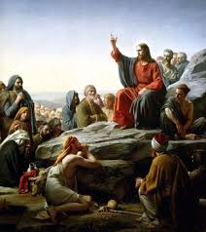
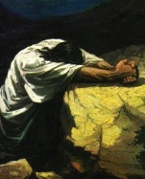
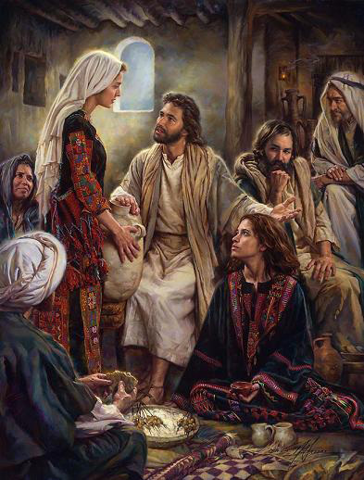
Understanding the Four Gospel Portraits
Notes:
Could use the stage left, right, balcony, backstage analogy – note that its imperfect because the gospels are actually different (it’s not the same play).
Could use the zooming in on Heinrich Hoffman and rich young ruler image.

Slide 20
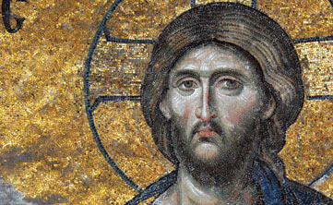
Christology is the study of the nature of Christ.
Low Christology
(Jesus completely Human)
High Christology
(Jesus completely God)

Slide 21
Christology
The Nature of Christ: Human or Divine?
Low Christology
(Jesus completely Human)
High Christology
(Jesus completely God)
Mark? John?

Slide 22
Key Themes in Mark
Emphasizes the Humanity of Christ

Slide 23
The Human Emotions of Christ
1:41–__________
3:5 –__________
6:6 –__________
8:12 –__________
9:12 –__________
10:14 –__________
10:21 –__________
14:33-45 –_________
15:34–_________
Notes:
With a group of three, each choose three and see if you can ID an emotion Christ was feeling

Slide 24
The Human Emotions of Christ
“For in that he himself hath suffered being tempted, he is able to succour them that are tempted.
Hebrews 2:18
1:41–Compassion
3:5–Anger/Grief
6:6–Amazed
8:12–Disappointment
9:12–Suffering
10:14–Very Displeased
10:21–Loving
14:33-45–Sore Amazed
15:34–Completely Forsaken
“For we have not an high priest which cannot be touched with the feeling of our infirmities; but was in all points tempted like as we are, yet without sin. Let us therefore come boldly unto the throne of grace, that we may obtain mercy, and find grace to help in time of need.
Hebrews 4:15–16

Slide 25
Christology
The Nature of Christ: Human or Divine?
Low Christology
(Jesus completely Human)
High Christology
(Jesus completely God)
Mark? John?

Slide 26
In John, Christ is Always in Control, Always Knows, Never Surprised
“He saith unto Philip, Whence shall we buy bread, that these may eat? And this he said to prove him: for he himself knew what he would do” (John 6:5–6).
“Jesus knew from the beginning who they were that believed not, and who should betray him” (John 6:64).
Jesus knew “all things that should come upon him” (John 18:4), and his disciples specifically testified that they knew Jesus knew “all things” (John 16:30).

Slide 27
Compare Final Statements from the Cross in Mark and John
Mark 15:34
John 19:30

Slide 28
Check Yourself
Which Gospel has the highest Christology?
Which Gospel has the lowest Christology?

Slide 29
Three Unique Elements from the
Gospel of Matthew
1. Matthew emphasizes fulfillment of OT prophecy.

Slide 30
Matthew’s Use of the Old Testament His “Current Testament”!
Isaiah 7:14 (Matthew 1:23)
Numbers 24:27 (Matthew 2:2)
Micah 5:2 (Matthew 2:6)
Hosea 11:1 (Matthew 2:15)
Jeremiah 31:15 (Matthew 2:18)
Isaiah 40:3 (Matthew 3:3)

Slide 31
Three Unique Elements from the
Gospel of Matthew
Matthew emphasizes fulfillment of OT prophecy.
Matthew connects Christ and David—The phrase “Son of David” referring to Christ appears 9 time in Matthew, three times in Mark, twice in Luke, and never in John.

Slide 32
“All the generations from Abraham to David are fourteen generations; and from David until the carrying away into Babylon are fourteen generations; and from the carrying away into Babylon unto Christ [Messiah, the anointed one] are fourteen generations.”
Matthew 1:17
What is the significance of 14?
In Hebrew letters,
the name David = 14.
D+V+D = 4+6+4 = 14.
Symbolic way of saying:
Jesus is the Son of DAVID
(the Messiah)
Gematria or numerology: Individual letters have numeric value
(i.e. A=1, B=2, C=3, etc.).
Notes:
https://www.gotquestions.org/14-generations.html (Note David counted twice to get 42 generations
Can also point out emphasis on Bethlehem – city of David
1 Samuel 17:12

Slide 33
Three Unique Elements from the
Gospel of Matthew
Matthew emphasizes fulfillment of OT prophecy.
Matthew connects Christ and David—The phrase “Son of David” referring to Christ appears 9 time in Matthew, three times in Mark, twice in Luke, and never in John.
3. Within the Gospels people “dream” only in Matthew.

Slide 34
Three Themes from the
Gospel of Luke
Jesus as the universal Savior.

Slide 35
“The book of the generation of Jesus Christ, the son of David, the son of Abraham.”
Matt 1:1
Matthew’s genealogy of Jesus:
Begins with…?
Luke’s
genealogy of Jesus:
Begins with…?
ABRAHAM
(father of the Jews)
ADAM
(father of all humanity)

Slide 36
Jesus as the Universal Savior
Angels at the Birth of Jesus: “Great tidings of great joy…to all people” (2:10)
Simeon: “Thy salvation, which you have prepared for all people; a light to the gentiles” (2:30-32)
John the Baptist: “All flesh will see the salvation of God” (3:6)
Notes:
See also: Luke 3:8-9, Luke 4:25-27

Slide 37
Three Themes from the
Gospel of Luke
Jesus as the universal Savior.
Greater emphasis on women.

Slide 38
Stories Involving Women that are Unique to Luke
Elisabeth and John the Baptist
Announcement of Christ’s birth to Mary
Mary’s visit to Elisabeth
Anna seeing baby Jesus in the temple
Raising of the widow’s son at Nain
Joanna and Susanna ministering to Christ
Healing of Mary Magdalene
Mary and Martha ministering to Christ
Healing of a crippled woman
Christ speaking to women on the way to the cross.

Slide 39
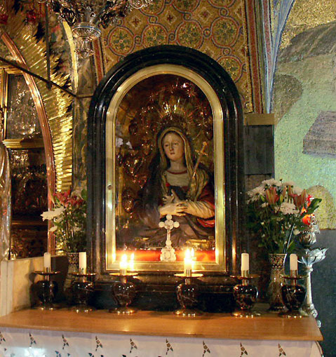
A Poignant Passage About Mary
“Simeon blessed them, and said unto Mary his mother, Behold, this child is set for the fall and rising again of many in Israel; and for a sign which shall be spoken against; (Yea, a sword shall pierce through thy own soul also,) that the thoughts of many hearts may be revealed” (Luke 2:34–35).

Slide 40
A Poignant Passage About Mary
The Joseph Smith Translation changes Simeon’s words as follows: “Yea, a spear shall pierce through him to the wounding of thine own soul also…”
Simeon thus prophesies to Mary about the spear that would be thrust into the Savior’s side (see John 19:34) and how this would wound Mary’s soul.

Slide 41
Three Themes from the
Gospel of Luke
Jesus as the universal Savior.
Greater emphasis on women.
Ministry to the poor and outcast

Slide 42
Ministry to the Poor and Outcast
Mary’s Magnificat (Luke 1:53)
Christ’s first speech (Luke 4:18-19)
Samaritans as heroes (Luke 10:30-37, 17:11-19)
Rich man who builds bigger barns (Luke 12:13-21)
Parable of Lazarus and the rich man (Luke 16:11-15, 19-31)
The penitent Publican and prideful Pharisee (Luke 18:9-14)
Dining with Zacchaeus (Luke 19:1-10)
Notes:
In 211 you’ll want to review Magnificat and first speech – these were done on FTs.
This is obvious a core part of Christ’s ministry throughout the gospels, but you can see by all of these “Luke exclusive” stories, that it is a special theme for him. Also shepherds in the field, changes in parables (see next slide), etc.

Slide 43
Check Yourself
What are three unique elements in the Gospel of Matthew?
What are three themes in the Gospel of Luke?

Slide 44
Practicing a Synopsis Study

