Slide 1
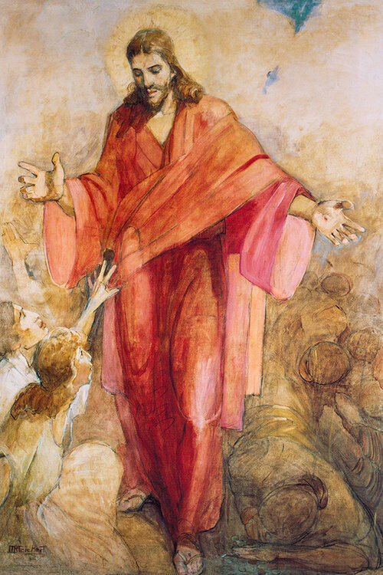
Welcome to Class! Before We Start…
Enjoy this music: “Who you say I am,” by Hillsong Worship.
Be on the lookout for an email with a “midcourse evaluation.”
Note: special guest (and change in class order) next Monday, March 8.
Loved your papers!
Common Paper Issues

Slide 2
Common Paper Issues
Clear thesis statement and signposting in the introduction
Clear methodology (separate section)
Using footnotes (tool within Word), proper citation formats.
Before you turn in draft two, you need to get feedback by at least two strong readers (could be a parent, BYU writing lab, classmate willing to give serious feedback, etc.).

Slide 3
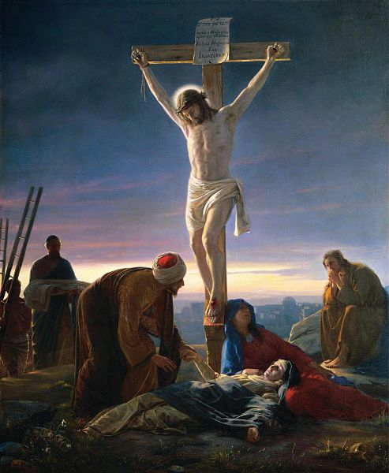
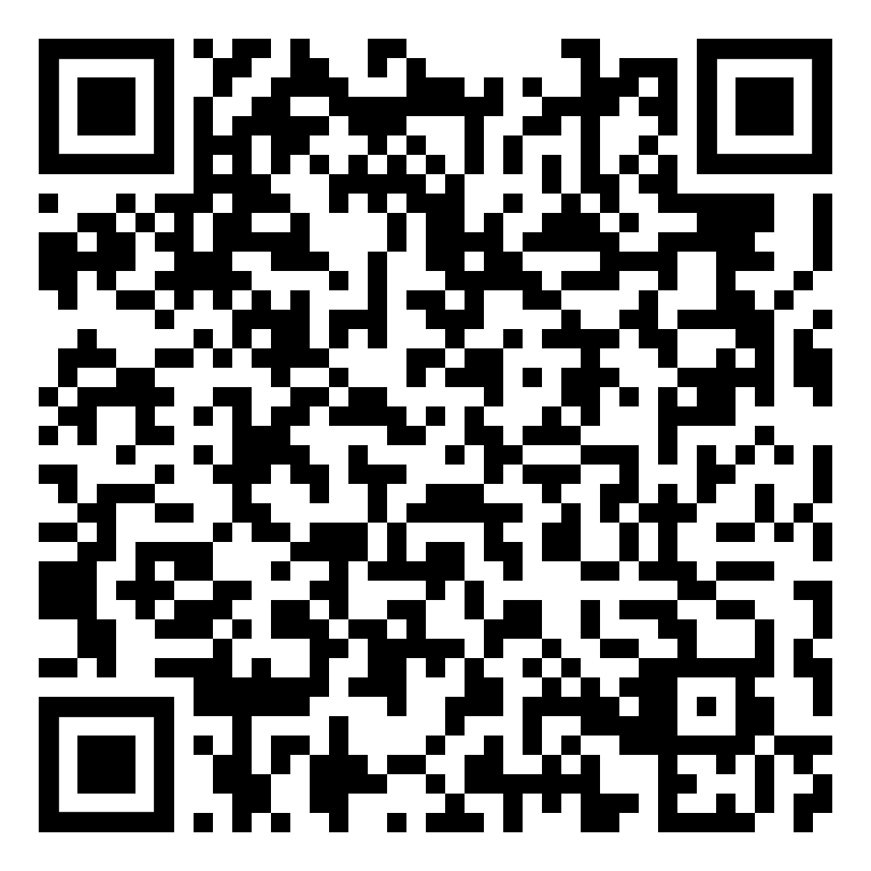
The Via Dolorosa and Christ’s Crucifixion
The following are the learning outcomes for this lesson:
Feel the Holy Ghost
Identify and act on at least one specific thing you will do in your life as a result of our discussion today.
Be able to answer the questions from today’s class period (see QR code)

Slide 4
The Final Hours of Christ: An Approximate Timeline

Slide 5
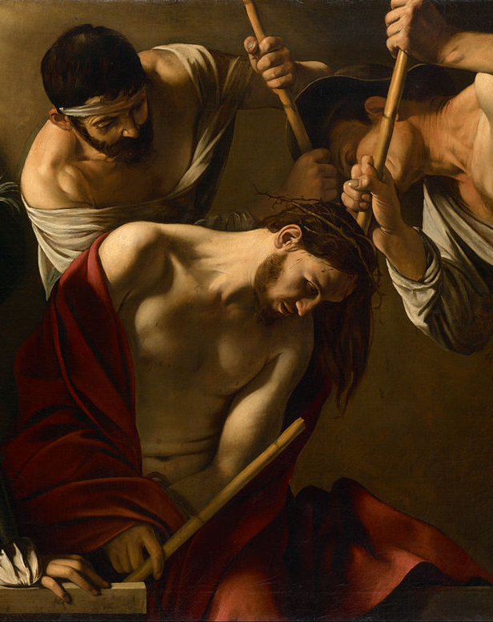
“And the soldiers led him away into the hall, called Prætorium; and they call together the whole band. And they clothed him with purple, and plaited a crown of thorns, and put it about his head, And began to salute him, Hail, King of the Jews! And they smote him on the head with a reed, and did spit upon him, and bowing their knees worshipped him. And when they had mocked him, they took off the purple from him, and put his own clothes on him, and led him out to crucify him” (Mark 15:16–20).
Notes:
Image: https://en.wikipedia.org/wiki/The_Crowning_with_Thorns_(Caravaggio,_Vienna)#/media/File:Michelangelo_Merisi,_called_Caravaggio_-_The_Crowning_with_Thorns_-_Google_Art_Project.jpg

Slide 6
Symbols of Love
The previous scourging and coming crucifixion were incomprehensibly inhumane, but the Roman soldiers had been ordered to take these actions. In contrast, the robe, crown of thorns, pretend scepter, and accompanying abuse seem to have come from the soldiers’ own cruel imaginations. This mockery provides us with three significant symbols—a robe, a crown, and a reed. Looking closer at each one can deepen our perspective of the Savior’s love for us.
Notes:
Image: https://commons.wikimedia.org/wiki/File:ChristandThorns.jpg

Slide 7
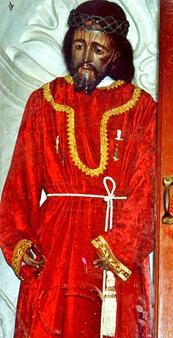
The Robe: Trials Become Triumphs
Matthew describes the color of the robe as “scarlet,” the color of the red cloak worn by soldiers.
At the Second Coming, Christ “shall be red in his apparel, and his garments like him that treadeth in the wine-vat. . . . And his voice shall be heard: I have trodden the wine-press alone . . . ; and none were with me” (D&C 133:48, 50).
Notes:
Image: https://commons.wikimedia.org/wiki/File:EjutlaXPassion.jpg

Slide 8
The Robe: Trials Become Triumphs
The red robe given to the Savior in derision reminds us that trials can become triumphs. Although Christ was once clothed in red and abandoned, he will again come clothed in red, this time accompanied by angels. Because he wore the red robe, each of us can be “encircl[ed] around in the robe of [his] righteousness” (2 Ne. 4:33).

Slide 9
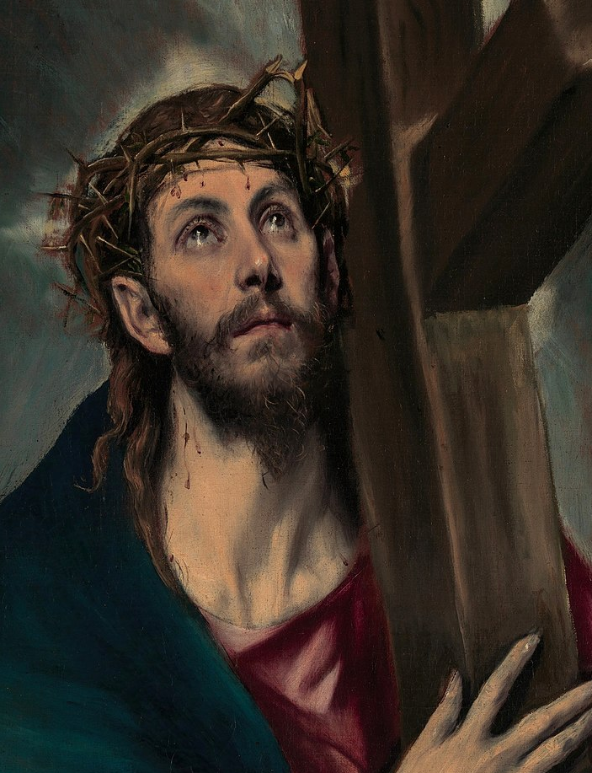
The Crown: A Source of Strength
“Cursed is the ground for thy sake; . . . Thorns also and thistles shall it bring forth to thee” (Gen. 3:17–18, KJV).
Thorns could represent not only the results of sin but also the temptations and trials we face. Paul begged to be rid of his “thorn in the flesh.” Given this context, the Savior, wearing the crown of thorns, was figuratively encircled by sin and weakness.
Notes:
Image: https://en.wikipedia.org/wiki/Crown_of_thorns#/media/File:Christ_Carrying_the_Cross_1580.jpg

Slide 10
The Crown: A Source of Strength
When Paul asked God to take away his thorn in the flesh, the Lord said, “My grace is sufficient for you, for [my] power is made perfect in weakness” (2 Cor. 12:9). Because Jesus wore the crown of thorns, we do not need to be afraid of our personal thorns in the flesh—our challenges and weaknesses. His grace is enough for each of us.

Slide 11
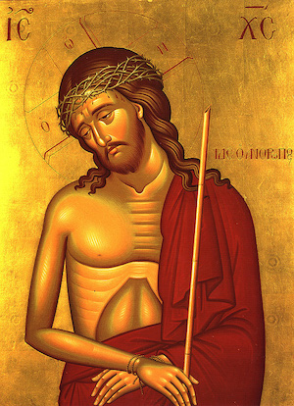
The Reed: Reminder of Power
To complete their scornful depiction of Jesus as a king, the soldiers placed a reed in his hand, representing a royal scepter. Then they snatched it from his hand and hit him on the head with it. Although Christ had the power to stop the soldiers, he didn’t.
From the reed, we learn that although Jesus has all power, he only uses it at the right time. If we wonder why Christ does not always exercise his power in our behalf, we can remember that he did not always exercise it on his own behalf.
Notes:
Image: https://www.missioalliance.org/the-bridegroom-icon/

Slide 12
“And the world, because of their iniquity, shall judge him to be a thing of naught; wherefore they scourge him, and he suffereth it; and they smite him, and he suffereth it. Yea, they spit upon him, and he suffereth it, because of his loving kindness and his long-suffering towards the children of men” (1 Nephi 19:9).
Notes:
Image: https://commons.wikimedia.org/wiki/File:ChristandThorns.jpg

Slide 13
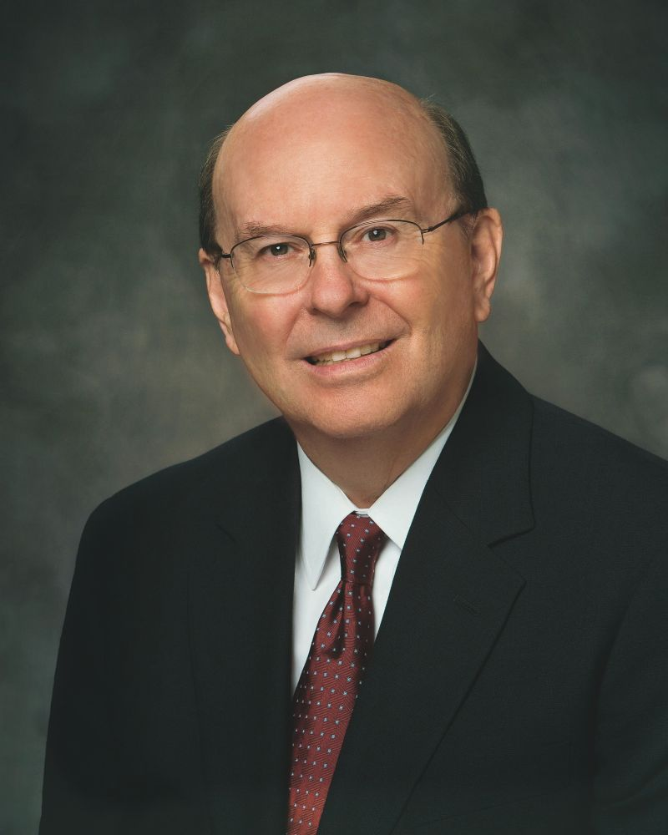
“If the grim realities you are facing at this time seem dark and heavy and almost unbearable, remember that in the soul-wrenching darkness of Gethsemane and the incomprehensible torture and pain of Calvary, the Savior accomplished the Atonement, which resolves the most terrible burdens that can occur in this life. He did it for you, and He did it for me. He did it because He loves us.”
Quentin L. Cook, “The Lord Is My Light,” Ensign, May 2015.
Notes:
Image: https://newsroom.churchofjesuschrist.org/leader-biographies/elder-quentin-l-cook

Slide 15
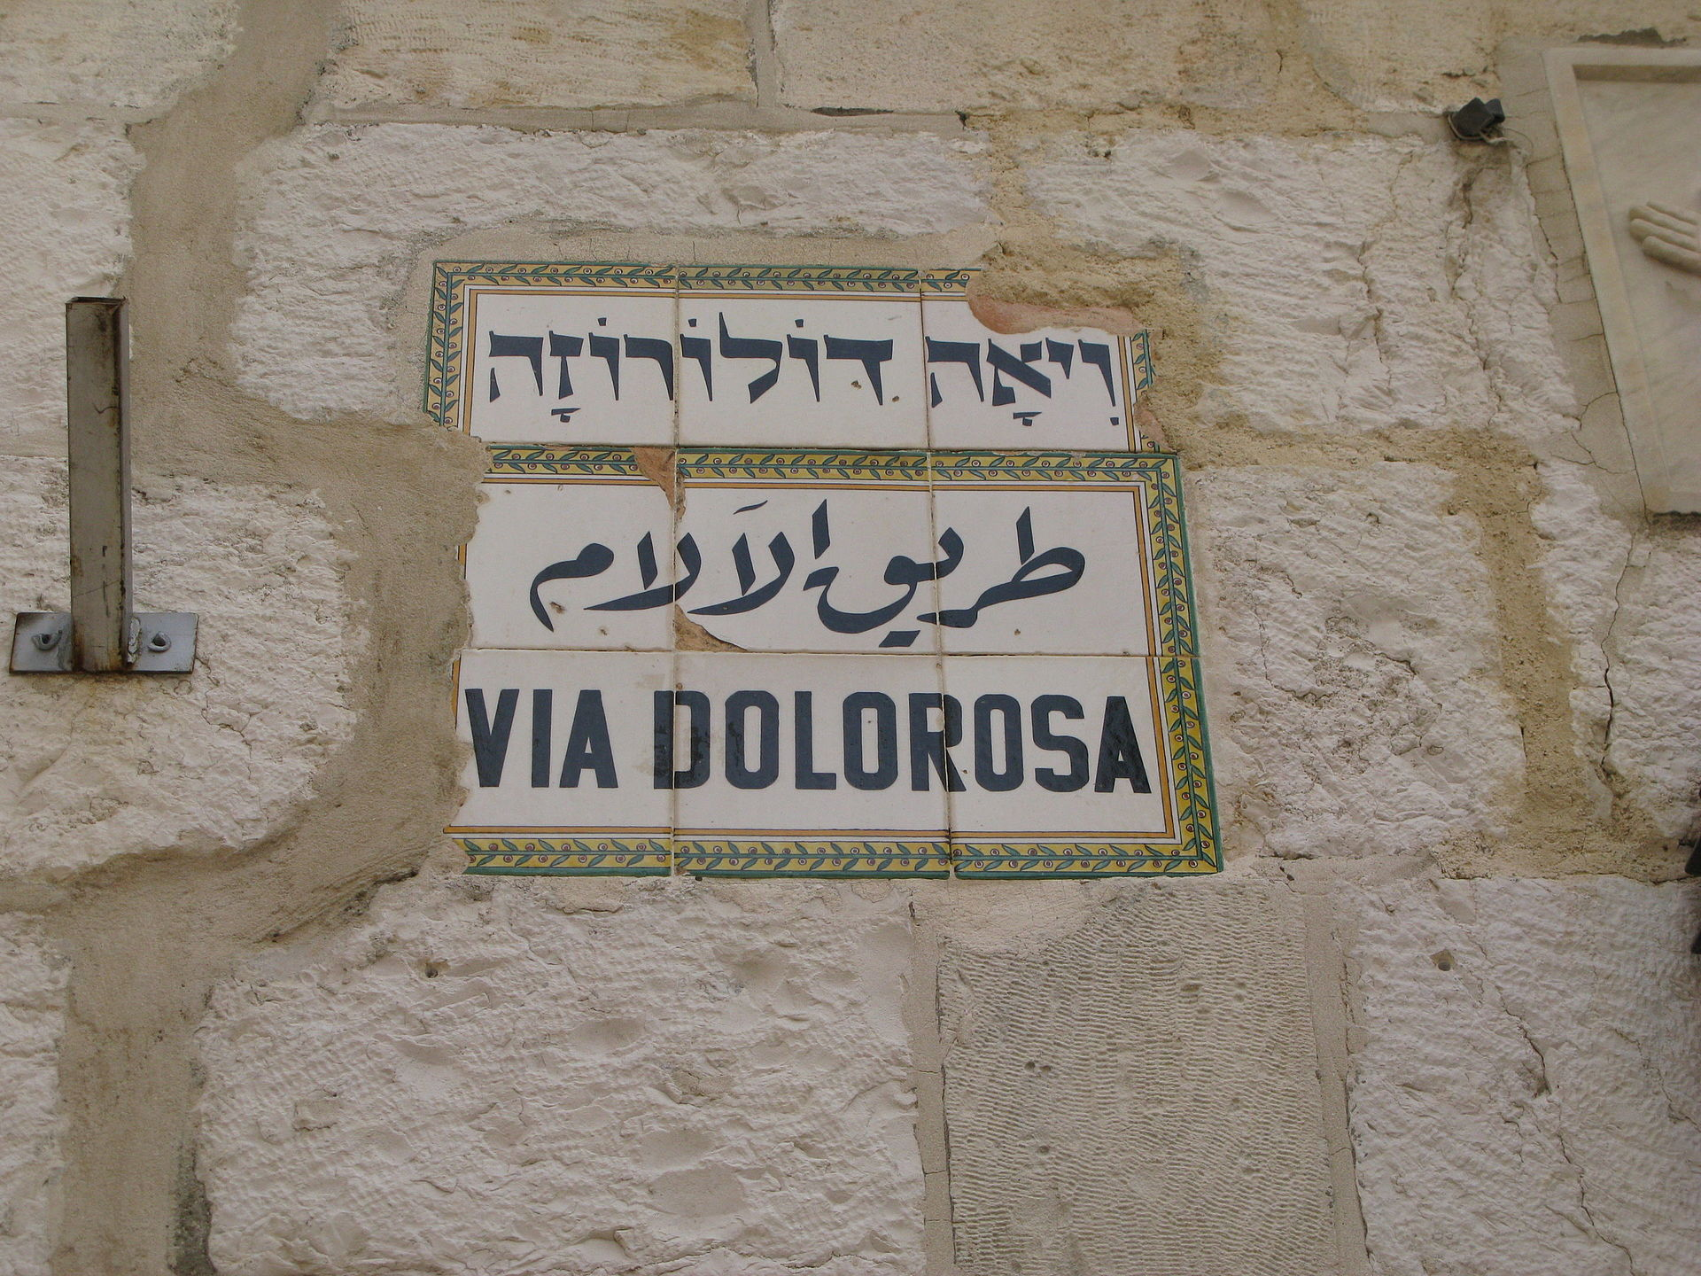
Notes:
Image: https://www.touristisrael.com/via-dolorosa/28670/

Slide 16
Matthew 27:32 | Mark 15:21 | Luke 23:26 | John 19:16–17
And as they came out, they found a man of Cyrene, Simon by name: him they compelled to bear his cross. | And they compel one Simon a Cyrenian, who passed by, coming out of the country, the father of Alexander and Rufus, to bear his cross. | And as they led him away, they laid hold upon one Simon, a Cyrenian, coming out of the country, and on him they laid the cross, that he might bear it after [following] Jesus. | They took Jesus, and led him away. And he [Jesus] bearing his cross went forth into a place called the place of a skull.

Slide 17
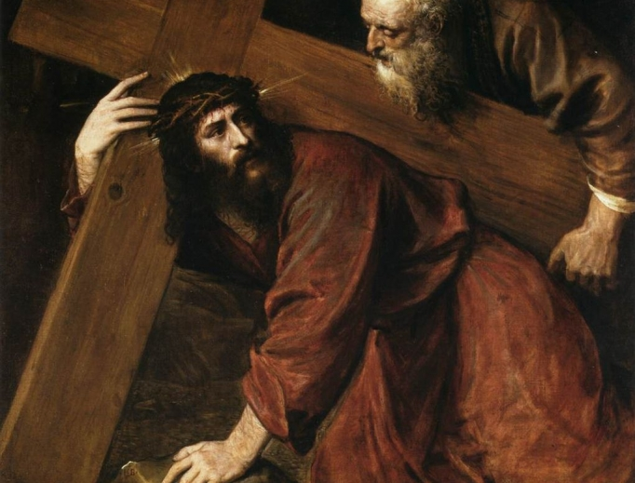
Will we allow others to serve us? Can we remember that we and those we love might be blessed when we do good—even when we are compelled? Will we pick up our own crosses in the attitude of following Jesus? And on a day when it seems like we can’t go on, will we remember a Savior who carried his own cross and know that he can help us carry ours?
Notes:
Image: https://commons.wikimedia.org/wiki/File:Titian_-_Christ_Carrying_the_Cross_-_WGA22830.jpg

Slide 18
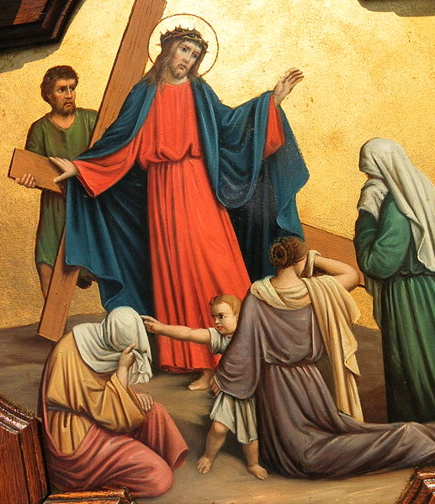
Jesus told the women, who were “beating their breasts and wailing for him,” to “not weep for [him]” but rather to “weep for yourselves and for your children.” He prophesied of a coming day of calamity (Luke 23:27–29).
Both Jesus and the women awaited unfathomable suffering, yet both were more concerned for the well-being of the other.
Notes:
Christ was likely referencing the destruction of Jerusalem that took place in 70 AD, when more than one million people were massacred. Josephus described people resorting to eating scraps of leather and, in some instances, their own children.
Both Jesus and the women awaited unfathomable suffering, yet both were more concerned for the well-being of the other.
Image: https://commons.wikimedia.org/wiki/File:Fr_Pfettisheim_Chemin_de_croix_station_VIII_full.jpg

Slide 19
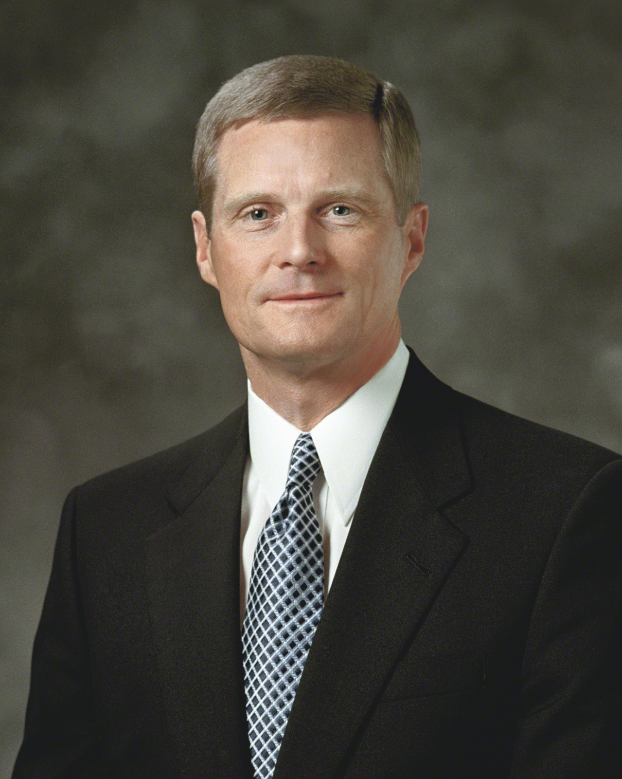
“Throughout His mortal ministry, and especially during the events leading up to and including the atoning sacrifice, the Savior of the world turned outward.” As we strive to emulate the Savior’s example, we can be enabled through Jesus “to reach outward when the natural tendency is for us to turn inward.”
Elder David A. Bednar, “The Character of Christ” (address, Brigham Young University–Idaho Religious Symposium, Rexburg, ID, June 25, 2003),
Notes:
Image: https://www.churchofjesuschrist.org/media/image/elder-david-a-bednar-lds-1307952?lang=eng

Slide 20
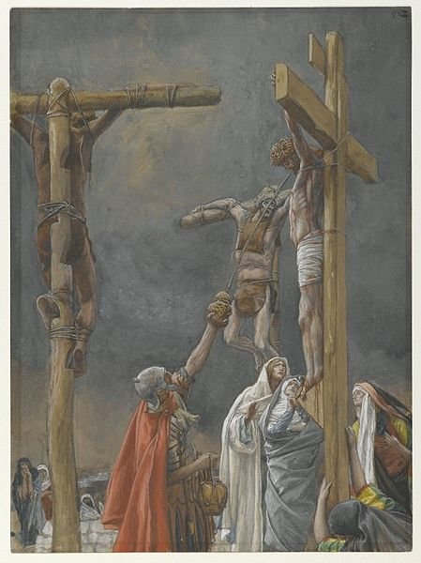
“They gave him vinegar to drink mingled with gall: and when he had tasted thereof, he would not drink” (Matt. 27:34). “They gave me also gall for my meat” (Psalm 69:21). Adding gall (a bitter flavor) to sweet wine is a derisive action that one might expect from the soldiers, who had no desire to ease Christ’s pain.
Notes:
Image: https://commons.wikimedia.org/wiki/File:Brooklyn_Museum_-_%22I_Thirst%22_The_Vinegar_Given_to_Jesus_(%22J%27ai_soif.%22_Le_vinaigre_donné_à_Jésus)_-_James_Tissot.jpg

Slide 21
Notes:
Image: https://www.churchofjesuschrist.org/media/image/easter-pictures-soldiers-gamble-2f23a4e?lang=eng

Slide 22
“During a tragic afternoon on Calvary, a handful of soldiers waited at the foot of a cross. The most important event in all eternity was taking place on the cross above their heads. Oblivious to that fact, they occupied themselves casting lots to divide the earthly property of the dying Son of God.”
Dallin H. Oaks, “Spirituality,” Ensign, November 1985.
Notes:
Image: https://speeches.byu.edu/speakers/dallin-h-oaks/

Slide 23
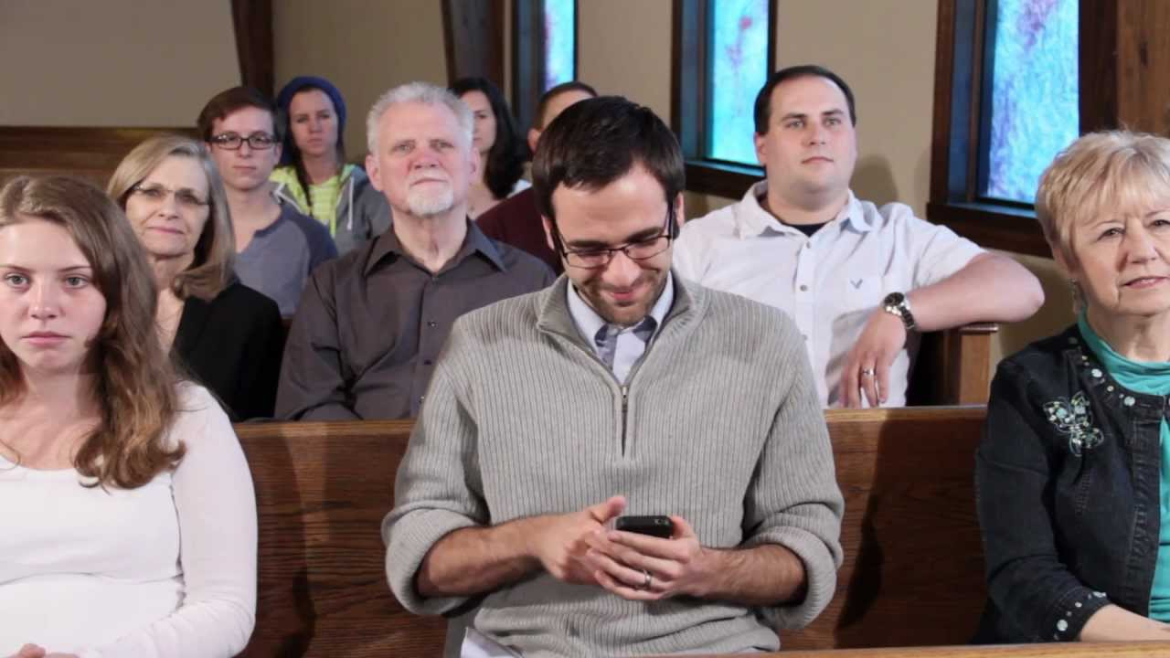
Lord, is it I?
Notes:
Image: https://thesmarttview.com/2019/06/23/cell-phones-in-church/

Slide 24
Pause to Ponder: What message are you hearing for your life?
The robe, the crown, the reed.
Lessons from Simon and the carrying of the cross
Christ’s words to the women on the Via Dolorosa
Soldiers gambling

Slide 25
Matthew, Mark, and John all specify that Christ was crucified at a place called Golgotha, an Aramaic word translated as “the place of a skull” (Mark 15:22). Luke refers to the location as kranion in Greek which is translated into English as “Calvary.” It was “outside the city gate” but “near the city,” likely close to a public road so that people “who passed by” could witness it (Heb. 13:12; John 19:20; Matt. 27:39).
Notes:
Image: https://commons.wikimedia.org/wiki/File:Golgotha_hill2.jpg

Slide 26
Identify the verse that talks about “Calvary’s hill.”
Notes:
Image: https://commons.wikimedia.org/wiki/File:Golgotha_hill2.jpg

Slide 27
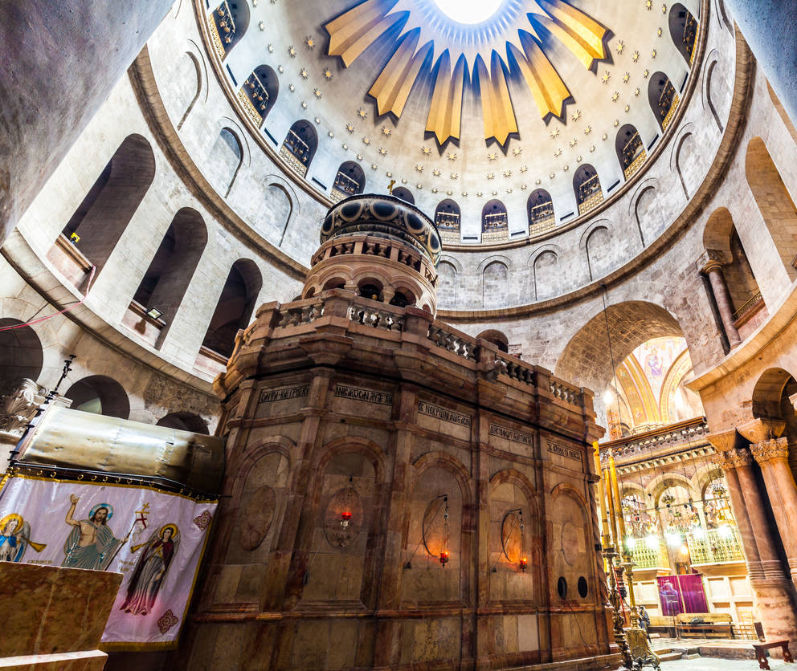
Where Was Golgotha?

Slide 28
“For the bodies of those animals whose blood is brought into the sanctuary by the high priest as a sacrifice for sin are burned outside the camp. Therefore Jesus also suffered outside the city gate in order to sanctify the people by his own blood. Let us then go to him outside the camp and bear the abuse he endured” (Heb. 13:11–13).
Notes:
Image: https://en.wikipedia.org/wiki/Calvary
STORY FROM BOOK

Slide 29
Finding the Old Testament in the New
Mark 15:24 and Psalm 22:18
Mark 15:27 and Psalm 22:16
Mark 15:29 and Psalm 22:7
Mark 15:34 and Psalm 22:1
How does Psalm 22 end?

Slide 30
The Savior’s placement between two criminals also relates with Isaiah 53:12: “And the scripture was fulfilled, which saith, And he was numbered with the transgressors.”
“And with him they crucify two thieves; the one on his right hand, and the other on his left” (Mark 15:27).
Notes:
In Mark 15:28 we read that the Savior’s placement between two criminals also relates with Isaiah 53:12: “And the scripture was fulfilled, which saith, And he was numbered with the transgressors.”
Image 1: https://commons.wikimedia.org/wiki/File:Dettaglio_della_Vocazione_dei_figli_di_Zebedeo_di_Marco_Basaiti_(4).JPG
Image 2: https://commons.wikimedia.org/wiki/File:Peter_Paul_Rubens_-_Le_Christ_entre_les_deux_larrons_-_Musée_des_Augustins_-_2004_1_46.jpg

Slide 31
“They said unto him, Grant unto us that we may sit, one on thy right hand, and the other on thy left hand, in thy glory” (Mark 10:37).
Notes:
In Mark 15:28 we read that the Savior’s placement between two criminals also relates with Isaiah 53:12: “And the scripture was fulfilled, which saith, And he was numbered with the transgressors.”
Image 1: https://commons.wikimedia.org/wiki/File:Dettaglio_della_Vocazione_dei_figli_di_Zebedeo_di_Marco_Basaiti_(4).JPG
Image 2: https://commons.wikimedia.org/wiki/File:Peter_Paul_Rubens_-_Le_Christ_entre_les_deux_larrons_-_Musée_des_Augustins_-_2004_1_46.jpg

Slide 32
“They said unto him, Grant unto us that we may sit, one on thy right hand, and the other on thy left hand, in thy glory” (Mark 10:37).
“And with him they crucify two thieves; the one on his right hand, and the other on his left” (Mark 15:27).
Notes:
In Mark 15:28 we read that the Savior’s placement between two criminals also relates with Isaiah 53:12: “And the scripture was fulfilled, which saith, And he was numbered with the transgressors.”
Image 1: https://commons.wikimedia.org/wiki/File:Dettaglio_della_Vocazione_dei_figli_di_Zebedeo_di_Marco_Basaiti_(4).JPG
Image 2: https://commons.wikimedia.org/wiki/File:Peter_Paul_Rubens_-_Le_Christ_entre_les_deux_larrons_-_Musée_des_Augustins_-_2004_1_46.jpg

Slide 33
Julie Smith Gospel According to Mark
Mark’s phrase “one on his right and one on his left” is “not only an odd detail to include but also a very long alternative to having Jesus ‘between’ two thieves. This language is almost surely used to echo the intemperate request of James and John to be given the seats of honor on Jesus’ left and right hand [in his glory] ([Mark] 10:37–40). The alert audience member would thus realize that the crucifixion is, shockingly, the ‘glory’ of Jesus.”
Notes:
Image: https://www.amazon.com/Gospel-according-Mark-Testament-Commentary/dp/1942161530

Slide 34
Julie Smith Gospel According to Mark
“This connection is strengthened by the fact that, in the exchange with James and John, Jesus referred to his suffering and death as his ‘baptism’ and ‘cup’ and asked if they were capable of participating in those with him. Despite James and John’s affirmations, it is not them but rather two strangers who are at Jesus’ right and left here. Thus, the reference to the thieves is a commentary on the disciples’ abandonment of Jesus.”
Notes:
Image: https://www.amazon.com/Gospel-according-Mark-Testament-Commentary/dp/1942161530

Slide 35
And Pilate wrote a title, and put it on the cross. And the writing was Jesus Of Nazareth The King Of The Jews.
This title then read many of the Jews: for the place where Jesus was crucified was nigh to the city: and it was written in Hebrew, and Greek, and Latin.
Then said the chief priests of the Jews to Pilate, Write not, The King of the Jews; but that he said, I am King of the Jews.
Pilate answered, What I have written I have written.
John 19:19–22
Notes:
Image: https://en.wikipedia.org/wiki/Christ_on_the_Cross_(Rembrandt)#/media/File:Crucifixion_by_Rembrandt_(1631,_S.Vincent_du_Mas-d'Agenais).jpg
“the representative of the greatest power on earth . . . verified that Jesus is king for every passerby to see.”
The inscription was written in three different languages: Hebrew, Latin, and Greek (see John 19:20). Hebrew was the local written language in Jerusalem, Latin was the language of the Romans, and Greek was the international language. Although these languages might not have theological significance, perhaps Pilate’s inscription foreshadows the good news of Christ being preached to people “from every tribe and language and people and nation” (Rev. 5:9).

