Slide 1
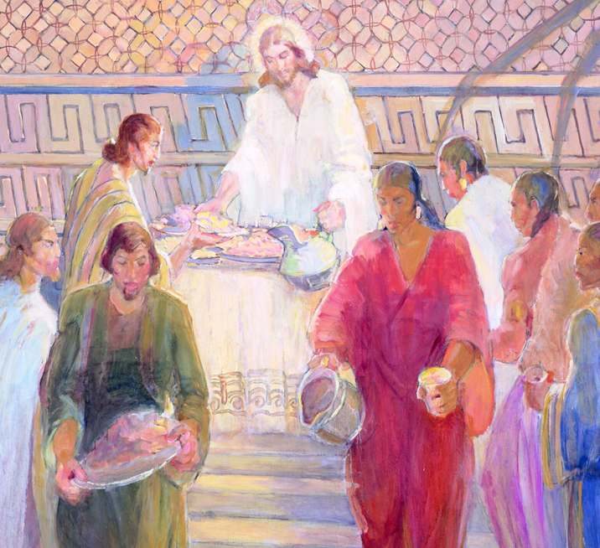
Welcome to Class! Before We Start…
Enjoy this music: “Glorious Day,” by Casting Crowns
Test opens today, closes Saturday at 11:59 PM (same structure as previous test)
No readings for class on Monday—take the test, work on your paper!

Slide 2
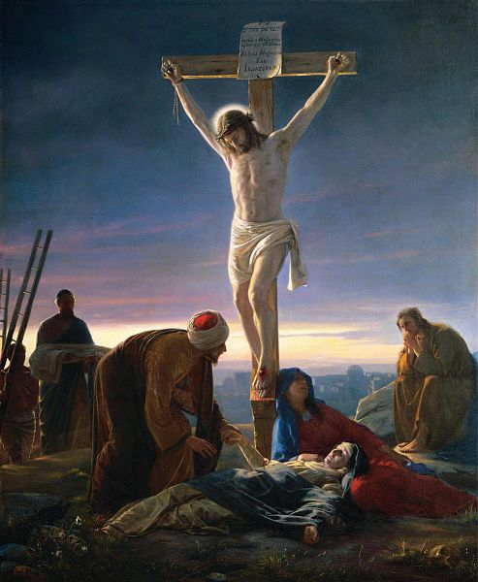
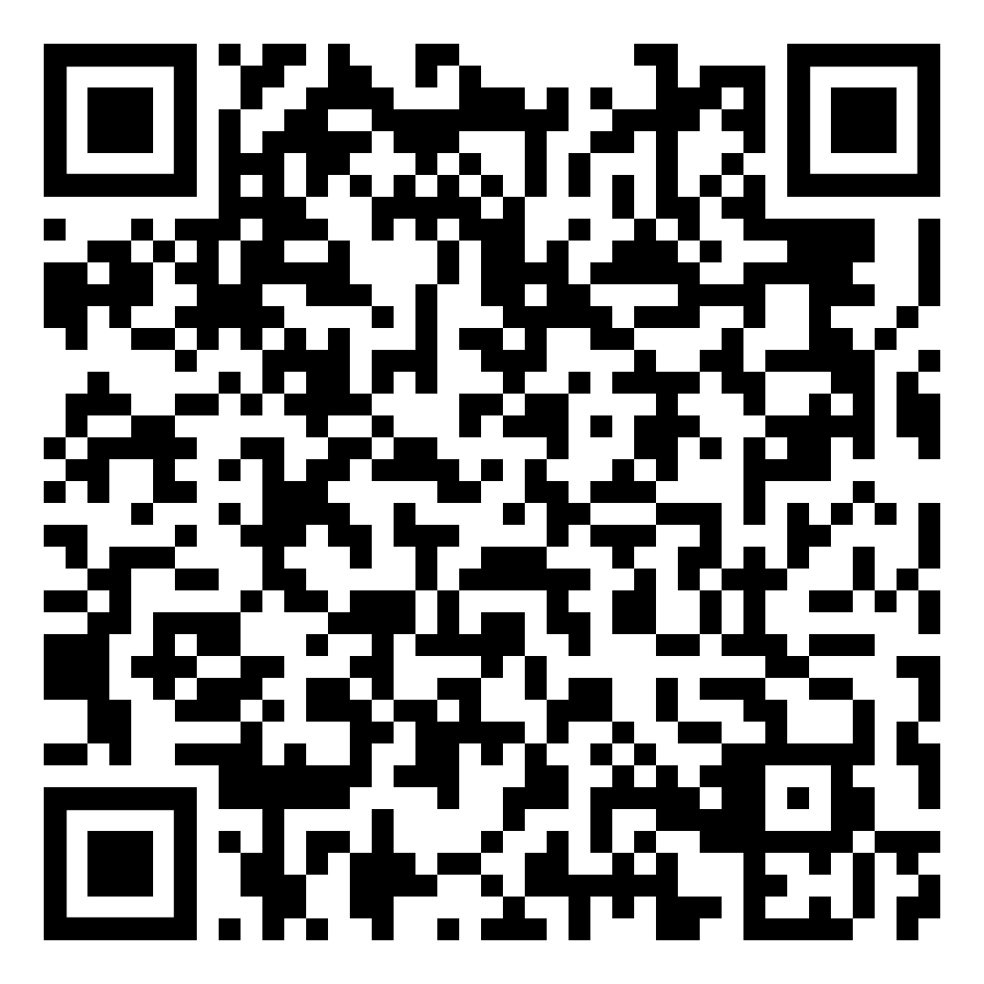
Crucifixion Symbolism in Gospel Ordinances
The following are the learning outcomes for this lesson:
Feel the Holy Ghost
Identify and act on at least one specific thing you will do in your life as a result of our discussion today.
Be able to answer the questions from today’s class period (see QR code)

Slide 3
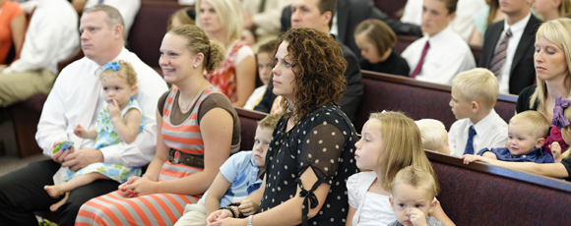
A man once asked President Spencer W. Kimball, “What do you do when you find yourself in a boring sacrament meeting?” After a moment of thought, President Kimball responded,
Notes:
Notes: https://www.ldsliving.com/5-Powerful-Sacrament-Talk-Tips-I-Learned-from-Teaching-Relief-Society/s/84158

Slide 4
A man once asked President Spencer W. Kimball, “What do you do when you find yourself in a boring sacrament meeting?” After a moment of thought, President Kimball responded, “I don’t know. I’ve never been in one.”
Notes:
Notes: https://www.ldsliving.com/5-Powerful-Sacrament-Talk-Tips-I-Learned-from-Teaching-Relief-Society/s/84158

Slide 5
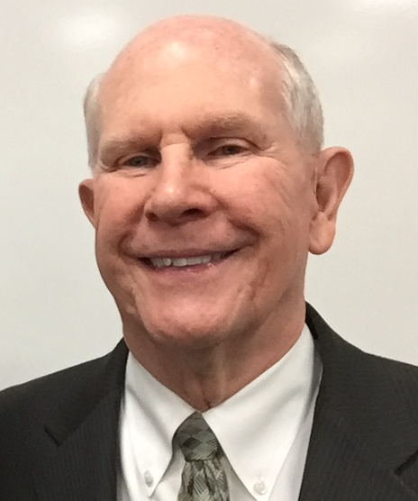
Elder Gene R. Cook, who related this story, said, “That’s interesting, isn’t it? That tells me that the real meeting was between President Kimball and the Lord. . . . If you enter a meeting with your heart prepared to be written upon by the Lord, then that will happen.”
Notes:
Gerry Avant, “Learning Gospel Is Lifetime Pursuit,” Church News, March 24, 1990, 10.
Image: https://en.wikipedia.org/wiki/Spencer_W._Kimball

Slide 6
Crucifixion Symbolism in Gospel Ordinances
Baptism/Baptism for the Dead
The Sacrament
Initiatory
Endowment
Sealing

Slide 7
“Know ye not, that so many of us as were baptized into Jesus Christ were baptized into his death. Therefore we are buried with him by baptism into death: that like as Christ was raised up from the dead by the glory of the Father, even so we also should walk in newness of life. For if we have been planted together in the likeness of his death, we shall be also in the likeness of his resurrection” (Romans 6:3–5).

Slide 8
“Jesus descends beneath the wave, / The emblem of his future grave”
“As an emblem of thy passion, / And thy vict’ry o’er the grave, / We, who know the great salvation, / Are baptized beneath the wave.”
A Collection of Sacred Hymns, 1835
Notes:
Hymn 55” and “Hymn 54,” in A Collection of Sacred Hymns for the Church of the Latter Day Saints (Kirtland, OH: F. G. Williams & Co., 1835), 71, available at https://www.josephsmithpapers.org/paper-summary/collection-of-sacred-hymns-1835/73.
Image: https://commons.wikimedia.org/wiki/File:LDS_Baptism_Panama.JPG

Slide 9
Alma taught that at baptism we covenant “...to stand as witnesses of God at all times and in all things, and in all places that ye may be in, even until death” (Mosiah 18:9).
Notes:
Image: https://en.wikipedia.org/wiki/Abinadi#/media/File:DeathOfAbinadi.png

Slide 10
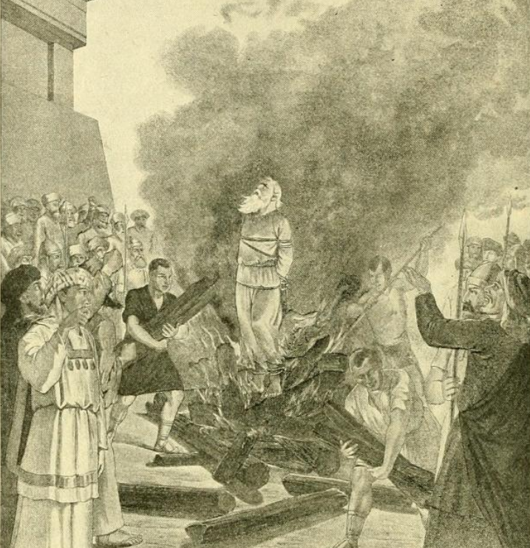
Alma taught that at baptism we covenant “...to stand as witnesses of God at all times and in all things, and in all places that ye may be in, even until death” (Mosiah 18:9).
Notes:
Image: https://en.wikipedia.org/wiki/Abinadi#/media/File:DeathOfAbinadi.png

Slide 11
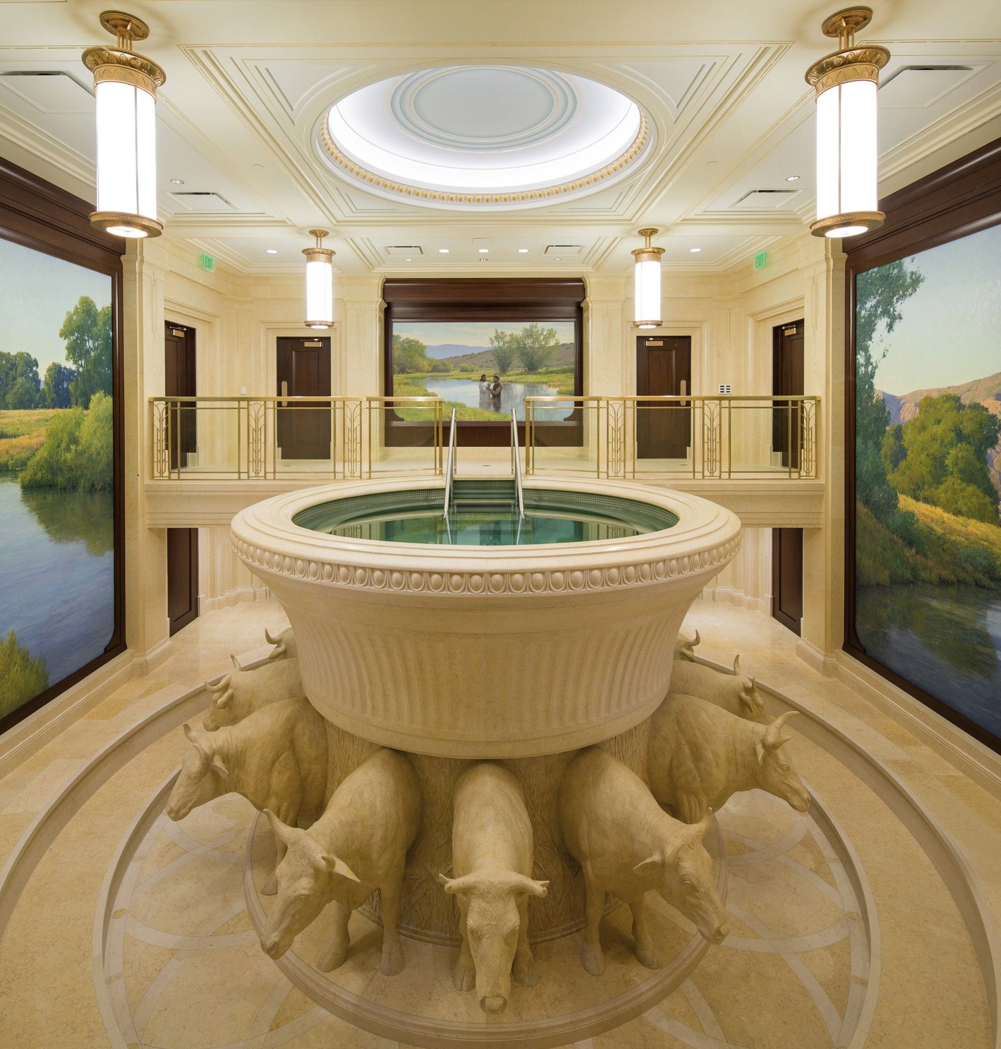
“The baptismal font was instituted as a similitude of the grave, and was commanded to be in a place underneath where the living are wont to assemble, to show forth the living and the dead” (D&C 128:13).
Notes:
Image: https://www.churchofjesuschrist.org/media/image/ogden-temple-font-baptistry-3743b95?lang=eng

Slide 12
Make it Personal
How do connections between the Savior’s death and your baptism change the way you feel about your baptism?
How do these connections strengthen your desire to keep your covenants?

Slide 13
Crucifixion Symbolism in Gospel Ordinances
Baptism/Baptism for the Dead
The Sacrament
Initiatory
Endowment
Sealing

Slide 14
He took the bread, and bles’d, and brake—
What wondrous words of grace he spake!
“This is my body broke for sin;
“Receive and eat the living food.”
Then took the cup, and bless’d the wine,
“’Tis the new cov’nant in my blood.”
For us his flesh with nails was torn,
He bore the scourge, he felt the thorn;
When for our sins, he suff’ring dies
And gave his life a sacrifice.
“Do this”, he cried, “till time shall end,
“In mem’ry of your dying friend;
“Meet at my table, and record
The love of your departed Lord.
A Collection of Sacred Hymns, 1835

Slide 15
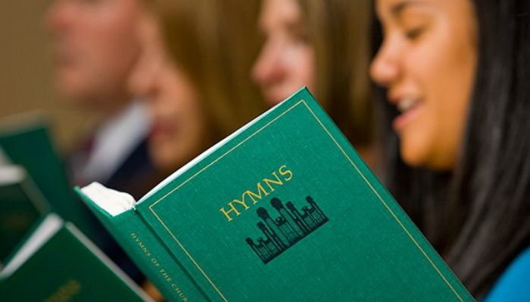
What Other Lines from Sacrament Hymns Connect with Christ’s Crucifixion?

Slide 16
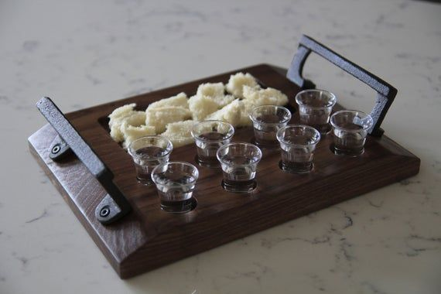
“For as often as ye eat this bread, and drink this cup, ye do shew the Lord’s death till he come” (1 Cor. 11:26).
“As often as you eat this bread and drink the cup, you proclaim the Lord’s death” (NRSV)
“Every time you eat this bread and drink this cup, you are announcing the Lord’s death” (NLT).

Slide 17
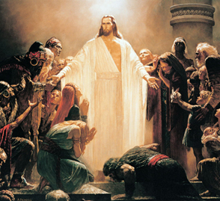
3 Nephi 11:14-15
3 Nephi 18:7
Notes:
Image 1: The Sacrament Mural, Minerva Teichert https://knowhy.bookofmormoncentral.org/knowhy/why-did-the-savior-emphasize-his-risen-body-in-the-nephite-sacrament
Image 2: The Risen Lord, Arnold Friberg https://knowhy.bookofmormoncentral.org/knowhy/why-did-the-savior-emphasize-his-risen-body-in-the-nephite-sacrament

Slide 18
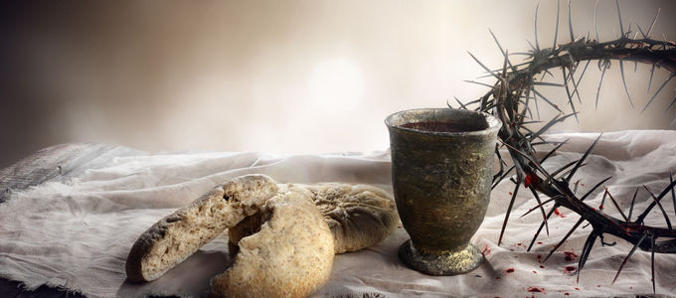
“For, behold, I say unto you, that it mattereth not what ye shall eat or what ye shall drink when ye partake of the sacrament, if it so be that ye do it with an eye single to my glory—remembering unto the Father my body which was laid down for you, and my blood which was shed for the remission of your sins” (D&C 27:2).
Notes:
Image from https://nac.today/en/a/503328

Slide 19
Make it Personal
How could connections between the Savior’s death and the sacrament change the way you approach the sacrament each week?
How do these connections strengthen your desire to partake of the sacrament?

Slide 20
Crucifixion Symbolism in Gospel Ordinances
Baptism/Baptism for the Dead
The Sacrament
Initiatory
Endowment
Sealing

Slide 21
“And Aaron and his sons thou shalt bring unto the door of the tabernacle of the congregation, and shalt wash them with water...Then shalt thou take the anointing oil, and pour it upon his head, and anoint him. And thou shalt bring his sons, and put coats upon them... And thou shalt cause a bullock to be brought before the tabernacle…thou shalt kill the bullock before the Lord…”
(Ex. 29:4, 7–8, 10-11, compare Ex. 40:12-15)
Notes:
Context goes on with additional sacrifices.

Slide 22
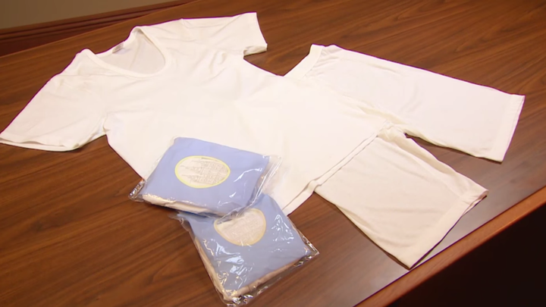
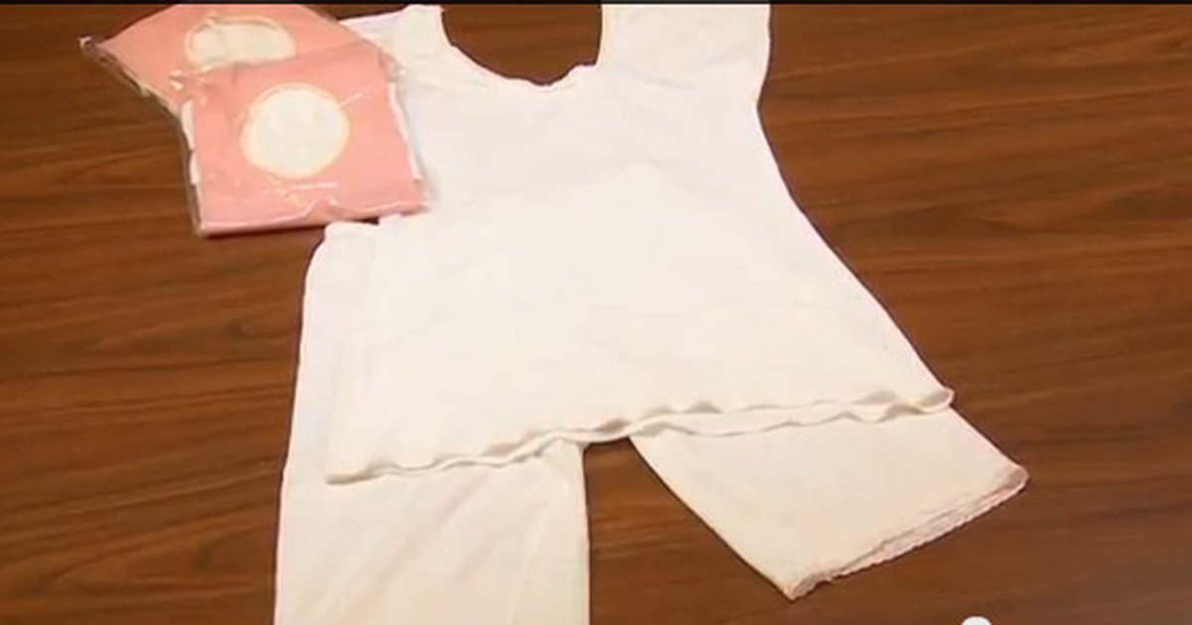
“Thou shalt put upon Aaron the holy garments, and anoint him, and sanctify him” (Exodus 40:13‎)‎
The parallels between the temple veil (a symbol of Christ’s sacrificed body, as we will discuss) and the temple garment (with its “several simple marks”) help us see the garment as a powerful symbol of the Savior’s body, sacrificed for us.
Notes:
Carlos Asay, “The Temple Garment, an Outward Expression of an Inward Commitment, Ensign, August 1997.

Slide 23
Crucifixion Symbolism in Gospel Ordinances
Baptism/Baptism for the Dead
The Sacrament
Initiatory
Endowment
Sealing

Slide 24
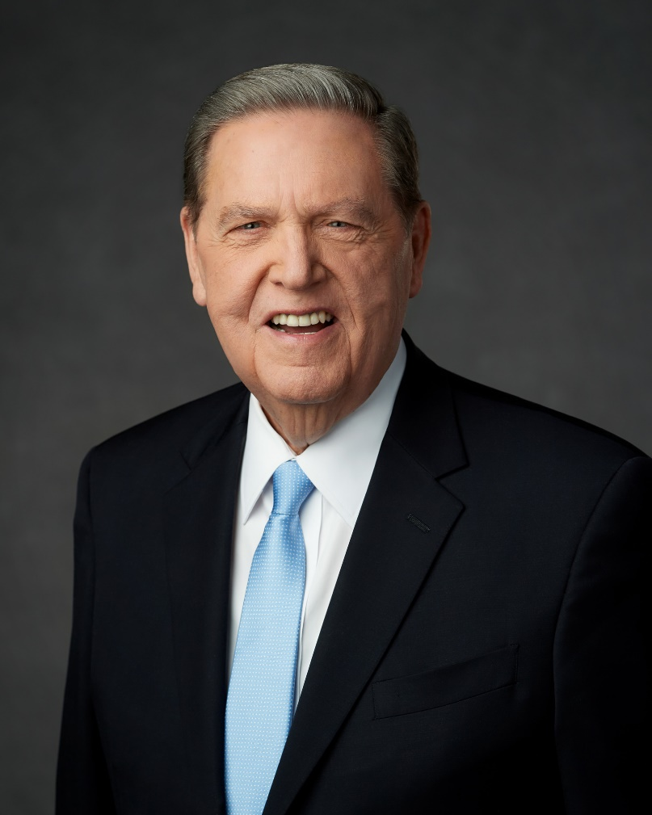
“We are to see, above all else, the meaning of Jesus in the temple.”
Elder Jeffrey R. Holland, Ensign, November 2019
Notes:
Image: https://newsroom.churchofjesuschrist.org/article/elder-jeffrey-r-holland-admitted-hospital

Slide 25
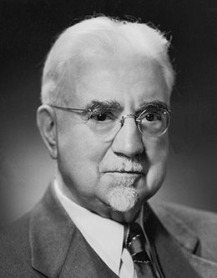
“No man or woman can come out of the temple endowed as he should be, unless he has seen, beyond the symbol, the mighty realities for which the symbols stand.”
John A. Widstoe, “Temple Worship,” The Utah Genealogical and Historical Magazine 12 (1921): 62.
Notes:
Image: https://speeches.byu.edu/speakers/john-a-widtsoe/

Slide 26
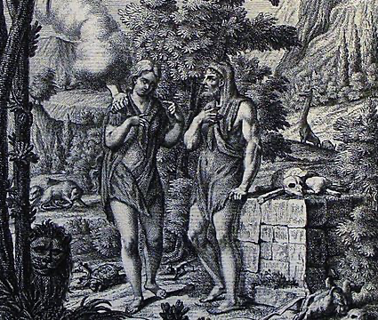
Moses 5:5-7
Notes:
Image: https://commons.wikimedia.org/wiki/File:The_Phillip_Medhurst_Picture_Torah_24._Adam_and_Eve_are_clothed_in_skins._Genesis_cap_3_v_21._Tyroff.jpg

Slide 27
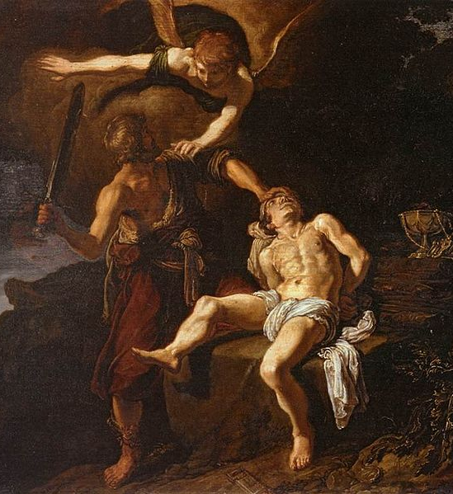
For millennia, altars have pointed to the death of Jesus Christ. For example, Abraham “built an altar . . . and bound Isaac his son, and laid him on the altar” (Gen. 22:9), which was “a similitude of God and his Only Begotten Son” (Jacob 4:5, see also Lev. 9:7, 2 Chron. 29:24).
Notes:
Image 1: https://upload.wikimedia.org/wikipedia/commons/0/09/Pieter_Lastman_-_The_Angel_of_the_Lord_Preventing_Abraham_from_Sacrificing_his_Son_Isaac_-_WGA12483.jpg
Image 2: https://www.ldsliving.com/5-Gifts-We-Are-Given-When-We-Receive-Our-Temple-Endowment/s/91583

Slide 28
Notes:
Image 1: https://upload.wikimedia.org/wikipedia/commons/0/09/Pieter_Lastman_-_The_Angel_of_the_Lord_Preventing_Abraham_from_Sacrificing_his_Son_Isaac_-_WGA12483.jpg
Image 2: https://www.ldsliving.com/5-Gifts-We-Are-Given-When-We-Receive-Our-Temple-Endowment/s/91583

Slide 29
As part of the endowment ceremony, “men and women dressed in temple clothing, surround an altar in a circle formation to participate unitedly in prayer.” This symbolism suggests that as Latter-day Saints today surround an altar to pray, Christ’s death is central to the prayer. Those participating in this ceremony can easily identify additional Crucifixion imagery that is part of “the true order of prayer.”
Notes:
Image 1: https://upload.wikimedia.org/wikipedia/commons/0/09/Pieter_Lastman_-_The_Angel_of_the_Lord_Preventing_Abraham_from_Sacrificing_his_Son_Isaac_-_WGA12483.jpg
Image 2: https://www.ldsliving.com/5-Gifts-We-Are-Given-When-We-Receive-Our-Temple-Endowment/s/91583

Slide 30
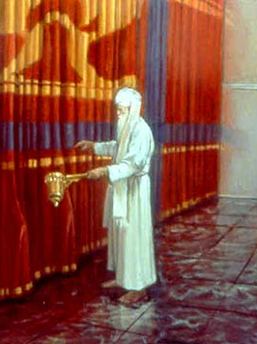
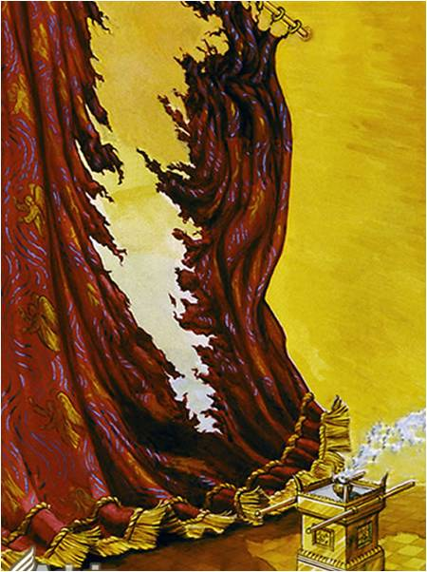
Matt. 27:51 // Hebrews 10:19-20
Notes:
In the ancient temple, the Holy of Holies, representing God’s dwelling place, was separated from other parts of the temple by a veil. At Christ’s Crucifixion, the veil of the temple was torn in two (see Matt. 27:51). According to the author of the book of Hebrews, the torn veil means that now all humanity can enter into God’s presence through “the blood of Jesus, by a new and living way . . . through the veil, that is to say, his flesh” (Heb. 10:19–20). In other words, the temple veil represents Christ’s sacrificed body.
The parallels between the temple veil (a symbol of Christ’s sacrificed body, discussed below) and the temple garment (with its “several simple marks”) help us see the garment as a powerful symbol of the Savior’s body, sacrificed for us.
Image 1: http://sinagogadoboj.org/bhs/wp-content/uploads/2015/09/B-JK-DivrejTora-5778.pdf
Image 2: https://sites.google.com/a/desertsunlimitedatonement.com/desert-sun/desert-sun/jesus-death-resurrection-ascension/122---the-crucifixion

Slide 31
“Having therefore, brethren, boldness to enter into the holiest by the blood of Jesus, by a new and living way, which he hath consecrated for us, through the veil, that is to say, his flesh” (Hebrews 10:19–20).
Notes:
Image: https://commons.wikimedia.org/wiki/File:Hanky_Linen_Sheer_Curtains_with_pleats_and_rings.jpg

Slide 32
“The rituals of the temple . . . crescendo with palpable crucifixion imagery at the veil, that symbolic, porous membrane joining heaven and earth. It is through . . . the severed flesh of Christ . . . that all find full incorporation into the Heavenly Family.”
Fiona and Terryl Givens, The Christ Who Heals: How God Restored the Truth That Saves Us (Salt Lake City: Deseret Book, 2017), 61–62.

Slide 33
Make it Personal
How do the connections between the Savior’s death and the temple ordinances we have discussed deepen your understanding of the temple endowment?
How do these connections strengthen your desire to make and keep temple covenants?

Slide 34
Crucifixion Symbolism in Gospel Ordinances
Baptism/Baptism for the Dead
The Sacrament
Initiatory
Endowment
Sealing

Slide 35
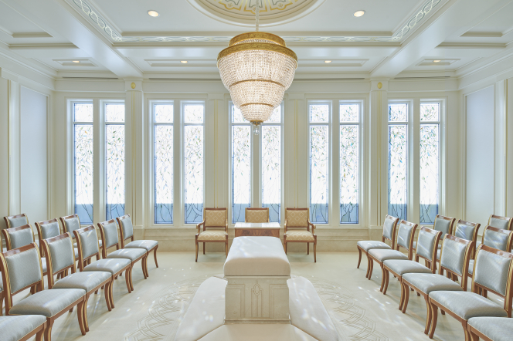
http://temples.churchofjesuschrist.org
Notes:
Image: https://www.churchofjesuschrist.org/media-library/images/rome-italy-temple-2160441?lang=eng

Slide 36
“They killed also the lambs, and they sprinkled the blood upon the altar” (2 Chronicles 29:22)

Slide 37
I invited them to the altar, and…the groom took the bride by the hand…” (Elder Bruce C. Hafen)
Notes:
Whether one thinks of the altar, or the hands clasped together on the altar, the Crucifixion of Jesus Christ is literally at the center of the sealing ordinance. When a husband and wife are sealed together in the temple, their marriage is no longer just about a man and a woman—the Savior is a central third party.

Slide 38
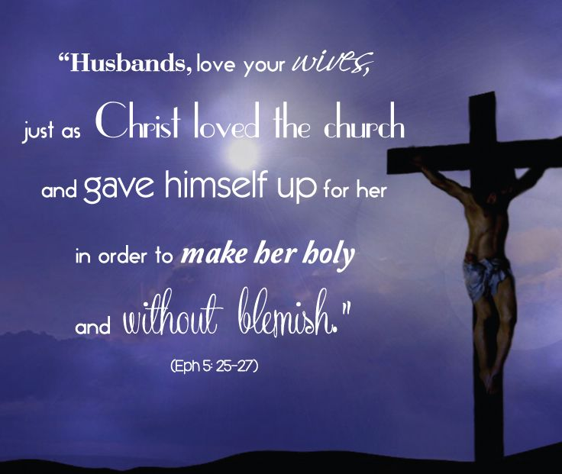

Slide 39
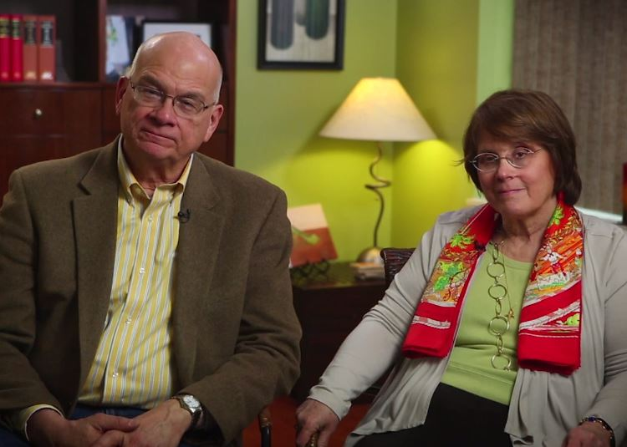
“In Ephesians 5, Paul tells us that Jesus laid down his life for us, forgiving us at great cost to make us something beautiful. And because he has done it for us, we can do the same for others.
Timothy and Kathy Keller,
The Meaning of Marriage,
135, 186

Slide 40
“On the cross, Jesus did not look down on us with a heart full of admiration and affection. He felt no ‘chemistry.’ But he gave himself. He put our needs ahead of his own; he sacrificed for us.
Timothy and Kathy Keller,
The Meaning of Marriage,
135, 186

Slide 41
“But the Bible tells spouses not only to imitate the quality and manner of Christ’s love but also the goal of it. Jesus died not because we were lovely, but to make us lovely. He died, Paul says, to ‘make us holy’ [Ephesians 5:26].
Timothy and Kathy Keller,
The Meaning of Marriage,
135, 186

Slide 42
“Paradoxically, this means Paul is urging spouses to help their mates love Jesus more than them. It’s a paradox but not a contradiction. The simple fact is that only if I love Jesus more than my wife will I be able to serve her needs ahead of my own.
Timothy and Kathy Keller,
The Meaning of Marriage,
135, 186

Slide 43
“Only if my emotional tank is filled with love from God will I be able to be patient, faithful, tender, and open with my wife when things are not going well in life or in the relationship. And the more joy I get from my relationship with Christ, the more I can share that joy with my wife and family.”
Timothy and Kathy Keller,
The Meaning of Marriage,
135, 186

Slide 44
Make it Personal
How do the connections between the Savior’s death and the sealing ordinance change the way you view marriage?
How do these connections strengthen your desire to become a better spouse (either now or in the future)?

Slide 45
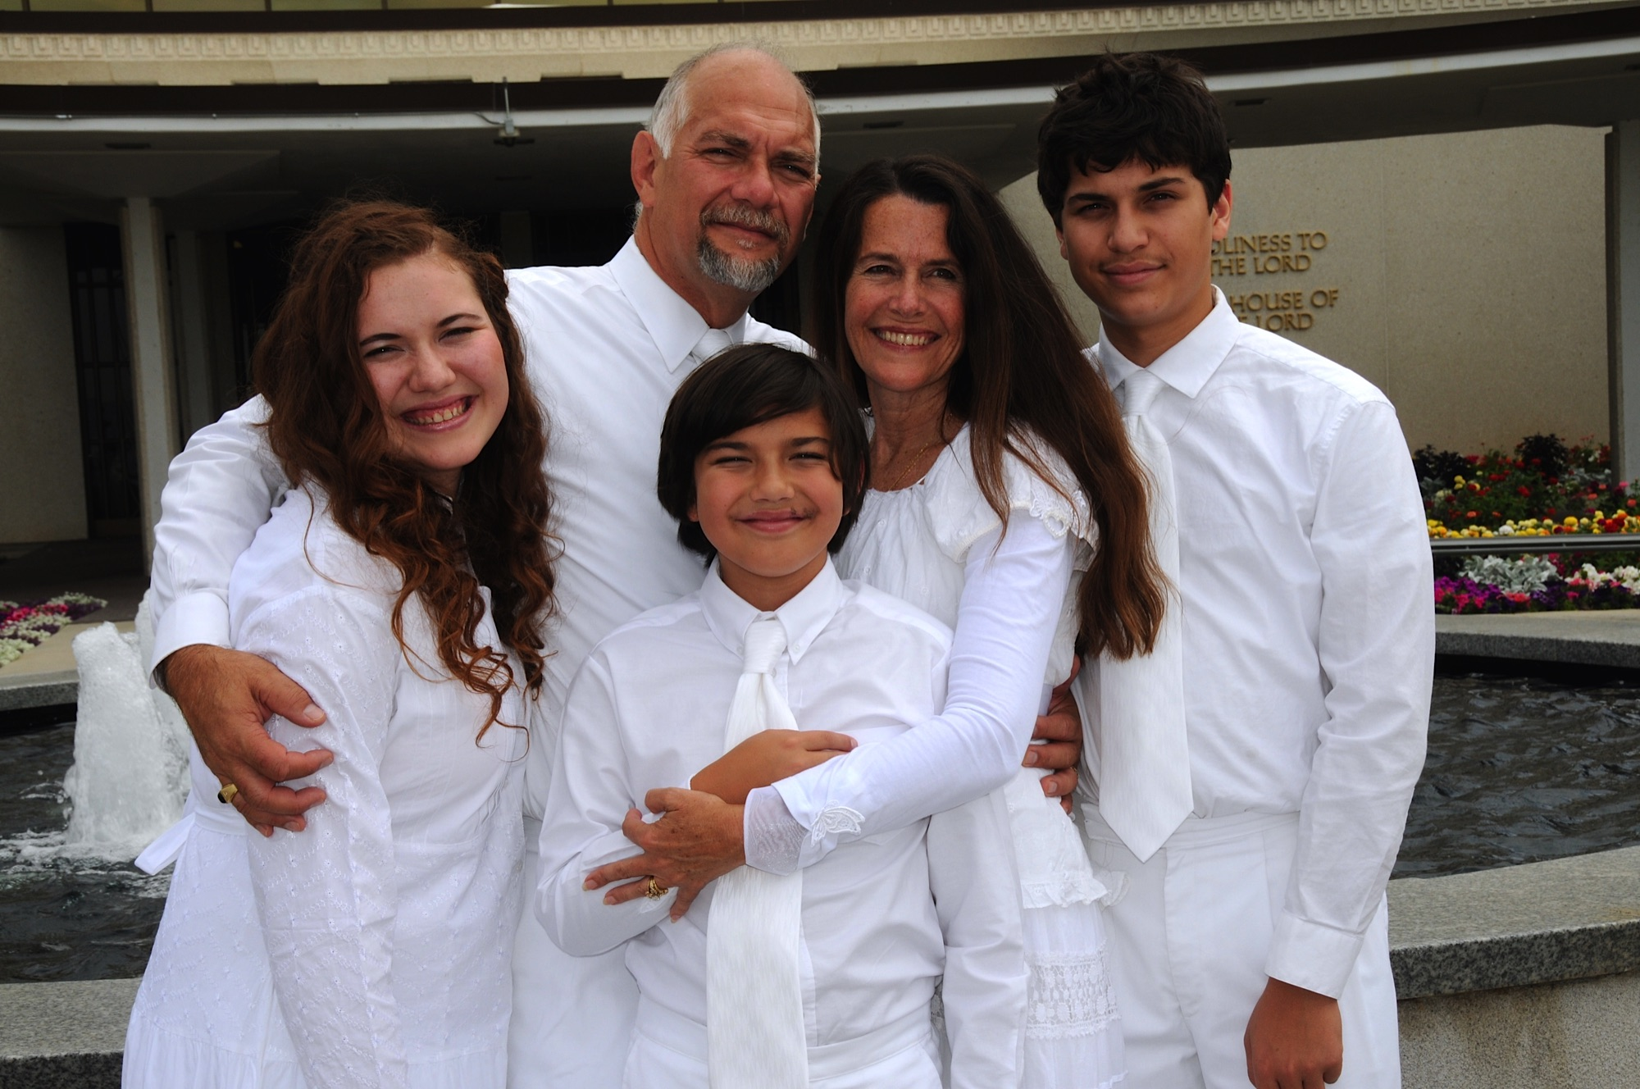
Sealing of Parents to Children

Slide 46
In the temple, parents are sealed to children at the altar of the sealing room as participants clasp hands. In a sense, we can see children supported on the foundation of Christ’s cross.

