Slide 1
Notes:
Image: https://unsplash.com/photos/PxM8aeJbzvk

Slide 2
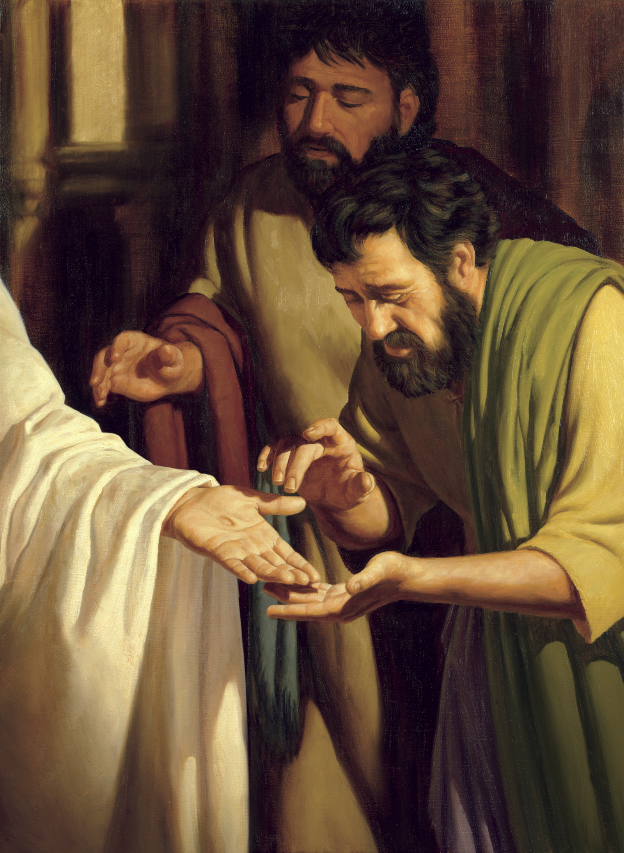
“That Jesus Christ is the Son of God, and that he was crucified for the sins of the world.”
(Doctrine and Covenants 46:13)
Jeff Ward
Notes:
You’ve probably prayed for charity, maybe for the gift of discernment…have you ever prayed for this spiritual gift?
Image: https://www.churchofjesuschrist.org/media/image/christ-wounds-apostles-636651d?lang=eng&collectionId=063f9cd3a6e737d1baa1213d98cefdc81d1ac8ba

Slide 3
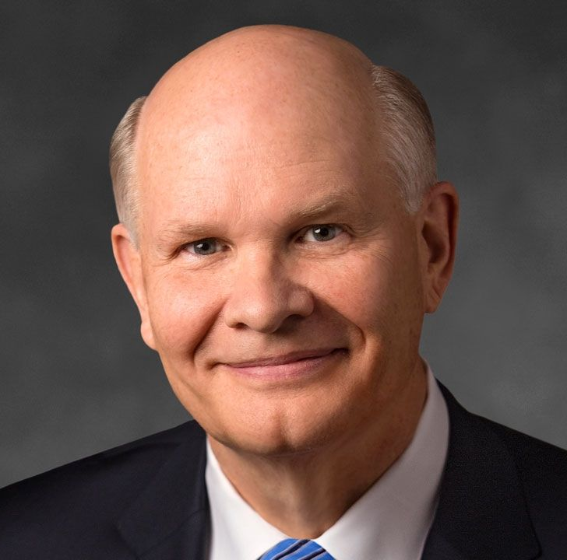
“Qualifying for this gift is not gender-dependent and it is not priesthood office-dependent. It is dependent upon qualifying for that gift by choosing faith, by choosing the covenant path.”
Dale G. Renlund, “Doubt Not, but Be Believing,” Seminaries and Institutes of Religion Annual Training Broadcast
Notes:
My hope is that this course will help you choose faith and choose the covenant path by deepening your understanding of Jesus Christ. I hope our testimonies of him grow throughout this course and that we deepen our desire to be witnesses of him.
Share testimony
**When creating the online version, note DC 46 spiritual gift video for text

Slide 4
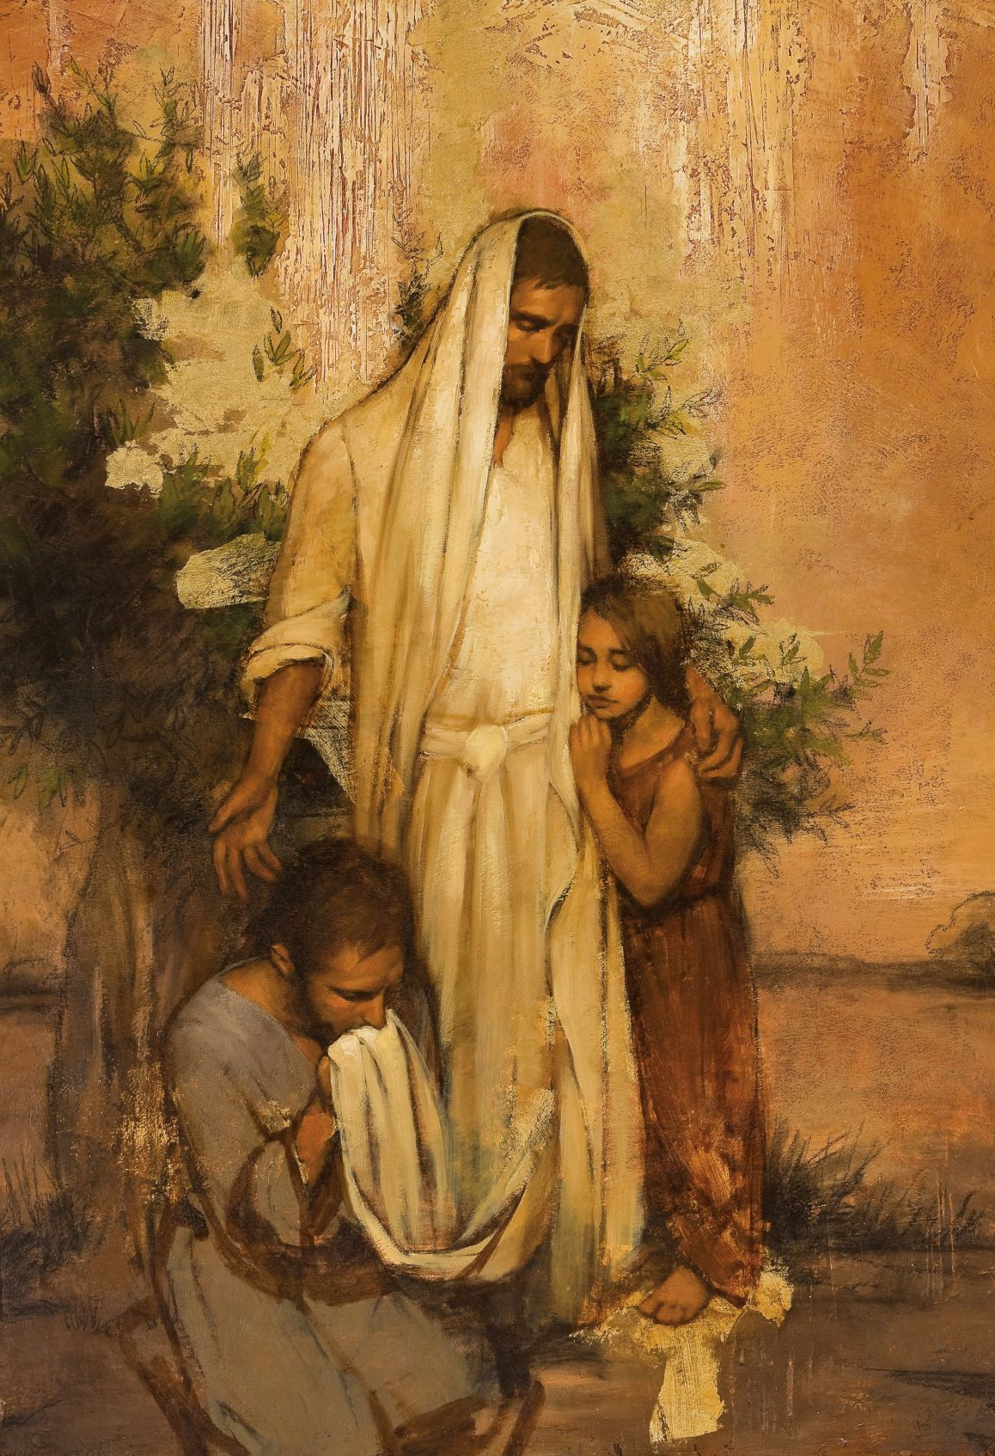
“Learn of me”
Matt. 11:29, D&C 19:23, 32:1, 58:1
Annie Henrie
Notes:
This is a gift Jesus wants us to have. If we’re going to “learn” of Jesus, let’s think about different types of knowledge
Image: https://www.churchofjesuschrist.org/media/image/balm-gilead-christ-white-shawl-567ba46?lang=eng&collectionId=867cf70ec67d467498611c99263461f0

Slide 5
Seven Ways to Learn More About Jesus Christ
Living Prophets
The Scriptures
Modern Scholarship
Personal Experiences
Artwork
Movies
Music
Notes:
The ones in yellow, we’ll talk about today, and the ones in orange we will discuss in a future class.

Slide 6
“Special witnesses of the name of Christ in all the world.”
(Doctrine and Covenants 107:23)
Notes:
You’ve probably prayed for charity, maybe for the gift of discernment…have you ever prayed for this spiritual gift?
Image: https://www.churchofjesuschrist.org/media/image/christ-wounds-apostles-636651d?lang=eng&collectionId=063f9cd3a6e737d1baa1213d98cefdc81d1ac8ba

Slide 7
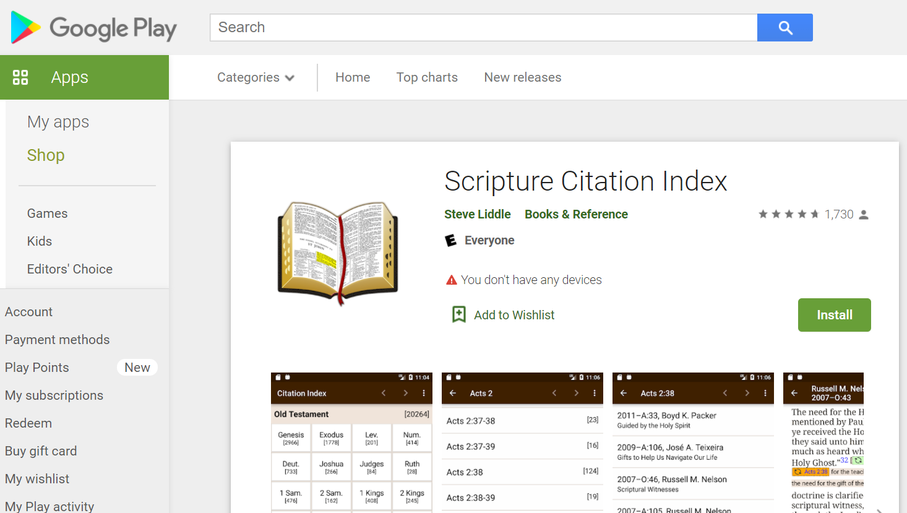
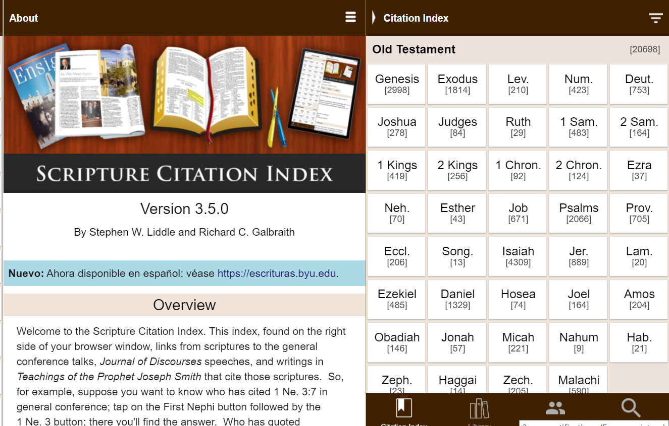
http://scriptures.byu.edu

Slide 8
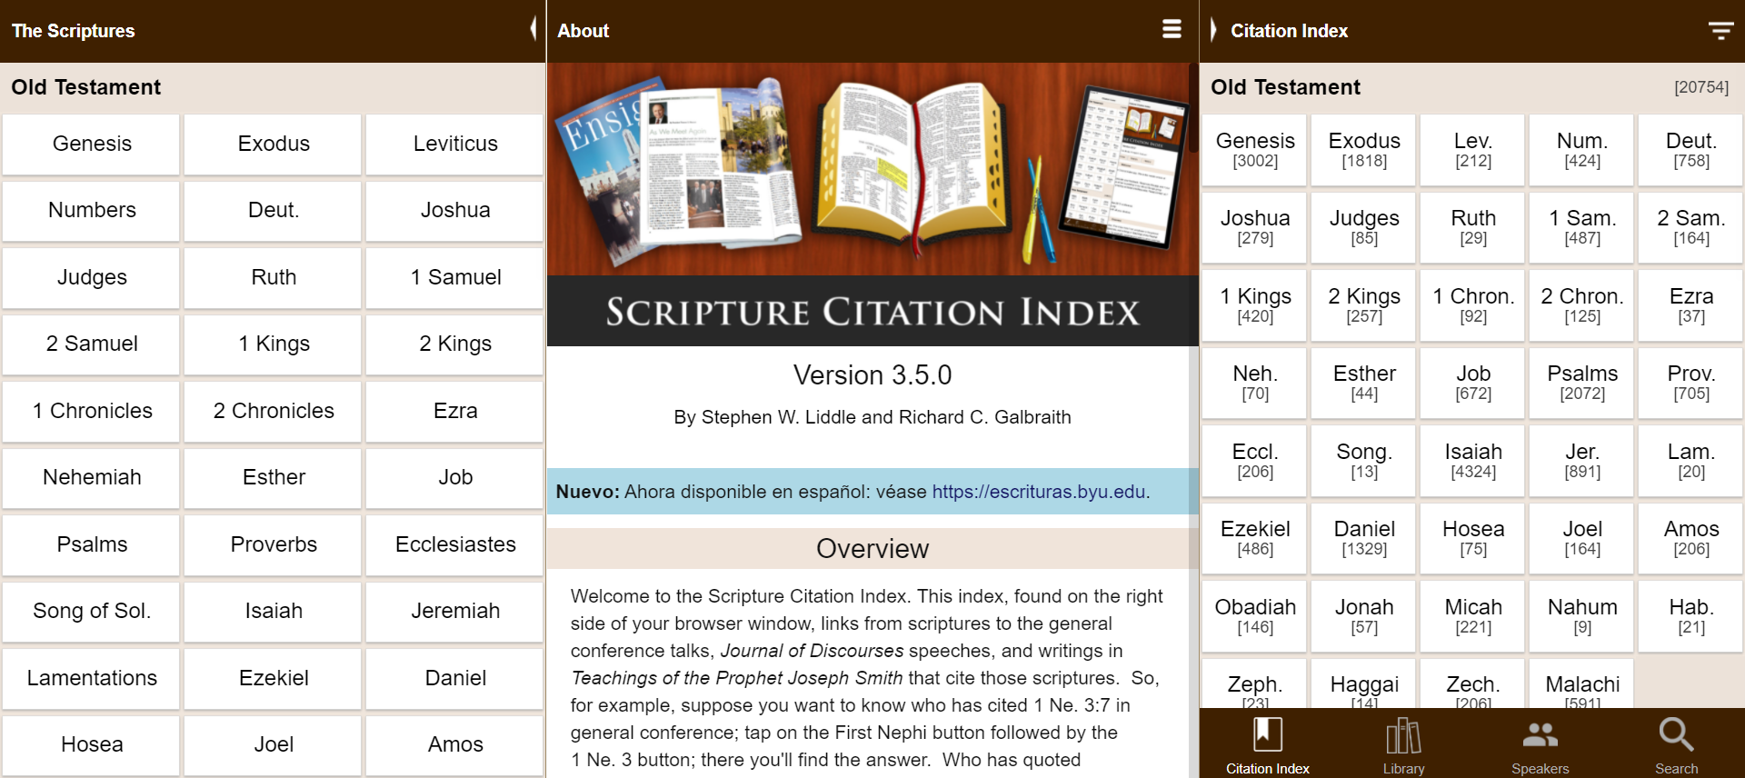

Slide 9
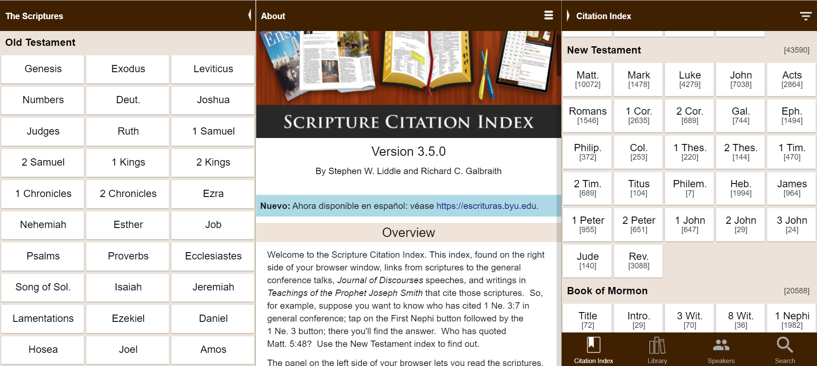

Slide 11
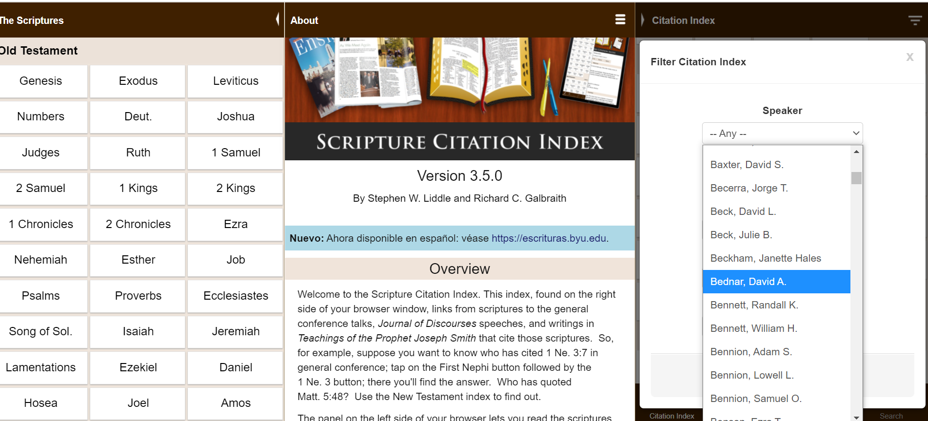

Slide 12
48
145
279
179
35

Slide 13
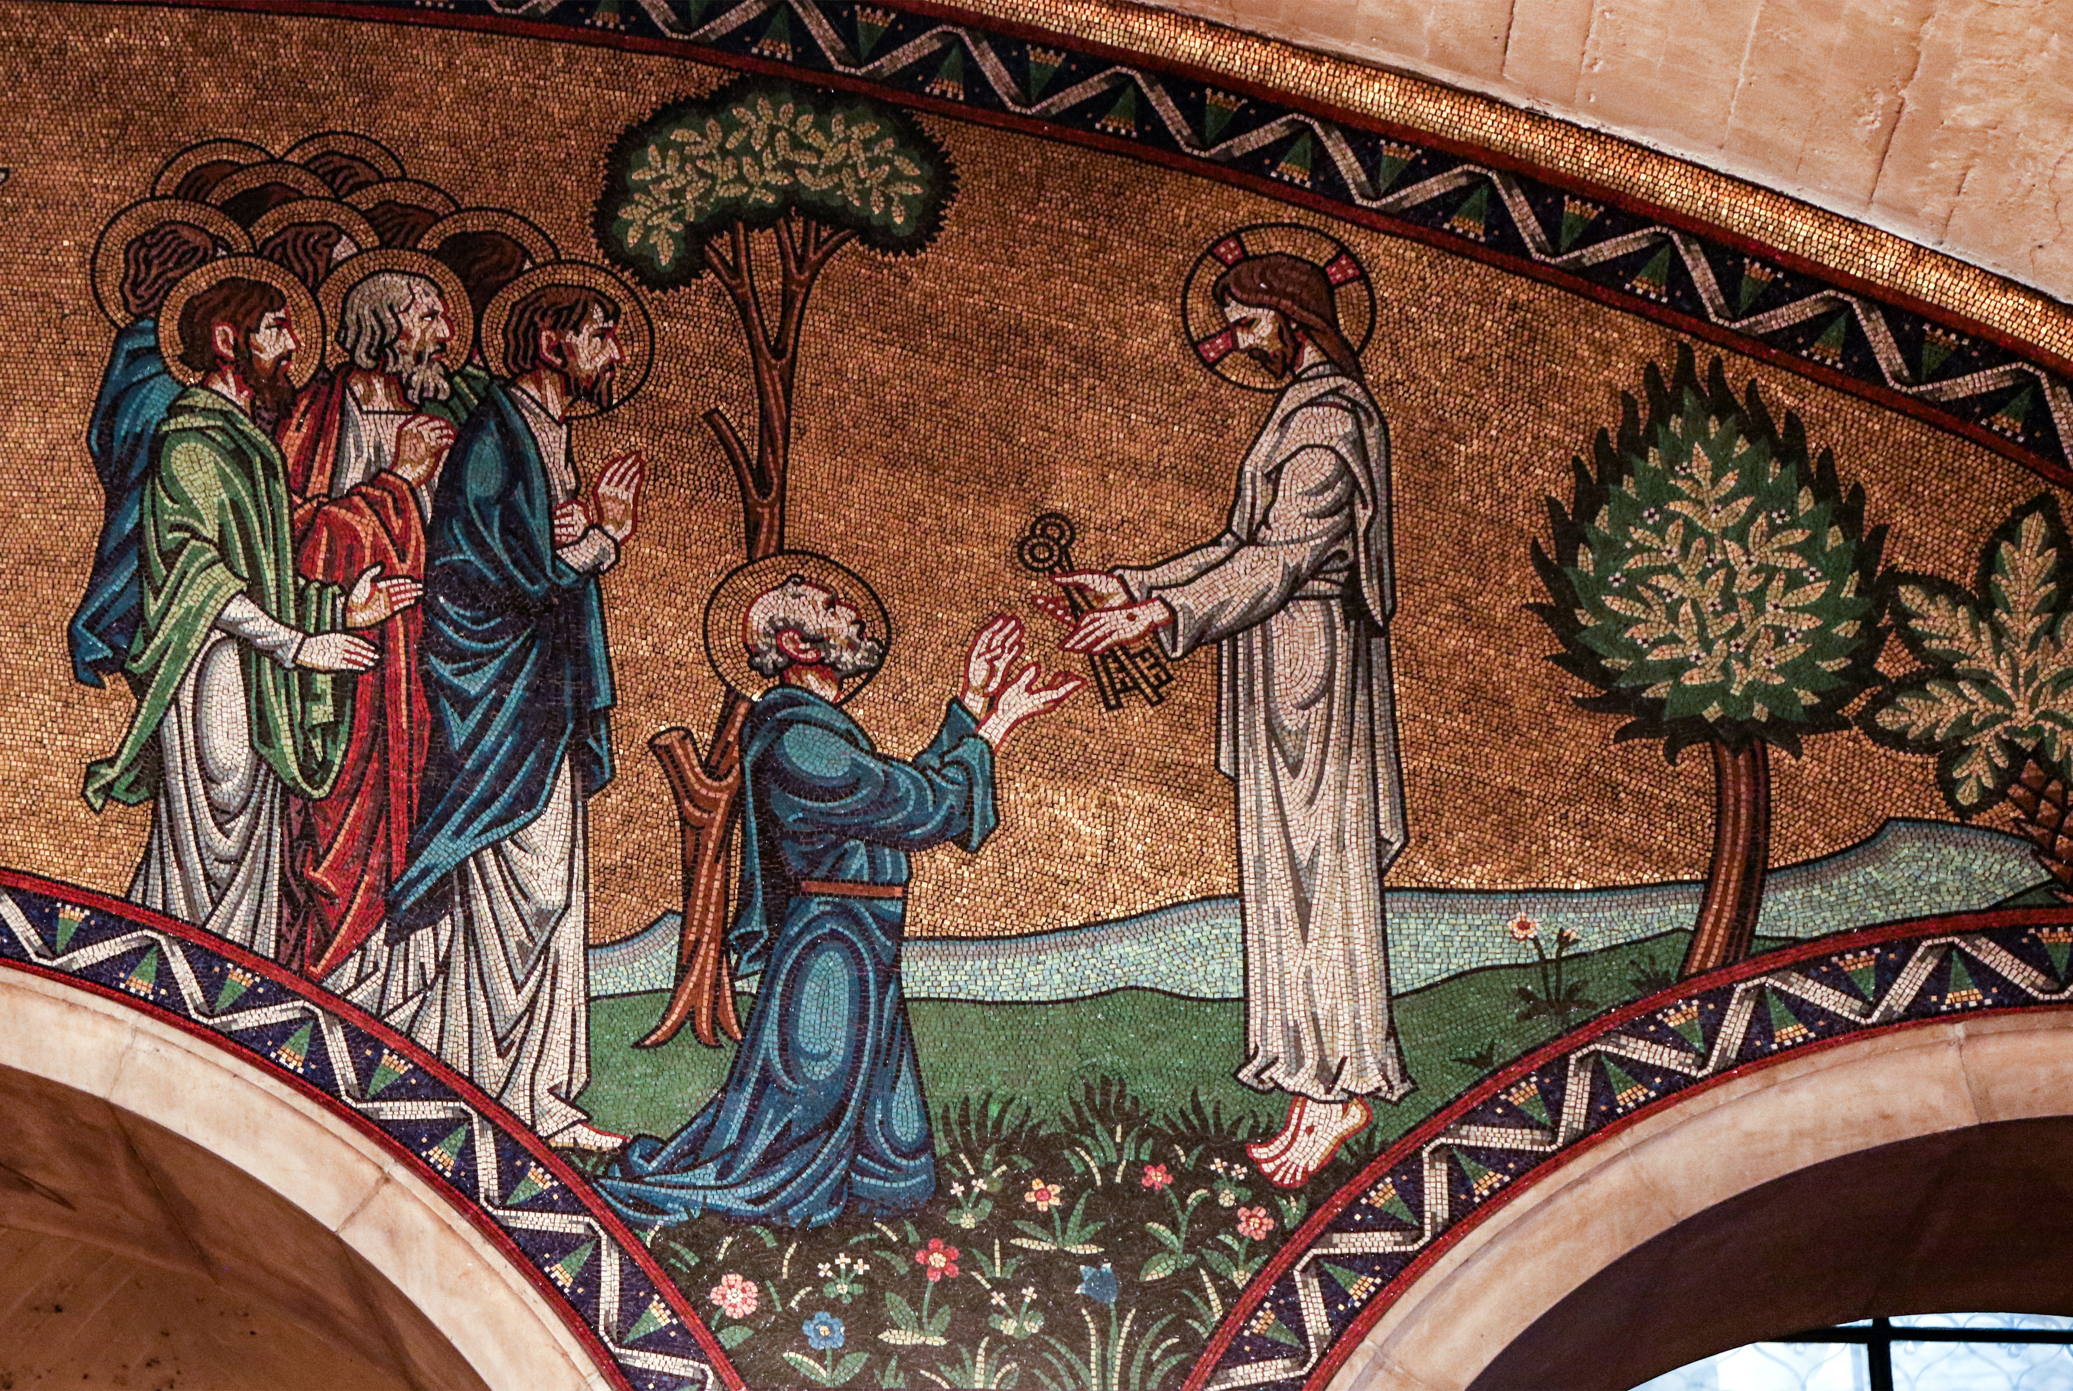
“When Jesus came into the coasts of Cæsarea Philippi, he asked his disciples, saying, Whom do men say that I the Son of man am? And they said, Some say that thou art John the Baptist: some, Elias; and others, Jeremias, or one of the prophets. He saith unto them, But whom say ye that I am?
Lawrence OP
Matthew 16:13–19

Slide 14
“And Simon Peter answered and said, Thou art the Christ, the Son of the living God. And Jesus answered and said unto him, Blessed art thou, Simon Bar-jona: for flesh and blood hath not revealed it unto thee, but my Father which is in heaven.
Lawrence OP
Matthew 16:13–19

Slide 15
“And I say also unto thee, That thou art Peter, and upon this rock I will build my church; and the gates of hell shall not prevail against it. And I will give unto thee the keys of the kingdom of heaven: and whatsoever thou shalt bind on earth shall be bound in heaven: and whatsoever thou shalt loose on earth shall be loosed in heaven.”
Lawrence OP
Matthew 16:13–19

Slide 16
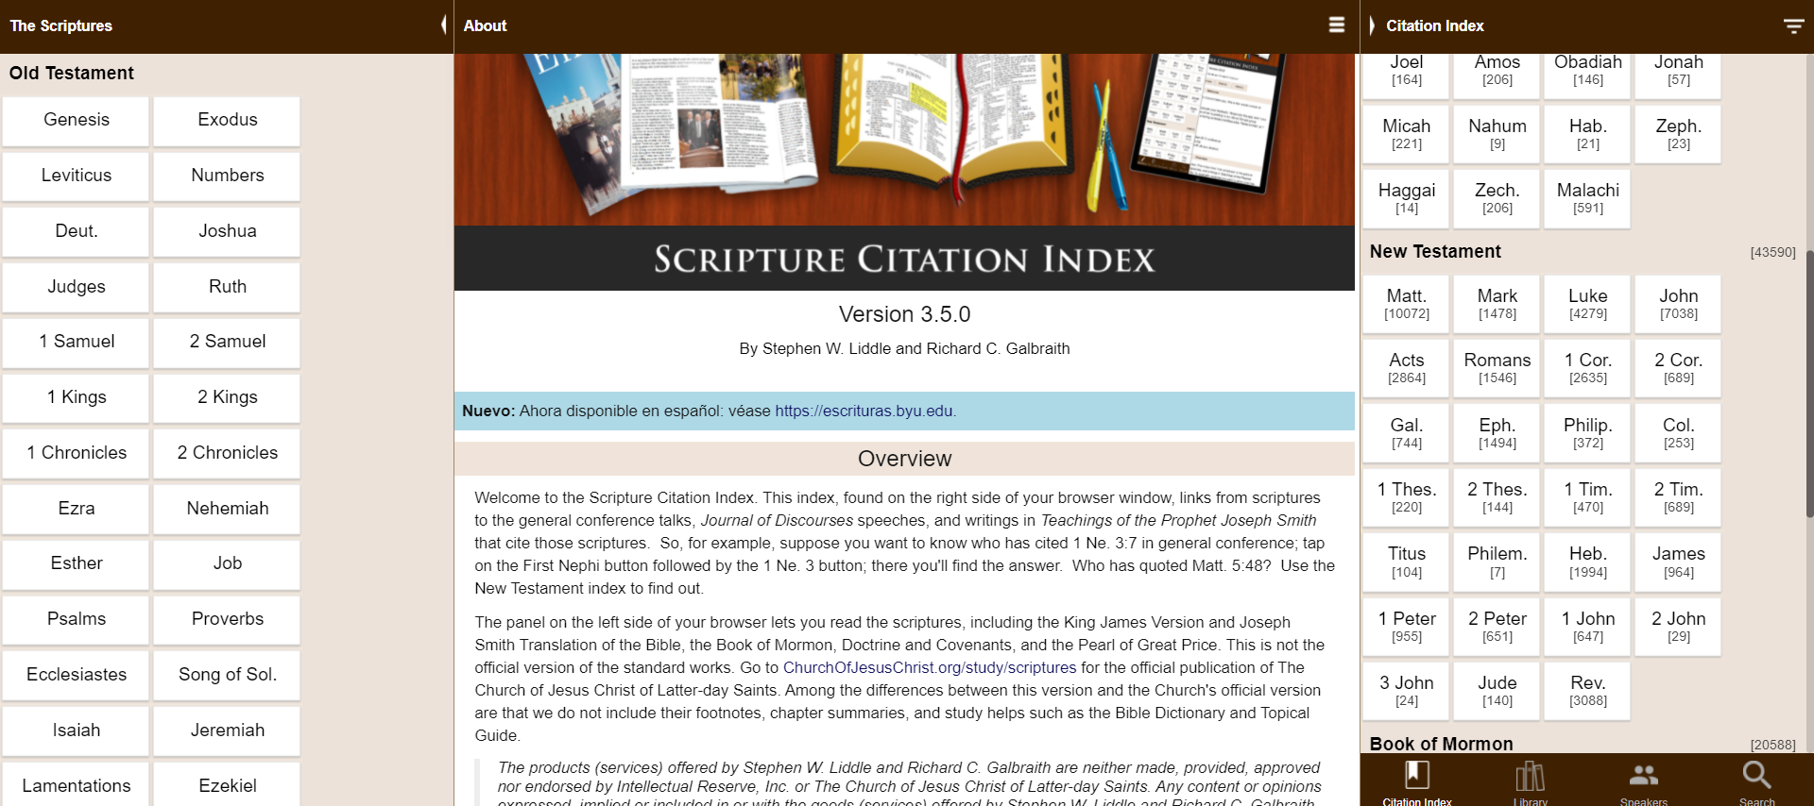

Slide 17
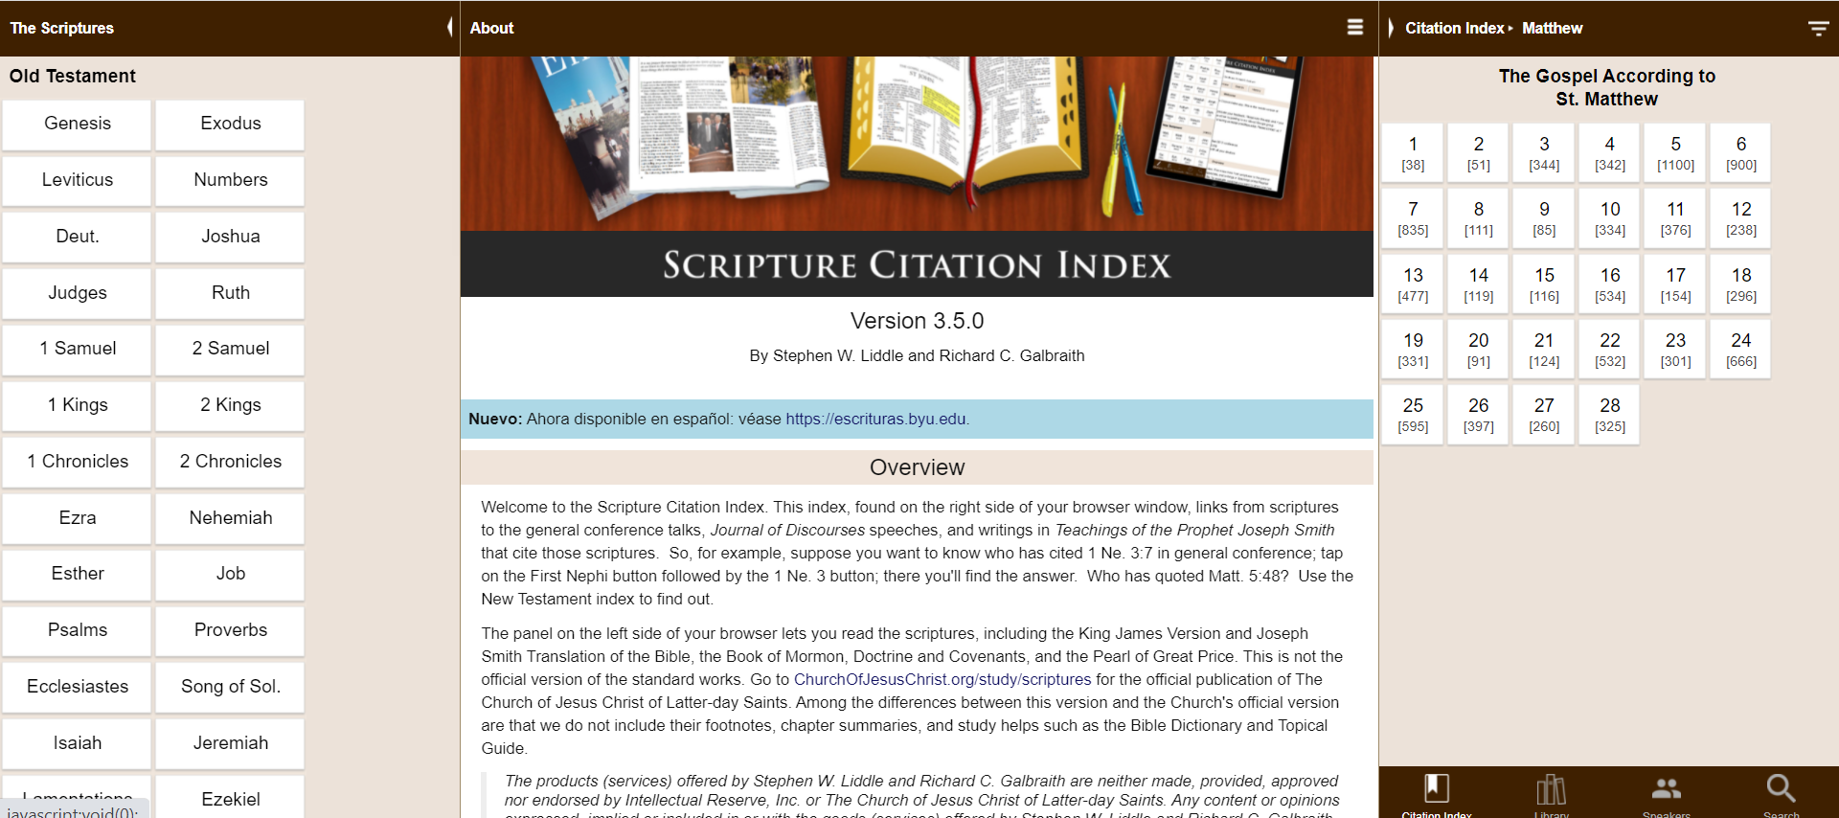

Slide 18
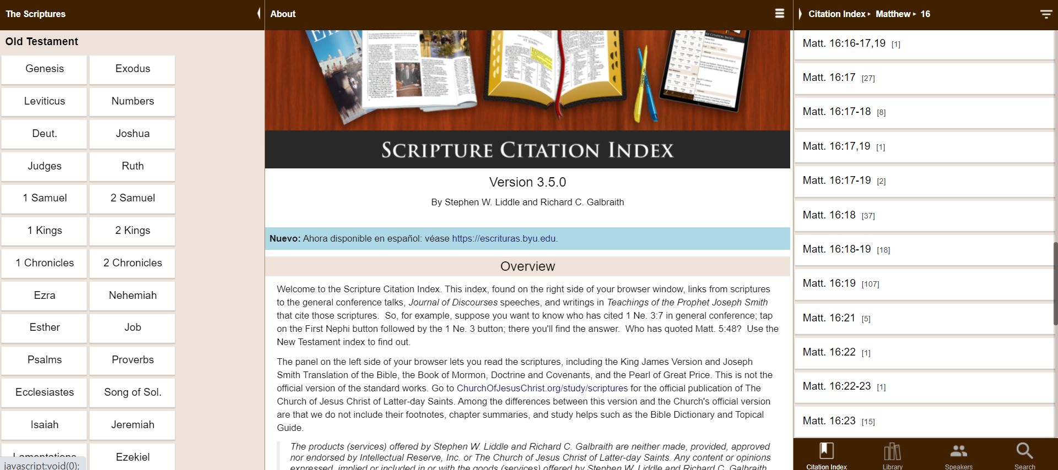

Slide 19
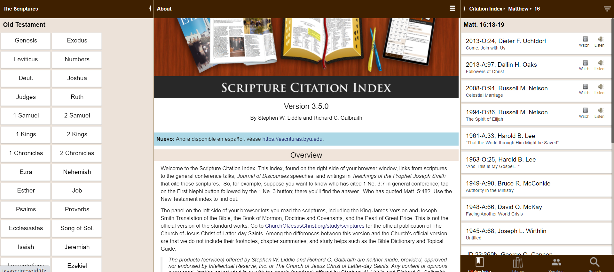

Slide 20
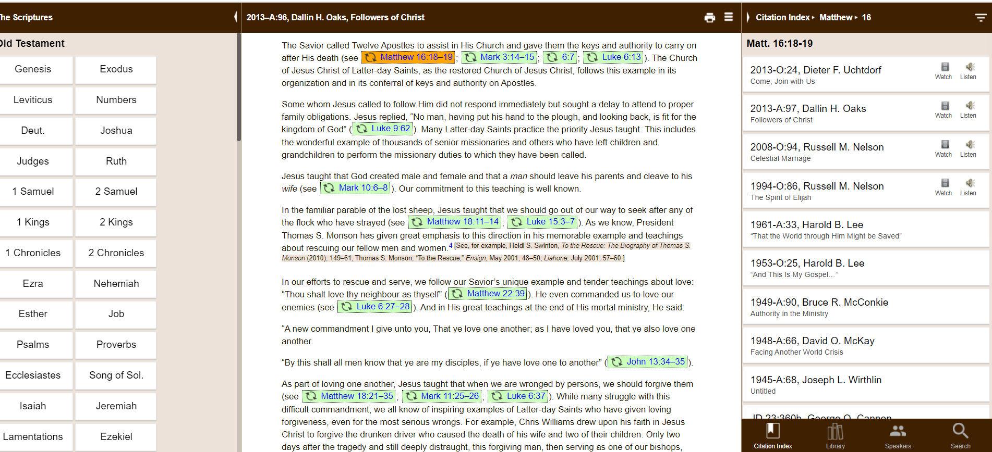

Slide 21
“The Savior called Twelve Apostles to assist in His Church and gave them the keys and authority to carry on after His death. The Church of Jesus Christ of Latter-day Saints, as the restored Church of Jesus Christ, follows this example in its organization and in its conferral of keys and authority on Apostles.”
President
Dallin H. Oaks, Ensign, May 2013
Notes:
https://www.churchofjesuschrist.org/learn/dallin-h-oaks?lang=eng

Slide 22
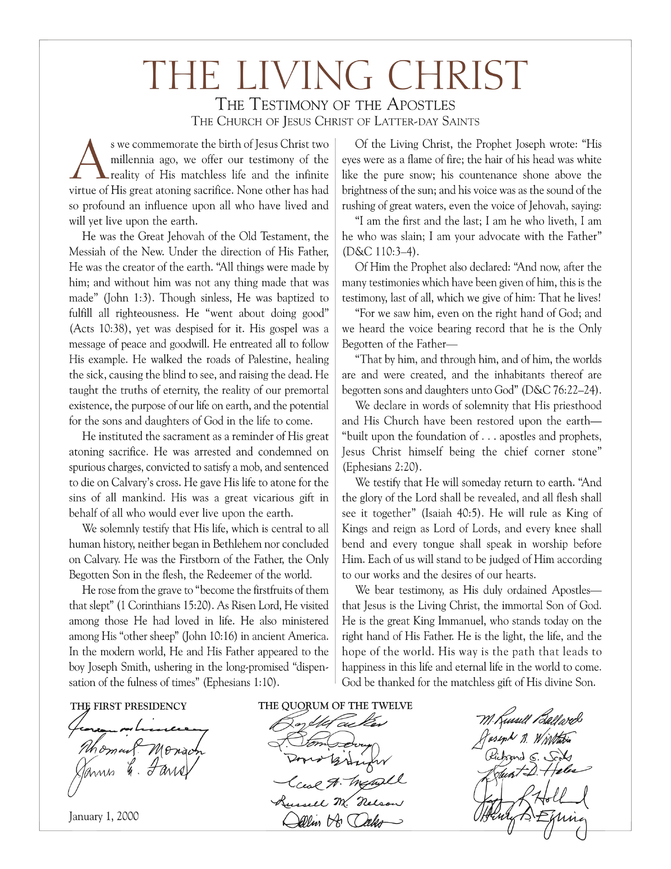

Slide 23
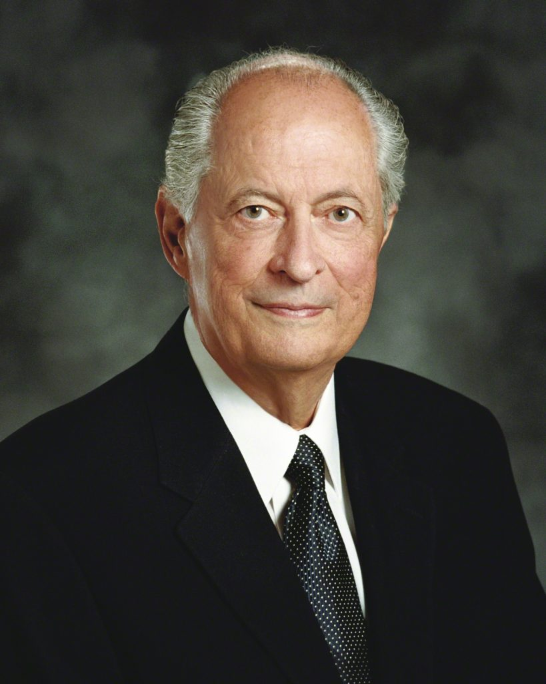
Robert D. Hales, “Strengthening Faith and Testimony,” Ensign, November 2013.
“‘The Family: A Proclamation to the World’ was given long before we experienced the challenges now facing the family. ‘The Living Christ: The Testimony of the Apostles’ was prepared in advance of when we will need it most.”
Notes:
Image: https://www.churchofjesuschrist.org/church/leader/robert-d-hales?lang=eng

Slide 24
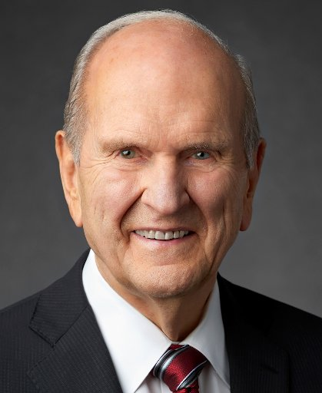
“I gave that challenge because I had already accepted it myself. I read and underlined every verse [more than 2,000!] cited about Jesus Christ, as listed under the main heading and the 57 subtitles in the Topical Guide. When I finished that exciting exercise, my wife asked me what impact it had on me. I told her, “I am a different man!” I felt a renewed devotion to Him…”
President Russell M. Nelson,
Ensign, May 2017
Notes:
What is YOUR PLAN to continue studying Christ?

Slide 25
Seven Ways to Learn More About Jesus Christ
Living Prophets
The Scriptures
Modern Scholarship
Personal Experiences
Artwork
Movies
Music
Notes:
The ones in yellow, we’ll talk about today, and the ones in orange we will discuss in a future class.

Slide 26
John 20:31
“These [things] are written, that ye might believe that Jesus is the Christ, the Son of God; and that believing ye might have life through his name.”

Slide 27
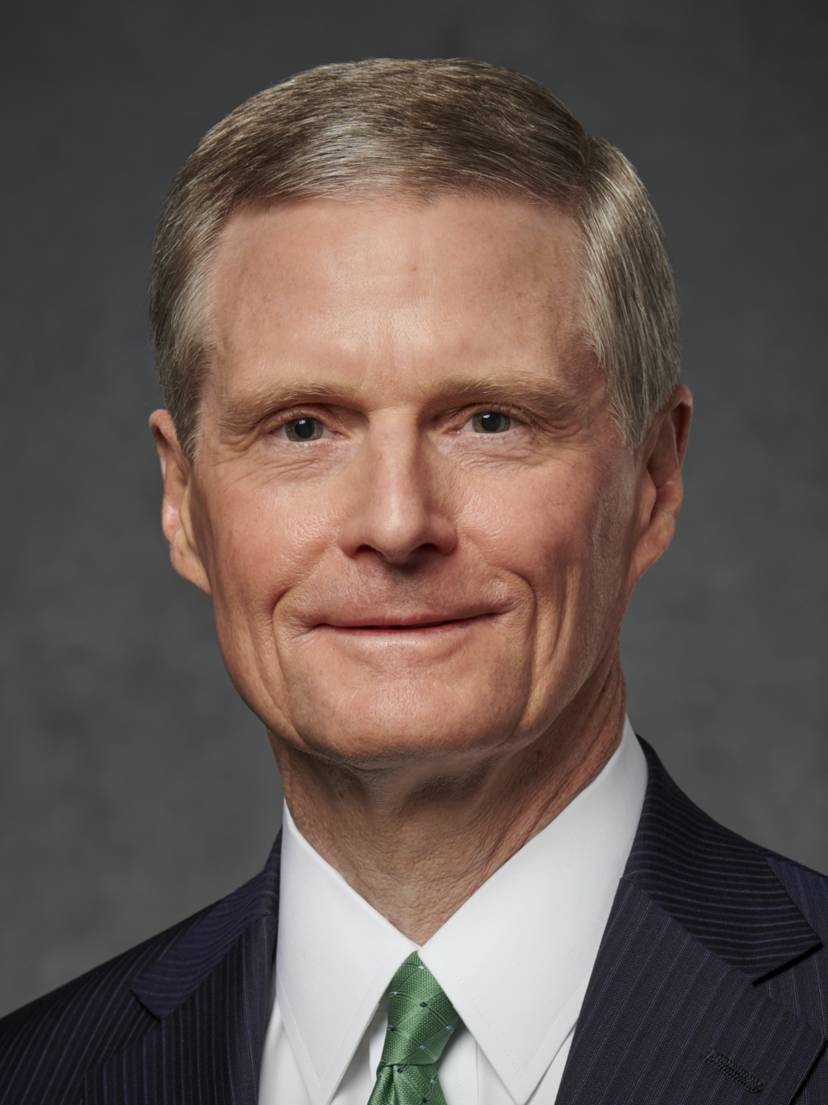
“My invitation…is, go into the Book of Mormon. Read it from the beginning to the end, looking for the Savior–his attributes, his characteristics. And as you do that, earnestly and sincerely, it no longer becomes looking at words on a page. You come to hear his voice. You come to know him in a very remarkable way.”
Elder David A. Bednar
Face-to-Face, Sept. 2021

Slide 28
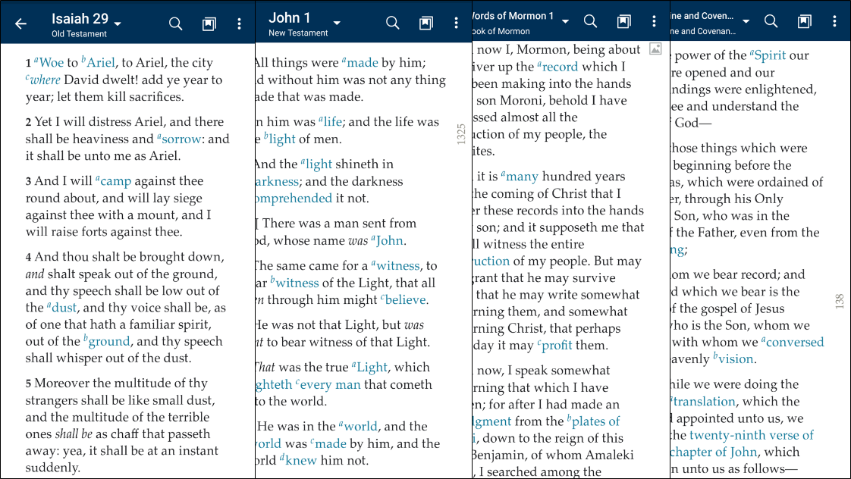
Notes:
The scriptures are some of our most important resources for learning about Jesus Christ. If you pick up modern printed scriptures or flip through them on a phone app, you’ll see that everything has been formatted to look the same. This uniform formatting, however, hides the fact that different books of scriptures were written by very different people living in very different times and places! They were written in different languages, on different materials, for different reasons. That diversity not only makes the scriptures more interesting, it helps us learn in different ways from different people who had different perspectives on the Savior.

Slide 29
Jesus
born ca. 6–4 bc ● died ca. ad 29–33
Old Testament
written ca. 1300–400 bc
New Testament
written ca. ad 50–100
Pearl of Great Price
translated/written ad 1830–1842
1000 bc
500 bc
ad 500
ad 1000
ad 1500
ad 2000
Book of Mormon
written ca. 600 bc–ad 420
Doctrine and Covenants
written ad 1828–present
Slide design by Josh Sears
Notes:
Overview image
WE NEED TO BE CAREFUL TO READ SCRIPTURE IN CONTEXT AND NOT GO BEYOND WHAT THAT TEXT IS ACTUALLY TEACHING
You’re probably familiar with how we got the Book of Mormon and Doctrine and Covenants; let’s spend some time talking about the Bible.

Slide 30
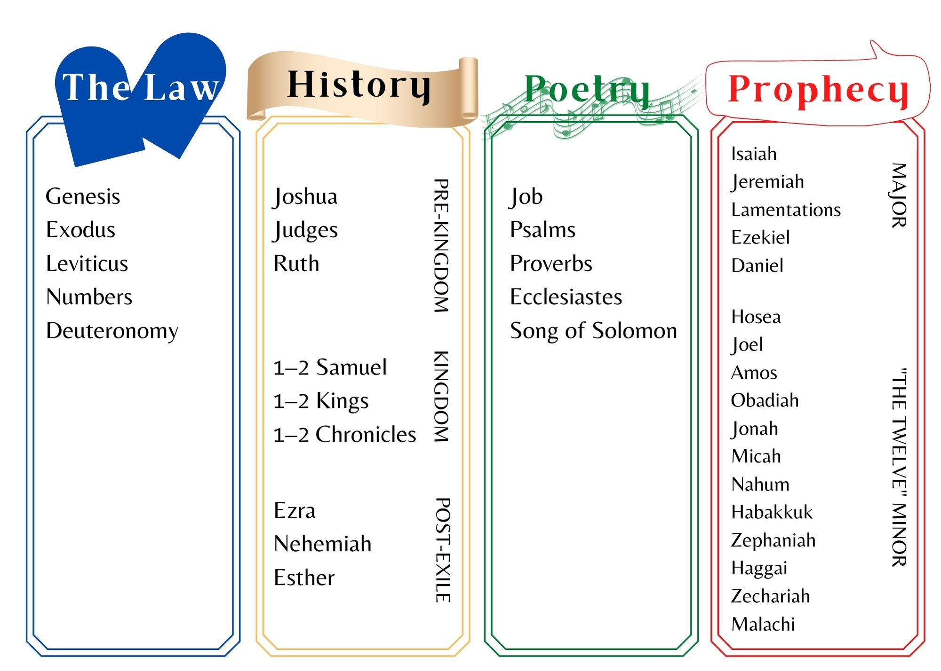
What is the Old Testament?
Notes:
The books of the Old Testament were mostly written separately from each other and were later gathered in a collection. These books contain several literary genres, including history, prophecy and poetry. Several different prophets contributed to the Old Testament. In major sections (e.g., 1 Samuel-2 Chronicles) the author is anonymous. Just like there were editors in the Book of Mormon (like Mormon) later editors played a role in the final form of the Old Testament.
39 books in the OT
Note: this arrangement follows our version of the OT. The Hebrew Bible is in a different order, TNK.
The Old Testament contains thirty-nine books written by ancient Israelites in the Hebrew language approximately 1300–400 B.C. (although scholars debate the specific dates).
Photo by Rachel Harper, permission to use

Slide 31
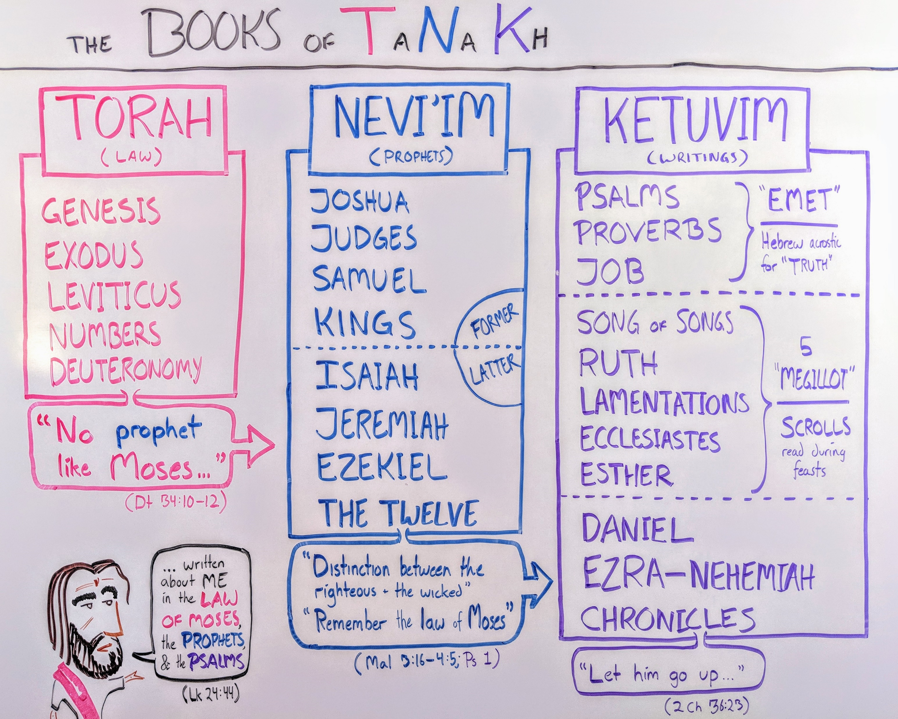
What is the Old Testament?
Overviewbible.com
Overviewbible.com
Notes:
TNK divisions appear to have been in place before Christ.
Jeffrey Kranz from overviewbible.com gave permission to use the TNK image.
39 books in the OT

Slide 32
What is the Old Testament?
“Thou shalt love the Lord thy God…This is the first and great commandment. And the second is like unto it, Thou shalt love thy neighbour as thyself. On these two commandments hang all the law and the prophets.”
(Matthew 22:37–40)
Overviewbible.com
Notes:
TNK divisions appear to have been in place before Christ.
Jeffrey Kranz from overviewbible.com gave permission to use the TNK image.
39 books in the OT

Slide 33
What is the Old Testament?
When the resurrected Christ appeared to his apostles he said, “These are the words which I spake unto you, while I was yet with you, that all things must be fulfilled, which were written in the law of Moses, and in the prophets, and in the psalms, concerning me”
(Luke 24:44)
Overviewbible.com
Overviewbible.com
Notes:
TNK divisions appear to have been in place before Christ.
Jeffrey Kranz from overviewbible.com gave permission to use the TNK image.
39 books in the OT

Slide 34
What is the New Testament?
Notes:
Photo by Rachel Harper, permission to use
Traditionally, the Gospel accounts were written by Matthew, Mark, Luke and John. Luke also wrote Acts. According to tradition, Paul and other Apostles wrote the epistles (which make up most of the New Testament books). The author of Hebrews is unstated in the text, and the author of Revelation is traditionally believed to be the Apostle John. While modern scholars debate specific authorship details, there is no doubt that Latter-day Saints “believe the Bible to be the word of God, as far as it is translated correctly.”

Slide 35
How did we get the New Testament? Developing the Canon

Slide 36
How did we get the New Testament? Developing the Canon
X

Slide 37
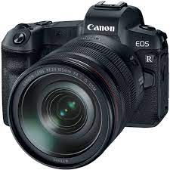
How did we get the New Testament? Developing the Canon
X
X

Slide 38
How did we get the New Testament? Developing the Canon
X
X
“Rod or stick for measuring” (Greek)
New Testament Canon =
collection of NT books by which we measure truth

Slide 39
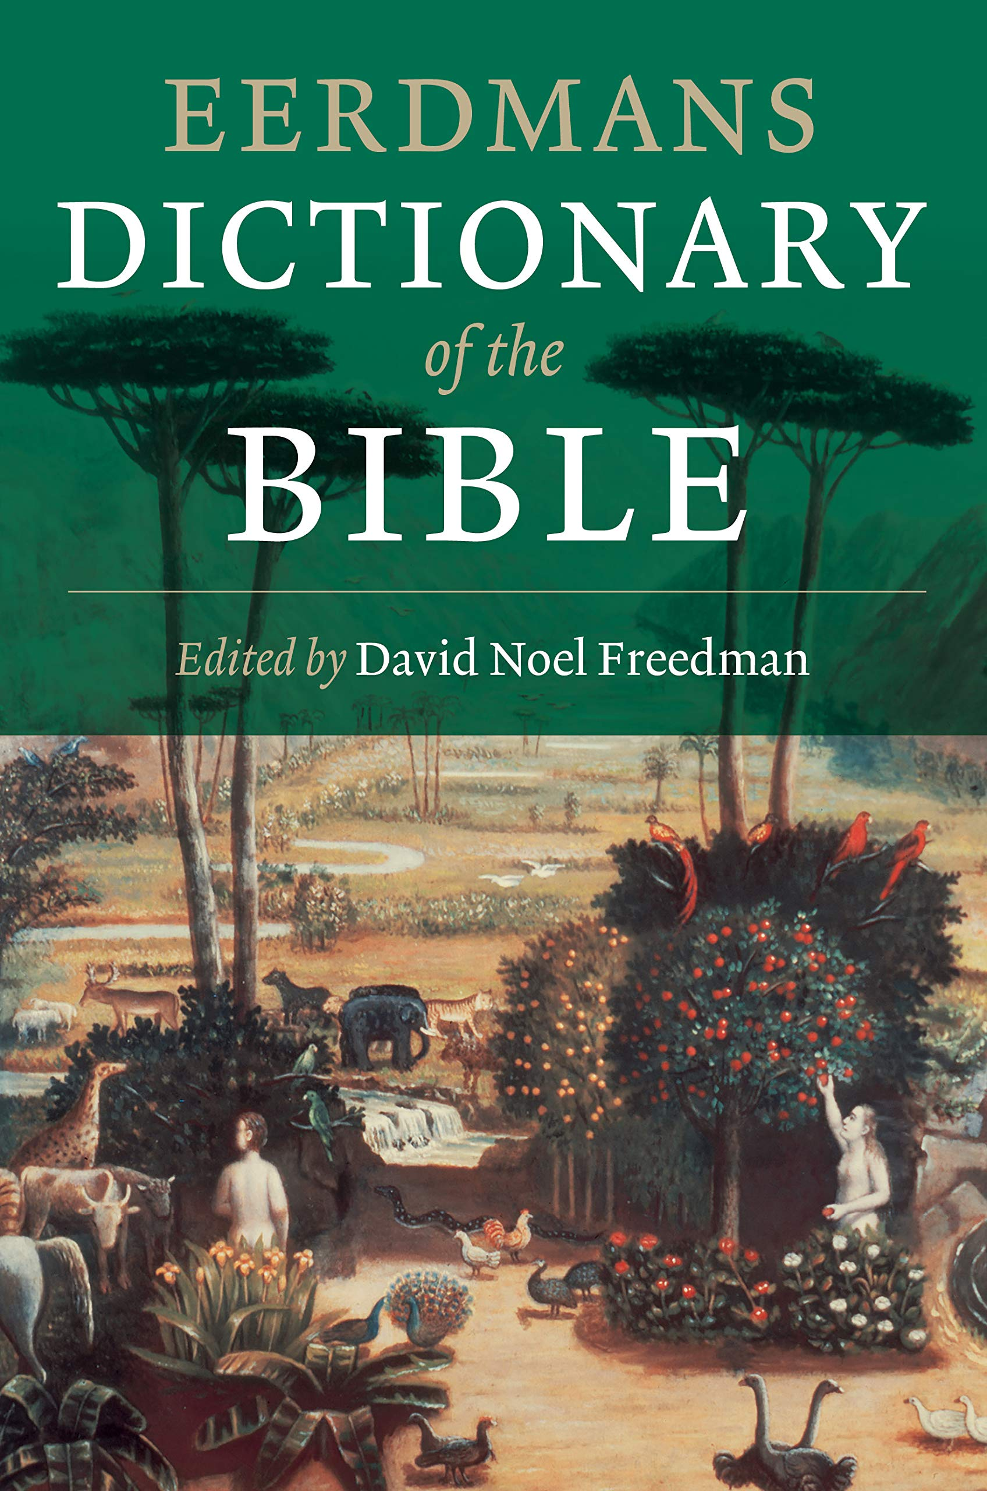
How did we get the New Testament? Developing the Canon
“It has been widely recognized that by the end of the 2nd century a ‘core canon’ of 20 or more books was generally acknowledged throughout the churches.”
Eerdmans Dictionary of the Bible, 219
Notes:
These are interesting discussions, we could have a whole semester on this topic, to dramatically simplify things…
https://www.amazon.com/Eerdmans-Dictionary-Bible-David-Freedman/dp/0802824005

Slide 40
What were possible criteria for determining inclusion in the New Testament Canon?
1. APOSTOLICITY
It was traditionally written by or associated with an apostle
2. POPULARITY
It was read often in the churches
3. ORTHODOXY
It taught what the Christians believed

Slide 41
Where are the Original Manuscripts of the New Testament today?
The Louvre in Paris
The British Museum in London
The Vatican Library in Rome
The First Presidency’s Vault in SLC

Slide 42
Where are the Original Manuscripts of the New Testament today?
X
The Louvre in Paris
The British Museum in London
The Vatican Library in Rome
The First Presidency’s Vault in SLC
THEY DON’T EXIST

Slide 43
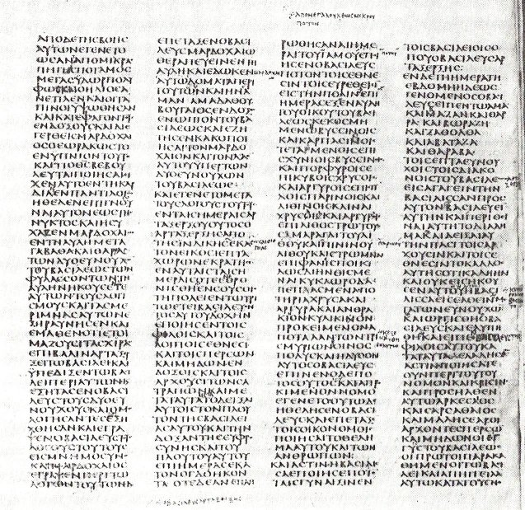
Codex Sinaiticus
The oldest completed copy of the Old Testament and New Testament both date to approximately 350 AD
Notes:
Image: https://en.wikipedia.org/wiki/Codex_Sinaiticus

Slide 44
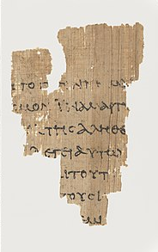
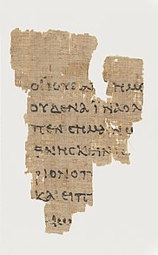
The oldest manuscript fragment of the New Testament dates to approximately 150 AD.
Notes:
Images: https://en.wikipedia.org/wiki/Rylands_Library_Papyrus_P52

Slide 45
“We believe the Bible to be the word of God, as far as it is translated correctly.”
Notes:
CC BY SA: https://commons.wikimedia.org/wiki/File:University_of_Cambridge_Wicked_Bible_Exodus_20.jpg

Slide 46
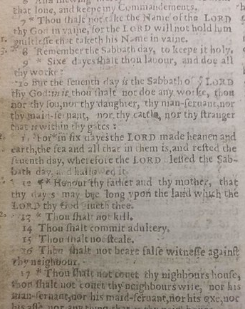
“We believe the Bible to be the word of God, as far as it is translated correctly.”
Cambsgooseking
Notes:
CC BY SA: https://commons.wikimedia.org/wiki/File:University_of_Cambridge_Wicked_Bible_Exodus_20.jpg

Slide 47
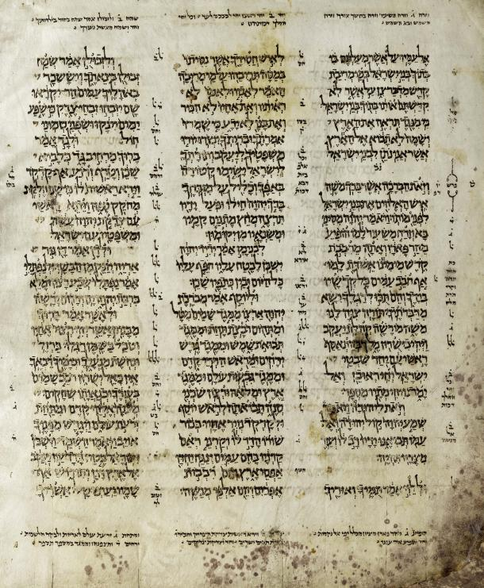
The early manuscripts of the Bible were written in
continuous script.
(i.e. no spaces
between words)
This, and many other issues, could lead to difficulties in transcribing.
Notes:
Image: https://en.wikipedia.org/wiki/Biblical_manuscript

Slide 48
GODISNOWHERE
Notes:
Lots of things made it hard for there to be accurate transcription.

Slide 49
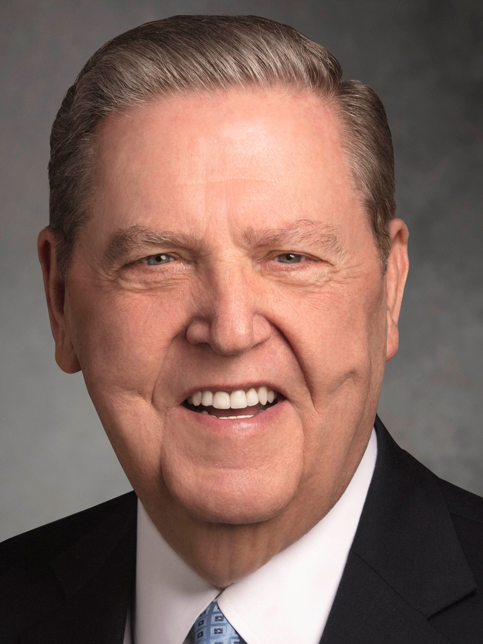
“I’m reading concurrently the Book of Mormon and the Doctrine and Covenants…I’m also doing the Oxford Study Bible, which is the revised English version…a delightful work, which I am loving.”
Elder Jeffrey R. Holland, quoted in the Deseret News, 2021

Slide 50
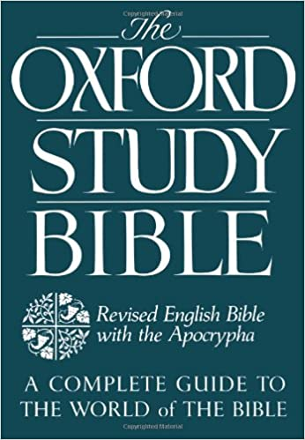
“When possible, members should use a preferred or Church-published edition of the Bible in Church classes and meetings. This helps maintain clarity in the discussion and consistent understanding of doctrine. Other editions of the Bible may be useful for personal or academic study.”
Handbook, 38.8.39.1
Notes:
https://www.amazon.com/Oxford-Study-Bible-Revised-Apocrypha/dp/0195290003

Slide 51
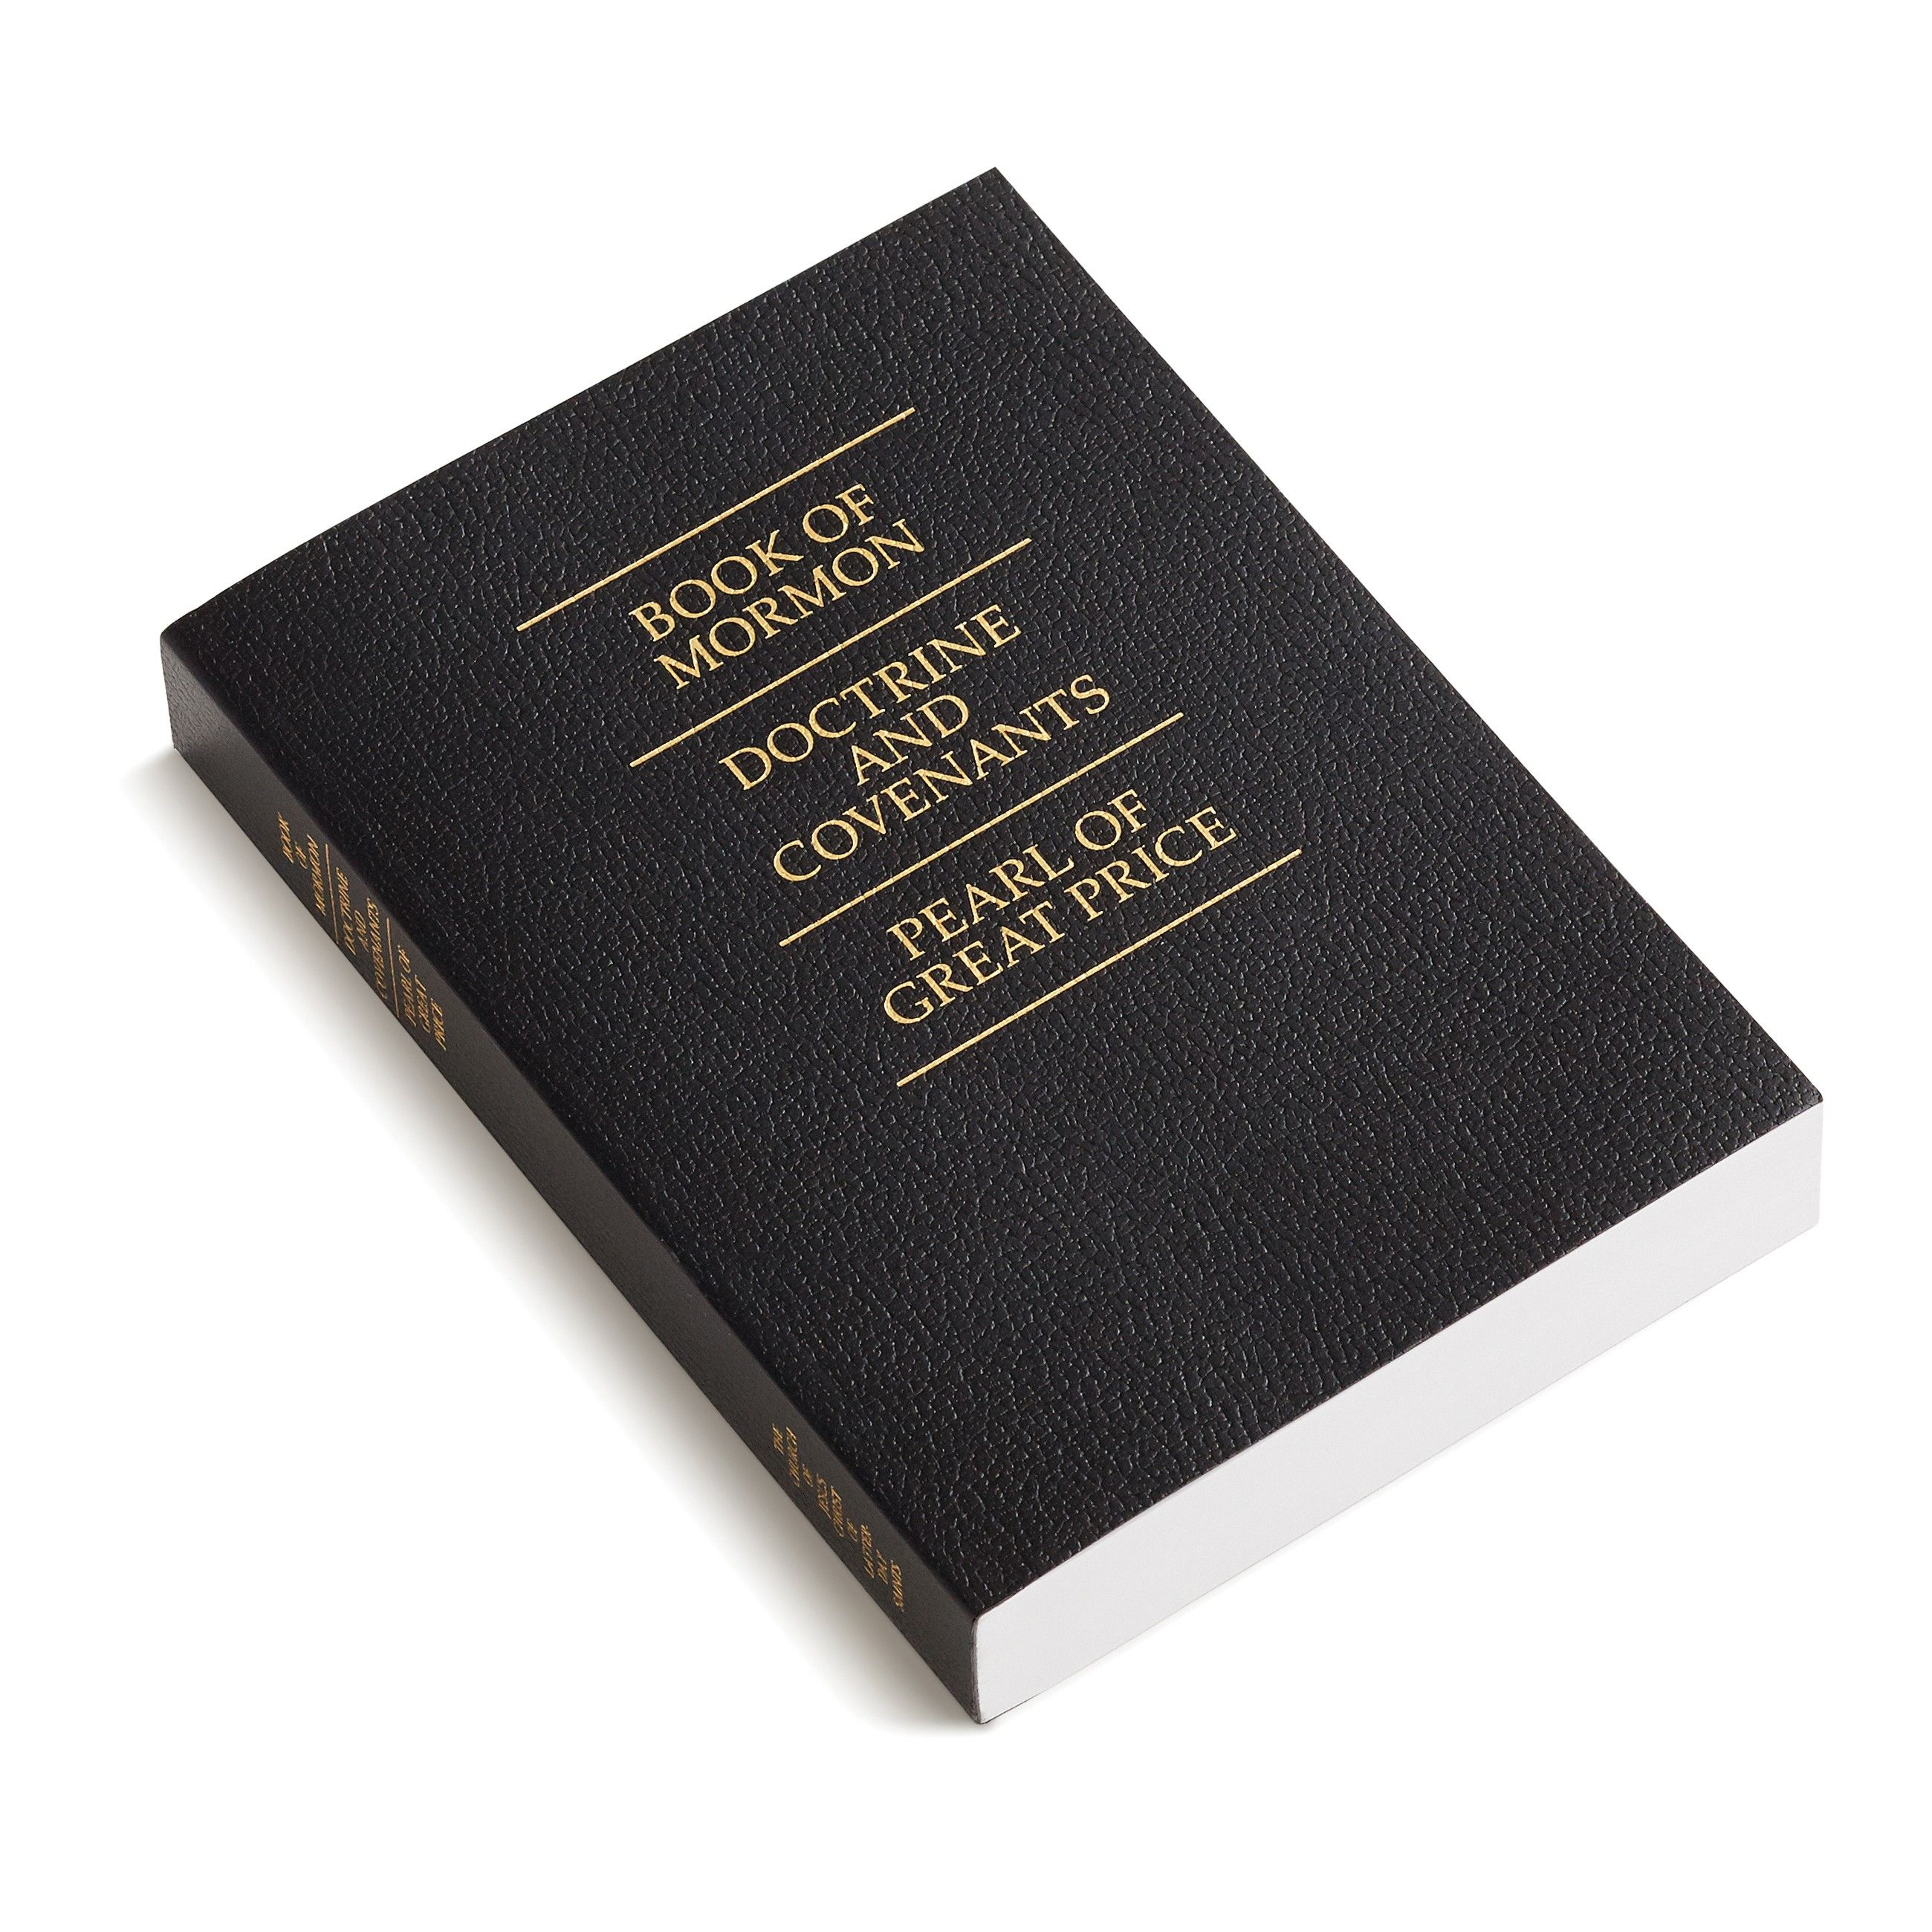
Restoration Scripture
Collectively, the Book of Mormon, Doctrine and Covenants and Pearl of Great Price are referred to as “Restoration Scripture.” These books teach “many plain and precious things” (1 Nephi 13:26).
Notes:
The Book of Mormon contains fifteen books written by American prophets in an ancient language over a thousand year period from about 600 B.C. to A.D. 420. These people were a remnant (a small group) of Israelites who were led to the ancient Americas by the Lord. The Book of Mormon also contains several chapters of Christ’s teachings to these people when He visited them shortly after His Resurrection. Jesus Christ directed the creation of the Book of Mormon so that it could be brought forth in the last days to teach people about Christ and His plan for the human family.
The Doctrine and Covenants contains 138 sections and two proclamations recorded by the Prophet Joseph Smith and other Church leaders in the English language beginning in 1828. The sections of the Doctrine and Covenants contain revelations from Jesus Christ, prophetic instructions, angelic annunciations, important letters, and even hymns. In the Doctrine and Covenants, we hear the voice of Jesus Christ giving testimony and commandments people in our modern world.
More details on how these books came to be are available in courses that focus on Restoration Scripture.
Image: https://www.churchofjesuschrist.org/media/image/triple-combination-scripture-cover-bae554c?lang=eng

Slide 52
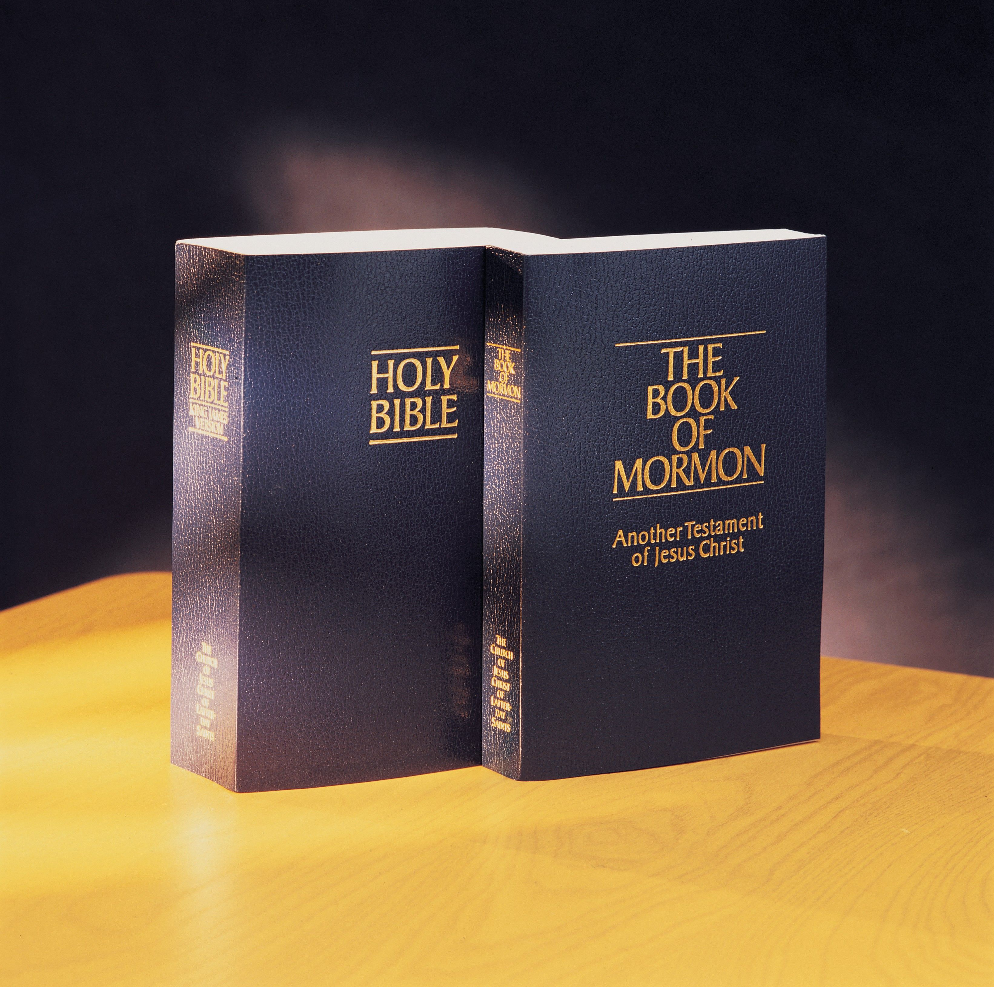
The Bible and Restoration Scripture Work Together
The Book of Mormon “is written for the intent that ye may believe that [the Bible]; and if ye believe [the Bible] ye will believe [the Book of Mormon].” (Mormon 7:9, see also 1 Nephi 13:38-40, 2 Nephi 3:12).
Notes:
1 Nephi 13:38-40 and Mormon 7:8-9 were part of the pre-class readings

Slide 53
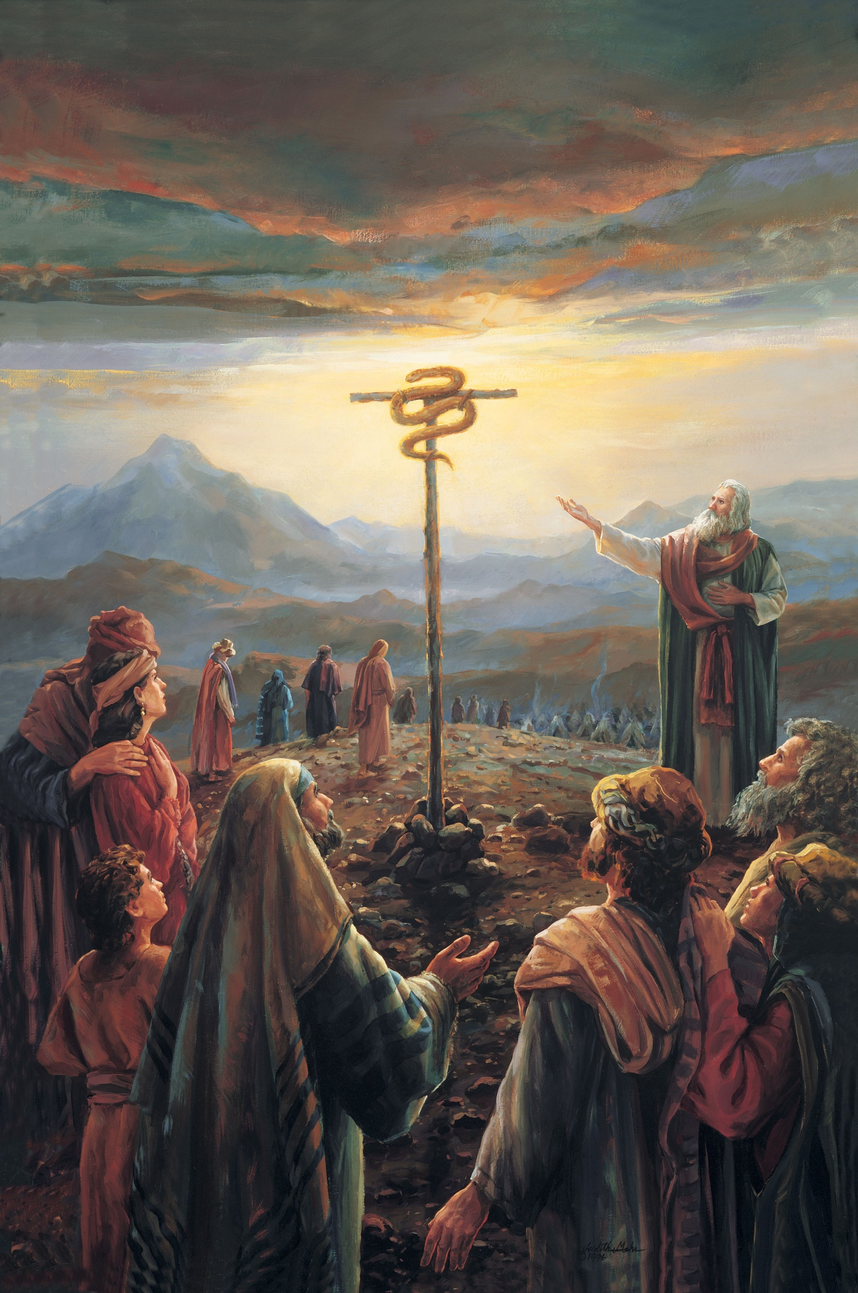
How Do We Know What We Know?
Judith Mehr
Notes:
Shifting gears from how scripture came to be and details of the specific books to how do we know what we know?
Image: https://www.churchofjesuschrist.org/media/image/moses-brass-serpent-e4d489d?lang=eng

Slide 54
“And the Lord sent fiery serpents among the people, and they bit the people; and much people of Israel died. Therefore the people came to Moses, and said, We have sinned, for we have spoken against the Lord, and against thee; pray unto the Lord, that he take away the serpents from us.
Judith Mehr

Slide 55
“And Moses prayed for the people. And the Lord said unto Moses, Make thee a fiery serpent, and set it upon a pole: and it shall come to pass, that every one that is bitten, when he looketh upon it, shall live. And Moses made a serpent of brass, and put it upon a pole, and it came to pass, that if a serpent had bitten any man, when he beheld the serpent of brass, he lived.”
(Numbers 21:5-9)
Judith Mehr

Slide 56
“And as Moses lifted up the serpent in the wilderness, even so must the Son of man be lifted up: That whosoever believeth in him should not perish, but have eternal life. For God so loved the world, that he gave his only begotten Son, that whosoever believeth in him should not perish, but have everlasting life.”
(John 3:14-16)
Judith Mehr

Slide 57
“The Son of God…was spoken of by Moses; yea, and behold a type was raised up in the wilderness, that whosoever would look upon it might live. And many did look and live….But there were many who were so hardened that they would not look, therefore they perished. Now the reason they would not look is because they did not believe that it would heal them….[so] cast about your eyes and…believe in the Son of God.”
(Alma 33:18–20, 22)
Judith Mehr

Slide 58
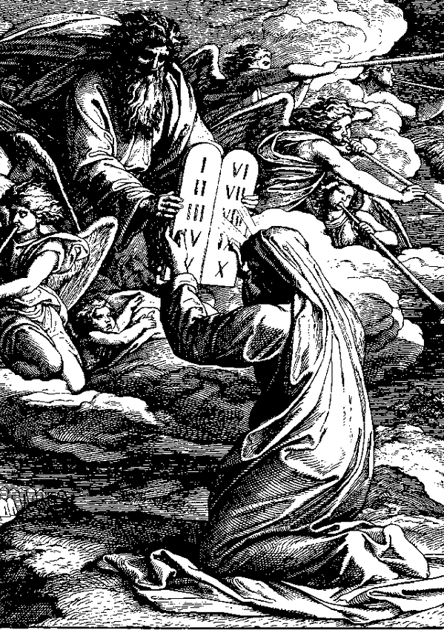
“And the LORD said unto Moses, Come up to me into the mount, and be there: and I will give thee tables of stone, and a law, and commandments which I have written”
(Exodus 24:12)
Julius Schnorr von Carolsfeld
Notes:
In the OT, when you see LORD in all caps, that is a reference to YHWH—transliterated into English as “Jehovah.”
Image: https://en.wikipedia.org/wiki/Ten_Commandments

Slide 59
Note
In the King James version of the Old Testament, when the word “LORD” spelled in all capital letters it means it’s coming from the Hebrew word “YHWH,” which is transliterated as “Yahweh,” or “Jehovah.”
Notes:
See for example D&C 110:2-4.

Slide 60
“And the LORD said unto Moses, Come up to me into the mount, and be there: and I will give thee tables of stone, and a law, and commandments which I have written”
(Exodus 24:12)
“I am he that gave the law”
(3 Nephi 15:5)
In the Book of Mormon, it is clear that Jesus Christ is Jehovah.
Julius Schnorr von Carolsfeld
Notes:
In the OT, when you see LORD in all caps, that is a reference to YHWH—transliterated into English as “Jehovah.”
Image: https://en.wikipedia.org/wiki/Ten_Commandments

Slide 61
Jehovah and Jesus Christ
“He was the Great Jehovah of the
Old Testament, the Messiah
of the New.”
--The Living Christ
Notes:
This was a tricky section of the verses in the pre-class readings.
Photo by Rachel Harper, permission to use

Slide 62
Seven Ways to Learn More About Jesus Christ
Living Prophets
The Scriptures
Modern Scholarship
Personal Experiences
Artwork
Movies
Music
Notes:
The ones in yellow, we’ll talk about today, and the ones in orange we will discuss in a future class.

Slide 63
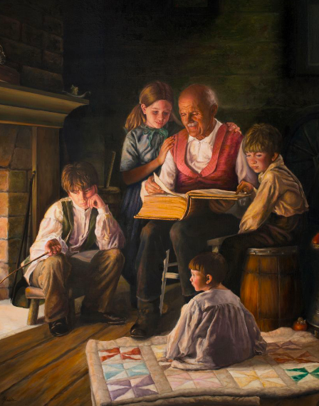
“Seek ye diligently and teach one another words of wisdom; yea, seek ye out of the best books words of wisdom; seek learning, even by study and also by faith.”
(Doctrine and Covenants 88:118)
Glenda Cheryl Gleave
Notes:
Josh Sears: This counsel to study and to seek learning out of the best books applies to all kinds of subjects, so surely it also applies to our mandate to learn all we can about Jesus Christ. Scholarship and academic study—using the intelligence God has given us—are divinely appointed means of approaching Jesus.
Image: https://history.churchofjesuschrist.org/exhibit/iac-2015-tell-me-the-stories-of-jesus?lang=eng#mv38

Slide 64
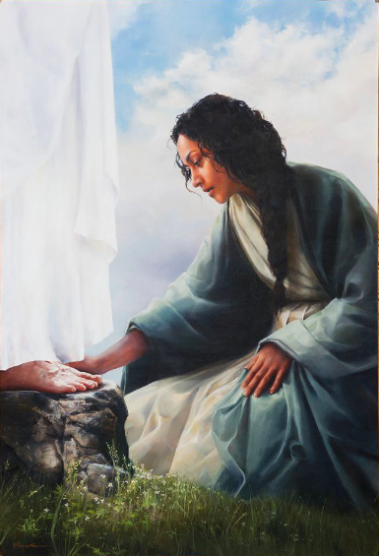
“Thou shalt love the Lord thy God with all thy heart, and with all thy soul, and with all thy mind.”
(Matthew 22:37)
Elspeth Young
Notes:
Image: https://history.churchofjesuschrist.org/exhibit/iac-2015-tell-me-the-stories-of-jesus?lang=eng#mv98

Slide 65
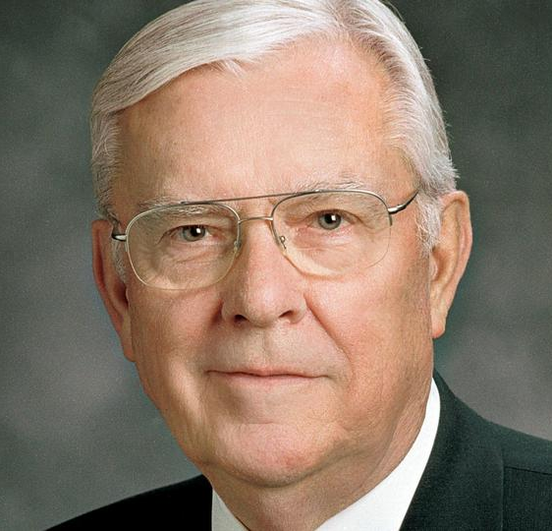
“I am a General Authority, but that does not make me an authority in general! My calling and life experiences allow me to respond to certain types of questions. There are other types of questions that require an expert in a specific subject matter. This is exactly what I do when I need an answer to such questions: I seek help from others, including those with degrees and expertise in such fields.
President M. Russell Ballard, “Questions and Answers,” BYU Devotional, Nov. 14, 2017
Notes:
Image: https://history.churchofjesuschrist.org/content/testimony/m-russell-ballard?lang=eng

Slide 66
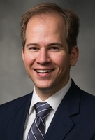
Dr. Joshua Sears
“We of course need to keep in mind that scholarship, like all human endeavors, is imperfect. Sometimes scholars may disagree because there is more than one legitimate way to interpret the data. All scholarly conclusions, no matter how well researched, are subject to re-evaluation in light of new information (either through prophetic revelation or by updated scholarship).”
Notes:
Pause on this for a moment. Being academically qualified is important, but not sufficient. There are some people who have the right credentials but don’t believe in Jesus Christ. I believe scholarship is important and it’s really important to discern faithful scholarship from faithless scholarship. Sometimes the data can be interpreted in different ways, and I would rather focus on a faithful interpretation, rather than a skeptical one. At the same time we need to make sure that we aren’t so overly cautious to avoid scholarship (worrying that it might make us lose our faith) that we miss the amazing insights that can come from focusing our minds on Jesus.
Image: https://religion.byu.edu/directory/josh-sears

Slide 67
Learning from Websites
Notes:
https://bookofmormoncentral.org
https://mi.byu.edu
https://rsc.byu.edu
https://byustudies.byu.edu

Slide 68
Learning from Podcasts
Notes:
Again, you have to be discerning when you listen to podcasts. Just because it’s on a podcast doesn’t mean it’s true. There are some people who have the right credentials but don’t believe in Jesus Christ. But I don’t think that means we have to be scared of all podcasts that aren’t LDS-based. There is much good we can learn from other Christians as well!
https://ldsperspectives.com
https://followhim.co
https://mi.byu.edu/mipodcast/
https://podcasts.apple.com/us/podcast/the-bible-in-a-year-with-fr-mike-schmitz/id1539568321
https://rsc.byu.edu/media/y-religion
https://podacre.blogspot.com

Slide 69
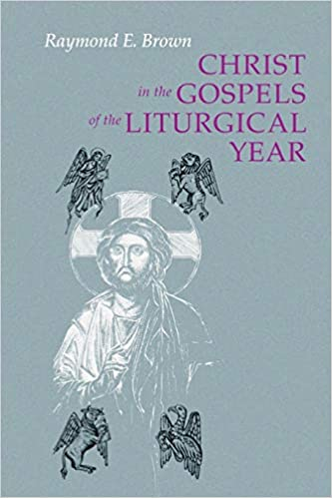
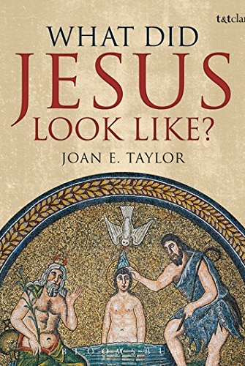
Learning from Books
Notes:
https://deseretbook.com/p/jesus-christ-world-new-testament-lds-perspective-richard-neitzel-holzapfel-5718?variant_id=104343-ebook
https://deseretbook.com/p/finding-christ-in-the-covenant-path-ancient-insights-for-modern-life?variant_id=183457-hardcover
https://www.amazon.com/What-Did-Jesus-Look-Like/dp/056767150X
https://www.amazon.com/Christ-Gospels-Liturgical-Year-1928-1998/dp/081461860X

Slide 70
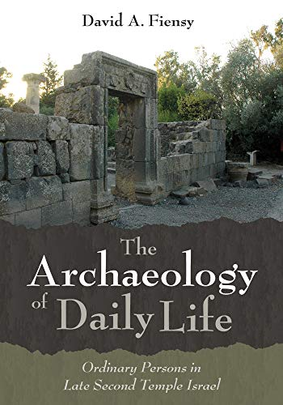
Learning from Books

Slide 71
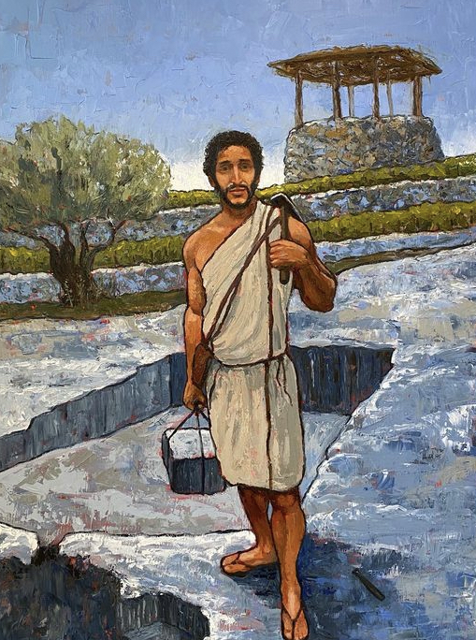
Anthony Sweat

Slide 72
“Therefore I tell you, do not worry…about your body, what you will wear” (Matthew 6:25, NRSV).
“Why do you worry about clothing? Consider the lilies of the field, how they grow; they neither toil nor spin…if God so clothes the grass of the field…will he not much more clothe you—you of little faith?” (Matthew 6:28-30, NRSV).
Anthony Sweat

Slide 73
“Therefore I tell you, do not worry…about your body, what you will wear” (Matthew 6:25, NRSV).
“Why do you worry about clothing? Consider the lilies of the field, how they grow; they neither toil nor spin…if God so clothes the grass of the field…will he not much more clothe you—you of little faith?” (Matthew 6:28-30, NRSV).
Anthony Sweat

Slide 74
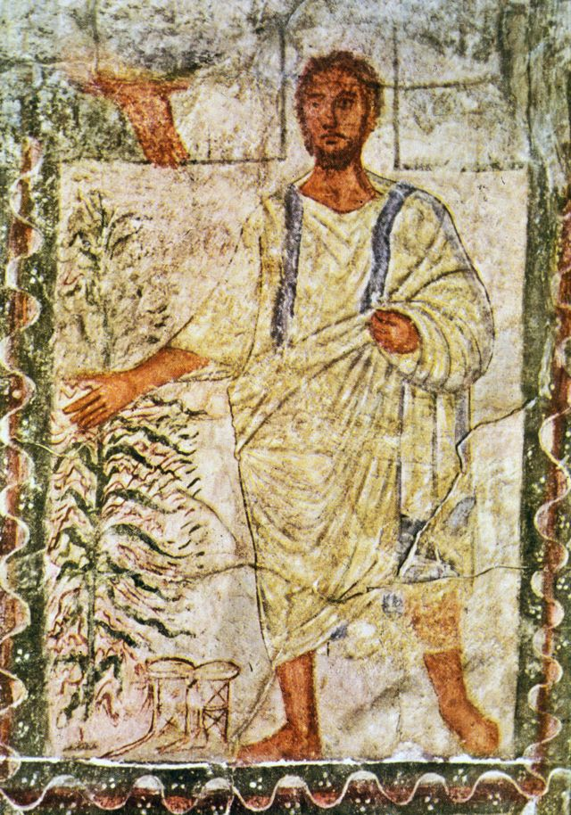
“If anyone wants to sue you and take your coat [chitōn=tunic], give your cloak [himation] as well.” (Matthew 5:40)
Notes:
“…the depiction of Moses on the walls of the 3rd Century synagogue of Dura-Europos, since it shows how a Jewish sage was imagined in the Graeco-Roman world. Moses is imagined in undyed clothing, and in fact his one mantle is a tallith, since in the Dura image of Moses parting the Red Sea one can see tassels (tzitzith) at the corners. At any rate, this image is far more correct as a basis for imagining the historical Jesus than the adaptations of the Byzantine Jesus that have become standard: he's short-haired and with a slight beard, and he's wearing a short tunic, with short sleeves, and a himation.” (https://www.bbc.com/news/magazine-35120965)

Slide 75
Seven Ways to Learn More About Jesus Christ
Living Prophets
The Scriptures
Modern Scholarship
Personal Experiences
Artwork
Movies
Music
Notes:
The ones in yellow, we’ll talk about today, and the ones in orange we will discuss in a future class.

Slide 76
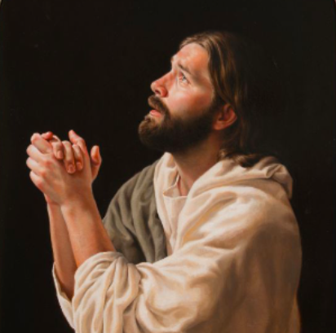
Eternal life is to know Jesus Christ
“This is life eternal, that they might know thee the only true God, and Jesus Christ, whom thou hast sent.”
(John 17:3)
Daniel Alma Wilson
Notes:
Ultimately, your personal experiences with the Savior can be the most powerful ways to learn of him.
Image: https://history.churchofjesuschrist.org/exhibit/iac-2015-tell-me-the-stories-of-jesus?lang=eng#mv94

Slide 77
Eternal life is to know Jesus Christ
Which kind of “know”?
NOT oida = know facts, data
BUT ginōskō = know by experience
Note “conocer” not “saber” in Spanish.
“Y esta es la vida eterna: que te conozcan a ti, el único Dios verdadero, y a Jesucristo, a quien has enviado.”
Daniel Alma Wilson
Notes:
Ultimately, your personal experiences with the Savior can be the most powerful ways to learn of him.
Image: https://history.churchofjesuschrist.org/exhibit/iac-2015-tell-me-the-stories-of-jesus?lang=eng#mv94

Slide 78
Eternal life is to know Jesus Christ
Which kind of “know”?
NOT oida = know facts, data
BUT ginōskō = know by experience
Note “conocer” not “saber” in Spanish.
“Y esta es la vida eterna: que te conozcan a ti, el único Dios verdadero, y a Jesucristo, a quien has enviado.”
Daniel Alma Wilson
Notes:
Ultimately, your personal experiences with the Savior can be the most powerful ways to learn of him.
Image: https://history.churchofjesuschrist.org/exhibit/iac-2015-tell-me-the-stories-of-jesus?lang=eng#mv94

Slide 79
How Can I Better Know Christ Through Personal Experience?
“Every one that loveth…knoweth God” (1 John 4:7).
“Hereby we do know that we know him, if we keep his commandments” (1 John 2:3).
“He defended the cause of the poor and needy . . . Is that not what it means to know me?” (Jeremiah 22:26, NIV).
“How knoweth a man the master whom he has not served?” (Mosiah 5:13).
Notes:
Loving others, keeping his commandments, defending the poor/needy, serving Jesus==this is how we come to know him.

Slide 80
“Doth [Jesus] cry unto any, saying: Depart from me? Behold, I say unto you, Nay; but he saith: Come unto me.”
(2 Nephi 26:25)
Notes:
Loving others, keeping his commandments, defending the poor/needy, serving Jesus==this is how we come to know him.

Slide 81
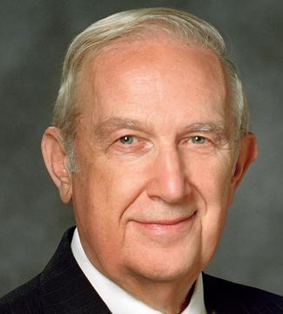
“If you pray for the gift, and live like you have it, the gift will be yours.” What would you do differently in your life to live like you already have this spiritual gift?
Notes:
Share experience with Elder Richard G. Scott.
Image: https://www.churchofjesuschrist.org/church/leader/richard-g-scott?lang=eng

Slide 82
Every member of the Church is entitled to and can “develop an apostolic-like relationship with the Lord.”
President M. Russell Ballard, cited in “We are Witnesses,” Ensign, July 2019
Notes:
What are you and I doing to develop this kind of relationship?

Slide 83
“Draw near unto me and I will draw near unto you; seek me diligently and ye shall find me”
(Doctrine and Covenants 88:63)
Notes:
Loving others, keeping his commandments, defending the poor/needy, serving Jesus==this is how we come to know him.

