Slide 1
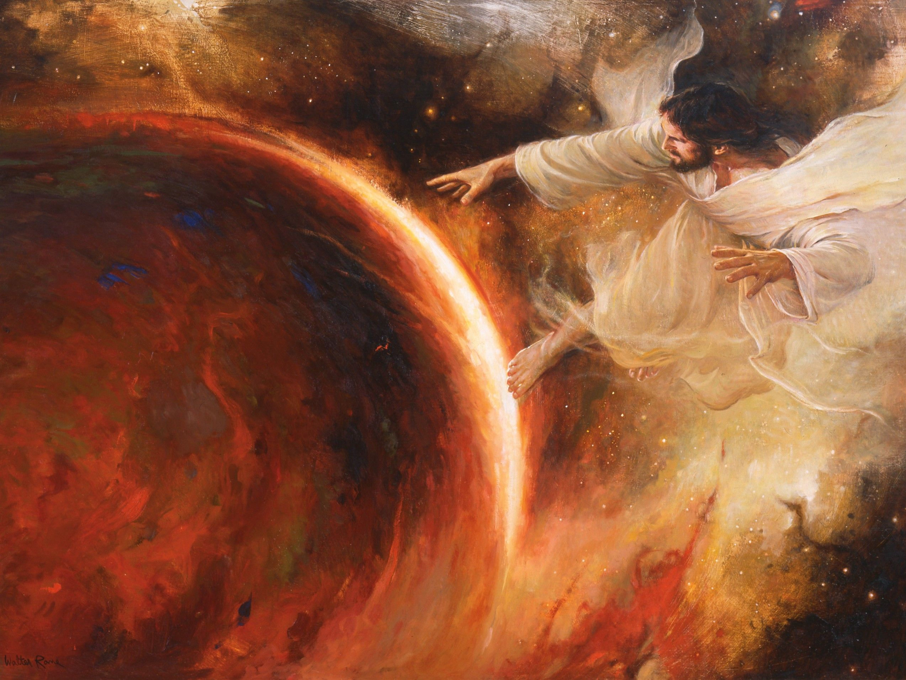
“In the beginning was the Word, and the Word was with God, and the Word was God. He was in the beginning with God. All things came into being through him, and without him not one thing came into being.
Walter Rane
Notes:
Which book am I about to quote from?
In your pre-class reading, you saw passages that clearly teach that Jesus Christ created the earth. The Savior did this under the direction of his Father. We don’t know all the details about how the earth was created—as one of the passages in the pre-reading points out, more will be revealed on that topic in the future. For the purposes of this class focused on Jesus Christ, we want to know that the Savior created the world.
Image: https://www.churchofjesuschrist.org/media/image/jehovah-creates-earth-rane-fa3141a?lang=eng

Slide 2
“In the beginning was the Word, and the Word was with God, and the Word was God. He was in the beginning with God. All things came into being through him, and without him not one thing came into being” (John 1:1-3, NRSV)
Walter Rane
Notes:
Which book am I about to quote from?
In your pre-class reading, you saw passages that clearly teach that Jesus Christ created the earth. The Savior did this under the direction of his Father. We don’t know all the details about how the earth was created—as one of the passages in the pre-reading points out, more will be revealed on that topic in the future. For the purposes of this class focused on Jesus Christ, we want to know that the Savior created the world.
Image: https://www.churchofjesuschrist.org/media/image/jehovah-creates-earth-rane-fa3141a?lang=eng

Slide 3
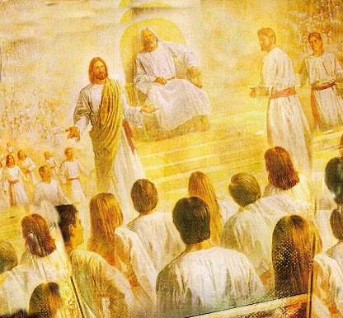
“The Lord had shown unto me, Abraham, the intelligences that were organized before the world was; and among all these there were many of the noble and great ones; And God saw these souls that they were good, and he stood in the midst of them, and he said: These I will make my rulers; for he stood among those that were spirits, and he saw that they were good; and he said unto me: Abraham, thou art one of them; thou wast chosen before thou wast born.
Abraham 3:22-27
Notes:
Which book am I about to quote from?
In your pre-class reading, you saw passages that clearly teach that Jesus Christ created the earth. The Savior did this under the direction of his Father. We don’t know all the details about how the earth was created—as one of the passages in the pre-reading points out, more will be revealed on that topic in the future. For the purposes of this class focused on Jesus Christ, we want to know that the Savior created the world.
Image: https://www.mormonwiki.com/File:Pre-Mortal_Life.jpg

Slide 4
“And there stood one among them that was like unto God, and he said unto those who were with him: We will go down, for there is space there, and we will take of these materials, and we will make an earth whereon these may dwell; And we will prove them herewith, to see if they will do all things whatsoever the Lord their God shall command them;
Abraham 3:22-27
Notes:
Image: https://www.mormonwiki.com/File:Pre-Mortal_Life.jpg

Slide 5
“And they who keep their first estate shall be added upon; and they who keep not their first estate shall not have glory in the same kingdom with those who keep their first estate; and they who keep their second estate shall have glory added upon their heads for ever and ever. And the Lord said: Whom shall I send? And one answered like unto the Son of Man: Here am I, send me. And another answered and said: Here am I, send me. And the Lord said: I will send the first.”
Abraham 3:22-27
Notes:
Image: https://www.mormonwiki.com/File:Pre-Mortal_Life.jpg

Slide 6
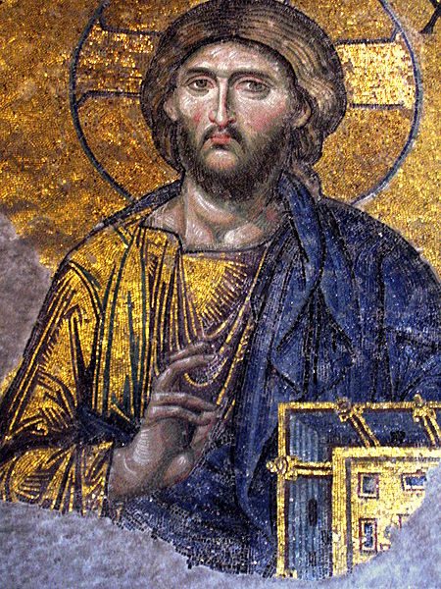
“I am Alpha and Omega, the beginning and the end” (Revelation 21:6)
Acaro
Notes:
Image credit: https://commons.wikimedia.org/wiki/File:Hagia_Sofia_mosaic_Jesus.JPG

Slide 7
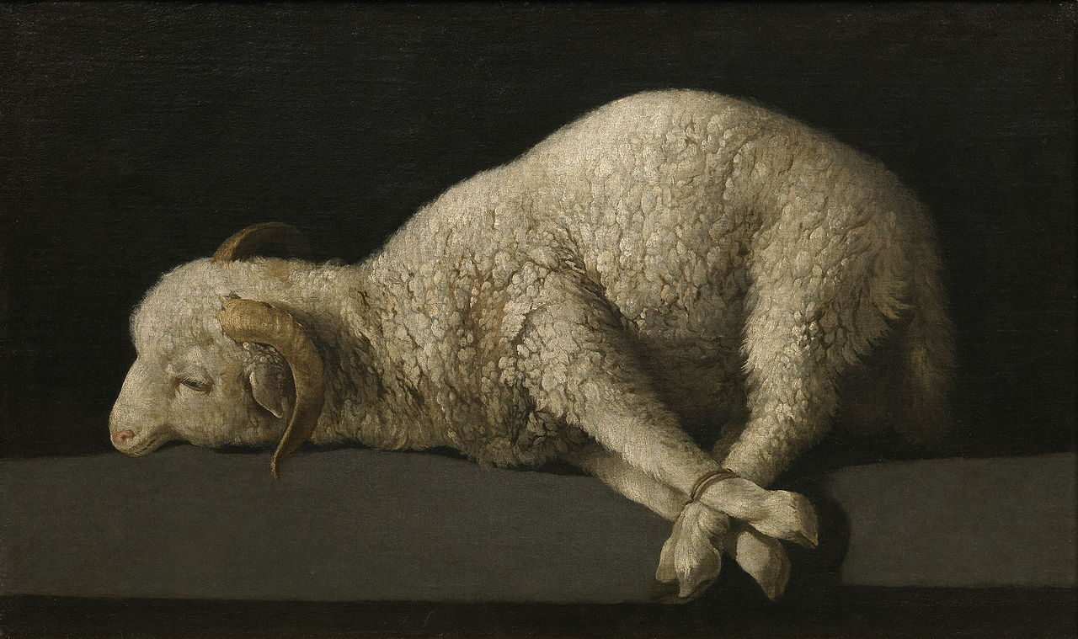
Francisco de Zurbarán
“The Lamb slain from the foundation of the world”
(Rev. 13:8).
Notes:
Brief discussion of the fall of Adam and Eve. Jesus Christ was involved in your life in the premortal realms, from the beginning of mortality on earth, and he’s involved in your life today.
Image: https://en.wikipedia.org/wiki/Agnus_Dei_(Zurbarán)

Slide 8
Christ’s Atonement was not “the
back up plan,”
it was
“the plan.”
Francisco de Zurbarán
“The Lamb slain from the foundation of the world”
(Rev. 13:8).
Notes:
Brief discussion of the fall of Adam and Eve. Jesus Christ was involved in your life in the premortal realms, from the beginning of mortality on earth, and he’s involved in your life today.
Image: https://en.wikipedia.org/wiki/Agnus_Dei_(Zurbarán)

Slide 9
“He shall be called Jesus Christ, the Son of God, the Father of heaven and earth, the Creator of all things from the beginning”
(Mosiah 3:8)
Walter Rane
Notes:
Which book am I about to quote from?
In your pre-class reading, you saw passages that clearly teach that Jesus Christ created the earth. The Savior did this under the direction of his Father. We don’t know all the details about how the earth was created—as one of the passages in the pre-reading points out, more will be revealed on that topic in the future. For the purposes of this class focused on Jesus Christ, we want to know that the Savior created the world.
Image: https://www.churchofjesuschrist.org/media/image/jehovah-creates-earth-rane-fa3141a?lang=eng

Slide 10
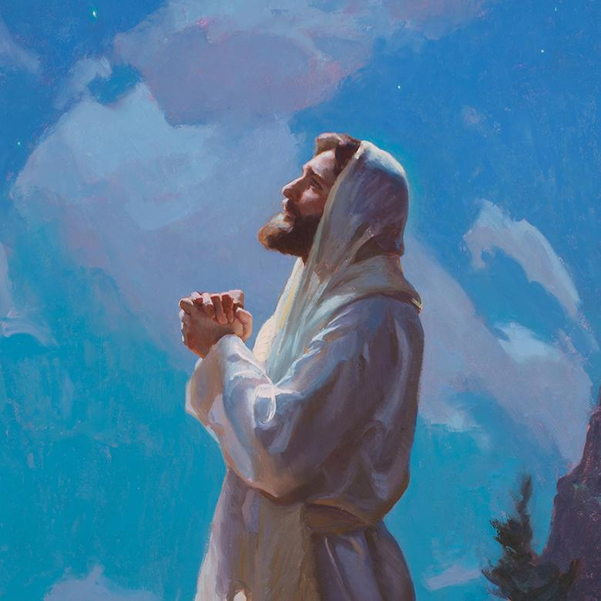
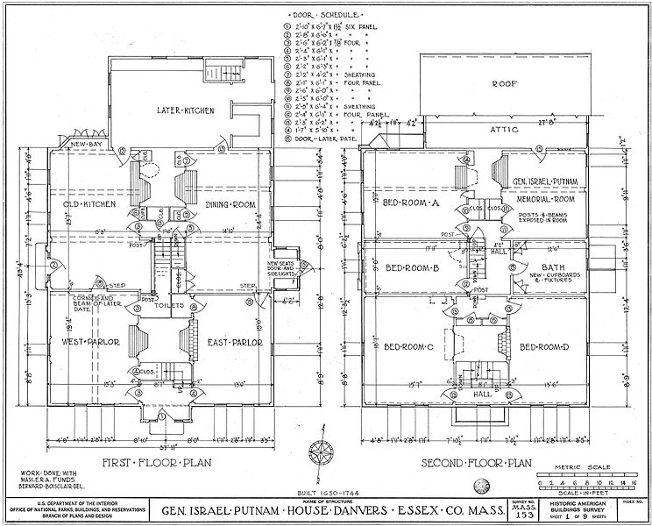
Three Lessons from Jesus Christ and the Creation
Michael Malm
Lowell Bruce Bennett
Notes:
Image 1: https://history.churchofjesuschrist.org/exhibit/iac-2015-tell-me-the-stories-of-jesus?lang=eng
Image 2: https://commons.wikimedia.org/wiki/File:Putnam_House_-_floor_plans.jpg
Image 3: https://www.churchofjesuschrist.org/media/image/adam-eve-1623179?lang=eng&collectionId=65a92c1051e01cb5bea39a2451a9310ba63e01a2

Slide 11
“On the seventh day God ended his work which he had made; and he rested on the seventh day from all his work which he had made. And God blessed the seventh day, and sanctified it: because that in it he had rested from all his work which God created and made”
Michael Malm
Genesis 2:2-3
Notes:
Note that Genesis 2:2-3 is what Christ does
Ezekiel 20:20, Matthew 12:10-13, and Doctrine and Covenants 59:9-10 are all what Christ says.

Slide 12
“Hallow my sabbaths; and they shall be a sign between me and you, that ye may know that I am the Lord your God.”
Michael Malm
Ezekiel 20:20
Notes:
Note that Genesis 2:2-3 is what Christ does
Ezekiel 20:20, Matthew 12:10-13, and Doctrine and Covenants 59:9-10 are all what Christ says.

Slide 13
“There was a man which had his hand withered. And they asked [Jesus], saying, Is it lawful to heal on the sabbath days? that they might accuse him. And he said unto them, What man shall there be among you, that shall have one sheep, and if it fall into a pit on the sabbath day, will he not lay hold on it, and lift it out?
Michael Malm
Matthew 12:10-13
Notes:
Note that Genesis 2:2-3 is what Christ does
Ezekiel 20:20, Matthew 12:10-13, and Doctrine and Covenants 59:9-10 are all what Christ says.

Slide 14
“How much then is a man better than a sheep? Wherefore it is lawful to do well on the sabbath days. Then saith he to the man, Stretch forth thine hand. And he stretched it forth; and it was restored whole, like as the other.”
Michael Malm
Matthew 12:10-13
Notes:
Note that Genesis 2:2-3 is what Christ does
Ezekiel 20:20, Matthew 12:10-13, and Doctrine and Covenants 59:9-10 are all what Christ says.

Slide 15
“And that thou mayest more fully keep thyself unspotted from the world, thou shalt go to the house of prayer and offer up thy sacraments upon my holy day; For verily this is a day appointed unto you to rest from your labors, and to pay thy devotions unto the Most High.”
Michael Malm
Doctrine and Covenants 59:9-10
Notes:
Note that Genesis 2:2-3 is what Christ does
Ezekiel 20:20, Matthew 12:10-13, and Doctrine and Covenants 59:9-10 are all what Christ says.

Slide 16
From Elder David A. Bednar, Increase in Learning
Notes:
Image credit: https://oneclimbs.com/2013/08/01/what-are-doctrines-principles-applications/
In an email on April 26, 2021 at 12:34 PM, Steve Reed gave permission to use this image without attribution.

Slide 17
The Holy Ghost is a member of the Godhead.
Doctrine
Principle
Application
_________________________
Notes:
Could share your experience with homework on the Sabbath as an example of “application.” Quotes at the end of this PPT if students are interested in learning more about the specific issue of homework on Sunday.
Highlight that while we don’t have specific “I’m trying to be like Jesus” assignments, I hope we’ll keep that in the forefront of our minds (key learning outcome of each class period).

Slide 18
The Holy Ghost is a member of the Godhead.
Doctrine
“As I always remember Jesus Christ, I will have the Holy Spirit as my constant companion.” OR “Keeping the Word of Wisdom will help me be more in tune with the Holy Spirit.”
Principle
Application
_________________________
Notes:
Could share your experience with homework on the Sabbath as an example of “application.” Quotes at the end of this PPT if students are interested in learning more about the specific issue of homework on Sunday.
Highlight that while we don’t have specific “I’m trying to be like Jesus” assignments, I hope we’ll keep that in the forefront of our minds (key learning outcome of each class period).

Slide 19
Michael Malm
Under God’s direction, Jesus Christ created the earth
Doctrine
The Sabbath is a day for me to demonstrate my devotion to God
Principle
Application
_________________________
Notes:
Could share your experience with homework on the Sabbath as an example of “application.” Quotes at the end of this PPT if students are interested in learning more about the specific issue of homework on Sunday.
Highlight that while we don’t have specific “I’m trying to be like Jesus” assignments, I hope we’ll keep that in the forefront of our minds (key learning outcome of each class period).

Slide 20
“I, the Lord God, created all things, of which I have spoken, spiritually, before they were naturally upon the face of the earth…all things were before created; but spiritually were they created and made according to my word” (Moses 3:5, 7)
Notes:
Image: https://commons.wikimedia.org/wiki/File:Putnam_House_-_floor_plans.jpg

Slide 21
Notes:
Image by Kenley Kohls

Slide 24
Elder Richard G. Scott
“You need a retreat of peace and quiet where periodically you can ponder and let the Lord establish the direction in your life… Sometime soon you may benefit from taking this personal inventory:
What are my highest priorities of life?
How do I use my discretionary time? Is some of it consistently used for my highest priorities?
Is there anything I know I should not be doing? If so, I will stop now.
“To Acquire Knowledge…” http://speeches.byu.edu
Notes:
USE AUDIO CLIP IN THE
Image: https://www.churchofjesuschrist.org/church/leader/richard-g-scott?lang=eng

Slide 25
Notes:
For more information see, https://johnhiltoniii.com/understanding-and-implementing-the-lords-vision-for-your-life/

Slide 27
Under God’s direction, Jesus Christ created the earth
Doctrine
Jesus Christ created things “spiritually” before they were created “physically.”
Principle
Application
_________________________

Slide 28
“Therefore shall a man leave his father and his mother, and shall cleave unto his wife: and they shall be one flesh.”
Lowell Bruce Bennett
Genesis 2:24
Notes:
For the reference to Moses’ permitting divorce, see Deut. 24:1-4.
Note: This is a consistent teaching: Matthew 5:31–32 (compare Luke 16:18, 3 Nephi 12:31-32), Matthew 19:1–12 (compare Mark 10:1–12), and also 1 Corinthians 7:10–11.

Slide 29
“The Pharisees also came unto him, tempting him, and saying unto him, Is it lawful for a man to put away his wife for every cause?”
Lowell Bruce Bennett
Matthew 19:4-9
Notes:
For the reference to Moses’ permitting divorce, see Deut. 24:1-4.
Note: This is a consistent teaching: Matthew 5:31–32 (compare Luke 16:18, 3 Nephi 12:31-32), Matthew 19:1–12 (compare Mark 10:1–12), and also 1 Corinthians 7:10–11.

Slide 30
“[Jesus] answered and said unto them, Have ye not read, that he which made them at the beginning made them male and female, And said, For this cause shall a man leave father and mother, and shall cleave to his wife: and they twain shall be one flesh? Wherefore they are no more twain, but one flesh. What therefore God hath joined together, let not man put asunder.”
Lowell Bruce Bennett
Matthew 19:4-9
Notes:
For the reference to Moses’ permitting divorce, see Deut. 24:1-4.
Note: This is a consistent teaching: Matthew 5:31–32 (compare Luke 16:18, 3 Nephi 12:31-32), Matthew 19:1–12 (compare Mark 10:1–12), and also 1 Corinthians 7:10–11.

Slide 31
[The Pharisees] say unto [Jesus], “Why did Moses then command to give a writing of divorcement, and to put her away?”
Lowell Bruce Bennett
Matthew 19:4-9
Notes:
For the reference to Moses’ permitting divorce, see Deut. 24:1-4.
Note: This is a consistent teaching: Matthew 5:31–32 (compare Luke 16:18, 3 Nephi 12:31-32), Matthew 19:1–12 (compare Mark 10:1–12), and also 1 Corinthians 7:10–11.

Slide 32
“[Jesus] saith unto them, Moses because of the hardness of your hearts suffered you to put away your wives: but from the beginning it was not so. And I say unto you, Whosoever shall put away his wife, except it be for fornication, and shall marry another, committeth adultery: and whoso marrieth her which is put away doth commit adultery.”
Lowell Bruce Bennett
Matthew 19:4-9
Notes:
For the reference to Moses’ permitting divorce, see Deut. 24:1-4.
Note: This is a consistent teaching: Matthew 5:31–32 (compare Luke 16:18, 3 Nephi 12:31-32), Matthew 19:1–12 (compare Mark 10:1–12), and also 1 Corinthians 7:10–11.

Slide 33
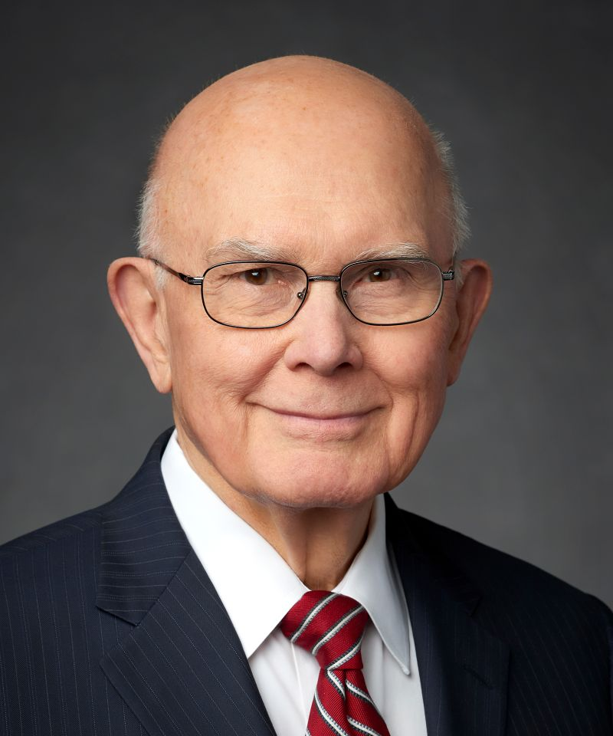
President Dallin H. Oaks
“In the temples of the Lord, couples are married for all eternity. But some marriages do not progress toward that ideal. Because “of the hardness of [our] hearts,” the Lord does not currently enforce the consequences of the celestial standard. He permits divorced persons to marry again without the stain of immorality specified in the higher law. Unless a divorced member has committed serious transgressions, he or she can become eligible for a temple recommend under the same worthiness standards that apply to other members.”
Notes:
Image: https://www.churchofjesuschrist.org/church/leader/richard-g-scott?lang=eng

Slide 34
“Husbands, love your wives, even as Christ also loved the church, and gave himself for it”
Lowell Bruce Bennett
Ephesians 5:25

Slide 36
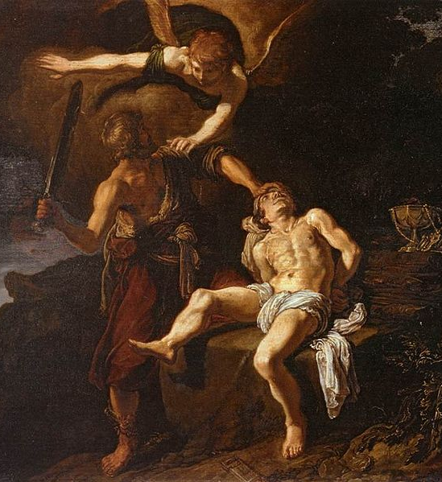
Abraham “built an altar . . . and bound Isaac his son, and laid him on the altar” (Gen. 22:9), which was “a similitude of God and his Only Begotten Son.”
(Jacob 4:5, see also Lev. 9:7, 2 Chron. 29:24)
Notes:
Image 1: https://upload.wikimedia.org/wikipedia/commons/0/09/Pieter_Lastman_-_The_Angel_of_the_Lord_Preventing_Abraham_from_Sacrificing_his_Son_Isaac_-_WGA12483.jpg
Image 2: https://www.ldsliving.com/5-Gifts-We-Are-Given-When-We-Receive-Our-Temple-Endowment/s/91583

Slide 37
“I invited them to the altar, and…the groom took the bride by the hand…” (Elder Bruce C. Hafen)

Slide 38
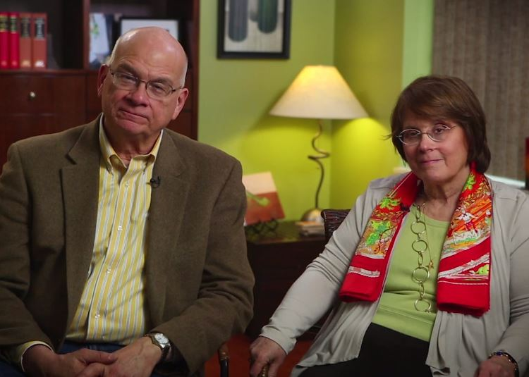
“On the cross, Jesus did not look down on us with a heart full of admiration and affection. He felt no ‘chemistry.’ But he gave himself. He put our needs ahead of his own; he sacrificed for us.
Timothy and Kathy Keller,
The Meaning of Marriage,
135, 186

Slide 39
“The Bible tells spouses not only to imitate the quality and manner of Christ’s love but also the goal of it. Jesus died not because we were lovely, but to make us lovely. He died, Paul says, to ‘make us holy’ [Ephesians 5:26].”
Timothy and Kathy Keller,
The Meaning of Marriage,
135, 186

Slide 40
“Paradoxically, this means Paul is urging spouses to help their mates love Jesus more than them. It’s a paradox but not a contradiction. The simple fact is that only if I love Jesus more than my wife will I be able to serve her needs ahead of my own.
Timothy and Kathy Keller,
The Meaning of Marriage,
135, 186

Slide 41
“Only if my emotional tank is filled with love from God will I be able to be patient, faithful, tender, and open with my wife when things are not going well in life or in the relationship. And the more joy I get from my relationship with Christ, the more I can share that joy with my wife and family.”
Timothy and Kathy Keller,
The Meaning of Marriage,
135, 186

Slide 42
Lowell Bruce Bennett
Under God’s direction, Jesus Christ created the earth
Doctrine
Marriage between man and woman is essential to God’s eternal plan.
Principle
Application
_________________________

Slide 43
Walter Rane
Under God’s direction, Jesus Christ created the earth
Doctrine
Follow Christ’s example and create.
What other principles do you see from the Creation?
Principle
Application
_________________________
Notes:
Students create their own principle and application that grow out of the doctrine that Jesus Christ created the earth. Other principles might include the importance of creating things in our own lives, large endeavor.

Slide 44
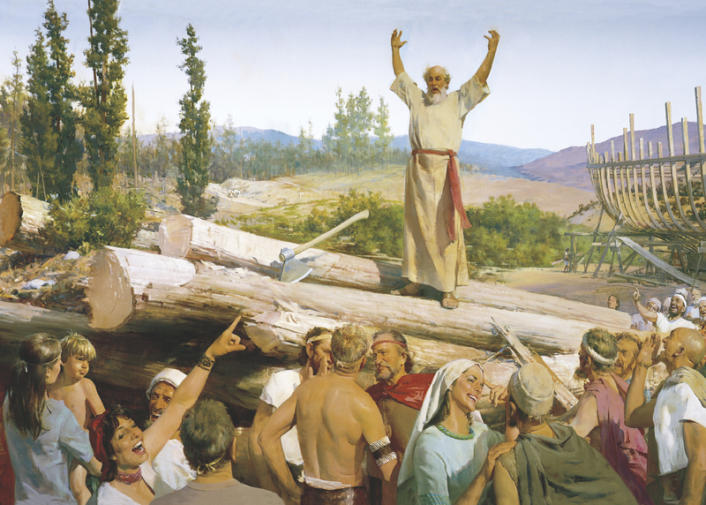
Abraham in Context: An Approximate Timeline
Adam
Flood
Jared
Abraham
Joseph
Moses
Isaac
Jacob
BC
(Tower of Babel)
c. 2000
c. 1700
c. 1300
“The Lord ordained Noah after his own order, and commanded him that he should go forth and declare his Gospel unto the children of men” (Moses 8:19)
Harry Anderson
Notes:
I care more about sequence more than specific dates. Earlier in class, we talked about how Jesus was involved with Adam and Eve. We see the same with others before Abraham.
Image: https://www.churchofjesuschrist.org/media/image/noah-building-ark-8742114?lang=eng&collectionId=3a47a0bf222294ac519e1cc8a333d1029972509c

Slide 45
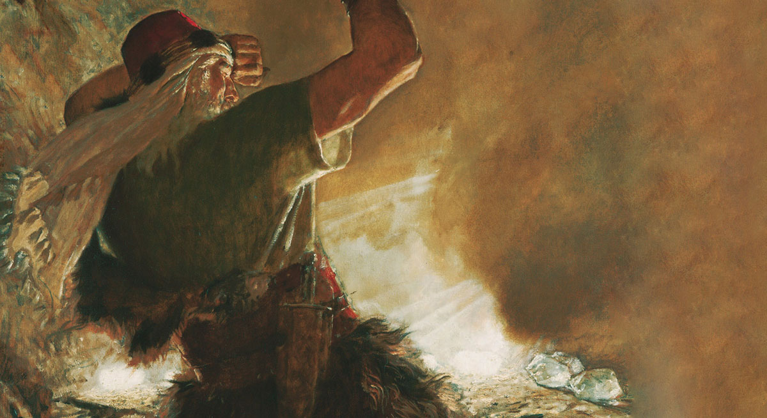
Abraham in Context: An Approximate Timeline
Adam
Flood
Jared
Abraham
Joseph
Moses
Isaac
Jacob
BC
(Tower of Babel)
c. 2000
c. 1700
c. 1300
“Behold, I am he who was prepared from the foundation of the world to redeem my people. Behold, I am Jesus Christ.” (Ether 3:14.)
Arnold Friberg
Notes:
I care more about approximate centuries and especially sequence more than specific dates. Earlier in class, we talked about how Jesus was involved with Adam and Eve. We see the same with others before Abraham.
Need about 8 minutes to discuss the Abrahamic Covenant and practice scriptures.byu.edu. More time can be used for the DPA discussion on the seed of Abraham, and to explain the paper.
Image: https://www.churchofjesuschrist.org/media/image/brother-of-jared-seeing-finger-of-lord-7971980?lang=eng

Slide 46
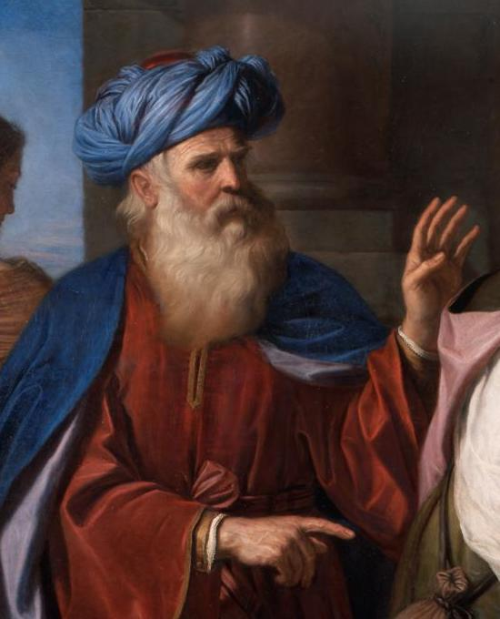
Abraham in Context: An Approximate Timeline
Adam
Flood
Jared
Abraham
Joseph
Moses
Isaac
Jacob
BC
(Tower of Babel)
c. 2000
c. 1700
c. 1300
“The LORD said unto Abraham…” (Genesis 18:3)
Giovanni Francesco Barbieri
Notes:
Need about 8 minutes to discuss the Abrahamic Covenant and practice scriptures.byu.edu. More time can be used for the DPA discussion on the seed of Abraham, and to explain the paper.
Our time is limited for the Abrahamic covenant, which you carefully studied before class, but I want to focus on the fact, as discussed in our previous class, that it’s Jesus Christ who is making this covenant and giving these responsibilities.
Painting in public domain: https://en.wikipedia.org/wiki/Abraham#/media/File:Guercino_Abramo_ripudia_Agar_(cropped).jpg

Slide 47
Abraham and The Lord: A Personal Note
“I, Abraham, built an altar…and made an offering unto the Lord, and prayed that the famine might be turned away…I offered sacrifice there in the plains of Moreh, and called on the Lord devoutly” (Abraham 2:17-18)
here was a continuation of a famine in the land; and I… concluded to go down into Egypt, to sojourn there, for the famine became very grievous” (Abraham 2:21)
Notes:
Abraham has a problem and he turns to the Lord…what do you think happens next?

Slide 48
Abraham and The Lord: A Personal Note
“I, Abraham, built an altar…and made an offering unto the Lord, and prayed that the famine might be turned away…I offered sacrifice there in the plains of Moreh, and called on the Lord devoutly” (Abraham 2:17-18)
“There was a continuation of a famine in the land; and I… concluded to go down into Egypt, to sojourn there, for the famine became very grievous” (Abraham 2:21)
Notes:
Abraham has a problem and he turns to the Lord…what do you think happens next?

Slide 49
Genesis 17:1,4, 6–8
“The LORD appeared to [Abraham], and said unto him…my covenant is with thee, and thou shalt be a father of many nations….I will make thee exceeding fruitful, and I will make nations of thee, and kings shall come out of thee. And I will establish my covenant between me and thee and thy seed after thee in their generations for an everlasting covenant, to be a God unto thee, and to thy seed after thee. And I will give unto thee, and to thy seed after thee, the land wherein thou art a stranger, all the land of Canaan, for an everlasting possession; and I will be their God.”

Slide 50
Abraham 2:9
“I will make of thee a great nation, and I will bless thee above measure, and make thy name great among all nations, and thou shalt be a blessing unto thy seed after thee, that in their hands they shall bear this ministry and Priesthood unto all nations.”

Slide 51
Note the scriptural emphasis on our responsibility in the Abrahamic Covenant.
“In thy seed shall all the nations of the earth be blessed” (Genesis 22:18)
Ye are… of the covenant which God made with our fathers, saying unto Abraham, And in thy seed shall all the kindreds of the earth be blessed” (Acts 3:25).
“Which covenant the Lord made to our father Abraham, saying: In thy seed shall all the kindreds of the earth be blessed” (1 Nephi 15:18).
“Elias appeared, and committed the dispensation of the gospel of Abraham, saying that in us and our seed all generations after us should be blessed” (Doctrine and Covenants 110:12).
“In thy seed after thee . . . shall all the families of the earth be blessed, even with the blessings of the Gospel, which are the blessings of salvation, even of life eternal” (Abraham 2:11)
Notes:
IT’S IN EVERY ONE OF THE STADARD WORKS

Slide 52
The Doctrine of the Abrahamic Covenant: A Summary
Jesus gave the following promised blessings to Abraham and his descendants:
Posterity (Gen. 13:16, 15:5-6, 17:6)
Promised land (Gen. 13:14-15, 17:9)
Priesthood (Abraham 2:11)
Jesus gave Abraham and his posterity the responsibility to “bear this ministry unto all nations” (Abraham 2:9) so that all the families of the earth will be blessed (Gen. 12:3, Abr. 2:11). This will happen through the restoration of the gospel in the latter days (1 Nephi 22:7-12). We have an important role to play in taking the Gospel to the nations of the earth.
Notes:
Our time is limited for the Abrahamic covenant, which you carefully studied before class, but I want to focus on the fact, as discussed in our previous class, that it’s Jesus Christ who is making this covenant and giving these responsibilities.

Slide 53
How can I learn more about what prophets have taught regarding the Abrahamic Covenant?
http://scriptures.byu.edu or Scripture Citation Index App
Notes:
Image from Please Pass the Scriptures, okay to use

Slide 54
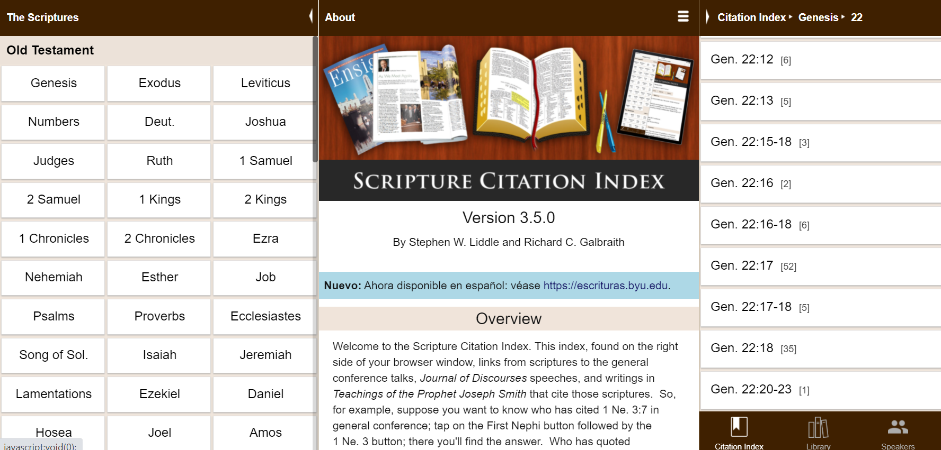

Slide 55
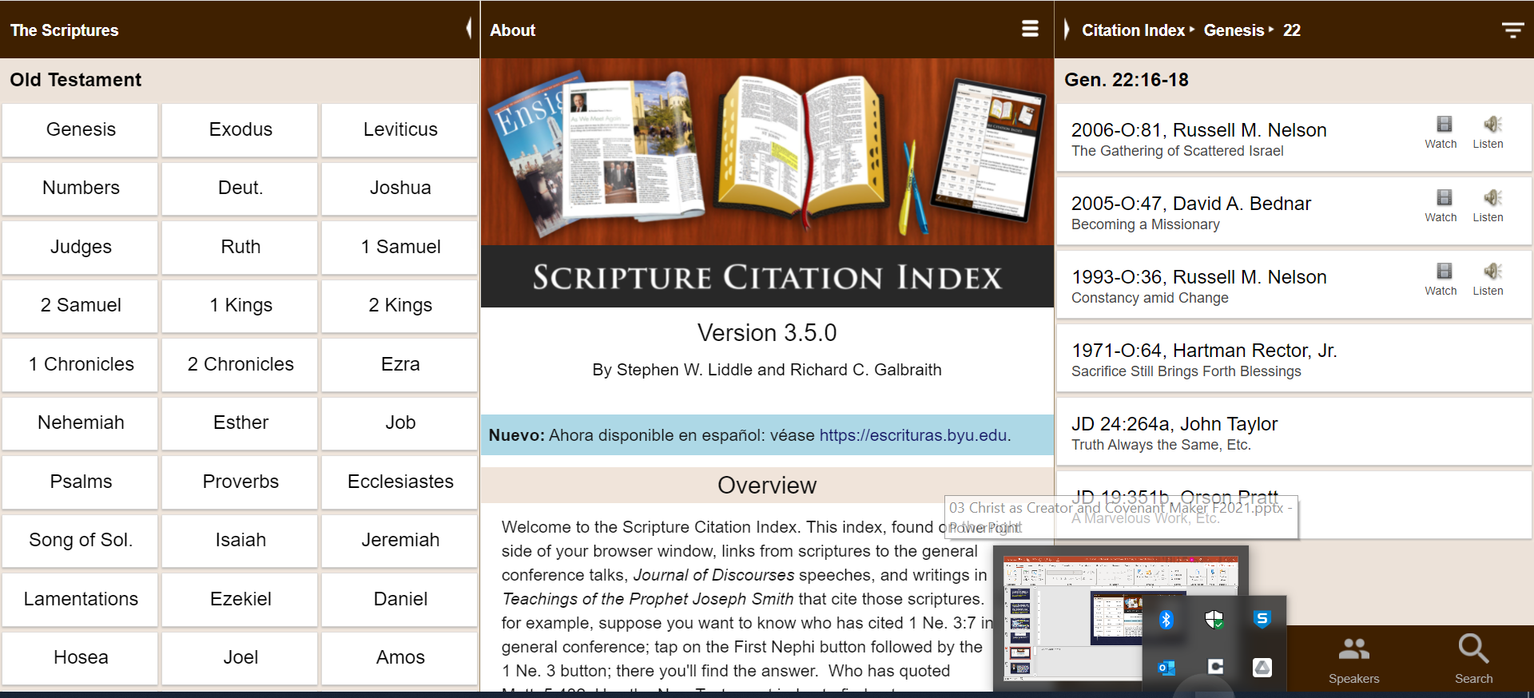

Slide 56
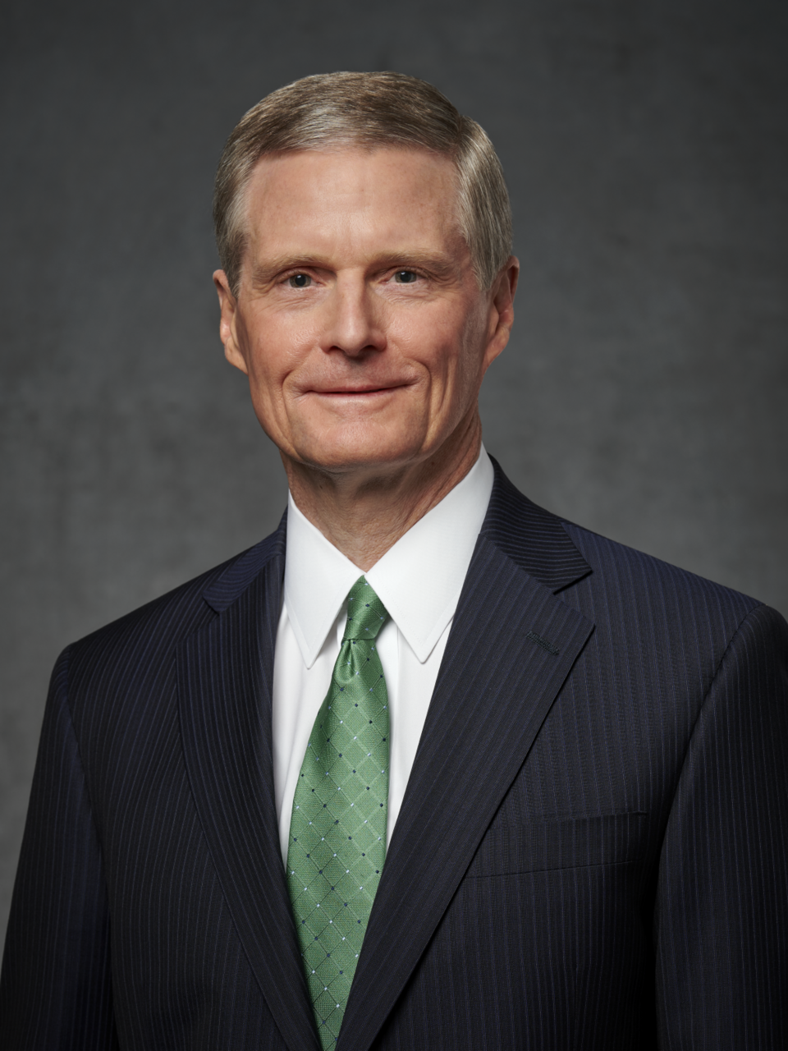
“We are the seed of Abraham. We were foreordained in the premortal existence and born into mortality to fulfill the covenant and promise God made to Abraham. You and I, today and always, are to bless all peoples in all the nations of the earth. …That is who we are, and that is why we are here—today and always. First and foremost, we are spiritual beings. We are [children] of God and the seed of Abraham.”
Elder David A. Bednar
“Becoming a Missionary”
Notes:
Here is a quote that you could find via scriptures.byu.edu at Genesis 22:16-18.
Image: https://newsroom.churchofjesuschrist.org/leader-biographies/elder-david-a-bednar

Slide 57
Giovanni Francesco Barbieri
As part of the seed of Abraham, I inherit important responsibilities and beautiful blessings
Doctrine
Principle
A core purpose why we’re here is to share the gospel.
Application
_________________________
Notes:
Ponder, write, and then pair share. Explanation of the paper is the final slide.

