Slide 1
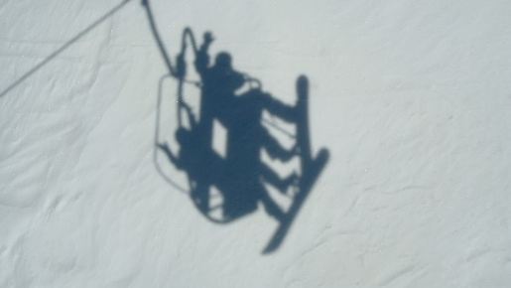
Remy Sharp
Notes:
Even though I only showed you a shadow of the activity, you were able to figure it out!
Photo credit Remy Sharp, licensed CC-BY-SA.

Slide 2
“If ye teach the law of Moses, also teach that it is a shadow of those things which are to come.”
Mosiah 16:14
Notes:
This class is going to focus on how the Law of Moses points us to Christ. Much of what we will discuss isn’t apparent from the Old Testament itself, but when bathed in the light of the New Testament and Restoration scripture, it becomes clear that these aspects of the Law of Moses are about Jesus Christ.
Bridge—that’s what we saw with Abraham and Isaac, with Jacob’s ladder—they are shadows pointing to Christ.
Image: https://www.churchofjesuschrist.org/media/image/abinadi-before-king-noah-bc303dd?lang=eng&collectionId=160129958f7b49fa8e40baad88aa69f5

Slide 3
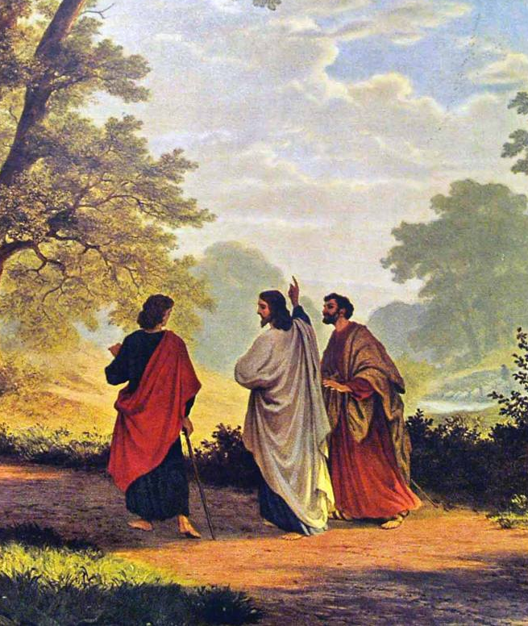
Jesus Christ himself explained that “Moses and all the prophets” had taught about the Savior and his death (Luke 24:27; see also Luke 24:20; John 5:46)
Robert Zund
Notes:
Image: https://commons.wikimedia.org/wiki/File:Zünd_Gang_nach_Emmaus_1877.jpg

Slide 4
Genesis 22:2
“Take…thine only son Isaac, whom thou lovest, and get thee into the land of Moriah; and offer him there for a burnt offering upon one of the mountains which I will tell thee of.”

Slide 5
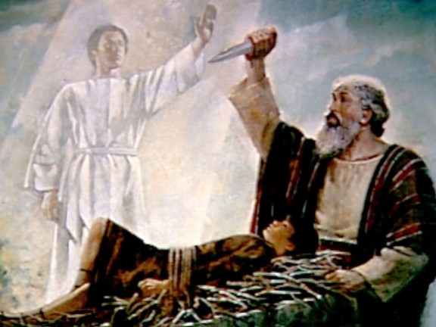
“They came to the place which God had told him of; and Abraham built an altar there, and laid the wood in order, and bound Isaac his son, and laid him on the altar upon the wood. And Abraham stretched forth his hand, and took the knife to slay his son. And the angel of the Lord called unto him out of heaven, and said, Abraham…
Genesis 22:9–13

Slide 6
“Lay not thine hand upon the lad, neither do thou any thing unto him: for now I know that thou fearest God, seeing thou hast not withheld thy son, thine only son from me. And Abraham lifted up his eyes, and looked, and behold behind him a ram caught in a thicket by his horns: and Abraham went and took the ram, and offered him up for a burnt offering in the stead of his son.”
Genesis 22:9–13

Slide 7
Abraham offering up Isaac was “a similitude of God and his Only Begotten Son.”
Jacob 4:5

Slide 8
Misheard Hymn Lyrics…
NOT: “Find in thee my strength, my bacon.”
Notes:
https://www.ldsliving.com/Hilarious-Misheard-LDS-Hymn-Lyrics/s/76445

Slide 9
Misheard Hymn Lyrics…
NOT: “Find in thee my strength, my bacon.”
BUT: “Find in thee my strength, my beacon.”
Notes:
https://www.ldsliving.com/Hilarious-Misheard-LDS-Hymn-Lyrics/s/76445

Slide 10
Misheard Hymn Lyrics…
NOT: “When appeared two Heavenly Beans”
Notes:
https://www.ldsliving.com/Hilarious-Misheard-LDS-Hymn-Lyrics/s/76445

Slide 11
Misheard Hymn Lyrics…
NOT: “When appeared two Heavenly Beans”
BUT: “When appeared two heavenly beings”
Notes:
https://www.ldsliving.com/Hilarious-Misheard-LDS-Hymn-Lyrics/s/76445

Slide 12
Misheard Hymn Lyrics…
“My niece came home from Primary one day and told her mom . . . that they sang about Santa in Primary. Her mom said, 'Are you sure you sang about Santa?’
'Yes, [the song] said 'Oh Santa, oh Santa all hail triumphant King'. . .” -Leslee Bushell Coates
“Hosanna! Hosanna! All hail, triumphant King!”
Notes:
https://www.ldsliving.com/Hilarious-Misheard-LDS-Hymn-Lyrics/s/76445

Slide 13
Misheard Hymn Lyrics…
“My niece came home from Primary one day and told her mom . . . that they sang about Santa in Primary. Her mom said, 'Are you sure you sang about Santa?’
'Yes, [the song] said 'Oh Santa, oh Santa all hail triumphant King'. . .” -Leslee Bushell Coates
“Hosanna! Hosanna! All hail, triumphant King!”
Notes:
https://www.ldsliving.com/Hilarious-Misheard-LDS-Hymn-Lyrics/s/76445

Slide 14
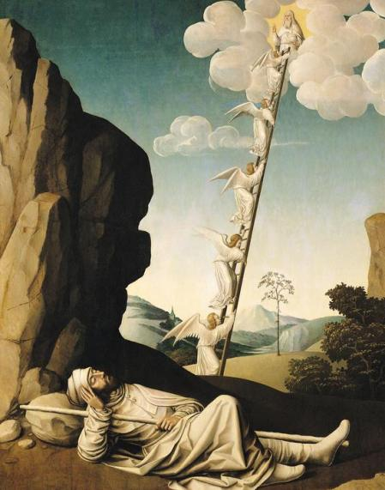
Actual Hymn Lyrics
Though like the wanderer,
The sun gone down,
Darkness be over me,
My rest a stone,
What does “my rest a stone” mean?

Slide 15
Actual Hymn Lyrics
Though like the wanderer,
The sun gone down,
Darkness be over me,
My rest a stone,
“The sun was set; and [Jacob] took of the stones of that place, and put them for his pillows, and lay down in that place to sleep”
(Genesis 28:10-11)
Notes:
https://www.ldsliving.com/Hilarious-Misheard-LDS-Hymn-Lyrics/s/76445

Slide 16
What is the Ladder?
“[Jacob] dreamed, and behold a ladder set up on the earth, and the top of it reached to heaven: and behold the angels of God ascending and descending on it.
(Genesis 28:12)
Notes:
Image: https://onevisionart.printstoreonline.com/schools/french-school/jacobs-ladder-c1490-oil-panel-12758327.html

Slide 17
Jesus is the Ladder!
“Ye shall see heaven open, and the angels of God ascending and descending upon the Son of man.”
(John 1:51)
Notes:
Image: https://onevisionart.printstoreonline.com/schools/french-school/jacobs-ladder-c1490-oil-panel-12758327.html

Slide 19
Selected Types of Christ in the Law of Moses
Celebrations: Feast of Tabernacles and The Passover
Sacrifices: The Daily Sacrifice and the Freewill Offering
The Blood of the Covenant

Slide 20
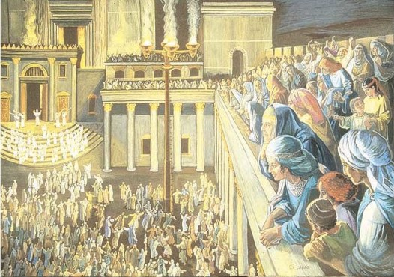
The Feast of Tabernacles
“The fifteenth day of this seventh month shall be the feast of tabernacles for seven days unto the Lord”
(Leviticus 23:34)
Notes:
Image: http://www.minimannamoments.com/tag/hosanna/

Slide 21
A key feature of the Feast of Tabernacles: Water
Notes:
(Mishnah Sukkah 4:9; 5:1; Talmud Sukkah 48b)
Cite Ryan Gardner

Slide 22
On “the last day of the festival, the great day,” while Jesus was teaching in the temple complex, “he cried out, “Let anyone who is thirsty come to me, and let the one who believes in me drink.” (John 7:37–38, NRSV)
Notes:
See also John 19:34
Image: https://www.churchofjesuschrist.org/media/image/jesus-authority-questioned-c47f29f?lang=eng&collectionId=d72eb60be594bcec1ad8a57671c4c0e949ae42f4

Slide 23
A Key feature of the Feast of Tabernacles: Light
Notes:
In the court four huge candelabra were placed, each “with four golden bowls at their tops and four ladders to each one.” The Talmud says that each were fifty cubits in height (Sukkah 52b). Wicks made “from the worn-out drawers and girdles of the priests” were placed in each bowl and lit (Mishnah Sukkah 5:3). A Mishnaic source informs us that “there was no courtyard in Jerusalem that was not lit up with the light” which came from these candelabras (Sukkah 5:3) and the Talmud mentions that “a woman could sift wheat by the illumination” of these lights (Sukkah 53a). The rest of the night was spent in joyous activities in the Court of Women.
See ***http://scholarsarchive.byu.edu/cgi/viewcontent.cgi?article=1599&amp;context=re***
Image: http://www.minimannamoments.com/tag/hosanna/

Slide 24
“I am the light of the world.” (John 8:12)
Notes:
See also John 19:34
Image: https://www.churchofjesuschrist.org/media/image/jesus-authority-questioned-c47f29f?lang=eng&collectionId=d72eb60be594bcec1ad8a57671c4c0e949ae42f4

Slide 25
A Key feature of the Feast of Tabernacles: Sacrifice (Death)
James Tissot
Notes:
Image: https://commons.wikimedia.org/wiki/File:Brooklyn_Museum_-_Reconstruction_of_Jerusalem_and_the_Temple_of_Herod_(Réconstitution_de_Jérusalem_et_du_temple_d%27Hérode)_-_James_Tissot.jpg

Slide 26
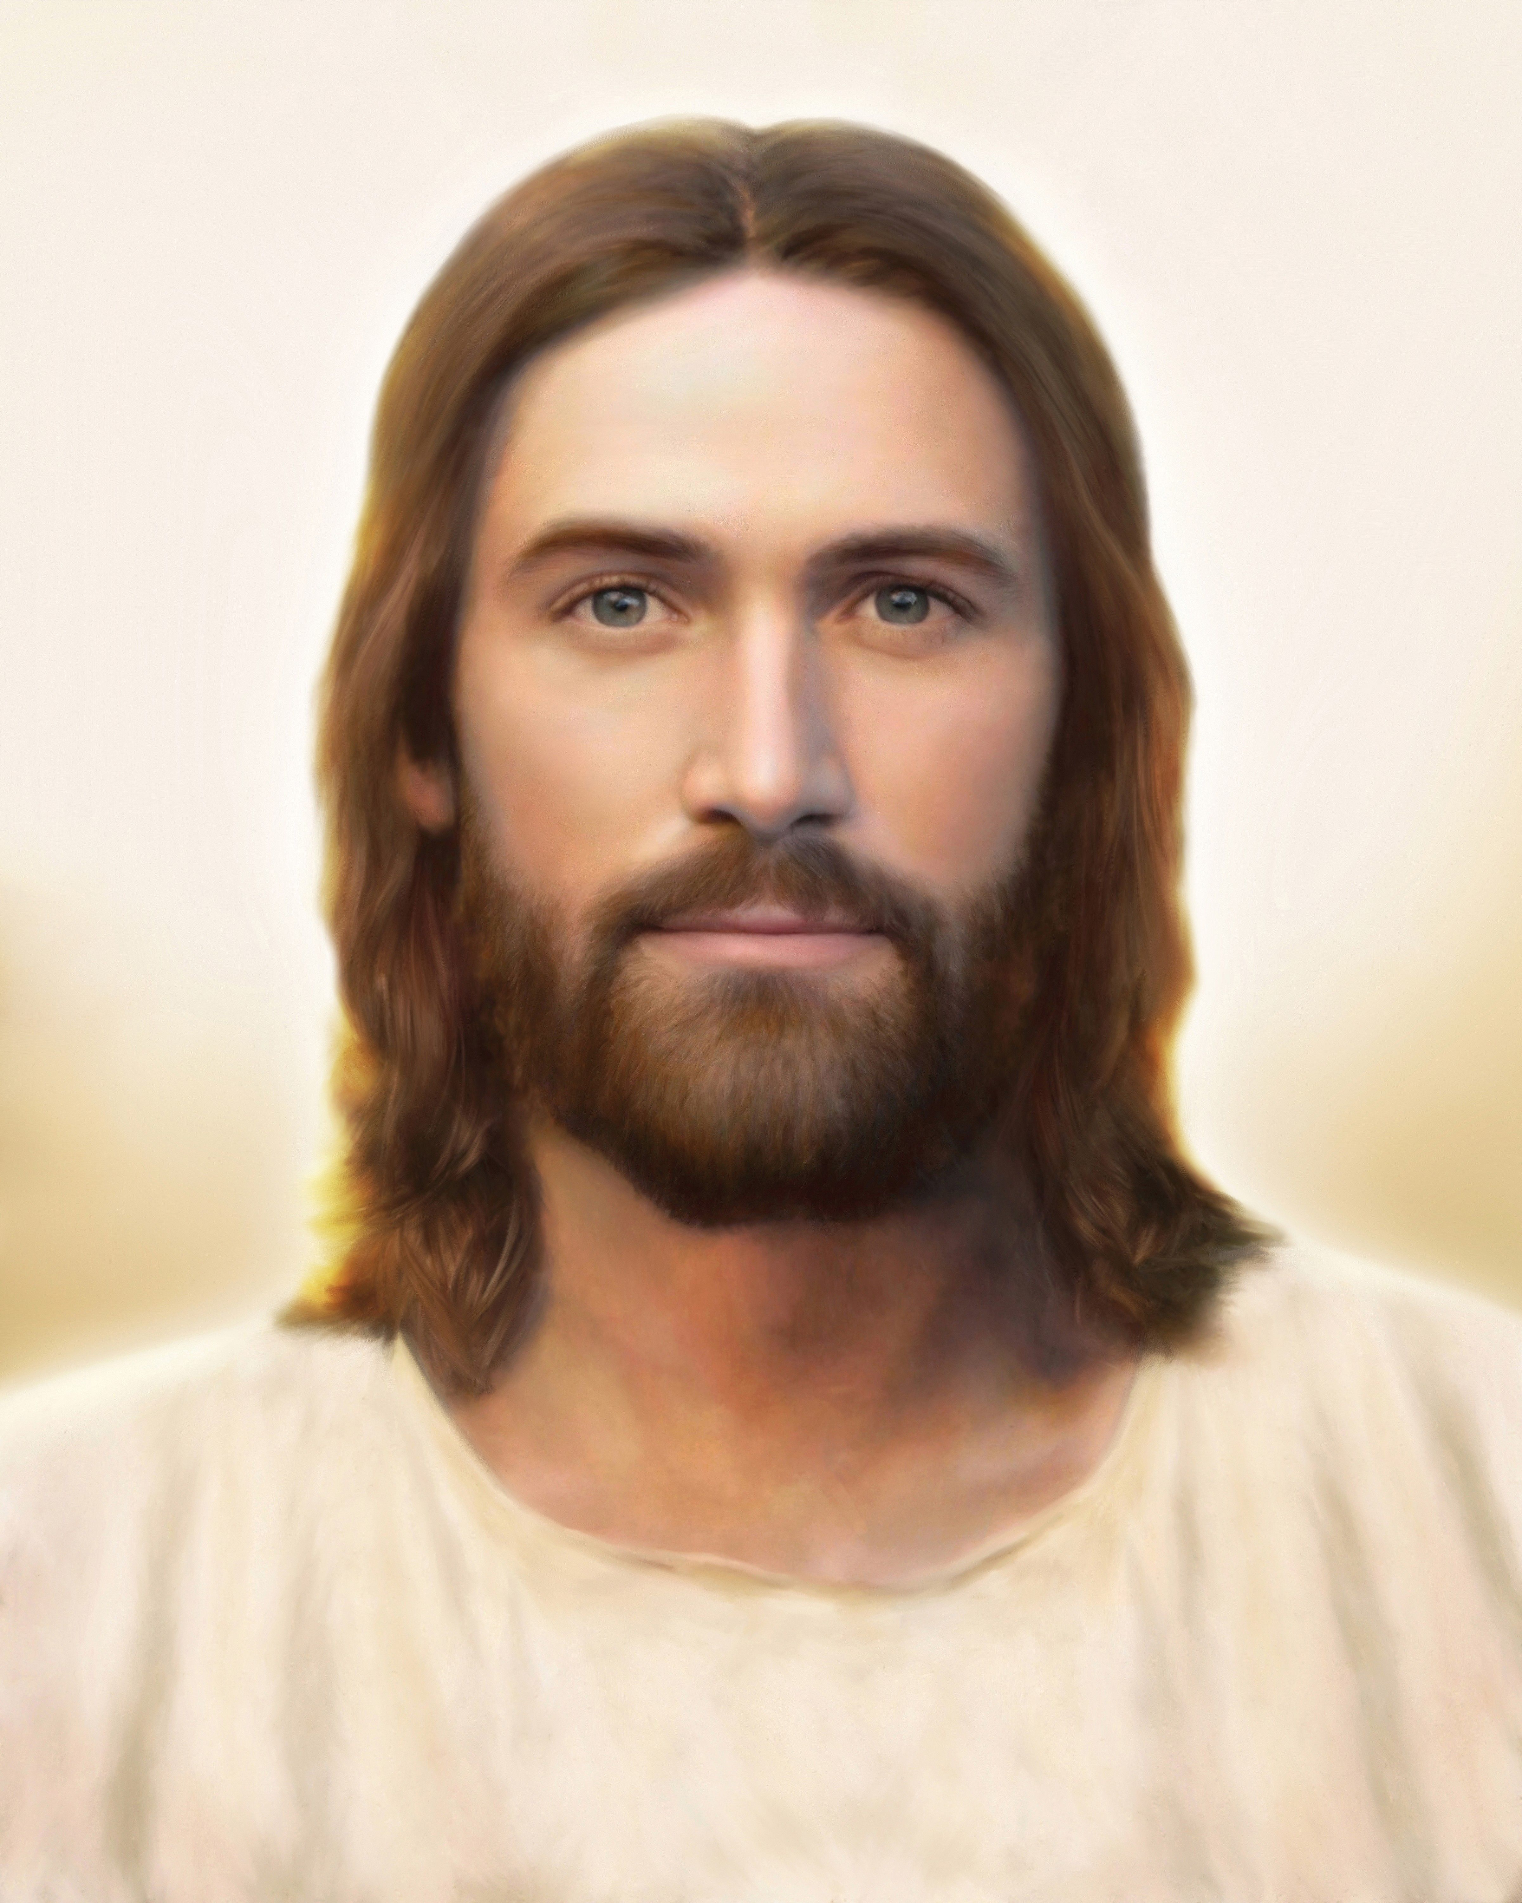
“Whoever keeps my word will never see death”
(John 8:51, NRSV)
Brent Borup
Notes:
Ryan Gardner, TRE article noted above.
While [this statement is] inherently powerful, understanding it in the immediate context of the many sacrifices at the Feast of Tabernacles adds to its poignancy.
Image: https://www.churchofjesuschrist.org/media/image/light-of-the-world-jesus-christ-3cf7b89?lang=eng&collectionId=06675c8e54154e21afee68280bdd5a2e

Slide 27
Are you thirsty? Come to me!
Do you need light? I am the light of the world.
Do you fear death? Through me, you will have life.
Jesus replaces key elements of the Feast of Tabernacles
Notes:
Image: https://www.churchofjesuschrist.org/media/image/jesus-authority-questioned-c47f29f?lang=eng&collectionId=d72eb60be594bcec1ad8a57671c4c0e949ae42f4

Slide 28
Jesus Christ as the Passover Lamb
Jesus is the Lamb of God: Exodus 12:21 (compare John 1:29, 36)
Mathis Gothart Grünewald
Notes:
According to Josephus, on the preparation day leading up to Passover, lambs were slaughtered in the temple beginning at the ninth hour and continuing until the eleventh hour, so the sacrifices would be completed before the festival began at sundown. While John does not give an actual time for Jesus’s death on the cross, the Synoptics indicate that He died at or near the ninth hour
Image: https://commons.wikimedia.org/wiki/File:Mathis_Gothart_Grünewald_025.jpg

Slide 29
Jesus Christ as the Passover Lamb
“It was early in the morning. [The Jewish authorities] did not enter the headquarters so as to avoid ritual defilement and to be able to eat the Passover.” (John 18:28, NRSV)
Mathis Gothart Grünewald
Notes:
According to Josephus, on the preparation day leading up to Passover, lambs were slaughtered in the temple beginning at the ninth hour and continuing until the eleventh hour, so the sacrifices would be completed before the festival began at sundown. While John does not give an actual time for Jesus’s death on the cross, the Synoptics indicate that He died at or near the ninth hour
Image: https://commons.wikimedia.org/wiki/File:Mathis_Gothart_Grünewald_025.jpg

Slide 30
Jesus Christ as the Passover Lamb
Just before Christ is crucified John tells us, “It was the day of preparation for the Passover.”
(John 19:14, NRSV)
Mathis Gothart Grünewald
Notes:
According to Josephus, on the preparation day leading up to Passover, lambs were slaughtered in the temple beginning at the ninth hour and continuing until the eleventh hour, so the sacrifices would be completed before the festival began at sundown. While John does not give an actual time for Jesus’s death on the cross, the Synoptics indicate that He died at or near the ninth hour
Image: https://commons.wikimedia.org/wiki/File:Mathis_Gothart_Grünewald_025.jpg

Slide 31
Jesus Christ as the Passover Lamb
“Dip a hyssop branch into the blood, and use that to paint the blood over the door of the lamb” (Exodus 12:22).
Jesus said, “I thirst.” In response, some bystanders “put a sponge full of wine on a branch of hyssop and held it to his mouth (John 19:29, NRSV).
Mathis Gothart Grünewald
Notes:
According to Josephus, on the preparation day leading up to Passover, lambs were slaughtered in the temple beginning at the ninth hour and continuing until the eleventh hour, so the sacrifices would be completed before the festival began at sundown. While John does not give an actual time for Jesus’s death on the cross, the Synoptics indicate that He died at or near the ninth hour
Image: https://commons.wikimedia.org/wiki/File:Mathis_Gothart_Grünewald_025.jpg

Slide 32
Jesus Christ as the Passover Lamb
“For these things were done, that the scripture should be fulfilled, a bone of him shall not be broken.”
(John 19:36, compare Exodus 12:46)
Mathis Gothart Grünewald
Notes:
According to Josephus, on the preparation day leading up to Passover, lambs were slaughtered in the temple beginning at the ninth hour and continuing until the eleventh hour, so the sacrifices would be completed before the festival began at sundown. While John does not give an actual time for Jesus’s death on the cross, the Synoptics indicate that He died at or near the ninth hour
Image: https://commons.wikimedia.org/wiki/File:Mathis_Gothart_Grünewald_025.jpg

Slide 33
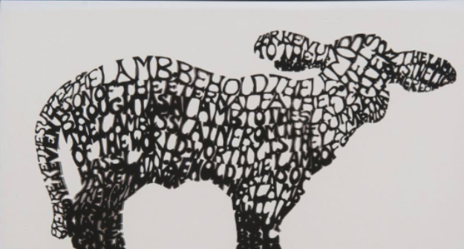
How does this help me in my life? Jesus as living water, light, conqueror of death, and Passover Lamb
Carl Bloch
Melissa Clark
Notes:
Note how Jesus replaces the key elements of the Feast of Tabernacles and Passover. It’s like saying, “These key parts of your religion, they are ALL about me!”
What does this mean FOR US TODAY? <Discussion>
One key point to bring out: Do we focus on JESUS. As I’m taking the sacrament, worshipping in the temple, reading my scriptures, etc. am I on autopilot, or am I really getting that these things to POINT ME TO JESUS?
Image 1: https://unsplash.com/photos/cCthPLHmrzI
Image 2: https://unsplash.com/photos/3B1LLagxmCE
Image 3: https://commons.wikimedia.org/wiki/File:The_Resurrection_by_Carl_Heinrich_Bloch,_1881.jpg
Image 4: https://history.churchofjesuschrist.org/exhibit/iac-2015-tell-me-the-stories-of-jesus?lang=eng#mv18

Slide 34
Jacob wrote, “For this intent we keep the law of Moses, it pointing our souls to [Christ]” (Jacob 4:5).
Mathis Gothart Grünewald
Notes:
What does this mean for us today? Does our scripture study, prayer, FHE, ward prayer, Eagle Scout, YW Medallion, ministering, RS meetings, EQ activities, etc. etc. POINT us to Jesus Christ and his great and last sacrifice?

Slide 35
Amulek taught, “This is the whole meaning of the law, every whit pointing to that great and last sacrifice; and that great and last sacrifice will be the Son of God” (Alma 34:14).
Mathis Gothart Grünewald
Notes:
What does this mean for us today? Does our scripture study, prayer, FHE, ward prayer, Eagle Scout, YW Medallion, ministering, RS meetings, EQ activities, etc. etc. POINT us to Jesus Christ and his great and last sacrifice?

Slide 36
The Anti-Nephi-Lehis “Did not suppose that salvation came by the law of Moses; but the law of Moses did serve to strengthen their faith in Christ” (Alma 25:16).
Mathis Gothart Grünewald
Notes:
What does this mean for us today? Does our scripture study, prayer, FHE, ward prayer, Eagle Scout, YW Medallion, ministering, RS meetings, EQ activities, etc. etc. POINT us to Jesus Christ and his great and last sacrifice?

Slide 37
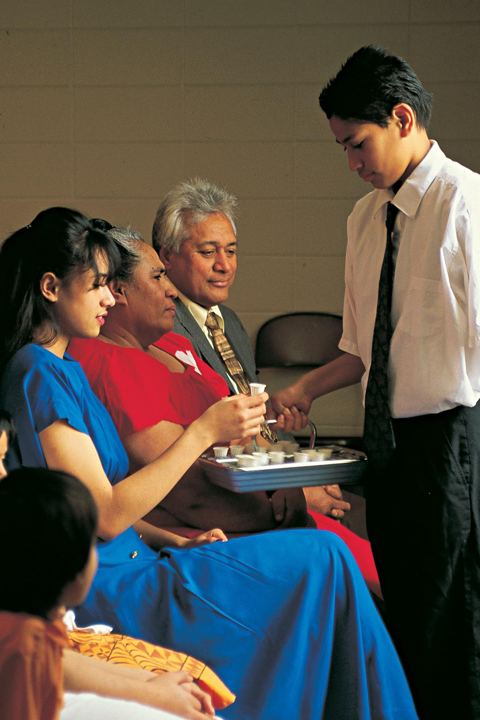
Am I participating in the rituals and activities of the Church in a way that points me to Christ?
Notes:
https://newsroom.churchofjesuschrist.org/article/sacrament
https://www.churchofjesuschrist.org/ministering/?lang=eng

Slide 38
Selected Types of Christ in the Law of Moses
Celebrations: Feast of Tabernacles and The Passover
Sacrifices: The Daily Sacrifice and the Freewill Offering
The Blood of the Covenant

Slide 39
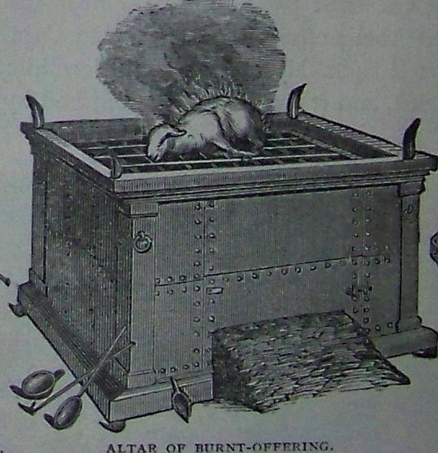
The Daily Sacrifice
“This is that which thou shalt offer upon the altar; two lambs of the first year day by day continually. The one lamb thou shalt offer in the morning; and the other lamb thou shalt offer at even” (Ex. 29:38–39; see also Num. 28:1–8).
Notes:
Image: https://en.wikipedia.org/wiki/Burnt_offering_(Judaism)#/media/File:Holman_Altar_of_Incense_Altar_of_Burnt-Offering_Laver.jpg

Slide 40
In the daily animal sacrifices, which were still taking place during the time of Christ, temple priests would cast lots to see who would perform specific acts of the sacrificial ritual, including dividing up portions of the animal.
Notes:
Image: https://commons.wikimedia.org/wiki/File:Blake_soldiers_casting_lots.jpg

Slide 41
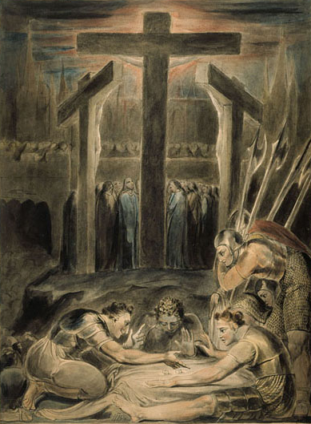
In the daily animal sacrifices, which were still taking place during the time of Christ, temple priests would cast lots to see who would perform specific acts of the sacrificial ritual, including dividing up portions of the animal. Casting lots and dividing portions may point to what happened on Calvary, where soldiers cast lots for and divided up Christ’s clothing.
William Blake
Notes:
Image: https://commons.wikimedia.org/wiki/File:Blake_soldiers_casting_lots.jpg

Slide 42
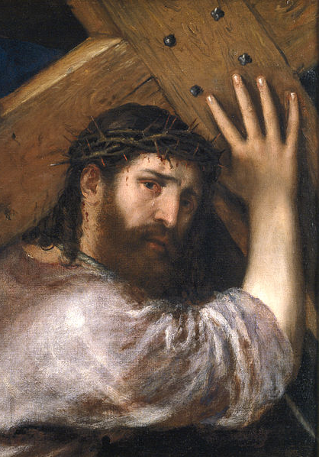
“If any want to become my followers, let them deny themselves and take up their cross daily and follow me.”
(Luke 9:23, NRSV)
Titian
Notes:
Note that we are instructed to take up our crosses daily and do so while following Jesus. How could we do this?
Today, when we hear the phrase, “Take up the cross” we perhaps think metaphorically about carrying our different burdens. How would Christ’s disciples have thought about this phrase? The Greek word translated as “cross” in Luke 9:23 is the exact same word used to describe Jesus on the physical cross where he was crucified (see Luke 23:26). The disciples had likely seen others literally take up their crosses on the way to execution. Is it possible that to Jesus’ disciples the phrase, “take up your cross” had a more graphic feel than it does to us today?
Image Credit: https://commons.wikimedia.org/wiki/File:Titian,_Christ_Carrying_the_Cross._Oil_on_canvas,_67_x_77_cm,_c._1565._Madrid,_Museo_Nacional_del_Prado.jpg

Slide 43
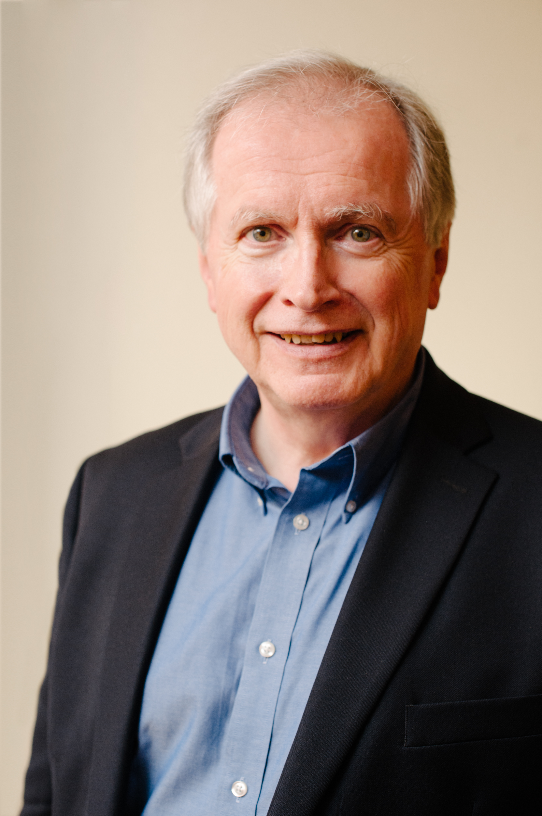
D.A. Carson, Scandalous: The Cross and Resurrection of Jesus (Wheaton, IL: Crossway, 2010), 25.
“In the first century it was as culturally unthinkable to make jokes about crucifixion as it would be today to make jokes about Auschwitz. To carry your cross does not mean to move forward with courage despite the fact you lost your job or your spouse. It means you are under sentence of death…You have abandoned all hope of life in this world. And then, Jesus says, and only then, are we ready to follow him.”
Notes:
Image: https://www.audible.com/author/D-A-Carson/B00MM0OHA0

Slide 44
The Free Will Offering
(Lev. 22:18, Ezra 1:4)
“Therefore doth my Father love me, because I lay down my life, that I might take it again. No man taketh it from me, but I lay it down of myself. I have power to lay it down, and I have power to take it again.” (John 10:17–18)
Mihály Munkácsy
Notes:
Paraphrase Lev. 22:18, Ezra 1:4, don’t read in class.
Although we don’t have formal freewill offerings today, thinking about them, along with Christ’s willing sacrifice can alter our feelings about the sacrifices we make. How we view our offerings can completely change when we transform our perspective from doing things because we have to into doing things because we willingly choose to do them. People sometimes say, “Christ was murdered,” and while that’s true in a sense, remember that he willingly laid down his life.
Image: https://en.wikipedia.org/wiki/Pontius_Pilate#/media/File:Munkacsy_-_Christ_in_front_of_Pilate.jpg

Slide 45
The Free Will Offering
(Lev. 22:18, Ezra 1:4)
Pilate said, “Knowest thou not that I have power to crucify thee, and have power to release thee?”
Jesus answered, “Thou couldest have no power at all against me, except it were given thee from above.”
(John 19:10-11)
Mihály Munkácsy
Notes:
Paraphrase Lev. 22:18, Ezra 1:4, don’t read in class.
Although we don’t have formal freewill offerings today, thinking about them, along with Christ’s willing sacrifice can alter our feelings about the sacrifices we make. How we view our offerings can completely change when we transform our perspective from doing things because we have to into doing things because we willingly choose to do them. People sometimes say, “Christ was murdered,” and while that’s true in a sense, remember that he willingly laid down his life.
Image: https://en.wikipedia.org/wiki/Pontius_Pilate#/media/File:Munkacsy_-_Christ_in_front_of_Pilate.jpg

Slide 46
Selected Types of Christ in the Law of Moses
Celebrations: Feast of Tabernacles and The Passover
Sacrifices: The Daily Sacrifice and the Freewill Offering
The Blood of the Covenant

Slide 47
Blueletterbible.org

Slide 48
Blueletterbible.org

Slide 49
Blueletterbible.org

Slide 50
Blueletterbible.org

Slide 51
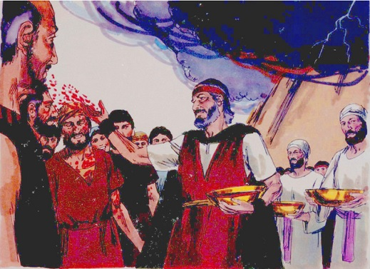
Jim Padgett
Notes:
You probably never saw this picture, nor heard this story in Primary!
With respect to Hebrews 9:19-21, see https://www.biblestudytools.com/history/flavius-josephus/antiquities-jews/book-3/chapter-8.html, v. 6. This specific detail is not mentioned in Exodus, the fact that both the author of Hebrews and Josephus mention it is interesting.
Image: https://epo.wikitrans.net/Mishpatim

Slide 52
Exodus 24:7-8
“[Moses] took the book of the covenant, and read in the audience of the people: and they said, All that the Lord hath said will we do, and be obedient. [Then] Moses took the blood, and sprinkled it on the people, and said, Behold the blood of the covenant, which the Lord hath made with you…”

Slide 53
Jeremiah 31:31-32
“Behold, the days come…that I will make a new covenant with the house of Israel…Not according to the covenant that I made with their fathers in the day that I took them by the hand to bring them out of the land of Egypt; which my covenant they brake…”

Slide 54
Matthew 26:27-28
“[Jesus] took the cup, and gave thanks, and gave it to them, saying, Drink ye all of it; For this is my blood of the new [covenant], which is shed for many.”

Slide 55
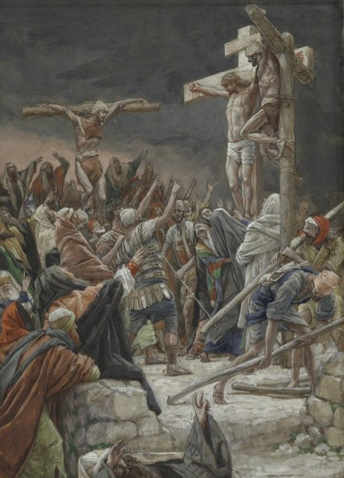
The Blood of the New Covenant
Jim Padgett
James Tissot
Notes:
Point out that the Exodus 24 story you just read was clearly about the death of an animal. His blood was shed.
Now, Jesus points to another covenant of blood
“For this is my blood of the new testament, which is shed for many
(Matthew 26:28)”
Testament = Covenant

Slide 56
“For when every commandment had been told to all the people by Moses in accordance with the law, he took the blood of calves…and sprinkled…all the people, saying, ‘This is the blood of the covenant that God has ordained for you.’”
(Hebrews 9:19-20, NRSV)
Jim Padgett

Slide 57
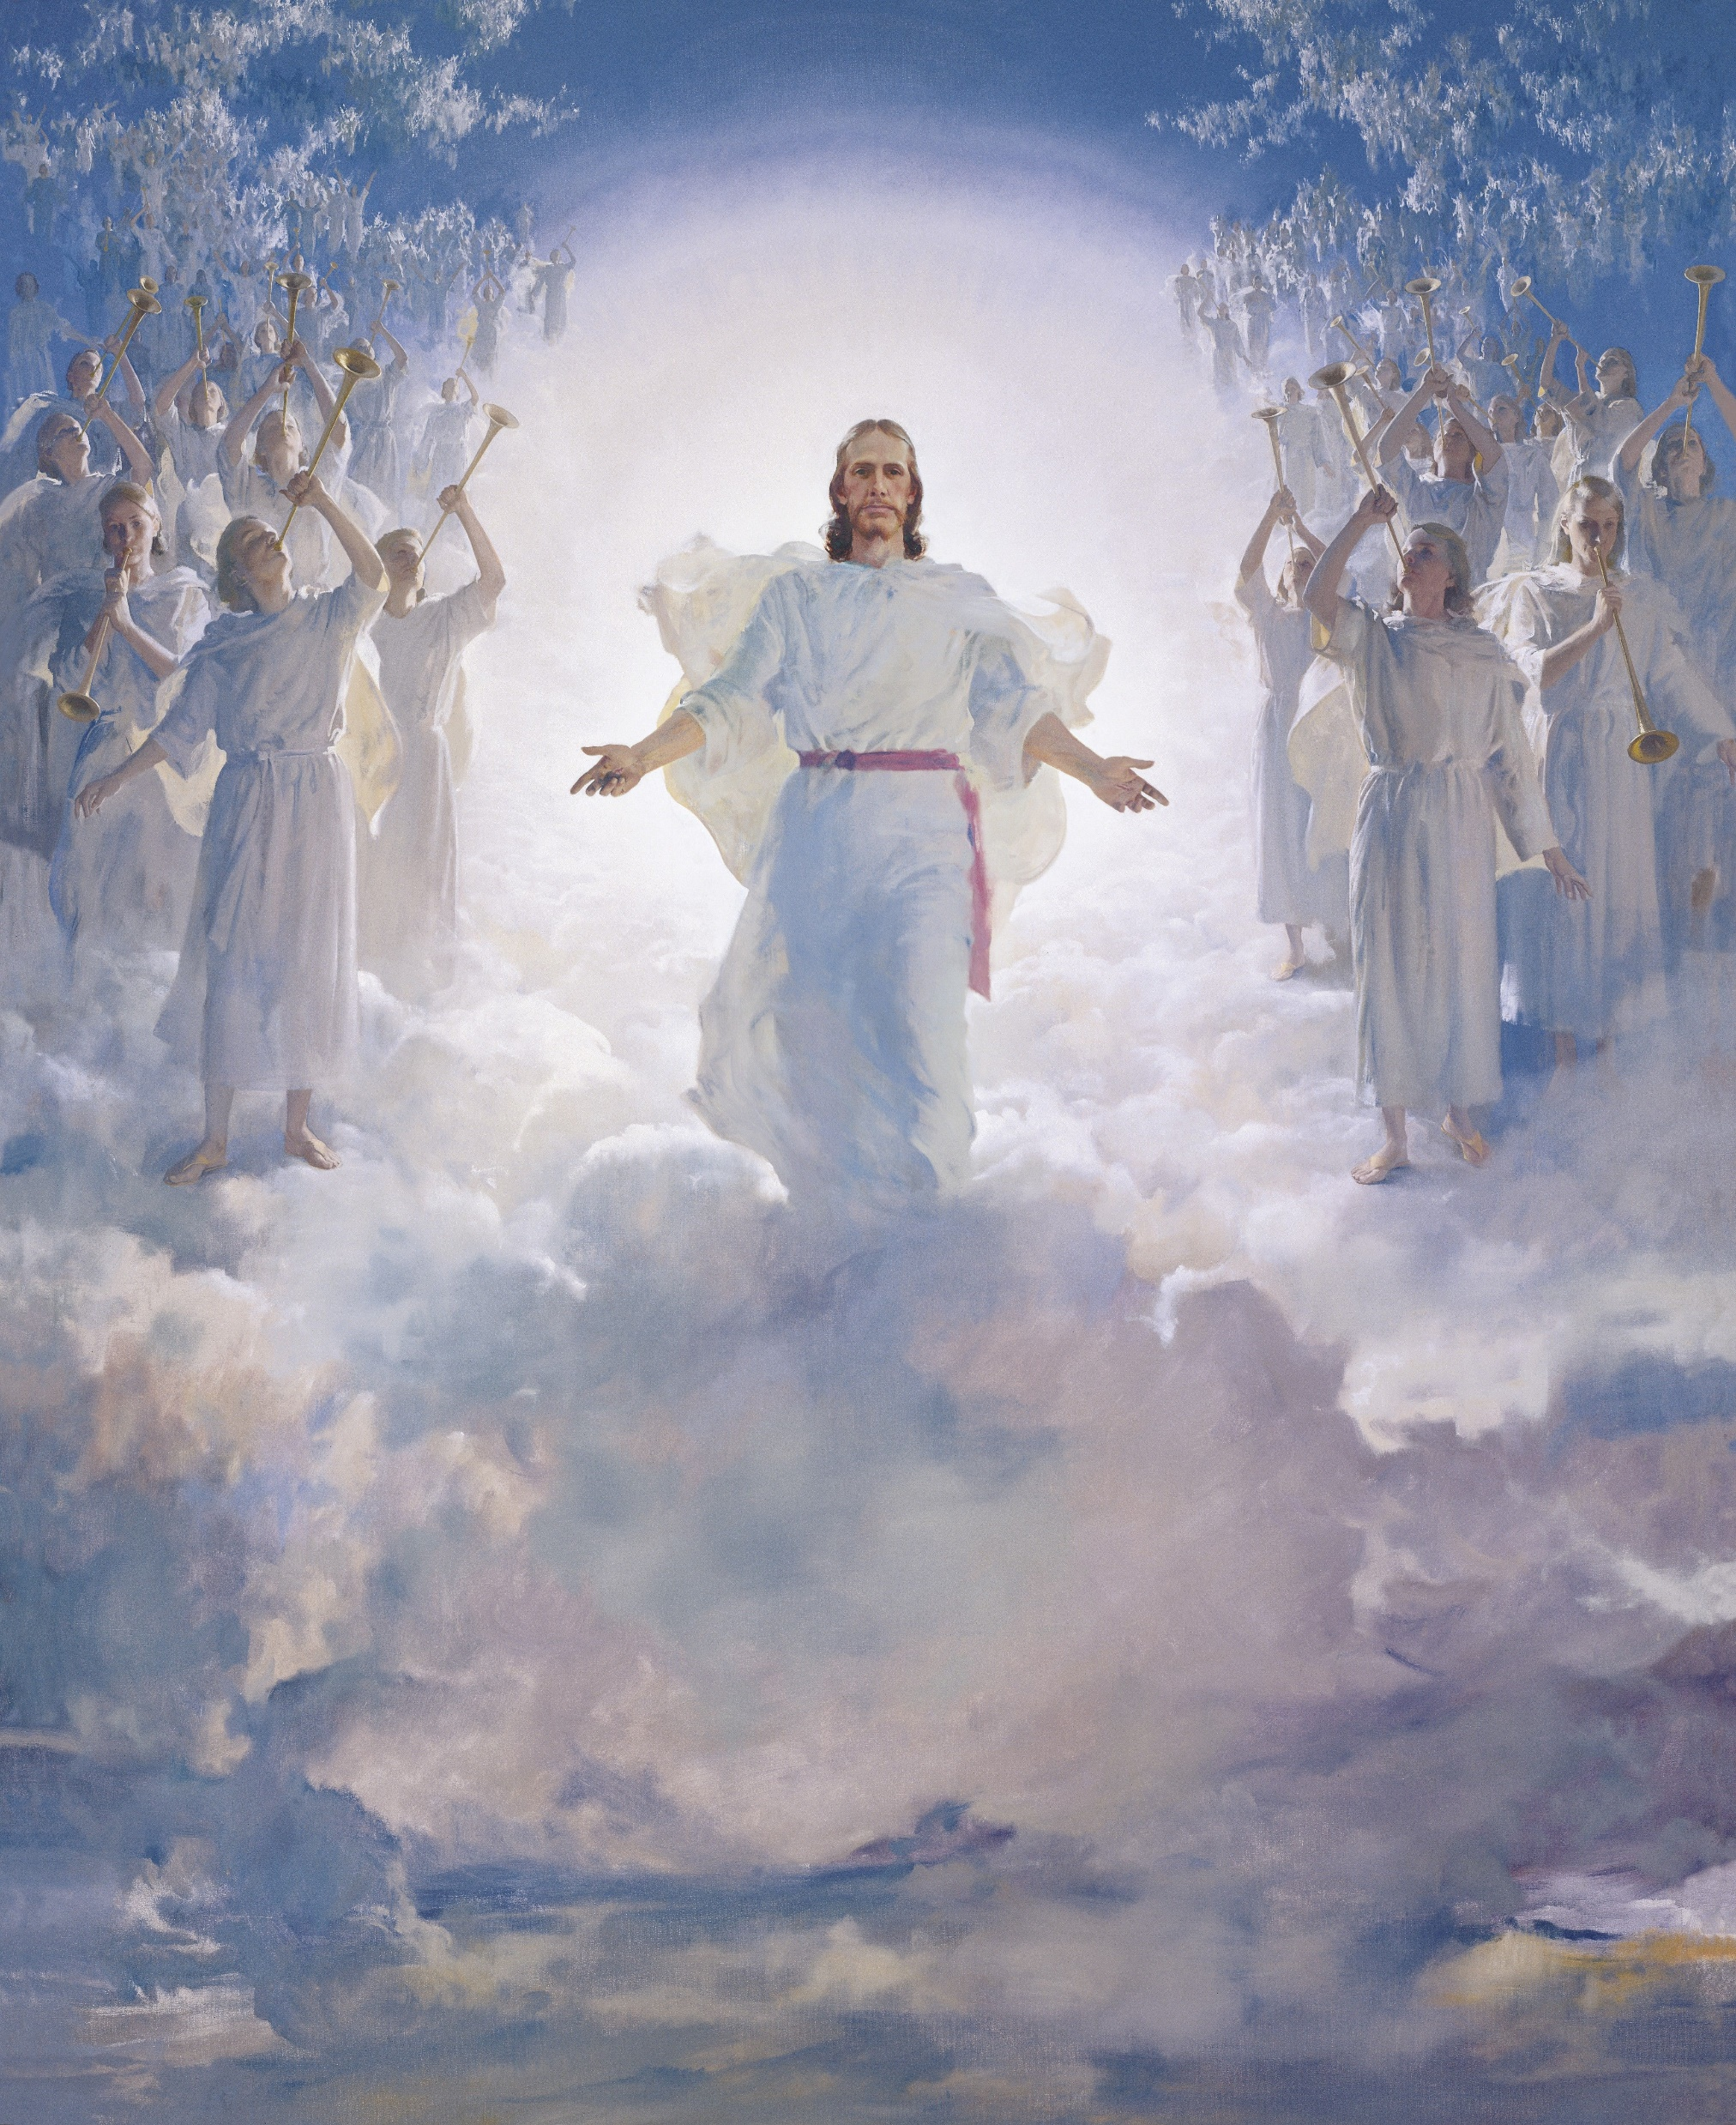
“[Christ] has appeared once for all at the end of the age to remove sin by the sacrifice of himself. And just as it is appointed for mortals to die once, and after that the judgment, so Christ, having been offered once to bear the sins of many, will appear a second time, not to deal with sin, but to save those who are eagerly waiting for him.” (Hebrews 9:26-28)
Harry Anderson

Slide 58
“Ye were not redeemed with corruptible things, as silver and gold…But with the precious blood of Christ.”
(1 Peter 1:18–19)
James Tissot

Slide 60
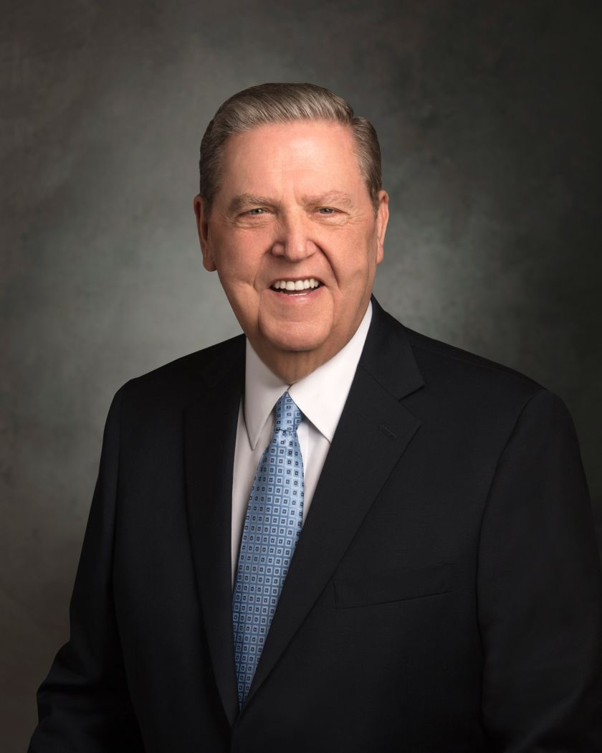
Jeffrey R. Holland, “Personal Purity,“ Ensign, Nov. 1998.
“In exploiting the body of another—which means exploiting his or her soul—one desecrates the Atonement of Christ, which saved that soul and which makes possible the gift of eternal life.”

Slide 61
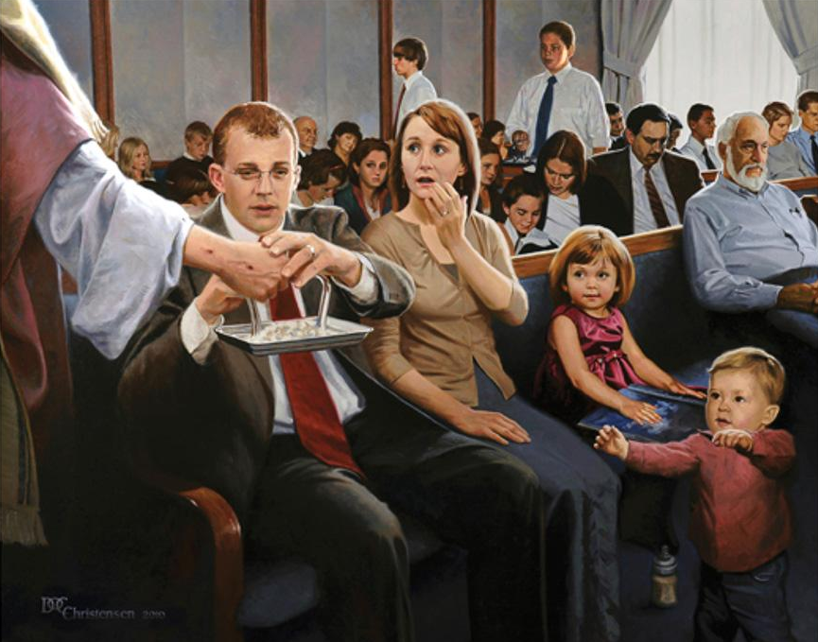
“O God, the Eternal Father, we ask thee in the name of thy Son, Jesus Christ, to bless and sanctify this [water] to the souls of all those who drink of it, that they may do it in remembrance of the blood of thy Son, which was shed for them” (Doctrine and Covenants 20:79).
Doc Christensen
Notes:
https://altusfineart.com/collections/doc-christensen/products/doc-christensen-sacrament-meeting-jesus-chapel-bread

Slide 65
The Shedding of Blood
More than forty scriptural passages explicitly connect the words “shed” and “blood” with death. For example, as Nephi debated whether or not to kill Laban, Nephi said, “Never at any time have I shed the blood of man. And I shrunk and would that I might not slay him” (1 Ne. 4:10).
See also Gen. 37:20–22; Deut.21:6–7; Matt. 23:35; Acts 22:20; Mosiah 17:10; Alma 1:13; 20:19; 39:5; D&C 132:19, 26; 136:36, among many others.
Antonio de Bellis
Notes:
Image: https://artsandculture.google.com/asset/the-sacrifice-of-noah-attributed-to-antonio-de-bellis/2gEQ6lYBni4ZOA

Slide 66
The Shedding of Blood
Joseph Smith taught, “When you find a spirit that wants blood shed, murder, the same is not of God, but is of the devil.”
Antonio de Bellis
Notes:
Also, while traveling with others in Zion’s Camp, Joseph recorded (for 16 May 1834), “I told them I felt much depressed in Spirit, and lonesome, and that there has had been a great deal of blood shed in that place, and whenever a man of God is in a place, where many have been killed; he will feel lonesome and unpleasant.”

Slide 67
“Having made peace through the blood of his cross”
(Colossians 1:20)
James Tissot
Notes:
Point out that the Exodus 24 story you just read was clearly about the death of an animal. His blood was shed.
Now, Jesus points to another covenant of blood
“For this is my blood of the new testament, which is shed for many
(Matthew 26:28)”
Testament = Covenant

Slide 68
“It mattereth not what ye shall eat or what ye shall drink when ye partake of the sacrament, if it so be that ye do it with an eye single to my glory—remembering unto the Father my body which was laid down for you, and my blood which was shed for the remission of your sins” (Doctrine and Covenants 27:2)
Doc Christensen
Notes:
https://altusfineart.com/collections/doc-christensen/products/doc-christensen-sacrament-meeting-jesus-chapel-bread

Slide 69
“The idea that Christ shed his blood on the cross is eye opening. Whenever I thought about the shedding of blood, I’d think of the Atonement as the whole, but more of the Garden of Gethsemane. This brings a whole new perspective during sacrament thinking about the Savior’s Atonement.”
Notes:
https://pixabay.com/photos/girl-senior-portrait-female-park-2098866/

Slide 70
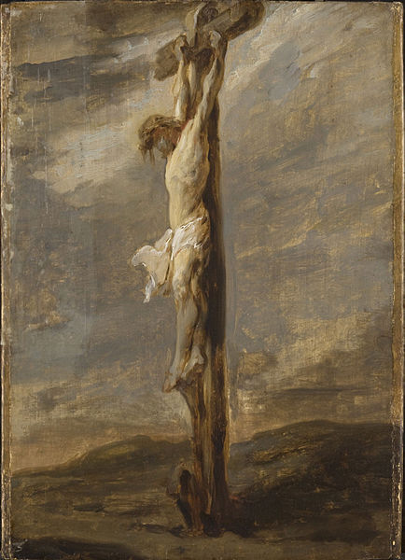
Jesus gave the all-in sacrifice, and he is all in with you and me today. The question is, are we all in with him?
Rembrandt
Notes:
He’s not giving up on me…
Am I all in?
Image: https://commons.wikimedia.org/wiki/File:Rembrandt_-_The_Crucifixion_-_Cat478.jpg

