Slide 1
Jarom 1:11
“The prophets, and the priests, and the teachers, did labor diligently, exhorting with all long-suffering the people to diligence; teaching the law of Moses, and the intent for which it was given; persuading them to look forward unto the Messiah, and believe in him to come as though he already was. And after this manner did they teach them.”
Jorge Coco
Notes:
This is a class on what ancient prophets taught about Christ. This testimony from Jarom, which I overlooked for many years, has recently stood out to me.
Image: https://www.churchofjesuschrist.org/media/image/the-waters-of-mormon-a922be5?lang=eng&collectionId=fcd16df04815472d9b90df097b422f22

Slide 2
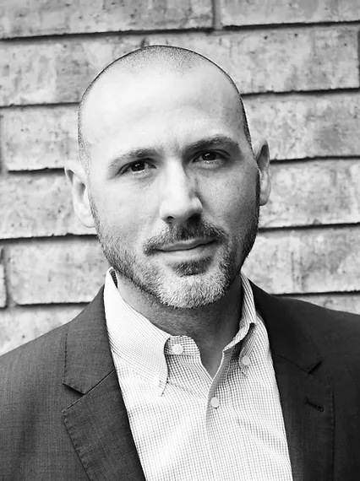
Dr. Adam Miller An Early Resurrection, 2-3
“That’s what’s different about Nephite Christianity: they lived in Christ before Christ came. They lived Christ’s future in their present…For the Nephites, the temptation was to think that Christ only belonged to the future. For me, the temptation is to think that Christ only belongs to the past (or, again, to some future world). Either way, the temptation is to think that Christ does not belong to the present. But a past or future Christ is not enough. It is not enough for me to believe in the past or future idea of Christ. To be Christian, I have to learn how to share my life with Christ in the present.”
Notes:
Ask class to think / write for 30 seconds—how do we learn to share our lives with Christ in the present? Let some in class raise hands to share, chat box for or vocal for Zoom.
Image: https://www.deseret.com/2018/8/30/20652375/what-s-new-adam-miller-s-an-early-resurrection-shares-about-taking-advantage-of-the-atonement-now#a-pharisee-named-nicodemus-comes-to-speak-with-jesus-at-night-and-testifies-that-he-knows-jesus-is-a-teacher-from-god-in-this-scene-in-the-bible-video-series

Slide 3
Lessons from Ancient Prophets that can help us live with Christ in the present
Enoch
The Brother of Jared
Hosea
Nehemiah
Moroni

Slide 4
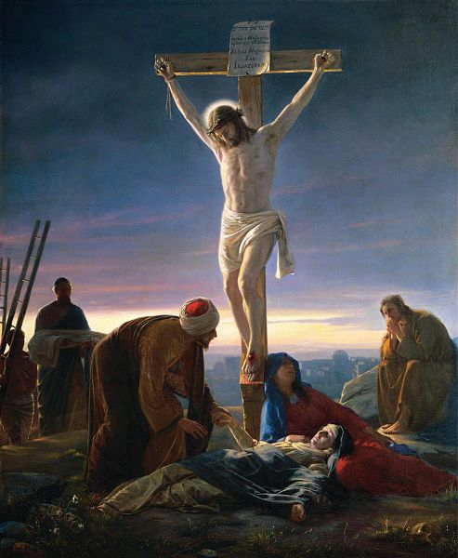
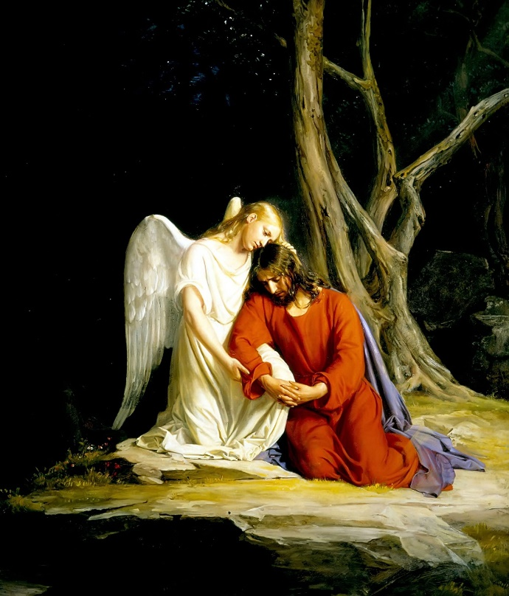
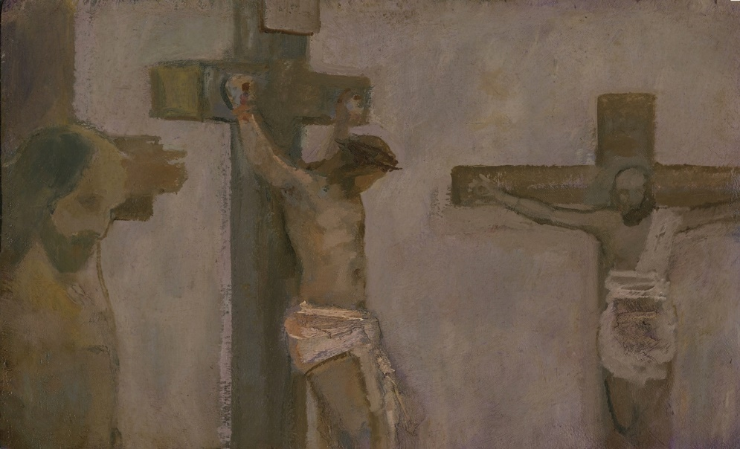
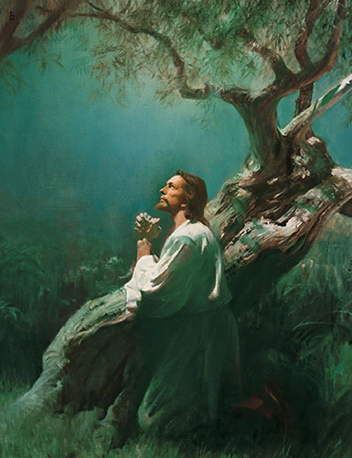
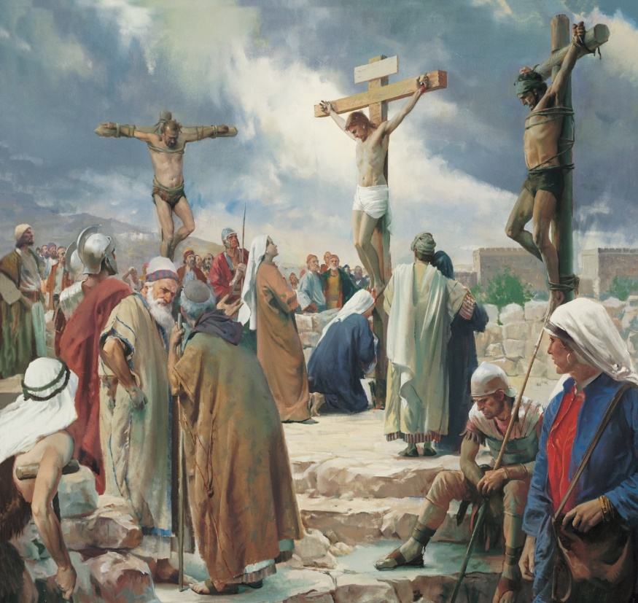
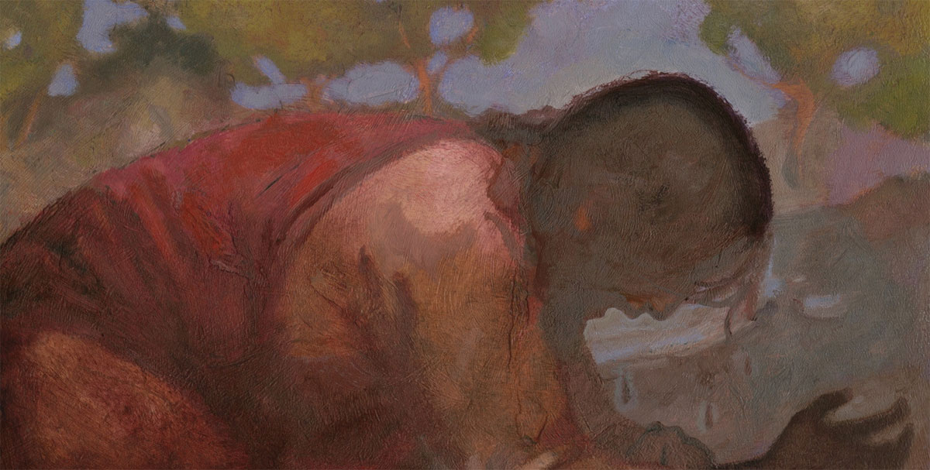
4
3
5
1
2
6
Notes:
Image 1: Crist at the Cross, Carl Bloch https://commons.wikimedia.org/wiki/File:Christ_at_the_Cross_-_Cristo_en_la_Cruz.jpg
Image 2: Christ in Gethsemane, Harry Anderson https://history.churchofjesuschrist.org/media/christ-in-gethsemane?lang=eng#1
Image 3: Gethsemane, Carl Bloch https://commons.wikimedia.org/wiki/File:Gethsemane_Carl_Bloch.jpg
Image 4: Crucifixion, Harry Anderson https://www.churchofjesuschrist.org/media/image/crucifixion-christ-anderson-43dad9f?lang=eng
Image 5: Crucifixion, J. Kirk Richards https://www.ldsliving.com/6-Unique-Paintings-that-Powerfully-Portray-the-Atonement-Resurrection/s/78336
Image 6: Gethsemane, J. Kirk Richards https://www.ldsliving.com/6-Unique-Paintings-that-Powerfully-Portray-the-Atonement-Resurrection/s/78336

Slide 5
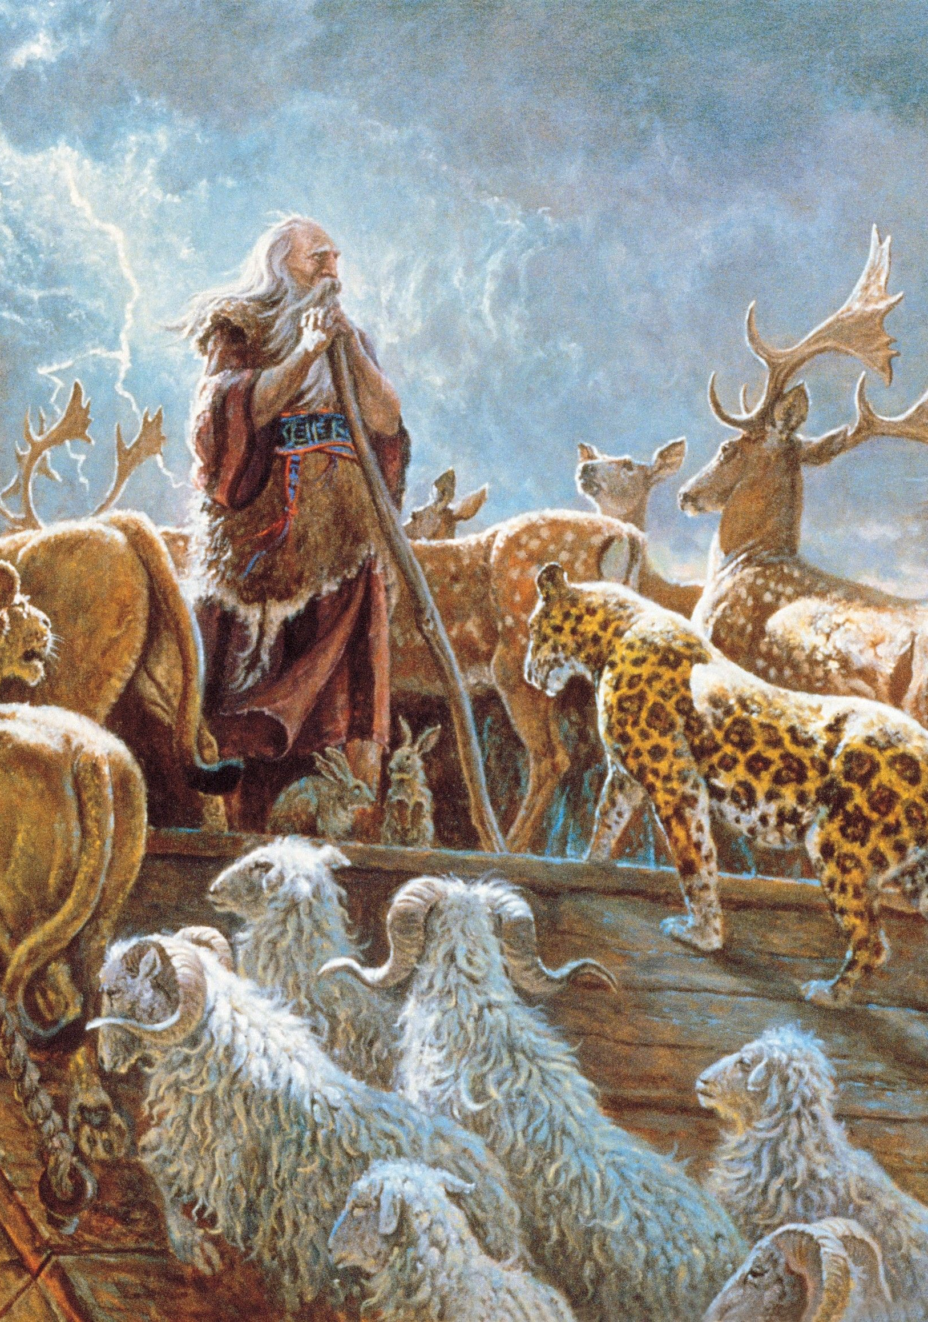
“Enoch saw that Noah built an ark…and…upon the residue of the wicked the floods came and swallowed them up. Enoch saw [the destruction of the people and] had bitterness of soul, and wept over his brethren, and said unto the heavens: I will refuse to be comforted.”
Clark Kelley Price
Moses 7:43-44
Notes:
Image: https://www.churchofjesuschrist.org/media/image/noah-and-animals-ce9b865?lang=eng&collectionId=65a92c1051e01cb5bea39a2451a9310ba63e01a2

Slide 6
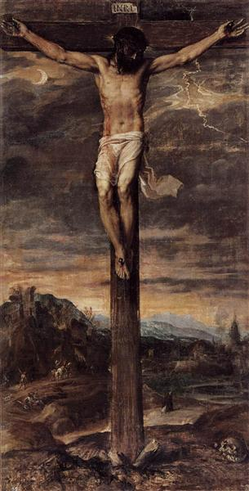
In response to Enoch’s anguish, the Lord showed him “The Son of Man lifted up on the cross, after the manner of men.”
The answer to the pain Enoch felt was found in the cross of Christ.
Titian
Moses 7:45, 47, 55
Notes:
Image: https://www.wikiart.org/en/titian/crucifixion

Slide 7
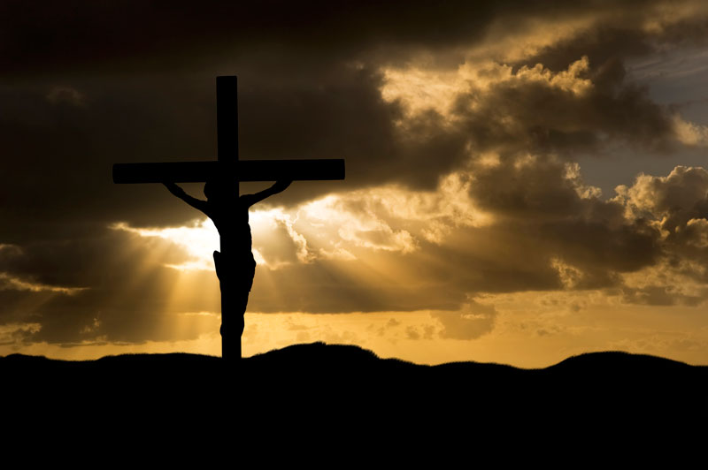
The Loving Christ
“God commendeth his love toward us, in that, while we were yet sinners, Christ died for us” (Romans 5:8).
Christ “loveth the world, even that he layeth down his own life that he may draw all men unto him” (2 Nephi 26:24).
“Greater love hath no man than this, that a man lay down his life for his friends” (John 15:13).

Slide 8
“Look unto me in every thought; doubt not, fear not.

Slide 9
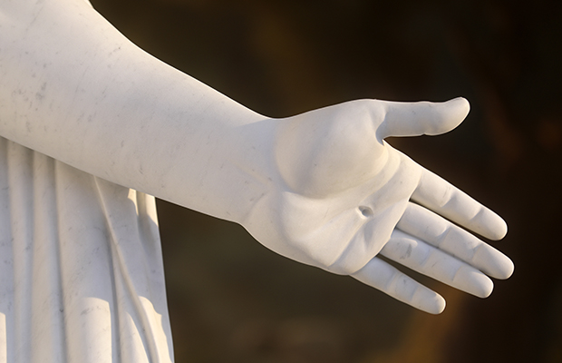
“Look unto me in every thought; doubt not, fear not. Behold [“fix your eyes upon”] the wounds which pierced my side, and also the prints of the nails in my hands and feet”
(Doctrine and Covenants 6:36–37)
Notes:
Image: https://www.churchofjesuschrist.org/church/news/a-closer-look-at-symbolism-of-christus-and-ancient-apostles-statues-in-rome?lang=eng

Slide 10
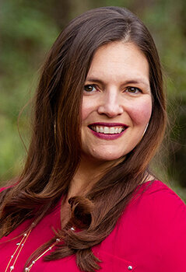
“Ugly tears coursed down my cheeks. Why? How could this have happened? The betrayal hit me like a gut punch. I wanted to scream it all away, or at the very least tear someone apart with my bare fingernails. But even that wouldn’t make it better, wouldn’t erase what I was going through…I felt so alone…
Jessica Brodie, “Finding Jesus in the Center of My Pain,”
Notes:
Image 1: https://www.jessicabrodie.com/about-jessica

Slide 11
“Talking to a counselor brought temporary relief but no real solutions. Blocking it out and staying as busy as possible only worked for so long. Then came Jesus. In the darkness, in the depths of my pain, I realized: He knew…He’d experienced the worst pain, the deepest betrayal, the hardest suffering—none of it deserved…
Jessica Brodie, “Finding Jesus in the Center of My Pain,”
Notes:
Image 1: https://www.jessicabrodie.com/about-jessica

Slide 12
“And it hurt Him—so very, very badly. But for some reason, I’d never before understood this.
Growing up, I’d been taught Jesus died on the cross, but His suffering seemed abstract. In paintings depicting the crucifixion, the holes from the nails had a bit of blood, and Jesus was frowning beneath His crown of thorns, but it was all rather contained—a PG version of what He’d really been through.
Jessica Brodie, “Finding Jesus in the Center of My Pain,”
Notes:
Image 1: https://www.jessicabrodie.com/about-jessica

Slide 13
“Then His suffering was over and, whoosh! Our Savior was dressed in head-to-toe white with a glowing golden halo, smiling like He’d never been gasping for His last breath or sobbing from the pain of being sold for thirty pieces of silver by one of His twelve best friends.
Jessica Brodie, “Finding Jesus in the Center of My Pain,”
Notes:
Image 1: https://www.jessicabrodie.com/about-jessica

Slide 14
“But when I encountered Jesus in my sorrow, it wasn’t the Sunday school, family-friendly version kneeling beside me as I collapsed before Him in a darkened room with my prayer of surrender.
Jessica Brodie, “Finding Jesus in the Center of My Pain,”
Notes:
Image 1: https://www.jessicabrodie.com/about-jessica

Slide 15
“It was the scarred-up Jesus, the One who remembered the ragged bloodstained holes from where they’d driven the nails in, who didn’t wince as they beat Him but cried out in agony, who didn’t just quietly and stoically accept that Judas let Him down but ached over the treachery. This Jesus understood. And when I realized that, and I allowed him to meet me in my suffering, I was no longer alone.”
Jessica Brodie, “Finding Jesus in the Center of My Pain,”
Notes:
Image 1: https://www.jessicabrodie.com/about-jessica

Slide 16
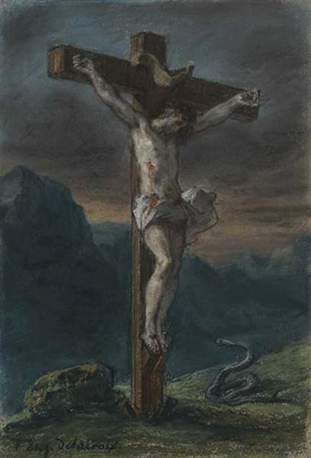
“We would to God that we could persuade all…[to] believe in Christ, and view his death…”
(Jacob 1:8)
Notes:
Image: https://www.wikiart.org/en/eugene-delacroix/christ-on-the-cross-1856-1

Slide 17
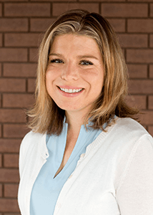
“The operative definition of the word view during Joseph Smith's time was ‘to survey intellectually; To examine with the mental eye; To consider the subject in all its aspects.’ Additionally, a sense from the Latin root is that of reaching or extending toward the object one views.
Deidre Green, Jacob: A Brief Theological Introduction, 22.

Slide 18
“The operative definition of the word view during Joseph Smith's time was ‘to survey intellectually; To examine with the mental eye; To consider the subject in all its aspects.’ Additionally, a sense from the Latin root is that of reaching or extending toward the object one views. Jacob desires for everyone to contemplate thoroughly the multifaceted death of Christ in a way that requires each person to reach or extend toward it.”
Deidre Green, Jacob: A Brief Theological Introduction, 22.

Slide 19
“May [Christ’s]…death…rest in your mind forever.”
(Moroni 9:25)
Notes:
Image: https://www.wikiart.org/en/eugene-delacroix/christ-on-the-cross-1856-1

Slide 20
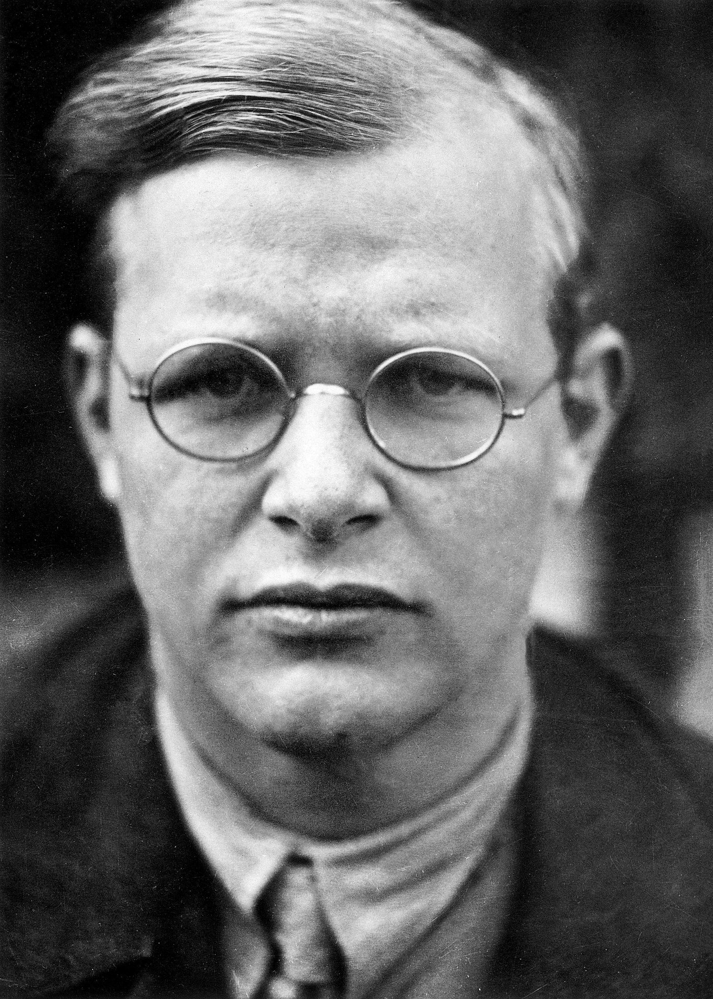
Dietrich Bonhoeffer, Letters and Papers from Prison (Minneapolis: Fortress Press, 2010), 479.
“Only the suffering God can help.”
Notes:
Image: https://www.nytimes.com/2014/08/10/books/review/strange-glory-a-life-of-dietrich-bonhoeffer-by-charles-marsh.html

Slide 21
“If Christ’s Crucifixion is so important, then why doesn’t the Church use the cross?”

Slide 22
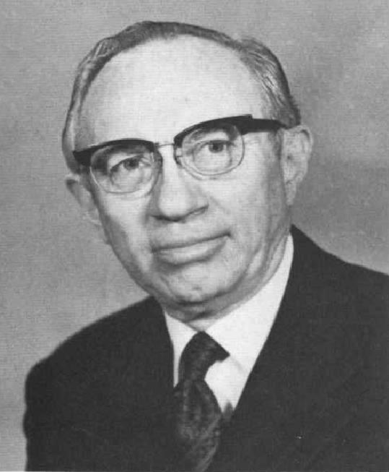
Gordon B. Hinckley, “The Symbol of Christ,” Ensign, May 1975. This talk was slightly modified to become a First Presidency message in the April 2005 Ensign and also appears in the March 1989, April 1990, and April 1994 editions of the Liahona. This phrase has been quoted more than twenty times in Church magazines, manuals, and other writings of Church leaders.
“I do not wish to give offense to any of my Christian brethren who use the cross on the steeples of their cathedrals and at the altars of their chapels, who wear it on their vestments, and imprint it on their books and other literature. But for us, the cross is the symbol of the dying Christ, while our message is a declaration of the living Christ. . . .”

Slide 23
Gordon B. Hinckley, “The Symbol of Christ,” Ensign, May 1975. This talk was slightly modified to become a First Presidency message in the April 2005 Ensign and also appears in the March 1989, April 1990, and April 1994 editions of the Liahona. This phrase has been quoted more than twenty times in Church magazines, manuals, and other writings of Church leaders.
In this same talk President Hinckley also referred to “the cross on which [Christ] hung and died,” and said “We cannot forget that. We must never forget it, for here our Savior, our Redeemer, the Son of God, gave Himself a vicarious sacrifice for each of us.”
Notes:
Note that the doctrine and the symbol are two different things!

Slide 24
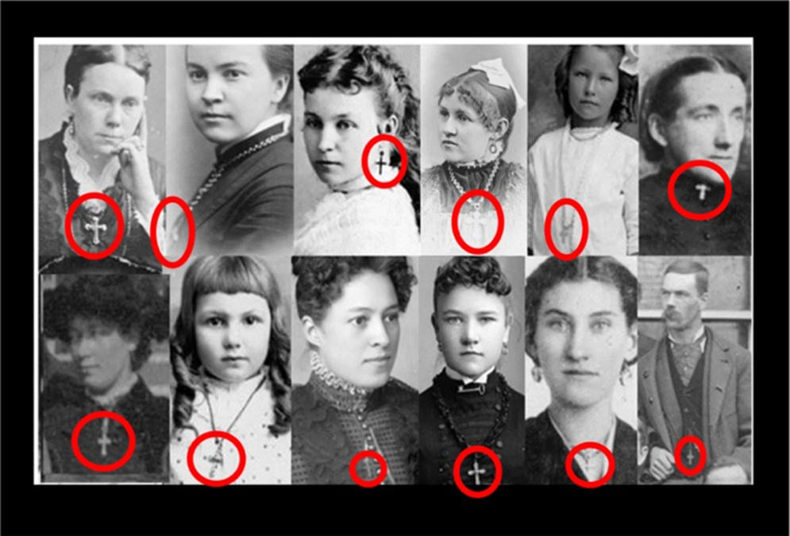
Notes:
Quick summary of these pictures and what they mean. The cross certainly isn’t super common, but nor is it forbidden

Slide 25
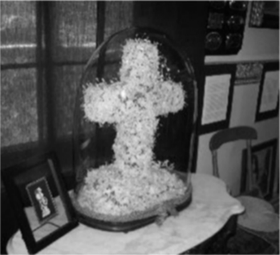
Notes:
Quick summary of these pictures and what they mean. The cross certainly isn’t super common, but nor is it forbidden

Slide 26
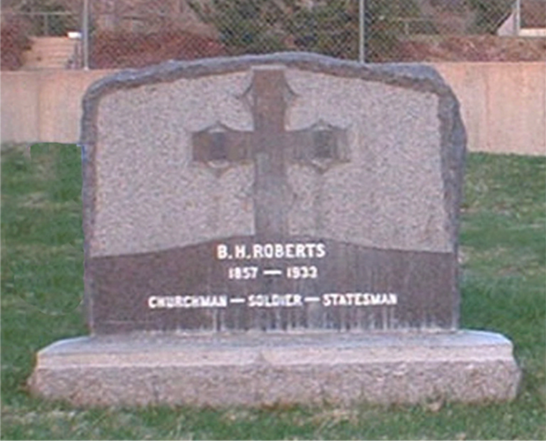
Notes:
Quick summary of these pictures and what they mean. The cross certainly isn’t super common, but nor is it forbidden

Slide 27
@SISTASinZION
Notes:
Quick summary of these pictures and what they mean. The cross certainly isn’t super common, but nor is it forbidden

Slide 28
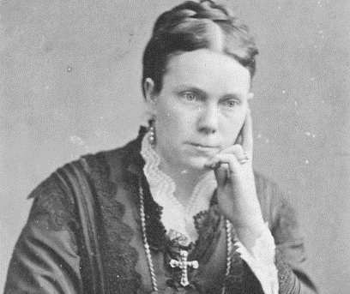
A Multi-Faceted Symbol
Eliza R. Snow referred to “the triumphs of the cross.”
“The cross that was then a sign of disgrace has become a symbol of love and salvation.”
(The Young Woman’s Journal, April, 1915)
“Christ changed the cross into a symbol of Glory.”
(The Relief Society Magazine, April, 1933)

Slide 29
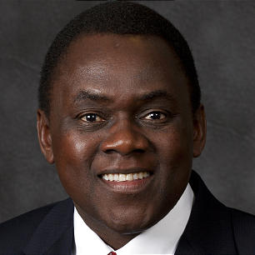
Elder Edward Dube, “Gaining My Faith One Step at a Time,” New Era, April 2020
Elder Edward Dube described one of the “defining moments” of his life occurring at the age of ten, while inside a Catholic Church looking at a painting of Christ’s Crucifixion.
Notes:
When President Hinckley was asked why the church, institutionally does not use crosses, he said that it was because we focus on the living Christ. At the same time, the quotes and images we have seen show there is quite a bit of diversity of thought about the cross as a symbol. But no matter what we think about the cross as a symbol, the scriptures have in fact told us that we should focus our attention on the death of Jesus Christ.
Image 1: https://www.thechurchnews.com/archives/2012-04-22/new-area-seventies-5-52236
Image 2: https://www.byudevotionals.com

Slide 30
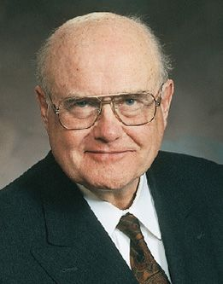
Elder F. Enzio Busche described how looking at a crucifix while on a hospital bed gave him “a tremendous hope.”
F. Enzio Busche and Tracie A. Lamb, Yearning for the Living God: Reflections from the Life of F. Enzio Busche [Salt Lake City: Deseret Book, 2004], 52.
Notes:
When President Hinckley was asked why the church, institutionally does not use crosses, he said that it was because we focus on the living Christ. At the same time, the quotes and images we have seen show there is quite a bit of diversity of thought about the cross as a symbol. But no matter what we think about the cross as a symbol, the scriptures have in fact told us that we should focus our attention on the death of Jesus Christ.

Slide 31
“Behold my wounds” (D&C 6:37)
“Let [Christ’s]…death…rest in your mind forever” (Moroni 9:25)
“View his death…” (Jacob 1:8)
How could you apply these teachings in your life?
Notes:
Image: https://www.wikiart.org/en/eugene-delacroix/christ-on-the-cross-1856-1

Slide 32
Lessons from Ancient Prophets that can help us live with Christ in the present
Enoch
The Brother of Jared
Hosea
Nehemiah
Moroni

Slide 33
Ether 3:1-12
Arnold Friberg
Notes:
Summarize Ether 3:1-12
Image: https://www.churchofjesuschrist.org/media/image/brother-of-jared-seeing-finger-of-lord-7971980?lang=eng&collectionId=3187df6f171c4f7a9e1f4100433ed7ff

Slide 34
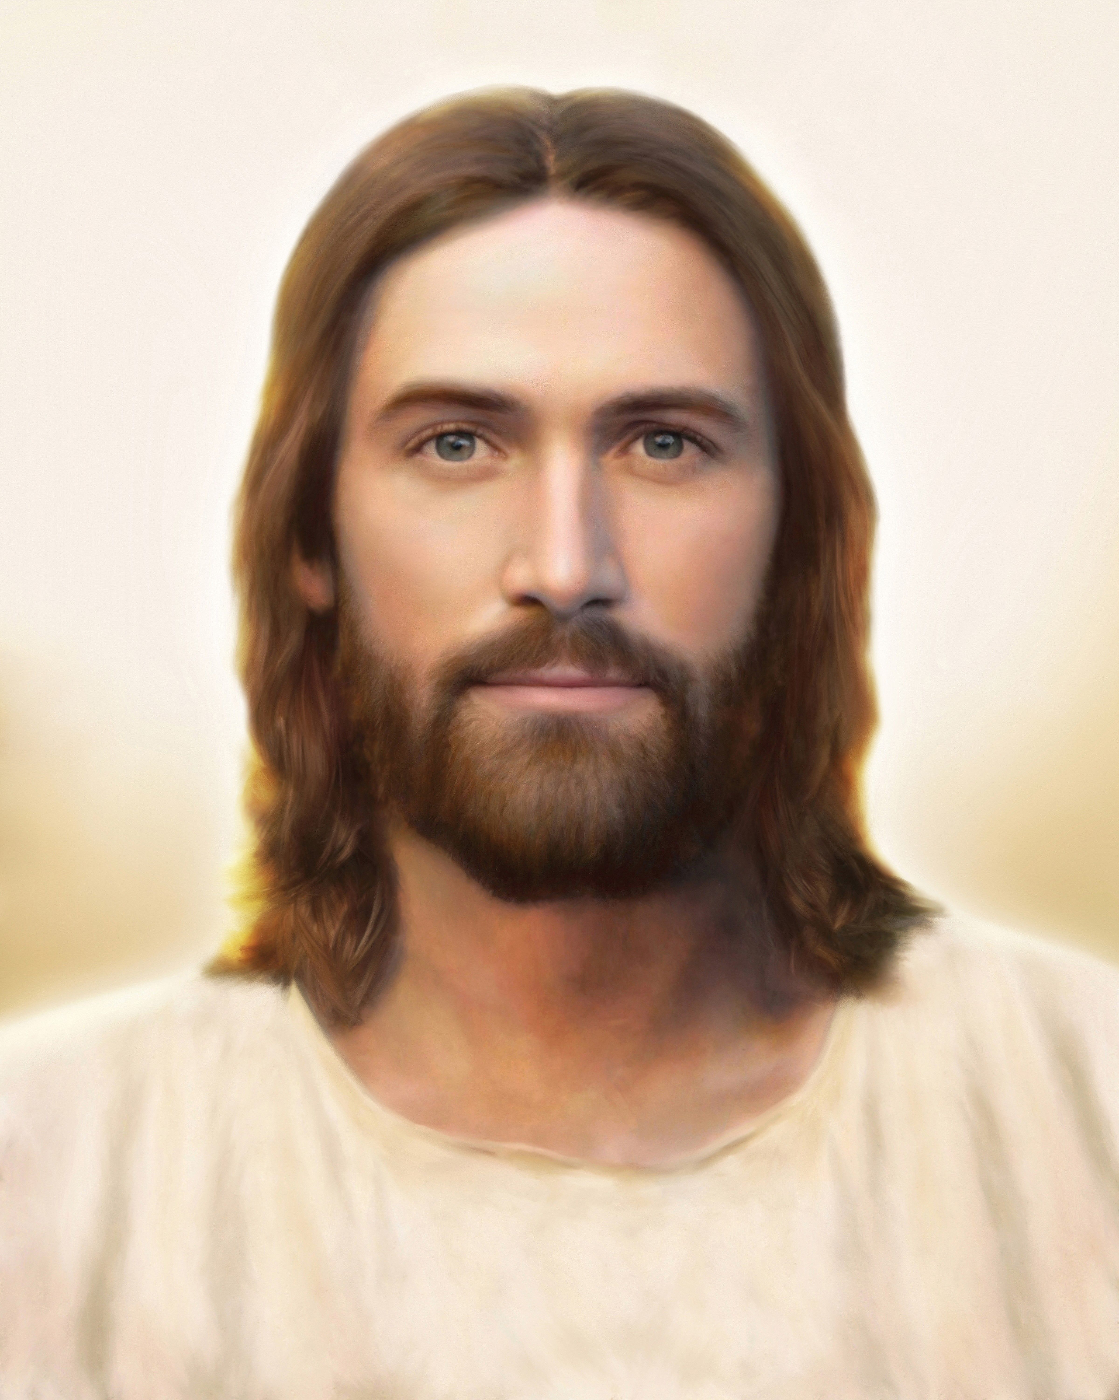
“Behold, I am he who was prepared from the foundation of the world to redeem my people. Behold, I am Jesus Christ. I am the Father and the Son.
Brent Borup
Ether 3:14
Notes:
Image: https://www.churchofjesuschrist.org/media/image/light-of-the-world-jesus-christ-3cf7b89?lang=eng&collectionId=3187df6f171c4f7a9e1f4100433ed7ff

Slide 35
How is Jesus Christ the Father?
“He shall be called Jesus Christ, the Son of God, the Father of heaven and earth, the Creator of all things from the beginning” (Mosiah 3:8, see also Hel. 14:12, 16:18).
Gary L. Kapp

Slide 36
“I am Jesus Christ. I am the Father and the Son. In me shall all mankind have life, and that eternally, even they who shall believe on my name; and they shall become my sons and my daughters.”
Brent Borup
Ether 3:14

Slide 37
“Because of the covenant which ye have made ye shall be called the children of Christ, his sons, and his daughters; for behold, this day he hath spiritually begotten you; for ye say that your hearts are changed through faith on his name; therefore, ye are born of him and have become his sons and his daughters.”
Gary L. Kapp
Mosiah 5:7
Notes:
After the people covenant to keep God’s commandments, King Benjamin says…
Image: https://www.churchofjesuschrist.org/media/image/king-benjamin-addresses-people-c502de1?lang=eng&collectionId=5144446e45c8967f25ba19fd52392443aa300449

Slide 38
How is Jesus Christ the Father?
Maybe this isn’t the most important question for us to focus on!

Slide 39
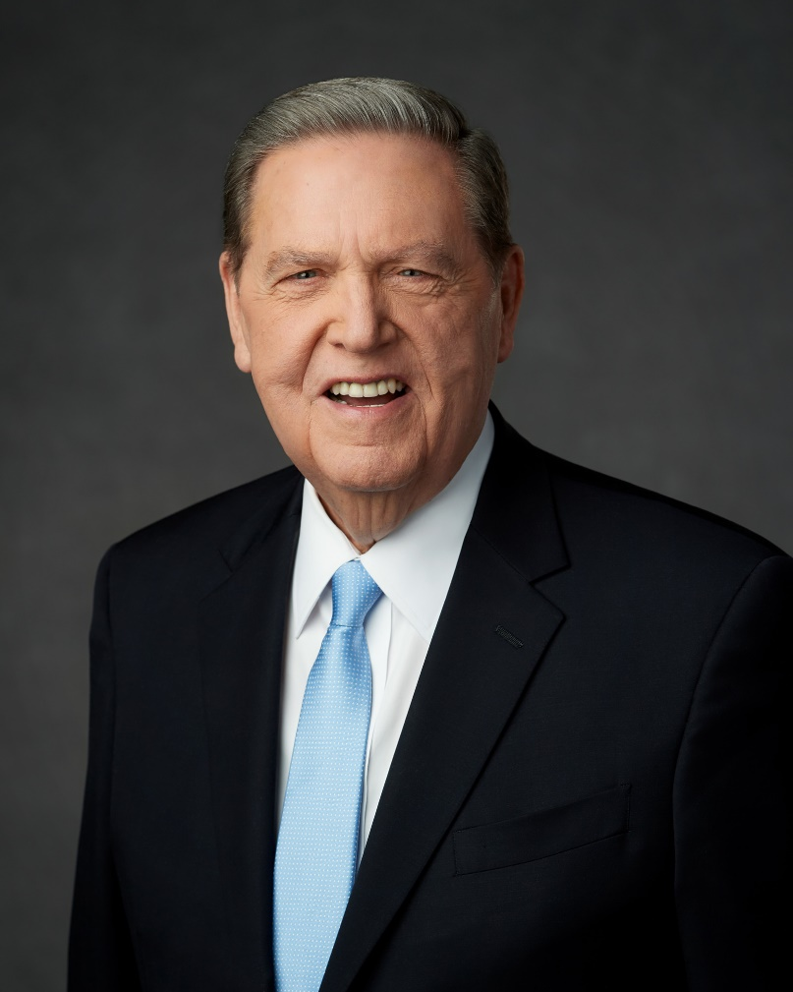
“Part of the reason we are so misunderstood by others in the Christian tradition is because in stressing the individual personages of the Godhead, we have not followed that up often enough by both conceding and insisting upon Their unity in virtually every other imaginable way. For this we have reaped needless criticism, and we have made our LDS position harder to be understood than it needs to be.”
Elder Jeffrey R. Holland, Ensign, January 2016
Notes:
Image: https://newsroom.churchofjesuschrist.org/leader-biographies/elder-jeffrey-r-holland

Slide 40
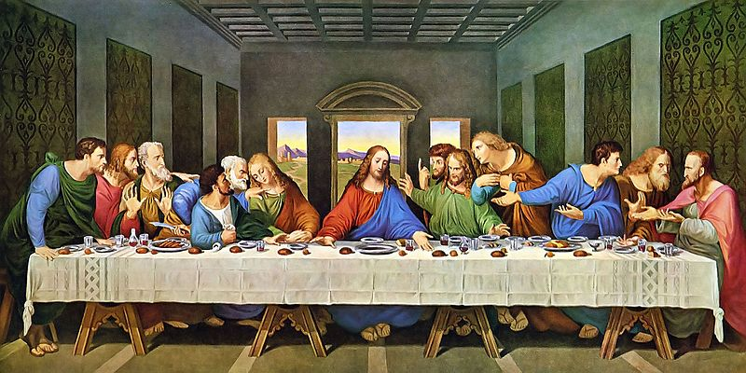
“He that hath seen me hath seen the Father…I am in the Father, and the Father in me. The words that I speak unto you I speak not of myself: but the Father that dwelleth in me.” (John 14:9–10)
Notes:
https://commons.wikimedia.org/wiki/File:The-Last-Supper-Restored-Da-Vinci_32x16.jpg

Slide 41
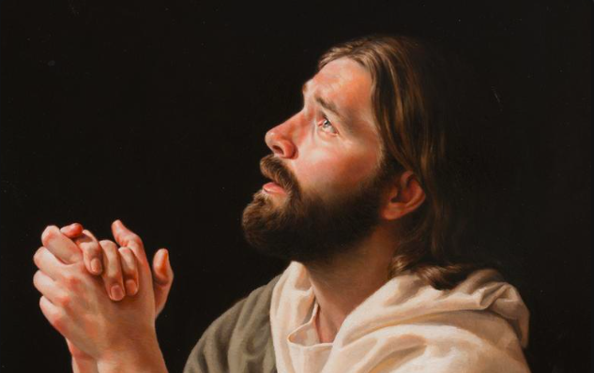
“I pray…for those who believe in me…I pray that they may all be one. Father! May they be in us, just as you are in me and I am in you. May they be one…just as you and I are one”
Daniel Alma Wilson
John 17:20-22, Good News Bible
Notes:
Image: https://history.churchofjesuschrist.org/exhibit/iac-2015-tell-me-the-stories-of-jesus?lang=eng

Slide 42
“I pray…for those who believe in me…I pray that they may all be one. Father! May they be in us, just as you are in me and I am in you. May they be one…just as you and I are one”
Daniel Alma Wilson
How could we increase our efforts to be one with God and Christ?
John 17:20-22, Good News Bible
Notes:
Image: https://history.churchofjesuschrist.org/exhibit/iac-2015-tell-me-the-stories-of-jesus?lang=eng

Slide 43
Lessons from Ancient Prophets that can help us live with Christ in the present
Enoch
The Brother of Jared
Hosea
Nehemiah
Moroni

Slide 44
“When the Lord began to speak through Hosea, the Lord said to him, “Go, marry a promiscuous woman and have children with her…So he married Gomer.”
Hosea 1:2-3
NIV

Slide 45
Gomer was unfaithful. She left Homer. Her children were “conceived…in disgrace. She said, ‘I will go after my lovers, who give me my food and my water, my wool and my linen, my olive oil and my drink.’”
Hosea 2:4-5
NIV

Slide 46
Then God ordered me, “Start all over: Love your wife again, your wife who’s in bed with her latest boyfriend, your cheating wife. Love her the way I, God, love the Israelite people, even as they flirt and party with every god that takes their fancy.” I did it.
Hosea 3:1-3
The Message

Slide 47
“I will take you for my wife forever; I will take you for my wife in righteousness and in justice, in steadfast love, and in mercy. I will take you for my wife in faithfulness; and you shall know the LORD.”
Ernst Friedrich von Liphart
Hosea 2:19-20
NRSV
Notes:
Testify—do you feel the love, the mercy, the forgiveness that Jesus Christ extends to you? He paid the price!
Take a minute to write down what the story of Hosea might mean for you.
Image: https://commons.wikimedia.org/wiki/File:Ernest_Karlovich_Lipgart_-_The_Parable_of_the_Wise_and_Foolish_Virgins,_1886.jpg

Slide 48
Lessons from Ancient Prophets that can help us live with Christ in the present
Enoch
The Brother of Jared
Hosea
Nehemiah
Moroni

Slide 49
“What my God had put in my heart…” (Nehemiah 2:12)

Slide 50
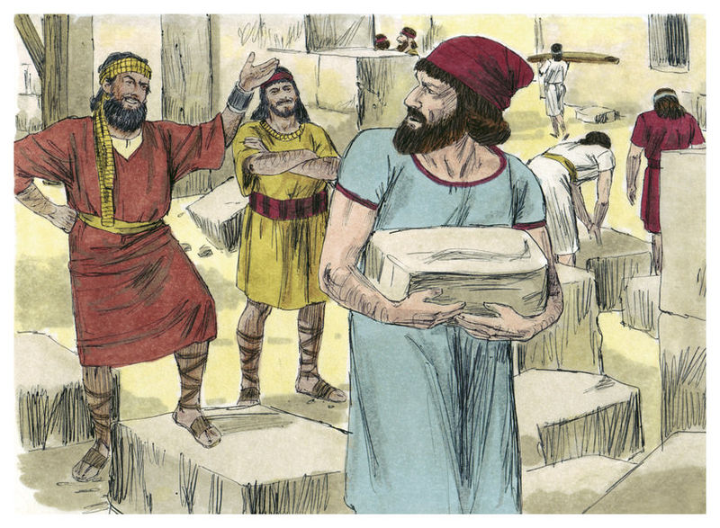
“There is much rubbish; so that we are not able to build the wall.”
(Nehemiah 4:10)
Distant Shores Media/Sweet Publishing
Notes:
Image: https://commons.wikimedia.org/wiki/File:Book_of_Nehemiah_Chapter_2-5_(Bible_Illustrations_by_Sweet_Media).jpg

Slide 51
A survey of 752 Christian leaders found that 75% of them said that the busyness of their lives either often or almost always gets in the way of developing their relationships with God.
Notes:
https://pixabay.com/photos/pedestrians-people-busy-movement-400811/

Slide 52
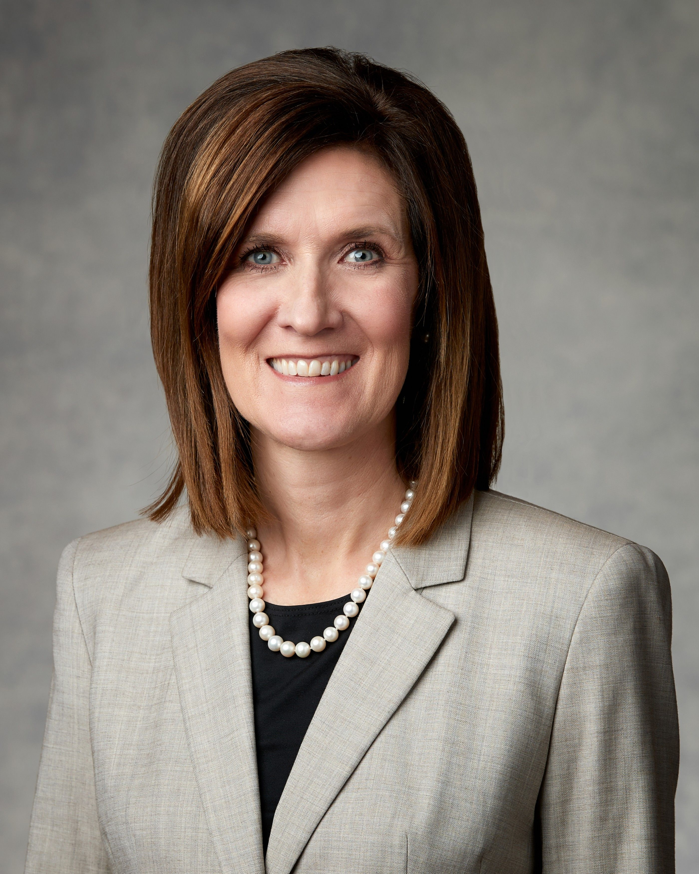
“If God speaks in a still, small voice, you and I need to draw close to hear Him. Just imagine what would happen if we were as intent on staying connected with heaven as we are on staying connected to Wi-Fi!”
Michelle D. Craig
Ensign, Nov. 2019

Slide 53
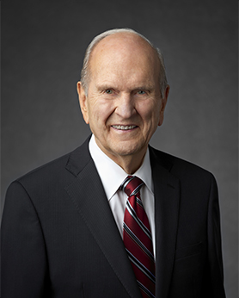
“Take an inventory of how you spend your time and where you devote your energy. That will tell you where your heart is.”
President Russell M. Nelson,
“We Can Do Better and Be Better,”
Ensign, May 2019.
Notes:
One of my students took President Nelson’s advice and took an inventory of how much time he spent on his phone. He was shocked at the results. He said, “I calculated that if I continue at my current rate, by the time I’m 80 I will have spent more than a decade of my life was spent on social media.”

Slide 54
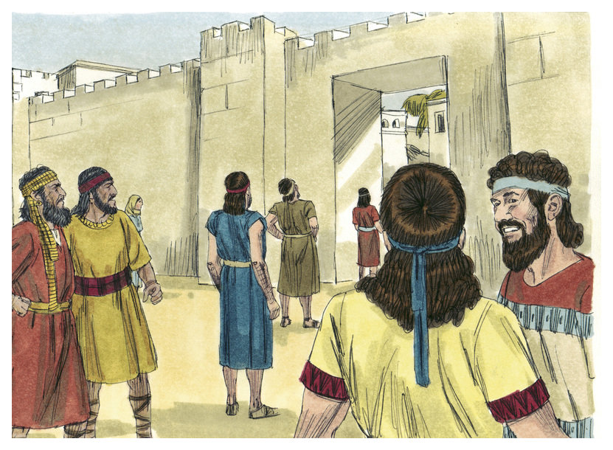
“I am doing a great work, so that I cannot come down: why should the work cease, whilst I leave it, and come down to you?”
(Nehemiah 6:3)
Distant Shores Media/Sweet Publishing
Notes:
https://commons.wikimedia.org/wiki/File:Book_of_Nehemiah_Chapter_6-2_(Bible_Illustrations_by_Sweet_Media).jpg

Slide 55
“They sent unto me four times after this sort; and I answered them after the same manner.”
(Nehemiah 6:4)
Distant Shores Media/Sweet Publishing
Notes:
https://commons.wikimedia.org/wiki/File:Book_of_Nehemiah_Chapter_6-2_(Bible_Illustrations_by_Sweet_Media).jpg

Slide 56
Lessons from Ancient Prophets that can help us live with Christ in the present
Enoch
The Brother of Jared
Hosea
Nehemiah
Moroni

Slide 58
Book Cover by Neill Marriott
Notes:
If possible, remake these images

Slide 59
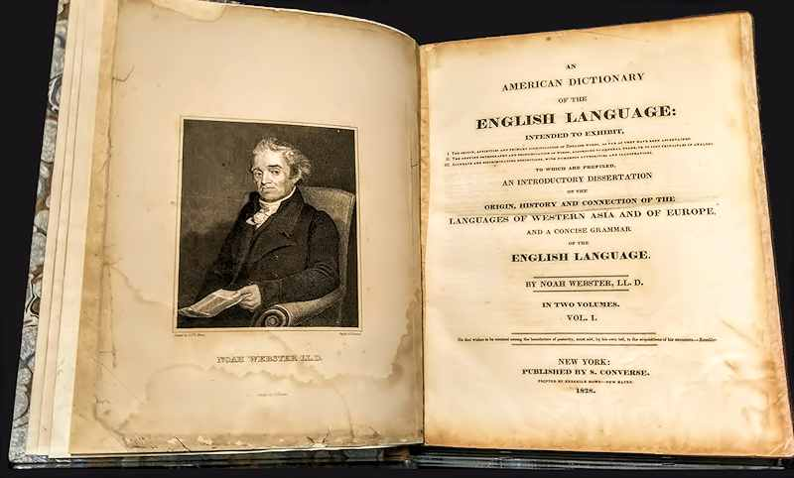
Notes:
http://www.webstersdictionary1828.com/NoahWebster

Slide 60
“Seek”
“To go in search or quest of; to look for…”
--Noah Webster’s 1828 Dictionary

Slide 62
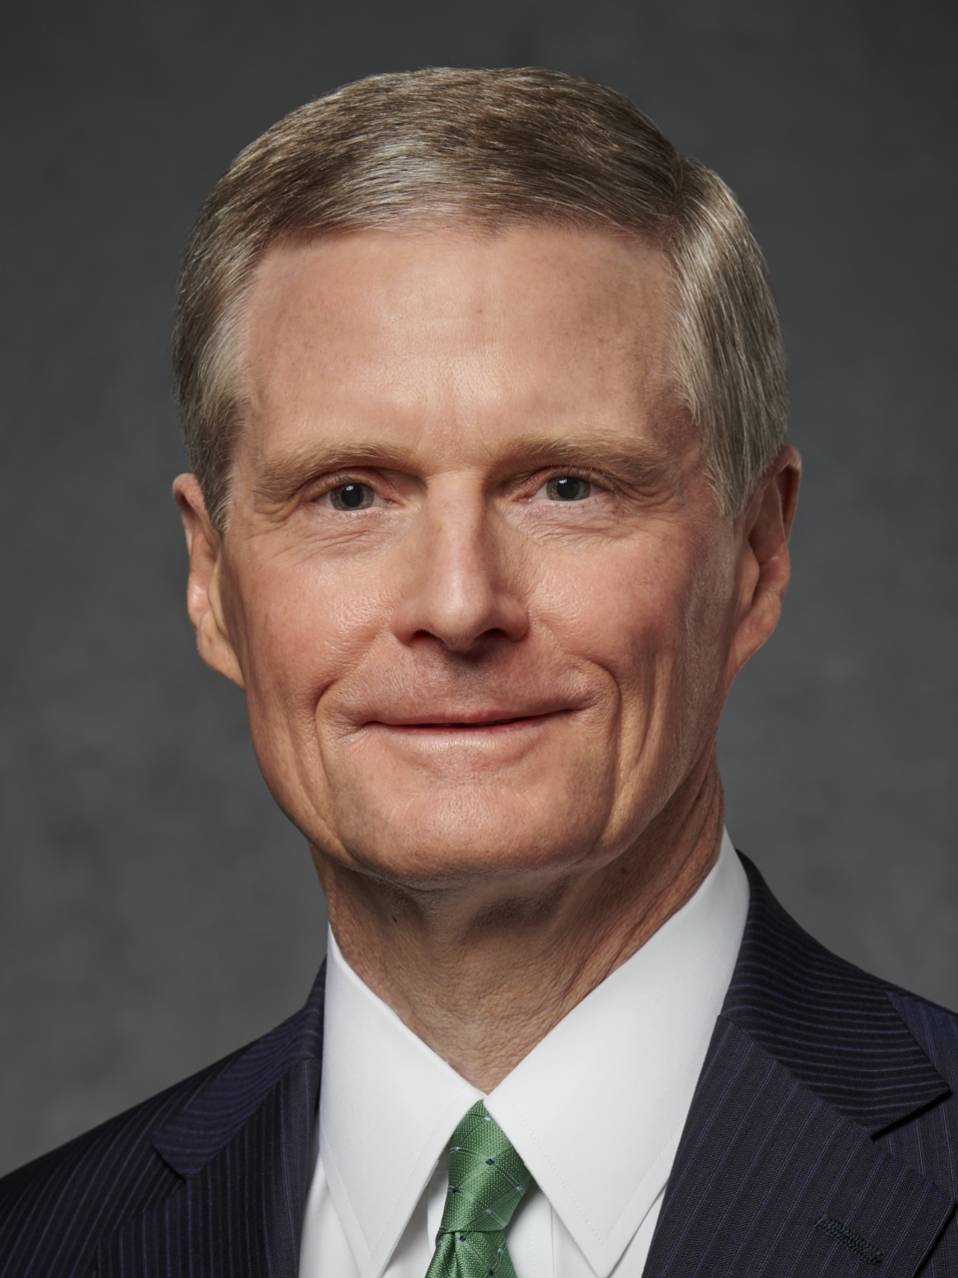
“We put way too much importance on what we say. We think that by telling people things that somehow that will connect and get inside. My observation is that the role of a parent [teacher] includes talking and telling, but it extends beyond that to inviting a child [student] to act in accordance with truth.
(Elder David A. Bednar and Susan Bednar, Conversations, “Episode 1” (mp3 audio file), radio.lds.org/eng/programs/conversations.)
Notes:
My hope is that this course will help you choose faith and choose the covenant path by deepening your understanding of Jesus Christ. I hope our testimonies of him grow throughout this course and that we deepen our desire to be witnesses of him.
Share testimony
**When creating the online version, note DC 46 spiritual gift video for text

Slide 63
“And only when the child [student] acts in accordance with the truth that has been explained or taught can the child [student] come to know for himself or herself the truthfulness of what they have heard and what they are doing. . . . It’s only when in that process of communicating, loving, and working with a child [student] you help them act in accordance with truth that they get it for themselves. It moves from their head to their heart.”
(Elder David A. Bednar and Susan Bednar, Conversations, “Episode 1” (mp3 audio file), radio.lds.org/eng/programs/conversations.)
Notes:
My hope is that this course will help you choose faith and choose the covenant path by deepening your understanding of Jesus Christ. I hope our testimonies of him grow throughout this course and that we deepen our desire to be witnesses of him.
Share testimony
**When creating the online version, note DC 46 spiritual gift video for text

