Slide 1
Notes:
No permissions needed for this image.

Slide 2
Notes:
No permissions needed for this image.

Slide 3
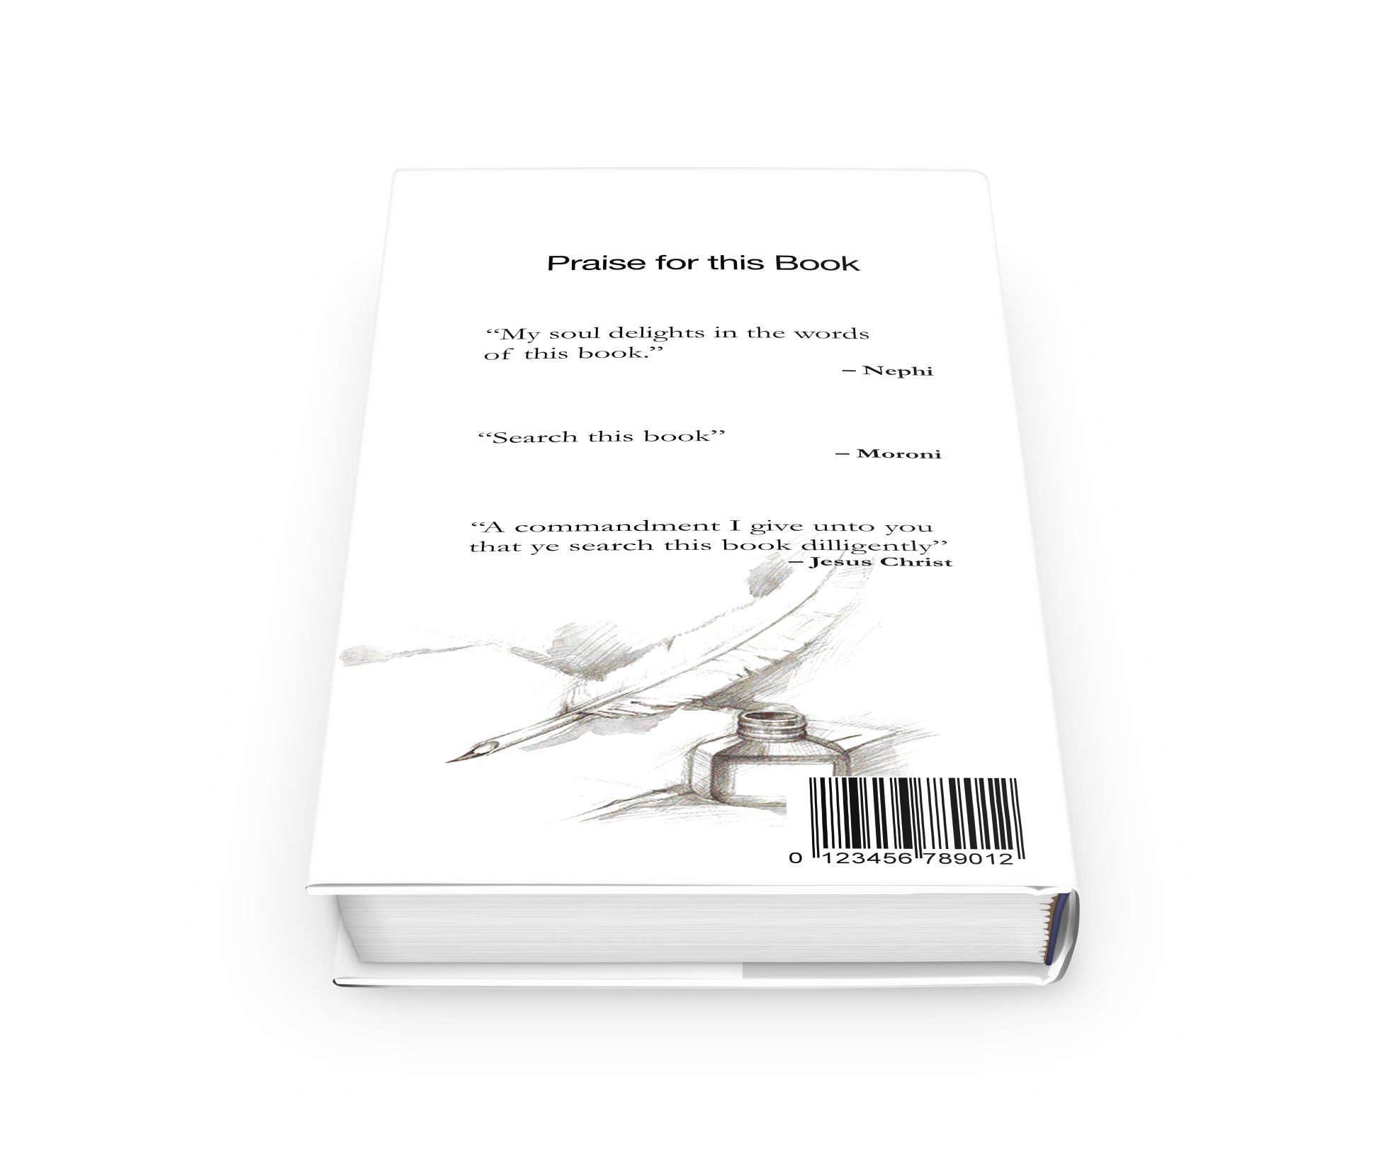
Notes:
No permissions needed for this image.

Slide 4
Notes:
No permissions needed for this image.

Slide 5
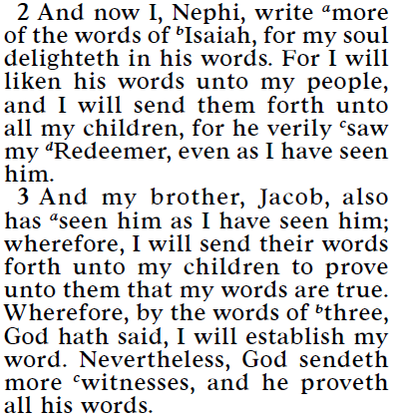
Why Does Nephi Quote 15+ Chapters of Isaiah?
2 Nephi 11:2-3

Slide 6
2 Nephi 25:8
Nephi testified that the words of Isaiah would be “of great worth unto them in the last days; for in that day shall they understand them.”

Slide 7
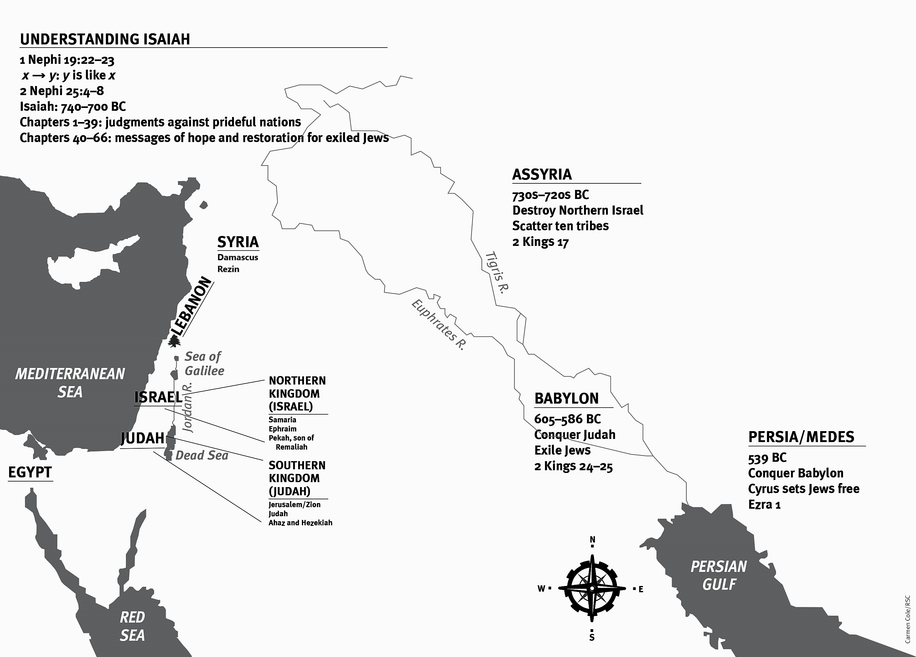
Notes:
You learned about this map either in the video or article. 3 minute review: Hit 2 Nephi 25:6, time period of Isaiah, and then jump to the rest of the map.

Slide 8
Notes:
You learned about this map either in the video or article. 3 minute review: Hit 2 Nephi 25:6, time period of Isaiah, and then jump to the rest of the map.

Slide 9
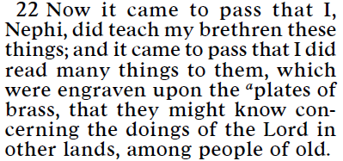
Why does Nephi read to his people from the plates of brass? (1 Nephi 19:22)

Slide 10
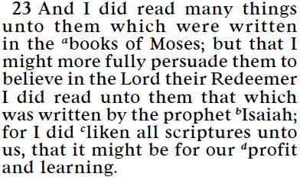
Why does Nephi specifically read Isaiah? (1 Nephi 19:23)

Slide 11
2 Nephi 25:6
“I . . . have dwelt at Jerusalem, wherefore I know concerning the regions round about; and I have made mention unto my children concerning the judgments of God, which hath come to pass among the Jews…according to all that which Isaiah hath spoken.”
Notes:
Enthusiasm about history. It makes a difference!

Slide 12
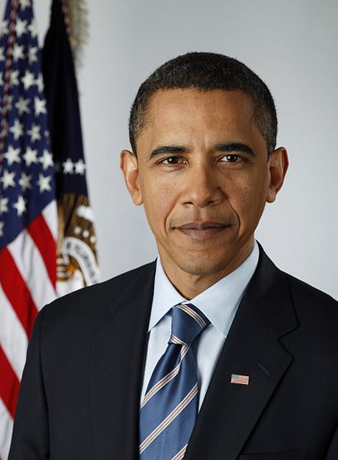
“Obama is going to the Big Apple to meet with the UN. He is angry at Beijing.”
Pete Souza
Notes:
https://commons.wikimedia.org/wiki/File:Official_portrait_of_Barack_Obama.jpg

Slide 13
Notes:
You learned about this map either in the video or article. 3 minute review: Hit 2 Nephi 25:6, time period of Isaiah, and then jump to the rest of the map.

Slide 14
Notes:
You learned about this map either in the video or article. 3 minute review: Hit 2 Nephi 25:6, time period of Isaiah, and then jump to the rest of the map.

Slide 15
Notes:
You learned about this map either in the video or article. 3 minute review: Hit 2 Nephi 25:6, time period of Isaiah, and then jump to the rest of the map.

Slide 16
Jesus and the…
The united kingdom of Israel splits into two kingdoms (Israel (ten tribes) and Judah) (950 BC)
Ten tribes scattered by Assyria and foreigners brought into their land (720 BC)
The people who are now living in that geographic area become known as…
Notes:
Enthusiasm about history. It makes a difference!

Slide 17
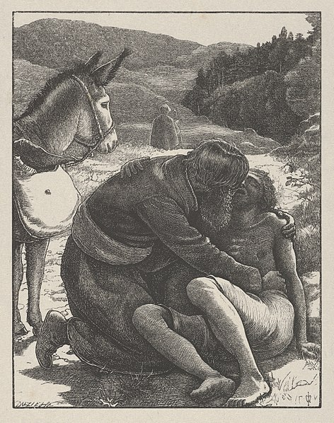
Jesus and the Samaritans
The parable of the Good Samaritan.
Jesus and the Samaritan woman at the well.
James and John wanting to call down fire on a Samaritan city and the Savior’s response.
John Everett Millais
Notes:
Understanding the centuries of enmity between the Samaritans and people living in Jerusalem can help us better understand these stories.
Image: https://commons.wikimedia.org/wiki/File:The_Good_Samaritan_(The_Parables_of_Our_Lord_and_Saviour_Jesus_Christ)_MET_DP835797.jpg

Slide 18
Notes:
You learned about this map either in the video or article. 3 minute review: Hit 2 Nephi 25:6, time period of Isaiah, and then jump to the rest of the map.

Slide 19
What are meanings of these lyrics?
If you ain't here, I just can't breathe It's no air, no air No air… I walked, I ran, I jumped, I flew Right off the ground to float to you There's no gravity to hold me down for real

Slide 20
“The book of Isaiah contains numerous prophecies that seem to have multiple fulfillments. One seems to involve the people of Isaiah’s day or the circumstances of the next generation.
Dallin H. Oaks
“Scripture Reading and Revelation,” Ensign (Jan. 1995), p. 8.
Notes:
20

Slide 21
“Another meaning, often symbolic, seems to refer to events in the meridian of time when Jerusalem was destroyed and her people scattered after the crucifixion of the Son of God. Still another meaning or fulfillment of the same prophecy seems to relate to the events attending the Second Coming of the Savior.”
Dallin H. Oaks
“Scripture Reading and Revelation,” Ensign (Jan. 1995), p. 8.
Notes:
21

Slide 22
Isaiah Testifies of Jesus Christ
“A virgin shall conceive”
“Be not afraid”
“I have graven thee upon the palms of my hand”
“The prey of the terrible shall be delivered”

Slide 23
“And it came to pass in the days of Ahaz the son of Jotham, the son of Uzziah, king of Judah, that Rezin the king of Syria, and Pekah the son of Remaliah, king of Israel, went up toward Jerusalem to war against it, but could not prevail against it.”
(Isaiah 7:1)
Notes:
23

Slide 24
“And it was told the house of David [that’s Ahaz, in Jerusalem], saying, Syria is confederate with Ephraim [remember that Ephraim is the capital of Israel]. And his heart was moved, and the heart of his people, as the trees of the wood are moved with the wind.”
(Isaiah 7:2)
Notes:
24

Slide 25
“Say unto [Ahaz], Take heed, and be quiet; fear not, neither be fainthearted for the two tails of these smoking firebrands.”
(Isaiah 7:4)
Notes:
25

Slide 26
“Because Syria, Ephraim, and the son of Remaliah, have taken evil counsel against thee, saying: Let us go up against Judah, and vex it, and let us make a breach therein for us, and set a king in the midst of it, even the son of Tabeal.
[In other words, Syria and the Northern Kingdom plan to install a puppet king in Judah who will do their bidding].”
(Isaiah 7:5–6)
Notes:
26

Slide 27
“Thus saith the Lord God, It shall not stand, neither shall it come to pass. For the head of Syria is Damascus, and the head of Damascus is Rezin; and within threescore and five years shall Ephraim be broken, that it be not a people.”
(Isaiah 7:7)
Notes:
27

Slide 28
“Associate yourselves, O ye people, and ye shall be broken in pieces.”
(Isaiah 8:9)
Notes:
28

Slide 29
“Then Rezin king of Syria and Pekah son of Remaliah king of Israel came up to Jerusalem to war: and they besieged Ahaz, but could not overcome him.”
(2 Kings 16:5)
Notes:
29

Slide 30
2 Kings 16:7–9
“So Ahaz sent messengers to Tiglathpileser king of Assyria, saying, I am thy servant and thy son: come up, and save me out of the hand of the king of Syria, and out of the hand of the king of Israel, which rise up against me. And Ahaz took the silver and gold that was found in the house of the Lord, and in the treasures of the king’s house, and sent it for a present to the king of Assyria. And the king of Assyria hearkened unto him...went up against Damascus, and took it, and carried the people of it captive…and slew Rezin.”

Slide 31
“The Lord spake again unto Ahaz, saying, Ask thee a sign of the Lord thy God; ask it either in the depths, or in the heights above. But Ahaz said, I will not ask, neither will I tempt the Lord”
(Isaiah 7:10–12)
Notes:
31

Slide 32
“Behold, a virgin shall conceive, and bear a son, and shall call his name Immanuel.” (Isaiah 7:14)
Notes:
32
Discussion, I know that some of you are thinking (a) name is Jesus, not Emmanuel,
Image: https://johnknoxbc.org/immanuels-invitation/

Slide 33
Before this child is old enough to know good from evil, “the land that thou abhorrest shall be forsaken of both her kings.”
(Isaiah 7:16)
Notes:
33
Discussion, I know that some of you are thinking (a) name is Jesus, not Emmanuel,
Image: https://johnknoxbc.org/immanuels-invitation/

Slide 34
Isaiah 8:1
“The Lord said unto me, Take thee a great roll, and write in it with a man’s pen concerning Maher-shalal-hash-baz.” Note that Maher-shalal-hash-baz means “the spoil speeds, the prey hastens…I went unto the prophetess; and she conceived, and bare a son. Then said the Lord to me, Call his name Maher-shalal-hash-baz. For before the child shall have knowledge to cry, My father, and my mother, the riches of Damascus and the spoil of Samaria shall be taken away before the king of Assyria”

Slide 35
Isaiah 8:3–4
“I went unto the prophetess; and she conceived, and bare a son. Then said the Lord to me, Call his name Maher-shalal-hash-baz. For before the child shall have knowledge to cry, My father, and my mother, the riches of Damascus and the spoil of Samaria shall be taken away before the king of Assyria.”

Slide 36
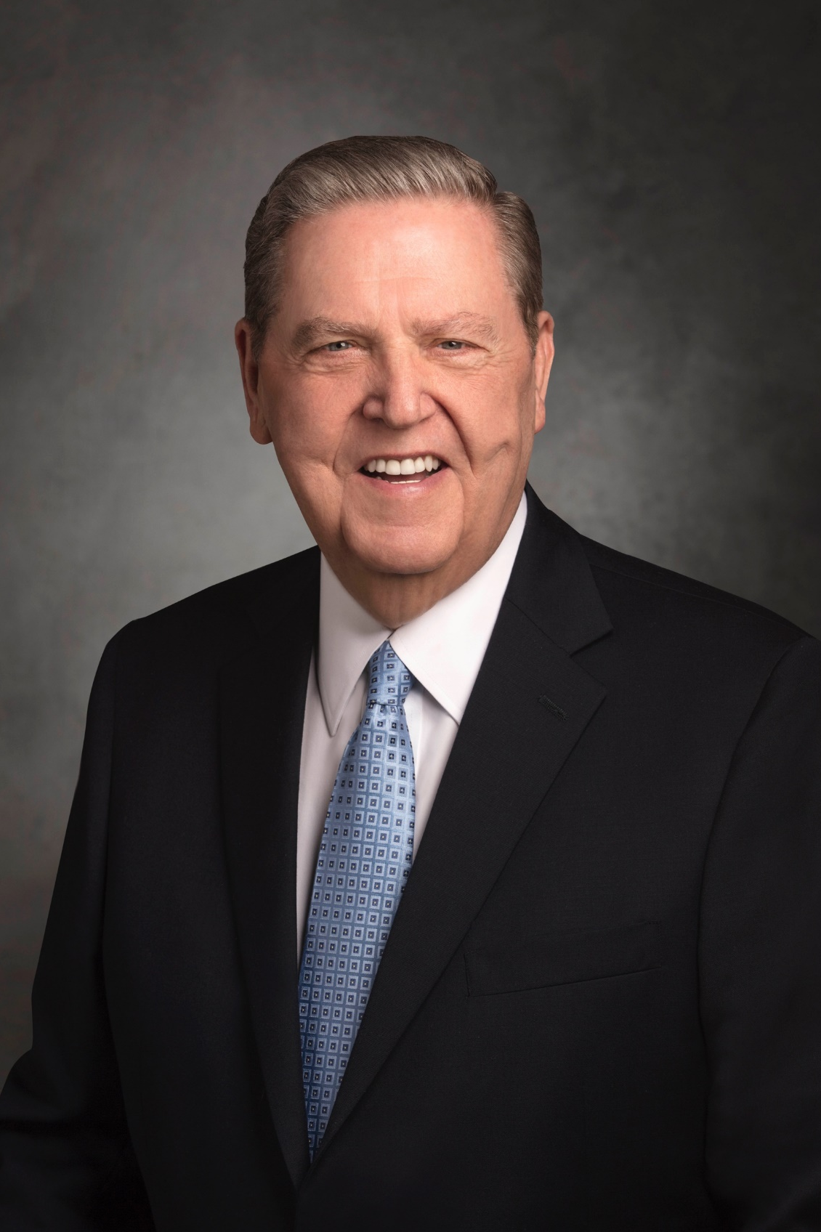
[Regarding Isaiah 7:14-15] “This sign was given to the Old Testament King Ahaz, encouraging him to take his strength from the Lord rather than the military might of Damascus, Samaria, or other militant camps...There are plural or parallel elements to this prophecy, as with so much of Isaiah’s writing. The most immediate meaning was probably focused on Isaiah's wife…who brought forth a son about this time, the child becoming a type and shadow of the greater, later fulfillment of the prophecy that would be realized in the birth of Jesus Christ.”
Elder Jeffrey R. Holland
Christ and the New Covenant, 79
Notes:
Explain how understanding the historical context can help us appreciate Jesus Christ even more! Mahershalahasbaz came as a sign to a people desperately afraid of Syria and Israel. You and I face twin enemies—sin and death. But Jesus was born—he delivers us!
Image: https://newsroom.churchofjesuschrist.org/leader-biographies/elder-jeffrey-r-holland

Slide 37
“Now all this was done, that it might be fulfilled which was spoken of the Lord by the prophet, saying,
‘Behold, a virgin shall be with child, and shall bring forth a son, and they shall call his name Emmanuel ’ [Isa. 7:14],
which being interpreted is, ‘God with us’.” (Matt. 1:22-23)
*Isaiah 7:14 can be applied to BOTH Isaiah’s day AND to the birth of Jesus Christ!
Notes:
37
Explain how understanding the historical context can help us appreciate Jesus Christ even more!
Image: https://www.carlbloch.org/the-complete-works.html?pageno=3

Slide 38
Isaiah Testifies of Jesus Christ
“A virgin shall conceive”
“Be not afraid”
“I have graven thee upon the palms of my hand”
“The prey of the terrible shall be delivered”

Slide 39
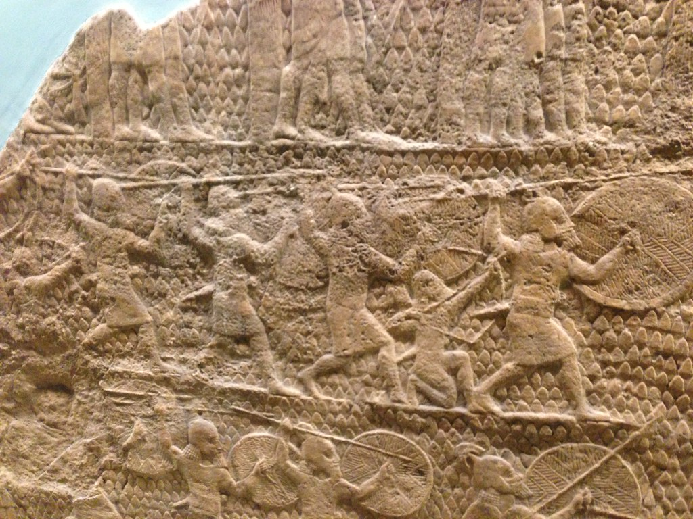
Isaiah 36-37
Image by Nate Loper
Notes:
Think “LOTR” siege…this is a grim situation. Tens of thousands of Assyrians are on your front step—the mightiest army in the world! Isaiah 36-37 were read prior to class so a quick review is all that’s needed.
Image: https://www.flickr.com/photos/genesisscience/43494318472 CCBY

Slide 40
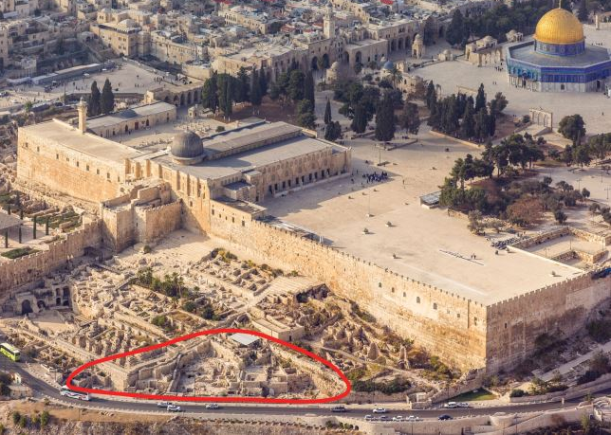
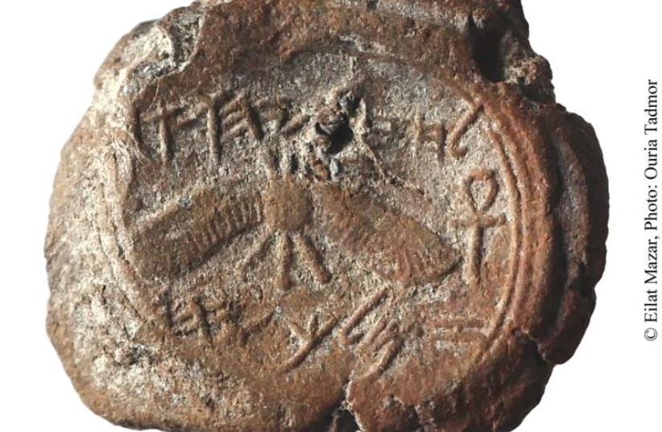
Historical Side Note
Notes:
Images: https://www.jpost.com/Israel-News/Culture/First-ever-seal-impression-of-an-Israelite-or-Judean-king-exposed-near-Temple-Mount-436061
The royal seal of King Hezekiah was unearthed by a Hebrew University of Jerusalem archeological team during excavations at the foot of the southern wall of the Temple Mount. Dating back to 727–698 BCE, the impression bears an inscription in ancient Hebrew script stating: “Belonging to Hezekiah [son of] Ahaz king of Judah.” Hezekiah is real. This situation he is facing is real. This may seem like an old story, but we are reading about a real person, with a real problem, who plead to Jesus for help.

Slide 41
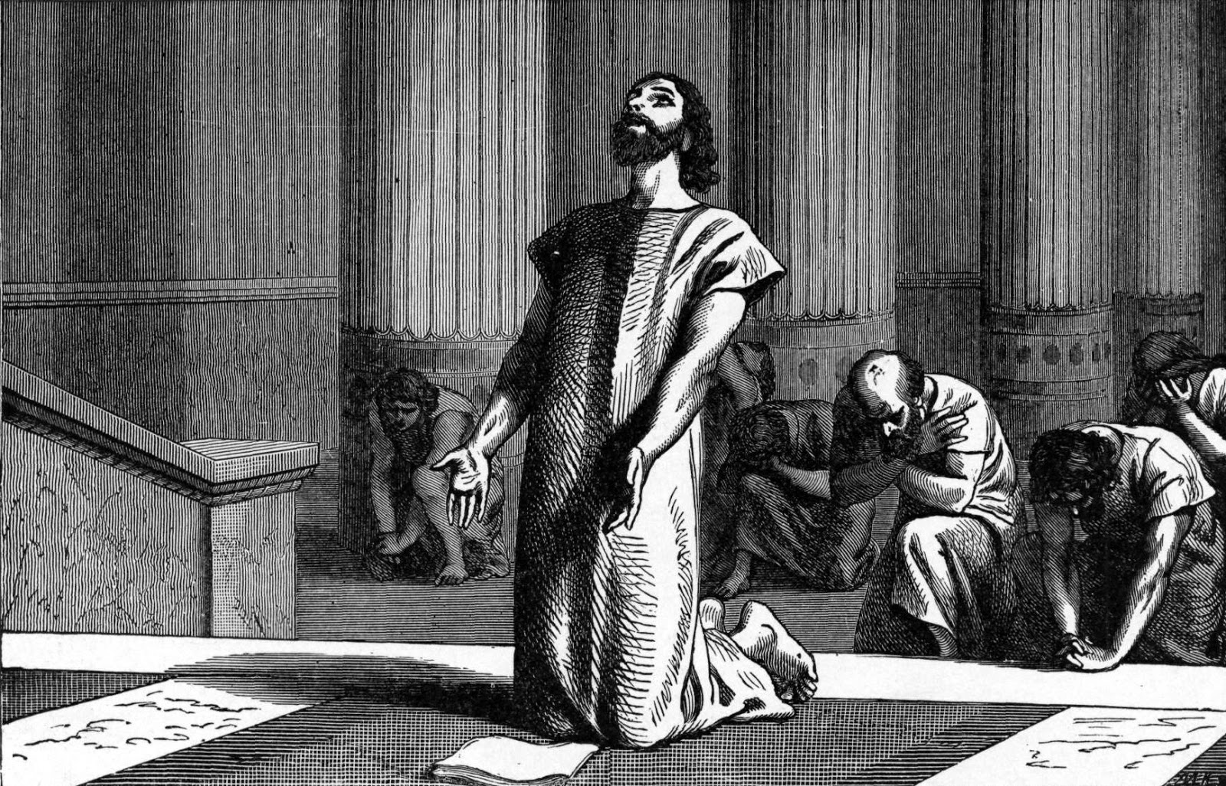
“This day is a day of trouble, and of rebuke, and of blasphemy: for the children are come to the birth, and there is not strength to bring forth” (Isaiah 37:3)
Notes:
Image: https://commons.wikimedia.org/wiki/File:King_Hezekiah,_clouthed_in_sackcloth,_spreads_open_the_letter_before_the_Lord.jpg

Slide 42
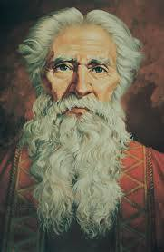
“Isaiah said unto them, Thus saith the LORD,
‘Be not afraid’”
(Isaiah 37:6)
Ted Henninger
Notes:
Note the words from Jehovah—Jesus Christ to Hezekiah in a desperate situation. These are still his words to YOU today.
Image: https://www.churchofjesuschrist.org/media/image/isaiah-4e7875b?lang=eng

Slide 43
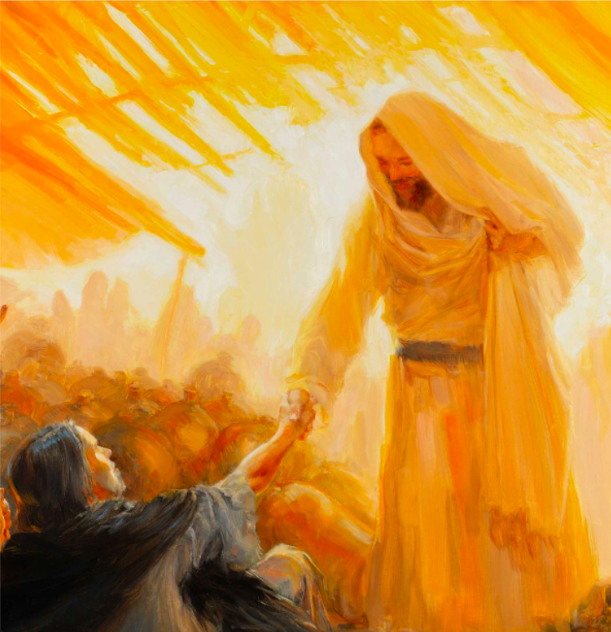
“Let not your heart be troubled” (John 14:1)
Richard Lance Russell
Notes:
Image: https://history.churchofjesuschrist.org/exhibit/theme/2019-international-art-competition-meditations-on-belief?lang=eng#mv39

Slide 44
“Peace I leave with you, my peace I give unto you: not as the world giveth, give I unto you. Let not your heart be troubled, neither let it be afraid.”
(John 14:27)
Richard Lance Russell

Slide 45
“I will not leave you comfortless, I will come to you.”
(John 14:18)
Richard Lance Russell

Slide 46
“Hezekiah…trusted in the LORD God of Israel; so that after him was none like him among all the kings of Judah, nor any that were before him”
(2 Kings 18:5)
Notes:
Image: https://commons.wikimedia.org/wiki/File:King_Hezekiah,_clouthed_in_sackcloth,_spreads_open_the_letter_before_the_Lord.jpg

Slide 47
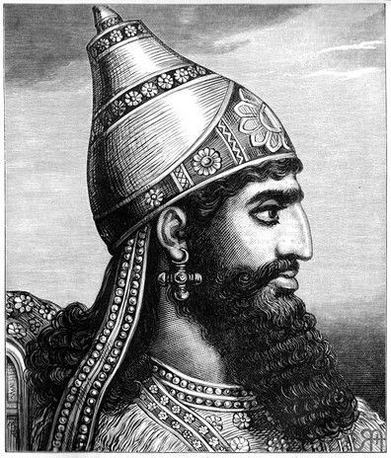
“What confidence is this wherein thou trustest? On whom dost thou trust? Thou trustest in the staff of this broken reed, on Egypt…How then wilt thou…put thy trust on Egypt for chariots and for horsemen? Neither let Hezekiah make you trust in the Lord…” (Isaiah 36:4–9, 15)
Notes:
Trust is obviously a key theme here. And the question is—on who do you trust? Do you trust in Egypt? Or the Lord?
Image: https://pixels.com/featured/sennacherib-lionel-f-stevenson.html

Slide 48
Notes:
Walk through the four quadrants – where are you? On which matters?
Where is Hezekiah right now? How is Rabshekah trying to shift Hezekiah’s position?
Note: Trust Matrix image is fine and legal to use as is.

Slide 49
Notes:
Walk through the four quadrants – where are you? On which matters?
Where is Hezekiah right now? How is Rabshekah trying to shift Hezekiah’s position?
Note: Trust Matrix image is fine and legal to use as is.

Slide 50
Notes:
Walk through the four quadrants – where are you? On which matters?
Where is Hezekiah right now? How is Rabshekah trying to shift Hezekiah’s position?
Note: Trust Matrix image is fine and legal to use as is.

Slide 51
Notes:
Walk through the four quadrants – where are you? On which matters?
Where is Hezekiah right now? How is Rabshekah trying to shift Hezekiah’s position?
Note: Trust Matrix image is fine and legal to use as is.

Slide 52
Notes:
Walk through the four quadrants – where are you? On which matters?
Where is Hezekiah right now? How is Rabshekah trying to shift Hezekiah’s position?
Note: Trust Matrix image is fine and legal to use as is.

Slide 53
Notes:
Walk through the four quadrants – where are you? On which matters?
Where is Hezekiah right now? How is Rabshekah trying to shift Hezekiah’s position?
Note: Trust Matrix image is fine and legal to use as is.

Slide 54
Ahaz
Notes:
Walk through the four quadrants – where are you? On which matters?
Where is Hezekiah right now? How is Rabshekah trying to shift Hezekiah’s position?
Note: Trust Matrix image is fine and legal to use as is.

Slide 55
Hezekiah
Notes:
How is Rabshekah trying to shift Hezekiah’s position?

Slide 56
“How can I know whether I need to trust in God more, or whether I need to work harder?”
Notes:
Walk through the four quadrants – where are you? On which matters?

Slide 57
Notes:
Walk through the four quadrants – where are you? On which matters?
Where is Hezekiah right now? How is Rabshekah trying to shift Hezekiah’s position?

Slide 58
Notes:
Walk through the four quadrants – where are you? On which matters?
Where is Hezekiah right now? How is Rabshekah trying to shift Hezekiah’s position?

Slide 59
Notes:
DO ALL THINGS IN YOUR POWER
BE STILL
PRAY FOR DELIVERANCE—THIS IS WHAT HEZEKIAH DOES

Slide 60
How can we shift from worrying too much to more fully trusting in God (while still cheerfully doing all things in our power)?
Notes:
DO ALL THINGS IN YOUR POWER
BE STILL
PRAY FOR DELIVERANCE—THIS IS WHAT HEZEKIAH DOES

Slide 61
“O LORD of hosts…thou hast made heaven and earth. Incline thine ear, O LORD…O LORD our God, save us from his [the king of Assyria’s] hand.”
(Isaiah 37:16–17, 20)
Notes:
Hezekiah’s prayer at the temple. Do you and I spend enough time on our knees praying for deliverance, showing our trust in the Lord?
Image: https://commons.wikimedia.org/wiki/File:King_Hezekiah,_clouthed_in_sackcloth,_spreads_open_the_letter_before_the_Lord.jpg

Slide 62
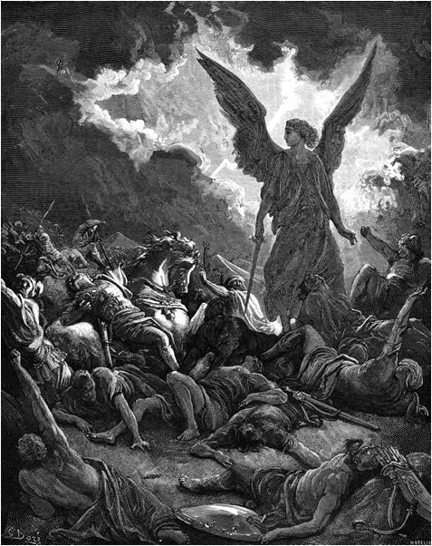
Gustav Doré
Notes:
Image: https://en.wikipedia.org/wiki/Sennacherib#/media/File:DESTRUCTION_OF_SENNACHERIB'S_HOST..jpg

Slide 63
Isaiah Testifies of Jesus Christ
“A virgin shall conceive”
“Be not afraid”
“I have graven thee upon the palms of my hand”
“The prey of the terrible shall be delivered”

Slide 64
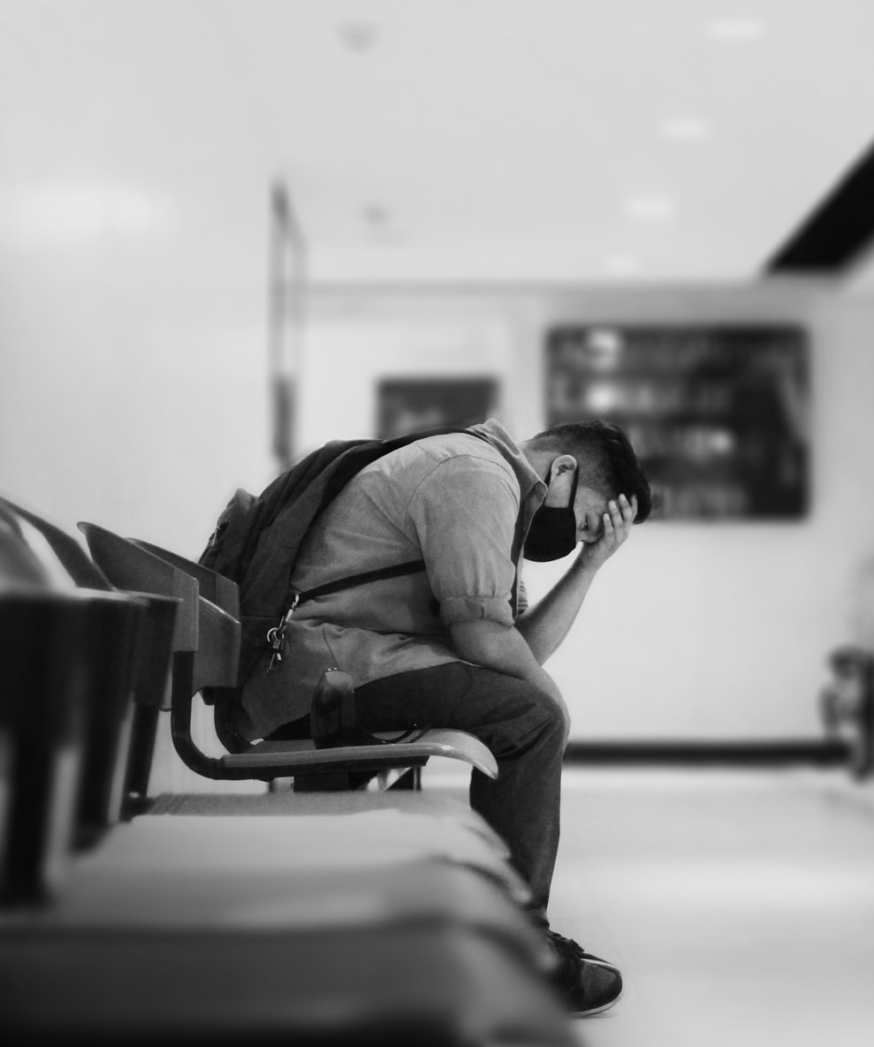
Zion said, “The LORD hath forsaken me, and my Lord hath forgotten me” (Isaiah 49:14)
Notes:
Provide brief historical context—70 year trial—some of us freak out about a 70 day or even 70 hour trial.
Image: https://unsplash.com/photos/GJsyfWI2XQ0

Slide 65
Notes:
You learned about this map either in the video or article. 3 minute review: Hit 2 Nephi 25:6, time period of Isaiah, and then jump to the rest of the map.

Slide 66
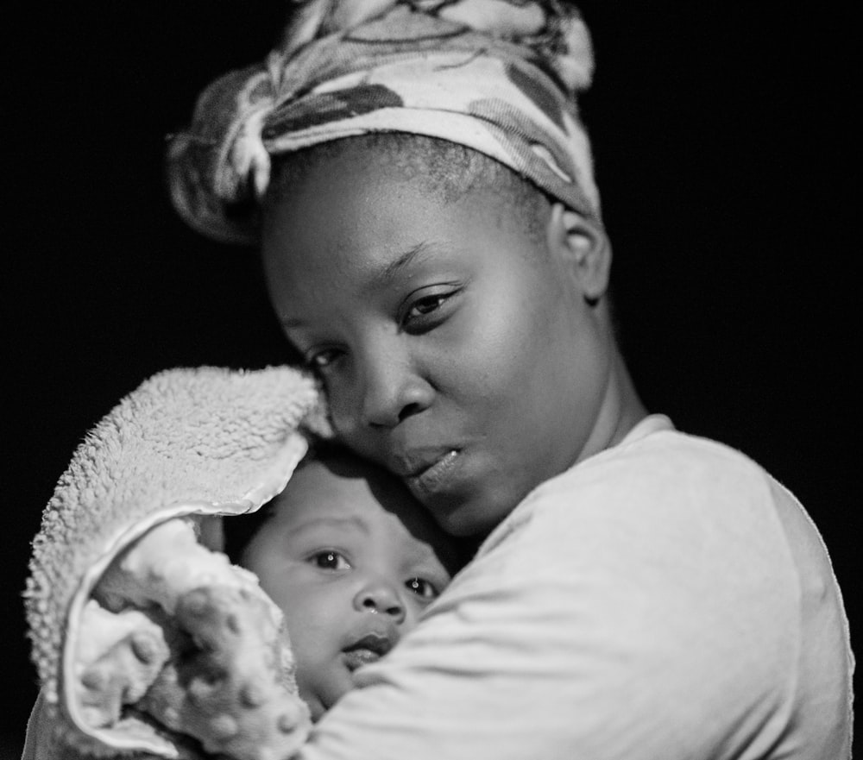
“Can a woman forget her nursing child, that she should have no compassion on the son of her womb? Even these may forget, yet I will not forget you.
Isaiah 49:15
Notes:
This is the Lord’s response
Image: https://unsplash.com/photos/Q9_zv0LN4jU

Slide 67
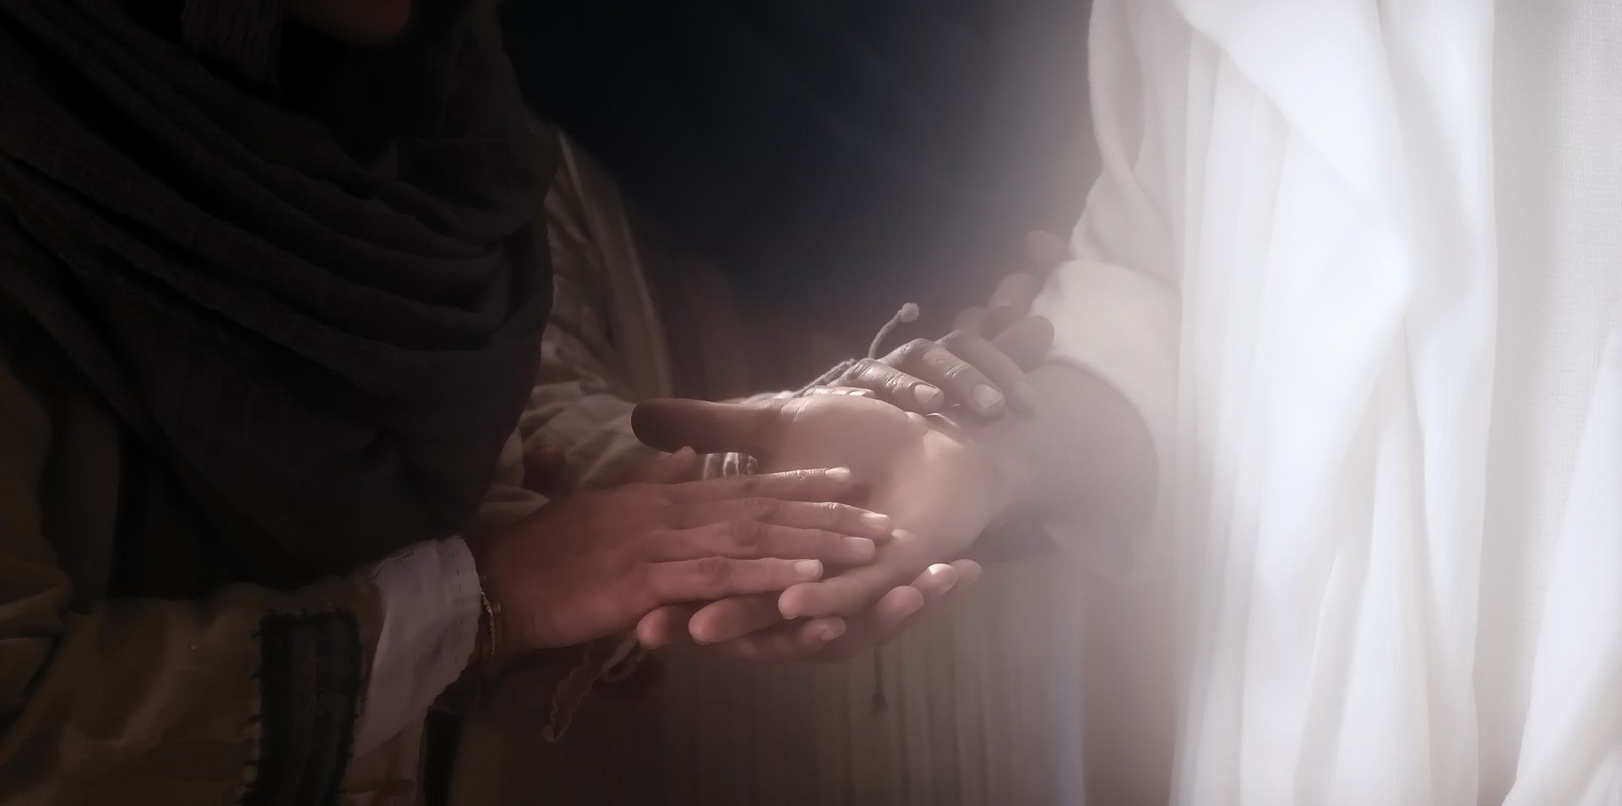
“Behold, I have graven thee upon the palms of my hands” (Isaiah 49:16)
Notes:
Notice that the word “thee” is a singular pronoun—it’s personal. It’s “you,” not “you all.” Also note that the Lord doesn’t say, “I have graven your name,” but rather, “I have graven you—your circumstances, your hopes, your fears, every part of you—on the palms of my hands.”
Image: https://www.churchofjesuschrist.org/media/image/bible-videos-jesus-resurrected-a1eb716?lang=eng&collectionId=540325ab91d18e0e1e52262aac51c33c10c4724b

Slide 68
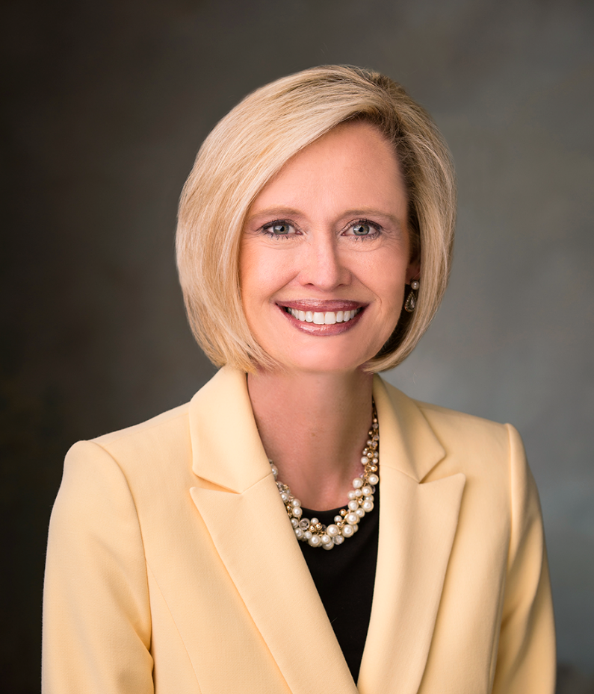
“The Savior knows you and loves you. If you wonder if that is true, you need only contemplate that He has ‘graven [you] upon the palms of [His] hands.’”
Bonnie H. Cordon, “Becoming a Shepherd,” Ensign, November 2018.
Notes:
Image: https://www.churchofjesuschrist.org/learn/bonnie-h-cordon?lang=eng

Slide 69
Isaiah Testifies of Jesus Christ
“A virgin shall conceive”
“Be not afraid”
“I have graven thee upon the palms of my hand”
“The prey of the terrible shall be delivered”

Slide 70
Then shalt thou say in thine heart, “I have lost my children, and am desolate, a captive…I was left alone” (Isaiah 49:21)
Notes:
Note—this continues from the section where we just left off. If time give historical application and then one to us.
Do we feel this? You are discouraged, desolate, feeling left alone. You have a deliverer! Jesus is coming to your rescue. You are the captive prey, but you will be delivered!!!!
Image: https://unsplash.com/photos/akT1bnnuMMk

Slide 71
“I will lift up mine hand to the Gentiles, and set up my standard to the people: and they shall bring thy sons in their arms, and thy daughters shall be carried upon their shoulders.” (Isaiah 49:22)
Notes:
Image: https://unsplash.com/photos/b3r5U405EIk

Slide 72
Notes:
You learned about this map either in the video or article. 3 minute review: Hit 2 Nephi 25:6, time period of Isaiah, and then jump to the rest of the map.

Slide 73
“And kings shall be thy nursing fathers, and their queens thy nursing mothers: they shall bow down to thee with their face toward the earth, and lick up the dust of thy feet…
Notes:
Image: https://unsplash.com/photos/b3r5U405EIk

Slide 74
“And kings shall be thy nursing fathers, and their queens thy nursing mothers: they shall bow down to thee with their face toward the earth, and lick up the dust of thy feet…they shall not be ashamed that wait for me. Shall the prey be taken from the mighty, or the lawful captive delivered?
Notes:
Image: https://unsplash.com/photos/b3r5U405EIk

Slide 75
“But thus saith the Lord, Even the captives of the mighty shall be taken away, and the prey of the terrible shall be delivered: for I will contend with him that contendeth with thee, and I will save thy children…. all flesh shall know that I the Lord am thy Saviour and thy Redeemer…” (Isaiah 49:23–26).
Notes:
Remind students that explanations for this were in both the video and article, feel free to go back and review if needed, article is more in-depth.

Slide 76
“[In the latter days] they that fight against…the covenant people of the Lord shall lick up the dust of their feet; and the people of the Lord shall not be ashamed. For the people of the Lord are they who wait for him; for they still wait for the coming of the Messiah. and thou shalt know that I am the Lord: for they shall not be ashamed that wait for me.…All flesh shall know that I the Lord am thy Savior and thy Redeemer.”
(2 Nephi 6:13-14, 18)
J. Kirk Richards
Notes:
Image: https://www.churchofjesuschrist.org/media/collection/march-22-28-doctrine-covenants-29-images?lang=eng

Slide 77
Isaiah Testifies of Jesus Christ
“A virgin shall conceive”
“Be not afraid”
“I have graven thee upon the palms of my hand”
“The prey of the terrible shall be delivered”

