Slide 1
Between the Testaments
We end the Old Testament with Jews having relative freedom under Persia.

Slide 2
Between the Testaments
We end the Old Testament with Jews having relative freedom under Persia.
When we start the New Testament, the Jews are ruled by Romans, there is a King named Herod and scripture is written in Greek.
What happened?

Slide 3
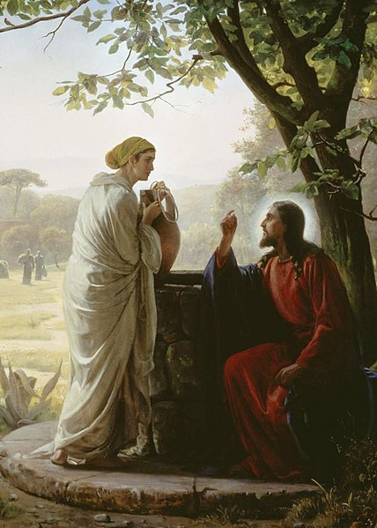

Slide 5
Between the Testaments
Period of Hellenization
Maccabean Revolt
Hasmonean Dynasty
Roman Rule through the Herodian Dynasty

Slide 6
Selected Key Events Between 1000-325 B.C. (all dates approximate)
United twelve tribes being led by King David (1000 BC).
United kingdom of Israel splits into two kingdoms (Israel and Judah) (950 BC)
Ten tribes scattered by Assyria (720 BC)
Jerusalem destroyed by Babylon (587 BC)
Persia defeats Babylon and allows Jerusalem to be rebuilt (539 BC) Time period of Zerubbabel, Ezra, and Nehemiah.
Old Testament ends (~400 BC)
Alexander the Great conquers; Hellenization begins (~330 BC)
Notes:
Enthusiasm about history. It makes a difference!

Slide 7
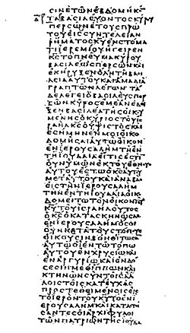
Hellenism – How Far is too Far?
Language
Koine (“Common”) Greek
Notes:
Image: https://en.wikipedia.org/wiki/Septuagint

Slide 8
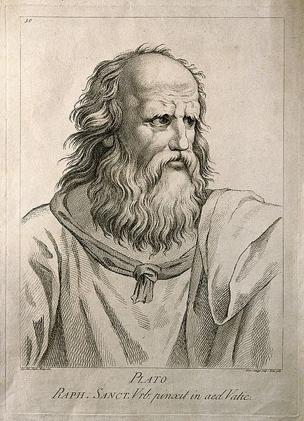
Hellenism – How Far is too Far?
Philosophy and Ethics
Socrates
Plato
Aristotle
Notes:
Image: https://commons.wikimedia.org/wiki/File:Plato._Etching_by_D._Cunego,_1783,_after_R._Mengs_after_Raph_Wellcome_V0004702.jpg

Slide 9
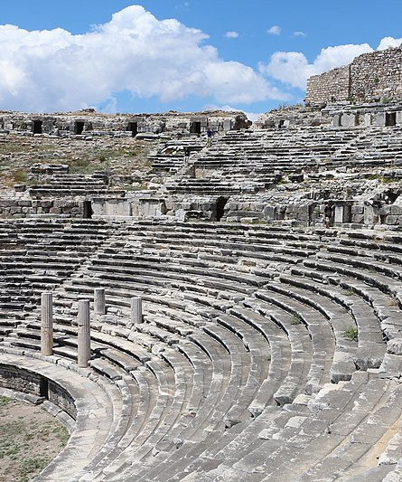
Hellenism – How Far is too Far?
Entertainment
Theaters (Greek Drama)
Stadiums (Athletic Competition)
Notes:
Image: https://commons.wikimedia.org/wiki/File:Miletus_-_Ancient_Greek_theatre_04.jpg

Slide 10
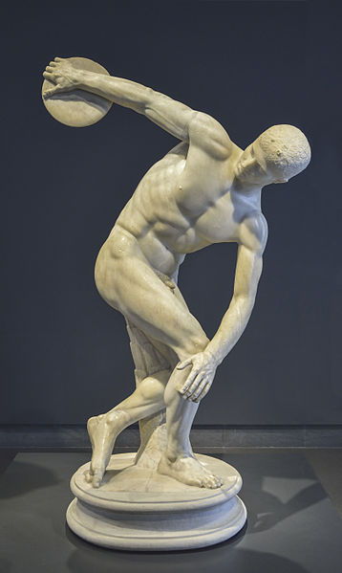
Hellenism – How Far is too Far?
Education and Lifestyle
Gymnasium and Nudity
Notes:
Image: https://commons.wikimedia.org/wiki/File:Discobolus_in_National_Roman_Museum_Palazzo_Massimo_alle_Terme.JPG

Slide 11
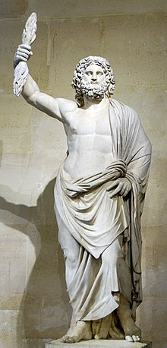
Hellenism – How Far is too Far?
Greek Gods and Mythology
Notes:
These issues of how far can one Hellenize were alive and well in the time of Jesus. We’ll see more about this topic, and how some reacted to Hellenization in a future class period.
Image: https://en.wikipedia.org/wiki/Zeus

Slide 12
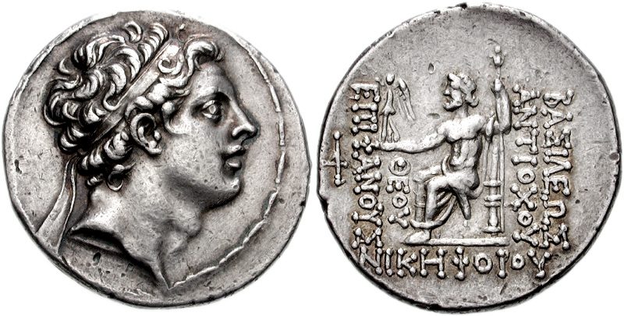
1 Maccabees 1:11-15 Reign of Antiochus IV Epiphanes (175 – 164 BC)
“In those days certain renegades came out from Israel and misled many, saying, ‘Let us go and make a covenant with the Gentiles around us, for since we separated from them many disasters have come upon us.’ …This proposal pleased them, and some of the people eagerly went to the king, who authorized them to observe the ordinances of the Gentiles.
Notes:
NRSV
Image: https://commons.wikimedia.org/wiki/File:Antiochos_IV_Epiphanes.jpg

Slide 13
1 Maccabees 1:11-15 Reign of Antiochus IV Epiphanes (175 – 164 BC)
“So they built a gymnasium in Jerusalem, according to Gentile custom, and removed the marks of circumcision, and abandoned the holy covenant. They joined with the Gentiles and sold themselves to do evil.”
Notes:
NRSV

Slide 14
1 Maccabees on the reign of Antiochus IV (175 – 164 BC)
“The books of the law that they [the Greeks] found they tore to pieces and burned with fire. Anyone found possessing the book of the covenant, or anyone who adhered to the law, was condemned to death by decree of the king. According to the decree, they put to death the women who had their children circumcised…they hung the infants from their mothers' necks.”
Notes:
NRSV

Slide 15
1 Maccabees on the reign of Antiochus IV (175 – 164 BC)
“Mattathias…moved from Jerusalem and settled in Modein…He saw the blasphemies being committed in Judah and Jerusalem…The king’s officers who were enforcing the apostasy came to the town of Modein to make them offer sacrifice. Many from Israel came to them; and Mattathias and his sons were assembled. Then the king’s officers spoke to Mattathias as follows:
Notes:
NRSV

Slide 16
1 Maccabees on the reign of Antiochus IV (175 – 164 BC)
“You are a leader, honored and great in this town, and supported by sons and brothers. Now be the first to come and do what the king commands, as all the Gentiles and the people of Judah and those that are left in Jerusalem have done. Then you and your sons will be numbered among the Friends of the king, and you and your sons will be honored with silver and gold and many gifts.”
Notes:
NRSV

Slide 17
1 Maccabees on the reign of Antiochus IV (175 – 164 BC)
But Mattathias answered and said in a loud voice: “Even if all the nations that live under the rule of the king obey him, and have chosen to obey his commandments, every one of them abandoning the religion of their ancestors, I and my sons and my brothers will continue to live by the covenant of our ancestors. Far be it from us to desert the law and the ordinances. We will not obey the king’s words by turning aside from our religion to the right hand or to the left.”
Notes:
NRSV

Slide 18
1 Maccabees on the reign of Antiochus IV (175 – 164 BC)
“When Mattathias saw [a Jew offering to do the pagan sacrifice], he burned with zeal and his heart was stirred. He gave vent to righteous anger; he ran and killed him on the altar. At the same time he killed the king’s officer who was forcing them to sacrifice, and he tore down the altar.
Notes:
NRSV

Slide 19
Between the Testaments
Period of Hellenization
Maccabean Revolt
Hasmonean Dynasty
Roman Rule through the Herodian Dynasty

Slide 20
Why are we learning all this history? I want to learn about Jesus!
Joshua Matson, in “The New Testament History, Culture, and Society,” Lincoln Blumell, Ed.
Notes:
I get it—sometimes this history can seem dry…let me help you see how this history will be helpful to us.

Slide 21
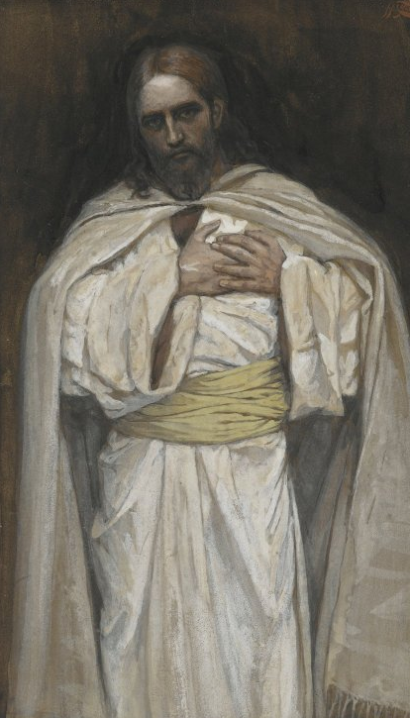
“It was at Jerusalem the feast of the dedication, and it was winter. And Jesus walked in the temple in Solomon’s porch” (John 10:22–23).
Hanukkah was called “the feast of dedication” because the temple was “dedicated” or “purified” when the Maccabees regained control of it. It’s interesting that at this feast, Jesus describes himself as the one “whom the Father hath sanctified” or made pure (John 10:36). Just as the Maccabees had purified the temple, so too the Father had purified Jesus.
Notes:
https://picryl.com/media/brooklyn-museum-our-lord-jesus-christ-notre-seigneur-jesus-christ-james-tissot-51333f

Slide 22
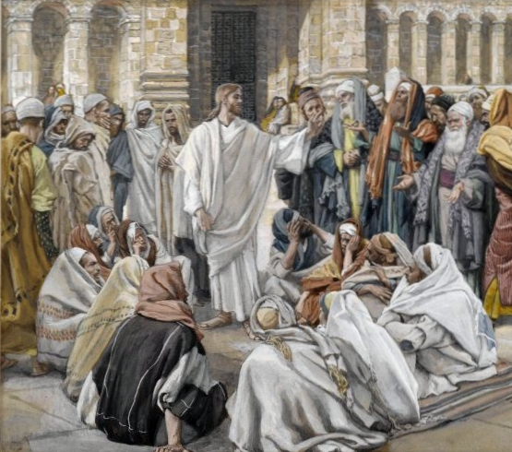
Jesus and the Pharisees
“The Pharisees and scribes asked [Jesus], Why walk not thy disciples according to the tradition of the elders, but eat bread with unwashen hands?
(Mark 7:5)
James Tissot
Notes:
So I hope you can see

Slide 23
Jesus and the Pharisees
“The Pharisees said unto [Jesus], Behold, why do [your disciples] on the sabbath day that which is not lawful?
(Mark 2:24)
James Tissot

Slide 24
Jesus and the Pharisees
“When the scribes and Pharisees saw him eat with publicans and sinners, they said…‘How is it that he eateth and drinketh with publicans and sinners?’” (Mark 2:16)
James Tissot

Slide 25
Between the Testaments
Period of Hellenization
Maccabean Revolt
Hasmonean Dynasty
Roman Rule through the Herodian Dynasty
Notes:
Connect what you’ve just discussed with the Maccabean Revolt

Slide 26
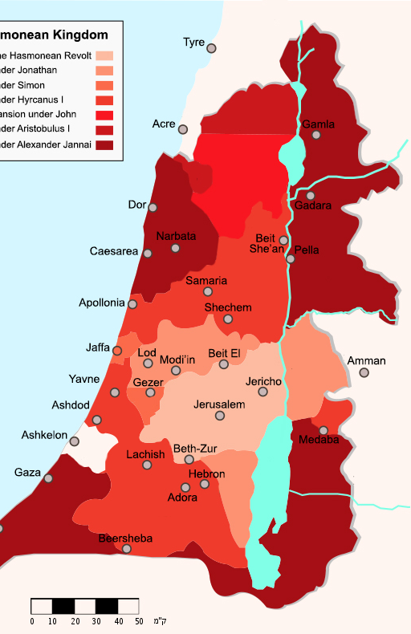
The Hasmoneans
During the 100 years of Hasmonean rule, the geography they controlled increased substantially. At first, they controlled just a few areas around Jerusalem, but over time they conquered territories around the Sea of Galilee. This of course would have important implications for the life of Christ, who grew up in Galilee. The Hasmoneans even conquered lands in the south that traditionally had been possessed by their rivals.
Image by Effib
Notes:
Image: https://en.wikipedia.org/wiki/Hasmonean_dynasty
By Effib - https://he.wikipedia.org/wiki/ממלכת_החשמונאים#/media/File:Map_Hasmonean_Kingdom-he.svg, CC BY-SA 4.0, https://commons.wikimedia.org/w/index.php?curid=63408877

Slide 27
Between the Testaments
Period of Hellenization
Maccabean Revolt
Hasmonean Dynasty
Roman Rule through the Herodian Dynasty

Slide 28
From the Hasmoneans to Herod
Notes:
Image: https://www.flickr.com/photos/carolemage/22205132751
In about 60 BC, the Roman general Pompey learned about a civil war among Hasmonean leaders. He was near Israel, and he basically said, “I’ll help you solve this problem,” and solved it by having Rome take over. Pompey appointed a Hasmonean as a leader until about 40 BC)

Slide 29
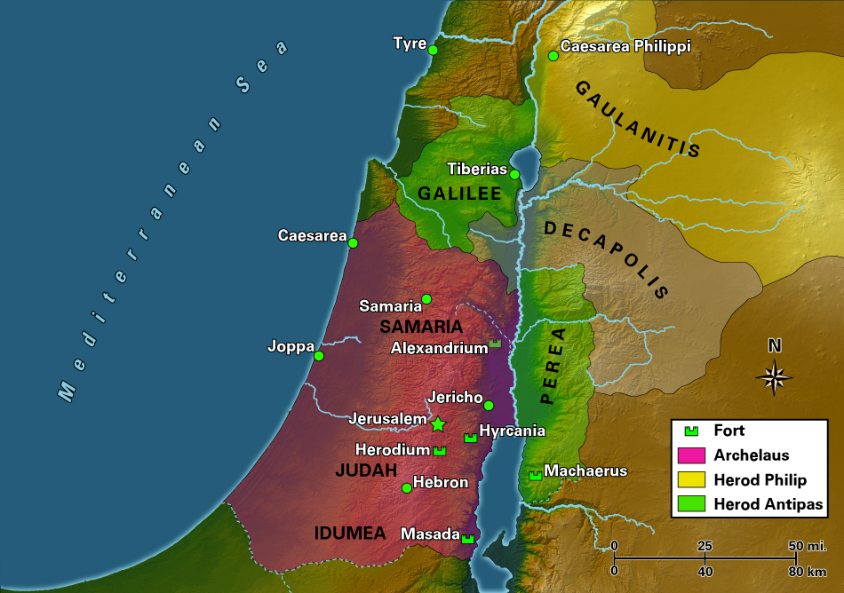
After Herod the Great
Image copyright bibleodyssey.org
Notes:
Make note on the map that says copyright Bible Odyssey
https://www.bibleodyssey.org/en/tools/map-gallery/h/map-Herod
Talk through why this map is important--

Slide 30
Duccio di Buoninsegna
Notes:
Image: By Duccio di Buoninsegna - The Yorck Project (2002) 10.000 Meisterwerke der Malerei (DVD-ROM), distributed by DIRECTMEDIA Publishing GmbH. ISBN: 3936122202., Public Domain, https://commons.wikimedia.org/w/index.php?curid=4694444

Slide 31
James Tissot
Notes:
Image: https://commons.wikimedia.org/wiki/File:Brooklyn_Museum_-_Jesus_Before_Pilate_Second_Interview_(Jésus_devant_Pilate._Deuxième_entretien)_-_James_Tissot.jpg

Slide 32
The Sadducees
Although Rome was in charge politically, a Jewish group known as the Sadducees generally had responsibility for the temple. They were among the wealthy elites of Jerusalem.
Notes:
Image: By Ariely - Own work, CC BY 3.0, https://commons.wikimedia.org/w/index.php?curid=4533576

Slide 33
Background Topics
Historical background (see readings)
Jewish expectations for a Messiah
Background to the four Gospel accounts
Notes:
One check yourself question on the following slide

Slide 34
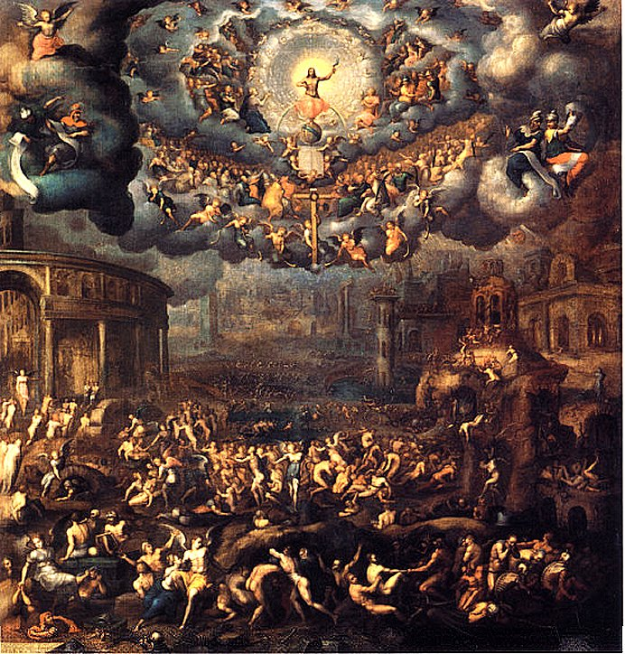
Pre-Christian, Jewish texts present the following expectations of the Messiah among many early Jews:
All people would worship him
He would be a king
He would judge the wicked and overthrow Israel’s foreign enemies
His kingdom would be everlasting
Trevan G. Hatch, “Messianism and Jewish Messiahs in the New Testament Period.”
Notes:
Time doesn’t permit us to go into all of these prophecies; let’s just look at two.
https://en.wikipedia.org/wiki/Messiah#/media/File:The_Last_Judgement._Jean_Cousin..jpg

Slide 35
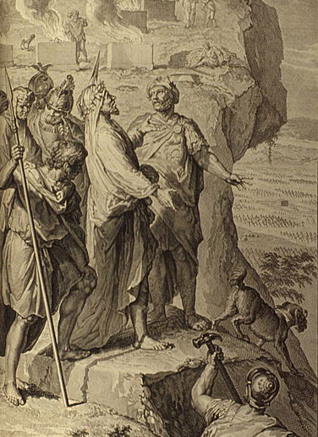
“There shall come a Star out of Jacob, and a Sceptre shall rise out of Israel, and shall smite the corners of Moab…And Edom shall be a possession…Israel shall do valiantly. Out of Jacob shall come he that shall have dominion, and shall destroy him that remaineth of the city.” (Numbers 24:17–19)
Notes:
Image: https://commons.wikimedia.org/wiki/File:Figures_Balaam_blessing_the_Israelites.jpg

Slide 36
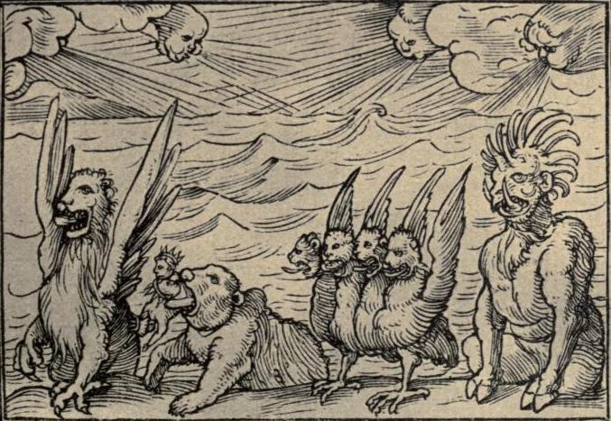
Daniel 7
“I saw in the night visions…one like the Son of man came with the clouds of heaven…And there was given him dominion, and glory, and a kingdom, that all people, nations, and languages, should serve him: his dominion is an everlasting dominion, which shall not pass away, and his kingdom that which shall not be destroyed” (Daniel 7:13–14).
Hans Holbein
Notes:
Image: By Hind, Arthur Mayger (ed.) &amp; Hans Holbein the Younger - Hans Holbein, the younger: his Old Testament illustrations, Dance of death and other woodcuts. London: William Heinemann, 1912.Transferred from en.wikipedia by SreeBot, Public Domain, https://commons.wikimedia.org/w/index.php?curid=16979057

Slide 37
Matthew 16:21
“Jesus [began] to shew unto his disciples, how that he must go unto Jerusalem, and suffer many things of the elders and chief priests and scribes, and be killed, and be raised again the third day.”
Notes:
Point out

Slide 38
Matthew 16:22
“Then Peter took him, and began to rebuke him, saying, Be it far from thee, Lord: this shall not be unto thee.”
Notes:
Point out

Slide 39
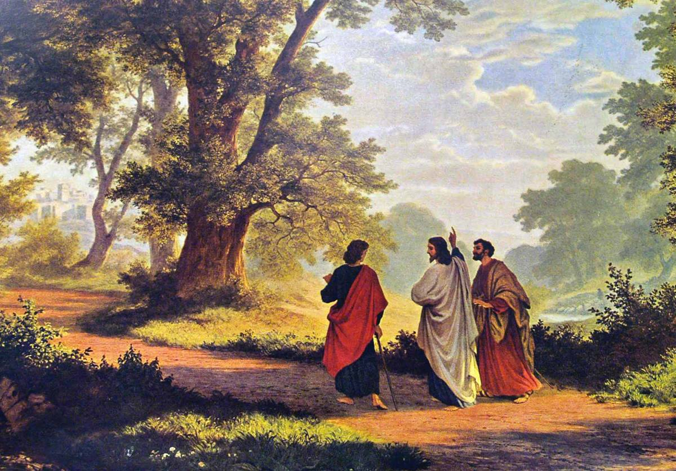
Disciples: “Jesus of Nazareth [was] crucified…We trusted that it had been he which should have redeemed Israel”
Robert Zund
Notes:
Image: https://commons.wikimedia.org/wiki/File:Zünd_Gang_nach_Emmaus_1877.jpg
Keep your eye on this tension—whether Jesus is the “Messiah” in the way that many Jews were expecting (would overtake a worldly kingdom) will have a major impact on how he is viewed by the common people, the Jewish authorities, and the Roman military leaders. I’m not sharing all this stuff as random fun facts, historical background will improve your ability to understand Jesus Christ in his context and draw closer to him.

Slide 40
Disciples: “Jesus of Nazareth [was] crucified…We trusted that it had been he which should have redeemed Israel”
Jesus: O fools, and slow of heart to believe all that the prophets have spoken: Ought not Christ to have suffered these things, and to enter into his glory? And beginning at Moses and all the prophets, he expounded unto them in all the scriptures the things concerning himself” (Luke 24:19–21, 25-27)
Robert Zund
Notes:
Image: https://commons.wikimedia.org/wiki/File:Zünd_Gang_nach_Emmaus_1877.jpg
Keep your eye on this tension—whether Jesus is the “Messiah” in the way that many Jews were expecting (would overtake a worldly kingdom) will have a major impact on how he is viewed by the common people, the Jewish authorities, and the Roman military leaders. I’m not sharing all this stuff as random fun facts, historical background will improve your ability to understand Jesus Christ in his context and draw closer to him.

Slide 41
Background Topics
Historical background (see readings)
Jewish expectations for a Messiah
Background to the four Gospel accounts

Slide 42
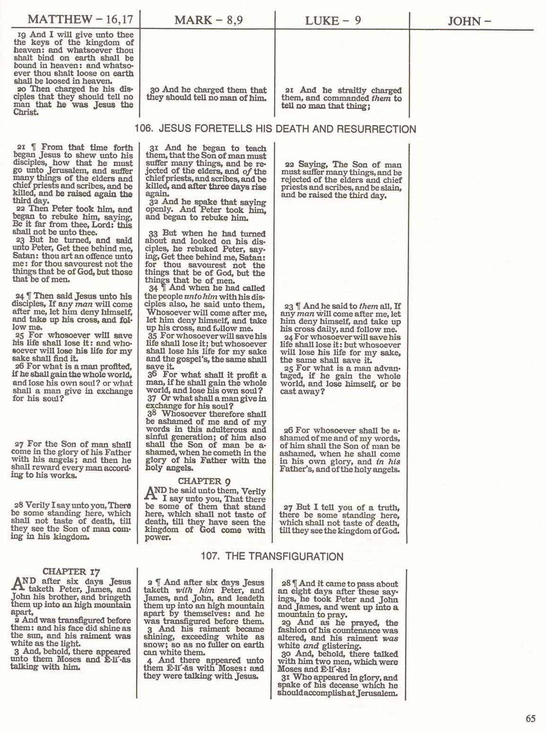
Matthew, Mark, & Luke =
The Synoptic Gospels
(“The Synoptics”)
Synoptic = “see together”
Matthew, Mark, & Luke have the same basic stories and sequence.
Notes:
Image is okay to use

Slide 43
If two research papers were word-for-word identical in some sections, what would be the natural conclusion?

Slide 44
If two research papers were word-for-word identical in some sections, what would be the natural conclusion?
Because of the word-for-word connections there is very likely a literary relationship between the Synoptic Gospels.

Slide 45
If two research papers were word-for-word identical in some sections, what would be the natural conclusion?
Because of the word-for-word connections there is very likely a literary relationship between the Synoptic Gospels.
Which was written first and who copied whom?

Slide 46
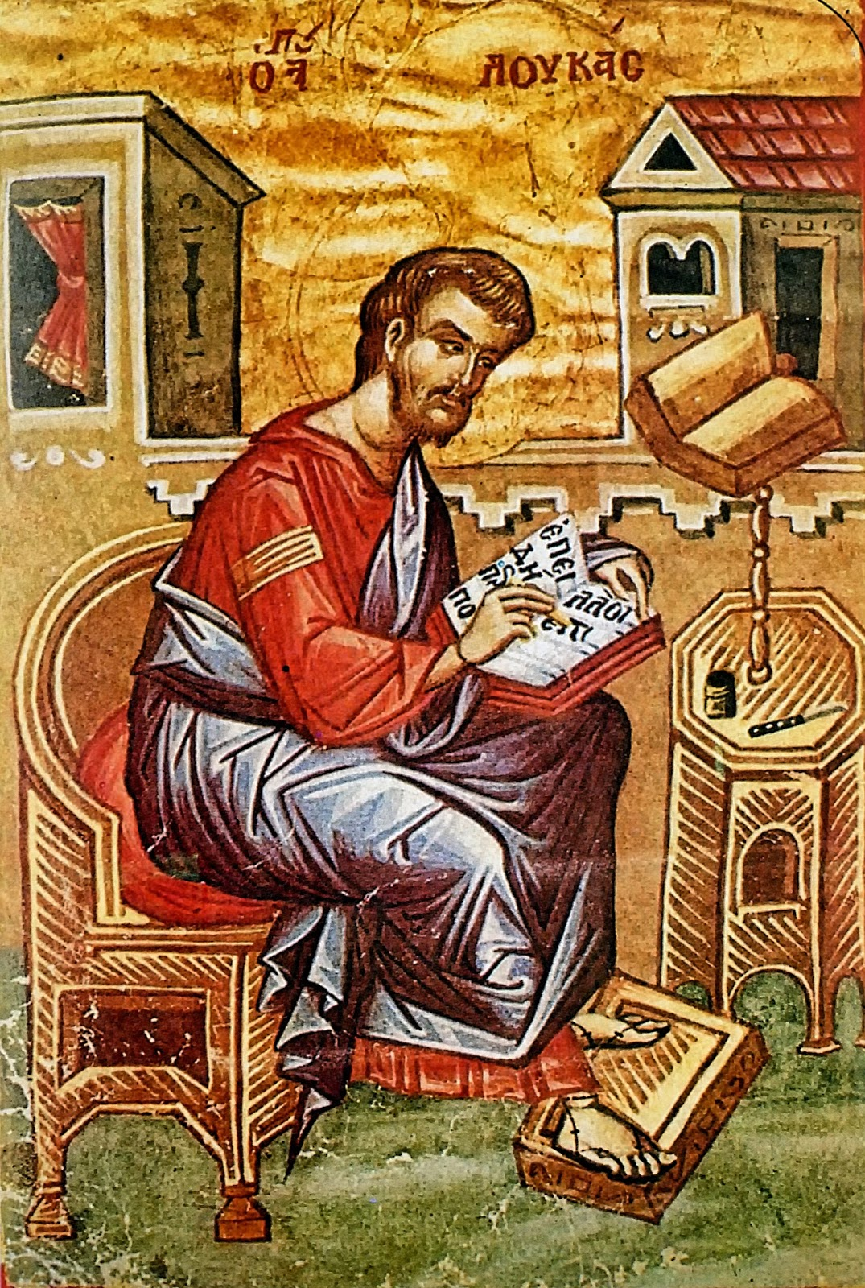
“For as much as many have taken in hand to set forth in order a declaration of those things which are most surely believed among us… It seemed good to me also… to write unto thee in order…” (Luke 1:1-3)
“Many have taken in hand” = I know many other written Gospels
“To write in order” = I will write an orderly account (better than the others)
The Lord did not simply give Luke a revelation—Luke used written sources.
Notes:
Label image: https://en.wikipedia.org/wiki/Luke_the_Evangelist

Slide 47
Four Source Hypothesis
Mark
Matt
Luke
Q
Notes:
This is just one possibility—not the only one!

Slide 48
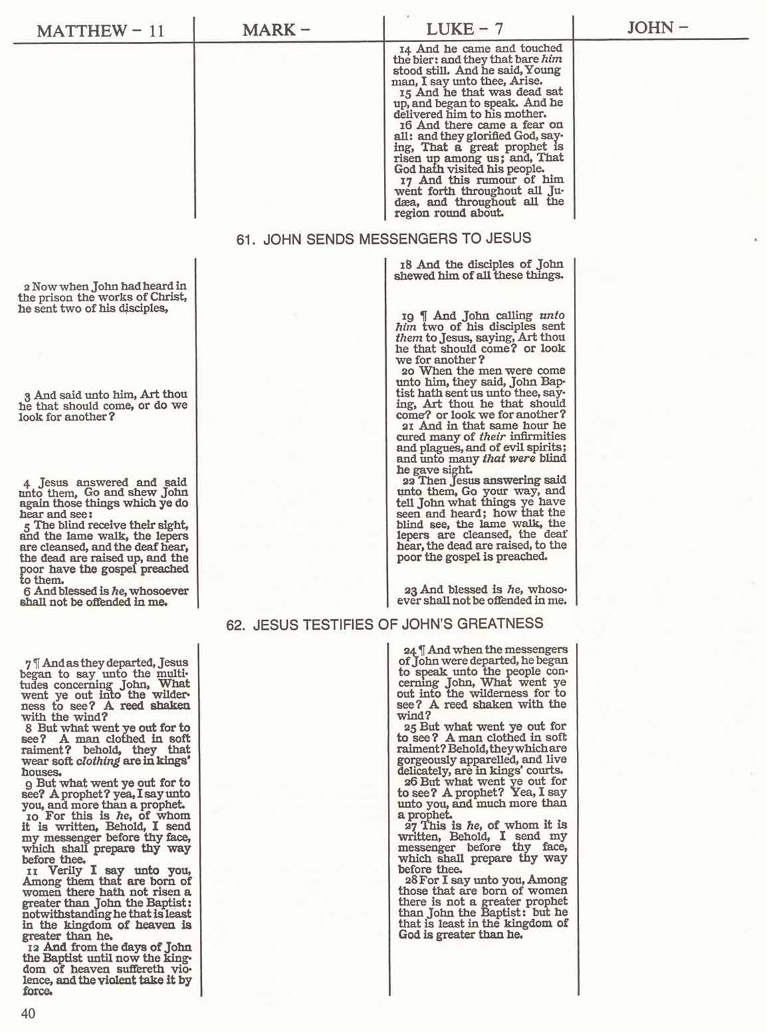
Q = quelle = “source” (German)
Matthew and Luke have common stories, often word-for-word the same (thus, probably from a common written source).
Q = material found in both Matt and Luke, but not in Mark

Slide 49
Four Source Hypothesis
Mark
M
Matt
Luke
L
Q
Q = quelle = “source” (German)
Notes:
This is just one possibility—not the only one!

Slide 50
John is Unique
Gospel Unique Common
Mark 7% 93%
Matthew 42% 58%
Luke 59% 41%
John 92% 8%

Slide 51
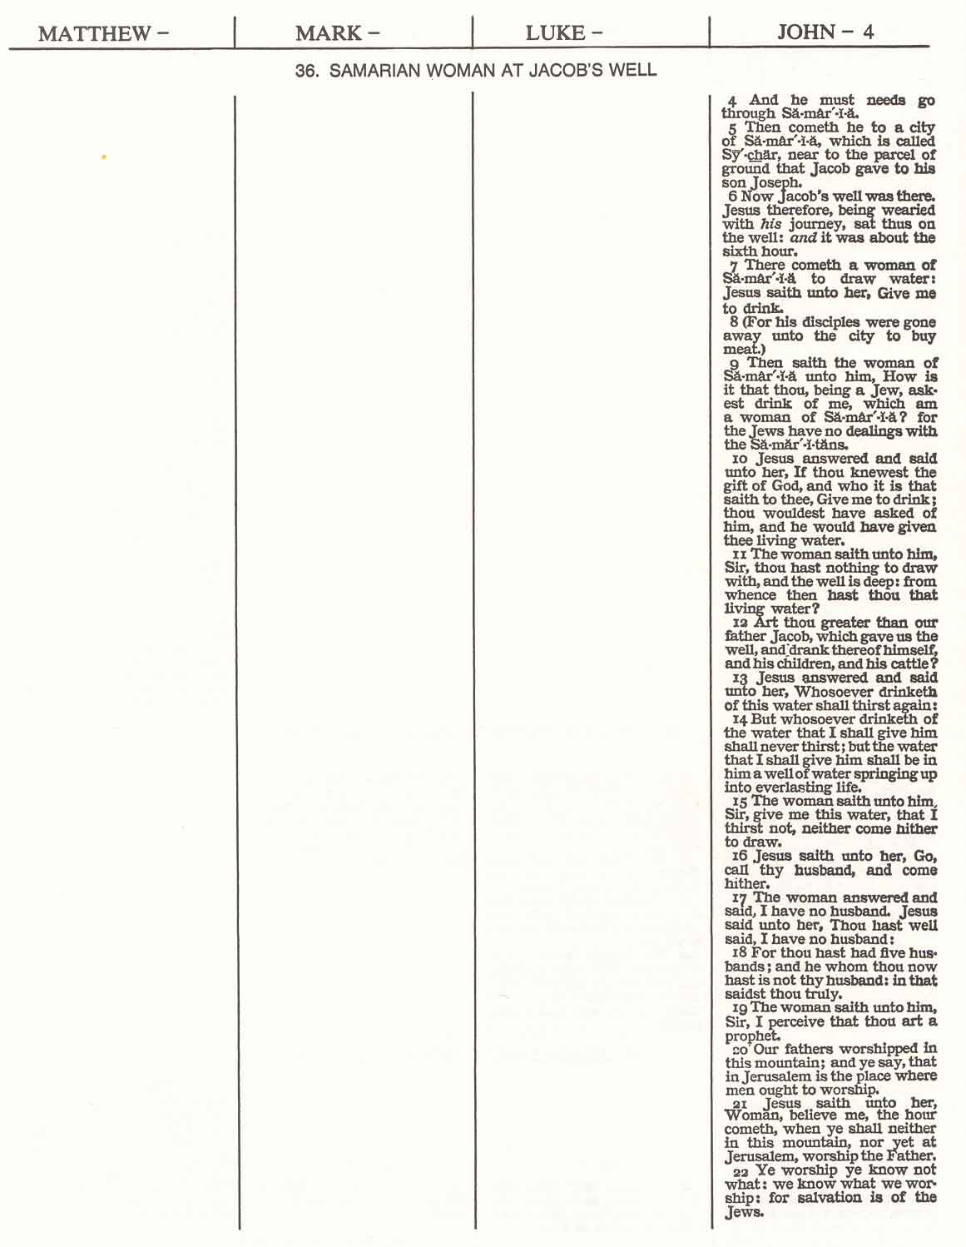
John very often has material that is not in any other Gospel.

Slide 52
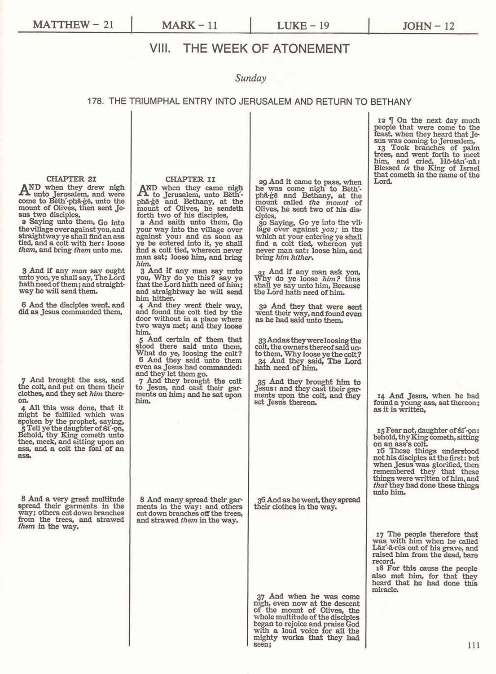
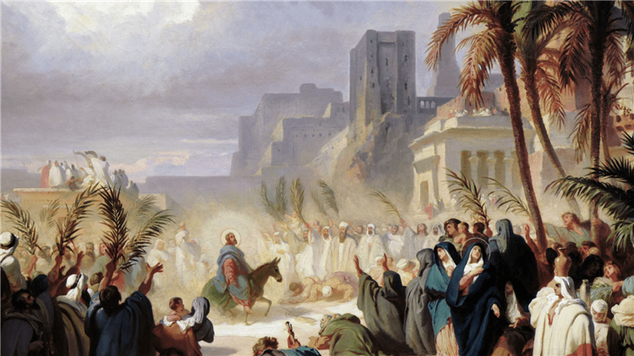
Even when all four Gospels have the same story, John often has different information.
Félix Louis Leullier
Notes:
Image: https://www.wikiart.org/en/felix-louis-leullier/christs-triumphal-entry-into-jerusalem

Slide 53
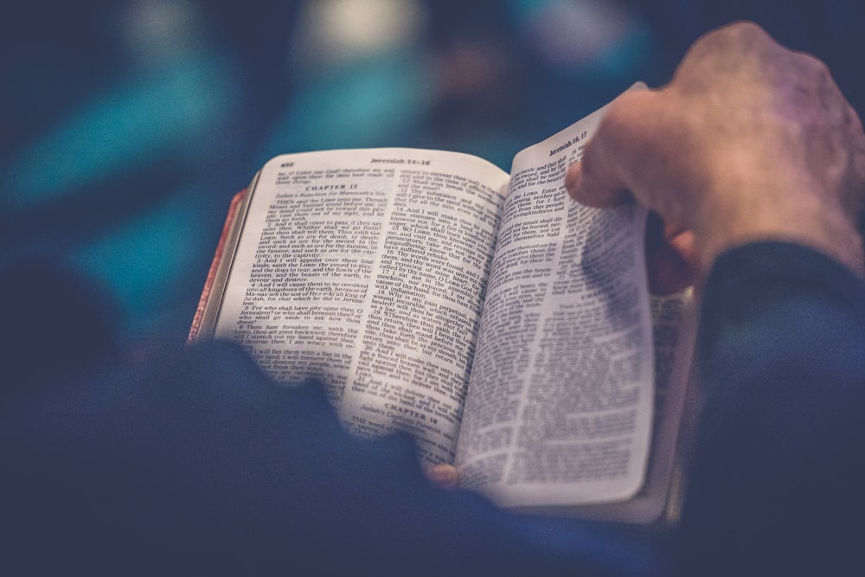
So How Should We Read the Gospels?
Notes:
Image: https://unsplash.com/photos/DRgrzQQsJDA

Slide 54
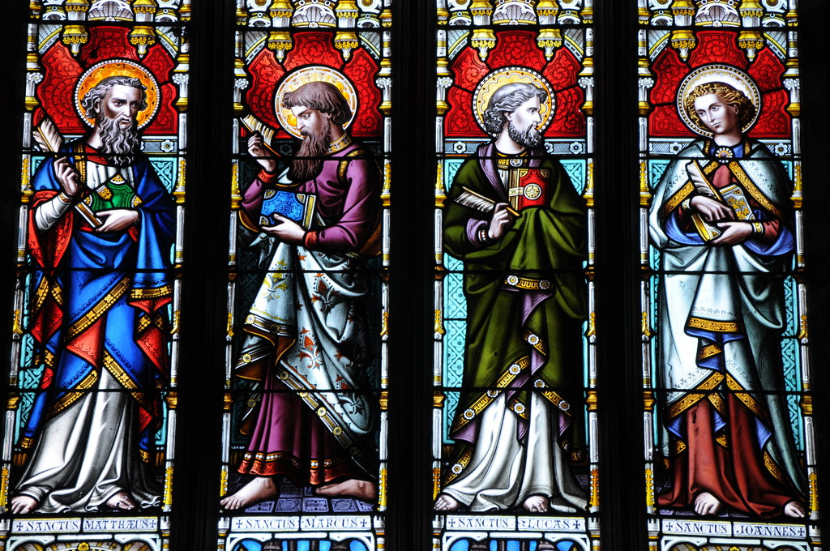
Reading the Gospels as a “Harmony”
A “harmony” is an artificial blending of the four gospels into one story.
PRO: Perhaps easier to read as one clear narrative
Philip Halling
Notes:
We will read as a “harmony” as we study the birth of Jesus Christ
Image: https://www.geograph.org.uk/photo/2858163

Slide 55
Downside to Harmony
There is a significant con to reading in a Harmony.
Carl Bloch
Harry Anderson
Carl Bloch
Harry Anderson
Notes:
Image 1: https://www.churchofjesuschrist.org/study/manual/new-testament-seminary-teacher-manual/matthew/lesson-12-matthew-7?lang=eng
Image 2: https://www.churchofjesuschrist.org/media-library/images/jesus-praying-in-gethsemane-39591?lang=eng&clang=ase
Image 3:https://www.ldsliving.com/How-the-Samaritan-Woman-at-the-Well-Teaches-Us-Powerful-Truths-About-Christ-s-Nature-and-Message/s/90265
Image 4: https://www.churchofjesuschrist.org/media/image/mary-and-the-resurrected-christ-1728928?lang=eng&collectionId=063f9cd3a6e737d1baa1213d98cefdc81d1ac8ba

Slide 56
Downside to Harmony

Slide 57
Reading the Gospels Sequentially
PRO: Focuses on the audience, message, narrative, and structure of each individual Gospel
Philip Halling
Notes:
Image: https://www.geograph.org.uk/photo/2858163

Slide 58
Luke 2:49
“Did you not know that I must be about my father’s business?”
Notes:
Point out

Slide 59
Luke 2:49
“Did you not know that I must be about my father’s business?”
Luke 23:46
“Father into your hands I commend my spirit.”
Notes:
Point out

Slide 60
Reading the Gospels Sequentially
PRO: Focuses on the audience, message, narrative, and structure of each individual Gospel
Philip Halling
CON: Can be repetitive (some accounts are very similar).
Notes:
Image: https://www.geograph.org.uk/photo/2858163

Slide 61
Reading the Gospels in a Synopsis
PRO: Comparing the Gospels in a synopsis, or in parallel helps you examine what each does differently and gain new insights.
Philip Halling
Notes:
As to the con – but it’s worth it! You’ll be looking at a synopsis study of Christ’s baptism for our next class and later this semester we’ll have a paper that helps you study in this way.

Slide 63
Reading the Gospels in a Synopsis
PRO: Comparing the Gospels in a synopsis, or in parallel helps you examine what each does differently and gain new insights.
Philip Halling
CON: Can be harder to match up accounts side by side passages and do a careful reading.
Notes:
As to the con – but it’s worth it! You’ll be looking at a synopsis study of Christ’s baptism for our next class and later this semester we’ll have a paper that helps you study in this way.

