Slide 1
Of Course, Start with Genealogy!
Joseph | Zerubbabel | Joram | Salmon [Rahab]
Jacob | Salathiel | Jehoshaphat | Nahshon
Matthan | Jechoniah [Babylonian Captivity] | Asa | Aminadab
Eleazar | Josiah | Abijah | Aram
Eliud | Amon | Rehoboam | Hezron
Achim | Manasseh | Solomon [Bathsheba] | Perez
Zadok | Hezekiah | King David | Judah [Thamar]
Azor | Ahaz | Jesse | Jacob
Eliakim | Jotham | Obed | Isaac
Abiud | Uzziah | Boaz [Ruth] | Abraham

Slide 2
“All the generations from Abraham to David are fourteen generations; and from David until the carrying away into Babylon are fourteen generations; and from the carrying away into Babylon unto Christ [Messiah, the anointed one] are fourteen generations.”
Matthew 1:17

Slide 3
“All the generations from Abraham to David are fourteen generations; and from David until the carrying away into Babylon are fourteen generations; and from the carrying away into Babylon unto Christ [Messiah, the anointed one] are fourteen generations.”
Matthew 1:17
What is the significance of 14?
Gematria or numerology: Individual letters have numeric value
(i.e. A=1, B=2, C=3, etc.).

Slide 4
“All the generations from Abraham to David are fourteen generations; and from David until the carrying away into Babylon are fourteen generations; and from the carrying away into Babylon unto Christ [Messiah, the anointed one] are fourteen generations.”
Matthew 1:17
What is the significance of 14?
In Hebrew letters,
the name David = 14.
D+V+D = 4+6+4 = 14.
Symbolic way of saying:
Jesus is the Son of DAVID
(the Messiah)
Gematria or numerology: Individual letters have numeric value
(i.e. A=1, B=2, C=3, etc.).

Slide 5
“All the generations from Abraham to David are fourteen generations; and from David until the carrying away into Babylon are fourteen generations; and from the carrying away into Babylon unto Christ [Messiah, the anointed one] are fourteen generations.”
Matthew 1:17
What is the significance of 14?
In Hebrew letters,
the name David = 14.
D+V+D = 4+6+4 = 14.
Symbolic way of saying:
Jesus is the Son of DAVID
(the Messiah)
Gematria or numerology: Individual letters have numeric value
(i.e. A=1, B=2, C=3, etc.).

Slide 6
The Lord said to David, “Thine house and thy kingdom shall be established for ever before thee: thy throne shall be established for ever”
(2 Samuel 7:16)

Slide 7
The Lord said to David, “Thine house and thy kingdom shall be established for ever before thee: thy throne shall be established for ever”
(2 Samuel 7:16)
Matthew uses the term “Son of David” almost twice as often as all the other gospel accounts combined!

Slide 8
The Lord said to David, “Thine house and thy kingdom shall be established for ever before thee: thy throne shall be established for ever”
(2 Samuel 7:16)
James Tissot
“A very great multitude spread their garments in the way; others cut down branches from the trees, and strawed them in the way. And the multitudes… cried, saying, Hosanna to the Son of David: Blessed is he that cometh in the name of the Lord” (Matthew 21:8–9)

Slide 9
Many years ago, somebody about the age of fourteen had an experience with a divine being and it changed the course of the world. Prophets saw this person in vision centuries in advance; God chose this young person for a special mission. Who am I describing?

Slide 10
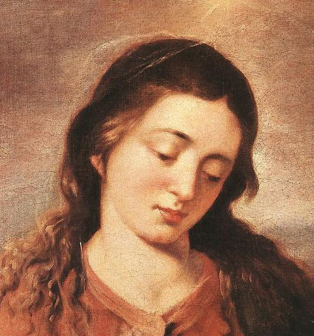
The five women in Christ’s genealogy
Francisco Hayez
James Tissot
Francisco Hayez
Rembrandt
Alonso Cano
Notes:
Image 1: https://commons.wikimedia.org/wiki/File:Francesco_Hayez._Tamar_of_Judah_-_1847.jpg
Image 2: By James Tissot - http://www.thejewishmuseum.org/onlinecollection/object_collection.php?objectid=26407&amp;artistlist=1&amp;an=James Jacques Joseph Tissot, Public Domain, https://commons.wikimedia.org/w/index.php?curid=8850936
Image 3: By Francesco Hayez - Own work, Public Domain, https://commons.wikimedia.org/w/index.php?curid=30208555
Image 4: https://commons.wikimedia.org/wiki/File:Rembrandt_Harmensz._van_Rijn_016.jpg
Image 5: https://commons.wikimedia.org/wiki/File:Alonso_Cano_-_Mary_-_WGA3997.jpg

Slide 11
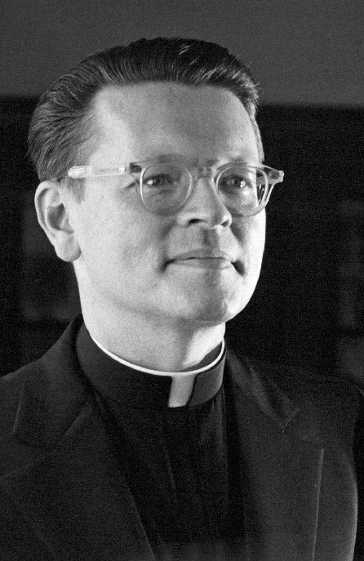
Raymond Brown, Introduction to the New Testament, 175.
“The backgrounds to the marital unions of all four women with the husbands mentioned in the genealogy were irregular…Yet the women themselves were the instruments of God in continuing the messianic line. Does that prepare for the unusualness of Mary’s conceiving?”

Slide 12
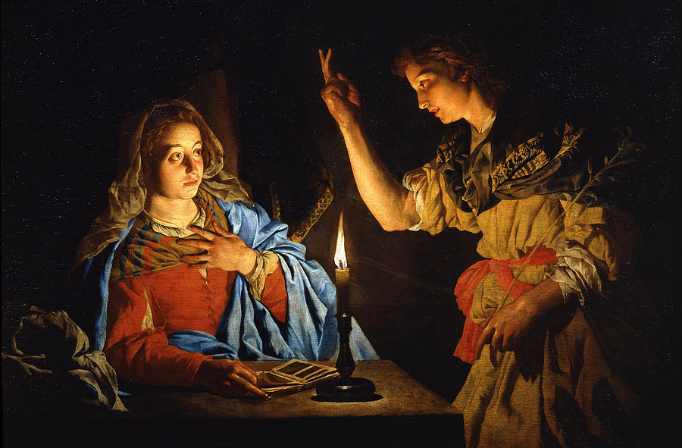
Matthias Stomer
“The Annunciation”
Luke 1:26-38
Notes:
Image: https://commons.wikimedia.org/wiki/File:Matthias_Stomer_-_Annunciazione_-_Google_Art_Project.jpg

Slide 13
Luke 1:26-33, NRSV
“In the sixth month the angel Gabriel was sent by God to a town in Galilee called Nazareth, to a virgin engaged to a man whose name was Joseph, of the house of David. The virgin’s name was Mary. And he came to her and said, ‘Greetings, favored one! The Lord is with you.’ But she was much perplexed by his words and pondered what sort of greeting this might be.

Slide 14
Luke 1:26-33, NRSV
“The angel said to her, ‘Do not be afraid, Mary, for you have found favor with God. And now, you will conceive in your womb and bear a son, and you will name him Jesus. He will be great, and will be called the Son of the Most High, and the Lord God will give to him the throne of his ancestor David. He will reign over the house of Jacob forever, and of his kingdom there will be no end.’”

Slide 15
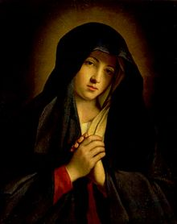
“First, she was a woman. Second, she was young. Third, she was most likely poor and living in an insignificant town. Finally, she was a Jew living in a land ultimately ruled by the Roman Empire. Taken together, Mary can be seen as a figure with little power. For a more contemporary image, think of God’s appearing to a young girl in a small village in Africa.”
(James Martin, Jesus, A Pilgrimage, p. 37)
“God hath chosen the weak things of the world to confound the things which are mighty” (1 Corinthians 1:27)
Notes:
One lesson we learn from Mary is that God knows our names and has specific missions prepared for us. While our missions may not be as dramatic as Mary’s, each of us has an important work that God has foreordained us to do, and he will often give us glimpses into what his plan is for us.

Slide 16
“First, she was a woman. Second, she was young. Third, she was most likely poor and living in an insignificant town. Finally, she was a Jew living in a land ultimately ruled by the Roman Empire. Taken together, Mary can be seen as a figure with little power. For a more contemporary image, think of God’s appearing to a young girl in a small village in Africa.”
(James Martin, Jesus, A Pilgrimage, p. 37)
“God hath chosen the weak things of the world to confound the things which are mighty” (1 Corinthians 1:27)
Notes:
One lesson we learn from Mary is that God knows our names and has specific missions prepared for us. While our missions may not be as dramatic as Mary’s, each of us has an important work that God has foreordained us to do, and he will often give us glimpses into what his plan is for us.

Slide 17
“Behold, thy cousin Elisabeth, she hath also conceived a son in her old age: and this is the sixth month with her, who was called barren. For with God nothing shall be impossible” (Luke 1:36-37)
Matthias Stomer

Slide 18
“Behold the handmaid of the Lord” (Luke 1:38).
Note that the Greek word translated as “handmaid” (doulē) means “slave.” In other words, Mary is saying, “I am the Lord’s slave.”
What would it look like in our lives to have Mary’s attitude of “Behold the handmaid of the Lord”?
Matthias Stomer

Slide 19
“Behold the handmaid of the Lord” (Luke 1:38).
Note that the Greek word translated as “handmaid” (doulē) means “slave.” In other words, Mary is saying, “I am the Lord’s servant.”
What would it look like in our lives to have Mary’s attitude of “Behold the handmaid of the Lord”?
Matthias Stomer
Do you remember the Blue Letter Bible?

Slide 20
“Behold the handmaid of the Lord” (Luke 1:38).
Note that the Greek word translated as “handmaid” (doulē) means “slave.” In other words, Mary is saying, “I am the Lord’s servant.”
What would it look like in our lives to have Mary’s attitude of “Behold the handmaid of the Lord”?
Matthias Stomer
Do you remember the Blue Letter Bible?

Slide 21
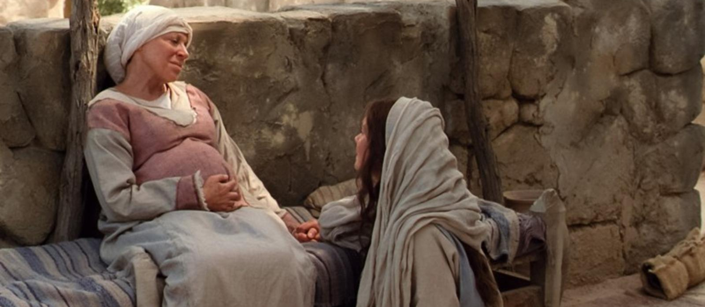
Bible Videos

Slide 22
The Magnificat: Luke 1:46-55
Bible Videos

Slide 23
Luke 1:46-55, NRSV
“My soul magnifies the Lord, and my spirit rejoices in God my Savior, for he has looked with favor on the lowliness of his servant. Surely, from now on all generations will call me blessed; for the Mighty One has done great things for me, and holy is his name. His mercy is for those who fear him from generation to generation. He has shown strength with his arm; he has scattered the proud in the thoughts of their hearts.

Slide 24
Luke 1:46-55, NRSV
“He has brought down the powerful from their thrones, and lifted up the lowly; he has filled the hungry with good things, and sent the rich away empty. He has helped his servant Israel, in remembrance of his mercy, according to the promise he made to our ancestors, to Abraham and to his descendants forever.”

Slide 25
“My soul doth magnify the Lord”
Bible Videos

Slide 26
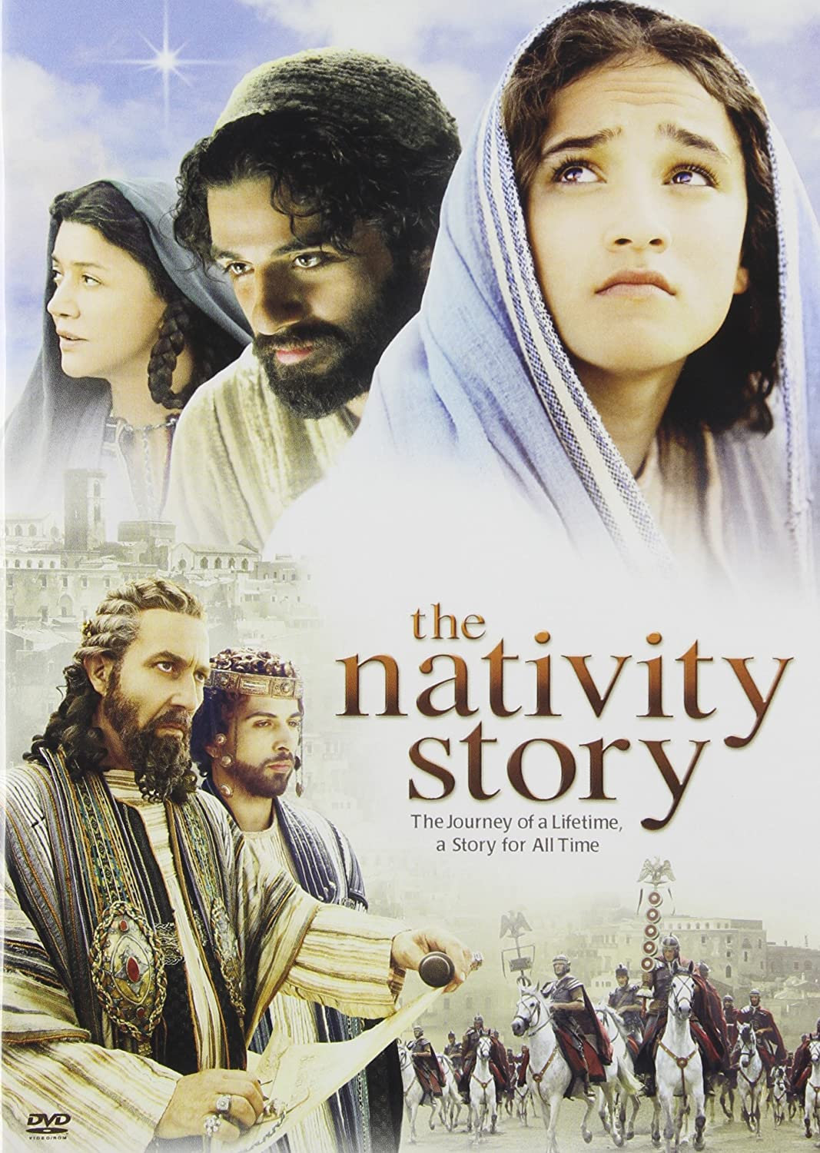
Seeing the Human Side of Mary

Slide 27
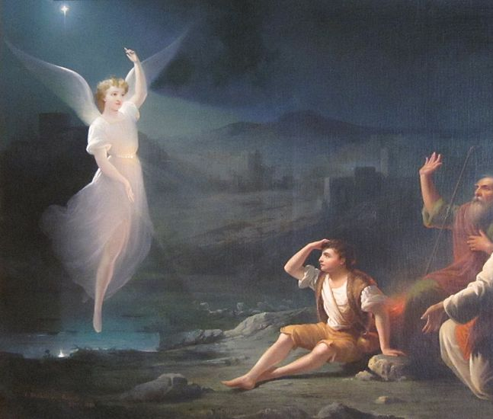
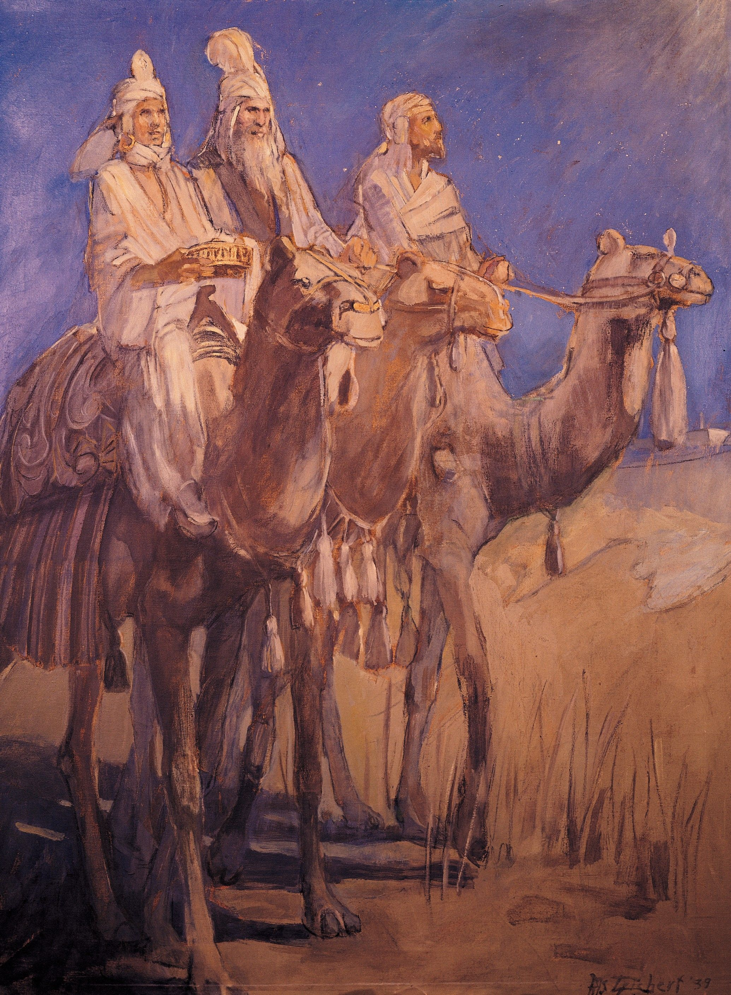
Seeking Jesus…
The wise ones studied and worked hard to seek Jesus
The shepherds dropped everything and ran to seek Jesus
Thomas Buchanan Read
Minerva Teichert
Notes:
How might the different efforts these groups to seek Jesus relate to me in my life?
Image 1: https://www.churchofjesuschrist.org/media/image/three-wise-men-lds-aae3271?lang=eng&collectionId=e1e5a0ca39f8cd49eddffddcb9e294a689d12b88
Image 2: https://commons.wikimedia.org/wiki/File:%27The_Angel_Appearing_before_the_Shepherds%27_by_Thomas_Buchanan_Read,_Dayton_Art_Institute.JPG

Slide 28
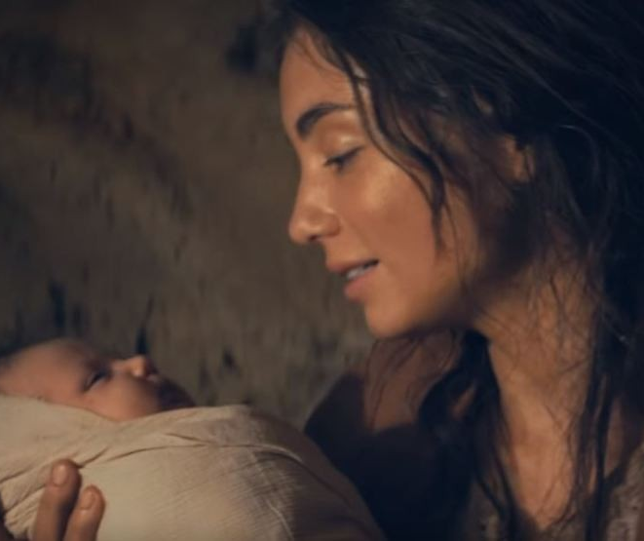
Seeking Jesus…
The wise ones studied and worked hard to seek Jesus
“Mary kept all these things, and pondered them in her heart.”
The shepherds dropped everything and ran to seek Jesus
Thomas Buchanan Read
“The Christ Child”
Minerva Teichert

Slide 29
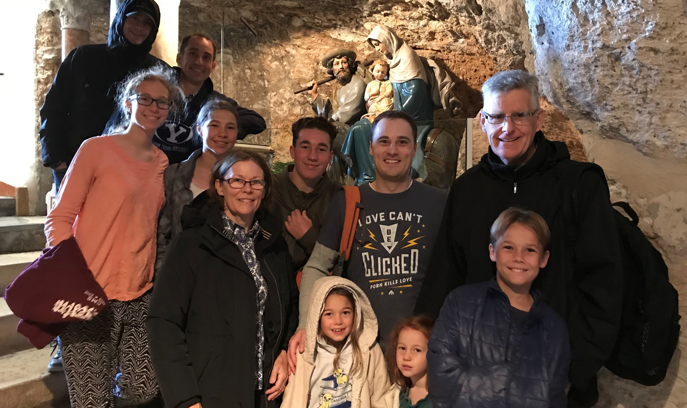

Slide 30
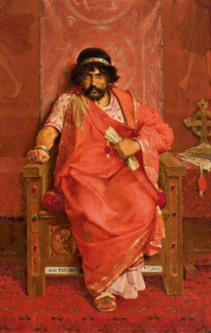
The Kingdom of Herod VS The Kingdom of Christ
“The Christ Child”
Théophile Lybaert
Notes:
Image 1: https://en.wikipedia.org/wiki/Matthew_2:3

Slide 31
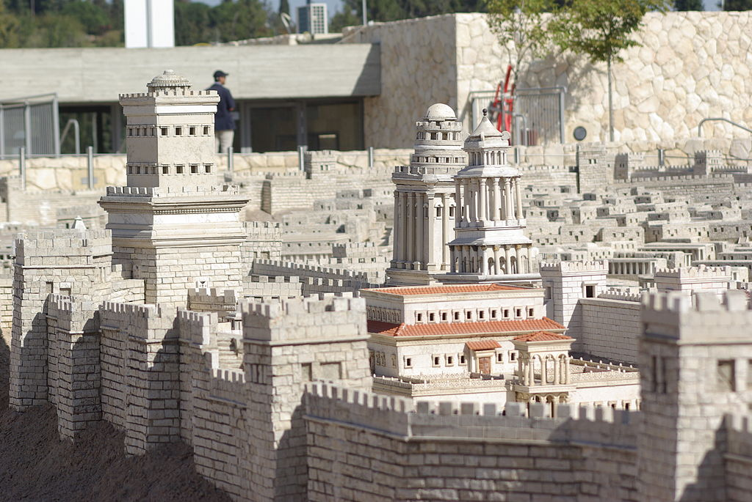
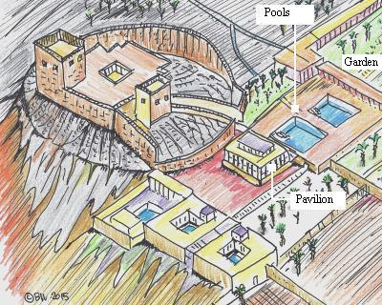
Notes:
Image: By Berthold Werner - Own work, Public Domain, https://commons.wikimedia.org/w/index.php?curid=5557741

Slide 32
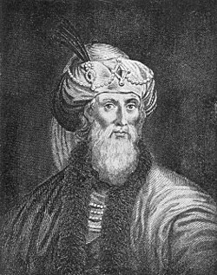
“There was…an intolerable itching over all the surface of [Herod’s] body, and continual pains in his colon, and dropsical tumors about his feet, and an inflammation of the abdomen,—and a putrefaction of his privy member, that produced worms. He…could not breathe but when he sat upright, and had a convulsion of all his members, insomuch that the diviners said those diseases were a punishment upon him for what he had done…”
Josephus
Jewish Historian
37-100 A.D.
Notes:
Distemper = to throw out of order
Image: https://en.wikipedia.org/wiki/Josephus

Slide 33
Théophile Lybaert
“Herod…was troubled.” (Matthew 2:3
Notes:
Image 1: https://en.wikipedia.org/wiki/Matthew_2:3
Image 2: https://commons.wikimedia.org/wiki/File:Champaigne_eccehomo.jpg

Slide 34
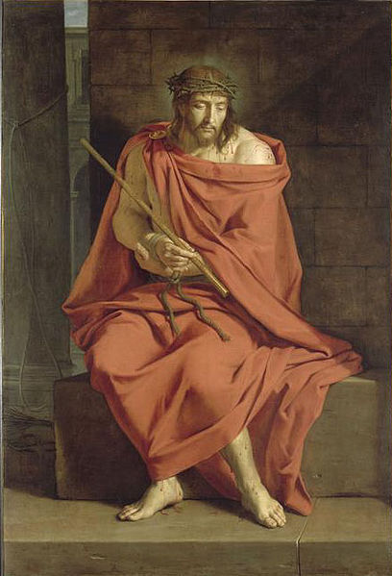
Théophile Lybaert
Philippe de Champagne
“Herod…was troubled.” (Matthew 2:3
“My kingdom is not of this world.”
(John 18:36)
Notes:
Image 1: https://en.wikipedia.org/wiki/Matthew_2:3
Image 2: https://commons.wikimedia.org/wiki/File:Champaigne_eccehomo.jpg

Slide 35
“This is my beloved son, in whom I am well pleased.” (Matthew 3:17)
Greg Olsen
Notes:
What did Christ’s baptism mean for him?
How can we apply this principle to our own lives?

Slide 36
“Now when all the people were baptized, and when Jesus also had been baptized and was praying. The heaven was opened, and the Holy Spirit descended upon him in bodily form like a dove. And a voice came from heaven, ‘You are my Beloved Son, with you I am well pleased’”
(Luke 3:21–22, NRSV).
Greg Olsen
Notes:
What did Christ’s baptism mean for him?
How can we apply this principle to our own lives?

Slide 37
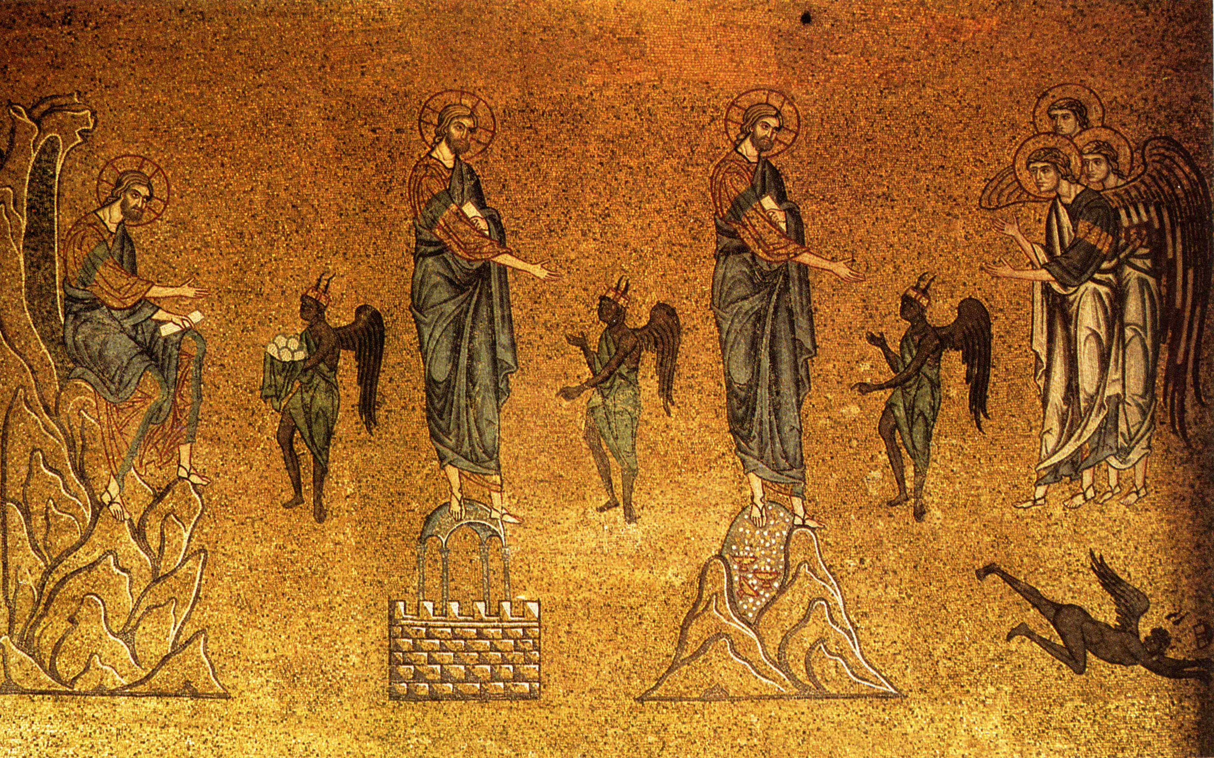
Christ’s Temptations in the Wilderness
Notes:
The art is “The Temptation of Christ” from the Basilica of St. Mark, Venice

Slide 38
Christ’s Temptations in the Wilderness
“If thou be the Son of God, command this stone that it be made bread” (Luke 4:3).
“If thou be the Son of God, cast thyself down from [the pinnacle of the temple]” Luke 4:9.
Notes:
The art is “The Temptation of Christ” from the Basilica of St. Mark, Venice.

Slide 39
“I wish to encourage every one of us regarding the opposition that so often comes after enlightened decisions have been made, after moments of revelation and conviction have given us a peace and an assurance we thought we would never lose. With any major decision there are cautions and considerations to make, but once there has been illumination, beware the temptation to retreat from a good thing.
Elder Jeffrey R. Holland
“Cast Not Away Your Confidence”
http://speeches.byu.edu

Slide 40
“If it was right when you prayed about it and trusted it and lived for it, it is right now. Don’t give up when the pressure mounts. Certainly don’t give in to that being who is bent on the destruction of your happiness. Face your doubts. Master your fears. ‘Cast not away therefore your confidence.’ Stay the course and see the beauty of life unfold for you.”
Elder Jeffrey R. Holland
“Cast Not Away Your Confidence”
http://speeches.byu.edu

Slide 42
Christ’s Temptations
Turn stones to bread: Put your physical needs – your body, your comfort, your physical well-being above anything else.
Jump off the temple in front of everyone: Pride. Show everyone how great you are.
All the treasures of the world: Seek for worldly power

Slide 43
Christ’s Temptations
Turn stones to bread: Put your physical needs – your body, your comfort, your physical well-being above anything else.
Jump off the temple in front of everyone: Pride. Show everyone how great you are.
All the treasures of the world: Seek for worldly power
How do you see these temptations
in your life? How did Christ respond to all three?

Slide 44
Christ’s Temptations
Turn stones to bread: Put your physical needs – your body, your comfort, your physical well-being above anything else.
Jump off the temple in front of everyone: Pride. Show everyone how great you are.
All the treasures of the world: Seek for worldly power
How do you see these temptations
in your life? How did Christ respond to all three?

Slide 45
Christ’s Temptations
Turn stones to bread: Put your physical needs – your body, your comfort, your physical well-being above anything else.
Jump off the temple in front of everyone: Pride. Show everyone how great you are.
All the treasures of the world: Seek for worldly power
How do you see these temptations
in your life? How did Christ respond to all three?

Slide 46
Christ’s Temptations
Turn stones to bread: Put your physical needs – your body, your comfort, your physical well-being above anything else.
Jump off the temple in front of everyone: Pride. Show everyone how great you are.
All the treasures of the world: Seek for worldly power
How do you see these temptations
in your life? How did Christ respond to all three?

Slide 47
“It is written, that Man shall not live by bread alone, but by every word of God.”
(Luke 4:4)
Notes:
If time, note: He humbled you by letting you hunger, then [same context]
https://picryl.com/media/the-temptation-of-christ-in-the-desert-satan-asks-christ-to-change-stones-into-6332b7

Slide 48
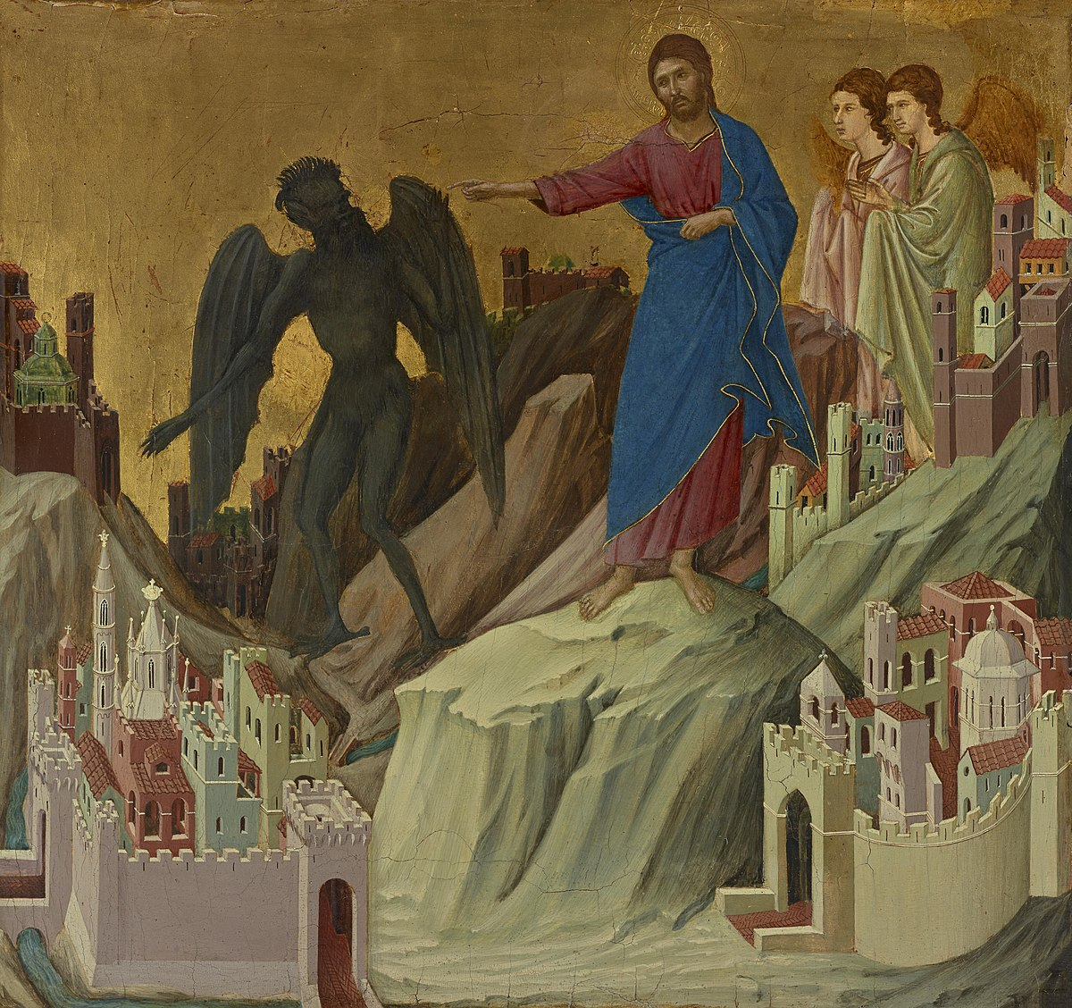
“Get thee hence, Satan: for it is written, Thou shalt worship the Lord thy God, and him only shalt thou serve.”
(Luke 4:8)
Notes:
Duccio's The Temptation on the Mount

Slide 49
“It is said, Thou shalt not tempt the Lord thy God.”
(Luke 4:12)
Notes:
https://picryl.com/media/the-temptation-of-christ-in-the-desert-satan-asks-christ-to-change-stones-into-6332b7

Slide 50
This was not the only time Christ was tempted. Luke records, “When the devil had ended all the temptation, he departed from him for a season” (Luke 4:13).
He would be back.
Félix Joseph Barrias
Notes:
Jesus understands what it feels like to be tempted! Turn to him! Approach God with confidence!!
Image: By Félix Joseph Barrias (1822 - 1907) (French)Details of artist on Google Art Project - 3QEGFuTo_jzXog at Google Cultural Institute maximum zoom level, Public Domain, https://commons.wikimedia.org/w/index.php?curid=23599104

Slide 51
“Because he himself suffered when he was tempted, he is able to help those who are being tempted…For we do not have a high priest who is unable to empathize with our weaknesses, but we have one who has been tempted in every way, just as we are—yet he did not sin. Let us then approach God’s throne of grace with confidence, so that we may receive mercy and find grace to help us in our time of need.”
(Hebrews 2:18, 4:15-16 (NIV)
Félix Joseph Barrias
Notes:
Jesus understands what it feels like to be tempted! Turn to him! Approach God with confidence!!
Image: By Félix Joseph Barrias (1822 - 1907) (French)Details of artist on Google Art Project - 3QEGFuTo_jzXog at Google Cultural Institute maximum zoom level, Public Domain, https://commons.wikimedia.org/w/index.php?curid=23599104

Slide 52
“Because he himself suffered when he was tempted, he is able to help those who are being tempted…For we do not have a high priest who is unable to empathize with our weaknesses, but we have one who has been tempted in every way, just as we are—yet he did not sin. Let us then approach God’s throne of grace with confidence, so that we may receive mercy and find grace to help us in our time of need.”
(Hebrews 2:18, 4:15-16 (NIV)
Félix Joseph Barrias
Notes:
Jesus understands what it feels like to be tempted! Turn to him! Approach God with confidence!!
Image: By Félix Joseph Barrias (1822 - 1907) (French)Details of artist on Google Art Project - 3QEGFuTo_jzXog at Google Cultural Institute maximum zoom level, Public Domain, https://commons.wikimedia.org/w/index.php?curid=23599104

Slide 53
Acknowledgements
Insights from, discussions with, and resources authored by Dr. Matthew Grey, Dr. Frank Judd, Dr. Raymond Brown and James Martin, SJ were used in the creation of this video.

