Slide 5
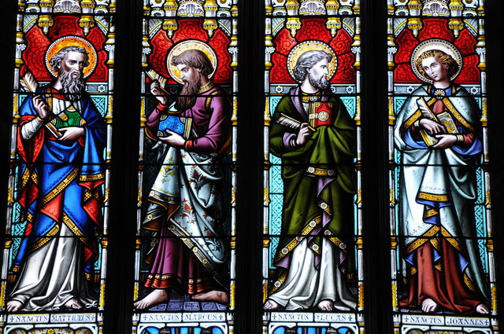
A question: If Mark was Written First, Why is Matthew the First Gospel?
Philip Halling
Notes:
Image: https://www.geograph.org.uk/photo/2858163
“Matthew also issued a written Gospel…while Peter and Paul were preaching at Rome, and laying the foundations of the Church. After their departure, Mark, the disciple and interpreter of Peter, did also hand down to us in writing what had been preached by Peter. Luke also, the companion of Paul, recorded in a book the Gospel preached by him. Afterwards, John, the disciple of the Lord, who also had leaned upon His breast, did himself publish a Gospel during his residence at Ephesus in Asia.” Irenaeus, “Against Heresies,” 3.1.1 (early Christian leader writing in ~150 AD)

Slide 6
Three Themes from the
Gospel According to Matthew
Matthew connects Jesus and David
Matthew emphasizes fulfillment of Old Testament prophecy.
Notes:
Connect this with the previous point. Matthew is the most “Old Testament” like of the four Gospels, having the most connections to the Old Testament. This makes it an appropriate starting point for the New Testament after finishing the Old Testament.

Slide 7
Matthew frequently quotes the Old Testament His “Current Testament”!
Isaiah 7:14 (Matt. 1:22-23)
Micah 5:2 (Matt. 2:5-6)
Hosea 11:1 (Matt. 2:15)
Jeremiah 31:15 (Matt. 2:17-18)
Isaiah 40:3 (Matt. 3:3)
Isaiah 9:1-2 (Matt. 4:14-16)
Isaiah 53:4 (Matt. 8:17)
Isaiah 42:1-3 (Matt. 12:17-21)
Psalm 78:2 (Matt. 13:35)
Zech. 9:9 (Matt. 21:4-5)
Zech. 11:13 (Matt. 27:9)
Psalm 22:18 (Matt. 27:35)
Notes:
On ten occasions, Jesus uses a citation formula, something like, “that it might be fulfilled which was spoken of the Lord by the prophet, saying…”
(Matthew 2:15). Another dozen or so times Matthew refers to the Old Testament without using that specific formula to show how Christ fulfilled a statement from the OT. Matthew quotes the Old Testament twice as often as any other Gospel.
See also Matthew 2:23 (unclear what verse he’s quoting from)

Slide 8
Three Themes from the
Gospel According to Matthew
Matthew connects Jesus and David (see genealogy)
Matthew emphasizes fulfillment of OT prophecy.
Matthew connects Christ and Moses

Slide 9
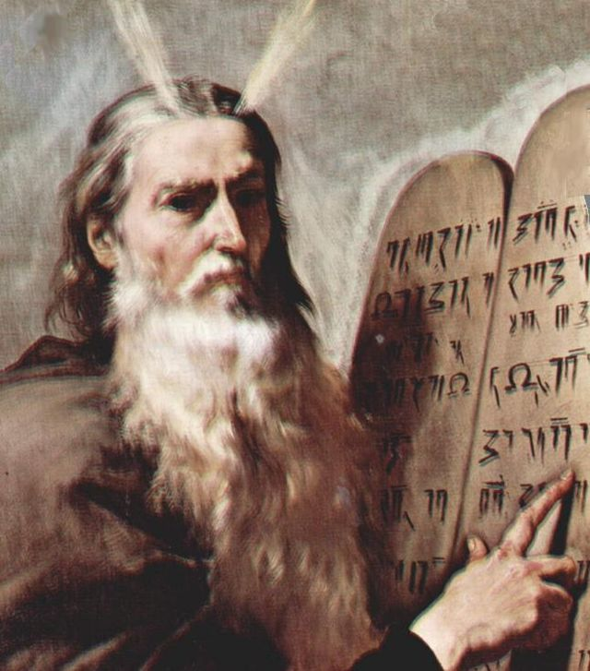
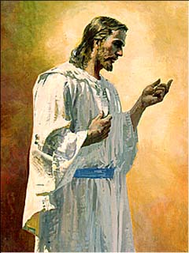
“The LORD said unto me [Moses]… I will raise them up a Prophet from among their brethren, like unto thee, and will put my words in his mouth; and he shall speak unto them all that I shall command him.”
Deut. 18:17-18
Jusepe de Ribera
Harry Anderson
Notes:
https://newsroom.churchofjesuschrist.org/article/art-foyers-entryways-reverence-jesus-christ
https://commons.wikimedia.org/wiki/File:Moses-Ribera.jpg

Slide 10
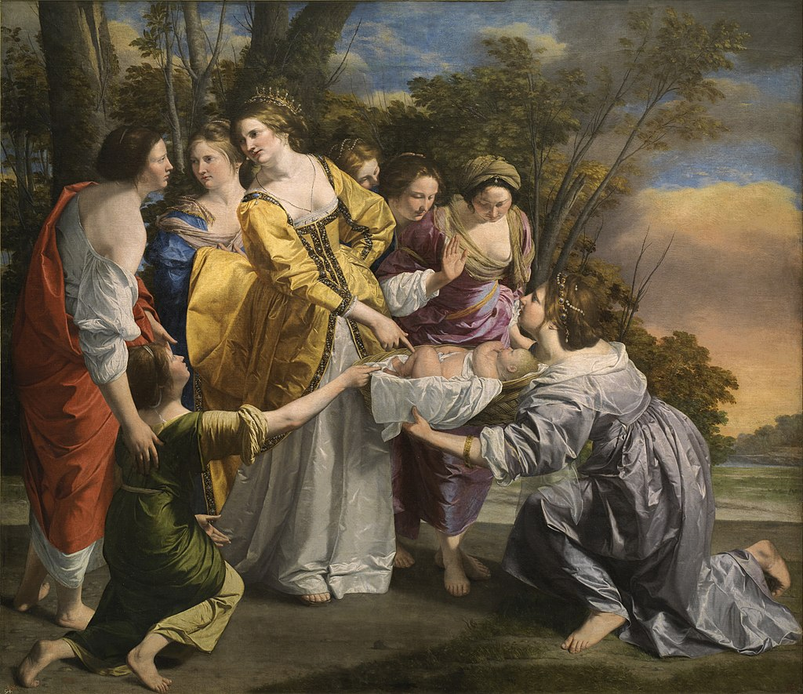
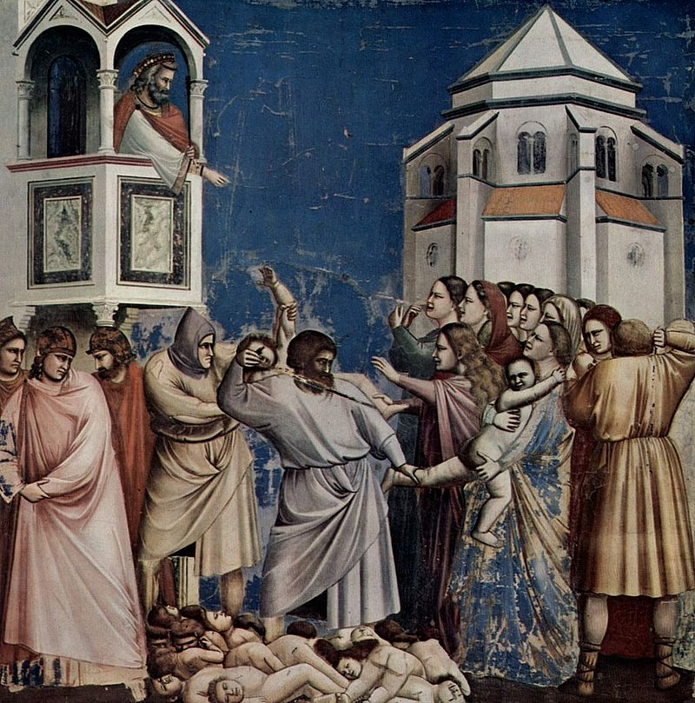
Both Moses and Jesus escaped from a slaughter of children
Notes:
https://en.wikipedia.org/wiki/Finding_of_Moses#/media/File:Mois%C3%A9s_salvado_de_las_aguas_(Orazio_Gentileschi).jpg
https://en.wikipedia.org/wiki/Massacre_of_the_Innocents#/media/File:Giotto_di_Bondone_-_No._21_Scenes_from_the_Life_of_Christ_-_5._Massacre_of_the_Innocents_-_.jpg

Slide 11
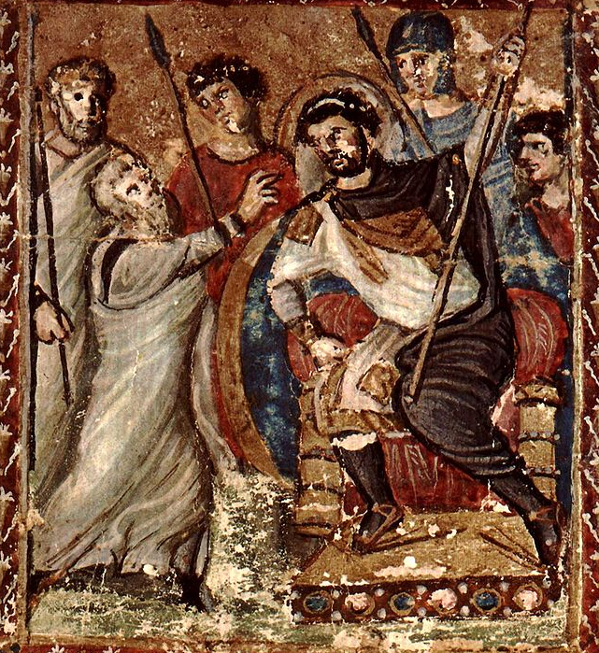
Moses and Jesus fled from/to Egypt; inspiration to return home
Notes:
https://en.wikipedia.org/wiki/Flight_into_Egypt#/media/File:Adorazione_dei_Magi_by_Gentile_da_Fabriano_-_Predella.jpg
https://en.wikipedia.org/wiki/Moses#/media/File:SyriacBibleParisFolio8rrMosesBeforePharaoh.jpg

Slide 12
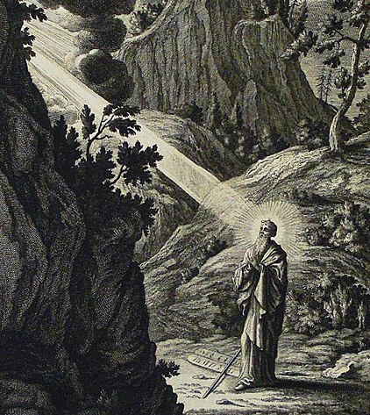
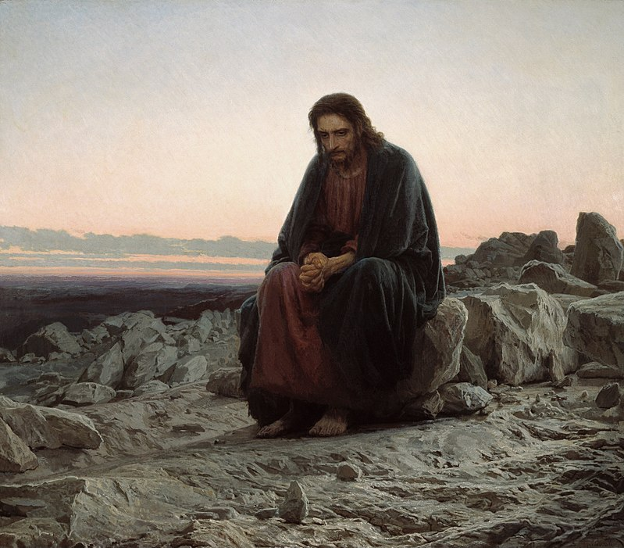
Fasted with God in the desert
for 40 days
Philip De Vere
Notes:
https://commons.wikimedia.org/wiki/File:The_Phillip_Medhurst_Picture_Torah_467._Moses_descends_from_Mount_Sinai._Exodus_cap_34_vv_29-35._Heuman.jpg
https://en.wikipedia.org/wiki/Christ_in_the_Desert#/media/File:Christ_in_the_Wilderness_-_Ivan_Kramskoy_-_Google_Cultural_Institute.jpg

Slide 13
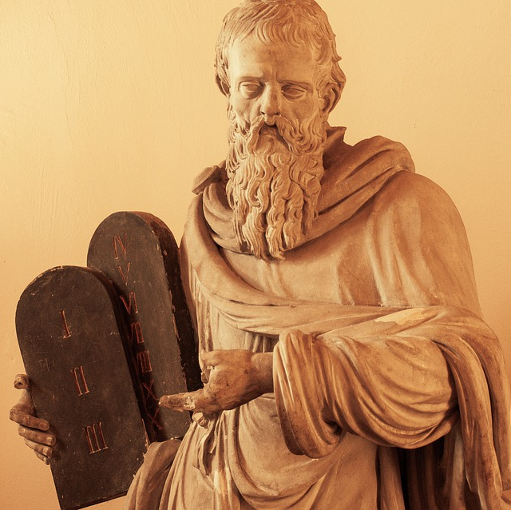
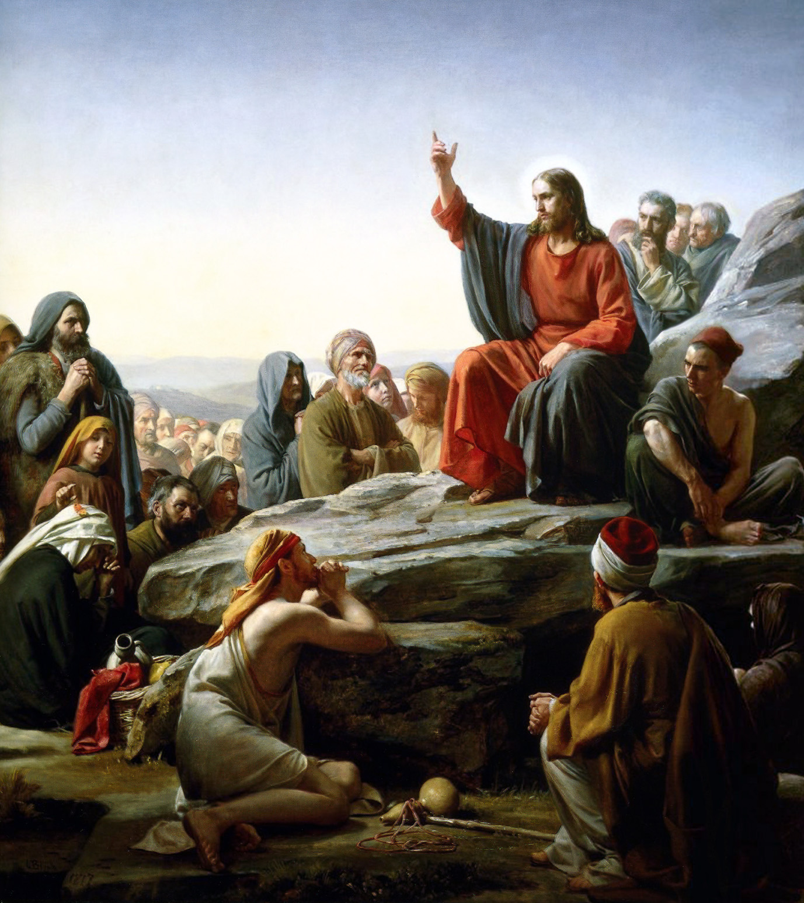
Moses received the old law on Mount Sinai
Jesus taught the new law on a Mountain
Notes:
https://pixabay.com/photos/moses-statue-moses-sculpture-6930536/
https://en.wikipedia.org/wiki/Sermon_on_the_Mount#/media/File:Bloch-SermonOnTheMount.jpg

Slide 14
Matthew 5:17, 19
“Think not that I am come to destroy the law, or the prophets: I am not come to destroy, but to fulfil….Whosoever therefore shall break one of these least commandments, and shall teach men so, he shall be called the least in the kingdom of heaven: but whosoever shall do and teach them, the same shall be called great in the kingdom of heaven.”

Slide 15
Law of Moses
The Law of Moses Set a Standard
Marie-Lan Nguyen
Notes:
https://commons.wikimedia.org/wiki/File:Women_high_jump_French_Athletics_Championships_2013_t150931.jpg

Slide 16
Gospel of Christ
Law of Moses
Christ Raises
That Standard
Marie-Lan Nguyen
Notes:
https://commons.wikimedia.org/wiki/File:Women_high_jump_French_Athletics_Championships_2013_t150931.jpg

Slide 17
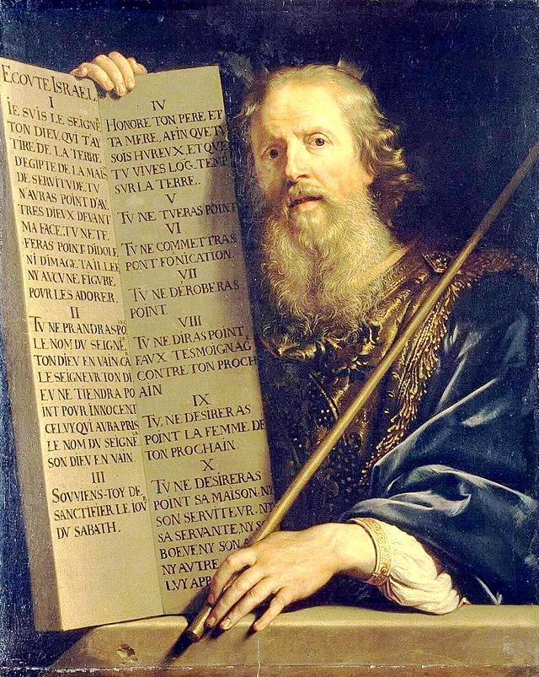
Philippe de Champaigne
“It hath been said, An eye for an eye, and a tooth for a tooth.”
Matthew 5:38 (alluding to Exodus 21:24)
Notes:
https://commons.wikimedia.org/wiki/File:Philippe_de_Champaigne_-_Moses_with_the_Ten_Commandments_-_WGA04717.jpg
https://www.churchofjesuschrist.org/media/image/christ-teaching-the-people-31eb3e7?lang=eng&collectionId=3cbf78e787498a07417814a31656063f9227b4c6

Slide 18
Harry Anderson
“But I say unto you…whosoever shall smite thee on thy right cheek, turn to him the other also”
Matthew 5:39
Philippe de Champaigne
“It hath been said, An eye for an eye, and a tooth for a tooth.”
Matthew 5:38 (alluding to Exodus 21:24)
Notes:
https://commons.wikimedia.org/wiki/File:Philippe_de_Champaigne_-_Moses_with_the_Ten_Commandments_-_WGA04717.jpg
https://www.churchofjesuschrist.org/media/image/christ-teaching-the-people-31eb3e7?lang=eng&collectionId=3cbf78e787498a07417814a31656063f9227b4c6

Slide 19
Matthew: A Summary
Matthew connects Jesus and David
Matthew emphasizes that Jesus has come to fulfill Old Testament prophecy.
Matthew, portrays Jesus as a new Moses, both validating and extending Moses’s teachings.

Slide 21
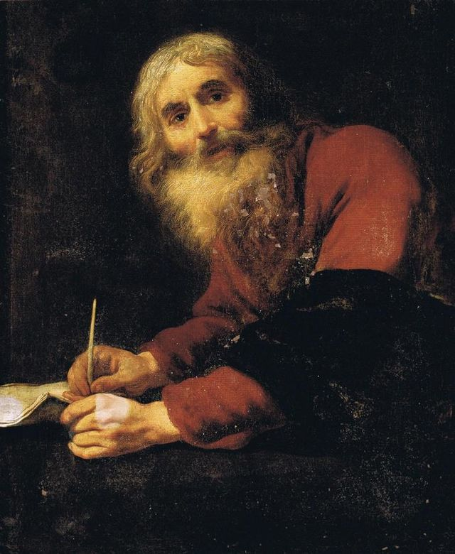
The Gospel According to Luke: An “orderly” account
“I decided, after investigating everything carefully from the very first, to write an orderly account for you…” (Luke 1:3)
Luke gives more dates and historical details than other Gospel authors.
Claude Vignon
Notes:
https://commons.wikimedia.org/wiki/File:Claude_Vignon_-_Saint_Luke_the_Evangelist.jpg

Slide 22
Luke and Acts A Two-Book Series
“I decided, after investigating everything carefully from the very first, to write an orderly account for you, most excellent Theophilus, so that you may know the truth…” (Luke 1:2-3)
**
“The former treatise have I made, O Theophilus, of all that Jesus began both to do and teach, Until the day in which he was taken up…” (Acts 1:1-2)
Claude Vignon
Notes:
https://commons.wikimedia.org/wiki/File:Claude_Vignon_-_Saint_Luke_the_Evangelist.jpg

Slide 23
Luke is the longest book in the New Testament.
Luke-Acts combined makes Luke the author of more material than any other New Testament author!
(About 25% of the NT)
Claude Vignon

Slide 24
Three Key Themes in Luke
Christ’s relationships with women
Christ’s focus on the poor
Christ’s outreach to all of God’s children—even the marginalized and those viewed as outcasts.

Slide 25
Stories Involving Women that are Unique to Luke
Elisabeth and John the Baptist
Announcement of Christ’s birth to Mary
Mary’s visit to Elisabeth
Anna seeing baby Jesus in the temple
Raising of the widow’s son at Nain
Joanna and Susanna ministering to Christ
Healing of Mary Magdalene
Mary, Martha and Jesus
Healing of a crippled woman
Christ speaking to women on the way to the cross.
Notes:
Some of these we have discussed in earlier class periods, and some we will discuss in future class periods. Today we’ll talk about three.

Slide 26
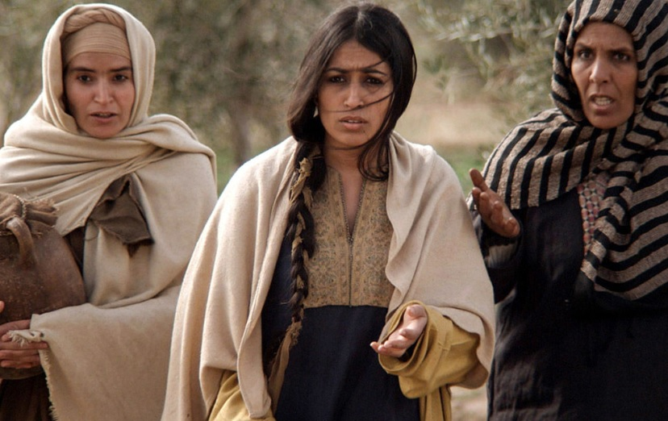
“Soon afterwards he went on through cities and villages, proclaiming and bringing the good news of the kingdom of God. The twelve were with him, as well as some women who had been cured of evil spirits and infirmities:
Lionsgate, The Gospel of Luke
Notes:
EMPHASIZE JOANNA

Slide 27
Mary, called Magdalene, from whom seven demons had gone out, and Joanna, the wife of Herod’s steward Chuza, and Susanna, and many others, who provided for them out of their resources.” (Luke 8:1-3, NRSV)
Lionsgate, The Gospel of Luke

Slide 28
bradleypjohnson
Notes:
https://commons.wikimedia.org/wiki/File:Wicked,_oriental_theater_in_chicago.jpg

Slide 29
“But all his acquaintances, including the women who had followed him from Galilee, stood at a distance, watching these things.” (Luke 23:49)
Lionsgate, The Gospel of Luke

Slide 30
Luke 10:38–42, NSRV
“Now as they went on their way, he entered a certain village, where a woman named Martha welcomed him into her home. She had a sister named Mary, who sat at the Lord’s feet and listened to what he was saying. But Martha was distracted by her many tasks; so she came to him and asked, ‘Lord, do you not care that my sister has left me to do all the work by myself? Tell her then to help me.’ But the Lord answered her, ‘Martha, Martha, you are worried and distracted by many things; there is need of only one thing. Mary has chosen the better part, which will not be taken away from her.’”

Slide 31
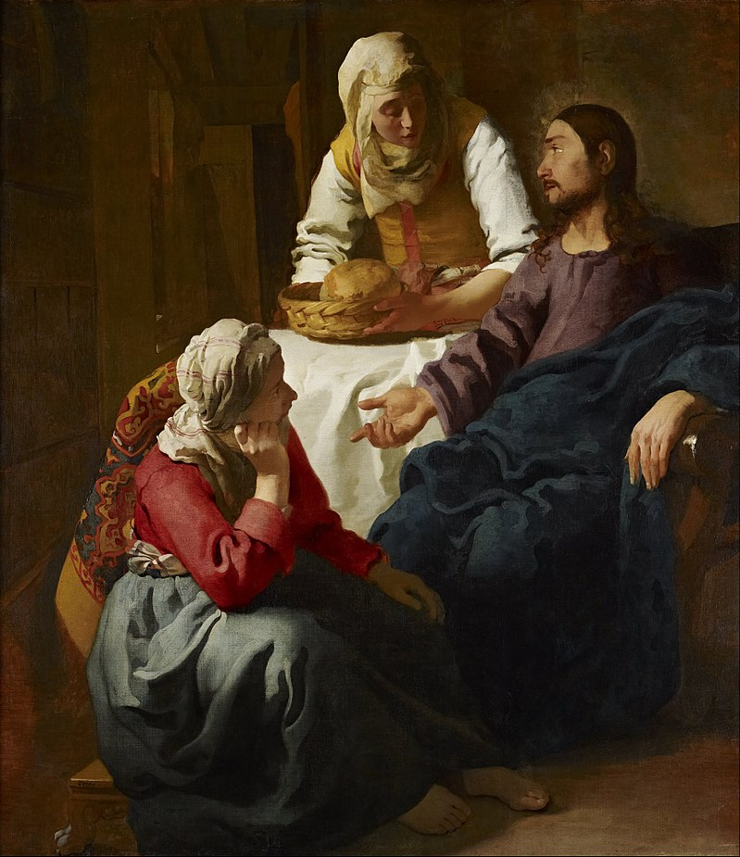
scriptures.byu.edu
Johannes Vermeer
Notes:
Public Domain: https://en.wikipedia.org/wiki/Mary_of_Bethany#/media/File:Johannes_(Jan)_Vermeer_-_Christ_in_the_House_of_Martha_and_Mary_-_Google_Art_Project.jpg

Slide 32
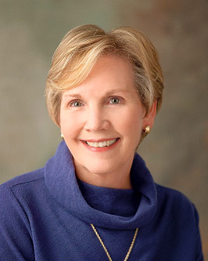
President Bonnie D. Parkin, Former Relief Society General President
“The Savior’s response strikingly clarified what mattered most. On that evening in Martha’s home, the good part was not in the kitchen; it was at the Lord’s feet. Dinner could wait.
Like Mary, I hunger to feast at the Savior’s feet, while, like Martha, I need to somehow find the laundry room floor, empty my in-box, and serve my husband something other than cold pizza. I have 15 grandchildren whose tender little spirits and daily challenges I want to better understand, yet I also have a slightly demanding Church calling!
Notes:
https://www.churchofjesuschrist.org/callings/relief-society/relief-society-presidents/bonnie-d-parkin?lang=eng

Slide 33
President Bonnie D. Parkin, Former Relief Society General President
“I don’t have lots of time. Like all of you, I have to choose. We all are trying to choose the good part which cannot be taken from us, to balance the spiritual and the temporal in our lives. Wouldn’t it be easy if we were choosing between visiting teaching or robbing a bank? Instead, our choices are often more subtle. We must choose between many worthy options.
Notes:
https://www.churchofjesuschrist.org/callings/relief-society/relief-society-presidents/bonnie-d-parkin?lang=eng

Slide 34
President Bonnie D. Parkin, Former Relief Society General President
“Mary and Martha are you and me; they are every sister in Relief Society. These two loved the Lord and wanted to show that love. On this occasion, it seems to me that Mary expressed her love by hearing His word, while Martha expressed hers by serving Him.
Martha thought she was doing right and that her sister should be helping her.
Notes:
https://www.churchofjesuschrist.org/callings/relief-society/relief-society-presidents/bonnie-d-parkin?lang=eng

Slide 35
President Bonnie D. Parkin, Former Relief Society General President
“I don’t believe the Lord was saying there are Marthas and there are Marys. Jesus did not dismiss Martha’s concern, but instead redirected her focus by saying choose “that good part.” And what is that? We “should look to the great Mediator, and hearken unto his great commandments” [2 Nephi 2:28].
The one thing that is needful is to choose eternal life. We choose daily.
Notes:
https://www.churchofjesuschrist.org/callings/relief-society/relief-society-presidents/bonnie-d-parkin?lang=eng

Slide 36
Take an Application Moment
“Martha, you are worried and distracted by many things; there is need of only one thing. Mary has chosen the better part.”
(Luke 10:41–42, NRSV).
What might these words from Jesus mean for you today?
Johannes Vermeer

Slide 37
Three Key Themes in Luke
Christ’s relationships with women
Christ’s focus on the poor
Christ’s outreach to all of God’s children—even the marginalized and those viewed as outcasts.

Slide 38
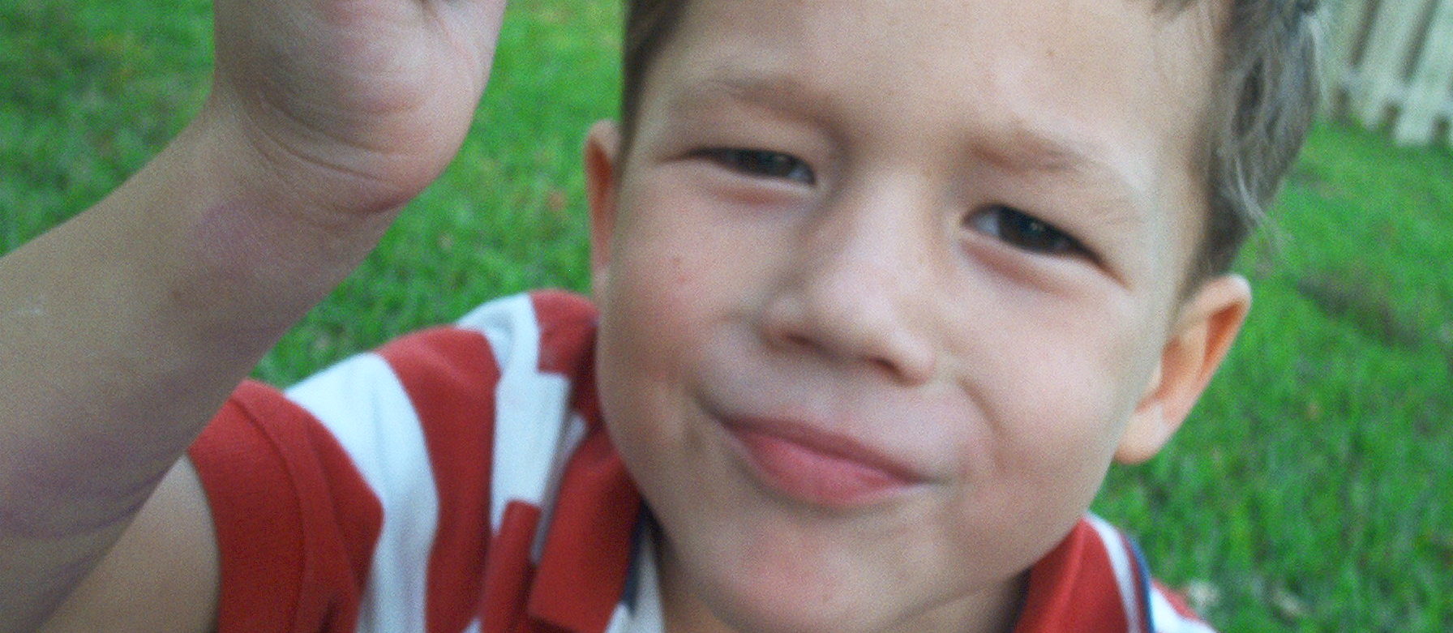
“Dad, I Want You”

Slide 39
“No, I mean, I want your money! I’m trying to get your money every day.”

Slide 40
Selected Teachings from Christ Regarding the Poor that are Unique to Luke
Mary’s Magnificat
Christ’s first sermon
Sermon on the plain
Rich man who builds bigger barns
Parable of the Banquet
Parable of Lazarus and the rich man
Widow of Nain
Repentance of Zacchaeus

Slide 41
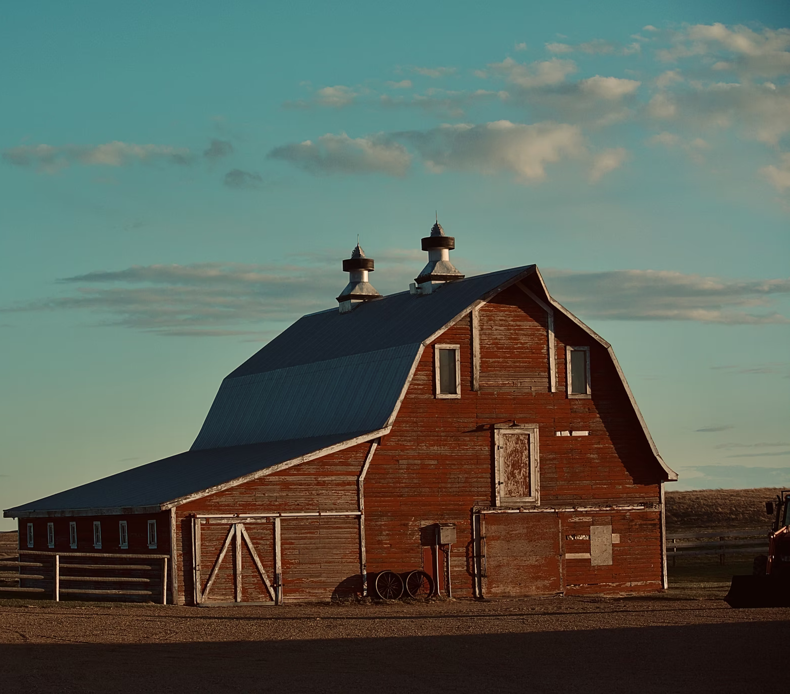
The Rich Fool
Luke 12:13-21
Sawyer
Notes:
https://unsplash.com/photos/WyfVUa2FJm8

Slide 42
Luke 12:13–21
“Someone in the crowd said to him, ‘Teacher, tell my brother to divide the family inheritance with me.’” Jesus responded, “‘Friend, who set me to be a judge or arbitrator over you?’ And he said to them, ‘Take care! Be on your guard against all kinds of greed; for one’s life does not consist in the abundance of possessions.’

Slide 43
Luke 12:13–21
Then he told them a parable: ‘The land of a rich man produced abundantly. And he thought to himself, “What should I do, for I have no place to store my crops?” Then he said, “I will do this: I will pull down my barns and build larger ones, and there I will store all my grain and my goods. And I will say to my soul, Soul, you have ample goods laid up for many years; relax, eat, drink, be merry.”

Slide 44
Luke 12:13–21
“But God said to him, “You fool! This very night your life is being demanded of you. And the things you have prepared, whose will they be?” So it is with those who store up treasures for themselves but are not rich toward God.’”

Slide 45
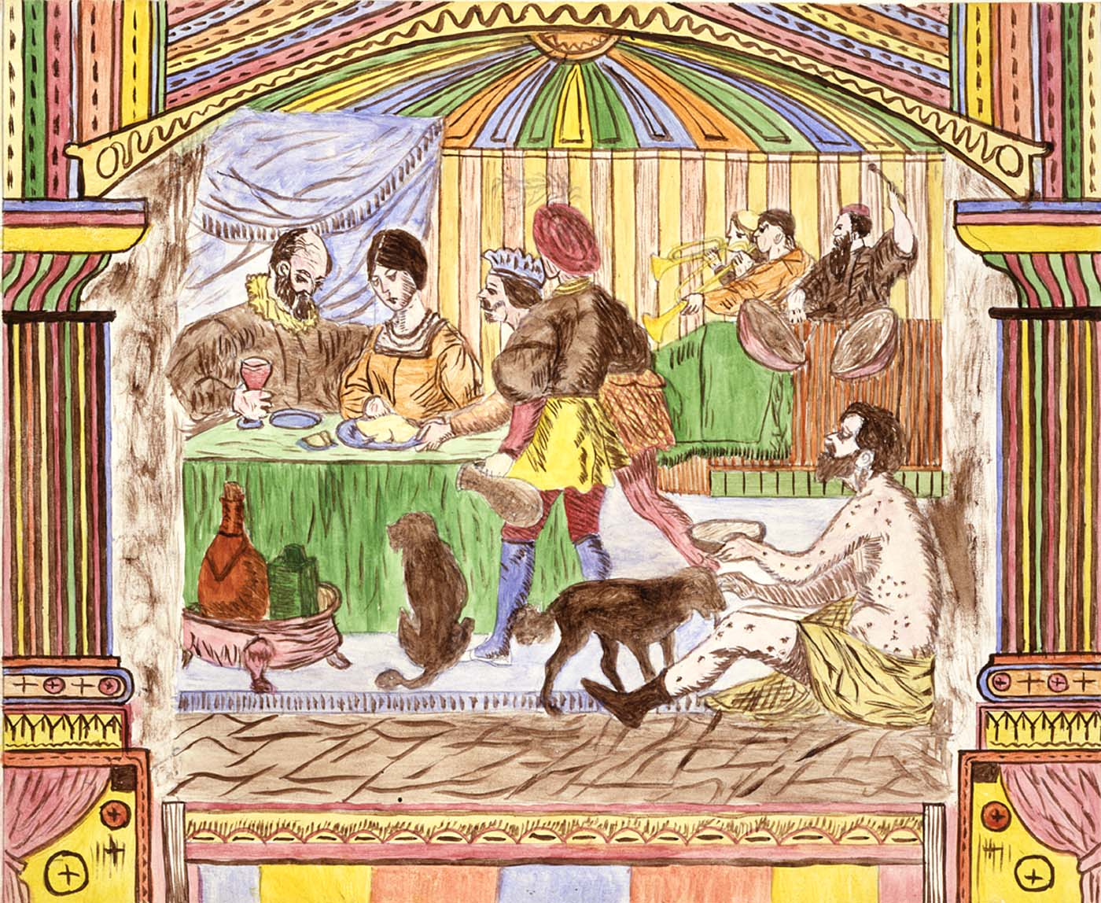
“No slave can serve two masters; for a slave will either hate the one and love the other, or be devoted to the one and despise the other. You cannot serve God and wealth. The Pharisees, who were lovers of money, heard all this, and they ridiculed him. So he said to them, ‘You are those who justify yourselves in the sight of others; but God knows your hearts; for what is prized by human beings is an abomination in the sight of God.’” (Luke 16:13-15, NRSV)
Lawrence W. Ladd

Slide 46
“There was a certain rich man, which was clothed in purple and fine linen, and fared sumptuously every day: And there was a certain beggar named Lazarus, which was laid at his gate, full of sores, And desiring to be fed with the crumbs which fell from the rich man’s table: moreover the dogs came and licked his sores.”
Lawrence W. Ladd

Slide 47
“And it came to pass, that the beggar died, and was carried by the angels into Abraham’s bosom: the rich man also died, and was buried; And in hell he lifted up his eyes, being in torments, and seeth Abraham afar off, and Lazarus in his bosom. And he cried and said, Father Abraham, have mercy on me, and send Lazarus, that he may dip the tip of his finger in water, and cool my tongue; for I am tormented in this flame. But Abraham said, Son, remember that thou in thy lifetime receivedst thy good things, and likewise Lazarus evil things: but now he is comforted, and thou art tormented.’”
Lawrence W. Ladd

Slide 48
Jesus in Luke
“The beggar died, and was carried by the angels into Abraham’s bosom: the rich man also died, and was buried; And in hell he lifted up his eyes, being in torments”
Notes:
1. Can you see how Jesus is referencing this parable in our day? HE IS SAYING THAT IF WE DO WHAT, THEN WE ARE LIKE THE RICH MAN (IMPART NOT OUR PORTION).
2. What does it mean to impart our portion?

Slide 49
Jesus in Luke
Jesus in the D&C
“The beggar died, and was carried by the angels into Abraham’s bosom: the rich man also died, and was buried; And in hell he lifted up his eyes, being in torments”
“The earth is full, and there is enough and to spare…if any man shall take of the abundance which I have made, and impart not his portion, according to the law of my gospel, unto the poor and the needy, he shall, with the wicked, lift up his eyes in hell, being in torment.
Notes:
1. Can you see how Jesus is referencing this parable in our day? HE IS SAYING THAT IF WE DO WHAT, THEN WE ARE LIKE THE RICH MAN (IMPART NOT OUR PORTION).
2. What does it mean to impart our portion?

Slide 50
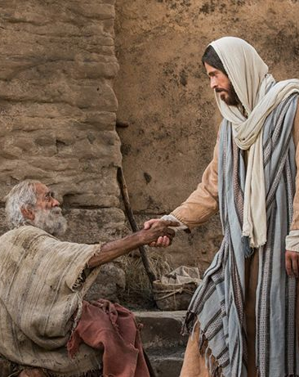
What is my portion? Jesus Speaking in the Latter Days
“I, the Lord, built the earth, all things therein are mine.” (D&C 104:14)
Bible Videos
Notes:
Everything you have belongs to God (D&C 104:14).
God has made you a steward over the things that you have been given (D&C 42:32, 104:14).
You will be held accountable for that stewardship (D&C 104:11-13).
https://www.churchofjesuschrist.org/media/image/bible-pictures-pool-of-bethesda-67c452f?lang=eng&collectionId=3cbf78e787498a07417814a31656063f9227b4c6

Slide 51
What is my portion? Jesus Speaking in the Latter Days
“I, the Lord…make every[one]… a steward over earthly blessings.”
(D&C 104:13)
Bible Videos
Notes:
Everything you have belongs to God (D&C 104:14).
God has made you a steward over the things that you have been given (D&C 42:32, 104:14).
You will be held accountable for that stewardship (D&C 104:11-13).
https://www.churchofjesuschrist.org/media/image/bible-pictures-pool-of-bethesda-67c452f?lang=eng&collectionId=3cbf78e787498a07417814a31656063f9227b4c6

Slide 52
What is my portion? Jesus Speaking in the Latter Days
“I, the Lord…make every[one] accountable.”
(D&C 104:13)
Bible Videos
Notes:
Everything you have belongs to God (D&C 104:14).
God has made you a steward over the things that you have been given (D&C 42:32, 104:14).
You will be held accountable for that stewardship (D&C 104:11-13).
https://www.churchofjesuschrist.org/media/image/bible-pictures-pool-of-bethesda-67c452f?lang=eng&collectionId=3cbf78e787498a07417814a31656063f9227b4c6

Slide 53
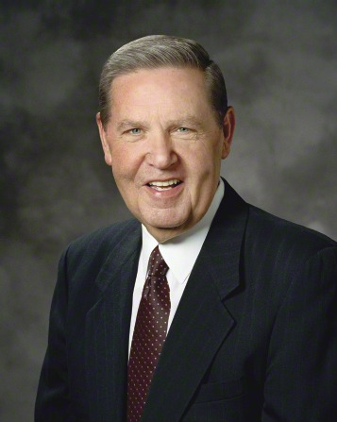
“I don’t know exactly how each of you should fulfill your obligation to those who do not or cannot always help themselves. But I know that God knows, and He will help you and guide you in compassionate acts of discipleship if you are conscientiously wanting and praying and looking for ways to keep a commandment He has given us again and again.”
Elder Jeffrey R. Holland, Ensign, Nov. 2014
Notes:
https://news-ca.churchofjesuschrist.org/leader-biographies/elder-jeffrey-r-holland

Slide 54
Take time to ponder:
“What is my portion?”
In serving the financially
poor and needy
right now.

Slide 55
Three Key Themes in Luke
Christ’s relationships with women
Christ’s focus on the poor
Christ’s outreach to all of God’s children—even those viewed as outcasts.

Slide 56
Unique accounts from Luke showing that the Gospel is for all of God’s children—even those we view as outcasts.
Angels at the Birth of Jesus: “Joy…to all people” (2:10).
Simeon: “Lord…mine eyes have seen thy salvation, which you have prepared for all people; a light to the gentiles” (2:29–32).
John the Baptist: “All flesh will see the salvation of God” (3:6).
Genealogy of Jesus: “son of Adam, son of God” (3:38).
Christ’s first speech
Calling of the Seventy
Parable of the Good Samaritan, story of the ten lepers
Outreach to Zacchaeus

Slide 57
Matthew’s genealogy of Jesus:
Begins with…
ABRAHAM
(father of the Jews)

Slide 58
Matthew’s genealogy of Jesus:
Begins with…
Luke’s
genealogy of Jesus:
Begins with…
ABRAHAM
(father of the Jews)
ADAM
(father of all humanity)

Slide 59
Genesis 10
Notes:
Seventy mentioned only in Luke—compare Gen. 10, seventy nations of the Gentiles—universal salvation.

Slide 60
“The Lord appointed seventy” (Luke 10:1)
Notes:
Seventy mentioned only in Luke—compare Gen. 10, seventy nations of the Gentiles—universal salvation.

Slide 61
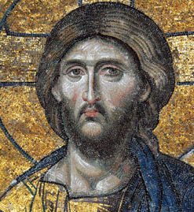
Why Read the Gospel According to John?
“These [things] are written, that ye might believe that Jesus is the Christ, the Son of God; and that believing ye might have life through his name.” (John 20:31)
Notes:
https://en.wikipedia.org/wiki/File:Christ_Pantocrator_mosaic_from_Hagia_Sophia_2240_x_3109_pixels_2.5_MB.jpg

Slide 62
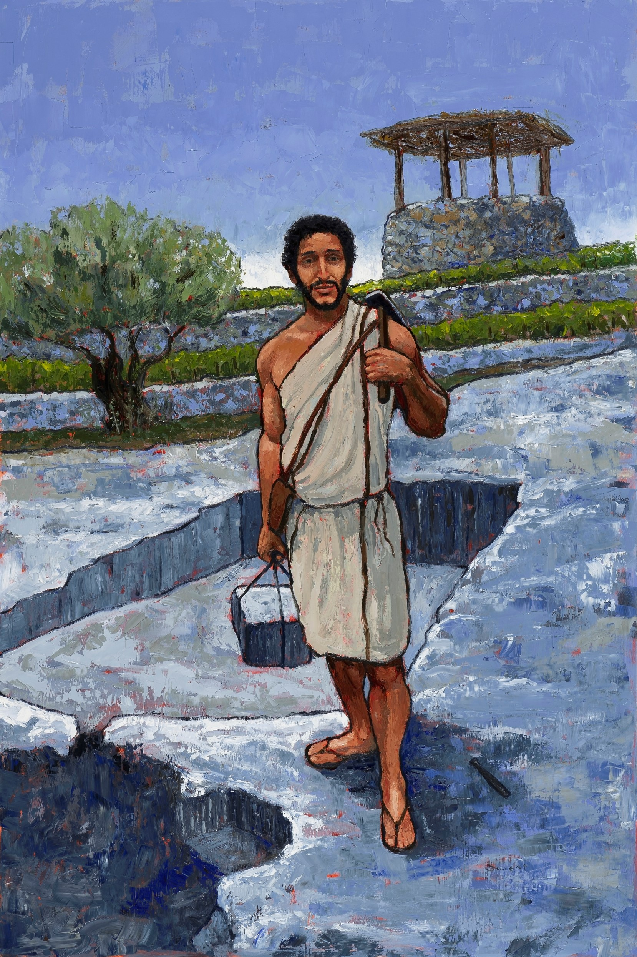
Anthony Sweat
Pudienza Mosiac, ~400 AD
Low Christology
(Emphasizes Jesus’s humanity)
High Christology
(Emphasizes Christ’s divinity)

Slide 63
The Divine Christ
Christ was “in the beginning.” (John 1:1)
Jesus knew “all things that should come upon him” (John 18:4), and his disciples specifically testified, “we know that you know all things.” (John 16:30)
Notes:
https://en.wikipedia.org/wiki/File:Christ_Pantocrator_mosaic_from_Hagia_Sophia_2240_x_3109_pixels_2.5_MB.jpg

Slide 64
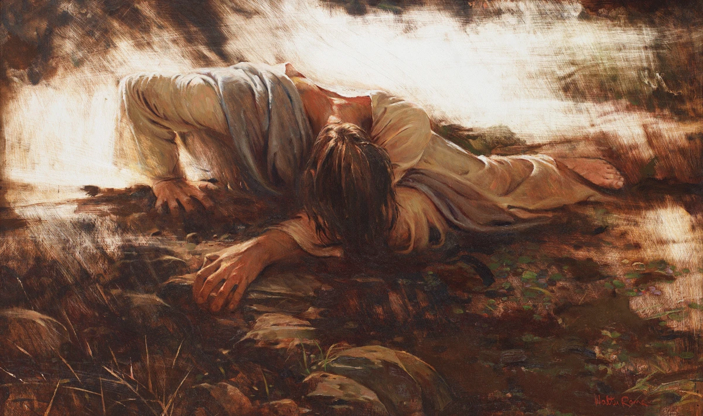
“Father, all things are possible unto thee; take away this cup from me…”
(Mark 14:36)
Walter Rane
Notes:
https://walterraneprints.com/products/not-my-will-but-thine-free-download
https://picturestoriesfromthebible.wordpress.com/2017/08/17/phillip-medhurst-presents-262392-the-james-tissot-jesus-c-1896-the-guards-falling-backwards-john-183-9/ (public domain)

Slide 65
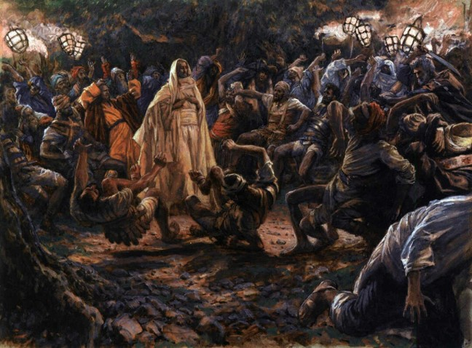
“Father, all things are possible unto thee; take away this cup from me…”
(Mark 14:36)
Walter Rane
“Put [away your] sword, the cup which my Father hath given me, shall I not drink it?”
(John 18:11)
James Tissot
Notes:
https://walterraneprints.com/products/not-my-will-but-thine-free-download
https://picturestoriesfromthebible.wordpress.com/2017/08/17/phillip-medhurst-presents-262392-the-james-tissot-jesus-c-1896-the-guards-falling-backwards-john-183-9/ (public domain)

Slide 66
A basic structure of the Gospel According to John
Prologue (John 1)
The Book of Signs (John 2-12)
The Book of Glory (John 13-20)
Epilogue (John 21)

Slide 67
John 5:2–3
“Now in Jerusalem by the Sheep Gate there is a pool, called in Hebrew Bethesda, which has five porticoes. In these lay many invalids—blind, lame, and paralyzed.”

Slide 68
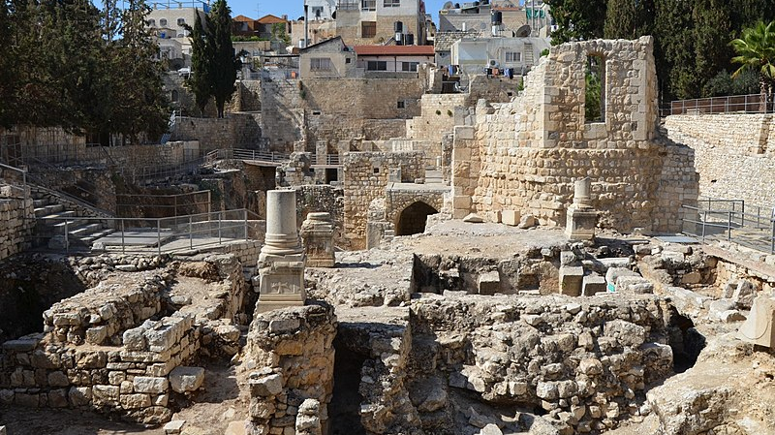
Carole Raddato
Notes:
https://commons.wikimedia.org/wiki/File:Excavations_at_the_Pool_of_Bethesda_showing_the_ruins_of_the_Temple_of_Serapis_with_a_column_from_an_early_Christian_church,_Aelia_Capitolina_(15522624480).jpg

Slide 69
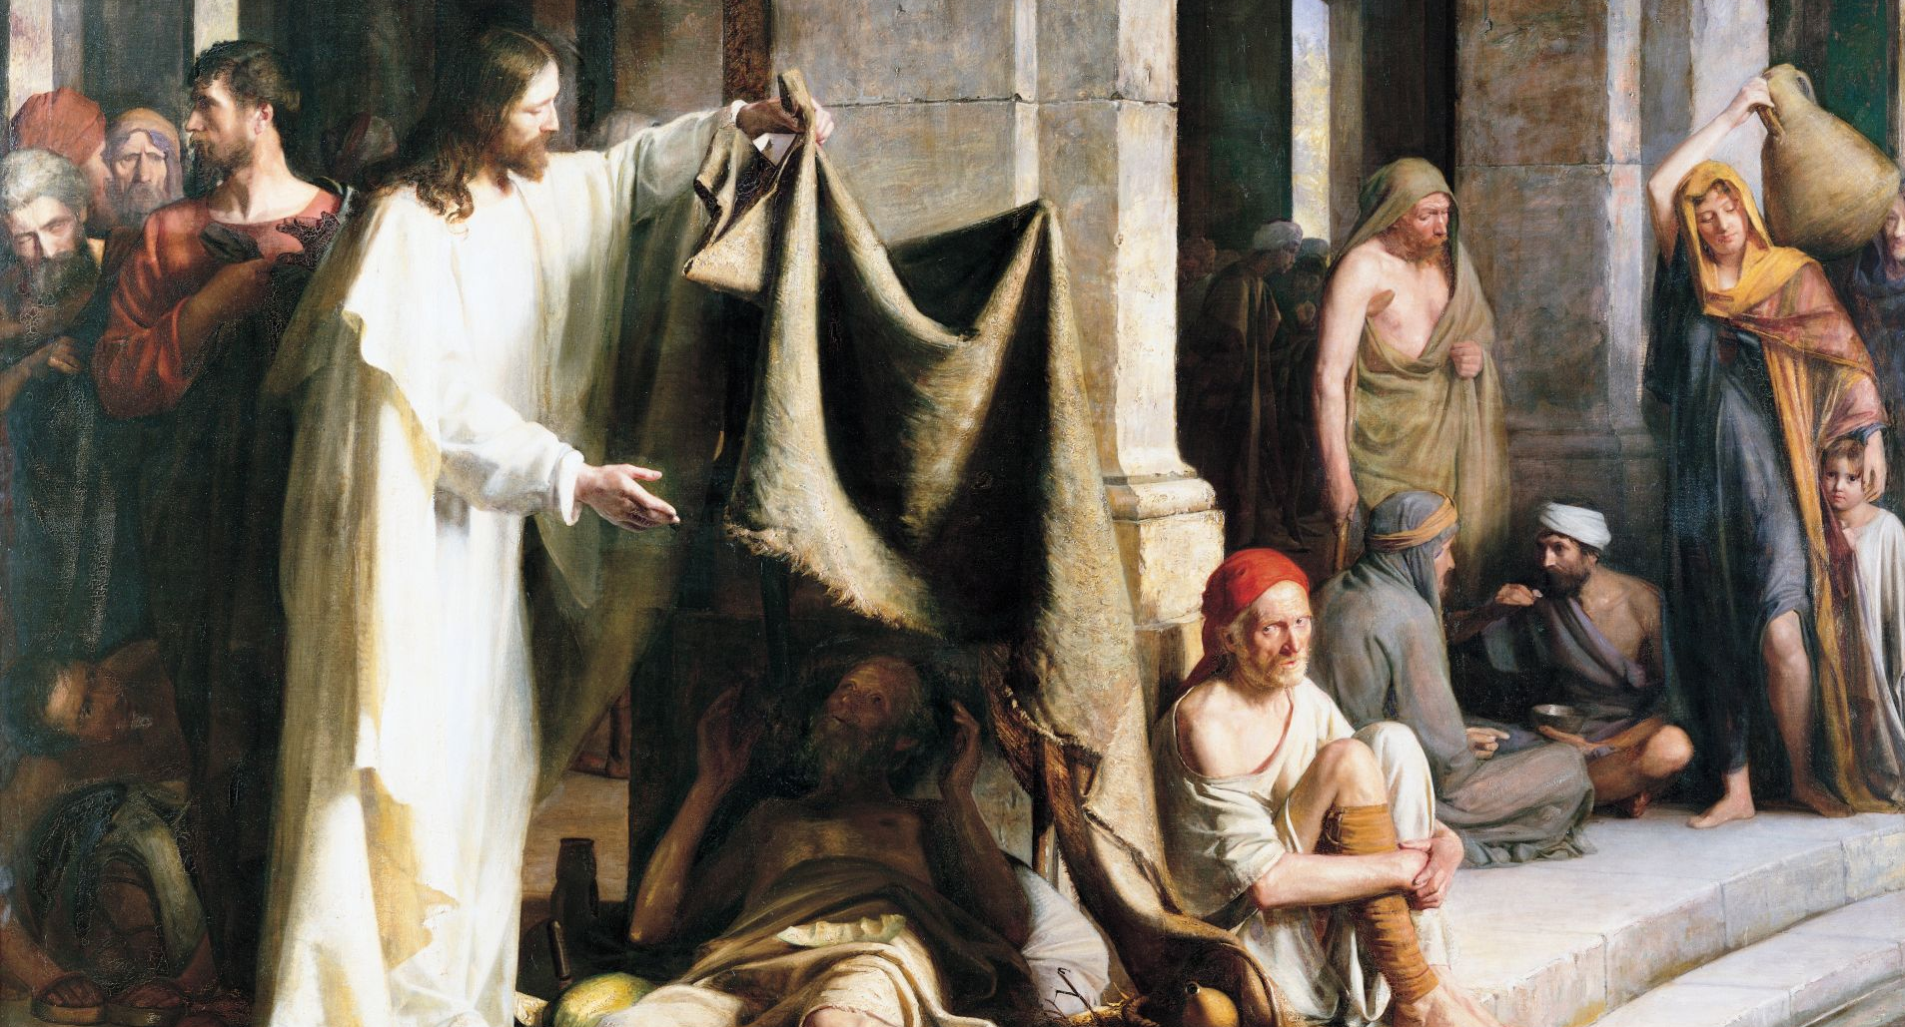
“Do you want to be made well?”
Carl Bloch
Notes:
https://www.churchofjesuschrist.org/media/image/pool-of-bethesda-carl-bloch-5b6576e?lang=eng

Slide 72
Matthew, Luke and John: A “Big Picture” Summary
In the Gospel according to Matthew, we see that Jesus has come to fulfill Old Testament prophecy and Jesus as a new Moses, both validating and extending Moses’s teachings.
In the Gospel according to Luke, we see a focus on women, helping the poor, and outreach to the marginalized.
In John we see a divine Jesus who has always existed, knows all things, and is always in control.

Slide 73
Acknowledgements
Insights from, discussions with, and resources authored by Dr. Frank Judd, Dr. Matthew Grey, Dr. Mark Strauss, and Dr. Hank Smith were used in the creation of this video.

