Slide 1
Per page, Mark has more miracles than any other account.
Overall, Luke recounts the most miracles.
37 Miracles of Jesus
# | Miracle | Matthew | Mark | Luke | John
1 | Jesus Turns Water into Wine at the Wedding in Cana |  |  |  | 2:1-11
2 | Jesus Heals an Official's Son at Capernaum in Galilee |  |  |  | 4:43-54
3 | Jesus Drives Out an Evil Spirit From a Man in Capernaum |  | 1:21-27 | 4:31-36
4 | Jesus Heals Peter's Mother-in-Law Sick With Fever | 8:14-15 | 1:29-31 | 4:38-39
5 | Jesus Heals Many Sick and Oppressed at Evening | 8:16-17 | 1:32-34 | 4:40-41
6 | First Miraculous Catch of Fish on the Lake of Gennesaret |  |  | 5:1-11
7 | Jesus Cleanses a Man With Leprosy | 8:1-4 | 1:40-45 | 5:12-14
8 | Jesus Heals a Centurion's Paralyzed Servant in Capernaum | 8:5-13 |  | 7:1-10
9 | Jesus Heals a Paralytic Who Was Let Down From the Roof | 9:1-8 | 2:1-12 | 5:17-26
10 | Jesus Heals a Man's Withered Hand on the Sabbath | 12:9-14 | 3:1-6 | 6:6-11
11 | Jesus Raises a Widow's Son From the Dead in Nain |  |  | 7:11-17
12 | Jesus Calms a Storm on the Sea | 8:23-27 | 4:35-41 | 8:22-25
13 | Jesus Casts Demons into a Herd of Pigs | 8:28-33 | 5:1-20 | 8:26-39
14 | Jesus Heals a Woman in the Crowd With an Issue of Blood | 9:20-22 | 5:25-34 | 8:42-48
15 | Jesus Raises Jairus' Daughter Back to Life | 9:18, 23-26 | 5:21-24, 35-43 | 8:40-42, 49-56
16 | Jesus Heals Two Blind Men | 9:27-31
17 | Jesus Heals a Man Who Was Unable to Speak | 9:32-34
18 | Jesus Heals an Invalid at Bethesda |  |  |  | 5:1-15
19 | Jesus Feeds 5,000 Plus Women and Children | 14:13-21 | 6:30-44 | 9:10-17 | 6:1-15
20 | Jesus Walks on Water | 14:22-33 | 6:45-52 |  | 6:16-21
21 | Jesus Heals Many Sick in Gennesaret as They Touch His Garment | 14:34-36 | 6:53-56
22 | Jesus Heals a Gentile Woman's Demon-Possessed Daughter | 15:21-28 | 7:24-30
23 | Jesus Heals a Deaf and Dumb Man |  | 7:31-37
24 | Jesus Feeds 4,000 Plus Women and Children | 15:32-39 | 8:1-13
25 | Jesus Heals a Blind Man at Bethsaida |  | 8:22-26
26 | Jesus Heals a Man Born Blind by Spitting in His Eyes |  |  |  | 9:1-12
27 | Jesus Heals a Boy With an Unclean Spirit | 17:14-20 | 9:14-29 | 9:37-43
28 | Miraculous Temple Tax in a Fish's Mouth | 17:24-27
29 | Jesus Heals a Blind, Mute Demoniac | 12:22-23 |  | 11:14-23
30 | Jesus Heals a Woman Who Had Been Crippled for 18 Years |  |  | 13:10-17
31 | Jesus Heals a Man With Dropsy on the Sabbath |  |  | 14:1-6
32 | Jesus Cleanses Ten Lepers on the Way to Jerusalem |  |  | 17:11-19
33 | Jesus Raises Lazarus from the Dead in Bethany |  |  |  | 11:1-45
34 | Jesus Restores Sight to Bartimaeus in Jericho | 20:29-34 | 10:46-52 | 18:35-43
35 | Jesus Withers the Fig Tree on the Road From Bethany | 21:18:22 | 11:12-14
36 | Jesus Heals a Servant's Severed Ear While He Is Being Arrested |  |  | 22:50-51
37 | The Second Miraculous Catch of Fish at the Sea of Tiberias |  |  |  | 21:4-11
Notes:
Although Matthew and Luke have a couple more miracles than Mark, they are each about 1/3 longer – per page, Mark has more miracles than any other gospel.

Slide 2
Types of Miracles in the Gospel Accounts
Healings (19+)
Nature miracles (9)
Calming the storm, feeding the multitudes (2x), walking on water, coin in fish, withered fig tree, miraculous catch of fish (2x), water to wine
Exorcisms (7+, these occur only in the Synoptic Gospels)
Jesus Drives Out an Evil Spirit From a Man in Capernaum, Casts Demons into Pigs, A Gentile Woman's Demon-Possessed Daughter, a Blind, Mute Demoniac, a Boy With an Unclean Spirit, a Man Who Was Unable to Speak, Mary Magdalene and many others
Raising the Dead (3)
Son of the widow of Nain, Daughter of Jairus, Lazarus
Notes:
Jesus Heals an Official's Son at Capernaum in Galilee
Jesus Heals Peter's Mother-in-Law Sick With Fever
Jesus Heals Many Sick and Oppressed at Evening
Jesus Cleanses a Man With Leprosy
Jesus Heals a Centurion's Paralyzed Servant in Capernaum
Jesus Heals a Paralytic Who Was Let Down From the Roof
Jesus Heals a Man's Withered Hand on the Sabbath
Jesus Heals a Woman in the Crowd With an Issue of Blood
Jesus Heals Two Blind Men
Jesus Heals an Invalid at Bethesda
Jesus Heals Many Sick in Gennesaret as They Touch His Garment
Jesus Heals a Deaf and Dumb Man
Jesus Heals a Blind Man at Bethsaida
Jesus Heals a Man Born Blind by Spitting in His Eyes
Jesus Heals a Woman Who Had Been Crippled for 18 Years
Jesus Heals a Man With Dropsy on the Sabbath
Jesus Cleanses Ten Lepers on the Way to Jerusalem
Jesus Restores Sight to Bartimaeus in Jericho
Jesus Heals a Servant's Severed Ear While He Is Being Arrested
Jesus Drives Out an Evil Spirit From a Man in Capernaum
Jesus Casts Demons into a Herd of Pigs
Jesus Heals a Gentile Woman's Demon-Possessed Daughter
Jesus Heals a Blind, Mute Demoniac
Jesus Heals a Boy With an Unclean Spirit
Jesus Heals a Man Who Was Unable to Speak
Mary Magdalene and many others, (Luke 4:40-41, 8:2)

Slide 3
“The person who has the leprous disease shall wear torn clothes and let the hair of his head be disheveled; and he shall cover his upper lip and cry out, ‘Unclean, unclean.’ He shall remain unclean as long as he has the disease; he is unclean. He shall live alone; his dwelling shall be outside the camp.”
(Leviticus 13:45, NRSV)
See also Leviticus 5:2-3, Numbers 19:22

Slide 4
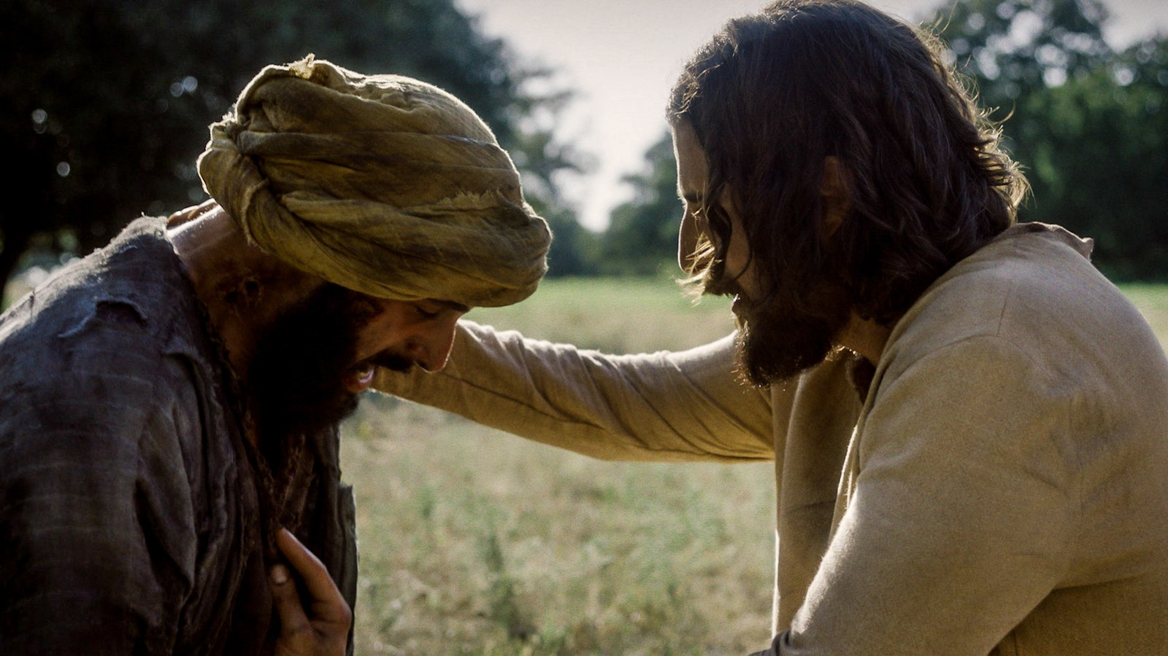
“If you choose, you can make me clean”
(Mark 1:40, NRSV).
“[Jesus] stretched out his hand and touched him, and said to him, ‘I do choose. Be made clean!’ Immediately the leprosy left him, and he was made clean” (Mark 1:41-42, NRSV).

Slide 5
“If you choose, you can make me clean”
(Mark 1:40, NRSV).
“[Jesus] stretched out his hand and touched him, and said to him, ‘I do choose. Be made clean!’ Immediately the leprosy left him, and he was made clean.” (Mark 1:41-42, NRSV)

Slide 6
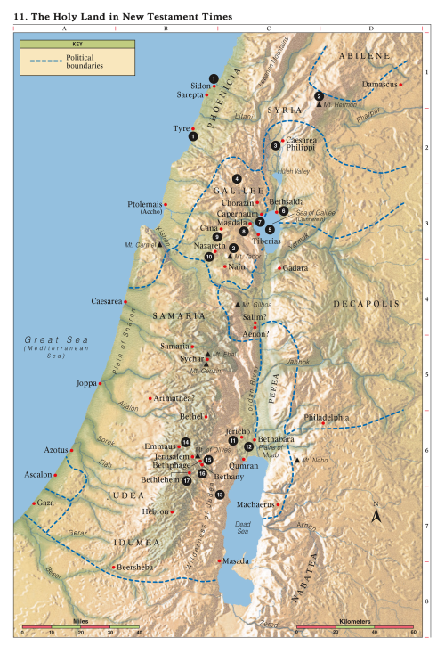
Capernaum
Jesus’s “own city” (Matthew 9:1)
Capernaum
Nazareth
Jerusalem
Bethlehem
Notes:
https://www.biblicalarchaeology.org/daily/biblical-sites-places/biblical-archaeology-sites/the-house-of-peter-the-home-of-jesus-in-capernaum/
Photo: Garo Nalbandian

Slide 7
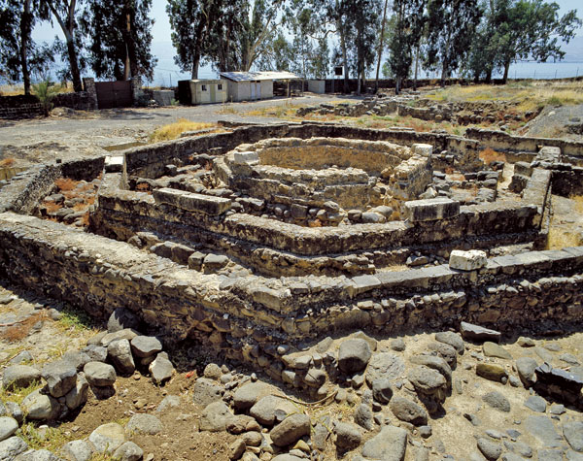
Capernaum
Jesus’s “own city” (Matthew 9:1)
“He was in the house” (Mark 2:1, note footnote)
Garo Nalbandian
Notes:
https://www.biblicalarchaeology.org/daily/biblical-sites-places/biblical-archaeology-sites/the-house-of-peter-the-home-of-jesus-in-capernaum/
Photo: Garo Nalbandian

Slide 8
Capernaum
“So many gathered around that there was no longer room for them, not even in front of the door; and he was speaking the word to them. Then some people came, bringing to him a paralyzed man, carried by four of them.”
(Mark 2:2, NRSV)
Garo Nalbandian
Notes:
https://www.biblicalarchaeology.org/daily/biblical-sites-places/biblical-archaeology-sites/the-house-of-peter-the-home-of-jesus-in-capernaum/
Photo: Garo Nalbandian

Slide 9
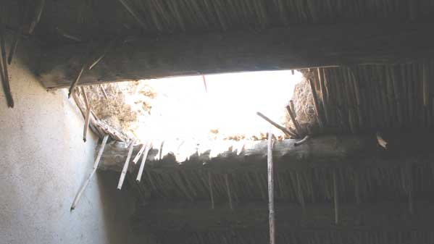
“And when they could not bring him to Jesus because of the crowd, they removed the roof above him; and after having dug through it, they let down the mat on which the paralytic lay.”
(Mark 2:2-4, NRSV)
Notes:
Two lessons: 1. Jesus didn’t get mad about the broken roof—he sees the good. 2. YOUR faith can make a difference as you pray for others. It was the faith of those who worked hard to help their friend.
“Hole in Synagogue roof from inside” by James Emery is licensed under CC BY 2.0
https://commons.wikimedia.org/wiki/File:Hole_in_Synagogue_roof_from_inside_0734m_(508120545).jpg

Slide 10
“Jesus saw their faith.” (Mark 2:5)
Notes:
Two lessons: 1. Jesus didn’t get mad about the broken roof—he sees the good. 2. YOUR faith can make a difference as you pray for others. It was the faith of those who worked hard to help their friend.
“Hole in Synagogue roof from inside” by James Emery is licensed under CC BY 2.0
https://commons.wikimedia.org/wiki/File:Hole_in_Synagogue_roof_from_inside_0734m_(508120545).jpg

Slide 11
Mark 2:11–12
“Arise, and take up thy bed, and go thy way into thine house. And immediately he arose, took up the bed…
they were all amazed.”

Slide 12
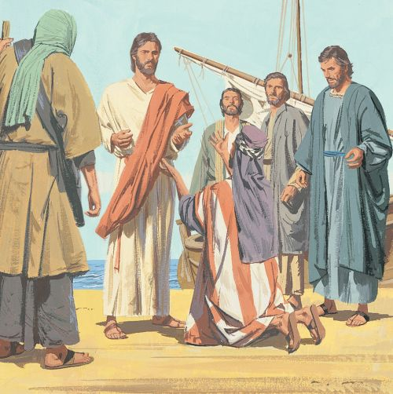
Another Day in Capernaum: Mark 5:21-42
“Jesus passed over again by ship unto the other side, much people gathered unto him: and he was nigh unto the sea.” (5:21)
In other words, he just got home and everybody is crowding him.
Notes:
https://www.churchofjesuschrist.org/bc/content/shared/content/english/pdf/language-materials/36618_eng.pdf Page 59
When Jesus gets back, probably tired from casting out demons and a long boat ride, everybody crowds around him. He could have said, “Let’s put things on hold, but when Jairus pleads for help, Jesus goes with him.”
HWH: The words, “and Jesus went with him” follow. We would not suppose that this event had been within the plans for the day. The Master had come back across the sea where the multitude was waiting on the shore for him to teach them. “And behold”—suddenly and unexpectedly—he was interrupted by the plea of a father. He could have ignored the request because many others were waiting. He could have said to Jairus that he would come to see his daughter tomorrow, but “Jesus went with him.” If we follow in the footsteps of the Master, would we ever be too busy to ignore the needs of our fellowmen?

Slide 13
Another Day in Capernaum: Mark 5:21-42
“When he saw [Jesus], [Jairus] fell at his feet and begged him repeatedly, “My little daughter is at the point of death. Come and lay your hands on her, so that she may be made well, and live.” (Mark 5:22-23, NRSV)
Notes:
https://www.churchofjesuschrist.org/bc/content/shared/content/english/pdf/language-materials/36618_eng.pdf Page 59
When Jesus gets back, probably tired from casting out demons and a long boat ride, everybody crowds around him. He could have said, “Let’s put things on hold, but when Jairus pleads for help, Jesus goes with him.”
HWH: The words, “and Jesus went with him” follow. We would not suppose that this event had been within the plans for the day. The Master had come back across the sea where the multitude was waiting on the shore for him to teach them. “And behold”—suddenly and unexpectedly—he was interrupted by the plea of a father. He could have ignored the request because many others were waiting. He could have said to Jairus that he would come to see his daughter tomorrow, but “Jesus went with him.” If we follow in the footsteps of the Master, would we ever be too busy to ignore the needs of our fellowmen?

Slide 14
Another Day in Capernaum: Mark 5:21-42
“When he saw [Jesus], [Jairus] fell at his feet and begged him repeatedly, “My little daughter is at the point of death. Come and lay your hands on her, so that she may be made well, and live.” (Mark 5:22-23, NRSV)
“Jesus went with him.” (5:24)
Notes:
https://www.churchofjesuschrist.org/bc/content/shared/content/english/pdf/language-materials/36618_eng.pdf Page 59
When Jesus gets back, probably tired from casting out demons and a long boat ride, everybody crowds around him. He could have said, “Let’s put things on hold, but when Jairus pleads for help, Jesus goes with him.”
HWH: The words, “and Jesus went with him” follow. We would not suppose that this event had been within the plans for the day. The Master had come back across the sea where the multitude was waiting on the shore for him to teach them. “And behold”—suddenly and unexpectedly—he was interrupted by the plea of a father. He could have ignored the request because many others were waiting. He could have said to Jairus that he would come to see his daughter tomorrow, but “Jesus went with him.” If we follow in the footsteps of the Master, would we ever be too busy to ignore the needs of our fellowmen?

Slide 15
The Markan Sandwich
Notes:
https://unsplash.com/photos/FZ4y_IDUJ6w

Slide 16
Mark 5:25–28, NRSV
“Now there was a woman who had been suffering from hemorrhages for twelve years. She had endured much under many physicians, and had spent all that she had; and she was no better, but rather grew worse. She had heard about Jesus, and came up behind him in the crowd and touched his cloak, for she said, “If I but touch his clothes, I will be made well.”

Slide 17
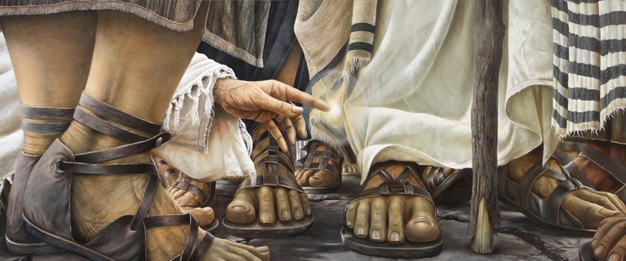
“Jesus Turned Around”
Daniel Cariola
Notes:
https://www.youtube.com/watch?v=cVD9gOYZ48c

Slide 18
“The woman “came and fell down before him, and told him all the truth.” (Mark 5:33) Jesus said, “Daughter be of good comfort, your faith has made you whole; go in peace.” (Mark 5:34)
Daniel Cariola
Notes:
https://www.youtube.com/watch?v=cVD9gOYZ48c

Slide 19
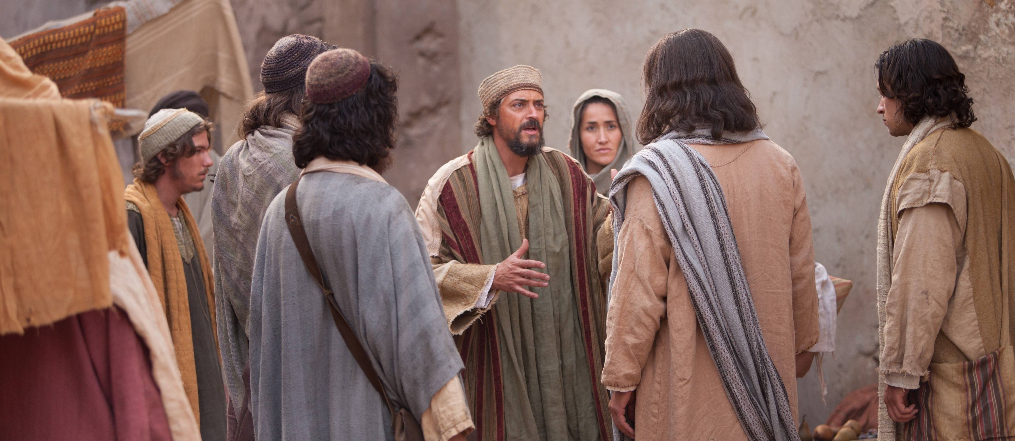
“Be not afraid, only believe.”
(Mark 5:36)
Notes:
https://www.churchofjesuschrist.org/media/image/pictures-of-jesus-jairus-ed72e2f?lang=eng

Slide 20
What do these miracles mean to you?
“Jesus Touched Him”
“Jesus Saw Their Faith”
“Jesus Went With Him”
“Jesus Turned Around”

Slide 21
Types of Miracles in the Gospel Accounts
Healings (19+)
Nature miracles (9)
Calming the storm, feeding the multitudes (2x), walking on water, coin in fish, withered fig tree, miraculous catch of fish (2x), water to wine
Exorcisms (7+, occurring only in the Synoptic Gospels)
Jesus Drives Out an Evil Spirit From a Man in Capernaum, Casts Demons into Pigs, A Gentile Woman's Demon-Possessed Daughter, a Blind, Mute Demoniac, a Boy With an Unclean Spirit, a Man Who Was Unable to Speak, Mary Magdalene and many others
Raising the Dead (3)
Son of the widow of Nain, Daughter of Jairus, Lazarus
Notes:
Jesus Heals an Official's Son at Capernaum in Galilee
Jesus Heals Peter's Mother-in-Law Sick With Fever
Jesus Heals Many Sick and Oppressed at Evening
Jesus Cleanses a Man With Leprosy
Jesus Heals a Centurion's Paralyzed Servant in Capernaum
Jesus Heals a Paralytic Who Was Let Down From the Roof
Jesus Heals a Man's Withered Hand on the Sabbath
Jesus Heals a Woman in the Crowd With an Issue of Blood
Jesus Heals Two Blind Men
Jesus Heals an Invalid at Bethesda
Jesus Heals Many Sick in Gennesaret as They Touch His Garment
Jesus Heals a Deaf and Dumb Man
Jesus Heals a Blind Man at Bethsaida
Jesus Heals a Man Born Blind by Spitting in His Eyes
Jesus Heals a Woman Who Had Been Crippled for 18 Years
Jesus Heals a Man With Dropsy on the Sabbath
Jesus Cleanses Ten Lepers on the Way to Jerusalem
Jesus Restores Sight to Bartimaeus in Jericho
Jesus Heals a Servant's Severed Ear While He Is Being Arrested
Jesus Drives Out an Evil Spirit From a Man in Capernaum
Jesus Casts Demons into a Herd of Pigs
Jesus Heals a Gentile Woman's Demon-Possessed Daughter
Jesus Heals a Blind, Mute Demoniac
Jesus Heals a Boy With an Unclean Spirit
Jesus Heals a Man Who Was Unable to Speak
Mary Magdalene and many others, (Luke 4:40-41, 8:2)

Slide 22
Mark 4:37–38, NRSV
“A great windstorm arose, and the waves beat into the boat, so that the boat was already being swamped. But [Jesus] was in the stern, asleep on the cushion; and they woke him up and said to him, “‘Teacher, do you not care that we are perishing?’”

Slide 23
“He woke up and rebuked the wind, and said to the sea, “Peace! Be still!” Then the wind ceased, and there was a dead calm.”
(Mark 4:39, NRSV)
Ted Henninger
Notes:
https://www.churchofjesuschrist.org/media/image/jesus-calms-the-storm-5c4cb06?lang=eng

Slide 24
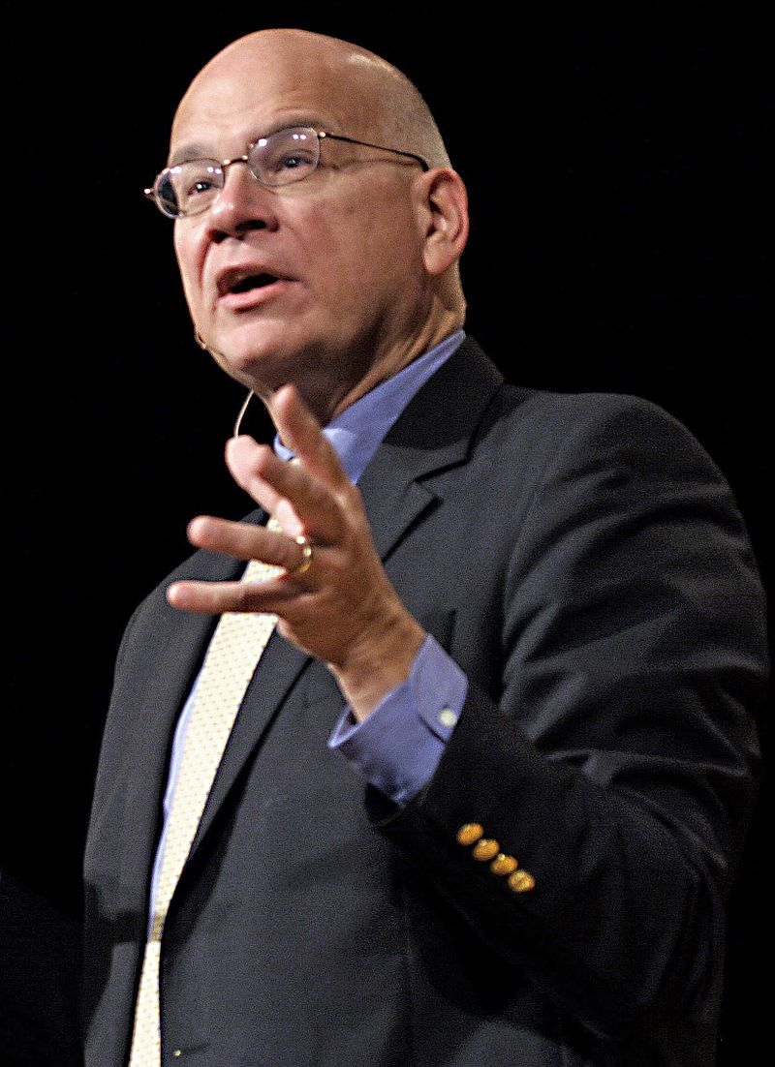
“Mark is intentionally recapping the Jonah episode…He uses nearly identical words and phrases. Both Jesus and Jonah are in a boat. Both are in storms described in similar terms. Both boats are filled with others who are terrified of death. Both groups wake the sleeping prophets angrily, rebuking them. Both storms are miraculously calmed and the companions saved.
Frank Licorice
Timothy Keller,
Preaching,
79–80
Notes:
https://en.wikipedia.org/wiki/Tim_Keller_(pastor)#/media/File:Timothy_Keller.jpg

Slide 25
“And both stories conclude with the men in the boats more terrified after the storm is stilled than they were before. Every feature is the same—with one rather large apparent exception. Jonah is sacrificed into the storm, thrown into the deep, satisfying the wrath of God so the others will be saved from it—but Jesus is not. Or are the accounts really different at that point?
Frank Licorice
Timothy Keller,
Preaching,
79–80
Notes:
https://en.wikipedia.org/wiki/Tim_Keller_(pastor)#/media/File:Timothy_Keller.jpg

Slide 26
“No, they are not. As Jesus says in Matthew 12:41, he is the ultimate Jonah, who was thrown into the ultimate deep—of eternal justice—for us. How ironic it is that in Mark 4 the disciples ask, “Teacher, don’t you care if we drown?” (Mark 4:38). They believe he is going to sleep on them in their hour of greatest need. Actually, it’s the other way around.
Frank Licorice
Timothy Keller,
Preaching,
79–80
Notes:
https://en.wikipedia.org/wiki/Tim_Keller_(pastor)#/media/File:Timothy_Keller.jpg

Slide 27
“In the garden of Gethsemane, they will go to sleep on him. They will truly abandon him. And yet he loves them to the end. See? Jonah was thrown overboard for his own sin, but Jesus is thrown into the ultimate storm for our sin. Jesus was able to save the disciples from the storm because he was thrown into the ultimate storm.”
Frank Licorice
Timothy Keller,
Preaching,
79–80
Notes:
https://en.wikipedia.org/wiki/Tim_Keller_(pastor)#/media/File:Timothy_Keller.jpg

Slide 28
The Loaves and the Fishes
The only miracle performed by the mortal Christ in all four Gospels
Notes:
https://www.churchofjesuschrist.org/media/image/miracles-of-jesus-feeding-5000-ca48f6b?lang=eng

Slide 29
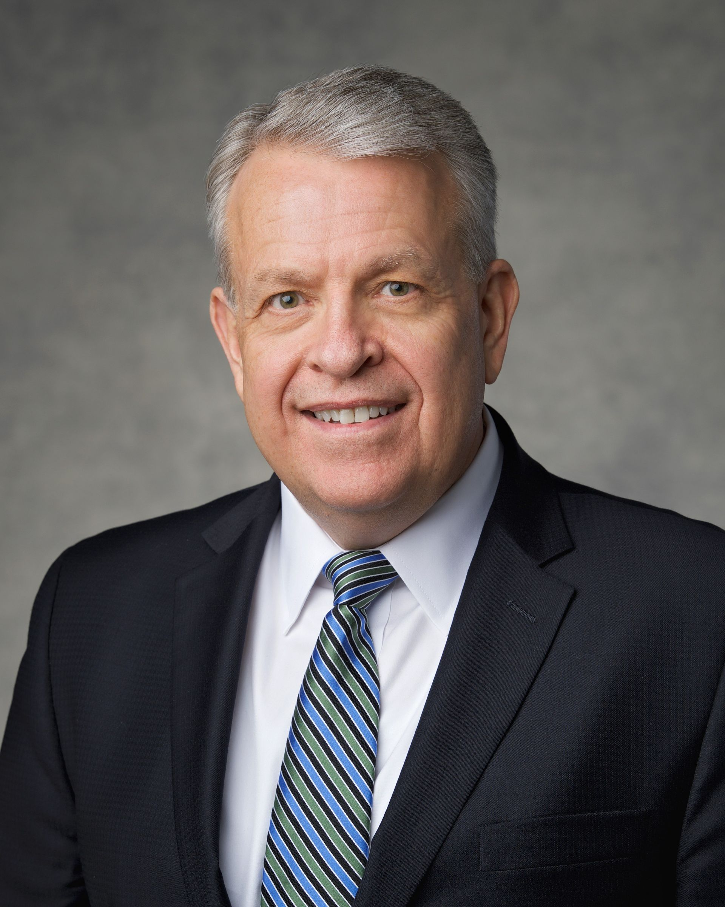
“After the Savior fed 5,000, He asked His disciples to gather up the remaining fragments, the leftovers, which filled 12 baskets…One lesson we can learn from that occasion [is] this: He could feed 5,000 and there were leftovers…The Savior’s redeeming and healing power can cover any sin, wound, or trial—no matter how large or how difficult—and there are leftovers. His grace is sufficient.”
Elder Brent H. Nielson
Ensign, Nov. 2021

Slide 30
Do we forget the great things God has done for us?
Notes:
One of my favorite illustrations of this comes from two miracles performed by the Savior in back-to-back chapters. In Matthew 14 there were 5,000 men, plus women and children assembled together, listening to the Savior. The disciples urged the Savior to send the people home as there were only five loaves and two fishes among them – nowhere near the quantity of food necessary to feed such a multitude. Instead, the Savior performed a miracle, multiplying the food so that there was more than enough for everyone. In the very next chapter, 4,000 men, plus women and children were gathered to listen to Christ. The Savior said, “I have compassion on the multitude, because they continue with me now three days, and have nothing to eat: and I will not send them away fasting, lest they faint in the way” (Matthew 15:32). Note the disciples response: “Whence should we have so much bread in the wilderness, as to fill so great a multitude?” (Matthew 15:33) What? Have you already forgotten the previous miracle? Don’t you remember the 5,000? Surely the Lord can feed 4,000!
https://www.churchofjesuschrist.org/media/image/miracles-of-jesus-feeding-5000-ca48f6b?lang=eng

Slide 31
Write Down Miracles You’ve Seen So You Don’t Forget Them
How have you seen Christ work miracles in your life?
Notes:
https://unsplash.com/photos/fVUl6kzIvLg

Slide 32
Miracles in my Life
Seeing my brother healed
Finding my key at EFY
McGee family baptism
IMPACT became a reality as did living in Mexico
Got accepted to graduate school
Found amazing housing – in Nyssa, Boston, Miami and Utah
Sold our home during a housing crisis
WHY? was published
My family and I had multiple opportunities to travel to China, after following a prompting to learn Chinese….
Notes:
Kenley Kohls- Canva

Slide 33
Types of Miracles in the Gospel Accounts
Healings (19+)
Nature miracles (9)
Calming the storm, feeding the multitudes (2x), walking on water, coin in fish, withered fig tree, miraculous catch of fish (2x), water to wine
Exorcisms (7+, occurring only in the Synoptic Gospels)
Jesus Drives Out an Evil Spirit From a Man in Capernaum, Casts Demons into Pigs, A Gentile Woman's Demon-Possessed Daughter, a Blind, Mute Demoniac, a Boy With an Unclean Spirit, a Man Who Was Unable to Speak, Mary Magdalene and many others
Raising the Dead (3)
Son of the widow of Nain, Daughter of Jairus, Lazarus
Notes:
Jesus Heals an Official's Son at Capernaum in Galilee
Jesus Heals Peter's Mother-in-Law Sick With Fever
Jesus Heals Many Sick and Oppressed at Evening
Jesus Cleanses a Man With Leprosy
Jesus Heals a Centurion's Paralyzed Servant in Capernaum
Jesus Heals a Paralytic Who Was Let Down From the Roof
Jesus Heals a Man's Withered Hand on the Sabbath
Jesus Heals a Woman in the Crowd With an Issue of Blood
Jesus Heals Two Blind Men
Jesus Heals an Invalid at Bethesda
Jesus Heals Many Sick in Gennesaret as They Touch His Garment
Jesus Heals a Deaf and Dumb Man
Jesus Heals a Blind Man at Bethsaida
Jesus Heals a Man Born Blind by Spitting in His Eyes
Jesus Heals a Woman Who Had Been Crippled for 18 Years
Jesus Heals a Man With Dropsy on the Sabbath
Jesus Cleanses Ten Lepers on the Way to Jerusalem
Jesus Restores Sight to Bartimaeus in Jericho
Jesus Heals a Servant's Severed Ear While He Is Being Arrested
Jesus Drives Out an Evil Spirit From a Man in Capernaum
Jesus Casts Demons into a Herd of Pigs
Jesus Heals a Gentile Woman's Demon-Possessed Daughter
Jesus Heals a Blind, Mute Demoniac
Jesus Heals a Boy With an Unclean Spirit
Jesus Heals a Man Who Was Unable to Speak
Mary Magdalene and many others, (Luke 4:40-41, 8:2)

Slide 34
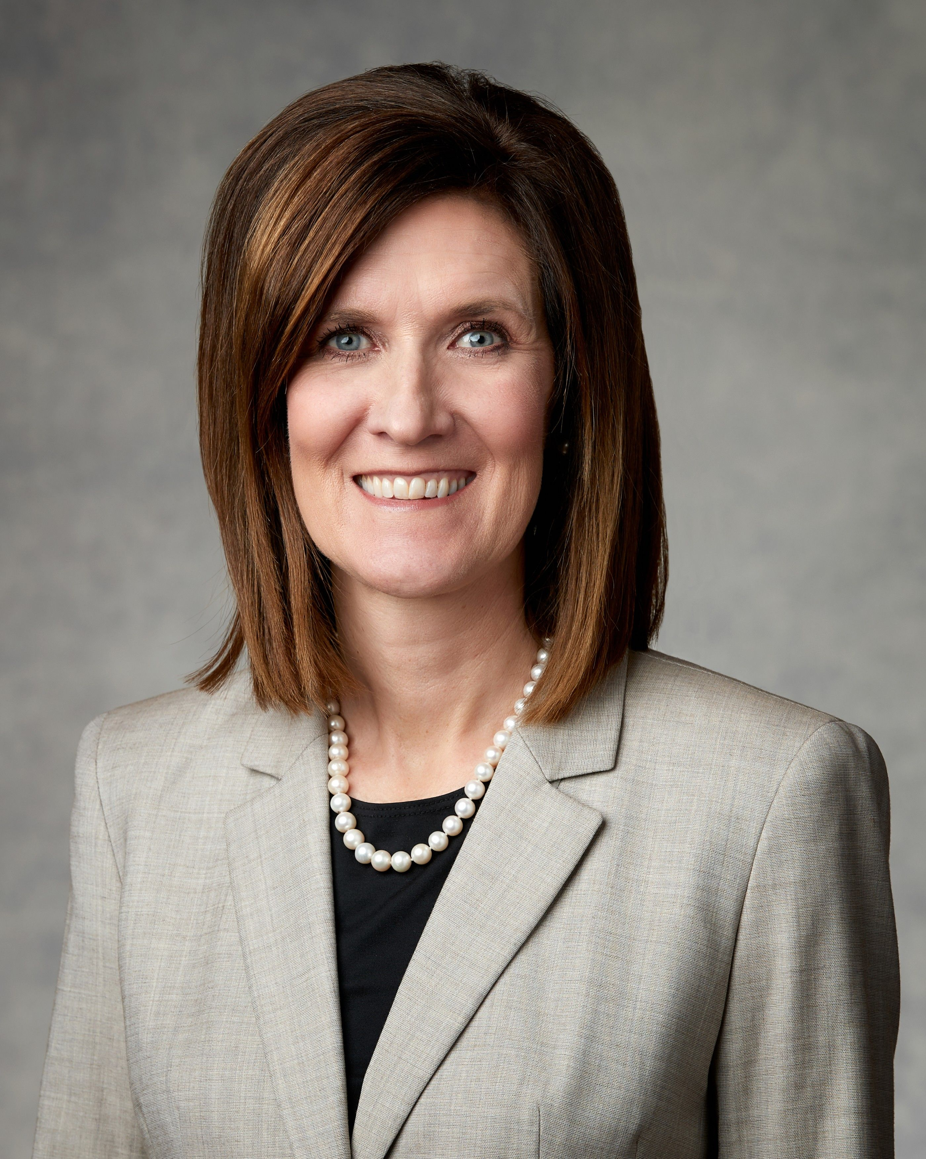
“Jesus Christ sees people deeply. He sees individuals, their needs, and who they can become. Where others saw fishermen, sinners, or publicans, Jesus saw disciples; where others saw a man possessed by devils, Jesus looked past the outward distress, acknowledged the man, and healed him.
Even in our busy lives, we can follow the example of Jesus and see individuals﻿—their needs, their faith, their struggle, and who they can become.”
Michelle D. Craig
Ensign, Nov. 2020

Slide 35
Luke 11:20
“If I with the finger of God cast out devils, no doubt the kingdom of God is come upon you.”

Slide 36
Types of Miracles in the Gospel Accounts
Healings (19+)
Nature miracles (9)
Calming the storm, feeding the multitudes (2x), walking on water, coin in fish, withered fig tree, miraculous catch of fish (2x), water to wine
Exorcisms (7+, occurring only in the Synoptic Gospels)
Jesus Drives Out an Evil Spirit From a Man in Capernaum, Casts Demons into Pigs, A Gentile Woman's Demon-Possessed Daughter, a Blind, Mute Demoniac, a Boy With an Unclean Spirit, a Man Who Was Unable to Speak, Mary Magdalene and many others
Raising the Dead (3)
Son of the widow of Nain, Daughter of Jairus, Lazarus
Notes:
Jesus Heals an Official's Son at Capernaum in Galilee
Jesus Heals Peter's Mother-in-Law Sick With Fever
Jesus Heals Many Sick and Oppressed at Evening
Jesus Cleanses a Man With Leprosy
Jesus Heals a Centurion's Paralyzed Servant in Capernaum
Jesus Heals a Paralytic Who Was Let Down From the Roof
Jesus Heals a Man's Withered Hand on the Sabbath
Jesus Heals a Woman in the Crowd With an Issue of Blood
Jesus Heals Two Blind Men
Jesus Heals an Invalid at Bethesda
Jesus Heals Many Sick in Gennesaret as They Touch His Garment
Jesus Heals a Deaf and Dumb Man
Jesus Heals a Blind Man at Bethsaida
Jesus Heals a Man Born Blind by Spitting in His Eyes
Jesus Heals a Woman Who Had Been Crippled for 18 Years
Jesus Heals a Man With Dropsy on the Sabbath
Jesus Cleanses Ten Lepers on the Way to Jerusalem
Jesus Restores Sight to Bartimaeus in Jericho
Jesus Heals a Servant's Severed Ear While He Is Being Arrested
Jesus Drives Out an Evil Spirit From a Man in Capernaum
Jesus Casts Demons into a Herd of Pigs
Jesus Heals a Gentile Woman's Demon-Possessed Daughter
Jesus Heals a Blind, Mute Demoniac
Jesus Heals a Boy With an Unclean Spirit
Jesus Heals a Man Who Was Unable to Speak
Mary Magdalene and many others, (Luke 4:40-41, 8:2)

Slide 37
John 11:1–4
“Now a certain man was sick, named Lazarus, of Bethany, the town of Mary and her sister Martha… Therefore his sisters sent unto him, saying, Lord, behold, he whom thou lovest is sick. When Jesus heard that, he said, This sickness is not unto death, but for the glory of God, that the Son of God might be glorified thereby.

Slide 38
Have You Seen This In Your Life?
Notes:
Kenley Kohls - Canva

Slide 39
Notes:
“It was a superstition among [some Jews] that the spirit lingered around the body for three days, but on the fourth day, it departed. Jesus was very familiar with their beliefs. He therefore delayed His arrival in Bethany until Lazarus had been in the grave for four days. In that way there would be no question about the miracle He was to perform.” Ezra Taft Benson, “Five Marks of the Divinity of Jesus Christ,” New Era (Dec. 1980), pp. 46-47.

Slide 40
Do You Believe This? A Scriptural Pattern
“As thou hast believed, so be it done unto thee.” (Matthew 8:13).
“Jesus saith unto [the blind men], Believe ye that I am able to do this?” (Matthew 9:28).
“Jesus said… If thou canst believe, all things are possible to him that believeth” (Mark 9:23).
“Believest thou this?” (John 11:26)

Slide 41
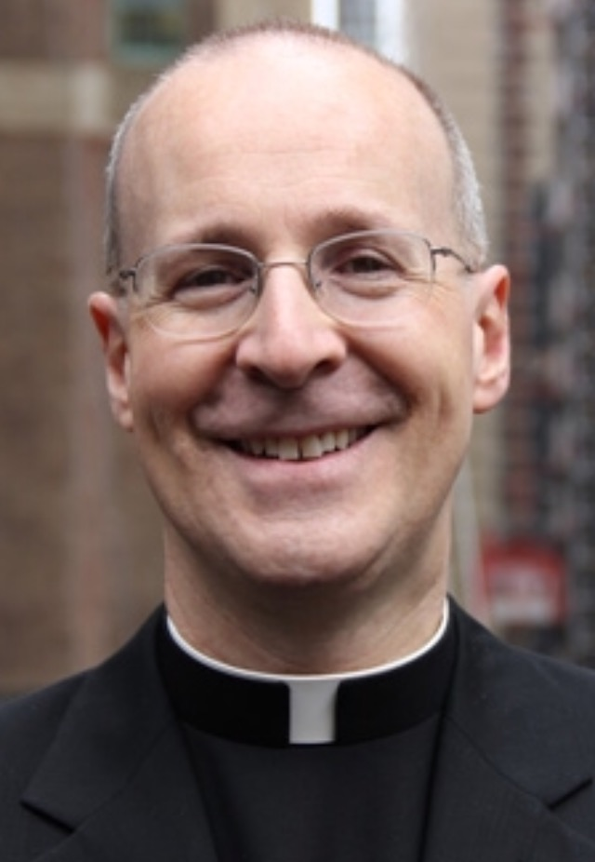
“Like most of us, Martha grapples with both faith (‘Yes, I believe’) and doubt, or at least confusion (‘There is a stench’).”
(James Martin, Jesus, A Pilgrimage, p. 326)
Editeurcoreen
Notes:
https://en.wikipedia.org/wiki/James_Martin_(priest,_born_1960)#/media/File:JamesMartin.jpg

Slide 42
Sometimes God delays for our benefit.

Slide 43
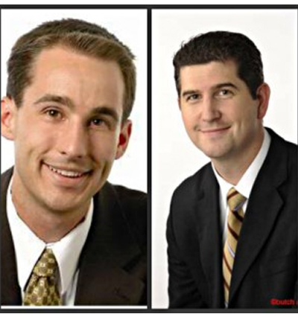
Sometimes God delays for our benefit.

Slide 44
“For years, I had wanted to speak and publish. I did both, but I learned that I don’t love traveling to speak and I don’t find the satisfaction in publishing that I thought I would.”
He went on to tell me that for the past eight years he has worked as an adjunct professor in Community, Family, and Addiction Sciences, in addition to his full-time job.
He said, “I love working with addicts in recovery. My experiences teaching on campus have changed my life in wonderful ways. I don’t know that I would have accepted this position to teach if I had been successful at publishing and speaking.”

Slide 45
Acknowledgements
Insights from, discussions with, and resources authored by Dr. Eric Huntsman, Dr. Timothy Keller, Dr. Matthew Grey, James Martin, SJ, David Butler, Judah Smith, and Dr. Ryan Sharp were used in the creation of this video.

