Slide 1
A Hole
(Dangerous!)

Slide 2
A Fence (To Protect From the Hole)
A Hole
(Dangerous!)

Slide 3
A Fence (To Protect From the Sin)
Sin

Slide 4
A Fence Around the Law
Break the Word of Wisdom
Fence Law: Don’t spend time in bars

Slide 5
“…make a fence around the Law.”
A Fence Around the Law
The Law
From the Mishnah
(collection of Jewish writings, circa 200 AD)
Notes:
The concept of “fence laws” is drawn from the Mishnah, a written collection of the Jewish oral traditions. In one section of the Mishnah, readers are told that in addition to the written laws given to Moses, Moses received “The [oral] Law from Sinai and committed it to Joshua, and Joshua to the elders, and the elders to the Prophets, and the Prophets committed it to the men of the Great Synagogue. They said make three things: Be deliberate in judgment, raise up many disciples, and make a fence around the Law.” The idea that was promulgated by these leaders what that a protective fence was needed to keep people from breaking the law of Moses.
Mishnah, Pirke Avoth 1:1:5. Throughout this book I will make references to the Mishnah, and at times use it as support for ideas that seem to be have been held by the Pharisees. It is important to note that this is not iron-clad support given that the Mishnah is not composed until the beginning of the 3rd century (~200 A.D.). While the Mishnah is compiled after the time of Christ, it appears that in some cases the Pharisees operated under similar principles with respect to fence laws.

Slide 6
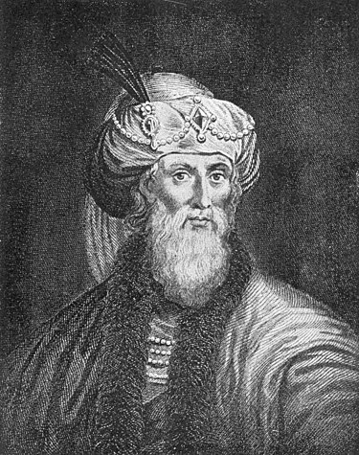
“The Pharisees have delivered to the people a great many observances by succession from their fathers, which are not written in the law of Moses.”
John Winston
Josephus, Antiquities 13.10.6 (§297)
Notes:
Image: https://en.wikipedia.org/wiki/Josephus

Slide 7
Matthew 15:2
“Then came to Jesus…Pharisees…saying, Why do your disciples transgress the tradition of the elders?”

Slide 8
A Fence Around the Law
Honor the Sabbath Day
Don’t walk too far, Don’t carry a mat, Don’t start or put out fires, etc.

Slide 9
A Fence Around the Law
Break the Law of Chastity
Fence Laws: Don’t kiss for more than five seconds, don’t go into bedrooms, don’t be alone with person of the opposite sex

Slide 10
Six Aspects of Fence Laws
Have Spirit-driven fence laws
Lighten your heavy yoke.
Focus on the mark, not the fence
Focus on the core, not the fence when teaching others
Don’t judge others on fence laws
Follow the prophet
Notes:
In these six aspects, we’ll explore some Pros and Cons of Fence Laws

Slide 11
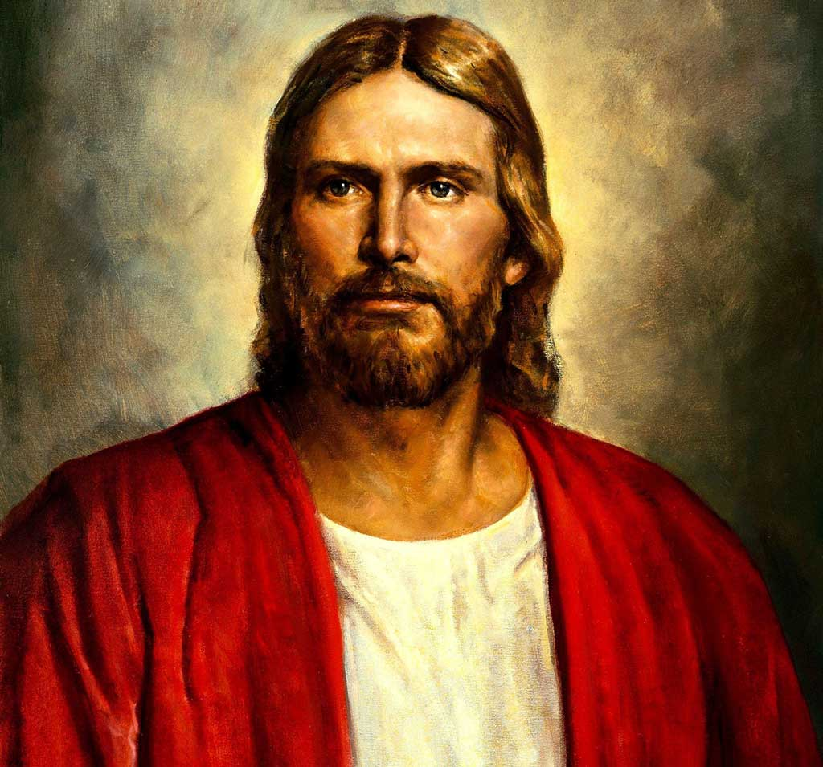
Why call ye me, Lord, Lord, and do not the things which I say?
Del Parson
Luke 6:46
Notes:
IMAGE: https://www.churchofjesuschrist.org/media/image/jesus-christ-74e791b?lang=eng&collectionId=3cbf78e787498a07417814a31656063f9227b4c6

Slide 12
A Fence Around the Law
What fence laws do you have?
Sin
Inspired fence laws can come from the Holy Ghost, prophets and from our observations of others.

Slide 13
Elder Richard G. Scott “Do What is Right” http://speeches.byu.edu
“Firmly establish personal standards. Choose a time of deep spiritual reflection, when there is no pressure on you, and you can confirm your decisions by sacred impressions. Decide then what you will do and what you will not do to express feelings. The Spirit will guide you. Then do not vary from those decisions no matter how right it may seem when the temptation comes…The realization of your dreams depends upon your determination to never betray your standards.”
Notes:
Could tell the “you set a standard” story

Slide 14
Six Aspects of Fence Laws
Have Spirit-driven fence laws
Lighten your heavy yoke.
Focus on the mark, not the fence
Focus on the core, not the fence when teaching others
Don’t judge others on fence laws
Follow the prophet

Slide 16
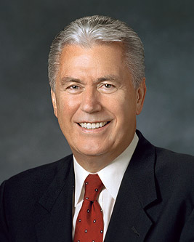
President Dieter F. Uchtdorf Ensign, November 2009.
“[Keeping the commandments] may present a problem for some because there are so many ‘shoulds’ and ‘should nots’ that merely keeping track of them can be a challenge. Sometimes, well-meaning amplifications of divine principles—many coming from uninspired sources—complicate matters further, diluting the purity of divine truth with man-made addenda. One person’s good idea—something that may work for him or her—takes root and becomes an expectation.”
Notes:
For example, a woman feels inspired to read 30 minutes a day from theBook of Mormon. Later in RS she is challenged to read all General Conference Talksbetween conferences, then the VT come and invite you to keep a tender mercy journal, and then the HT come … collectively this could turnthe joy of scripture studyfor feelilgn theHG intoa burden.
One woman said, “If I follow everything that has ever been suggested as something I should do, I’m going to break!” For her (and for many others), trying to live to the letter of every fence law that has ever been suggested is overwhelming. In some cases, these fence laws could be good ideas of things to do to invite the Spirit into our lives, but when collectively considered become demoralizing because of the feeling that we cannot do it all.
Part of this stress may be due to the different personality types that each of us have. One friend shared with me the story of how his bishop invited the ward to participate in a series of complicated and time-consuming tasks throughout a year in order to strengthen their spirituality. In this case, the sin would be falling into spiritual malaise, and the fence law was to complete several challenging activities (designed to build spirituality). This friend worked hard to comply with his bishop’s counsel, and often found himself feeling stressed because he was not fully accomplishing the ward goal. He was astonished when, partway through the year, he heard the bishop say in ward council that even he (the bishop) was not doing all of the goals because they were too hard. “Wait a minute,” my friend thought. “I’ve been going crazy trying to keep this goal and you aren’t doing it yourself!” From the bishop’s perspective, it was good to set lofty goals and if you didn’t attain them, that was okay. In contrast, my friend believed that if you set a goal, you must achieve it. The fact that my friend had a different perspective and was not aware of how the bishop perceived the goal led to him being unnecessarily burdened.
On a much longer session, could have a breakout: Discuss in groups – what do you think Pres. Uchtdorf is talking about?

Slide 17
**
“Come unto me, all ye that labour and are heavy laden, and I will give you rest. Take my yoke upon you, and learn of me; for I am meek and lowly in heart: and ye shall find rest unto your souls. For my yoke is easy, and my burden is light” (Matthew 11:28-30)
Heinrich Hofmann
Notes:
Image: https://www.churchofjesuschrist.org/study/manual/gospel-art-book/old-testament?lang=eng
The Pharisaical fence laws numbered in the hundreds. With this fact in mind, we can find new meaning in the Savior’s statement, “Come unto me, all ye that labour and are heavy laden, and I will give you rest” (Matthew 11:28). What is the heavy burden that the people faced? While there are many possible answers, recall that Christ said the Pharisees would “bind heavy burdens…on men’s shoulders” (Matthew 23:4). Perhaps Christ’s reference to being “heavy laden,” has to do with being laden down with burdensome fence laws. In fact, collectively these fence laws were sometimes known as the “yoke of the Pharisees.” When Christ says, “Take my yoke upon you, and learn of me…For my yoke is easy, and my burden is light” (Matthew 11:29–30), it may be that he is saying, “Trade in the heavy yoke of the Pharisees (all of their fence laws) for my yoke of loving God and your neighbor. Living these commandments is not grievous, but joyful.”

Slide 18
“The scribes and the Pharisees sit in Moses’ seat…they bind heavy burdens and grievous to be borne, and lay them on men’s shoulders” (Matthew 23:2,4)
**
“Come unto me, all ye that labour and are heavy laden, and I will give you rest. Take my yoke upon you, and learn of me; for I am meek and lowly in heart: and ye shall find rest unto your souls. For my yoke is easy, and my burden is light” (Matthew 11:28-30)
Heinrich Hofmann
Notes:
Image: https://www.churchofjesuschrist.org/study/manual/gospel-art-book/old-testament?lang=eng
The Pharisaical fence laws numbered in the hundreds. With this fact in mind, we can find new meaning in the Savior’s statement, “Come unto me, all ye that labour and are heavy laden, and I will give you rest” (Matthew 11:28). What is the heavy burden that the people faced? While there are many possible answers, recall that Christ said the Pharisees would “bind heavy burdens…on men’s shoulders” (Matthew 23:4). Perhaps Christ’s reference to being “heavy laden,” has to do with being laden down with burdensome fence laws. In fact, collectively these fence laws were sometimes known as the “yoke of the Pharisees.” When Christ says, “Take my yoke upon you, and learn of me…For my yoke is easy, and my burden is light” (Matthew 11:29–30), it may be that he is saying, “Trade in the heavy yoke of the Pharisees (all of their fence laws) for my yoke of loving God and your neighbor. Living these commandments is not grievous, but joyful.”

Slide 19
“The scribes and the Pharisees sit in Moses’ seat…they bind heavy burdens and grievous to be borne, and lay them on men’s shoulders” (Matthew 23:2,4)
**
“Come unto me, all ye that labour and are heavy laden, and I will give you rest. Take my yoke upon you, and learn of me; for I am meek and lowly in heart: and ye shall find rest unto your souls. For my yoke is easy, and my burden is light” (Matthew 11:28-30)
Heinrich Hofmann
Collectively, the Pharisees’ fence laws were anciently known as the “yoke of the law.”
Notes:
Image: https://www.churchofjesuschrist.org/study/manual/gospel-art-book/old-testament?lang=eng
The Pharisaical fence laws numbered in the hundreds. With this fact in mind, we can find new meaning in the Savior’s statement, “Come unto me, all ye that labour and are heavy laden, and I will give you rest” (Matthew 11:28). What is the heavy burden that the people faced? While there are many possible answers, recall that Christ said the Pharisees would “bind heavy burdens…on men’s shoulders” (Matthew 23:4). Perhaps Christ’s reference to being “heavy laden,” has to do with being laden down with burdensome fence laws. In fact, collectively these fence laws were sometimes known as the “yoke of the Pharisees.” When Christ says, “Take my yoke upon you, and learn of me…For my yoke is easy, and my burden is light” (Matthew 11:29–30), it may be that he is saying, “Trade in the heavy yoke of the Pharisees (all of their fence laws) for my yoke of loving God and your neighbor. Living these commandments is not grievous, but joyful.”

Slide 20
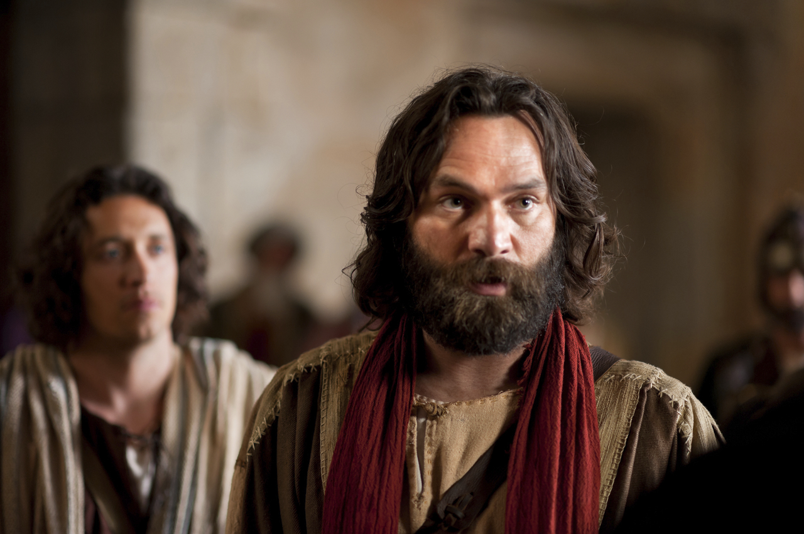
“When there had been much disputing, Peter rose up, and said unto them…Why tempt ye God, to put a yoke upon the neck of the disciples, which neither our fathers nor we were able to bear?”
Bible Videos
Acts 15:6-7, 10
Notes:
Image: https://www.churchofjesuschrist.org/media/image/bible-videos-peter-f72b637?lang=eng
“Yoke of the Law” (m. Avot 3:5)
“The Pharisees have delivered to the people a great many observances by succession from their fathers, which are not written in the laws of Moses…and have the multitude on their side.” (Josephus, Ant. 13.297-298)
Keep in mind that some of these fence laws were very stringent. Like with the Sabbath – can’t put out a fire – so if you home is on fire, can’t put it out. But if a person is in the home, you’re obligated to put it out. So if I get home and my house is on fire, I might throw a kid in so I could put out the fire! ☺

Slide 21
President Dieter F. Uchtdorf Ensign, November 2009.
“One person’s good idea—something that may work for him or her—takes root and becomes an expectation.”
Notes:
For example, a woman feels inspired to read 30 minutes a day from theBook of Mormon. Later in RS she is challenged to read all General Conference Talksbetween conferences, then the VT come and invite you to keep a tender mercy journal, and then the HT come … collectively this could turnthe joy of scripture studyfor feelilgn theHG intoa burden.
On a much longer session, could have a breakout: Discuss in groups – what do you think Pres. Uchtdorf is talking about?

Slide 22
Six Aspects of Fence Laws
Have Spirit-driven fence laws
Lighten your heavy yoke.
Focus on the mark, not the fence
Focus on the core, not the fence when teaching others
Don’t judge others on fence laws
Follow the prophet

Slide 23
Pharisees: “Why do your disciples break the tradition of the elders? For they do not wash their hands before they eat.”
Matthew 15:1-20,
New Revised Standard Version
Notes:
Image: https://www.churchofjesuschrist.org/study/manual/gospel-art-book/old-testament?lang=eng
The “tradition of the elders” of course was a fence law.
Christ rebuked the Pharisees because they had put their fence laws (traditions relating to how one could delay giving money to parents) above the core law (honoring father and mother).

Slide 24
Pharisees: “Why do your disciples break the tradition of the elders? For they do not wash their hands before they eat.”
Christ: “Why do you break the commandment of God for the sake of your tradition? For God said, ‘Honor your father and your mother,’ and, ‘Whoever speaks evil of father or mother must surely die.’ But you say that whoever tells father or mother, ‘Whatever support you might have had from me is given to God,’ then that person need not honor the father or the mother.
Matthew 15:1-20,
New Revised Standard Version
Notes:
Image: https://www.churchofjesuschrist.org/study/manual/gospel-art-book/old-testament?lang=eng
The “tradition of the elders” of course was a fence law.
Christ rebuked the Pharisees because they had put their fence laws (traditions relating to how one could delay giving money to parents) above the core law (honoring father and mother).

Slide 25
Pharisees: “Why do your disciples break the tradition of the elders? For they do not wash their hands before they eat.”
Christ: “Why do you break the commandment of God for the sake of your tradition? For God said, ‘Honor your father and your mother,’ and, ‘Whoever speaks evil of father or mother must surely die.’ But you say that whoever tells father or mother, ‘Whatever support you might have had from me is given to God,’ then that person need not honor the father or the mother. So, for the sake of your tradition, you make void the word of God. You hypocrites!”
Matthew 15:1-20,
New Revised Standard Version
Notes:
Image: https://www.churchofjesuschrist.org/study/manual/gospel-art-book/old-testament?lang=eng
The “tradition of the elders” of course was a fence law.
Christ rebuked the Pharisees because they had put their fence laws (traditions relating to how one could delay giving money to parents) above the core law (honoring father and mother).

Slide 26
Christ: “Do you not see that whatever goes into the mouth enters the stomach, and goes out into the sewer? But what comes out of the mouth proceeds from the heart, and this is what defiles. For out of the heart come evil intentions, murder, adultery, fornication, theft, false witness, slander. These are what defile a person, but to eat with unwashed hands does not defile.”
Matthew 15:1-20,
New Revised Standard Version
Notes:
Image: https://www.churchofjesuschrist.org/study/manual/gospel-art-book/old-testament?lang=eng
The “tradition of the elders” of course was a fence law.
Christ rebuked the Pharisees because they had put their fence laws (traditions relating to how one could delay giving money to parents) above the core law (honoring father and mother).

Slide 27
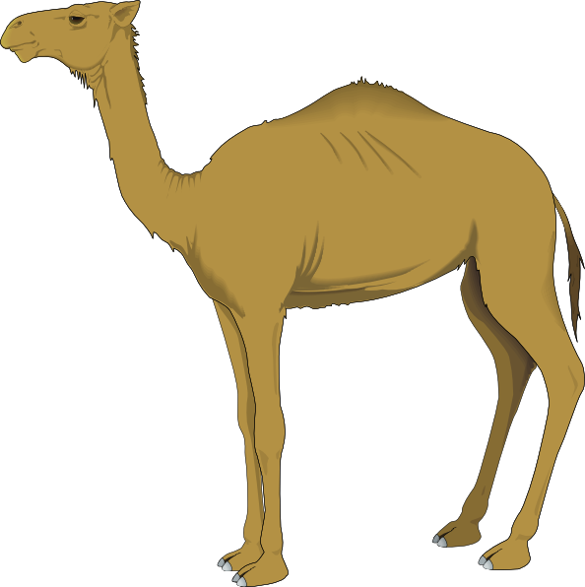
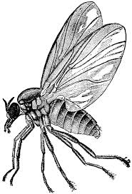
Matthew 23:23-24
Strain a Gnat
Swallow a Camel
“You blind guides! You strain out a gnat but swallow a camel!”
Notes:
Image 1: http://clipart-library.com/cartoon-camel-pictures.html
Image 2: http://clipart-library.com/search2/?q=gnat#gsc.tab=1&gsc.q=gnat&gsc.page=1
Ye blind guides, which strain at a gnat, and swallow a camel. (New Testament, Matthew 23:24)
*The gnat is one of the smallest unkosher animals.
*The camel is one of the largest unkosher animals.
*They strain out unkosher gnats. But by ignoring more important commandments, the Jewish leaders figuratively swallowed an unkosher camel.

Slide 28
What’s the mark?
A lawyer asked, “Master, which is the great commandment in the law?”
Jesus said unto him, “Thou shalt love the Lord thy God with all thy heart…And the second is like unto it, Thou shalt love thy neighbour as thyself.”
(Matthew 22:35–39)
James Tissot
Notes:
Image: https://www.brooklynmuseum.org/opencollection/objects/13456
Sometimes we can get caught up in the “offerings and sacrifices” (like “We’ve got to make our monthly visit,” “We’ve got to have reverence during family scripture study,” “We need to dress modestly,”) and miss the mark of loving God and neighbors. These commandments are our target. Fence laws make it harder for LA to join in.

Slide 29
Six Aspects of Fence Laws
Have Spirit-driven fence laws
Lighten your heavy yoke.
Focus on the mark, not the fence
Focus on the core, not the fence when teaching others
Don’t judge others on fence laws
Follow the prophet

Slide 30
Notes:
Elder Robbins fence law story … “my list is going church wide” tie back to how all three were fence laws, but the LGR principle gets us closer to the underlying law.

Slide 31
A Fence Around the Law
Receive the Holy Ghost
No PG-13 Movies
Notes:
Maria/Levi story.
Teach the principles and the doctrines

Slide 33
“Of tenets [beliefs or opinions] thou shalt not talk, but thou shalt declare repentance and faith on the Savior, and remission of sins by baptism, and by fire, yea, even the Holy Ghost.”
Doctrine and Covenants 19:31
Notes:
Image: https://www.churchofjesuschrist.org/study/manual/gospel-art-book/old-testament?lang=eng
The “tradition of the elders” of course was a fence law.
Christ rebuked the Pharisees because they had put their fence laws (traditions relating to how one could delay giving money to parents) above the core law (honoring father and mother).

Slide 34
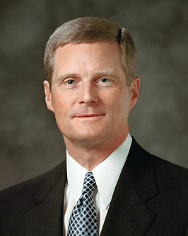
Elder David A. Bednar Increase in Learning
“Applications, such as…items on the lengthy "to do" lists of many members, tend to receive disproportionate and excessive attention. I…am not suggesting that applications should never be studied, learned, or taught. Appropriate applications are necessary but can never stand alone. What is needed is a balance among doctrines, principles, and applications. And for many conscientious and diligent members, a serious imbalance exists.”
Notes:
President Nelson, Sabbath
Sister Dalton, swimsuits

Slide 35
Six Aspects of Fence Laws
Have Spirit-driven fence laws
Lighten your heavy yoke.
Focus on the mark, not the fence
Focus on the core, not the fence when teaching others
Don’t judge others on fence laws
Follow the prophet

Slide 36
Notes:
We should never judge people – I’ve noticed that in many cases we judge people based on FL even more than real laws.

Slide 37
Denise’s daughter Jennifer was asked to prom – the problem was that Jennifer turned sixteen four days after Prom. Denise told Jennifer that she could decide for herself if she went. After some deliberation, Jennifer decided to go to Prom. A few days later, the boy who had invited Jennifer to Prom asked her, “How old are you?” Jennifer explained that she was fifteen but that she would be turning sixteen four days after prom. The young man promptly uninvited her from the dance.
Notes:
As I share this story, different people judge. Serves Jennifer right, why wasn’t denise a better parent? Or, “I’m sure it wasn’t the boy who wanted to uninvite the girl…” Some times we judge the judgers.

Slide 38
Matthew 7:3-5 New Living Translation
Why worry about a speck in your friend’s eye when you have a log in your own? How can you think of saying to your friend, ‘Let me help you get rid of that speck in your eye,’ when you can’t see past the log in your own eye? Hypocrite! First get rid of the log in your own eye; then you will see well enough to deal with the speck in your friend’s eye.
Notes:
Image: https://www.churchofjesuschrist.org/study/manual/gospel-art-book/old-testament?lang=eng

Slide 39
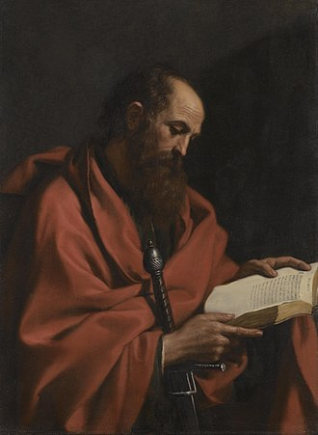
“Welcome those who are weak in faith, but not for the purpose of quarrelling over opinions. Some believe in eating anything, while the weak eat only vegetables. Those who eat must not despise those who abstain, and those who abstain must not pass judgement on those who eat; for God has welcomed them. Who are you to pass judgment on servants of another?”
Guercino
Romans 14:2-4 NRSV
Notes:
Image: https://en.wikipedia.org/wiki/Paul_the_Apostle
Could riff on something like this:
In a modern context, we might see debates about whether it’s okay to drink Coke, have a vegan (or all-meat) diet, whole wheat, white bread, and so forth. Paul did not want the members to argue about these issues which are tangential to faith in Christ.

Slide 40
“Welcome those who are weak in faith, but not for the purpose of quarrelling over opinions. Some believe in eating anything, while the weak eat only vegetables. Those who eat must not despise those who abstain, and those who abstain must not pass judgement on those who eat; for God has welcomed them. Who are you to pass judgment on servants of another?”
Guercino
Romans 14:2-4 NRSV
Notes:
Image: https://en.wikipedia.org/wiki/Paul_the_Apostle
Could riff on something like this:
In a modern context, we might see debates about whether it’s okay to drink Coke, have a vegan (or all-meat) diet, whole wheat, white bread, and so forth. Paul did not want the members to argue about these issues which are tangential to faith in Christ.

Slide 41
“Let us therefore no longer pass judgment on one another, but resolve instead never to put a stumbling block or hindrance in the way of another...
Guercino
Romans 14:13-15, 20-21 NRSV
Notes:
For example, what if some of my family members judge me for drinking a Coke, but it’s not actually wrong to drink a Coke.

Slide 42
“Let us therefore no longer pass judgment on one another, but resolve instead never to put a stumbling block or hindrance in the way of another...If your brother or sister is being injured by what you eat, you are no longer walking in love.
Guercino
Romans 14:13-15, 20-21 NRSV
Notes:
So according to Paul, even though it’s not wrong for me to drink a Coke, if I’m hurting other people by drinking it, I’m no longer walking in love.

Slide 43
“Let us therefore no longer pass judgment on one another, but resolve instead never to put a stumbling block or hindrance in the way of another...If your brother or sister is being injured by what you eat, you are no longer walking in love. Do not let what you eat cause the ruin of one for whom Christ died….Do not, for the sake of food, destroy the work of God. Everything is indeed clean, but it is wrong for you to make others fall by what you eat; it is good not to eat meat…or do anything that makes your brother or sister stumble.”
Guercino
Romans 14:13-15, 20-21 NRSV
Notes:
Sometimes we might have the attitude of “Don’t judge me” I can do whatever I want, but Paul also reminds us that to be Christlike, we should not only not judge others, but be gracious and not do things that we technically could do if it’s going to hurt others. These are important principles for us to consider as we think about judging and fence laws.

Slide 44
Six Aspects of Fence Laws
Have Spirit-driven fence laws
Lighten your heavy yoke.
Focus on the mark, not the fence
Focus on the core, not the fence when teaching others
Don’t judge others on fence laws
Follow the prophet

Slide 46
“Do you sustain the members of the First Presidency and the Quorum of the Twelve Apostles as prophets, seers, and revelators?”

Slide 47
Doctrine and Covenants 21:4-5
“Thou shalt give heed unto all his [the prophet’s] words and commandments which he shall give unto you as he receiveth them, walking in all holiness before me; For his word ye shall receive, as if from mine own mouth, in all patience and faith.”
Notes:
Image: https://www.churchofjesuschrist.org/study/manual/gospel-art-book/old-testament?lang=eng

Slide 48
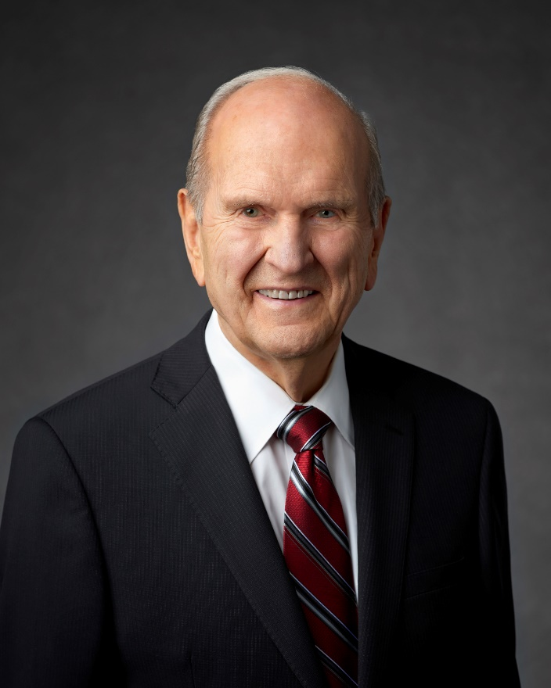
President Russell M. Nelson
“For the Strength of Youth should be your standard. It is the standard that the Lord expects all of His youth to uphold.”
Notes:
Point out that recording and responding to promptings will help us to obtain additional light.

Slide 49
President Dieter F. Uchtdorf Ensign, May 2006.
“You…who are already 18 or older, if you don’t have [the For the Strength of Youth] booklet anymore, make sure to get one, keep it, and use it.”

Slide 50
President Eyring, Ensign, May 1997.
“Every time in my life when I have chosen to delay following inspired counsel or decided that I was an exception, I came to know that I had put myself in harm’s way. Every time that I have listened to the counsel of prophets, felt it confirmed in prayer, and then followed it, I have found that I moved toward safety.”

Slide 51
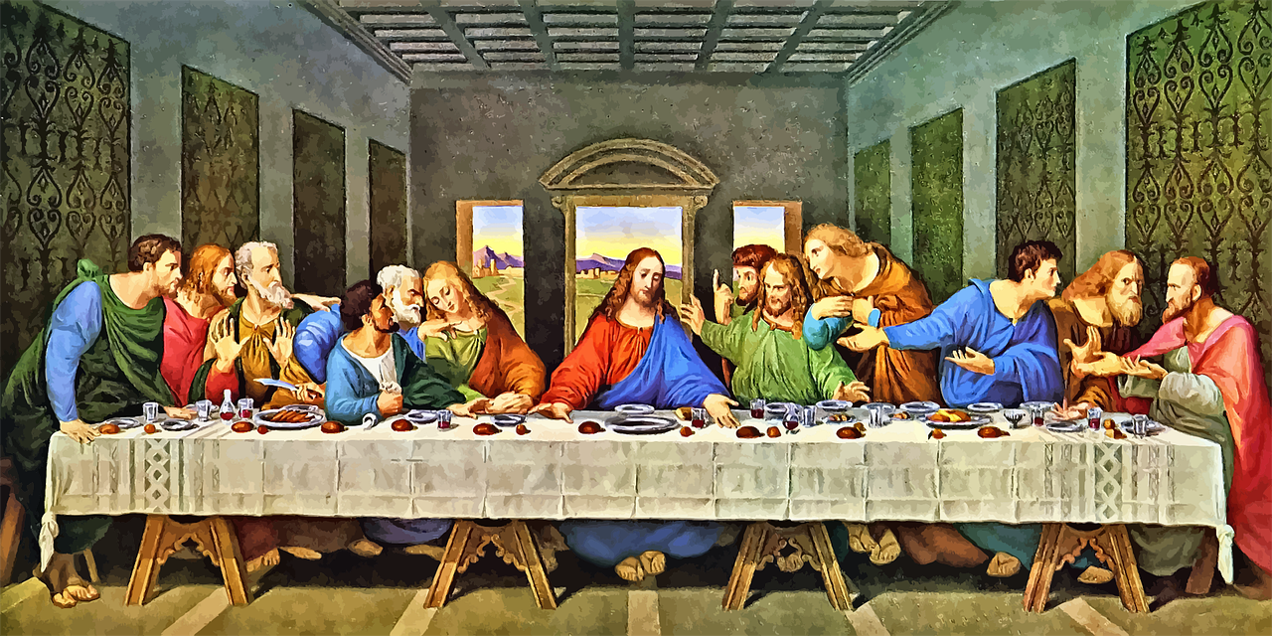
Lord, is it I? (Matthew 26:22)
Leonardo Da Vinci
Notes:
Image: https://pixabay.com/vectors/last-supper-jesus-leonardo-da-vinci-4997322/
In a meeting like this we sometimes think, “I wish my sister were here,” (or brother, or neighbor, etc.).

Slide 52
“As servants of God, live as free people, yet do not use your freedom as a pretext for evil.”
(1 Peter 2:16, NRSV)

Slide 53
“Live by the Spirit . . .and do not gratify the desires of the flesh.”
(Galatians 5:16, NRSV)

Slide 54
As we “search diligently in the light of Christ” to know how to correctly apply or reject specific fence laws, we will find “peace, and joy in the Holy Ghost.”
(Moroni 7:19; Romans 14:17)

Slide 55
Acknowledgements
Insights from, discussions with, and resources authored by Dr. Matthew Grey, Dr. Frank Judd, and Dr. Anthony Sweat were used in the creation of this video.

