Slide 1
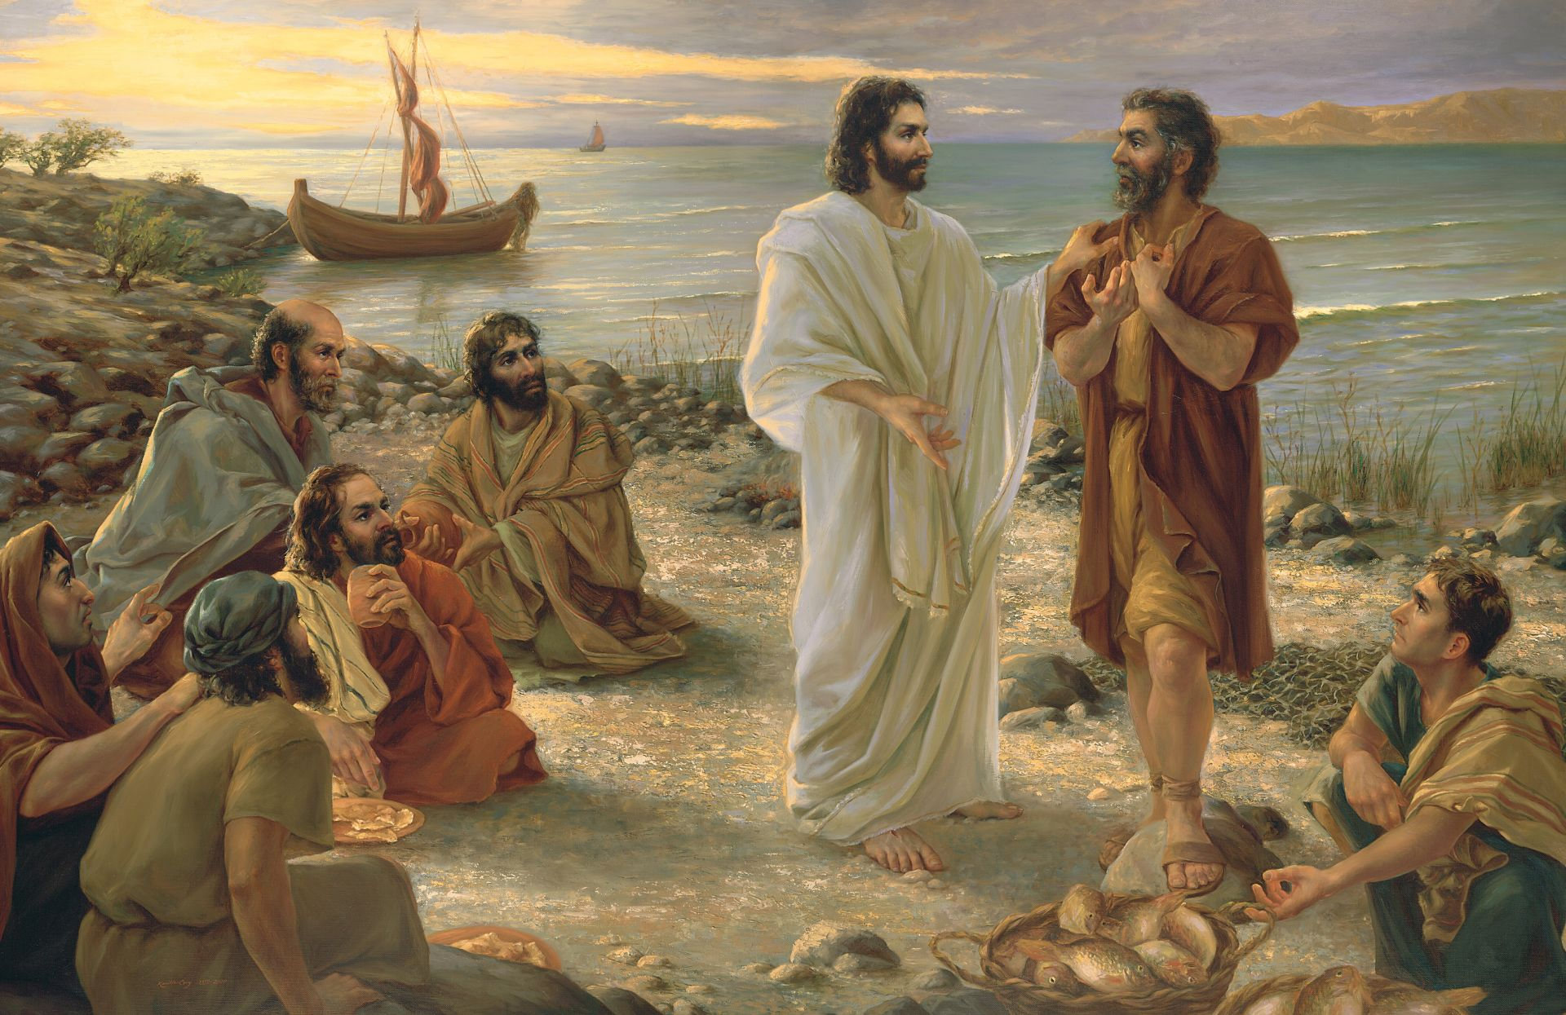
An Introduction to Parables
parable = “to set beside or compare”
A story from everyday experience that compares to some higher reality or truth.
Kamille Corry
Notes:
https://www.churchofjesuschrist.org/media/image/jesus-christ-feed-my-sheep-e104990?lang=eng&collectionId=3cbf78e787498a07417814a31656063f9227b4c6

Slide 2
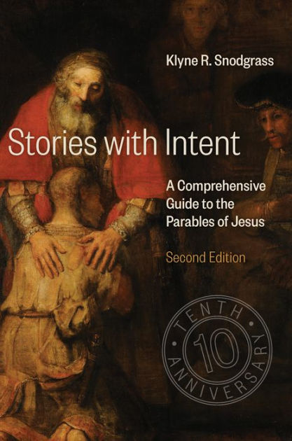

Slide 3
An Introduction to Parables
parable = “to set beside or compare”
The parables make up about 1/3 of Christ’s teachings in the Synoptic Gospels.
Kamille Corry
Notes:
https://www.churchofjesuschrist.org/media/image/jesus-christ-feed-my-sheep-e104990?lang=eng&collectionId=3cbf78e787498a07417814a31656063f9227b4c6

Slide 4
An Introduction to Parables
parable = “to set beside or compare”
 | Total Parables | Unique Parables
Matthew | 19 | 10
Mark | 7 | 1
Luke | 20 | 12
John | 0 | 0
All numbers approximate: defining parables is tricky
Notes:
Perhaps John has one parable (John 10:1-6, where the word “parable” appears in John 10:6). But consider that The Greek word παραβολή (parabolē) is never used in the Fourth Gospel—rather it’s a “proverb” or “figure of speech.”

Slide 5
Interpreting Parables: Some Ground Rules
Don’t push a parable too far—it’s a story, not comprehensive theology.
There are multiple interpretations—often no “one right answer.”
Titles matter. Jesus only named one parable (“The parable of the sower.”)
Notice how the title can influence interpretation—Is it “The prodigal son”? “The Jealous son”? “The Father who lost his sons”? “The compassionate father and his two lost sons”? The titles we use will influence how we interpret the parables.
Notes:
see this optional article for more info https://rsc.byu.edu/vol-4-no-1-2003/names-parables

Slide 6
Our Parables For Today
The parable of the sower
Three parables in Luke 15
The parable of the unforgiving servant
The parable of the good Samaritan
The parable of the laborers in the vineyard

Slide 7
The Parable of the Sower
“Listen! A sower went out to sow. And as he sowed, some seed fell on the path, and the birds came and ate it up. Other seed fell on rocky ground, where it did not have much soil, and it sprang up quickly, since it had no depth of soil. And when the sun rose, it was scorched; and since it had no root, it withered away. Other seed fell among thorns, and the thorns grew up and choked it, and it yielded no grain. Other seed fell into good soil and brought forth grain, growing up and increasing and yielding thirty and sixty and a hundredfold.” And he said, “Let anyone with ears to hear listen!” (Mark 4:3-9, NRSV)
Notes:
KJV Mark 4:3 says “hearken” which also means listen, but I’m using NRSV here to make it really clear.

Slide 8
The Parable of the Sower
“The sower soweth the word. And these are they by the way side, where the word is sown; but when they have heard, Satan cometh immediately, and taketh away the word that was sown in their hearts. And these are they likewise which are sown on stony ground; who, when they have heard the word, immediately receive it with gladness; And have no root in themselves, and so endure but for a time: afterward, when affliction or persecution ariseth for the word’s sake, immediately they are offended. And these are they which are sown among thorns; such as hear the word, And the cares of this world, and the deceitfulness of riches, and the lusts of other things entering in, choke the word, and it becometh unfruitful. And these are they which are sown on good ground; such as hear the word, and receive it, and bring forth fruit, some thirtyfold, some sixty, and some an hundred.” (Mark 4:14–20, KJV).
Notes:
Mark 4:3-9

Slide 9
What is the Word?
“The sower soweth the word” (Mark 4:14)
Notes:
Mark 4:3-9

Slide 10
What is the Word?
“The sower soweth the word” (Mark 4:14)
“In the beginning was the Word… And the Word was made flesh, and dwelt among us”
(John 1:1, 14)
Notes:
Mark 4:3-9

Slide 11
What is the Word?
“The sower soweth the word” (Mark 4:14)
“In the beginning was the Word… And the Word was made flesh, and dwelt among us”
(John 1:1, 14)
“We will compare the word unto a seed”
(Alma 32:28)
“Nourish the word”
(Alma 32:40)
Notes:
Mark 4:3-9

Slide 12
What is the Word?
“The sower soweth the word” (Mark 4:14)
“In the beginning was the Word… And the Word was made flesh, and dwelt among us”
(John 1:1, 14)
“We will compare the word unto a seed”
(Alma 32:28)
“Nourish the word”
(Alma 32:40)
“Begin to believe in the Son of God, that he will come to redeem his people, and that he shall suffer and die to atone for their sins; and that he shall rise again from the dead, which shall bring to pass the resurrection…I desire that ye shall plant this word in your hearts” (Alma 33:22–23)
Notes:
Mark 4:3-9

Slide 13
What Could We Do Today To Hear, receive, and do something with The Word?
Notes:
Time to ponder

Slide 14
Our Parables For Today
The parable of the sower
Three parables in Luke 15
The parable of the unforgiving servant
The parable of the good Samaritan
The parable of the laborers in the vineyard

Slide 15
Three Parables in Luke 15
Notes:
Canva- Kenley Kohls

Slide 16
Three Parables in Luke 15
“Enter not into the path of the wicked, and go not in the way of evil men” (Proverbs 4:14).
Don’t follow the path of the wicked
Don’t eat with wicked people.
Notes:
Canva- Kenley Kohls

Slide 17
Notes:
https://unsplash.com/photos/jmYJBQXvLNI
Photo by John Fowler
(there are in fact 100 sheep)

Slide 18
Notes:
https://pxhere.com/en/photo/1454523

Slide 19
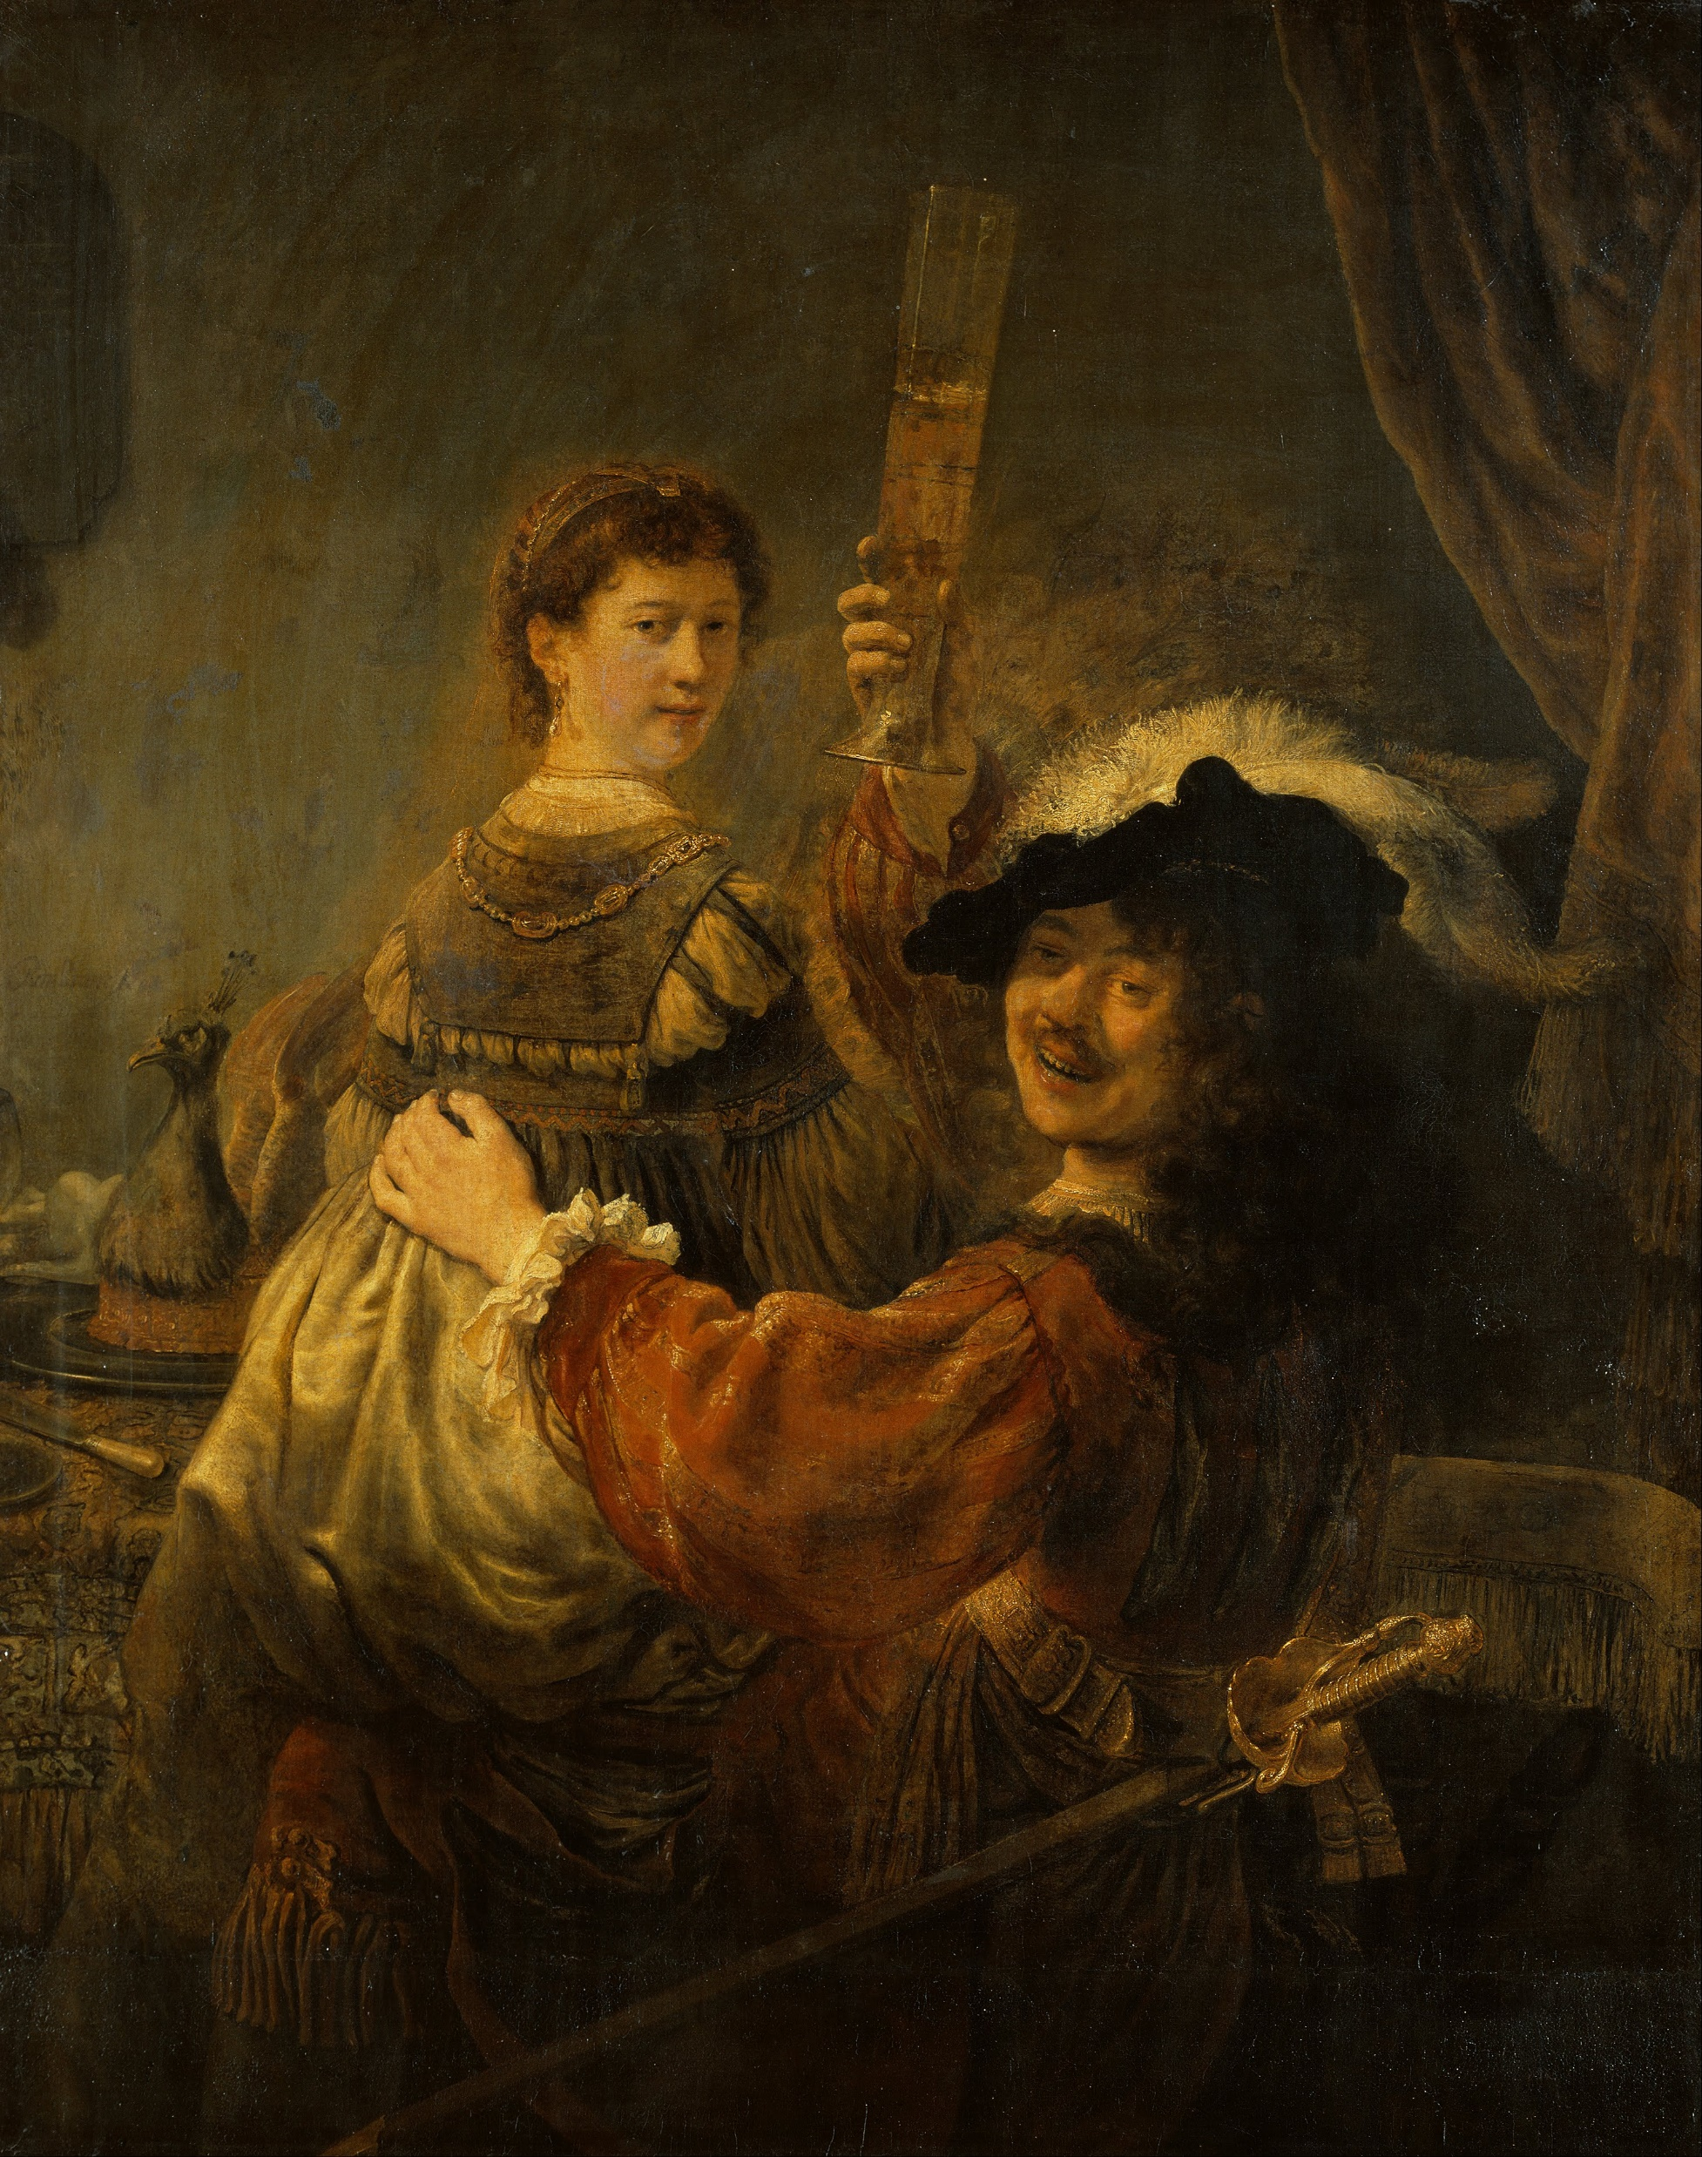
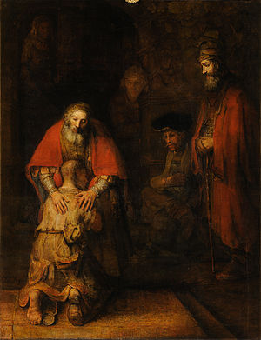
Notes:
Both images were done by master painter Rembrandt. One on the left, the prodigal in his wasteful state is actually a self-portrait of Rembrandt and his wife, showing that in some sense we are all the prodigal.

Slide 20
Luke 15:3-7
“And he spake this parable unto them, saying, What man of you, having an hundred sheep, if he lose one of them, doth not leave the ninety and nine in the wilderness, and go after that which is lost, until he find it? And when he hath found it, he layeth it on his shoulders, rejoicing. And when he cometh home, he calleth together his friends and neighbours, saying unto them, Rejoice with me; for I have found my sheep which was lost. I say unto you, that likewise joy shall be in heaven over one sinner that repenteth, more than over ninety and nine just persons, which need no repentance.”

Slide 21
Notes:
Read Luke 15:3-7—what observations do you want to share? Point out how hard it is to notice that one sheep is missing! ;)
https://unsplash.com/photos/jmYJBQXvLNI
Photo by John Fowler

Slide 22
Notes:
https://unsplash.com/photos/jmYJBQXvLNI
Photo by John Fowler
(there are in fact 100 sheep)

Slide 23
Notes:
Read Luke 15:3-6—what observations do you want to share? Point out how hard it is to notice that one sheep is missing! ;)
https://unsplash.com/photos/jmYJBQXvLNI
Photo by John Fowler

Slide 24
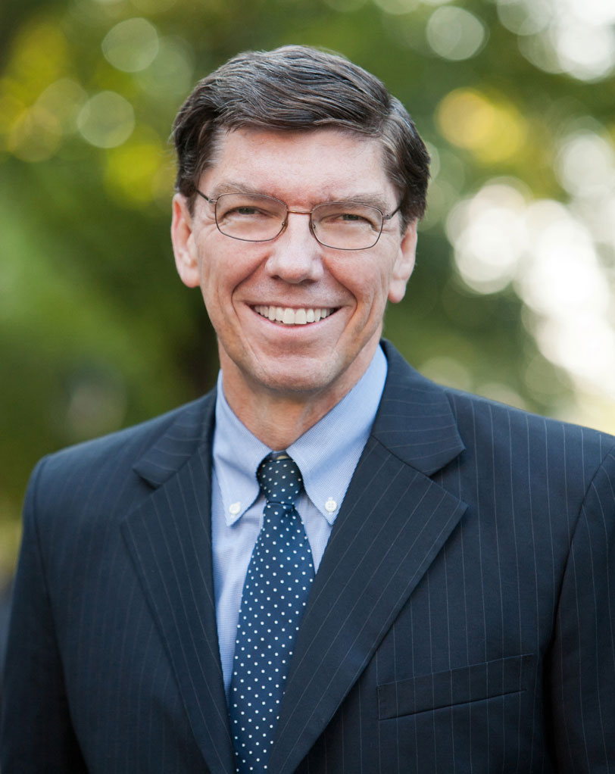
“In every sacrament meeting…our clerks count the number of sheep who returned to the fold. They store this number in a safe place for the quarterly report, and then we go home. If we conformed our ways to God’s ways, we’d list the names of the individual members who could have returned to the fold on that Sunday but didn’t come. Then we’d go find them.
Elder Clayton M. Christensen
Ensign, Feb. 2007
Notes:
https://www.alumni.hbs.edu/stories/Pages/story-bulletin.aspx?num=7254

Slide 25
“[In a district in France], at the end of Sunday meetings, the branch councils and missionaries together named the members and investigators who could have been there but didn’t come. They each took an assignment to contact one of those individuals that same day with this message: “We sure missed you today. Are you OK? It’s not the same for the rest of us when you can’t come. Can I help? Can you come next Sunday?”
Elder Clayton M. Christensen
Ensign, Feb. 2007
Notes:
https://www.alumni.hbs.edu/stories/Pages/story-bulletin.aspx?num=7254

Slide 26
“Within two years, sacrament meeting attendance in the district increased from 540 to 725—in a region where convert baptisms are infrequent.
We should be careful not to offend members who deliberately do not want to attend. But helping each member who only occasionally returns to the fold on Sunday to feel needed and feel our love is a simple practice that every ward and branch can begin. Many less-active members got that way because they didn’t return to the fold one Sunday and nobody seemed to notice.”
Elder Clayton M. Christensen
Ensign, Feb. 2007
Notes:
https://www.alumni.hbs.edu/stories/Pages/story-bulletin.aspx?num=7254

Slide 27
“How think ye? if a man have an hundred sheep, and one of them be gone astray, doth he not leave the ninety and nine, and goeth into the mountains, and seeketh that which is gone astray? And if so be that he find it, verily I say unto you, he rejoiceth more of that sheep, than of the ninety and nine which went not astray. Even so it is not the will of your Father which is in heaven, that one of these little ones should perish.” (Matthew 18:12–14)
Heinrich Hofmann
Notes:
Image: https://www.churchofjesuschrist.org/study/manual/gospel-art-book/old-testament?lang=eng

Slide 28
What man of you, having an hundred sheep, if he lose one of them, doth not leave the ninety and nine in the wilderness, and go after that which is lost, until he find it? And when he hath found it, he layeth it on his shoulders, rejoicing. And when he cometh home, he calleth together his friends and neighbours, saying unto them, Rejoice with me; for I have found my sheep which was lost. I say unto you, that likewise joy shall be in heaven over one sinner that repenteth, more than over ninety and nine just persons, which need no repentance. (Luke 15:4–7)
Heinrich Hofmann
Notes:
Image: https://www.churchofjesuschrist.org/study/manual/gospel-art-book/old-testament?lang=eng

Slide 29
“What woman having ten pieces of silver, if she lose one piece, doth not light a candle, and sweep the house, and seek diligently till she find it? And when she hath found it, she calleth her friends and her neighbours together, saying, Rejoice with me; for I have found the piece which I had lost. Likewise, I say unto you, there is joy in the presence of the angels of God over one sinner that repenteth.” (Luke 15:8–10)
Notes:
https://pxhere.com/en/photo/1454523
Note that the message of this parable is similar to the shepherd—rejoicing over the sinner who repents. Have you ever felt bothered by this parable though? Maybe you say, “Well, I’m pretty righteous, so this isn’t that cool—doesn’t God rejoice over me.” Two things: 1. We’re all sinners. 2. Let’s see how this idea is addressed in the final chapter of the parable.

Slide 30
Luke 15:11-32: The Longest Parable
Notes:
Note the younger son took all his stuff. When you’re in college did you take all your stuff—no! You thought you were going back. You only take all you’re stuff, when you’re permanently leaving!
Note the contrasting attitudes between the elder brother and the father towards those who are repenting.

Slide 31
Luke 15:11-32: The Longest Parable “A certain man had TWO sons”
“He would not go in” (v. 28)
“His father came out” (v. 28)
Notes:
Note the younger son took all his stuff. When you’re in college did you take all your stuff—no! You thought you were going back. You only take all you’re stuff, when you’re permanently leaving!
Note the contrasting attitudes between the elder brother and the father towards those who are repenting.

Slide 32
Luke 15:11-32: The Longest Parable “A certain man had TWO sons”
“He would not go in” (v. 28)
“You never gave me a goat” (v. 29)
“His father came out” (v. 28)
“You are always with me” (v. 31)
Notes:
Note the younger son took all his stuff. When you’re in college did you take all your stuff—no! You thought you were going back. You only take all you’re stuff, when you’re permanently leaving!
Note the contrasting attitudes between the elder brother and the father towards those who are repenting.

Slide 33
Luke 15:11-32: The Longest Parable “A certain man had TWO sons”
“He would not go in” (v. 28)
“You never gave me a goat” (v. 29)
“As soon as this thy son was come…” (v. 30)
“His father came out” (v. 28)
“You are always with me” (v. 31)
“Thy brother was dead, and is alive again” (v. 32)
Notes:
Note the younger son took all his stuff. When you’re in college did you take all your stuff—no! You thought you were going back. You only take all you’re stuff, when you’re permanently leaving!
Note the contrasting attitudes between the elder brother and the father towards those who are repenting.

Slide 34
Luke 15:11-32: The Longest Parable “A certain man had TWO sons”
“He would not go in” (v. 28)
“You never gave me a goat” (v. 29)
“As soon as this thy son was come…” (v. 30)
“He was angry” (v. 28)
“His father came out” (v. 28)
“You are always with me” (v. 31)
“Thy brother was dead, and is alive again” (v. 32)
“We should rejoice” (v. 32)
Notes:
Note the younger son took all his stuff. When you’re in college did you take all your stuff—no! You thought you were going back. You only take all you’re stuff, when you’re permanently leaving!
Note the contrasting attitudes between the elder brother and the father towards those who are repenting.

Slide 35
Our Parables For Today
The parable of the sower
Three parables in Luke 15
The parable of the unforgiving servant
The parable of the good Samaritan
The parable of the laborers in the vineyard

Slide 36
Parable of the Unforgiving Servant
Dollar amounts
1 “pence” (denarius) = 1 day’s wages = (e.g.,) $100.00
1 talent = 6,000 pennies = $600,000 = 25 year’s wages
100 pence = $10,000
10,000 talents = $6,000,000,000 = 164,000 year’s wages
Ten thousand talents = more than the entire tribute paid by Galilee to Rome over a fifty-year period.

Slide 37
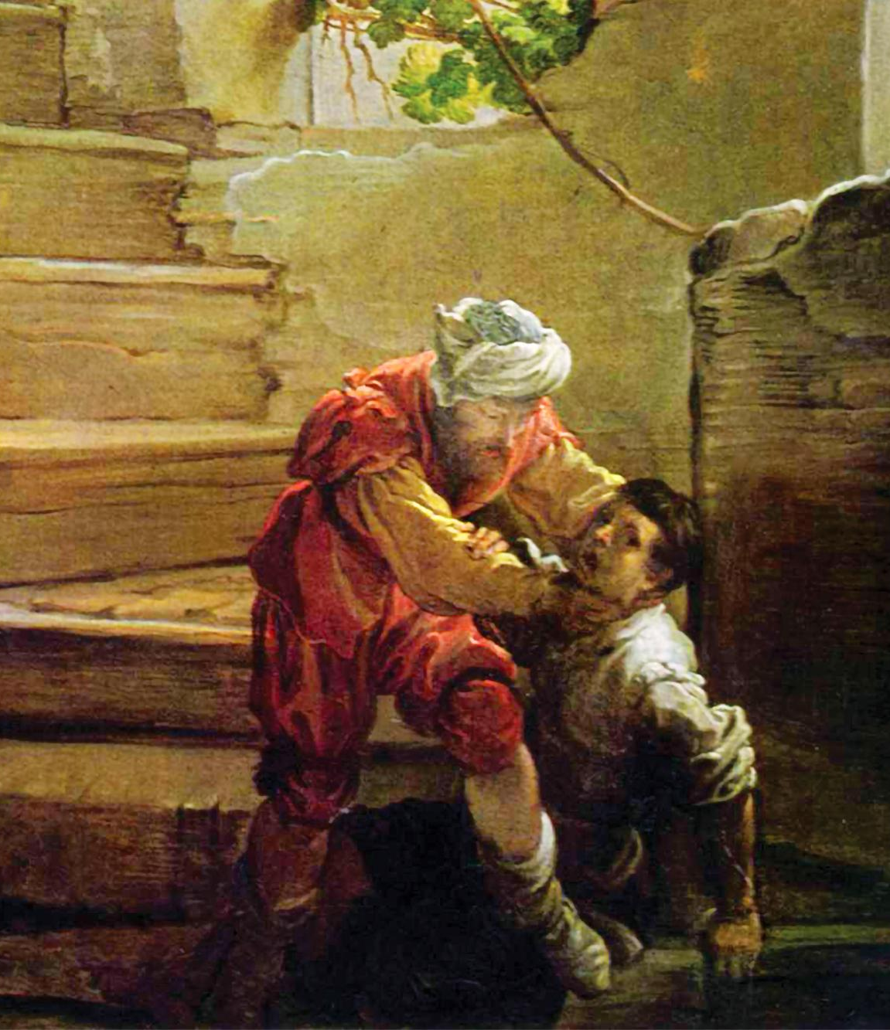
“When the king began to reckon, one was brought unto him, which owed him ten thousand talents. But forasmuch as he had not to pay, his lord commanded him to be sold…The servant therefore fell down, and worshipped him, saying, Lord, have patience with me, and I will pay thee all.
Then the lord of that servant was moved with compassion, and loosed him, and forgave him the debt. But the same servant went out, and found one of his fellowservants, which owed him an hundred pence: and he laid hands on him, and took him by the throat, saying, Pay me that thou owest. And his fellowservant fell down at his feet, and besought him, saying, Have patience with me, and I will pay thee all.”
Domenico Fetti
Matthew 18:24–29
Notes:
https://commons.wikimedia.org/wiki/File:Domenico_Fetti_001.jpg

Slide 38
“O thou wicked servant, I forgave thee all that debt, because thou desiredst me: Shouldest not thou also have had compassion on thy fellowservant, even as I had pity on thee?”
His lord was wroth, and delivered him to the tormentors, till he should pay all that was due unto him. So likewise shall my heavenly Father do also unto you, if ye from your hearts forgive not every one his brother their trespasses.” (Matthew 18:32–35)
Domenico Fetti
Matthew 18:24–29
Notes:
https://commons.wikimedia.org/wiki/File:Domenico_Fetti_001.jpg

Slide 39
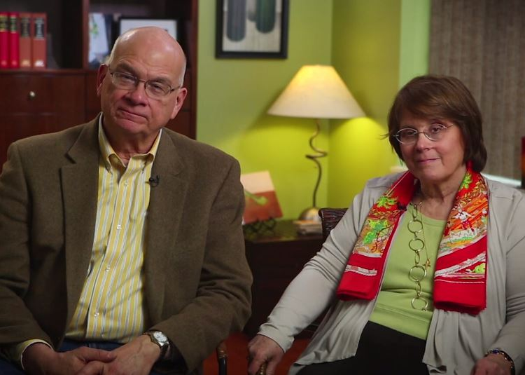
“If you see Jesus dying on the cross for others, forgiving the people who killed him, that can be just a crushing example of forgiving love that you will never be able to live up to. But if instead you see Jesus dying on the cross for you, forgiving you, putting away your sin, that changes everything. . . . The joy and freedom that comes from knowing that the Son of God did that for you enables you to do the same for [others.]”
Timothy and Kathy Keller,
The Meaning of Marriage,
185-186

Slide 40
“[Jesus] did not say, ‘You are not allowed to feel true pain or real sorrow from the shattering experiences you have had at the hand of another.’ Nor did He say, ‘In order to forgive fully, you have to reenter a toxic relationship or return to an abusive, destructive circumstance.’ But notwithstanding even the most terrible offenses that might come to us, we can rise above our pain only when we put our feet onto the path of true healing. That path is the forgiving one walked by Jesus of Nazareth, who calls out to each of us, ‘Come, follow me.’”
Elder Jeffrey R. Holland
Ensign, Nov. 2018
Notes:
See also: http://www.lds.org/general-conference/2008/04/to-heal-the-shattering-consequences-of-abuse?lang=eng
https://www.churchofjesuschrist.org/learn/jeffrey-r-holland?lang=eng

Slide 41
Our Parables For Today
The parable of the sower
Three parables in Luke 15
The parable of the unforgiving servant
The parable of the good Samaritan
The parable of the laborers in the vineyard

Slide 42
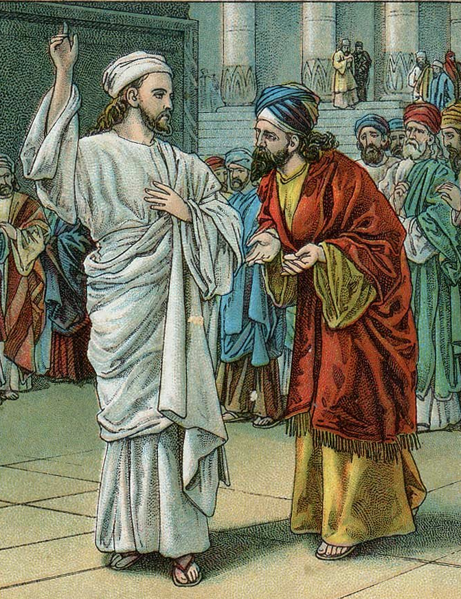
A scholar of religion stood up with a question to test Jesus. “Teacher, what do I need to do to get eternal life?”
He answered, “What’s written in God’s Law? How do you interpret it?”
He said, “That you love the Lord your God with all your passion and prayer and muscle and intelligence—and that you love your neighbor as well as you do yourself.”
“Good answer!” said Jesus. “Do it and you’ll live.”
Looking for a loophole, he asked, “And just how would you define ‘neighbor’?”
Luke 10:25-29,
The Message
Notes:
http://thebiblerevival.com/clipart38.htm

Slide 43
Luke 10:30–32
“A certain man went down from Jerusalem to Jericho, and fell among thieves, which stripped him of his raiment, and wounded him, and departed, leaving him half dead. And by chance there came down a certain priest that way: and when he saw him, he passed by on the other side. And likewise a Levite, when he was at the place, came and looked on him, and passed by on the other side.”

Slide 44
Notes:
Background on Samaritan-Jewish enmity—dating from ~950 BC with events coming into the time of Christ.
Picture taken by John Hilton III

Slide 45
Luke 10:33–35
“But a certain Samaritan, as he journeyed, came where he was: and when he saw him, he had compassion on him, And went to him, and bound up his wounds, pouring in oil and wine, and set him on his own beast, and brought him to an inn, and took care of him. And on the morrow when he departed, he took out two pence, and gave them to the host, and said unto him, Take care of him; and whatsoever thou spendest more, when I come again, I will repay thee.”

Slide 46
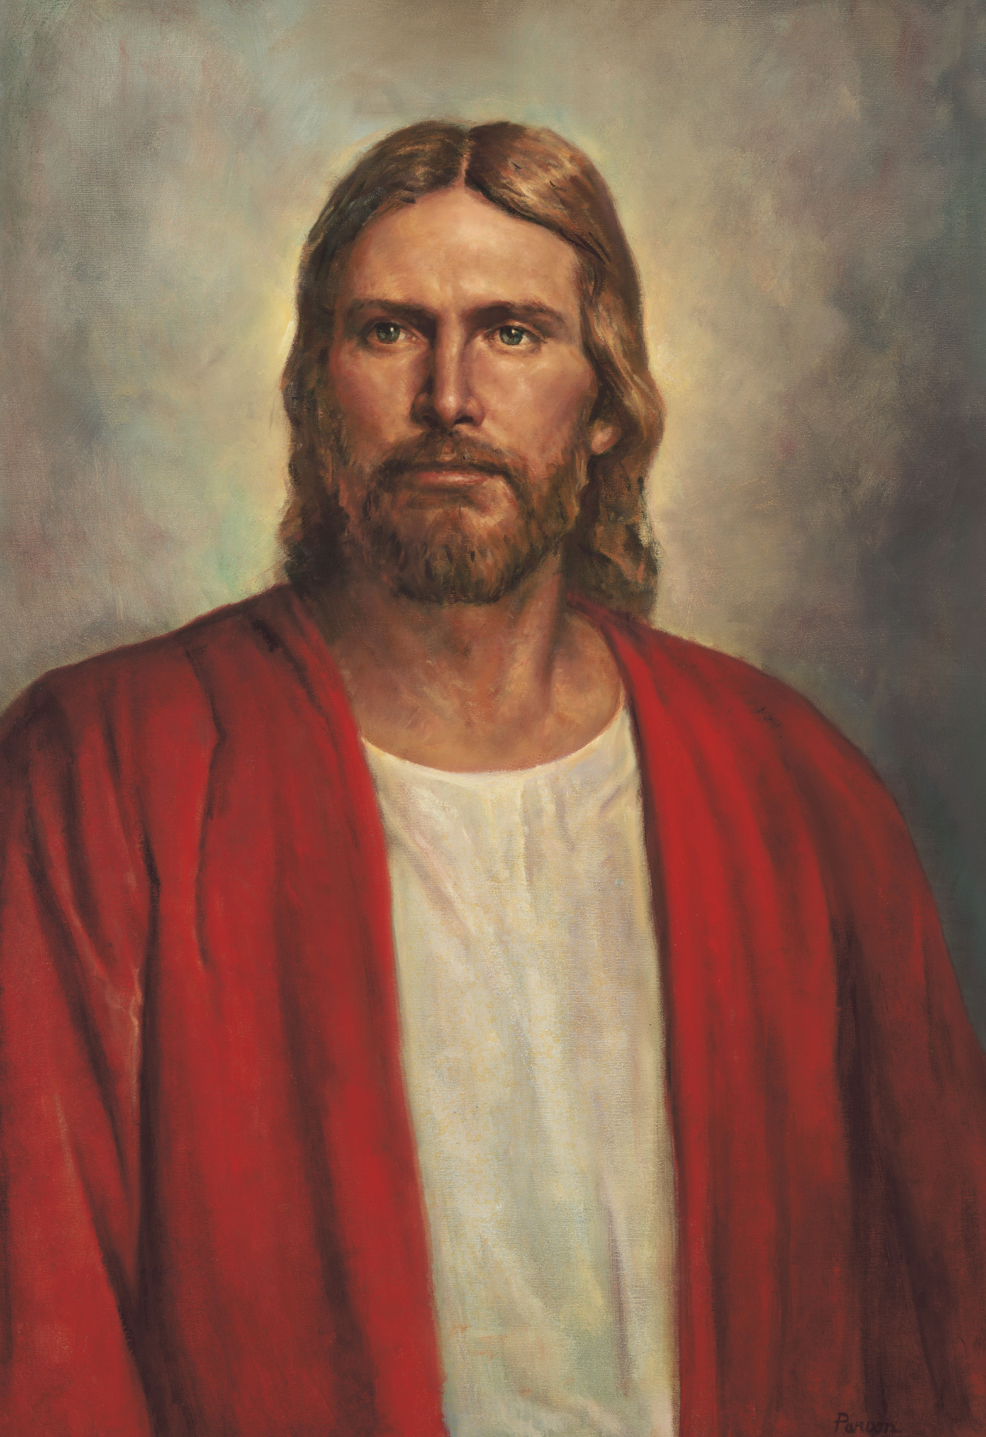
“Which now of these three, thinkest thou, was neighbour unto him that fell among the thieves?”
And he said, “He that shewed mercy on him.” Then said Jesus unto him, “Go, and do thou likewise.”
Del Parson
Luke 10:36-37
Notes:
https://www.churchofjesuschrist.org/media/image/jesus-christ-74e791b?lang=eng

Slide 47
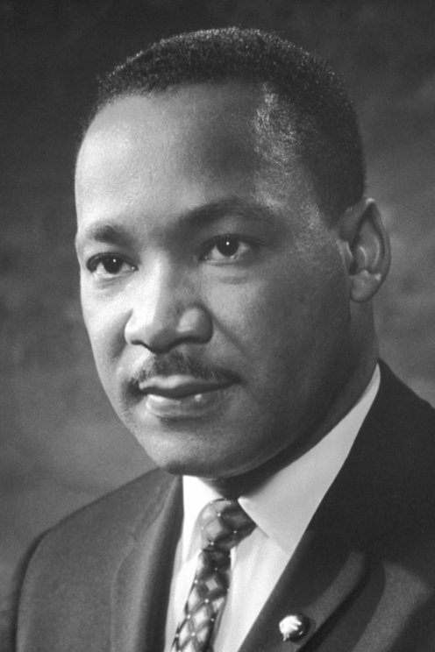
“It’s possible that the priest and the Levite looked over that man on the ground and wondered if the robbers were still around. Or it’s possible that they felt that the man on the ground was merely faking…in order to…lure them there for quick and easy seizure. And so the first question that the priest asked -- the first question that the Levite asked was, ‘If I stop to help this man, what will happen to me?’ But then the Good Samaritan came by. And he reversed the question: ‘If I do not stop to help this man, what will happen to him?’”
Dr. Martin Luther King Jr.
“I've Been to the Mountaintop,”
Delivered April 3, 1968, the day before he was assassinated.
Notes:
https://en.wikipedia.org/wiki/Martin_Luther_King_Jr.#/media/File:Martin_Luther_King,_Jr..jpg

Slide 48
Our Parables For Today
The parable of the sower
Three parables in Luke 15
The parable of the unforgiving servant
The parable of the good Samaritan
The parable of the laborers in the vineyard

Slide 49
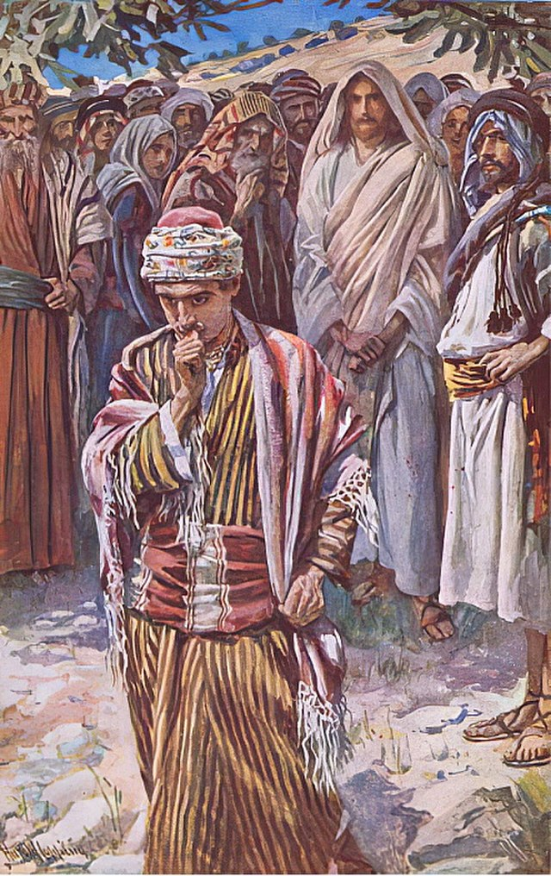
Matt. 19:16-26—Story of the rich young ruler, who won’t leave his riches behind.
Matt. 19:27-29—“Then Peter said in reply, “Look, we have left everything and followed you. What then will we have?” Jesus said to them… “You will have a great reward…”
Matt. 19:30—“But many who are first will be last, and the last will be first.”
Matt. 20:1-15—Parable of the Laborers
Matt. 20:16—“So the last will be first, and the first will be last.”
Harold Copping
Notes:
Remember rich young ruler won’t leave everything behind, but Peter and others did.
https://commons.wikimedia.org/wiki/File:Harold_Copping_-_The_rich_young_ruler_illustration_fromHarold_Copping_Pictures_The_Crown_Series_c_-_(MeisterDrucke-391719).jpg

Slide 50
Matthew 20:1–8, NRSV
“For the kingdom of heaven is like a landowner who went out early in the morning to hire laborers for his vineyard. After agreeing with the laborers for the usual daily wage, he sent them into his vineyard. When he went out about nine o’clock, he saw others standing idle in the marketplace; and he said to them, ‘You also go into the vineyard, and I will pay you whatever is right.’ So they went.

Slide 51
Matthew 20:1–8, NRSV
“When he went out again about noon and about three o’clock, he did the same. And about five o’clock he went out and found others standing around; and he said to them, ‘Why are you standing here idle all day?’ They said to him, ‘Because no one has hired us.’ He said to them, ‘You also go into the vineyard.’ When evening came, the owner of the vineyard said to his manager, ‘Call the laborers and give them their pay, beginning with the last and then going to the first.’

Slide 52
Matthew 20:9–15, NRSV
“When those hired about five o’clock came, each of them received the usual daily wage. Now when the first came, they thought they would receive more; but each of them also received the usual daily wage. And when they received it, they grumbled against the landowner, saying, ‘These last worked only one hour, and you have made them equal to us who have borne the burden of the day and the scorching heat.’

Slide 53
Matthew 20:9–15, NRSV
But he replied to one of them, ‘Friend, I am doing you no wrong; did you not agree with me for the usual daily wage? Take what belongs to you and go; I choose to give to this last the same as I give to you. Am I not allowed to do what I choose with what belongs to me? Or are you envious because I am generous?’”

Slide 54
Hank: “[Hypothetically,] What if you find out in the next life that everybody gets the celestial kingdom? No matter what, everyone gets the exact same reward. How would you feel?”
Hank’s friend: “I would be really upset.”
Hank Smith,
Living the Parables, 214

Slide 55
Hank: “Why?”
Hank’s friend: “Because I've worked hard and sacrificed a lot to get there.”
Hank: “You worked hard and sacrificed a lot, and you got the reward you were planning on. So what's wrong?”
Hank’s friend: “Yes, but it would still bother me.”
Hank Smith,
Living the Parables, 214

Slide 56
“We are not diminished when someone else is added upon. We are not in a race against each other to see who is the wealthiest or the most talented or the most beautiful or even the most blessed. The race we are really in is the race against sin…So be kind, and be grateful that God is kind. It is a happy way to live.”
Elder Jeffrey R. Holland, “The Laborers in the Vineyard,”
Ensign, May 2012
Notes:
https://newsroom.churchofjesuschrist.org/leader-biographies/elder-jeffrey-r-holland

Slide 57
President Henry B. Eyring “Always,” http://speeches.byu.edu
“As the forces around us increase in intensity, whatever spiritual strength was once sufficient will not be enough. And whatever growth in spiritual strength we once thought was possible, greater growth will be made available to us. Both the need for spiritual strength and the opportunity to acquire it will increase at rates which we underestimate at our peril.”

Slide 58
Acknowledgements
Insights from, discussions with, and resources authored by Dr. Hank Smith, Dr. Frank Judd, Dr. Klyne Snodgrass, Dr. Thomas Wayment, and Dr. Amy-Jill Levine were used in the creation of this video.

