Slide 1
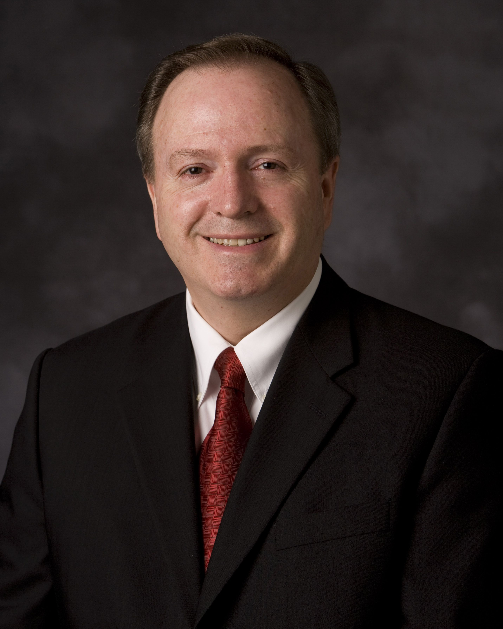
Elder Lynn G. Robbins
“Any time you blame, point a finger or self justify it will hurt you.”
“Even if you’re right it will hurt you to blame, to make an excuse, to justify.”

Slide 2
Elder Lynn G. Robbins
“When people understand [responsibility] and make no more excuses is the day they’re on the top and achieve things they’ve never done.”

Slide 3
Three Sermons from the Savior
Jesus’s first sermon in Luke
The Sermon on the Mount
The Bread of Life Discourse

Slide 4
Luke 4:16–19
“And he came to Nazareth, where he had been brought up: and, as his custom was, he went into the synagogue on the sabbath day, and stood up for to read. And there was delivered unto him the book of the prophet Isaiah. And when he had opened the book, he found the place where it was written, ‘The Spirit of the Lord is upon me, because he hath anointed me to preach the gospel to the poor; he hath sent me to heal the brokenhearted, to preach deliverance to the captives, and recovering of sight to the blind, to set at liberty them that are bruised, To preach the acceptable year of the Lord.’”

Slide 5
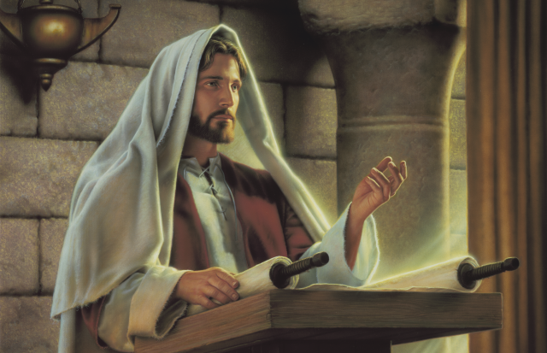
Luke 4:20–21
“He closed the book, and he gave it again to the minister, and sat down. And the eyes of all them that were in the synagogue were fastened on him. And he began to say unto them, This day is this scripture fulfilled in your ears.”
Simon Dewey

Slide 6
“He hath sent me to heal the brokenhearted.”
Nicolas Raymond
Notes:
https://www.flickr.com/photos/80497449@N04/10011881004

Slide 7
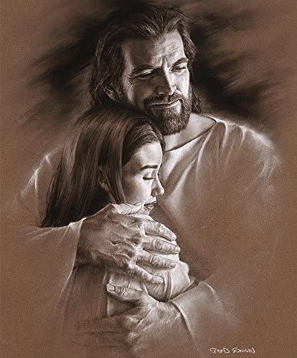
“God’s love was revealed among us in this way: God sent his only Son into the world so that we might live through him. In this is love, not that we loved God but that he loved us and sent his Son to be the atoning sacrifice for our sins.”
(1 John 4:9–10, NRSV)
David Bowman

Slide 8
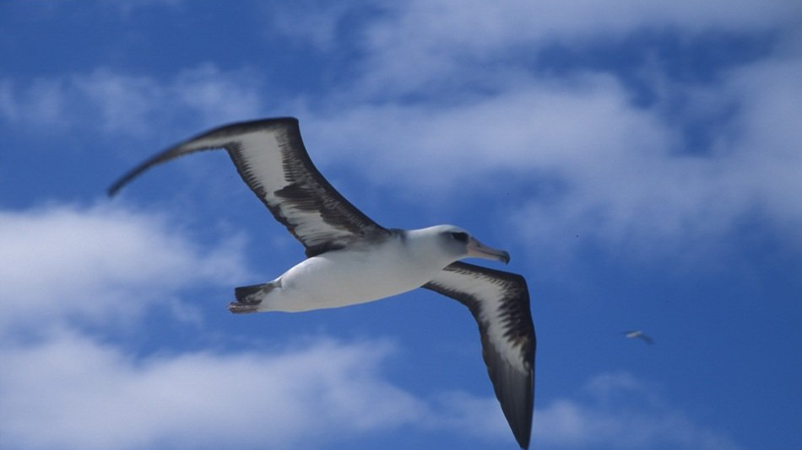
Notes:
https://pixy.org/4673359/

Slide 9
Luke 4:22
“All bare him witness, and wondered at the gracious words which proceeded out of his mouth. And they said, Is not this Joseph’s son?”

Slide 10
“The truth is, there were many widows in Israel in the time of Elijah, when the heaven was shut up three years and six months, and there was a severe famine over all the land; yet Elijah was sent to none of them except to a widow at Zarephath in Sidon.
(Luke 4:25–26, NRSV)
Rijksmuseum
Notes:
https://commons.wikimedia.org/wiki/File:Elia_en_de_weduwe_van_Sarefat,_RP-P-OB-45.886.jpg

Slide 11
“There were also many lepers in Israel in the time of the prophet Elisha, and none of them was cleansed except Naaman the Syrian.”
(Luke 4:27, NRSV)
Jim Padgett
Notes:
https://commons.wikimedia.org/wiki/File:Second_Book_of_Kings_Chapter_5-10_(Bible_Illustrations_by_Sweet_Media).jpg

Slide 12
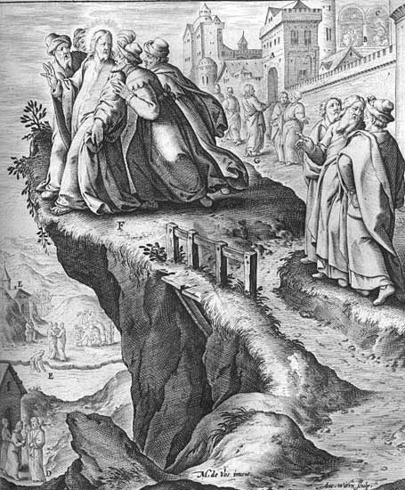
“All they in the synagogue, when they heard these things, were filled with wrath, And rose up, and thrust him out of the city, and led him unto the brow of the hill whereon their city was built, that they might cast him down headlong. But he passing through the midst of them went his way.”
(Luke 4:28–30)
Jerome Nadal

Slide 13
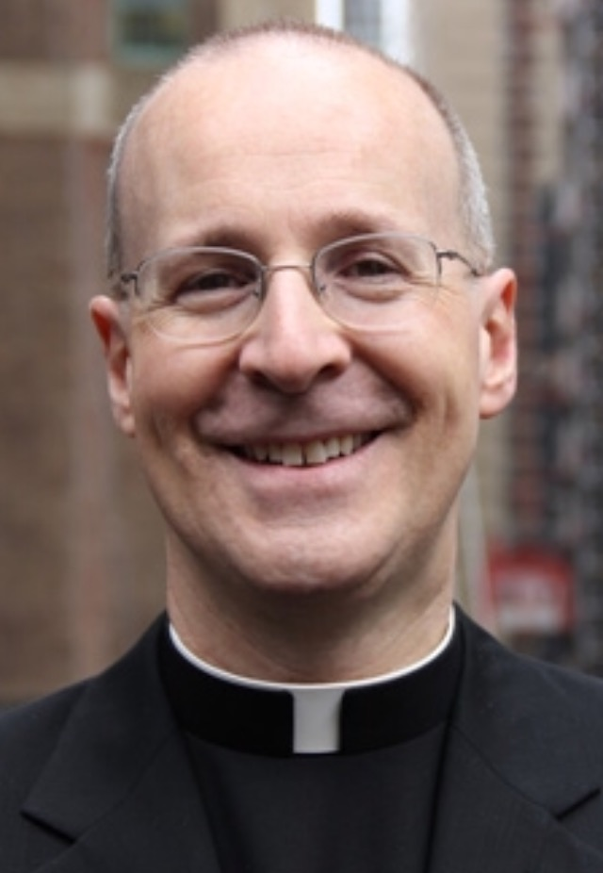
“Whenever I thought of saying or doing something that might have seemed controversial or unpopular I often wondered, What will people think? It’s a dangerous snare—you can easily end up paralyzed with inactivity, bound by the chains of approval. Jesus was the opposite: entirely free. Perhaps this came from his intimate relationship with the Father, with whom he was united in prayer. Jesus’s freedom sprang from an unwillingness to let other people’s opinions determine his actions.”
Editeurcoreen
James Martin, Jesus, A Pilgrimage
Notes:
https://en.wikipedia.org/wiki/James_Martin_(priest,_born_1960)#/media/File:JamesMartin.jpg

Slide 14
Three Sermons from the Savior
Jesus’s first sermon in Luke
The Sermon on the Mount
The Bread of Life Discourse

Slide 15
The Sermon on the Mount: A Few Key Ideas
Being the Beatitudes
Focusing on the heart
Perfecting love
Letting go of worry

Slide 16
The Beatitudes
“Blessed are the…”
Blessed, happy = beatus (Latin)
James Tissot

Slide 17
Matthew 5:3–12
“Blessed are the poor in spirit: for theirs is the kingdom of heaven. Blessed are they that mourn: for they shall be comforted. Blessed are the meek: for they shall inherit the earth. Blessed are they which do hunger and thirst after righteousness: for they shall be filled. Blessed are the merciful: for they shall obtain mercy. Blessed are the pure in heart: for they shall see God. Blessed are the peacemakers: for they shall be called the children of God. Blessed are they which are persecuted for righteousness’ sake: for theirs is the kingdom of heaven. Blessed are ye, when men shall revile you, and persecute you, and shall say all manner of evil against you falsely, for my sake. Rejoice, and be exceeding glad: for great is your reward in heaven: for so persecuted they the prophets which were before you”

Slide 18
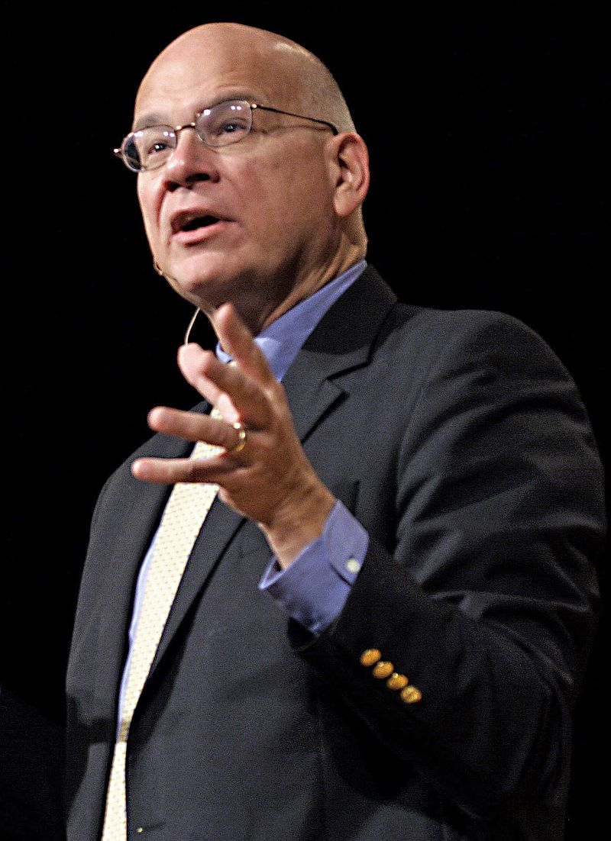
“You might look at those beatitudes, those descriptors and those rewards, and realize that they also describe Jesus himself. And when we think of that we see how what he did gives us what each beatitude promises. Why can you and I be as rich as kings? Because he became spiritually and utterly poor. Why can you and I be comforted? Only because he mourned; because he wept inconsolably and died in the dark.
Frank Licorice
Timothy Keller,
Preaching,
89–90
Notes:
https://en.wikipedia.org/wiki/Tim_Keller_(pastor)#/media/File:Timothy_Keller.jpg

Slide 19
“Why are you and I inheriting the earth? Because he became meek; because he was like a lamb before his shearers. Because he was stripped of everything—they even cast lots for his garment. Why can you and I be filled and satisfied? Because on the cross he said, “I thirst.” Why are you and I obtaining mercy? Because he got none: not from Pilate, not from the crowd, not even from his Father.
Frank Licorice
Timothy Keller,
Preaching,
89–90
Notes:
https://en.wikipedia.org/wiki/Tim_Keller_(pastor)#/media/File:Timothy_Keller.jpg

Slide 20
“Why will you and I be able to someday see God? Because he was pure. Do you know what the word “pure” means? It means to be single-minded, absolutely undivided, laser focused. So why is it that someday we will see God? Because Jesus Christ set his face like a flint to go up to Jerusalem and die for us (Luke 9:51). You and I can see God because, on the cross, Jesus could not.
Frank Licorice
Timothy Keller,
Preaching,
89–90
Notes:
https://en.wikipedia.org/wiki/Tim_Keller_(pastor)#/media/File:Timothy_Keller.jpg

Slide 21
“When you see Jesus Christ being poor in spirit for you, that helps you become poor in spirit before God and say, “I need your grace.” And once you get it and you are filled, then you are merciful, you become a peacemaker, you find God in prayer and wait someday for the beatific vision, to see God as he is (1 John 3:1–3). The beatitudes, like nearly everything else in Scripture, point us to Jesus far more than we think.”
Frank Licorice
Timothy Keller,
Preaching,
89–90
Notes:
https://en.wikipedia.org/wiki/Tim_Keller_(pastor)#/media/File:Timothy_Keller.jpg

Slide 22
The Sermon on the Mount: A Few Key Ideas
Being the Beatitudes
Focusing on the heart
Perfecting love
Letting go of worry

Slide 23
Gospel of Christ
Law of Moses
Christ Raises
The Standard
Marie-Lan Nguyen
Notes:
https://commons.wikimedia.org/wiki/File:Women_high_jump_French_Athletics_Championships_2013_t150931.jpg

Slide 24
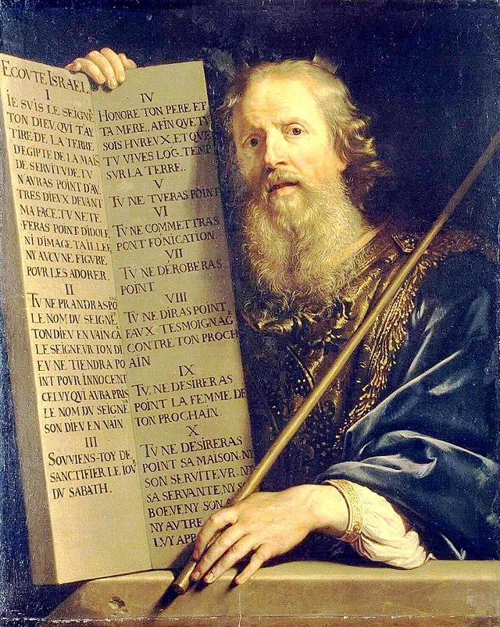
Philippe de Champaigne
“It has been said by them of old time, Thou shalt not kill, and whosoever shall kill shall be in danger of the judgment of God.”
Matthew 5:21 (alluding to Exodus 20:13)
Notes:
https://commons.wikimedia.org/wiki/File:Philippe_de_Champaigne_-_Moses_with_the_Ten_Commandments_-_WGA04717.jpg
https://www.churchofjesuschrist.org/media/image/christ-teaching-the-people-31eb3e7?lang=eng&collectionId=3cbf78e787498a07417814a31656063f9227b4c6
JST also changes “the judgment” to “his judgment” likely referring to God’s based on the previous verse.

Slide 25
Harry Anderson
“But I say unto you, that whosoever is angry with his brother without a cause shall be in danger of the judgment.”
KJV Matthew 5:22
Philippe de Champaigne
“It has been said by them of old time, Thou shalt not kill, and whosoever shall kill shall be in danger of the judgment of God.”
Matthew 5:21 (alluding to Exodus 20:13)
Notes:
https://commons.wikimedia.org/wiki/File:Philippe_de_Champaigne_-_Moses_with_the_Ten_Commandments_-_WGA04717.jpg
https://www.churchofjesuschrist.org/media/image/christ-teaching-the-people-31eb3e7?lang=eng&collectionId=3cbf78e787498a07417814a31656063f9227b4c6
JST also changes “the judgment” to “his judgment” likely referring to God’s based on the previous verse.

Slide 26
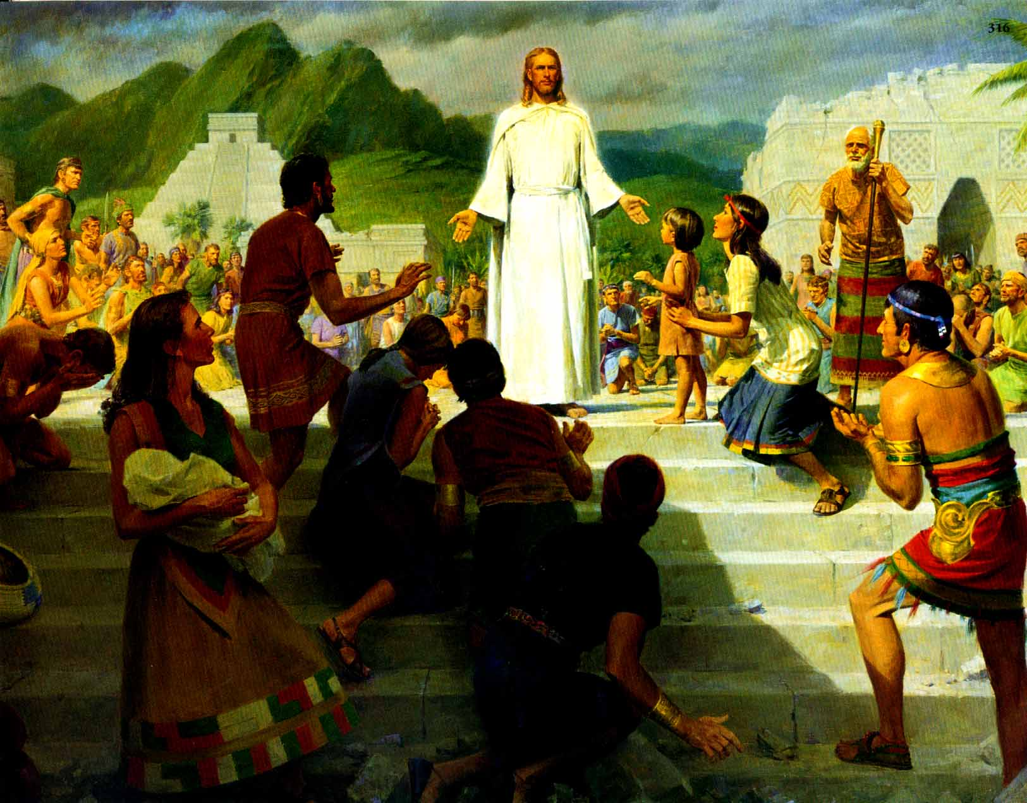
“Whosoever is angry with his brother shall be in danger of his judgment.”
(3 Nephi 12:22)
Anger
“He that hath the spirit of contention is not of me, but is of the devil.”
(3 Nephi 11:29)
John Scott
Notes:
https://www.churchofjesuschrist.org/media/image/jesus-nephites-8ddd1aa?lang=eng&collectionId=3cbf78e787498a07417814a31656063f9227b4c6

Slide 27
Philippe de Champaigne
“Ye have heard that it was said by them of old time, Thou shalt not commit adultery.”
Matthew 5:27 (alluding to Ex. 20:14)
Notes:
https://commons.wikimedia.org/wiki/File:Philippe_de_Champaigne_-_Moses_with_the_Ten_Commandments_-_WGA04717.jpg
https://www.churchofjesuschrist.org/media/image/christ-teaching-the-people-31eb3e7?lang=eng&collectionId=3cbf78e787498a07417814a31656063f9227b4c6

Slide 28
Harry Anderson
“But I say unto you, that whosoever looks on a woman, to lust after her, has committed adultery already in his heart.”
Matthew 5:28
Philippe de Champaigne
“Ye have heard that it was said by them of old time, Thou shalt not commit adultery.”
Matthew 5:27 (alluding to Ex. 20:14)
Notes:
https://commons.wikimedia.org/wiki/File:Philippe_de_Champaigne_-_Moses_with_the_Ten_Commandments_-_WGA04717.jpg
https://www.churchofjesuschrist.org/media/image/christ-teaching-the-people-31eb3e7?lang=eng&collectionId=3cbf78e787498a07417814a31656063f9227b4c6

Slide 29
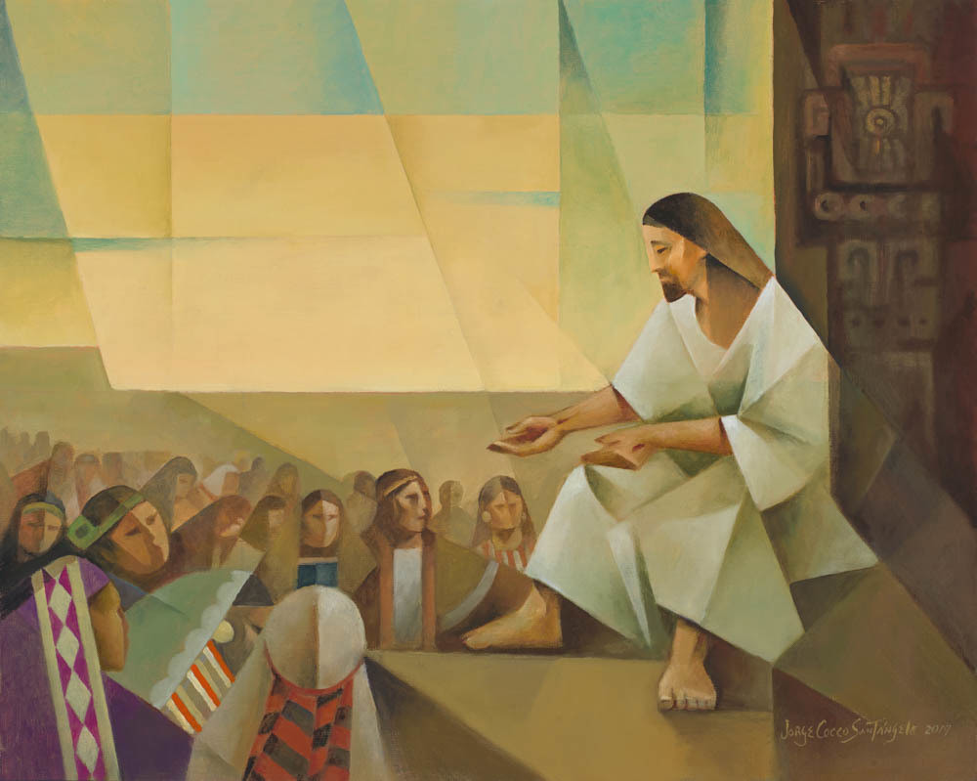
“Whosoever looketh on a woman, to lust after her, hath committed adultery already in his heart. Behold, I give unto you a commandment, that ye suffer none of these things to enter into your heart; For it is better that ye should deny yourselves of these things, wherein ye will take up your cross, than that ye should be cast into hell.”
Jorge Cocco
3 Nephi 12:28–30
Notes:
https://www.churchofjesuschrist.org/media/image/jesus-nephites-8ddd1aa?lang=eng&collectionId=3cbf78e787498a07417814a31656063f9227b4c6

Slide 30
Don’t think about a cat playing ukulele

Slide 31
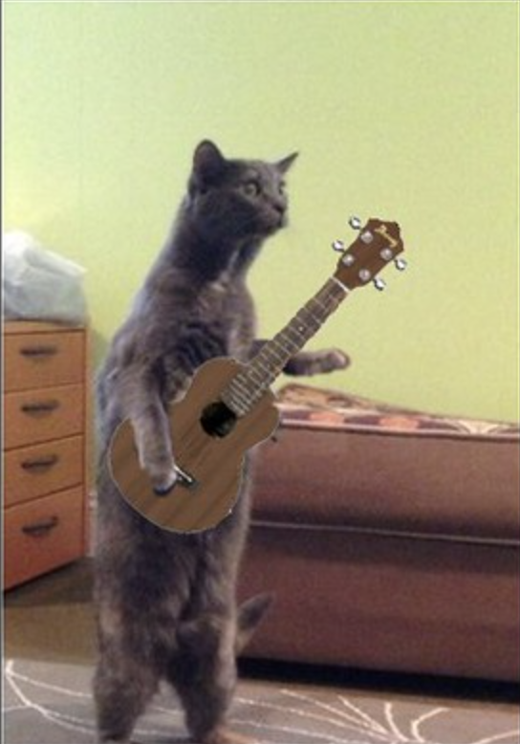
Don’t think about a cat playing ukulele
FolsomNatural
Notes:
https://www.flickr.com/photos/87249144@N08/33367945125/in/photostream/

Slide 32
Don’t think about a cat playing ukulele
Sometimes when we try to stop thinking about something, it’s hard!
There are many approaches to reduce lustful thoughts, (filters, getting advice from trusted friends/family/counselors/church leaders, continual practicing, etc.).

Slide 33
“The light of the body is the eye: if therefore thine eye be single to the glory of God, thy whole body shall be full of light.”
(Matthew 6:22, JST, see also Doctrine and Covenants 88:67)
“Look unto me in every thought.” (Doctrine and Covenants 6:36)
Del Parson

Slide 34
The Sermon on the Mount: A Few Key Ideas
Being the Beatitudes
Focusing on the heart
Perfecting love
Letting go of worry

Slide 35
Philippe de Champaigne
“Ye have heard that it has been said, Thou shalt love thy neighbor and hate thine enemy.”
Matthew 5:43

Slide 36
Harry Anderson
“But behold I say unto you, Love your enemies, bless them that curse you, do good to them that hate you, and pray for them which despitefully use you and persecute you.”
Matthew 5:44
Philippe de Champaigne
“Ye have heard that it has been said, Thou shalt love thy neighbor and hate thine enemy.”
Matthew 5:43

Slide 37
Matthew 5:45–48
“Love your enemies…That ye may be the children of your Father which is in heaven: for he maketh his sun to rise on the evil and on the good, and sendeth rain on the just and on the unjust. For if ye love them which love you, what reward have ye? do not even the publicans the same? And if ye salute your brethren only, what do ye more than others? do not even the publicans so? Be ye therefore perfect, even as your Father which is in heaven is perfect.”

Slide 38
Matthew 5:45–48
“Love your enemies…That ye may be the children of your Father which is in heaven: for he maketh his sun to rise on the evil and on the good, and sendeth rain on the just and on the unjust. For if ye love them which love you, what reward have ye? do not even the publicans the same? And if ye salute your brethren only, what do ye more than others? do not even the publicans so? Be ye therefore perfect, even as your Father which is in heaven is perfect.”

Slide 39
Do Not Worry
Do not worry about tomorrow, for tomorrow will bring worries of its own. Today’s trouble is enough for today.”
(Matt. 6:34, NSRV)
Harry Anderson

Slide 40
Do Not Worry
“Do not worry about your life...”
“Can any of you by worrying add a single hour to your span of life?”
“Why do you worry…?
“Do not worry.”
Harry Anderson
Matthew 6:25, 27, 28–31 (NRSV)

Slide 41
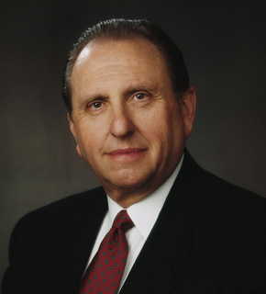
President Thomas S. Monson, Ensign, May 2012
“Life by the yard is hard; by the inch it’s a cinch. Each of us can be true for just one day—and then one more and then one more after that.”
Notes:
https://www.churchofjesuschrist.org/study/ensign/1995/07/president-thomas-s-monson?lang=eng

Slide 42
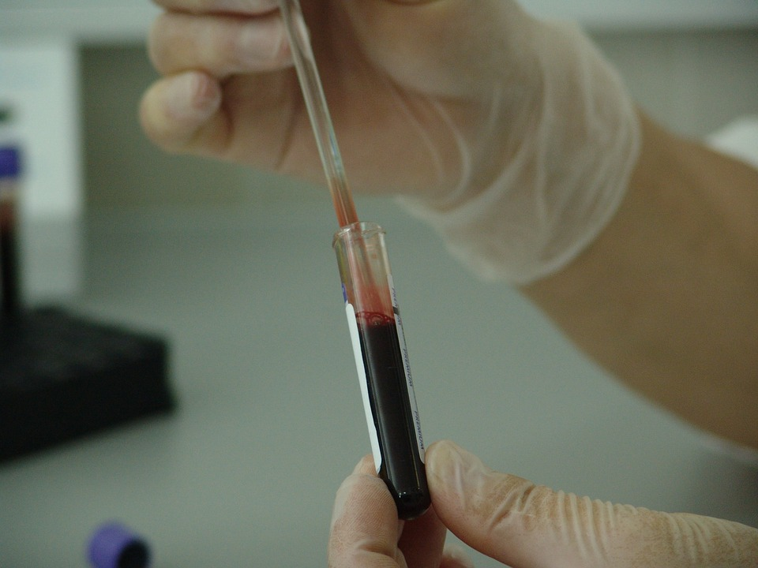
Notes:
https://pixabay.com/photos/blood-vial-analysis-laboratory-20745/

Slide 43
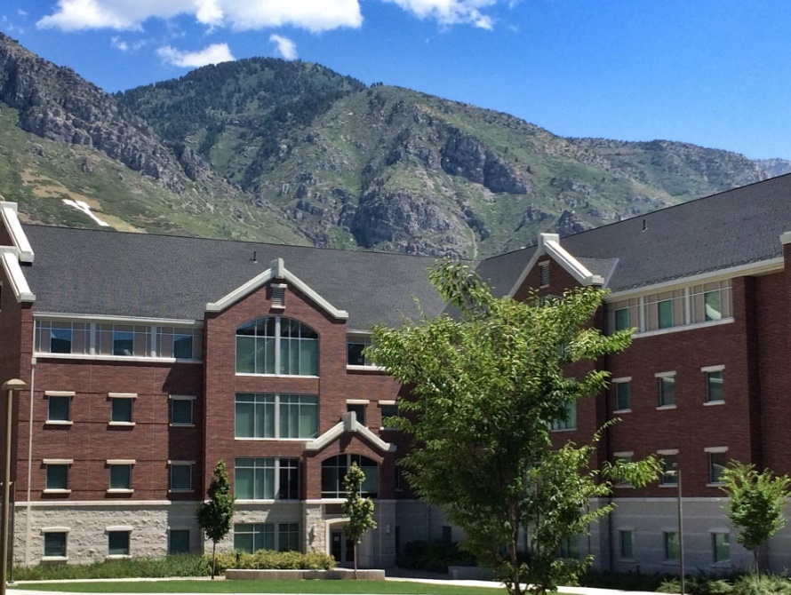
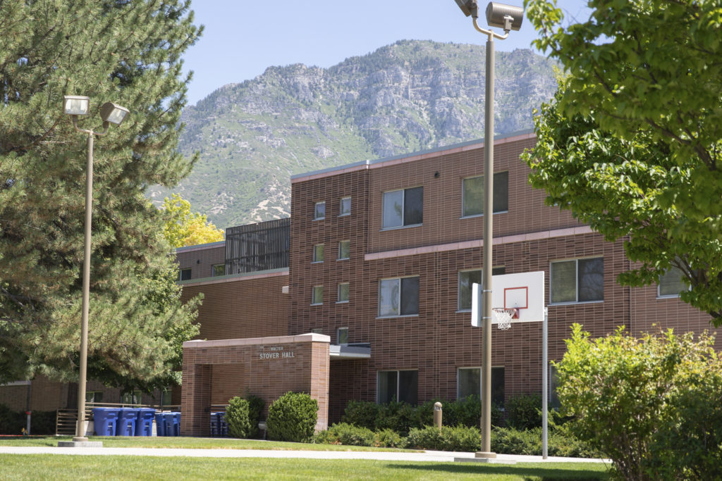
Notes:
Images of BYU dorms

Slide 45
We think what we will worry about is likelier to happen than it really is.

Slide 46
We think what we will worry about will hurt more than it really will.

Slide 47
We think we will be less able to cope than we actually will be.

Slide 48
A worry that is actually this:
Ends up feeling like this:

Slide 49
For every worry under the sun
There is a remedy or there is none
If there is one, hurry and find it
If there is not, never mind it
Notes:
IMAGE NEEDS REPLACING
Part of the challenge with worry is that it can consume us, spinning us into negative feedback loops where we spiral downward into discouragement. One intervention for breaking this cycle is instead of focusing on our worries, focus on what we can do about the situation causing concern. A focus on our agency and power to act can lead us to hope. In other words, if there is something you are worried about, either take action to solve the problem or, if there is no action you can take, turn it over to the Lord. This advice may be particularly helpful when our worries concern the actions of others that we cannot control, such as a loved one who turns away from gospel paths. I love this counsel from Elder Richard G. Scott:

Slide 50
Three Sermons from the Savior
Jesus’s first sermon in Luke
The Sermon on the Mount
The Bread of Life Discourse

Slide 51
“Our ancestors ate the manna in the wilderness; as it is written, ‘He gave them bread from heaven to eat.’”
(John 6:31, NRSV)
Compare Psalm 78:24, Exodus 16:14
Notes:
https://www.churchofjesuschrist.org/media/image/jesus-christ-public-ministry-aac1245?lang=eng&collectionId=d72eb60be594bcec1ad8a57671c4c0e949ae42f4

Slide 52
“It was not Moses who gave you the bread from heaven, but it is my Father who gives you the true bread from heaven. For the bread of God is that which comes down from heaven and gives life to the world…I am the bread of life.”
(John 6:32–33, 35, NRSV)
Notes:
https://www.churchofjesuschrist.org/media/image/jesus-christ-public-ministry-aac1245?lang=eng&collectionId=d72eb60be594bcec1ad8a57671c4c0e949ae42f4

Slide 53
“Then the Jews began to complain about him because he said, ‘I am the bread that came down from heaven.’ They were saying, ‘Is not this Jesus, the son of Joseph, whose father and mother we know? How can he now say, ‘I have come down from heaven?’’”
(John 6:41–42, NRSV)
Notes:
https://www.churchofjesuschrist.org/media/image/jesus-christ-public-ministry-aac1245?lang=eng&collectionId=d72eb60be594bcec1ad8a57671c4c0e949ae42f4

Slide 54
“I am the bread of life. Your ancestors ate the manna in the wilderness, and they died. This is the bread that comes down from heaven, so that one may eat of it and not die. I am the living bread that came down from heaven. Whoever eats of this bread will live forever; and the bread that I will give for the life of the world is my flesh.”
John 6:48–51, NRSV
Notes:
Seriously. Think deeply about this. What does this mean?
https://www.churchofjesuschrist.org/media/image/jesus-speaking-crowd-9c29ff7?lang=eng

Slide 55
“Unless you eat the flesh of the Son of Man and drink his blood, you have no life in you. Those who eat my flesh and drink my blood have eternal life, and I will raise them up on the last day; for my flesh is true food and my blood is true drink. Those who eat my flesh and drink my blood abide in me, and I in them. Just as the living Father sent me, and I live because of the Father, so whoever eats me will live because of me. This is the bread that came down from heaven, not like that which your ancestors ate, and they died. But the one who eats this bread will live forever.”
John 6:53–58, NRSV
Notes:
Seriously. Think deeply about this. What does this mean?
https://www.churchofjesuschrist.org/media/image/jesus-speaking-crowd-9c29ff7?lang=eng

Slide 56
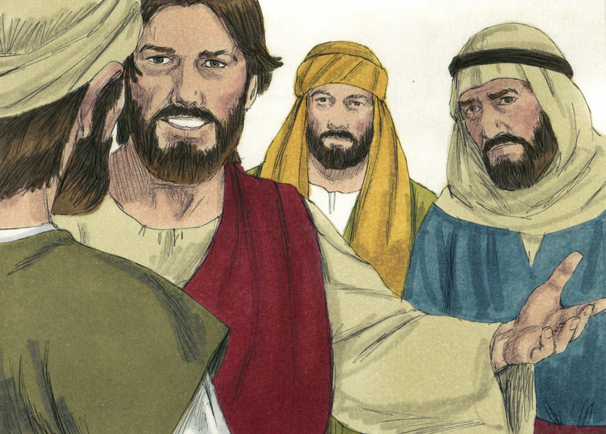
“Many therefore of his disciples, when they had heard this, said, This is an hard saying; who can hear it?”
(John 6:60)
Jim Padgett
Notes:
https://commons.wikimedia.org/wiki/File:Gospel_of_John_Chapter_6-4_(Bible_Illustrations_by_Sweet_Media).jpg

Slide 57
Jesus said, “Doth this offend you?”
…From that time, many of his disciples went back, and walked no more with him.
(John 6:61)
Jim Padgett
Notes:
https://commons.wikimedia.org/wiki/File:Gospel_of_John_Chapter_6-4_(Bible_Illustrations_by_Sweet_Media).jpg

Slide 58
Jesus said, “Doth this offend you?”
…From that time, many of his disciples went back, and walked no more with him.
(John 6:61, 66)
Jim Padgett
Notes:
https://commons.wikimedia.org/wiki/File:Gospel_of_John_Chapter_6-4_(Bible_Illustrations_by_Sweet_Media).jpg

Slide 59
John 6:67-69
“Then Jesus turned to the twelve and said, “Will ye also go away? Simon Peter answered him, Lord, to whom shall we go? ...We believe and are sure that thou art that Christ, the Son of the living God.”

Slide 60
How Will We React to Hard Sayings?
“This is an hard saying, who can hear it?”
“We believe and are sure that thou art that Christ!”

Slide 61
Acknowledgements
Insights from, discussions with, and resources authored by Dr. Frank Judd, Dr. Mark Ellison, Dr. Gaye Strathearn, Dr. Matthew Grey, Dr. Anthony Sweat, Dr. Robert Kegan, James Martin, SJ, Dr. Timothy Keller, Dr. Daniel Becerra, and Dr. Terry Ball were used in the creation of this video.

