Slide 1
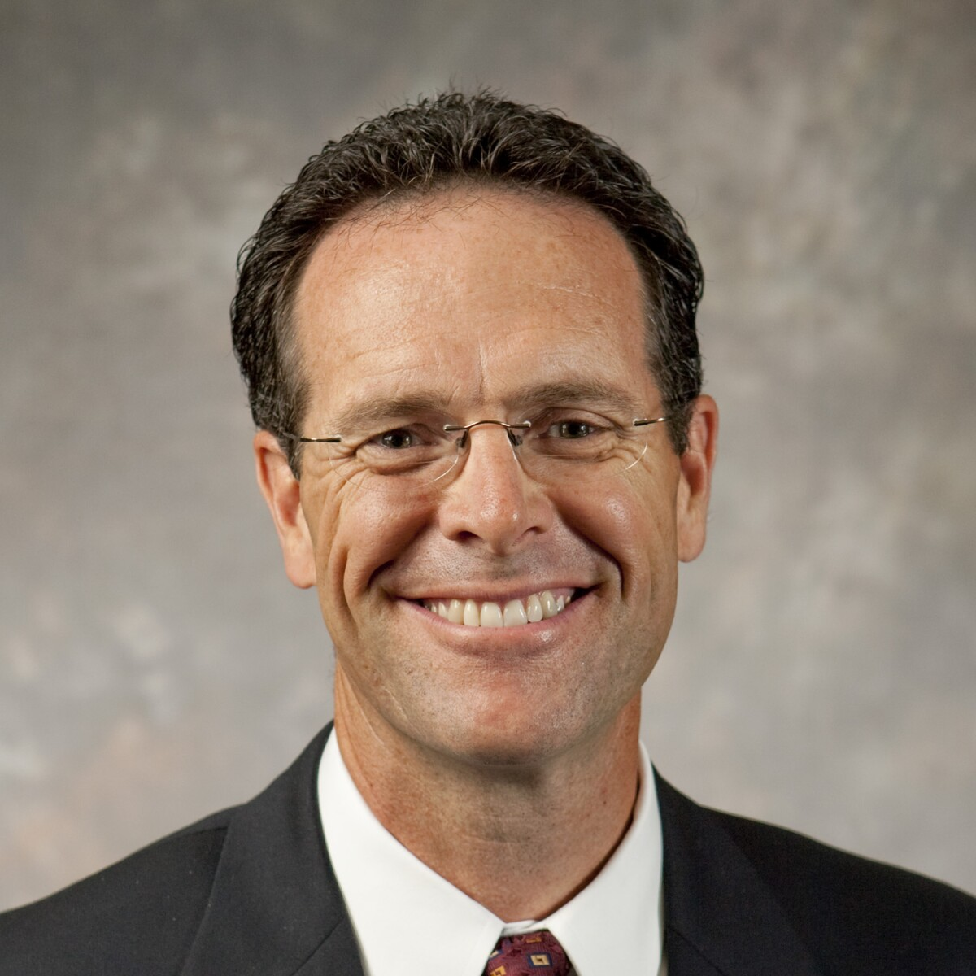

Slide 2
A Pattern in Jesus’s Ministry
“The multitude went forth, and thrust their hands into his side…going forth one by one” (3 Nephi 11:15).
“[Jesus] took their little children, one by one, and blessed them” (3 Nephi 17:21).
“[Jesus] touched with his hand the disciples whom he had chosen, one by one” (3 Nephi 18:36).
“[Jesus] spake unto his disciples, one by one” (3 Nephi 28:1).

Slide 3
Jesus and Individuals
Nicodemus
The woman at the well
The anointing woman in Luke
John the Baptist
Peter

Slide 4
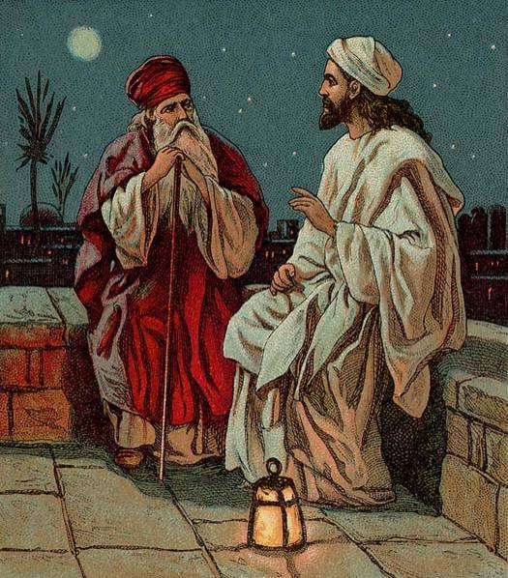
Nicodemus and Jesus
Nicodemus, “A Pharisee... a leader of the Jews…came to Jesus by night and said to him, “Rabbi, we know that you are a teacher who has come from God; for no one can do these signs that you do apart from the presence of God.” (John 3:1–2, NRSV)
Providence Lithograph Company
Notes:
https://commons.wikimedia.org/wiki/File:Jesus_and_Nicodemus.jpg

Slide 5
Nicodemus and Jesus
“Jesus answered and said unto him, ‘Verily, verily, I say unto thee, Except a man be born again, he cannot see the kingdom of God.’ Nicodemus saith unto him, ‘How can a man be born when he is old? can he enter the second time into his mother’s womb, and be born?’” (John 3:3–4)
Providence Lithograph Company
Notes:
https://commons.wikimedia.org/wiki/File:Jesus_and_Nicodemus.jpg

Slide 6
Born Again John 3:3
“again” = anōthen (Greek)
Can mean “a second time”
or “from above.”
In context, Jesus is talking about spiritual rebirth, but Nicodemus doesn’t get it.
Providence Lithograph Company
Notes:
https://commons.wikimedia.org/wiki/File:Jesus_and_Nicodemus.jpg

Slide 7
“‘Marvel not that I said unto thee, Ye must be born again…’ Nicodemus answered and said unto him, ‘How can these things be?’ Jesus answered and said unto him, ‘Art thou a master of Israel, and knowest not these things? …If I have told you earthly things, and ye believe not, how shall ye believe, if I tell you of heavenly things?’”
(John 3:7, 9–12)
Providence Lithograph Company
Notes:
https://commons.wikimedia.org/wiki/File:Jesus_and_Nicodemus.jpg

Slide 8
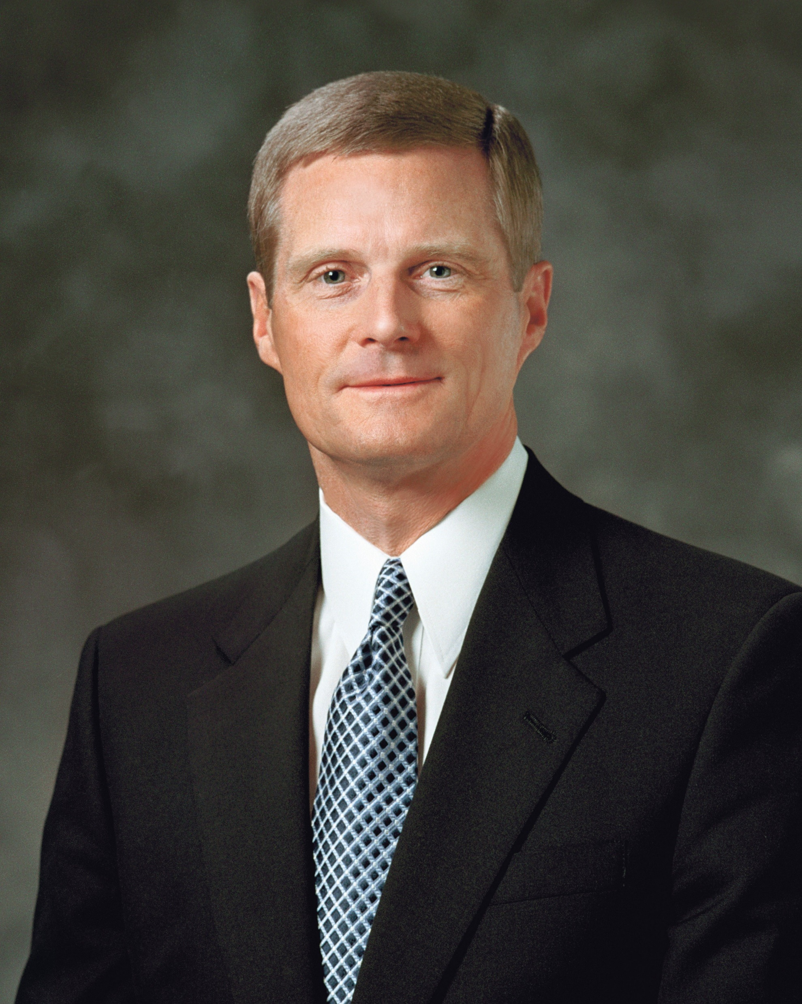
“As the president of BYU-Idaho, Elder Bednar and President Henry B. Eyring, who was Commissioner of Church Education and a member of the Quorum of the Twelve at the time, had differing opinions about how the university was to transition from Ricks College to BYU-Idaho.
“Meekness vital to inspiring learning, Elder Bednar tells BYU employees,” https://news.byu.edu/news/meekness-vital-inspiring-learning-elder-bednar-tells-byu-employees.

Slide 9
“The two worked throughout the day to find a resolution but were unsuccessful. The next morning, President Eyring told Elder Bednar that he had been rebuked by the Holy Ghost and indicated that Elder Bednar’s plan for the transition should continue forward.
“Meekness vital to inspiring learning, Elder Bednar tells BYU employees,” https://news.byu.edu/news/meekness-vital-inspiring-learning-elder-bednar-tells-byu-employees.

Slide 10
“[President Eyring] then said to me something I have never forgotten,” Elder Bednar said. “‘President, if you have not been rebuked lately by the Holy Ghost as you are praying, then you need to improve your prayers.’”
“Meekness vital to inspiring learning, Elder Bednar tells BYU employees,” https://news.byu.edu/news/meekness-vital-inspiring-learning-elder-bednar-tells-byu-employees.

Slide 11
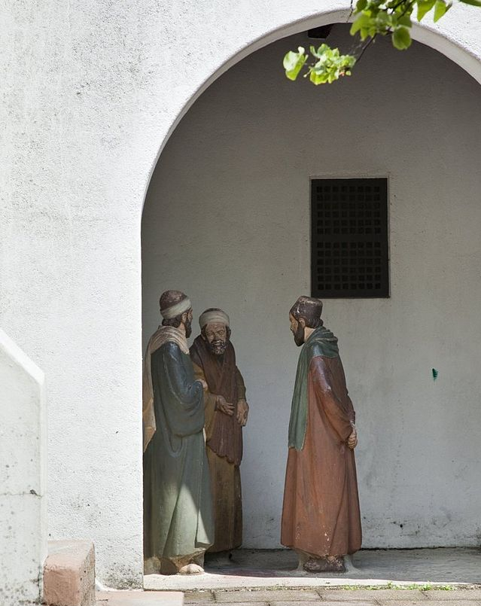
What Happens to Nicodemus?
“Are ye also deceived? Have any of the rulers or of the Pharisees believed on him? But this people who knoweth not the law are cursed.” (John 7:47–49)
Booms, C.S. (Photo)
Notes:
https://commons.wikimedia.org/wiki/File:Beeldengroep_op_de_binnenplaats_van_het_Sanhedrin_-_Heilig_Land-stichting_-_20531459_-_RCE.jpg

Slide 12
What Happens to Nicodemus?
“Nicodemus saith unto them…Doth our law judge any man, before it hear him, and know what he doeth?” (John 7:50–51)
Booms, C.S. (Photo)
Notes:
https://commons.wikimedia.org/wiki/File:Beeldengroep_op_de_binnenplaats_van_het_Sanhedrin_-_Heilig_Land-stichting_-_20531459_-_RCE.jpg

Slide 13
What Happens to Nicodemus?
The other Pharisees “answered and said unto him, ‘Art thou also of Galilee? Search, and look: for out of Galilee ariseth no prophet.’”
(John 7:52–53)
Booms, C.S. (Photo)
Notes:
https://commons.wikimedia.org/wiki/File:Beeldengroep_op_de_binnenplaats_van_het_Sanhedrin_-_Heilig_Land-stichting_-_20531459_-_RCE.jpg

Slide 14
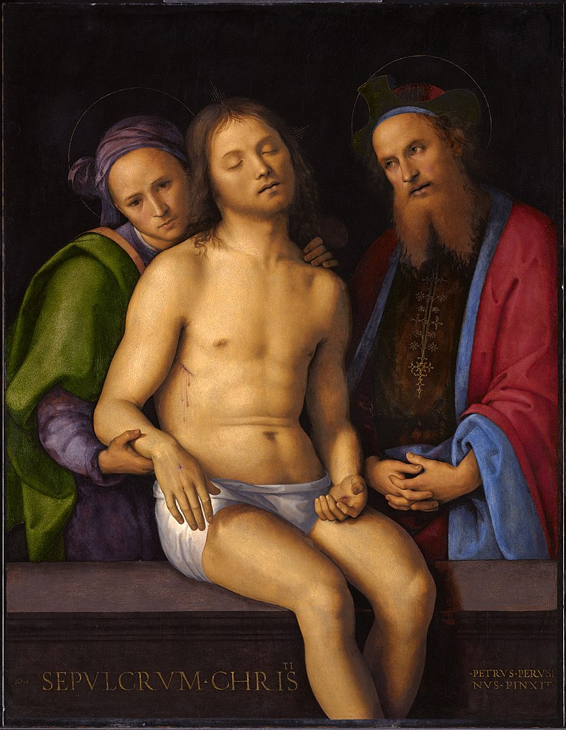
What Happens to Nicodemus?
“Nicodemus, who had at first come to Jesus by night, also came, bringing a mixture of myrrh and aloes, weighing about a hundred pounds…
[Nicodemus and Joseph of Arimathea] “took the body of Jesus and wrapped it with the spices in linen cloths, according to the burial custom of the Jews.”
(John 19:39–40, NRSV).
Pietro Perugino
Notes:
Public domain: https://en.wikipedia.org/wiki/Nicodemus#/media/File:Pietro_Perugino_cat39.jpg

Slide 15
What Happens to Nicodemus?
“I, when I am lifted up from the earth, will draw all people to myself.” Nicodemus seems to be one fulfillment of this promise.
Pietro Perugino
Notes:
Public domain: https://en.wikipedia.org/wiki/Nicodemus#/media/File:Pietro_Perugino_cat39.jpg

Slide 16
Jesus and Individuals
Nicodemus
The woman at the well
The anointing woman in Luke
John the Baptist
Peter

Slide 17
Jesus and the Samaritan woman at the well
“A Samaritan woman came to draw water, and Jesus said to her, “Give me a drink.” …The Samaritan woman said to him, “How is it that you, a Jew, ask a drink of me, a woman of Samaria?” (Jews do not share things in common with Samaritans.)
Carl Bloch
Notes:
https://commons.wikimedia.org/wiki/File:Carl_Heinrich_Bloch_-_Woman_at_the_Well.jpg

Slide 18
Jesus and the Samaritan woman at the well
“Jesus answered her, “If you knew the gift of God, and who it is that is saying to you, ‘Give me a drink,’ you would have asked him, and he would have given you living water.” The woman said to him, “Sir, you have no bucket, and the well is deep. Where do you get that living water? Are you greater than our ancestor Jacob, who gave us the well?” (John 4:7–12, NRSV)
Carl Bloch
Notes:
https://commons.wikimedia.org/wiki/File:Carl_Heinrich_Bloch_-_Woman_at_the_Well.jpg

Slide 19
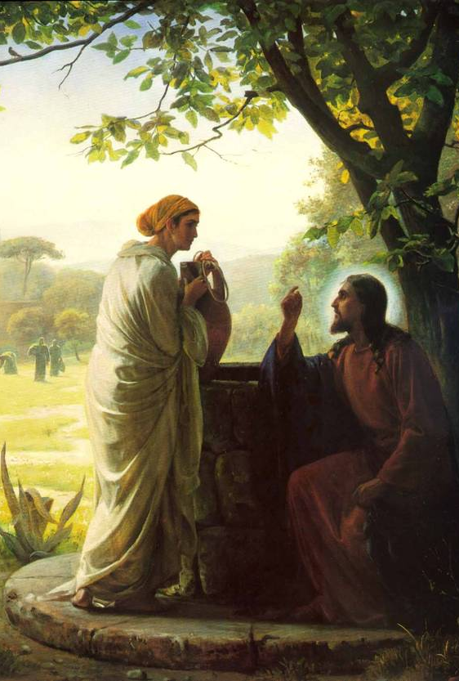
Jesus and the Samaritan woman at the well
Like “born again/born from above,” “Living water” can have multiple meanings
1) “running water” (a spring, stream, or river as opposed to “dead water” = well or pond.
2) “water that gives life” (physical or spiritual)
Carl Bloch
Notes:
https://commons.wikimedia.org/wiki/File:Carl_Heinrich_Bloch_-_Woman_at_the_Well.jpg

Slide 20
“Jesus said to her, “Everyone who drinks of this water will be thirsty again, but those who drink of the water that I will give them will never be thirsty. The water that I will give will become in them a spring of water gushing up to eternal life.” The woman said to him, “Sir, give me this water, so that I may never be thirsty or have to keep coming here to draw water.” (John 4:13-15, NRSV).
Carl Bloch
Notes:
https://commons.wikimedia.org/wiki/File:Carl_Heinrich_Bloch_-_Woman_at_the_Well.jpg

Slide 21
“Jesus said to her, ‘Go, call your husband, and come back.’ The woman answered him, ‘I have no husband.’ Jesus said to her, ‘You are right in saying, “I have no husband”; for you have had five husbands, and the one you have now is not your husband. What you have said is true!’ The woman said to him, ‘Sir, I see that you are a prophet.’”
(John 4:16-19, NRSV)
Carl Bloch
Notes:
https://commons.wikimedia.org/wiki/File:Carl_Heinrich_Bloch_-_Woman_at_the_Well.jpg

Slide 22
“The woman said to him, ‘I know that [the] Messiah is coming…When he comes, he will proclaim all things to us.’ Jesus said to her, ‘I am he, the one who is speaking to you….’
Then the woman left her water jar and went back to the city.”
(John 4:25–26, 28, NRSV)
Carl Bloch
Notes:
https://commons.wikimedia.org/wiki/File:Carl_Heinrich_Bloch_-_Woman_at_the_Well.jpg

Slide 23
“Many Samaritans from that city believed in him because of the woman’s testimony…So when the Samaritans came to him, they asked him to stay with them; and he stayed there two days. And many more believed because of his word.”
(John 4:39–41, NRSV)
Carl Bloch
Notes:
https://commons.wikimedia.org/wiki/File:Carl_Heinrich_Bloch_-_Woman_at_the_Well.jpg

Slide 24
Interesting contrasts in the two longest New Testament conversations between Jesus and another individual.
Where: Jerusalem
Who: Nicodemus
Who initiates: Nicodemus
When: Night
Key phrase: Born Again
Where: Samaria
Who: Samaritan Woman at well
Who initiates: Jesus
When: Noon
Key phrase: Living Water
The woman at the well gets it faster, but both she and Nicodemus come to Christ!

Slide 25
Jesus and Individuals
Nicodemus
The woman at the well
The anointing woman in Luke
John the Baptist
Peter

Slide 26
Luke 7:37–39, NRSV
During the meal, “a woman in the city, who was a sinner, having learned that he was eating in the Pharisee’s house, brought an alabaster jar of ointment. She stood behind him at his feet, weeping, and began to bathe his feet with her tears and to dry them with her hair. Then she continued kissing his feet and anointing them with the ointment. Now when the Pharisee who had invited him saw it, he said to himself, “If this man were a prophet, he would have known who and what kind of woman this is who is touching him—that she is a sinner.”

Slide 27
Luke 7:41–44
“There was a certain creditor which had two debtors: the one owed five hundred pence, and the other fifty. And when they had nothing to pay, he frankly forgave them both. Tell me therefore, which of them will love him most? Simon answered and said, I suppose that he, to whom he forgave most. [Jesus] said unto [Simon], Thou hast rightly judged. And he turned to the woman, and said unto Simon, Seest thou this woman?”

Slide 28
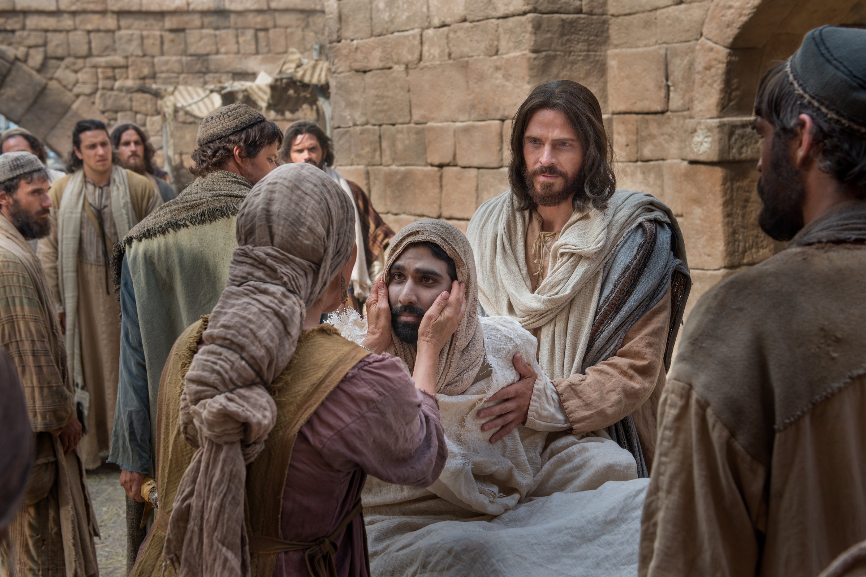
“When the Lord saw her, he had compassion on her.”
(Luke 7:13)
Bible Videos
Notes:
https://www.churchofjesuschrist.org/media/image/woman-wiping-feet-2a6d375?lang=eng

Slide 29
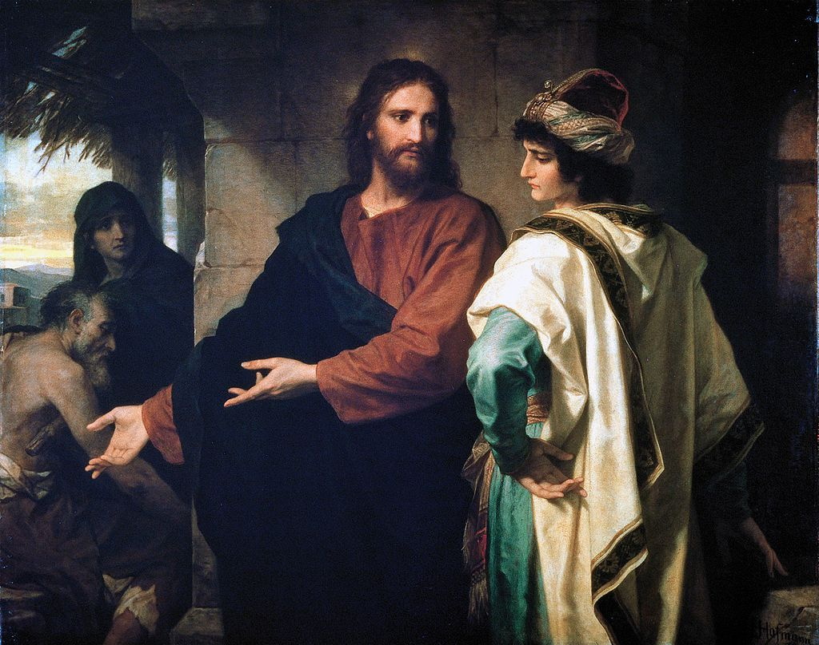
“Jesus, looking at him, loved him.”
(Mark 10:21, NRSV)
Heinrich Hoffman
Notes:
https://en.wikipedia.org/wiki/Jesus_and_the_rich_young_man#/media/File:Hoffman-ChristAndTheRichYoungRuler.jpg

Slide 30
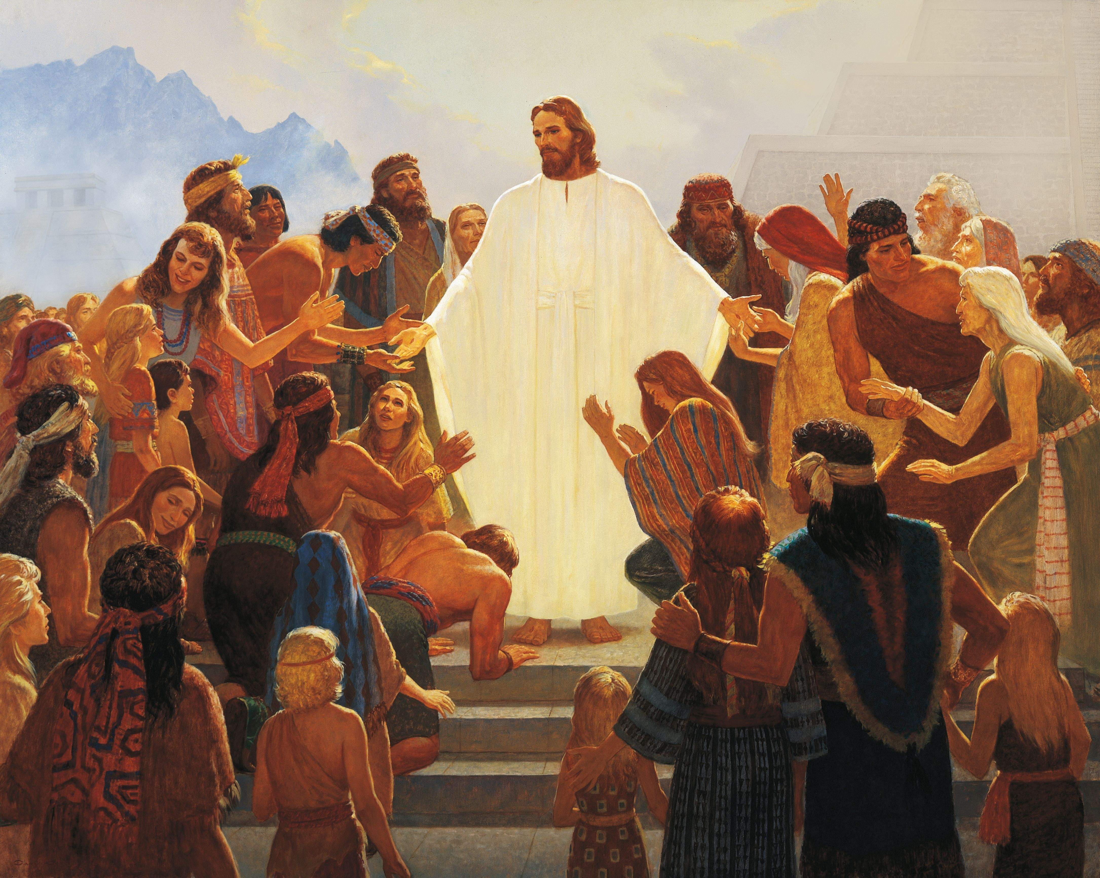
“He cast his eyes…on the multitude…and said…my bowels are filled with compassion.”
(3 Nephi 17:5–6)
Gary L. Kapp
Notes:
https://en.wikipedia.org/wiki/Jesus_and_the_rich_young_man#/media/File:Hoffman-ChristAndTheRichYoungRuler.jpg

Slide 31
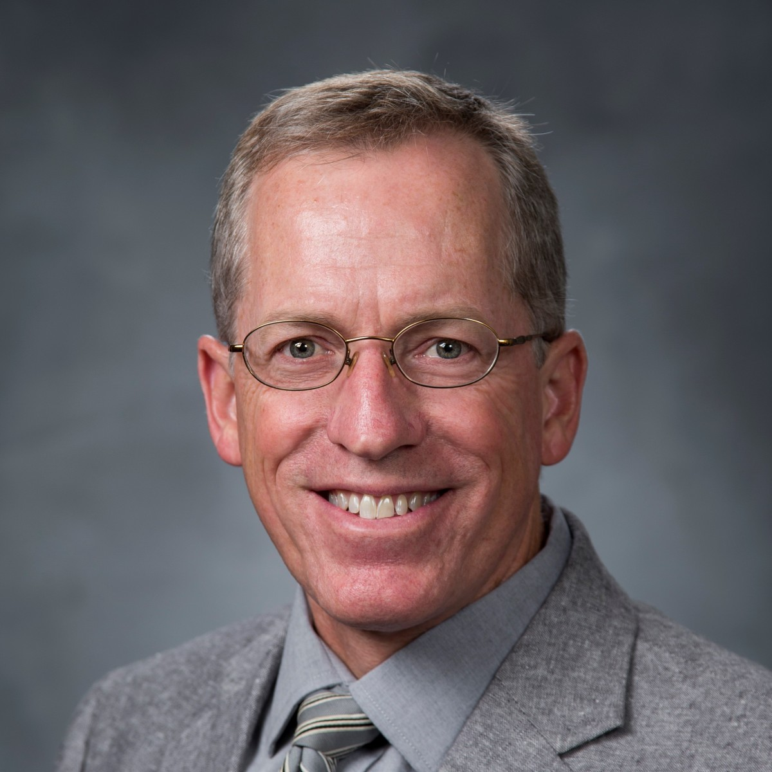
Mark Ellison, Religion Professor, Brigham Young University
“The King James Version of Luke 7:47 says, ‘Her sins, which are many, are forgiven, for she loved much.’ That makes it sound like Jesus is forgiving the woman’s sins, right now, because of her outpouring of love. But that seems odd. Do we really obtain forgiveness by kind gestures? Isn't repentance required? And it doesn’t seem to fit the parable in Luke 7:41-43, which implies that love results from forgiveness, rather than forgiveness resulting from love.

Slide 32
“It might help to recognize that the verb translated ‘forgiven’ in Luke 7:47-48 is not in the present tense (‘you are forgiven right now’), but in the perfect tense (‘you have been forgiven’). A perfect tense verb in Greek indicates a past event with continuing effects in the present. So Jesus isn't saying that he is forgiving the woman here and now, he’s saying that in the past her sins were forgiven. There’s more to the woman's story here than Luke has told us.
Mark Ellison, Religion Professor, Brigham Young University

Slide 33
“At some point in the past this woman apparently listened to Jesus's teaching and either repented and received forgiveness, or had already repented and finally understood that she was forgiven. Now she's coming to Jesus with overflowing gratitude. That gratitude is the continuing effect, in the present, of her forgiveness in the past. Her act of love in washing Jesus's feet at the dinner was not what earned her forgiveness, it’s what resulted from her forgiveness.”
Mark Ellison, Religion Professor, Brigham Young University

Slide 34
Jesus and Individuals
Nicodemus
The woman at the well
The anointing woman in Luke
John the Baptist
Peter

Slide 35
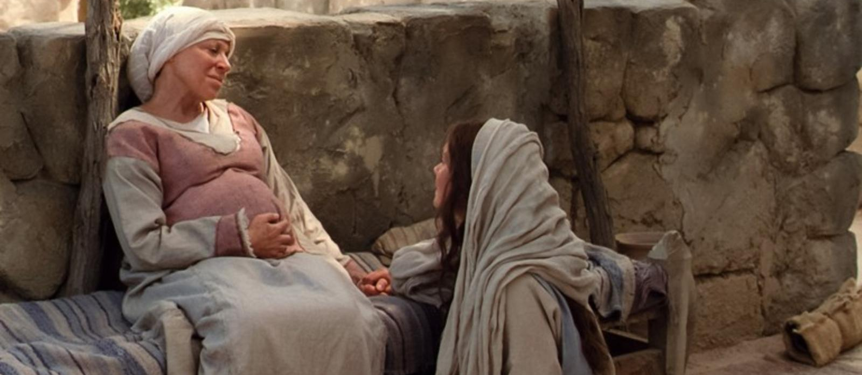
Jesus and John the Baptist
Bible Videos
Connected at birth!

Slide 36
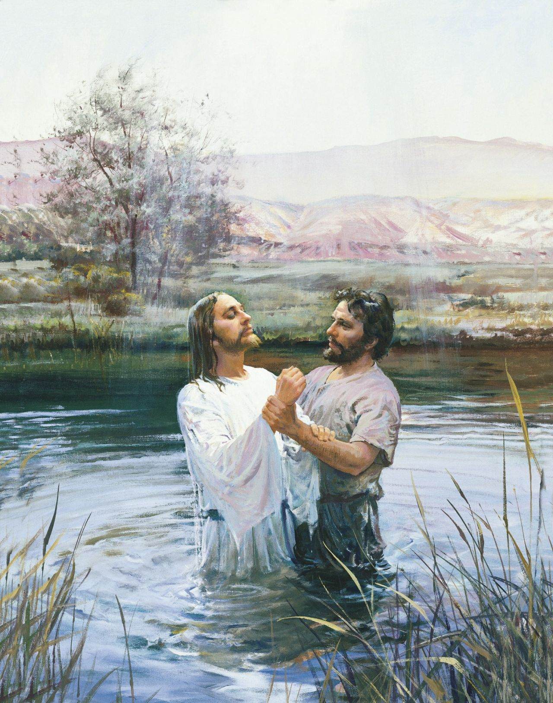
John the Baptist’s Testimony of Jesus
“I have need to be baptized of thee, and comest thou to me?” (Matthew 3:14)
“Behold the Lamb of God, which taketh away the sin of the world.” (John 1:29)
Harry Anderson
Notes:
https://www.churchofjesuschrist.org/media/image/john-baptizes-christ-568a680?lang=eng

Slide 37
John the Baptist’s Testimony of Jesus
Some of John’s disciples “Came to John, and said to him, ‘Rabbi, [Jesus] … to whom you testified, here he is baptizing, and all are going to him.’
John answered…‘You yourselves are my witnesses that I said, I am not the Messiah, but I have been sent ahead of him…He must increase, but I must decrease.’” (John 3:25–30)
Harry Anderson
Notes:
https://www.churchofjesuschrist.org/media/image/john-baptizes-christ-568a680?lang=eng

Slide 38
John the Baptist’s Testimony of Jesus
“When John had heard in the prison the works of Christ, he sent two of his disciples, And said unto him, Art thou he that should come, or do we look for another?” (Matthew 11:2–3)
“He that cometh after me is mightier than I, whose shoes I am not worthy to bear.” (Matthew 3:11)
Chrispijn van den Broeck
Notes:
In Greek these are the English phrases in yellow are distinctive and show a connection.
Possibly John is just trying to connect his disciple with Jesus.
Maybe he’s losing faith/hope.
https://commons.wikimedia.org/wiki/File:John_the_baptist_in_prison_print_by_Chrispijn_van_den_Broeck,_S.I_1074,_Prints_Department,_Royal_Library_of_Belgium.jpg

Slide 39
Jesus’s Response
“Jesus answered and said unto them, Go and shew John again those things which ye do hear and see: The blind receive their sight, and the lame walk, the lepers are cleansed, and the deaf hear, the dead are raised up, and the poor have the gospel preached to them.” (Matthew 11:4–5)
Bible Videos
Notes:
https://www.churchofjesuschrist.org/media-library/images/jesus-miracle-healing-1617366?lang=eng&clang=ase

Slide 40
Jesus’s Response
“The blind receive their sight,
and the lame walk,
the lepers are cleansed,
and the deaf hear,
the dead are raised up,
and the poor have the gospel preached to them.
Isaiah 35:5
Isaiah 35:5
Isaiah 25:8
Isaiah 61:1

Slide 41
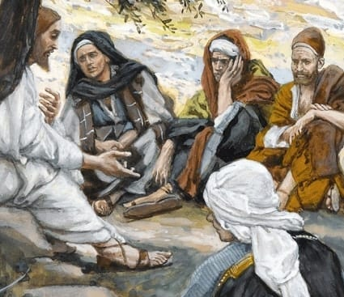
Jesus and John the Baptist
“Among them that are born of women there hath not risen a greater than John the Baptist” (Matthew 11:11)
James Tissot

Slide 42
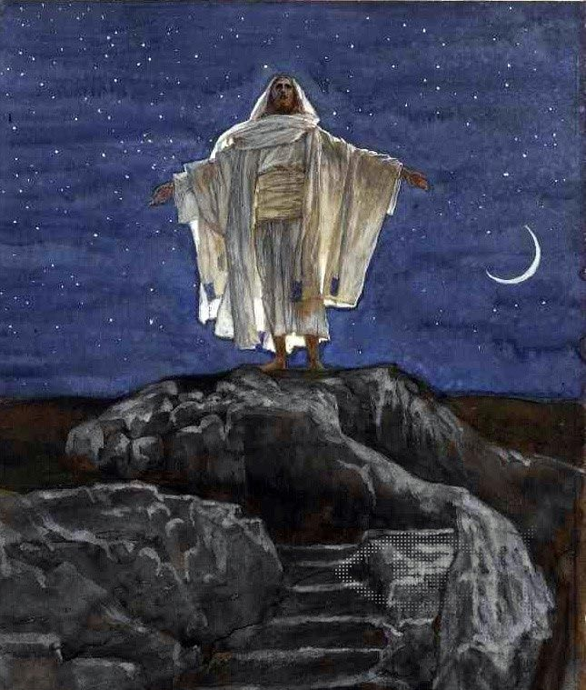
Matthew 14:22–23
“Jesus constrained his disciples to get into a ship, and to go before him unto the other side, while he sent the multitudes away. And when he had sent the multitudes away, he went up into a mountain apart to pray.”
James Tissot
Notes:
https://commons.wikimedia.org/wiki/File:Brooklyn_Museum_-_Jesus_Goes_Up_Alone_onto_a_Mountain_to_Pray_(J%C3%A9sus_monte_seul_sur_une_montagne_pour_prier)_-_James_Tissot_-_overall.jpg

Slide 43
Jesus and Individuals
Nicodemus
The woman at the well
The anointing woman in Luke
John the Baptist
Peter

Slide 44
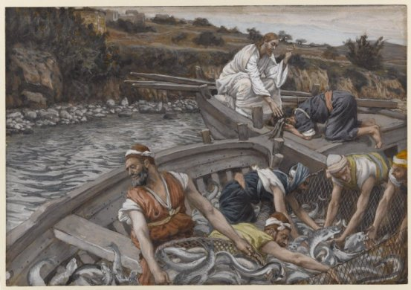
Christ asked Peter (and asks us) to leave when the nets are full.
James Tissot
Notes:
https://commons.wikimedia.org/wiki/File:Brooklyn_Museum_-_The_Miraculous_Draught_of_Fishes_(La_p%C3%AAche_miraculeuse)_-_James_Tissot_-_overall.jpg

Slide 45
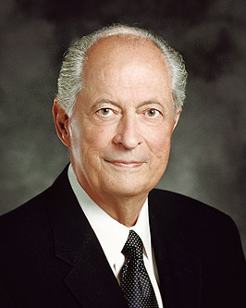
Elder Robert D. Hales
I was at Harvard Business School. I was stretched to my capacity…At an important point in my schooling, a mission president asked me to be an Elders Quorum President. It is the only time in my life that I ever questioned an assignment…

Slide 46
Elder Robert D. Hales
So I went home and said to my wife, “There is a chance of failing in my schooling if I become an elders quorum president.” She said to me the words which have helped for many years: “Bob, I would rather have an active priesthood holder than a man who holds a master’s degree from Harvard.” But as she put her arms around me, she said, “We’ll do them both.”

Slide 47
Elder Robert D. Hales
“That decision was much harder to make then than when, years later, I accepted the call to serve as [a General Authority] and left my business career behind…. I believe you really show the Lord who you are and what you are willing to become when you make those hard decisions as a young person.”
New Era, Feb. 2006
Christ asks us to leave when the nets are full.

Slide 48
Elder Robert D. Hales
“That decision was much harder to make then than when, years later, I accepted the call to serve as [a General Authority] and left my business career behind…. I believe you really show the Lord who you are and what you are willing to become when you make those hard decisions as a young person.”
New Era, Feb. 2006
Christ asks us to leave when the nets are full.

Slide 49
Mark 6:46-48
“When even was come, the ship was in the midst of the sea, and he alone on the land. And he saw them toiling in rowing.”
James Tissot
Notes:
https://commons.wikimedia.org/wiki/File:Brooklyn_Museum_-_Jesus_Goes_Up_Alone_onto_a_Mountain_to_Pray_(J%C3%A9sus_monte_seul_sur_une_montagne_pour_prier)_-_James_Tissot_-_overall.jpg

Slide 50
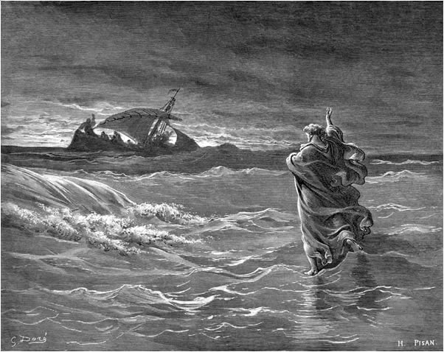
“The ship was now in the midst of the sea, tossed with waves: for the wind was contrary.
And in the fourth watch of the night Jesus went unto them” (Matthew 14:24–25).
Gustave Doré
Notes:
https://commons.wikimedia.org/wiki/File:Jesus_walks_on_the_sea.jpg

Slide 51
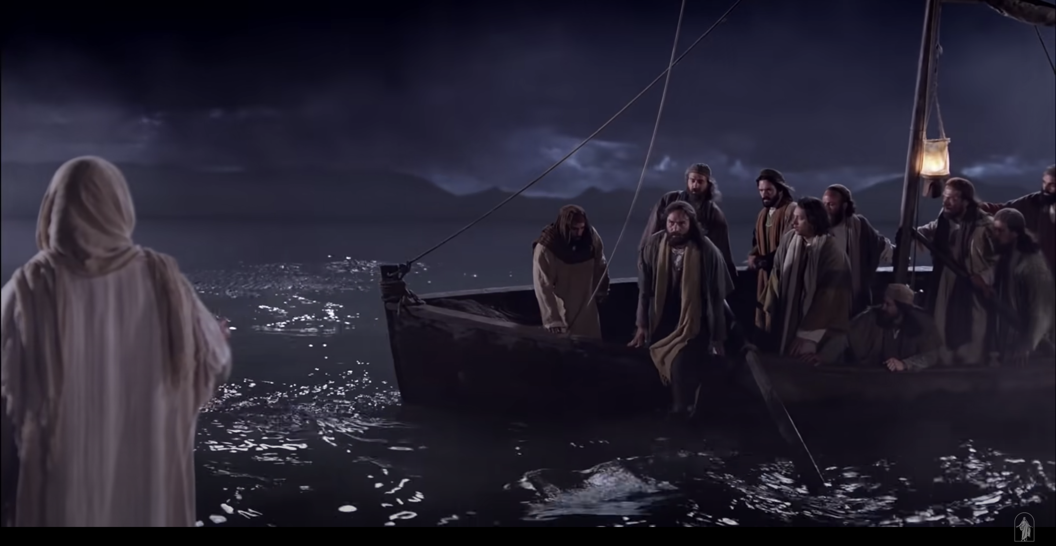
“Jesus spake unto them, saying, ‘Be of good cheer; it is I; be not afraid.’ And Peter answered him and said, ‘Lord, if it be thou, bid me come unto thee on the water’” (Matthew 14:27–28).
Bible Videos
Notes:
https://www.churchofjesuschrist.org/media-library/images/bible-video-jesus-walking-water-1432836?lang=eng&clang=ase

Slide 52
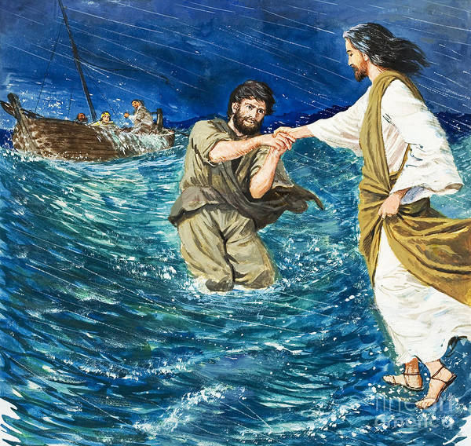
Clive Uptton
Notes:
https://paintingandframe.com/prints/clive_uptton_the_miracles_of_jesus_walking_on_water-8333.html

Slide 53
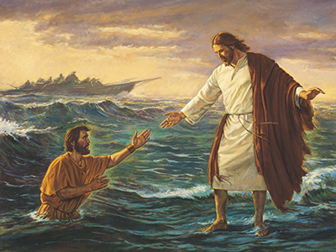
Robert T. Barrett
Notes:
https://www.churchofjesuschrist.org/media/image/jesus-walking-on-water-7beb022?lang=eng

Slide 54
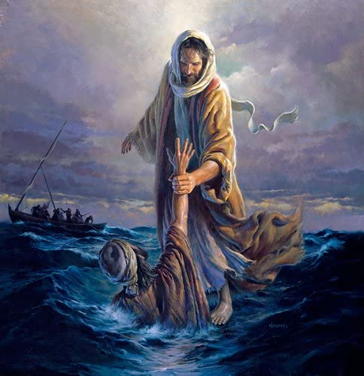
Morgan Weistling
Notes:
https://www.amazon.com/Planejunkie-Refuge-Strength-Morgan-Weistling/dp/B07CQRSG49

Slide 55
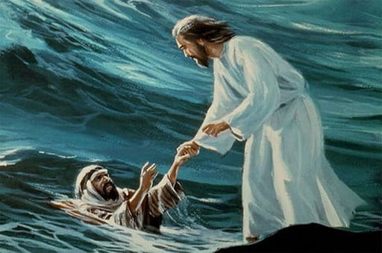
Pacific Press
Notes:
https://www.goodsalt.com/search/Pacific_Press.html

Slide 56
Sight and Sound Theater
Notes:
https://www.facebook.com/sightsoundtheatreslancaster/photos/over-3-million-people-tuned-in-easter-weekend-to-watch-the-worldwide-debut-of-je/10159765082163327/

Slide 57
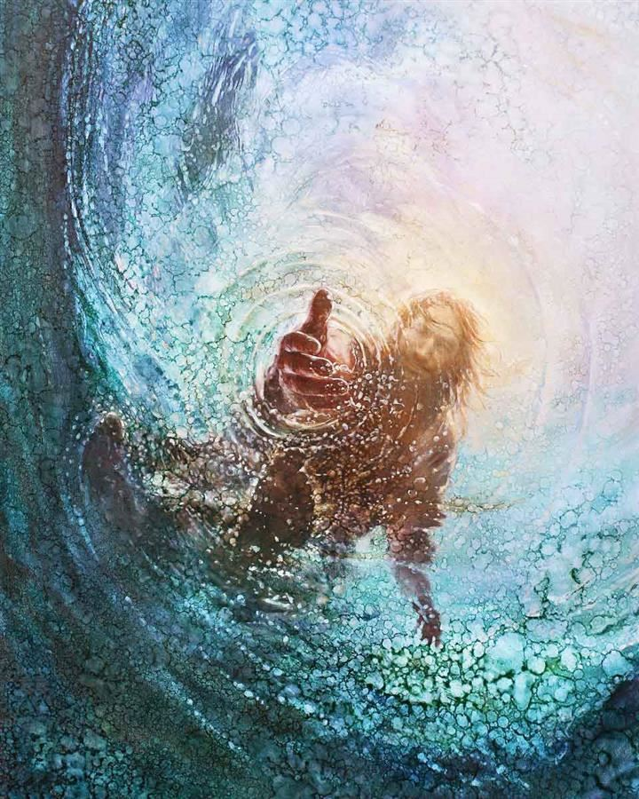
Yongsung Kim
Notes:
https://havenlight.com/products/the-hand-of-god-by-yongsung-kim?variant=36720650191012

Slide 58
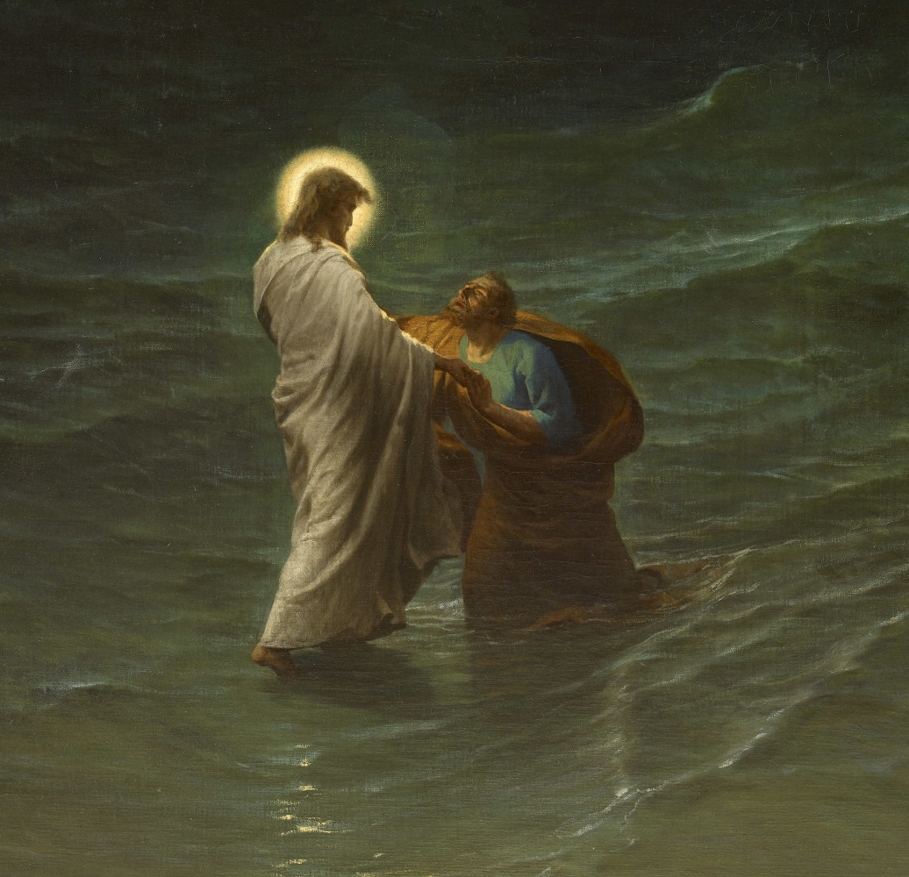
“Jesus immediately reached out his hand”
(Matthew 14:31)
Gustave Brion
Notes:
https://arts.byu.edu/rend-heavens/

Slide 59
Lessons from Peter and Christ in The Storm
Bible Videos
“He saw them” (Mark 6:48)
“The fourth watch” (Matt. 14:25)
“Immediately” (Matt. 14:31)
“Come” (Matt. 14:29)
What examples have you seen in your life that illustrate these principles?
Notes:
https://www.churchofjesuschrist.org/media-library/images/bible-video-jesus-walking-water-1432836?lang=eng&clang=ase

Slide 60
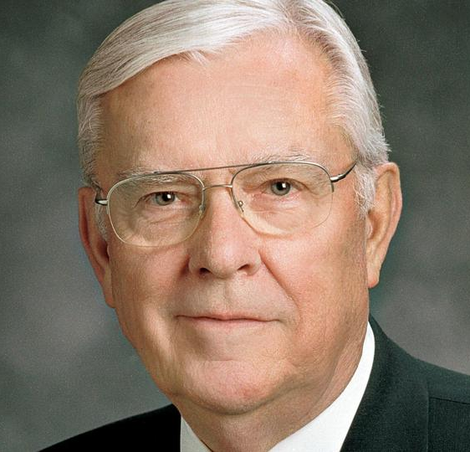
“To me, when my ministry is all over, it will not be any talk that I gave that will be very important in the sight of the Lord; but what will be important to him will be my hearing his voice and responding to his promptings. I constantly pray that the Spirit might direct me to be an instrument in the hands of the Lord to do his will and his bidding.”
President M. Russell Ballard,
“Respond to the Prompting
of the Spirit”
8 January 1988

Slide 61
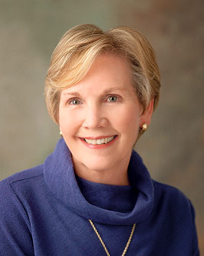
President Bonnie D. Parkin, Former Relief Society General President
“Our personal ministry is sacred and precious. It allows us to become an extension of the Lord’s love. It embraces all who cross our path. What are those things you can do for another person that only you can do? I invite you to find out.…Today, you will have immediate opportunities to practice your personal ministry.”
Notes:
https://www.churchofjesuschrist.org/callings/relief-society/relief-society-presidents/bonnie-d-parkin?lang=eng

Slide 62
Acknowledgements
Insights from, discussions with, and resources authored by Dr. Frank Judd, Dr. Mark Ellison, Dr. Gaye Strathearn, Dr. Matthew Grey, and Dr. S. Michael Wilcox were used in the creation of this video.

