Slide 1
We know Christ will be Crucified… but who are his main opponents in his arrest, trial and crucifixion?
Pharisees
Chief Priests
Equally Pharisees and Chief Priests
The Romans

Slide 2
We know Christ will be Crucified… but who are his main opponents in his arrest, trial and crucifixion?
“Judas Iscariot, went unto the chief priests” (Matthew 26:14).
“Judas, one of the twelve, came, and with him a great multitude… from the chief priests…” (Matthew 26:47).
“The chief priests and all the council sought for witness against Jesus…” (Mark 14:55).
“When the chief priests therefore and officers saw him, they cried out, saying, Crucify him, crucify him.” (John 19:6).

Slide 3
Pharisees or Chief Priests? Matthew 26-27, Mark 14-15, Luke 22-23, John 18-19
 | Matt. | Mark | Luke | John | Total
Pharisees | 1 | 0 | 0 | 1 | 2
Priests | 18 | 17 | 10 | 14 | 59

Slide 4
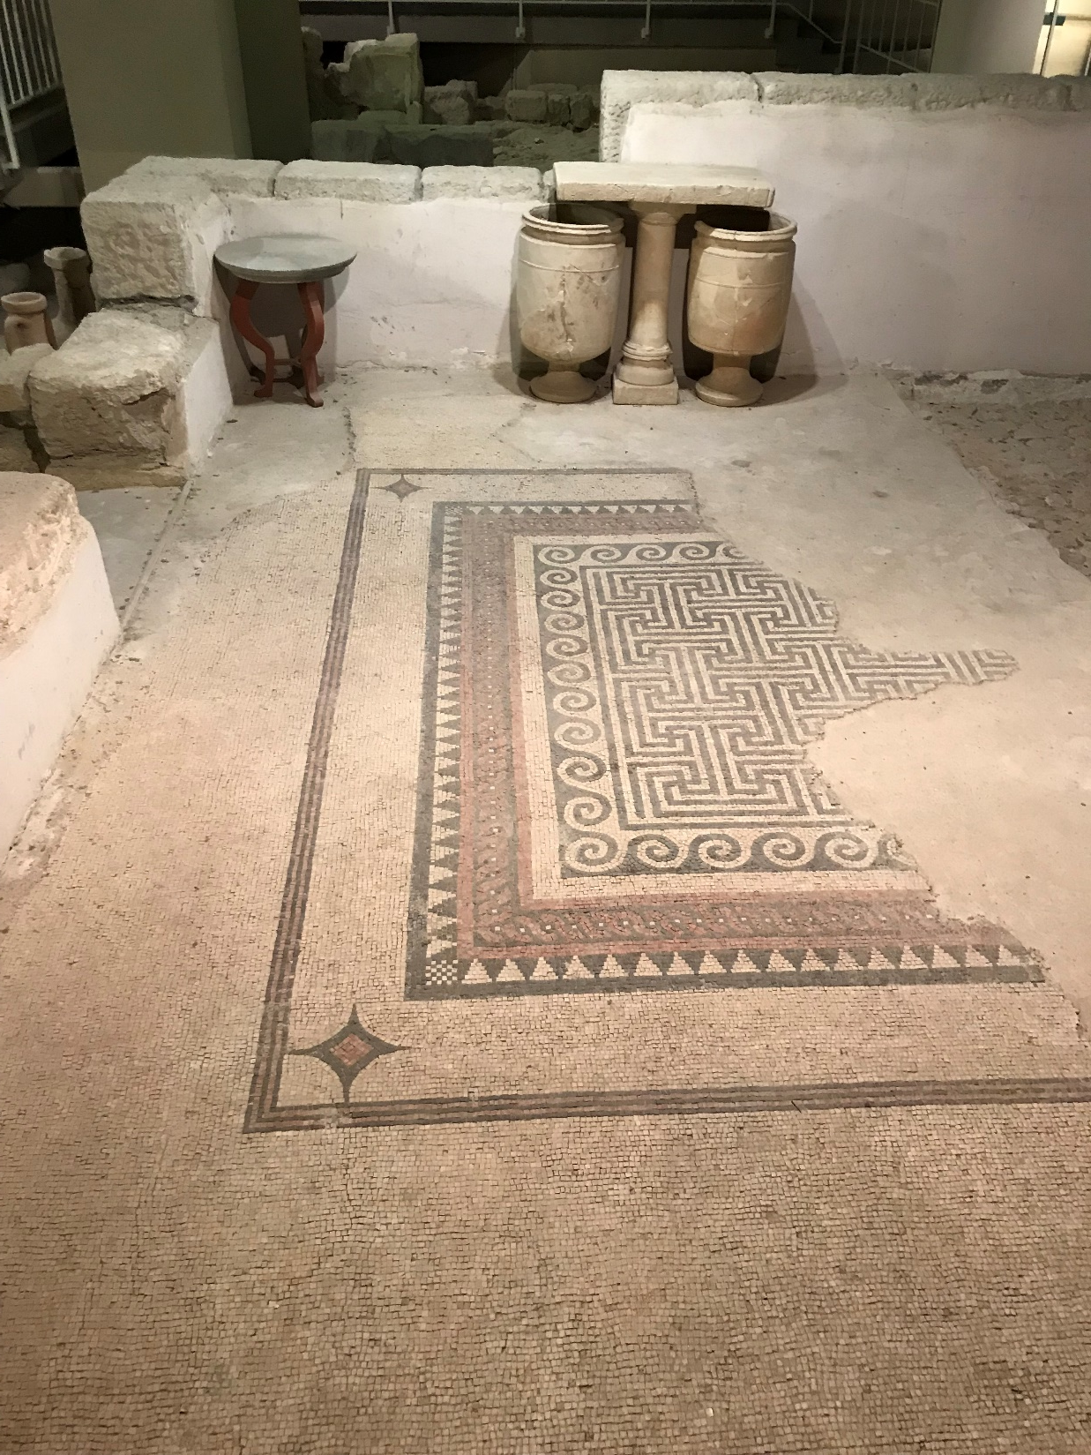
Notes:
Photo credit – John Hilton III

Slide 5
Notes:
Photo credit – John Hilton III

Slide 6
Notes:
Photo credit – John Hilton III

Slide 7
“Then gathered the chief priests and the Pharisees a council, and said, What do we? for this man doeth many miracles. If we let him thus alone, all men will believe on him: and the Romans shall come and take away both our place and nation” (John 11:47–48)
Notes:
Note – some people believe this is the temple. The Greek simply says “our place” which could be construed as what we might intuitively think, “Take my place” – “They will replace me.”

Slide 8
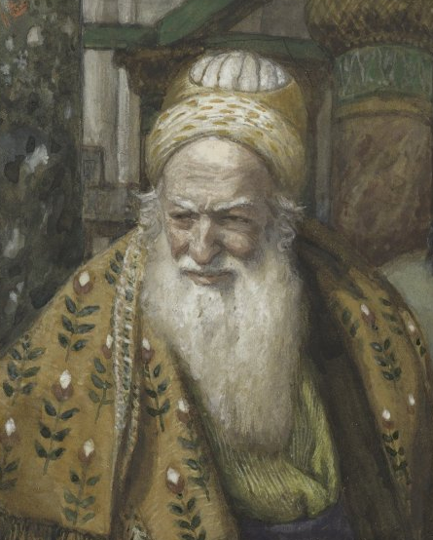
“And one of them, named Caiaphas, being the high priest that same year, said unto them, ‘Ye know nothing at all, Nor consider that it is expedient for us, that one man should die for the people, and that the whole nation perish not.’
And this spake he not of himself: but being high priest that year, he prophesied that Jesus should die for that nation; And not for that nation only, but that also he should gather together in one the children of God that were scattered abroad.
Then from that day forth they took counsel together for to put him to death.”
James Tissot
John 11:49–53
Notes:
https://commons.wikimedia.org/wiki/File:Brooklyn_Museum_-_Annas_and_Caiaphas_(Anne_et_Ca%C3%AFphe)_-_James_Tissot.jpg

Slide 9
“And one of them, named Caiaphas, being the high priest that same year, said unto them, ‘Ye know nothing at all, Nor consider that it is expedient for us, that one man should die for the people, and that the whole nation perish not.’
And this spake he not of himself: but being high priest that year, he prophesied that Jesus should die for that nation; And not for that nation only, but that also he should gather together in one the children of God that were scattered abroad.
Then from that day forth they took counsel together for to put him to death.”
James Tissot
John 11:49–53
Notes:
https://commons.wikimedia.org/wiki/File:Brooklyn_Museum_-_Annas_and_Caiaphas_(Anne_et_Ca%C3%AFphe)_-_James_Tissot.jpg

Slide 10
From the Triumphal Entry to the Last Supper
Background on Christ’s final week
The Triumphal Entry
Hypocrisy: the fig tree and temple sandwich
A woman anoints Christ
Casting out the ruler of this world
The Last Supper

Slide 11
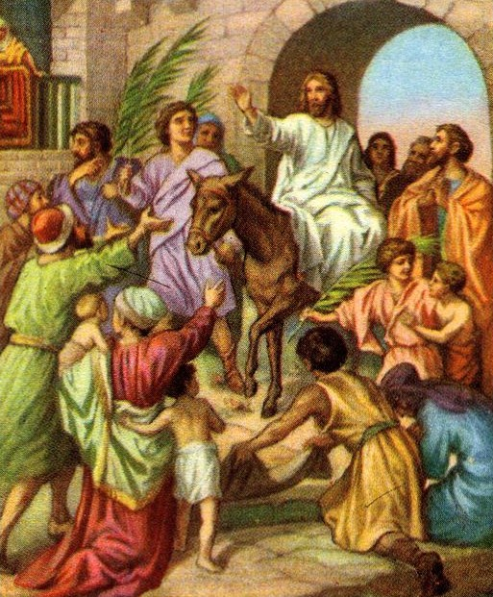
“See, Lord, and raise up for them their king, the son of David, to rule over Israel, your servant, in the time which you chose, o God, Undergird him with the strength to destroy the unrighteous rulers, to cleanse Jerusalem from gentiles who trample her to destruction.” (Psalms of Solomon 17:21-22)
Bible Card
Notes:
Note Psalm 118:19-28 and parallels to the triumphal entry (procession, Hosanna, “Blessed be he who enters in the name of the Lord” , carrying branches
“When thy days be fulfilled, and thou shalt sleep with thy fathers, I will set up thy seed after thee, which shall proceed out of thy bowels, and I will establish his kingdom… I will be his father, and he shall be my son… And thine house and thy kingdom shall be established for ever before thee: thy throne shall be established for ever… So did Nathan speak unto David.” 2 Sam 7:12-17
https://commons.wikimedia.org/wiki/File:Jesus_entering_jerusalem_on_a_donkey.jpg

Slide 12
“As [Jesus] was now approaching the path down from the Mount of Olives, the whole multitude of the disciples began to praise God joyfully with a loud voice for all the deeds of power that they had seen, saying,
“Blessed is the king
who comes in the name of the Lord!
Peace in heaven,
and glory in the highest heaven!”
Some of the Pharisees in the crowd said to him, “Teacher, order your disciples to stop.” He answered, “I tell you, if these were silent, the stones would shout out.”
Bible Card
Luke 19:37-40
Notes:
25 Save now, I beseech thee, O Lord: O Lord, I beseech thee, send now prosperity.
26 Blessed be he that cometh in the name of the Lord: we have blessed you out of the house of the Lord.
(Psalms 118:25–26)
https://commons.wikimedia.org/wiki/File:Jesus_entering_jerusalem_on_a_donkey.jpg

Slide 13
“[Jesus] is not literally saying that the stones on the street will open their mouths and sing hymns. What he is saying is that all of creation was made to exalt and worship the Lord, and if we will not do it with our words, God’s Word is still preached.
Bible Card
Natalie Regoli
Notes:
Quote from: https://connectusfund.org/the-rocks-will-cry-out-meaning-in-scripture-luke-19-40-kjv

Slide 14
“The example to follow is that of the early apostles [after the Resurrection]. We should never become complacent or fearful of God’s message, hoarding it to ourselves or remaining quiet for fear of judgment or condemnation. We should be bold in our testimony and faithful in our witness, vocal in our praise and confident in our hope.
Bible Card
Natalie Regoli
Notes:
Quote from: https://connectusfund.org/the-rocks-will-cry-out-meaning-in-scripture-luke-19-40-kjv

Slide 15
“If we remain faithful to God and publicly proclaim His Name to the world, the rocks will join us in singing, and sin will lose all of its power to oppose the purposes of God.”
Bible Card
Natalie Regoli
Notes:
Quote from: https://connectusfund.org/the-rocks-will-cry-out-meaning-in-scripture-luke-19-40-kjv

Slide 16
From the Triumphal Entry to the Last Supper
Background on Christ’s final week
The Triumphal Entry
Hypocrisy: the fig tree and temple sandwich
A woman anoints Christ
Casting out the ruler of this world
The Last Supper

Slide 17
Mark 11:11–14 (NRSV)
“On the following day, when they came from Bethany, he was hungry. Seeing in the distance a fig tree in leaf [that’s a key phrase], he went to see whether perhaps he would find anything on it. When he came to it, he found nothing but leaves, for it was not the season for figs. He said to it, ‘May no one ever eat fruit from you again.’ And his disciples heard it.”

Slide 18
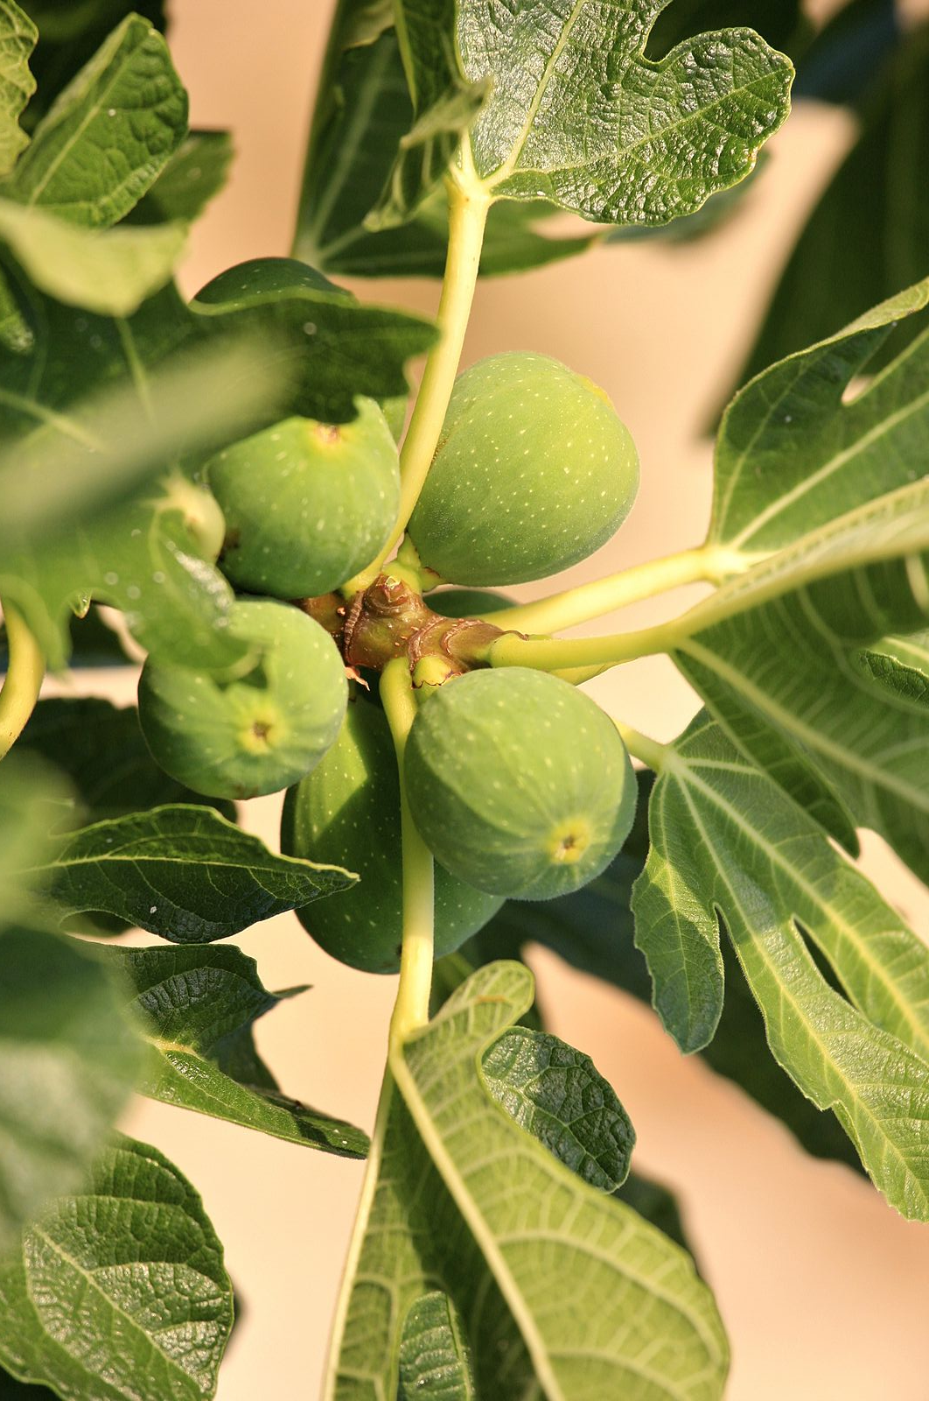
Background:
Fig trees normally bud leaves after figs appear.
This fig tree was budding leaves, but no fruit.
As a symbol, this fig tree was a hypocrite—acting as though it had fruit.
Alex Proimos
Notes:
https://commons.wikimedia.org/wiki/File:Fig_Tree_(5967272441).jpg

Slide 19
Mark 11:19–21 (NRSV)
“And when evening came, Jesus and his disciples went out of the city. In the morning as they passed by, they saw the fig tree withered away to its roots. Then Peter remembered and said to him, ‘Rabbi, look! The fig tree that you cursed has withered.’”

Slide 20
Mark 11:15–16 (NRSV)
“Then they came to Jerusalem. And he entered the temple and began to drive out those who were selling and those who were buying in the temple, and he overturned the tables of the money changers and the seats of those who sold doves; and he would not allow anyone to carry anything through the temple.”

Slide 21
Notes:
Image: https://en.wikipedia.org/wiki/Second_Temple#/media/File:Jerusalem_Modell_BW_2.JPG

Slide 22
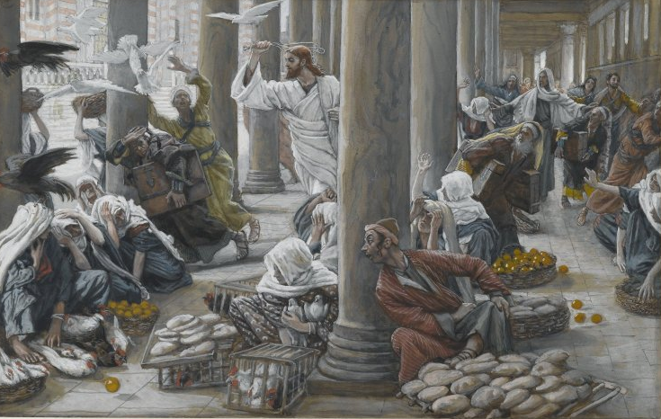
A “Cleansing” of the Temple, or Foreshadowing of Destruction?
James Tissot
“[Jesus said unto them] Is it not written, ‘My house shall be called of all nations the house of prayer’? [Isaiah 56:7] but ye have made it a ‘den of thieves.’ [Jeremiah 7:11] (Mark 11:17)
Notes:
NOTE: THE verses that follow in Jeremiah 7 discuss Shiloh, where the ark earlier rested “I set my name at the first.” The ark was lost, Shiloh was destroyed. In other words, Jeremiah is saying, just like that holy site (Shiloh) was destroyed, so too will this holy site (Jerusalem) be destroyed. Christ’s words are an extension of Jeremiah’s word to the same place.
12 But go ye now unto my place which was in Shiloh, where I set my name at the first, and see what I did to it for the wickedness of my people Israel.
13 And now, because ye have done all these works, saith the Lord, and I spake unto you, rising up early and speaking, but ye heard not; and I called you, but ye answered not;
14 Therefore will I do unto this house, which is called by my name, wherein ye trust, and unto the place which I gave to you and to your fathers, as I have done to Shiloh.
(Jeremiah 7:12–14)
https://commons.wikimedia.org/wiki/File:Brooklyn_Museum_-_The_Merchants_Chased_from_the_Temple_(Les_vendeurs_chass%C3%A9s_du_Temple)_-_James_Tissot.jpg

Slide 23
A “Cleansing” of the Temple, or Foreshadowing of Destruction?
“Is this house, which is called by my name, become a den of robbers in your eyes?...Therefore will I do unto this house... as I have done to Shiloh.”
(Jer. 7:9–14)
James Tissot
“[Jesus said unto them] Is it not written, ‘My house shall be called of all nations the house of prayer’? [Isaiah 56:7] but ye have made it a ‘den of thieves.’ [Jeremiah 7:11] (Mark 11:17)
Notes:
NOTE: THE verses that follow in Jeremiah 7 discuss Shiloh, where the ark earlier rested “I set my name at the first.” The ark was lost, Shiloh was destroyed. In other words, Jeremiah is saying, just like that holy site (Shiloh) was destroyed, so too will this holy site (Jerusalem) be destroyed. Christ’s words are an extension of Jeremiah’s word to the same place.
12 But go ye now unto my place which was in Shiloh, where I set my name at the first, and see what I did to it for the wickedness of my people Israel.
13 And now, because ye have done all these works, saith the Lord, and I spake unto you, rising up early and speaking, but ye heard not; and I called you, but ye answered not;
14 Therefore will I do unto this house, which is called by my name, wherein ye trust, and unto the place which I gave to you and to your fathers, as I have done to Shiloh.
(Jeremiah 7:12–14)
https://commons.wikimedia.org/wiki/File:Brooklyn_Museum_-_The_Merchants_Chased_from_the_Temple_(Les_vendeurs_chass%C3%A9s_du_Temple)_-_James_Tissot.jpg

Slide 24
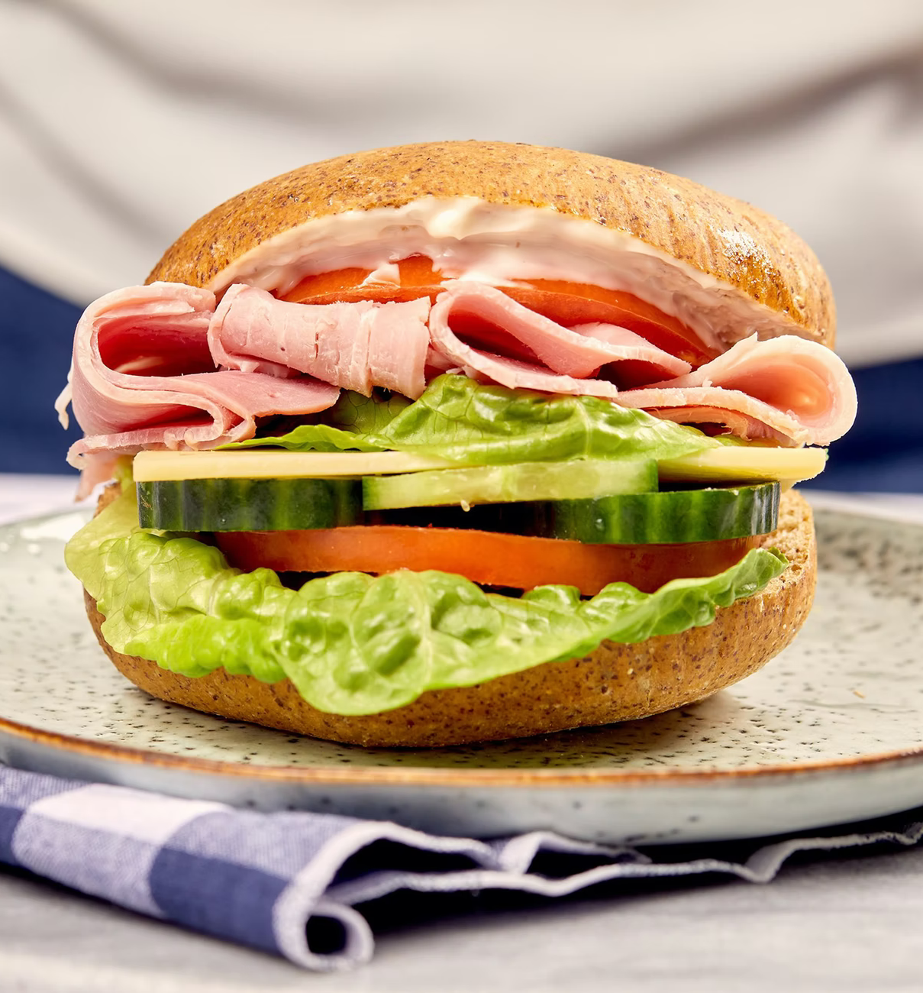
Cleansing the Temple and Cursing a Fig Tree
The fig tree looks like it’s bearing fruit, but it’s not. It’s a hypocrite and is destroyed.
The temple should be a place of holiness, but it has become a place of greed. Hypocrisy is rampant at the temple; it will be destroyed.
Seriously Low Carb
Notes:
Read Mark 11:19-21
https://unsplash.com/photos/3rM8htZWC8E
It’s easy to spot hypocrisy in others—but much harder to find it in ourselves. Take a moment to look inside yourself. Do you see any examples of hypocrisy?

Slide 25
From the Triumphal Entry to the Last Supper
Background on Christ’s final week
The Triumphal Entry
Hypocrisy: the fig tree and temple sandwich
A woman anoints Christ
Casting out the ruler of this world
The Last Supper

Slide 26
Amy Tran
“The chief priests… sought how they might take him” (Mark 14:1)
James Tissot
“[Judas] sought how he might conveniently betray him” (Mark 14:11)
Notes:
What does seeing these events sandwiched together do for our understanding?
Mary spends money on Jesus, she enters the house to anoint him.
Judas sells Jesus for money, he leaves the house to betray him.
https://unsplash.com/photos/pTcexK1TB98

Slide 27
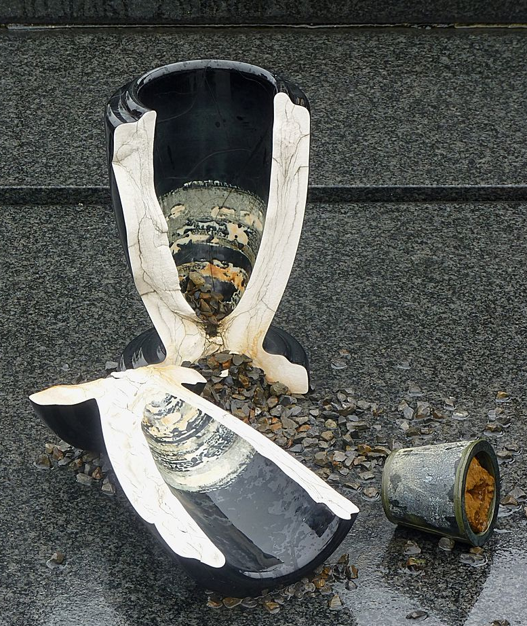
“She broke open the jar and poured the ointment on his head” (Mark 14:3)
Christ’s body was “broken for you”; he “poured out his soul unto death”
(1 Cor. 11:24, Isaiah 53:12)
Jamain
Notes:
https://commons.wikimedia.org/wiki/File:Broken_vase_on_a_grave_J1.jpg

Slide 28
Julie Smith Gospel According to Mark
“[This woman receives] more praise from Jesus than anyone else in [Mark.] In Mark’s Gospel, it is not the Twelve but the anointing woman (among others) who is presented as an ideal. The disciples deny and avoid Jesus’ death, but the woman acknowledges it, honors it, and responds appropriately to it. Mark’s Gospel is focused on the theme of discipleship and the anointing woman is presented as a model disciple.”
Notes:
Gospel of Mark Commentary, 721-723

Slide 29
Julie Smith Gospel According to Mark
“The broken vial and the complete use of the ointment serve as symbols of the completeness of her sacrifice and thus suggest that she foreshadows Jesus and his own sacrifice.”
Notes:
Gospel of Mark Commentary, 721-723

Slide 30
From the Triumphal Entry to the Last Supper
Background on Christ’s final week
The Triumphal Entry
Hypocrisy: the fig tree and temple sandwich
A woman anoints Christ
Casting out the ruler of this world
The Last Supper

Slide 31
What Was the Purpose of Christ’s Atonement?
Notes:
Jot down a quick sentence. First thing that comes to your mind.

Slide 32
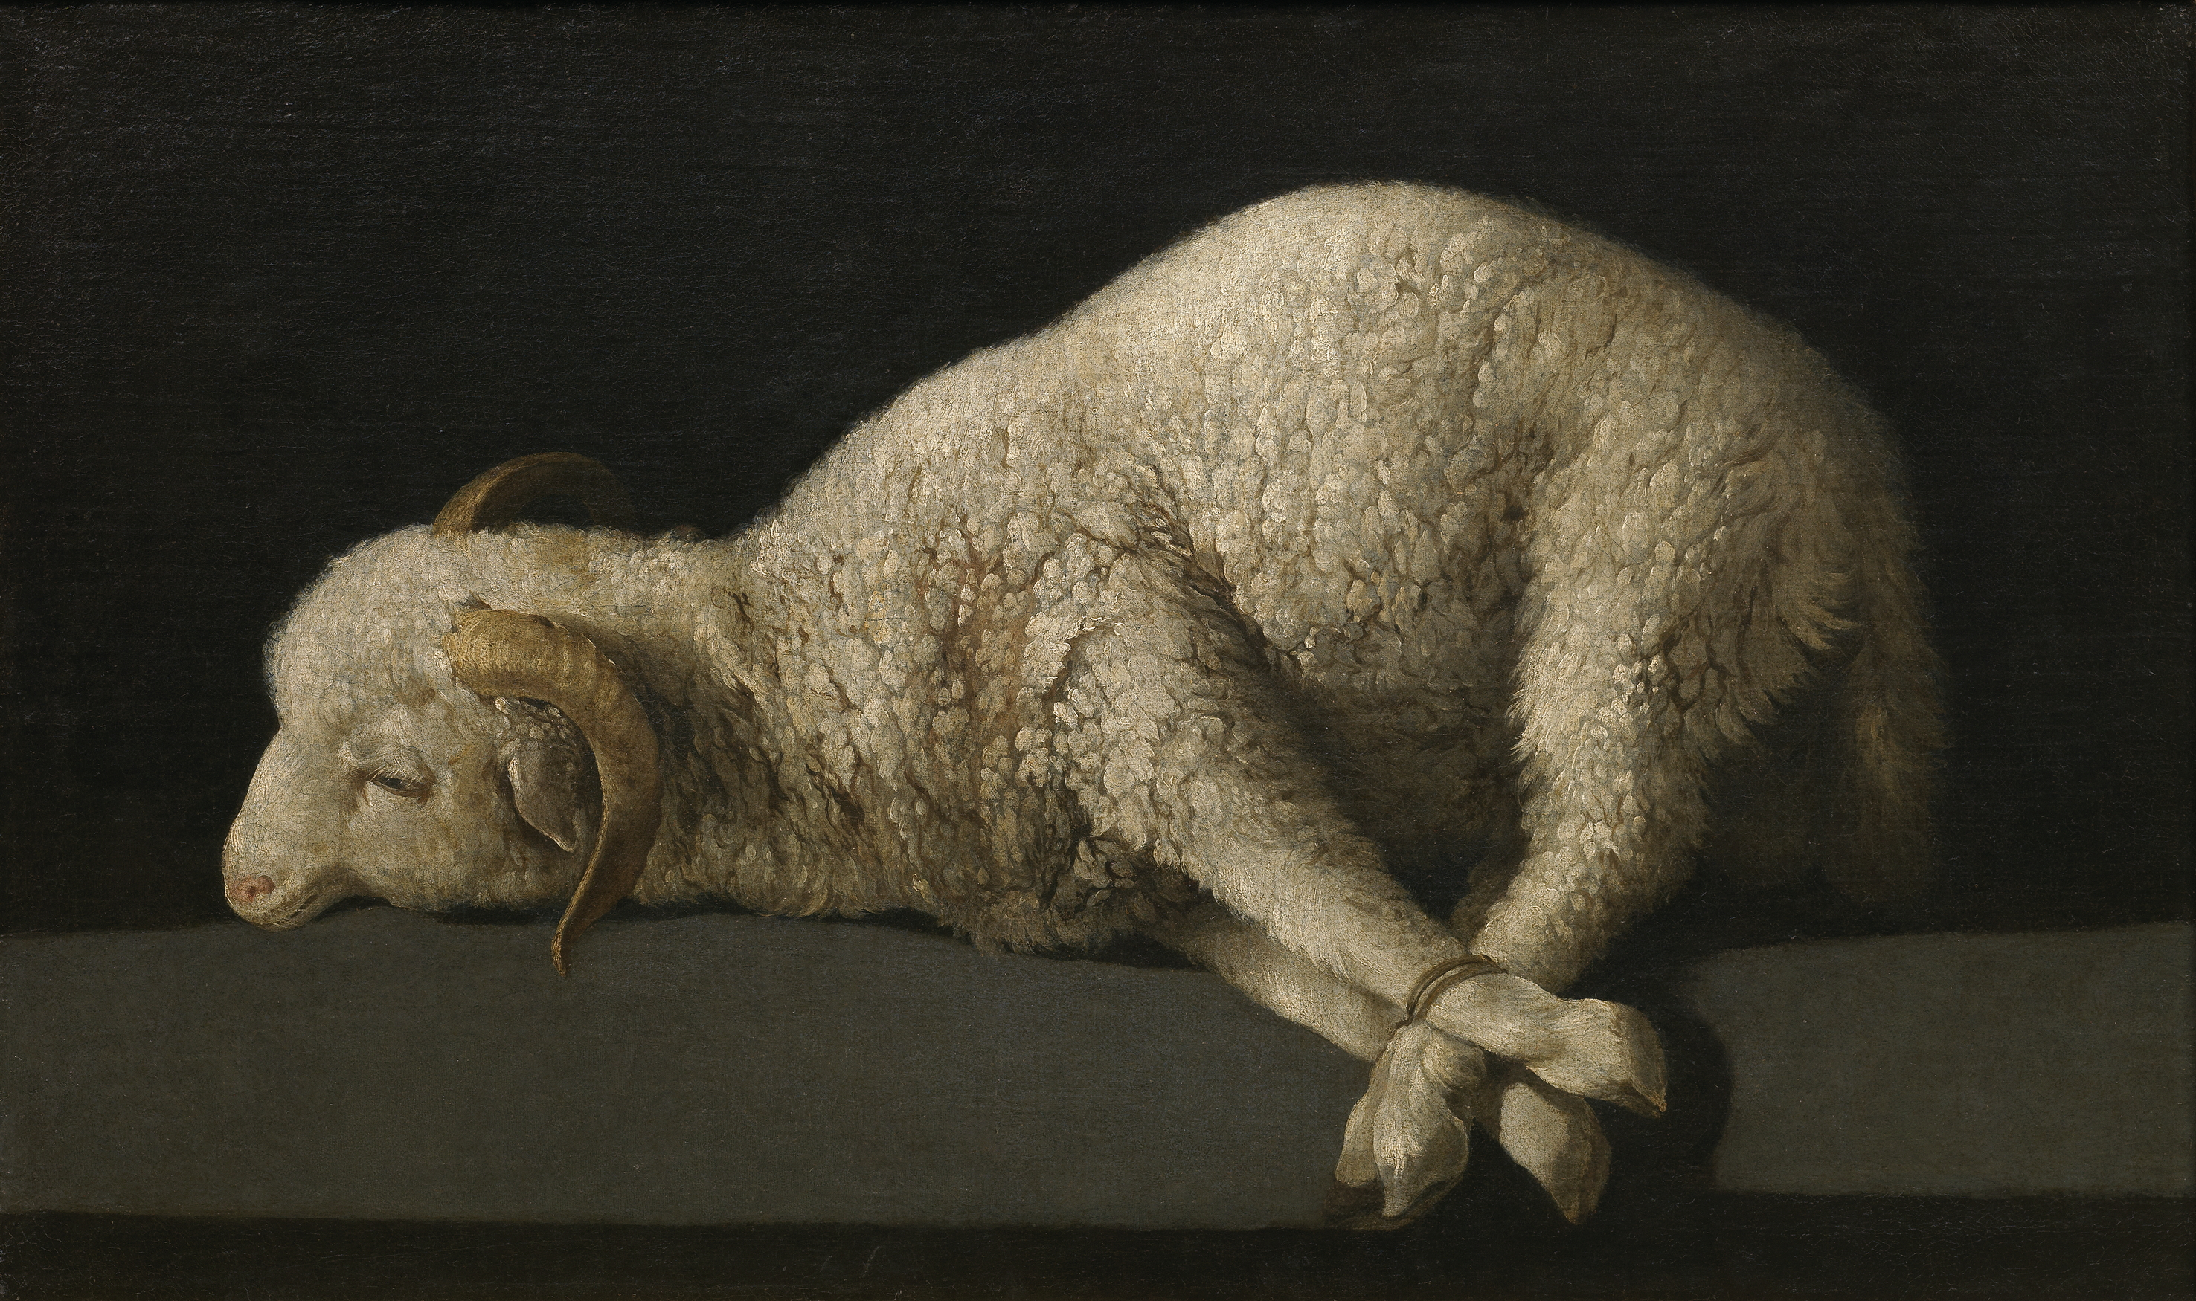
What Was the Purpose of Christ’s Atonement?
Francisco de Zurbarán
Sacrifice for sin
“Penal Substitution”
Notes:
How many of you said something like this?
https://commons.wikimedia.org/wiki/File:Francisco_de_Zurbar%C3%A1n_006.jpg

Slide 33
What Was the Purpose of Christ’s Atonement?
Francisco de Zurbarán
Caravaggio
Sacrifice for sin
“Penal Substitution”
Conquer Satan
“Christus Victor”
Notes:
Did anybody say, “To conquer Satan?” While both answers are correct, many tend to focus on the “Sacrifice for sin” and not “conquering Satan.”
https://commons.wikimedia.org/wiki/File:Francisco_de_Zurbar%C3%A1n_006.jpg
https://commons.wikimedia.org/wiki/File:Madonna_with_the_Serpent.jpg

Slide 34
“Now is the judgment of this world; now the ruler of this world [Satan] will be driven out. And I, when I am lifted up from the earth, will draw all people to myself.” He said this to indicate the kind of death he was to die.”
(John 12:31-33, NRSV)
Bible Images
Notes:
https://www.churchofjesuschrist.org/media/image/christ-teaching-in-jerusalem-5d091c2?lang=eng

Slide 35
“The ruler of this world has been condemned.”
(John 16:11, NRSV)
Bible Images

Slide 36
“Since, therefore, the children share flesh and blood, [Jesus] himself likewise shared the same things, so that through death he might destroy the one who has the power of death, that is, the devil, and free those who all their lives were held in slavery by the fear of death.” (Hebrews 2:14-15)
Caravaggio
Notes:
https://commons.wikimedia.org/wiki/File:Madonna_with_the_Serpent.jpg

Slide 37
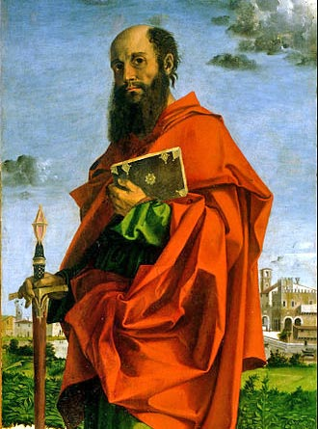
On “the cross [Christ] disarmed the powers and authorities, he made a public spectacle of them, triumphing over them by the cross.”
^{(Colossians 2:14–15, NIV)}
Bartolomeo Montagna
Notes:
https://commons.wikimedia.org/wiki/File:Bartolomeo_Montagna_-_Saint_Paul_-_Google_Art_Project.jpg

Slide 38
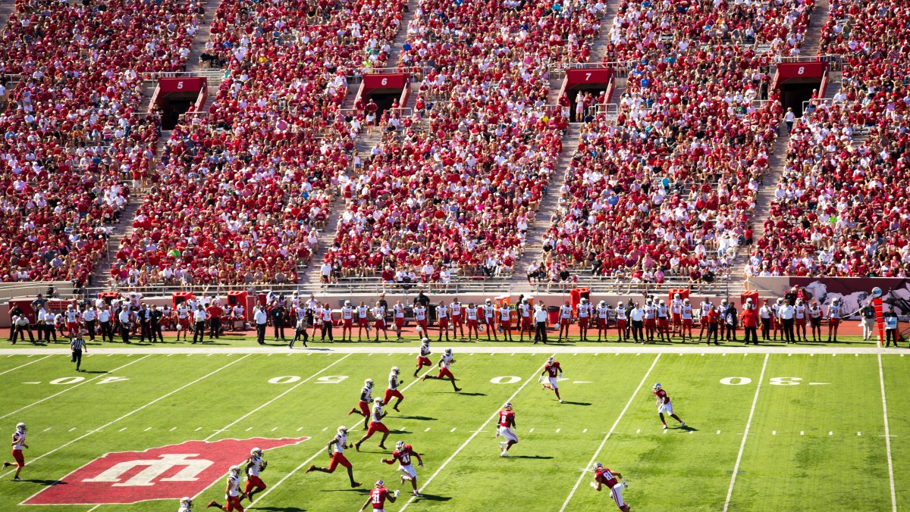
Notes:
Imagine watching a sporting event in which you care deeply about the outcome. What if you knew from the outset that no matter how far behind your team was, no matter how many mistakes your favorite player made, no matter how bleak things looked, your team would win?
https://pxhere.com/en/photo/706568

Slide 39
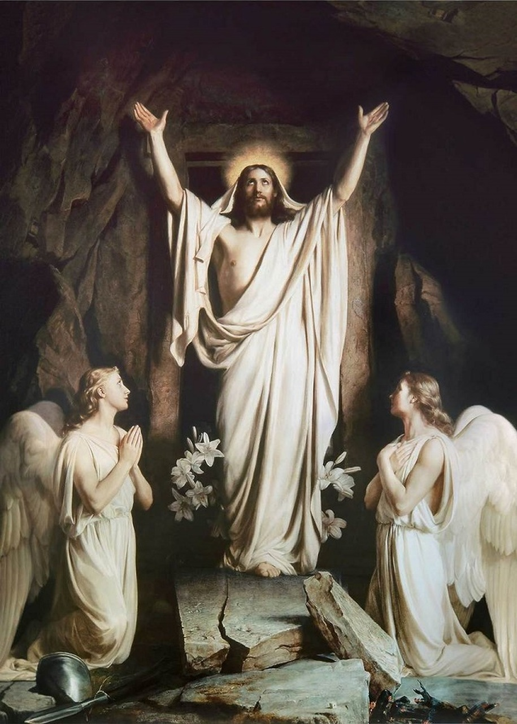
Spoiler Alert: Jesus Wins
We can have confidence in “the triumph and the glory of the Lamb, who was slain.”
(Doctrine and Covenants 76:39)
Carl Bloch
Notes:
https://www.jesus-story.net/resurrection/

Slide 40
“Regardless of the state of the world or the poll results of your favorite politician, Jesus is still in control. He wasn’t voted in and he can’t be voted out. He rules and reigns over the affairs of mankind. Because Jesus lives, I can live differently. I can act and react from a place of peace and an attitude of assurance. Jesus is in control of my past, my present, and my future. Despair over my past failures or fear over future problems cannot control my present because Jesus rules me with peace.”
Judah Smith, Jesus Is ___, p. 190
Notes:
Picture is okay
Scott Woodward unpublished paper: The time between the kingdom launch of Jesus’s first coming and the kingdom consummation of his second coming has been cleverly likened to the time between the election of a new national leader and the day he officially takes office. During such an in between time, the people may orient their lives toward the “lame-duck” administrator still in power, or toward the new leader whose presidency has already been secured and whose rise to power is a foregone conclusion. Indeed, we live in just such an in between time. Jesus’s mortal mission millennia ago secured his immortal reign in his Millennial kingdom to come. The victory, for all intents and purposes, has already been won. The devil’s lame-duck administration, though technically still in power, is soon to be thrown down—and he knows it! Thus, with certain hope in their hearts, millions of people are currently orienting their lives toward Jesus Christ and preparing for his reign by living “the gospel of the kingdom” he taught (Mark 1:14), repenting and being baptized to enter into the kingdom of God, and serving under the direction of those who hold the keys of the kingdom to do their part in helping “the kingdom of God go forth” on earth “that the kingdom of heaven may come” (D&C 65:6).

Slide 41
“Christ sitteth on the right hand of God”(Colossians 3:1)
Judah Smith, Jesus Is ___, p. 190
Notes:
Picture is okay
Scott Woodward unpublished paper: The time between the kingdom launch of Jesus’s first coming and the kingdom consummation of his second coming has been cleverly likened to the time between the election of a new national leader and the day he officially takes office. During such an in between time, the people may orient their lives toward the “lame-duck” administrator still in power, or toward the new leader whose presidency has already been secured and whose rise to power is a foregone conclusion. Indeed, we live in just such an in between time. Jesus’s mortal mission millennia ago secured his immortal reign in his Millennial kingdom to come. The victory, for all intents and purposes, has already been won. The devil’s lame-duck administration, though technically still in power, is soon to be thrown down—and he knows it! Thus, with certain hope in their hearts, millions of people are currently orienting their lives toward Jesus Christ and preparing for his reign by living “the gospel of the kingdom” he taught (Mark 1:14), repenting and being baptized to enter into the kingdom of God, and serving under the direction of those who hold the keys of the kingdom to do their part in helping “the kingdom of God go forth” on earth “that the kingdom of heaven may come” (D&C 65:6).

Slide 42
Judah Smith, Jesus Is ___, p. 190
“Christ sitteth on the right hand of God”(Colossians 3:1)
“Sits? He is seated?...Shouldn’t he be pacing the sidelines, yelling at his team to run the play, make the pass, beat the opposition? Standing implies action. Urgency. Activity. Jesus should be standing. But Jesus is sitting. Sitting is the position of reigning. Jesus is not on his feet….He is relaxing…He is in heaven and all is well. All is finished.
Notes:
Picture is okay
Scott Woodward unpublished paper: The time between the kingdom launch of Jesus’s first coming and the kingdom consummation of his second coming has been cleverly likened to the time between the election of a new national leader and the day he officially takes office. During such an in between time, the people may orient their lives toward the “lame-duck” administrator still in power, or toward the new leader whose presidency has already been secured and whose rise to power is a foregone conclusion. Indeed, we live in just such an in between time. Jesus’s mortal mission millennia ago secured his immortal reign in his Millennial kingdom to come. The victory, for all intents and purposes, has already been won. The devil’s lame-duck administration, though technically still in power, is soon to be thrown down—and he knows it! Thus, with certain hope in their hearts, millions of people are currently orienting their lives toward Jesus Christ and preparing for his reign by living “the gospel of the kingdom” he taught (Mark 1:14), repenting and being baptized to enter into the kingdom of God, and serving under the direction of those who hold the keys of the kingdom to do their part in helping “the kingdom of God go forth” on earth “that the kingdom of heaven may come” (D&C 65:6).

Slide 43
What troubles are you facing in your life today that you could let go of by knowing—deeply knowing—that Jesus Christ wins?
Carl Bloch

Slide 44
From the Triumphal Entry to the Last Supper
Background on Christ’s final week
The Triumphal Entry
Hypocrisy: the fig tree and temple sandwich
A woman anoints Christ
Casting out the ruler of this world
The Last Supper

Slide 45
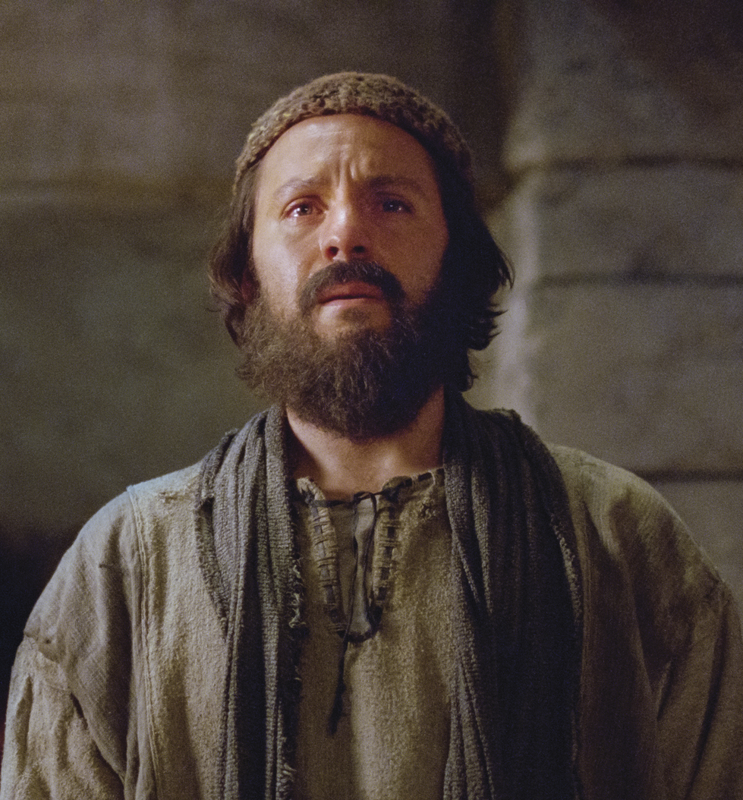
Lord, is it I?
“And as they did eat, he said… One of you shall betray me. And they were exceeding sorrowful, and began every one of them to say unto him, Lord, is it I?”
Matthew 26:21–23
Bible Images
Notes:
Synopsis note: In Matthew 26:21-22, the disciples respond to the Savior’s statement that one would betray him by saying, “Lord, is it I?” How is this different in Luke 22:21-24 [next slide]?
https://www.churchofjesuschrist.org/media/image/bible-video-jesus-cleopas-emmaus-91397f8?lang=eng&collectionId=540325ab91d18e0e1e52262aac51c33c10c4724b

Slide 46
Lord, who is it ?
“Behold, the hand of him that betrayeth me is with me on the table…They began to inquire among themselves, which of them it was that should do this thing.”
Luke 22:21, 23
Bible Images
Notes:
Synopsis note: In Matthew 26:21-22, the disciples respond to the Savior’s statement that one would betray him by saying, “Lord, is it I?” How is this different in Luke 22:21-24 [next slide]?
https://www.churchofjesuschrist.org/media/image/bible-video-jesus-cleopas-emmaus-91397f8?lang=eng&collectionId=540325ab91d18e0e1e52262aac51c33c10c4724b

Slide 47
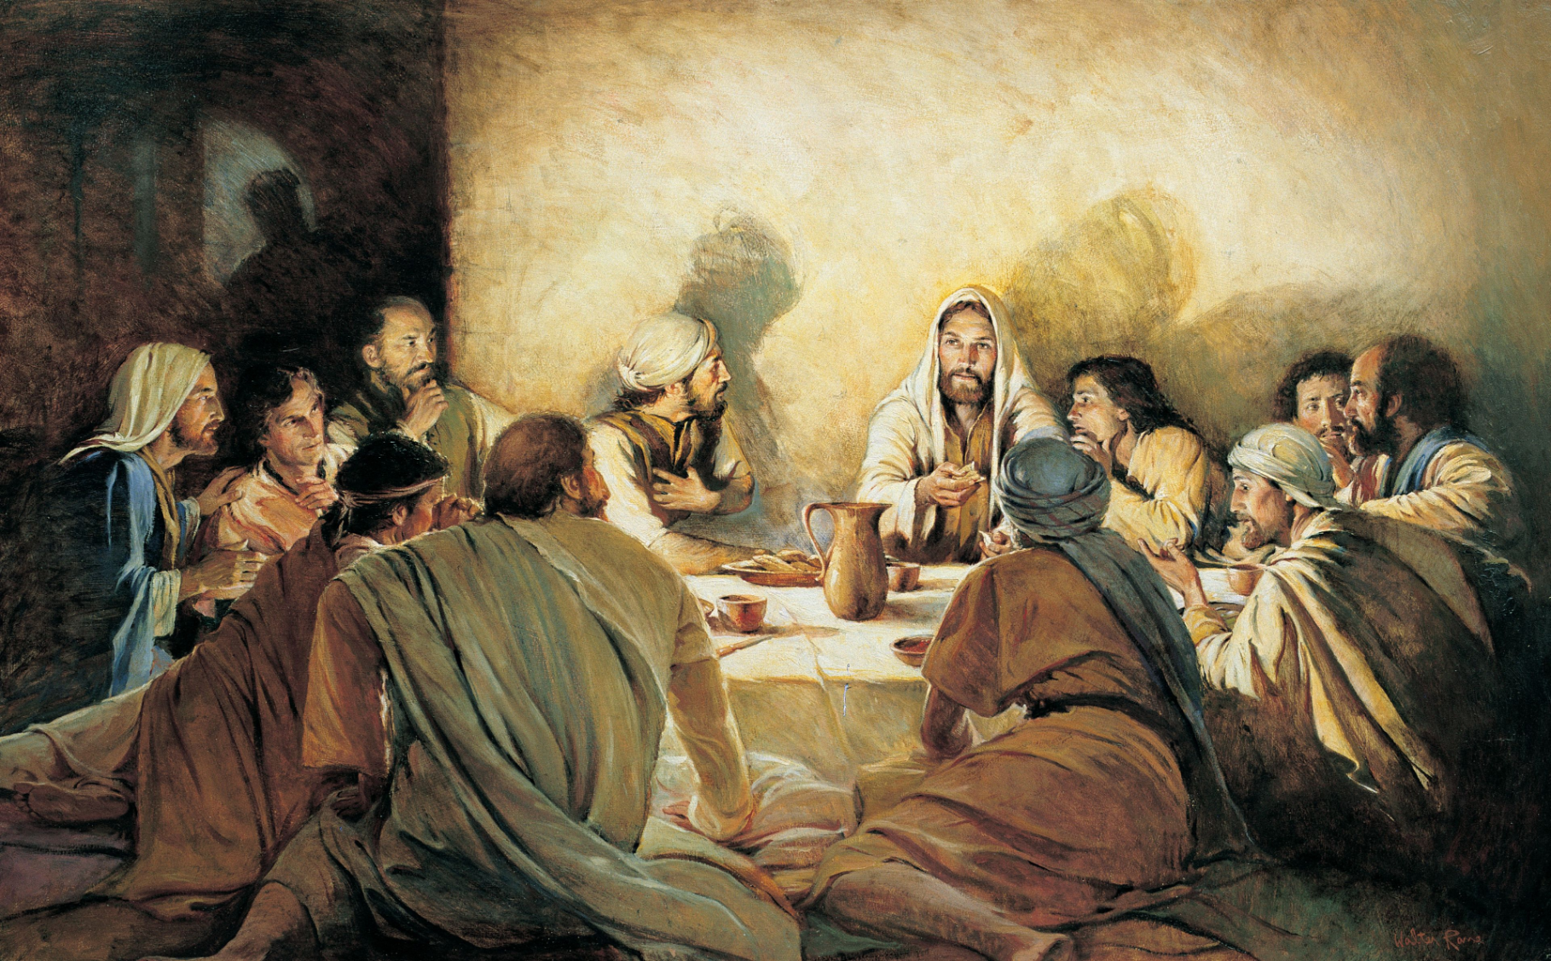
Lord is it I?
Who is it?
Walter Rane
What lesson do we learn from this contrast?
Notes:
https://www.churchofjesuschrist.org/media/image/jesus-last-supper-08e1294?lang=eng

Slide 48
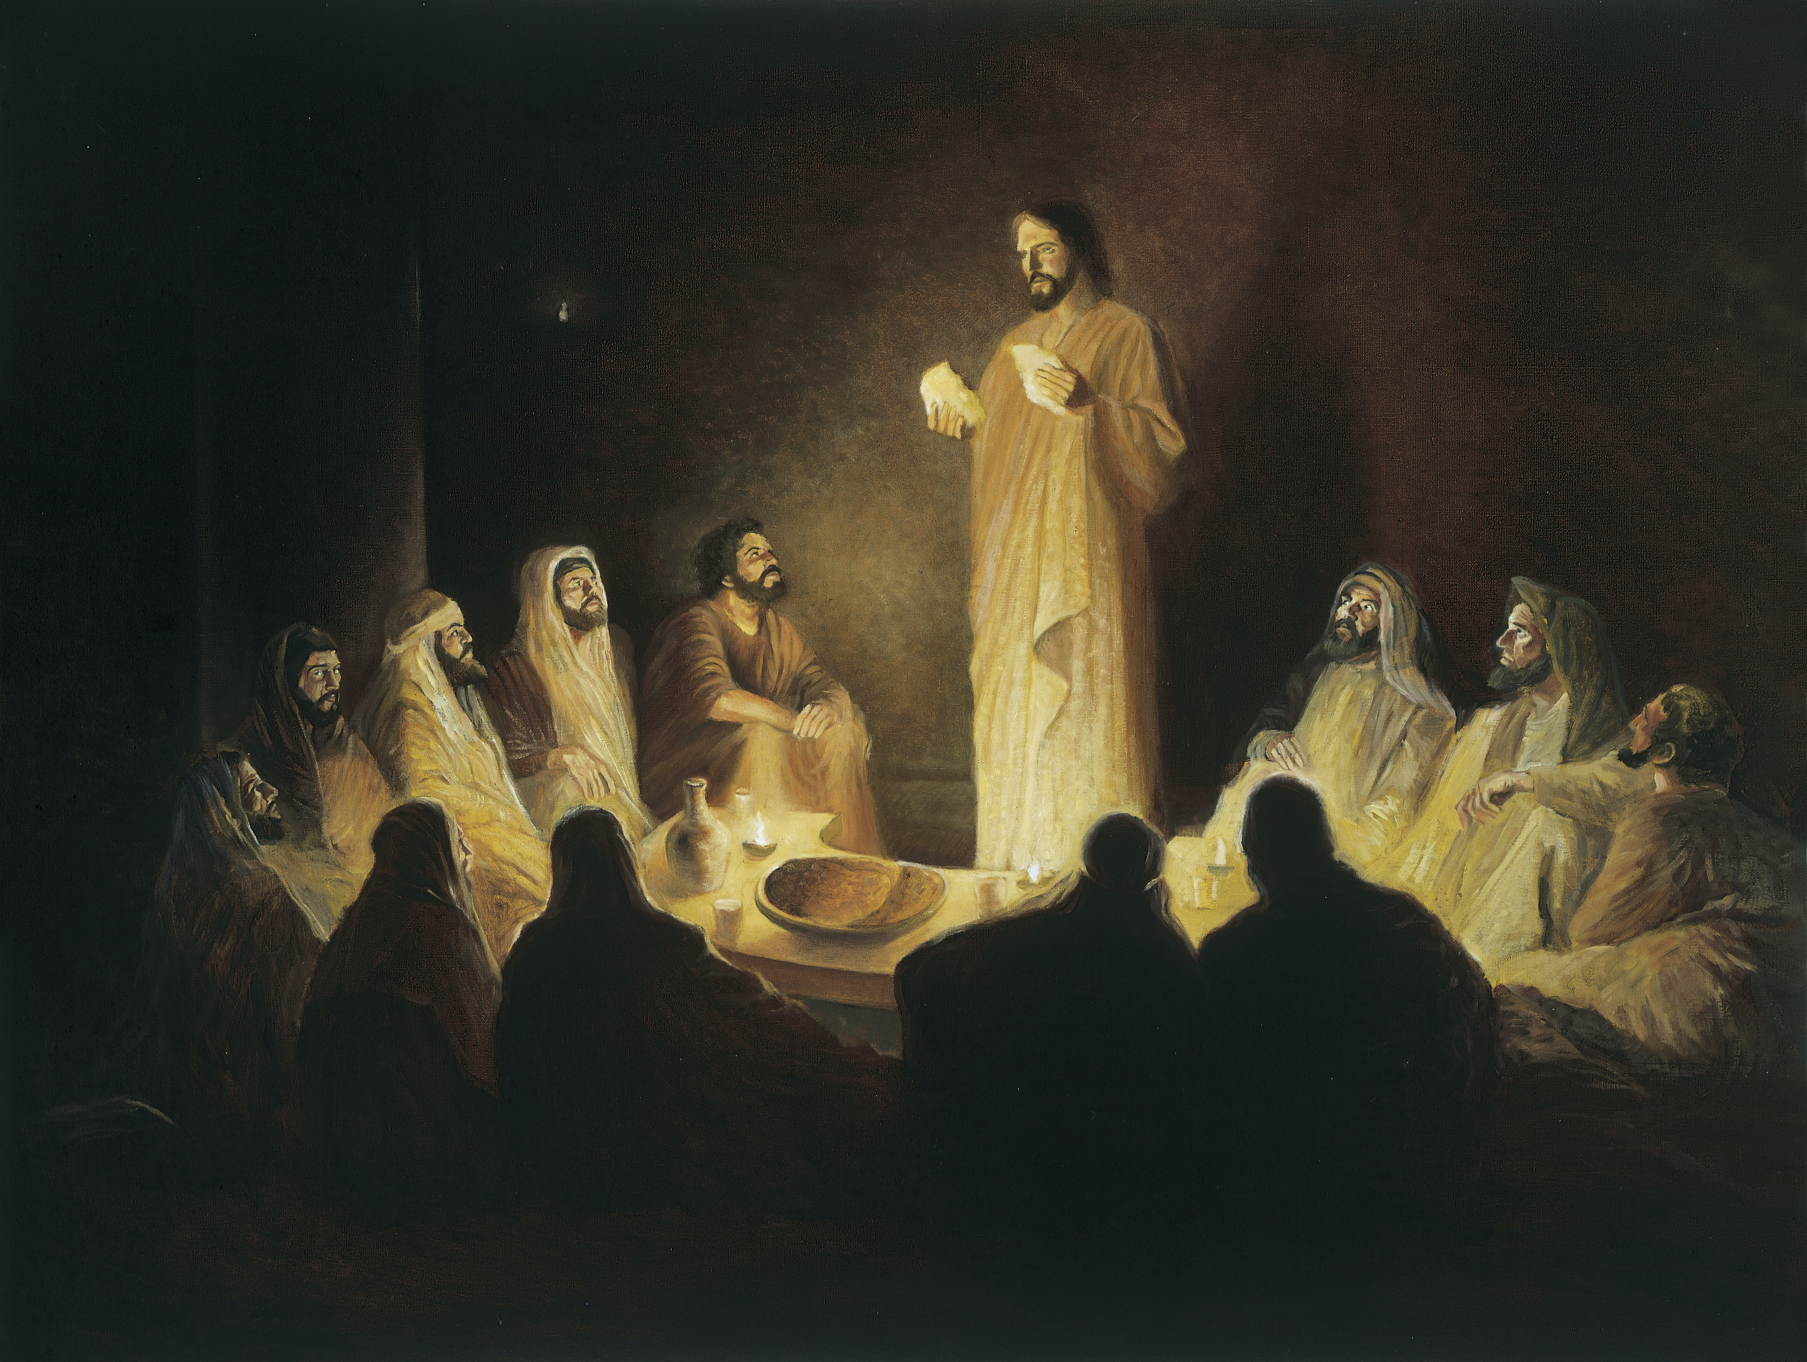
“I have received of the Lord that which also I delivered unto you, That the Lord Jesus the same night in which he was betrayed took bread:
And when he had given thanks, he brake it, and said, Take, eat: this is my body, which is broken for you: this do in remembrance of me.
Gary E. Smith
1 Corinthians was written ~53 AD—before any of the Gospel accounts!
Notes:
https://www.churchofjesuschrist.org/church/news/viewpoint-sacrament-on-christmas-sunday-a-poignant-event?lang=eng

Slide 49
“After the same manner also he took the cup, when he had supped, saying, This cup is the new testament in my blood: this do ye, as oft as ye drink it, in remembrance of me.
Gary E. Smith
1 Corinthians was written ~53 AD—before any of the Gospel accounts!
Notes:
https://www.churchofjesuschrist.org/church/news/viewpoint-sacrament-on-christmas-sunday-a-poignant-event?lang=eng

Slide 50
“For as often as ye eat this bread, and drink this cup, ye do shew the Lord’s death till he come”
(1 Corinthians 11:23–26)
Gary E. Smith
1 Corinthians was written ~53 AD—before any of the Gospel accounts!
Notes:
https://www.churchofjesuschrist.org/church/news/viewpoint-sacrament-on-christmas-sunday-a-poignant-event?lang=eng

Slide 51
“For as often as ye eat this bread, and drink this cup, ye do shew the Lord’s death till he come”
(1 Corinthians 11:23–26)
“shew” = “proclaim publicly” “announce,” or “testify of”
Gary E. Smith
1 Corinthians was written ~53 AD—before any of the Gospel accounts!
Notes:
https://www.churchofjesuschrist.org/church/news/viewpoint-sacrament-on-christmas-sunday-a-poignant-event?lang=eng

Slide 52
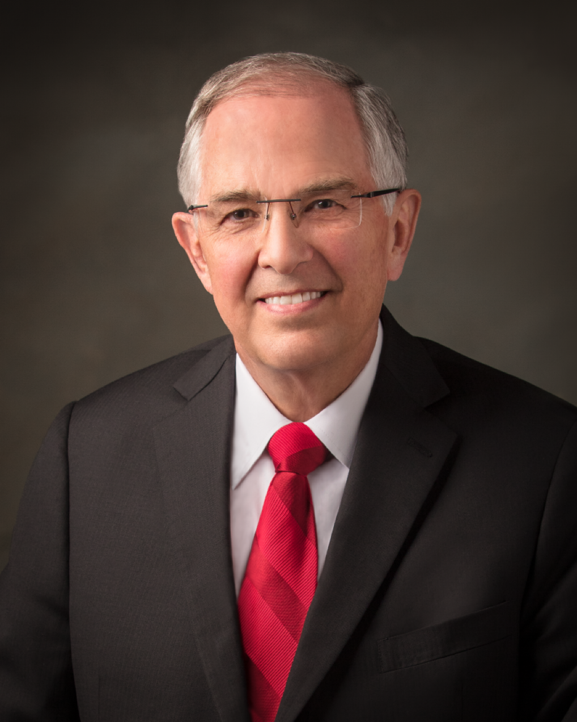
“The title ‘renewing our baptismal covenants’ is not found in the scriptures. It’s not inappropriate. Many of you have used it in talks; we have used it in talks. But it is not something that is used in the scriptures, and it can’t be the keynote of what we say about the sacrament.… The sacrament is a beautiful time to not just renew our baptismal covenant, but to commit to Him to renew all our covenants, all our promises, and to approach Him in a spiritual power that we did not have previously as we move forward.”
Elder Neil L. Andersen
“Witnessing to Live the Commandments”
General Conference Leadership Training on the Sabbath Day Observance at Church
(April 2015).

Slide 53
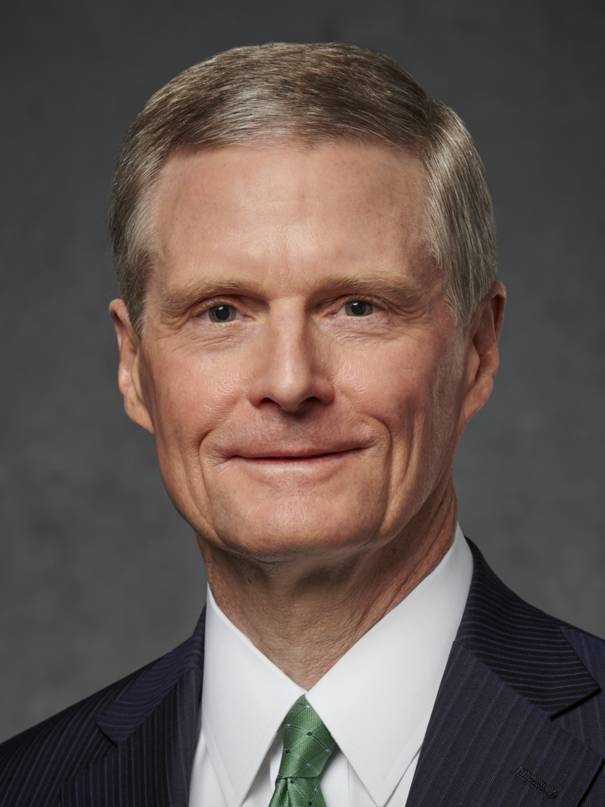
“The act of partaking of the sacrament, in and of itself, does not remit sins. But as we prepare conscientiously and participate in this holy ordinance with a broken heart and a contrite spirit, then the promise is that we may always have the Spirit of the Lord to be with us. And by the sanctifying power of the Holy Ghost as our constant companion, we can always retain a remission of our sins.”
Elder David A. Bednar
“Always Retain a Remission of Your Sins,” Ensign, May 2016

Slide 54
John 12:42–43 (NRSV)
“Many, even of the authorities, believed in him. But because of the Pharisees they did not confess it, for fear that they would be put out of the synagogue;
for they loved human glory more than the glory that comes from God.”

Slide 55
Acknowledgements
Insights from, discussions with, and resources authored by Julie M. Smith, Dr. Frank Judd, Dr. Matthew Grey, Dr. Joshua Sears, Dr. James R. Edwards, Natalie Regoli, and Judah Smith were used in the creation of this video.

