Slide 1
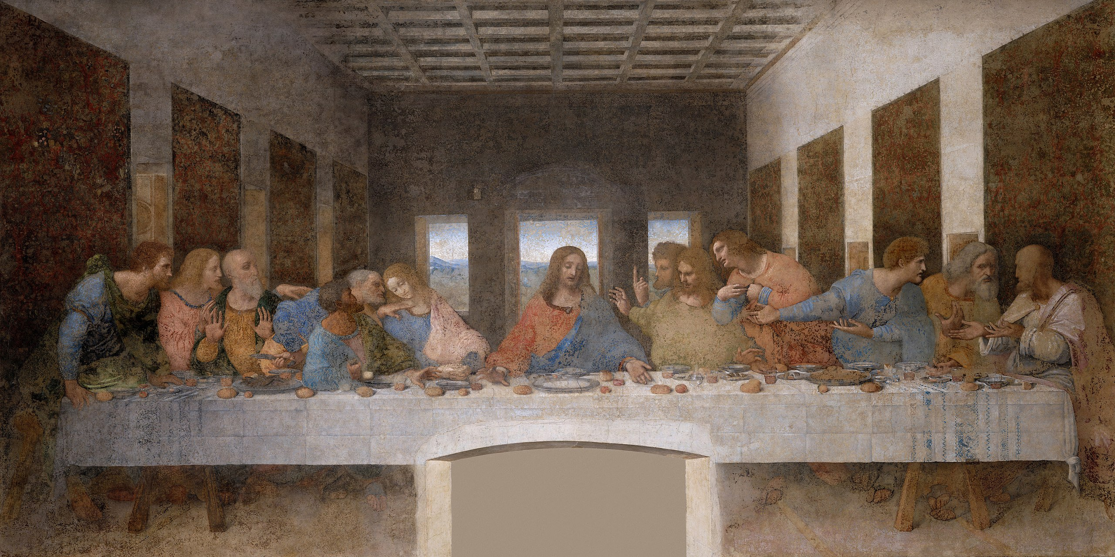
Notes:
https://en.wikipedia.org/wiki/File:The_Last_Supper_-_Leonardo_Da_Vinci_-_High_Resolution_32x16.jpg

Slide 2
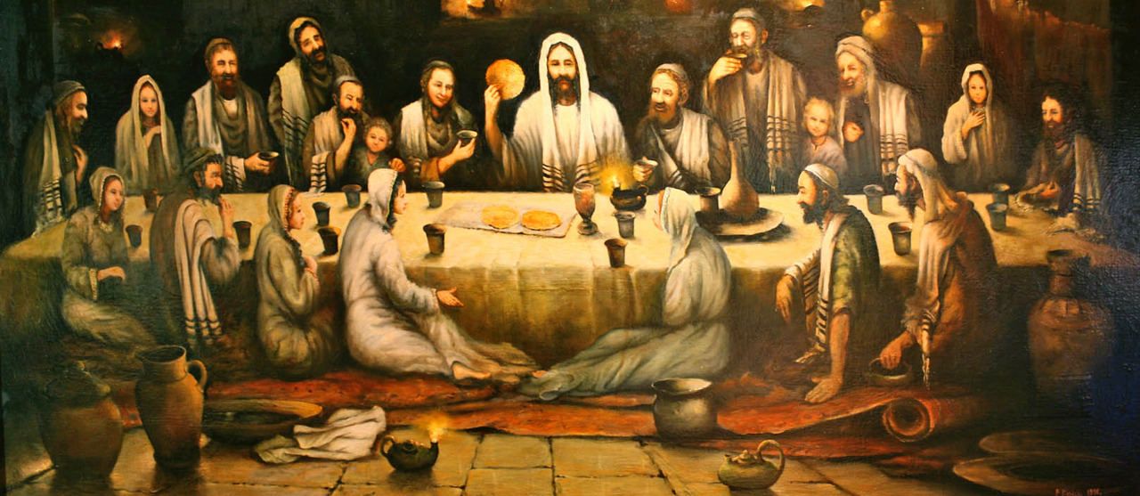
What Stands Out to You in this Picture?
Bohdan Piasecki
Notes:
https://www.catholica.com.au/forum/index.php?mode=thread&id=60962

Slide 3
Mark 14:18–19
“When they had taken their places and were eating, Jesus said, truly I tell you, one of you will betray me, one who is eating with me.”

Slide 4
Mark 14:18–19
“When they had taken their places and were eating, Jesus said, truly I tell you, one of you will betray me, one who is eating with me.”
“They began to be distressed and to say one after another, surely not I. [Jesus] said to them, it is one of the twelve, one who is dipping bread into the bowl with me.”

Slide 5
“After I am raised up, I will go before you to Galilee” (Mark 14:28).
“Go, tell his disciples and Peter that he is going before you to Galilee. There you will see him, just as he told you” (Mark 16:7).
Notes:
https://commons.wikimedia.org/wiki/File:Irma_Martin_-_The_three_women_on_the_tomb_of_Christ.jpg

Slide 6
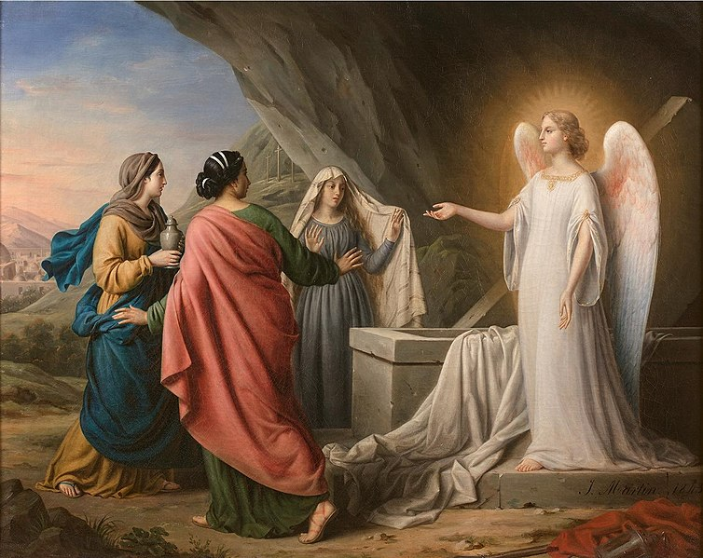
“After I am raised up, I will go before you to Galilee” (Mark 14:28).
“Go, tell his disciples and Peter that he is going before you to Galilee. There you will see him, just as he told you” (Mark 16:7).
Notes:
https://commons.wikimedia.org/wiki/File:Irma_Martin_-_The_three_women_on_the_tomb_of_Christ.jpg

Slide 7
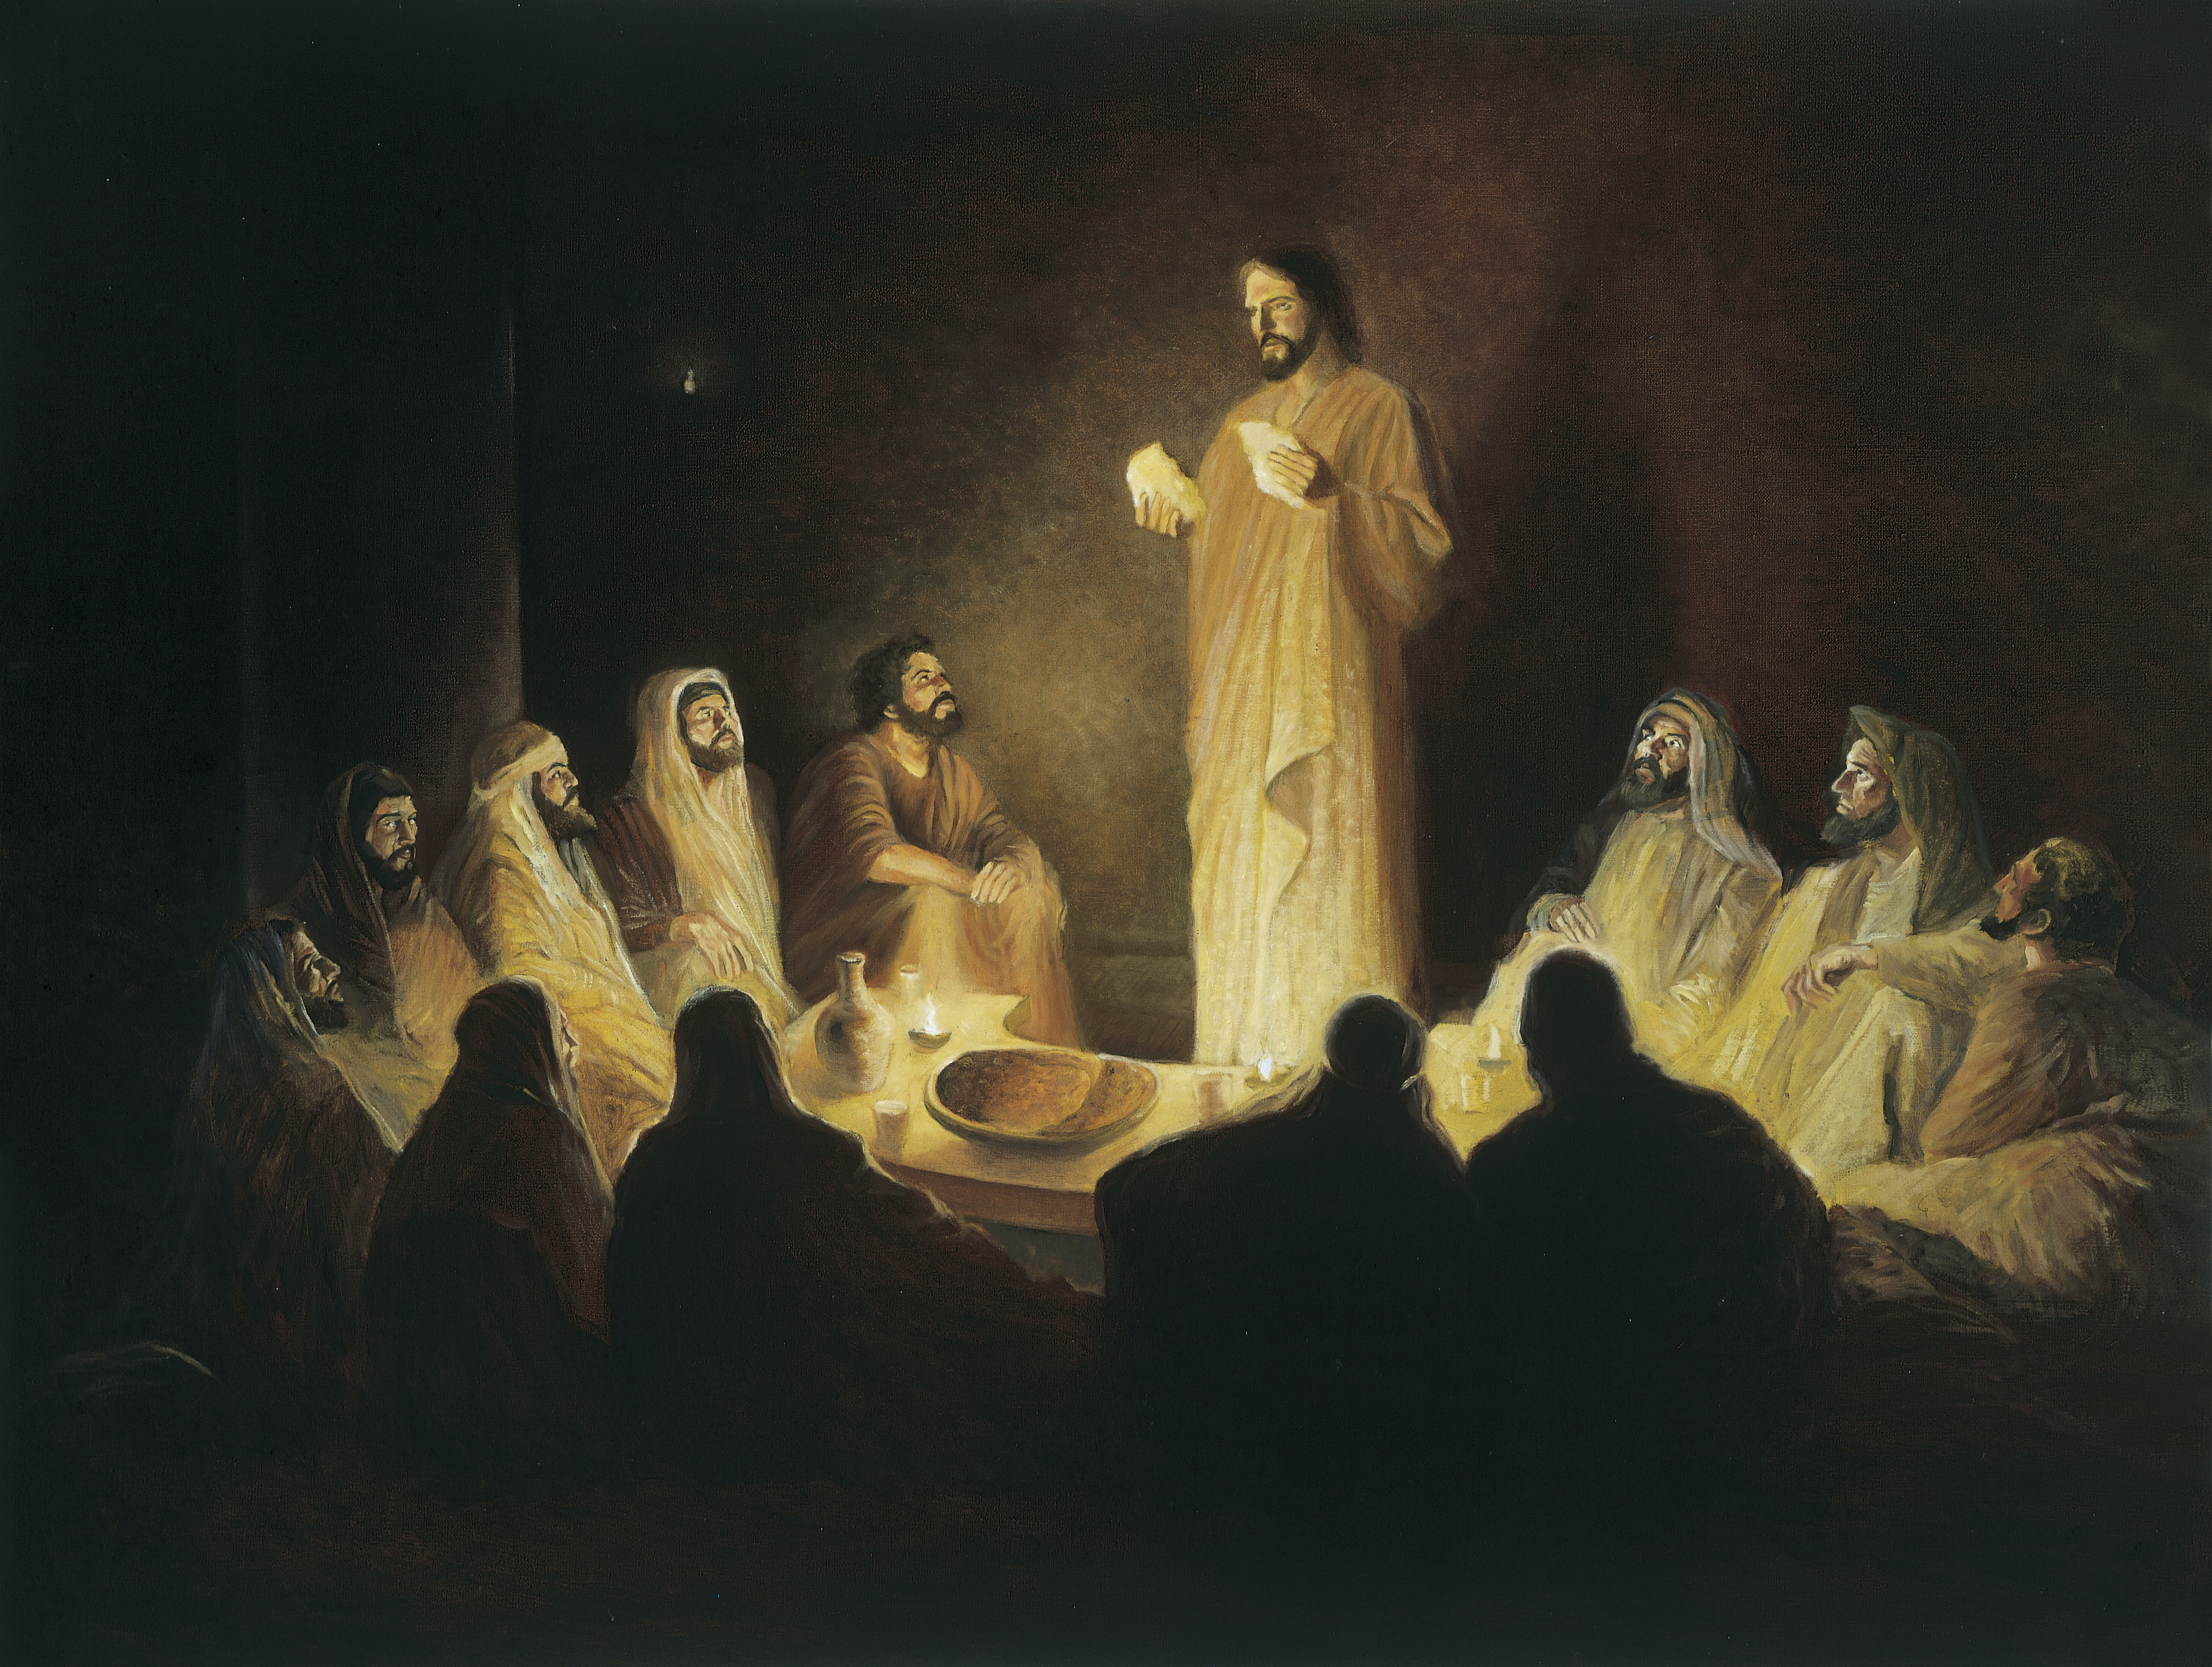
“And as they were eating, Jesus took bread, and blessed it, and brake it, and gave it to the disciples, and said, Take, eat; this is my body. And he took the cup, and gave thanks, and gave it to them, saying, Drink ye all of it; For this is my blood of the new testament, which is shed for many for the remission of sins.” (Matthew 26:26–28)
Gary E. Smith

Slide 8
“Jesus…got up from the table, took off his outer robe, and tied a towel around himself. Then he poured water into a basin and began to wash the disciples’ feet and to wipe them with the towel that was tied around him…
Henry Ossawa Tanner
(John 13:3-5, 12-14, NRSV)
Notes:
https://commons.wikimedia.org/wiki/File:Study,_Christ_Washing_the_Feet_of_the_Disciples_1983.95.186_1a.JPG

Slide 9
“After he had washed their feet, had put on his robe, and had returned to the table, he said to them, ‘Do you know what I have done to you? You call me Teacher and Lord—and you are right, for that is what I am. So if I, your Lord and Teacher, have washed your feet, you also ought to wash one another’s feet.
Henry Ossawa Tanner
(John 13:3-5, 12-14, NRSV)
Notes:
https://commons.wikimedia.org/wiki/File:Study,_Christ_Washing_the_Feet_of_the_Disciples_1983.95.186_1a.JPG

Slide 10
“If ye know these things [that you should provide selfless service] happy are ye if ye do them.”
John 13:17
Notes:
-Kohls made

Slide 11
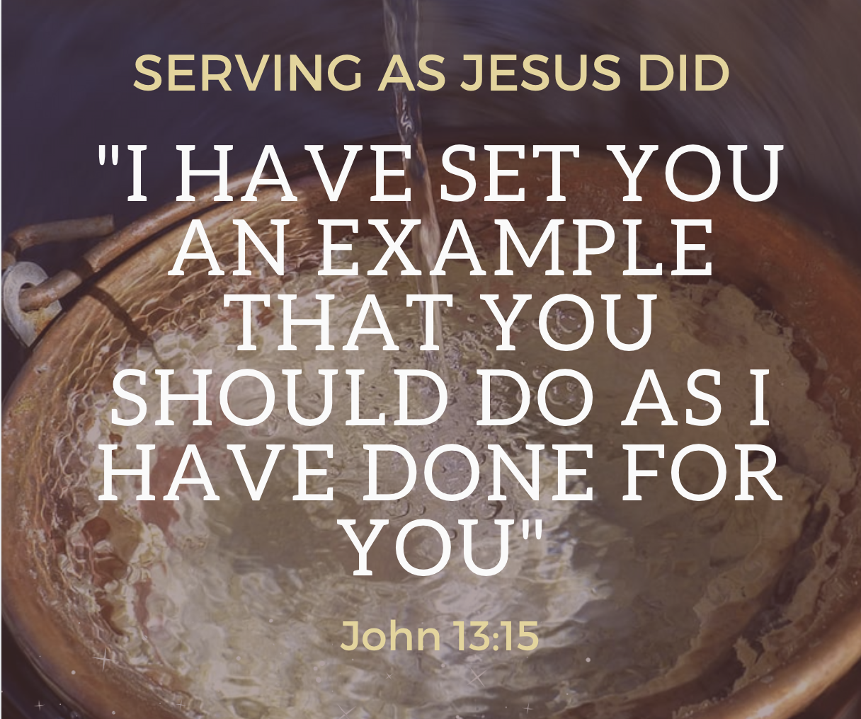
“If ye know these things [that you should provide selfless service] happy are ye if ye do them.”
John 13:17

Slide 12
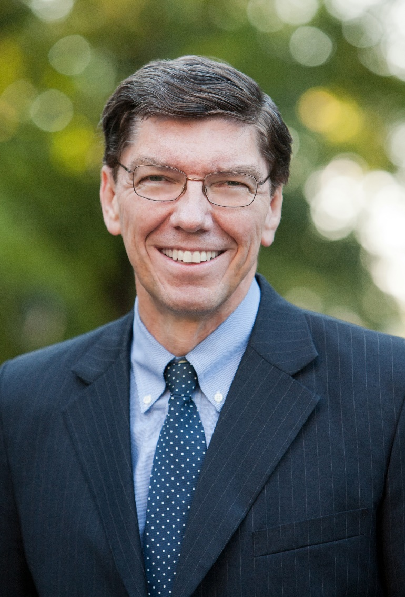
“I once felt passed over when another man was called to a leadership position I had felt I might receive. In the crisis of self-confidence that ensued, I realized that because our minds are finite, we create hierarchies and statistically aggregate people. We perceive stake presidents to be higher than bishops and Primary presidents higher than Primary teachers because they preside over more people. But God has an infinite mind.
Elder Clayton Christensen
Ensign, Feb. 2007

Slide 13
“He needs no statistics above the level of the individual in order to have a perfect understanding of what is happening. This means, I realized, that the way God will measure my life is not by the numbers of people over whom I have presided but by the individual people whose lives I have touched with His love and with the gospel of Jesus Christ.
Elder Clayton Christensen
Ensign, Feb. 2007

Slide 14
“With this sense of my most important calling, I began to fast and pray that God would give me opportunities daily to bless and help people. As I acted upon the promptings I received, it was as if God spoke to me more frequently because He knew I was listening. This period in my life proved to be one of extraordinary spiritual growth. There is a calling far higher than that of stake president, bishop, or Relief Society president. It is to be a doer of good, a disciple of Christ, an intermediary through whom God answers others’ prayers.”
Elder Clayton Christensen
Ensign, Feb. 2007

Slide 15
How is this a new commandment?
A new commandment I give unto you, That ye love one another; as I have loved you, that ye also love one another. By this shall all men know that ye are my disciples, if ye have love one to another.
(John 13:34–35)

Slide 16
The Last Commandment
“This is my commandment, that you love one another as I have loved you. No one has greater love than this, to lay down one’s life for one’s friends.” (John 15:12–13)
“These things I command you, that ye love one another.” (John 15:17)

Slide 17
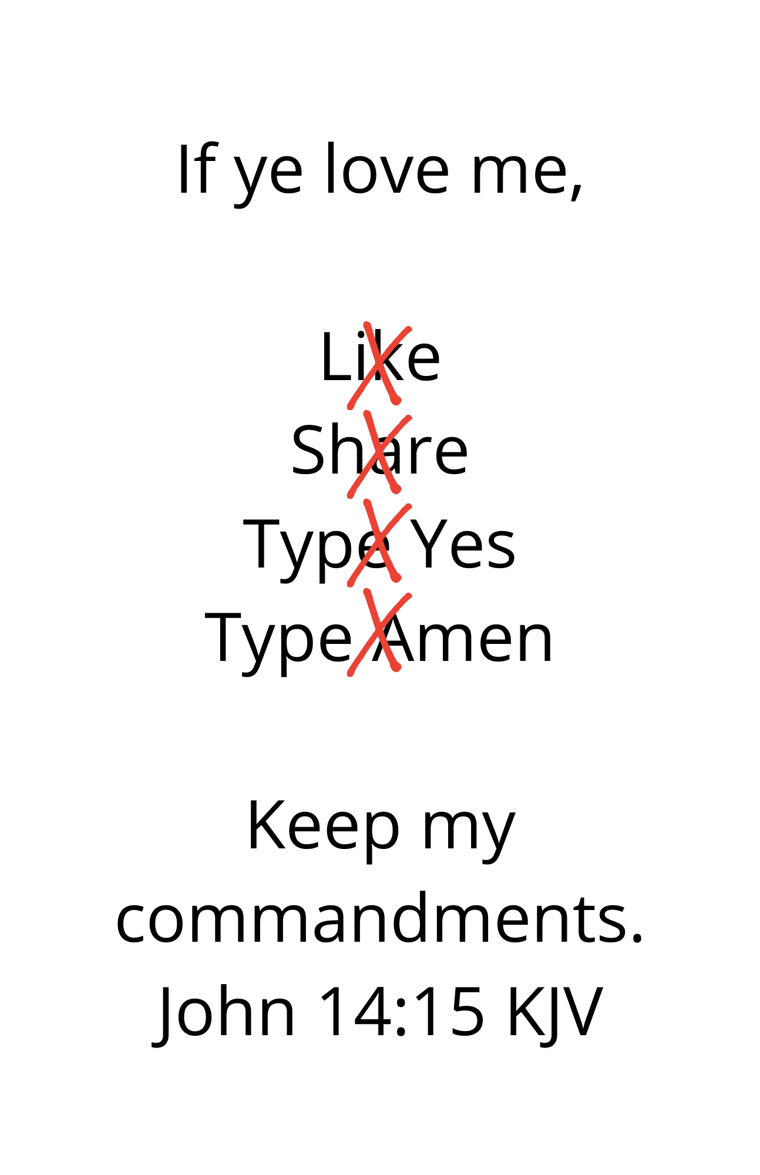

Slide 18
“They who have my commandments and keep them are those who love me.” (John 14:21)
“Those who love me will keep my word.” (John 14:23)
“If you keep my commandments you will abide in my love.” (John 15:10)
“You are my friends if you do what I command you.” (John 15:14)

Slide 19
“If ye love me, keep my commandments” (John 14:15)

Slide 21
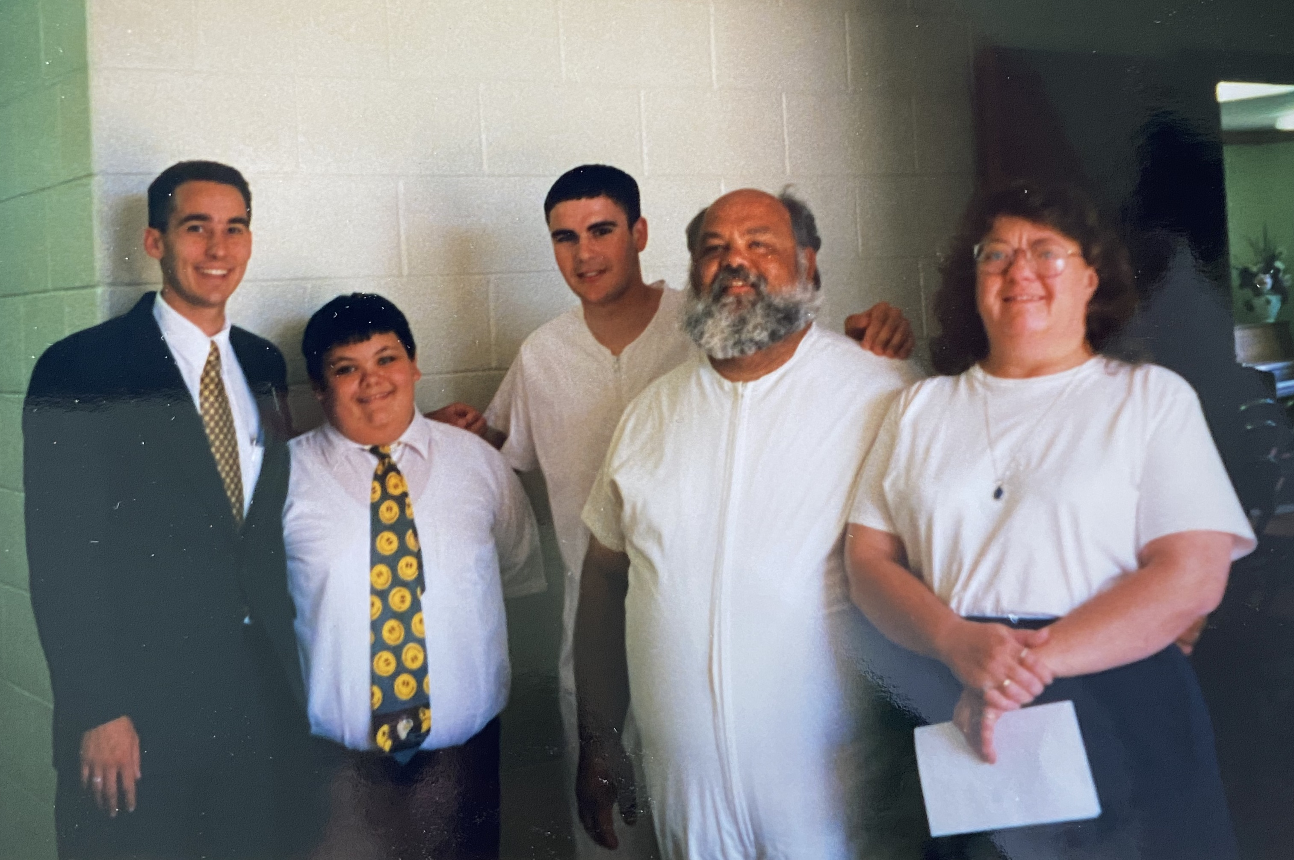

Slide 22
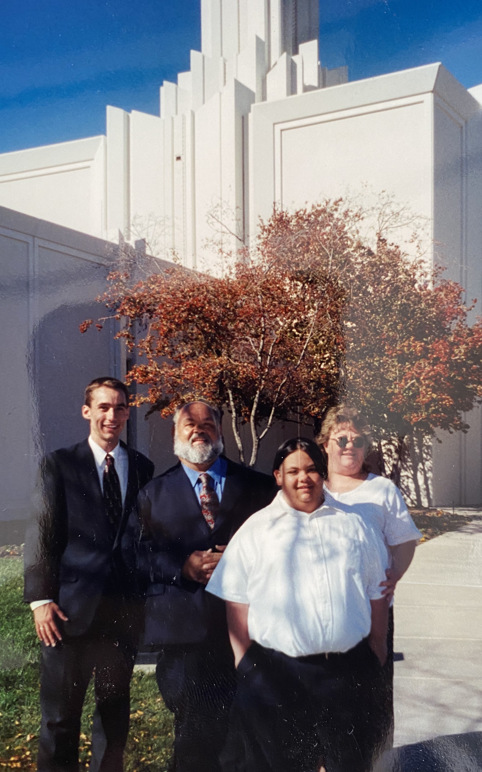

Slide 23
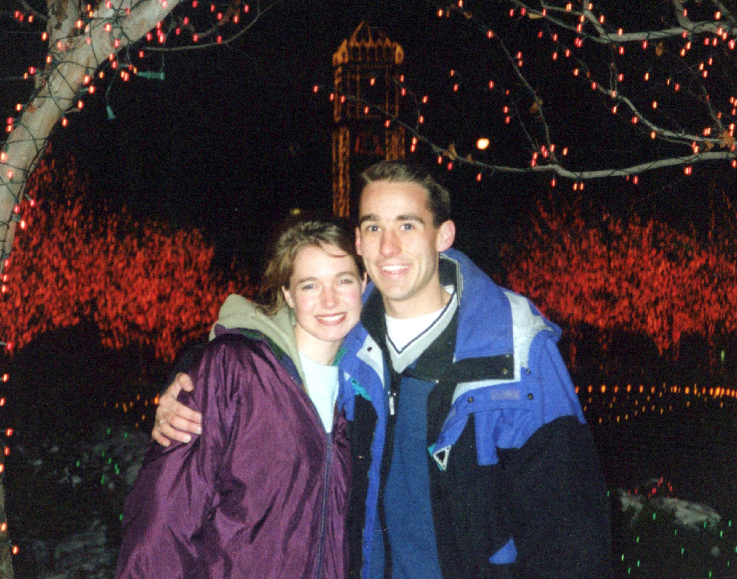

Slide 24
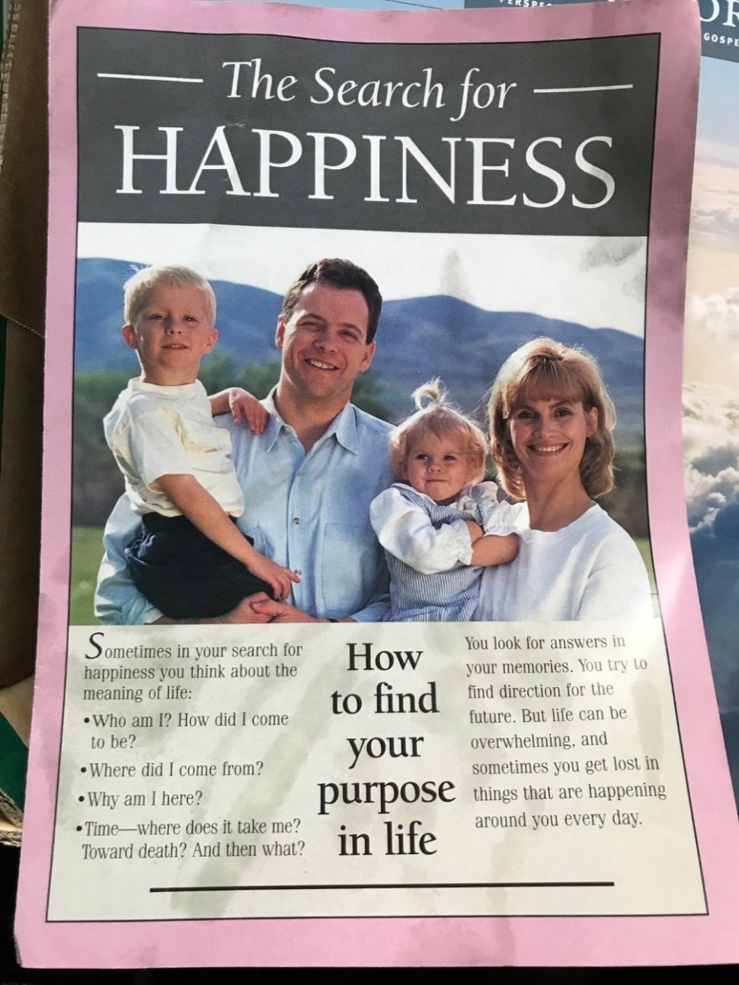

Slide 26
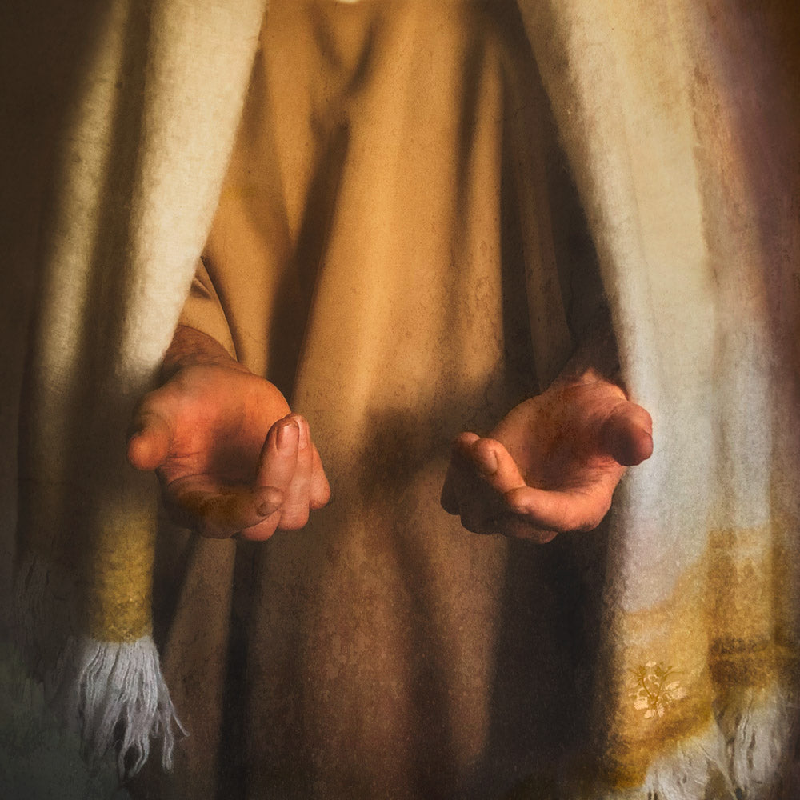
John 8:31–32, John 14:6
“If ye continue in my word, then are ye my disciples indeed; And ye shall know the truth, and the truth shall make you free.”
“I am…the truth”
Eva Koleva Timothy
Notes:
https://altusfineart.com/collections/eva-timothy/products/eva-koleva-timothy-come-unto-me-hands-christ-outstretched used with permission

Slide 28
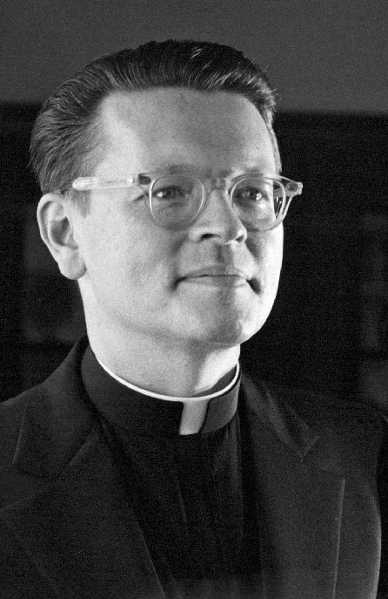
Raymond Brown, The Gospel According to John XIII – XXI, 674.
“[Jesus] is emphasizing that he is the source of ‘real’ life, a life that can come only from above and from the father.”

Slide 29
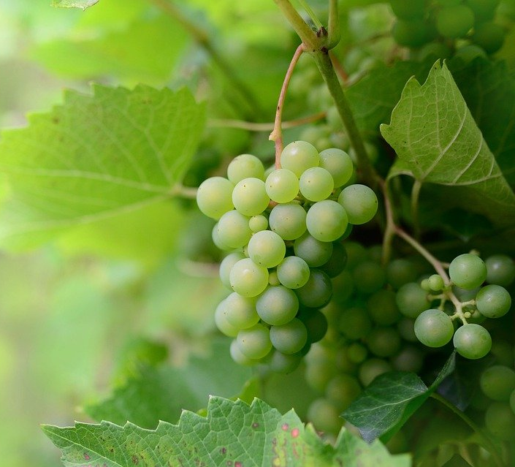
“Just as the branch cannot bear fruit by itself unless it abides in the vine, neither can you unless you abide in me. I am the vine, you are the branches. Those who abide in me and I in them bear much fruit, because apart from me you can do nothing.” (John 15:4–5, NRSV)
Notes:
https://pixabay.com/photos/fruit-grapes-vine-healthy-organic-6630377/

Slide 30
“Christ is everything to us and we are to ‘abide’ in Him permanently, unyieldingly, steadfastly, forever. For the fruit of the gospel to blossom and bless our lives, we must be firmly attached to Him, the Savior of us all, and to this His Church, which bears His holy name. He is the vine that is our true source of strength and the only source of eternal life.”
Elder Jeffrey R. Holland
“Abide in Me”
Ensign, May 2004

Slide 31
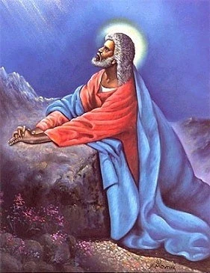
Christ’s Prayer Before Gethsemane
“I pray for them” (John 17:9).
“Sanctify them through thy truth” (John 17:17).
“[I] pray…for them…which shall believe” (John 17:20).
“I pray unto thee for them” (3 Nephi 19:23).
“I pray…for those whom thou hast given me” (3 Nephi 19:29).
Hulis Mavruk
Notes:
https://www.blackartdepot.com/products/the-lord-by-hulis-mavruk

Slide 32
“I pray…for those who believe in me…I pray that they may all be one. Father! May they be in us, just as you are in me and I am in you. May they be one…just as you and I are one”
Christ’s Prayer Before Gethsemane
John 17:20-22, Good News Bible
Hulis Mavruk
Notes:
https://www.blackartdepot.com/products/the-lord-by-hulis-mavruk

Slide 33
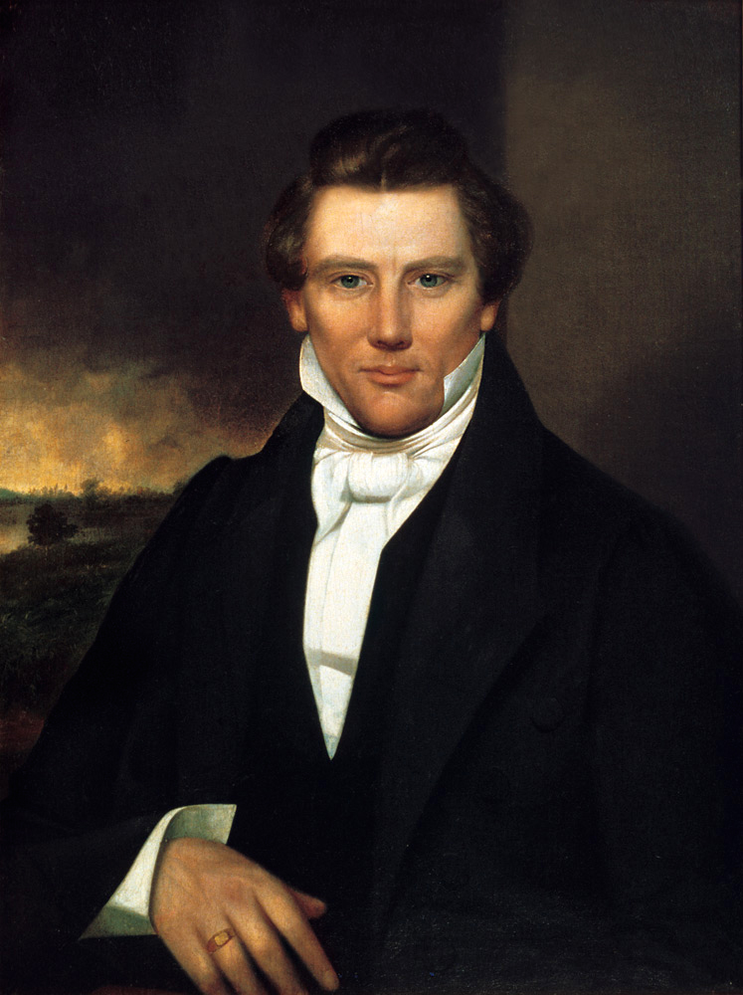
“The enquiry is frequently made of me, ‘Wherein do you differ from others in your religious views?’ In reality and essence we do not differ so far in our religious views. . . . Christians should cease wrangling and contention with each other and cultivate the principles of union and friendship in their midst; and they will do it before the Millennium can be ushered in, and Christ takes possession of his kingdom.”
William Warner Major
“History, 1838–1856, volume E-1 [1 July 1843–30 April 1844],” 1666, The Joseph Smith Papers
Notes:
https://commons.wikimedia.org/wiki/File:Joseph_Smith,_Jr._portrait_owned_by_Joseph_Smith_III.jpg

Slide 34
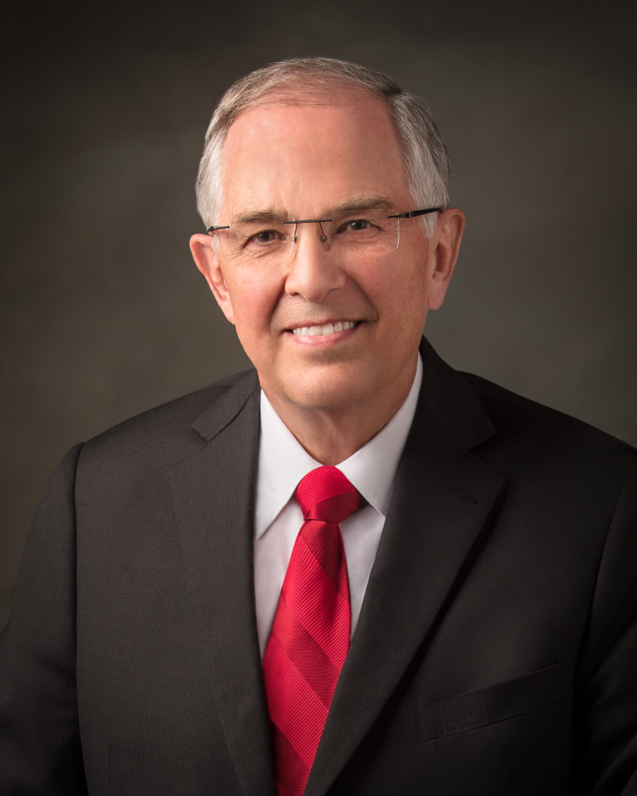
“Some of our fellow Christians are, at times, uncertain about our beliefs and motives. Let us genuinely rejoice with them in our shared faith in Jesus Christ and in the New Testament scriptures we all love. In the days ahead, those who believe in Jesus Christ will need the friendship and support of one another.”
“We talk of Christ”
Ensign, Nov. 2020

Slide 35
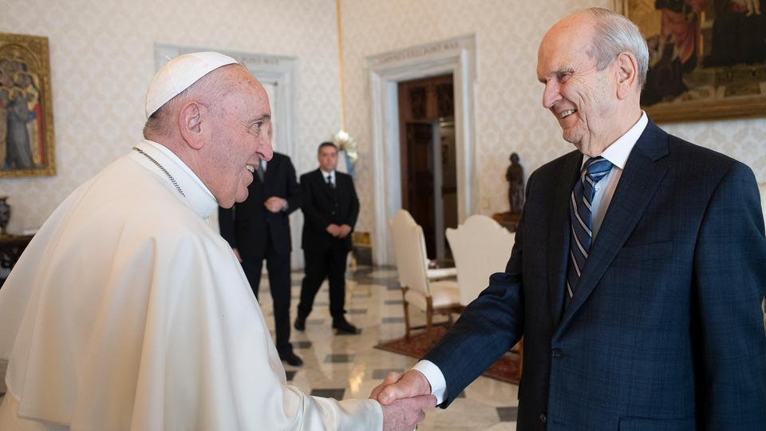
“The differences in doctrine are real and they’re important, but they’re not nearly as important as the things we have in common — our concern for human suffering, the importance of religious liberty for all of society, and the importance of building bridges of friendship instead of building walls of segregation.” (President Nelson, Deseret News)
Notes:
Image from https://newsroom.churchofjesuschrist.org/article/prophet-meets-pope-francis-Vatican

Slide 36
“Father! May they be in us, just as you are in me and I am in you. May they be one…just as you and I are one. I in them and you in me, so that they may be completely one”
Christ’s Prayer Before Gethsemane
John 17:21-22, Good News Bible
Hulis Mavruk
Notes:
https://www.blackartdepot.com/products/the-lord-by-hulis-mavruk

Slide 37
Christ in You
“Christ in you” (Colossians 1:27)
“It is no longer I who live, but it is Christ who lives in me” (Galatians 2:20, NRSV)
“Father, I pray unto thee for them…that I may be in them as thou, Father, art in me, that we may be one.” (3 Nephi 19:23)
Don Christensen
Notes:
https://history.churchofjesuschrist.org/exhibit/2002-international-art-competition?lang=eng#mv31

Slide 38
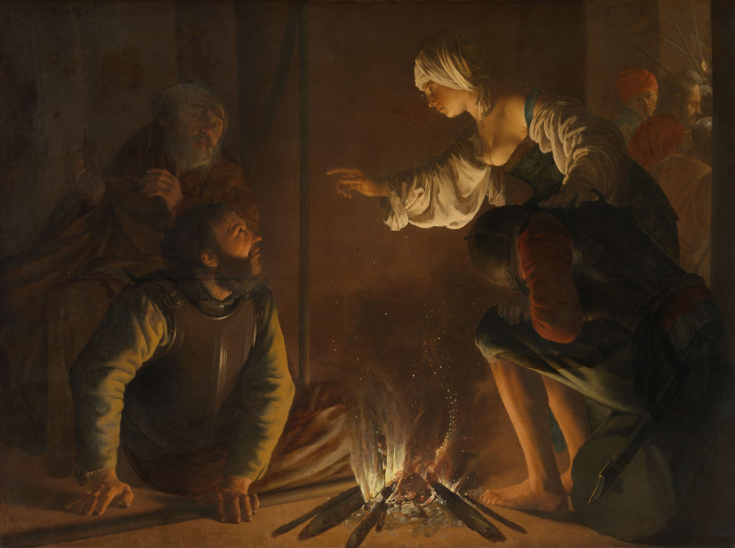
What was the weather like that night?
Mark 14:54, Luke 22:55-56, John 18:18
Notes:
Public Domain https://en.wikipedia.org/wiki/The_Denial_of_Saint_Peter_(Hendrick_ter_Brugghen)#/media/File:Hendrick_ter_Brugghen_The_Denial_of_St_Peter.jpg

Slide 39
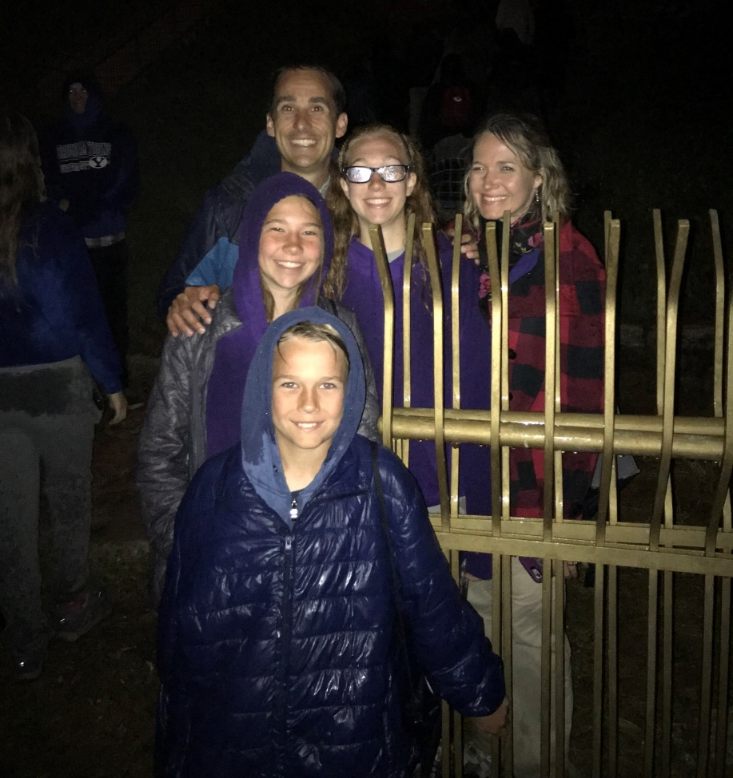

Slide 40
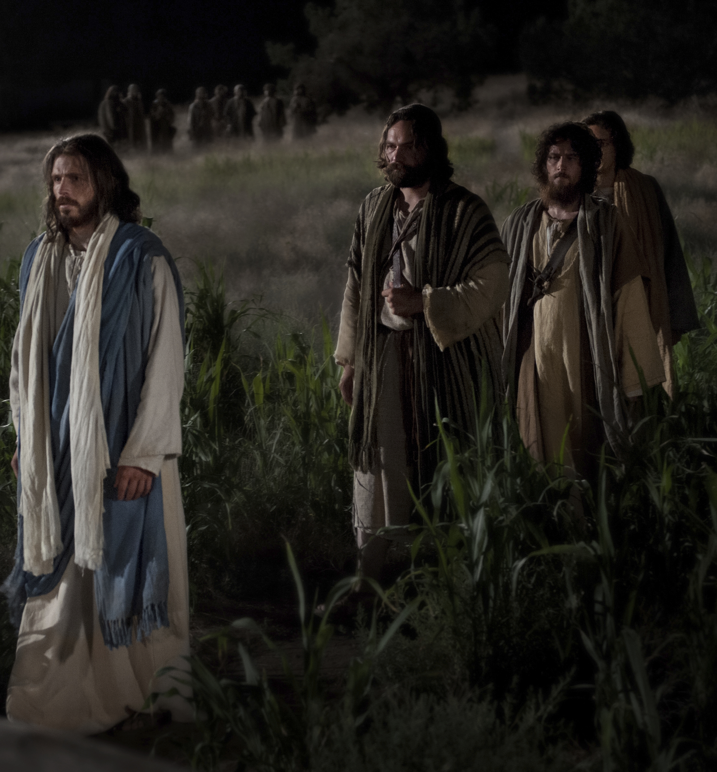
What Was the Mood Going Into Gethsemane?
“Jesus took with him Peter and the two sons of Zebedee, and began to be sorrowful and very heavy. Then saith he unto them, My soul is exceeding sorrowful, even unto death”
(Matthew 26:37–38).
Bible Images
Notes:
https://www.churchofjesuschrist.org/media/image/pictures-of-jesus-gethsemane-2016541?lang=eng

Slide 41
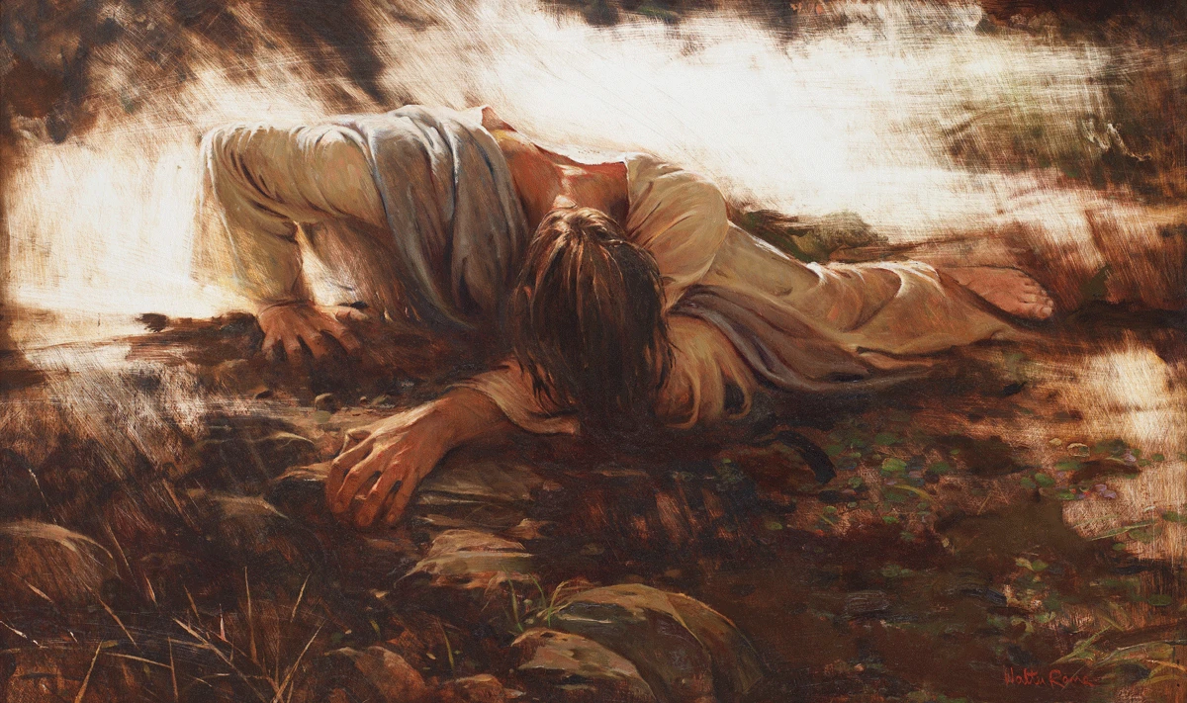
“He went a little further, and fell on his face, and prayed, saying, O my Father, if it be possible, let this cup pass from me: nevertheless not as I will, but as thou wilt” (Matthew 26:39)
Walter Rane
Notes:
https://walterraneprints.com/products/not-my-will-but-thine-free-download

Slide 42
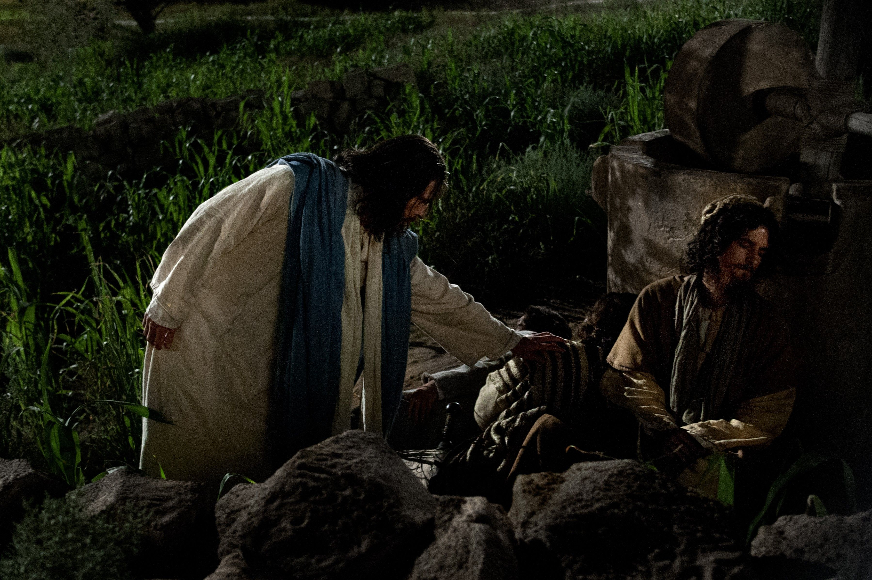
Jesus returned to the disciples “and found them sleeping; …he said to Peter, ‘So, could you not stay awake with me one hour? Stay awake and pray that you may not come into the time of trial; the spirit indeed is willing, but the flesh is weak.’” (Matthew 26:40–41, NRSV)
Bible Videos

Slide 43
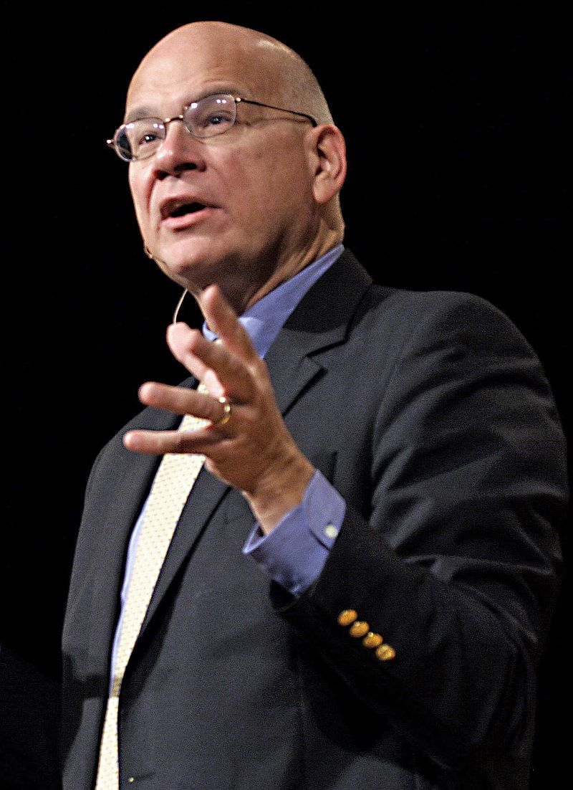
“Here is a man under the most crushing weight asking his friends for a little support and finding that they have gone to sleep on him. He has been completely let down, but what does he say? … ‘The spirit is willing, but the flesh is weak.’ Isn’t that remarkable? He is giving them some credit. He says, ‘you let me down, but I know you mean well.’
Frank Licorice
Timothy Keller,
Encounters with Jesus,
167
Notes:
https://en.wikipedia.org/wiki/Tim_Keller_(pastor)#/media/File:Timothy_Keller.jpg

Slide 44
“In the depths of his agony he can still find something affirming to say to his friends. There are about twenty things wrong with the disciples’ performance that night, but he finds the one or two things that are right and points them out.”
Frank Licorice
Timothy Keller,
Encounters with Jesus,
167
Notes:
https://en.wikipedia.org/wiki/Tim_Keller_(pastor)#/media/File:Timothy_Keller.jpg

Slide 45
Luke 22:44
“And being in an agony he prayed more earnestly: and his sweat was as it were great drops of blood falling down to the ground.”
Walter Rane
Notes:
https://walterraneprints.com/products/not-my-will-but-thine-free-download

Slide 46
Mosiah 3:7
“And lo, he shall suffer temptations, and pain of body, hunger, thirst, and fatigue, even more than man can suffer, except it be unto death; for behold, blood cometh from every pore, so great shall be his anguish for the wickedness and the abominations of his people.”
Walter Rane
Notes:
https://walterraneprints.com/products/not-my-will-but-thine-free-download

Slide 47
Doctrine and Covenants 19:16–19
“For behold, I, God, have suffered these things for all, that they might not suffer if they would repent; But if they would not repent they must suffer even as I;
Walter Rane
Notes:
https://walterraneprints.com/products/not-my-will-but-thine-free-download

Slide 48
Doctrine and Covenants 19:16–19
“Which suffering caused myself, even God, the greatest of all, to tremble because of pain, and to bleed at every pore, and to suffer both body and spirit—and would that I might not drink the bitter cup, and shrink—
Walter Rane
Notes:
https://walterraneprints.com/products/not-my-will-but-thine-free-download

Slide 49
Doctrine and Covenants 19:16–19
“Nevertheless, glory be to the Father, and I partook and finished my preparations unto the children of men.”
Walter Rane
Notes:
https://walterraneprints.com/products/not-my-will-but-thine-free-download

Slide 50
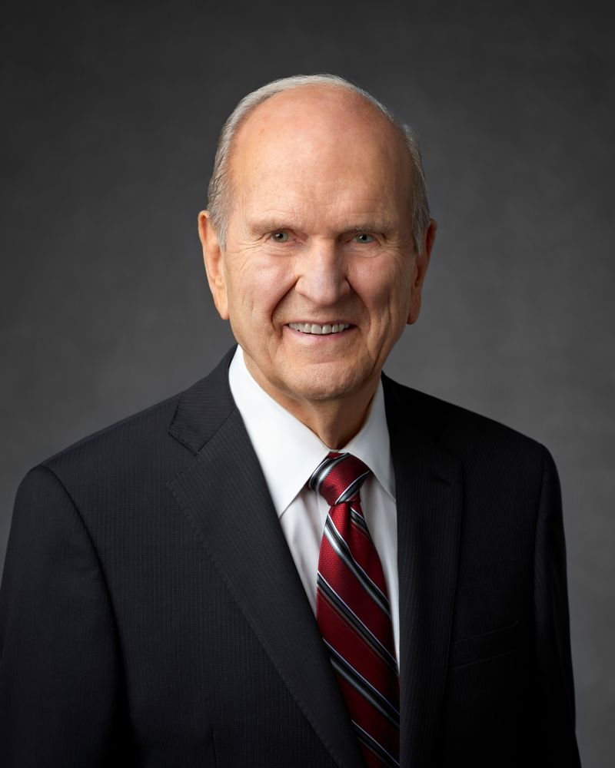
“The word Gethsemane comes from two Hebrew roots: gath, meaning ‘press,’ and shemen, meaning ‘oil,’ especially that of the olive. There olives had been pressed under the weight of great stone wheels to squeeze precious oil from the olives. …Christ in the Garden of Gethsemane was literally pressed under the weight of the sins of the world. He sweated great drops of blood—his life’s ‘oil’—which issued from every pore.”
President Russell M. Nelson, Ensign, December 1989.

Slide 51
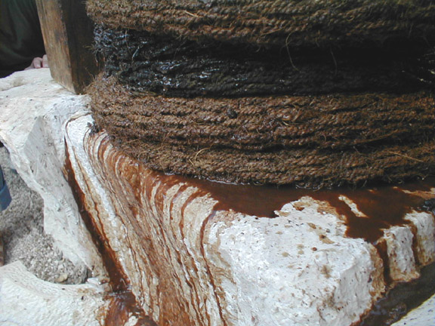
Bruce Satterfield

Slide 52
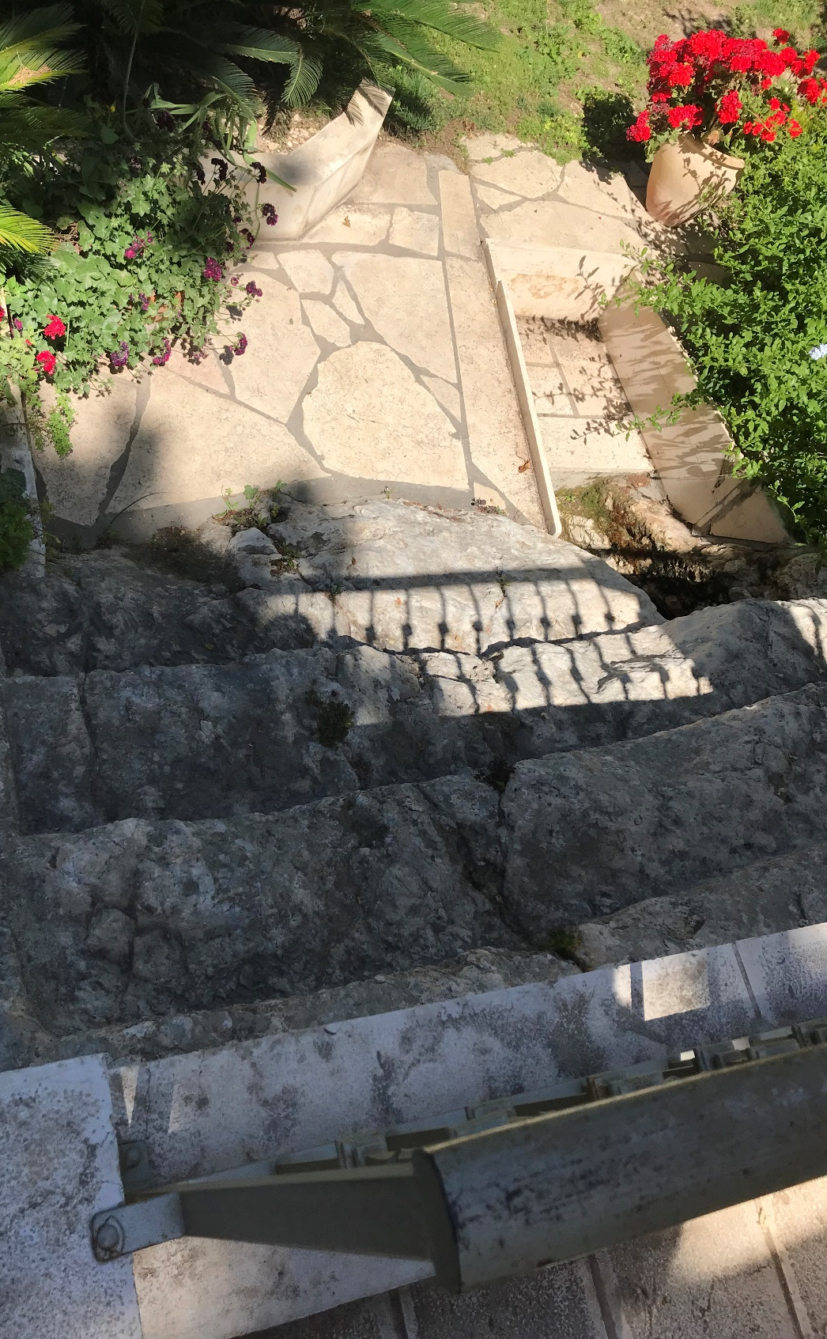
There was a road just past Gethsemane

Slide 53
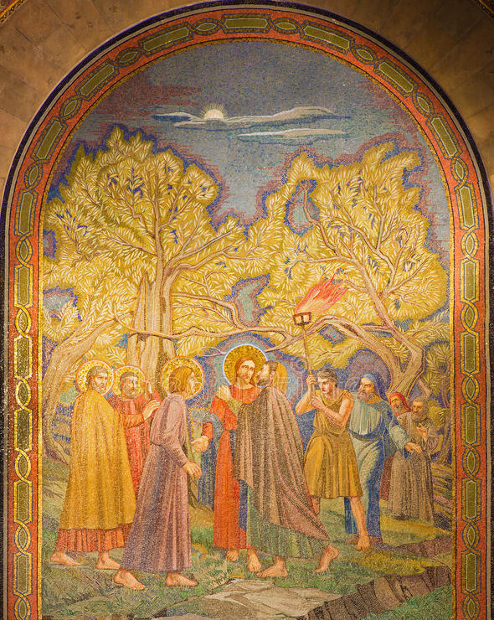
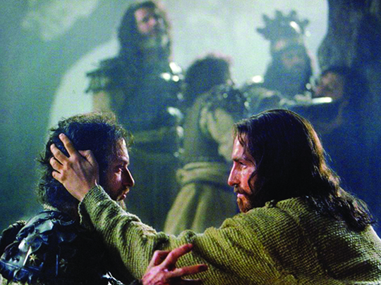
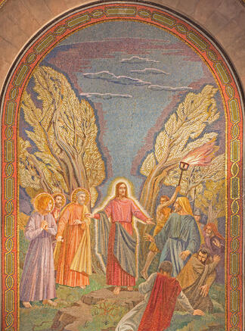
The Human, Healing, Divine Christ in Gethsemane
Pietro D'Achiardi
Pietro D'Achiardi

Slide 54
Acknowledgements
Insights from, discussions with, and resources authored by Dr. Frank Judd, Dr. Matthew Grey, Dr. Mark Ellison, Dr. Timothy Keller, Dr. Raymond Brown, and Dr. Roy Huff were used in the creation of this video.

