Slide 1
Notes:
https://pixabay.com/photos/bonfire-burning-campfire-dark-fire-1835829/

Slide 2
Kimjon12
Notes:
https://commons.wikimedia.org/wiki/File:Can_Coors_Light.jpg

Slide 3
Notes:
https://world.openfoodfacts.org/images/products/07891205/front_en.17.full.jpg

Slide 4
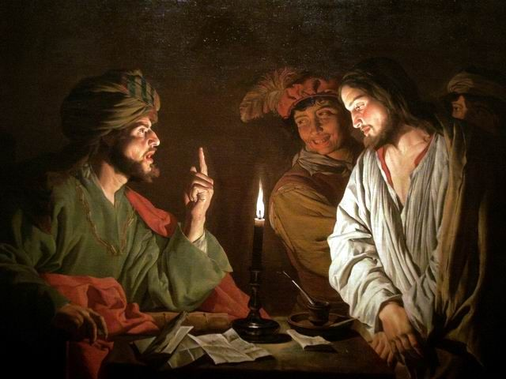
The Trial Before Caiaphas
“And they that had laid hold on Jesus led him away to Caiaphas the high priest, where the scribes and the elders were assembled. But Peter followed him afar off unto the high priest’s palace, and went in, and sat with the servants, to see the end” (Matthew 26:57–58).
Matthias Stom
Notes:
Christ Before Caiaphas, by Matthias Stom.
https://commons.wikimedia.org/wiki/File:Mattias_Stom,_Christ_before_Caiaphas.jpg

Slide 5
The Trial Before Caiaphas
“I adjure thee by the living God, that thou tell us whether thou be the Christ, the Son of God. Jesus saith unto him, Thou hast said: nevertheless I say unto you, Hereafter shall ye see the Son of man sitting on the right hand of power, and coming in the clouds of heaven.”
Matthias Stom
Notes:
Christ Before Caiaphas, by Matthias Stom.
https://commons.wikimedia.org/wiki/File:Mattias_Stom,_Christ_before_Caiaphas.jpg

Slide 6
The Trial Before Caiaphas
“Then the high priest rent his clothes, saying, He hath spoken blasphemy; what further need have we of witnesses? behold, now ye have heard his blasphemy. What think ye? They answered and said, He is guilty of death.”
(Matthew 26:63–66)
Matthias Stom
Notes:
What caused such a violent reaction?
Christ Before Caiaphas, by Matthias Stom.

Slide 7
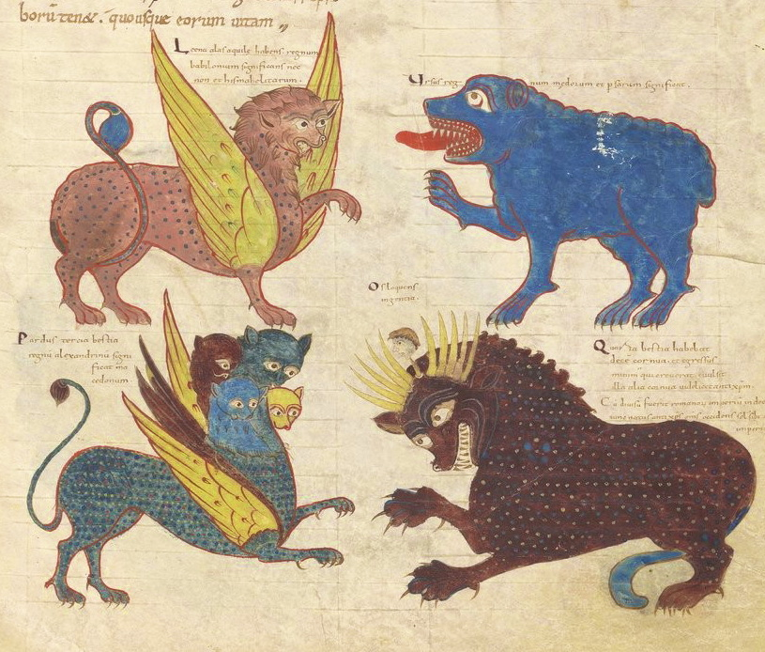
“[After seeing four terrible beasts] I saw…one like the Son of man came with the clouds of heaven…And there was given him dominion…his dominion is an everlasting dominion, which shall not pass away.” (Daniel 7:13–14)
Stephanus Garsia
Notes:
https://commons.wikimedia.org/wiki/File:Saint-Sever_Beatus_f._051r_-_Vision_of_Daniel_-_crop.jpg

Slide 8
Daniel 7 | Christ
“One like the Son of man came with the clouds of heaven…And there was given him dominion” (7:13-14). | “Again the high priest asked him, and said unto him, Art thou the Christ, the Son of the Blessed? And Jesus said, I am: and ye shall see the Son of man sitting on the right hand of power, and coming in the clouds of heaven” (Mark 14:61–62).

Slide 9
The Trial Before Caiaphas
“Then the high priest rent his clothes, saying, He hath spoken blasphemy; what further need have we of witnesses? behold, now ye have heard his blasphemy. What think ye? They answered and said, He is guilty of death.”
(Matthew 26:63–66)
Matthias Stom
Notes:
What caused such a violent reaction?
Christ Before Caiaphas, by Matthias Stom.

Slide 10
All Will Deny Christ…
“Then saith Jesus unto them, All ye shall be offended because of me this night…Peter answered and said unto him, Though all men shall be offended because of thee, yet will I never be offended.
Notes:
Just a few hours before Christ was found guilty, at the last supper, Jesus had said…
https://commons.wikimedia.org/wiki/File:The_Denial_of_Saint_Peter,_about_1648,_Mathieu_Le_Nain.jpg
Image was cropped

Slide 11
All Will Deny Christ…
“Then saith Jesus unto them, All ye shall be offended because of me this night…Peter answered and said unto him, Though all men shall be offended because of thee, yet will I never be offended. Jesus said unto him, Verily I say unto thee, That this night, before the cock crow, thou shalt deny me thrice.”
(Matthew 26:31, 33–34).
Notes:
Just a few hours before Christ was found guilty, at the last supper, Jesus had said…
https://commons.wikimedia.org/wiki/File:The_Denial_of_Saint_Peter,_about_1648,_Mathieu_Le_Nain.jpg
Image was cropped

Slide 12
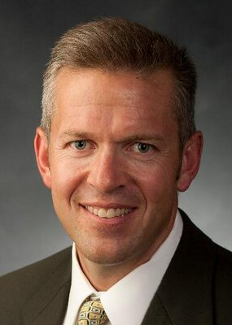
Did Christ Command Peter to Deny Him?
“While arguments based upon grammar remain inconclusive, they incline against the possibility that Jesus had issued a command to Peter….The context and a straightforward reading of the texts support the traditional interpretation that Jesus was predicting what Peter would do.”
Eric D. Huntsman,
“The Accounts of Peter’s Denial: Understanding the Texts and Motifs”

Slide 13
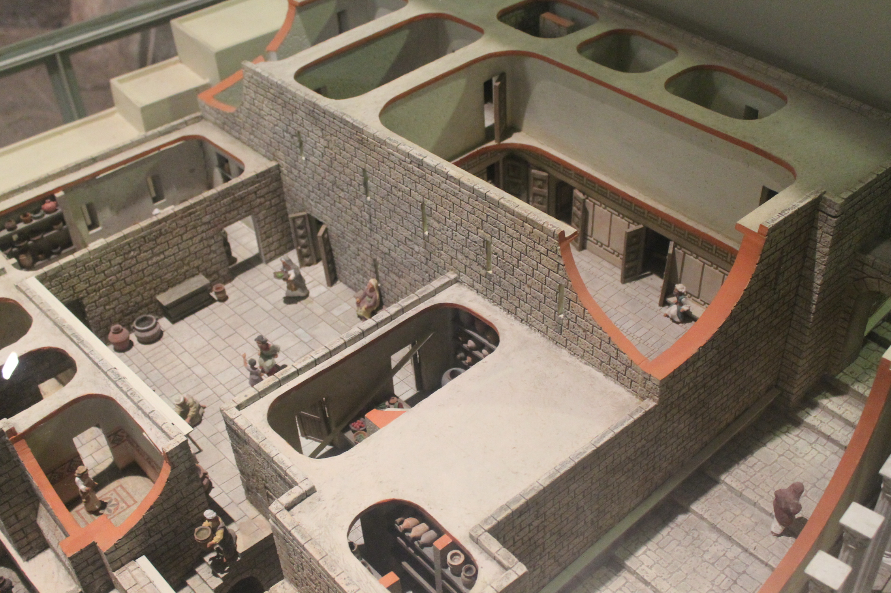
Photo by Mark Ellison

Slide 14
Mark 14:65-68, NRSV
“Some began to spit on him, to blindfold him, and to strike him, saying to him, ‘Prophesy!’ The guards also took him over and beat him. While Peter was below in the courtyard, one of the servant-girls of the high priest came by. When she saw Peter warming himself, she stared at him and said, ‘You also were with Jesus, the man from Nazareth.’ But he denied it, saying, ‘I do not know or understand what you are talking about.’ And he went out into the forecourt.”

Slide 15
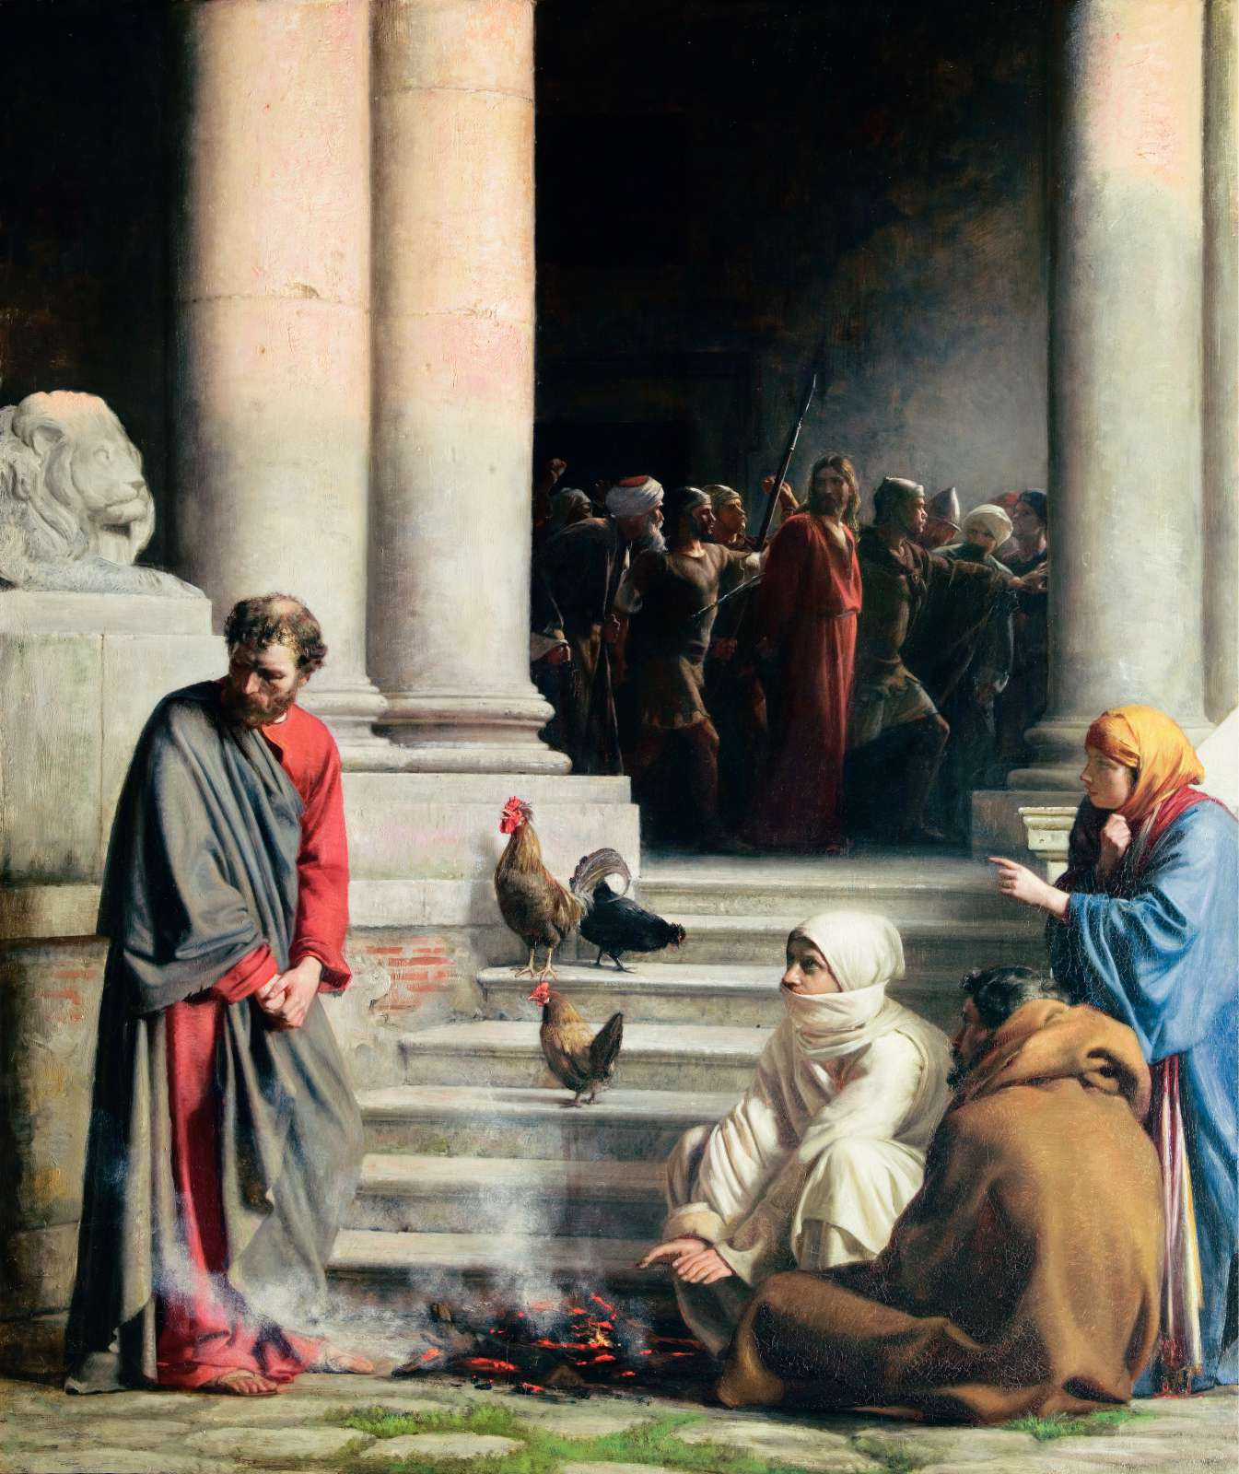
Carl Bloch

Slide 16
“A little later someone else, on seeing him, said, ‘You also are one of them.’ But Peter said, ‘Man, I am not!’ Then about an hour later still another kept insisting, ‘Surely this man also was with him; for he is a Galilean.’ But Peter said, ‘Man, I do not know what you are talking about!’ At that moment, while he was still speaking, the cock crowed.
Carl Bloch

Slide 17
The Lord turned and looked at Peter.
Then Peter remembered the word of the Lord, how he had said to him, ‘Before the cock crows today, you will deny me three times.’ And he went out and wept bitterly.”
(Luke 22:58-62, NRSV)
Carl Bloch

Slide 18
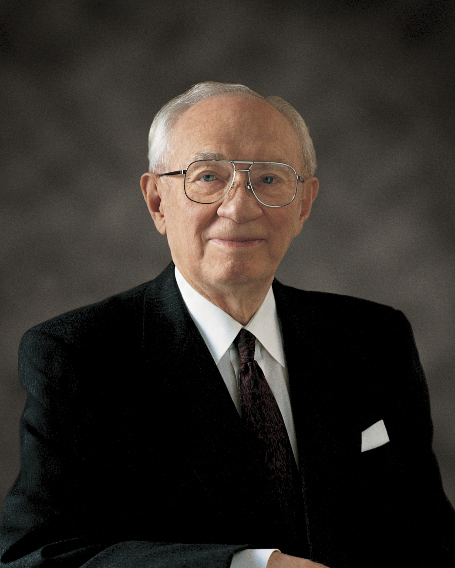
“If there be any within the sound of my voice today who by word or act have denied the faith, I pray that you may draw comfort and resolution from the example of Peter who, though he had walked daily with Jesus, in an hour of extremity denied both the Lord and the testimony which he carried in his own heart. But he rose above this, and became a mighty defender and a powerful advocate. So too, there is a way for you to turn about.”
President Gordon B. Hinckley, Conference Report, April 1979
Notes:
https://www.churchofjesuschrist.org/media/image/bible-video-jesus-pilate-2a5b178?lang=eng

Slide 19
The Final Hours of Christ: An Approximate Timeline

Slide 21
Picture by BRBurton

Slide 22
Pilate asked the Savior, “‘Are you the King of the Jews?’ Jesus answered, ‘Do you ask this on your own, or did others tell you about me?’ Pilate replied, ‘I am not a Jew, am I? Your own nation and the chief priests have handed you over to me. What have you done?’ Jesus answered, ‘My kingdom is not from this world. If my kingdom were from this world, my followers would be fighting to keep me from being handed over to the Jews. But as it is, my kingdom is not from here.’” (John 18:33–36)
Bible Images
Notes:
https://www.churchofjesuschrist.org/media/image/bible-video-jesus-pilate-2a5b178?lang=eng

Slide 23
“Pilate asked him, ‘So you are a king?’ Jesus answered, ‘You say that I am a king. For this I was born, and for this I came into the world, to testify to the truth. Everyone who belongs to the truth listens to my voice.’”
(John 18:37)
Bible Images
Notes:
https://www.churchofjesuschrist.org/media/image/bible-video-jesus-pilate-2a5b178?lang=eng

Slide 24
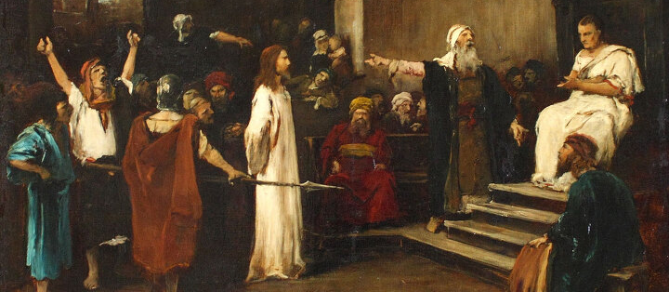
“If you release this man, you are no friend of the emperor. Everyone who claims to be a king sets himself against the emperor.” John 19:12, NRSV
Mihály Munkácsy
Notes:
https://commons.wikimedia.org/wiki/File:Munkacsy_-_Christ_in_front_of_Pilate.jpg

Slide 25
Story #1: The Standards

Slide 26
“Overcome with astonishment at such intense religious zeal, Pilate gave orders for the immediate removal of the standards from Jerusalem.”
Bible Images
Josephus, Antiquities, 18:55–59
Notes:
https://www.churchofjesuschrist.org/media/image/bible-video-jesus-pilate-2a5b178?lang=eng

Slide 27
Story #2: The Aqueduct
Son of God: 36:35-39:06

Slide 28
Large numbers of the Jews perished, some from the blows which they received, others trodden to death by their companions in the ensuing flight. Cowed by the fate of the victims, the multitude was reduced to silence.
Josephus, Antiquities, 18:60–62
Bible Images
Notes:
https://www.churchofjesuschrist.org/media/image/bible-videos-jesus-pilate-200ce4e?lang=eng

Slide 29
Story #3: The Shields

Slide 30
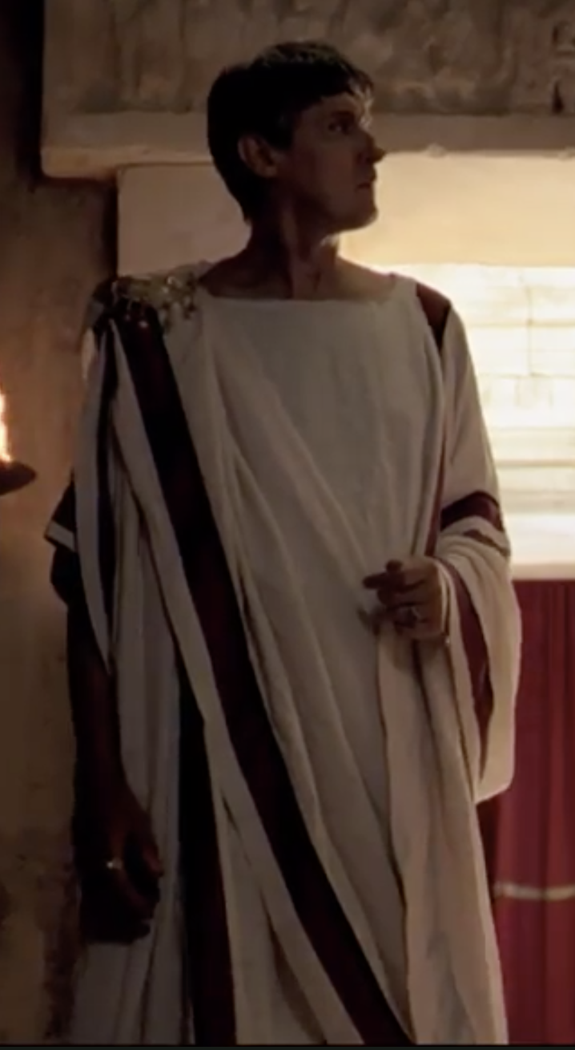
The people, believing Pilate did this “not so much to honour Tiberius as to annoy the multitude,” were furious about the shields, believing they violated Jewish customs. The people sent Herod the Great’s four sons, including Herod Antipas, to protest Pilate’s actions.
Bible Videos
Philo, Embassy 38:299–305
Notes:
Written in the 40s CE
https://www.churchofjesuschrist.org/media/video/2011-10-018-jesus-is-condemned-before-pilate?lang=por
0:20

Slide 31
These important Jewish leaders shouted at Pilate, saying, “Do not arouse sedition, do not make war, do not destroy the peace; you do not honour the emperor by dishonouring ancient laws. Do not take Tiberius as your pretext for outraging the nation; he does not wish any of our customs to be overthrown.”
Bible Videos
Philo, Embassy 38:299–305
Notes:
Written in the 40s CE
https://www.churchofjesuschrist.org/media/video/2011-10-018-jesus-is-condemned-before-pilate?lang=por
0:20

Slide 32
When Pilate refused to act, the Jewish officials wrote a letter to Tiberius protesting the shields. Tiberius swiftly responded by writing to Pilate “with a host of reproaches and rebukes for his audacious violation of precedent and bade him at once take down the shields.”
Bible Videos
Philo, Embassy 38:299–305
Notes:
Written in the 40s CE
https://www.churchofjesuschrist.org/media/video/2011-10-018-jesus-is-condemned-before-pilate?lang=por
0:20

Slide 33
“If you release this man, you are no friend of the emperor. Everyone who claims to be a king sets himself against the emperor.” John 19:12, NRSV
Mihály Munkácsy
Notes:
https://commons.wikimedia.org/wiki/File:Munkacsy_-_Christ_in_front_of_Pilate.jpg

Slide 34
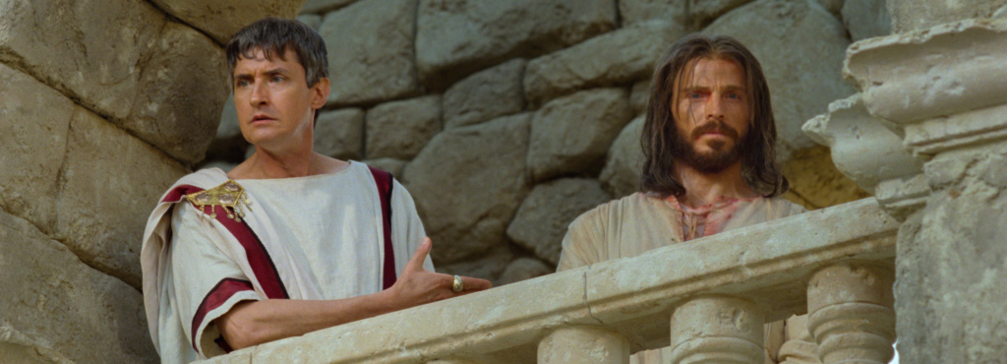
Bible Images
What will you and I do when we feel pressure to turn away from Jesus?

Slide 35
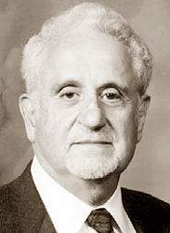
Frederick T. Zugibe, The Crucifixion of Jesus Christ, A Forensic Inquiry, 2nd ed. (New York: M. Evans, 2005), 19, 21.
“Many people today conceive of the scourging as a mere beating with a whiplike object. In a sense, this is true, but it is like comparing an electric shock to a lightning bolt.”
Notes:
Image: https://www.recordonline.com/article/20130910/news0301/309109996

Slide 36
Frederick T. Zugibe, The Crucifixion of Jesus Christ, A Forensic Inquiry, 2nd ed. (New York: M. Evans, 2005), 19, 21.
“Many people today conceive of the scourging as a mere beating with a whiplike object. In a sense, this is true, but it is like comparing an electric shock to a lightning bolt.”
“The victim would writhe and twist in agony, falling to his knees, only to be jerked back on his feet time and time again until he could no longer stand up. The victim’s breathing would be severely affected because the severe blows to the chest would cause excruciating rib pain . . . every time he attempted to take a breath.”
Notes:
Image: https://www.recordonline.com/article/20130910/news0301/309109996

Slide 37
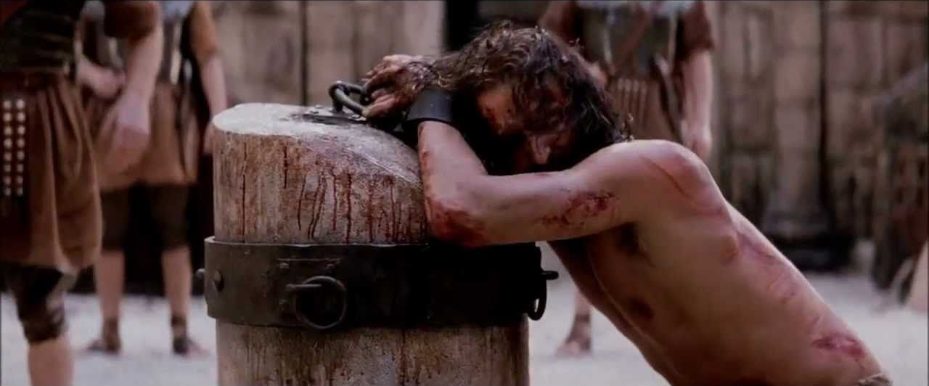
The Passion of Christ
Recognizing the realities of scourging gives new meaning to Isaiah’s words: “He was pierced for our transgressions, he was crushed for our iniquities; the punishment that brought us peace was on him, and by his wounds [KJV = with his stripes] we are healed.” (Isaiah 53:5, NIV)

Slide 38
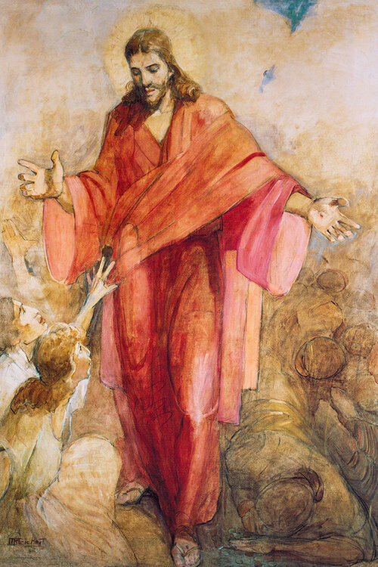
The Robe: Trials Become Triumphs
At the Second Coming, Christ “shall be red in his apparel. . . . And his voice shall be heard: I have trodden the wine-press alone . . . ; and none were with me” (D&C 133:48, 50).
Minerva Teichert
Notes:
https://www.churchofjesuschrist.org/media/image/red-robe-christ-10cac9b?lang=eng

Slide 39
The Robe: Trials Become Triumphs
Because he wore the red robe, each of us can be “encircl[ed] around in the robe of [his] righteousness.”
(2 Nephi 4:33)
Minerva Teichert
Notes:
https://www.churchofjesuschrist.org/media/image/red-robe-christ-10cac9b?lang=eng

Slide 40
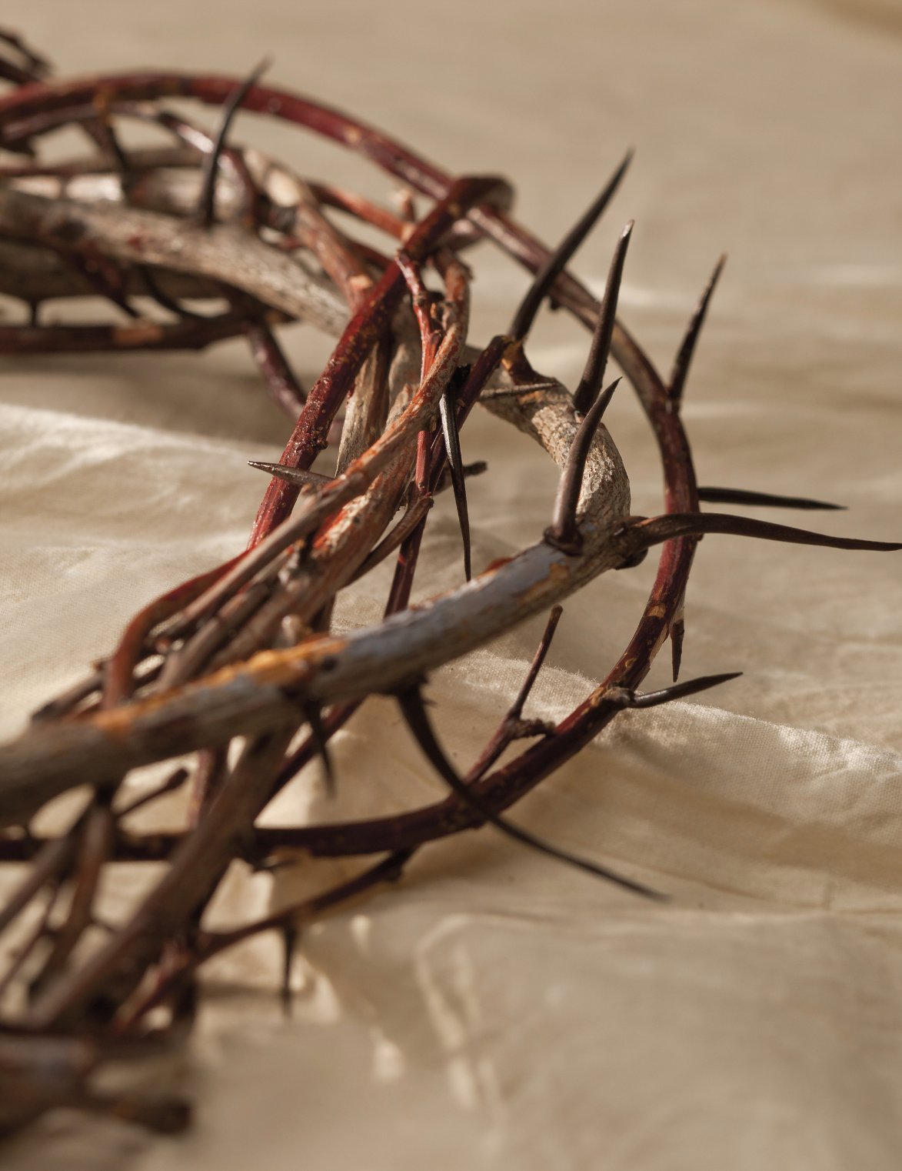
The Crown: A Source of Strength
“Cursed is the ground for thy sake; . . . Thorns also and thistles shall it bring forth to thee” (Gen. 3:17–18).
Thorns could represent not only the results of sin but also the temptations and trials we face. Paul begged to be rid of his “thorn in the flesh.” Given this context, the Savior, wearing the crown of thorns, was figuratively encircled by sin and weakness.
Bible Images
Notes:
https://www.churchofjesuschrist.org/media/image/jesus-christ-crown-thorns-5720e36?lang=eng

Slide 41
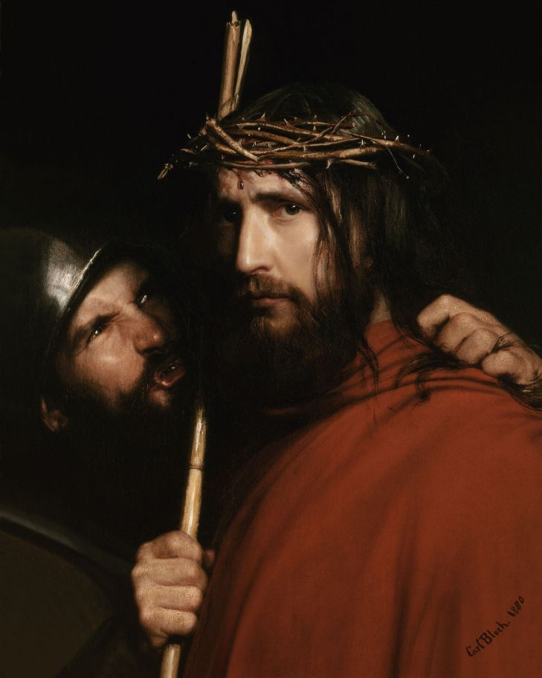
“And the world, because of their iniquity, shall judge him to be a thing of naught; wherefore they scourge him, and he suffereth [allows] it; and they smite him, and he suffereth it. Yea, they spit upon him, and he suffereth it, because of his loving kindness and his long-suffering towards the children of men” (1 Nephi 19:9).
Carl Bloch
Notes:
https://moastore.byu.edu/product/the-mocking-of-christ/

Slide 42
Matthew 27:32 | Mark 15:21 | Luke 23:26 | John 19:16–17
And as they came out, they found a man of Cyrene, Simon by name: him they compelled to bear his cross. | And they compel one Simon a Cyrenian, who passed by, coming out of the country, the father of Alexander and Rufus, to bear his cross. | And as they led him away, they laid hold upon one Simon, a Cyrenian, coming out of the country, and on him they laid the cross, that he might bear it after [following] Jesus. | They took Jesus, and led him away. And he [Jesus] bearing his cross went forth into a place called the place of a skull.

Slide 43
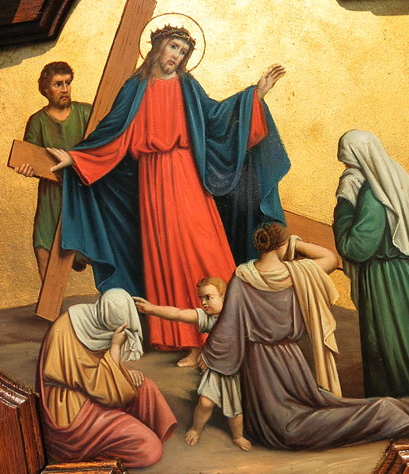
Jesus told the women, who were “beating their breasts and wailing for him,” to “not weep for [him]” but rather to “weep for yourselves and for your children.” He prophesied of a coming day of calamity (Luke 23:27–29).
Both Jesus and the women awaited unfathomable suffering, yet both were more concerned for the well-being of the other.
Photo by Pethrus
Notes:
Image: https://commons.wikimedia.org/wiki/File:Fr_Pfettisheim_Chemin_de_croix_station_VIII_full.jpg

Slide 44
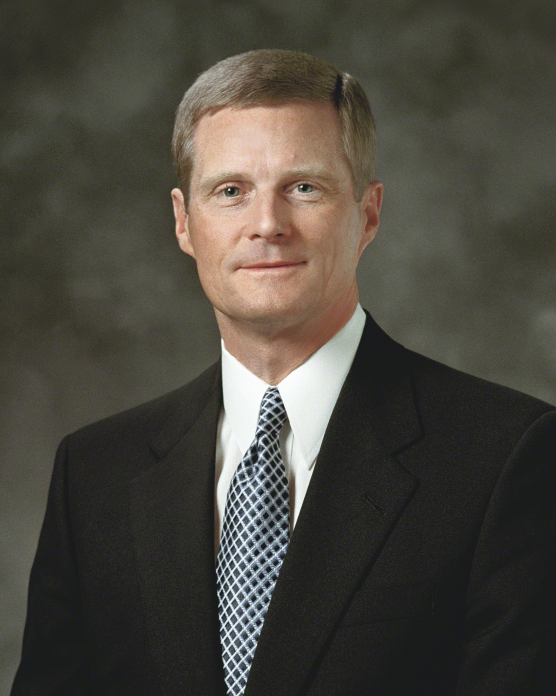
“Throughout His mortal ministry, and especially during the events leading up to and including the atoning sacrifice, the Savior of the world turned outward.” As we strive to emulate the Savior’s example, we can be enabled through Jesus “to reach outward when the natural tendency is for us to turn inward.”
Elder David A. Bednar, “The Character of Christ” (address, Brigham Young University–Idaho Religious Symposium, Rexburg, ID, June 25, 2003),
Notes:
Image: https://www.churchofjesuschrist.org/media/image/elder-david-a-bednar-lds-1307952?lang=eng

Slide 45
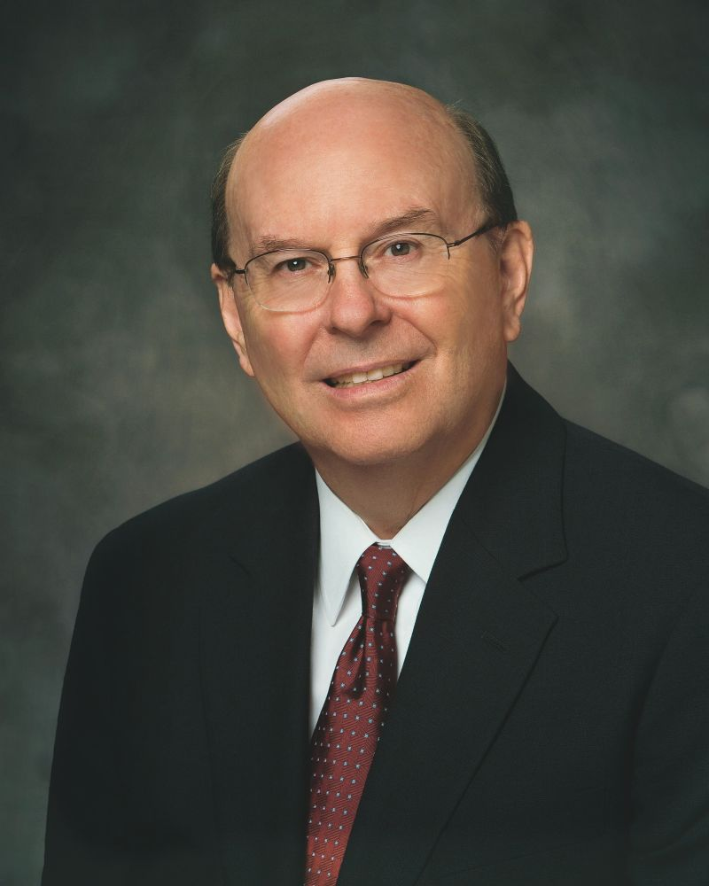
“If the grim realities you are facing at this time seem dark and heavy and almost unbearable, remember that in the soul-wrenching darkness of Gethsemane and the incomprehensible torture and pain of Calvary, the Savior accomplished the Atonement, which resolves the most terrible burdens that can occur in this life. He did it for you, and He did it for me. He did it because He loves us.”
Quentin L. Cook, “The Lord Is My Light,” Ensign, May 2015.

Slide 46
Acknowledgements
Insights from, discussions with, and resources authored by Judah Smith, Dr. Raymond Brown, Dr. Mark Ellison, Dr. Matthew Grey, Dr. Eric Huntsman, Dr. Frederick Zugibe, Rand Packer, Max Lucado, and Leonard Vander Zee were used in the creation of this video.

