Slide 1
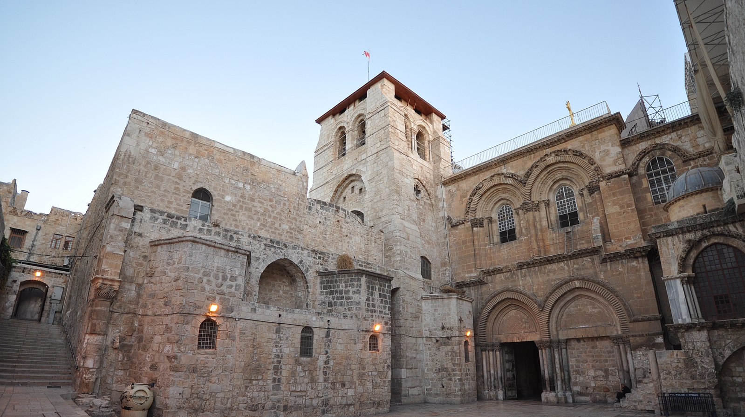
Jorge Láscar
Notes:
https://commons.wikimedia.org/wiki/File:The_Church_of_the_Holy_Sepulchre-Jerusalem.JPG
Author:
https://www.flickr.com/photos/jlascar/

Slide 3
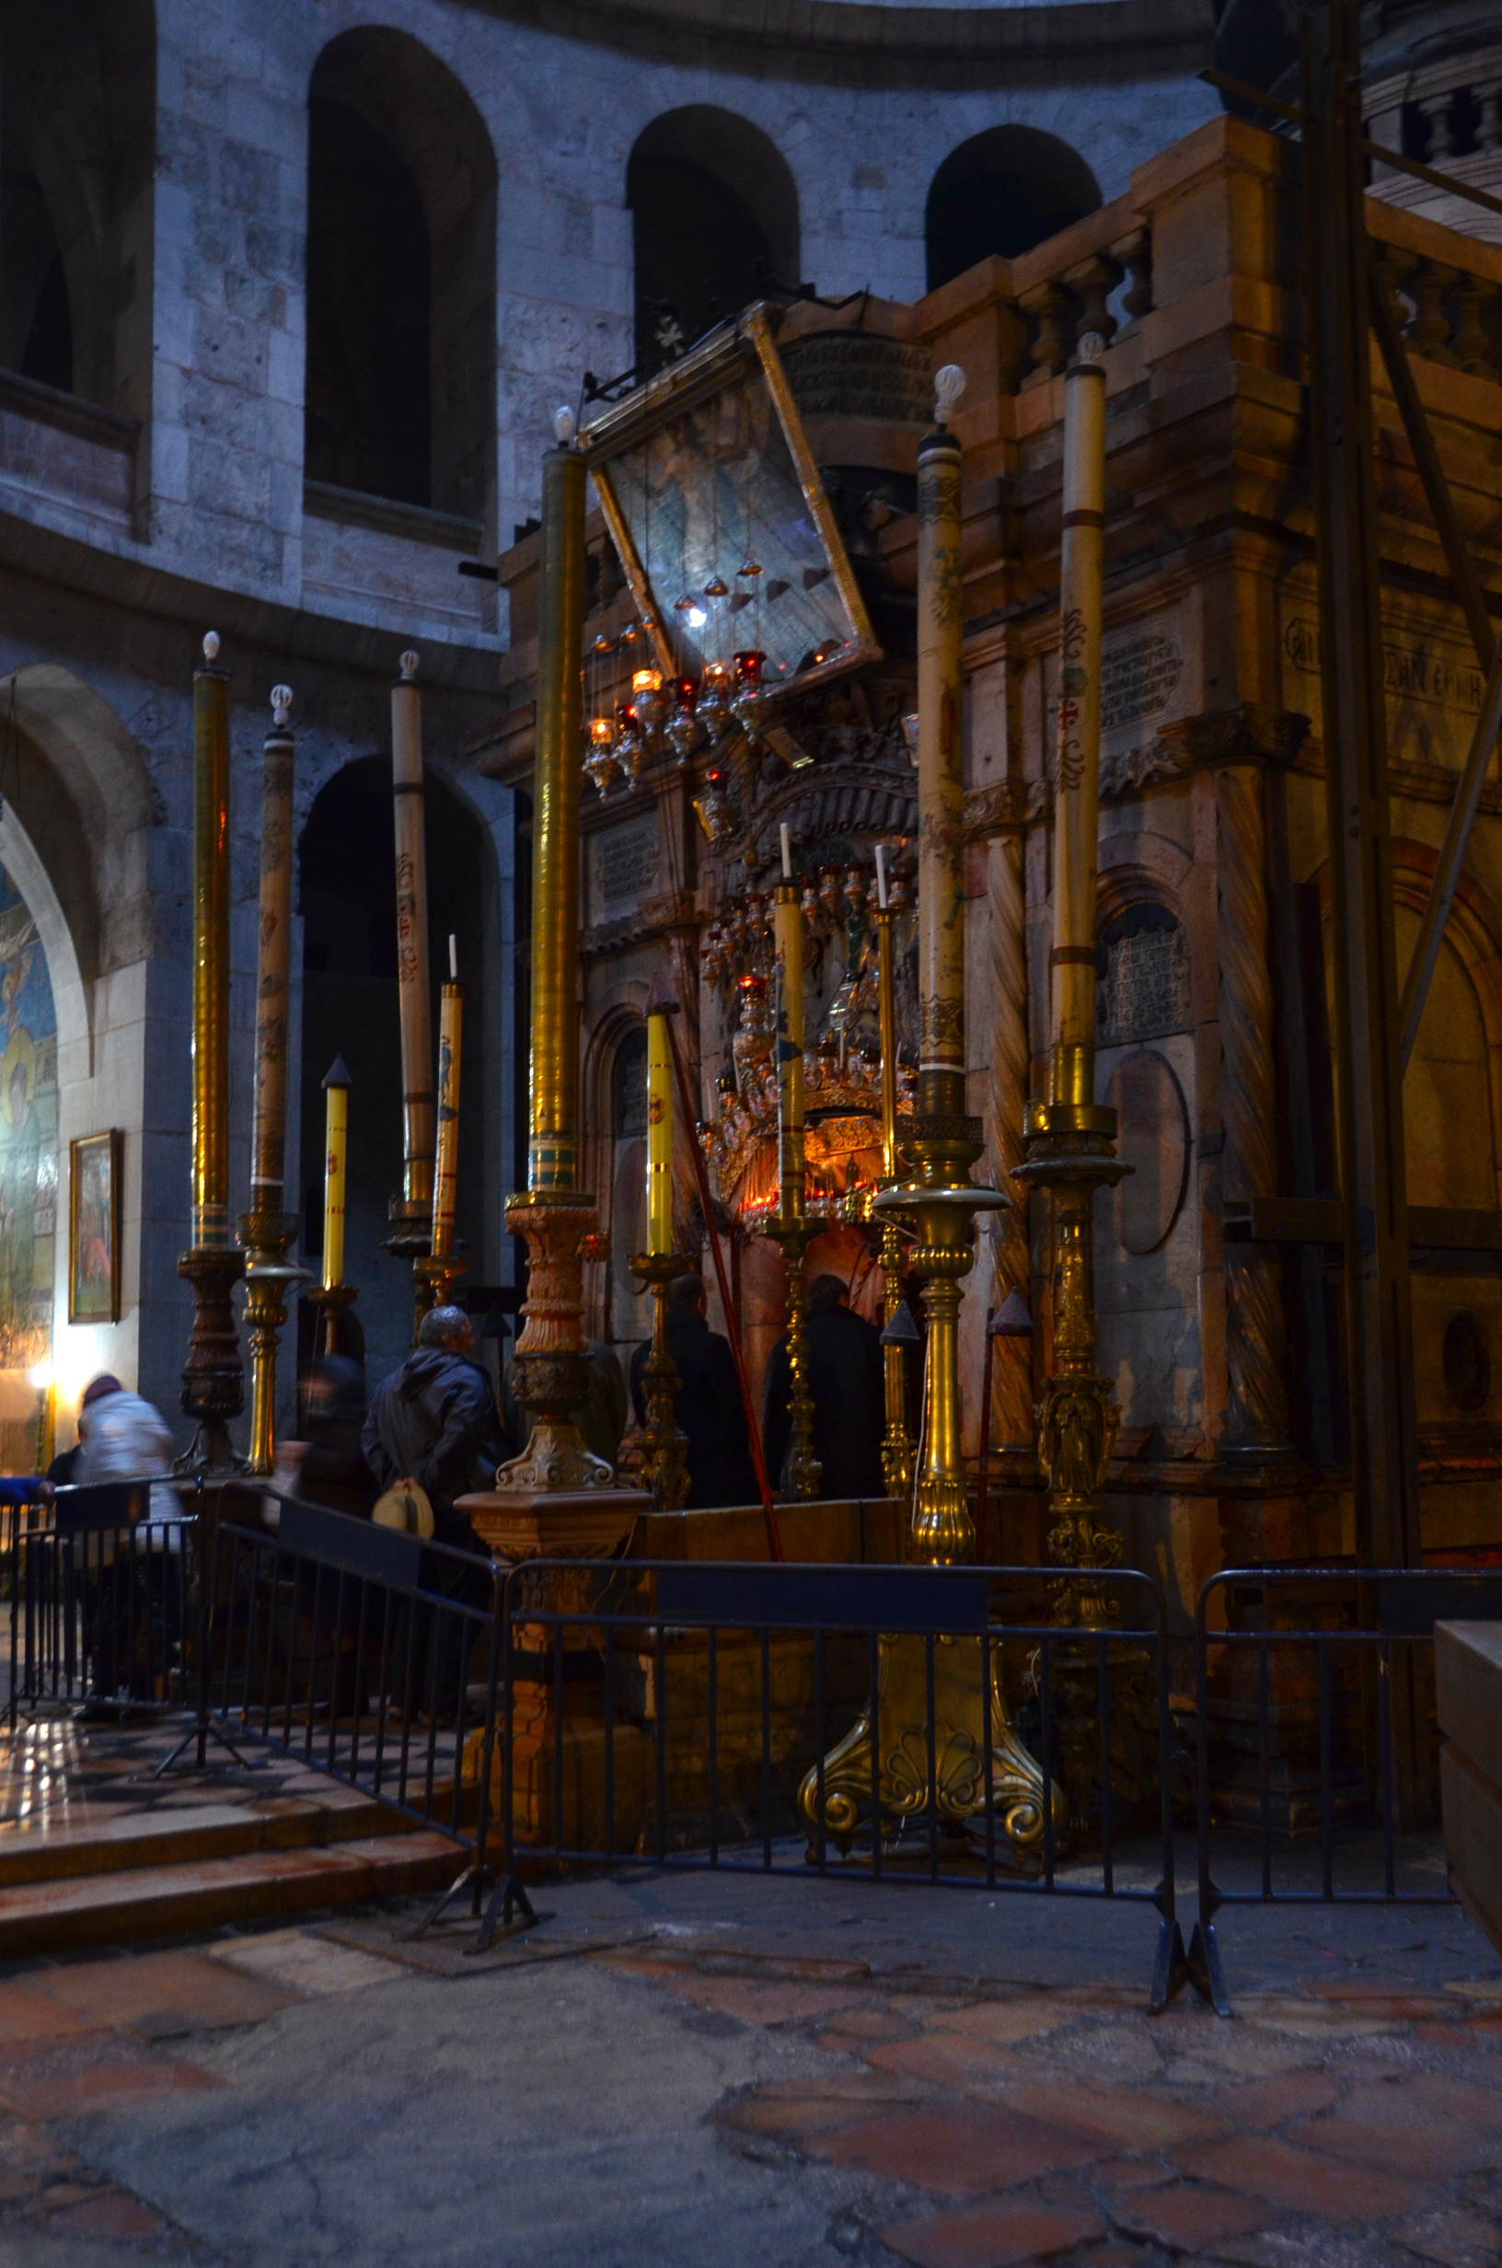
Luke 24:5–6
“Why seek ye the living among the dead?
He is not here,
but is risen.”
Adam Fagen
Notes:
https://www.flickr.com/photos/afagen/43643059050

Slide 4
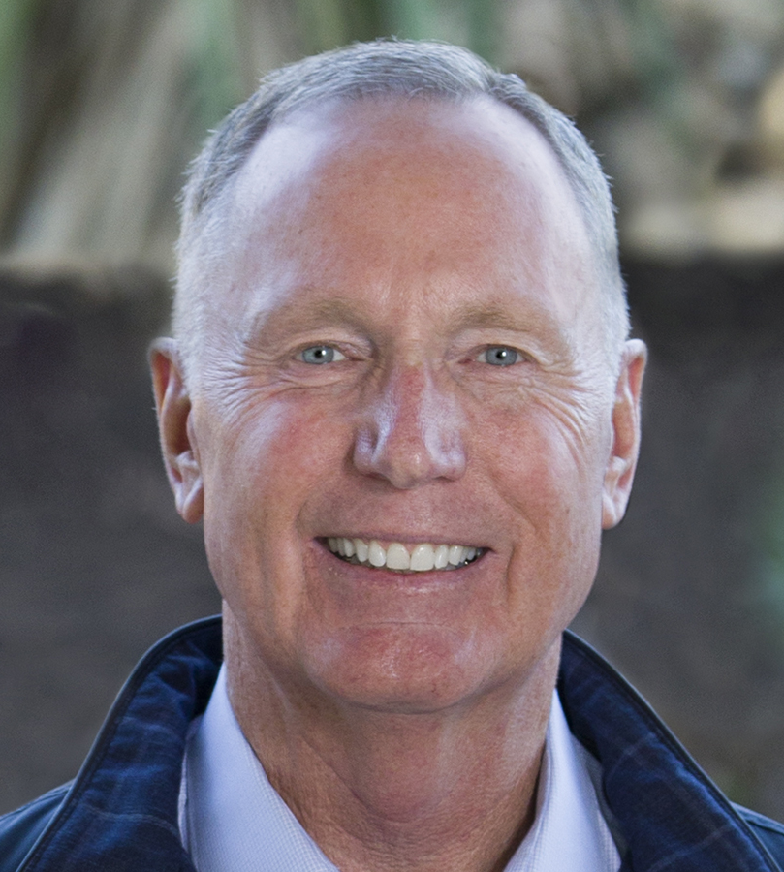
“What do you do [when you’re in the position of those early disciples?] When it’s Saturday in your life, how do you react? When you are somewhere between yesterday’s tragedy and tomorrow’s triumph, what do you do? Do you leave God—or do you linger near him?”
Max Lucado, He Chose the Nails, 206.

Slide 5
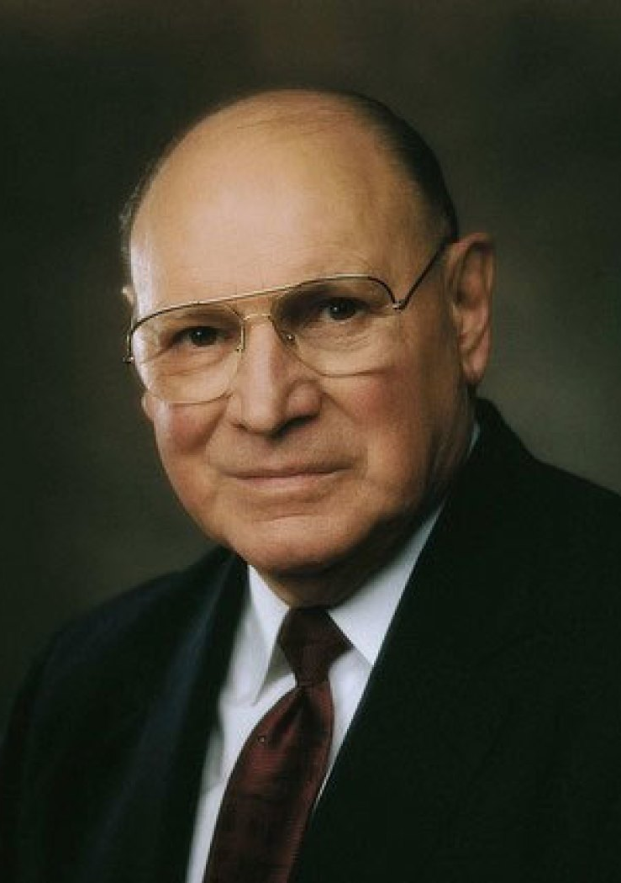
“Each of us will have our own Fridays﻿—those days when the universe itself seems shattered and the shards of our world lie littered about us in pieces. We all will experience those broken times when it seems we can never be put together again. We will all have our Fridays.
Elder Joseph B. Wirthlin, “Sunday will come,” Ensign, November 2006.

Slide 6
But I testify to you in the name of the One who conquered death﻿—Sunday will come. In the darkness of our sorrow, Sunday will come.
No matter our desperation, no matter our grief, Sunday will come. In this life or the next, Sunday will come.”
Elder Joseph B. Wirthlin, “Sunday will come,” Ensign, November 2006.

Slide 7
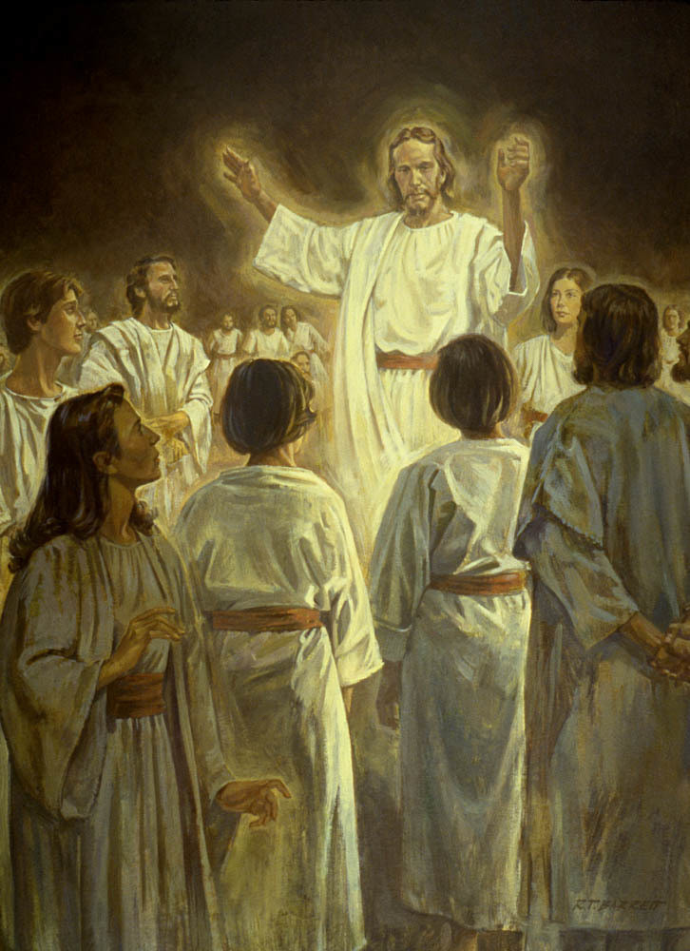
Christ “went not in person among the wicked…to teach them; But behold, from among the righteous, he organized his forces and appointed messengers, clothed with power and authority, and commissioned them to go forth and carry the light of the gospel to them that were in darkness, even to all the spirits of men; and thus was the gospel preached to the dead.”
Doctrine and Covenants 138:29–30
Bible Images
Notes:
https://www.churchofjesuschrist.org/study/manual/teachings-brigham-young/chapter-38?lang=eng

Slide 8
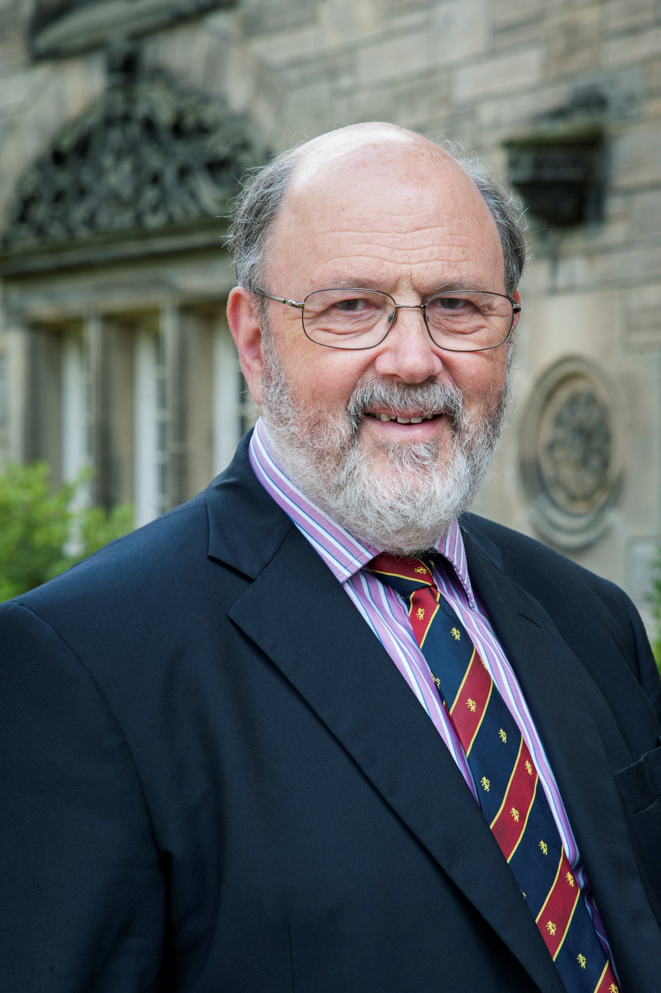
“Take Christmas away, and in biblical terms you lose two chapters at the front of Matthew and Luke, nothing else. Take Easter away, and you don’t have a New Testament; you don’t have a Christianity.”
N.T. Wright,
Surprised by Hope, 23

Slide 9
Bible Dictionary, “Miracles.”
“Christianity is founded on the greatest of all miracles, the Resurrection of our Lord. If that be admitted, other miracles cease to be improbable.”

Slide 10
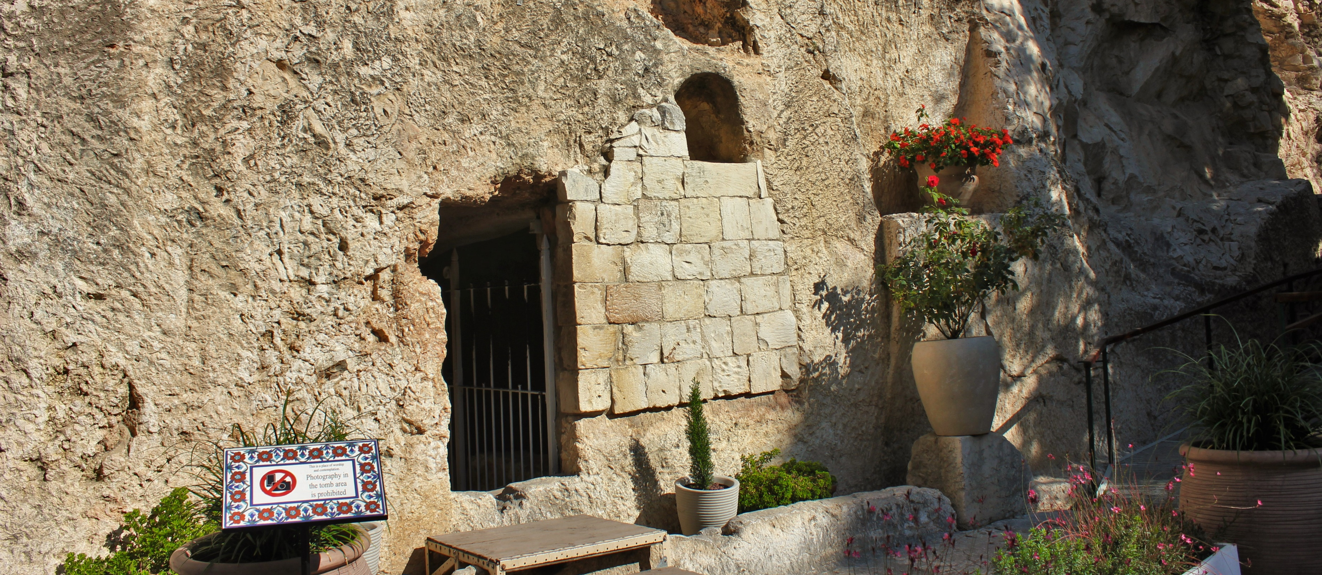
Photo by Beko
Notes:
https://commons.wikimedia.org/wiki/File:Garden_Tomb.jpg

Slide 11
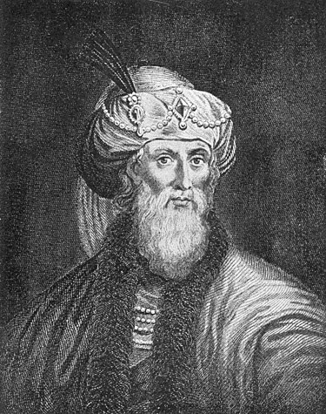
“From women let no evidence be accepted, because of the levity and temerity of their sex.”
John Winston
Josephus, Antiquities 4.219
Notes:
Image: https://en.wikipedia.org/wiki/Josephus

Slide 12
Multiple Resurrection Accounts, One Witness: He Lives!
John—Resurrection morning
Luke—the road to Emmaus
John—Jesus and Thomas
John—Feed my sheep
Matthew—The Great Commission

Slide 13
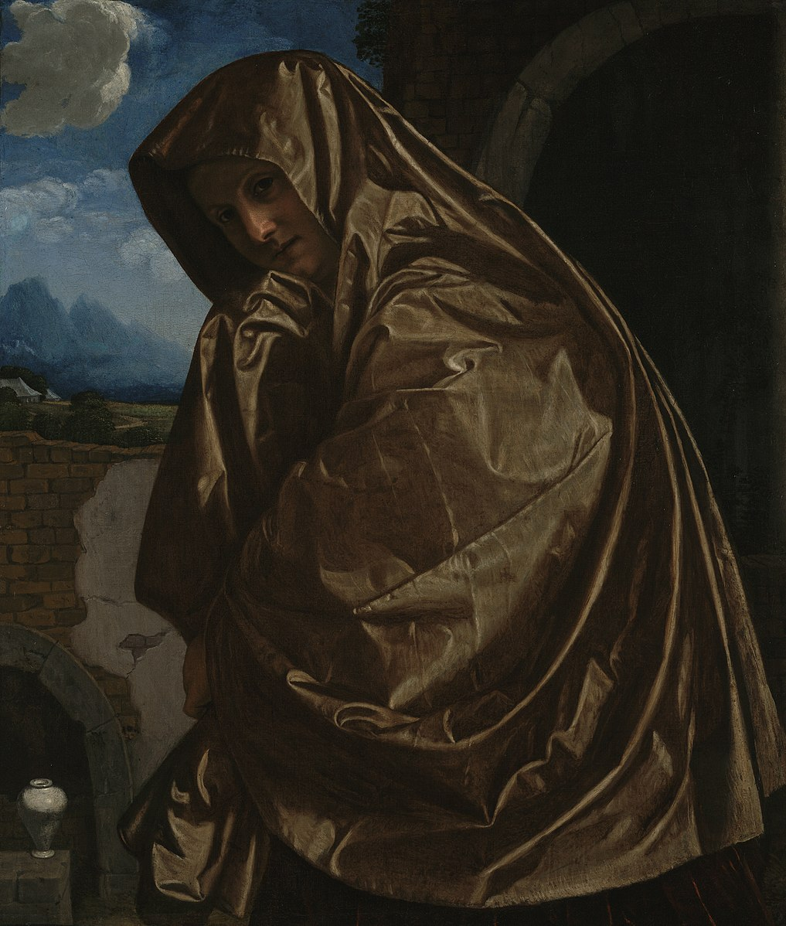
“Early on the first day of the week, while it was still dark, Mary Magdalene came to the tomb and saw that the stone had been removed from the tomb.
Giovanni Girolamo Savoldo
(John 20:1–2, NRSV)
Notes:
https://commons.wikimedia.org/wiki/File:Giovanni_Girolamo_Savoldo_-_Saint_Mary_Magdalene_at_the_Sepulchre_-_97.PA.55_-_J._Paul_Getty_Museum.jpg

Slide 14
“Early on the first day of the week, while it was still dark, Mary Magdalene came to the tomb and saw that the stone had been removed from the tomb. So she ran and went to Simon Peter and the other disciple, the one whom Jesus loved, and said to them, “They have taken the Lord out of the tomb, and we do not know where they have laid him.”
Giovanni Girolamo Savoldo
(John 20:1–2, NRSV)
Notes:
https://commons.wikimedia.org/wiki/File:Giovanni_Girolamo_Savoldo_-_Saint_Mary_Magdalene_at_the_Sepulchre_-_97.PA.55_-_J._Paul_Getty_Museum.jpg

Slide 15
“Then Peter and the other disciple set out and went toward the tomb. The two were running together, but the other disciple outran Peter and reached the tomb first. He bent down to look in and saw the linen wrappings lying there, but he did not go in.”
Giovanni Girolamo Savoldo
(John 20:3-5, NRSV)
Notes:
https://commons.wikimedia.org/wiki/File:Giovanni_Girolamo_Savoldo_-_Saint_Mary_Magdalene_at_the_Sepulchre_-_97.PA.55_-_J._Paul_Getty_Museum.jpg

Slide 16
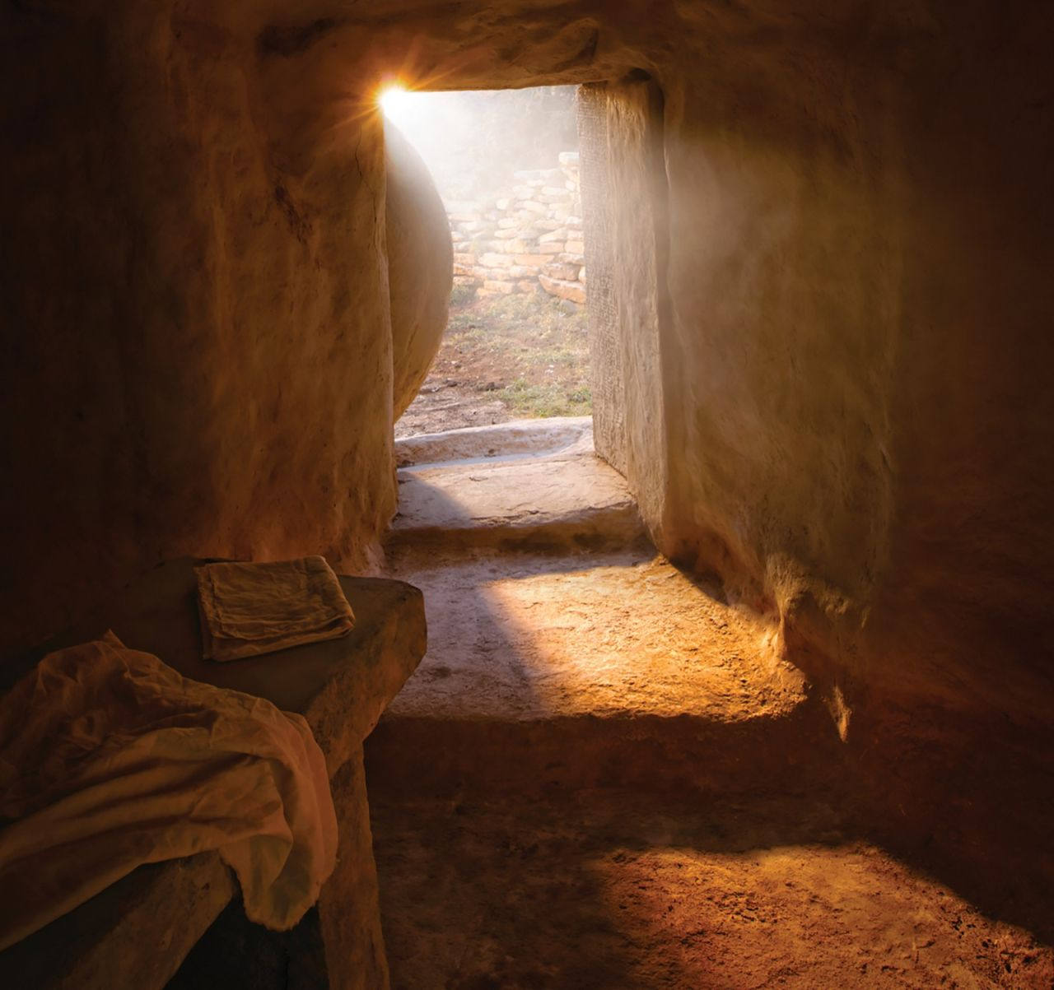
“Then Simon Peter came, following him, and went into the tomb. He saw the linen wrappings lying there, and the cloth that had been on Jesus’ head, not lying with the linen wrappings but rolled up in a place by itself. Then the other disciple, who reached the tomb first, also went in, and he saw and believed.”
Bible Images
(John 20:6-9, NRSV)
Notes:
https://www.churchofjesuschrist.org/media/image/jesus-christ-empty-tomb-goshen-utah-f3d2253?lang=eng

Slide 17
“Then the disciples returned to their homes. But Mary stood weeping outside the tomb. As she wept, she bent over to look into the tomb; and she saw two angels in white, sitting where the body of Jesus had been lying, one at the head and the other at the feet. They said to her, ‘Woman, why are you weeping?’ She said to them, ‘They have taken away my Lord, and I do not know where they have laid him.’”
Bible Images
(John 20:10-13, NRSV)
Notes:
https://www.churchofjesuschrist.org/media/image/jesus-christ-empty-tomb-goshen-utah-f3d2253?lang=eng

Slide 18
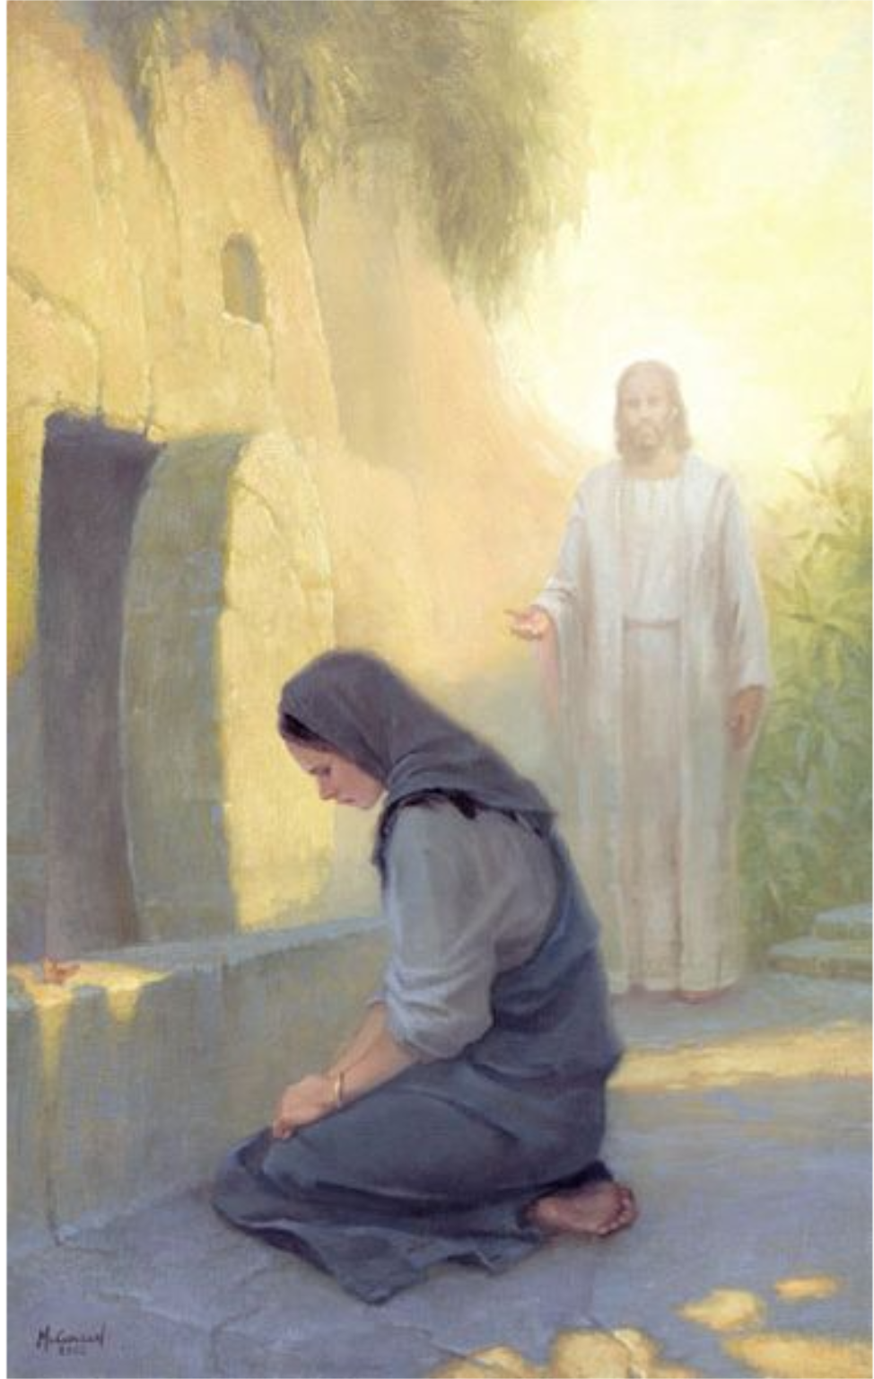
“When she had said this, she turned around and saw Jesus standing there, but she did not know that it was Jesus. Jesus said to her, ‘Woman, why are you weeping? Whom are you looking for?’”
(John 20:14–15, NRSV)
David McClellan
Notes:
https://history.churchofjesuschrist.org/exhibit/atonement-of-christ?lang=eng&cid=HP_MO_3-23-2015_dCHD_fHSTY_xLIDyL2-4_#mv23

Slide 19
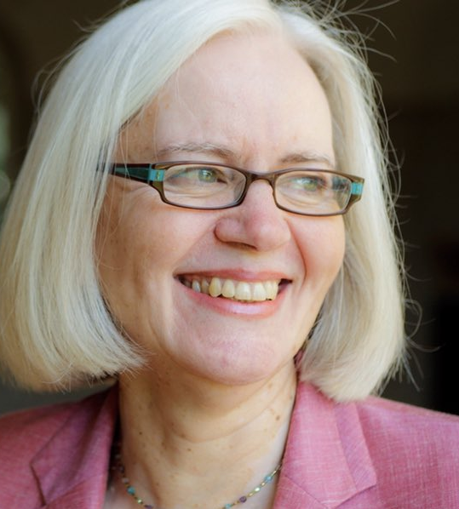
Woman, why weepest thou? Whom seekest thou?” (John 20:15).
“These questions are the first words spoken by the risen Jesus. His question, ‘Whom are you looking for?’ mirrors the first words he spoke in his ministry. When the followers of John the Baptist approached Jesus, he asked them, ‘What are you looking for?’” (John 1:38).
Gail R. O'Day, "John," The Women's Bible Commentary, 301.

Slide 20
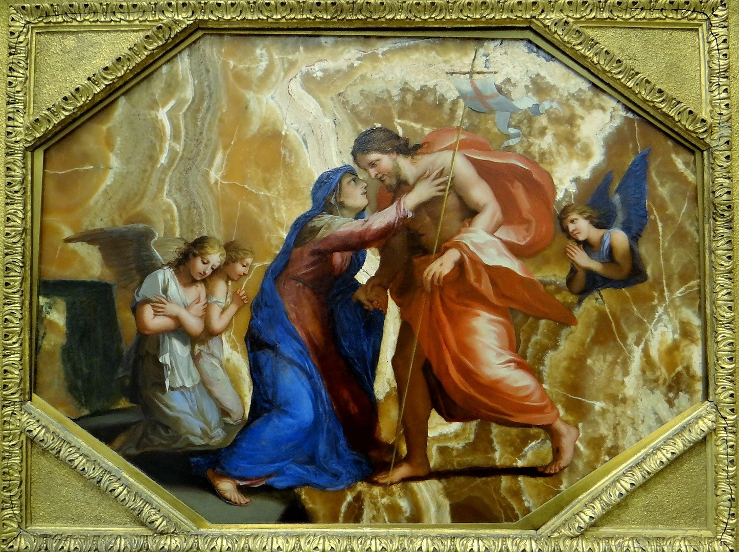
“Hold me not; for I am not yet ascended to my Father.”
(JST, John 20:17)
Jacques Stella
Notes:
https://commons.wikimedia.org/wiki/File:The_Risen_Christ_appearing_to_the_Virgin,_Jacques_Stella,_about_1640_(2).jpg

Slide 21
“Jesus’ command, “Do not hold on to me,” is the first post-resurrection
teaching. When he speaks these words, Jesus teaches Mary that he cannot and will not be held and controlled. One cannot hold Jesus to preconceived standards and expectations of who he should be, because to do so is to interfere with Jesus’ work and thereby limit what Jesus has to offer.”
Gail R. O'Day, "John," The Women's Bible Commentary, 301–302.

Slide 22
Multiple Resurrection Accounts, One Witness: He Lives!
John—Resurrection morning
Luke—the road to Emmaus
John—Jesus and Thomas
John—Feed my sheep
Matthew—The Great Commission

Slide 23
Multiple Resurrection Accounts, One Witness: He Lives!
John—Resurrection morning
Luke—the road to Emmaus
John—Jesus and Thomas
John—Feed my sheep
Matthew—The Great Commission

Slide 24
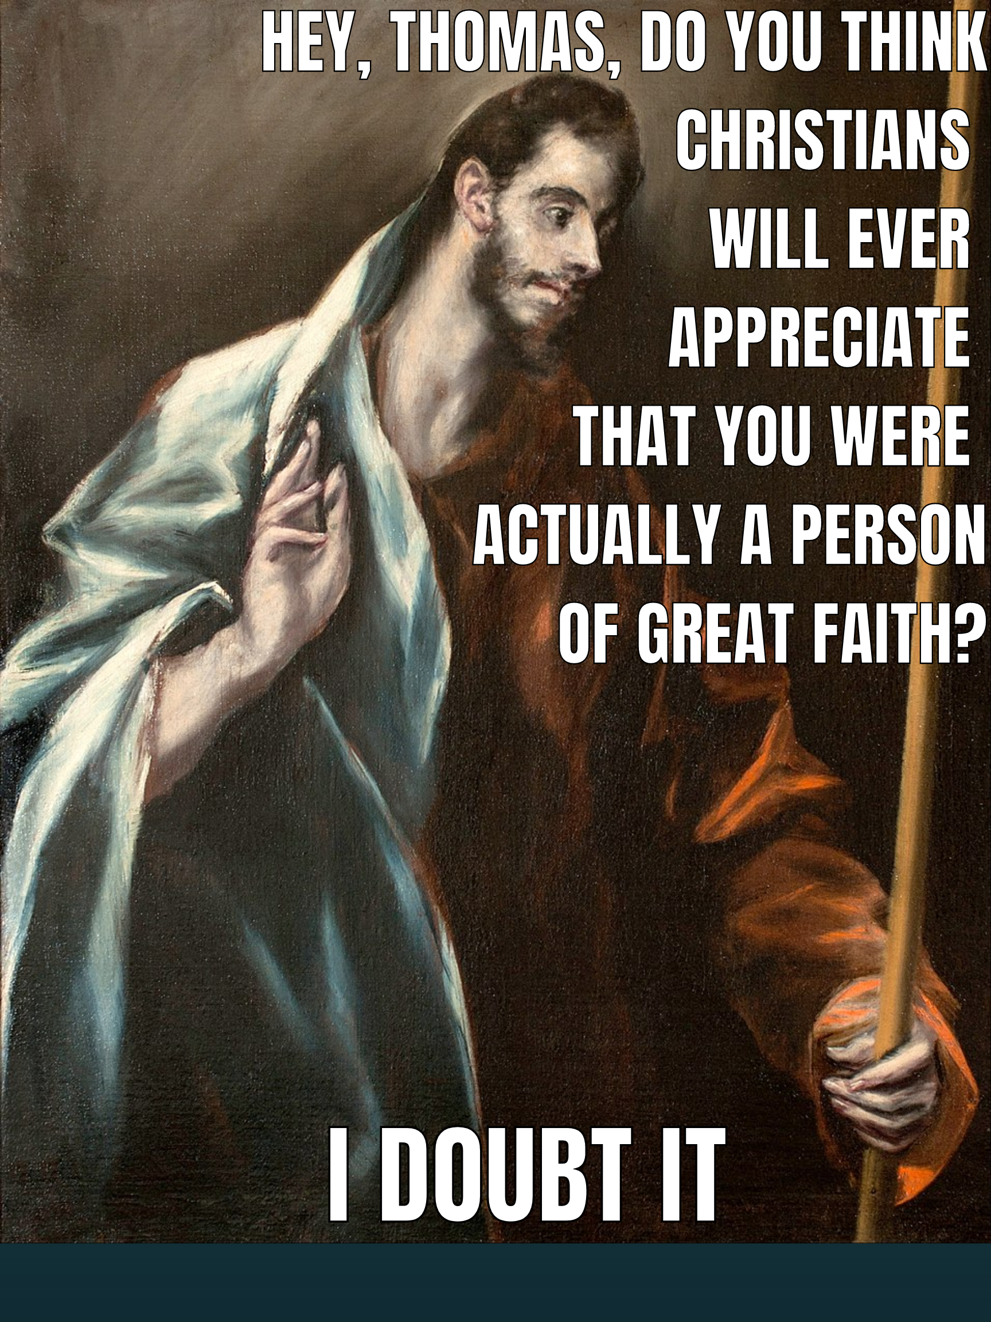
El Greco
Notes:
Created by Kohls

Slide 25
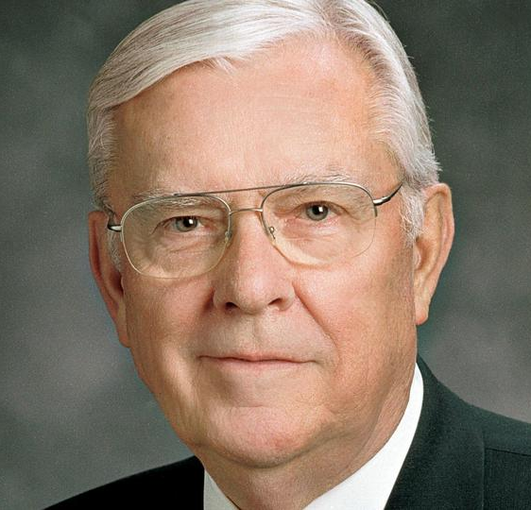
Every member of the Church is entitled to and can “develop an apostolic-like relationship with the Lord.”
President M. Russell Ballard, cited in “We are Witnesses,” Ensign, July 2019,

Slide 26
Multiple Resurrection Accounts, One Witness: He Lives!
John—Resurrection morning
Luke—the road to Emmaus
John—Jesus and Thomas
John—Feed my sheep
Matthew—The Great Commission

Slide 27
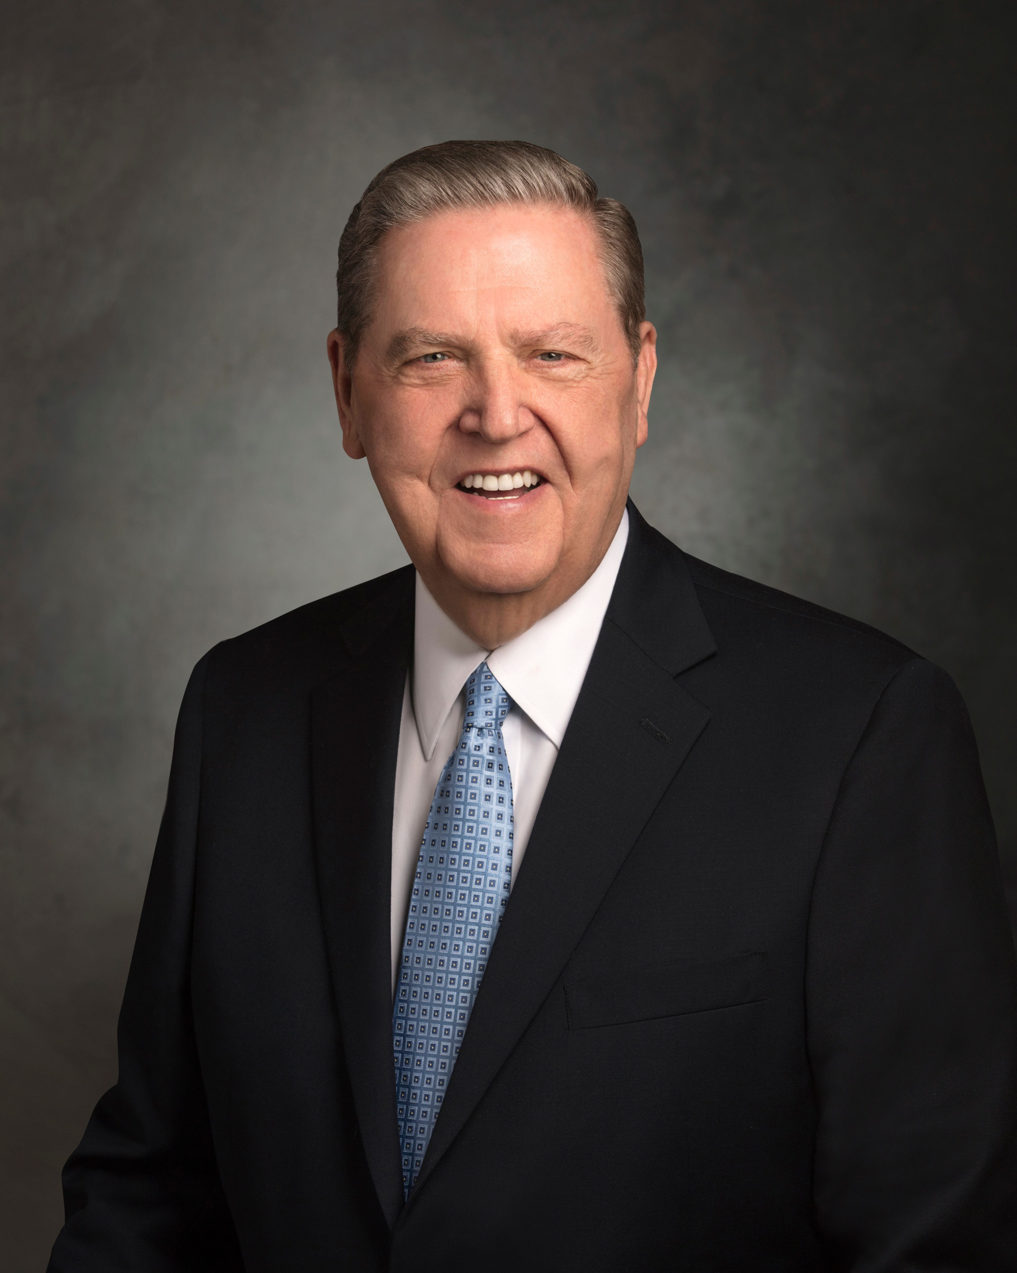
“In effect, Peter said to his associates: “Brethren, it has been a glorious three years. None of us could have imagined such a few short months ago the miracles we have seen and the divinity we have enjoyed. We have talked with, prayed with, and labored with the very Son of God Himself. We have walked with Him and wept with Him, and on the night of that horrible ending, no one wept more bitterly than I.
Jeffrey R. Holland, "The First Great Commandment," Ensign, November 2012
Notes:
Video link here: https://youtu.be/-mxNFV7RrT8

Slide 28
“But that is over. He has finished His work, and He has risen from the tomb. He has worked out His salvation and ours. So you ask, ‘What do we do now?’ I don’t know more to tell you than to return to your former life, rejoicing. I intend to ‘go a fishing.’”
Jeffrey R. Holland, "The First Great Commandment," Ensign, November 2012
Notes:
Video link here: https://youtu.be/-mxNFV7RrT8

Slide 29
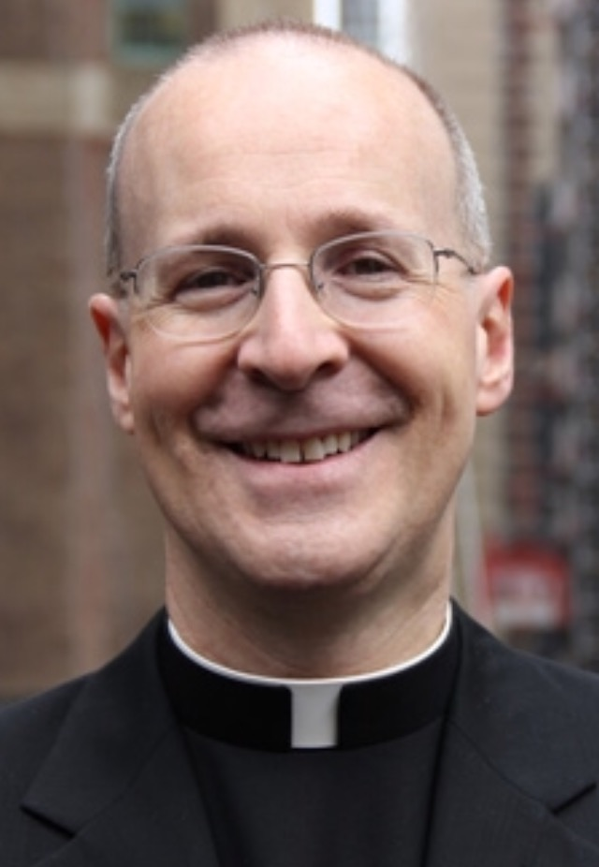
“Notice how Peter has changed over the course of Jesus’s ministry. At the Miraculous Catch of Fish, recognizing his own sinfulness, he shrinks before Jesus. He cannot bear his own limitations. At the Breakfast by the Sea, he does not fail to rush to Jesus, even knowing his sinfulness. It is a transformation that has come from spending time with Jesus.”
Editeurcoreen
James Martin, Jesus, A Pilgrimage, p. 326
Notes:
https://en.wikipedia.org/wiki/James_Martin_(priest,_born_1960)#/media/File:JamesMartin.jpg

Slide 30
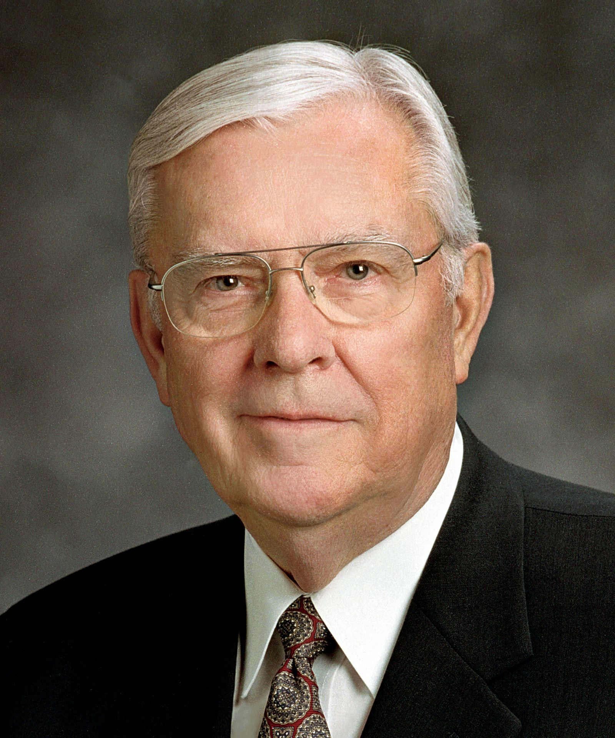
“Relating this question to ourselves in our day, the Lord may be asking us about how busy we are and about the many positive and negative influences competing for our attention and our time. He may be asking each of us if we love Him more than the things of this world. This may be a question about what we really value in life.”
M. Russell Ballard, “Lovest Thou Me More Than These?” Liahona, November 2021

Slide 31
“[Perhaps Jesus was saying to Peter something like] Peter, [if you really love me,] why are you here? Why are we back on this same shore, by these same nets, having this same conversation? Wasn’t it obvious then and isn’t it obvious now that if I want fish, I can get fish?”
Jeffrey R. Holland, "The First Great Commandment," Ensign, November 2012
Notes:
Video link here: https://youtu.be/-mxNFV7RrT8

Slide 32
What I need, Peter, are disciples—and I need them forever. I need someone to feed my sheep and save my lambs. I need someone to preach my gospel and defend my faith. I need someone who loves me, truly, truly loves me, and loves what our Father in Heaven has commissioned me to do...
Jeffrey R. Holland, "The First Great Commandment," Ensign, November 2012
Notes:
Video link here: https://youtu.be/-mxNFV7RrT8

Slide 33
“So, Peter, for the second and presumably the last time, I am asking you to leave all this and to go teach and testify, labor and serve loyally until the day in which they will do to you exactly what they did to me.”
Jeffrey R. Holland, "The First Great Commandment," Ensign, November 2012
Notes:
Video link here: https://youtu.be/-mxNFV7RrT8

Slide 34
Multiple Resurrection Accounts, One Witness: He Lives!
John—Resurrection morning
Luke—the road to Emmaus
John—Jesus and Thomas
John—Feed my sheep
Matthew—The Great Commission

Slide 35
Matthew’s Inclusio
“All this was done, that it might be fulfilled which was spoken of the Lord by the prophet, saying,
Behold, a virgin shall be with child, and shall bring forth a son, and they shall call his name Emmanuel, which being interpreted is, God with us”
(Matthew 1:22–23)
“Lo, I am with you always, even unto the end of the world”
(Matthew 28:20)

Slide 36
Note the Consistent Message of Matthew 28, Mark 16, Luke 24, John 20-21
NOT Jesus has been resurrected and you will be also.
BUT Jesus has been resurrected and now you need to go tell people about it.

Slide 37
The Savior’s Scars
“[Jesus] shewed unto them his hands and his side.” (John 20:20)
“Reach hither thy finger, and behold my hands; and reach hither thy hand, and thrust it into my side.” (John 20:27)
Bertel Thorvaldsen
Notes:
https://www.churchofjesuschrist.org/media/image/christus-lds-d135bb9?lang=eng
Image is a replica of Bertel Thorvaldsen's work

Slide 38
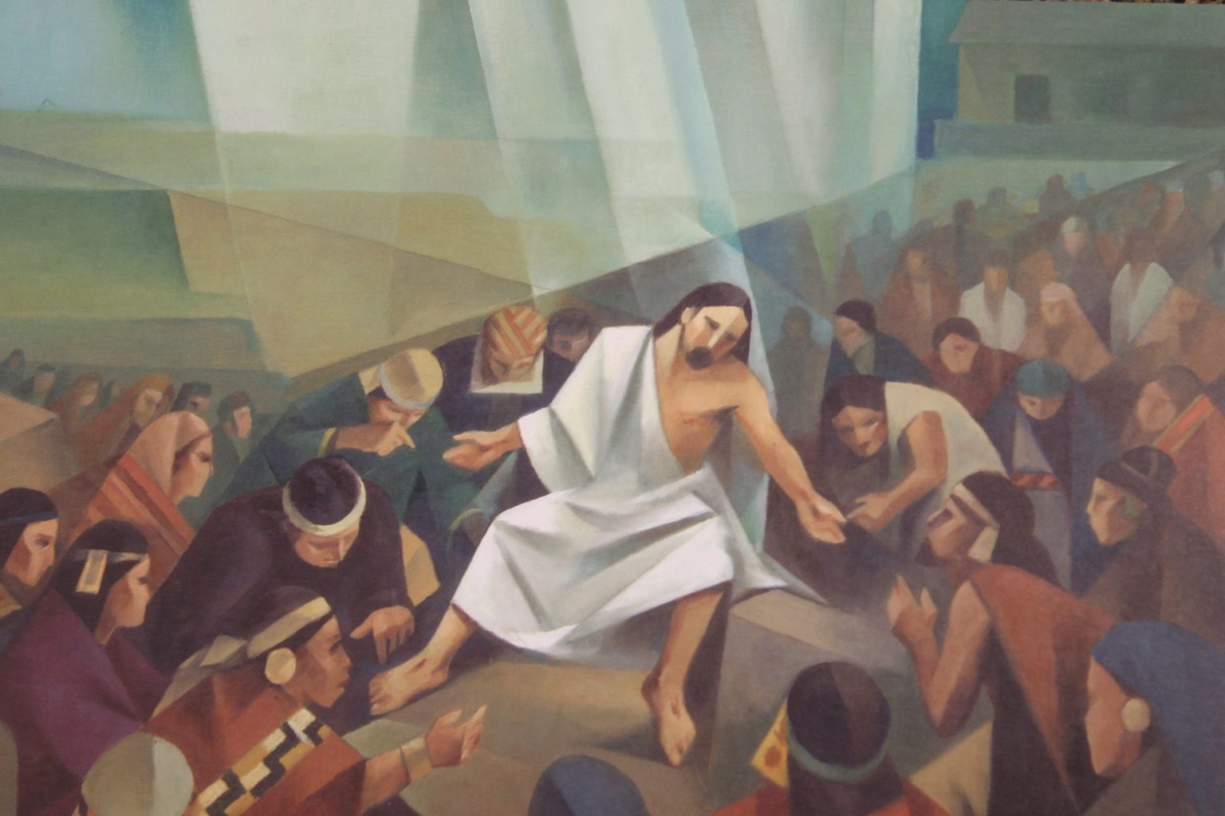
The Savior’s Scars
“Come forth unto me, that ye may thrust your hands into my side, and also that ye may feel the prints of the nails in my hands and in my feet, that ye may know that I am…the God of the whole earth.”
(3 Nephi 11:14)
Jorge Cocco Santángelo
Notes:
https://altusfineart.com/collections/jorge-cocco/products/jorge-cocco-his-marks-jesus-marks-crucifixion

Slide 39
The Savior’s Scars
“Then shall the Jews look upon me and say: What are these wounds in thine hands and in thy feet?”
Rebekah Goldthwaite
Notes:
https://history.churchofjesuschrist.org/exhibit/2013-international-art-competition-for-youth?lang=eng#mv35

Slide 40
The Savior’s Scars
“Then shall they know that I am the Lord; for I will say unto them: These wounds are the wounds with which I was wounded in the house of my friends. I am he who was lifted up. I am Jesus that was crucified.” (D&C 45:51-52)
Rebekah Goldthwaite
Notes:
https://history.churchofjesuschrist.org/exhibit/2013-international-art-competition-for-youth?lang=eng#mv35

Slide 41
“However dim our days may seem, they have been a lot darker for the Savior of the world. As a reminder of those days, Jesus has chosen, even in a resurrected, otherwise perfected body, to retain for the benefit of His disciples the wounds in His hands and in His feet and in His side—signs, if you will, that painful things happen even to the pure and the perfect; signs, if you will, that pain in this world is not evidence that God doesn’t love you; signs, if you will, that problems pass and happiness can be ours. . . .
Jeffrey R. Holland, “Teaching, Preaching, Healing,”
Ensign, January 2003.

Slide 42
“It is the wounded Christ who is the Captain of our souls… These wounds are the principal way we are to recognize Him when He comes.”
Jeffrey R. Holland, “Teaching, Preaching, Healing,”
Ensign, January 2003.

Slide 43
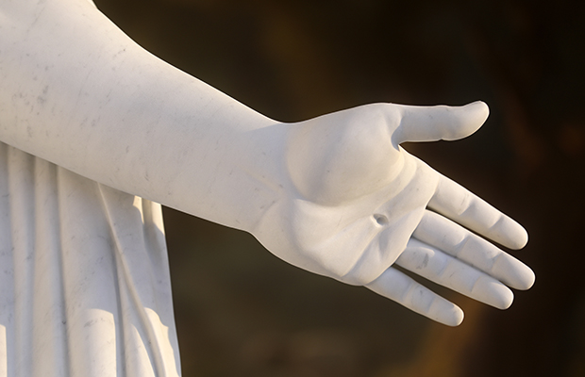
His Prints of Peace

Slide 44
The Prince of Peace
His Prints of Peace

Slide 45
Acknowledgements
Insights from, discussions with, and resources authored by Dr. Raymond Brown, Dr. N.T. Wright, Dr. Matthew Grey, Dr. Gail R. O’Day, Dr. Tyler Griffin, Dr. Hank Smith, James Martin, SJ, Max Lucado, and Michelle Wilson were used in the creation of this video.

