Slide 1
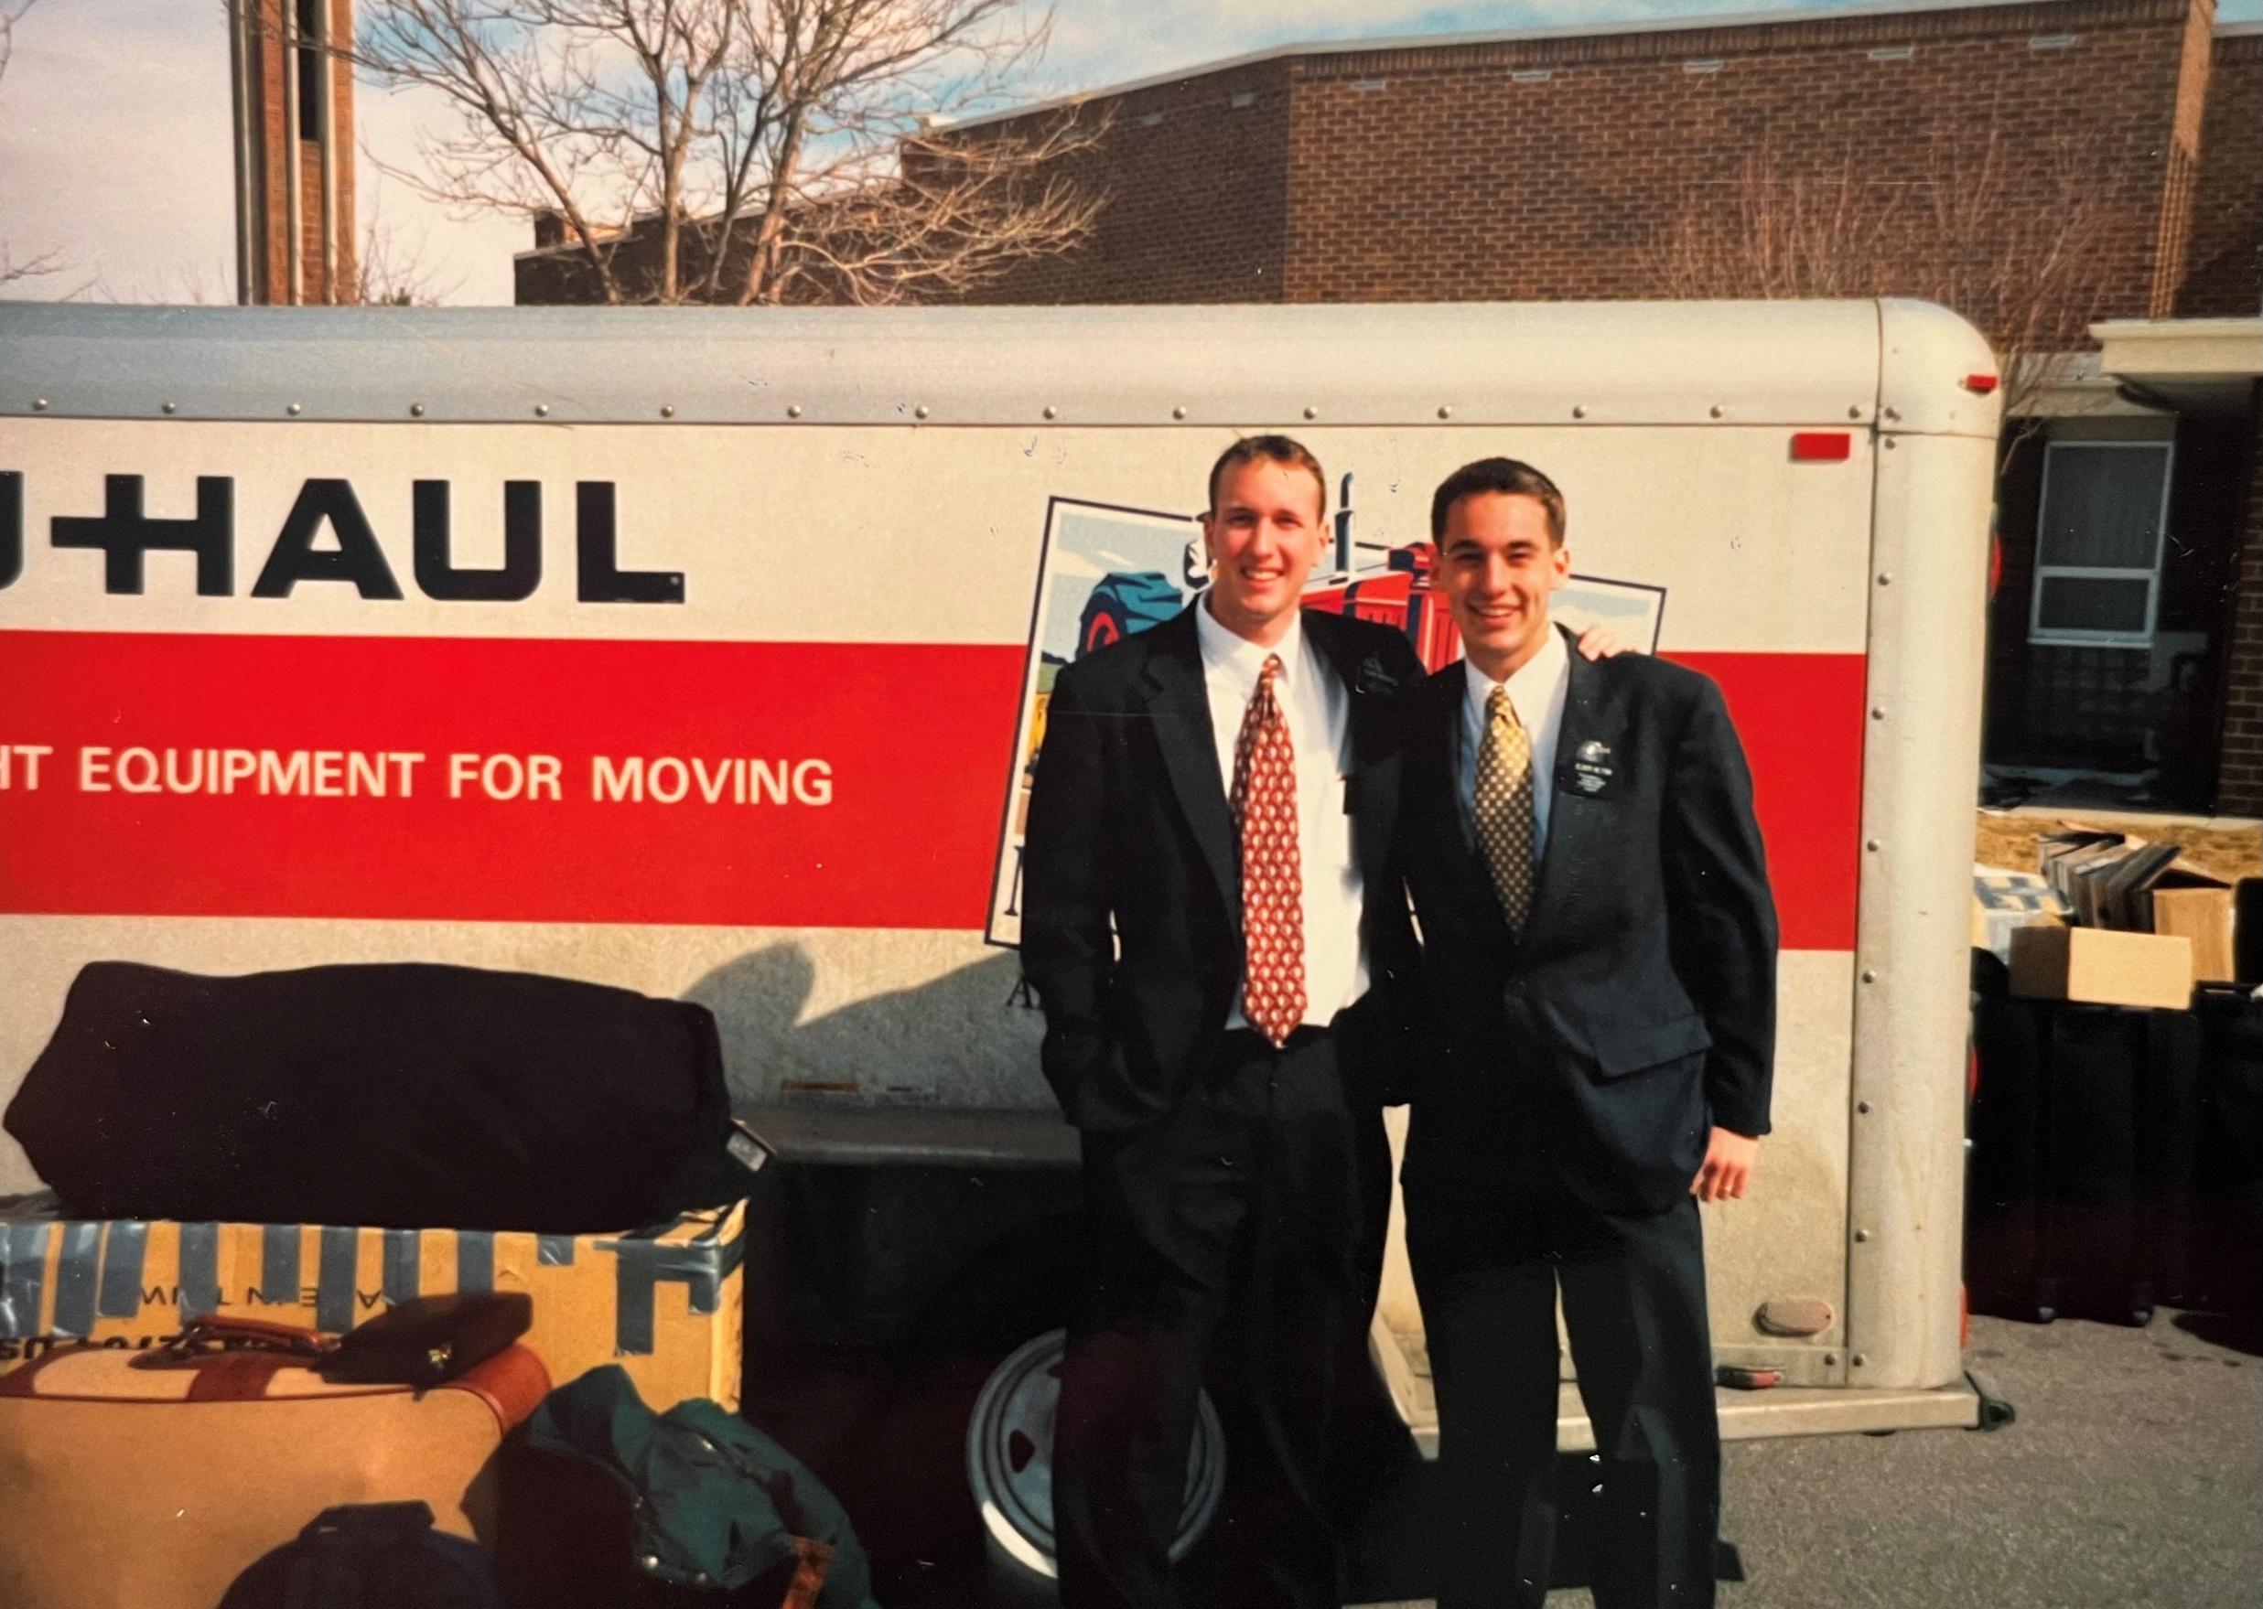

Slide 2
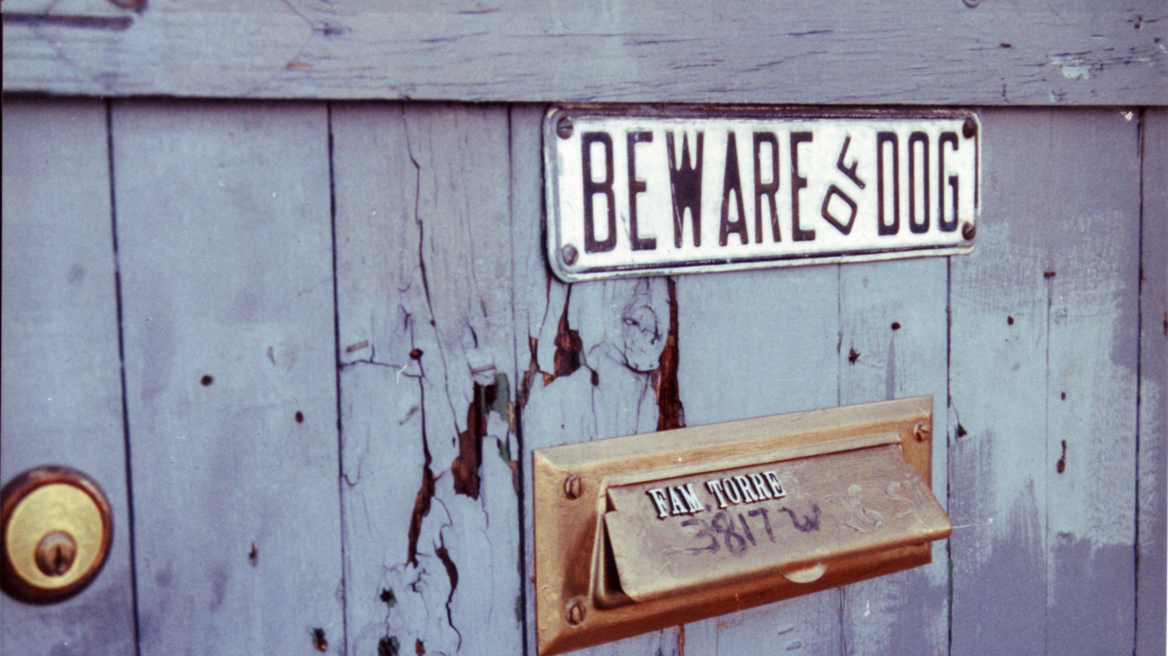
Paul Keller
Notes:
https://www.flickr.com/photos/paulk/32579490

Slide 6
Five Key Themes in the Gospel of Mark
Highlights “Human” Aspects of Jesus

Slide 7
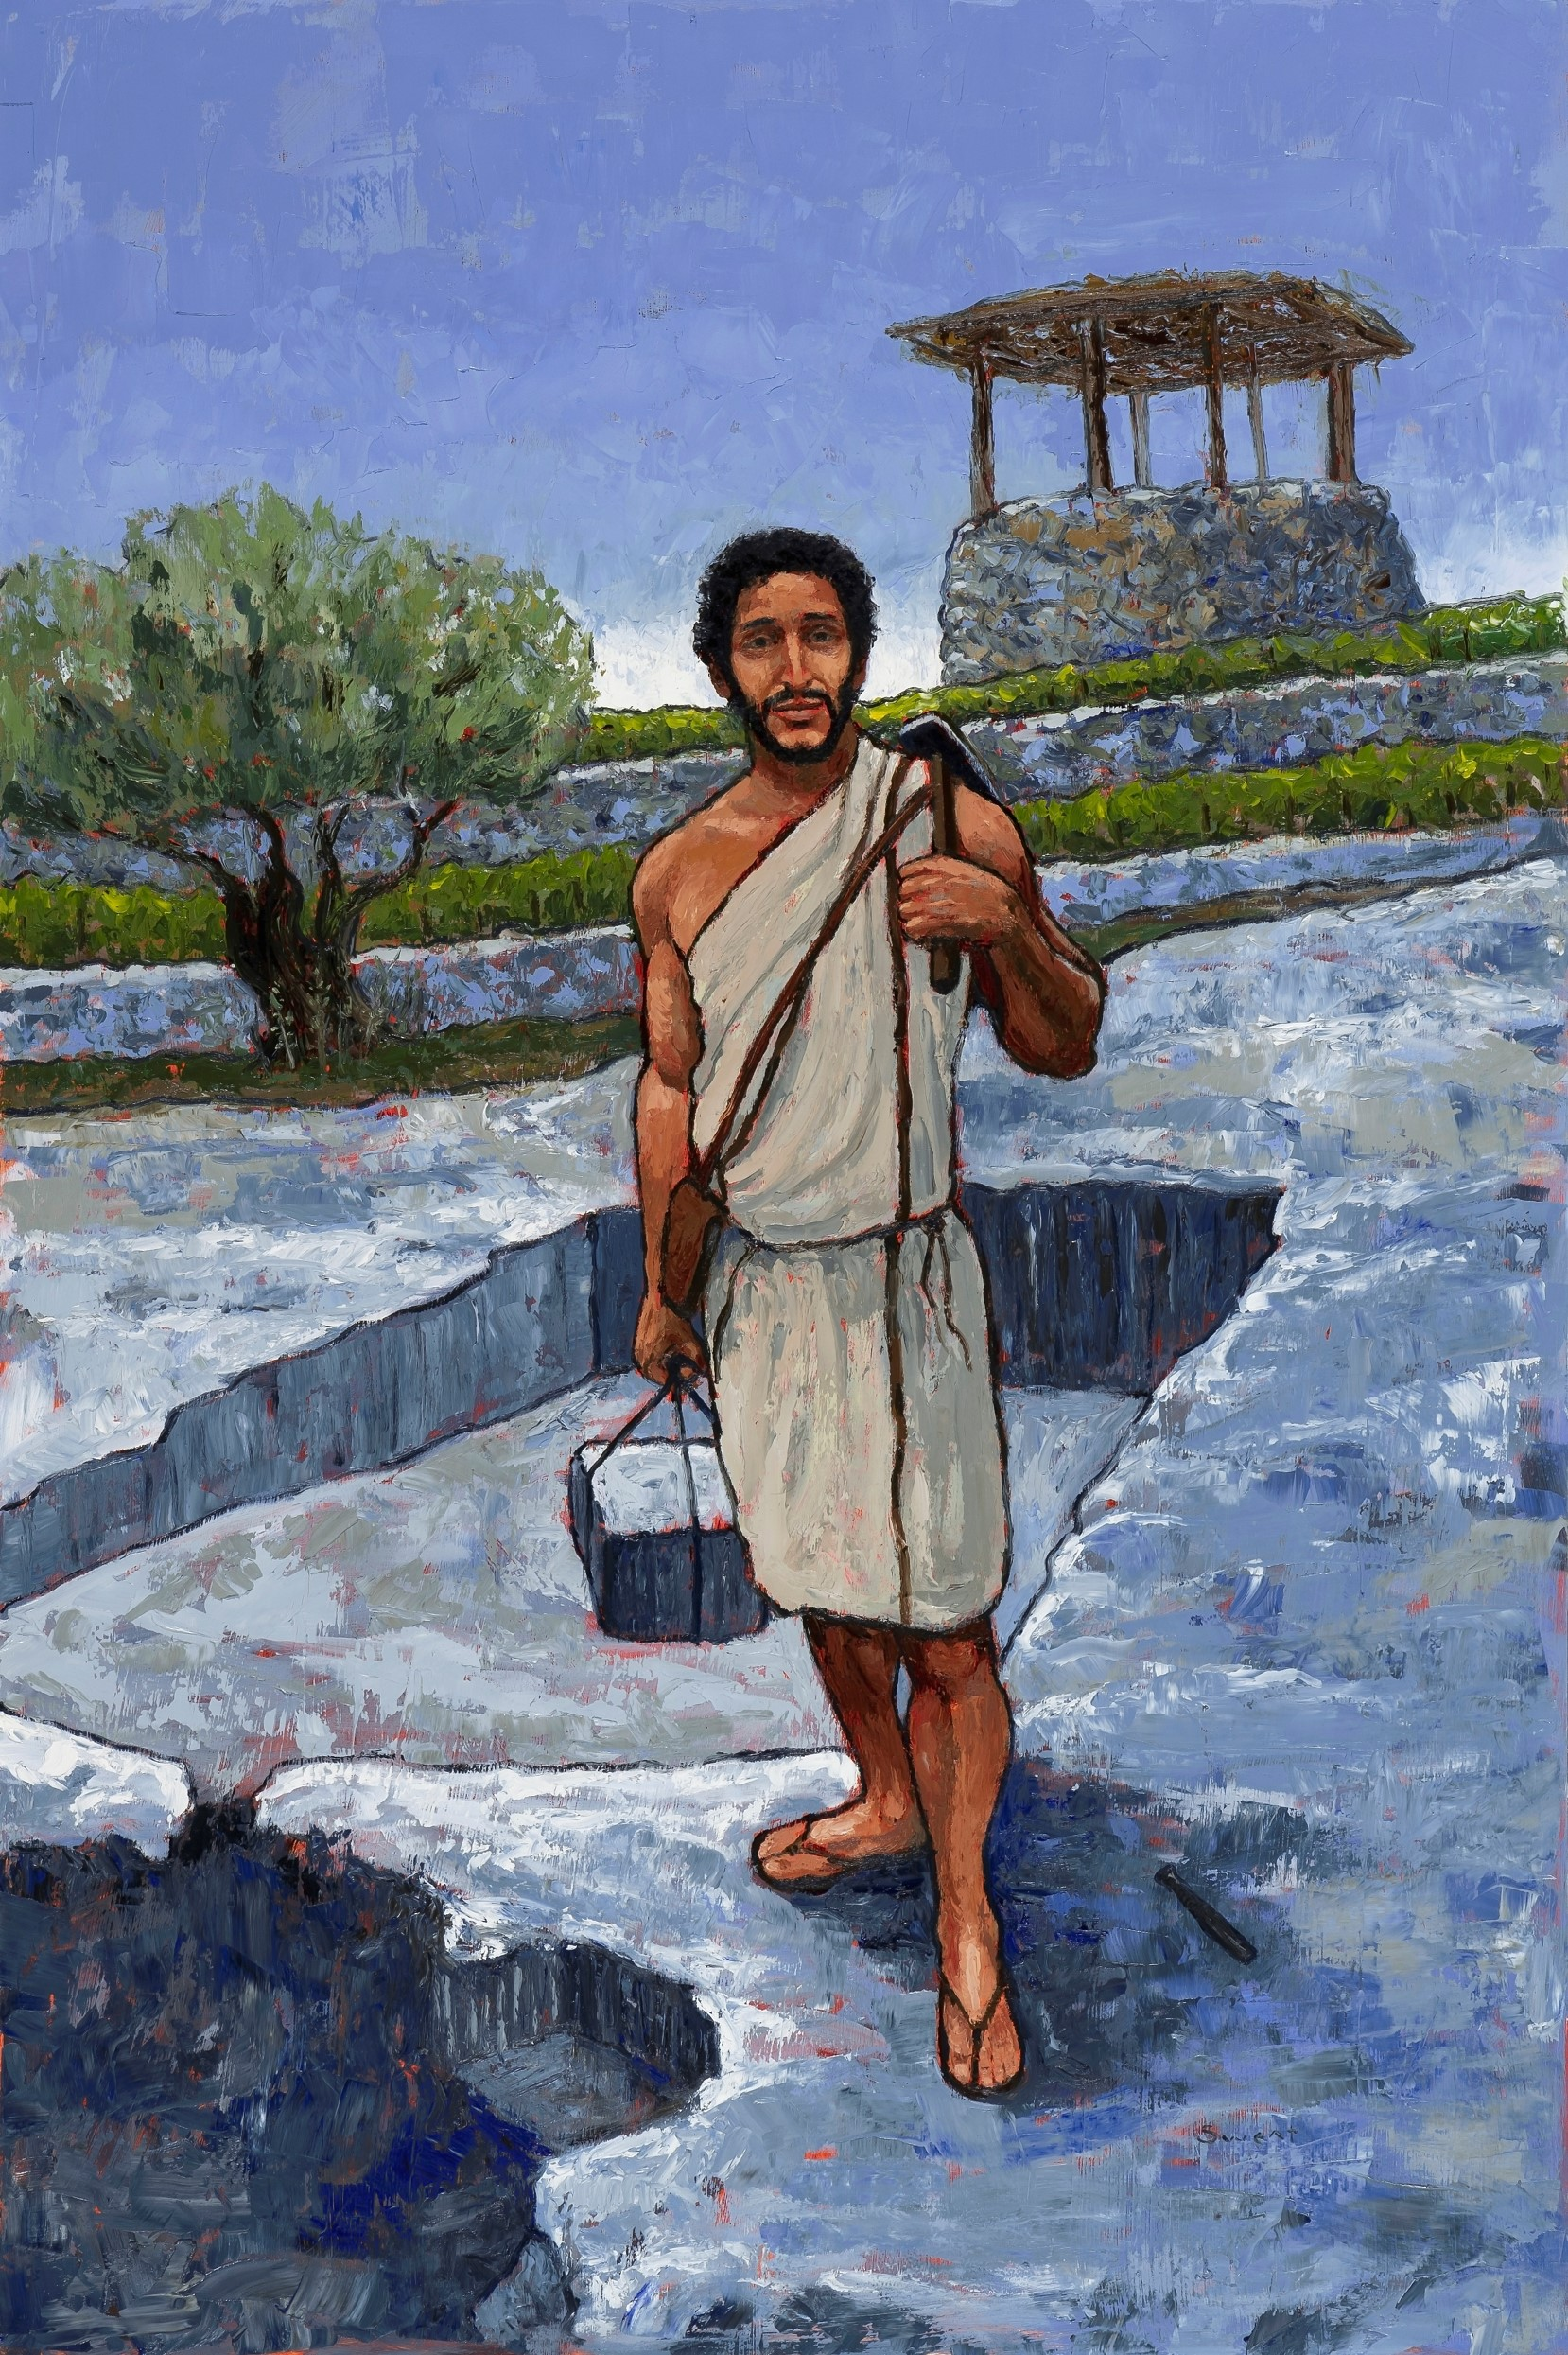
Anthony Sweat
Pudienza Mosiac, ~400 AD
Low Christology
(Emphasizes Jesus’s humanity)
High Christology
(Emphasizes Christ’s divinity)

Slide 8
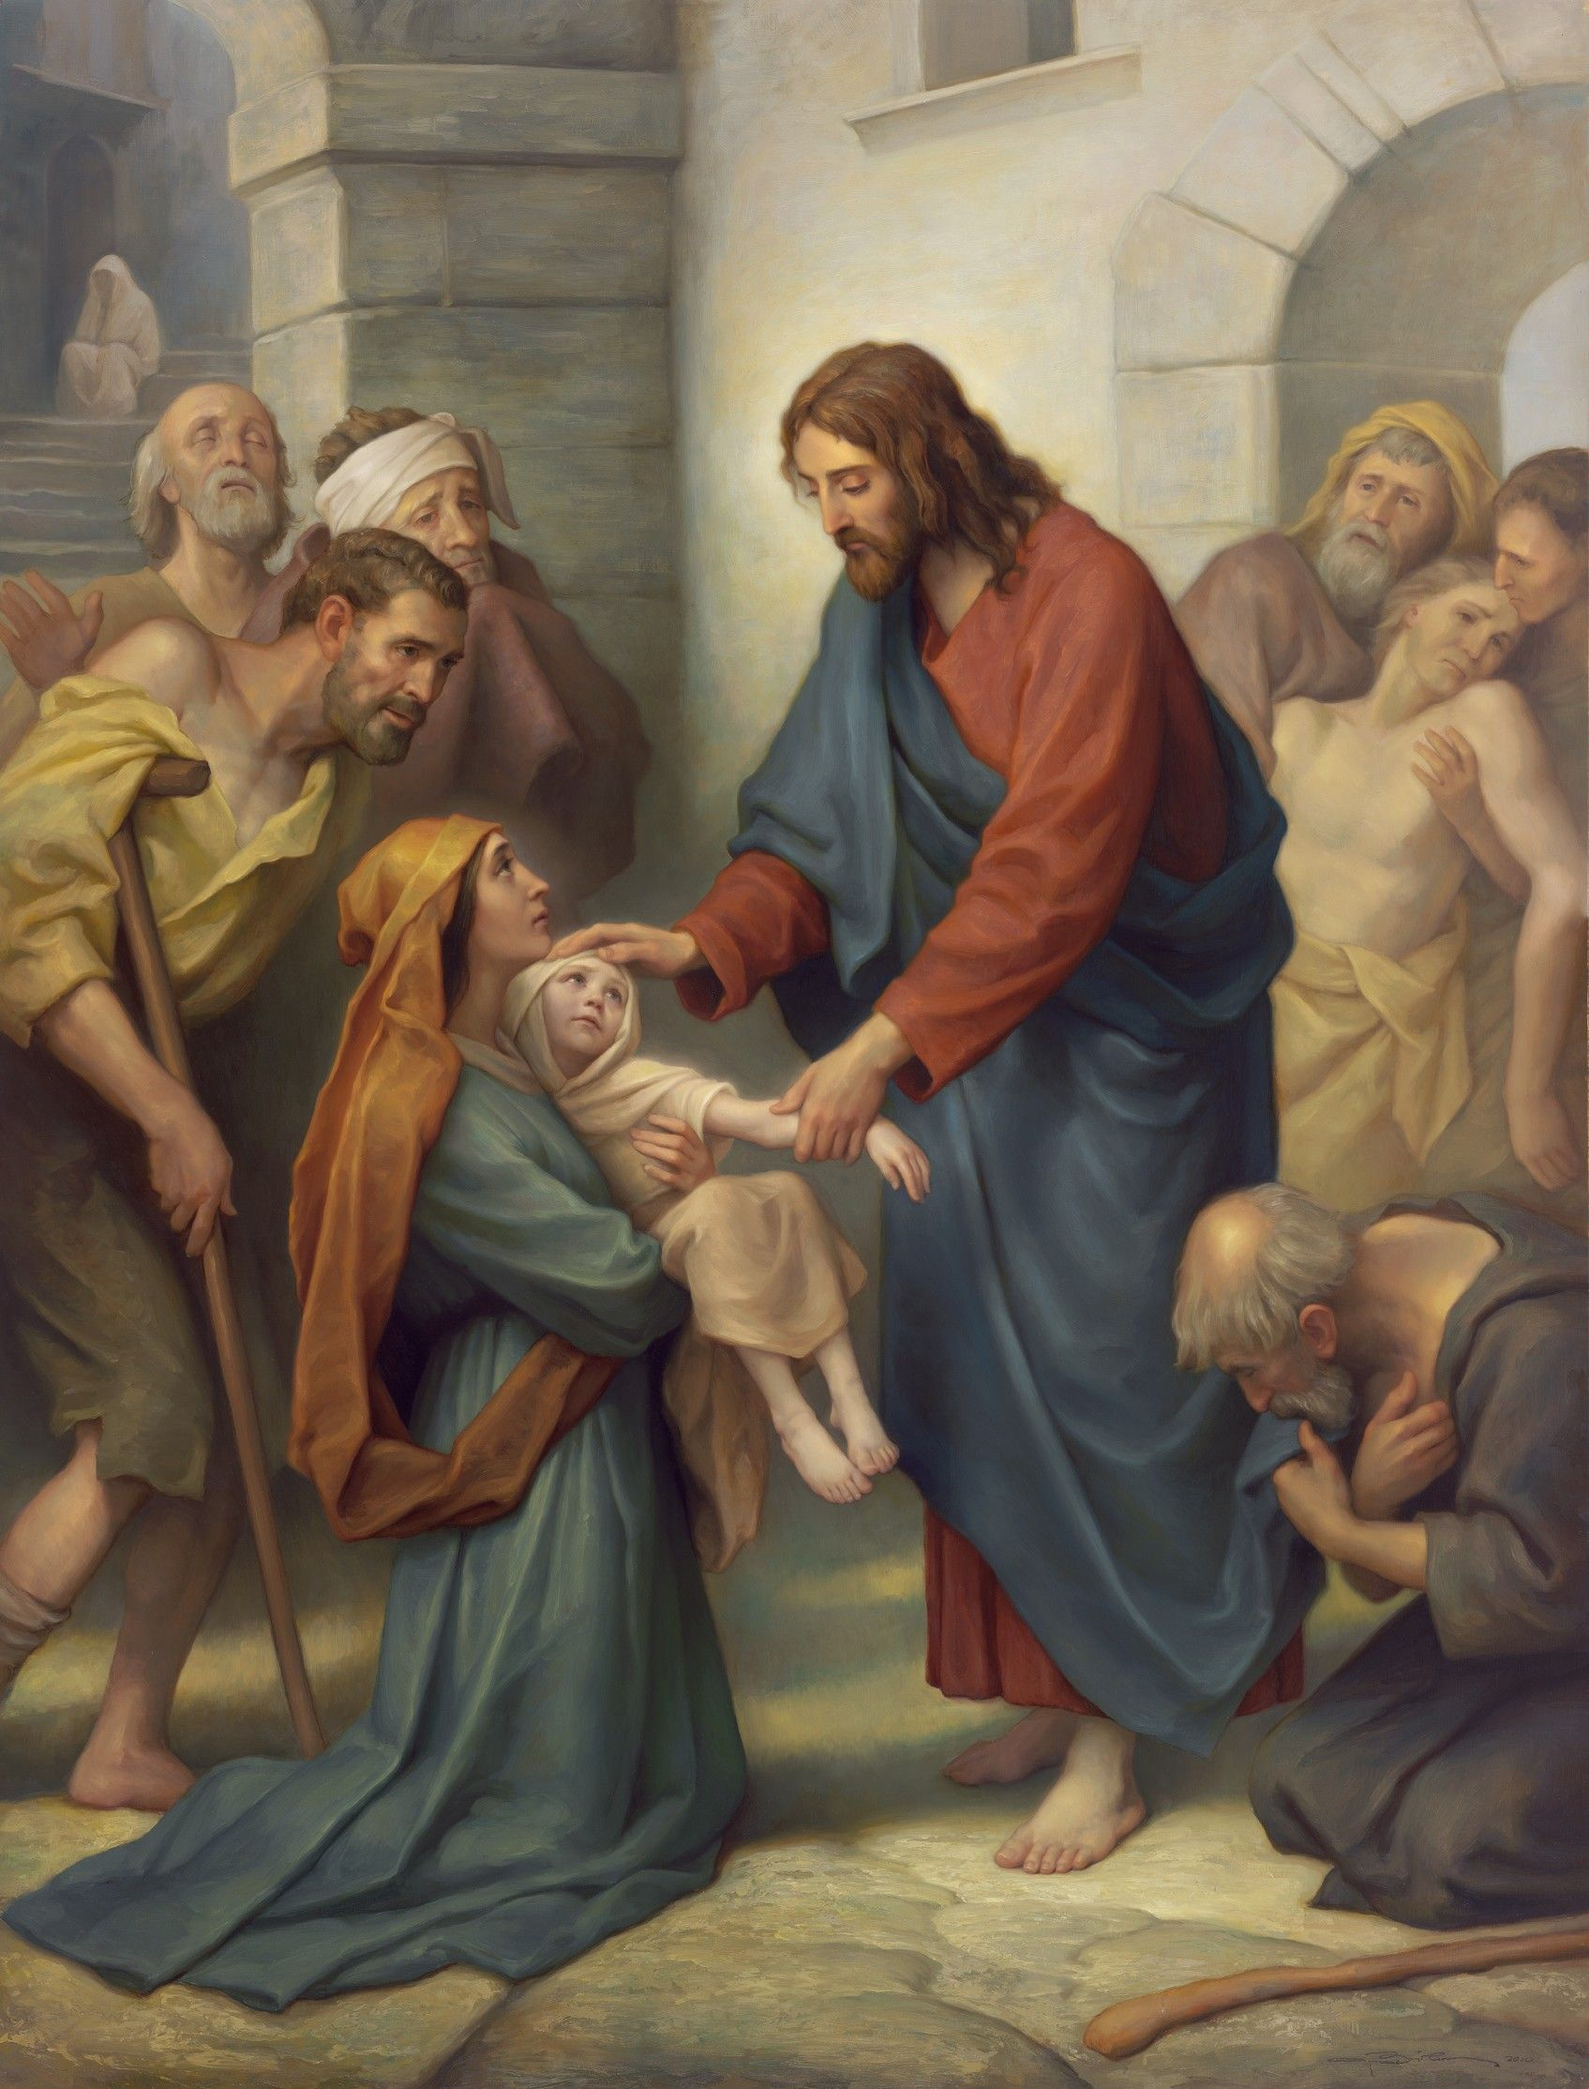
“He shall go forth, suffering pains and afflictions and temptations of every kind; and this that the word might be fulfilled which saith he will take upon him the pains and the sicknesses of his people” (Alma 7:11)
Joseph Brickey
Notes:
https://www.churchofjesuschrist.org/media/image/gila-valley-temple-art-lds-d1affae?lang=eng

Slide 9
The Human Emotions of Christ
“Jesus [was] moved with compassion”
(Mark 1:41).
“He…looked round about on them with anger, being grieved for the hardness of their hearts” (Mark 3:5).

Slide 10
The Human Emotions of Christ
“They brought young children to him, that he should touch them: and his disciples rebuked those that brought them. But when Jesus saw it, he was much displeased” (Mark 10:13–14).
“Jesus beholding him loved him” (Mark 10:21).
“My God, my God, why hast thou forsaken me” (Mark 15:34).

Slide 11
Five Key Themes in the Gospel of Mark
Highlights “Human” Aspects of Jesus
The Gospel, Kingdom and Servant Leadership

Slide 13
Remember our friend, the Blue Letter Bible?
The Greek word euangelion means “Good news”
Notes:
Response Paper #1 is due in 2 weeks—I hope you’re using the tools as you study the scriptural passages in preparation for each class.

Slide 14
“The euangelion”
A stone inscription dating to 9 B.C., found in the Roman Empire, referred to the birth the Caesar Augustus (who died in 14 BC), celebrating “The birthday of [Augustus, who has become God] has been for the whole world the beginning of the gospel (euangelion) concerning him.”
Notes:
See https://nickcady.org/2019/01/09/the-gospel-of-caesar-augustus-what-it-tells-us-about-the-gospel-of-jesus-christ/ for more insights on this idea.
Image in the public domain: https://commons.wikimedia.org/wiki/File:Priene_Calendar_Inscription_II,_32-60.png

Slide 15
“The euangelion”
Mark contrasts the idea of “good news” from a “god” such as Augustus with the “good news” of victory over Satan and death, brought about a real God (Jesus). The gospel is the good news that Jesus has come and he has conquered!
Notes:
See https://nickcady.org/2019/01/09/the-gospel-of-caesar-augustus-what-it-tells-us-about-the-gospel-of-jesus-christ/ for more insights on this idea.

Slide 16
“The Kingdom”
The first thing Jesus declares in Mark is that the kingdom of God is at hand.
What is this kingdom like, and what kind of king is Jesus?

Slide 17
Jesus: A Servant King
In Mark, Christ Predicts His Death Three Times
1st Prediction: 8:31
2nd Prediction: 9:31
3rd Prediction: 10:32-34
Each Time the Savior Teaches Servant Leadership
8:33-35
9:35-37
10:42-45
Each Time the Disciples Misunderstand
8:32
9:32-34
10:35-37, 41
Chart adapted from Mark Strauss, Four Portraits, One Jesus, 185

Slide 18
Mark 8:31–32, NRSV
“And [Jesus] began to teach them, that the Son of man must suffer many things, and be rejected of the elders, and of the chief priests, and scribes, and be killed, and after three days rise again. And he spake that saying openly.”

Slide 19
Mark 8:34–35, NRSV
“Whosoever will come after me, let him deny himself, and take up his cross, and follow me. For whosoever will save his life shall lose it; but whosoever shall lose his life for my sake and the gospel’s, the same shall save it.”

Slide 20
Mark 9:31, NRSV
“For [Jesus] taught his disciples, and said unto them, The Son of man is delivered into the hands of men, and they shall kill him; and after that he is killed, he shall rise the third day.”

Slide 21
Mark 9:33–34, NRSV
Jesus asked his disciples, “‘What were you arguing about on the way?’ But they were silent, for on the way they had argued with one another who was the greatest.”

Slide 22
Mark 9:35–37, NRSV
“He sat down, called the twelve, and said to them, ‘Whoever wants to be first must be last of all and servant of all.’ Then he took a little child and put it among them; and taking it in his arms, he said to them, ‘Whoever welcomes one such child in my name welcomes me, and whoever welcomes me welcomes not me but the one who sent me.’”

Slide 23
Mark 10:32–34, NRSV
“[Jesus] took the twelve aside again and began to tell them what was to happen to him, saying, ‘See, we are going up to Jerusalem, and the Son of Man will be handed over to the chief priests and the scribes, and they will condemn him to death; then they will hand him over to the Gentiles; they will mock him, and spit upon him, and flog him, and kill him; and after three days he will rise again.’”

Slide 24
Mark 10:36–37, NRSV
“James and John, the sons of Zebedee, came forward to him and said to him, ‘Teacher, we want you to do for us whatever we ask of you.’”
“‘What is it you want me to do for you?’ And they said to him, ‘Grant us to sit, one at your right hand and one at your left, in your glory’”

Slide 25
Mark 10:36–37, NRSV
“James and John, the sons of Zebedee, came forward to him and said to him, ‘Teacher, we want you to do for us whatever we ask of you.’”
“‘What is it you want me to do for you?’ And they said to him, ‘Grant us to sit, one at your right hand and one at your left, in your glory’”

Slide 26
Mark 10:42–45, NRSV
“You know that among the Gentiles those whom they recognize as their rulers lord it over them, and their great ones are tyrants over them. But it is not so among you; but whoever wishes to become great among you must be your servant, and whoever wishes to be first among you must be [the] slave of all. For the Son of Man came not to be served but to serve, and to give his life a ransom for many.”

Slide 27
Mark 10:44–45, NRSV
“You must be [the] slave of all. For the Son of Man came not to be served but to serve, and to give his life a ransom for many.”

Slide 29
Clark Kelley Price
“Truly this man was the Son of God.”
(Mark 15:39)
Notes:
https://history.churchofjesuschrist.org/exhibit/iac-2015-tell-me-the-stories-of-jesus?lang=eng#mv70

Slide 30
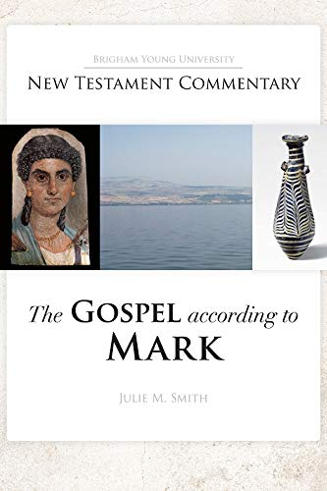

Slide 31
Julie Smith Gospel According to Mark
“Two thousand years of Christian tradition have probably made it impossible to appreciate how odd it was for a soldier to look at the corpse of a criminal and announce that the dead man was God’s Son. The parallel with the baptism, where the voice from heaven pronounces Jesus to be God’s Son, makes the centurion’s exclamation all the more profound because he is occupying the narrative role of God when he is the voice that attests to Jesus’ identity.

Slide 32
Julie Smith Gospel According to Mark
“Just as the rending of the heavens comes immediately before the divine announcement that Jesus is God’s son at the baptism, the rending of the temple veil comes immediately before the centurion’s announcement that Jesus is God’s son.”
Notes:
Gospel of Mark Commentary. Pause and reflect on this. Write down a thought or two. What does this mean for you and me today? Are there “hated pagan soldiers” about us that could be completely transformed because of the death of Jesus? Might that include you and me?

Slide 33
Julie Smith Gospel According to Mark
“Mark’s narrative teaches that the death of Jesus makes it possible for a centurion to do what God does. Even a hated pagan soldier can be elevated to a godlike status and possess a godlike knowledge because of the death of Jesus.”
Notes:
Gospel of Mark Commentary. Pause and reflect on this. Write down a thought or two. What does this mean for you and me today? Are there “hated pagan soldiers” about us that could be completely transformed because of the death of Jesus? Might that include you and me?

Slide 34
Five Key Themes in the Gospel of Mark
Highlights “Human” Aspects of Jesus
The Gospel, Kingdom and Servant Leadership
“The Son of God”
The Messianic Secret

Slide 35
1:34
1:44
3:11-12
5:43
7:36
8:26
8:29-30
9:9
Notes:
https://www.stockvault.net/photo/253533/man-telling-a-secret-silhouette
**Note – this is an observation of a phenomenon – there are challenges with it and we need to be cautious not to overstake the case. There are only 3 examples where Mark mentions the secret, where Matthew doesn’t, and two of those are miracles that only Mark includes. The best example (not included by Matthew) is the healing of the daughter of Jairus. But there is one occasion (5:19) where Mark has the person being healed to go out and tell others.

Slide 36
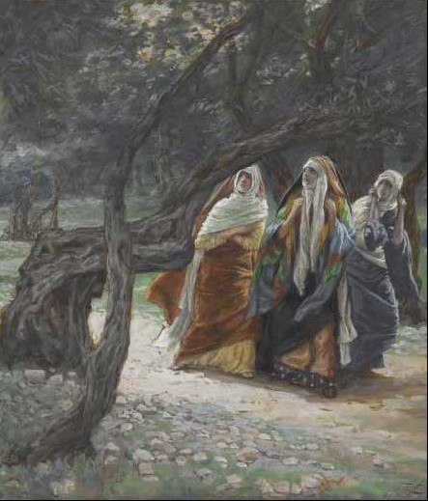
The Ending of Mark and The Messianic Secret
When the sabbath was over, Mary Magdalene, and Mary the mother of James, and Salome bought spices, so that they might go and anoint him. And very early on the first day of the week, when the sun had risen, they went to the tomb. They had been saying to one another, “Who will roll away the stone for us from the entrance to the tomb?”
James Tissot
Mark 16:1-8, NRSV
Notes:
Stop and read Mark 16:1-8
Image: https://thenoontimes.com/2017/04/25/john-2011-18-turning-again/

Slide 37
The Ending of Mark and The Messianic Secret
When they looked up, they saw that the stone, which was very large, had already been rolled back. As they entered the tomb, they saw a young man, dressed in a white robe, sitting on the right side; and they were alarmed. But he said to them, “Do not be alarmed; you are looking for Jesus of Nazareth, who was crucified.
James Tissot
Mark 16:1-8, NRSV
Notes:
Stop and read Mark 16:1-8
Image: https://thenoontimes.com/2017/04/25/john-2011-18-turning-again/

Slide 38
The Ending of Mark and The Messianic Secret
He has been raised; he is not here. Look, there is the place they laid him. But go, tell his disciples and Peter that he is going ahead of you to Galilee; there you will see him, just as he told you.” So they went out and fled from the tomb, for terror and amazement had seized them; and they said nothing to anyone, for they were afraid.
James Tissot
Mark 16:1-8, NRSV
Notes:
Stop and read Mark 16:1-8
Image: https://thenoontimes.com/2017/04/25/john-2011-18-turning-again/

Slide 39
Five Key Themes in the Gospel of Mark
Highlights “Human” Aspects of Jesus
The Gospel, Kingdom and Servant Leadership
“The Son of God”
The Messianic Secret
Discipleship Failure

Slide 40
Mark’s Theme of Discipleship Failure: An Example of a Benefit from a Synopsis Study
Mark 3:20–21—Mark only
Mark 4:13—Mark only
Mark 4:40–41—Matthew, Mark, Luke
Mark 6:51-52—Mark only (compare Matt. 14:33)
Mark 7:17—Mark and Matthew
Mark 8:4 —Mark and Matthew
Mark 8:17–18, 21—Mark and Matthew
Mark 8:31–33—Mark and Matthew
Mark 9:18—Matthew, Mark, Luke
Mark 9:30–32—Mark and Luke
Mark 9:34—Mark and Luke
Mark 9:38–39—Mark and Luke
Mark 10:35–38—Mark only (compare Matt. 20:20– 22)
Mark 14:37—Matthew, Mark and Luke
Mark 14:50—Mark and Matthew
Mark 14:72—Matthew, Mark and Luke
Mark 16:8—Mark only
Notes:
MARK 9:18
Compare Mark 6:51-52 with Matthew 14:33
Compare Mark 10:35-38 with Matthew 20:20
This is where you connect with Peter
Wayment: “The Second Gospel also presents a unique view of the disciples who struggle to understand Jesus. They are at times slow to comprehend, they argue among themselves, and they fail to heal a young boy. This feature….rhetorically encourages readers to see themselves as the struggling dicsciples who come to understand.
Julie Smith: Throughout the text, Mark carefully structures the message on discipleship: the twelve are shown to fail again and again. Jesus does not break faith with them, but rather continues to patiently teach them. At the end of the Gospel, the reference to Peter in Mark 16:7 continues this pattern: despite three outright denials that Peter even knew Jesus, it is assumed that Peter’s discipleship will continue. This would have been a very comforting message to Mark’s early audience, and perhaps to Mark himself. Jesus is patient with disciples, even when they make mistakes. And not minor mistakes—even when they fundamentally misunderstand his mission, betray him, deny him, and are afraid at the news of the Resurrection, he does not abandon them. They are continually invited to continue following him. https://www.byunewtestamentcommentary.com/a-major-theme-in-marks-gospel/
God calls the weak.

Slide 41
Mark 6:51-52, NRSV
“The wind ceased. And they were utterly astounded, for they did not understand about the loaves, but their hearts were hardened.”

Slide 42
Mark 6:51-52, NRSV
“The wind ceased. And they were utterly astounded, for they did not understand about the loaves, but their hearts were hardened.”
“Those in the boat worshiped him, saying, ‘Truly you are the Son of God.’”
Matthew 14:33, NRSV

Slide 43
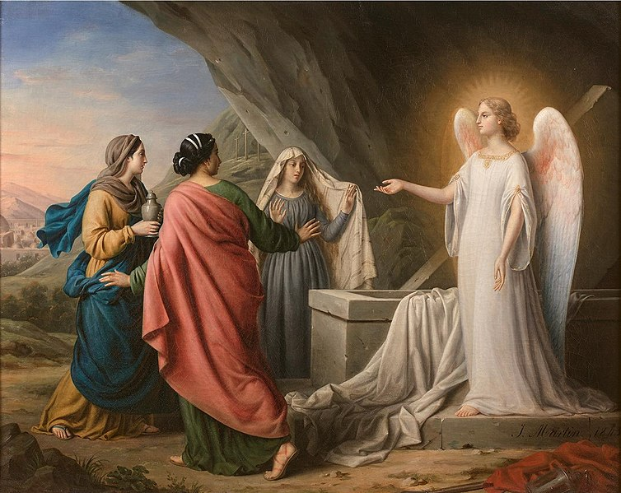
How does Jesus respond to disciples who stumble?
“But go your way, tell his disciples and Peter that he goeth before you into Galilee” (Mark 16:7)
Notes:
https://commons.wikimedia.org/wiki/File:Irma_Martin_-_The_three_women_on_the_tomb_of_Christ.jpg

Slide 44
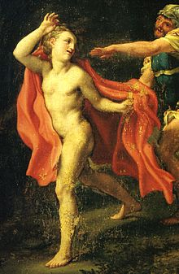
Mark’s Theme of Discipleship Failure: A Unique Figure to Mark
“A certain young man was following [Jesus], wearing nothing but a linen cloth. They caught hold of him, but he left the linen cloth and ran off naked.”
Mark 14:51-52, NRSV
Antonio Allegri da Correggio
Notes:
Remember—here we aren’t trying to harmonize different Gospel accounts, just looking at the message Mark was portraying to his readers.
Image 1: https://en.wikipedia.org/wiki/Saint_John_Fleeing_Christ%27s_Arrest
Image 2: http://www.kcarmenianchurch.com/home/news/weeklypostsfromdiocese-4

Slide 45
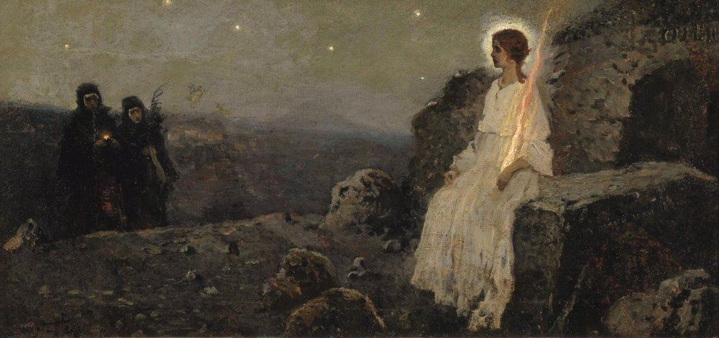
Mark’s Theme of Discipleship Failure: A Unique Figure to Mark
Mikhail Vasilyevich Nesterov
“As they entered the tomb, they saw a young man, dressed in a white robe.” (Mark 16:5, NRSV)
Antonio Allegri da Correggio
Notes:
Remember—here we aren’t trying to harmonize different Gospel accounts, just looking at the message Mark was portraying to his readers.
Image 1: https://en.wikipedia.org/wiki/Saint_John_Fleeing_Christ%27s_Arrest
Image 2: http://www.kcarmenianchurch.com/home/news/weeklypostsfromdiocese-4

Slide 46
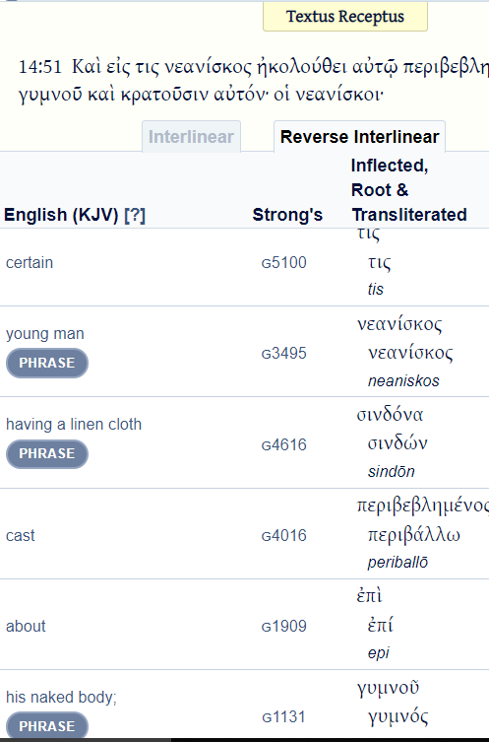
Remember our friend, the Blue Letter Bible?
In Mark, only appears in Mark 14:51 and 16:5
In Mark, only appears in Mark 14:51-52 and Mark 15:46.*
*In the entire New Testament, only appears in Mark 14:51-52 and accounts of Christ’s Burial (Mark 15:46, Matt. 27:59, Luke 23:53).

Slide 47
Julie Smith Gospel According to Mark
“The young man in Gethsemane was dressed in a linen cloth (using the same Greek word as is used to describe Jesus’ burial shroud…), and he runs away—sans clothing—when the authorities attempt to arrest him. . .The young man is presented as a close follower—at least before he flees. That is a picture of shame: the cloth suggests that he showed up with the intent of dying with Jesus but, under pressure, preferred the humiliation of running away naked to the pain of death.
Notes:
Gospel of Mark Commentary

Slide 48
Julie Smith Gospel According to Mark
“Jesus is crucified without clothing, just as the young man runs away without clothing, implying that Jesus is symbolically taking the young man’s shame upon himself. When the young man reappears at the tomb, he is now wearing clothing associated with honor and glory—clothing described as being like Jesus’ clothing at the Transfiguration [In Mark, the Greek word used to describe the young man’s clothing only appears in Mark 9:3 and Mark 16:5].”
Notes:
Gospel of Mark Commentary

Slide 49
Julie Smith Gospel According to Mark
“In other words, he has not only been restored from shame but is now assuming an even more honorable position. In effect, Jesus has swapped roles with this young man and thus made the young man’s restoration and glorification possible. The subtle but clear implication is that Jesus’ death and Resurrection have made this change possible for the young man.”
Notes:
What does this mean for your in your life? Take a moment and write down a short reflection.

Slide 50
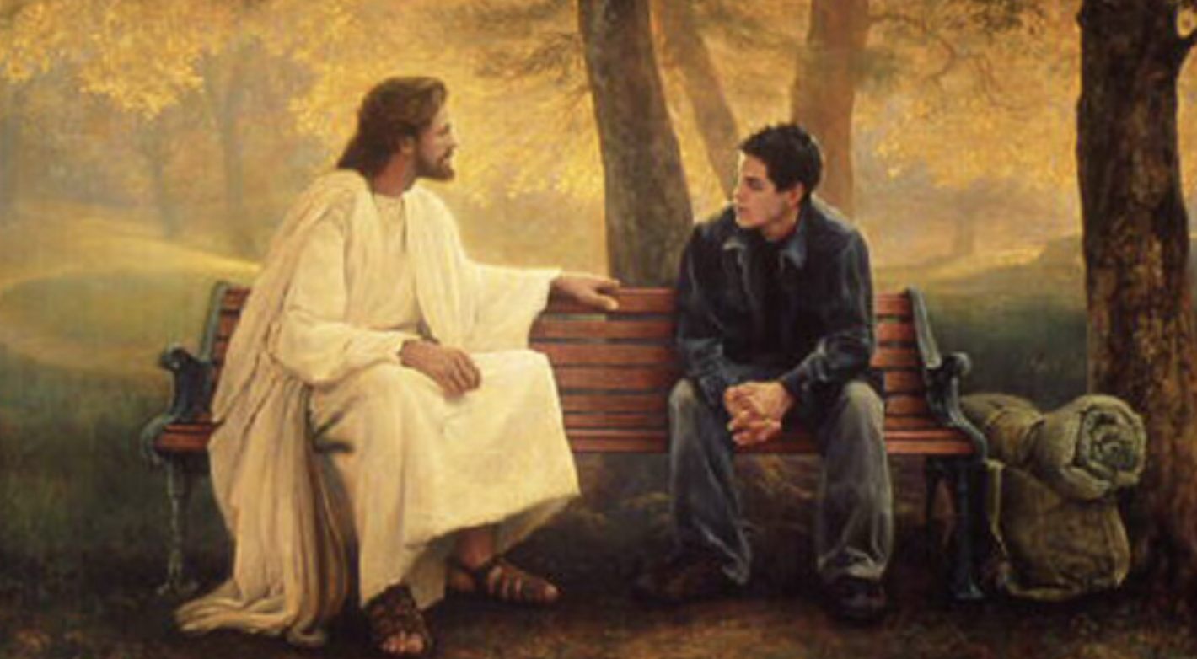
Even When We Stumble, Christ Still Wants Us On His Team
Greg Olson
What Does This Mean For You?
Notes:
Image: https://latterdaysaintmag.com/witnessing-christ-personal-accounts-of-teenagers-beholding-the-savior/

Slide 51
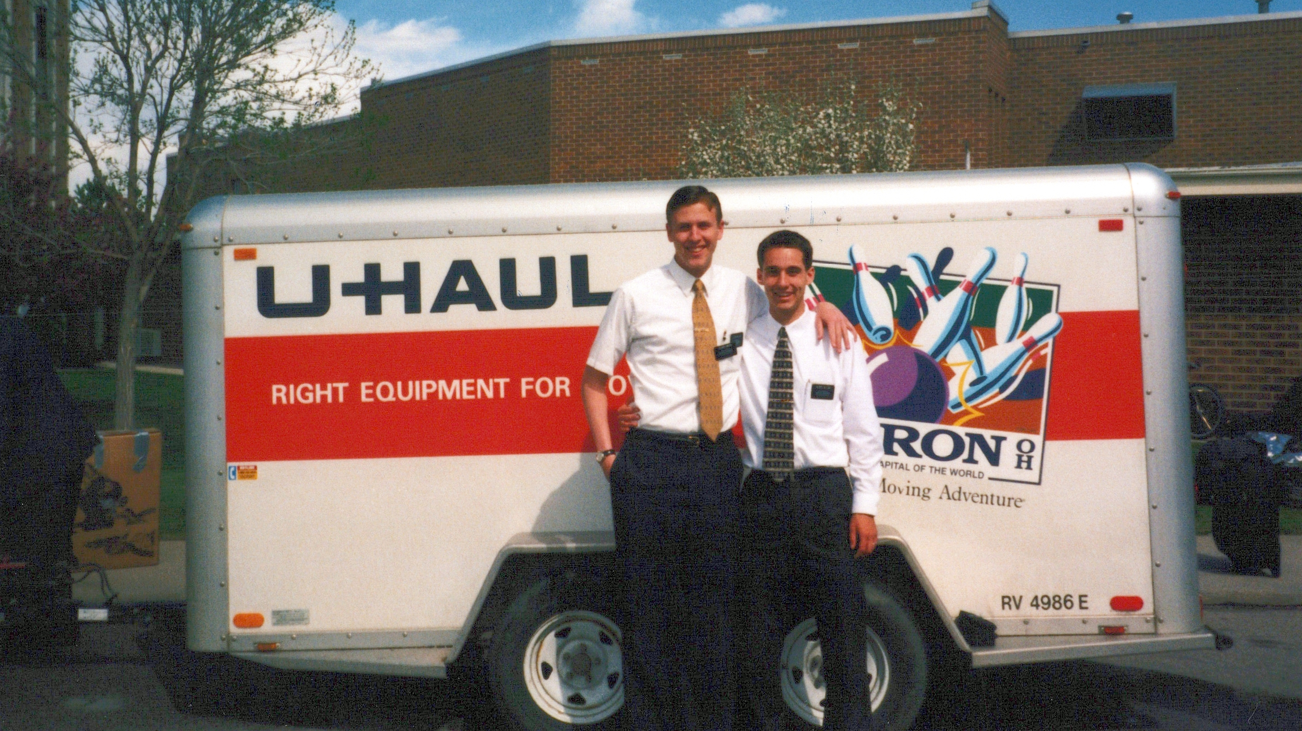

Slide 52
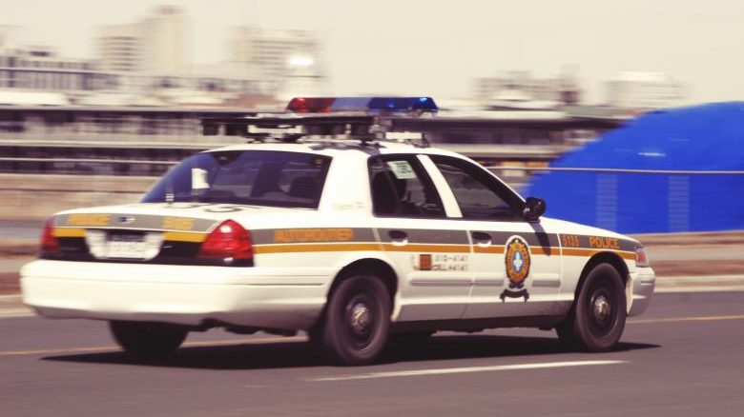

Slide 53
Acknowledgements
Insights from, discussions with, and resources authored by Julie M. Smith, Dr. Mark Strauss, Dr. Matthew Grey, Dr. Frank Judd, Dr. Jason Combs, Dr. Gaye Strathearn, and Dr. Josh Sears were used in the creation of this video. Thanks too to Elder Messervy and Elder Miller for putting up with me as a missionary. I love you guys! ☺

