Slide 1
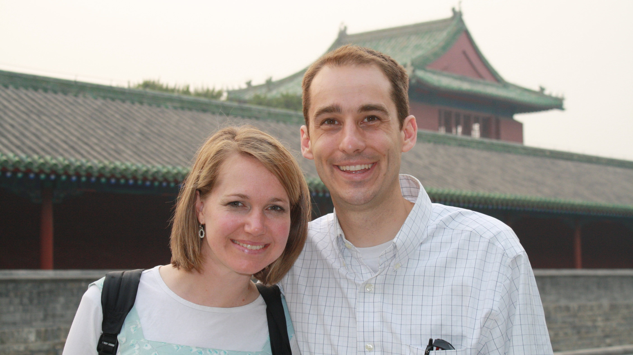

Slide 2
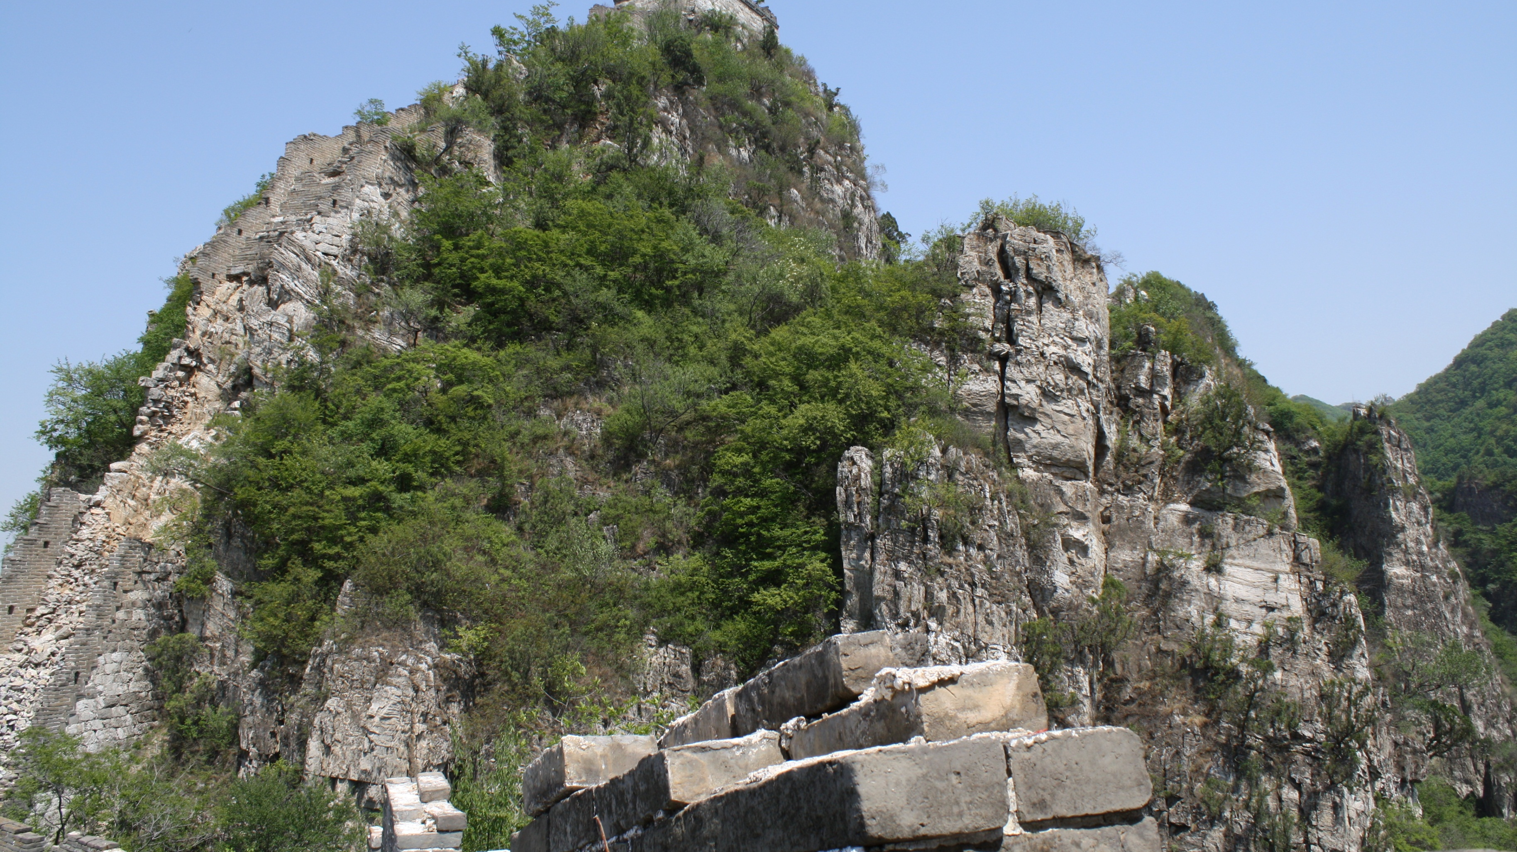

Slide 4
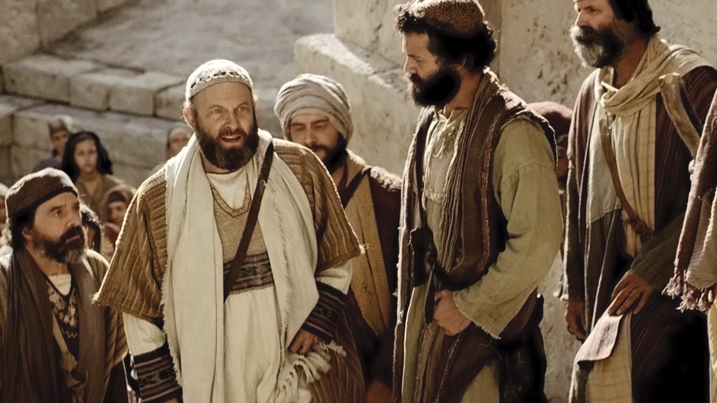
“These that have turned the world
upside down are come hither also.”
Acts 17:6
Notes:
https://assets.churchofjesuschrist.org/7b/d2/7bd23e6de3d970ef48150c70c52906ec4263f9201050225/paul_writing_to_ephesians.jpeg

Slide 5
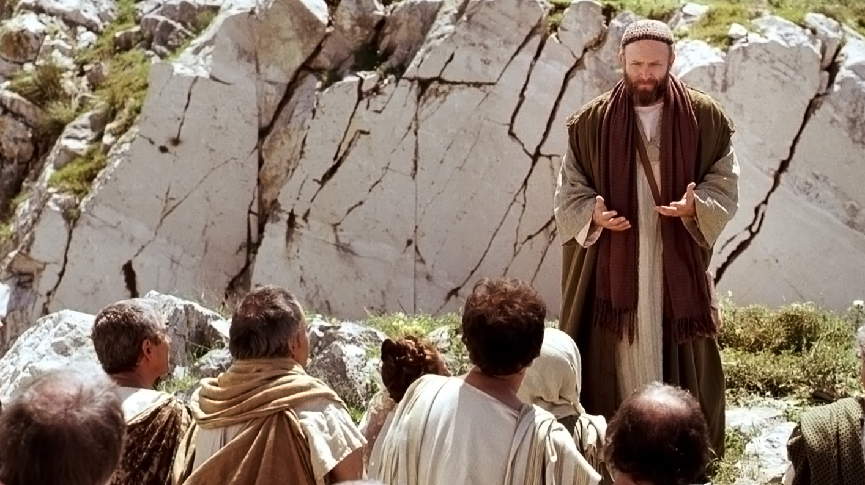
“Received the word
with all readiness of
mind, and searched
the scriptures daily.”
Acts 17:11
Notes:
https://assets.churchofjesuschrist.org/63/6b/636ba6174ac26a11b3bc2c8f3f6840f3e637c8f61073613/paul_preaching_on_mars_hill.jpeg

Slide 6
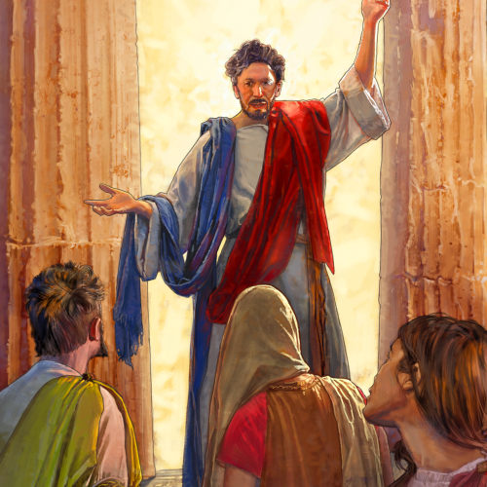
“‘Have ye received the
Holy Ghost since ye
believed?’ And they
said unto him, ‘We
have not so much as
heard whether there
be any Holy Ghost.’
And [Paul] said unto
them, ‘Unto what then
were ye baptized?’
And they said, ‘Unto
John’s baptism.’
Notes:
https://assets.churchofjesuschrist.org/30/4a/304ae8a7c49e5b094c39be05b5388f9b9e272f9b/paul_ephesus_missions.png

Slide 7
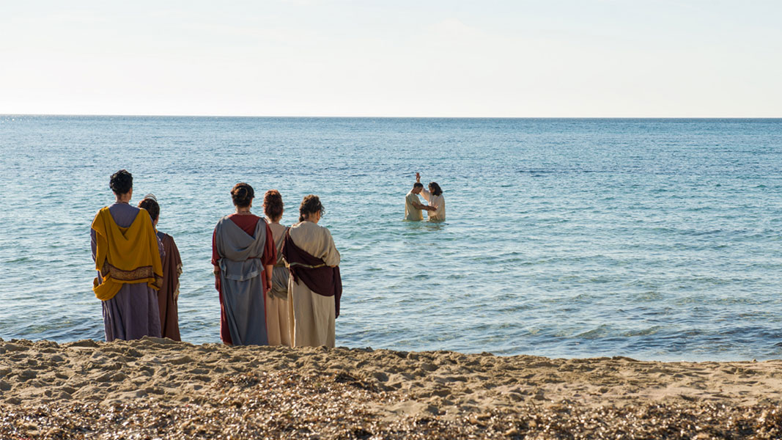
“Then said Paul,
‘John verily
baptized with
the baptism of
repentance,
saying unto the
people, that they
should believe on
him which should
come after him,
that is, on
Christ Jesus.’
Notes:
https://assets.churchofjesuschrist.org/df/26/df26cd9b6ed349ccdde9ab47f241c69e51cae238/peter_baptizes_cornelius_gentiles.jpeg

Slide 8
“When they heard
this, they were
baptized in the
name of the Lord
Jesus. And when
Paul had laid his
hands upon them,
the Holy Ghost
came on them; and
they spake with
tongues, and
prophesied.”
Acts 19:2-6
Notes:
https://assets.churchofjesuschrist.org/df/26/df26cd9b6ed349ccdde9ab47f241c69e51cae238/peter_baptizes_cornelius_gentiles.jpeg

Slide 9
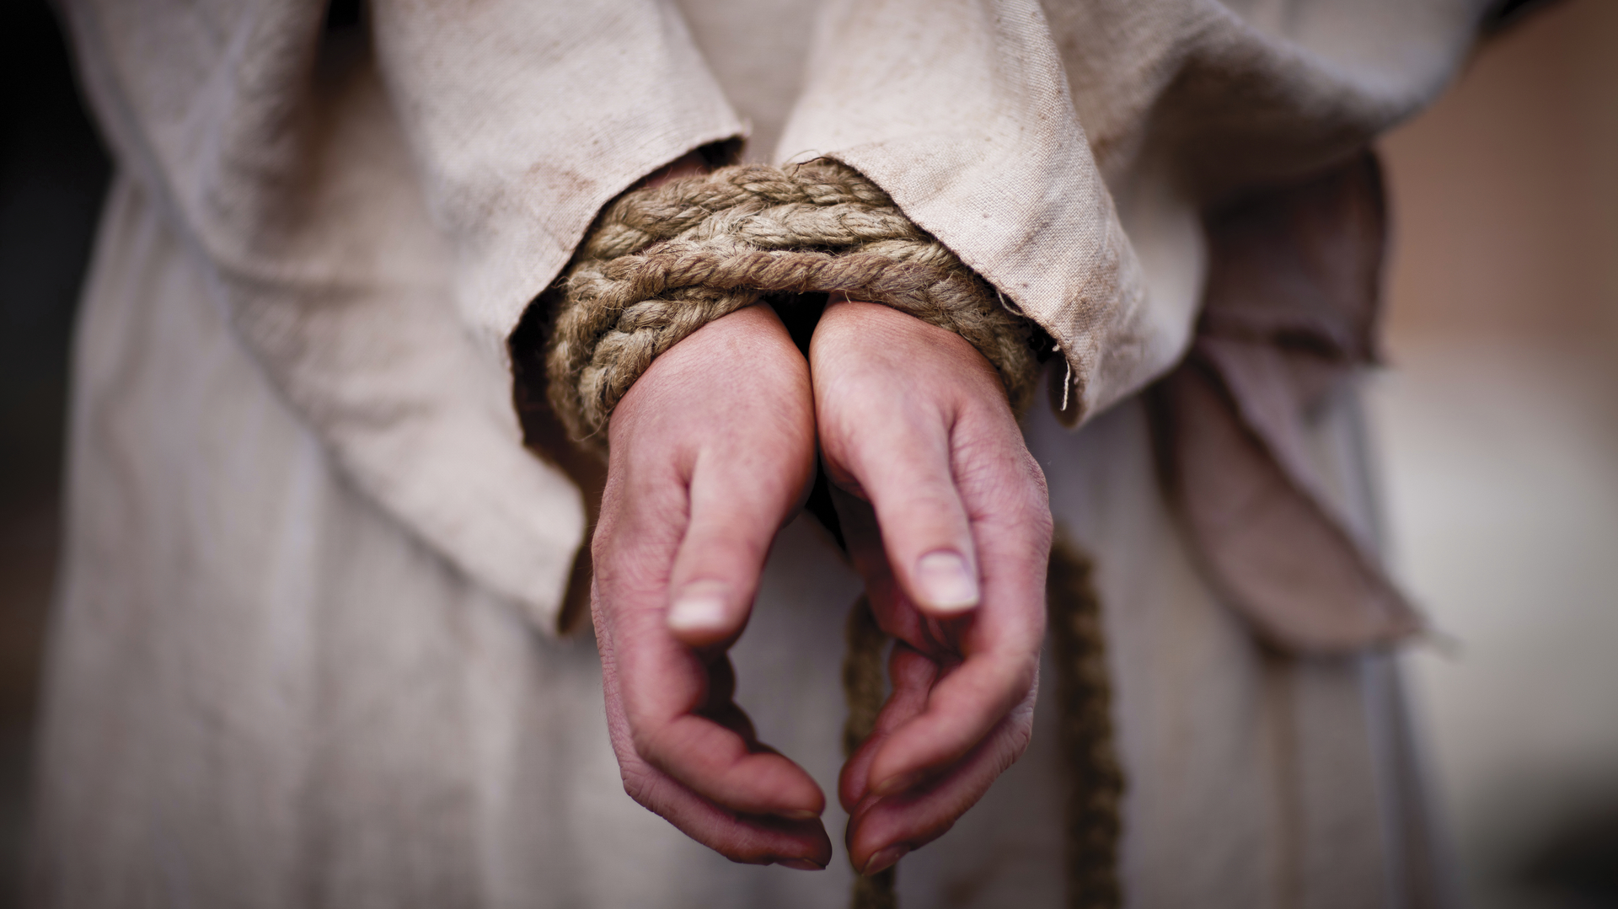
“While we were staying there for several days, a prophet
named Agabus came down from Judea. He came to us and
took Paul’s belt, bound his own feet and hands with it, and
said, “Thus says the Holy Spirit, ‘This is the way the Jews in
Jerusalem will bind the man who owns this belt and will
hand him over to the gentiles.’
Notes:
https://assets.churchofjesuschrist.org/6d/4c/6d4c1930d888660aef61ef4071a26689472e67d21047641/jesus_easter.jpeg

Slide 10
“When we heard this, we and the people there urged him not
to go up to Jerusalem. Then Paul answered, ‘What are you
doing, weeping and breaking my heart? For I am ready not
only to be bound but even to die in Jerusalem for the name
of the Lord Jesus.’ Since he would not be persuaded, we
remained silent except to say, ‘The Lord’s will be done.’”
Acts 21:10-14
Notes:
https://assets.churchofjesuschrist.org/6d/4c/6d4c1930d888660aef61ef4071a26689472e67d21047641/jesus_easter.jpeg

Slide 11
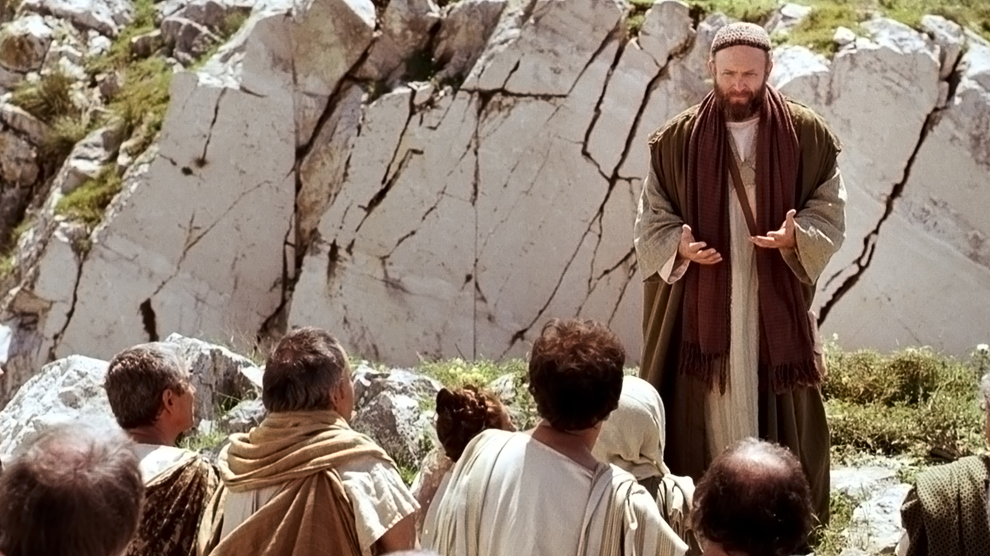
What do we really worship?
Powerful Female Disciples of
Christ
Burning Books (and Ships)
Feeding the Flock
Notes:
https://assets.churchofjesuschrist.org/63/6b/636ba6174ac26a11b3bc2c8f3f6840f3e637c8f61073613/paul_preaching_on_mars_hill.jpeg

Slide 12
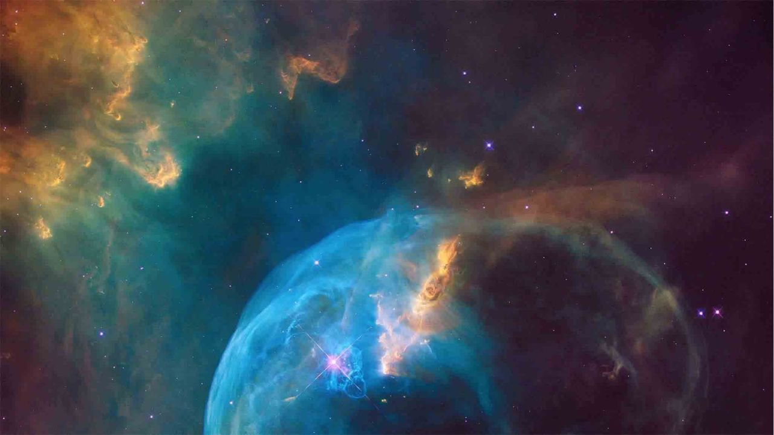
“What therefore you
worship as unknown,
this I proclaim to you.
The God who made the
world and everything in
it, he who is Lord of
heaven and earth, does
not live in shrines made
by human hands…
indeed he is not far from
each one of us.”
Acts 17:23-24, 27
Notes:
https://www.churchofjesuschrist.org/comeuntochrist/pxy/cdn/20/8f/208f4261224975409d5380a1bf0bc70d88aba6f8/bubble_nebula_space_creation.jpeg

Slide 13
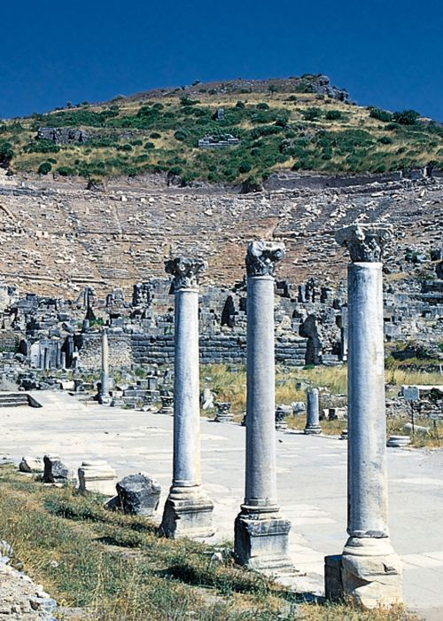
The people “were full of wrath, and cried out, saying, Great is Diana of the Ephesians.”
Acts 19:28
Notes:
https://assets.churchofjesuschrist.org/65/d9/65d9ffe36aae814e8f1f91ac722e56143a8439b8/ruins_ephesus.jpeg

Slide 14
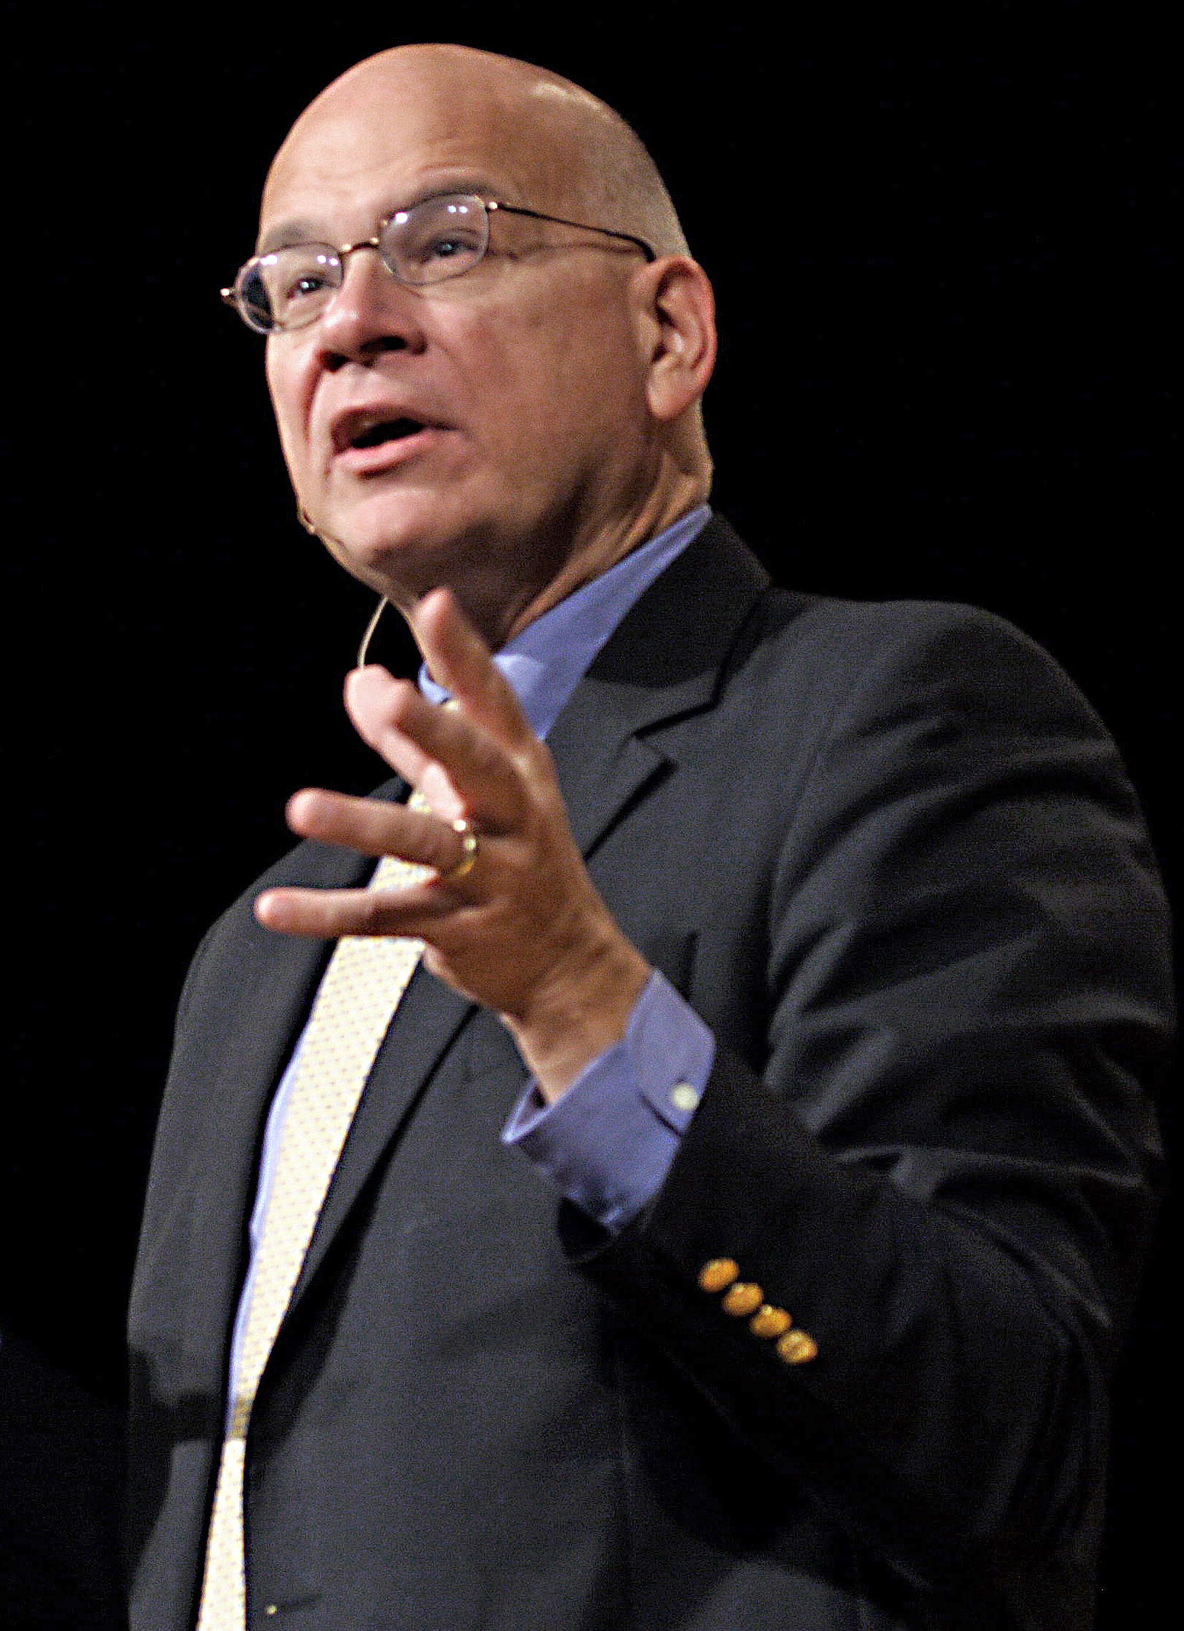
“We may not physically kneel before the
statue of Aphrodite, but many young
women today are driven into
depression and eating disorders by an
obsessive concern over their body
image. We may not actually burn
incense to Artemis, but when money
and career are raised to cosmic
proportions, we perform a kind of
child sacrifice, neglecting family and
community to achieve a higher place in
business and gain more wealth and
prestige.
Notes:
https://upload.wikimedia.org/wikipedia/commons/6/64/Timothy_Keller.jpg

Slide 15
“A counterfeit god is anything so central and essential to your life that, should you lose it, your life would feel hardly worth living….It can be family and children, or career and making money, or achievement…It can be a romantic relationship, peer approval, competence and skill, [or] secure and comfortable circumstances…An idol is whatever you look at and say, in your heart of hearts, ‘If I have that, then I’ll feel my life has meaning, then I’ll know I have value, then I’ll feel significant and secure.’”
Timothy Keller
Notes:
https://upload.wikimedia.org/wikipedia/commons/6/64/Timothy_Keller.jpg

Slide 16
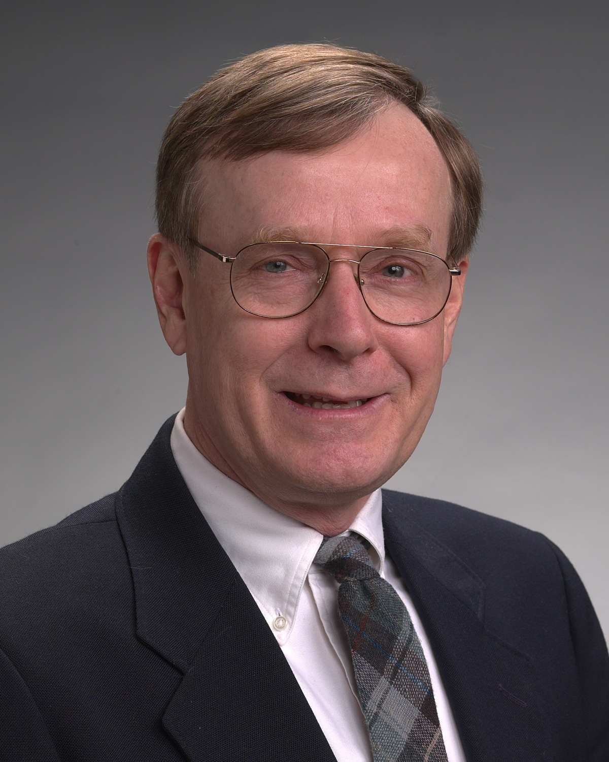
“Questions…bring some of people’s idol
systems to the surface. ‘To who or
what do you look for life-sustaining
stability, security and acceptance?
...What do you really want and expect
[out of life]? What would [really]
make you happy? What would make
you an acceptable person? Where do
you look for power and success?’
These questions or similar ones tease
out whether we serve God or idols,
whether we look for salvation from
Christ or from false saviors.”
David Powlison
Notes:
https://prpbooks.com/blog/wp-content/uploads/2014/06/Powlison_David.jpg

Slide 17
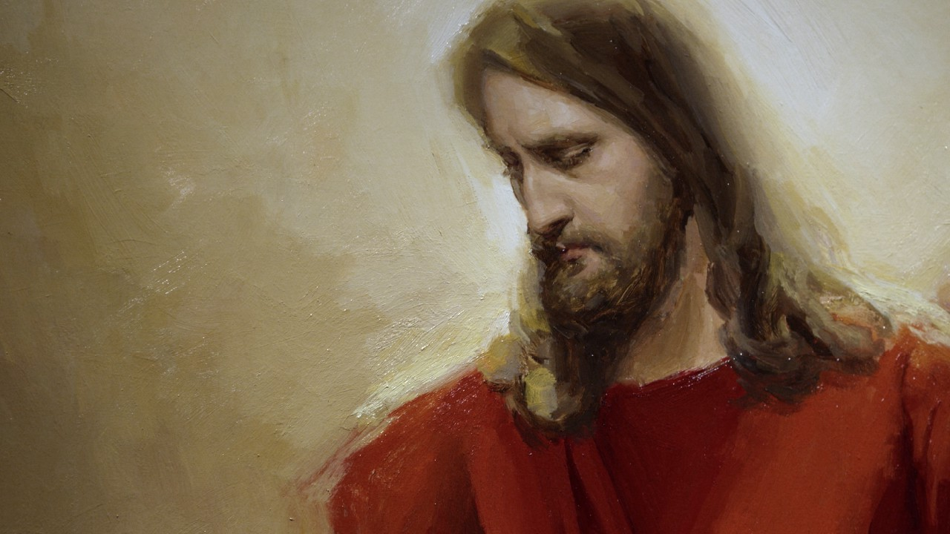
“Know the love of
Christ, which
passeth knowledge,
that ye might be
filled with all the
fulness of God.”
Ephesians 3:19
Notes:
https://assets.churchofjesuschrist.org/33/5b/335b1aa6e40a3a5fec0843a0e9f2fbaabbb0947d/335b1aa6e40a3a5fec0843a0e9f2fbaabbb0947d.jpeg

Slide 18
“If you have been raised with
Christ, seek the things that
are above, where Christ
is…not on the things that
are on earth, for you have
died, and your life is hidden
with Christ in God….Put to
death, therefore, whatever
in you is earthly: sexual
immorality, impurity,
passion, evil desire, and
greed (which is idolatry).”
Colossians 3:1-3, 5
Notes:
https://assets.churchofjesuschrist.org/33/5b/335b1aa6e40a3a5fec0843a0e9f2fbaabbb0947d/335b1aa6e40a3a5fec0843a0e9f2fbaabbb0947d.jpeg

Slide 19
How do you see idolatry applying in your life today?

Slide 20
What do we really worship?
Powerful Female Disciples of
Christ
Burning Books (and Ships)
Feeding the Flock
Notes:
https://assets.churchofjesuschrist.org/63/6b/636ba6174ac26a11b3bc2c8f3f6840f3e637c8f61073613/paul_preaching_on_mars_hill.jpeg

Slide 21
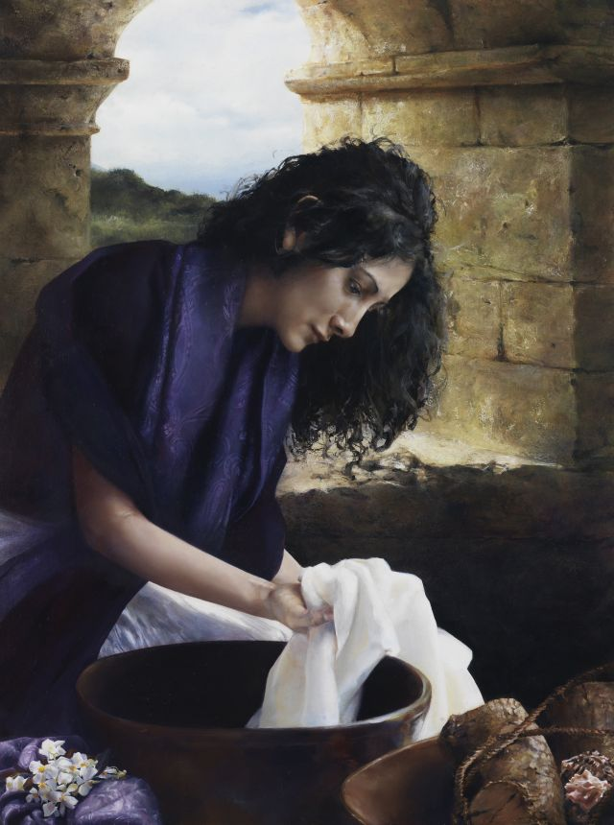
“On the sabbath day we went outside
the gate by the river, where we
supposed there was a place of prayer;
and we sat down and spoke to the
women who had gathered there.
A certain woman named Lydia, a
worshiper of God, was listening to us;
she was…a dealer in purple cloth.
The Lord opened her heart to listen
eagerly to what was said by Paul.
When she and her household were
baptized, she urged us, saying, ‘If you
have judged me to be faithful to the
Lord, come and stay at my home.’ And
she prevailed upon us.”
Acts 16:13-15
Elspeth Young
Notes:
https://assets.churchofjesuschrist.org/80/8c/808cbfd852c63fc081d7e260349910cf2e7b8609/new_testament_lydia_young.jpeg

Slide 22
“After Paul and Silas came
out of the prison, they
went to Lydia’s house,
where they met with the
brothers and sisters and
encouraged them. Then
they left.”
Acts 16:40
Elspeth Young
Notes:
https://assets.churchofjesuschrist.org/80/8c/808cbfd852c63fc081d7e260349910cf2e7b8609/new_testament_lydia_young.jpeg

Slide 23
“When Priscilla and Aquila heard
him, they took him aside and
explained the Way of God to
him more accurately.”
Acts 18:26

Slide 24
“Greet Prisca and Aquila, who work
with me in Christ Jesus, and who
risked their necks for my life, to
whom not only I give thanks, but
also all the churches of the Gentiles.”
Romans 16:3-4
“Greet…the church in their house.”
Romans 16:5

Slide 25
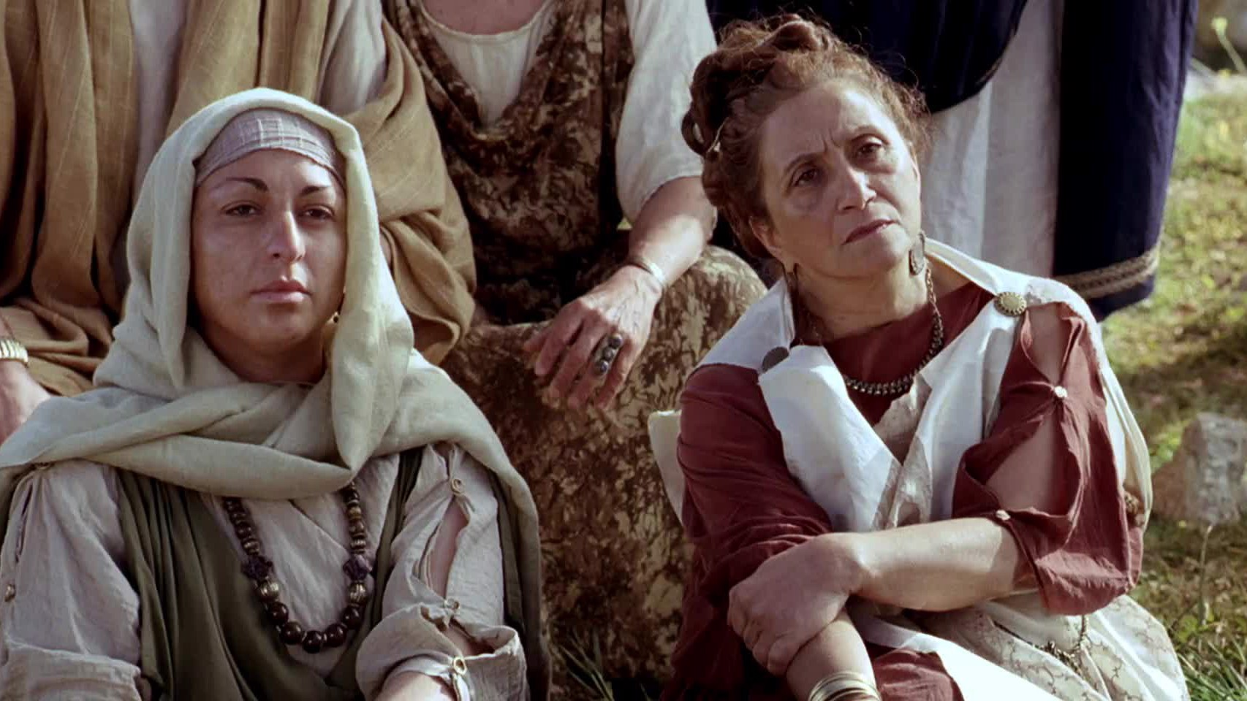
“Not a few of the leading women”
believed his words.
Many believed his testimony including
“not a few Greek women of high standing.”
Acts 17:4, 12
Notes:
https://assets.churchofjesuschrist.org/4a/ef/4aefc628db34d085a0c507d9fb88844949e67198/4aefc628db34d085a0c507d9fb88844949e67198.jpeg

Slide 26
“I call to remembrance the
unfeigned faith that is in thee,
which dwelt first in thy
grandmother Lois, and thy
mother Eunice.”
2 Timothy 1:5

Slide 27
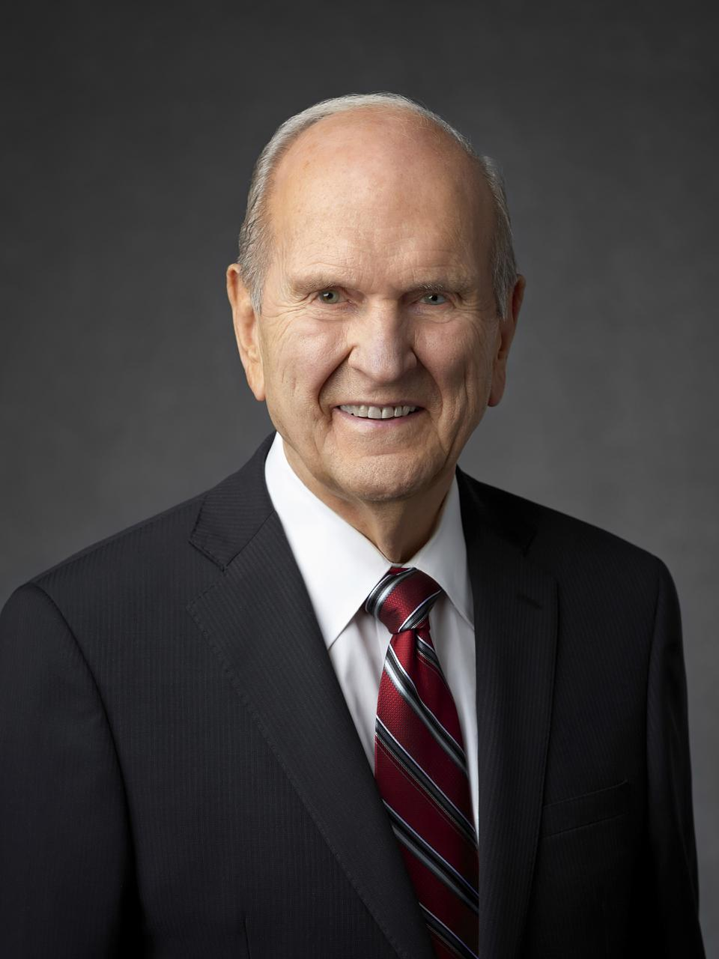
“We need women who know how to
make important things happen by their
faith (Tryphosa and Tryphena) and who
are courageous defenders of morality
and families in a sin-sick world (Mary of
Rome). We need women who are
devoted to shepherding God’s children
along the covenant path toward
exaltation (Lydia), women who know
how to receive personal revelation,
(Damaris)…
Notes:
https://newsroom.churchofjesuschrist.org/media/960x1280/President-Russell-M-Nelson-1-2018.jpg

Slide 28
“Women who know how to call upon the
powers of heaven to protect and
strengthen children and families (Lois and
Eunice); women who teach fearlessly
(Priscilla). Attacks against the Church, its
doctrine, and our way of life are going to
increase. Because of this, we need
women who have a bedrock
understanding of the doctrine of Christ
(the women converts in Berea and
Thessalonica) and help raise a sin-
resistant generation (Paul’s sister)…
Notes:
https://newsroom.churchofjesuschrist.org/media/960x1280/President-Russell-M-Nelson-1-2018.jpg

Slide 29
“We need women who can detect
deception in all of its forms (Julia and
Junia). We need women who know how
to access the power that God makes
available to covenant keepers (Euodia
and Syntyche) and who express their
beliefs with confidence and charity
(Claudia, Phebe, Chloe). We need women
who have the courage and vision of our
Mother Eve (Rufus’ mother and Persis).”
Notes:
https://newsroom.churchofjesuschrist.org/media/960x1280/President-Russell-M-Nelson-1-2018.jpg

Slide 30
Paul's sister | Helps Paul escape | Acts 23:16
Phebe | Helps many people, including Paul | Romans 16:1-2
Mary of Rome | Labored much | Romans 16:6

Slide 31
Tryphena, Tryphosa, and Persis | Worked very hard for the Lord | Romans 16:12
Mother of Rufus | Mother figure to Paul and others | Romans 16:13
Sister of Nerus, Julia, and Junia | Fellow saints to give greetings to | Romans 16:7, 15

Slide 32
Chloe | Offers her home and leadership | 1 Corinthians 1:11
Euodia and Syntyche | Labor at Paul’s side | Philippians 4:2-3
Claudia | Believer who sends her greetings to Timothy | 2 Timothy 4:21

Slide 33
What do we really worship?
Powerful Female Disciples of
Christ
Burning Books (and Ships)
Feeding the Flock
Notes:
https://assets.churchofjesuschrist.org/63/6b/636ba6174ac26a11b3bc2c8f3f6840f3e637c8f61073613/paul_preaching_on_mars_hill.jpeg

Slide 34
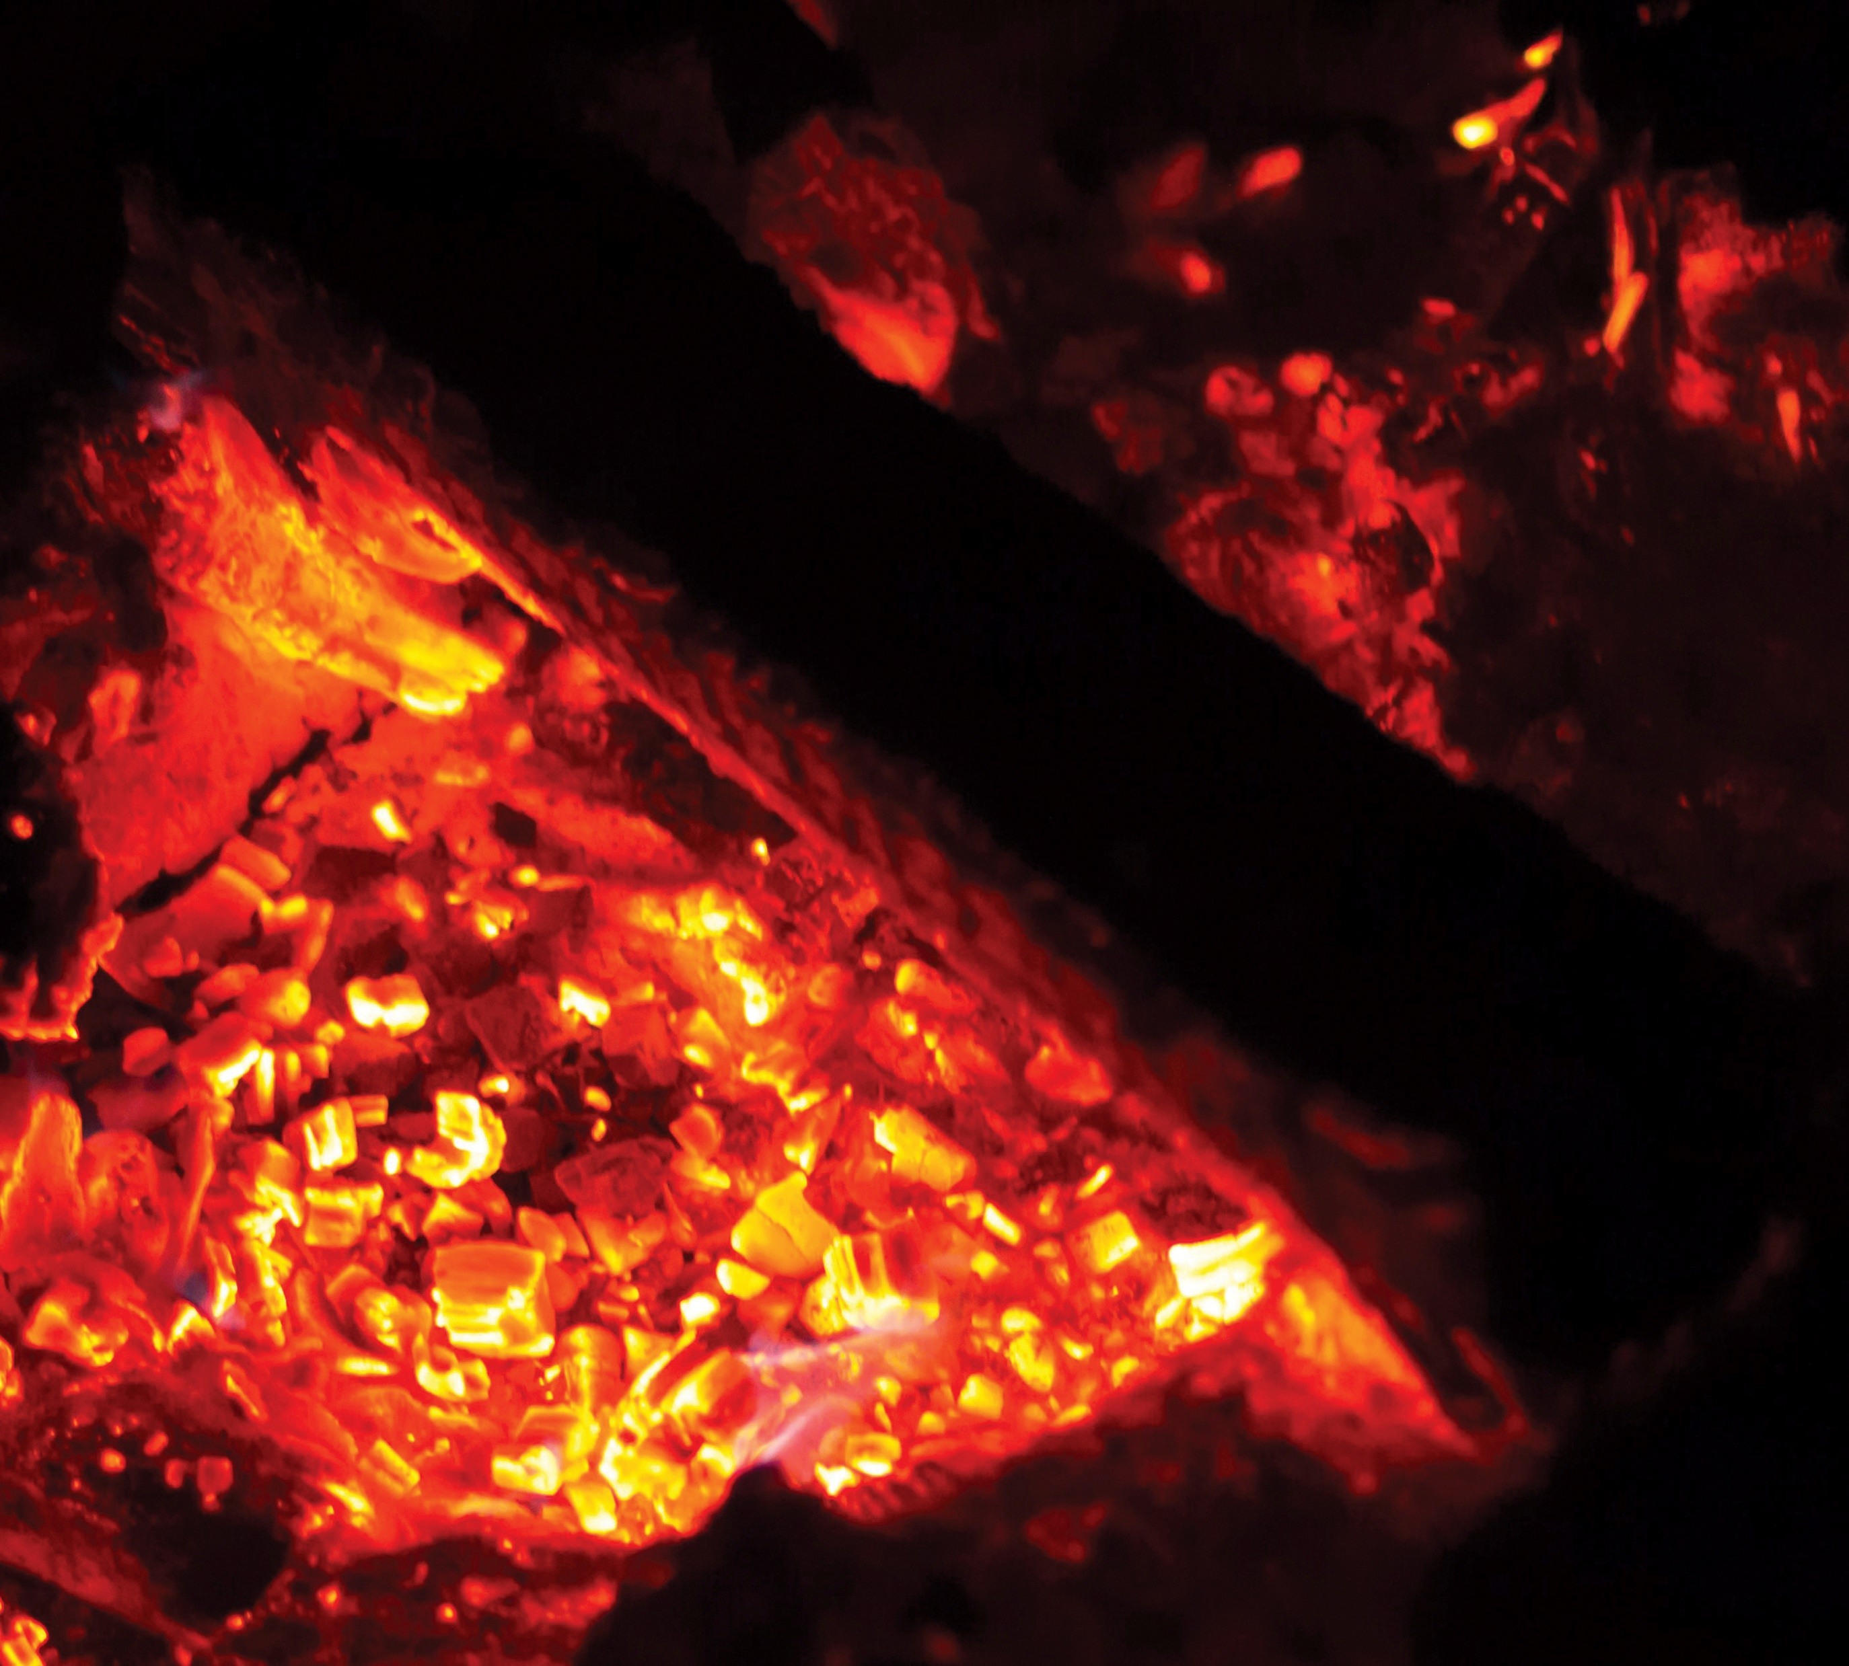
They “collected their books and burned them publicly; when the value of these books was calculated, it was found to come to fifty thousand silver coins. So the word of the Lord grew mightily and prevailed.”
Acts 19:19-20
Notes:
https://assets.churchofjesuschrist.org/36/35/363586f75a4d96be54ca7e9b845ef7f6b6abb3f91073890/glowing_embers.jpeg

Slide 35
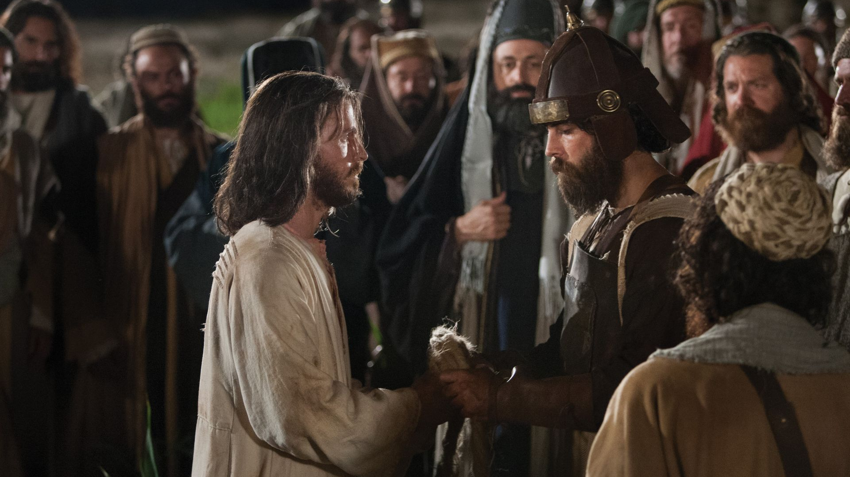
“Put up thy sword into
the sheath: the cup
which my Father hath
given me, shall I not
drink it?”
John 18:11
Notes:
https://assets.churchofjesuschrist.org/bd/1d/bd1df66d865380c9f6a0040d7fb92a9f0a9789be/bible_pictures_jesus_arrested.jpeg

Slide 36
What do we really worship?
Powerful Female Disciples of
Christ
Burning Books (and Ships)
Feeding the Flock
Notes:
https://assets.churchofjesuschrist.org/63/6b/636ba6174ac26a11b3bc2c8f3f6840f3e637c8f61073613/paul_preaching_on_mars_hill.jpeg

Slide 37
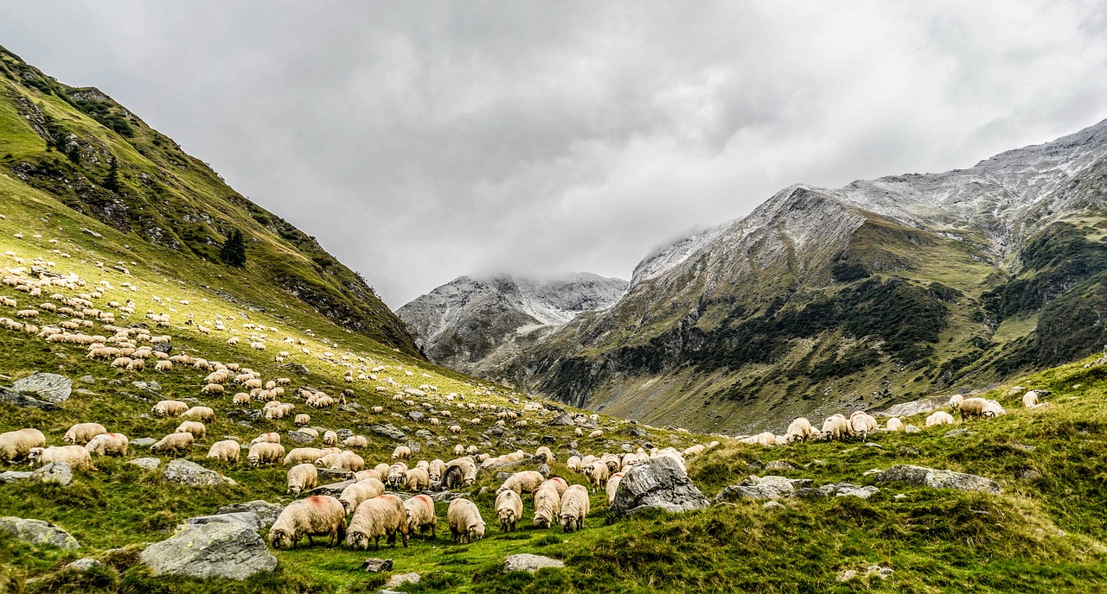
“Take heed therefore unto yourselves,
and to all the flock, over the which the
Holy Ghost hath made you overseers, to
feed the church of God, which he hath
purchased with his own blood.”
Acts 20:28
Pixabay
Notes:
https://pixabay.com/photos/animals-grazing-sheep-flock-herd-1868565/

