Slide 1
Notes:
https://pixabay.com/photos/dark-night-alley-street-lamp-post-2590544/

Slide 2
“Wo unto them that call evil good, and good evil, that put darkness for light, and light for darkness, that put bitter for sweet, and sweet for bitter!” 2 Nephi 15:20
Notes:
https://content.churchofjesuschrist.org/acp/bc/cp/Canada/images2019/Seeking%20the%20Illuminating%20Light%20of%20Christ/1200x675/1-banner-2154-keep-walking-mormon-channel.jpg

Slide 3
In your life, what examples have you seen of people calling evil good,
or good evil?
Notes:
https://content.churchofjesuschrist.org/acp/bc/cp/Canada/images2019/Seeking%20the%20Illuminating%20Light%20of%20Christ/1200x675/1-banner-2154-keep-walking-mormon-channel.jpg

Slide 4
“Manasseh, Ephraim; and Ephraim, Manasseh; they together shall be against Judah. For all this his anger is not turned away, but his hand is stretched out still.”
2 Nephi 19:21

Slide 5
True or False:
A principle from this verse is that no matter how bad things get, God’s hand is always stretched out.
“Manasseh, Ephraim; and Ephraim, Manasseh; they together shall be against Judah. For all this his anger is not turned away, but his hand is stretched out still.”
2 Nephi 19:21

Slide 6
True or False:
A principle from this verse is that no matter how bad things get, God’s hand is always stretched out.
“Manasseh, Ephraim; and Ephraim, Manasseh; they together shall be against Judah. For all this his anger is not turned away, but his hand is stretched out still.”
2 Nephi 19:21

Slide 7
“Therefore, is the anger of the Lord kindled against his people, and he hath stretched forth his hand against them, and hath smitten them; and the hills did tremble, and their carcasses were torn in the midst of the streets. For all this his anger is not turned away, but his hand is stretched out still.”
2 Nephi 15:25

Slide 8
2 Nephi 19:12, 17, 21; 20:4
“Therefore the Lord shall have no joy in their young men, neither shall have mercy on their fatherless and widows; for every one of them is a hypocrite and an evildoer, and every mouth speaketh folly. For all this his anger is not turned away, but his hand is stretched out still.”
2 Nephi 19:17

Slide 9
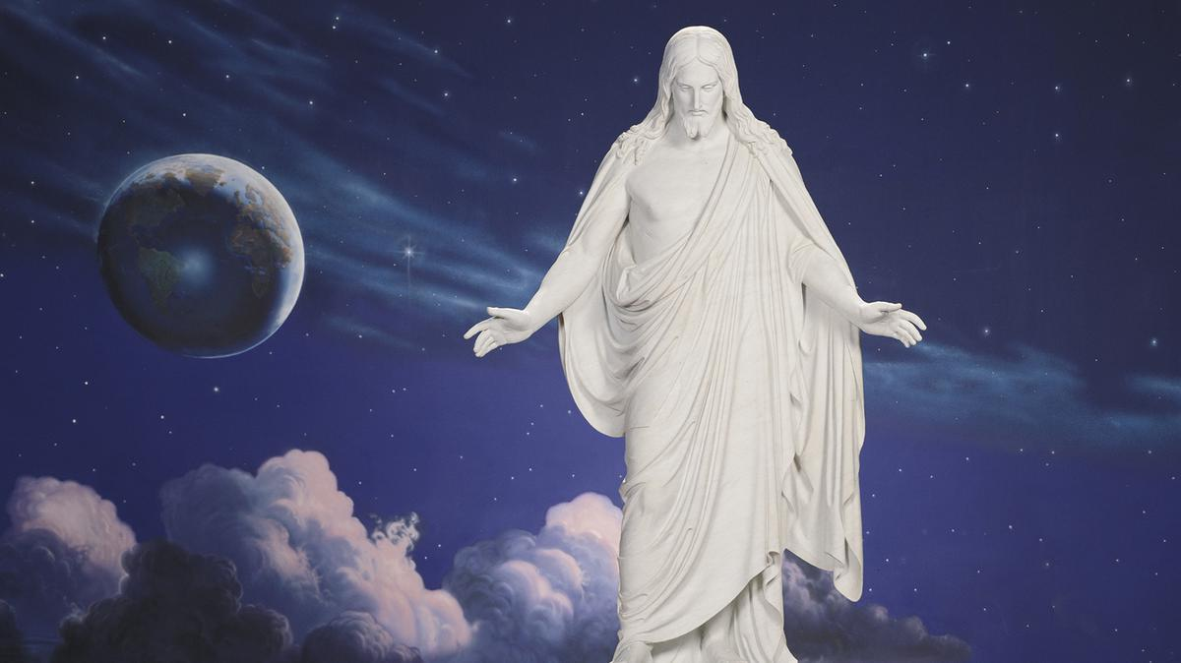
“I will be merciful unto them, saith the Lord God, if they will repent and come unto me; for mine arm is lengthened out all the day long, saith the Lord God of Hosts.”
2 Nephi 28:32
“How merciful is our God unto us, for he remembereth the house of Israel…and he stretches forth his hands unto them all the day long.”
Jacob 6:4
Notes:
https://content.churchofjesuschrist.org/acp/bc/cp/Canada/images2019/The%20Word%20of%20God%20Grew%20and%20Multiplied/1200x675/1-banner-christus-statue.jpg

Slide 10
This is a Judgment of God against ?
“The Lord sent his word unto Jacob and it hath lighted upon Israel. And all the people shall know, even Ephraim and the inhabitants of Samaria, that say in the pride and stoutness of heart: The bricks are fallen down, but we will build with hewn stones; the sycamores are cut down, but we will change them into cedars. Therefore the Lord shall set up the adversaries of Rezin against him, and join his enemies together; the Syrians before and the Philistines behind; and they shall devour Israel with open mouth. For all this his anger is not turned away, but his hand is stretched out still.”
2 Nephi 19:8–12

Slide 11
So we’ve seen judgments of God against Israel and Judah, what other nations receive God’s judgment?

Slide 12
“O Assyrian, the rod of mine anger, and the staff in their hand is their indignation. I will send him against a hypocritical nation, and against the people of my wrath will I give him a charge to take the spoil, and to take the prey, and to tread them down like the mire of the streets. Howbeit he meaneth not so, neither doth his heart think so; but in his heart it is to destroy and cut off nations not a few. For he saith: [“]Are not my princes altogether kings? Is not Calno as Carchemish? Is not Hamath as Arpad? Is not Samaria as Damascus? As my hand hath founded the kingdoms of the idols, and whose graven images did excel them of Jerusalem and of Samaria; Shall I not, as I have done unto Samaria and her idols, so do to Jerusalem and to her idols?[”]”
Notes:
If time see also 2 Nephi 19:9-16 – clear example of judgments of God against Israel

Slide 13
“When the Lord hath performed his whole work upon Mount Zion and upon Jerusalem, I will punish the fruit of the stout heart of the king of Assyria, and the glory of his high looks. For he saith: [“]By the strength of my hand and by my wisdom I have done these things; for I am prudent; and I have moved the borders of the people, and have robbed their treasures, and I have put down the inhabitants like a valiant man; And my hand hath found as a nest the riches of the people; and as one gathereth eggs that are left have I gathered all the earth; and there was none that moved the wing, or opened the mouth, or peeped.[”] Shall the ax boast itself against him that heweth therewith? Shall the saw magnify itself against him that shaketh it? As if the rod should shake itself against them that lift it up, or as if the staff should lift up itself as if it were no wood!
(2 Nephi 20:5–15)
Notes:
If time see also 2 Nephi 19:9-16 – clear example of judgments of God against Israel

Slide 14
“The burden of Babylon, which Isaiah the son of Amoz did see…Every one that is proud shall be thrust through; yea, and every one that is joined to the wicked shall fall by the sword. Their children also shall be dashed to pieces before their eyes; their houses shall be spoiled and their wives ravished. Behold, I will stir up the Medes against them, which shall not regard silver and gold, nor shall they delight in it…And Babylon, the glory of kingdoms, the beauty of the Chaldees’ excellency, shall be as when God overthrew Sodom and Gomorrah.”
Notes:
If time see also 2 Nephi 19:9-16 – clear example of judgments of God against Israel

Slide 15
“It shall never be inhabited, neither shall it be dwelt in from generation to generation: neither shall the Arabian pitch tent there; neither shall the shepherds make their fold there. But wild beasts of the desert shall lie there; and their houses shall be full of doleful creatures; and owls shall dwell there, and satyrs shall dance there. And the wild beasts of the islands shall cry in their desolate houses, and dragons in their pleasant palaces; and her time is near to come, and her day shall not be prolonged. For I will destroy her speedily; yea, for I will be merciful unto my people, but the wicked shall perish.”
(2 Nephi 23:15–22)
Notes:
If time see also 2 Nephi 19:9-16 – clear example of judgments of God against Israel

Slide 16
“And the Gentiles are lifted up in pride”
2 Nephi 26:20
“They have all gone out of the way…because
of pride”
2 Nephi 28:13–14
“In their pride they are puffed up”
2 Nephi 28:13

Slide 17
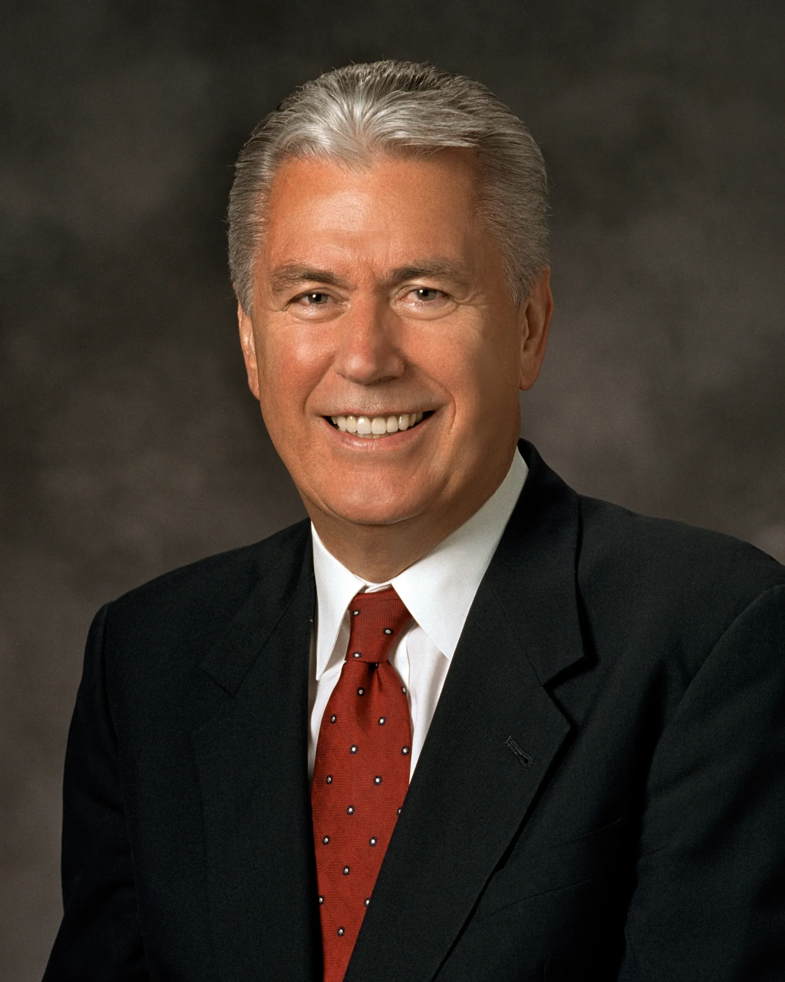
“At its core, pride is a sin of comparison, for though it usually begins with ‘Look how wonderful I am and what great things I have done,’ it always seems to end with ‘Therefore, I am better than you.’ When our hearts are filled with pride, we commit a grave sin, for we violate the two great commandments. Instead of worshipping God and loving our neighbor, we reveal the real object of our worship and love—the image we see in the mirror….
Notes:
https://churchofjesuschrist.org/imgs/a67ea44e15c8baa2ee172db318027cb6fb68121a/full/1920%2C/0/default

Slide 18
“So how do we conquer this sin of pride that is so prevalent and so damaging? How do we become more humble? We don’t discover humility by thinking less of ourselves; we discover humility by thinking less about ourselves. It comes as we go about our work with an attitude of serving God and our fellowman. Humility directs our attention and love toward others and to Heavenly Father’s purposes.
Notes:
https://churchofjesuschrist.org/imgs/a67ea44e15c8baa2ee172db318027cb6fb68121a/full/1920%2C/0/default

Slide 19
“Pride does the opposite. Pride draws its energy and strength from the deep wells of selfishness. The moment we stop obsessing with ourselves and lose ourselves in service, our pride diminishes and begins to die.”
President Dieter F. Uchtdorf,
“Pride and the Priesthood,” Oct. 2010
Notes:
https://churchofjesuschrist.org/imgs/a67ea44e15c8baa2ee172db318027cb6fb68121a/full/1920%2C/0/default

Slide 20
“The Lord spake also unto me again, saying: Forasmuch as this people refuseth the waters of Shiloah that go softly, and rejoice in Rezin and Remaliah’s son; Now therefore, behold, the Lord bringeth up upon them the waters of the river, strong and many, even the king of Assyria and all his glory; and he shall come up over all his channels, and go over all his banks. And he shall pass through Judah; he shall overflow and go over, he shall reach even to the neck; and the stretching out of his wings shall fill the breadth of thy land, O Immanuel.”
(2 Nephi 18:5–8)

Slide 21
“He is come to Aiath, he is passed to Migron; at Michmash he hath laid up his carriages. They are gone over the passage; they have taken up their lodging at Geba; Ramath is afraid; Gibeah of Saul is fled. Lift up the voice, O daughter of Gallim; cause it to be heard unto Laish, O poor Anathoth. Madmenah is removed; the inhabitants of Gebim gather themselves to flee. As yet shall he remain at Nob that day.” (2 Nephi 20:28–32)

Slide 22
“He is come to Aiath, he is passed to Migron; at Michmash he hath laid up his carriages. They are gone over the passage; they have taken up their lodging at Geba; Ramath is afraid; Gibeah of Saul is fled. Lift up the voice, O daughter of Gallim; cause it to be heard unto Laish, O poor Anathoth. Madmenah is removed; the inhabitants of Gebim gather themselves to flee. As yet shall he remain at Nob that day.” (2 Nephi 20:28–32)

Slide 23
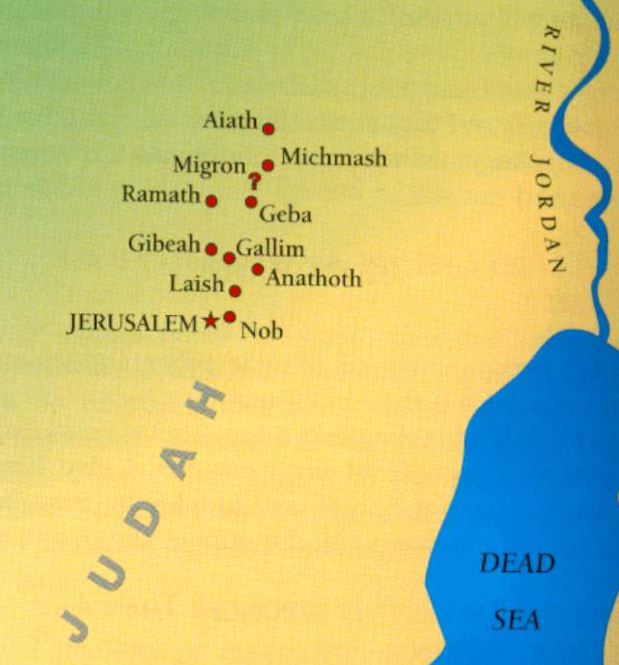
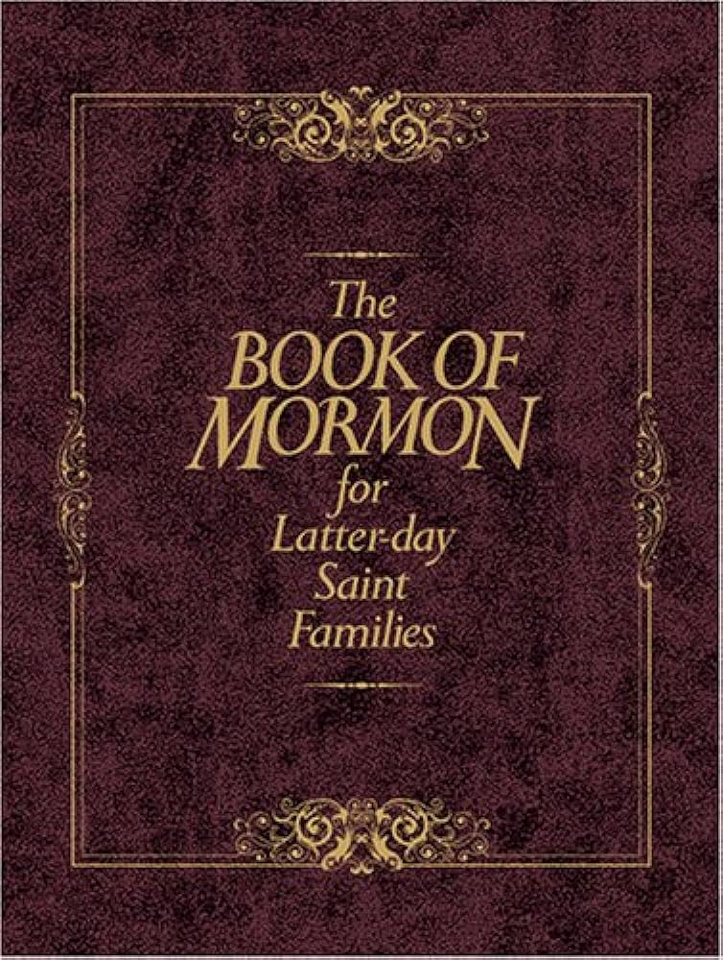

Slide 24
Notes:
If it’s before X:40, go to 2 Kings or Isaiah 36-39 to finish the story

Slide 25
The rest of the story is found in 2 Kings 18-19, Isaiah 36-39

Slide 27
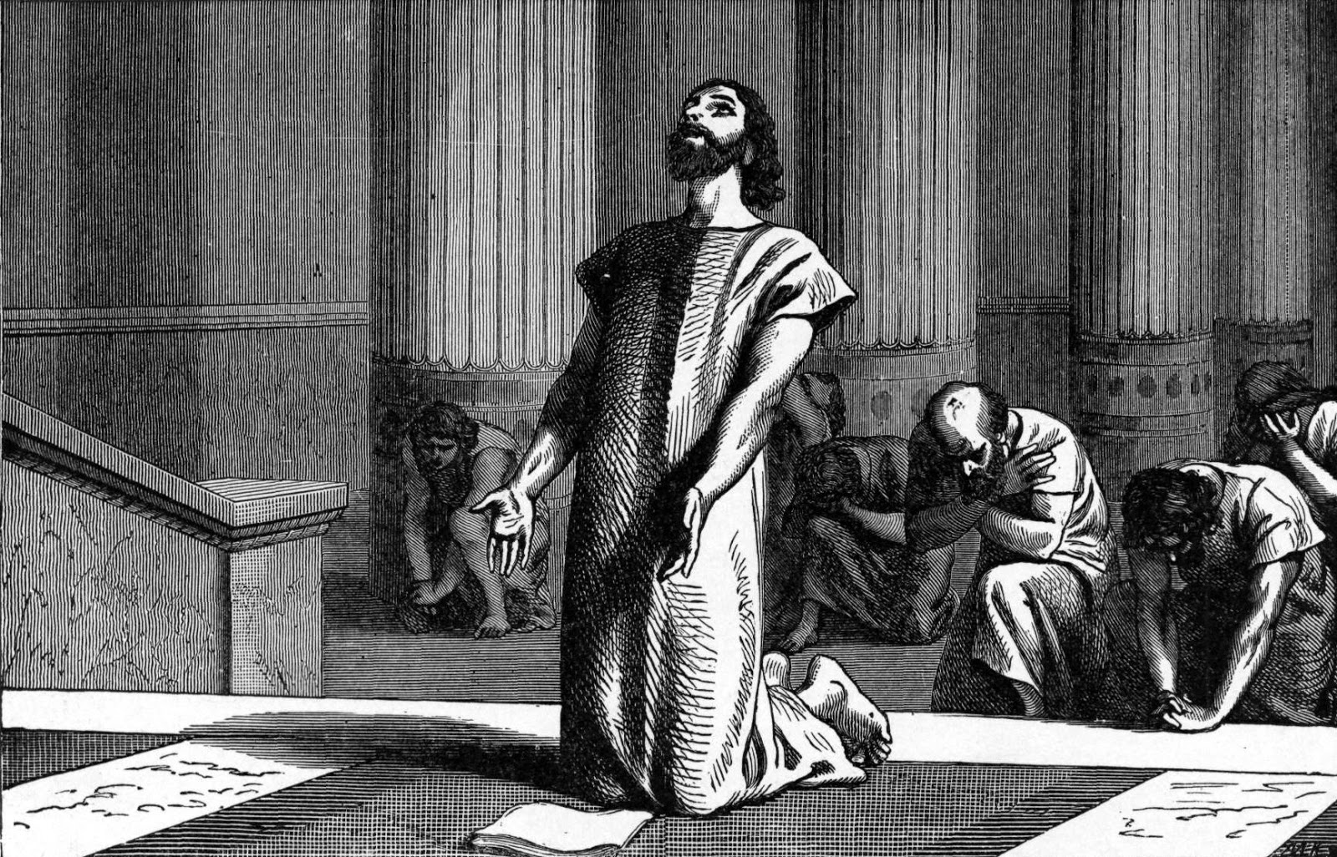
“This day is a day of trouble, and of rebuke, and of blasphemy: for the children are come to the birth, and there is not strength to bring forth.”
Isaiah 37:3
Notes:
Image: https://commons.wikimedia.org/wiki/File:King_Hezekiah,_clouthed_in_sackcloth,_spreads_open_the_letter_before_the_Lord.jpg

Slide 28
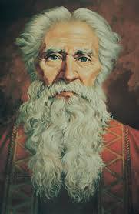
“Isaiah said unto them, Thus saith the LORD,
‘Be not afraid.’”
Isaiah 37:6
Ted Henninger
Notes:
Note the words from Jehovah—Jesus Christ to Hezekiah in a desperate situation. These are still his words to YOU today.
Image: https://www.churchofjesuschrist.org/media/image/isaiah-4e7875b?lang=eng

Slide 29
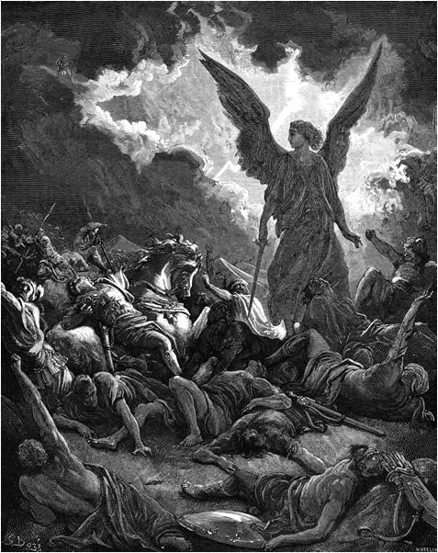
Gustav Doré
Notes:
Image: https://en.wikipedia.org/wiki/Sennacherib#/media/File:DESTRUCTION_OF_SENNACHERIB'S_HOST..jpg

Slide 30
“He is come to Aiath, he is passed to Migron; at Michmash he hath laid up his carriages. They are gone over the passage; they have taken up their lodging at Geba; Ramath is afraid; Gibeah of Saul is fled. Lift up the voice, O daughter of Gallim; cause it to be heard unto Laish, O poor Anathoth. Madmenah is removed; the inhabitants of Gebim gather themselves to flee. As yet shall he remain at Nob that day.” (2 Nephi 20:28–32)

Slide 31
“It will work out in the end…
If it’s not working out, it’s not the end…”

Slide 32
“It will work out in the end…
If it’s not working out, it’s not the end…”

Slide 33
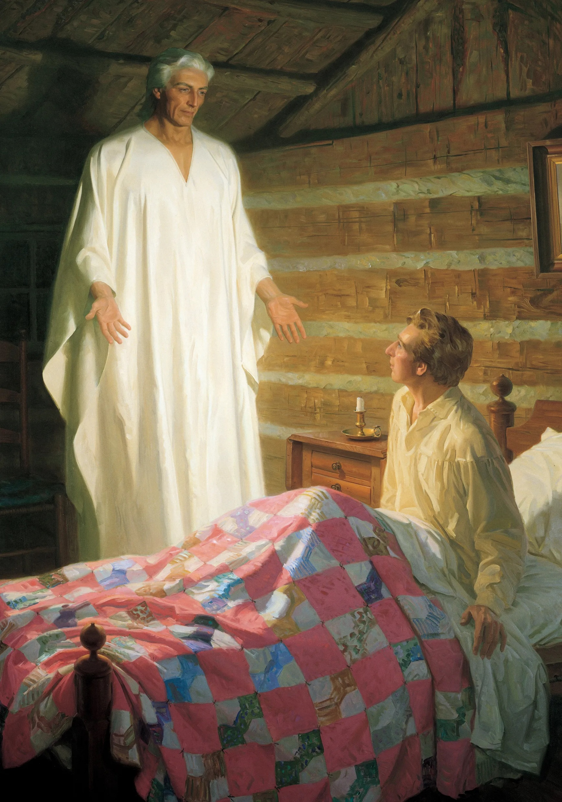
“[Moroni] quoted the eleventh chapter of Isaiah, saying that it was about to be fulfilled.”
Joseph Smith-History 1:40
2 Nephi 21 = Isaiah 11
Tom Lovell
Notes:
https://churchofjesuschrist.org/imgs/5f68ab3ebd717592dce9ee3819123a44f1853e1e/full/1920%2C/0/default

Slide 34
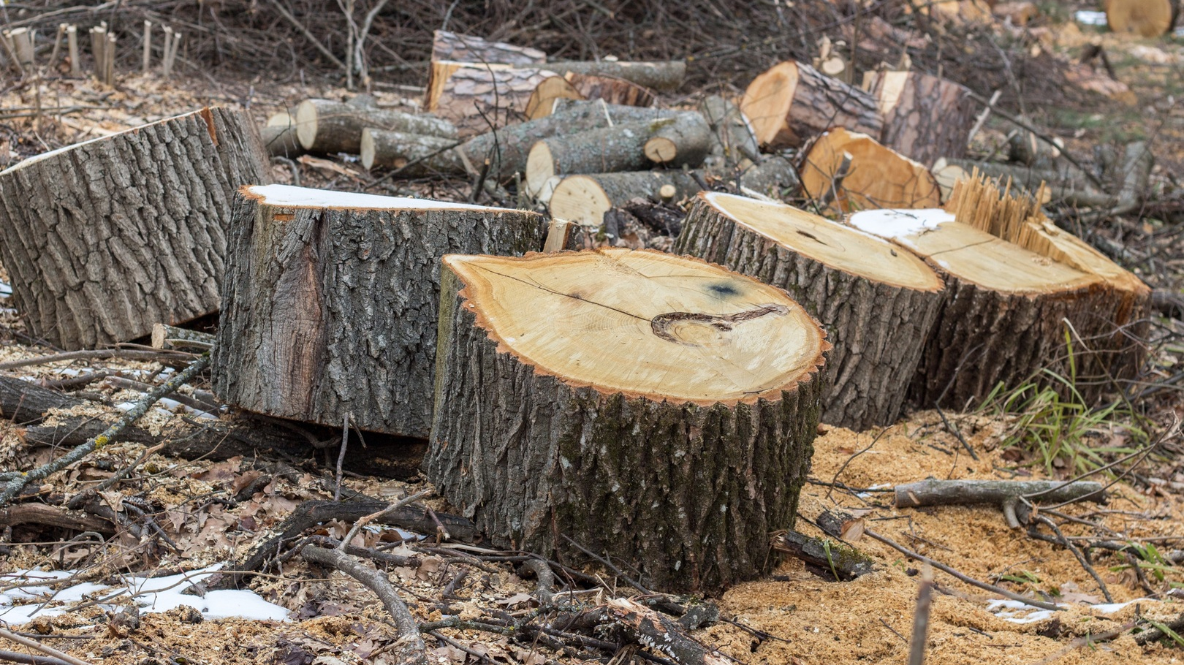
End of 2 Nephi 20
Notes:
https://pxhere.com/en/photo/552237

Slide 35
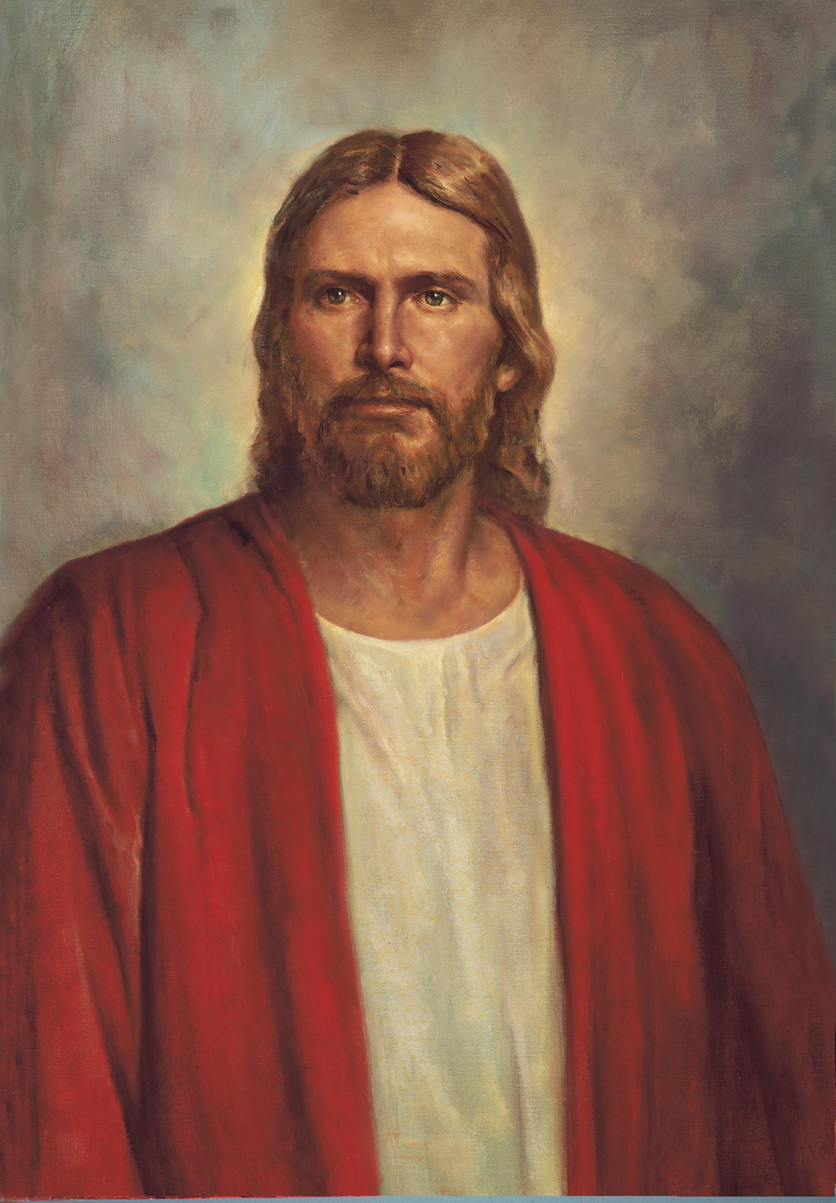
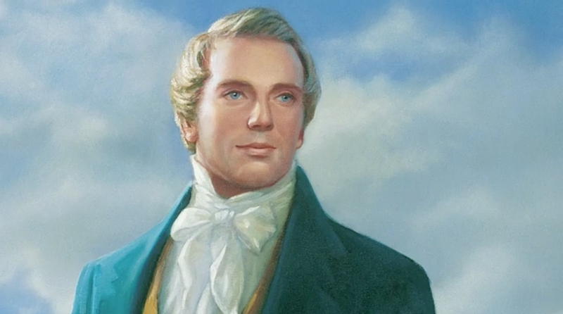
“And there shall come forth a rod out of the stem of Jesse, and a branch shall grow out of his roots.”
2 Nephi 21:1
“Who is the Stem of Jesse spoken of in the 1st, 2d, 3d, 4th, and 5th verses of the 11th chapter of Isaiah? Verily thus saith the Lord: It is Christ. What is the rod spoken of in the first verse of the 11th chapter of Isaiah, that should come of the Stem of Jesse? Behold, thus saith the Lord: It is a servant in the hands of Christ, who is partly a descendant of Jesse as well as of Ephraim, or of the house of Joseph, on whom there is laid much power.” (Doctrine and Covenants 113:1–4)
Notes:
https://assets.churchofjesuschrist.org/55/c1/55c1780e6fe111ecb00ceeeeac1e3d643e1c5a9b/plants_growth.jpeg
https://newsroom.churchofjesuschrist.org/media/orig/jesuschristredrobe_large.jpg

Slide 36
“And the Spirit of the Lord shall rest upon [Jesus]…and shall make him of quick understanding…With righteousness shall he judge the poor, and reprove with equity for the meek of the earth; and he shall smite the earth with the rod of his mouth, and with the breath of his lips shall he slay the wicked. And righteousness shall be the girdle of his loins, and faithfulness the girdle of his reins.” 2 Nephi 21:2–5
Notes:
https://newsroom.churchofjesuschrist.org/media/orig/jesuschristredrobe_large.jpg

Slide 37
“The wolf also shall dwell with the lamb, and the
leopard shall lie down with the kid, and the calf and the young lion and fatling together; and a little child shall lead them. And the cow and the bear shall feed; their young ones shall lie down together; and the lion shall eat straw like the ox. And the sucking child shall play on the hole of the asp, and the weaned child shall put his hand on the cockatrice’s den. They shall not hurt nor destroy in all my holy mountain, for the earth shall be full of the knowledge of the Lord, as the waters cover the sea.” 2 Nephi 21:6–9
Notes:
https://newsroom.churchofjesuschrist.org/media/orig/jesuschristredrobe_large.jpg
https://churchofjesuschrist.org/imgs/e535abdcc3a611ec8e0deeeeac1eb4d51bbe29e7/full/500%2C/0/default

Slide 38
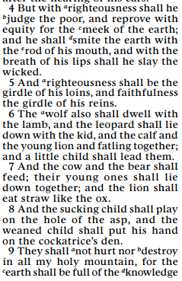
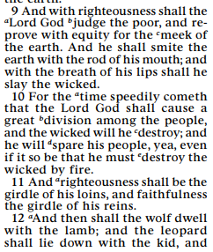
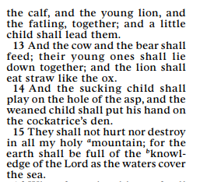
2 Nephi 21:4–9
2 Nephi 30:9–15

Slide 39
“And it shall come to pass in that day that the Lord shall set his hand again the second time to recover the remnant of his people which shall be left, from Assyria, and from Egypt, and from Pathros, and from Cush, and from Elam, and from Shinar, and from Hamath, and from the islands of the sea.”
2 Nephi 21:11

Slide 40
“And it shall come to pass in that day that the Lord shall set his hand again the second time to recover the remnant of his people which shall be left, from Assyria, and from Egypt, and from Pathros, and from Cush, and from Elam, and from Shinar, and from Hamath, and from the islands of the sea.”
2 Nephi 21:11
“After my father left Jerusalem…[the Jews] hardened their hearts; and according to my prophecy they have been destroyed, save it be those which are carried away captive into Babylon…Notwithstanding they have been carried away they shall return again, and possess the land of Jerusalem; wherefore, they shall be restored again to the land of their inheritance.” (2 Nephi 25:10–11)

Slide 41
“And it shall come to pass in that day that the Lord shall set his hand again the second time to recover the remnant of his people which shall be left, from Assyria, and from Egypt, and from Pathros, and from Cush, and from Elam, and from Shinar, and from Hamath, and from the islands of the sea.”
2 Nephi 21:11
“And the Lord will set his hand again the second time to restore his people from their lost and fallen state. Wherefore, he will proceed to do a marvelous work and a wonder among the children of men.”
(2 Nephi 25:17)

Slide 42
“And it shall come to pass in that day that the Lord shall set his hand again the second time to recover the remnant of his people which shall be left, from Assyria, and from Egypt, and from Pathros, and from Cush, and from Elam, and from Shinar, and from Hamath, and from the islands of the sea.”
2 Nephi 21:11
“At that day…I shall proceed to do a marvelous work among them, that I may remember my covenants which I have made unto the children of men, that I may set my hand again the second time to recover my people, which are of the house of Israel; And also, that I may remember the promises which I have made unto thee, Nephi…that the words of your seed should proceed forth out of my mouth… for a standard unto my people.”
(2 Nephi 29:1–2)

Slide 43
Download at johnhiltoniii.com/thebookofmormon

Slide 44
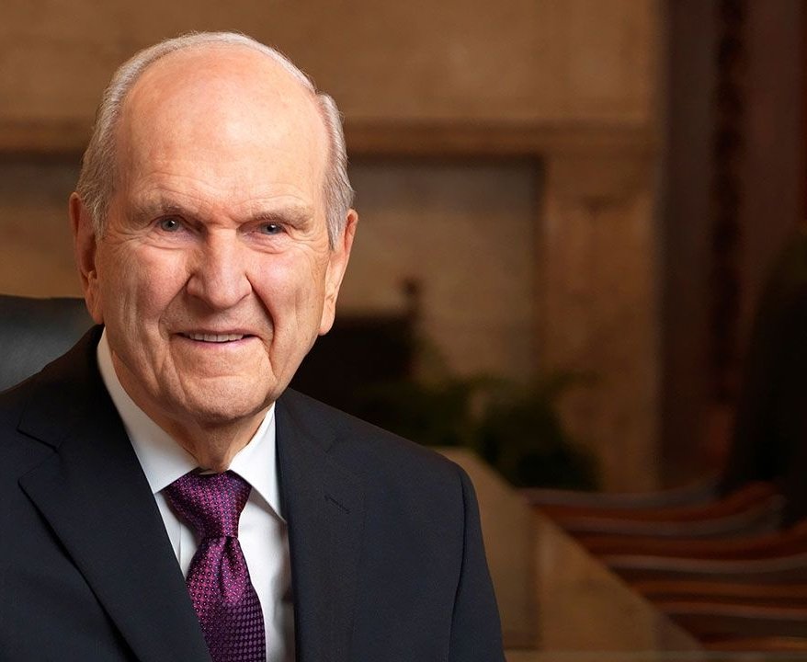
“The gathering of
Israel is the most
important work
taking place
on earth today.”
President Russell M. Nelson General Conference, October 2022

Slide 45
“The Book of Mormon [is] the most correct of any book on earth, and the keystone of our religion, and a
[person] would
get nearer to
God by abiding
by its precepts,
than by any
other book.”
David Lindsley
Notes:
https://assets.ldscdn.org/34/fc/34fcb157c81bd0c0bf7e41dbac0508f32de61fcc/joseph_smith_kirtland.jpeg

Slide 46
“The gathering of
Israel is the most
important work
taking place
on earth today.”
President Russell M. Nelson General Conference, October 2022

Slide 47
Isaiah Bringing us to Christ
“For can a woman forget her sucking child…? Yea, they may forget, yet will I not forget thee” (1 Nephi 21:15)
“Behold I have graven thee upon the palms of my hands” (1 Nephi 21:16)
“I am he that comforteth you” (2 Nephi 8:12)
“A virgin shall conceive and bear a son” (2 Nephi 17:14)
“His name shall be called, Wonderful Counselor, The Mighty God, the Everlasting Father, the Prince of Peace” (2 Nephi 19:6)
“The Lord Jehovah is my strength and my song” (2 Nephi 22:2)

