Slide 1
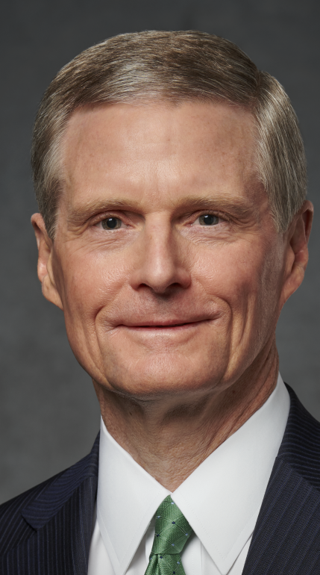
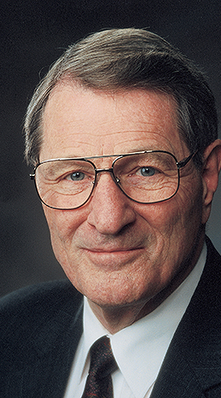
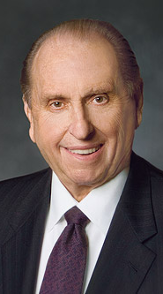
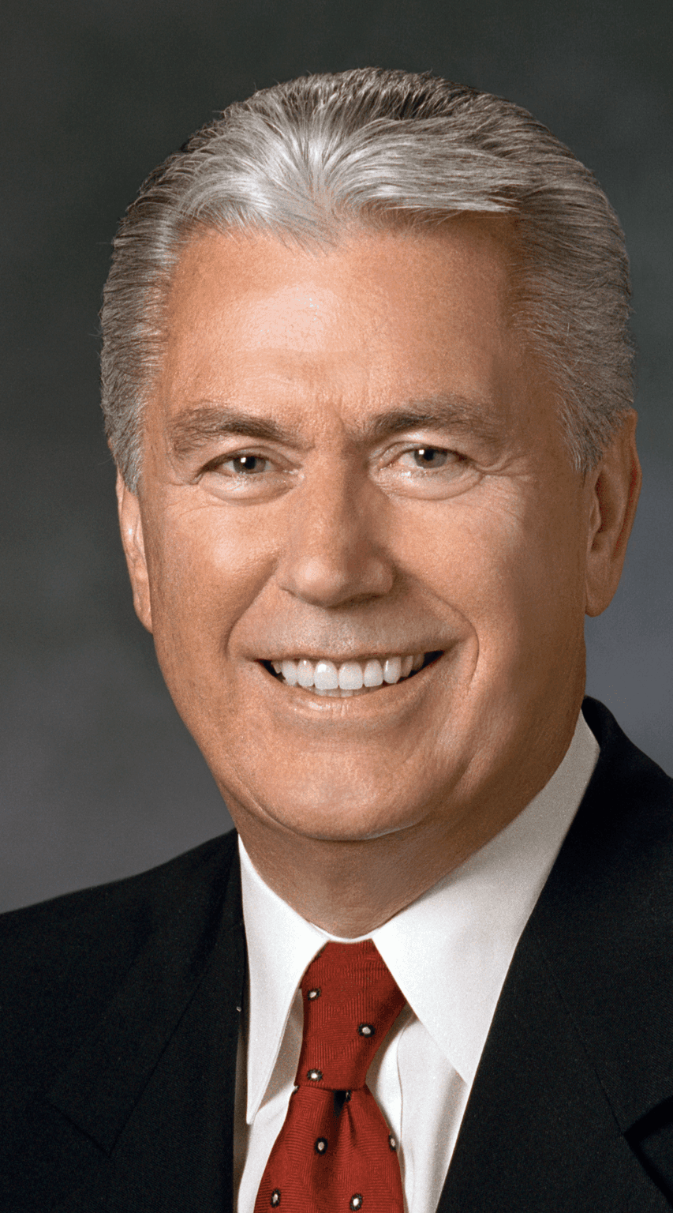
David A.
Bednar
Neal A.
Maxwell
Thomas S.
Monson
Dieter F.
Uchtdorf
Notes:
“In order to get an airplane off the ground, you must create lift.”
“I pray the Holy Ghost will confirm the truthfulness of the principles I emphasize.”
“In life, the sandpaper of circumstances often smooths our crustiness and patiently polishes our rough edges.”
“I admire the ward leaders who invite the widows to all social activities.”
https://assets.churchofjesuschrist.org/2d/80/2d80ffe3553647fce3aa56734a34fe259a26f606/bednar_official_portrait.png
https://www.churchofjesuschrist.org/bc/content/ldsorg/church/news/2018/11/14/350-1150013-MaxwellN-0309crp.jpg
https://www.churchofjesuschrist.org/bc/content/shared/content/images/leaders/thomas-s-monson-large.jpg
https://assets.churchofjesuschrist.org/f8e3f3665cadaf1f32602520e3fd2cd7aab9a266.png

Slide 2
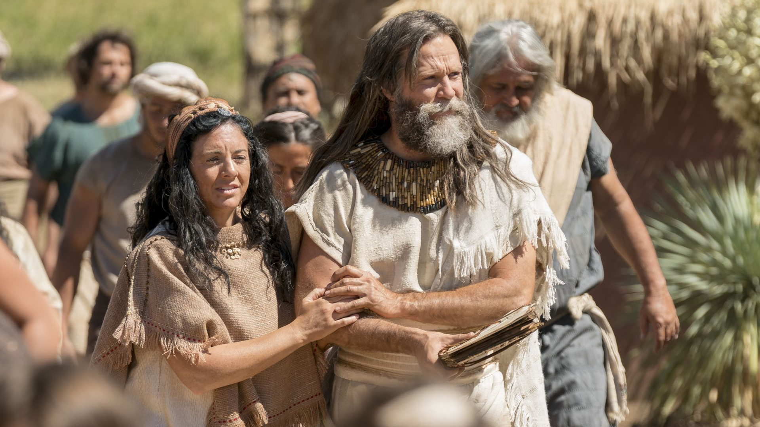
“For behold, it came to pass that fifty and five years had passed away from the time that Lehi left Jerusalem.”
Jacob 1:1
Notes:
https://assets.churchofjesuschrist.org/ba/75/ba75de5f47b5690944b3ab797a168c95a5b19f5b/jacob_with_wife.jpeg

Slide 3
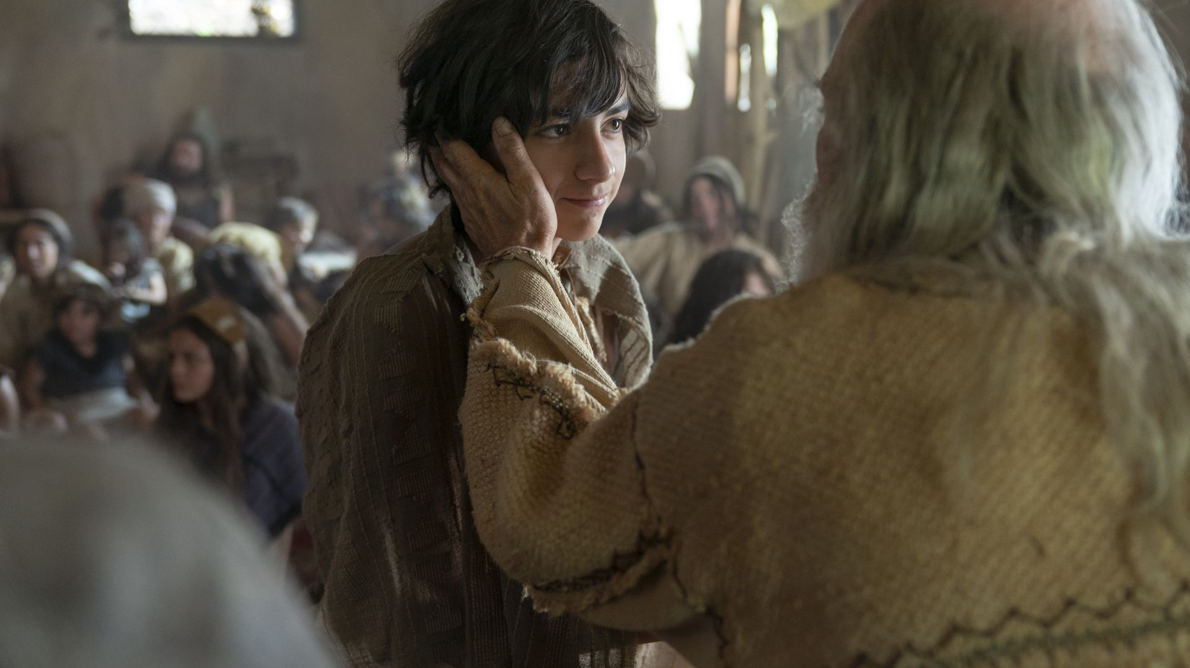
In his “childhood [he] suffered afflictions and much sorrow, because of the rudeness of [his brothers].”
2 Nephi 2:2
He knew “the greatness of God” and “beheld in [his] youth” the glory of Jesus Christ.
2 Nephi 2:2, 4
Witnessed his parents “brought down…near to be cast with sorrow into a watery grave” and was “grieved because of the afflictions of [his] mother.”
1 Nephi 18:18–19
Notes:
https://assets.churchofjesuschrist.org/68/75/68752bad63d209705264602c8b5d5fa86bd97c3d/lehi_teaching_in_his_home.jpeg

Slide 4
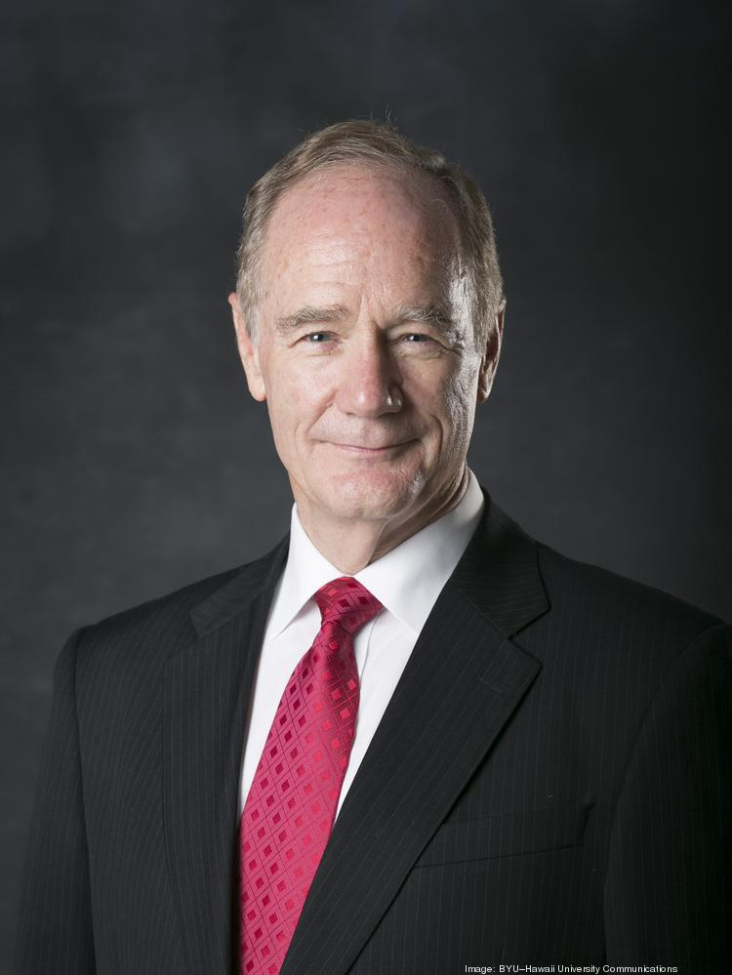
“Half the [Book of Mormon’s] references to anxiety occur in Jacob [he is the only person to use the word more than once], and over two-thirds of the references to grieve and tender (or their deriv­atives), as well as shame, are Jacob's. [Jacob] is the only person to have used delicate, contempt, and lonesome.
John Scott
Notes:
https://media.bizj.us/view/img/11662166/former-prestanner-byuh*750xx2563-3417-0-0.jpg

Slide 5
“Likewise, he is the only Book of Mormon author to have employed wound in reference to emotions; and he never used it, as everyone else did, to describe a physical injury.
John Scott
Notes:
https://media.bizj.us/view/img/11662166/former-prestanner-byuh*750xx2563-3417-0-0.jpg

Slide 6
“Similarly, Jacob used pierce or its variants frequently (four of the ten instances in the Book of Mormon), and he used it exclusively in a spiritual sense. Such evidence suggests an author who lived close to his emotions and who knew how to express those emotions.”
John Tanner, “Jacob and His
Descendants as Authors,” 59.
John Scott
Notes:
https://media.bizj.us/view/img/11662166/former-prestanner-byuh*750xx2563-3417-0-0.jpg

Slide 7
“Become devils, angels to a devil, to be shut out from the presence of our God.”
2 Nephi 9:9; see also 2 Nephi 9:16
“Shake yourselves that ye may awake from the slumber of death; and loose yourselves from the pains of hell that ye may not become angels to the devil, to be cast into that lake of fire and brimstone.”
Jacob 3:11
Notes:
There are six instances in the Book of Mormon that specifically refer to the devil’s angels, and half of them come from Jacob

Slide 8
“Nothing save it was exceeding harshness, preaching and prophesying of wars, and contentions, and destructions, and continually reminding them of death, and the duration of eternity, and the judgments and the power of God. . . would keep [the people] from going down speedily to destruction.”
Enos 1:23

Slide 9
“Power of…resurrection”
(5 of 7 instances in Jacob’s voice
“The power of the resurrection of the Holy One of Israel.”
2 Nephi 9:12
“The power of the resurrection which is in Christ.”
Jacob 4:11;
see also Jacob 6:9

Slide 10
“Suffered afflictions and much sorrow, because of the rudeness of [his] brethren.”
2 Nephi 2:1
Concerned he would “stumble because of [his] over anxiety.”
Jacob 4:18
Through the Lord’s “grace” weaknesses can be overcome.
Jacob 4:7
The “pleasing word of God…healeth the wounded soul.”
Jacob 2:8
Notes:
https://assets.churchofjesuschrist.org/68/75/68752bad63d209705264602c8b5d5fa86bd97c3d/lehi_teaching_in_his_home.jpeg

Slide 11


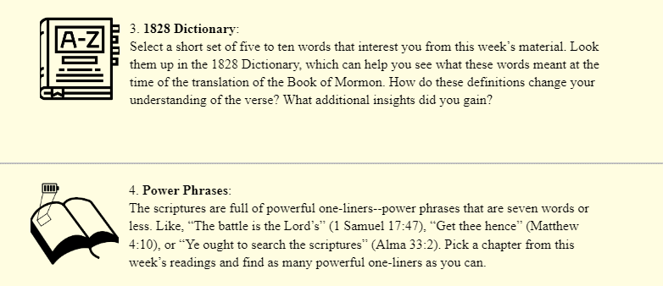

Slide 12
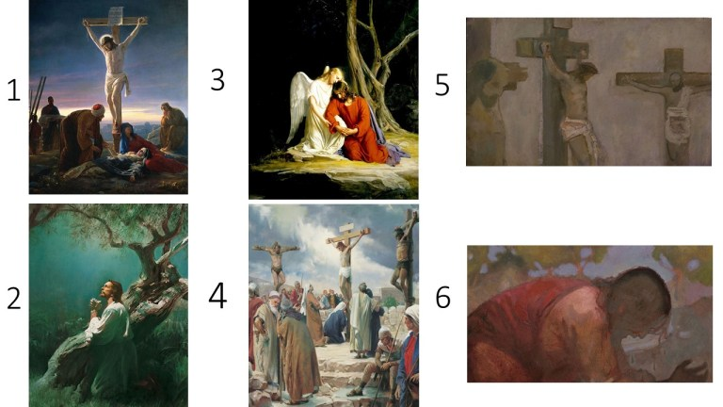
Notes:
My friend Anthony Sweat and I asked this question to more than eight hundred Latter-day Saints and found that ninety seven percent of them chose one of the Gethsemane images. Only three percent chose an image of the Crucifixion.
https://i0.wp.com/johnhiltoniii.com/wp-content/uploads/2021/01/Behold-my-wounds.jpg?resize=768%2C432&ssl=1

Slide 13
“We would to God that we could persuade all...[to] ...view [Christ’s] death.”
Jacob 1:8
Notes:
https://assets.churchofjesuschrist.org/ba/75/ba75de5f47b5690944b3ab797a168c95a5b19f5b/jacob_with_wife.jpeg

Slide 14

“The operative definition of the word ‘view’ during Joseph Smith's time was ‘to survey intellectually; To examine with the mental eye; To consider the subject in all its aspects.’
Notes:
https://www.gtu.edu/sites/default/files/styles/colorbox_full_size/public/paragraphs/images/dr_deidre_green_headshot.jpg?itok=sAg9E0Go

Slide 15
“Additionally, a sense from the Latin root is that of reaching or extending toward the object one views. Jacob desires for everyone to contemplate thoroughly the multifaceted death of Christ in a way that requires each person to reach or extend toward it.”
Deidre Green
Notes:
https://www.gtu.edu/sites/default/files/styles/colorbox_full_size/public/paragraphs/images/dr_deidre_green_headshot.jpg?itok=sAg9E0Go

Slide 16
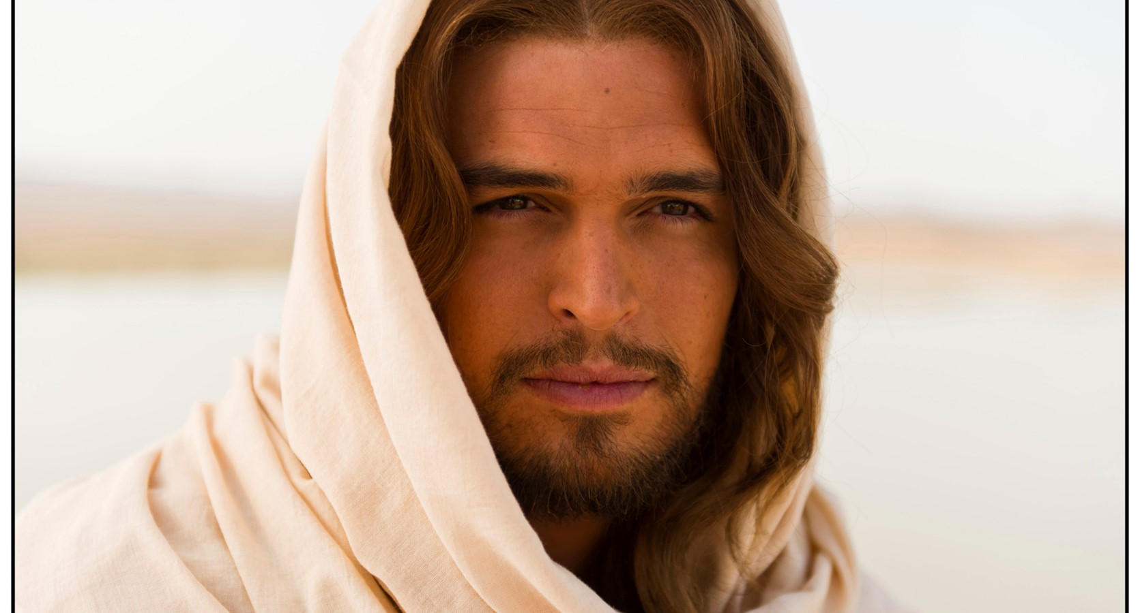
“Greater love hath no man than this, that a man lay down his life for his friend.”
John 15:13
Notes:
https://assets.churchofjesuschrist.org/ba/75/ba75de5f47b5690944b3ab797a168c95a5b19f5b/jacob_with_wife.jpeg

Slide 17
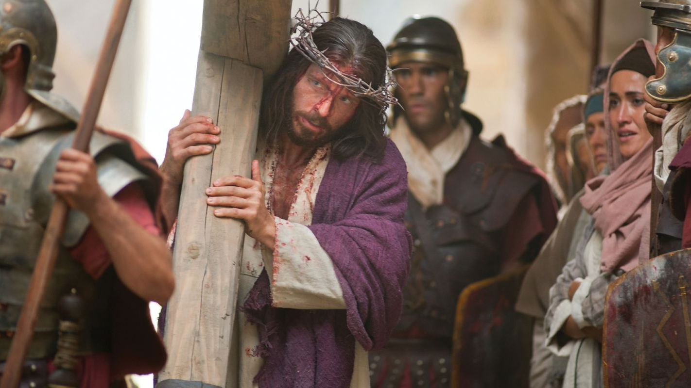
“May [Christ’s]...death...rest in your mind forever.”
Moroni 9:25
Notes:
https://assets.churchofjesuschrist.org/cf/cc/cfcca0f1fd9a2332ff006b81b80503c88be2380e/bible_videos_jesus_carrying_cross.jpeg

Slide 18
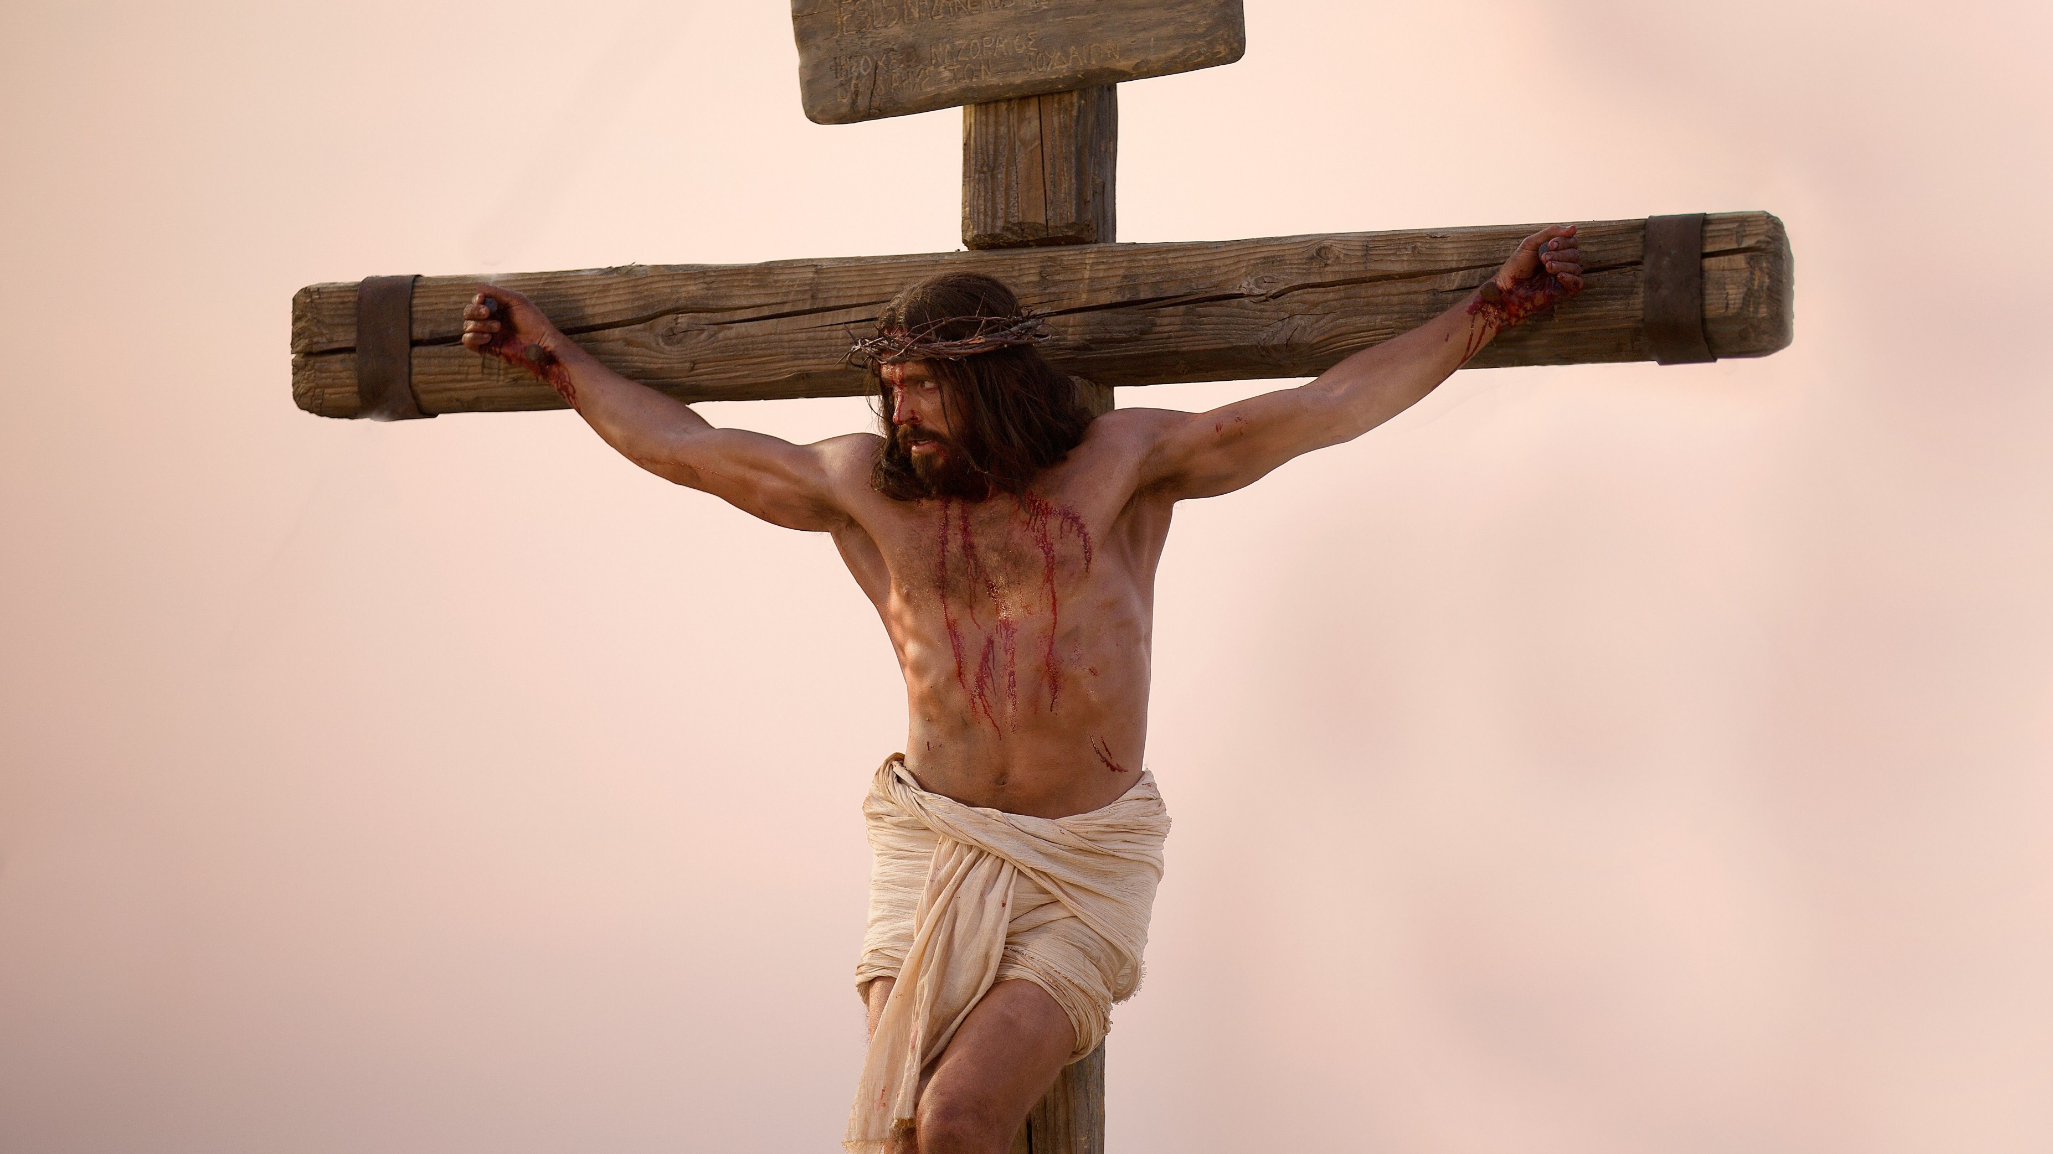
“Look unto me in every thought, doubt not, fear not.
Notes:
https://assets.churchofjesuschrist.org/cb/6e/cb6e029f85d425e6215cf21b5a5bfe352a965186/jesus_on_the_cross.jpeg

Slide 19
“Look unto me in every thought, doubt not, fear not.
“Behold [meaning ‘fix your eyes upon’] the wounds which pierced my side, and also the prints of the nails in my hands and feet.”
Doctrine and Covenants 6:36–37
Notes:
https://assets.churchofjesuschrist.org/cb/6e/cb6e029f85d425e6215cf21b5a5bfe352a965186/jesus_on_the_cross.jpeg

Slide 20
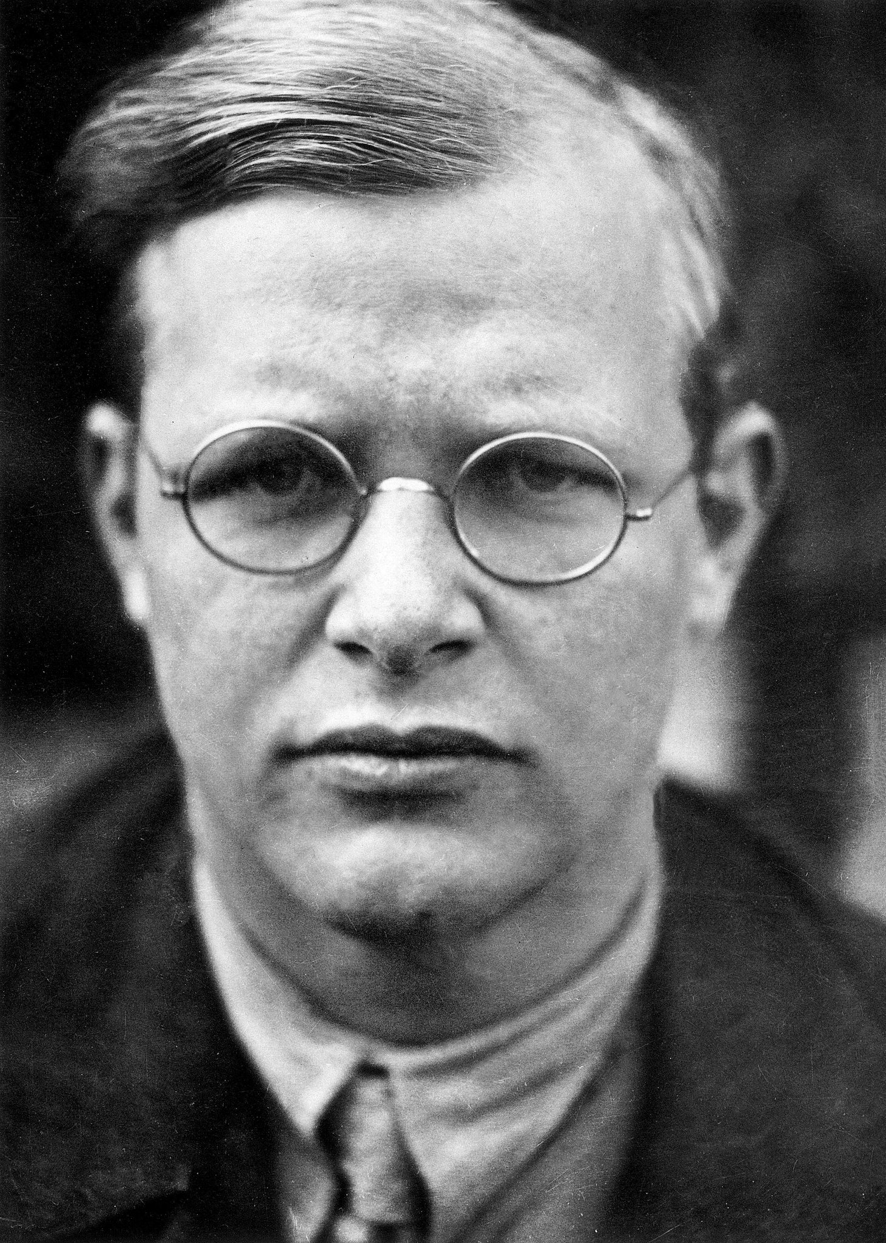
“Only the suffering God can help.”
Dietrich Bonhoeffer
John Scott
Notes:
https://static01.nyt.com/images/2014/08/10/books/review/10BALMER/10balmer-superJumbo.jpg

Slide 21
How do you think viewing Christ’s death could strengthen you in your life?
Notes:
https://assets.churchofjesuschrist.org/cb/6e/cb6e029f85d425e6215cf21b5a5bfe352a965186/jesus_on_the_cross.jpeg

Slide 22
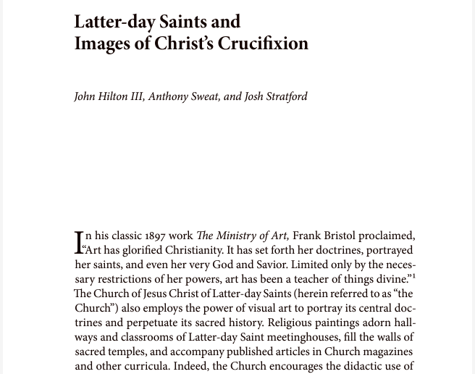

Slide 23
One-liner #2:
Obtaining our errand from the Lord

Slide 24
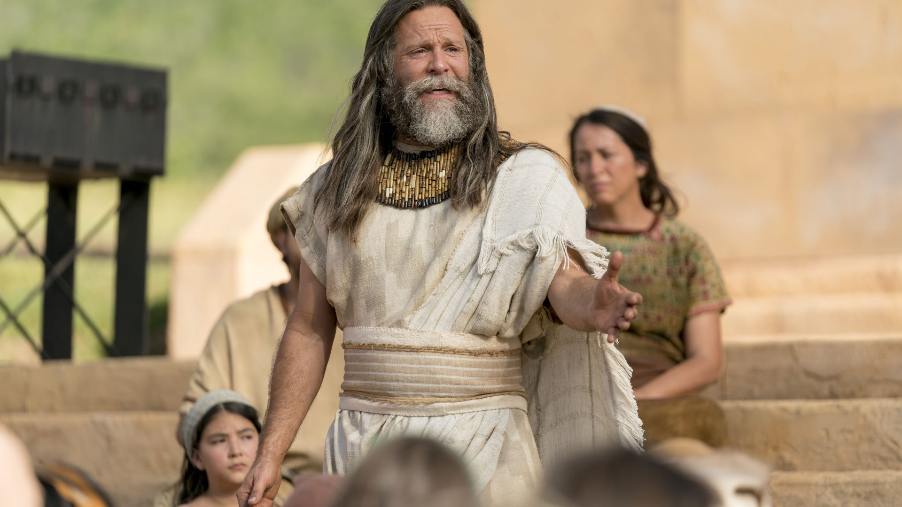
“I, Jacob, gave unto them these words as I taught them in the temple, having first obtained mine errand from the Lord.”
Jacob 1:17
Notes:
https://assets.churchofjesuschrist.org/5a/39/5a397dd5fcf625f218dfb9ce3476c77466fc28d8/jacob_preaching.jpeg

Slide 25
“Because of faith and great anxiety, it truly had been made manifest unto us concerning our people, what things should happen unto them.”
Jacob 1:5
Notes:
https://broadcast.lds.org/elearning/hrd/LDSLeader/RESOURCES/Bednar_Script_no%20timecodes%5B1%5D.pdf
https://assets.churchofjesuschrist.org/5a/39/5a397dd5fcf625f218dfb9ce3476c77466fc28d8/jacob_preaching.jpeg

Slide 26
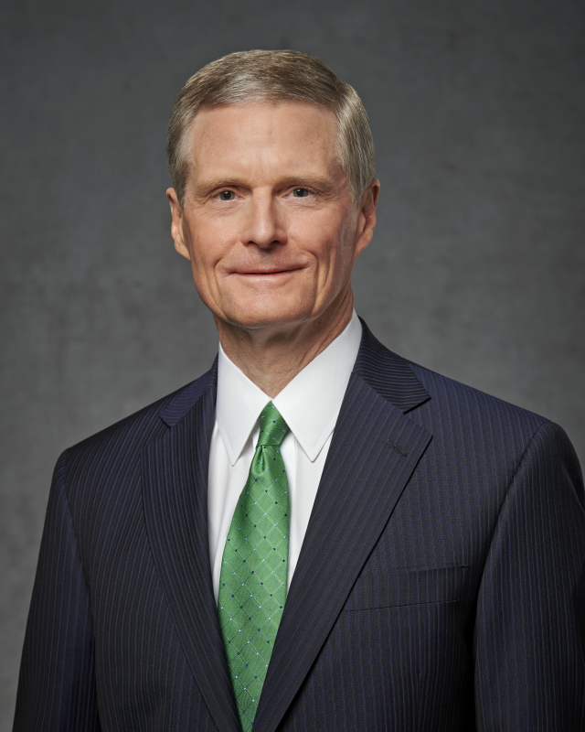
In a leadership training meeting, Elder David A. Bednar told a story that helps us see how this verse connects to the idea of obtaining our errand from the Lord. Elder Bednar and his son Mike were driving together. At the time, Mike was an assistant in the Priest quorum and was working to plan an activity. He asked Elder Bednar, “Dad, we’re having an activity with the Laurels in two weeks. Do you have any ideas about what we can do?”
Elder Bednar, https://broadcast.lds.org/elearning/hrd/LDSLeader/RESOURCES/Bednar_Script_no%20timecodes%5B1%5D.pdf
Notes:
https://assets.churchofjesuschrist.org/32/79/3279084dd79a59bc3b6eec726f1e78cfee206c62/bednar_official_portrait.png

Slide 27
Elder Bednar invited Mike to read Jacob 1:5—“For because of faith and great anxiety, it truly had been made manifest unto us concerning our people, what things should happen unto them.”
Elder Bednar said, “Mike, does that help you?” He said, “Dad, I love reading scriptures with you. Now would you pay attention and answer my question? My question is, we’re having a priests and Laurels activity. I’m in charge of helping to pull this off. Have you got any ideas?”
Elder Bednar, https://broadcast.lds.org/elearning/hrd/LDSLeader/RESOURCES/Bednar_Script_no%20timecodes%5B1%5D.pdf
Notes:
https://assets.churchofjesuschrist.org/32/79/3279084dd79a59bc3b6eec726f1e78cfee206c62/bednar_official_portrait.png

Slide 28
Elder Bednar asked him to read the verse again, which he did.
Elder Bednar asked, “Did it help you this time?”
Mike responded, “Earth to Dad. Dad, watch my lips. Can you help me with the priests and Laurels activity?”
Elder Bednar, https://broadcast.lds.org/elearning/hrd/LDSLeader/RESOURCES/Bednar_Script_no%20timecodes%5B1%5D.pdf
Notes:
https://assets.churchofjesuschrist.org/32/79/3279084dd79a59bc3b6eec726f1e78cfee206c62/bednar_official_portrait.png

Slide 29
Elder Bednar said, “Mike, read it again.” Elder Bednar then explained, “Mike, in this verse it says, ‘For because of faith and great anxiety.’ Anxiety in this verse doesn’t mean stress. It means anxious regarding concern. Now, have you thought about this [activity] before asking me?”
“Uh, no.” Mike responded.
Elder Bednar, https://broadcast.lds.org/elearning/hrd/LDSLeader/RESOURCES/Bednar_Script_no%20timecodes%5B1%5D.pdf
Notes:
https://assets.churchofjesuschrist.org/32/79/3279084dd79a59bc3b6eec726f1e78cfee206c62/bednar_official_portrait.png

Slide 30
“OK,” Elder Bednar said. “What are the things that should happen to the priests and the Laurels as a result of this activity?”
“I don’t really know.” His son responded.
“Then I can’t help you.” Elder Bednar said. “Why don’t you be prayerful and consider what things should happen unto the priests and the Laurels because of this activity. And then come back after you’ve thought about that and we’ll talk.”
Elder Bednar, https://broadcast.lds.org/elearning/hrd/LDSLeader/RESOURCES/Bednar_Script_no%20timecodes%5B1%5D.pdf
Notes:
https://assets.churchofjesuschrist.org/32/79/3279084dd79a59bc3b6eec726f1e78cfee206c62/bednar_official_portrait.png

Slide 31

Is there something in your life right now, where you need to obtain your errand from the Lord?
Notes:
https://assets.ldscdn.org/82/bb/82bb62675bcdaded3dba638f466edf4ebf1d4827/brazil_young_women_praying_prayer.jpeg

Slide 32
One-liner #3:
Pointing people to Christ with all diligence

Slide 33
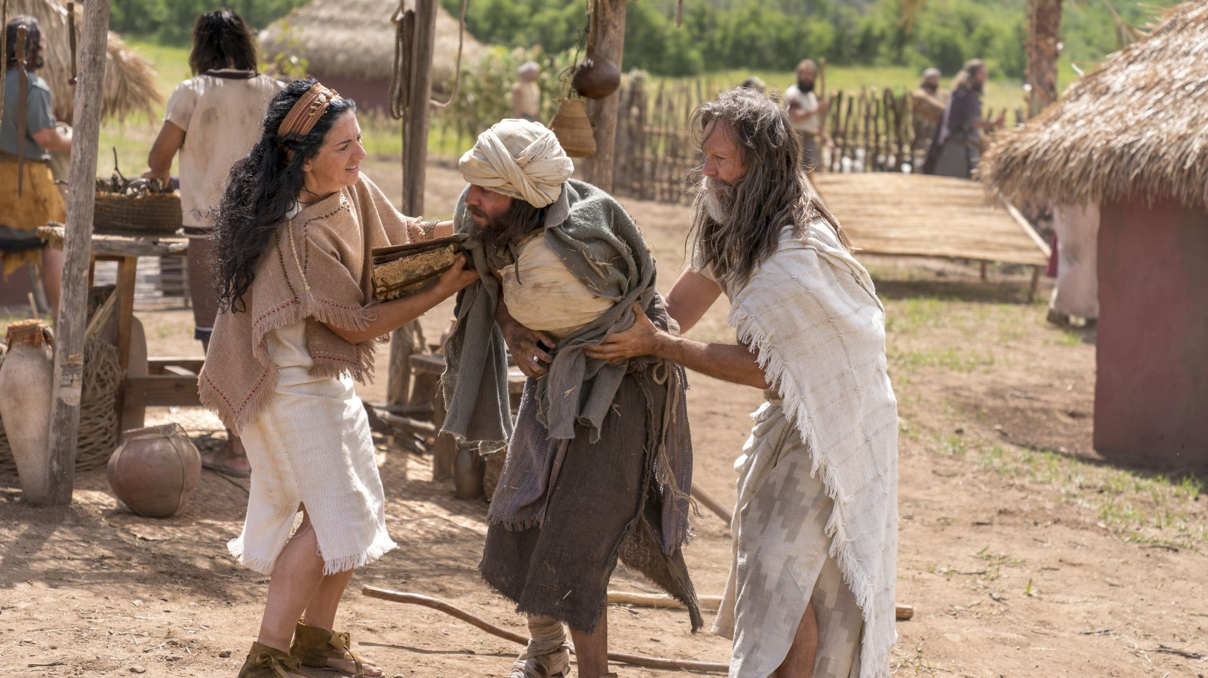
“We labored diligently among our people, that we might persuade them to come unto Christ.”
Jacob 1:7
Notes:
https://assets.churchofjesuschrist.org/ff/52/ff52134393bf9f70df7eae526d539ec049058f40/jacob_and_wife_help_crippled_man.jpeg

Slide 34
“We labor diligently to engraven these words upon plates, hoping that our beloved brethren and our children will...know that we knew of Christ.”
Jacob 4:3–4
Notes:
https://assets.churchofjesuschrist.org/ff/52/ff52134393bf9f70df7eae526d539ec049058f40/jacob_and_wife_help_crippled_man.jpeg

Slide 35
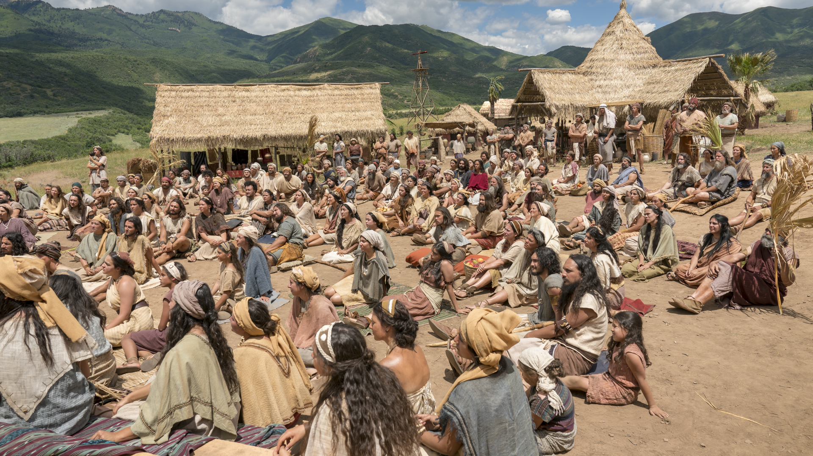
“We did magnify our office unto the Lord, taking upon us the responsibility, answering the sins of the people upon our own heads if we did not teach them the word of God with all diligence; wherefore, by laboring with our might their blood might not come upon our garments; otherwise their blood would come upon our garments, and we would not be found spotless at the last day.”
Jacob 1:19
Notes:
https://assets.churchofjesuschrist.org/72/49/72493fee3fa00c7425e4a36db7bbdad11776c08b/nephites_jacob.png

Slide 36
“In 1985, I was stationed as a U.S. Army officer in… Germany. We began attending a small branch [with] about 12 members…The second week after we began attending, we noticed a new man there. He was in his mid-40s, and we learned that he was the high councilor assigned to our branch. He wasn’t there to conduct stake business, just to visit. We spoke for some time after church, and when we said goodbye, I figured we would…see him again in …six months.
Notes:
Donald Coe writes,

Slide 37
“The next week, the high councilor was there again. I learned he lived about an hour away from our small town. During the remainder of his calling as a high councilor, he came to our branch two or three times a month. He was friendly and encouraging. He always spoke with each member of the branch… Impressed with his dedication, in my mind I nicknamed him ‘the Faithful High Councilor.’ One Sunday he came to the branch services in the morning and then returned at 6:00 p.m. to attend a baptism. In between, he had gone to another branch.”
Donald Coe, Ensign, June 2017
Notes:
The author goes on to describe how when he was out of town for two months, the “Faithful high councilor,” who was now the stake president ministered to his wife and son when they were in need.

Slide 38
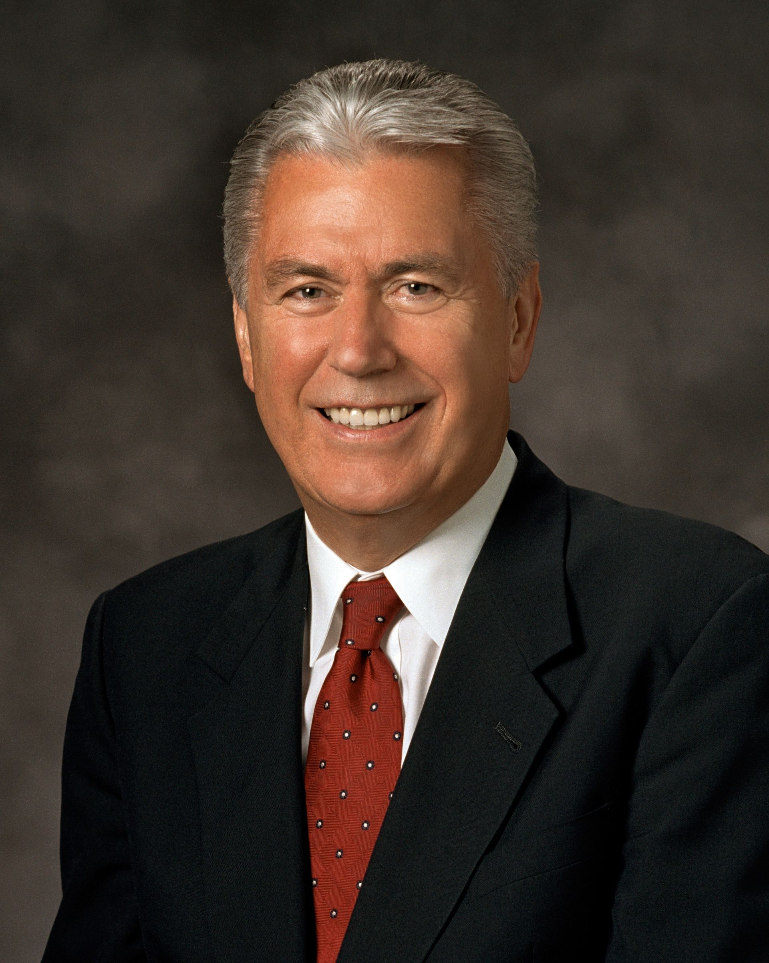

Slide 39
One-liner #4:
Don’t let pride destroy your soul

Slide 40
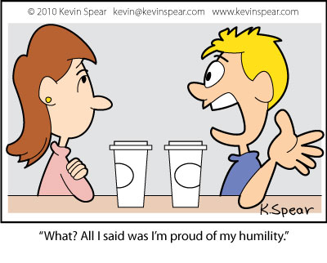

Notes:
https://kevinspear.com/webcomic/pride-humility

Slide 41
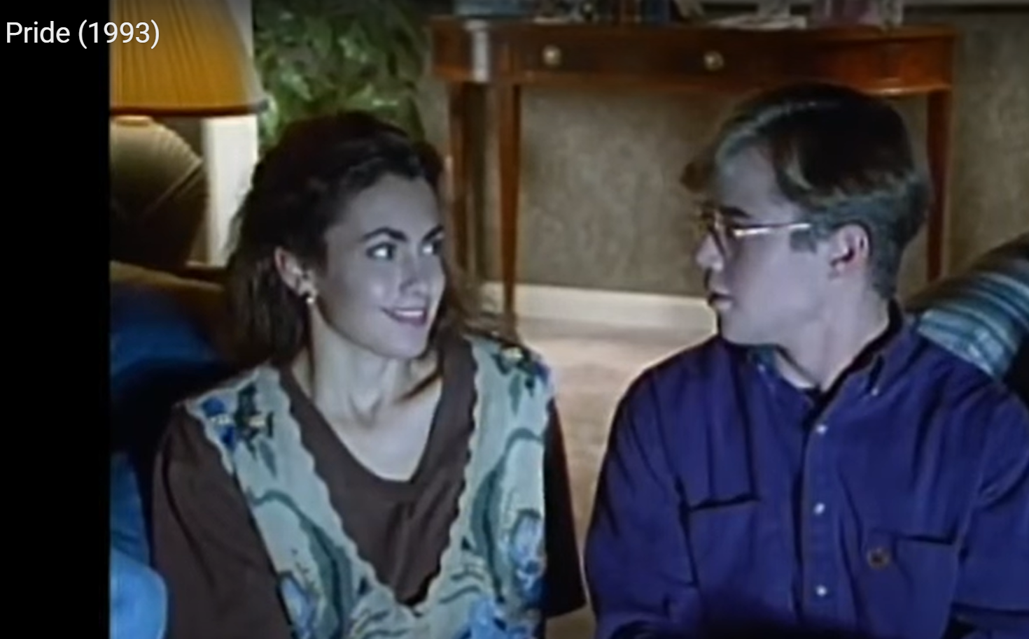

Slide 42
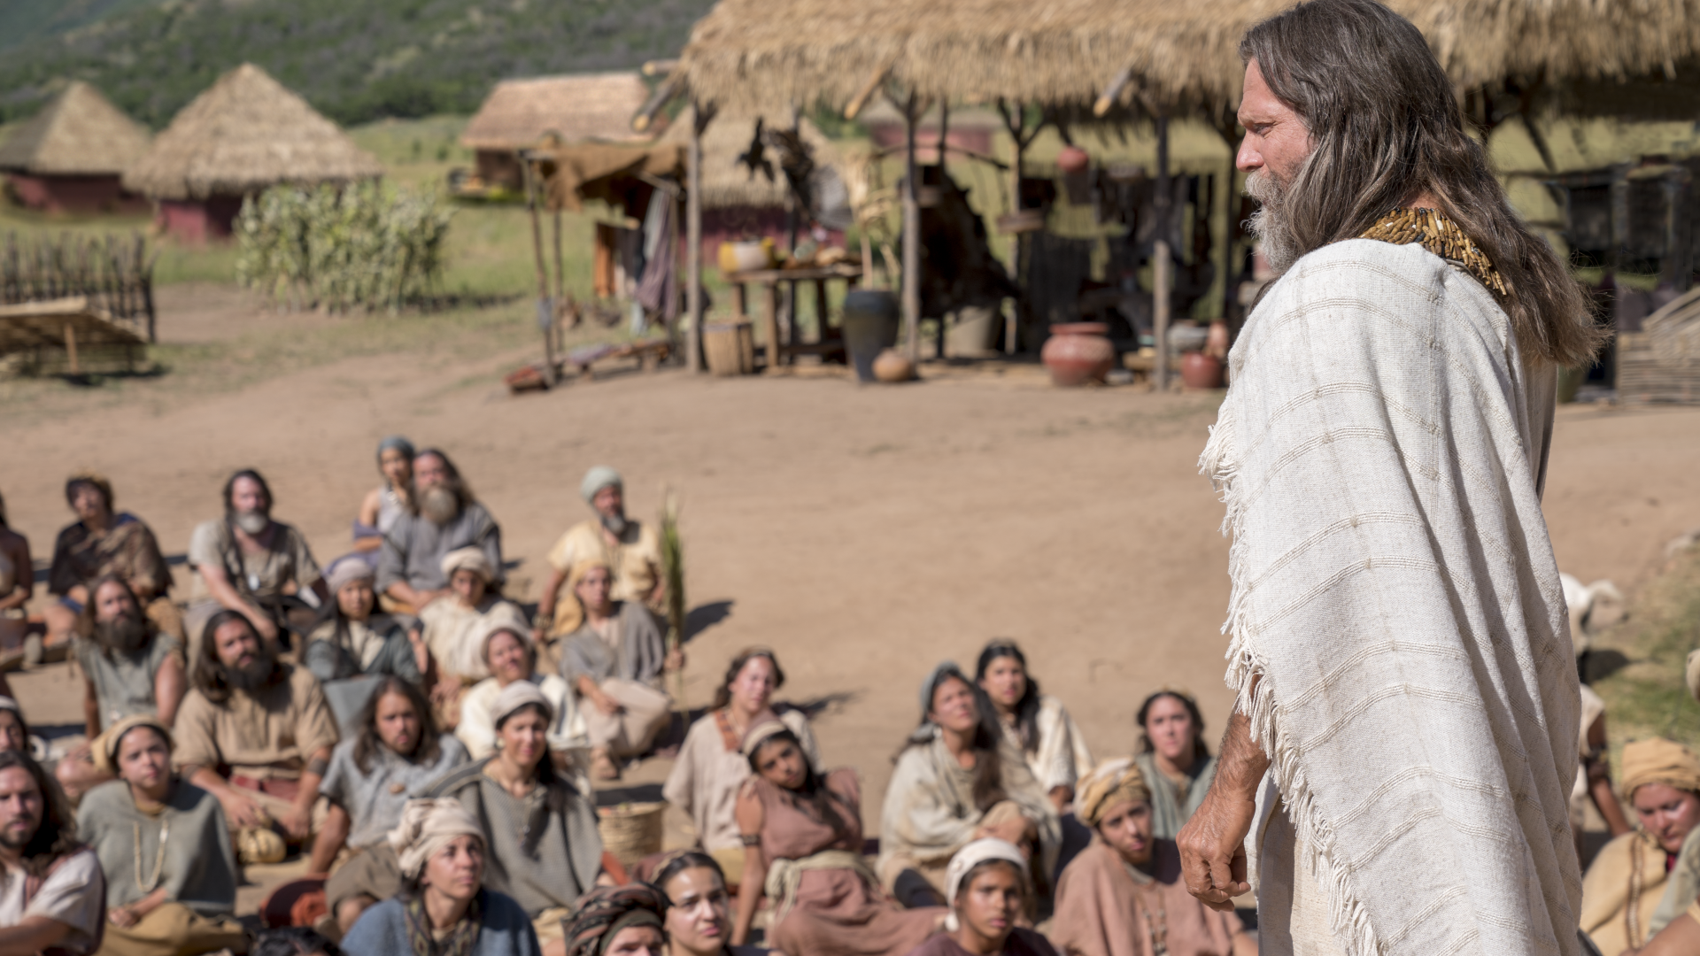
“Many of you have begun to search for gold…And the hand of providence hath smiled upon you most pleasingly, that you have obtained many riches; And because some of you have obtained more abundantly than that of your brethren ye are lifted up in the pride of your hearts…because of the costliness of your apparel, and persecute your brethren because ye suppose that ye are better than they....Do ye suppose that God justifieth you in this thing? Behold, I say unto you, Nay. But he condemneth you.”
Jacob 2:12–14
Notes:
https://assets.churchofjesuschrist.org/07/16/0716e64a935717bed2ebac19365ee0d9dd475d64/jacob_preaching.png

Slide 43
“Do ye not suppose that such things are abominable unto him who created all flesh? The one being is as precious in his sight as the other.”
Jacob 2:21
Notes:
https://assets.churchofjesuschrist.org/07/16/0716e64a935717bed2ebac19365ee0d9dd475d64/jacob_preaching.png

Slide 44
“Think of your brethren like unto yourselves, and be familiar with all and free with your substance, that they may be rich like unto you.”
Jacob 2:17
Notes:
https://assets.churchofjesuschrist.org/07/16/0716e64a935717bed2ebac19365ee0d9dd475d64/jacob_preaching.png

Slide 45
“But before ye seek for riches, seek ye for the kingdom of God. And after ye have obtained a hope in Christ ye shall obtain riches, if ye seek them; and ye will seek them for the intent to do good—to clothe the naked, and to feed the hungry, and to liberate the captive, and administer relief to the sick and the afflicted.”
Jacob 2:18–19
Notes:
https://assets.churchofjesuschrist.org/07/16/0716e64a935717bed2ebac19365ee0d9dd475d64/jacob_preaching.png

Slide 46
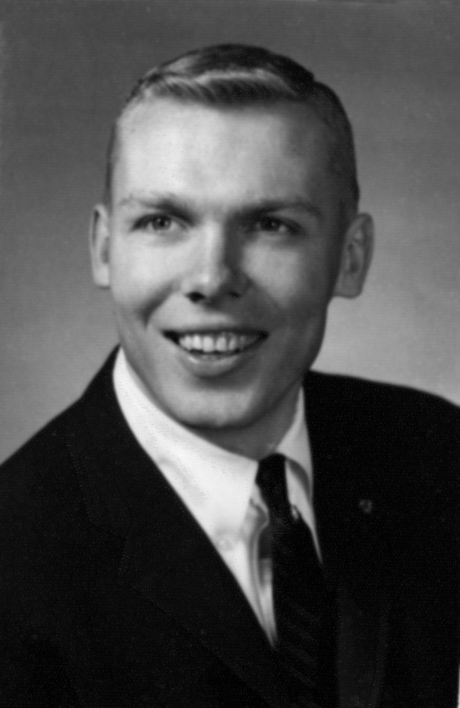
A modern-day example of living what Jacob is teaching is found in a man who was a military officer in Vietnam. He made $320 a month and paid $32 each month in tithing. But beyond that, he gave $50 each month to a family he felt was in greater need than he was. He didn’t have a lot of money, but that didn’t stop him from giving.
I wonder if God saw his giving heart when he didn’t have very much money and said, “This is a person I can trust to share with others what I to give him.”
Notes:
This young military officer was Jon Huntsman, Sr. went on to donate more than one billion dollars to philanthropic causes.
https://www.sltrib.com/news/2018/02/02/utah-billionaire-philanthropist-jon-huntsman-dies-at-80/

Slide 47
A modern-day example of living what Jacob is teaching is found in a man who was a military officer in Vietnam. He made $320 a month and paid $32 each month in tithing. But beyond that, he gave $50 each month to a family he felt was in greater need than he was. He didn’t have a lot of money, but that didn’t stop him from giving.
I wonder if God saw his giving heart when he didn’t have very much money and said, “This is a person I can trust to share with others what I to give him.”
Notes:
This young military officer was Jon Huntsman, Sr. went on to donate more than one billion dollars to philanthropic causes.
https://www.sltrib.com/news/2018/02/02/utah-billionaire-philanthropist-jon-huntsman-dies-at-80/

Slide 48
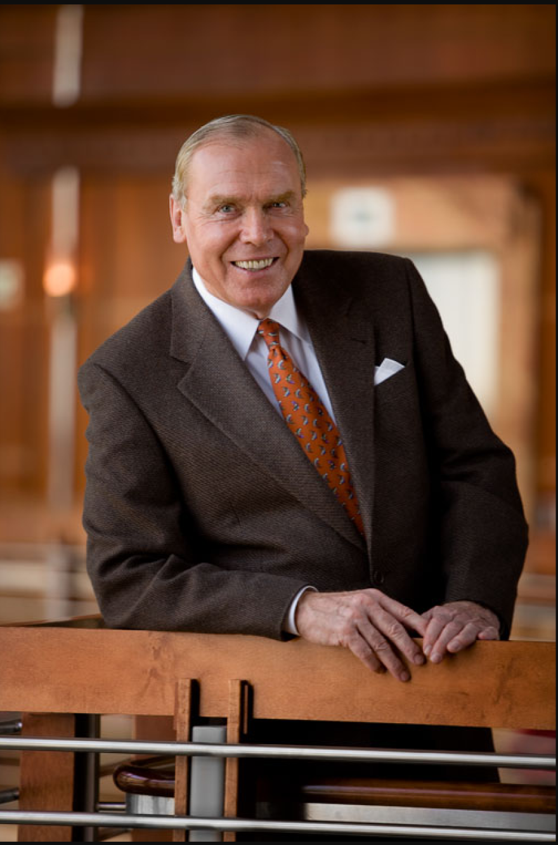
Notes:
This young military officer was Jon Huntsman, Sr. who went on to donate more than one billion dollars to philanthropic causes.
https://www.sltrib.com/news/2018/02/02/utah-billionaire-philanthropist-jon-huntsman-dies-at-80/

Slide 49

“People generally think about charitable work the wrong way. They think that when they’re older and comfortable they’ll give some amount of money to something but that’s not the way to do it. The way to do it is to get involved as early on as possible because, even if it’s just volunteer work or $5, the impact you’ll have over your lifetime is far greater than anything you could possibly do if you wait until you think you’re comfortable.
Notes:
https://thinkingheads.com/wp-content/uploads/2018/11/Biz-Stone-1.png

Slide 50
“Start now and start doing some volunteer work, donating a little bit here and there, over the next 40 years you’ll have a huge amount of impact and you’ll feel great about yourself.”
Biz Stone, Twitter co-founder
Notes:
https://thinkingheads.com/wp-content/uploads/2018/11/Biz-Stone-1.png

Slide 51
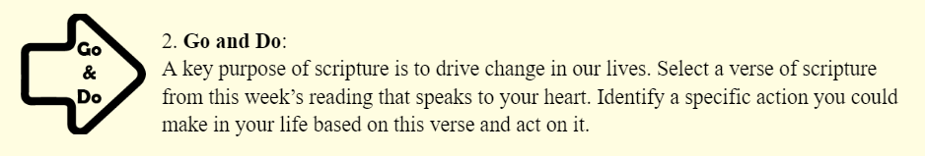

Slide 52
One-liner #5:
The Lord delights in chastity

Slide 53
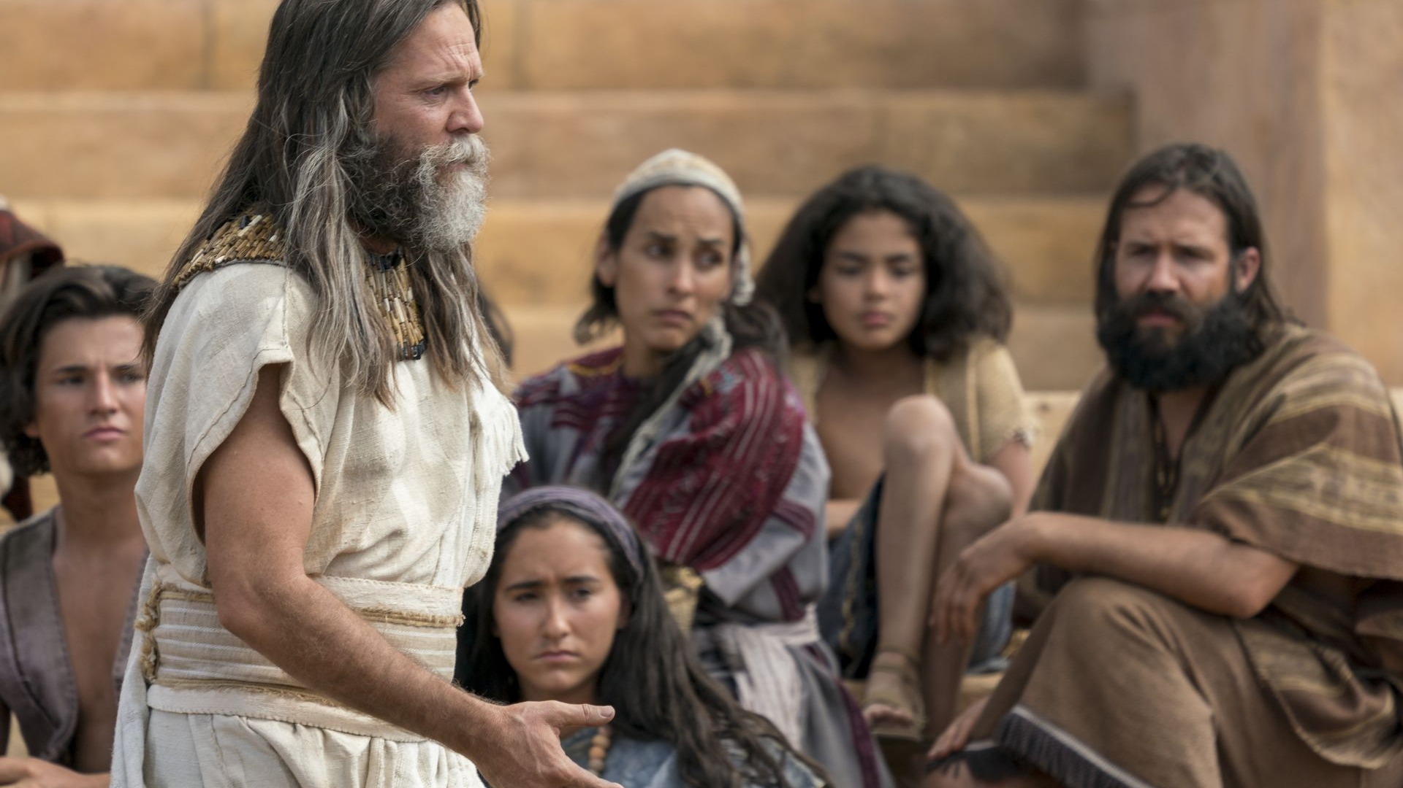
“Hearken to the word of the Lord: For there shall not any man among you have save it be one wife; and concubines he shall have none.”
Jacob 2:27
Notes:
https://assets.churchofjesuschrist.org/5e/5f/5e5fc1d08544c49b1e0905ea0a467339ea2ce0b6/jacob_teaching.jpeg

Slide 54
“If I will...raise up seed unto me, I will command my people.”
Jacob 2:30
Notes:
https://assets.churchofjesuschrist.org/5e/5f/5e5fc1d08544c49b1e0905ea0a467339ea2ce0b6/jacob_teaching.jpeg

Slide 55
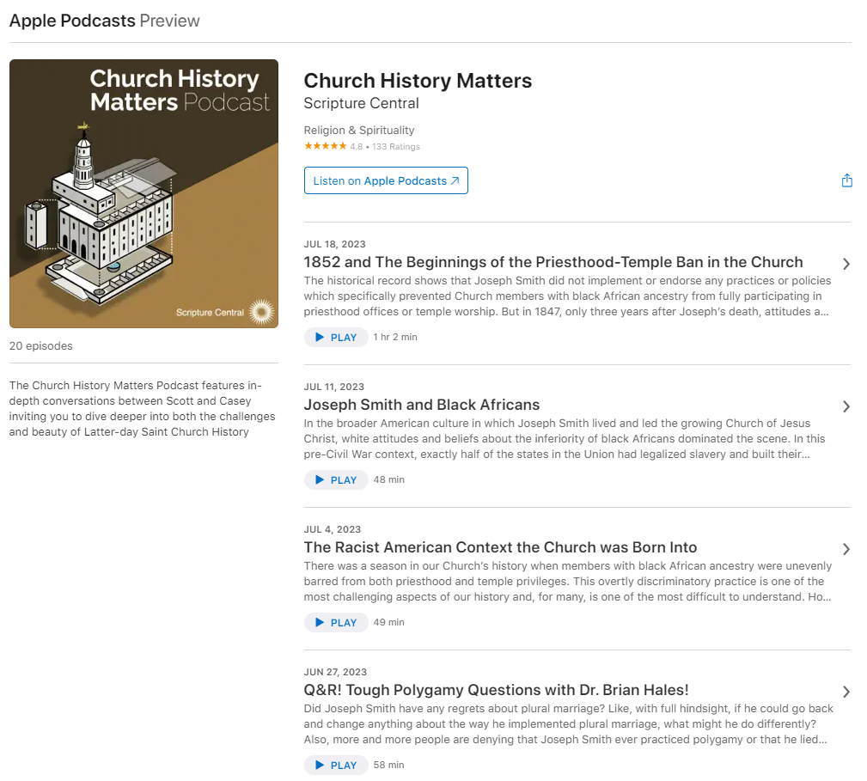
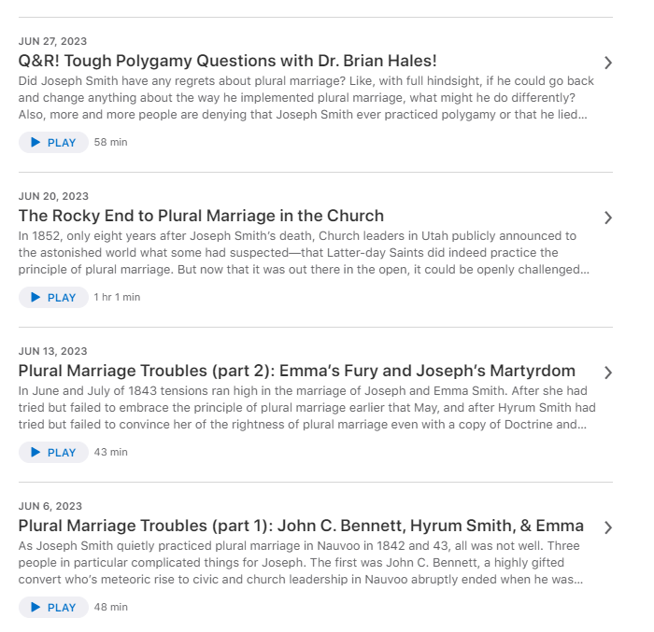

Slide 56
Why is it so important to stay sexually pure?

Slide 57

dailyhogar.com
Notes:
http://www.dailyhogar.com/20-signs-so-obvious-they-will-certainly-make-you-laugh/11/

Slide 58
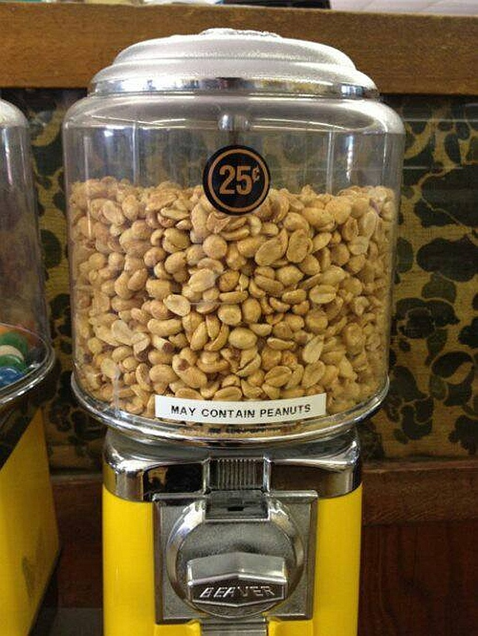
dailyhogar.com
Notes:
http://www.dailyhogar.com/20-signs-so-obvious-they-will-certainly-make-you-laugh/12/

Slide 59
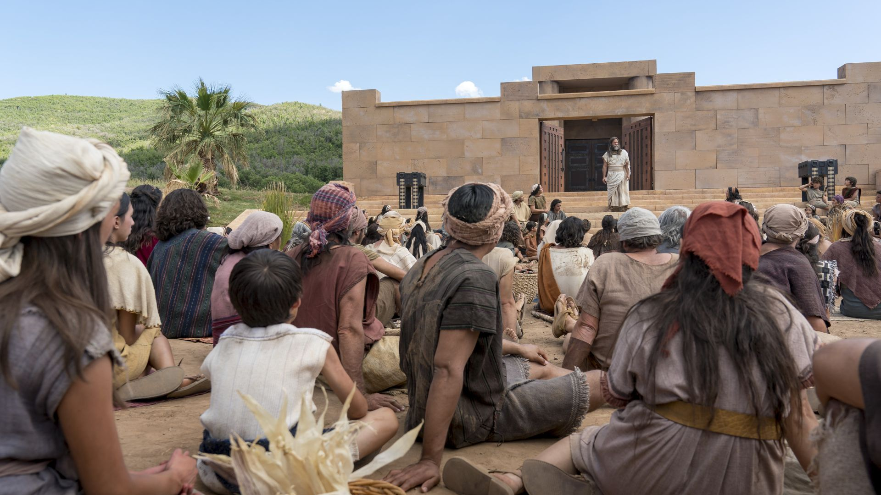
“I, the Lord God, delight in...chastity.”
Jacob 2:28
Notes:
https://assets.churchofjesuschrist.org/47/a4/47a4417e9fb531fdb2c99642837e2e475cd43d59/jacob_teaching.jpeg

Slide 60
Sexual sin is an “abomination” to God
Jacob 2:28
Notes:
https://assets.churchofjesuschrist.org/47/a4/47a4417e9fb531fdb2c99642837e2e475cd43d59/jacob_teaching.jpeg

Slide 61
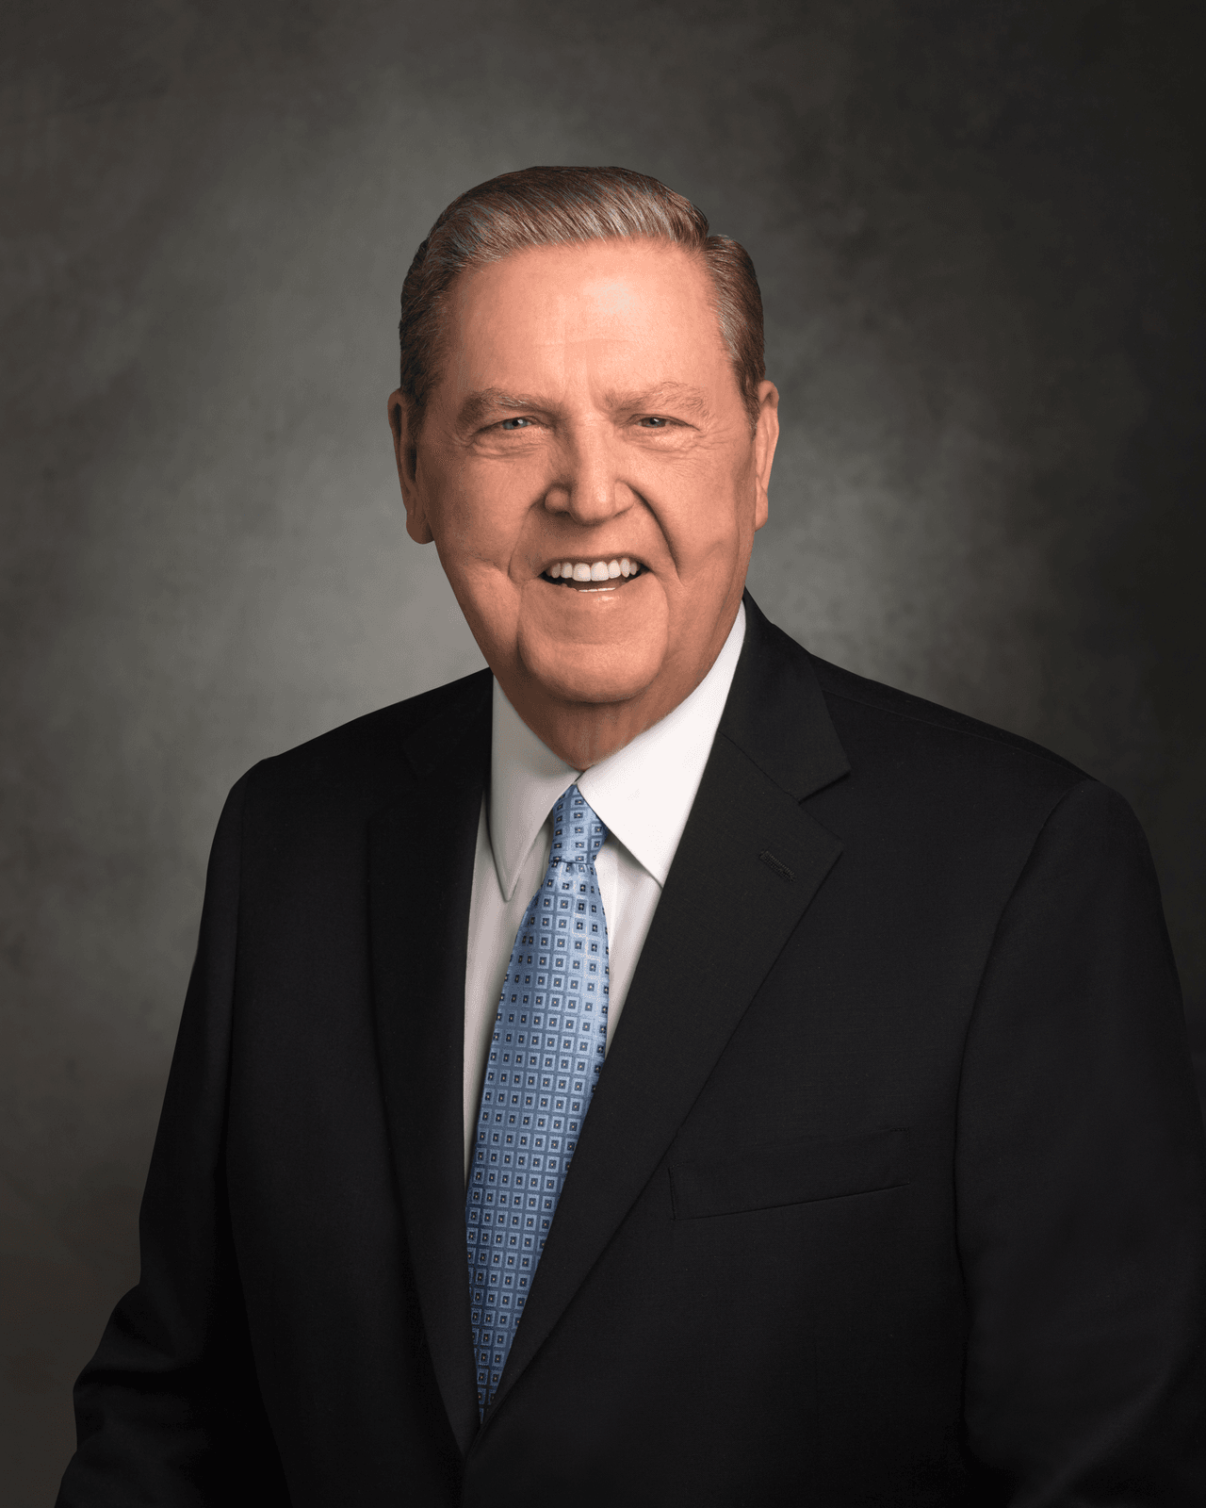
“We declare that one who uses the God- given body of another without divine sanction abuses the very soul of that individual...In exploiting the body of another—which means exploiting his or her soul—one desecrates the Atonement of Christ, which saved that soul and which makes possible the gift of eternal life. And when one mocks the Son of Righteousness, one steps into a realm of heat hotter and holier than the noonday sun. You cannot do so and not be burned.”
(Ensign, Nov. 1998, 76)
Notes:
https://assets.churchofjesuschrist.org/3277c15375c921b1ecfa89ce2d59d745719a1067.png

Slide 62
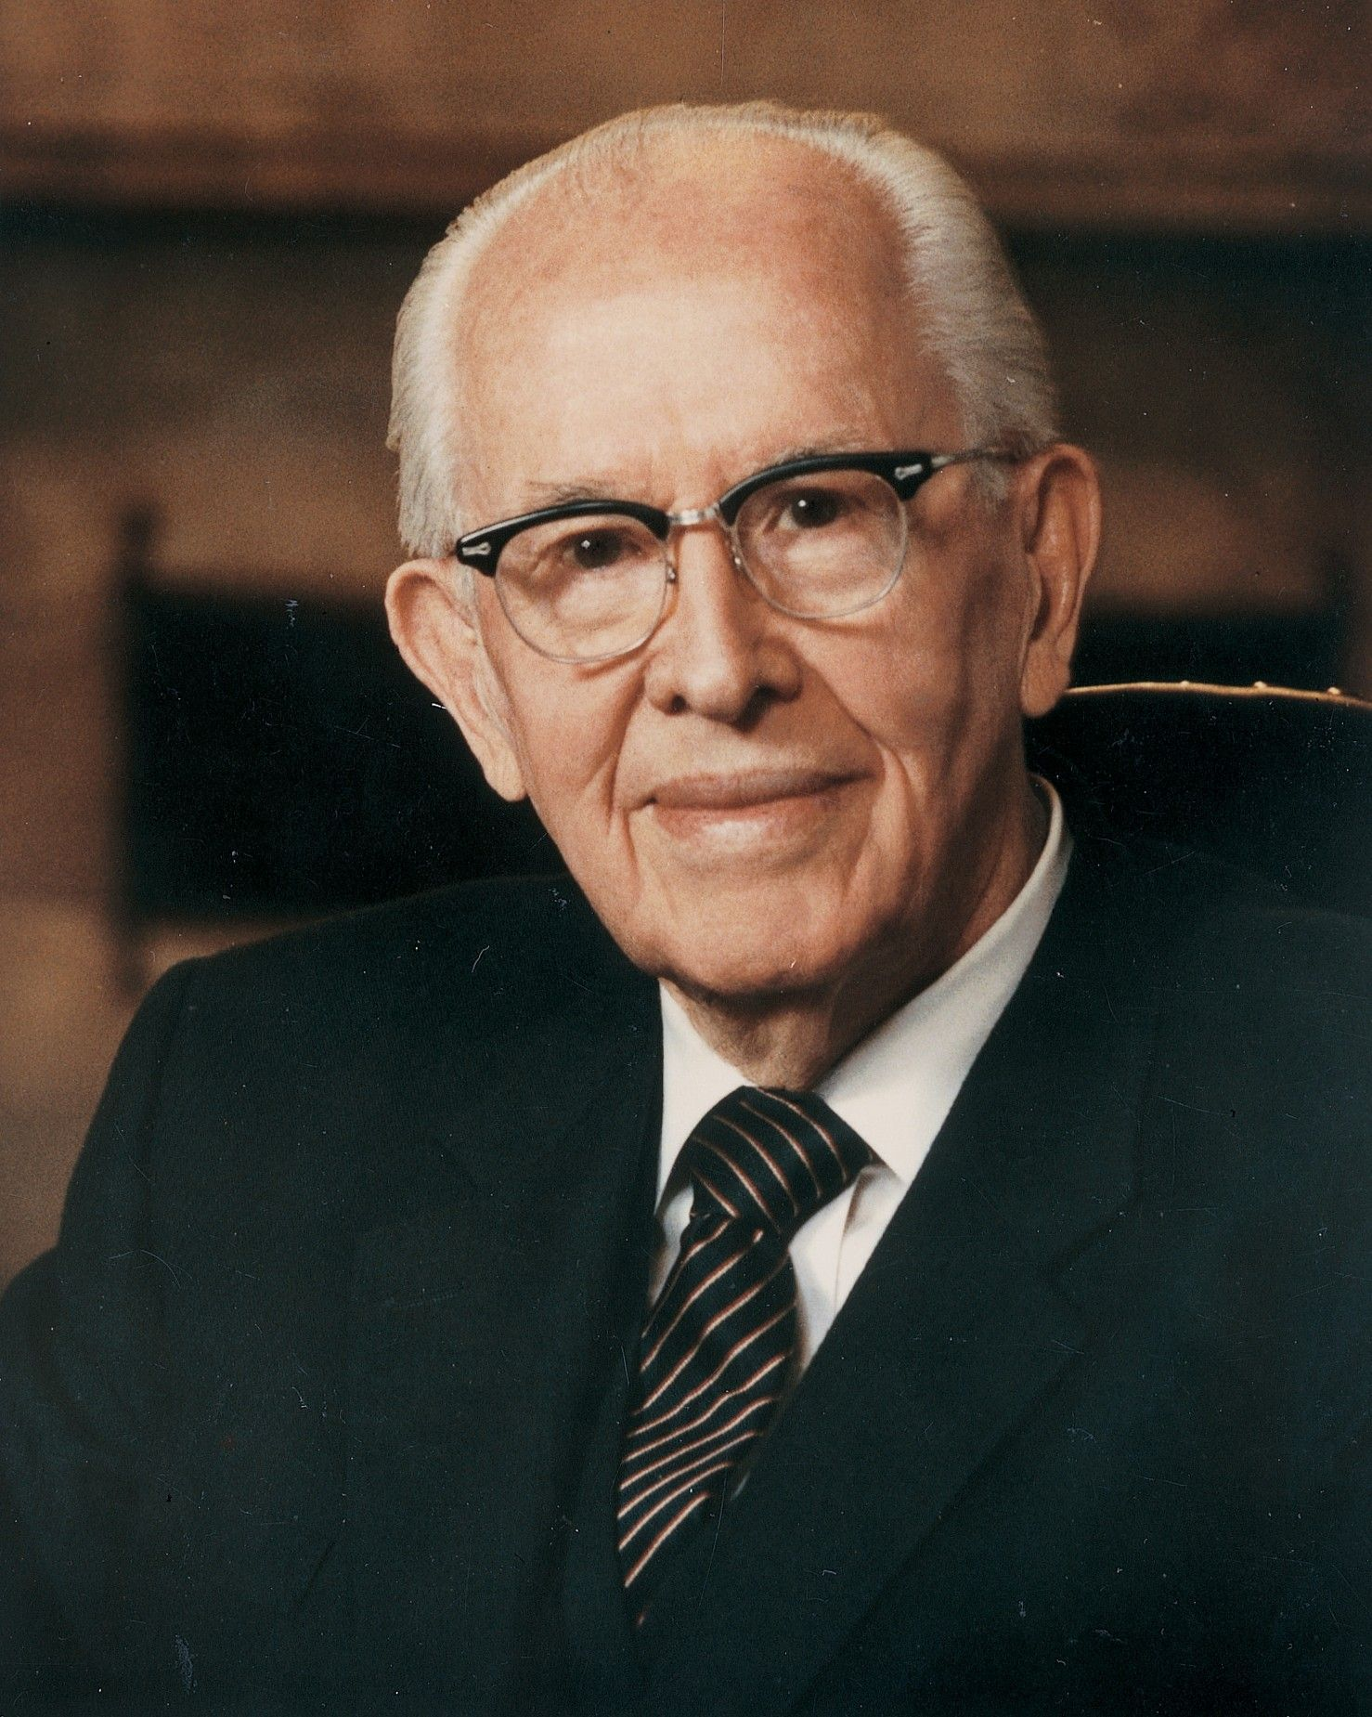
“We all have a need to feel loved and worthwhile…Knowing this, Satan often lures people into immorality by playing on their basic needs. He promises pleasure, happiness, and fulfillment. But this is, of course, a deception...Do not be misled by Satan’s lies. There is no lasting happiness in immorality. There is no joy to be found in breaking the law of chastity.
Notes:
https://assets.churchofjesuschrist.org/73/1d/731dba7762afb2310cb0c39571d9582d7bec335c/portrait_ezra_taft_benson_1986.jpeg

Slide 63
“Just the opposite is true. There may be momentary pleasure. For a time it may seem like everything is wonderful. But quickly the relationship will sour. Guilt and shame set in. We become fearful that our sins will be discovered. We must sneak and hide, lie and cheat. Love begins to die. Bitterness, jealousy, anger, and even hate begin to grow. All of these are the natural results of sin and transgression.”
Ezra Taft Benson, BYU Devotional, October 13, 1987
Notes:
https://assets.churchofjesuschrist.org/73/1d/731dba7762afb2310cb0c39571d9582d7bec335c/portrait_ezra_taft_benson_1986.jpeg

Slide 64
Just Friends
“The Line of Sin”
Sex

Slide 65
Quick hug
Hold hands
Quick kiss on the lips
Making out
Handshake
Sex
High Five
Side hug
Long hug
Kiss on the cheek
Long kiss
Touching private parts

Slide 66
Quick hug
Hold hands
Quick kiss on the lips
Making out
Handshake
Sex
High Five
Side hug
Long hug
Kiss on the cheek
Long kiss
Touching private parts

Slide 67
Quick hug
Hold hands
Quick kiss on the lips
Making out
Handshake
Sex
High Five
Side hug
Long hug
Kiss on the cheek
Long kiss
Touching private parts

Slide 68
Quick hug
Hold hands
Quick kiss on the lips
Making out
Handshake
Sex
High Five
Side hug
Long hug
Kiss on the cheek
Long kiss
Touching private parts

Slide 69
Quick hug
Hold hands
Quick kiss on the lips
Making out
Handshake
Sex
High Five
Side hug
Long hug
Kiss on the cheek
Long kiss
Touching private parts

Slide 70
Quick hug
Hold hands
Quick kiss on the lips
Making out
Handshake
Sex
High Five
Side hug
Long hug
Kiss on the cheek
Long kiss
Touching private parts

Slide 71
Quick hug
Hold hands
Quick kiss on the lips
Making out
Handshake
Sex
High Five
Side hug
Long hug
Kiss on the cheek
Long kiss
Touching private parts

Slide 72
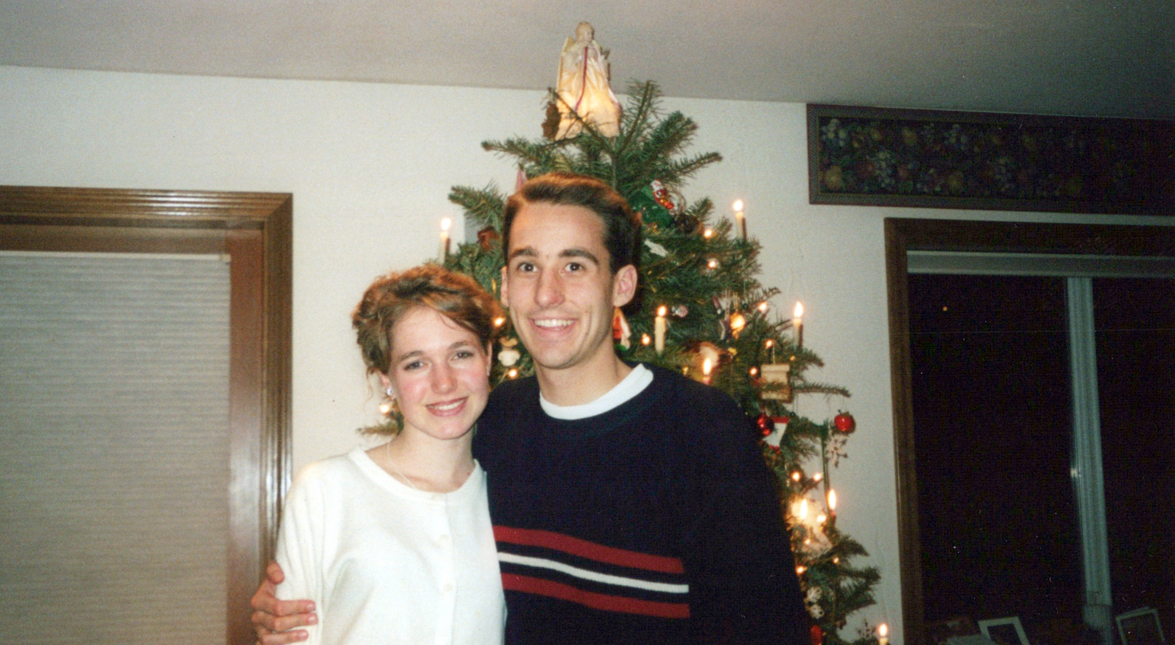

Slide 73
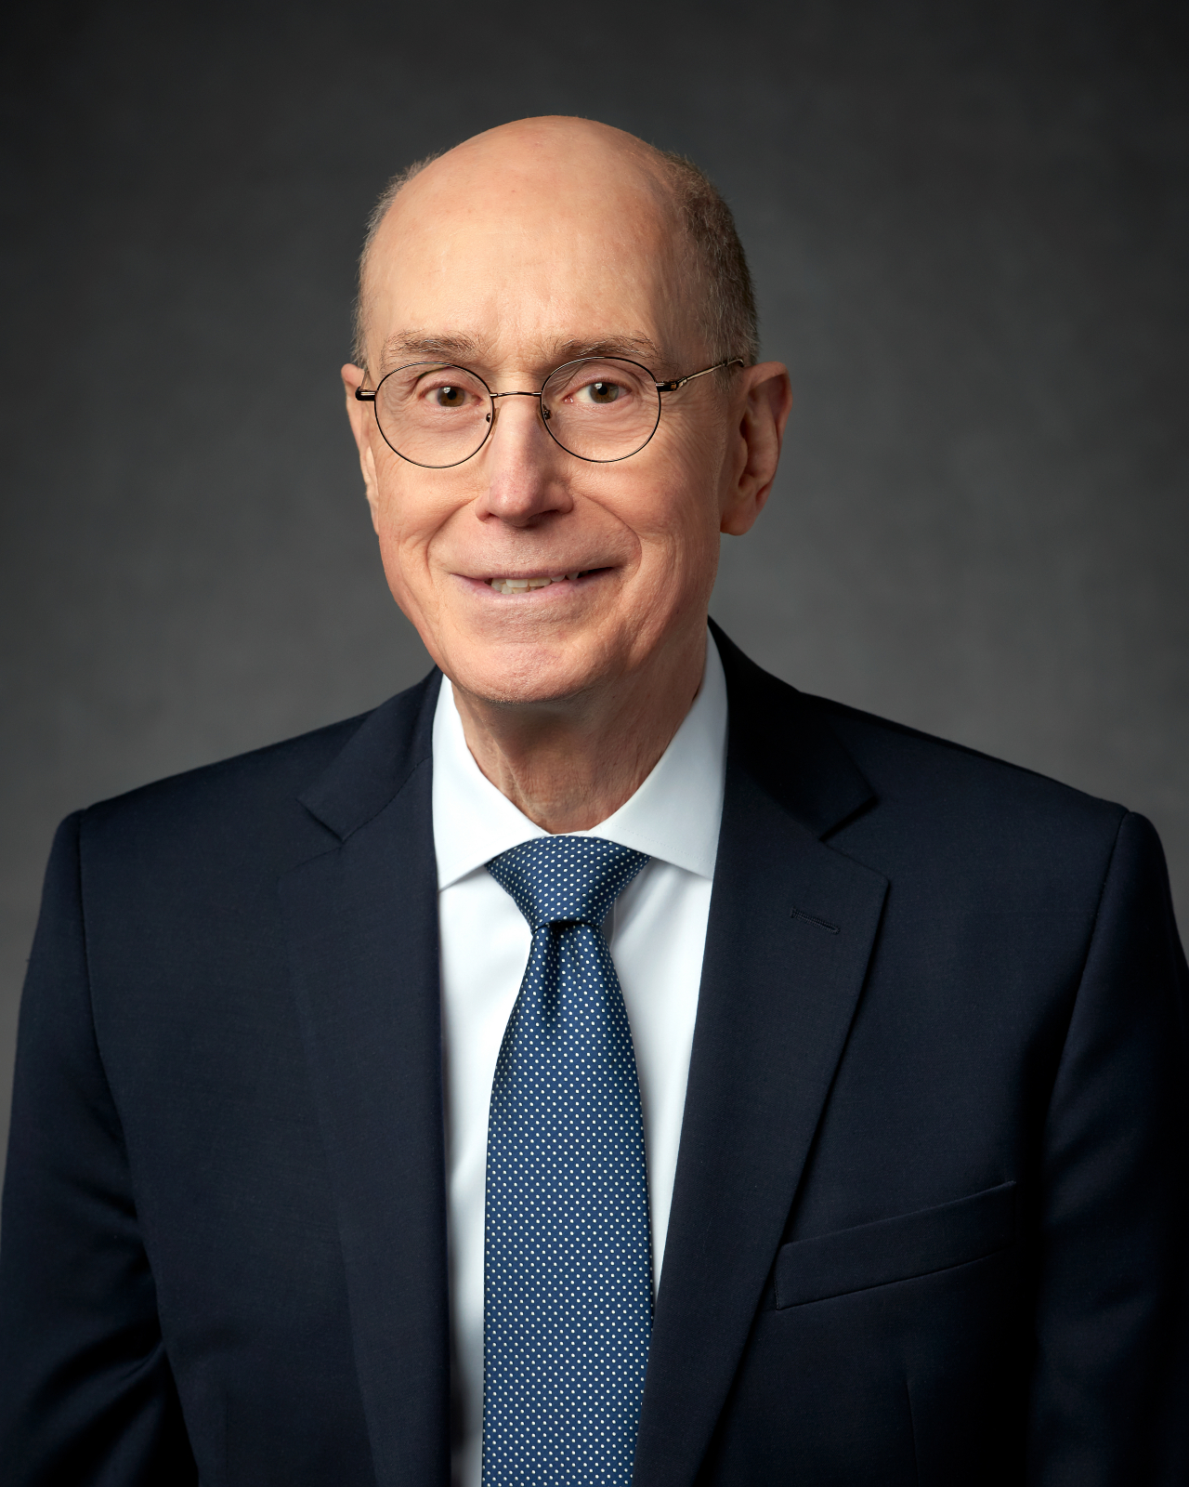
“The question that really matters is this: How can I learn to sense even the beginning of sin and so repent early?”
President Eyring, “Do Not Delay”
Notes:
https://assets.ldscdn.org/b3/15/b315d6ced1c9182f2afc0e29dd2d3139f950e78f/henry_eyring_official_portrait_2018.jpeg

Slide 74
Just Friends
“The Line of Sin”
All The Way
“A line you set for yourself to keep from ever getting close to the line.”

Slide 75
“Outside of marriage between a man and a woman, it is wrong to touch the private, sacred parts of another person’s body even if clothed.”
For the Strength of Youth, 2022

Slide 76
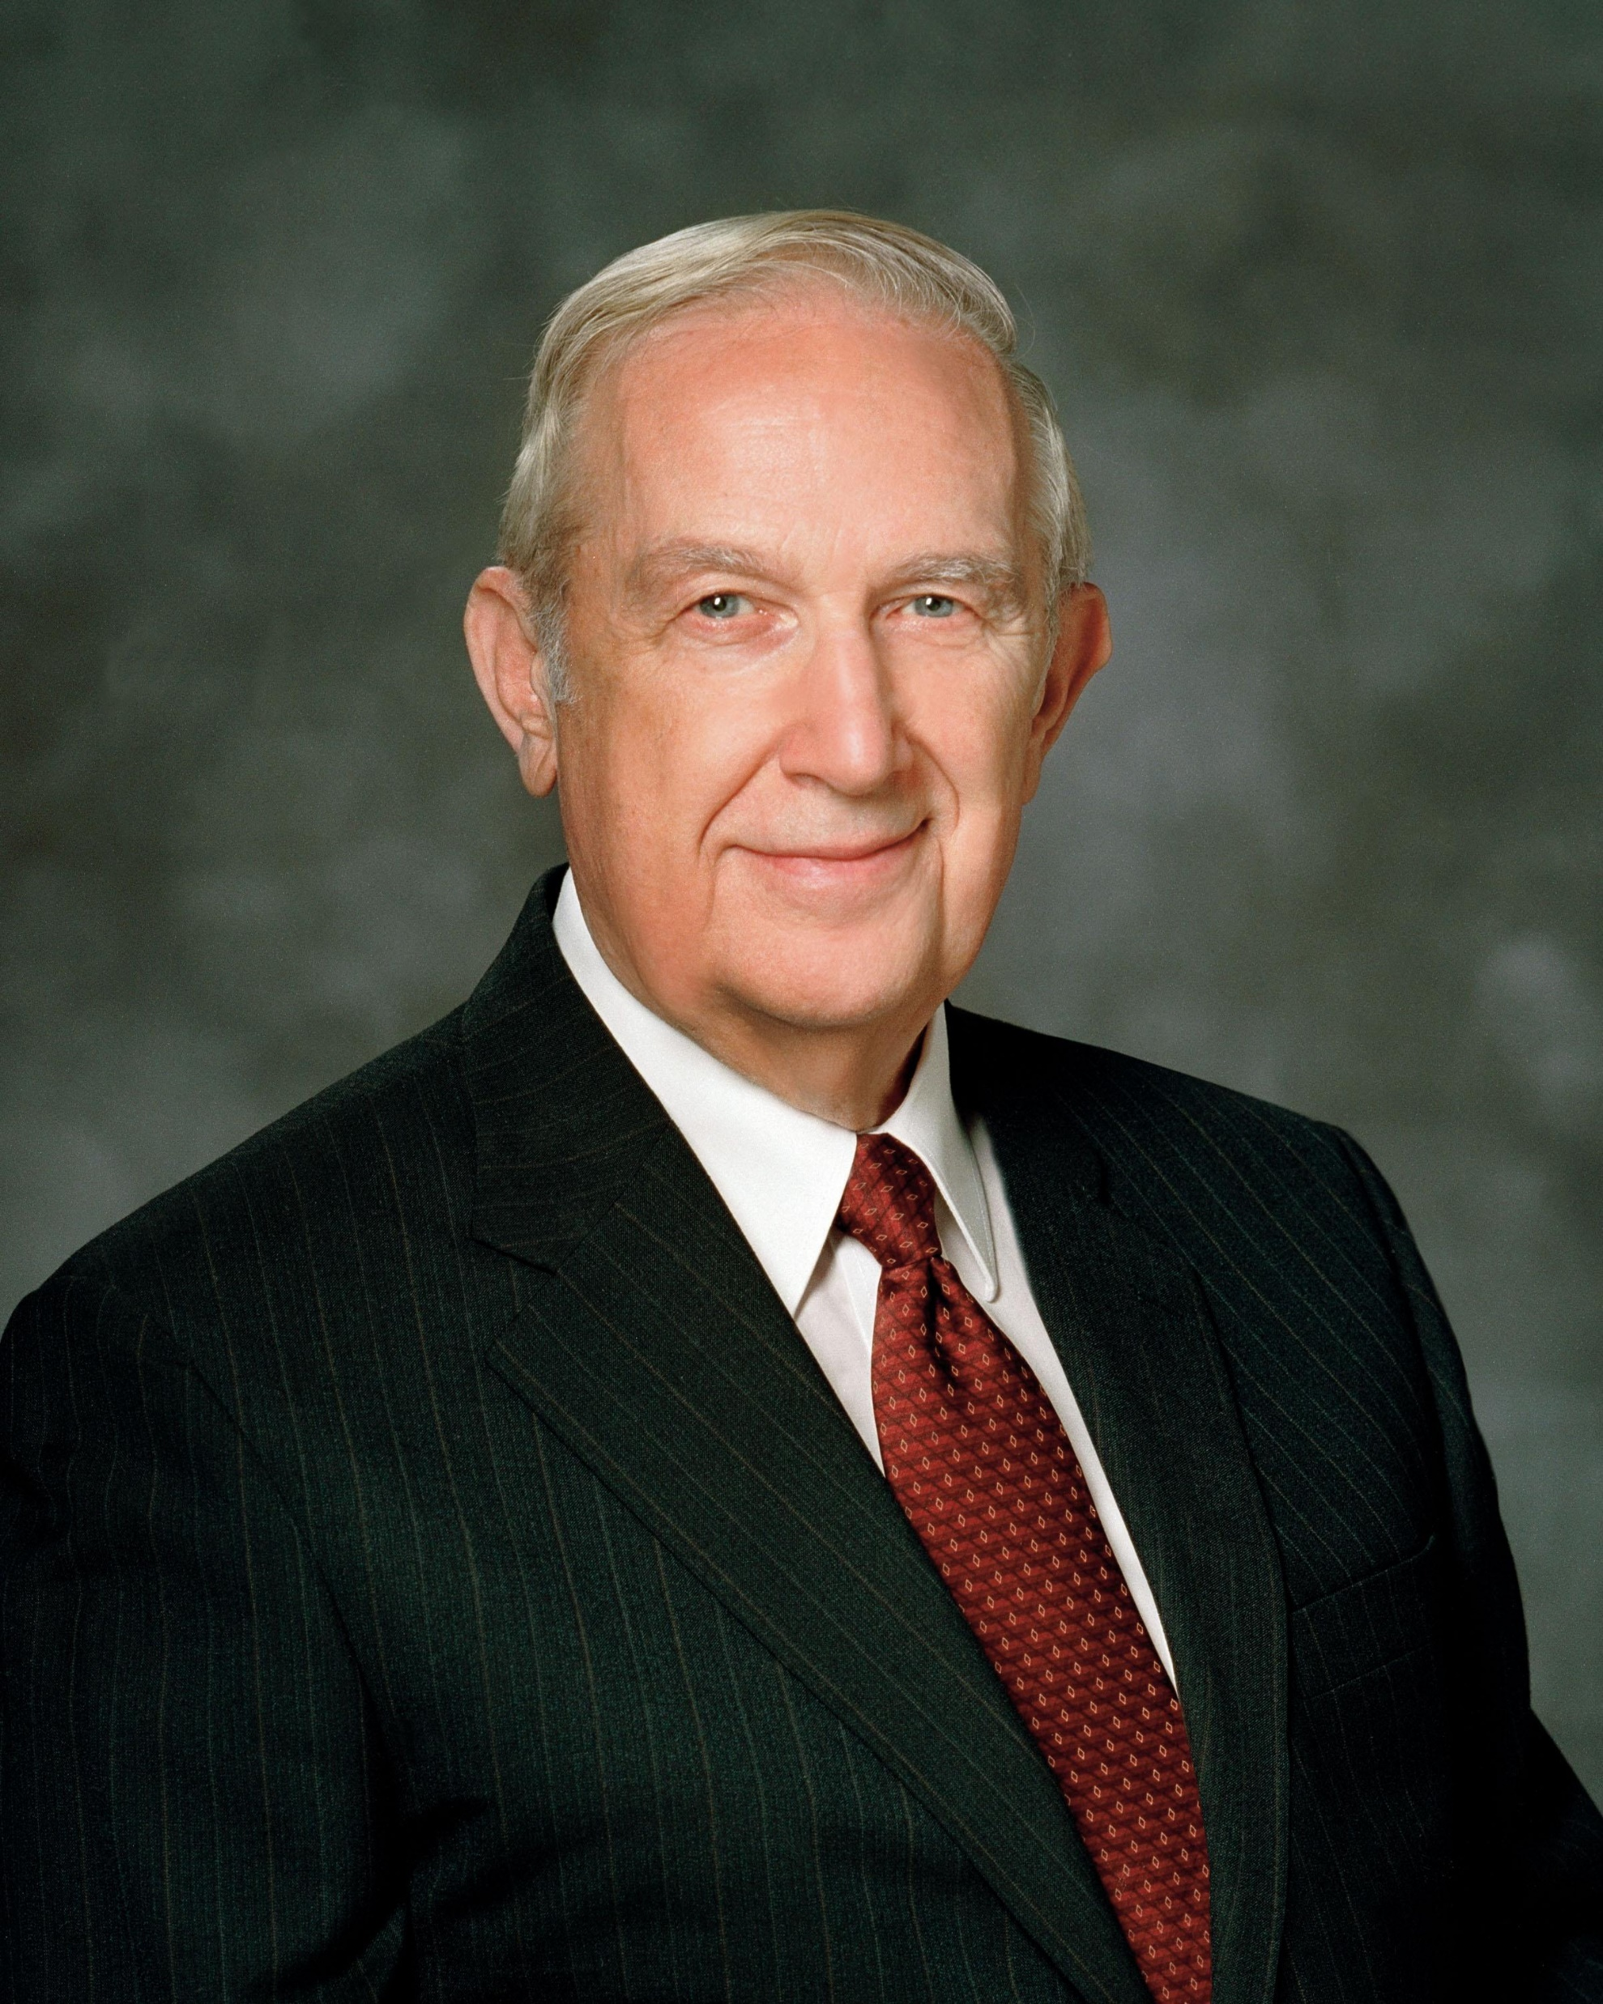
“Firmly establish personal standards. Choose a time of deep spiritual reflection, when there is no pressure on you, and you can confirm your decisions by sacred impressions. Decide then what you will do and what you will not do to express feelings. The Spirit will guide you. Then do not vary from those decisions no matter how right it may seem when the temptation comes...The realization of your dreams depends upon your determination to never betray your standards.”
Elder Richard G. Scott, “Do What is Right”
Notes:
https://newsroom.churchofjesuschrist.org/media/orig/Scott.jpg

Slide 77
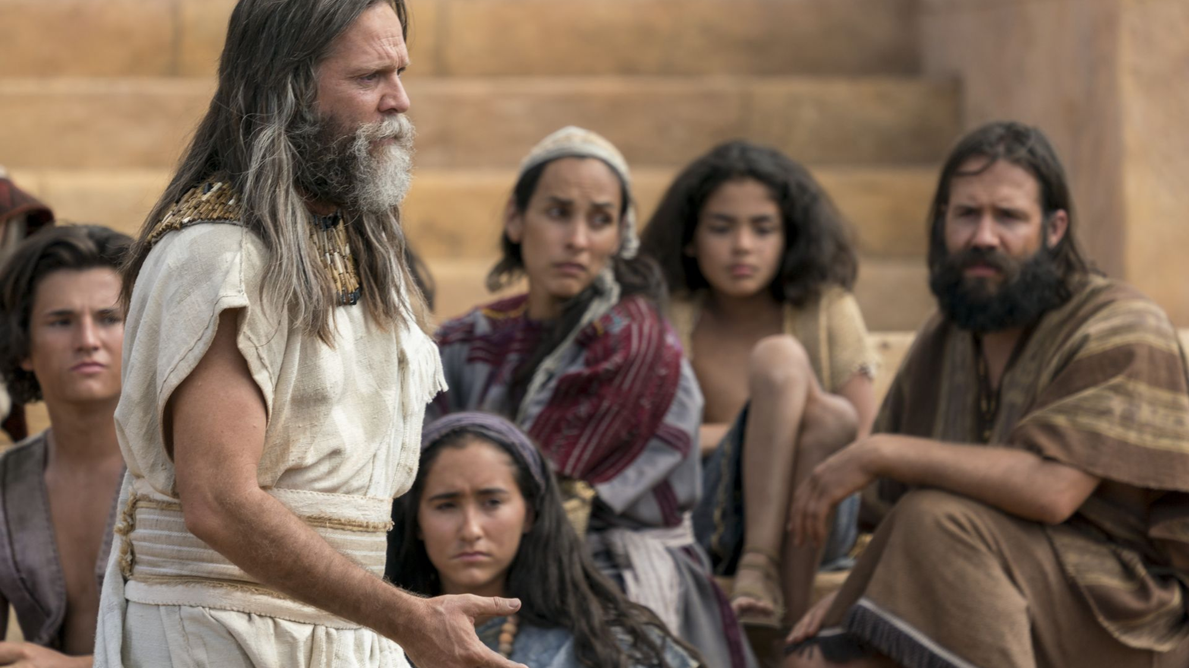
“I, Jacob, spake many more things unto the people of Nephi, warning them against fornication and lasciviousness [lust], and every kind of sin, telling them the awful consequences of them.”
Jacob 3:12
Notes:
https://assets.churchofjesuschrist.org/5e/5f/5e5fc1d08544c49b1e0905ea0a467339ea2ce0b6/jacob_teaching.jpeg

Slide 78
“Consider sin as a spiritual wound that causes guilt… Guilt is to our spirit what pain is to our body—a warning of danger and a protection from additional damage. From the Atonement of the Savior flows the soothing salve that can heal our spiritual wounds and remove guilt.”
Elder Bednar, “We Believe in Being Chaste”
Notes:
https://assets.churchofjesuschrist.org/32/79/3279084dd79a59bc3b6eec726f1e78cfee206c62/bednar_official_portrait.png

Slide 79
“The [law of chastity] will seem to be archaic and outdated to many people in a world that increasingly mocks the sanctity of procreation and minimizes the worth of human life. But the Lord’s truth is not altered by fads, popularity, or public opinion polls. I promise that obedience to the law of chastity will increase our happiness in mortality and make possible our progress in eternity.”
Elder Bednar, “We Believe in Being Chaste”
Notes:
https://assets.churchofjesuschrist.org/32/79/3279084dd79a59bc3b6eec726f1e78cfee206c62/bednar_official_portrait.png

Slide 80
One-Liner #6:
Love your spouse

Slide 81
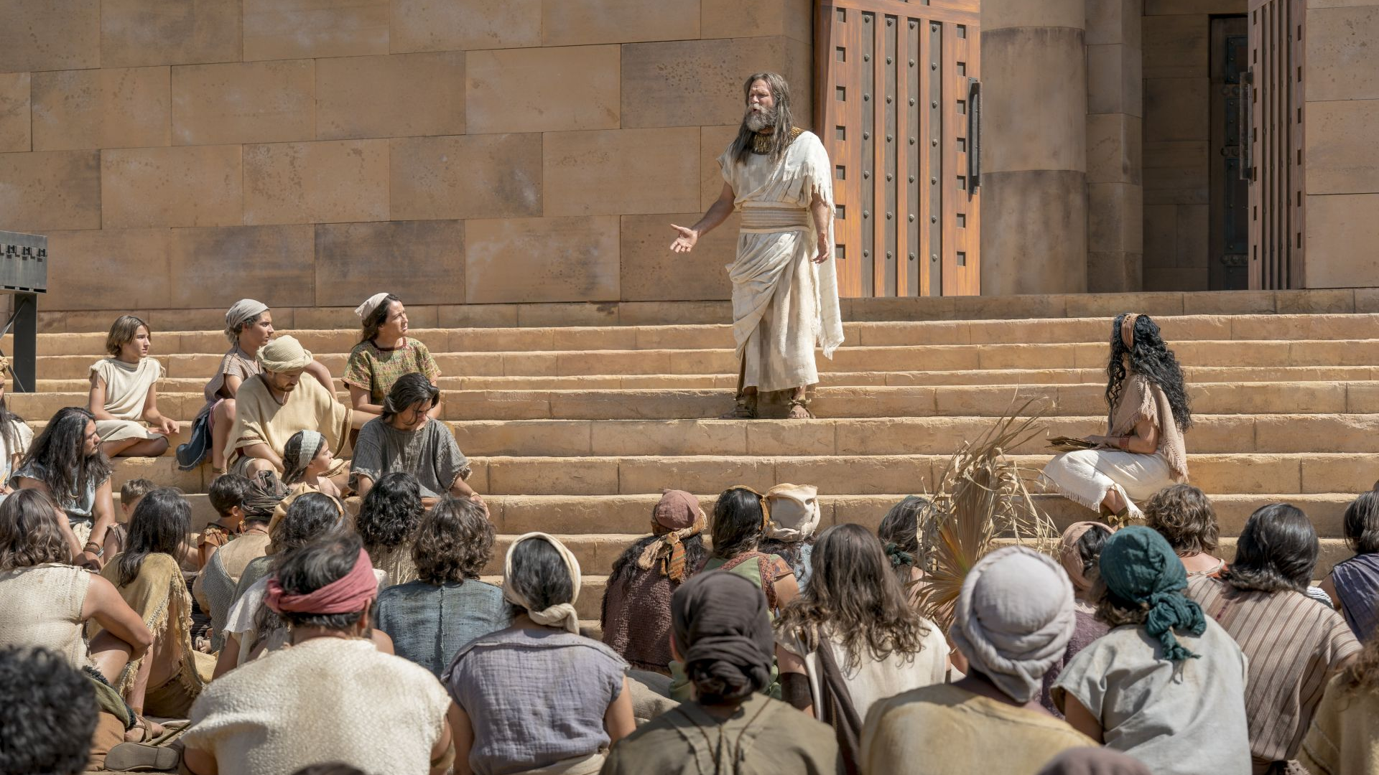
“Ye have done greater iniquities than the Lamanites, our brethren. Ye have broken the hearts of your tender wives, and lost the confidence of your children, because of your bad examples before them; and the sobbings of their hearts ascend up to God against you.”
Jacob 2:35
Notes:
https://assets.churchofjesuschrist.org/87/11/8711b5674028db9cc557f425073269363422656c/jacob_teaching.jpeg

Slide 82
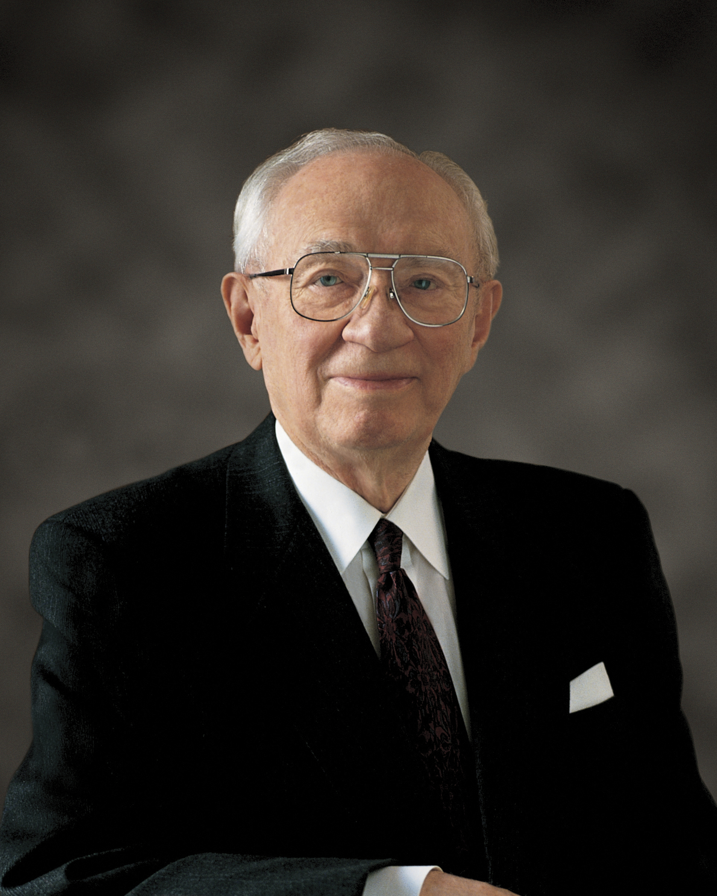
“Every woman is a daughter of God. You cannot offend her without offending Him.”
President Hinckley, “The Women in Our Lives”
Notes:
https://assets.churchofjesuschrist.org/d3/a5/d3a5940176422d380bbb93a1b984c3bf730a2f501074071/gordon_b_hinckley.jpeg

Slide 83
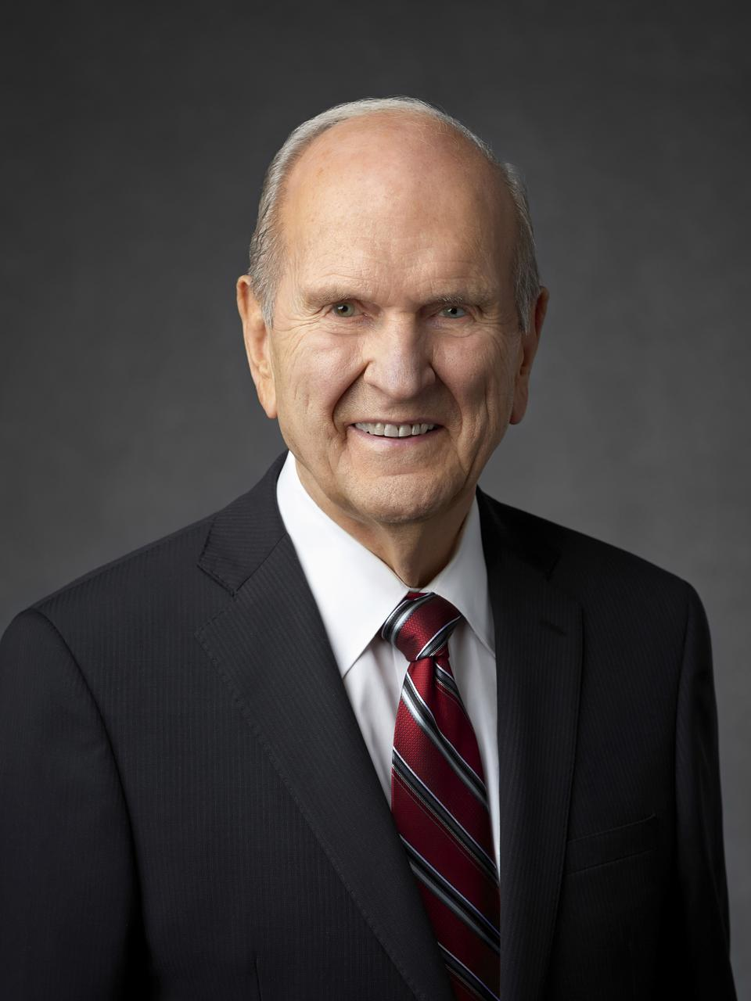
“On a recent flight, I sat behind a husband and wife. She obviously loved her husband. As she stroked the back of his neck I could see her wedding ring. She would nestle close to him and rest her head upon his shoulder, seeking his companionship. In contrast, he seemed totally oblivious to her presence. He was focused solely upon an electronic game player.
Notes:
https://newsroom.churchofjesuschrist.org/media/960x1280/President-Russell-M-Nelson-1-2018.jpg

Slide 84
“During the entire flight, his attention was riveted upon that device. Not once did he look at her, speak to her, or acknowledge her yearning for affection. His inattention made me feel like shouting: ‘Open your eyes, man! Can’t you see? Pay attention! Your wife loves you! She needs you!’ ... Marriage brings greater possibilities for happiness than does any other human relationship.
Notes:
https://newsroom.churchofjesuschrist.org/media/960x1280/President-Russell-M-Nelson-1-2018.jpg

Slide 85
“Yet some married couples fall short of their full potential. They let their romance become rusty, take each other for granted, allow other interests or clouds of neglect to obscure the vision of what their marriage really could be. Marriages would be happier if nurtured more carefully.”
President Nelson, “Nurturing Marriage”
Notes:
https://newsroom.churchofjesuschrist.org/media/960x1280/President-Russell-M-Nelson-1-2018.jpg

Slide 86
“[Lamanite] husbands love their wives, and their wives love their husbands; and their husbands and their wives love their children...because of this observance, in keeping this commandment, the Lord God will not destroy them, but will be merciful unto them; and one day they shall become a blessed people.”
Jacob 3:7, 6
Notes:
https://assets.churchofjesuschrist.org/47/a4/47a4417e9fb531fdb2c99642837e2e475cd43d59/jacob_teaching.jpeg

Slide 87
“Look unto God with firmness of mind, and pray unto him with exceeding faith, and he will console you in your afflictions… O all ye that are pure in heart, lift up your heads and receive the pleasing word of God, and feast upon his love; for ye may, if your minds are firm, forever.”
Jacob 3:1– 2
Notes:
https://assets.churchofjesuschrist.org/47/a4/47a4417e9fb531fdb2c99642837e2e475cd43d59/jacob_teaching.jpeg

Slide 88
“Feast upon his love; for ye may, if your minds are firm, forever.”
Jacob 3:2
Notes:
https://assets.churchofjesuschrist.org/47/a4/47a4417e9fb531fdb2c99642837e2e475cd43d59/jacob_teaching.jpeg

Slide 89


For free resources related to this video, please visit https://johnhiltoniii.com/TheBookofMormon
Join our course discussions on social media
@johnhiltoniii

Slide 90
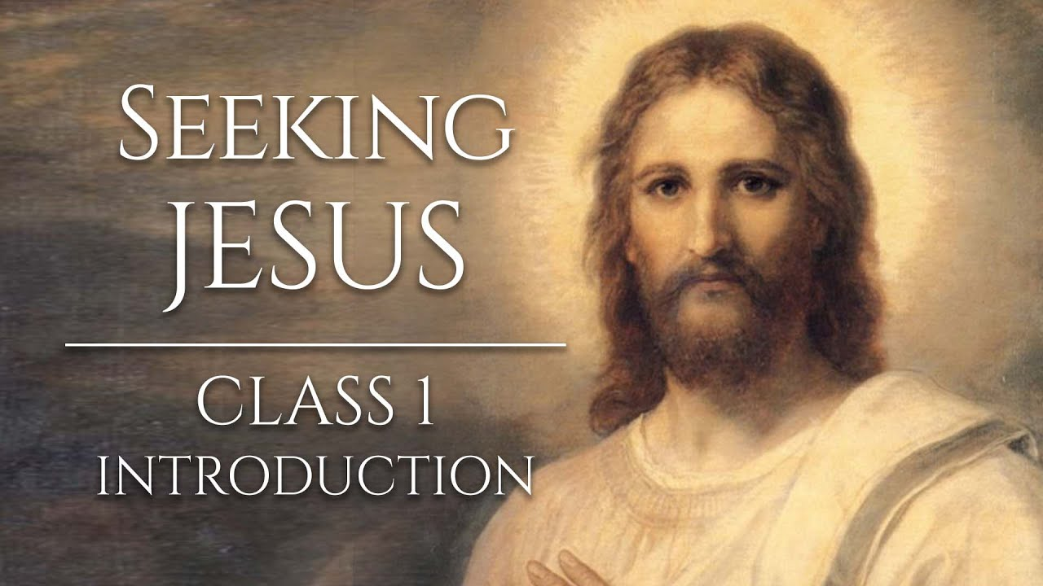
https://johnhiltoniii.com/SeekingJesus
You may also be interested in this
free video course…

Slide 91
This video is not produced or endorsed by Brigham Young University or the Church of Jesus Christ of Latter-day Saints.
John Hilton III is solely responsible for its contents
Insights from, discussions with, and resources authored by
by Bishop Hawkins, Deidre Green, Kevin Spear, Anthony Sweat and John Tanner were used in the creation of this video. See further acknowledgements at https://johnhiltoniii.com/thebookofmormon

