Slide 1


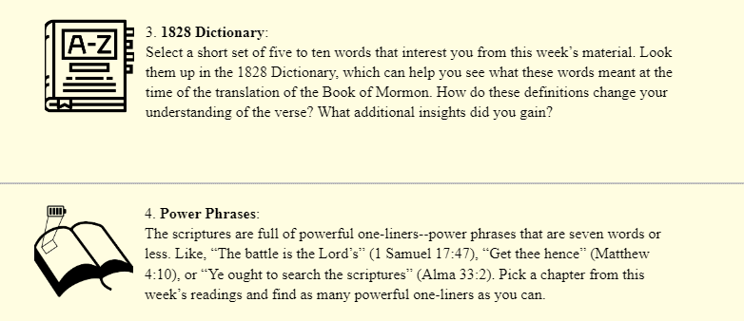
Find a list of scripture study tools at
johnhiltoniii.com/thebookofmormon/resources/

Slide 2
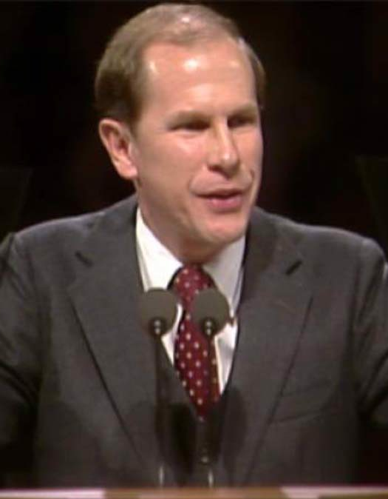
Elder Cook was on an airplane, sitting next to a woman who he described as “probably the most worldly looking” person he had ever been around.
They began to talk and once the woman found out that Elder Cook was a church member, she began to chew him out, saying that she had lived with many different men and that the church’s teachings on the law of chastity were ridiculous!
Elder Gene R. Cook, Searching the Scriptures, 33-35
Notes:
https://newsroom.churchofjesuschrist.org/media/960x1280/President-Russell-M-Nelson-1-2018.jpg

Slide 3
After she finished, she asked, “What do you think about that?”
Elder Cook said that he didn’t think she really wanted to know what he thought, but she said, “you’ve been polite listening to me. I’ll listen to what you think.
He said, “I’ll give you better [than what I think.] I’ll give you what the Lord said about it.”
Elder Gene R. Cook, Searching the Scriptures, 33-35
Notes:
https://newsroom.churchofjesuschrist.org/media/960x1280/President-Russell-M-Nelson-1-2018.jpg

Slide 4
He read from Doctrine and Covenants 63:16: “If any shall commit adultery in their hearts, they shall not have the Spirit, but shall deny the faith and fear.”
Elder Gene R. Cook, Searching the Scriptures, 33-35
Notes:
https://newsroom.churchofjesuschrist.org/media/960x1280/President-Russell-M-Nelson-1-2018.jpg

Slide 5
The woman began to cry. As the plane landed and the woman got off, she whispered quietly, “You are right, Mr. Cook.”
Elder Gene R. Cook, Searching the Scriptures, 33-35
Notes:
https://newsroom.churchofjesuschrist.org/media/960x1280/President-Russell-M-Nelson-1-2018.jpg

Slide 6
Elder Cook said, “I…know… that the Lord spoke to her that day. I certainly could not have touched her that way. I believe those words of the Lord, as found in the scriptures, penetrated that young woman’s heart, and she knew that what I had said was true.”
Elder Gene R. Cook, Searching the Scriptures, 33-35
Notes:
https://newsroom.churchofjesuschrist.org/media/960x1280/President-Russell-M-Nelson-1-2018.jpg

Slide 7
Try this with Mosiah 1:3-7. What question might you be asked in the future that is answered in these verses?

Slide 8
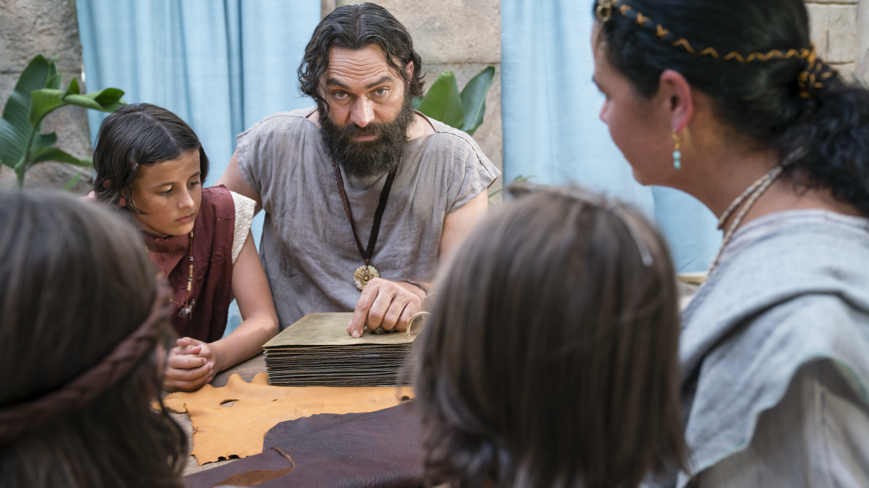
“Remember that were it not for these plates, which contain these records and these commandments, we must have suffered in ignorance, even at this present time, not knowing the mysteries of God. For it were not possible that our father, Lehi, could have remembered all these things, to have taught them to his children, except it were for the help of these plates…
Notes:
https://assets.churchofjesuschrist.org/ba/75/ba75de5f47b5690944b3ab797a168c95a5b19f5b/jacob_with_wife.jpeg

Slide 9
“Remember that were it not for these plates, which contain these records and these commandments, we must have suffered in ignorance, even at this present time, not knowing the mysteries of God. For it were not possible that our father, Lehi, could have remembered all these things, to have taught them to his children, except it were for the help of these plates…
Why do we need scriptures?
Notes:
https://assets.churchofjesuschrist.org/ba/75/ba75de5f47b5690944b3ab797a168c95a5b19f5b/jacob_with_wife.jpeg

Slide 10
“These sayings are true, and also that these records are true. And behold, also the plates of Nephi, which contain the records and the sayings of our fathers from the time they left Jerusalem until now, and they are true…”
Notes:
https://assets.churchofjesuschrist.org/ba/75/ba75de5f47b5690944b3ab797a168c95a5b19f5b/jacob_with_wife.jpeg

Slide 11
“These sayings are true, and also that these records are true. And behold, also the plates of Nephi, which contain the records and the sayings of our fathers from the time they left Jerusalem until now, and they are true…”
Why are the scriptures valuable?
Notes:
https://assets.churchofjesuschrist.org/ba/75/ba75de5f47b5690944b3ab797a168c95a5b19f5b/jacob_with_wife.jpeg

Slide 12
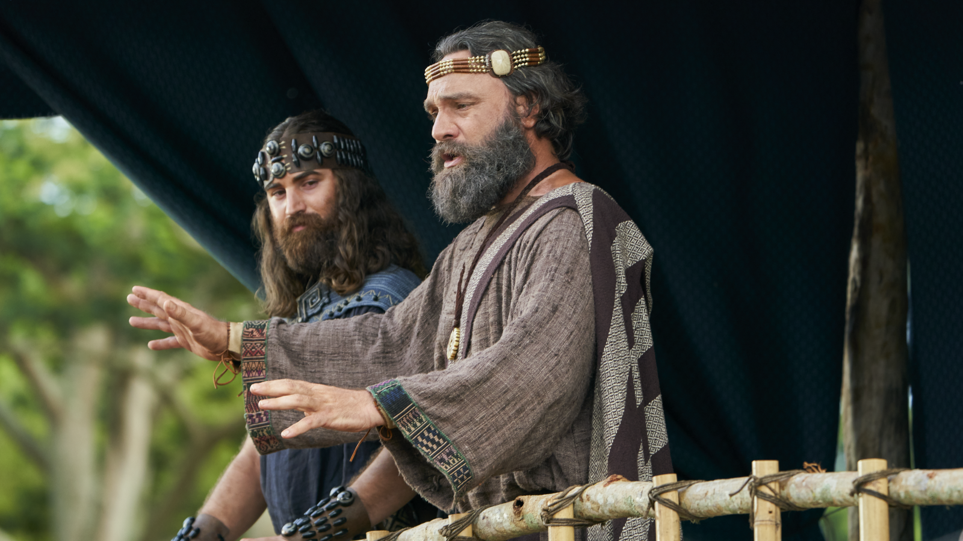
“The records…contain the prophecies which have been spoken by the holy prophets, even down to the time our father, Lehi, left Jerusalem; And also, all that has been spoken by our fathers until now….They spake that which was commanded them of the Lord; therefore, they are just and true.”
(Mosiah 2:34–35)

Slide 13
“We have them before our eyes…”
Notes:
There has never been a time in the history of the world where the scriptures were more accessible than they are today.
It wasn’t like there was a copy of the brass plates for each tent in the family.
https://assets.churchofjesuschrist.org/ba/75/ba75de5f47b5690944b3ab797a168c95a5b19f5b/jacob_with_wife.jpeg

Slide 14
“Remember to search them diligently, that ye may profit thereby; and I would that ye should keep the commandments of God, that ye may prosper in the land according to the promises which the Lord made unto our fathers.”
Mosiah 1:3–7
Notes:
https://assets.churchofjesuschrist.org/ba/75/ba75de5f47b5690944b3ab797a168c95a5b19f5b/jacob_with_wife.jpeg

Slide 15
“Remember to search them diligently, that ye may profit thereby; and I would that ye should keep the commandments of God, that ye may prosper in the land according to the promises which the Lord made unto our fathers.”
Mosiah 1:3–7
What do I do if my scripture study isn’t that meaningful?
How should I treat the scriptures?
Will I be blessed for keeping God’s commandments?
Notes:
https://assets.churchofjesuschrist.org/ba/75/ba75de5f47b5690944b3ab797a168c95a5b19f5b/jacob_with_wife.jpeg

Slide 16
Find a list of scripture study tools at
johnhiltoniii.com/thebookofmormon/resources/

Slide 17
How have the scriptures helped answer questions in your life?
Notes:
https://assets.churchofjesuschrist.org/ba/75/ba75de5f47b5690944b3ab797a168c95a5b19f5b/jacob_with_wife.jpeg

Slide 18
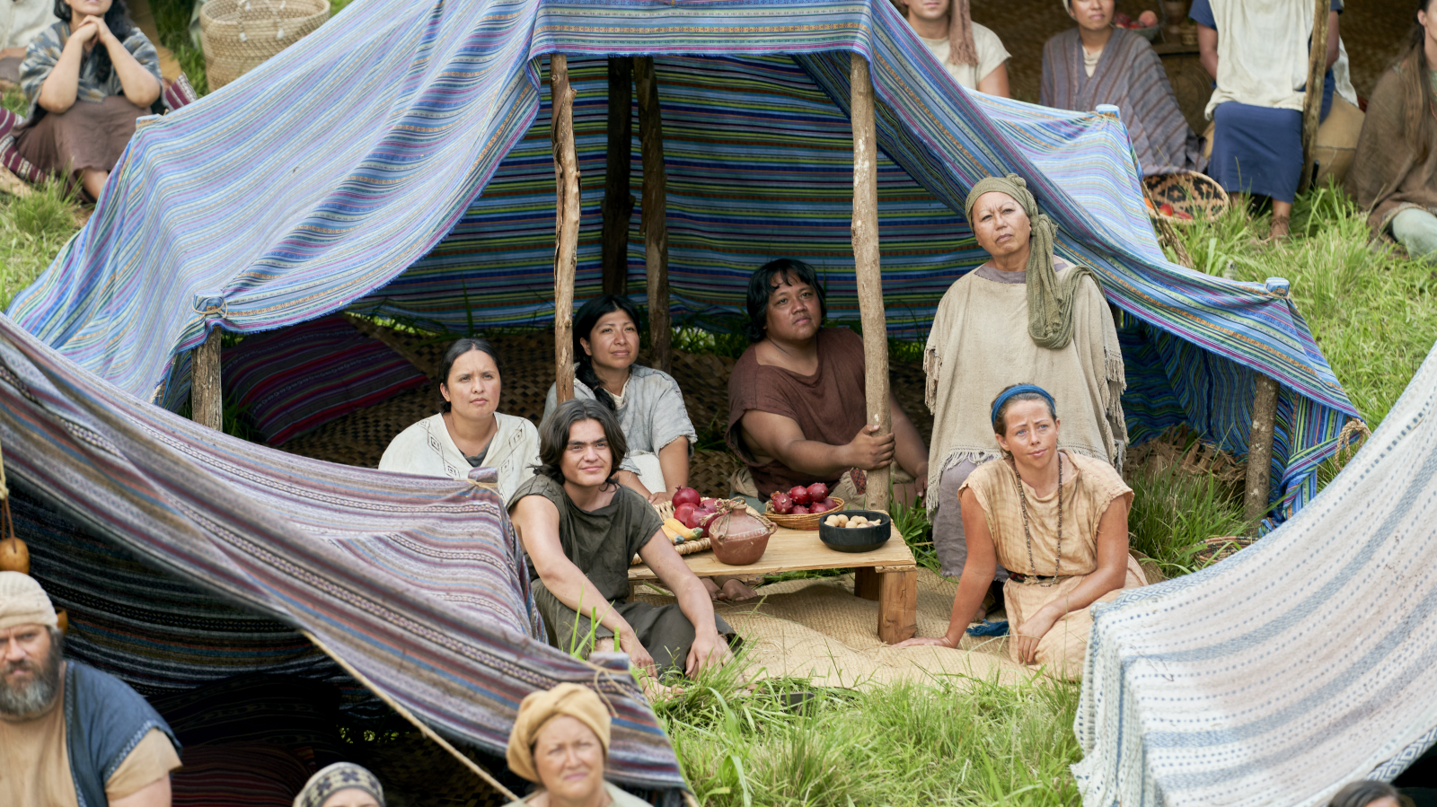
“They pitched their tents round about the temple, [everyone] having [their tents] with the door thereof towards the temple.”
Mosiah 2:6
Notes:
https://assets.churchofjesuschrist.org/ee/83/ee830a682d575431322c131729a6dedb211248f6/nephites_gather_king_benjamin.png

Slide 19
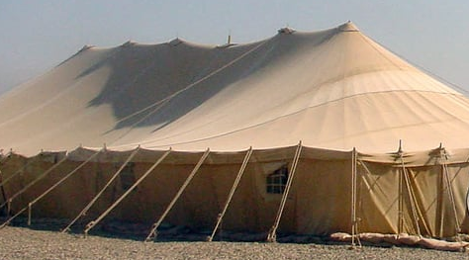
“Lot…pitched his tent toward Sodom”
(Genesis 13:12)
Notes:
https://nara.getarchive.net/media/a-view-of-the-morale-welfare-and-recreation-mwr-tent-located-at-camp-new-jersey-ed2024

Slide 20
Which way do I face?
“They pitched their tents round about the temple, [everyone] having [their tents] with the door thereof towards the temple.”
Mosiah 2:6
“Lot… pitched his tent toward Sodom”
(Genesis 13:12)
Notes:
https://assets.churchofjesuschrist.org/ee/83/ee830a682d575431322c131729a6dedb211248f6/nephites_gather_king_benjamin.png

Slide 21
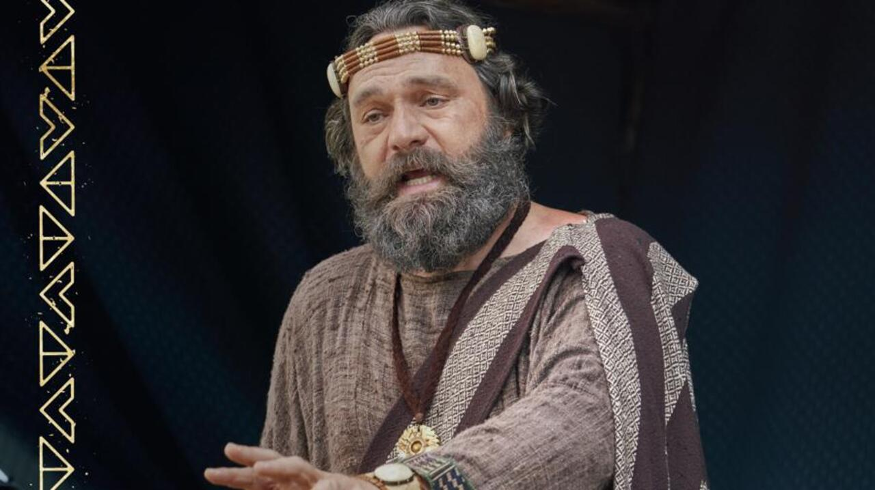

Notes:
Read and testify

Slide 22
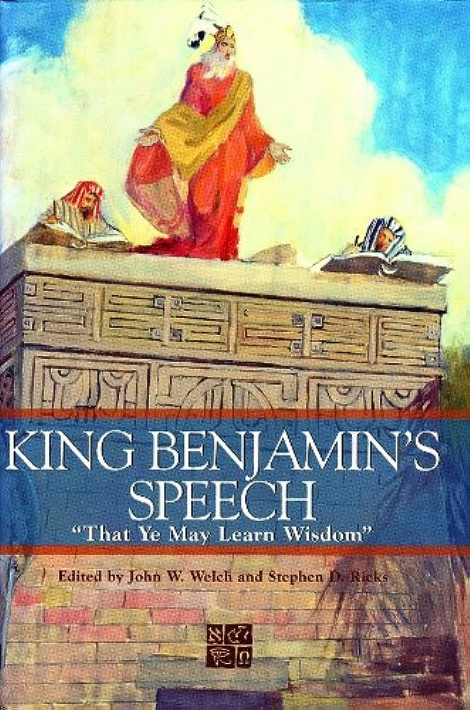
Free e-copy linked at
johnhiltoniii.com/thebookofmormon
Notes:
https://m.media-amazon.com/images/I/51N-bcLYA2L._AC_UF1000,1000_QL80_.jpg

Slide 23
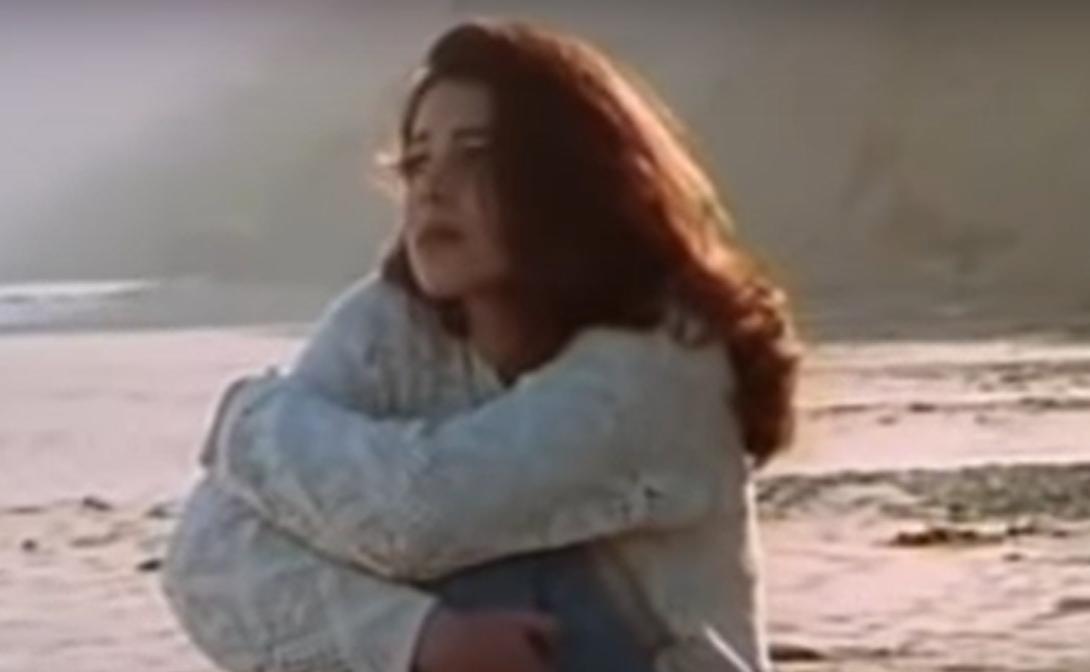

Slide 24

“When ye are in the service of your fellow beings ye are only in the service of your God.”
Mosiah 2:17
Notes:
https://assets.ldscdn.org/1a/23/1a237b016f667b786e3b7dc627a66d68cc554898/youth_service_mexico.jpeg

Slide 25

There were thirty whole beautiful minutes before my plane took off—time for me to be alone with my own thoughts, to open a book and let my mind wander. A voice next to me belonging to an elderly woman said, “I’ll bet it’s cold in Chicago.”
Notes:
https://brightspot-assets.churchofjesuschrist.org/dims4/default/4aaed1a/2147483647/strip/false/crop/1280x720+0+0/resize/1280x720!/format/jpg/quality/90/?url=https%3A%2F%2Fassets.churchofjesuschrist.org%2Fb0a779e007c595dc9d21611c0df1fae93cd5e740.jpeg

Slide 26
There were thirty whole beautiful minutes before my plane took off—time for me to be alone with my own thoughts, to open a book and let my mind wander. A voice next to me belonging to an elderly woman said, “I’ll bet it’s cold in Chicago.”
Stone-faced, I answered, “It’s likely.”
Notes:
https://brightspot-assets.churchofjesuschrist.org/dims4/default/4aaed1a/2147483647/strip/false/crop/1280x720+0+0/resize/1280x720!/format/jpg/quality/90/?url=https%3A%2F%2Fassets.churchofjesuschrist.org%2Fb0a779e007c595dc9d21611c0df1fae93cd5e740.jpeg

Slide 27
“‘I haven’t been to Chicago in nearly three years,’ she persisted. ‘My son lives there.’
Notes:
https://brightspot-assets.churchofjesuschrist.org/dims4/default/4aaed1a/2147483647/strip/false/crop/1280x720+0+0/resize/1280x720!/format/jpg/quality/90/?url=https%3A%2F%2Fassets.churchofjesuschrist.org%2Fb0a779e007c595dc9d21611c0df1fae93cd5e740.jpeg

Slide 28
“‘I haven’t been to Chicago in nearly three years,’ she persisted. ‘My son lives there.’
“‘That’s nice,’ I said, my eyes intent on the printed page of the book.
Notes:
https://brightspot-assets.churchofjesuschrist.org/dims4/default/4aaed1a/2147483647/strip/false/crop/1280x720+0+0/resize/1280x720!/format/jpg/quality/90/?url=https%3A%2F%2Fassets.churchofjesuschrist.org%2Fb0a779e007c595dc9d21611c0df1fae93cd5e740.jpeg

Slide 29
“My husband’s body is on this plane. We’ve been married for fifty-three years. I don’t drive, you know, and when he died a nun drove me from the hospital. We aren’t even Catholic. The funeral director let me come to the airport with him.”
Notes:
https://brightspot-assets.churchofjesuschrist.org/dims4/default/4aaed1a/2147483647/strip/false/crop/1280x720+0+0/resize/1280x720!/format/jpg/quality/90/?url=https%3A%2F%2Fassets.churchofjesuschrist.org%2Fb0a779e007c595dc9d21611c0df1fae93cd5e740.jpeg

Slide 30
I don’t think I have ever detested myself more than I did at that moment. Another human being was screaming to be heard and in desperation had turned to a cold stranger who was more interested in a novel than in the real-life drama at her elbow.
Notes:
https://brightspot-assets.churchofjesuschrist.org/dims4/default/4aaed1a/2147483647/strip/false/crop/1280x720+0+0/resize/1280x720!/format/jpg/quality/90/?url=https%3A%2F%2Fassets.churchofjesuschrist.org%2Fb0a779e007c595dc9d21611c0df1fae93cd5e740.jpeg

Slide 31
All she needed was a listener—no advice, wisdom, experience… expertise or even compassion—but just a minute or two to listen.
…She talked numbly and steadily until we boarded the plane, [and] then found her seat in another section. As I hung up my coat, I heard her plaintive voice say to her seat companion,
Notes:
https://brightspot-assets.churchofjesuschrist.org/dims4/default/4aaed1a/2147483647/strip/false/crop/1280x720+0+0/resize/1280x720!/format/jpg/quality/90/?url=https%3A%2F%2Fassets.churchofjesuschrist.org%2Fb0a779e007c595dc9d21611c0df1fae93cd5e740.jpeg

Slide 32
“I’ll bet it’s cold in Chicago.”
Notes:
https://brightspot-assets.churchofjesuschrist.org/dims4/default/4aaed1a/2147483647/strip/false/crop/1280x720+0+0/resize/1280x720!/format/jpg/quality/90/?url=https%3A%2F%2Fassets.churchofjesuschrist.org%2Fb0a779e007c595dc9d21611c0df1fae93cd5e740.jpeg

Slide 33
“I’ll bet it’s cold in Chicago.”
I prayed, “Please, God, let her listen.”
(Erma Bombeck, “Are You Listening?” If Life Is a Bowl of Cherries—What Am I Doing in the Pits?, 97–98.)
Notes:
https://brightspot-assets.churchofjesuschrist.org/dims4/default/4aaed1a/2147483647/strip/false/crop/1280x720+0+0/resize/1280x720!/format/jpg/quality/90/?url=https%3A%2F%2Fassets.churchofjesuschrist.org%2Fb0a779e007c595dc9d21611c0df1fae93cd5e740.jpeg

Slide 34

“Consider on the blessed and happy state of those that keep the commandments of God. For behold, they are blessed in all things, both temporal and spiritual; and if they hold out faithful to the end they are received into heaven, that thereby they may dwell with God in a state of never-ending happiness.”
Mosiah 2:41
Notes:
https://www.churchofjesuschrist.org/comeuntochrist/pxy/cdn/c6/33/c6334277274c3f9d3cc95d79d7ab1f0234d2fe19/portrait_brazil_woman_smiling.jpeg

Slide 35
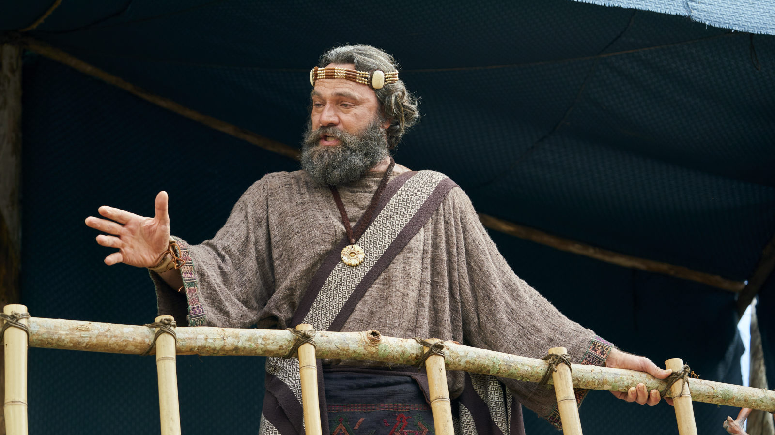
“If [a person] repenteth not, and remaineth and dieth an enemy to God, the demands of divine justice do awaken his immortal soul to a lively sense of his own guilt…and doth fill his breast with…pain and anguish. Therefore, his final doom is to endure a never-ending torment.” (Mosiah 2:36–39).
Notes:
https://assets.churchofjesuschrist.org/84/4e/844e2f5f73b8794a3135b1d7cae434b921f08c54/king_benjamin_testifies_on_tower.png

Slide 36
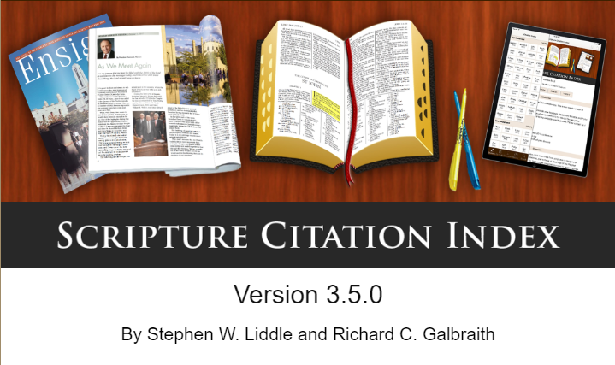
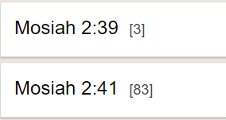
“Never-ending happiness”
“Never-ending torment”
Notes:
As we’ve discussed in previous classes, at this time, Nephite prophets specifically say that it was only through plain speech and talking about hell that the people could be persuaded to stay on right path. And we probably need a different focus in our day, which could be why we hear more about never-ending happiness than never-ending torment.
At the same time, I think it’s helpful to remember that King Benjamin, like many of prophets both before and after him have taught that we have a choice. We can follow the commandments and receive never-ending happiness, or we can rebel against God and receive never-ending torment. It’s that simple. And I think that kind of clarity can be helpful as we go out into the world. There are so many confusing messages, so many ways in which doing what is wrong seems like the path to happiness.

Slide 37
“I cannot tell you all the things whereby ye may commit sin; for there are divers ways and means, even so many that I cannot number them. But this much I can tell you, that if ye do not watch yourselves, and your thoughts, and your words, and your deeds, and observe the commandments of God, and continue in the faith of what ye have heard concerning the coming of our Lord, even unto the end of your lives, ye must perish. And now…remember, and perish not.” Mosiah 4:29–30
Notes:
Obviously we should do the right thing because it’s the right thing not because we’re worried about the eternal consequences. But sometimes it’s hard. Having in our minds the clear dichotomy: do I want never-ending happiness or never-ending torment can help us in a moment when we might waver.
https://assets.churchofjesuschrist.org/dd/80/dd80df3579602f79598f651b98ed96b3e76325d4/king_benjamin_testifies_on_tower.png

Slide 38
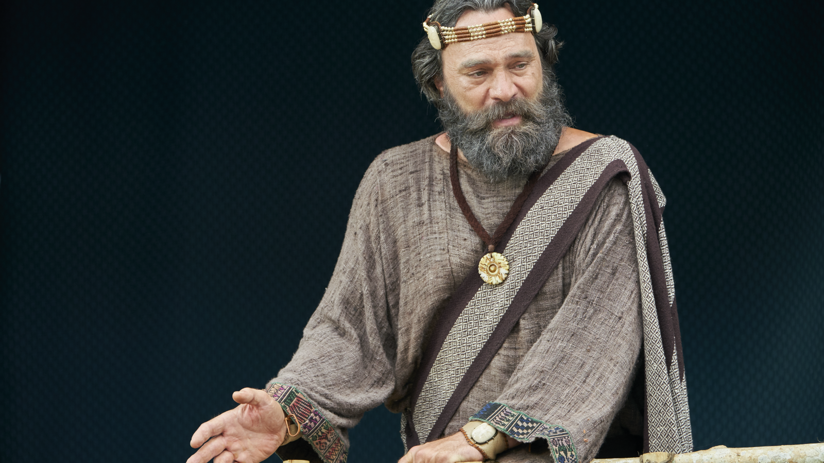
“If ye should serve [God] with all your whole souls yet ye would be unprofitable servants. All that he requires of you is to keep his commandments…[and] if ye do keep his commandments he doth bless you and prosper you….Can ye say aught of yourselves? I answer you, Nay. Ye cannot say that ye are even as much as the dust of the earth; yet ye were created of the dust of the earth; but behold, it belongeth to him who created you.” (Mosiah 2:21–25)
Notes:
Now if we look at this the wrong way, King Benjamin’s speech could seem like a downer. “If you rebel against God, you get never-ending torment. And by the way, you’re less than the dust of the earth!” In fact, I was interested to learn that the phrase “Ye cannot say that ye are even as much as the dust of the earth,” from Mosiah 2:25, has, as far as I can tell, never been quoted in General Conference! But let’s sit with it for a minute.
https://assets.churchofjesuschrist.org/95/b7/95b71bd8aac13ed3a4a76641c31178bd4056cf53/king_benjamin_testifies_on_tower.png

Slide 39
King Benjamin says that we are less than the dust of the earth. Rather than letting this depress us, how can this principle help us in our lives?
Notes:
One reason it’s important for us to see the reality of our own state is that it helps us rely more fully on God. If I think, “I’m amazing, I can do it all,” then I will come to rely on God less. But if I remember that I’m not even as much as the dust of the earth and that everything I have comes from God, I’ll be more likely to acknowledge his hand.
https://assets.churchofjesuschrist.org/95/b7/95b71bd8aac13ed3a4a76641c31178bd4056cf53/king_benjamin_testifies_on_tower.png

Slide 40
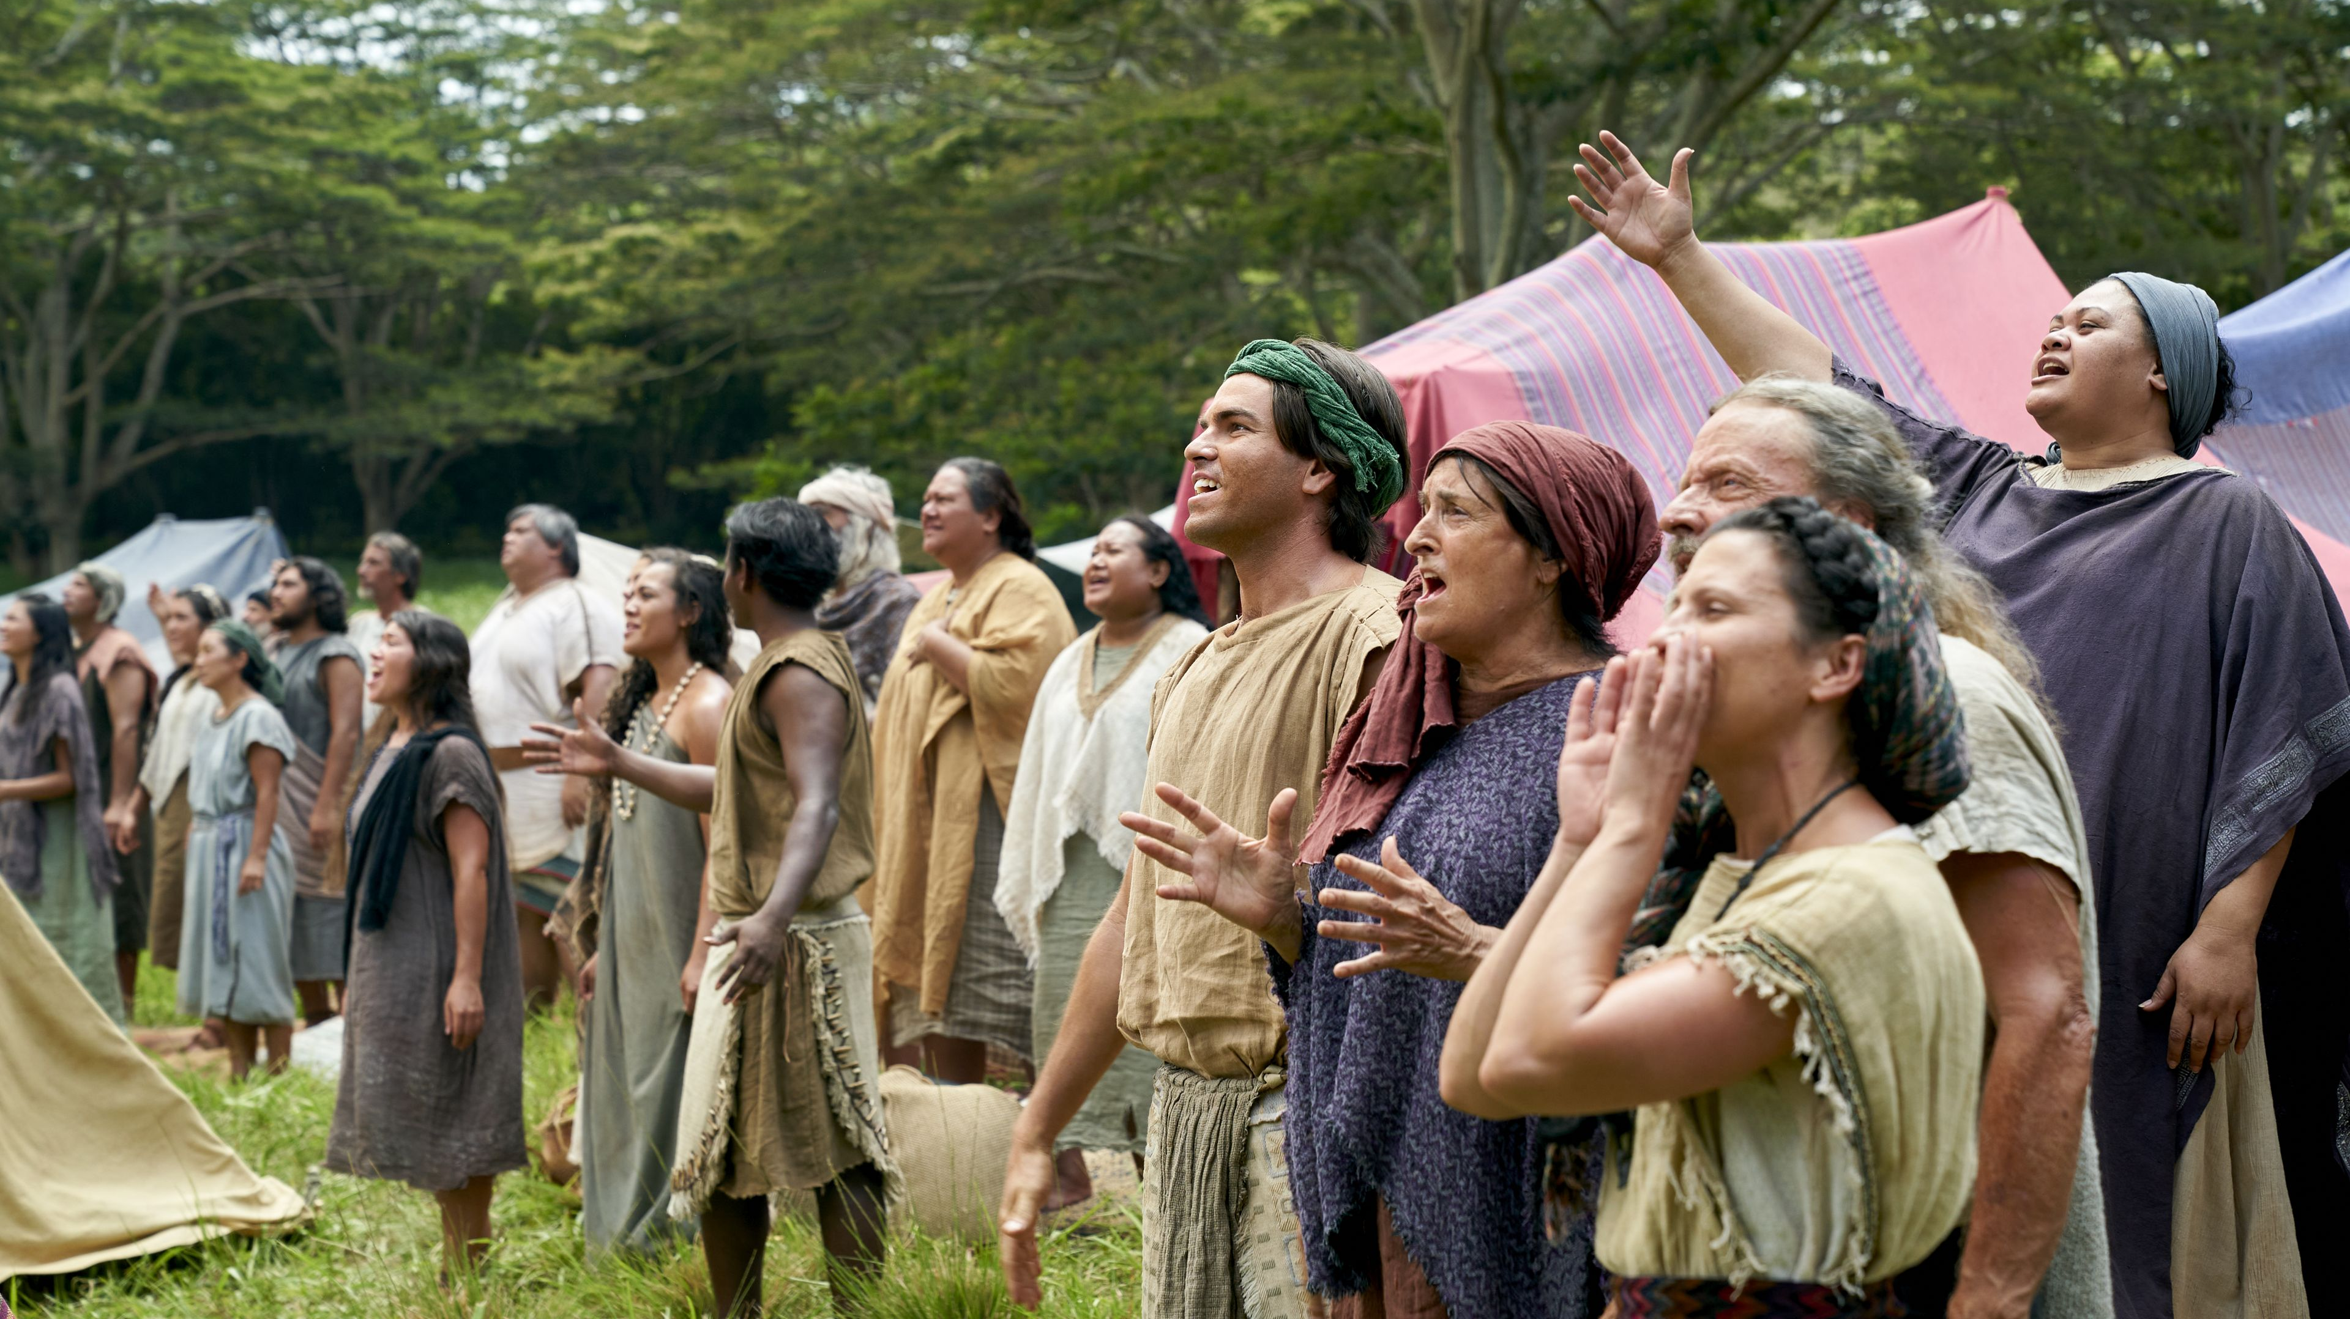
“They had viewed themselves in their own carnal state, even less than the dust of the earth. And they all cried aloud with one voice, saying: O have mercy, and apply the atoning blood of Christ that we may receive forgiveness of our sins…
Notes:
https://churchofjesuschrist.org/imgs/384b70fc84c9b837a688f9a18ee75e323effcb21/full/1920%2C/0/default

Slide 41
“After they had spoken these words the Spirit of the Lord came upon them, and they were filled with joy, having received a remission of their sins, and having peace of conscience, because of the exceeding faith which they had in Jesus Christ who should come.” (Mosiah 4:2–3)
Notes:
https://churchofjesuschrist.org/imgs/384b70fc84c9b837a688f9a18ee75e323effcb21/full/1920%2C/0/default

Slide 42
“He cometh unto his own, that salvation might come unto the children of men even through faith on his name; and even after all this they shall consider him a man, and say that he hath a devil, and shall scourge him, and shall crucify him. And he shall rise the third day from the dead”
(Mosiah 3:9–10)
Notes:
https://assets.churchofjesuschrist.org/84/4e/844e2f5f73b8794a3135b1d7cae434b921f08c54/king_benjamin_testifies_on_tower.png

Slide 43
“[Christ’s] blood atoneth for the sins of those who have fallen by the transgression of Adam…who have ignorantly sinned… And…little children…are blessed; for behold…the blood of Christ atoneth for their sins.” Mosiah 3:11, 16
Notes:
https://assets.churchofjesuschrist.org/84/4e/844e2f5f73b8794a3135b1d7cae434b921f08c54/king_benjamin_testifies_on_tower.png

Slide 44
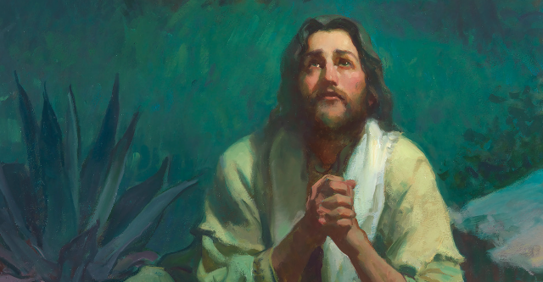
“Christ shall suffer temptations, and pain of body, hunger, thirst, and fatigue, even more than man can suffer, except it be unto death; for behold, blood cometh from every pore, so great shall be his anguish for the wickedness and the abominations of his people.”
Mosiah 3:7
Michael Malm
Notes:
https://assets.churchofjesuschrist.org/98/08/98082ac7a6d02b1c464ad0e4ab9a7cdedc1182ff/jesus_gethsemane_atonement.png

Slide 45
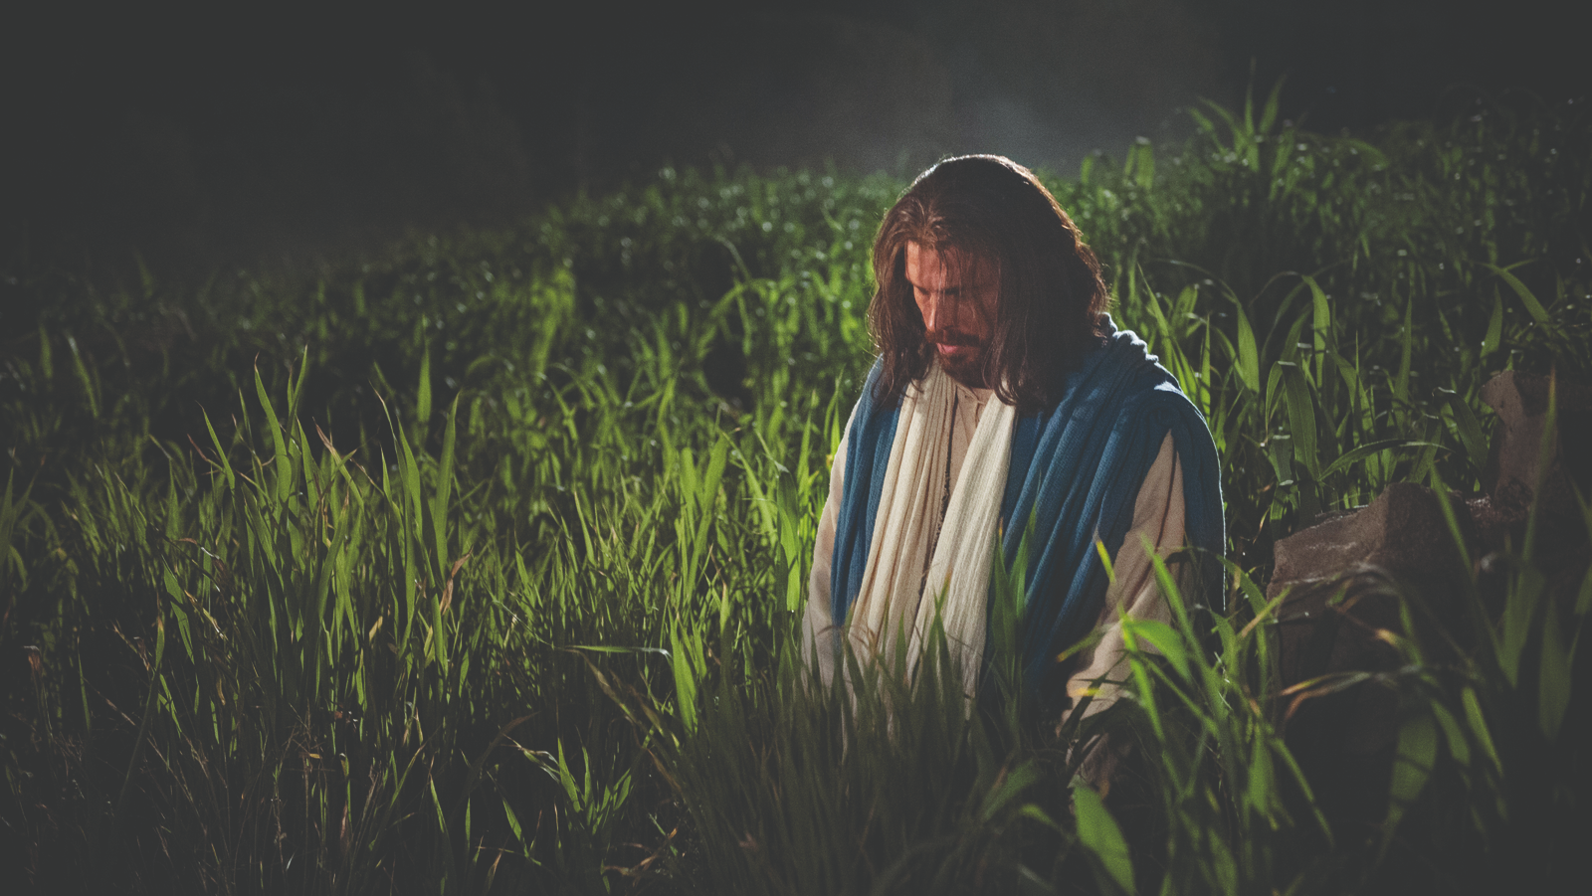
Christ “being in an agony . . . prayed more earnestly: and his sweat was as it were great drops of blood falling down to the ground.”
Luke 22:44
Notes:
https://assets.churchofjesuschrist.org/45/07/4507eeebed86c393b8b4f950e32f227f52894eae/christ_in_gethsemane_matthew_reier.jpg

Slide 46
Book of Mormon Verses Stating Christ Suffered for our Sins in Gethsemane
Book of Mormon Verses Stating Christ Died for our Sins
1 Passage
18 Passages
Mosiah 3:7
1 Nephi 11:33, 2 Nephi 2:7-8, 9:5, 26:24, Mosiah 14:12, 15:7-9, 12, 18:2,
Alma 21:9, 22:14, 30:26, 33:22, 34:15
Helaman 14:15,
3 Nephi 9:21-22, 11:14, 27:14, Ether 12:33

Slide 47
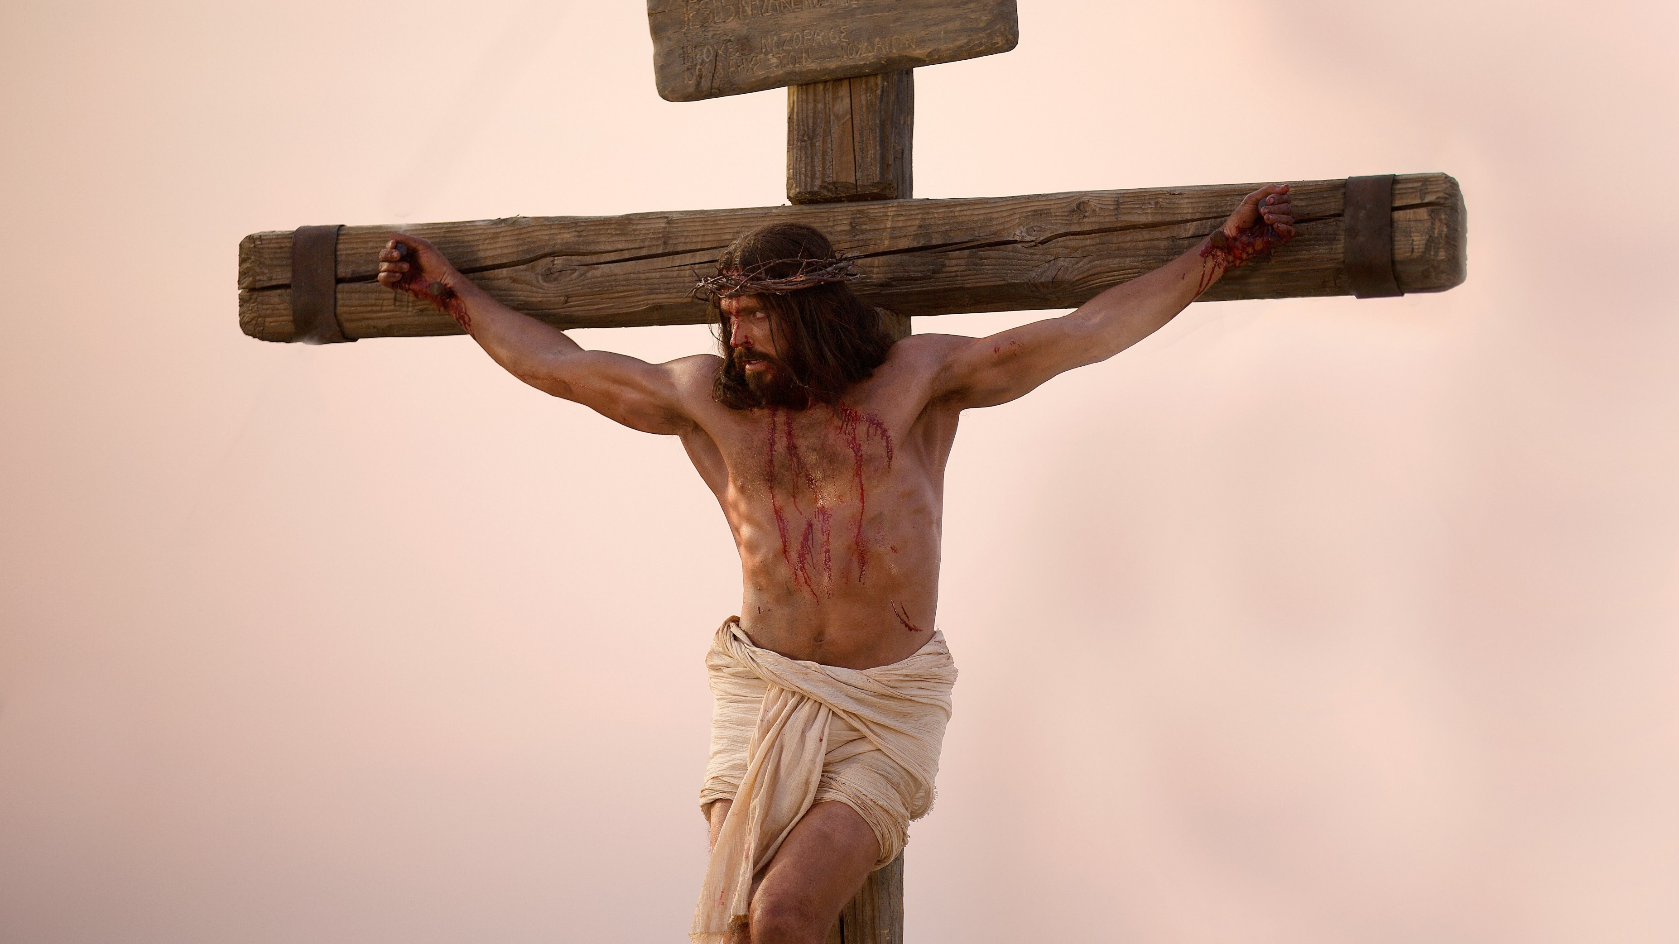
“I Nephi saw that [Christ] was lifted up upon the cross and slain for the sins of the world.” 1 Nephi 11:32
“[Christ] surely must die, that salvation may come.”
Helaman 14:15
“My Father sent me that I might be lifted up upon the cross…that I might draw all [people] unto me.” 3 Nephi 27:14
Notes:
https://assets.churchofjesuschrist.org/cb/6e/cb6e029f85d425e6215cf21b5a5bfe352a965186/jesus_on_the_cross.jpeg

Slide 48
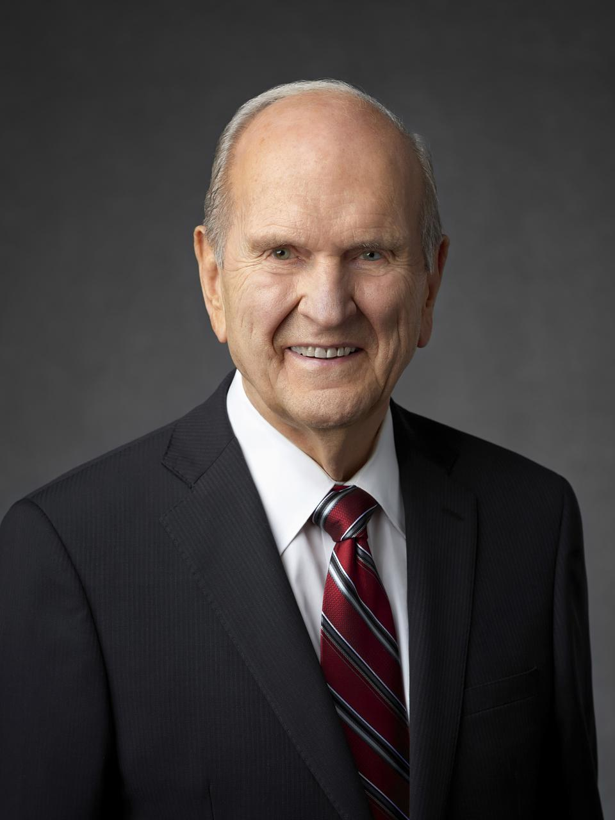
“In the Garden of Gethsemane, our Savior took upon Himself every pain, every sin, and all of the anguish and suffering ever experienced by you and me and by everyone who has ever lived or will ever live. Under the weight of that excruciating burden, He bled from every pore. All of this suffering was intensified as He was cruelly crucified on Calvary’s cross”
“The Correct Name of the Church,” Ensign 48, no. 11 (November 2018): 88
Notes:
https://newsroom.churchofjesuschrist.org/media/960x1280/President-Russell-M-Nelson-1-2018.jpg

Slide 49
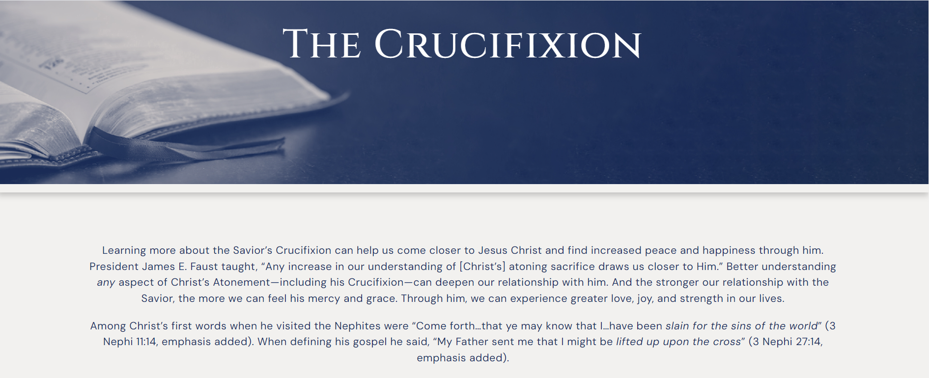
johnhiltoniii.com/crucifixion

Slide 50
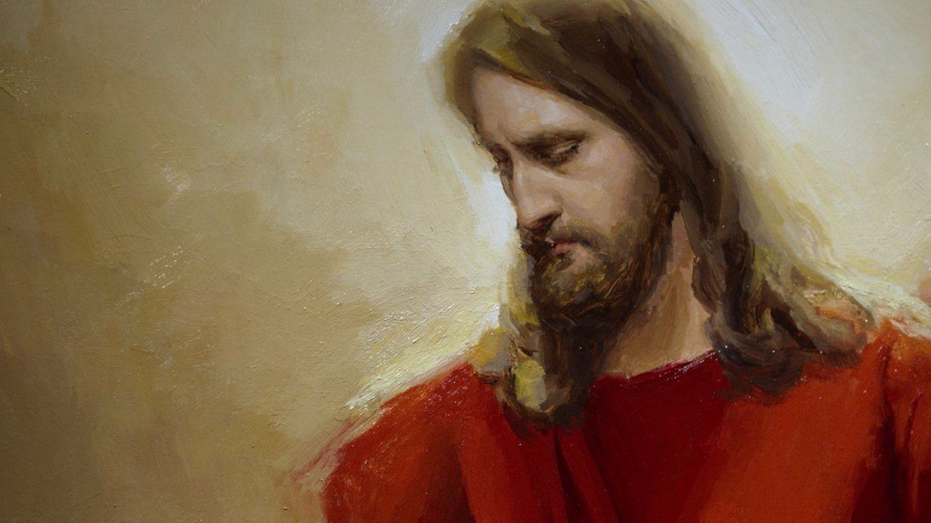
“There shall be no other name given nor any other way nor means whereby salvation can come unto the children of men, only in and through the name of Christ, the Lord Omnipotent.”
Mosiah 3:17
Notes:
https://assets.churchofjesuschrist.org/b2a911f470db3ab6f6e7a434a85161de2969d4bc

Slide 51
“There is none other salvation save this which hath been spoken.”
Mosiah 4:8
Notes:
https://assets.churchofjesuschrist.org/b2a911f470db3ab6f6e7a434a85161de2969d4bc

Slide 52
“There is no other name given whereby salvation cometh.”
Mosiah 5:8
Notes:
https://assets.churchofjesuschrist.org/b2a911f470db3ab6f6e7a434a85161de2969d4bc

Slide 53
“I am the way, and the
truth, and the life. No one comes to the Father except through me.”
John 14:6
Notes:
https://assets.churchofjesuschrist.org/b2a911f470db3ab6f6e7a434a85161de2969d4bc

Slide 54
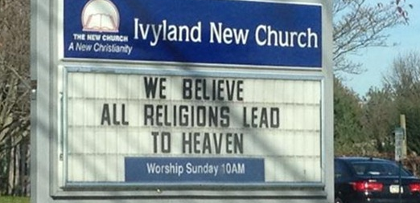

Slide 55
I should avoid offending others who believe differently than I do
Jesus Christ is the only way to heaven

Slide 56

Notes:
https://www.byui.edu/images/university-relations/Speeches/Summer%202018/Eaton_400x500.jpg

Slide 57
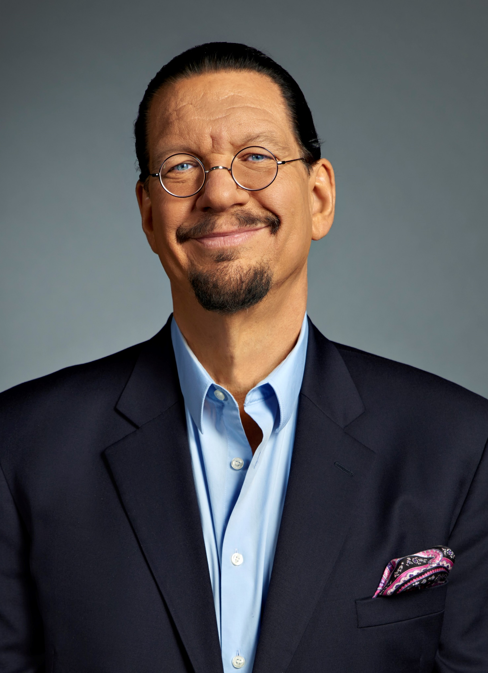
“I don’t respect people who don’t proselytize…If you believe that…people could be going to hell [but] you think that it’s not really worth telling them…because it would make it socially awkward…How much do you have to hate somebody to believe that everlasting life is possible and not tell them that? If I believed beyond a shadow of a doubt that if a truck was coming at you and you didn’t believe it…there’s a certain point where I tackle you. And this is more important than that.”

Slide 58
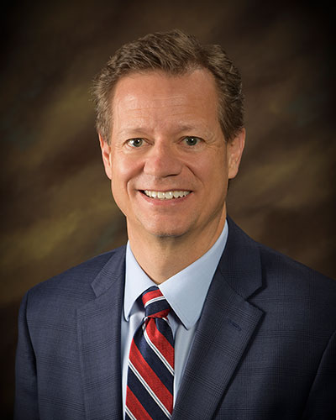
“Years ago, a woman cut my hair, and I was sharing the gospel. And she said, ‘Well, like Jesus said, “All roads lead to heaven.”’ I said, ‘You know, actually, that's not what He said. In fact, He kind of said the opposite. He said that He’s the way, the truth and the life and there's no way to the Father but by Him.’”
Rob Eaton
Notes:
https://www.byui.edu/images/university-relations/Speeches/Summer%202018/Eaton_400x500.jpg

Slide 59


Slide 60


Slide 61
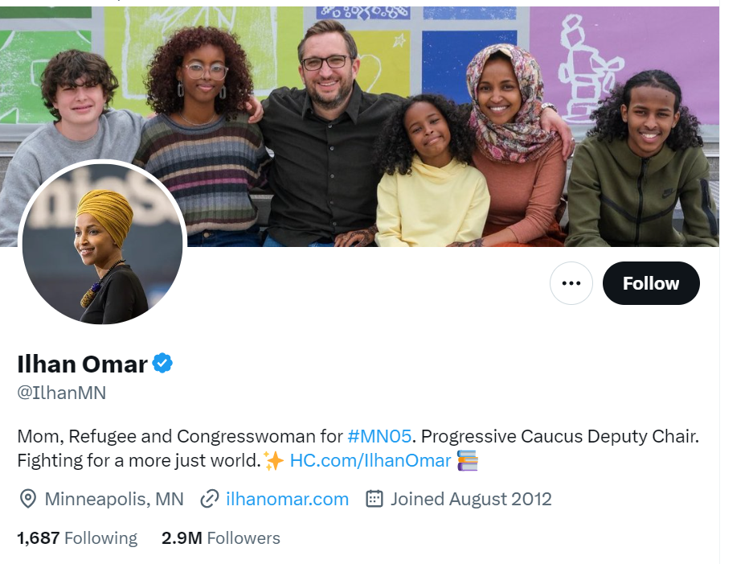

Slide 62
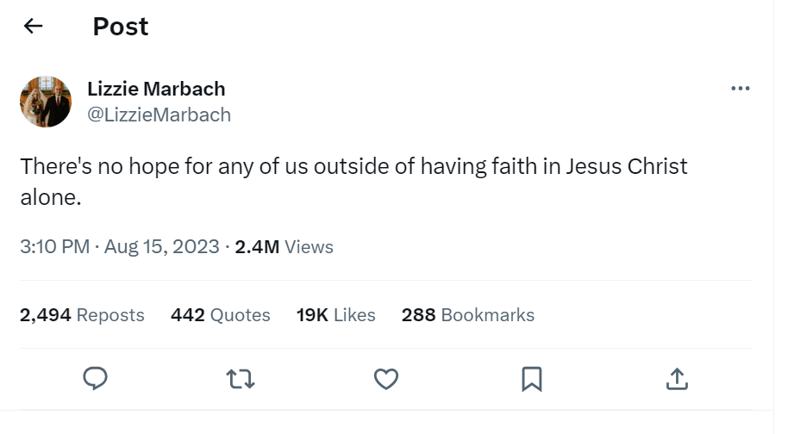

Slide 63
Do you think King Benjamin would retweet this?

Slide 64
Notes:
King Benjamin probably would have liked this post, but I’ll tell you who didn’t…

Slide 65
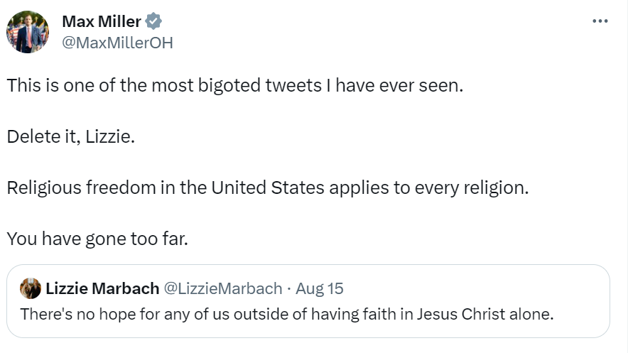

Slide 66
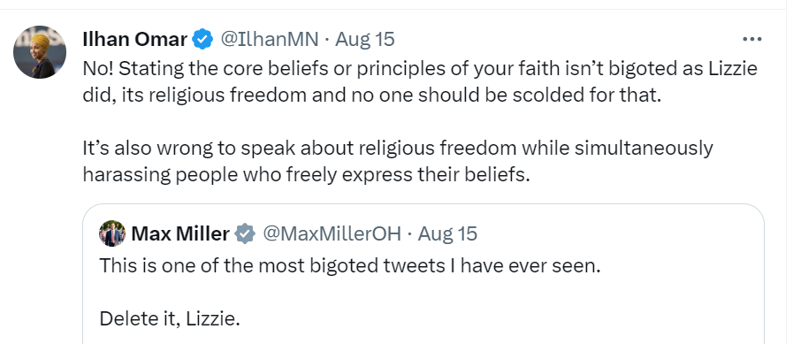

Slide 67
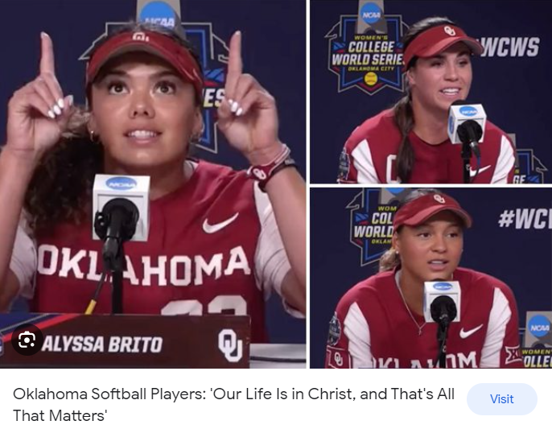
“The only way that you can have a joy that doesn’t fade away is from the Lord. Any other type of joy is actually happiness that comes from circumstances and outcomes.”
-Grace Lyons
Video linked at johnhiltoniii.com/thebookofmormon

Slide 68
“We wanna win, but it’s not the end of the world [if we lose] because our life is in Christ, and that’s all that matters.”
-Jayda Coleman
Video linked at johnhiltoniii.com/thebookofmormon

Slide 69
“We have an eternity of Joy with our father and I'm so excited about that…I live in the moment, but I know this isn't my home and…my sisters in Christ will be there with me in the end when we're with our our King.”
-Alyssa Brito
Video linked at johnhiltoniii.com/thebookofmormon

Slide 70
Notes:
https://assets.churchofjesuschrist.org/b2a911f470db3ab6f6e7a434a85161de2969d4bc

Slide 71
“Whosoever shall deny me before men, him will I also deny before my Father which is in heaven.”
(Matthew 10:33)
Notes:
https://assets.churchofjesuschrist.org/b2a911f470db3ab6f6e7a434a85161de2969d4bc

Slide 72
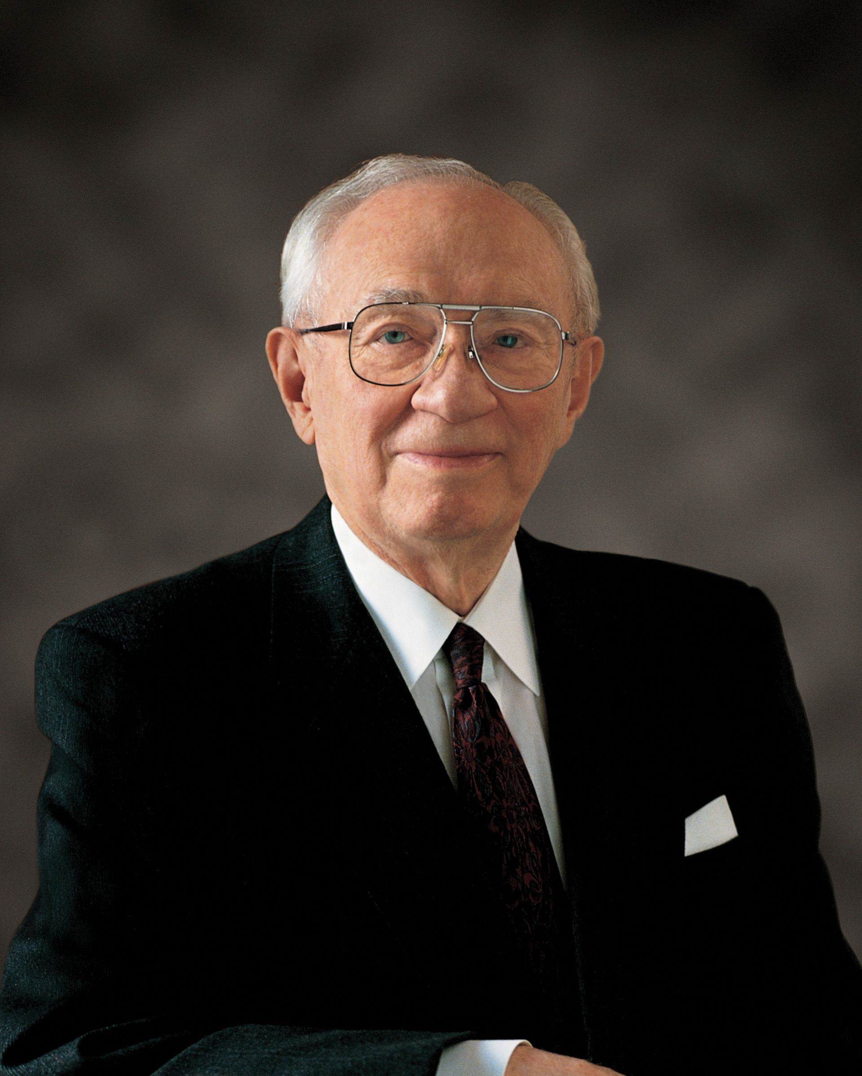
“The Lord said that this is the only true and living church upon the face of the earth with which He is well pleased [see D&C 1:30]. I didn’t say that. Those are His words. The Prophet Joseph was told that the other sects were wrong [see JS—H 1:19]. Those are not my words. Those are the Lord’s words. But they are hard words for those of other faiths. We don’t need to exploit them. We just need to be kind and good and gracious people to others, showing by our example the great truth of that which we believe and leading them in the direction which we would like to see them go.”
President Gordon B. Hinckley,
Ensign, June 2004
Notes:
https://assets.churchofjesuschrist.org/2d/80/2d80ffe3553647fce3aa56734a34fe259a26f606/bednar_official_portrait.png

Slide 73
“The Lord God hath sent his holy prophets among all the children of men, to declare these things to every kindred, nation, and tongue, that thereby whosoever should believe that Christ should come, the same might receive remission of their sins, and rejoice with exceedingly great joy, even as though he had already come among them.” (Mosiah 3:13)
Notes:
Obviously we should do the right thing because it’s the right thing not because we’re worried about the eternal consequences. But sometimes it’s hard. Having in our minds the clear dichotomy: do I want never-ending happiness or never-ending torment can help us in a moment when we might waver.
https://assets.churchofjesuschrist.org/dd/80/dd80df3579602f79598f651b98ed96b3e76325d4/king_benjamin_testifies_on_tower.png

Slide 74
“The natural man is an enemy to God…
Notes:
I remember a few months after my mission I was dating somebody and she was really frustrating me. I explained the situation to my roommate and said, “You have to admit it’s natural to be angry in a situation like this.” He said, “Yes, but the natural man is an enemy to God!”
https://assets.churchofjesuschrist.org/95/b7/95b71bd8aac13ed3a4a76641c31178bd4056cf53/king_benjamin_testifies_on_tower.png

Slide 75
“The natural man is an enemy to God, and has been from the fall of Adam, and will be, forever and ever, unless he yields to the enticings of the Holy Spirit, and putteth off the natural man and becometh a saint through the atonement of Christ the Lord…” Mosiah 3:19
Notes:
https://assets.churchofjesuschrist.org/95/b7/95b71bd8aac13ed3a4a76641c31178bd4056cf53/king_benjamin_testifies_on_tower.png

Slide 76
“The natural man is an enemy to God, and has been from the fall of Adam, and will be, forever and ever, unless he yields to the enticings of the Holy Spirit, and putteth off the natural man and becometh a saint through the atonement of Christ the Lord…” Mosiah 3:19
Notes:
https://assets.churchofjesuschrist.org/95/b7/95b71bd8aac13ed3a4a76641c31178bd4056cf53/king_benjamin_testifies_on_tower.png

Slide 77
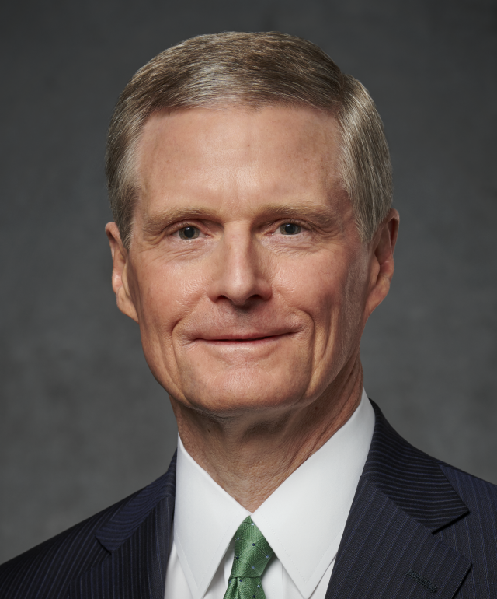
“Most of us clearly understand that the Atonement is for sinners. I am not so sure, however, that we know and understand that the Atonement is also for saints—for good men and women who are obedient and worthy and conscientious and who are striving to become better and serve more faithfully…
Notes:
https://assets.churchofjesuschrist.org/2d/80/2d80ffe3553647fce3aa56734a34fe259a26f606/bednar_official_portrait.png

Slide 78
“I wonder if we mistakenly believe we must make the journey from good to better and become a saint all by ourselves through sheer grit, willpower, and discipline, and with our obviously limited capacities.
Notes:
https://assets.churchofjesuschrist.org/2d/80/2d80ffe3553647fce3aa56734a34fe259a26f606/bednar_official_portrait.png

Slide 79
“Brothers and sisters, the gospel of the Savior is not simply about avoiding bad in our lives; it also is essentially about doing and becoming good. And the Atonement provides help for us to overcome and avoid bad and to do and become good. There is help from the Savior for the entire journey of life—from bad to good to better and to change our very nature.”
Notes:
https://assets.churchofjesuschrist.org/2d/80/2d80ffe3553647fce3aa56734a34fe259a26f606/bednar_official_portrait.png

Slide 80
“The natural man is an enemy to God, and has been from the fall of Adam, and will be, forever and ever, unless he yields to the enticings of the Holy Spirit, and putteth off the natural man and becometh a saint through the atonement of Christ the Lord…” Mosiah 3:19
Notes:
https://assets.churchofjesuschrist.org/95/b7/95b71bd8aac13ed3a4a76641c31178bd4056cf53/king_benjamin_testifies_on_tower.png

Slide 81
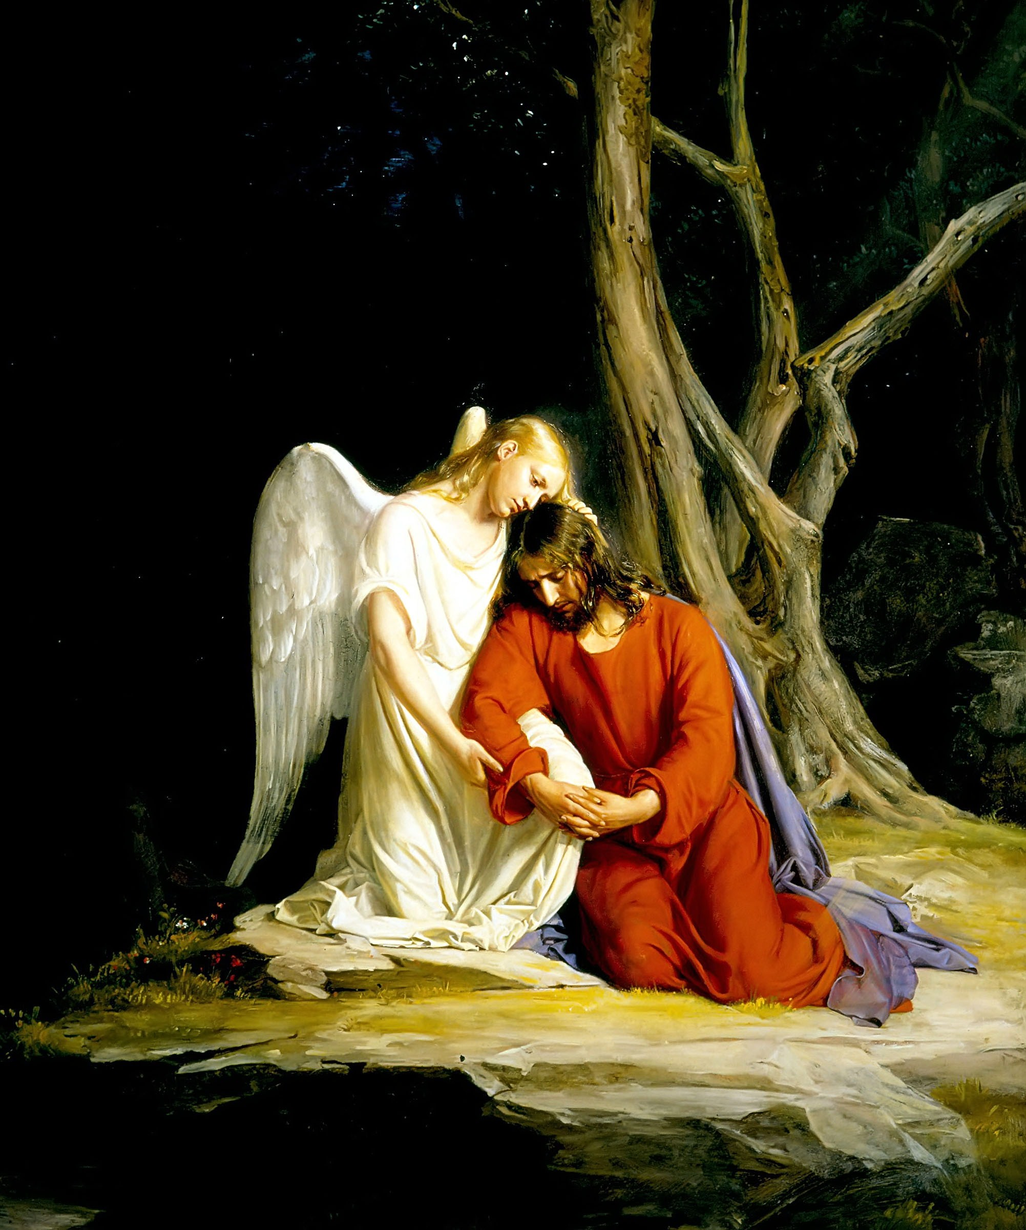
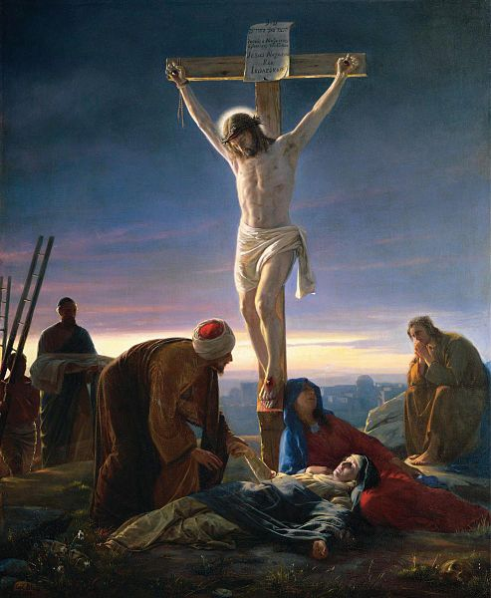
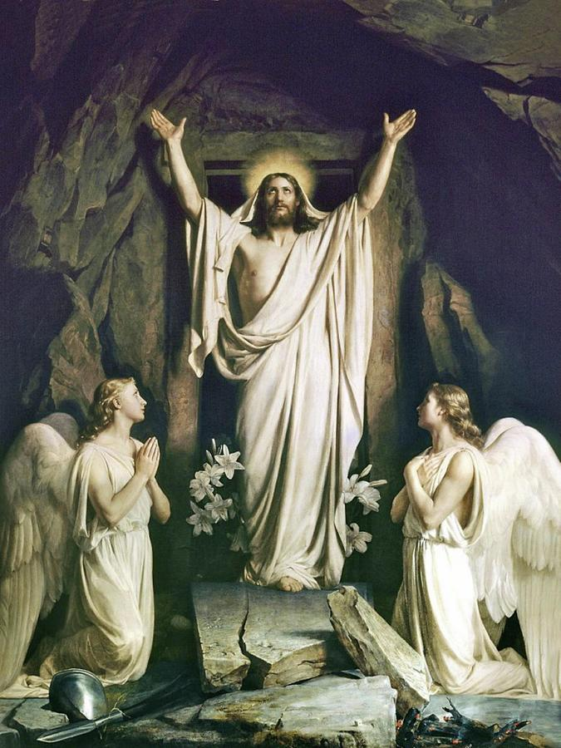

Slide 82


For free resources related to this video, please visit https://johnhiltoniii.com/TheBookofMormon
Join our course discussions on social media
@johnhiltoniii

Slide 83
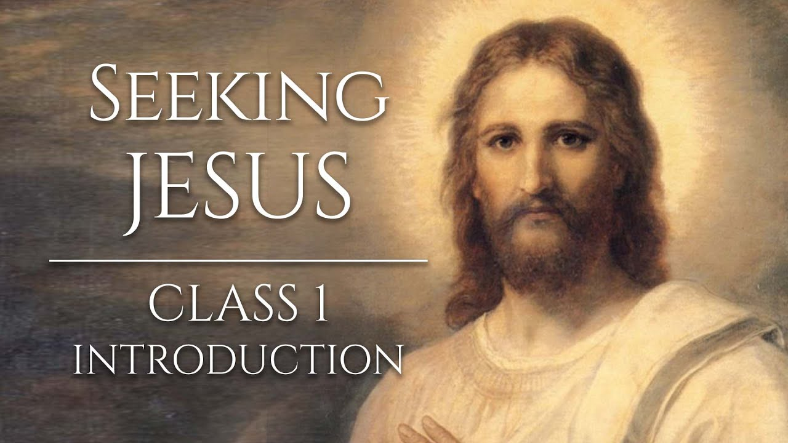
https://johnhiltoniii.com/SeekingJesus
You may also be interested in this
free video course…

Slide 84
This video is not produced or endorsed by Brigham Young University or the Church of Jesus Christ of Latter-day Saints.
John Hilton III is solely responsible for its contents
Acknowledgements at https://johnhiltoniii.com/thebookofmormon

