Slide 1
Today’s class will be a Silent Lesson. We’ll focus less on using our ears/mouth and more on using our eyes.

Slide 2
Please open your scriptures to Mosiah 14. All you need today is scriptures and something to write with.

Slide 3
I know that your life is busy, and probably stressful. I hope that as much as possible you can leave your cares behind and enjoy your time in class today.

Slide 4
Let’s begin with an opening prayer. Please offer a silent prayer on your own.

Slide 5
Today, We’re going back in time to when Abinadi was preaching to King Noah’s people…

Slide 6
In context, Abinadi is on trial, and King Noah’s priests are questioning him.
As Abinadi answers the priests’ questions, he focuses on Christ. He begins by quoting Isaiah 53 (in Mosiah 14) and then expands on these words in Mosiah 15-16.
Read Mosiah 14:1-3. What do you learn about Christ?
NOTE: In today’s class, please read slowly and carefully … if you finish before we move on, reread the verses.
These aren’t verses to rush through!

Slide 7
Read Mosiah 14:6-7 and 15:6.
What phrases stand out to you?

Slide 8
Read Mosiah 14:5 and Mosiah 15:5.
What do you think the phrase
“with his stripes we are healed” means?

Slide 9
Read Mosiah 14:8 and Mosiah 15:7.
Ponder on the sacrifice Christ made for you.

Slide 10
Please read Mosiah 14:9.

Slide 11
He shall SEE his seed
Mark Mosiah 14:10 and Mosiah 15:10-12
What does it mean that when he suffers,
Christ will “see” his seed?
Notes:
11

Slide 12
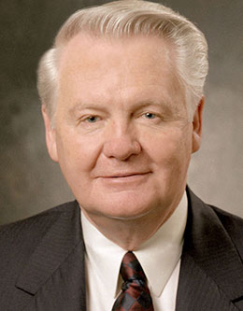
“The Savior, as a member of the Godhead, knows each of us personally. Isaiah and the prophet Abinadi said that when Christ would ‘make his soul an offering for sin, he shall see his seed.’ Abinadi explains that ‘his seed’ are the righteous, those who follow the prophets. In the garden and on the cross, Jesus saw each of us and not only bore our sins, but also experienced our deepest feelings so that he would know how to comfort and strengthen us.”
Elder Merrill J. Bateman, Ensign, May 1995
Notes:
12

Slide 13
“The Seed of Christ”
Just like King Benjamin talked about becoming “the children of Christ,” Abinadi spoke of becoming the “seed of Christ.”
These are two different ways of describing becoming spiritually reborn as disciples of Jesus Christ.

Slide 14
Some of us are feeling a lot of pain. the Savior knows what we are going through. He can heal us even if we feel broken.

Slide 15
Listen to this song. Can you feel that it’s true? It is!

Slide 16
write down what you felt during that song.

Slide 17
Consider these words as though they come directly from the Savior to you (I believe they do)
“I have loved thee with an everlasting love” (Jeremiah 31:3)
“I know thee by name” (Exodus 33:12)
“I will never leave thee, nor forsake thee” (Hebrews 13:5)

Slide 18
Carefully read Mosiah 15:8-9 and Mosiah 15:19-20.
What power-phrases from these
verses stand out to you?
While what we have seen today is painful,
in what ways is it joyful?

Slide 19
That video clip ended with a scene of the resurrection, and a passage talking about the importance of sharing the gospel with everyone.

Slide 20
Read these verses—what does the resurrected Savior focus on?
Matthew 28:19
Mark 16:15
Luke 24:45-48
John 21:15-17
3 Nephi 11:41

Slide 21
The message of THE RESURRECTION is a call to go and share the good news of Jesus Christ, or, as Abinadi phrases it, “publish peace.”

Slide 22
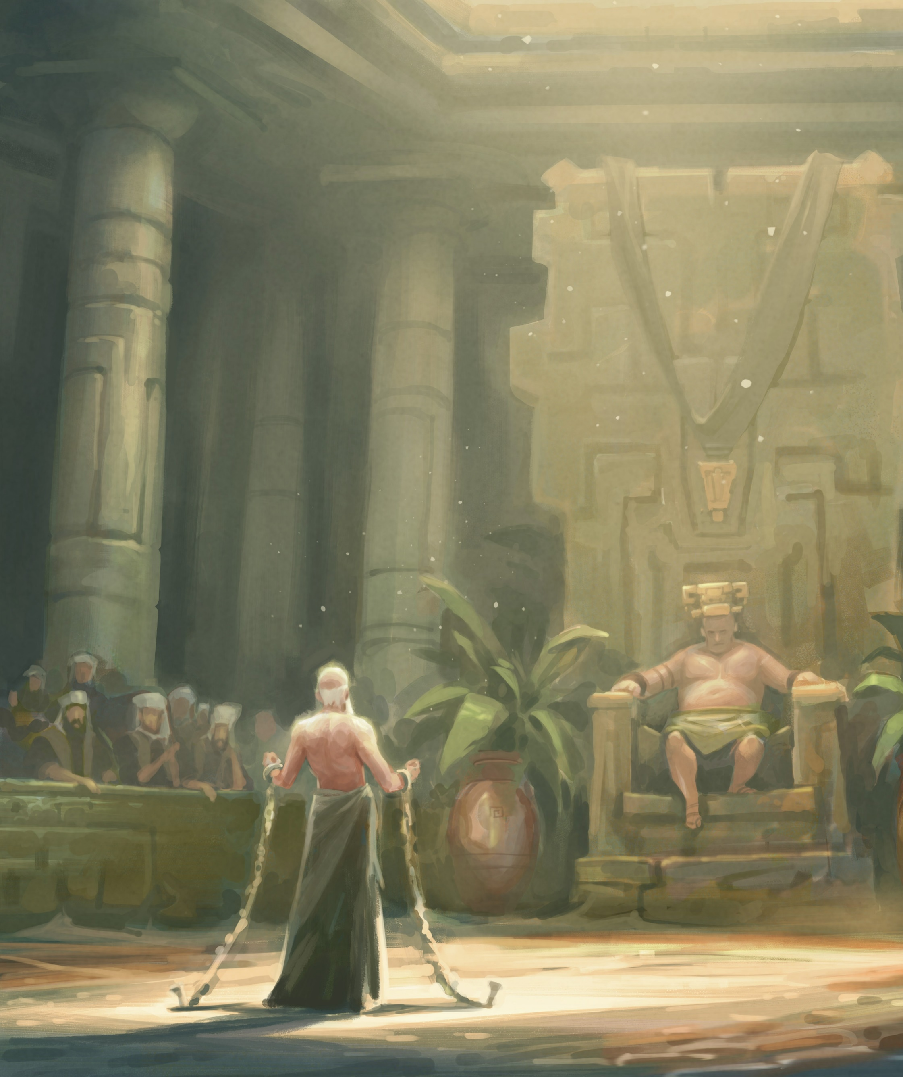
Mosiah 16 contains Abinadi’s final testimony of Christ. Carefully read Mosiah 16:6-9 and mark phrases that stand
out to you.

Slide 23
Let’s look at one other “final testimony” of Christ— from John the Revelator
Please read and mark the following verses:
Revelation 21:4
Revelation 22:7, 13, 21

Slide 25
What would you say while sharing your final testimony of Christ?
How has Jesus Christ changed your life?
How will you be a witness for his name?
Take a moment and write down your answers to these questions.

Slide 26
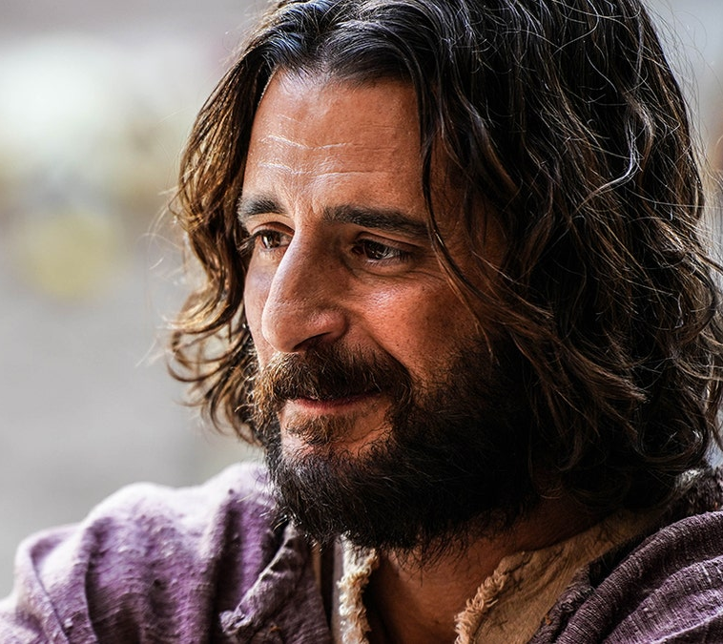
Jesus is the Founder of Peace
“I have loved thee with an everlasting love” (Jeremiah 31:3)
“I know thee by name” (Exodus 33:12)
“I will never leave thee, nor forsake thee” (Hebrews 13:5)

