Slide 2
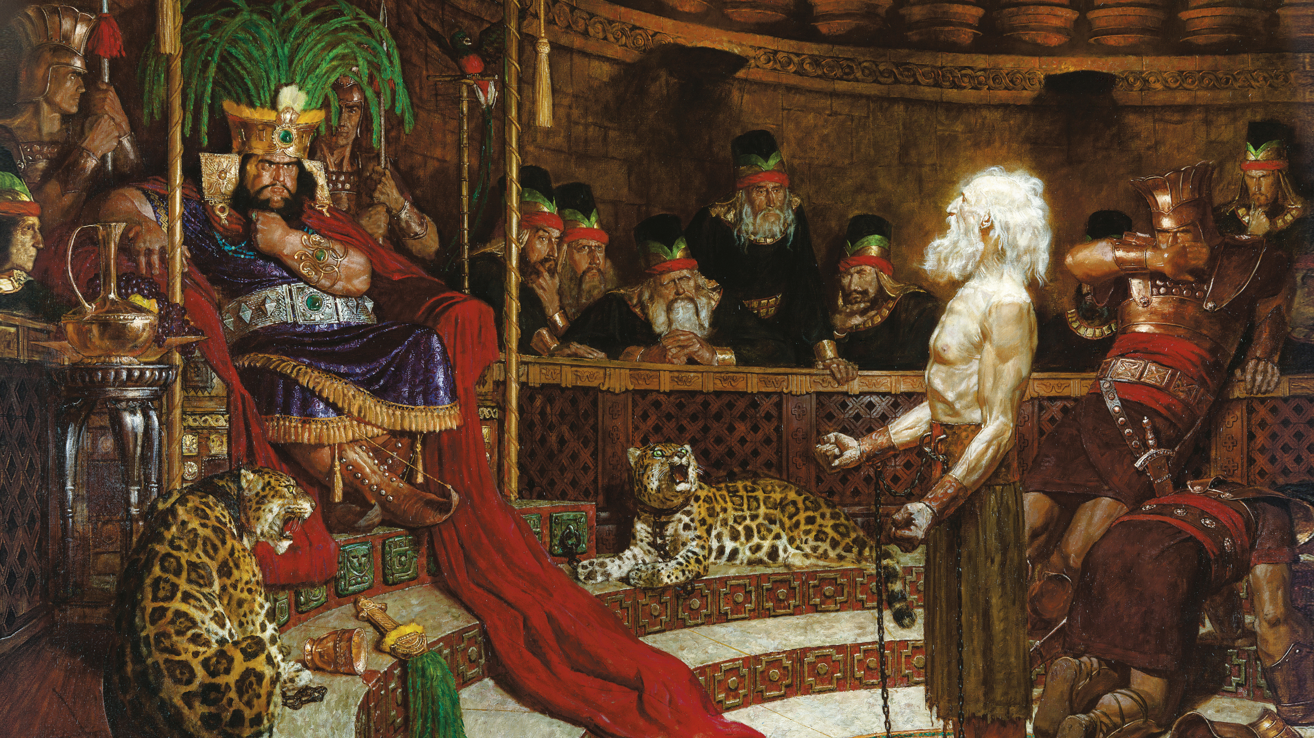
“When Abinadi finished these sayings, the king commanded that the priests should take him and cause that he should be put to death. But there was one among them whose name was Alma…he was a young man, and he believed the words which Abinadi had spoken…”
Mosiah 17:1–2
Notes:
https://www.churchofjesuschrist.org/bc/content/shared/content/images/gospel-library/manual/PD60004412/0001308altcrp.jpg

Slide 3
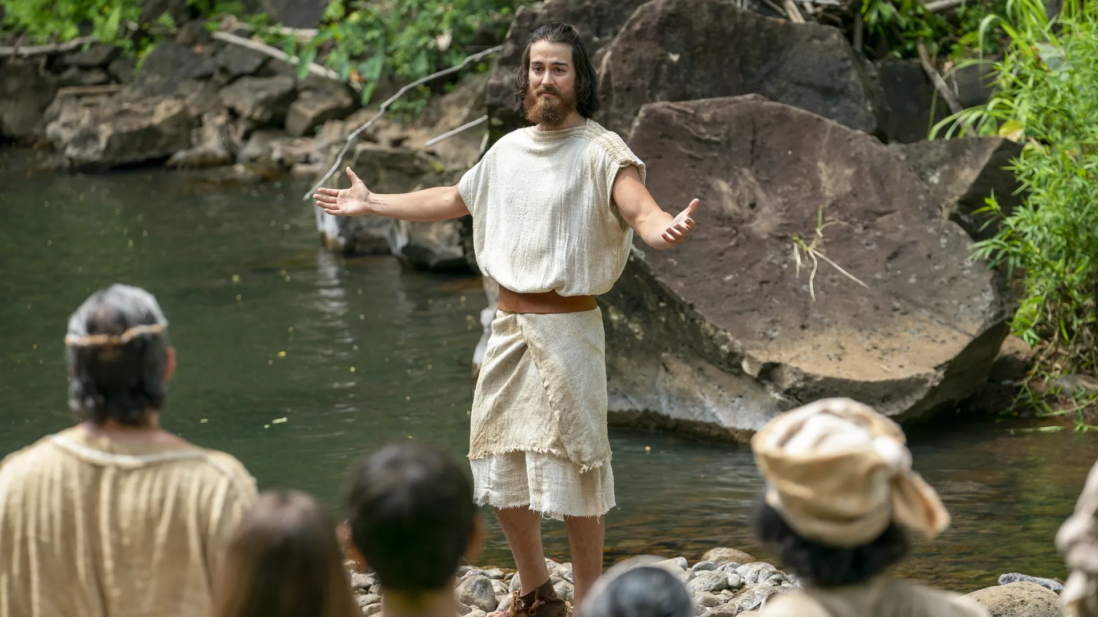
“Four hundred and fifty souls”
Mosiah 18:35
“The founder” of the church of the Nephites
Mosiah 23:16, 29:47
Notes:
https://churchofjesuschrist.org/imgs/29c448625bcba0664a79687e800450220e4a311b/full/1920%2C/0/default

Slide 4
“Four hundred and fifty souls”
Mosiah 18:35
Alma the Elder
Alma the Younger
“The founder” of the church of the Nephites
Mosiah 23:16, 29:47
Helaman
Helaman
Nephi
Nephi
Notes:
https://churchofjesuschrist.org/imgs/29c448625bcba0664a79687e800450220e4a311b/full/1920%2C/0/default

Slide 5
Intertextuality
“The relationship between texts, especially literary ones.”
--Oxford Languages

Slide 6
Rejoice, O my heart, and cry unto the Lord [Psalm 107:19, 28], and say: O Lord, I will praise thee forever [Psalm 52:9]; yea, my soul will rejoice in thee [Psalms 9:2; 85:6], my God, and the rock of my salvation [Psalm 89:26]. O Lord, wilt thou redeem my soul [Psalm 49:15]? Wilt thou deliver me out of the [Psalm 69:14] hands of mine enemies [Psalm 31:15]? Wilt thou make me that I may shake at the appearance of sin?

Slide 7
Psalm 95 and the Book of Jacob

Slide 8
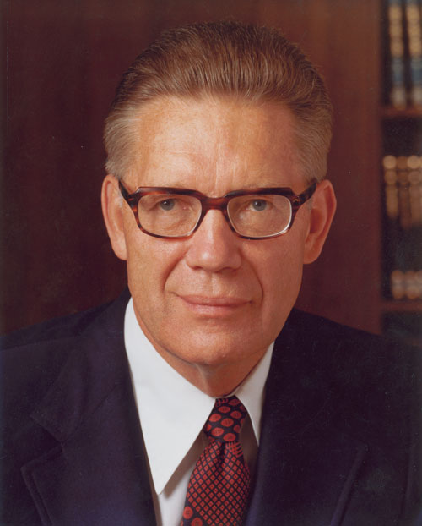
“Our understanding of the
prophetic word will be
greatly expanded if we
know how one prophet
quotes another, usually
without acknowledging
his source.”
Bruce R. McConkie
Apostle: 1972-1985
Bruce R. McConkie, “The Doctrinal Restoration,” in The Joseph Smith Translation, ed. Monte S. Nyman and Robert L. Millet (Provo, Utah: Religious Studies Center, Brigham Young University, 1985), 17.
Bruce R. McConkie
Apostle: 1972-1985

Slide 9
How do we know if a later Book of Mormon author intentionally refers to another, or if shared words are just coincidental?
Source. Could a later author have had access to the purported source?
Uniqueness. The less frequently the parallel phrases appear in scripture, the more likely that intentional intertextuality is present.
Length. Longer identical phrases argue for more probable connections than shorter ones.
Context. Are the contexts in which the phrases are used similar? Are there a series of allusions in close proximity to each other?

Slide 10
Benjamin’s words | Abinadi’s words
“The natural man is an enemy to God…[and] at the judgment day…every man…shall be judged…according to his works, whether they be good, or whether they be evil. And if they be evil…they have drunk damnation to their own souls. [But] the time shall come when the knowledge of a Savior shall spread throughout every nation, kindred, tongue and people…[for] salvation can come…only in and through the name of Christ, the Lord…” Mosiah 3:17–25 | “He that persists in his own carnal nature…is…an enemy to God…[and all] shall…be judged…according to their works whether they be good or whether they be evil…and if they be evil [they receive] the resurrection of endless damnation…[But] the time shall come when… every nation, kindred, tongue, and people…shall see the salvation of the Lord…[for] only in and through Christ can ye be saved…redemption cometh through Christ the Lord…” Mosiah 16:1–15

Slide 12
Notes:
The next time someone asks if the Chicken or the egg came first, you can do them one better: Which came first, Abinidai or King Benjamin?

Slide 13
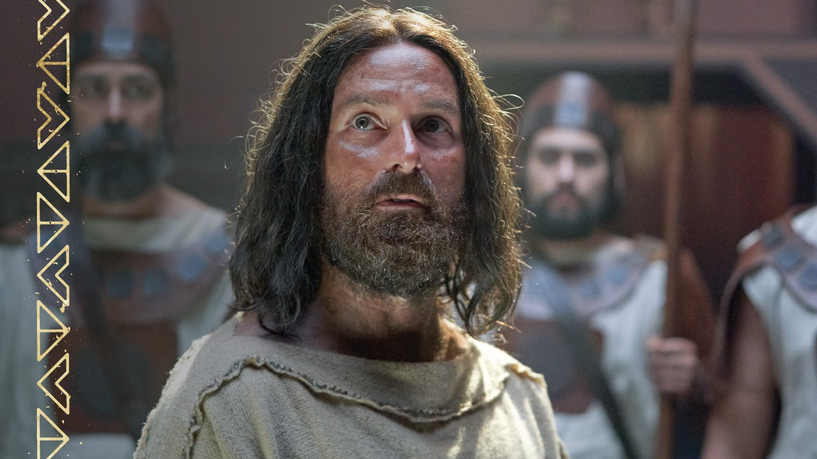
King Benjamin gave his address in 124 BC (Mosiah 6:4)
Who
Influenced
Who?
Notes:
https://assets.churchofjesuschrist.org/4f/6c/4f6c08919375a18747acb2b88db075d172f884d4/4f6c08919375a18747acb2b88db075d172f884d4.jpeg

Slide 14
King Benjamin gave his address in 124 BC (Mosiah 6:4)
Alma the Elder died in 91 BC at age 82 (Mosiah 29:46)
Who
Influenced
Who?
Notes:
https://assets.churchofjesuschrist.org/4f/6c/4f6c08919375a18747acb2b88db075d172f884d4/4f6c08919375a18747acb2b88db075d172f884d4.jpeg

Slide 15
King Benjamin gave his address in 124 BC (Mosiah 6:4)
Alma the Elder died in 91 BC at age 82 (Mosiah 29:46)
So Alma the Elder was born in 173 BC
Who
Influenced
Who?
Notes:
https://assets.churchofjesuschrist.org/4f/6c/4f6c08919375a18747acb2b88db075d172f884d4/4f6c08919375a18747acb2b88db075d172f884d4.jpeg

Slide 16
King Benjamin gave his address in 124 BC (Mosiah 6:4)
Alma the Elder died in 91 BC at age 82 (Mosiah 29:46)
So Alma the Elder was born in 173 BC
“Young man” at Abinadi’s trial (Mosiah 17:2)
Who
Influenced
Who?
Notes:
https://assets.churchofjesuschrist.org/4f/6c/4f6c08919375a18747acb2b88db075d172f884d4/4f6c08919375a18747acb2b88db075d172f884d4.jpeg

Slide 17
King Benjamin gave his address in 124 BC (Mosiah 6:4)
Alma the Elder died in 91 BC at age 82 (Mosiah 29:46)
So Alma the Elder was born in 173 BC
“Young man” at Abinadi’s trial (Mosiah 17:2)
Abinadi likely spoke ~153 BC, 30 years before King Benjamin
Who
Influenced
Who?
Notes:
https://assets.churchofjesuschrist.org/4f/6c/4f6c08919375a18747acb2b88db075d172f884d4/4f6c08919375a18747acb2b88db075d172f884d4.jpeg

Slide 19
King Benjamin most sounds like Abinadi in Mosiah 3
(Quotation from an angel)
Notes:
https://assets.churchofjesuschrist.org/4f/6c/4f6c08919375a18747acb2b88db075d172f884d4/4f6c08919375a18747acb2b88db075d172f884d4.jpeg

Slide 20
King Benjamin most sounds like Abinadi in Mosiah 3
(Quotation from an angel)
Maybe Abinadi was the angel who appeared to Benjamin
Notes:
https://assets.churchofjesuschrist.org/4f/6c/4f6c08919375a18747acb2b88db075d172f884d4/4f6c08919375a18747acb2b88db075d172f884d4.jpeg

Slide 21
Free e-copy
linked at
johnhiltoniii.com/
thebookofmormon

Slide 22
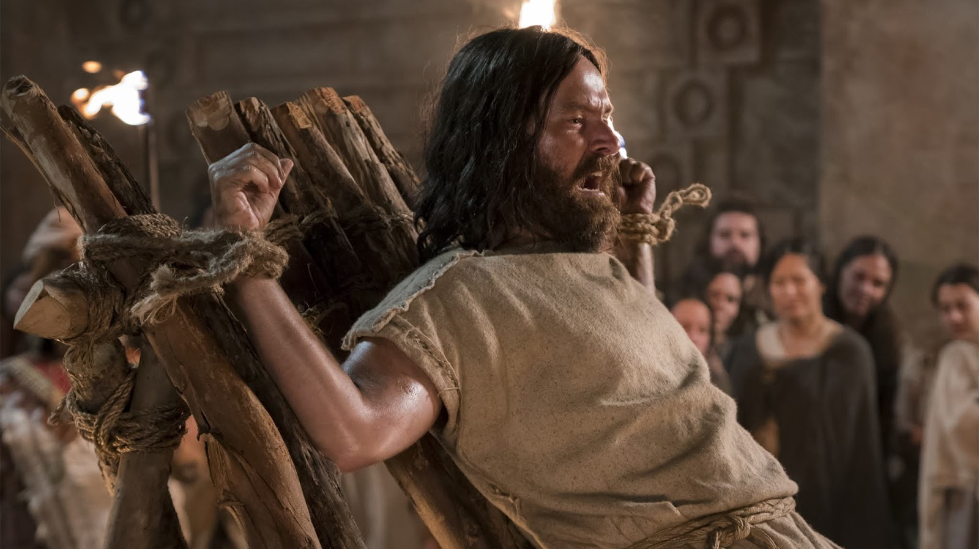
“I finish my message; and then it matters not whither I go, if it so be that I am saved…”
“O God, receive my soul.”
(Mosiah 13:9, 17:19)

Slide 23
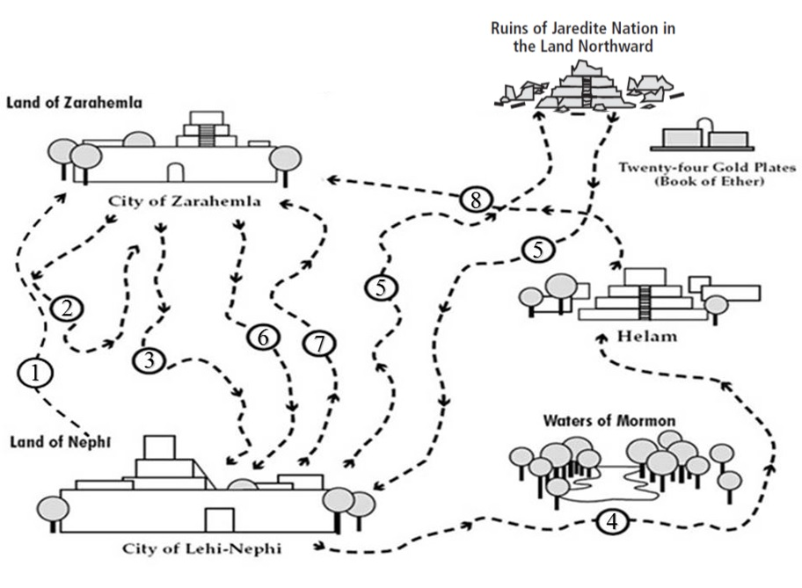

Slide 24
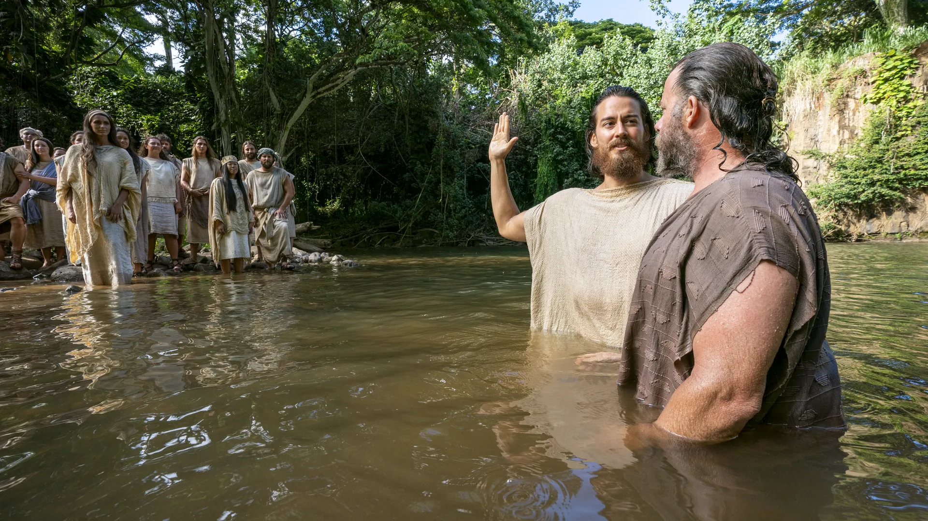
Notes:
https://churchofjesuschrist.org/imgs/cefd185f2dfa4ddb43831def7dd59a0f371b98bc/full/1920%2C/0/default

Slide 25
“As ye are desirous to come into the fold of God, and to be called his people, and are willing to bear one another’s burdens, that they may be light; Yea, and are willing to mourn with those that mourn; yea, and comfort those that stand in need of comfort, and to stand as witnesses of God at all times and in all things, and in all places that ye may be in, even until death, that ye may be redeemed of God…—Now I say unto you, if this be the desire of your hearts, what have you against being baptized in the name of the Lord, as a witness before him that ye have entered into a covenant with him, that ye will serve him and keep his commandments, that he may pour out his Spirit more abundantly upon you?”
Mosiah 18:8–10
Notes:
What stands out to you from this passage?
https://churchofjesuschrist.org/imgs/cefd185f2dfa4ddb43831def7dd59a0f371b98bc/full/1920%2C/0/default

Slide 26
“As ye are desirous to come into the fold of God, and to be called his people, and are willing to bear one another’s burdens, that they may be light; Yea, and are willing to mourn with those that mourn; yea, and comfort those that stand in need of comfort, and to stand as witnesses of God at all times and in all things, and in all places that ye may be in, even until death, that ye may be redeemed of God…—Now I say unto you, if this be the desire of your hearts, what have you against being baptized in the name of the Lord, as a witness before him that ye have entered into a covenant with him, that ye will serve him and keep his commandments, that he may pour out his Spirit more abundantly upon you?”
Mosiah 18:8–10
Notes:
What stands out to you from this passage?
https://churchofjesuschrist.org/imgs/cefd185f2dfa4ddb43831def7dd59a0f371b98bc/full/1920%2C/0/default

Slide 28
“As ye are desirous to come into the fold of God, and to be called his people, and are willing to bear one another’s burdens, that they may be light; Yea, and are willing to mourn with those that mourn; yea, and comfort those that stand in need of comfort, and to stand as witnesses of God at all times and in all things, and in all places that ye may be in, even until death [or awkward social situations], that ye may be redeemed of God…—Now I say unto you, if this be the desire of your hearts, what have you against being baptized in the name of the Lord, as a witness before him that ye have entered into a covenant with him, that ye will serve him and keep his commandments, that he may pour out his Spirit more abundantly upon you?” Mosiah 18:8–10
Notes:
What stands out to you from this passage?
https://churchofjesuschrist.org/imgs/cefd185f2dfa4ddb43831def7dd59a0f371b98bc/full/1920%2C/0/default

Slide 29
“All this was done in Mormon, yea, by the waters of Mormon, in the forest that was near the waters of Mormon…how beautiful are they to the eyes of them who there came to the knowledge of their Redeemer; yea, and how blessed are they, for they shall sing to his praise forever.”
Mosiah 18:30
Notes:
What stands out to you from this passage?
https://churchofjesuschrist.org/imgs/cefd185f2dfa4ddb43831def7dd59a0f371b98bc/full/1920%2C/0/default

Slide 30
“[They[ did go forth to a place which was called Mormon…being in the borders of the land having been infested, by times or at seasons, by wild beasts.” (Mosiah 18:4)
“All this was done in Mormon, yea, by the waters of Mormon, in the forest that was near the waters of Mormon…how beautiful are they to the eyes of them who there came to the knowledge of their Redeemer; yea, and how blessed are they, for they shall sing to his praise forever.”
Mosiah 18:30
Notes:
What stands out to you from this passage?
https://churchofjesuschrist.org/imgs/cefd185f2dfa4ddb43831def7dd59a0f371b98bc/full/1920%2C/0/default

Slide 32
What do you know about Shemlon?

Slide 33
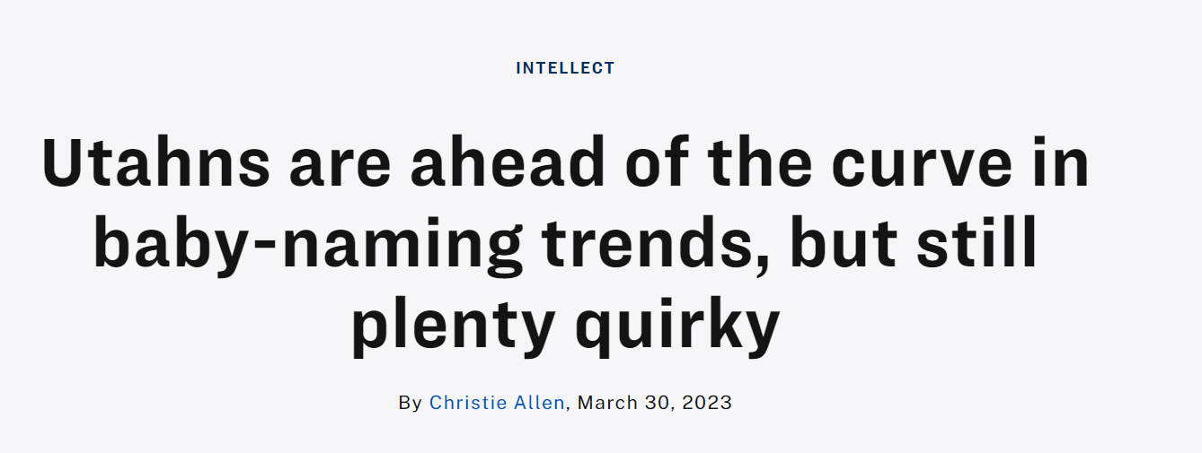
Shemlauwyne

Slide 34
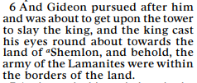
Mosiah 19:6

Slide 35
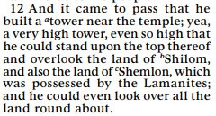
Mosiah 19:6
Mosiah 11:12

Slide 36
Mosiah 19 Summary
Gideon threatens Noah
The Lamanites attack the Nephites
The Nephites flee from the Lamanites
Noah commands men to leave their wives and children
Some men stay with their wives and children. They make a deal with the Lamanites and Noah’s son Limhi becomes king.
Some men go with Noah but later feel ashamed. They put King Noah to death, and want to put the priests to death too, but the priests run away.
We end Mosiah 19 with Limhi’s people in bondage, being forced to pay a 50% tax to the Lamanites each year.

Slide 37
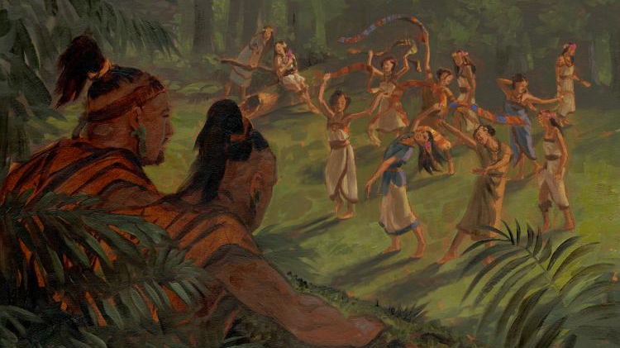
James H. Fullmer
Notes:
https://bookofmormonartcatalog.org/catalog/amulon-and-the-daughters-of-the-lamanites/

Slide 38
Find a list of scripture study tools at
johnhiltoniii.com/thebookofmormon/resources

Slide 39
“[King Limhi’s soldiers] said: Behold, here is the king of the Lamanites; he having received a wound has fallen among their dead, and they have left him; and behold, we have brought him before you; and now let us slay him.
Notes:
This is such a simple principle, but it’s really important—the King of the Lamanites jumped to a conclusion. King Limhi wanted to better understand the situation and so he started a dialogue. And then note, to his credit, King Laman admits he was wrong and works to bring peace. These are principles each of us can apply today.

Slide 40
“[King Limhi’s soldiers] said: Behold, here is the king of the Lamanites; he having received a wound has fallen among their dead, and they have left him; and behold, we have brought him before you; and now let us slay him. But Limhi said unto them: Ye shall not slay him, but bring him hither that I may see him. And they brought him. And Limhi said unto him: What cause have ye to come up to war against my people? Behold, my people have not broken the oath that I made unto you; therefore, why should ye break the oath which ye made unto my people.”
Mosiah 20:13–14
Notes:
This is such a simple principle, but it’s really important—the King of the Lamanites jumped to a conclusion. King Limhi wanted to better understand the situation and so he started a dialogue. And then note, to his credit, King Laman admits he was wrong and works to bring peace. These are principles each of us can apply today.

Slide 41
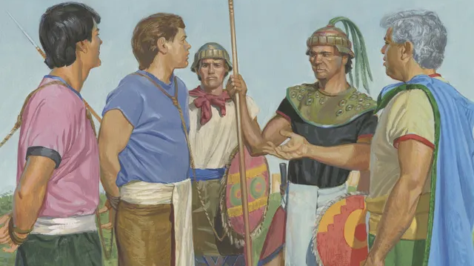
Notes:
https://churchofjesuschrist.org/imgs/d84fc018fba9076f18987100e14b1e5af8eb8662/full/640%2C/0/default

Slide 42
“Now king Limhi had sent, previous to the coming of Ammon, a small number of men to search for the land of Zarahemla; but they could not find it, and they were lost in the wilderness. Nevertheless, they did find a land which had been peopled…And they brought a record with them, even a record of the people whose bones they had found; and it was engraven on plates of ore. And now Limhi was again filled with joy on learning from the mouth of Ammon that king Mosiah had a gift from God, whereby he could interpret such engravings; yea, and Ammon also did rejoice.” (Mosiah 21:25–29)

Slide 43
“Now king Limhi had sent, previous to the coming of Ammon, a small number of men to search for the land of Zarahemla; but they could not find it, and they were lost in the wilderness. Nevertheless, they did find a land which had been peopled…And they brought a record with them, even a record of the people whose bones they had found; and it was engraven on plates of ore. And now Limhi was again filled with joy on learning from the mouth of Ammon that king Mosiah had a gift from God, whereby he could interpret such engravings; yea, and Ammon also did rejoice.” (Mosiah 21:25–29)
“I caused that forty and three of my people should take a journey into the wilderness, that thereby they might find the land of Zarahemla. And they were lost in the wilderness for the space of many days…and…having discovered a land which was covered with bones of men, and of beasts…And for a testimony that the things that they had said are true they have brought twenty-four plates which are filled with engravings…And I say unto thee again: Knowest thou of any one that can translate? Ammon said unto him: I can assuredly tell thee, O king, of a man that can translate the records…the same is called seer.” (Mosiah 8:7–19)

Slide 44
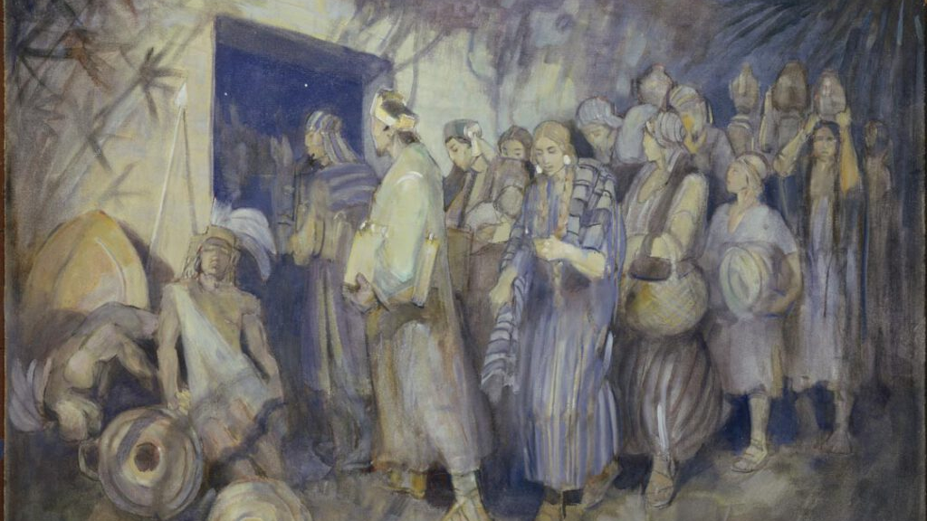
Minerva Teichert
Notes:
https://bookofmormonartcatalog.org/catalog/escape-of-king-limhi-and-his-people/

Slide 45
Notes:
Highlight journey 7

Slide 46
Find a list of scripture study tools at
johnhiltoniii.com/thebookofmormon/resources

Slide 47
A Theme of Deliverance:
Mosiah 7:15
Mosiah 7:33
Mosiah 8:7
Mosiah 9:17
Mosiah 11:21
Mosiah 11:23
Mosiah 11:25
Mosiah 11:26
9. Mosiah 21:5
10. Mosiah 21:14
11. Mosiah 21:15
12. Mosiah 21:36
13. Mosiah 22:1
14. Mosiah 22:2
15. Mosiah 22:4
16. Mosiah 23:13
17. Mosiah 23:23
18. Mosiah 23:24
19. Mosiah 23:27
20. Mosiah 24:13
21. Mosiah 24:16
22. Mosiah 24:17
23. Mosiah 24:21
24. Mosiah 25:16
The word “deliver” is used 231 in the Book of Mormon, and nowhere is it more concentrated in its use
than Mosiah chapters 7-25 (41 times).

Slide 48
Contrast how each group reacts to being captured by Lamanites.
Limhi and his People
Mosiah 19:13-14
Alma and his people
Mosiah 23:27-28
Notes:
Small groups, everybody answers.

Slide 49
Deliverance and the People of Limhi
“And now, behold, our brethren will deliver us out of our bondage” (Mosiah 7:15)
“that we might appeal unto our brethren to deliver us out of bondage” (Mosiah 8:7)
“All the study of… king Limhi and his people, was to deliver themselves out of the hands of the Lamanites (Mosiah 21:36)
“Limhi began to consult with the people how they should deliver themselves out of bondage” (Mosiah 22:1).
“I [Gideon] will be thy servant and deliver this people out of bondage.(Mosiah 22:4)
“[Alma] did exhort the people of Limhi…that they should remember that it was the Lord that did deliver them” (Mosiah 25:16).

Slide 50
Deliverance and the People of Alma
As Alma’s people received sore afflictions “they began to cry mightily to God” (Mosiah 24:10).
They “did pour out their hearts to” God (Mosiah 24:12). They then received the following assurances from the Lord:
“I [the Lord] will covenant with my people and deliver them out of bondage” (Mosiah 24:13).
“Be of good comfort, for on the morrow I [the Lord] will deliver you out of bondage” (Mosiah 24:16).
“I [the Lord] will go with thee and deliver this people out of bondage” (Mosiah 24:17)
Alma and his people knew the source of their deliverance; after they escaped, “they poured out their thanks to God because he had…delivered them” (Mosiah 24:21).

Slide 51
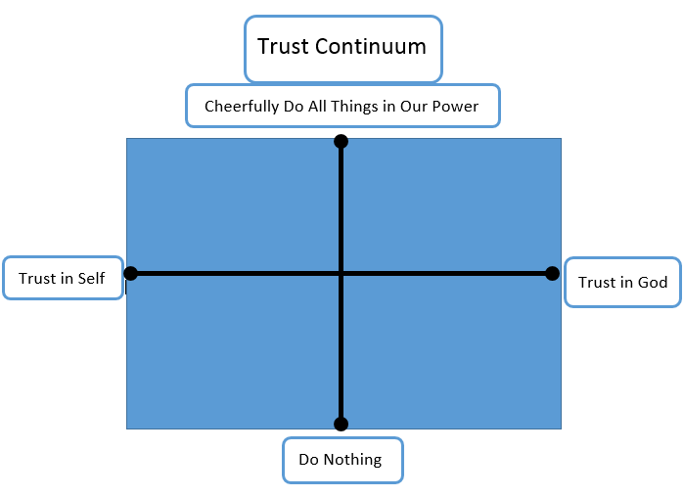

Slide 56
Limhi’s People
Alma’s People

Slide 57
“How can I know whether I need to trust in God more, or whether I need to work harder?”

Slide 61
“The voice of the Lord came to them in their afflictions, saying: Lift up your heads and be of good comfort, for I know of the covenant which ye have made unto me; and I will covenant with my people and deliver them out of bondage. And I will also ease the burdens which are put upon your shoulders, that even you cannot feel them upon your backs, even while you are in bondage; and this will I do that ye may stand as witnesses for me hereafter, and that ye may know of a surety that I, the Lord God, do visit my people in their afflictions. And now it came to pass that the burdens which were laid upon Alma and his brethren were made light; yea, the Lord did strengthen them that they could bear up their burdens with ease, and they did submit cheerfully and with patience to all the will of the Lord. And it came to pass that so great was their faith and their patience that the voice of the Lord came unto them again, saying: Be of good comfort, for on the morrow I will deliver you out of bondage.” Mosiah 24:13–16

Slide 62
Limhi’s People
Alma’s People

Slide 63
“In October 2003, Bolivia was experiencing a period of significant civil unrest that is now known as the Bolivian Gas War….One of the goals of the protesters was to shut down all transportation in the cities of El Alto and La Paz—cities that are located about twelve miles apart. To accomplish their goal, the protesters erected barricades and scattered broken glass in the streets to limit transportation inside of and between the two cities. Their leaders vowed that no goods, including fuel, would come in or out of the cities.”
Notes:
https://assets.byub.org/images/e9d20588-1107-4514-bf26-4378bba3cf3d/3840x2160.webp

Slide 64
“Violence soon broke out, and the government responded by declaring martial law. A dozen or so missionaries in El Alto were trapped and needed to get out…The news reported that three thousand miners from the rural areas of the country were on their way to El Alto armed with dynamite to reinforce the protesters. The danger was real and getting worse by the hour; it was clear that the missionaries needed to get out of El Alto and into the safety of the mission home in La Paz.”
Notes:
https://assets.byub.org/images/e9d20588-1107-4514-bf26-4378bba3cf3d/3840x2160.webp

Slide 65
“But there were two massive problems. First, the two mission vehicles each had less than one-fourth of a tank of gas—not enough to pick up all the missionaries. Furthermore, the news had reported that no gasoline had entered the city of La Paz for the past five days. Second, both my parents and their car would be targets for the protesters—my parents because they were foreigners with possible ties to the U.S. government and their large white Toyota vehicle because that vehicle was commonly used by government officials.”
Notes:
https://assets.byub.org/images/e9d20588-1107-4514-bf26-4378bba3cf3d/3840x2160.webp

Slide 66
“It was in this context that very early in the morning my father—after a night spent almost entirely in prayer—received the following impression: ‘Leave now and you will find gas.’
My dad turned to my mom and said, ‘We must leave right now if we want to find gas.’ Without a word she jumped up from bed. Off they went, like Nephi, ‘not knowing beforehand the things which [they] should do.’ [Miraculously, they found gasoline]”
Notes:
https://assets.byub.org/images/e9d20588-1107-4514-bf26-4378bba3cf3d/3840x2160.webp

Slide 67
“[Later…] My father and his assistant needed to drive on a very dangerous six-mile stretch of highway between La Paz and El Alto. As they approached the highway, they noticed an enormous convoy entering the highway ahead of them. This convoy consisted of military and police vehicles, including troop carriers with armed soldiers. To my father and his assistant’s surprise, they also noticed that many of the vehicles in the convoy were large and white, and a fair number of them were Toyotas.
Notes:
https://assets.byub.org/images/e9d20588-1107-4514-bf26-4378bba3cf3d/3840x2160.webp

Slide 68
“My father recorded that without being invited, they ‘slipped in behind the lead troop carrier. No one said a thing. We looked very official in our big white car.’”
They had thought that driving a very conspicuous big white Toyota would be a dangerous weakness. But instead it turned out to be precisely the vehicle they needed to drive to be inconspicuous within the convoy.
Notes:
https://assets.byub.org/images/e9d20588-1107-4514-bf26-4378bba3cf3d/3840x2160.webp

Slide 69
“What they didn’t know at the time was that they were now part of the military convoy evacuating the president of Bolivia and his family out of the city of La Paz to the airport in El Alto. This powerful military escort was not only protecting the president of the country of Bolivia but was also protecting the president of the Bolivia La Paz Mission.”
Notes:
https://assets.byub.org/images/e9d20588-1107-4514-bf26-4378bba3cf3d/3840x2160.webp

Slide 70
“My father and his assistant drove inside the convoy for as long as possible and then proceeded to the rendezvous point. When they arrived, they found a group of armed soldiers standing there, and in the midst of these soldiers they found five very anxious missionaries. My dad hugged each of the soldiers, who explained that when they had seen the missionaries in such a dangerous location, they knew they had to protect them. Miraculously, every missionary was safely evacuated that day.”
Michael S. Drake, “Deliverance,” BYU Speech
Notes:
https://assets.byub.org/images/e9d20588-1107-4514-bf26-4378bba3cf3d/3840x2160.webp

Slide 71
Notes:
https://lds-business-college.brightspotcdn.com/dims4/default/a0af3a3/2147483647/strip/true/crop/1895x2542+642+0/resize/820x1100!/format/webp/quality/90/?url=http%3A%2F%2Fensign-brightspot.s3.us-east-2.amazonaws.com%2F7b%2F0b%2F045c214ccacb3003a353cc956325%2Fpres-alynda-kusch.jpg

Slide 72
“In preparation for our departure into the mission field, we moved almost all of our belongings into a large storage room in our basement so that our daughter and her family could make our home their home while we were gone. On July 15, 2014, (with one year left on our mission) there was, what has since been described, a 100-year storm in Rexburg.
Notes:
https://lds-business-college.brightspotcdn.com/dims4/default/a0af3a3/2147483647/strip/true/crop/1895x2542+642+0/resize/820x1100!/format/webp/quality/90/?url=http%3A%2F%2Fensign-brightspot.s3.us-east-2.amazonaws.com%2F7b%2F0b%2F045c214ccacb3003a353cc956325%2Fpres-alynda-kusch.jpg

Slide 73
“As the water rose in the backyard of our home, the windows broke as they could not sustain its weight, and our basement filled with 8 feet of mud, water and debris. What was left, after approximately 220,000 gallons of water and mud were pumped out, was destruction and damage beyond what I could ever have imagined…Because our insurance company deemed that the damage to our home was caused by Mother Nature, none of the clean-up nor any of the repairs were covered under our policy. That meant that we had the burden of paying every penny of the cost to clean and rebuild our home.”
Notes:
Let me just pause for a moment and share something. I’ve talked with President and Sister Kusch about this experience, and when you just read it like we have, it almost seems like, “Yes, it was hard, but we did it.” But imagine, you’re on a mission, serving the Lord—you would think that he would protect you from any harm or danger. But they lost hundreds of thousands of dollars in repairs to their house, and literally lost all their possessions. How would you feel if you were them? Sister Kusch continues:
https://lds-business-college.brightspotcdn.com/dims4/default/a0af3a3/2147483647/strip/true/crop/1895x2542+642+0/resize/820x1100!/format/webp/quality/90/?url=http%3A%2F%2Fensign-brightspot.s3.us-east-2.amazonaws.com%2F7b%2F0b%2F045c214ccacb3003a353cc956325%2Fpres-alynda-kusch.jpg

Slide 74
“Soon after returning home from our mission, a neighbor came to my door and asked me this question, “You were serving the Lord in Mexico, and He allowed this tragedy to happen. How can you still believe?” My answer to him is, “How can I not believe?” Because I know about Jesus Christ, who he is, what he did for me, what he will yet do for me, I believe.”
Alynda Kusch, “From Despair to Hope,” Ensign College Devotional
Notes:
https://lds-business-college.brightspotcdn.com/dims4/default/a0af3a3/2147483647/strip/true/crop/1895x2542+642+0/resize/820x1100!/format/webp/quality/90/?url=http%3A%2F%2Fensign-brightspot.s3.us-east-2.amazonaws.com%2F7b%2F0b%2F045c214ccacb3003a353cc956325%2Fpres-alynda-kusch.jpg

Slide 75
“Soon after returning home from our mission, a neighbor came to my door and asked me this question, “You were serving the Lord in Mexico, and He allowed this tragedy to happen. How can you still believe?” My answer to him is, “How can I not believe?” Because I know about Jesus Christ, who he is, what he did for me, what he will yet do for me, I believe.”
Alynda Kusch, “From Despair to Hope,” Ensign College Devotional
Notes:
https://lds-business-college.brightspotcdn.com/dims4/default/a0af3a3/2147483647/strip/true/crop/1895x2542+642+0/resize/820x1100!/format/webp/quality/90/?url=http%3A%2F%2Fensign-brightspot.s3.us-east-2.amazonaws.com%2F7b%2F0b%2F045c214ccacb3003a353cc956325%2Fpres-alynda-kusch.jpg

Slide 77
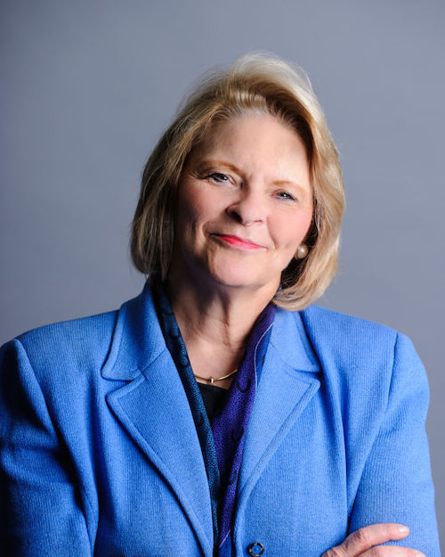
“Let prophets of God be your spiritual anchor. Listen to them. Study their words. Follow their counsel. It will protect you from deception and keep you from making major mistakes. Prophets will make you smarter. They will help you see things you cannot see.”
Sheri Dew, “Prophets can see around corners”
Notes:
https://www.deseretmanagement.com/executive-leadership/sheri-dew

Slide 78
Mosiah 12:2
Mosiah 21:3

Slide 79
Mosiah 12:3
Mosiah 19:20

Slide 80
Mosiah 12:5
Mosiah 21:3

Slide 81
Mosiah 11:24
Mosiah 21:15

Slide 82
Mosiah 11:23
Mosiah 23:23

Slide 83
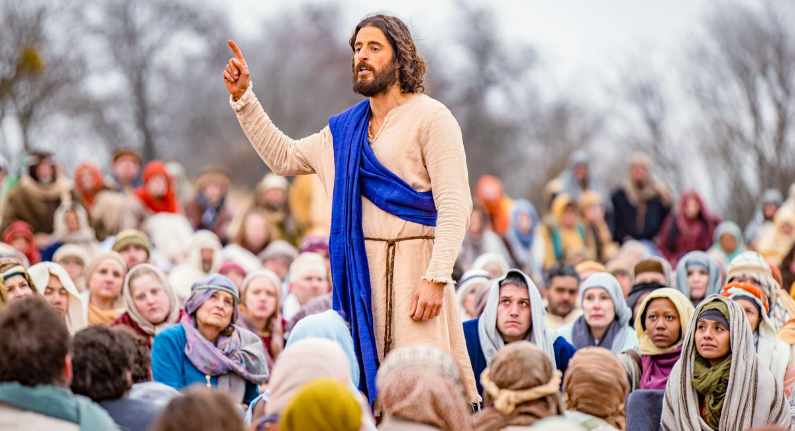
Notes:
https://newsroom.churchofjesuschrist.org/media/960x540/jesus-christ.jpg

Slide 84
For free resources related to this video, please visit https://johnhiltoniii.com/TheBookofMormon
Join our course discussions on social media
@johnhiltoniii

Slide 85
https://johnhiltoniii.com/SeekingJesus
You may also be interested in this
free video course…

Slide 86
This video is not produced or endorsed by Brigham Young University or the Church of Jesus Christ of Latter-day Saints. John Hilton III is solely responsible for its contents
Insights from, discussions with, and resources authored by
by Michael Drake, Heather Hardy and Alynda Kusch were used in the creation of this video. See further acknowledgements at https://johnhiltoniii.com/thebookofmormon

