Slide 1
Alma the Book

Slide 2
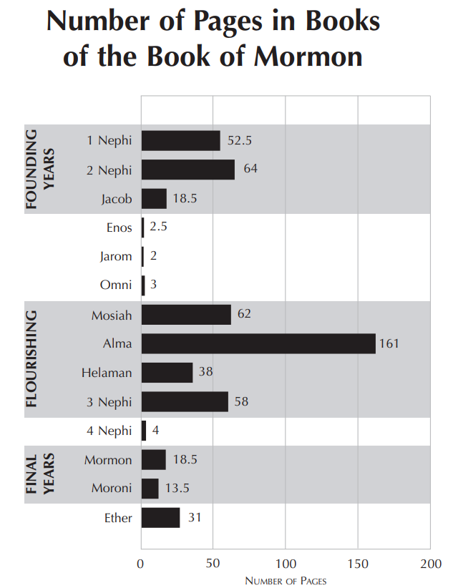
John W. Welch and J. Gregory Welch, Charting the Book of Mormon: Visual Aids for Personal Study and Teaching, 62

Slide 3
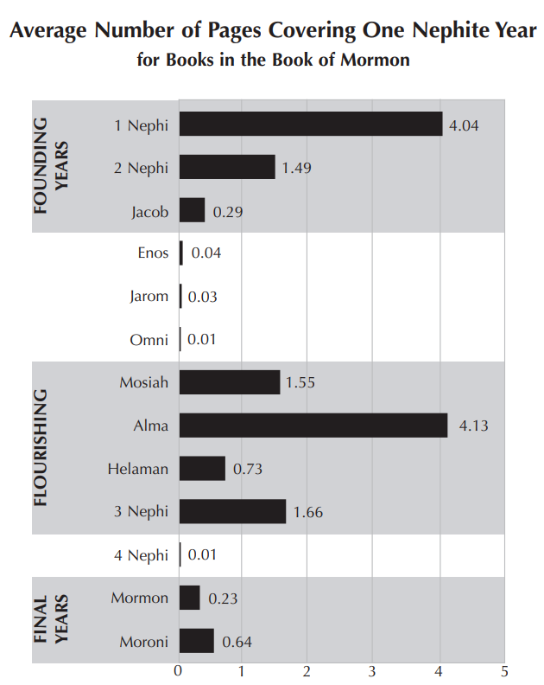
John W. Welch and J. Gregory Welch, Charting the Book of Mormon: Visual Aids for Personal Study and Teaching, 64

Slide 4
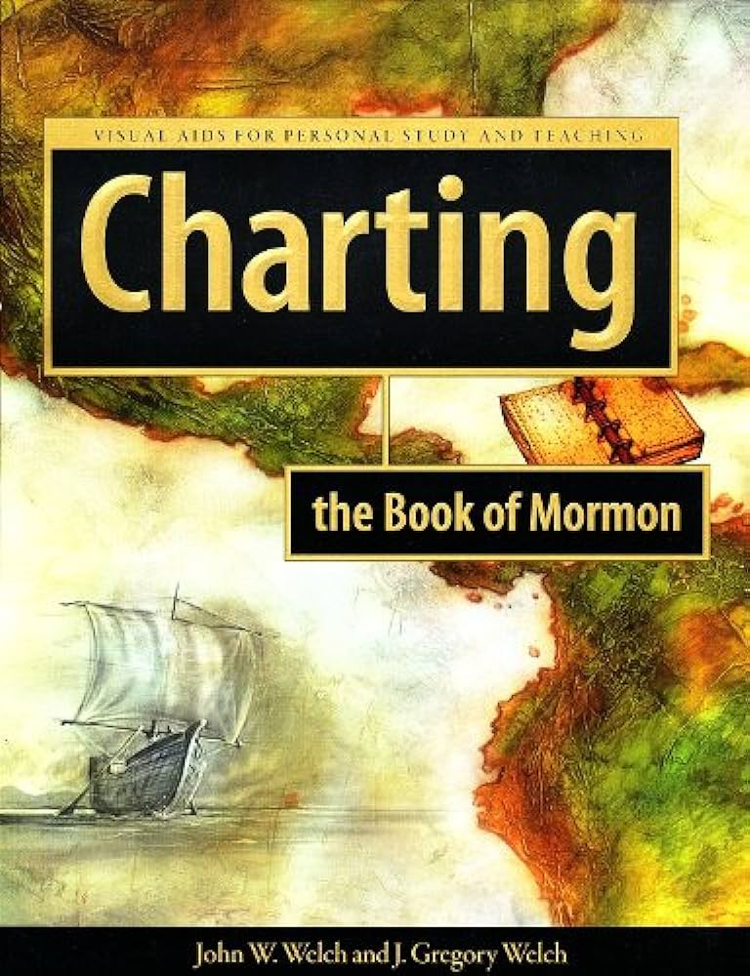
johnhiltoniii.com/thebookofmormon

Slide 5
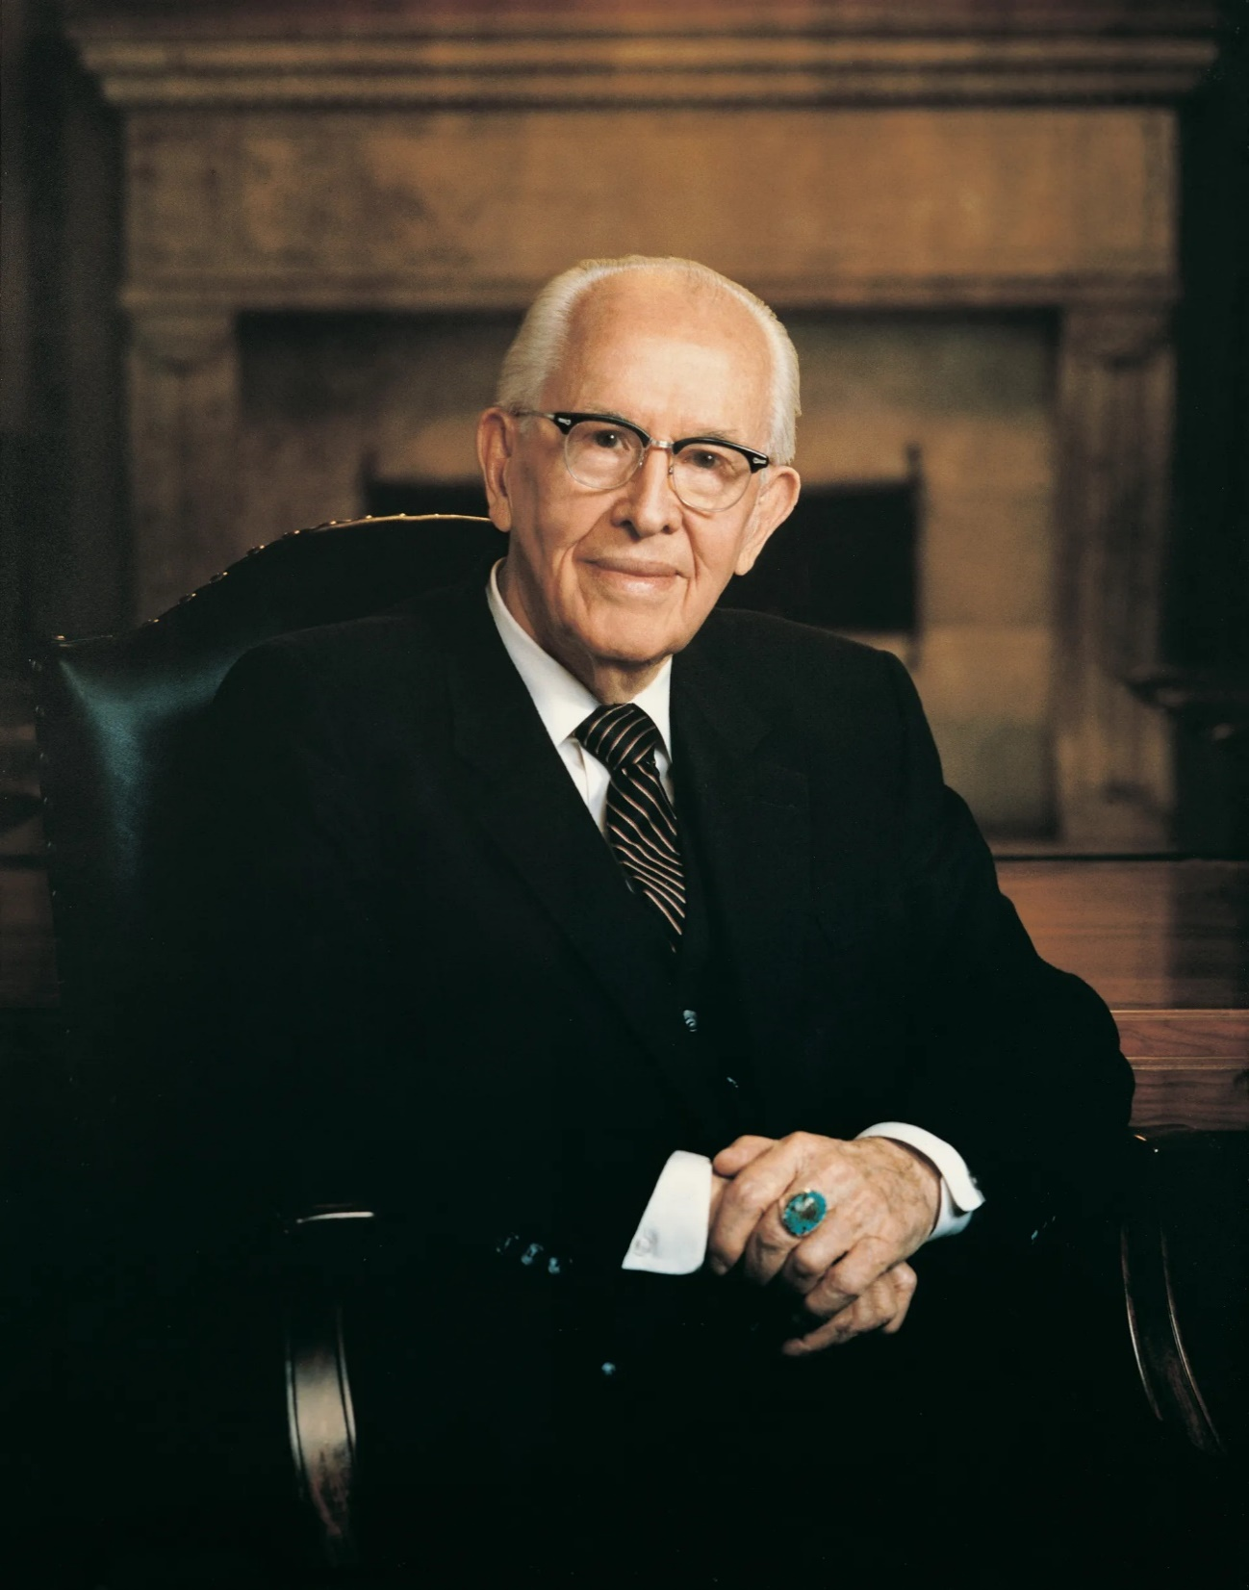
“The Book of Mormon…was written for
our day….Mormon wrote near the end of
the Nephite civilization. Under the
inspiration of God, who sees all things
from the beginning, he abridged
centuries of records, choosing the stories,
speeches, and events that would be most
helpful to us….We should constantly ask
ourselves, ‘Why did the Lord inspire
Mormon…to include that in his record?
What lesson can I learn from that to help
me live in this day and age.”
Teachings: Ezra Taft Benson, 140
Notes:
https://www.churchofjesuschrist.org/imgs/a8a0daf57c187fb40437de5c14cbc3859e59b3b5/full/1920%2C/0/default

Slide 6
The Book of Alma
Alma 1-4: Initial challenges in the reign of the Judges (Nehor, Amlici)
Alma 5-7: Alma’s sermons to the people of Zarahemla and Gideon
Alma 8-16: Alma and Amulek preach in Ammonihah
Alma 17-29: Mission of the sons of Mosiah to Lamanites (takes place at the same time as Alma 1-16).
Alma 30 - 35: Korihor and the Zoramites
Alma 36-42: Alma’s counsel to his sons
Alma 43-63: A series of Nephite-Lamanite wars with Chief Captain Moroni, Teancum, Free Men, and the Stripling Warriors facing Zerahemnah, Amalickiah, King Men and Ammoron.

Slide 7

First Quarter (Alma 1–16)
  Nehor (Alma 1)
  The Amlicites (Alma 2–3)
  Alma in Zarahemla (Alma 4–6)
  Alma in Gideon (Alma 7)
  Alma in Ammonihah (Alma 8–15)
  Details about War (Alma 16)
Third Quarter (Alma 30–44)
  Korihor (Alma 30)
  The Zoramites (Alma 31–35)
  Alma to Helaman (Alma 36–37)
  Alma to Shiblon (Alma 38)
  Alma to Corianton (Alma 39–42)
  Details about War (Alma 43–44)

Slide 8
First Quarter (Alma 1–16)
  Nehor (Alma 1)
  The Amlicites (Alma 2–3)
  Alma in Zarahemla (Alma 4–6)
  Alma in Gideon (Alma 7)
  Alma in Ammonihah (Alma 8–15)
  Details about War (Alma 16)
Second Quarter (Alma 17–29)
  Alma’s interrupted Journey (Alma 17)
  Ammon’s Mission (Alma 17–20)
  Aaron’s Mission (Alma 21–26)
  Aftermath and Cleanup (Alma 27–29)
Third Quarter (Alma 30–44)
  Korihor (Alma 30)
  The Zoramites (Alma 31–35)
  Alma to Helaman (Alma 36–37)
  Alma to Shiblon (Alma 38)
  Alma to Corianton (Alma 39–42)
  Details about War (Alma 43–44)
Fourth Quarter (Alma 45–63)
  Alma’s interrupted Journey (Alma 45)
  Amalickiah’s Dissension (Alma 45–51)
  Ammoron’s Dissension (Alma 52–62)
  Aftermath and Cleanup (Alma 63)

Slide 9
Alma the Person

Slide 10
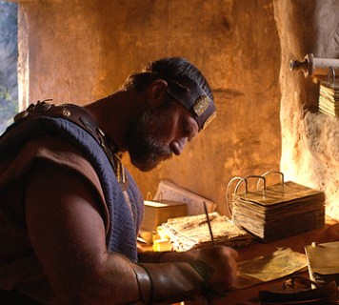
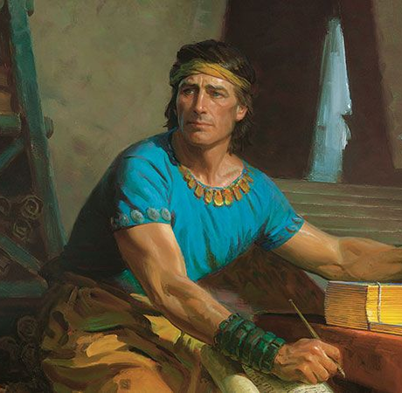
Mormon
Nephi
Notes:
Alma speaks some 20,000 words in the Book of Mormon, accounting for approximately 7.5 % of the entire text. His words occur more than the combined total of those of Lehi, King Benjamin, Amulek, Samuel the Lamanite, and Abinadi.
Now, and this is an important point, Mormon wrote the Book of Alma. As you read Alma, you’ll find that there is a narrator who is interjecting his thoughts—this is Mormon. But, more than with any other individual in the Book of Mormon, Mormon frequently notes that he is drawing from Alma’s records.
https://churchofjesuschrist.org/imgs/e2f30e2bdf421a0d91ce71fe2ebec4a8b55f3f23/full/800%2C/0/default
https://cf-images.us-east-1.prod.boltdns.net/v1/static/1241706627001/4d1fbdff-e7d8-4fe6-af39-bd39046809d4/9f666aa8-7cd9-4af9-a188-6e212572e744/1280x720/match/image.jpg
https://assets.churchofjesuschrist.org/67/4f/674fa7cb9f9fb10151545c16f3eba113d0153f4c/alma_the_younger_preaching.jpeg

Slide 11
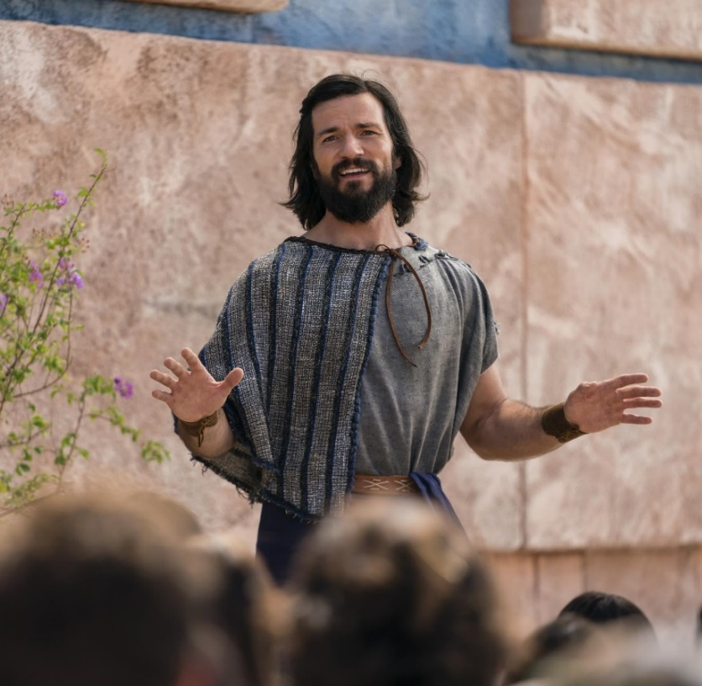
Mormon
Nephi
Alma the Younger
20,000 words
7.5% of the text
Notes:
Alma speaks some 20,000 words in the Book of Mormon, accounting for approximately 7.5 % of the entire text. His words occur more than the combined total of those of Lehi, King Benjamin, Amulek, Samuel the Lamanite, and Abinadi.
https://churchofjesuschrist.org/imgs/e2f30e2bdf421a0d91ce71fe2ebec4a8b55f3f23/full/800%2C/0/default
https://cf-images.us-east-1.prod.boltdns.net/v1/static/1241706627001/4d1fbdff-e7d8-4fe6-af39-bd39046809d4/9f666aa8-7cd9-4af9-a188-6e212572e744/1280x720/match/image.jpg
https://assets.churchofjesuschrist.org/67/4f/674fa7cb9f9fb10151545c16f3eba113d0153f4c/alma_the_younger_preaching.jpeg

Slide 12
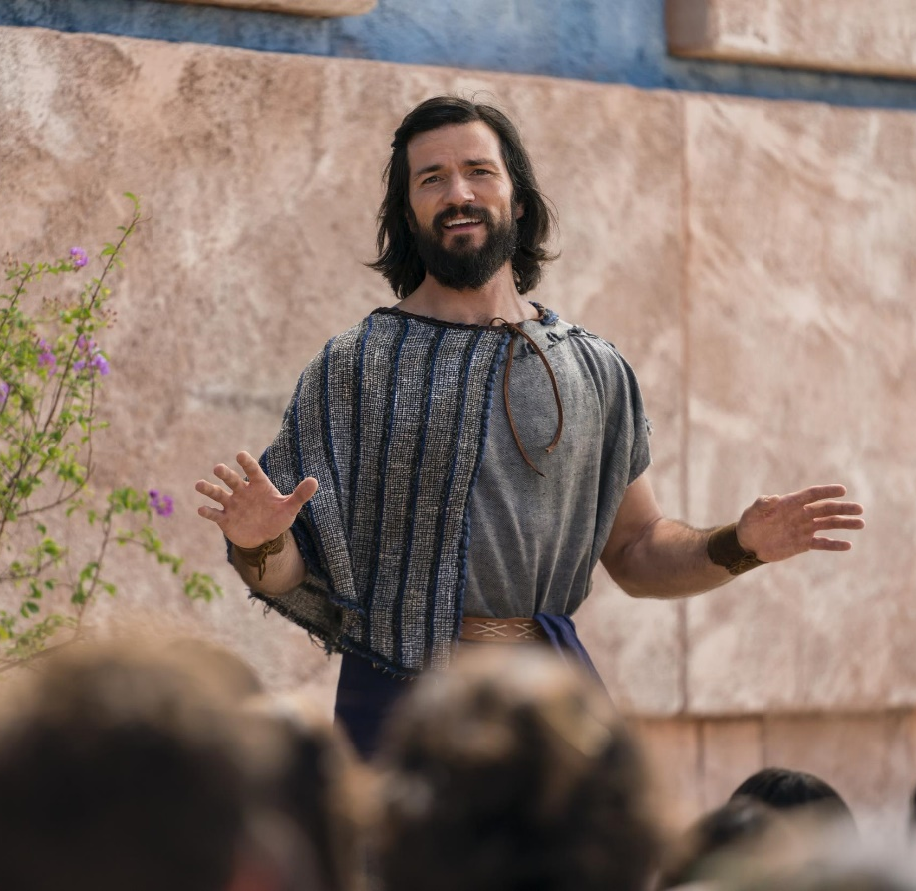
Mormon is the author of the Book of Alma, he frequently uses Alma’s first-hand records
Alma the Younger
20,000 words
7.5% of the text
Notes:
Now, and this is an important point, Mormon wrote the Book of Alma. As you read Alma, you’ll find that there is a narrator who is interjecting his thoughts—this is Mormon. But, more than with any other individual in the Book of Mormon, Mormon frequently notes that he is drawing from Alma’s records.
https://churchofjesuschrist.org/imgs/e2f30e2bdf421a0d91ce71fe2ebec4a8b55f3f23/full/800%2C/0/default
https://cf-images.us-east-1.prod.boltdns.net/v1/static/1241706627001/4d1fbdff-e7d8-4fe6-af39-bd39046809d4/9f666aa8-7cd9-4af9-a188-6e212572e744/1280x720/match/image.jpg
https://assets.churchofjesuschrist.org/67/4f/674fa7cb9f9fb10151545c16f3eba113d0153f4c/alma_the_younger_preaching.jpeg

Slide 13
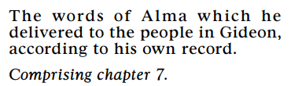
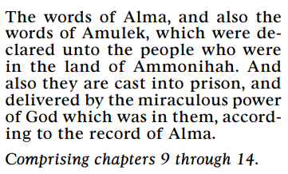
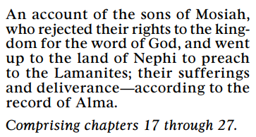

Mormon draws from Alma’s Record

Slide 14
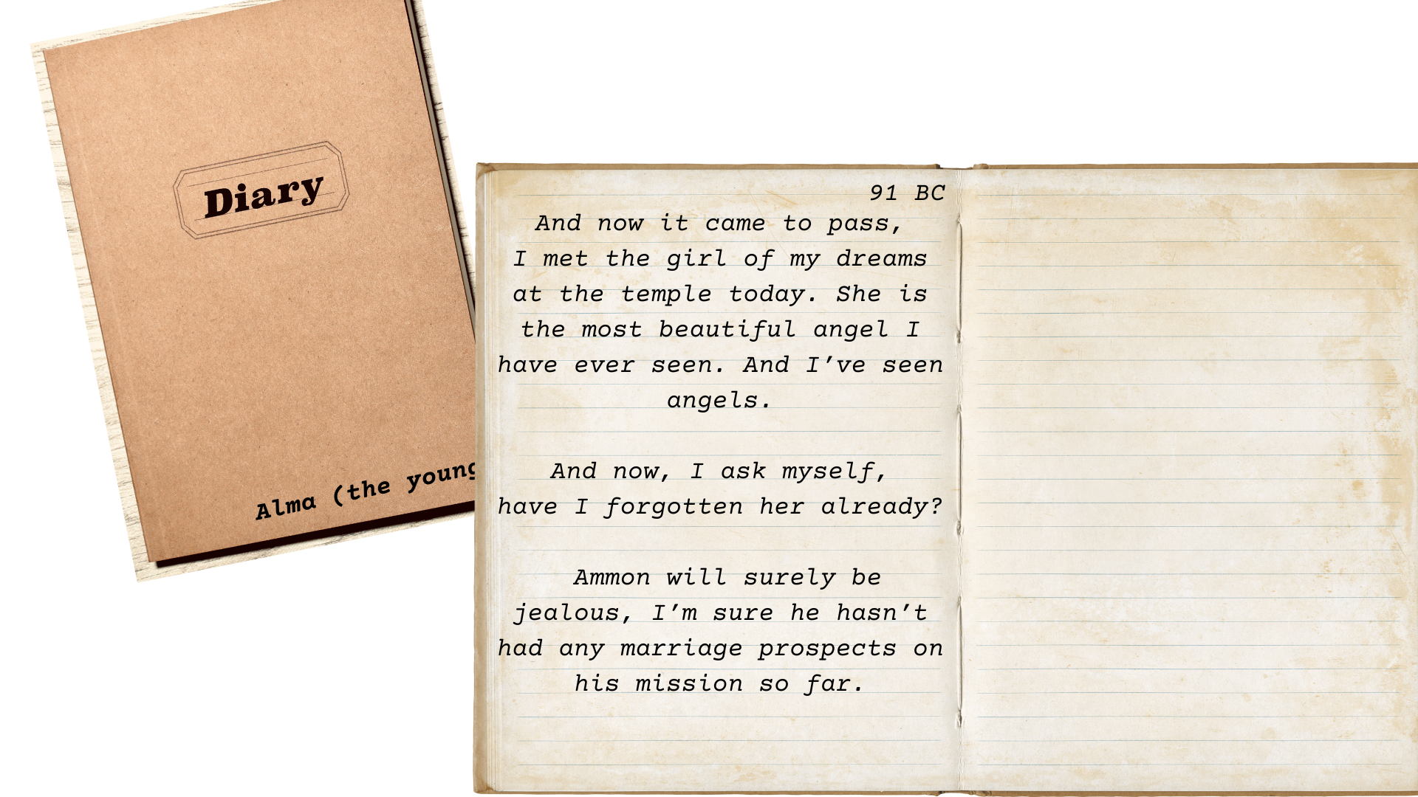

Slide 15



Slide 16
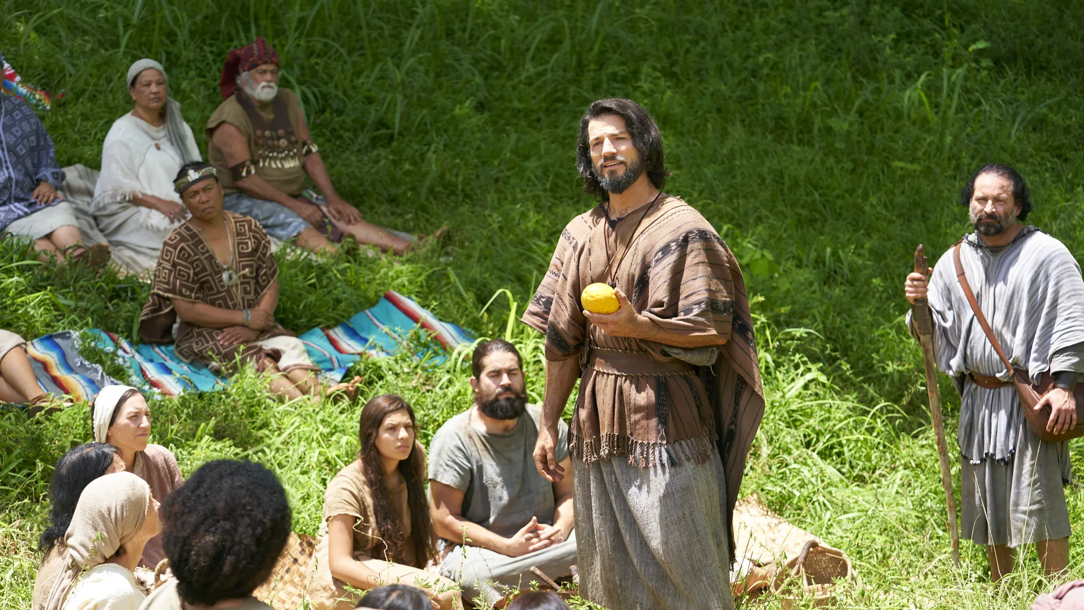
“[God] desireth, in the first place, that ye should believe, yea, even on his word. And now, he imparteth his word by angels unto men, yea, not only men but women also. Now this is not all…” Alma 32:22–23
Notes:
https://churchofjesuschrist.org/imgs/ebefbc07170887982f2e8c369ccaa00c6633b835/full/1920%2C/0/default

Slide 17
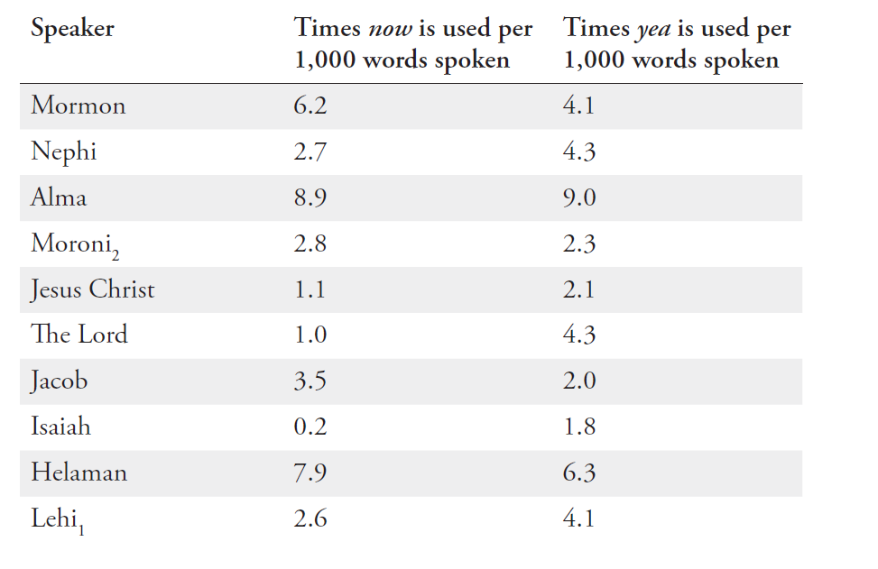

Slide 18
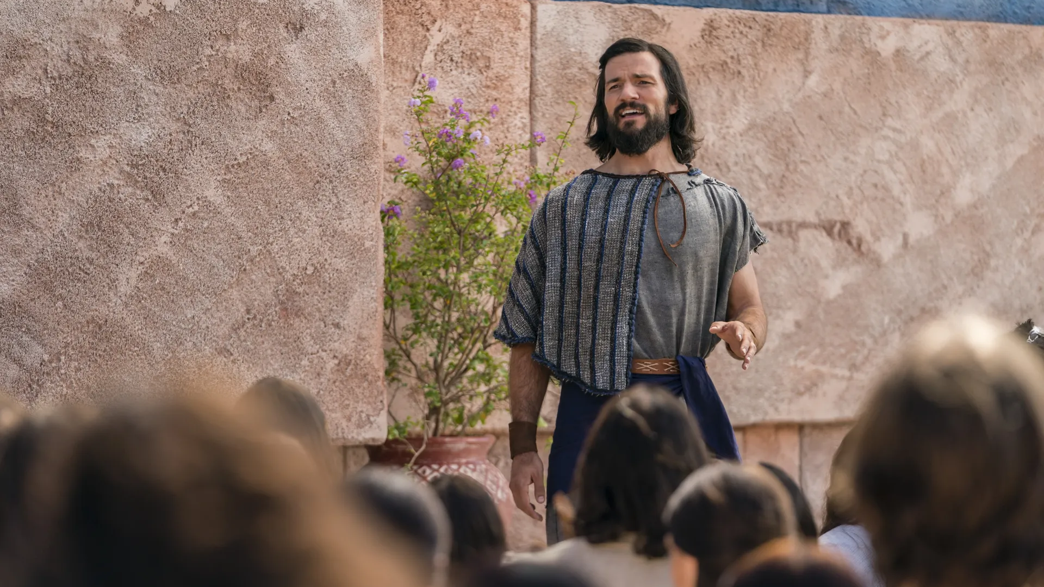
“Yea, can ye lay aside these things, and trample the Holy One under your feet; yea, can ye be puffed up in the pride of your hearts; yea, will ye still persist in the wearing of costly apparel and setting your hearts upon the vain things of the world, upon your riches? Yea, will ye persist in supposing that ye are better one than another; yea, will ye persist in the persecution of your brethren….Yea, and will you persist in turning your backs upon the poor.” Alma 5:53–55
Notes:
https://churchofjesuschrist.org/imgs/65115d820b6b2c15e98cafa060af607aea7c5888/full/1920%2C/0/default

Slide 19
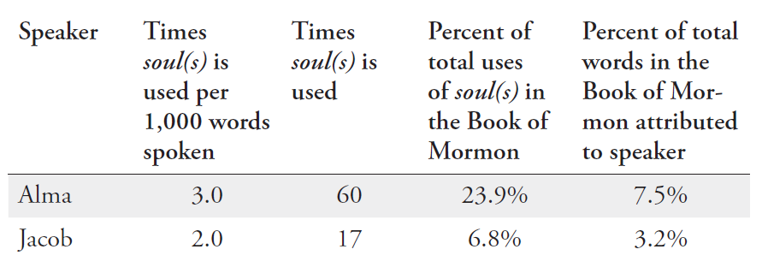
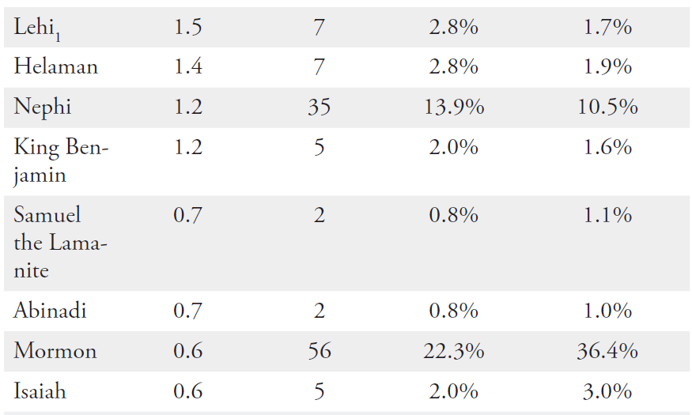
The words soul and souls collectively appear 251 times in the Book of Mormon, and 60 of these (24%) come from Alma.

Slide 20
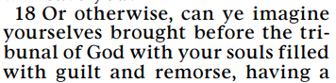
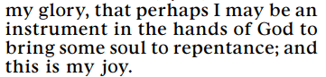
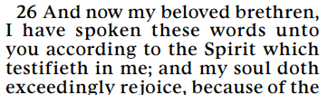
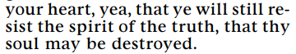
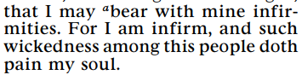
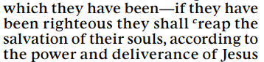

Alma 5:18
Alma 29:9
Alma 7:26
Alma 30:64
Alma 31:30
Alma 9:28
Alma 35:12

Slide 21
“And then shall it come to pass, that the spirits of the wicked, yea, who are evil—for behold, they have no part nor portion of the Spirit of the Lord; for behold, they chose evil works rather than good…” Alma 40:13
“Now this is the state of the souls of the wicked, yea, in darkness, and a state of awful, fearful looking for the fiery indignation of the wrath of God upon them; thus they remain in this state, as well as the righteous in paradise, until the time of their resurrection.” Alma 40:14

Slide 22



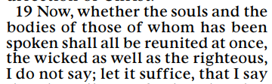




Alma 40:18
Alma 40:21
Alma 40:18
Alma 40:19
Alma 40:23
Alma 41:2
Alma 40:20

Slide 23
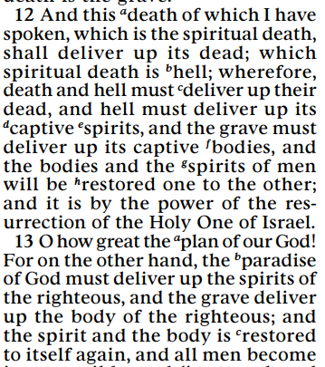
Jacob, who is proportionally the second-most frequent user of soul, never uses soul in connection with the Resurrection; he instead uses the word spirit
(2 Nephi 9:12 – 13)

Slide 24
Alma and Nehor

Slide 25
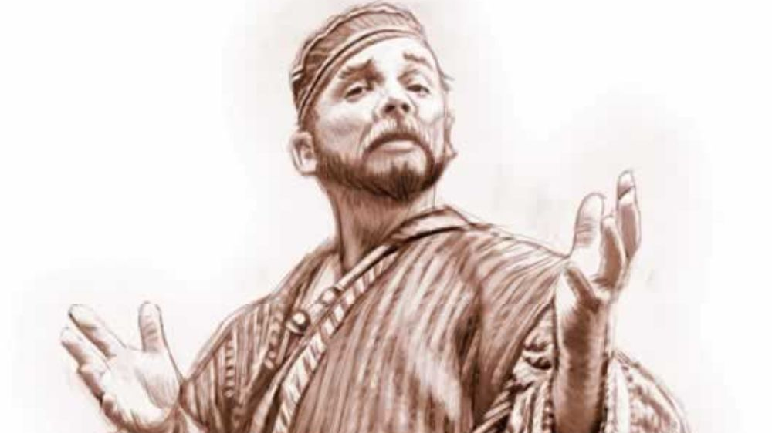
“Because Gideon withstood [Nehor] with the words of God [Nehor] was wroth with Gideon, and drew his sword and began to smite him.” Alma 1:9
Dan Burr
Notes:
https://bookofmormonartcatalog.org/catalog/nehor-introduces-priestcraft/

Slide 26
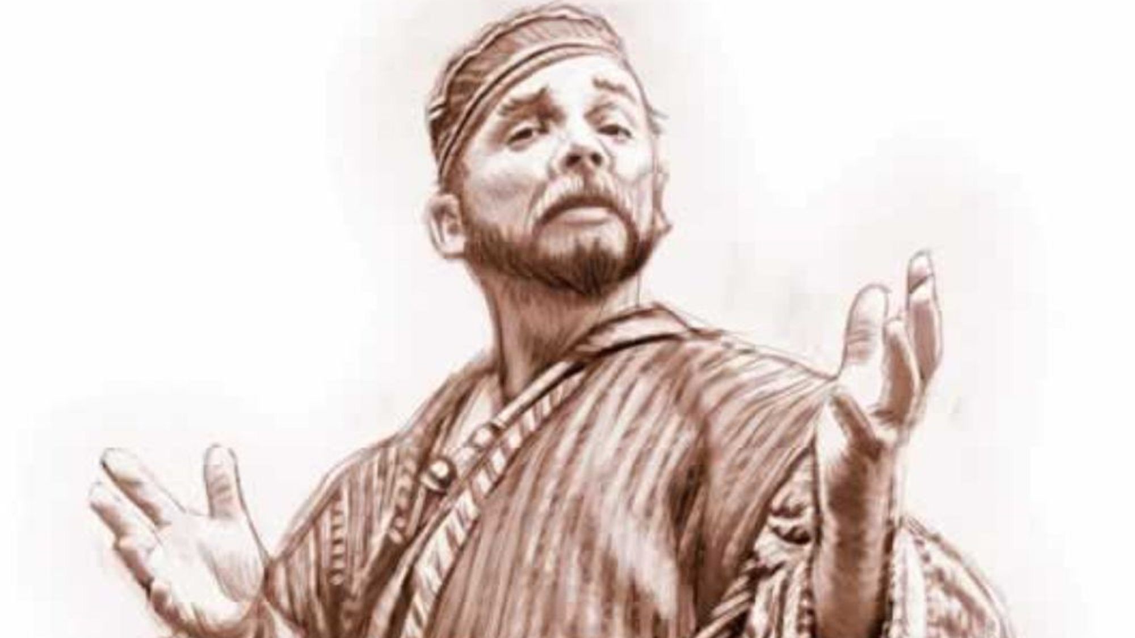
Nehor taught “that every priest and teacher...ought not to labor with their hands, but that they ought to be supported by the people.” Alma 1:3
Dan Burr
Notes:
https://bookofmormonartcatalog.org/catalog/nehor-introduces-priestcraft/

Slide 27
Nehor taught “that every priest and teacher...ought not to labor with their hands, but that they ought to be supported by the people.” Alma 1:3
“The priests were not to depend upon the people for their support; but for their labor they were to receive the grace of God.” Mosiah 18:26
Dan Burr
Notes:
https://bookofmormonartcatalog.org/catalog/nehor-introduces-priestcraft/

Slide 28
“The Book of Mormon exposes the
enemies of Christ...The type of apostates
in the Book of Mormon are similar to the
type we have today. God, with his infinite
foreknowledge, so molded the Book of
Mormon that we might see the error and
know how to combat false educational,
political, religious, and philosophical
concepts of our time.”
Ezra Taft Benson, “The Book of Mormon Is the Word of God,” Ensign, Jan. 1988, 3.
Notes:
https://www.churchofjesuschrist.org/imgs/a8a0daf57c187fb40437de5c14cbc3859e59b3b5/full/1920%2C/0/default

Slide 29

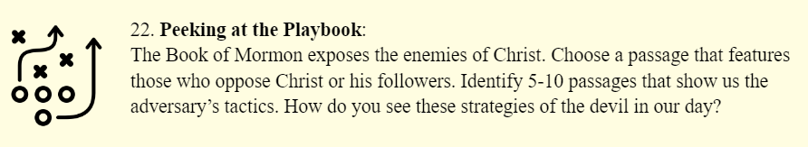
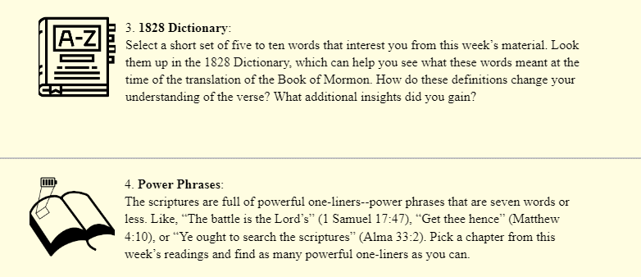
johnhiltoniii.com/thebookofmormon/resources

Slide 30
Nehor taught “All mankind should be saved at the last day, and that they need not fear nor tremble, but that they might lift up their heads and rejoice; for the Lord had created all men, and had also redeemed all men; and, in the end, all men should have eternal life.”
Alma 1:4
Dan Burr
Notes:
https://bookofmormonartcatalog.org/catalog/nehor-introduces-priestcraft/

Slide 31
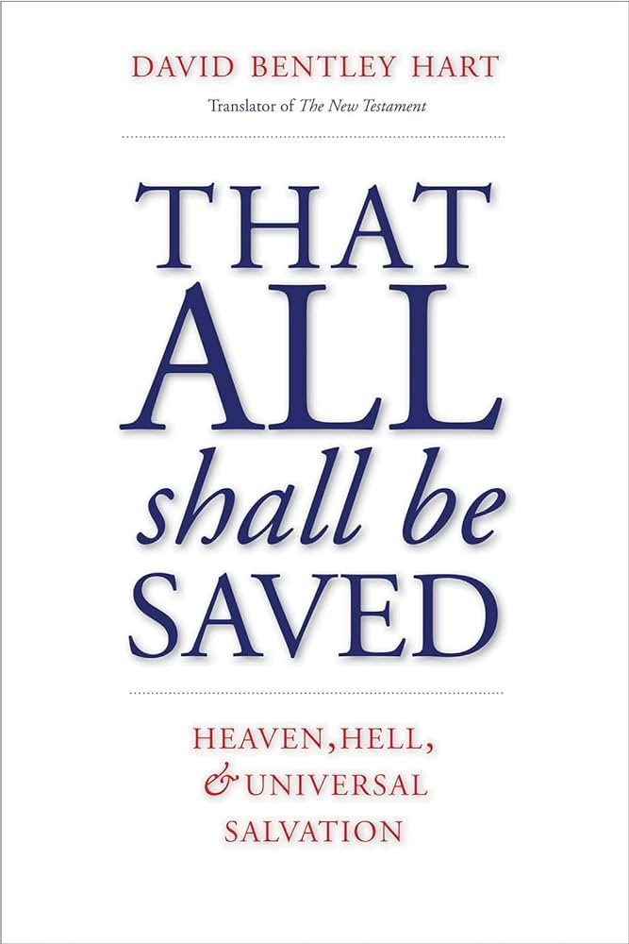



Universalism

Slide 32
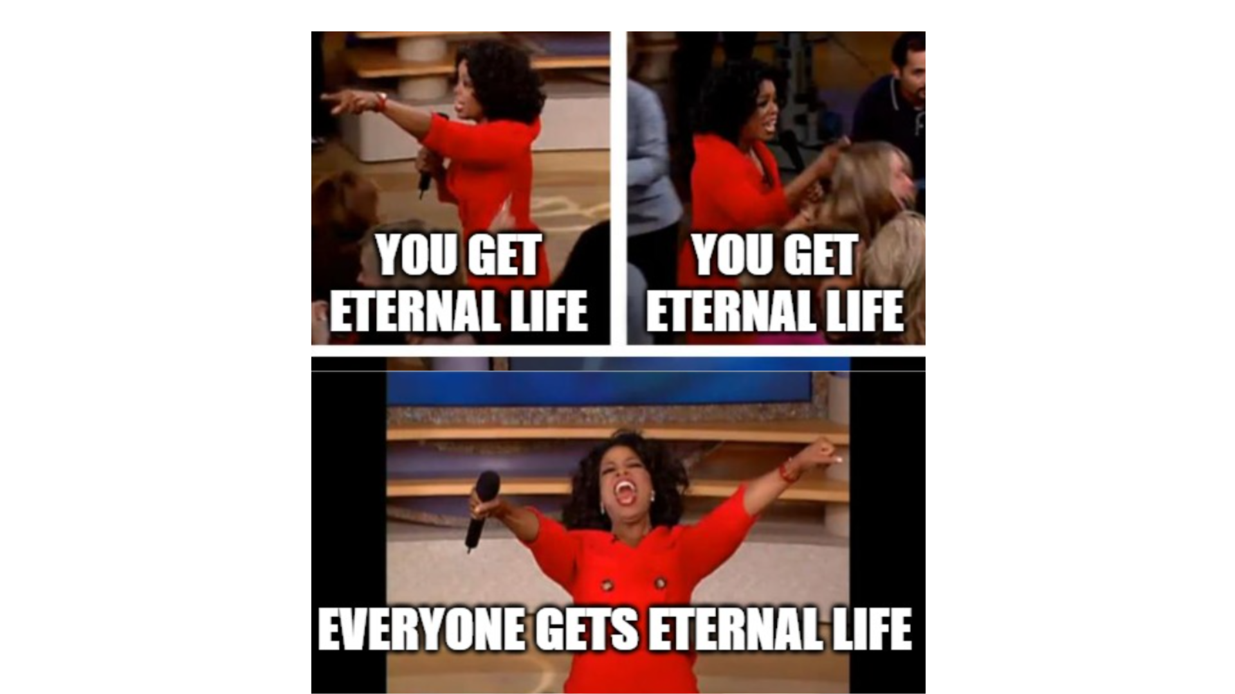
Notes:
The main problem with this idea is that it's false.

Slide 33
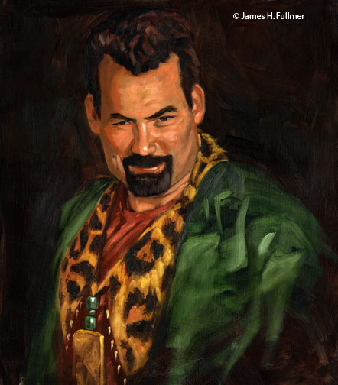
Nehor
“[People] need not fear nor tremble.”
Alma 1:4
James Fullmer
Notes:
https://www.churchofjesuschrist.org/imgs/a0f0165b90d993c251300d878b1b880d03d471df/full/640%2C/0/default
https://churchofjesuschrist.org/imgs/a0ae32bc03743b2288fd876941b75c8c06c4e1c4/full/3840%2C/0/default

Slide 34
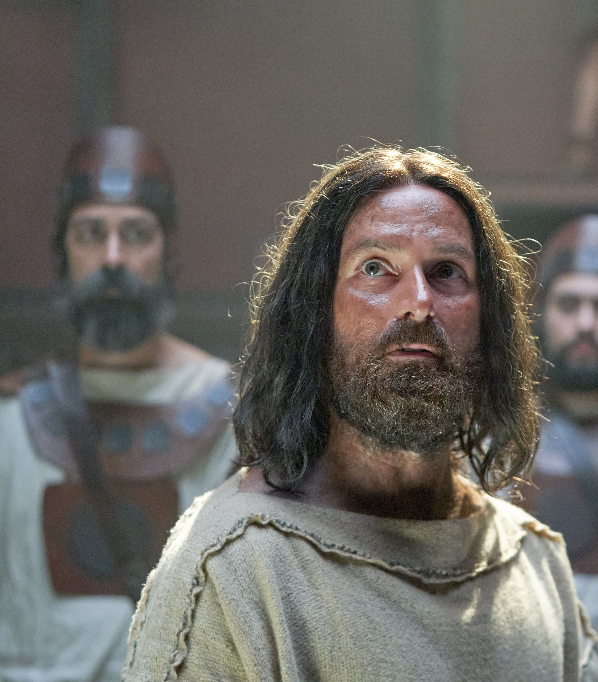
Nehor
Abinadi
“[People] need not fear nor tremble.”
Alma 1:4
“Fear and tremble before God.”
Mosiah 15:26
James Fullmer
Notes:
https://www.churchofjesuschrist.org/imgs/a0f0165b90d993c251300d878b1b880d03d471df/full/640%2C/0/default
https://churchofjesuschrist.org/imgs/a0ae32bc03743b2288fd876941b75c8c06c4e1c4/full/3840%2C/0/default

Slide 35
Nehor
“The Lord...redeemed all men.”
Alma 1:4
James Fullmer
Notes:
https://www.churchofjesuschrist.org/imgs/a0f0165b90d993c251300d878b1b880d03d471df/full/640%2C/0/default
https://churchofjesuschrist.org/imgs/a0ae32bc03743b2288fd876941b75c8c06c4e1c4/full/3840%2C/0/default

Slide 36
Nehor
Abinadi
“The Lord...redeemed all men.”
Alma 1:4
“The Lord redeemeth none...that rebel against him and die in their sins.”
Mosiah 15:26
James Fullmer
Notes:
https://www.churchofjesuschrist.org/imgs/a0f0165b90d993c251300d878b1b880d03d471df/full/640%2C/0/default
https://churchofjesuschrist.org/imgs/a0ae32bc03743b2288fd876941b75c8c06c4e1c4/full/3840%2C/0/default

Slide 37
Nehor
“All mankind should be saved at the last day.”
Alma 1:4
James Fullmer
Notes:
https://www.churchofjesuschrist.org/imgs/a0f0165b90d993c251300d878b1b880d03d471df/full/640%2C/0/default
https://cf-images.us-east-1.prod.boltdns.net/v1/static/1241706627001/4d1fbdff-e7d8-4fe6-af39-bd39046809d4/9f666aa8-7cd9-4af9-a188-6e212572e744/1280x720/match/image.jpg

Slide 38
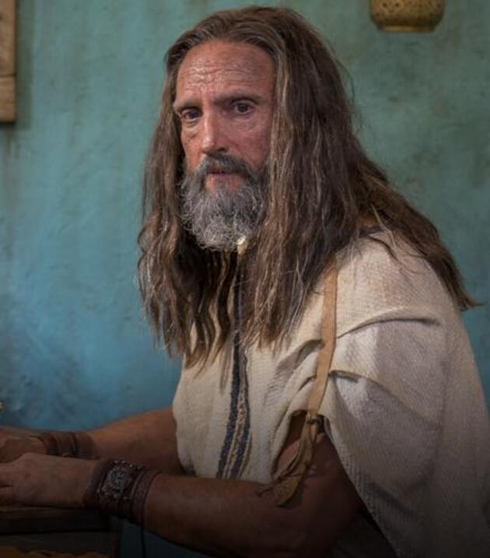
Nephi
Nehor
“If ye shall be obedient to the commandments, and endure to the end, ye shall be saved at the last day.” 1 Nephi 22:31
“All mankind should be saved at the last day.”
Alma 1:4
James Fullmer
Notes:
https://www.churchofjesuschrist.org/imgs/a0f0165b90d993c251300d878b1b880d03d471df/full/640%2C/0/default
https://cf-images.us-east-1.prod.boltdns.net/v1/static/1241706627001/4d1fbdff-e7d8-4fe6-af39-bd39046809d4/9f666aa8-7cd9-4af9-a188-6e212572e744/1280x720/match/image.jpg

Slide 39
“It's not fair that babies who die before baptism don't have the chance to receive salvation.”

Slide 40
“It's not fair that babies who die before baptism don't have the chance to receive salvation.”
“Little children...have eternal life.”
Mosiah 15:25

Slide 41
“How is it just for God to condemn good people who never had the chance to hear about Jesus Christ?”

Slide 42
“How is it just for God to condemn good people who never had the chance to hear about Jesus Christ?”
“[Christ’s] blood atoneth for the sins of those who have fallen by the transgression of Adam, who have died not knowing the will of God concerning them, or who have ignorantly sinned.”
(Mosiah 3:11)

Slide 43
“A loving God wouldn't condemn his children to an eternity in hell.”

Slide 44
“A loving God wouldn't condemn his children to an eternity in hell.”
Through modern revelation we know that while a form of hell does exist, ultimately, nearly every child of God will eventually receive a kingdom of glory.
Notes:
So in some senses, you could say that The Church of Jesus Christ of Latter-day Saints has some universalist teachings. Where we draw the line though is with Nehor's teaching that everyone receives "eternal life." If we understand "eternal life" to be the highest degree of the Celestial Kingdom, that is simply not what modern prophets teach.

Slide 45
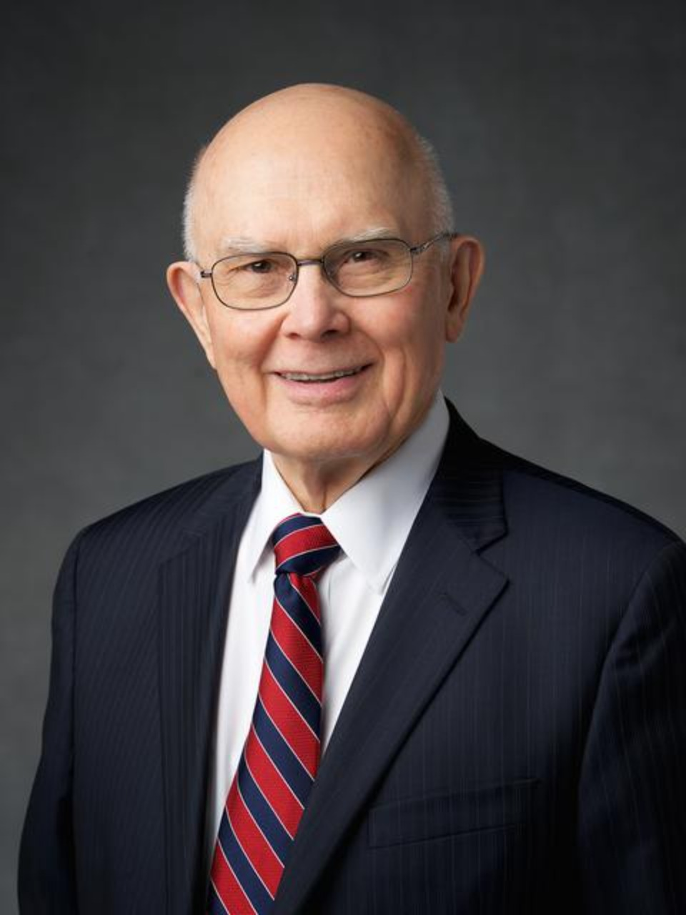
“The kingdom of glory we receive in the Final Judgment is determined by the laws we choose to follow in our mortal journey. God’s plan, founded on eternal truth, requires that exaltation can be attained only through faithfulness to the covenants of an eternal marriage between a man and a woman in the holy temple, which marriage will ultimately be available to all the faithful.”
President Dallin H. Oaks
“Kingdoms of Glory,”
Oct. 2023
Notes:
https://news-hk.churchofjesuschrist.org/eng/media/960x1280/oaks-bio-resized-hke1.jpg

Slide 46
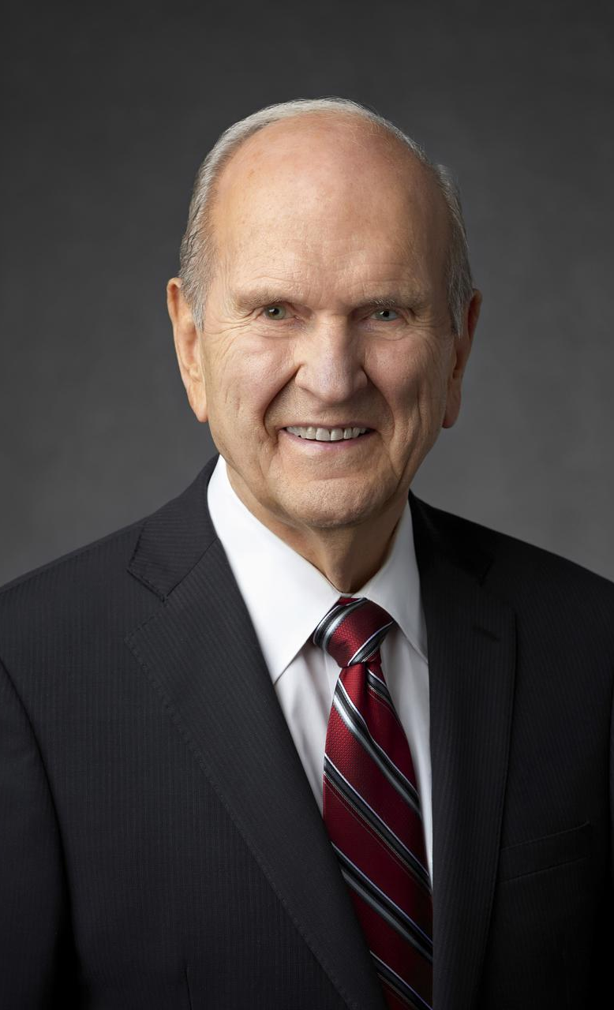
“Mortal lifetime is barely a nanosecond compared with eternity. But what a crucial nanosecond it is! Consider carefully how it works: During this mortal life you get to choose which laws you are willing to obey—those of the celestial kingdom, or the terrestrial, or the telestial—and, therefore, in which kingdom of glory you will live forever. What a plan! It is a plan that completely honors your agency.”
President Russell M. Nelson
Heart of the Matter (2023), 45.
Notes:
https://newsroom.churchofjesuschrist.org/media/960x1280/President-Russell-M-Nelson-1-2018.jpg

Slide 47
Mormon wants to warn us against the prevalent false doctrine, taught by Nehor, that “in the end, all [people] should have eternal life.”
Alma 1:5
James Fullmer
Notes:
Mormon likely included the story of Nehor because he wants to warn us against the prevalent false doctrine, taught by Nehor, that “in the end, all [people] should have eternal life” (Alma 1:5). God does not force anyone to heaven or hell. He honors our agency. He has prepared a place of glory for each of his children–we get to choose which kingdom we want to live in. We choose our ultimate kingdom as we choose which laws we will live.
https://www.churchofjesuschrist.org/imgs/a0f0165b90d993c251300d878b1b880d03d471df/full/640%2C/0/default

Slide 48
Alma and the Amlicites

Slide 49
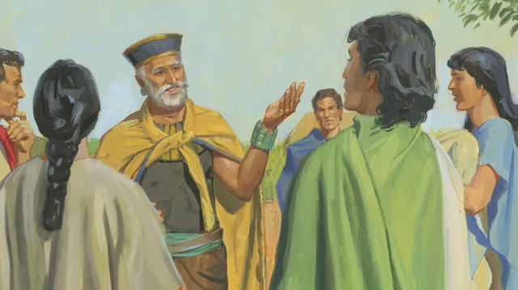
Amlici wanted “to destroy the church of God.”
Alma 2:4
Notes:
https://www.churchofjesuschrist.org/imgs/71d931b858357e8264d5c8d994cb7c5e644019bb/full/640%2C/0/default

Slide 50
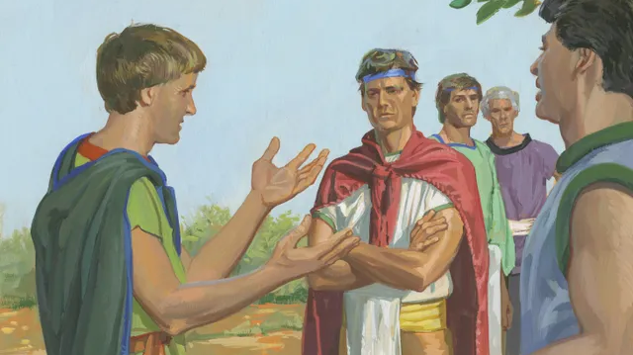
“Having much dispute and wonderful contentions one with another.”
Alma 2:5
Notes:
https://www.churchofjesuschrist.org/imgs/10a0cba17ffaef948e7b791feb91d839a4705bd0/full/640%2C/0/default

Slide 51
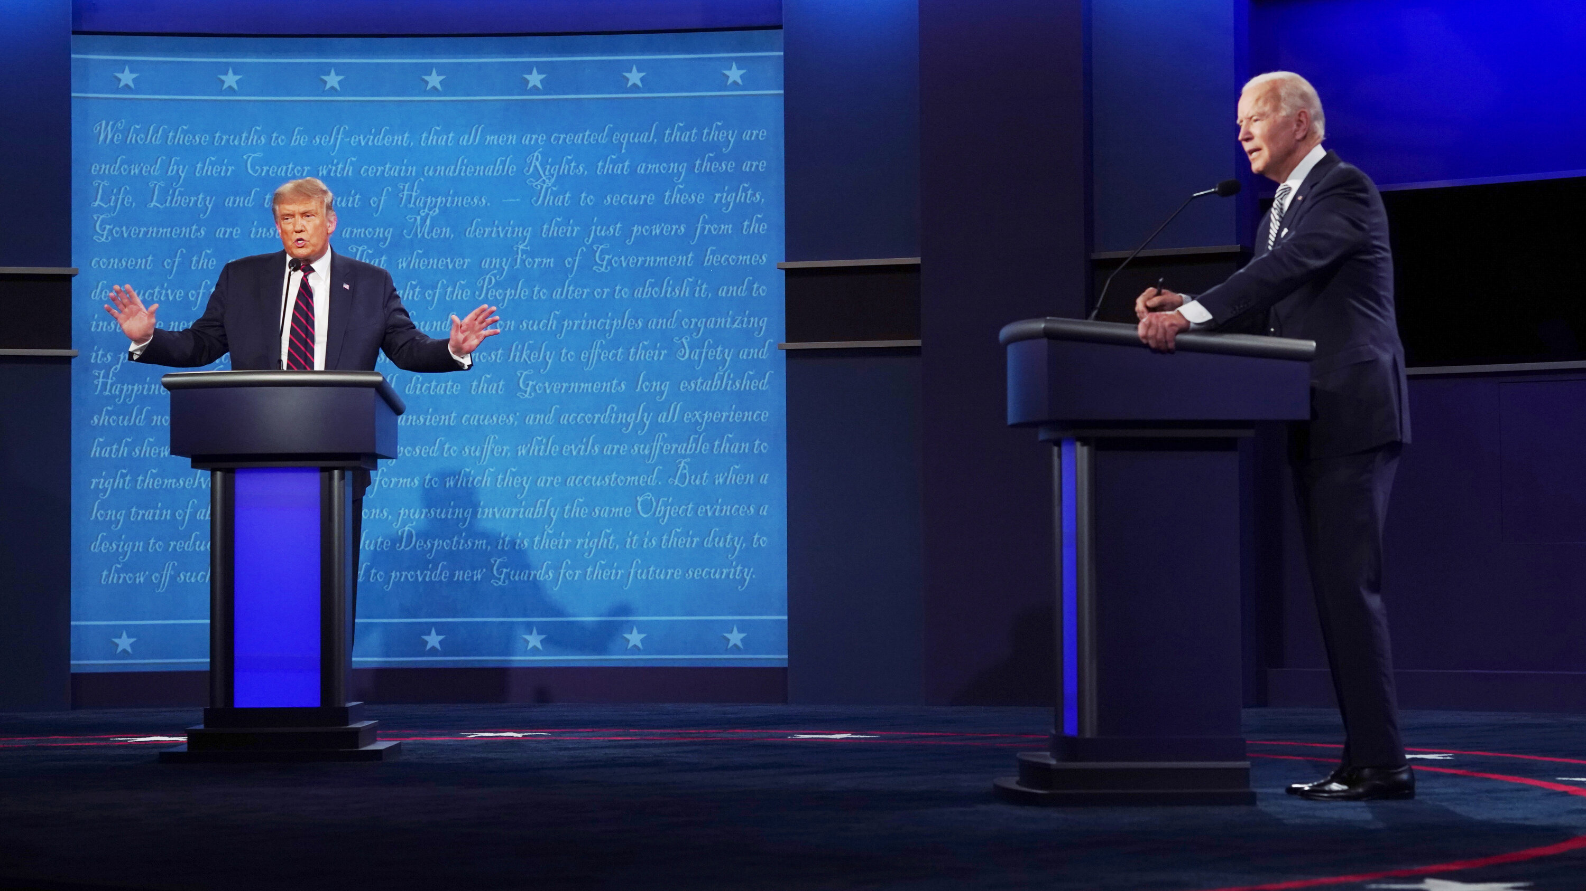

Slide 52
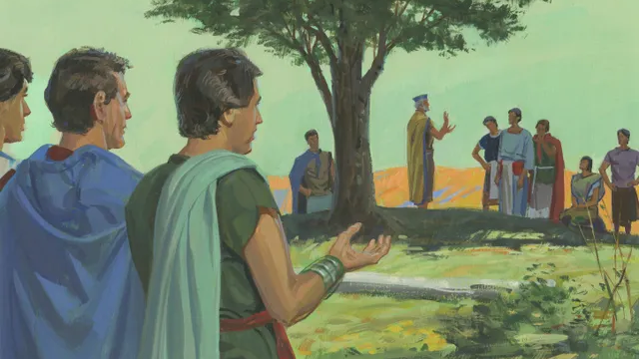
“The voice of the people came against Amlici, [and] he was not made king over the people.”
Alma 2:7
Notes:
Unfortunately, Amlici was a sore loser and began to stir up his followers to war against the Nephites. Eventually Amlici teamed up with the Lamanites leading to a huge battle. Alma himself led the Nephites, and I want to highlight a pattern that we see several times in this war:
https://www.churchofjesuschrist.org/imgs/a9f0e2840983f865dd3162568851e1846ba1deb2/full/640%2C/0/default

Slide 53
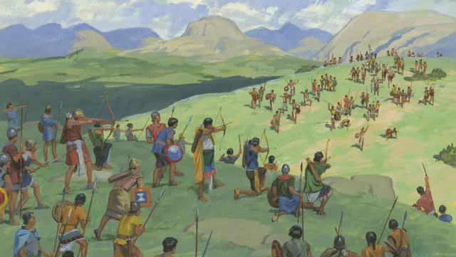
“The Lord did strengthen the hand of the Nephites.” Alma 2:18
“The Nephites being strengthened by the hand of the Lord.” Alma 2:28
“The Lord…did strengthen them.”
Alma 2:28
“Alma…was strengthened.”
Alma 2:31
Notes:
https://www.churchofjesuschrist.org/imgs/d79020afb68813fa1cd8b40ec064f7c6edeb117c/full/640%2C/0/default

Slide 54
“In one year were…tens of thousands of souls sent to the eternal world, that they might reap their rewards according to their works, whether they were good or whether they were bad, to reap eternal happiness or eternal misery, according to the spirit which they listed to obey, whether it be a good spirit or a bad one. For every man receiveth wages of him whom he listeth to obey, and this according to the words of the spirit of prophecy…”
Alma 3:26–27
Notes:
https://www.churchofjesuschrist.org/imgs/a9f0e2840983f865dd3162568851e1846ba1deb2/full/640%2C/0/default

Slide 55

Riches and Pride
“The love of money is the root of all evil.”
1 Timothy 6:10

Slide 56
Those who remained humble | Those who became prideful
“They did not send away any who were naked, or that were hungry or…athirst” Alma 1:30 | “Turning their backs upon the needy and the naked and those who were hungry, and those were athirst” Alma 4:12
“They did not set their hearts upon riches” Alma 1:30 | “[They] began to…set their hearts upon riches” Alma 4:8
“They did not wear costly apparel, yet they were neat and comely” Alma 1:27 | “[They] did indulge themselves in…wearing costly apparel” Alma 1:31
“[Some] were abasing themselves, succoring those who stood in need” Alma 4:13 | “Some [were] lifting themselves up with pride, despising others” Alma 4:12

Slide 57
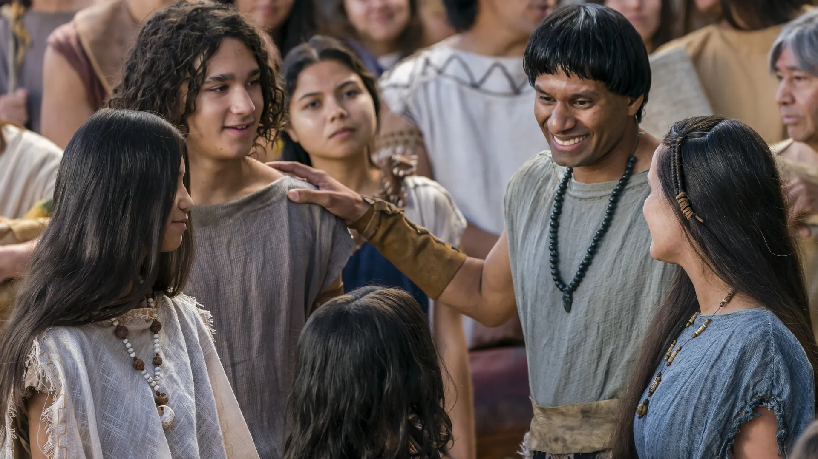
“[They were] imparting their substance to the poor and the needy [and] feeding the hungry…for Christ’s sake…thus retaining a remission of their sins; being filled with great joy because of…Jesus Christ.”
Alma 4:13–14
Notes:
This is a topic that we have seen before in The Book of Mormon and we will see it again. If the Book of Mormon was written for our day, what does this repetition mean for us? It’s a personal question, but perhaps I could ask myself a question like this: “A few weeks ago, I was studying Mosiah 4, and noticed King Benjamin’s emphasis on serving the poor. What have I done over the past few weeks to help the financially poor? If the answer is nothing, then today could be the day I need to pay my fast offering, contribute to a humanitarian cause, call a soup kitchen, or find another way to serve those who are truly in need.
https://churchofjesuschrist.org/imgs/d0592d42dd949fd6ecde243b08588104da7a04d9/full/1920%2C/0/default

Slide 58
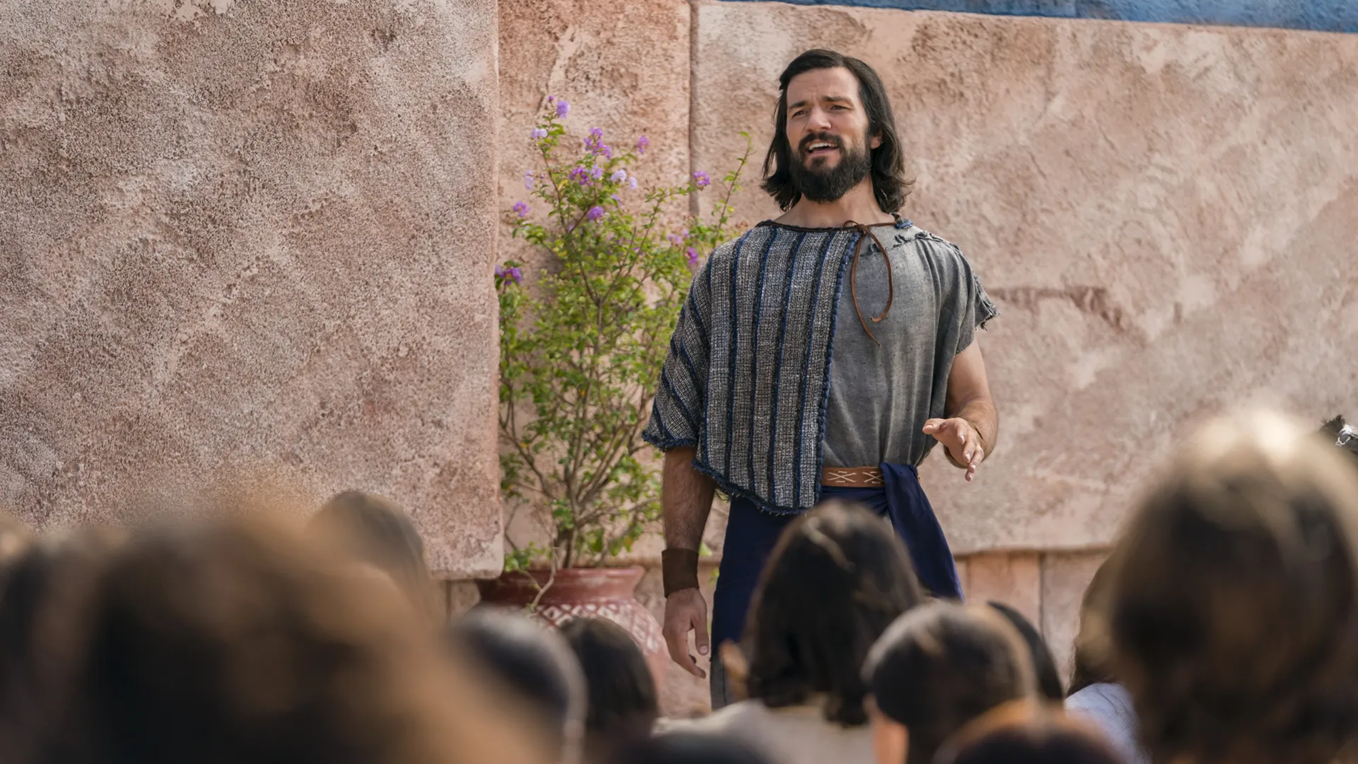

Notes:
https://churchofjesuschrist.org/imgs/65115d820b6b2c15e98cafa060af607aea7c5888/full/1920%2C/0/default

Slide 59
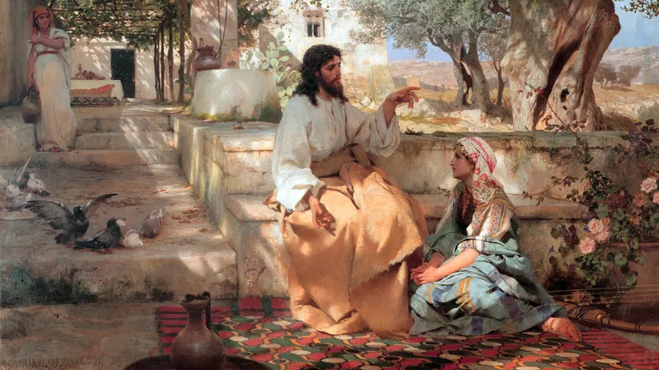
Notes:
Christ With Martha and Maria, by Henryk Siemiradzki, 1886.Public Domain

Slide 60
Luke 10:40 (paraphrase)
“Lord, don’t you care that my sister has left me to do all the work by myself? Tell her to come help me.”

Slide 61
Luke 10:41 (NSRV)
“Martha, Martha, you are worried and distracted by many things;

Slide 62
Luke 10:41 (NSRV)
“Martha, Martha, you are worried and distracted by many things;
There is need of only one thing.”

Slide 63
“The main thing is to keep the main thing, the main thing.”

Slide 64
“The main thing is to keep the main thing, the ONE thing.”

Slide 65
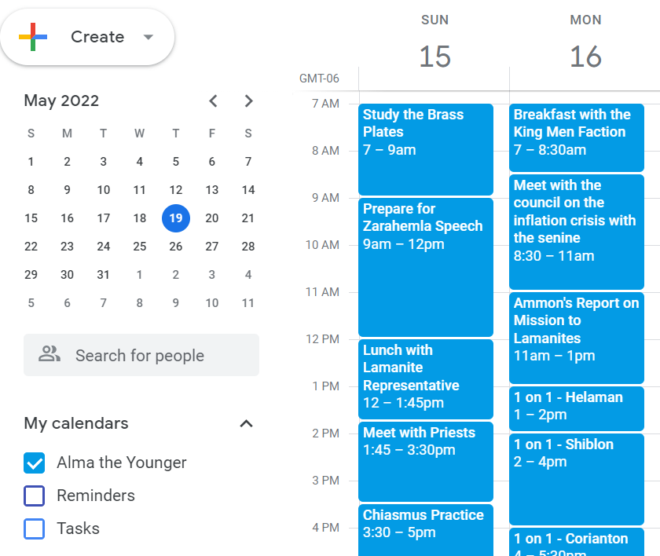
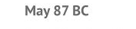

Slide 66
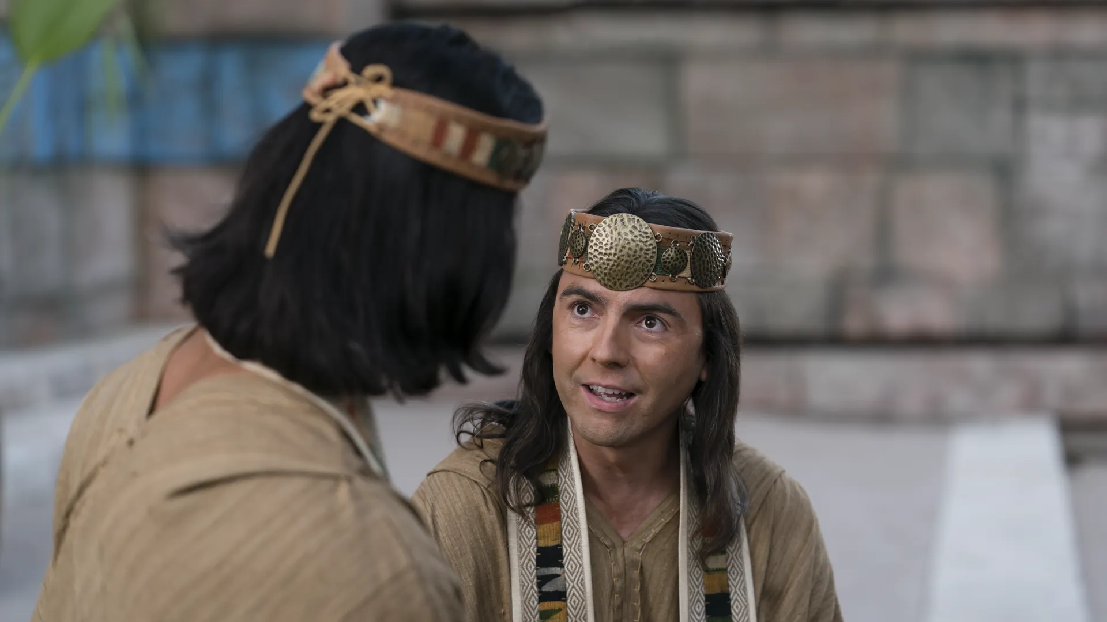
“[Alma] selected a wise man who was among the elders of the church, and gave him power according to the voice of the people, that he might have power to enact laws…Now Alma did not grant unto him the office of being high priest over the church…
Notes:
https://churchofjesuschrist.org/imgs/4879b582fdec734139fa80759f8d9c5709a6dc85/full/1920%2C/0/default

Slide 67
“ [Alma] delivered the judgment-seat…that he himself might go forth among his people… that he might preach the word of God unto them.”
Alma 4:16, 18–19
Notes:
https://churchofjesuschrist.org/imgs/4879b582fdec734139fa80759f8d9c5709a6dc85/full/1920%2C/0/default

Slide 68
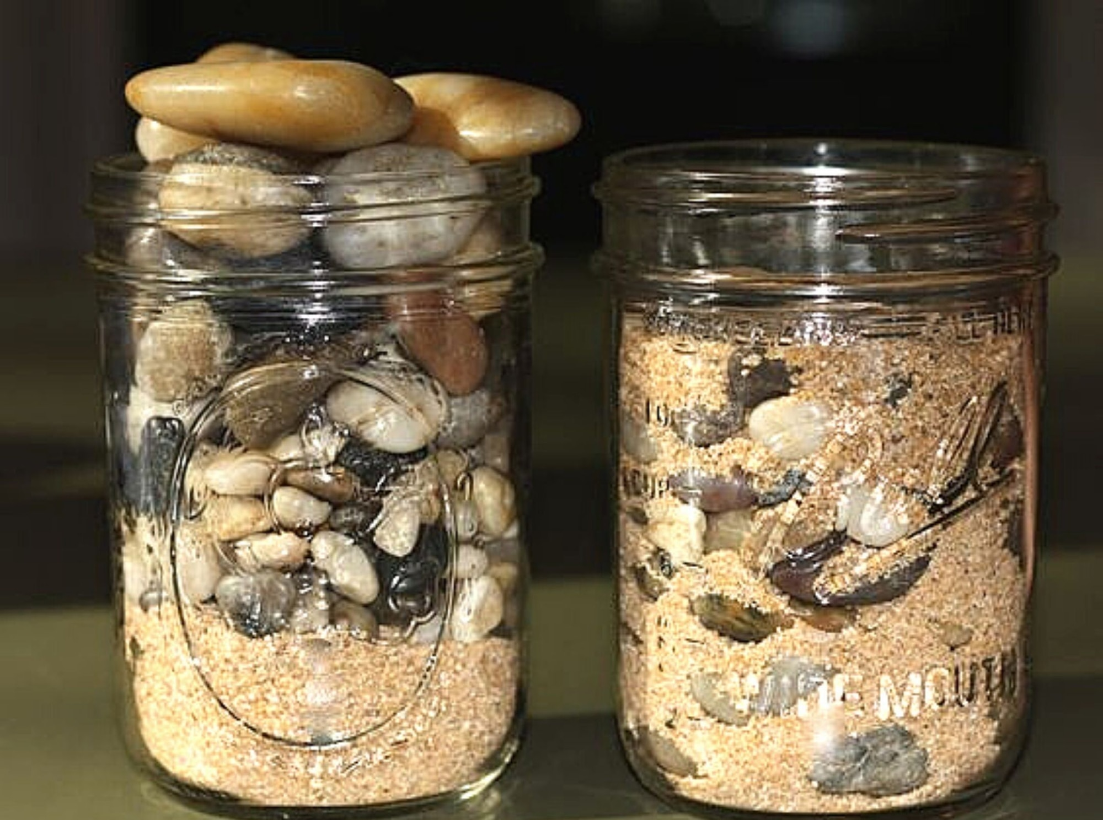

Slide 69
Alma 7:1–2
“Behold…[this] is the first time that I have spoken unto you by the words of my mouth, I having been wholly confined to the judgment-seat, having had much business that I could not come unto you. And I could not have come now at this time were it not that the judgment-seat hath been given to another.”

Slide 70
Alma 7:7
“There be many things to come; and behold, there is one thing which is of more importance than they all—

Slide 71
Alma 7:7
“There be many things to come; and behold, there is one thing which is of more importance than they all—
for behold, the time is not far distant that the Redeemer liveth and cometh among his people.”

Slide 72
One thing is needful
There is one thing which is of more importance than they all
One rock
The Rock

Slide 73
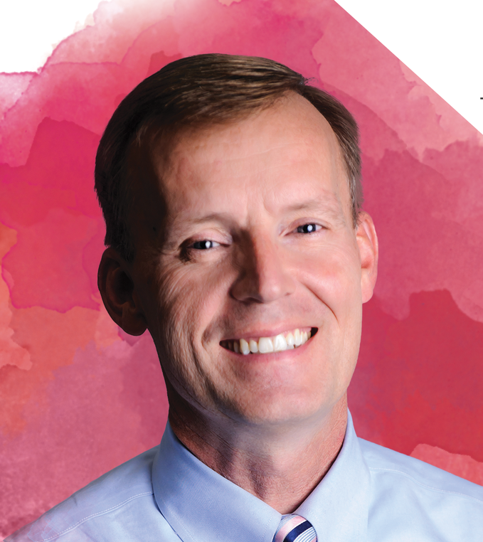

Slide 74


Slide 75
“I have been having a crisis of wondering what I can actually do to find joy in Christ instead of other things that are good, but not where I should be turning for joy. It can be hard when there are things you can turn to for instant pleasure, but I know from experience that those things really cannot make you happy long term. I think the idea of making Jesus Christ my rock, making him my one thing is something I want to work super hard to do because I know that will really help me to feel joy. I definitely have some priorities to rearrange, some habits to fix, but I know I have the time and I have the desire to make that change.”

Slide 76
Did Alma have FOMO?
Or
JOMO?

Slide 77


For free resources related to this video, please visit https://johnhiltoniii.com/TheBookofMormon
Join our course discussions on social media
@johnhiltoniii

Slide 78
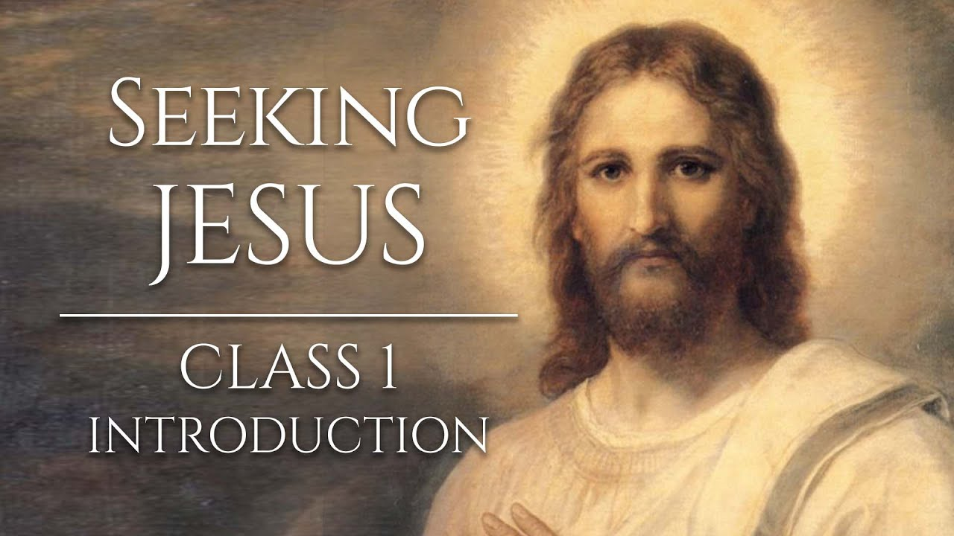
https://johnhiltoniii.com/SeekingJesus
You may also be interested in this
free video course…

Slide 79
This video is not produced or endorsed by Brigham Young University or the Church of Jesus Christ of Latter-day Saints.
John Hilton III is solely responsible for its contents
Insights from, discussions with, and resources authored by
by John Bytheway, Stephen Covey, Grant Hardy, Josh Matson, Joseph Spencer, Stephan Taeger, and John and Gregory Welch were used in the creation of this video. See further acknowledgements at https://johnhiltoniii.com/thebookofmormon

