Slide 1
LOREJOICERD

Slide 2
G O S P E L

Slide 3
BULL
He spoke to them
BULL

Slide 4
death life

Slide 6


Slide 7
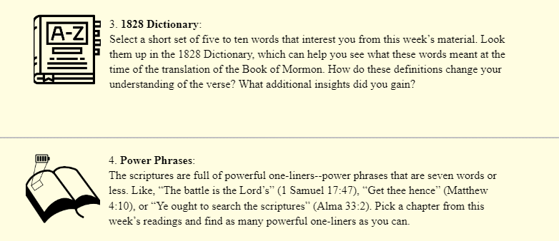

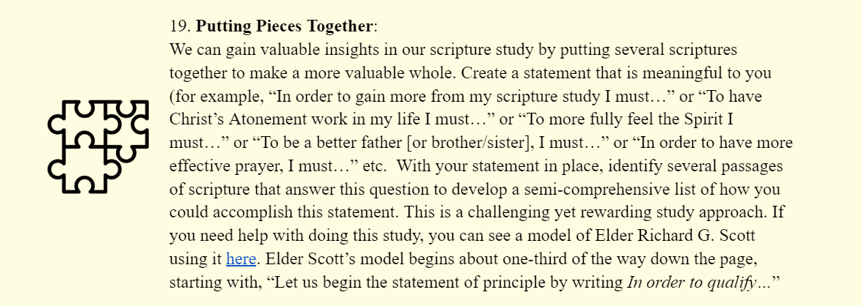

Slide 8

Notes:
What if I gave you a present…VW Gold

Slide 9
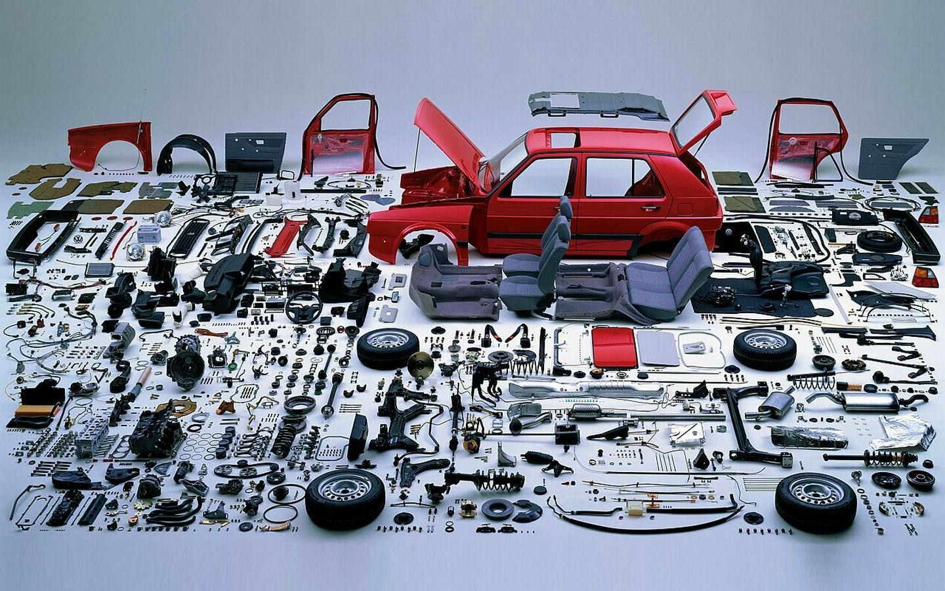
Notes:
But when I bring the car to your house to put it in your garage, you are surprised to find that what I am giving you are the pieces to the car. So now you have every piece necessary to put together your new car—the engine, brakes, steering components—everything!
What would you do with this gift? Would you take the carburetor and put it on your desk to show people?

Slide 10
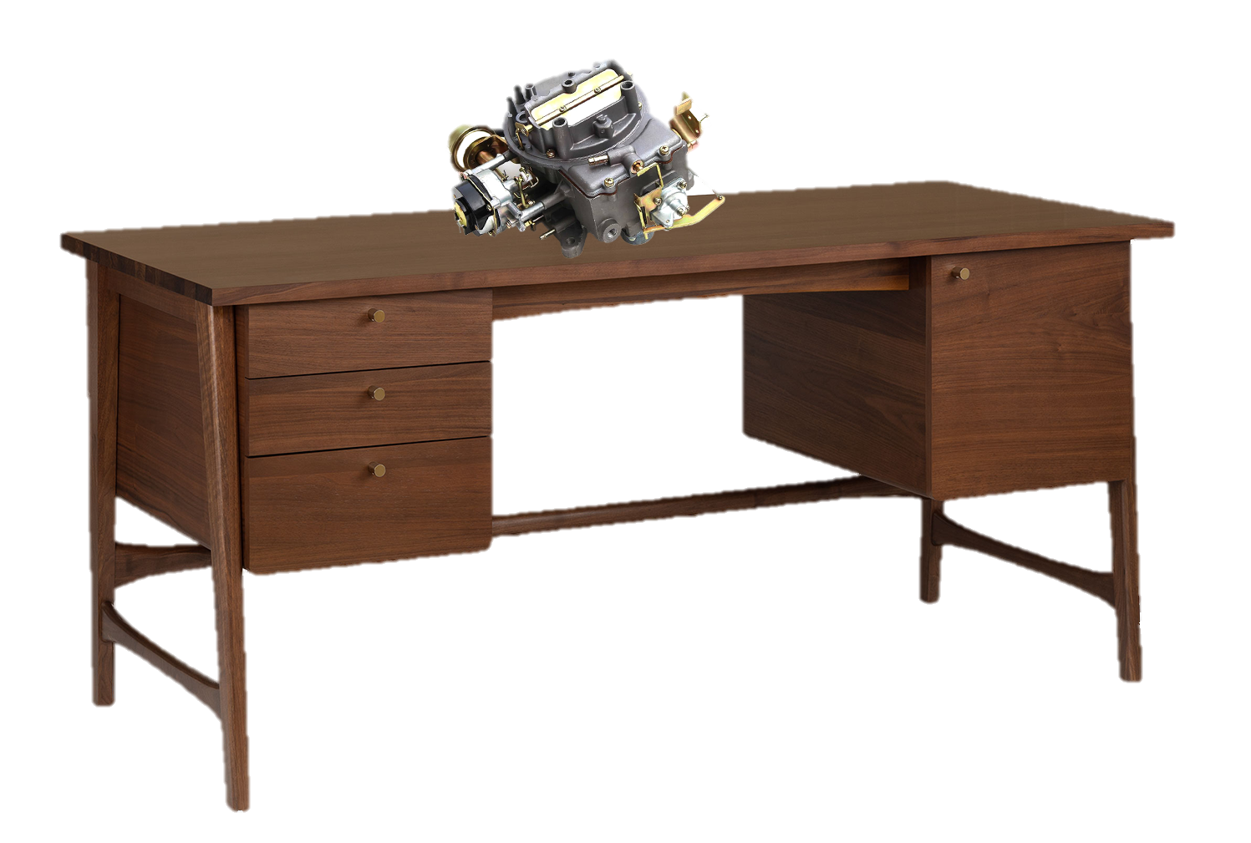
Notes:
“Hey, how do you like my new carburetor?” Probably not! You would want to put the car together. (But if you’re like me you would probably need some help!)

Slide 11
1. Identify, analyze and unite related scriptures
2. On a separate sheet of paper make a statement that
contains the truth found in those scriptures

Slide 12
In order to get more out of my scripture study I must:

Slide 13
Do I know of any scriptural accounts where somebody seemed to get a lot from their scripture study?

Slide 14
Do I know of any scriptural accounts where somebody seemed to get a lot from their scripture study?
“Never did any passage of scripture come with more power to the heart of man than this did at this time to mine. It seemed to enter with great force into every feeling of my heart. I reflected on it again and again…”
Joseph Smith History 1:12

Slide 15
In order to get more out of my scripture study I must:
Ponder the things I learn (Joseph Smith History 1:12)

Slide 16
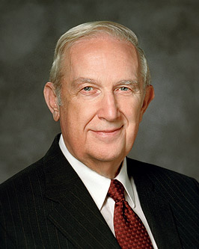
You may need to sometimes “alter [the words] so they fit into the format of what an individual should do. That needs to be done carefully so as not to lose the power of the doctrine.”
Elder Richard G. Scott,
“Helping Others to be Spiritually Led”
Notes:
https://www.churchofjesuschrist.org/bc/content/shared/content/images/leaders/richard-g-scott-large.jpg

Slide 17
Topical Guide: “Scriptures, Study of”
“For Ezra had prepared his heart to seek the law of the Lord, and to do it, and to teach in Israel statutes and judgments.” Ezra 7:10

Slide 18
In order to get more out of my scripture study I must:
Ponder the things I learn (Joseph Smith-History 1:12)
Prepare my heart before I read (Ezra 7:10)
Act on what I learn from the scriptures (Ezra)

Slide 19
Topical Guide: “Scriptures, Study of”
“They searched the scriptures.” Jacob 7:23
“He that hath the scriptures, let him search them.”
3 Nephi 10:14

Slide 20
In order to get more out of my scripture study I must:
Ponder the things I learn (Joseph Smith-History 1:12)
Prepare my heart before I read (Ezra 7:10)
Act on what I learn from the scriptures (Ezra 7:10 – note the phrase, and to do it)
Search the scriptures (Acts 17:11, Jacob 7:23, 3 Nephi 10:14)

Slide 21
Topical Guide: “Scriptures, Study of”
“They received the word with all readiness of mind, and searched the scriptures daily…” Acts 17:11

Slide 22
In order to get more out of my scripture study I must:
Ponder the things I learn (Joseph Smith-History 1:12)
Prepare my heart before I read (Ezra 7:10)
Act on what I learn from the scriptures (Ezra 7:10 – note the phrase, and to do it)
Search the scriptures (Acts 17:11, Jacob 7:23, 3 Nephi 10:14)
Make time for daily study (Acts 17:11)

Slide 23
Topical Guide: “Scriptures, Study of”
“I sat in my room pondering over the scriptures.”
Doctrine and Covenants 138:1

Slide 24
In order to get more out of my scripture study I must:
Ponder the things I learn (JSH 1:12 & D&C 138:1)
Prepare my heart before I read (Ezra 7:10)
Act on what I learn from the scriptures (Ezra 7:10 – note the phrase, and to do it)
Search the scriptures (Acts 17:11, Jacob 7:23, 3 Nephi 10:14)
Make time for daily study (Acts 17:11)

Slide 25
Topical Guide: “Scriptures, Study of”
“Treasureth up my word”
Joseph Smith Matthew 1:37

Slide 26
In order to get more out of my scripture study I must:
Ponder the things I learn (JSH 1:12 & D&C 138:1)
Prepare my heart before I read (Ezra 7:10)
Act on what I learn from the scriptures (Ezra 7:10 – note the phrase, and to do it)
Search the scriptures (Acts 17:11, Jacob 7:23, 3 Nephi 10:14)
Make time for daily study (Acts 17:11)
Treasure the scriptures (Joseph Smith Matthew 1:37)

Slide 27
“I did liken all scriptures unto us, that it might be for our profit and learning.”
1 Nephi 19:23

Slide 28
In order to get more out of my scripture study I must:
Ponder the things I learn (JSH 1:12 & D&C 138:1)
Prepare my heart before I read (Ezra 7:10)
Act on what I learn from the scriptures (Ezra 7:10 – note the phrase, and to do it)
Search the scriptures (Acts 17:11, Jacob 7:23, 3 Nephi 10:14)
Make time for daily study (Acts 17:11)
Treat the scriptures like a treasure (Joseph Smith Matthew 1:37)
Liken the scriptures to my life (1 Nephi 19:23)

Slide 29
To have the Savior’s Atonement work in my life I must…
To exercise the power of the priesthood more effectively, I must…
To benefit more from the ordinances of the temple, I must…
To be a better mother/father [or son/daughter, or brother/sister], I must…
In order to have more effective prayer, I must…
To fulfill my calling I must…
In order to more effectively share the gospel, I must…
In order to have charity, I must…

Slide 30
1. Identify, analyze and unite related scriptures
2. On a separate sheet of paper make a statement that
contains the truth found in those scriptures

Slide 32
In order to have a changed heart, I must:
Mosiah 4:2,
Alma 5:11-12,
Mosiah 5:2,
Alma 5:13,
Alma 19:33,
Mosiah 5:7,
Helaman 3:35,
Alma 5:7,
Helaman 15:7,

Slide 33
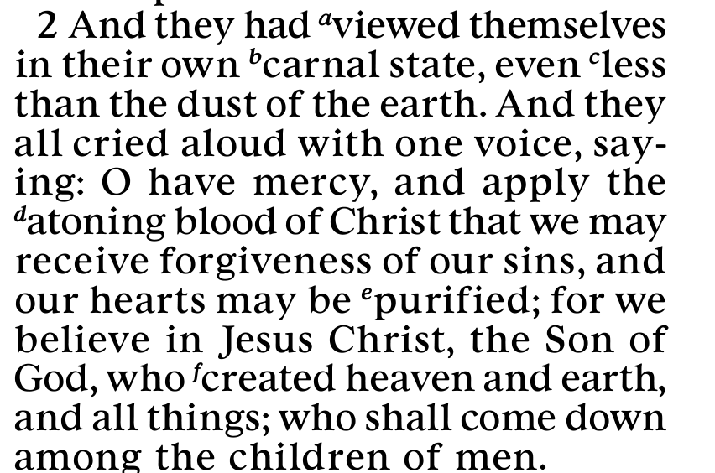

Slide 34
In order to have a changed heart, I must:
Mosiah 4:2, Pray for Christ’s Atonement to take effect in my life

Slide 35
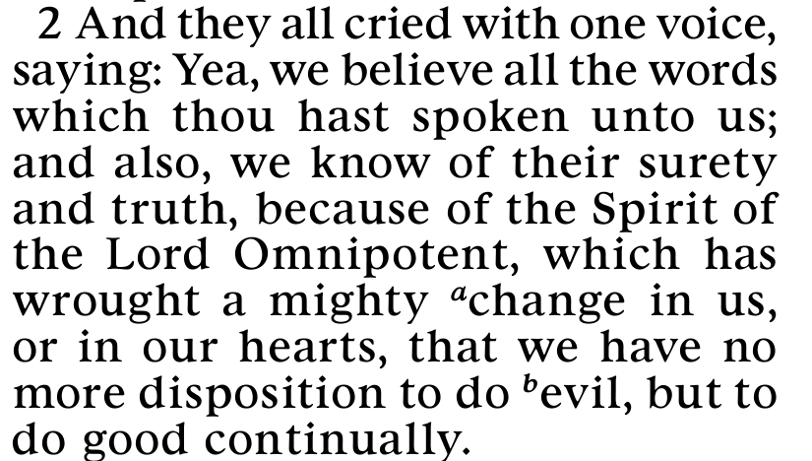

Slide 36
In order to have a changed heart, I must:
Mosiah 4:2, Pray for Christ’s Atonement to take effect in my life
Mosiah 5:2, Allow the Holy Ghost to work a mighty change in my heart.

Slide 37
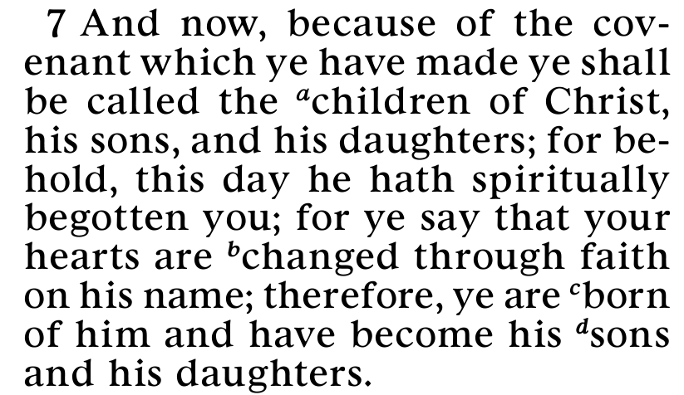

Slide 38
In order to have a changed heart, I must:
Mosiah 4:2, Pray for Christ’s Atonement to take effect in my life
Mosiah 5:2, Allow the Holy Ghost to work a mighty change in my heart.
Mosiah 5:7, Have deep faith in Jesus Christ

Slide 39
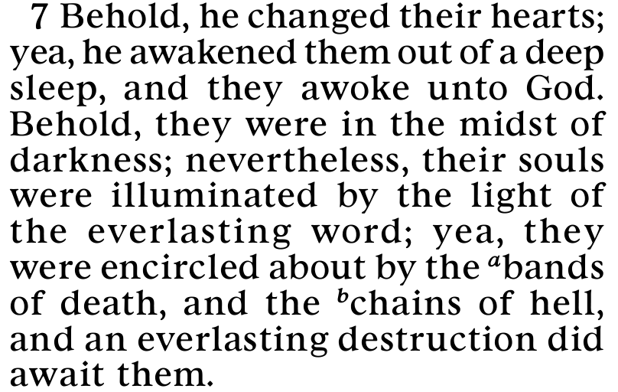

Slide 40
In order to have a changed heart, I must:
Mosiah 4:2, Pray for Christ’s Atonement to take effect in my life
Mosiah 5:2, Allow the Holy Ghost to work a mighty change in my heart.
Mosiah 5:7, Have deep faith in Jesus Christ
Alma 5:7, Allow God to change my heart / be illuminated by “the everlasting word”

Slide 41
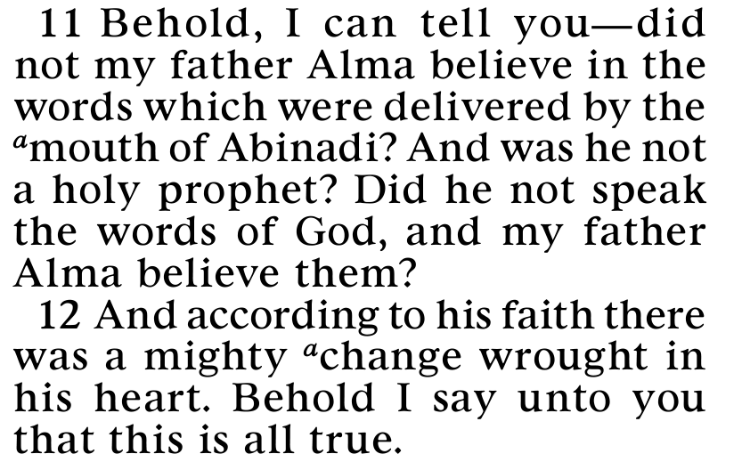

Slide 42
In order to have a changed heart, I must:
Mosiah 4:2, Pray for Christ’s Atonement to take effect in my life
Alma 5:11-12, Believe in the prophets and act on their words
Mosiah 5:2, Allow the Holy Ghost to work a mighty change in my heart.
Mosiah 5:7, Have deep faith in Jesus Christ
Alma 5:7, Allow God to change my heart / be illuminated by “the everlasting word”

Slide 43
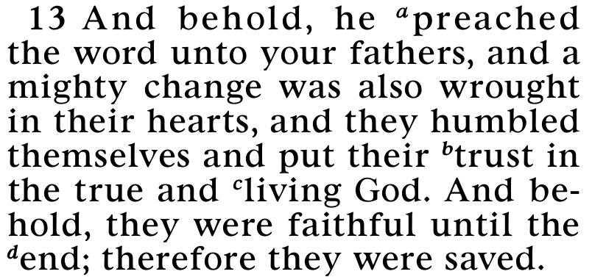

Slide 44
In order to have a changed heart, I must:
Mosiah 4:2, Pray for Christ’s Atonement to take effect in my life
Alma 5:11-12, Believe in the prophets and act on their words
Mosiah 5:2, Allow the Holy Ghost to work a mighty change in my heart.
Alma 5:13, Listen to the preaching of the word
Mosiah 5:7, Have deep faith in Jesus Christ
Alma 5:7, Allow God to change my heart / be illuminated by “the everlasting word”

Slide 45
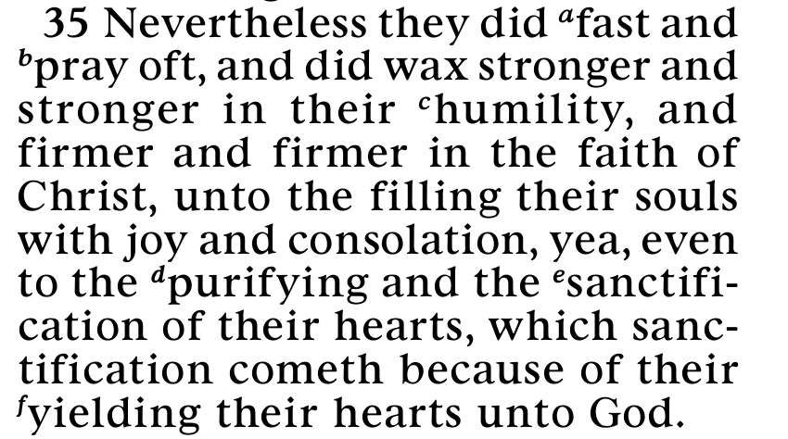

Slide 46
In order to have a changed heart, I must:
Mosiah 4:2, Pray for Christ’s Atonement to take effect in my life
Alma 5:11-12, Believe in the prophets and act on their words
Mosiah 5:2, Allow the Holy Ghost to work a mighty change in my heart.
Alma 5:13, Listen to the preaching of the word
Helaman 3:35, Fast and pray often, increase in humility, increase in faith in Christ, yield our hearts to God.
Mosiah 5:7, Have deep faith in Jesus Christ
Alma 5:7, Allow God to change my heart / be illuminated by “the everlasting word”

Slide 47
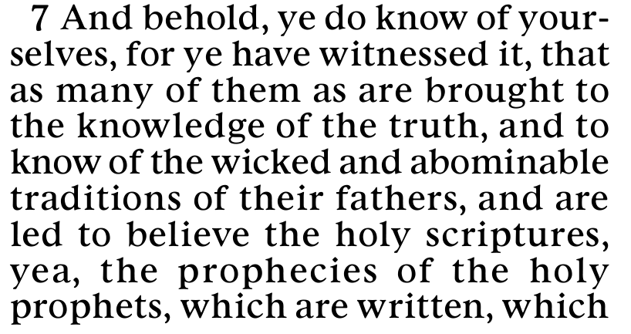
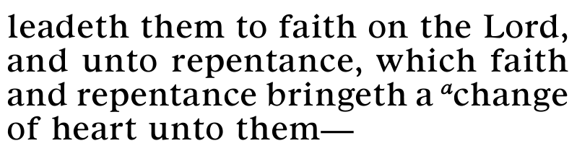

Slide 48
In order to have a changed heart, I must:
Mosiah 4:2, Pray for Christ’s Atonement to take effect in my life
Alma 5:11-12, Believe in the prophets and act on their words
Mosiah 5:2, Allow the Holy Ghost to work a mighty change in my heart.
Alma 5:13, Listen to the preaching of the word
Helaman 3:35, Fast and pray often, increase in humility, increase in faith in Christ, yield our hearts to God.
Mosiah 5:7, Have deep faith in Jesus Christ
Alma 5:7, Allow God to change my heart / be illuminated by “the everlasting word”
Helaman 15:7, Believe the scriptures, exercise faith and repent

Slide 49
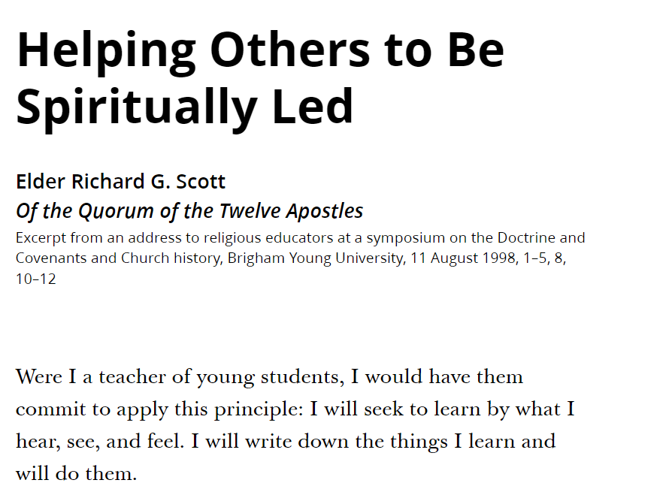

Slide 50
Has Your Heart Changed?
How do you think you can either maintain or receive a changed heart?

Slide 51
Based on its current punctuation, the Book of Mormon contains 543 questions, which are asked by a total of 61 people.

Slide 52
Based on its current punctuation, the Book of Mormon contains 543 questions, which are asked by a total of 61 people.
Alma asks 102 questions, or 19% of all the questions in the Book of Mormon, more questions than any other speaker.

Slide 53
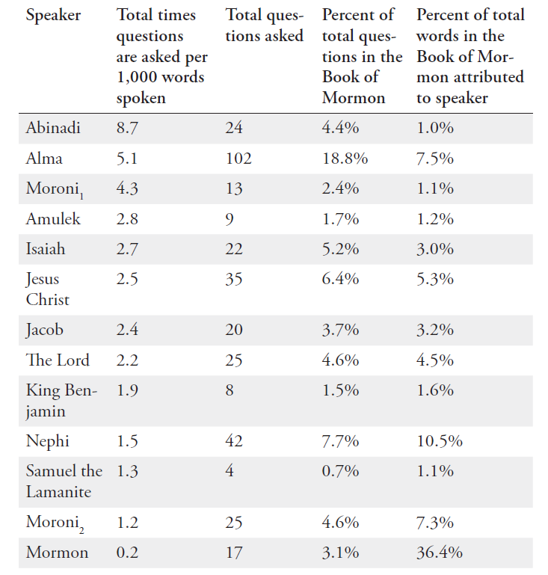

Slide 54
More than any other speaker, Alma uses questions that include the phrase “can ye” (17 times in the Book of Mormon, 8 of which are from Alma).

Slide 55
More than any other speaker, Alma uses questions that include the phrase “can ye” (17 times in the Book of Mormon, 8 of which are from Alma).
“Can ye imagine yourselves brought before the tribunal of God?” Alma 5:18

Slide 56
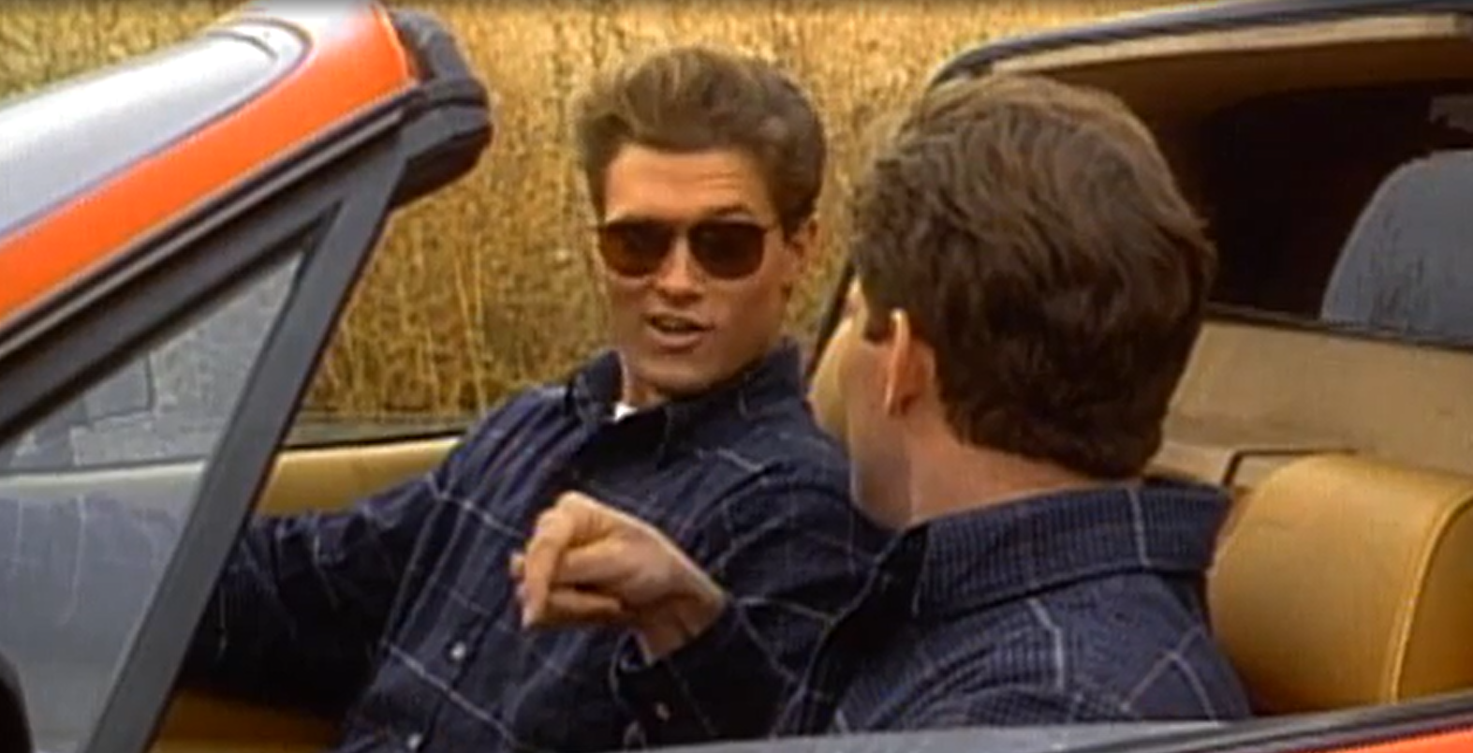

Slide 57
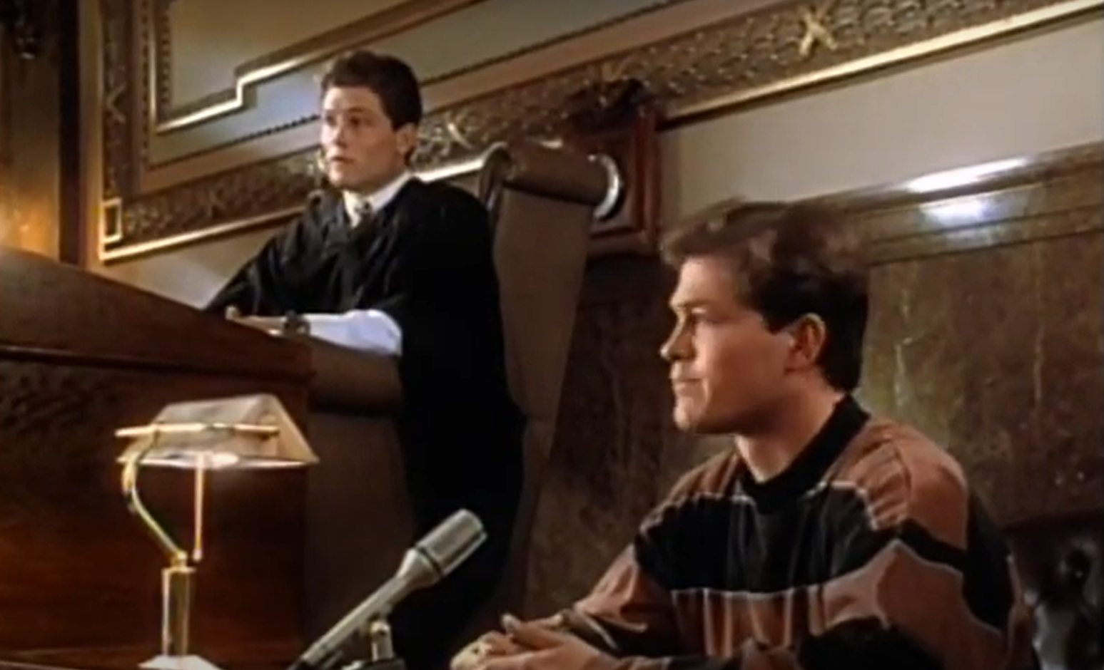
I’ve linked to this great seminary video at
johnhiltoniii.com/thebookofmormon

Slide 58
More than any other speaker, Alma uses questions that include the phrase “can ye” (17 times in the Book of Mormon, 8 of which are from Alma).
“Can ye imagine yourselves brought before the tribunal of God?” Alma 5:18
“Can ye look up to God at that day” of judgment?
Alma 5:19
If you’ve felt the song of redeeming love, “Can ye feel so now?”
Alma 5:26

Slide 59


Slide 60
Am I Ready to Meet God?
Have you sufficiently retained in remembrance [God’s] mercy and long-suffering?

Slide 61
Am I Ready to Meet God?
Have you sufficiently retained in remembrance [God’s] mercy and long-suffering?
Have you been spiritually born of God?

Slide 62
Am I Ready to Meet God?
Have you sufficiently retained in remembrance [God’s] mercy and long-suffering?
Have you been spiritually born of God?
Do you exercise faith in the redemption of him who created you?

Slide 63
Am I Ready to Meet God?
Have you sufficiently retained in remembrance [God’s] mercy and long-suffering?
Have you been spiritually born of God?
Do you exercise faith in the redemption of him who created you?
Have you received God’s image in your countenance?

Slide 64
Am I Ready to Meet God?
Have you sufficiently retained in remembrance [God’s] mercy and long-suffering?
Have you been spiritually born of God?
Do you exercise faith in the redemption of him who created you?
Have you received God’s image in your countenance?
Can you look up to God at the last day with clean hands and a pure heart?

Slide 65
Am I Ready to Meet God?
Have you sufficiently retained in remembrance [God’s] mercy and long-suffering?
Have you been spiritually born of God?
Do you exercise faith in the redemption of him who created you?
Have you received God’s image in your countenance?
Can you look up to God at the last day with clean hands and a pure heart?
Are you stripped of pride?

Slide 66
Am I Ready to Meet God?
Have you sufficiently retained in remembrance [God’s] mercy and long-suffering?
Have you been spiritually born of God?
Do you exercise faith in the redemption of him who created you?
Have you received God’s image in your countenance?
Can you look up to God at the last day with clean hands and a pure heart?
Are you stripped of pride?
Are you stripped of envy?

Slide 67
Am I Ready to Meet God?
Have you sufficiently retained in remembrance [God’s] mercy and long-suffering?
Have you been spiritually born of God?
Do you exercise faith in the redemption of him who created you?
Have you received God’s image in your countenance?
Can you look up to God at the last day with clean hands and a pure heart?
Are you stripped of pride?
Are you stripped of envy?
Will you persist in turning your backs upon the poor, and the needy, and in withholding your substance from them?

Slide 68
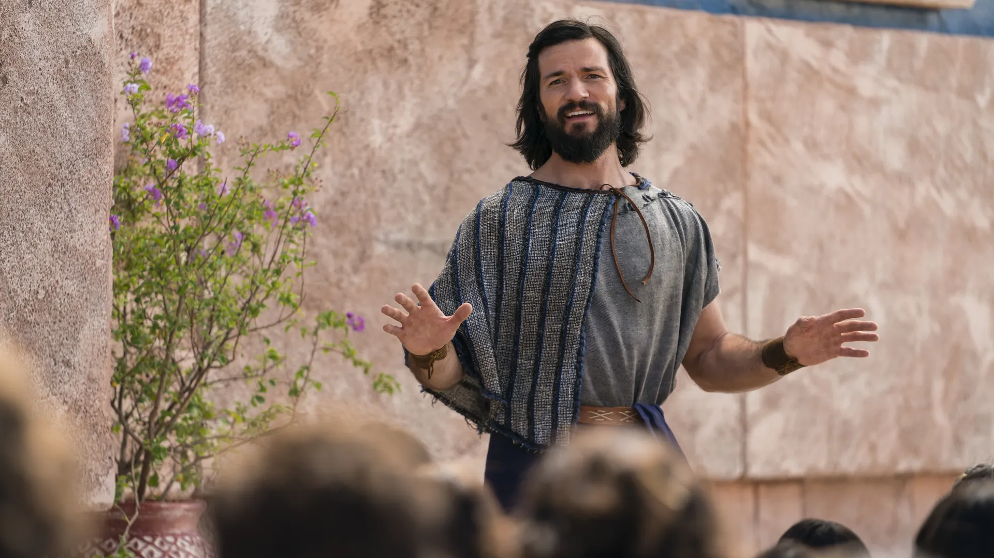
“And it came to pass that Alma declared, I have seen an angel, and this is how I gained my testimony.”
Alma 5:45
Notes:
https://churchofjesuschrist.org/imgs/674fa7cb9f9fb10151545c16f3eba113d0153f4c/full/1920%2C/0/default

Slide 69
“[These things] are made known unto me by the Holy Spirit of God…I have fasted and prayed many days that I might know these things of myself. And now I do know of myself that they are true; for the Lord God hath made them manifest unto me by his Holy Spirit.”
Alma 5:45–46
Notes:
https://churchofjesuschrist.org/imgs/674fa7cb9f9fb10151545c16f3eba113d0153f4c/full/1920%2C/0/default

Slide 70
“I know that Jesus Christ shall come, yea, the Son, the Only Begotten of the Father, full of grace, and mercy, and truth. And behold, it is he that cometh to take away the sins of the world, yea, the sins of every man who steadfastly believeth on his name.”
Alma 5:48
Notes:
https://churchofjesuschrist.org/imgs/674fa7cb9f9fb10151545c16f3eba113d0153f4c/full/1920%2C/0/default

Slide 71


Slide 74
Notes:
Similarly, if I imagine that Jesus Christ has only $2.00 worth of grace, I may get stressed out thinking, “He might not have enough to cover me!” But when I remember he’s full of grace my confidence in him increases. And I can turn around and try to emulate Christ with others. When I feel my patience running out, I can picture Christ, full of grace. The problem isn’t my outside circumstances, the problem is that I’m not tapping into the Savior’s full level of grace so that I can offer that to others. This has been a helpful principle to me, to remember to fill my heart with love from Jesus Christ, so then I can be full of love to share with others.
you

Slide 75
Alma 7:1–2
“Behold…[this] is the first time that I have spoken unto you by the words of my mouth, I having been wholly confined to the judgment-seat, having had much business that I could not come unto you. And I could not have come now at this time were it not that the judgment-seat hath been given to another.”

Slide 76
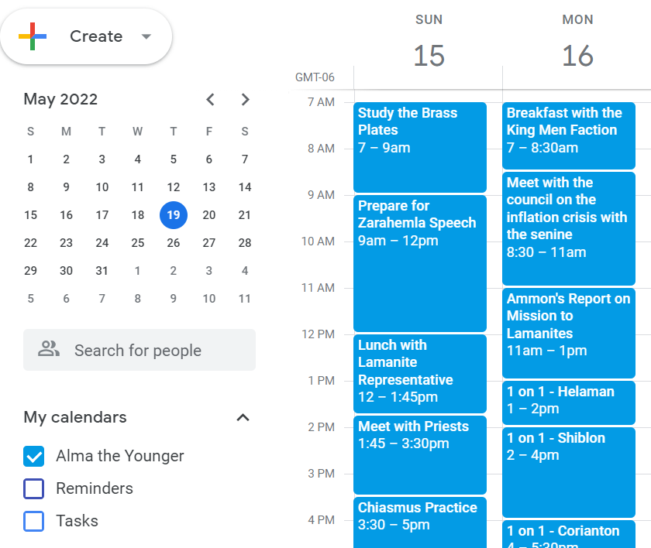
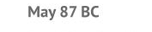

Slide 77
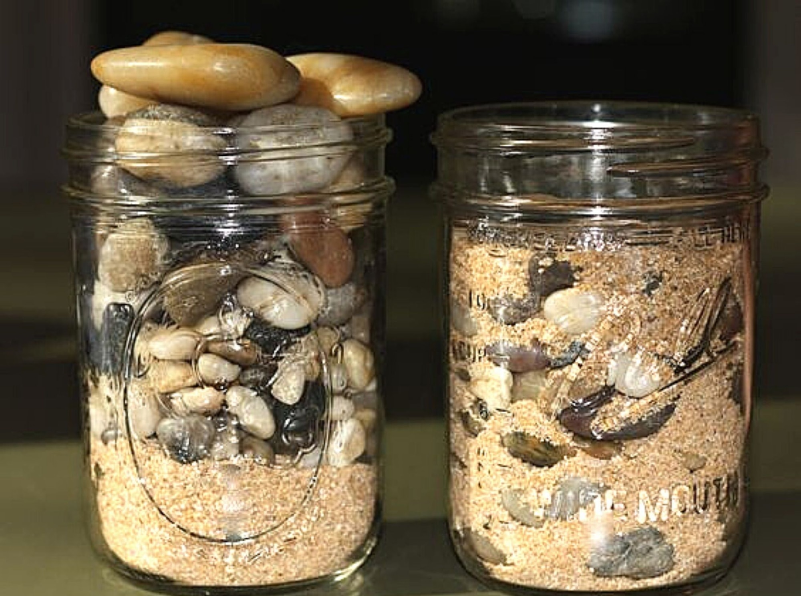

Slide 78
Which is Better?
Buying some lollipops for a fundraiser to help sick children.
Stealing lollipops from sick children.

Slide 79
Which is Better?
Going to the temple to do baptisms for the dead.
Taking cookies to, and visiting with, a widow.

Slide 80
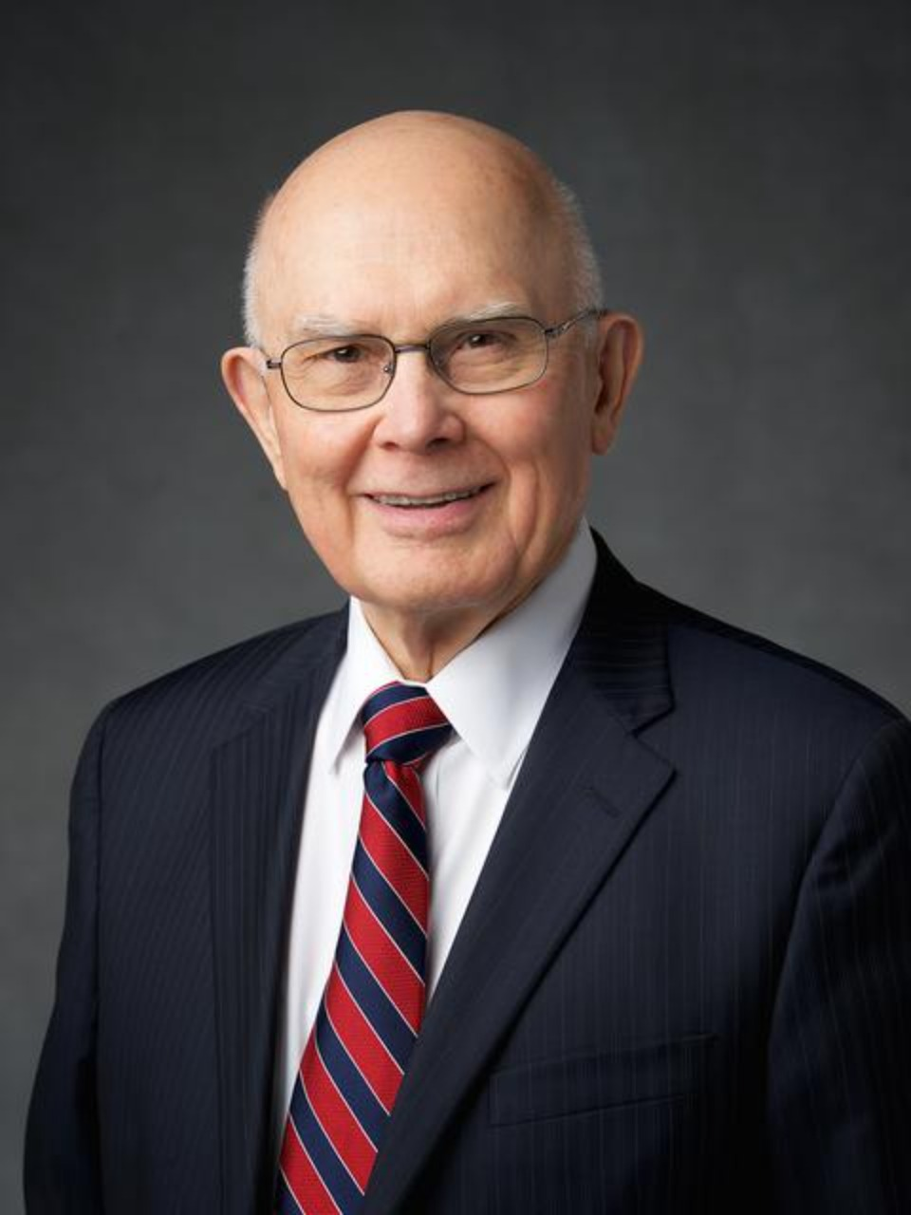
“The number of good things we can do far exceeds the time available to accomplish them. Some things are better than good, and these are the things that should command priority attention in our lives…
Of course it is good to view wholesome entertainment or to obtain interesting information. But not everything of that sort is worth the portion of our life we give to obtain it. Some things are better, and others are best.”
President Dallin H. Oaks. “Good, Better, Best,” 2007
Notes:
https://news-hk.churchofjesuschrist.org/eng/media/960x1280/oaks-bio-resized-hke1.jpg

Slide 81
“I do not say that he will come among us at the time of his dwelling in his mortal tabernacle; for behold, the Spirit hath not said unto me that this should be the case. Now as to this thing I do not know; but this much I do know, that the Lord God hath power to do all things which are according to his word.” Alma 7:8
Notes:
https://churchofjesuschrist.org/imgs/674fa7cb9f9fb10151545c16f3eba113d0153f4c/full/1920%2C/0/default

Slide 82
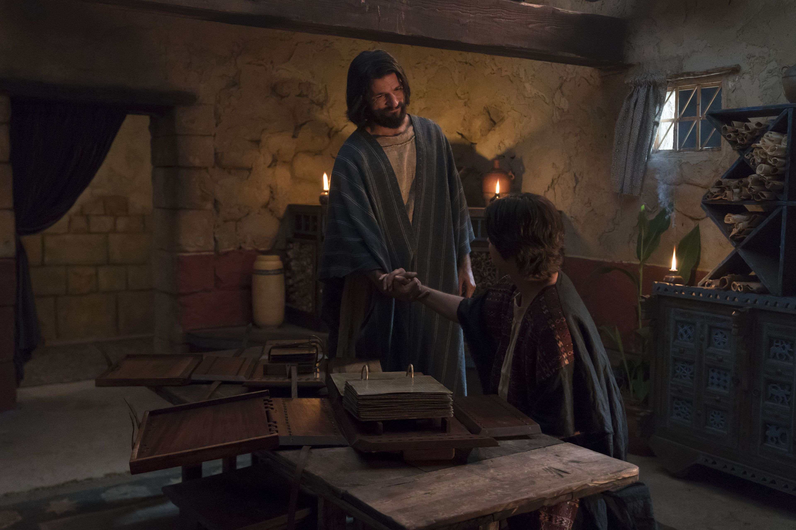
“Now these mysteries are not yet fully made known unto me; therefore I shall forbear.”
Alma 37:11
Notes:
https://churchofjesuschrist.org/imgs/2886020868773369e4b59257df258e53ef2f2d9f/full/1920%2C/0/default

Slide 83
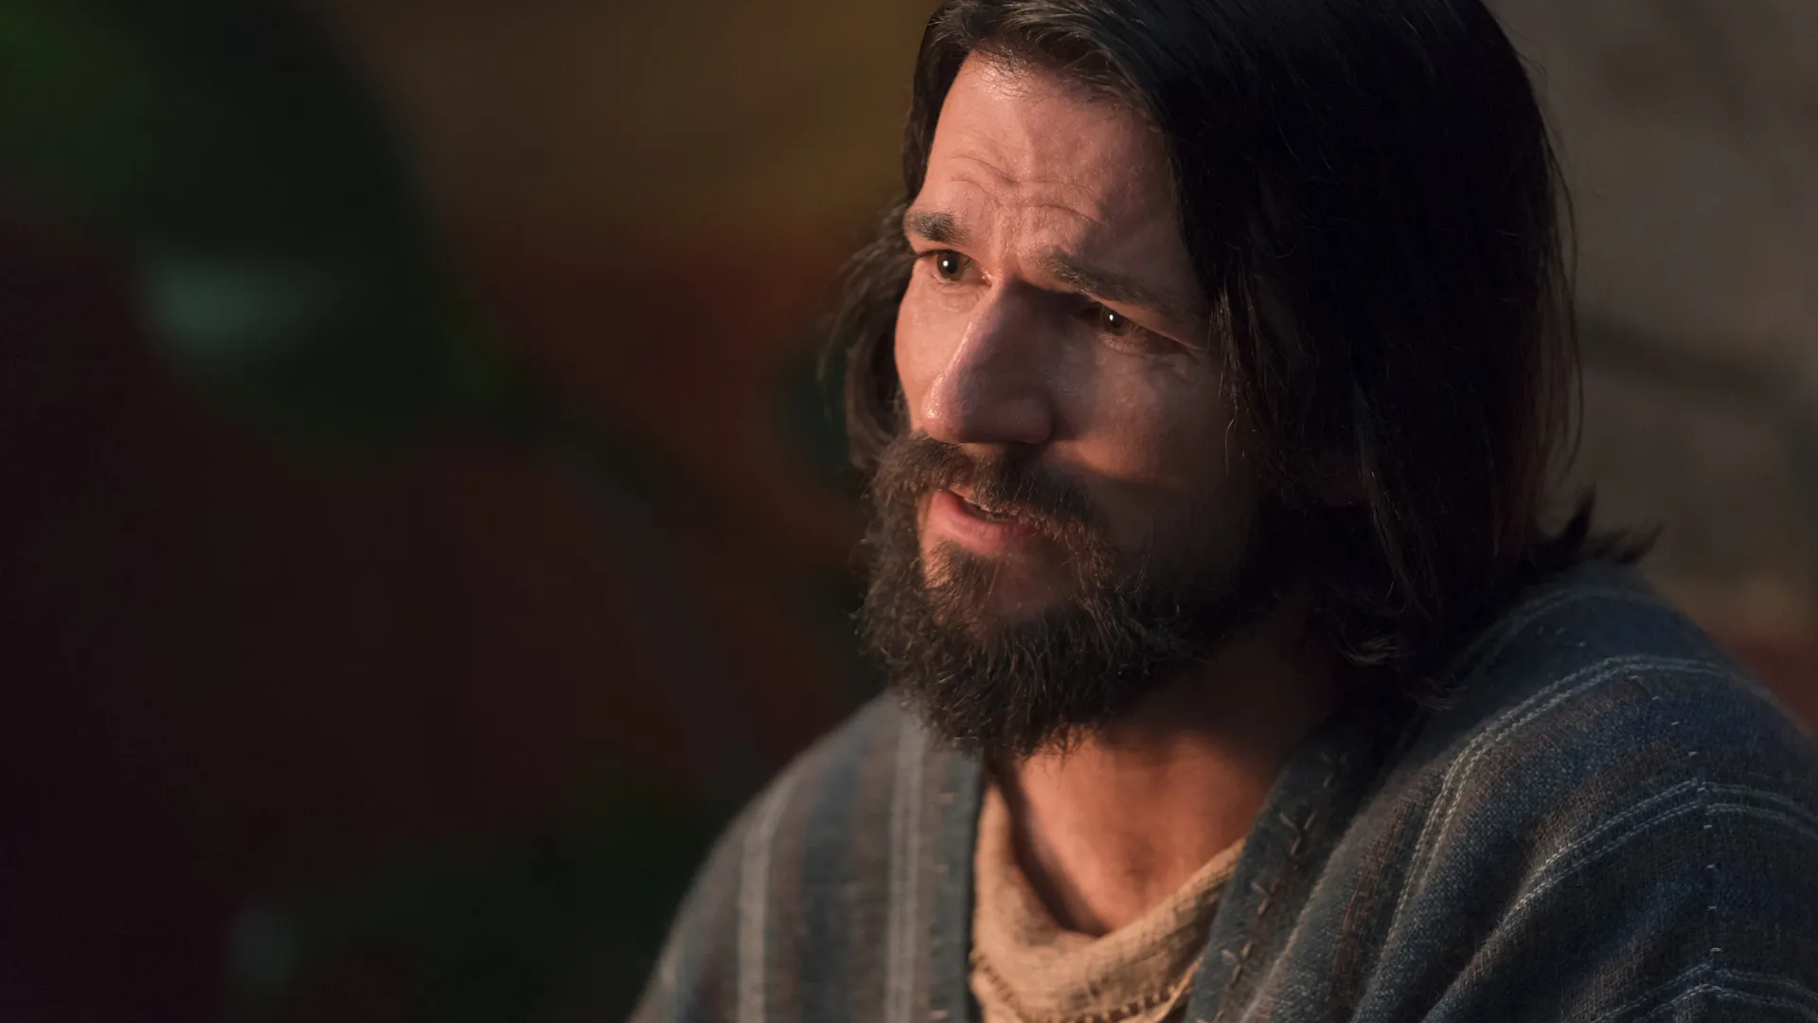
“There are many mysteries which are kept, that no one knoweth them save God himself.”
Alma 40:3
Notes:
https://churchofjesuschrist.org/imgs/2886020868773369e4b59257df258e53ef2f2d9f/full/1920%2C/0/default

Slide 84
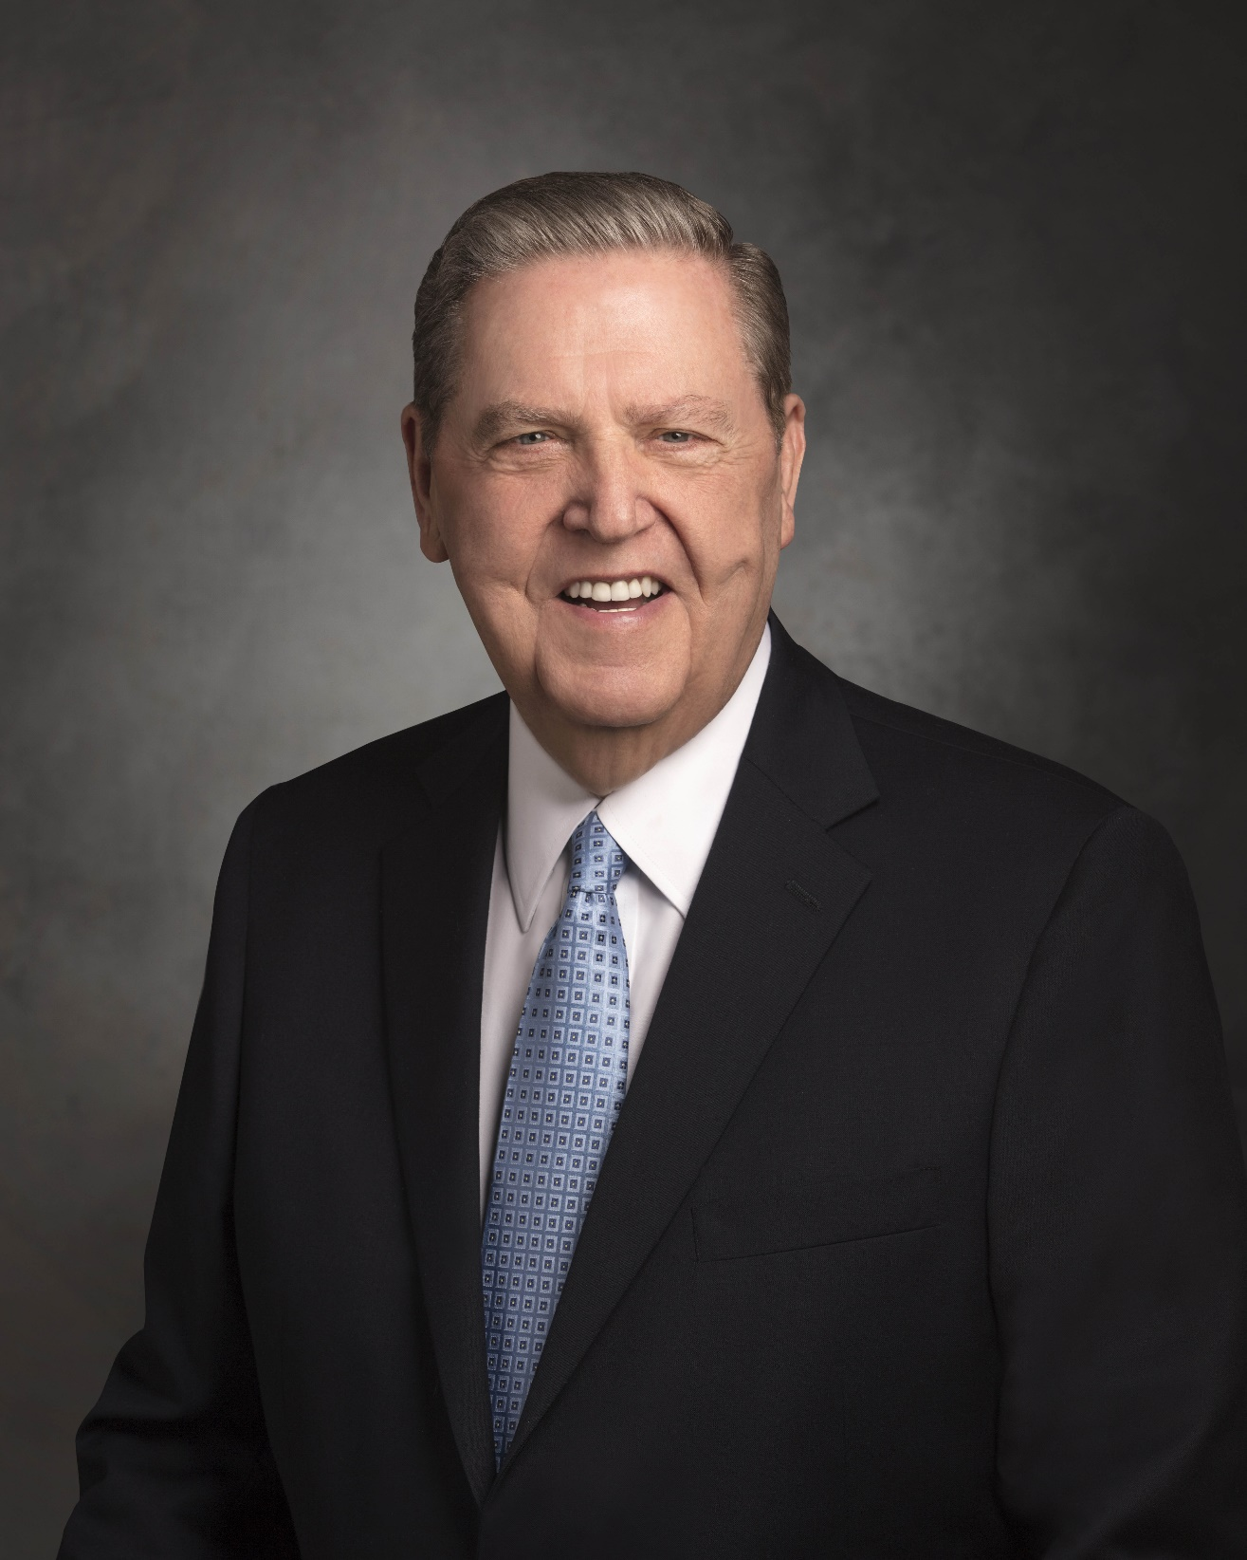
“When there is something you do not know, testify of what you do know.”
Elder Jeffrey R. Holland,
“Our Consuming Mission,”
(address to CES religious educators,
Salt Lake Tabernacle, February 5,1999)
Notes:
https://newsroom.churchofjesuschrist.org/media/orig/Jeffrey-R-Holland-official--portrait-June2018-resized.jpg

Slide 85
“I do not say that he will come among us at the time of his dwelling in his mortal tabernacle; for behold, the Spirit hath not said unto me that this should be the case. Now as to this thing I do not know; but this much I do know, that the Lord God hath power to do all things which are according to his word.” Alma 7:8
Notes:
https://churchofjesuschrist.org/imgs/674fa7cb9f9fb10151545c16f3eba113d0153f4c/full/1920%2C/0/default

Slide 86
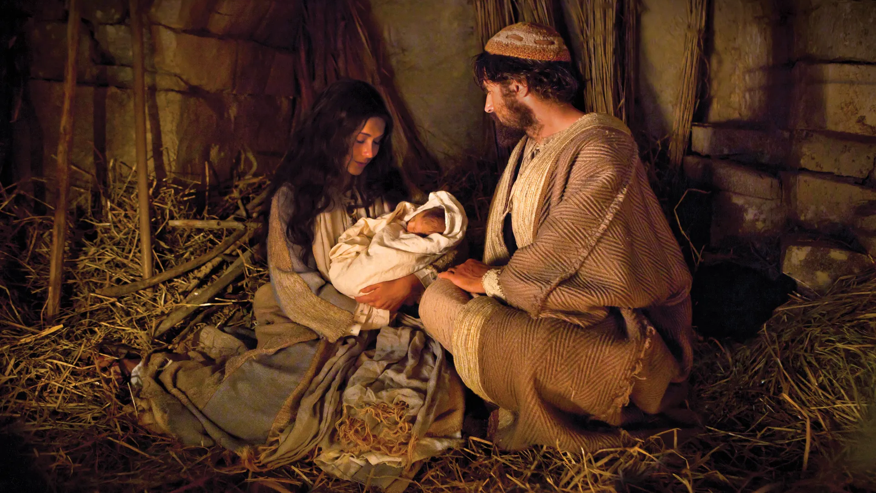
“And behold, he shall be born of Mary, at Jerusalem which is the land of our forefathers, she being a virgin, a precious and chosen vessel, who shall be overshadowed and conceive by the power of the Holy Ghost, and bring forth a son, yea, even the Son of God.” Alma 7:10
Notes:
https://www.churchofjesuschrist.org/imgs/35a6461ba57a4148ca7dc223b09daadd5f233a1b/full/1920%2C/0/default

Slide 87
“[Jesus] shall go forth, suffering pains and afflictions and temptations of every kind; and this that the word might be fulfilled which saith he will take upon him the pains and the sicknesses of his people. And he will take upon him death, that he may loose the bands of death which bind his people; and he will take upon him their infirmities, that his bowels may be filled with mercy, according to the flesh, that he may know according to the flesh how to succor his people according to their infirmities. Now the Spirit knoweth all things; nevertheless the Son of God suffereth according to the flesh that he might take upon him the sins of his people, that he might blot out their transgressions according to the power of his deliverance; and now behold, this is the testimony which is in me.”
Alma 7:11–13

Slide 88
“[Jesus] shall go forth, suffering pains and afflictions and temptations of every kind; and this that the word might be fulfilled which saith he will take upon him the pains and the sicknesses of his people. And he will take upon him death, that he may loose the bands of death which bind his people; and he will take upon him their infirmities, that his bowels may be filled with mercy, according to the flesh, that he may know according to the flesh how to succor his people according to their infirmities. Now the Spirit knoweth all things; nevertheless the Son of God suffereth according to the flesh that he might take upon him the sins of his people, that he might blot out their transgressions according to the power of his deliverance; and now behold, this is the testimony which is in me.”
Alma 7:11–13

Slide 89
“[Jesus] shall go forth, suffering pains and afflictions and temptations of every kind; and this that the word might be fulfilled which saith he will take upon him the pains and the sicknesses of his people. And he will take upon him death, that he may loose the bands of death which bind his people; and he will take upon him their infirmities, that his bowels may be filled with mercy, according to the flesh, that he may know according to the flesh how to succor his people according to their infirmities. Now the Spirit knoweth all things; nevertheless the Son of God suffereth according to the flesh that he might take upon him the sins of his people, that he might blot out their transgressions according to the power of his deliverance; and now behold, this is the testimony which is in me.”
Alma 7:11–13

Slide 90
“Surely he hath borne our griefs, and carried our sorrows.”
Isaiah 53:4

Slide 91
“Surely he hath borne our griefs, and carried our sorrows.”
Isaiah 53:4
“That it might be fulfilled which was spoken by [Isaiah] the prophet, saying, Himself took our infirmities, and bare our sicknesses.”
Matthew 8:17

Slide 92
“[Jesus] shall go forth, suffering pains and afflictions and temptations of every kind; and this that the word might be fulfilled which saith he will take upon him the pains and the sicknesses of his people. And he will take upon him death, that he may loose the bands of death which bind his people; and he will take upon him their infirmities, that his bowels may be filled with mercy, according to the flesh, that he may know according to the flesh how to succor his people according to their infirmities. Now the Spirit knoweth all things; nevertheless the Son of God suffereth according to the flesh that he might take upon him the sins of his people, that he might blot out their transgressions according to the power of his deliverance; and now behold, this is the testimony which is in me.”
Alma 7:11–13

Slide 93
“For we do not have a high priest who is unable to sympathize with our weaknesses, but we have one who in every respect has been tested as we are, yet without sin. Let us therefore approach the throne of grace with boldness, so that we may receive mercy and find grace to help in time of need.”
Hebrews 4:15–16, NRSV
“And he cometh into the world that he may save all men if they will hearken unto his voice; for behold, he suffereth the pains of all men, yea, the pains of every living creature, both men, women, and children, who belong to the family of Adam.”
2 Nephi 9:21
“[Thus] saith the Lord your God, even Jesus Christ, your advocate, who knoweth the weakness of man and how to succor them who are tempted.”
Doctrine and Covenants 62:1

Slide 94
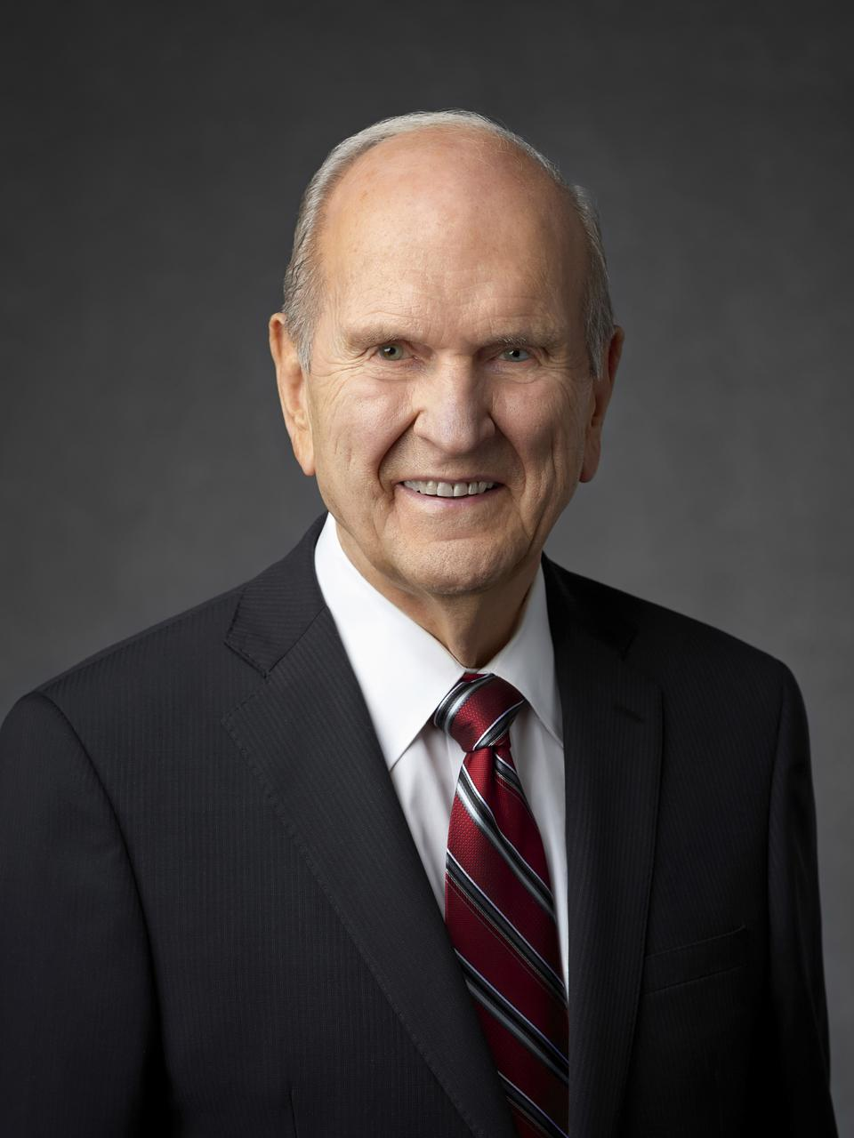
“In the Garden of Gethsemane, our Savior took upon Himself every pain, every sin, and all of the anguish and suffering ever experienced by you and me and by everyone who has ever lived or will ever live. Under the weight of that excruciating burden, He bled from every pore.
President Nelson, “The Correct Name of the Church”, Oct. 2018
Notes:
https://newsroom.churchofjesuschrist.org/media/960x1280/President-Russell-M-Nelson-1-2018.jpg

Slide 95
“In the Garden of Gethsemane, our Savior took upon Himself every pain, every sin, and all of the anguish and suffering ever experienced by you and me and by everyone who has ever lived or will ever live. Under the weight of that excruciating burden, He bled from every pore. All of this suffering was intensified as He was cruelly crucified on Calvary’s cross.”
President Nelson, “The Correct Name of the Church”, Oct. 2018
Notes:
Remind that Gethsemane is important. Our focus is on Christ’s Crucifixion, that doesn’t mean we are diminishing Gethsemane.
https://newsroom.churchofjesuschrist.org/media/960x1280/President-Russell-M-Nelson-1-2018.jpg

Slide 96
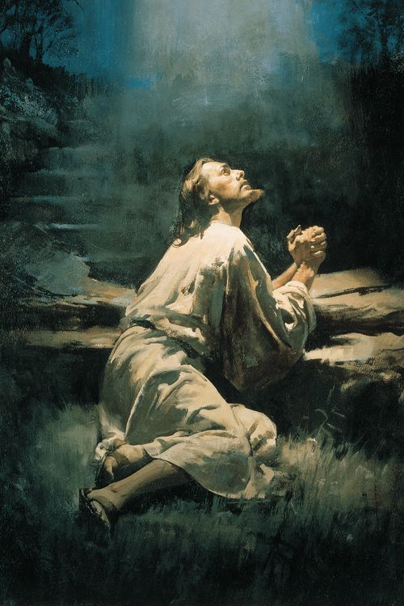
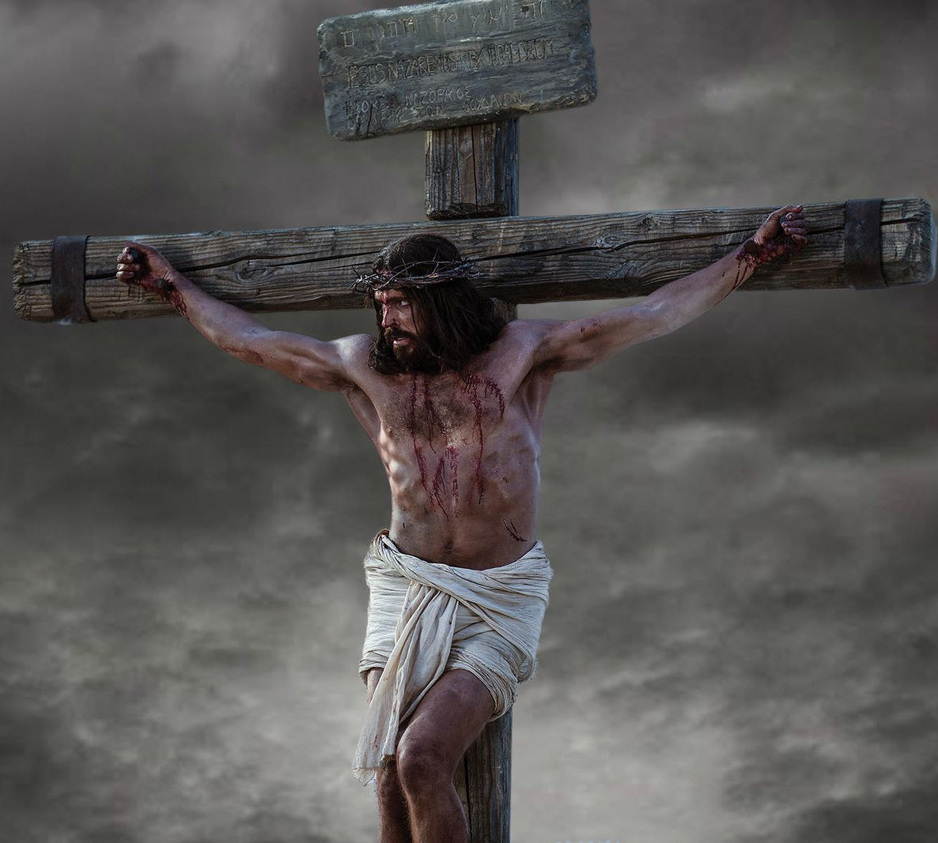
How has it helped you in your life to know that Jesus Christ has felt the pain and struggles you experience?
Harry Anderson
Notes:
https://churchofjesuschrist.org/imgs/d18b9972ee7bab34a49c18b21ac7b4b48af70f24/full/500%2C/0/default
https://www.churchofjesuschrist.org/imgs/6a3910a40c03383aca253f8e7ae6197aec7a701e/full/1600%2C/0/default

Slide 97


For free resources related to this video, please visit https://johnhiltoniii.com/TheBookofMormon
Join our course discussions on social media
@johnhiltoniii

Slide 98
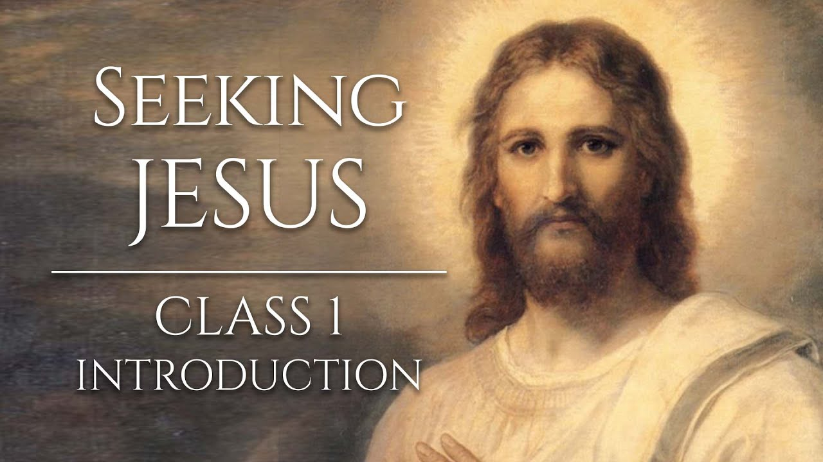
https://johnhiltoniii.com/SeekingJesus
You may also be interested in this
free video course…

Slide 99
This video is not produced or endorsed by Brigham Young University or the Church of Jesus Christ of Latter-day Saints.
John Hilton III is solely responsible for its contents
Insights from, discussions with, and resources authored by
by Greg Baer and Scott Woodward were used in the creation of this video. See further acknowledgements at https://johnhiltoniii.com/thebookofmormon

