Slide 1
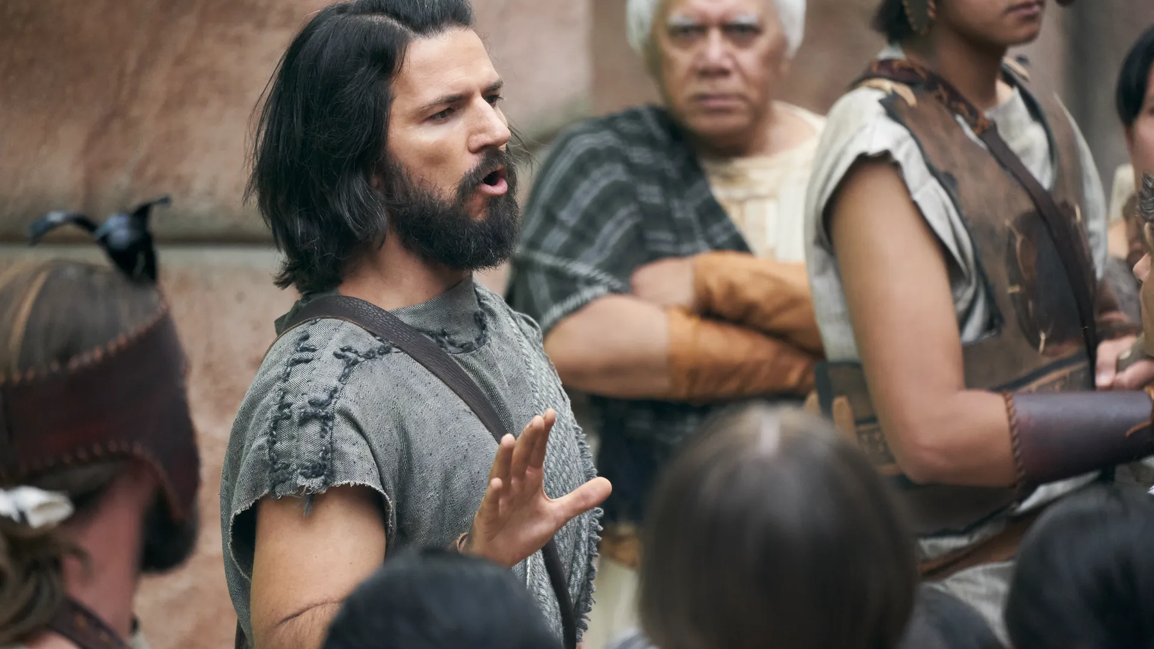
“Nevertheless Alma labored much in the spirit, wrestling with God in mighty prayer, that he would pour out his Spirit upon the people who were in the city; that he would also grant that he might baptize them unto repentance.”
Alma 8:10
Notes:
https://churchofjesuschrist.org/imgs/4977f5e19ff0cdb11337396de018f85177931a99/full/1920%2C/0/default

Slide 2
Alma 8:11
"And it came to pass that the people of Ammonihah listened to Alma’s words, and fed him delicious meals."

Slide 3
Alma 8:11
"And it came to pass that the people of Ammonihah listened to Alma’s words, and fed him delicious meals."

Slide 4
Alma 8:11
"Nevertheless, they hardened their hearts, saying unto him: Behold, we know that thou art Alma; and we know that thou art high priest over the church which thou hast established in many parts of the land, according to your tradition; and we are not of thy church, and we do not believe in such foolish traditions."

Slide 5
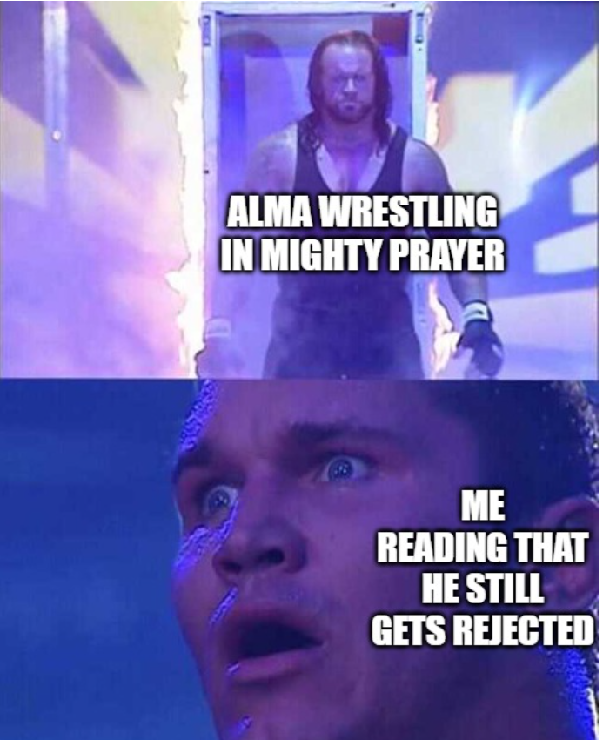

Slide 6
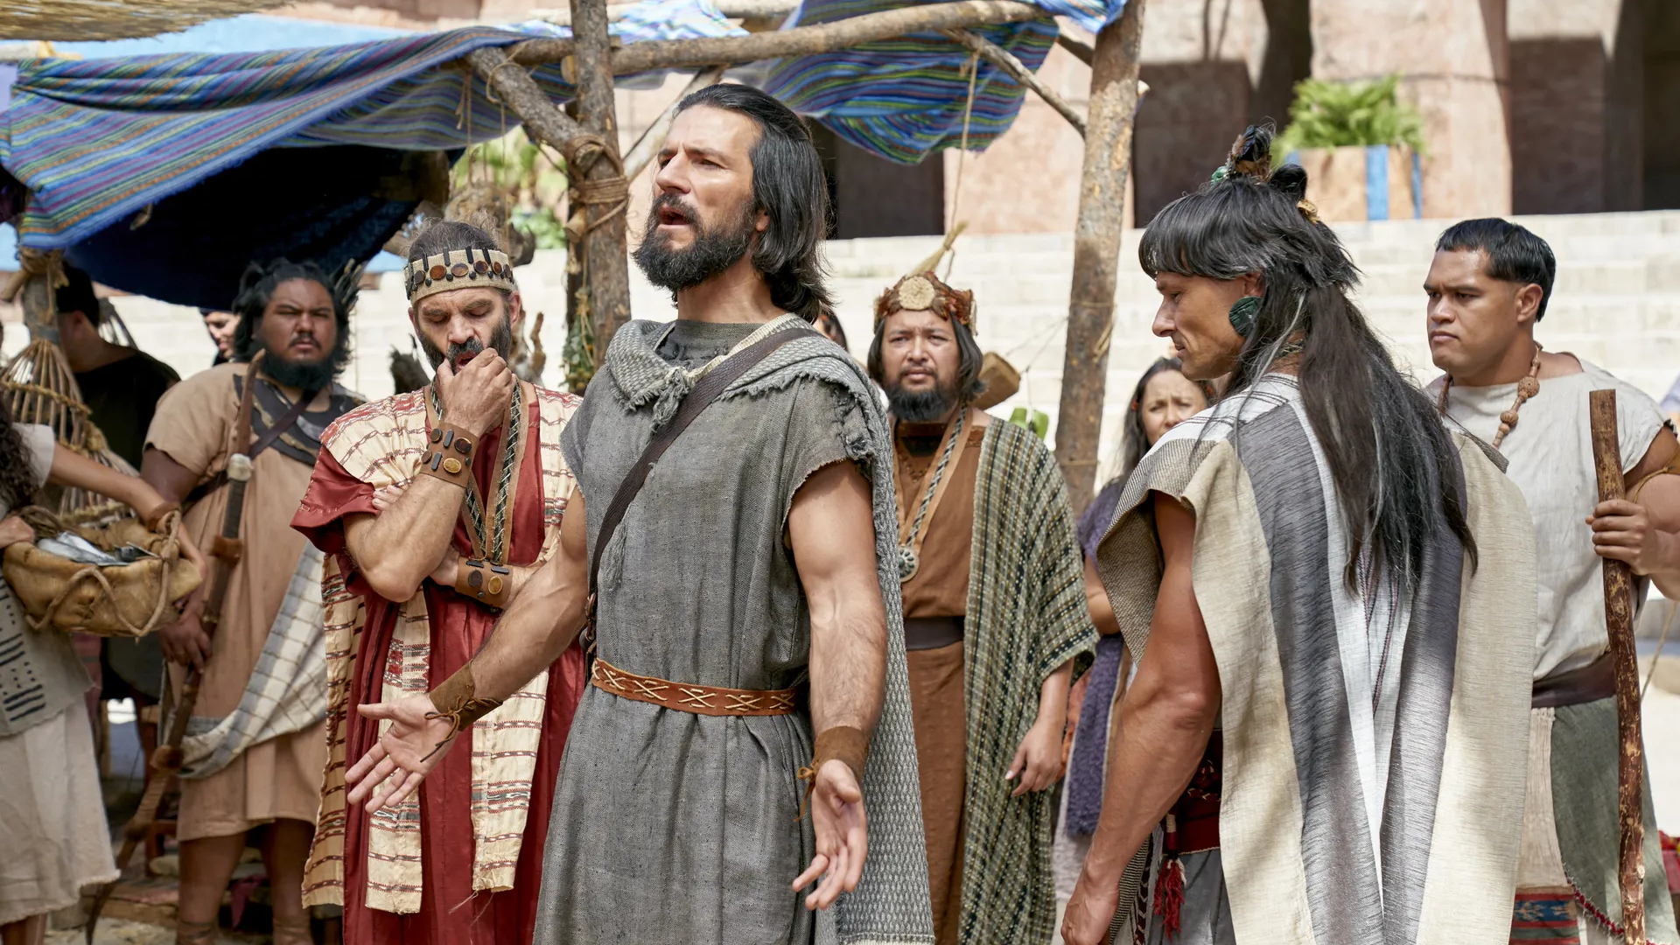
“After Alma had received his message from the angel of the Lord he returned speedily to the land of Ammonihah. And he entered the city by another way, yea, by the way which is on the south of the city of Ammonihah.”
Alma 8:18
Notes:
https://churchofjesuschrist.org/imgs/46b43771b9a1d65f08c2654378ef2a3f2c0b33d6/full/1920%2C/0/default

Slide 7
“Say unto [the people of Ammonihah], except they repent the Lord God will destroy them.”
Alma 8:16
Notes:
https://churchofjesuschrist.org/imgs/4977f5e19ff0cdb11337396de018f85177931a99/full/1920%2C/0/default

Slide 8
“Say unto [the people of Ammonihah], except they repent the Lord God will destroy them.”
Alma 8:16
“Except ye repent…[God] will utterly destroy you from off the face of the earth.”
Alma 9:12
Notes:
https://churchofjesuschrist.org/imgs/4977f5e19ff0cdb11337396de018f85177931a99/full/1920%2C/0/default

Slide 9
Alma’s Questions in Alma 9
“How have ye forgotten the tradition of your fathers?”
“Do ye not remember that our father, Lehi, was brought out of Jerusalem by the hand of God?”
“Do ye not remember that they were all led by him through the wilderness?”
“Have ye forgotten so soon how many times he delivered our fathers out of the hands of their enemies?”
“Do ye not remember the words which [God] spake unto Lehi?”
Alma 9:8–10, 13

Slide 10
543 Questions in the Book of Mormon
The most commonly asked question: whether people have remembered
or forgotten (26 times)

Slide 11
543 Questions in the Book of Mormon
The most commonly asked question: whether people have remembered
or forgotten (26 times)
“I will not forget you.”
1 Nephi 21:15

Slide 12
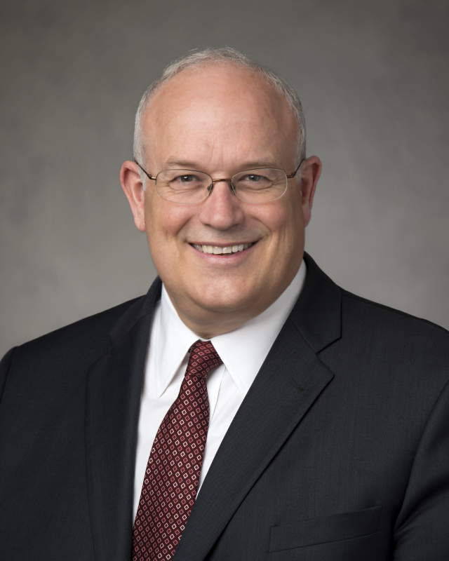
“In the Book of Mormon, those societies that were most steeped in false philosophies and sin—such as the people of King Noah, the people of Ammonihah, or the Zoramites—were most likely to react negatively to the messages of prophets.”
Elder Paul V. Johnson, “To Guide Us in These Latter Days,” Oct. 2023 Liahona
Notes:
https://assets.churchofjesuschrist.org/ed/5d/ed5dd29c90bb29233bea92aa12ebd5141bfb37e1/paul_johnson_qsv_portrait.png

Slide 13
“I never have known much of the ways of the Lord, and his mysteries and marvelous power…but behold, I mistake, for I have seen much of his mysteries and his marvelous power…
I was called many times and I would not hear; therefore I knew concerning these things, yet I would not know.”
(Alma 10:5–6)

Slide 14
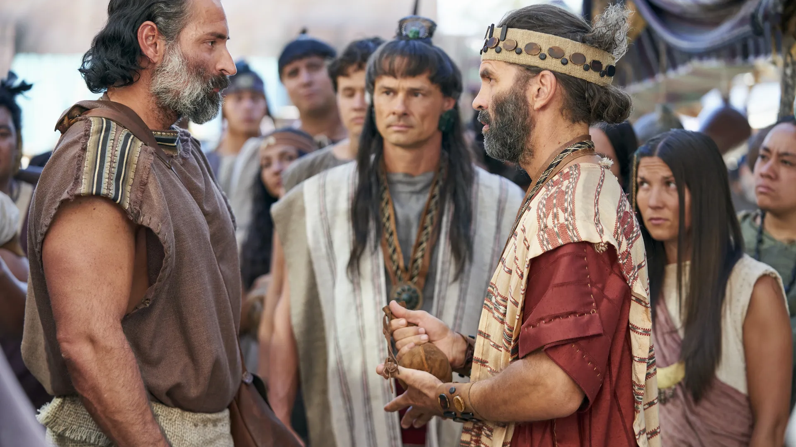
“A man who was expert in the devices of the devil.”
Alma 11:21
Notes:
https://churchofjesuschrist.org/imgs/0ece97bb1f3a5e882e10b5d70281c85a26ca5e2f/full/1920%2C/0/default

Slide 15
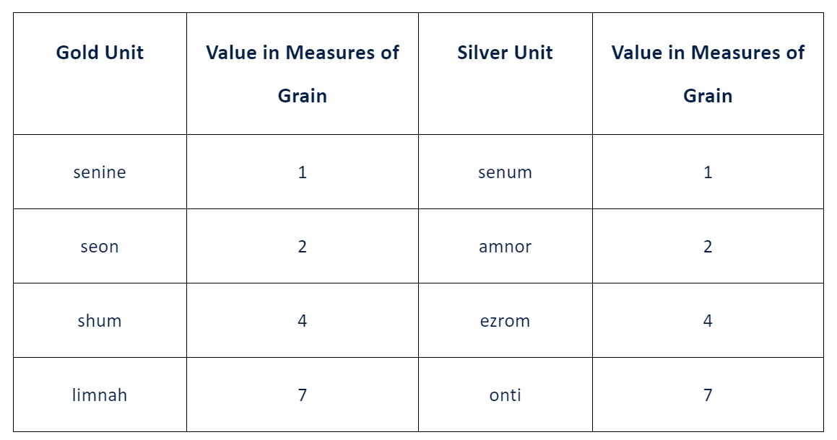
Scripture Central

Slide 16

Name:
Nephite Math Homework
If Amulek buys 32 watermelons for 8 Senines of gold each, how many Shums of gold could she also pay?
If Ammah has 8 Limnahs of gold and 5 Senums of silver, how many measure of grain could he trade for such
If Shiblon has 12 Shiblons of silver, Mosiah has 5 Leahs of silver, and Alma has 23 Antions of gold, how many Senines of gold do they have all together?
Which is worth more, 2 Ezroms of silver, or 5 Seons of gold?
Helamen has 24 Shiblums of silver. If there is a new necklace that costs 21 Senines, is he able to afford it?

Slide 17
Scripture Central

Slide 18
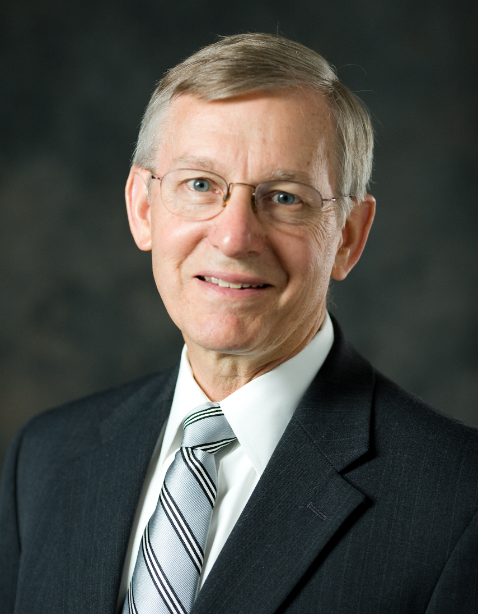
“Joseph Smith would have been hard pressed to produce on his own such an elegant, complex, yet practical system of measures.”
John W. Welch, “Book of Mormon Evidence: Mosiah’s Elegant Monetary System,” 2021
Notes:
https://mormonartsstg.lib.byu.edu/media/person/1007.jpg

Slide 19
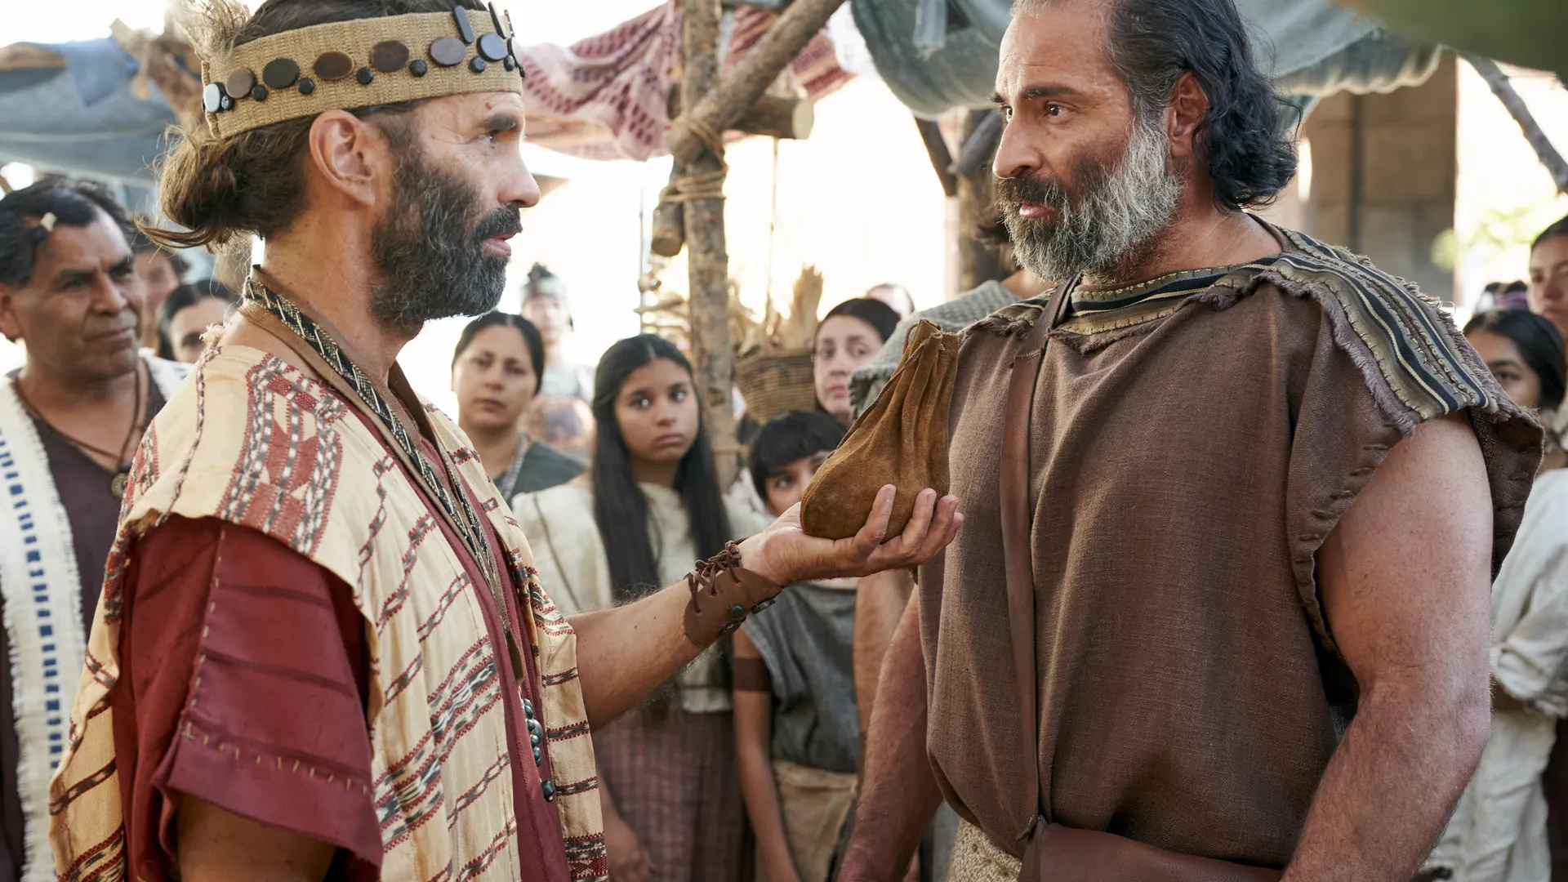
“Here are six onties of silver, and all these will I give thee if thou wilt deny the existence of a Supreme Being.”
Alma 11:22
Zeezrom offers Amulek the equivalent of 42 days of wages for a lawyer
Notes:
https://churchofjesuschrist.org/imgs/8e8df54d00a6e8041d6ea601d6b3811cebf45c92/full/1920%2C/0/default

Slide 20
“O thou child of hell, why tempt ye me? Knowest thou that the righteous yieldeth to no such temptations?”
Alma 11:23
Notes:
https://churchofjesuschrist.org/imgs/0ece97bb1f3a5e882e10b5d70281c85a26ca5e2f/full/1920%2C/0/default

Slide 21
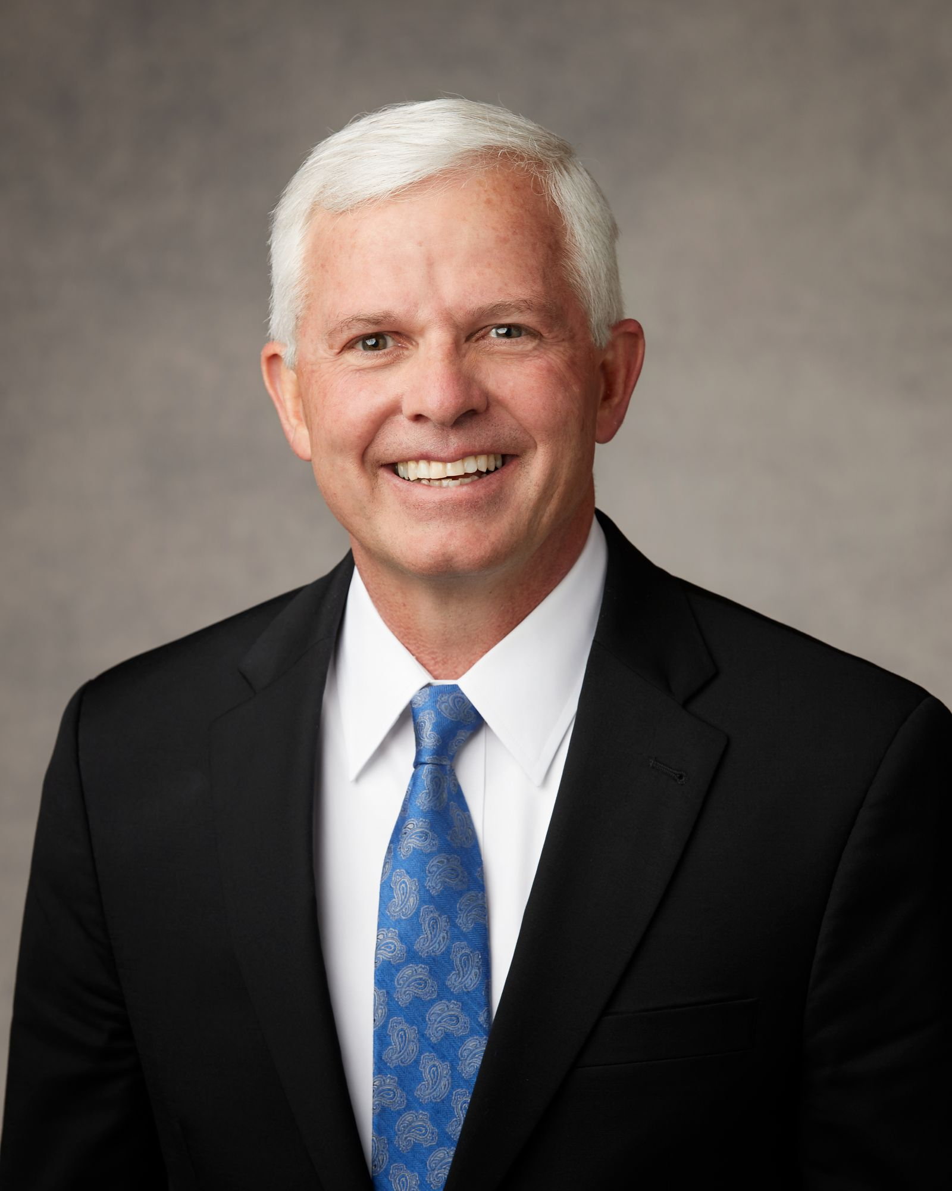
“When the day arrived for him to go home to Liberia—one of the poorest nations in Africa—his mission president in the Democratic Republic of the Congo provided him with one hundred dollars in cash to cover any unexpected expense he might incur on his trip home.
Elder Matthew L. Carpenter, “We Believe in Being Honest,” BYU Devotional Dec. 5, 2024
Notes:
https://mormonartsstg.lib.byu.edu/media/person/1007.jpg

Slide 22
“In Africa, traveling is complicated, and there are frequent delays in flight schedules. The one hundred dollars—drawn from Church funds designated to support missionary needs—was given with the instruction that the returning missionary was to use it for food and any bus, taxi, or lodging expense incurred on his way home.
Elder Matthew L. Carpenter, “We Believe in Being Honest,” BYU Devotional Dec. 5, 2024
Notes:
https://mormonartsstg.lib.byu.edu/media/person/1007.jpg

Slide 23
“He was asked to keep track of his expenses and to provide receipts, along with any unused money, to the priesthood leader who would be releasing him.
When the missionary landed in his home country, he was greeted by his priesthood leader…
Elder Matthew L. Carpenter, “We Believe in Being Honest,” BYU Devotional Dec. 5, 2024
Notes:
https://mormonartsstg.lib.byu.edu/media/person/1007.jpg

Slide 24
“At the conclusion of the release interview, this young returned missionary handed his priesthood leader ninety dollars and the receipts for the ten dollars spent en route. After the interview, the local priesthood leader drove this young man some distance into the bush near his village.
Elder Matthew L. Carpenter, “We Believe in Being Honest,” BYU Devotional Dec. 5, 2024
Notes:
https://mormonartsstg.lib.byu.edu/media/person/1007.jpg

Slide 25
“When they arrived at the place where his mother was waiting for him by the roadside, the missionary got out of the car. As the mission president watched this young man walk away with his mother, he realized that the ninety dollars could have fed this young man’s family for many months.
Elder Matthew L. Carpenter, “We Believe in Being Honest,” BYU Devotional Dec. 5, 2024
Notes:
https://mormonartsstg.lib.byu.edu/media/person/1007.jpg

Slide 26
“Sometimes there is a temptation for a returning missionary living in a poor country to say that they lost the receipts and that they spent all the travel money—and then keep any remaining funds for themselves or their family. But this elder did not fall to that temptation.”
Elder Matthew L. Carpenter, “We Believe in Being Honest,” BYU Devotional Dec. 5, 2024
Notes:
https://mormonartsstg.lib.byu.edu/media/person/1007.jpg

Slide 27

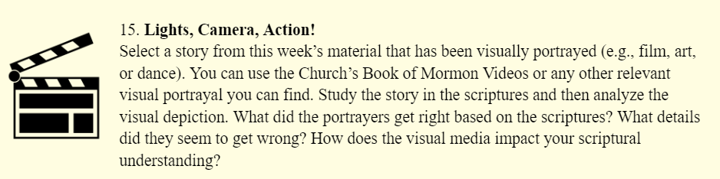
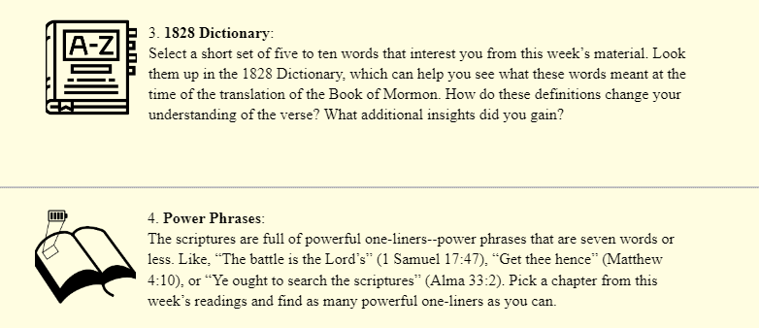
More scripture study tools at
johnhiltoniii.com/thebookofmormon/resources

Slide 28
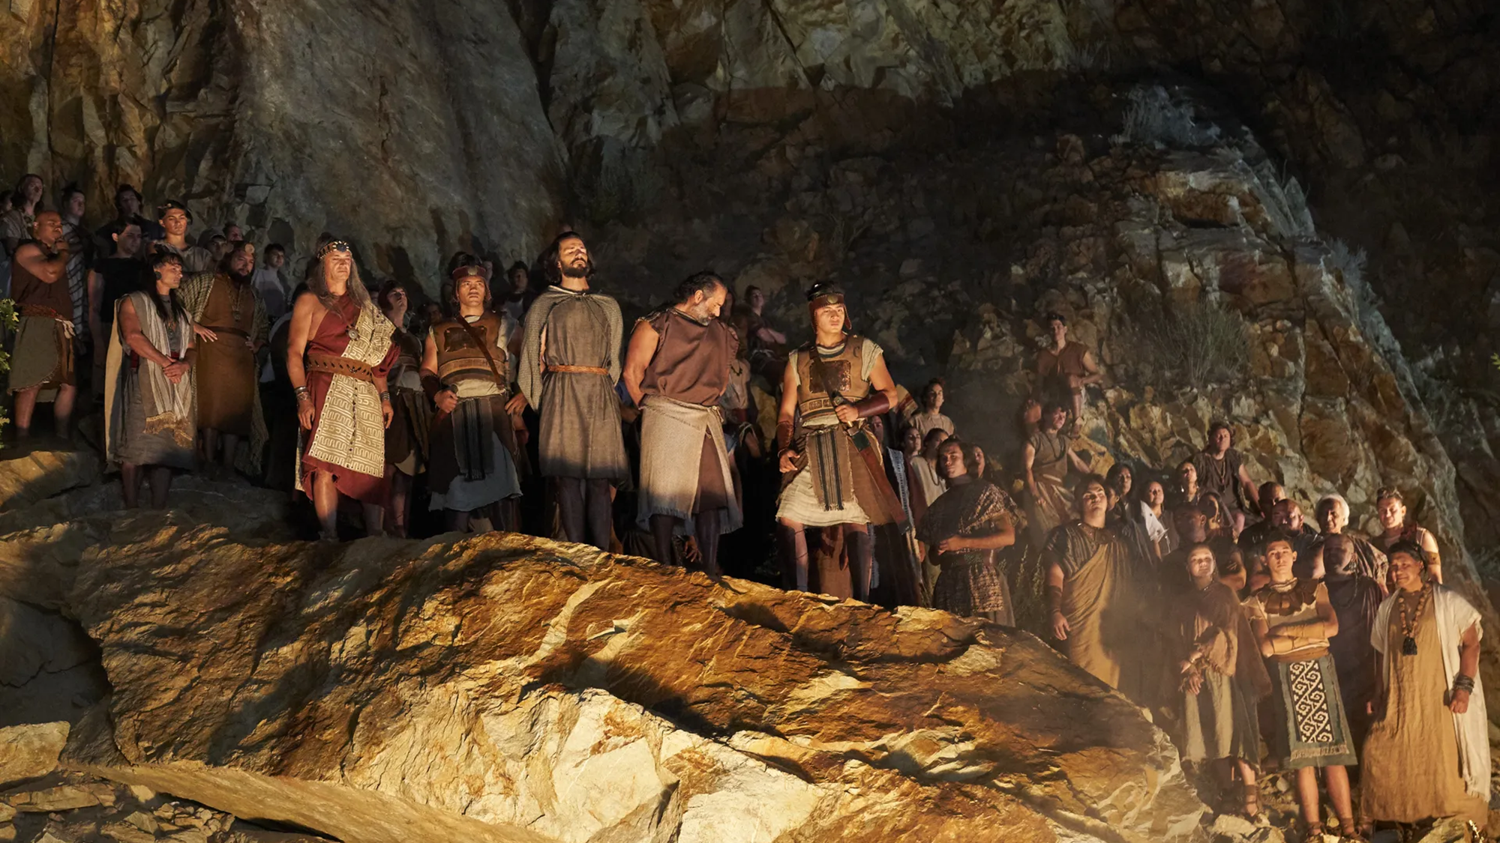
“Our work is not finished; therefore they burn us not.”
Alma 14:13
Notes:
https://churchofjesuschrist.org/imgs/3bd4c1739ab34893244e91ff21e886d7f8f0b125/full/1920%2C/0/default

Slide 29
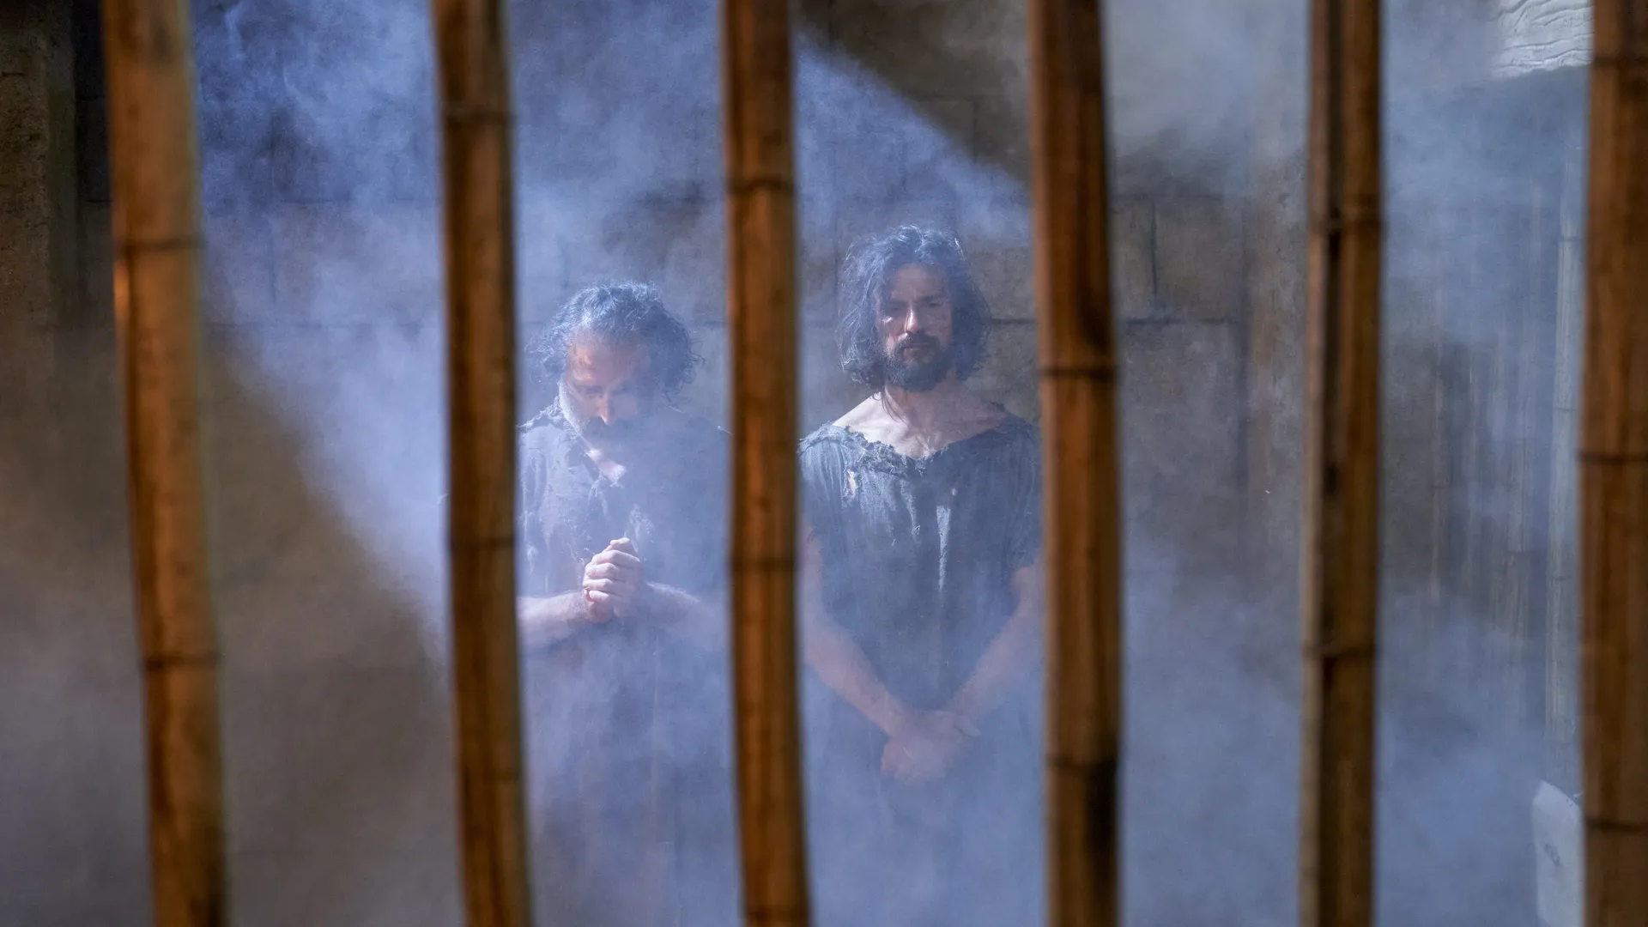
“Why do ye not answer the words of this people? Know ye not that I have power to deliver you up unto the flames?”
Alma 14:19
Notes:
https://churchofjesuschrist.org/imgs/202dce25970cf4e17a936ec9a91681abf83d1d81/full/1920%2C/0/default

Slide 30
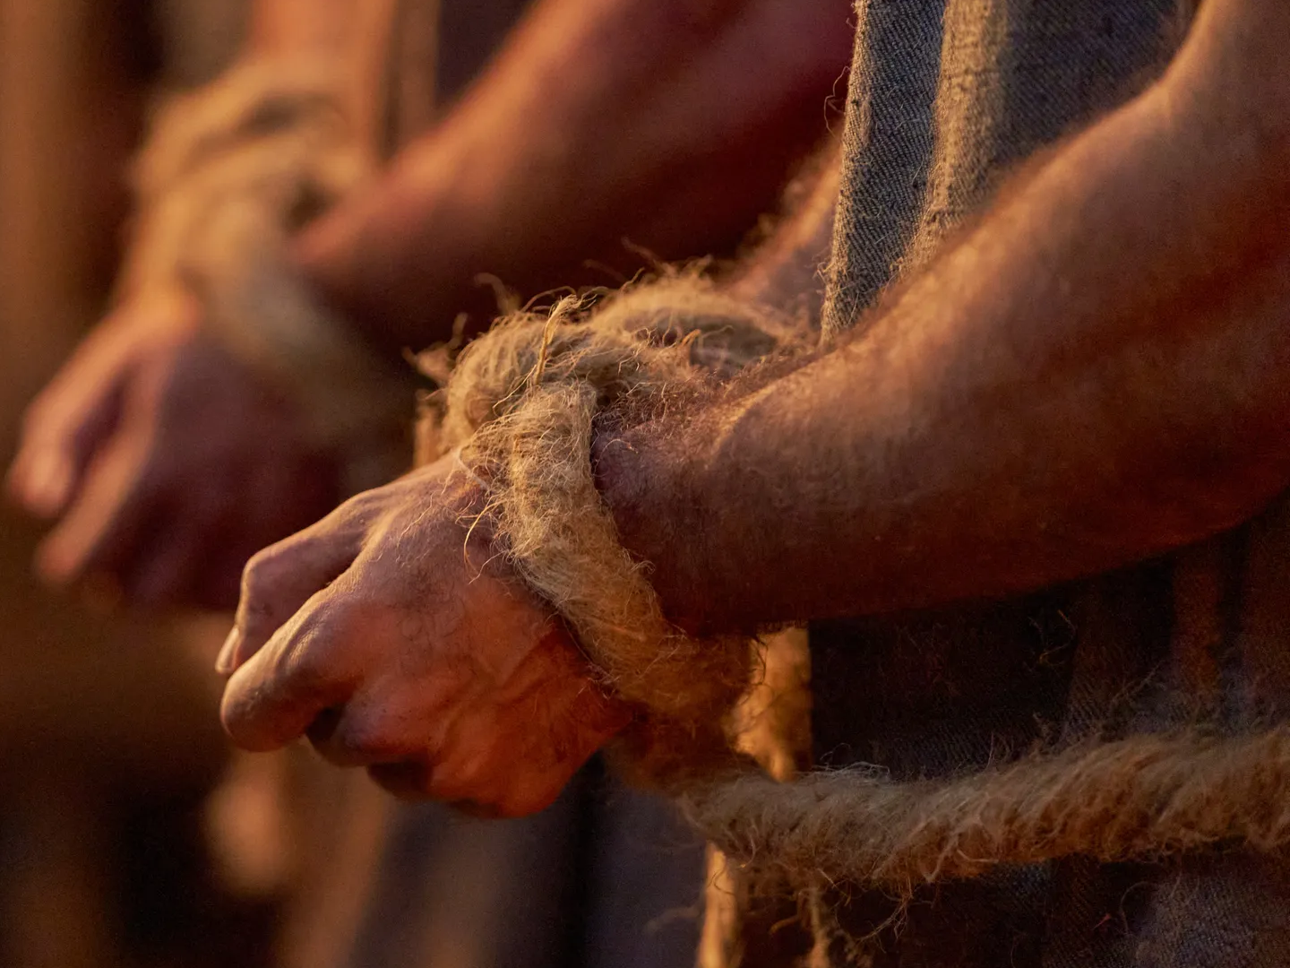
“They answered nothing.”
Alma 14:19
Notes:
https://churchofjesuschrist.org/imgs/1d1475beb0ef29604d20b259be33b95d23aa4ede/full/1920%2C/0/default

Slide 31
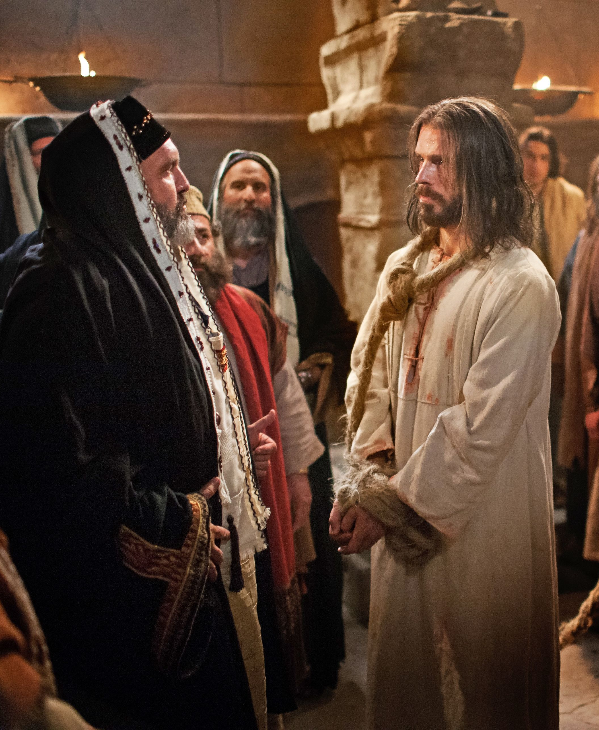
“They answered nothing.”
Alma 14:19
Notes:
https://churchofjesuschrist.org/imgs/1d1475beb0ef29604d20b259be33b95d23aa4ede/full/1920%2C/0/default

Slide 32
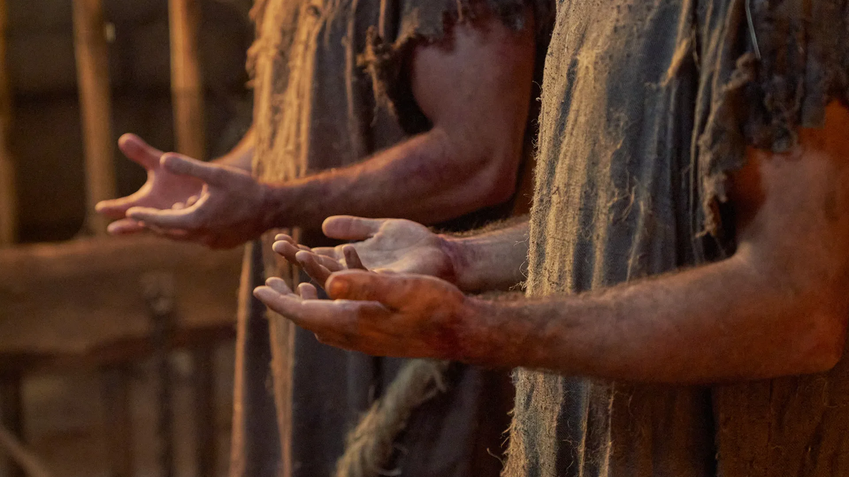
“How long shall we suffer these great afflictions, O Lord? O Lord, give us strength according to our faith which is in Christ, even unto deliverance. And they broke the cords with which they were bound.”
Alma 14:26
Notes:
https://churchofjesuschrist.org/imgs/fcc9cb967db55930758bf3c199d05d3f0b31ecf5/full/1920%2C/0/default

Slide 33
“How long shall we suffer these great afflictions, O Lord? O Lord, give us strength according to our faith which is in Christ, even unto deliverance. And they broke the cords with which they were bound.”
Alma 14:26
“Give me strength”
1 Nephi 7:17
Notes:
https://churchofjesuschrist.org/imgs/fcc9cb967db55930758bf3c199d05d3f0b31ecf5/full/1920%2C/0/default

Slide 34
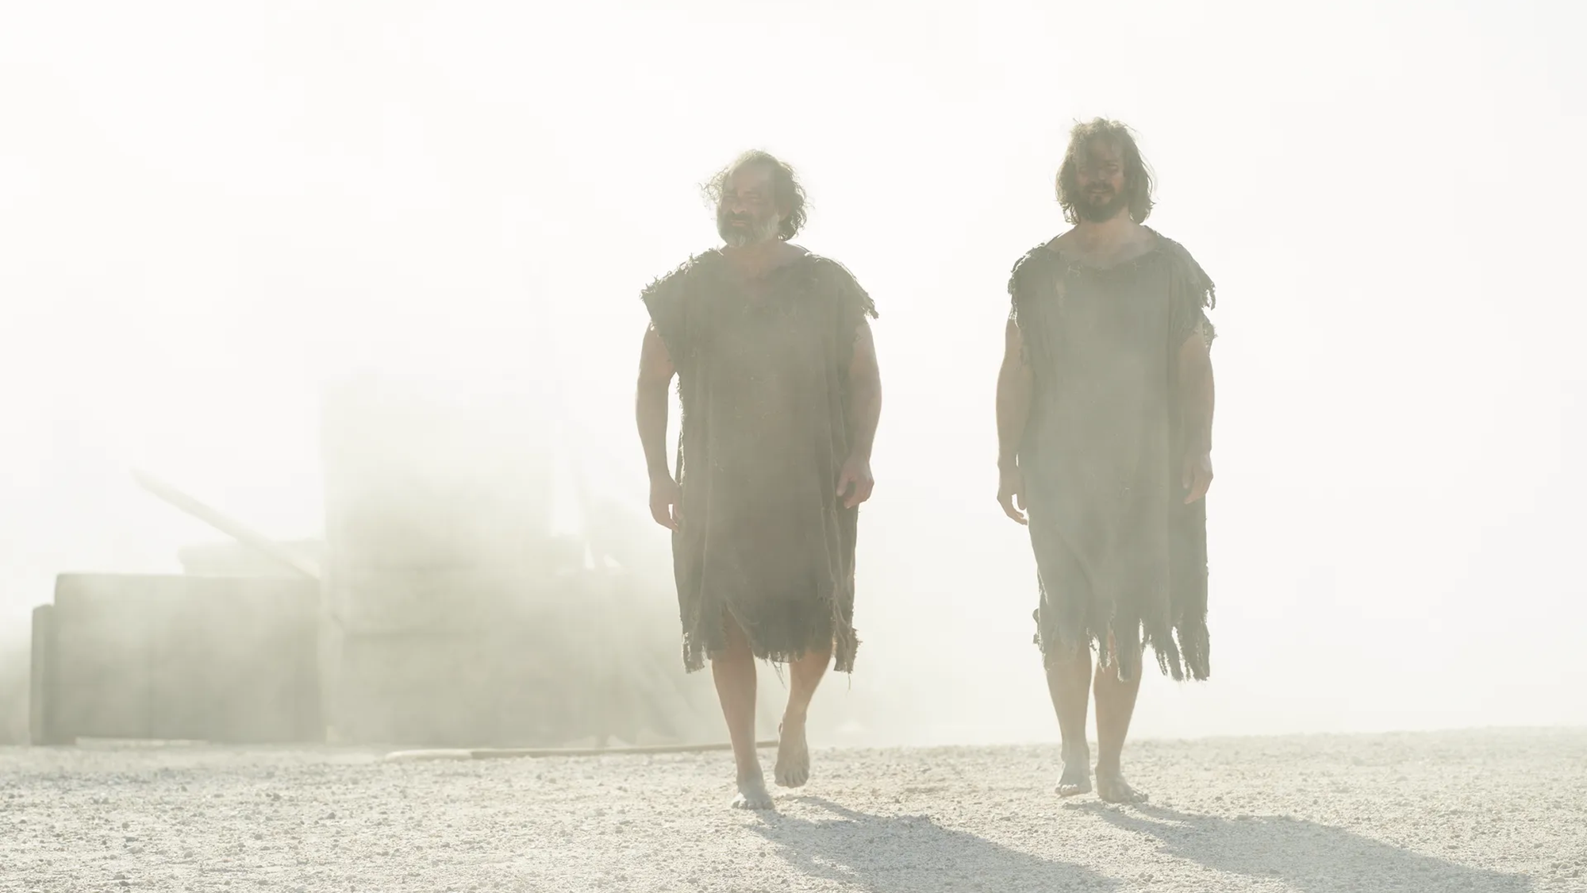
“On the twelfth day, in the tenth month, in the tenth year of the reign of the judges”
Alma 14:23
Alma met Amulek on “the fourth day of [the] seventh month…in the tenth year of the reign of the judges”
Alma 10:6
3 months
Notes:
https://churchofjesuschrist.org/imgs/ac116c0a357480ffedb2b45a97e17d2880822955/full/1920%2C/0/default

Slide 35
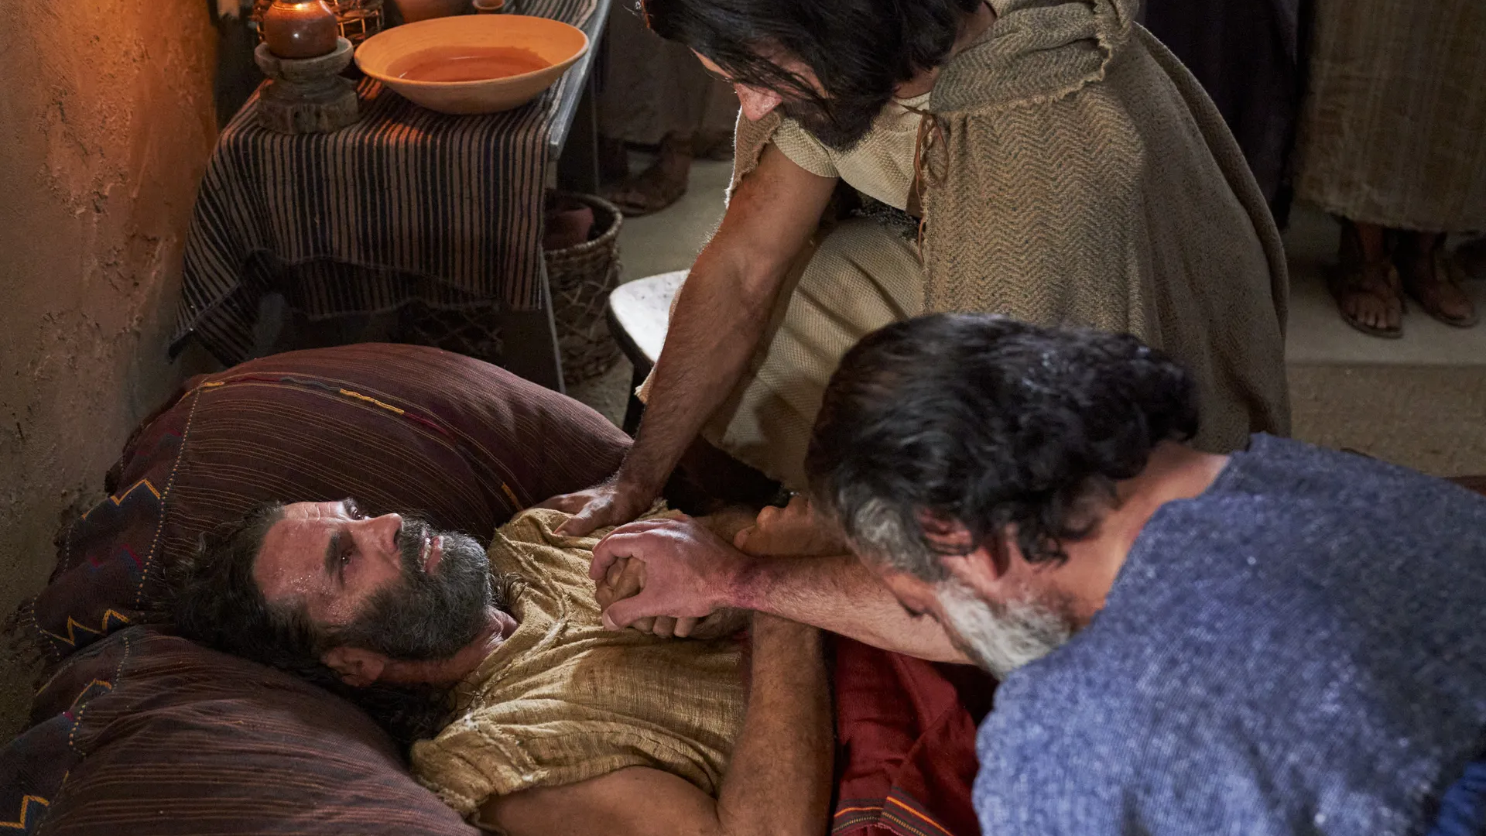
Zeezrom was “very low with a burning fever”
Alma 15:5
Notes:
https://churchofjesuschrist.org/imgs/d3b66313b4d9cec34112395df88d1e1a73f8ab1c/full/1920%2C/0/default

Slide 36
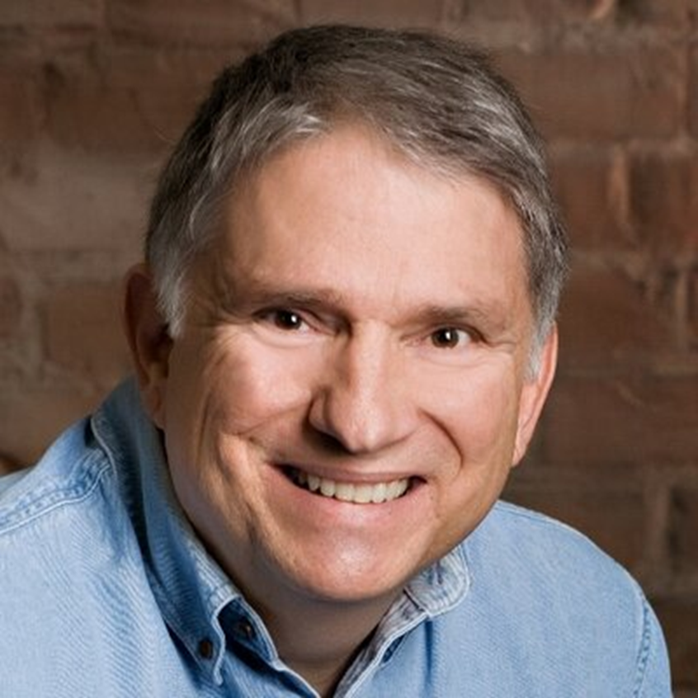
“Does [Amulek] remember when he testified that Alma had indeed blessed him, his wife and children, and all his family? The story of Alma and Amulek is one of the most poignant in all of scripture. What begins as a joyful story of an angel directing a man to receive a prophet, and the two of them becoming missionaries who get to preach the gospel, ends with the horrible death of innocent women and children and Amulek’s having lost everything…
Dr. Charles Swift, “When Less Is More: The Reticent Narrator in the Story of Alma
and Amulek,” Religious Educator,
vol. 13, no. 1, 2012
Notes:
https://media.bizj.us/view/img/11662166/former-prestanner-byuh*750xx2563-3417-0-0.jpg

Slide 37
“Alma…took Amulek and came over to the land of Zarahemla, and took him to his own house, and did administer unto him in his tribulations, and strengthened him in the Lord.” (Alma 15:18)

Slide 38
What lessons can you personally learn from Amulek?

Slide 39
“On the fifth day of the second month” in the “eleventh year of the reign of the judges”
Alma 16:1
This is 4 months after Alma and Amulek were miraculously delivered from prison

Slide 40
“On the fifth day of the second month” in the “eleventh year of the reign of the judges”
Alma 16:1
This is 4 months after Alma and Amulek were miraculously delivered from prison
“We will not believe thy words if thou shouldst prophesy that this great city should be destroyed in one day”
Alma 9:4
“In one day [Ammonihah] was left desolate”
Alma 16:10

Slide 41
“On the fifth day of the second month” in the “eleventh year of the reign of the judges”
Alma 16:1
This is 4 months after Alma and Amulek were miraculously delivered from prison
“We will not believe thy words if thou shouldst prophesy that this great city should be destroyed in one day”
Alma 9:4
“In one day [Ammonihah] was left desolate”
Alma 16:10

Slide 42
“Plan”
Bible: 0 times
Doctrine and Covenants: 3 times
Pearl of Great Price: 2 times
Book of Mormon: 55 times, 30 of which refer to God’s plan for his children

Slide 43
“Plan”
Bible: 0 times
Doctrine and Covenants: 3 times
Pearl of Great Price: 2 times
Book of Mormon: 55 times, 30 of which refer to God’s plan for his children
Alma uses “plan” more than all other speakers combined.

Slide 44
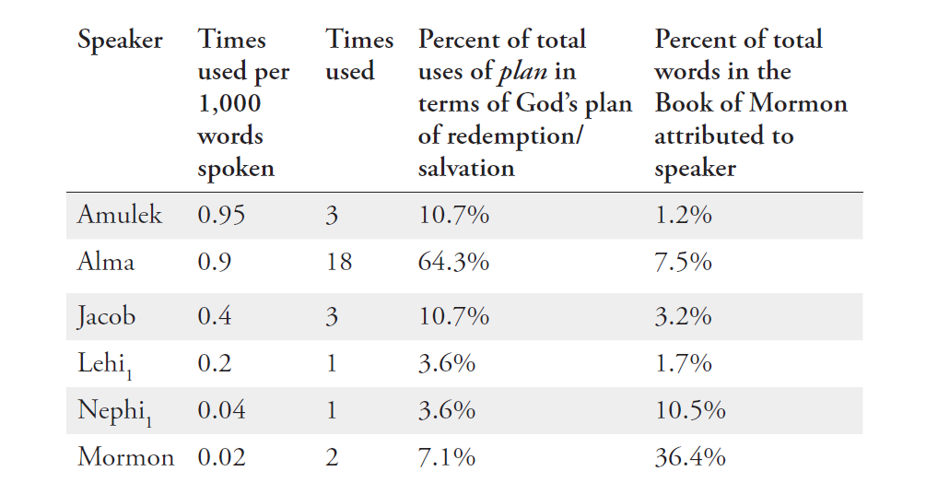

Slide 45
9 titles for God’s plan
1. “The merciful plan of the great Creator” (2 Nephi 9:6, unique to Jacob).
2. “The plan of our God” (2 Nephi 9:13, unique to Jacob).
3. “The great and eternal plan of deliverance from death” (2 Nephi 11:5, unique to Nephi).
4. The “plan of redemption” (first used by Jacob, then used eleven times by Alma, three times by Mormon, and twice by Amulek).
5. “The plan of salvation” (first used by Jarom, then once by Alma and once by King Anti-Nephi-Lehi).
6. “The great plan of the Eternal God” (Alma 34:19, unique to Amulek).
7. “The plan of restoration” (Alma 41:2, unique to Alma).
8. The “plan of happiness” (Alma 42:8, 16, unique to Alma).
9. “The plan of mercy” (Alma 42:15, 31, occurring three times, all in Alma’s voice).

Slide 46
“Plan”
Of the 9 titles for “the plan” in the Book of Mormon, Alma uses 5 of them.
3 of them are unique to Alma
“The plan of redemption” is the most popular title for “the plan” in the Book of Mormon: 17 times total, 11 from Alma

Slide 47

Notes:
https://www.pexels.com/photo/dense-forest-with-thin-trees-18736326/

Slide 48

Notes:
https://www.pexels.com/photo/aerial-photo-of-empty-meandering-road-in-between-forest-2876511/

Slide 49
The Plan of Redemption as a three-act play
Act 1: Premortal life
Act 2: Our life on earth
Act 3: Life after death

Slide 50
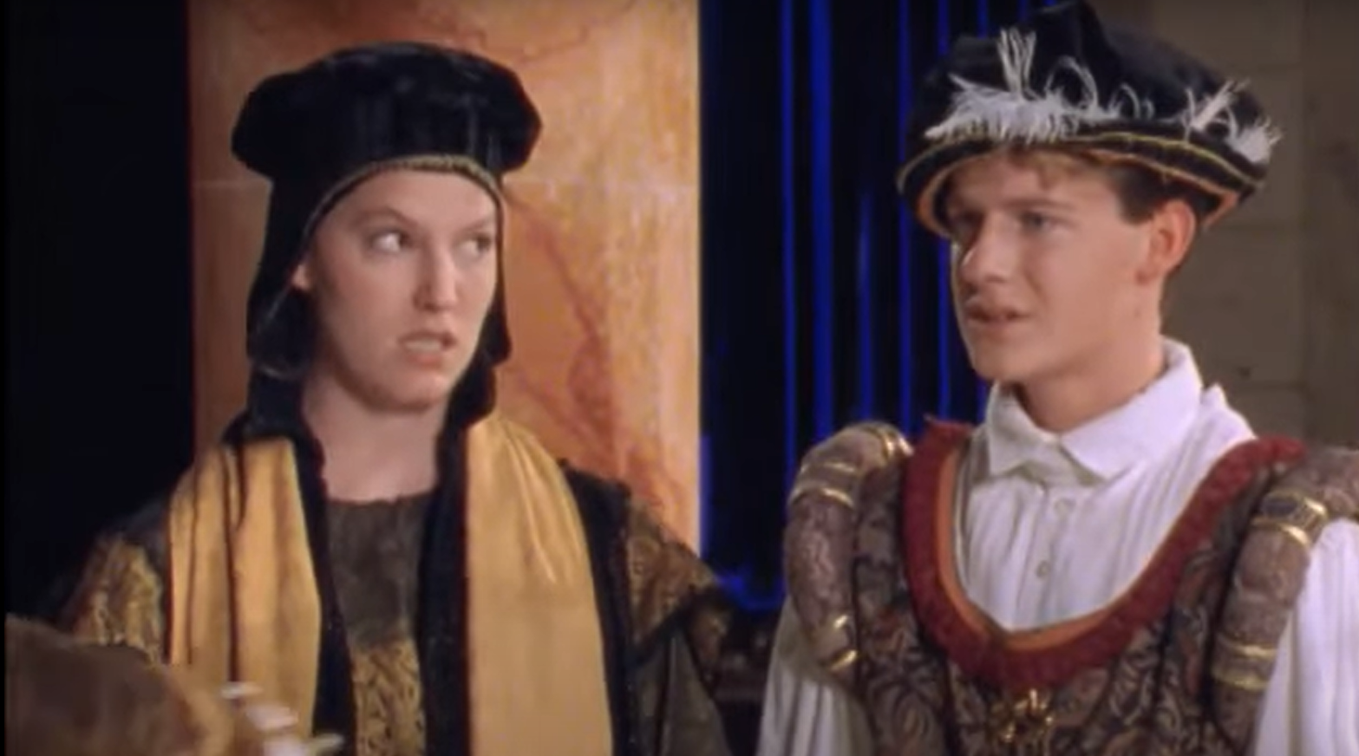
johnhiltoniii.com/thebookofmormon

Slide 51
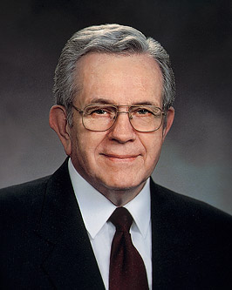
“In mortality, we are like actors who enter a theater just as the curtain goes up on the second act. We have missed act 1. The production has many plots and subplots that interweave, making it difficult to figure out who relates to whom and what relates to what, who are the heroes and who are the villains. It is further complicated because we are not just spectators; we are members of the cast, on stage, in the middle of it all!”
President Boyd K. Packer,
“The Play and the Plan,” 7 May 1995
Notes:
https://www.churchofjesuschrist.org/bc/content/shared/content/images/leaders/boyd-k-packer-large.jpg

Slide 52
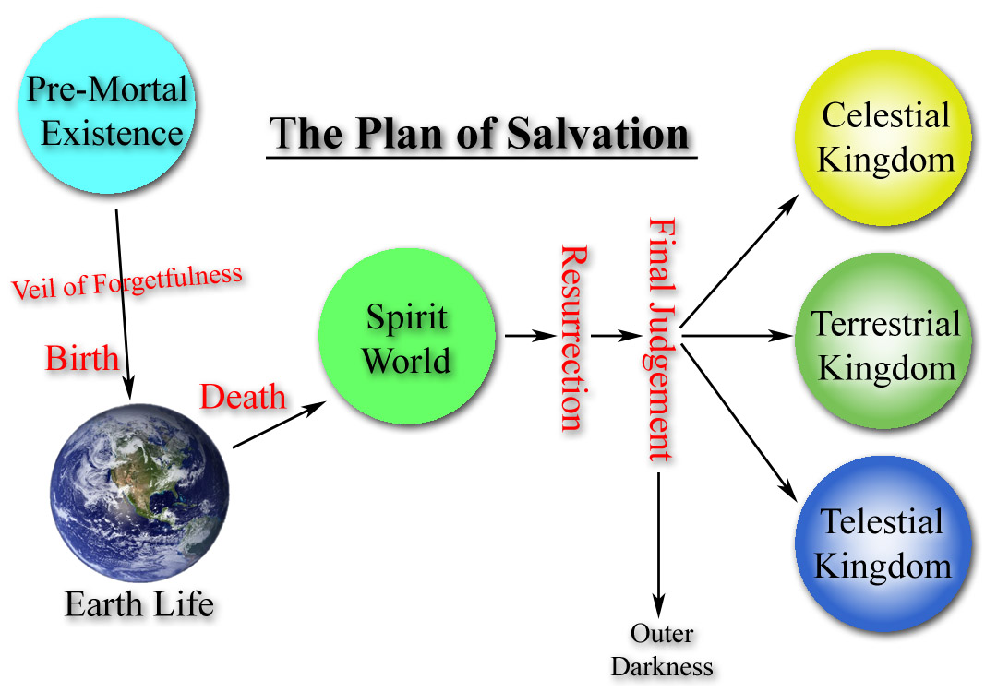
Alma 13:3–5
Alma 12:12–14
Alma 11:42–44
Alma 12:22, 24, 13:12

Slide 53
“Being called and prepared from the foundation of the world according to the foreknowledge of God, on account of their exceeding faith and good works; in the first place being left to choose good or evil; therefore they having chosen good, and exercising exceedingly great faith, are called with a holy calling, yea, with that holy calling which was prepared with, and according to, a preparatory redemption for such. And thus they have been called to this holy calling on account of their faith, while others would reject the Spirit of God on account of the hardness of their hearts and blindness of their minds, while, if it had not been for this they might have had as great privilege…

Slide 54
“Or in fine, in the first place they were on the same standing with their brethren; thus this holy calling being prepared from the foundation of the world for such as would not harden their hearts, being in and through the atonement of the Only Begotten Son.”
Alma 13:3–5

Slide 55
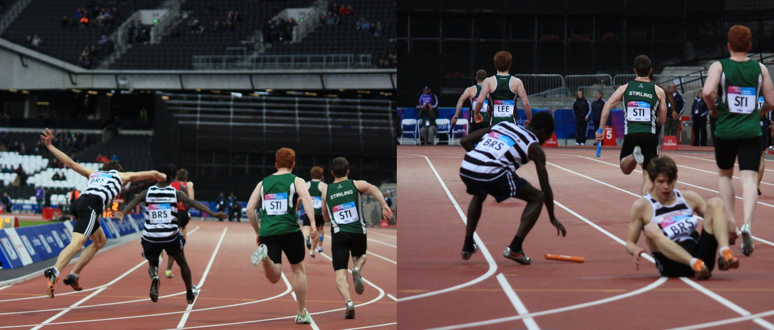
Sum_of_Marc
Notes:
https://www.flickr.com/photos/sumofmarc/7149072697/

Slide 56
“By [Adam’s] fall, all mankind became a lost and fallen people…nevertheless there was a space granted unto man in which he might repent; therefore this life became a probationary state; a time to prepare to meet God; a time to prepare for that endless state…which is after the resurrection of the dead.”
Alma 12:22,24

Slide 57
“Now they, after being sanctified by the Holy Ghost, having their garments made white, being pure and spotless before God, could not look upon sin save it were with abhorrence; and there were many, exceedingly great many, who were made pure and entered into the rest of the Lord their God.”
Alma 13:12

Slide 58
“Now, there is a death which is called a temporal death; and the death of Christ shall loose the bands of this temporal death, that all shall be raised from this temporal death. The spirit and the body shall be reunited again in its perfect form; both limb and joint shall be restored to its proper frame, even as we now are at this time…Now, this restoration shall come to all, both old and young, both bond and free, both male and female, both the wicked and the righteous; and even there shall not so much as a hair of their heads be lost; but every thing shall be restored to its perfect frame” Alma 11:42–44

Slide 59
“[We will be] brought before the bar of God, to be judged according to our works. Then if our hearts have been hardened, yea, if we have hardened our hearts against the word, insomuch that it has not been found in us, then will our state be awful, for then we shall be condemned. For our words will condemn us, yea, all our works will condemn us; we shall not be found spotless; and our thoughts will also condemn us; and in this awful state we shall not dare to look up to our God; and we would fain be glad if we could command the rocks and the mountains to fall upon us to hide us from his presence.”
Alma 12:12–14

Slide 60
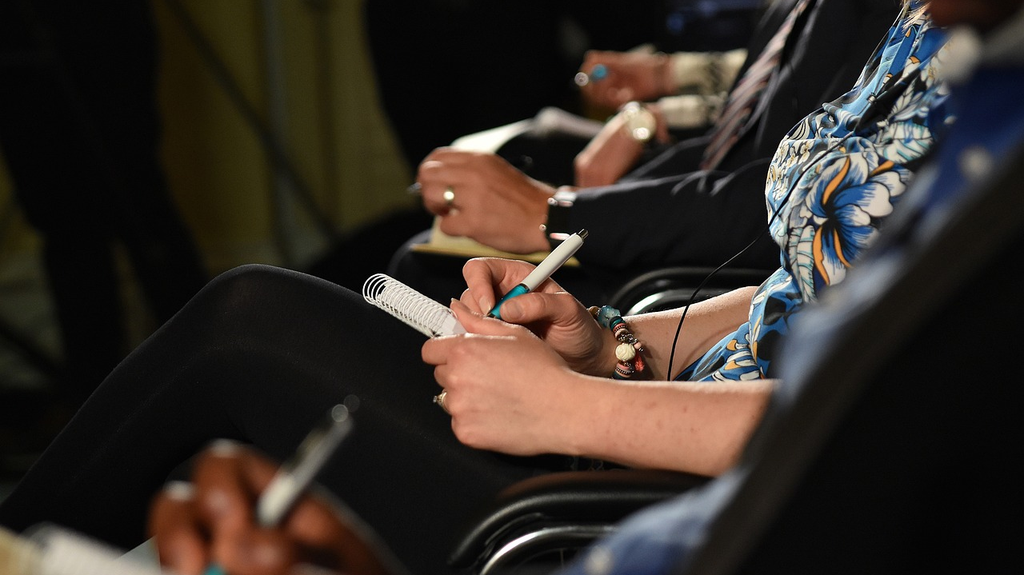
Notes:
https://pixabay.com/photos/taking-notes-training-writing-3475991/

Slide 61
Alma 13:3–5
Alma 12:12–14
Alma 11:42–44
Alma 12:22, 24, 13:12

Slide 62
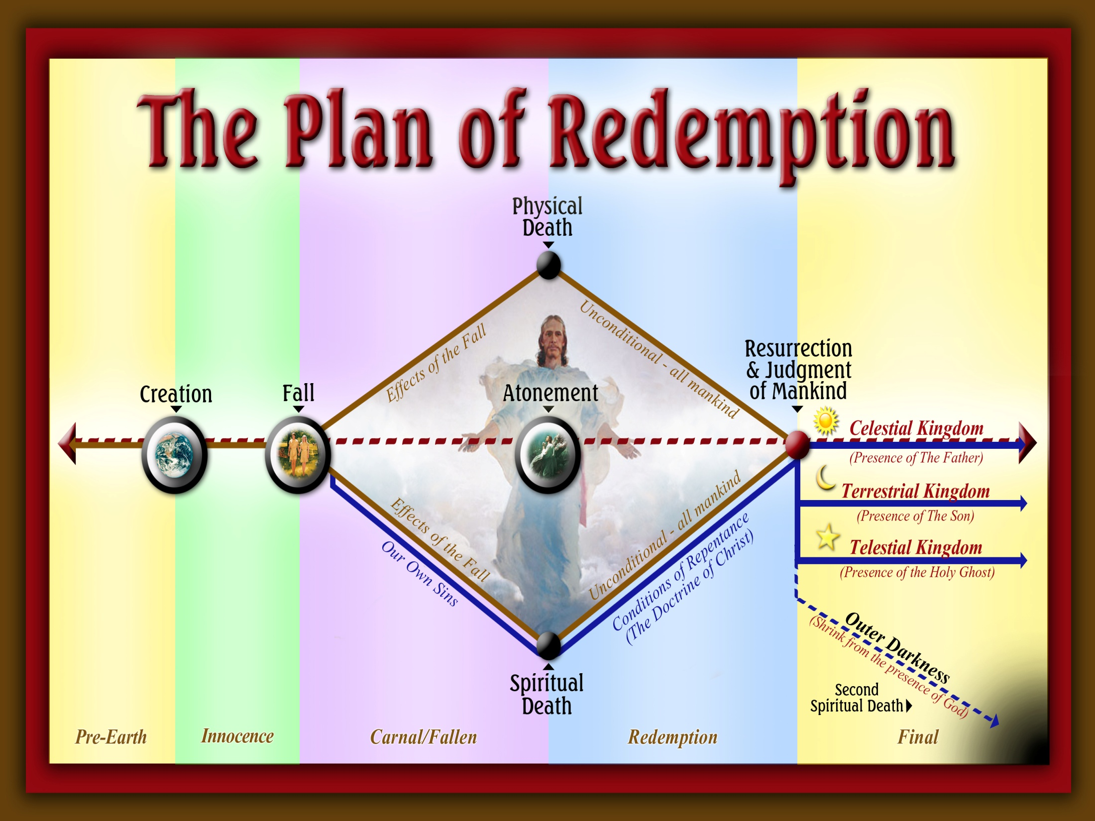
Donald Anderson and Tyler Griffin

Slide 63
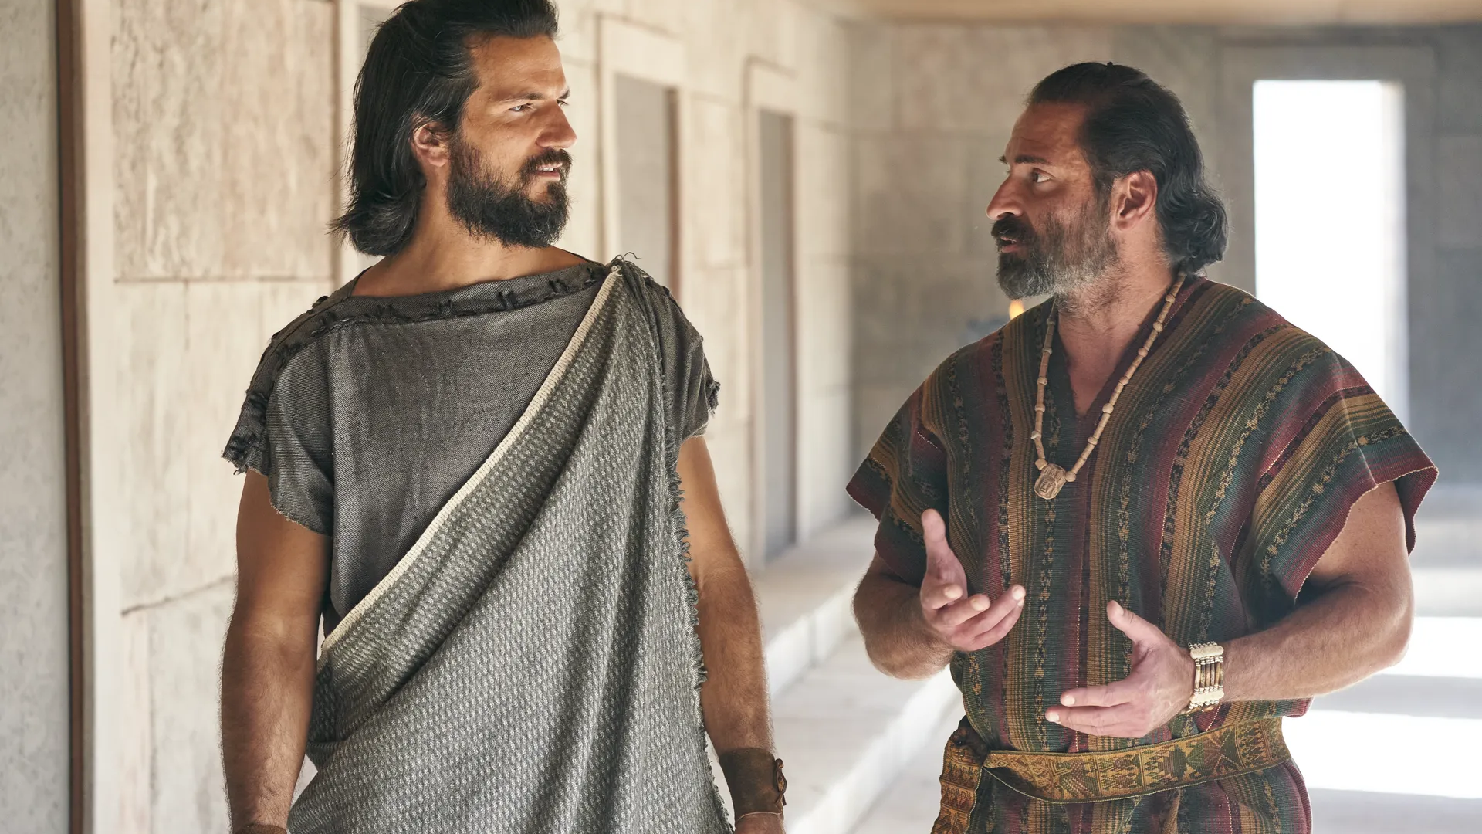
“[Jesus Christ] shall come into the world to redeem his people; and he shall take upon him the transgressions of those who believe on his name; and these are they that shall have eternal life, and salvation cometh to none else.”
Alma 11:40
Notes:
https://churchofjesuschrist.org/imgs/24c4ec06fcb57100127e3ed3207bac67ed4049e2/full/1920%2C/0/default

Slide 64
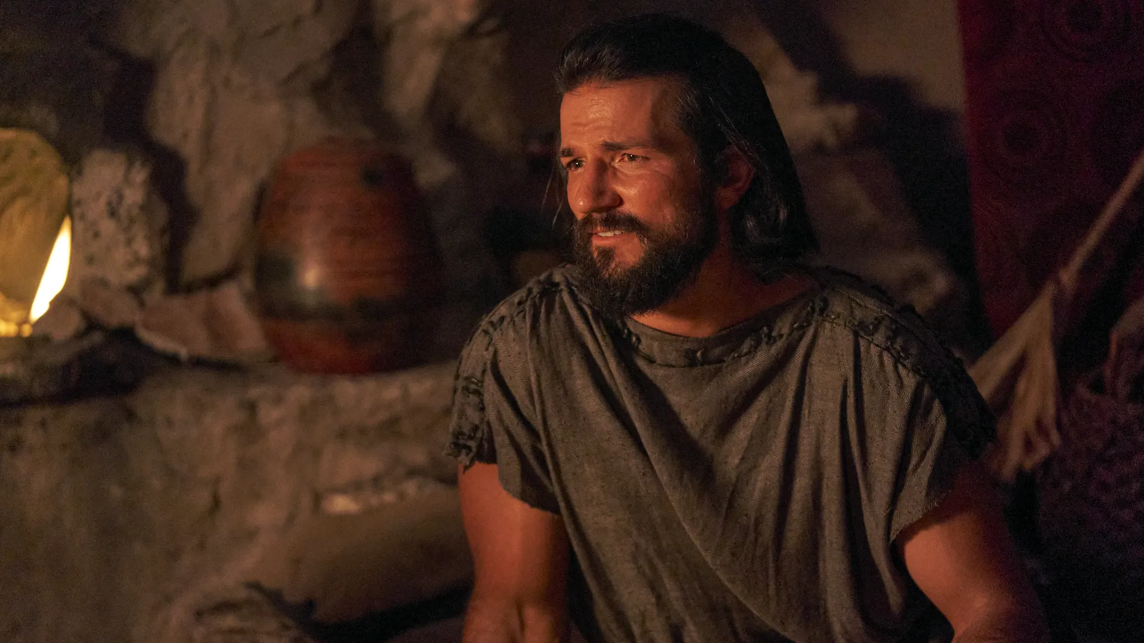
“God did call on [his children], in the name of his Son, (this being the plan of redemption which was laid) saying: If ye will repent, and harden not your hearts, then will I have mercy upon you, through mine Only Begotten Son.”
Alma 12:33
Notes:
https://churchofjesuschrist.org/imgs/e897ee929bbbc99d06f0c43797b300c96096da5d/full/1920%2C/0/default

Slide 65
How has God’s plan helped you in your life?
Donald Anderson and Tyler Griffin

Slide 66
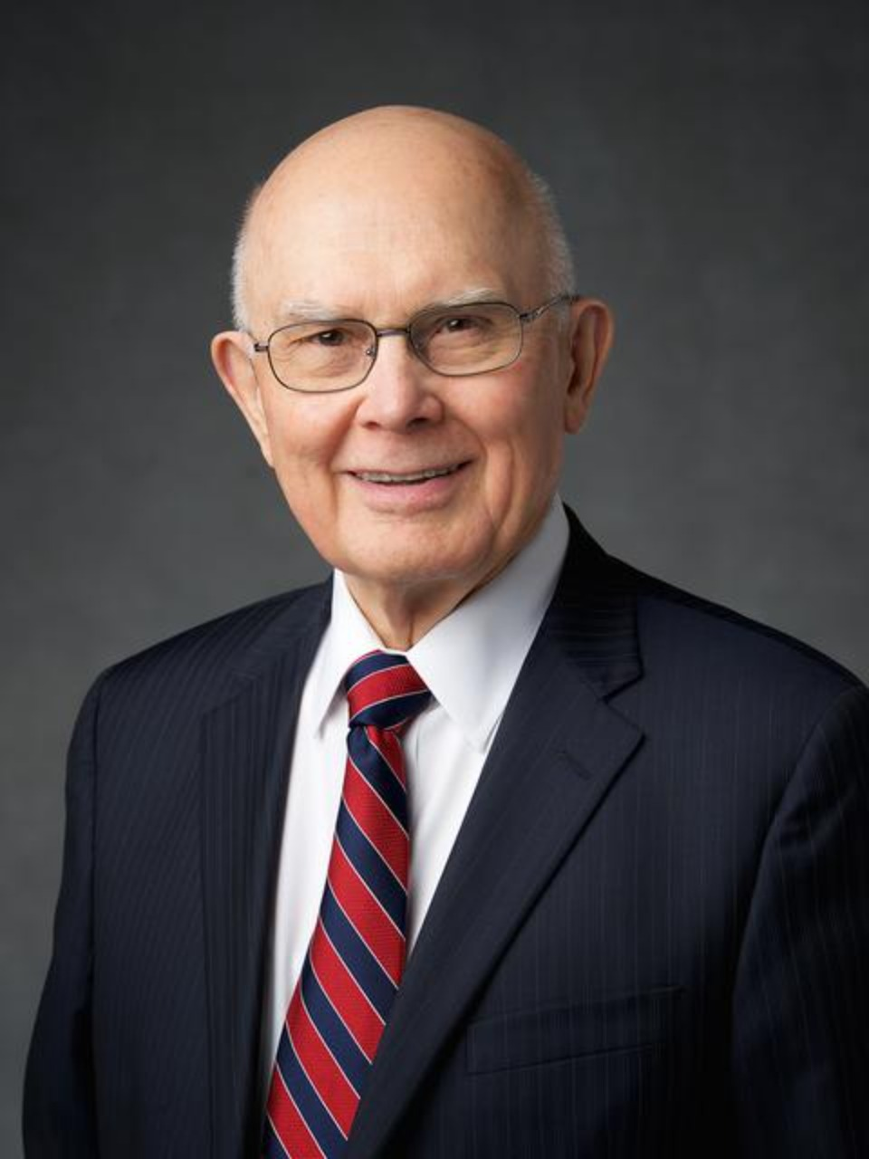
“On many important subjects our assumptions—our starting points or major premises—are different from many…assumptions currently used in the media and in other common discourse. For example, Because of our knowledge of [the plan [of salvation] and other truths that God has revealed, we start with different assumptions than those who do not share our knowledge. As a result, we reach different conclusions on many important subjects that others judge only in terms of their opinions about mortal life.”
President Dallin H. Oaks, “As He Thinketh in His Heart,” 2013 CES Devotional
Notes:
https://news-hk.churchofjesuschrist.org/eng/media/960x1280/oaks-bio-resized-hke1.jpg

Slide 67
“A powerful and influential modern school of thought is “moral relativism,” the idea that there is no absolute right or wrong. Behind that idea is the assumption that there is no God or, if there is a God, that He has given no commandments that apply to us today…
President Dallin H. Oaks, “As He Thinketh in His Heart,” 2013 CES Devotional
Notes:
https://news-hk.churchofjesuschrist.org/eng/media/960x1280/oaks-bio-resized-hke1.jpg

Slide 68
“Latter-day Saints obviously begin with a different premise: there is a God who is the source of eternal law, and He has given commandments that establish a right and a wrong for many choices. Also, in the third act of His eternal plan, we will be held accountable for the extent to which our mortal deeds and desires have been in harmony with those commandments.”
President Dallin H. Oaks, “As He Thinketh in His Heart,” 2013 CES Devotional
Notes:
https://news-hk.churchofjesuschrist.org/eng/media/960x1280/oaks-bio-resized-hke1.jpg

Slide 69
How could the Plan of Redemption Help?
“Why do good people who live the gospel also face adversity and trials in their lives?”

Slide 70
How could the Plan of Redemption Help?
“Why do good people who live the gospel also face adversity and trials in their lives?”
“I feel like it’s inconvenient to wear the temple garment, why is it so important?”

Slide 71
How could the Plan of Redemption Help?
“Why do good people who live the gospel also face adversity and trials in their lives?”
“I feel like it’s inconvenient to wear the temple garment, why is it so important?”
“The church has a lot of money, and I’m broke. So why should I pay tithing?”

Slide 72
How could the Plan of Redemption Help?
“Why do good people who live the gospel also face adversity and trials in their lives?”
“I feel like it’s inconvenient to wear the temple garment, why is it so important?”
“The church has a lot of money, and I’m broke. So why should I pay tithing?”
“My girlfriend and I love each other. Why should we live God’s law of chastity?

Slide 73
How could the Plan of Redemption Help?
“Why do good people who live the gospel also face adversity and trials in their lives?”
“I feel like it’s inconvenient to wear the temple garment, why is it so important?”
“The church has a lot of money, and I’m broke. So why should I pay tithing?”
“My girlfriend and I love each other. Why should we live God’s law of chastity?
“Why does the Church take positions on controversial issues like abortion?”

Slide 74


For free resources related to this video, please visit https://johnhiltoniii.com/TheBookofMormon
Join our course discussions on social media
@johnhiltoniii

Slide 75
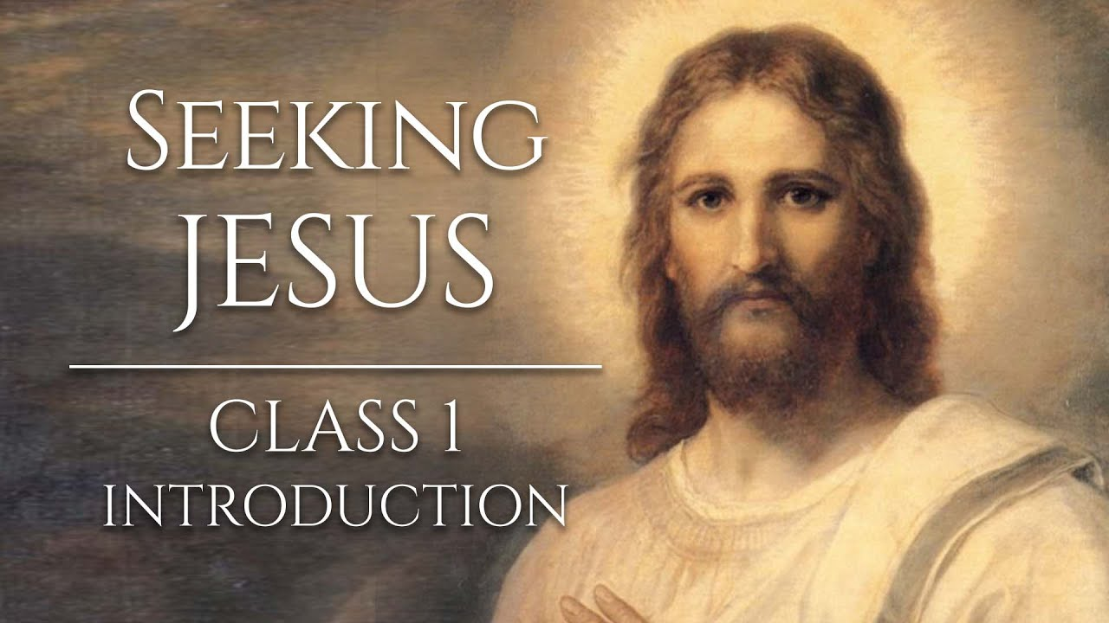
https://johnhiltoniii.com/SeekingJesus
You may also be interested in this
free video course…

Slide 76
This video is not produced or endorsed by Brigham Young University or the Church of Jesus Christ of Latter-day Saints.
John Hilton III is solely responsible for its contents
Insights from, discussions with, and resources authored by
by Anthony Sweat, Charles Swift and John W. Welch were used in the creation of this video. See further acknowledgements at https://johnhiltoniii.com/thebookofmormon

Slide 77
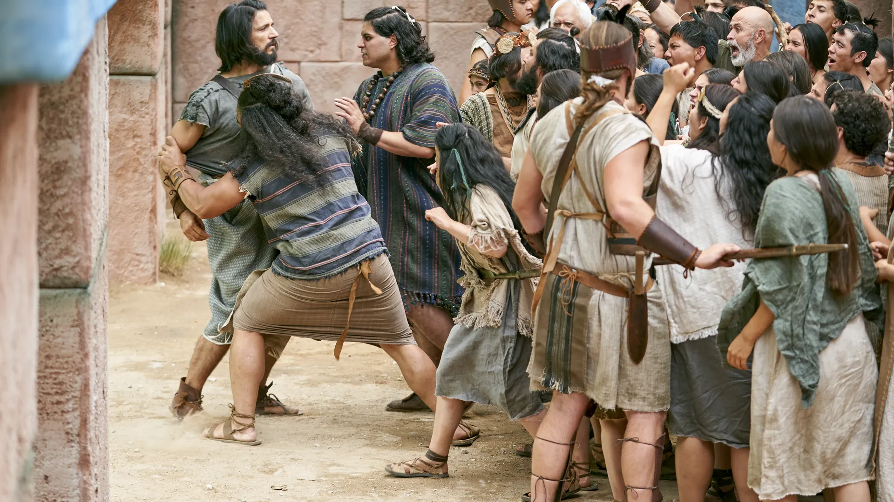
Notes:
https://churchofjesuschrist.org/imgs/d6526d0a2f16e180f584f10f40a86afbe24878f9/full/1920%2C/0/default

Slide 78
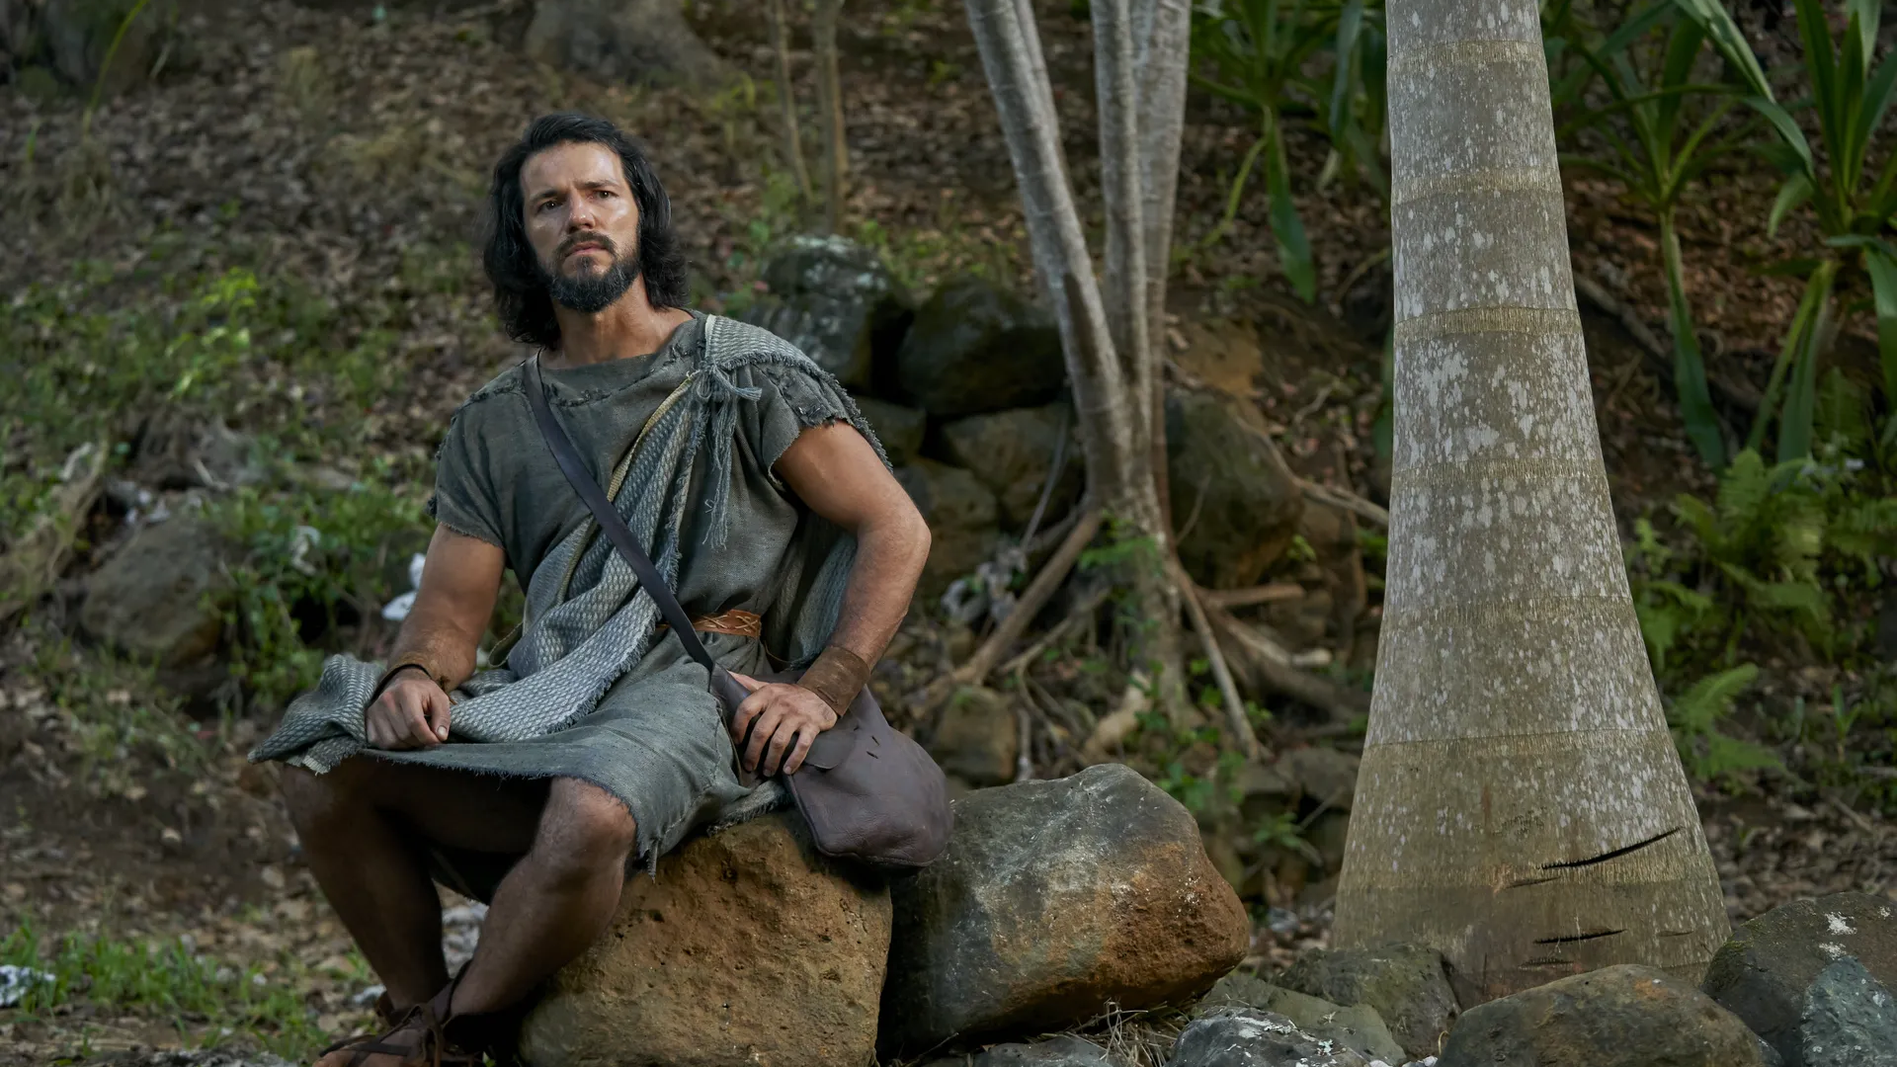
Notes:
https://churchofjesuschrist.org/imgs/f03d643de24c4e8c598b159a326a63fa271ea1b8/full/1920%2C/0/default

Slide 79
Notes:
https://churchofjesuschrist.org/imgs/24c4ec06fcb57100127e3ed3207bac67ed4049e2/full/1920%2C/0/default

Slide 80
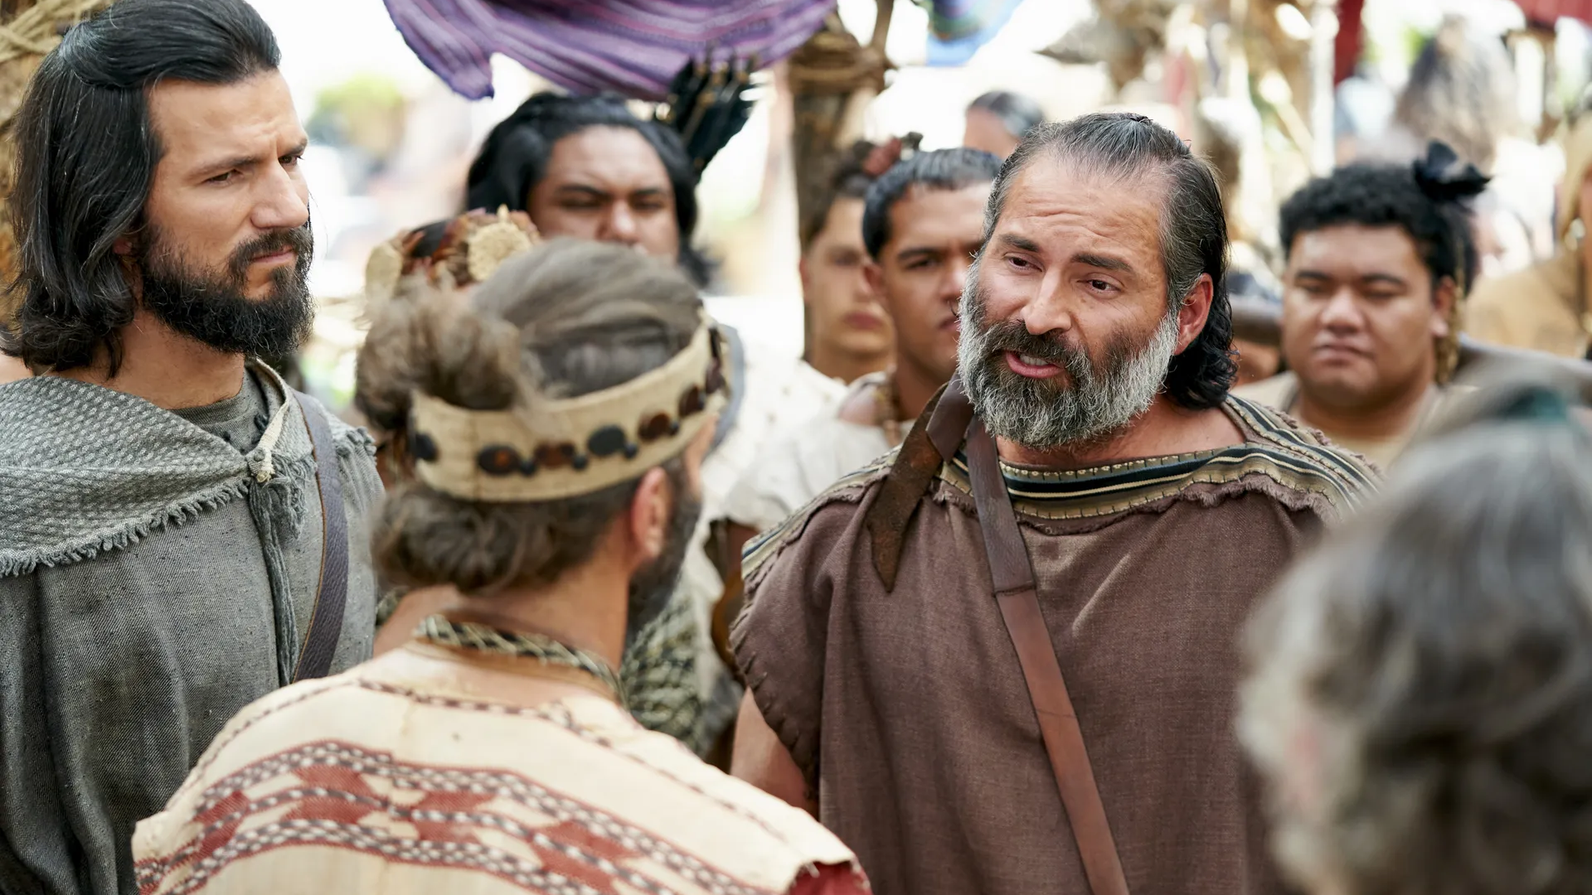
Notes:
https://churchofjesuschrist.org/imgs/43423bbdfe45696f10919fa849f108cf3c3f28ff/full/1920%2C/0/default

Slide 81
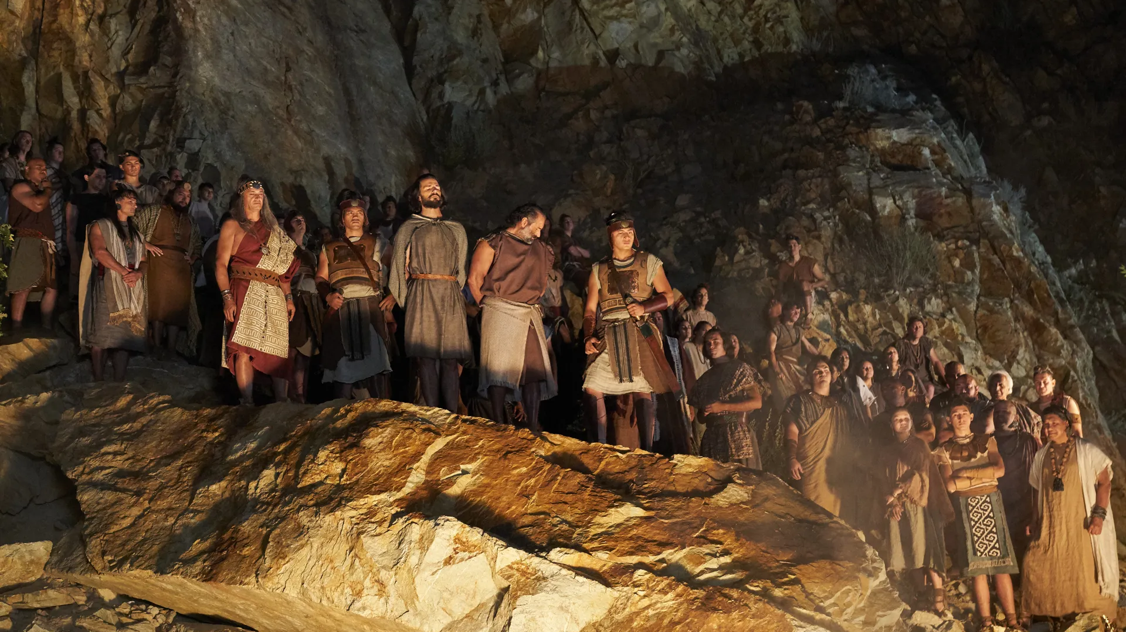
Notes:
https://churchofjesuschrist.org/imgs/3bd4c1739ab34893244e91ff21e886d7f8f0b125/full/1920%2C/0/default

Slide 82
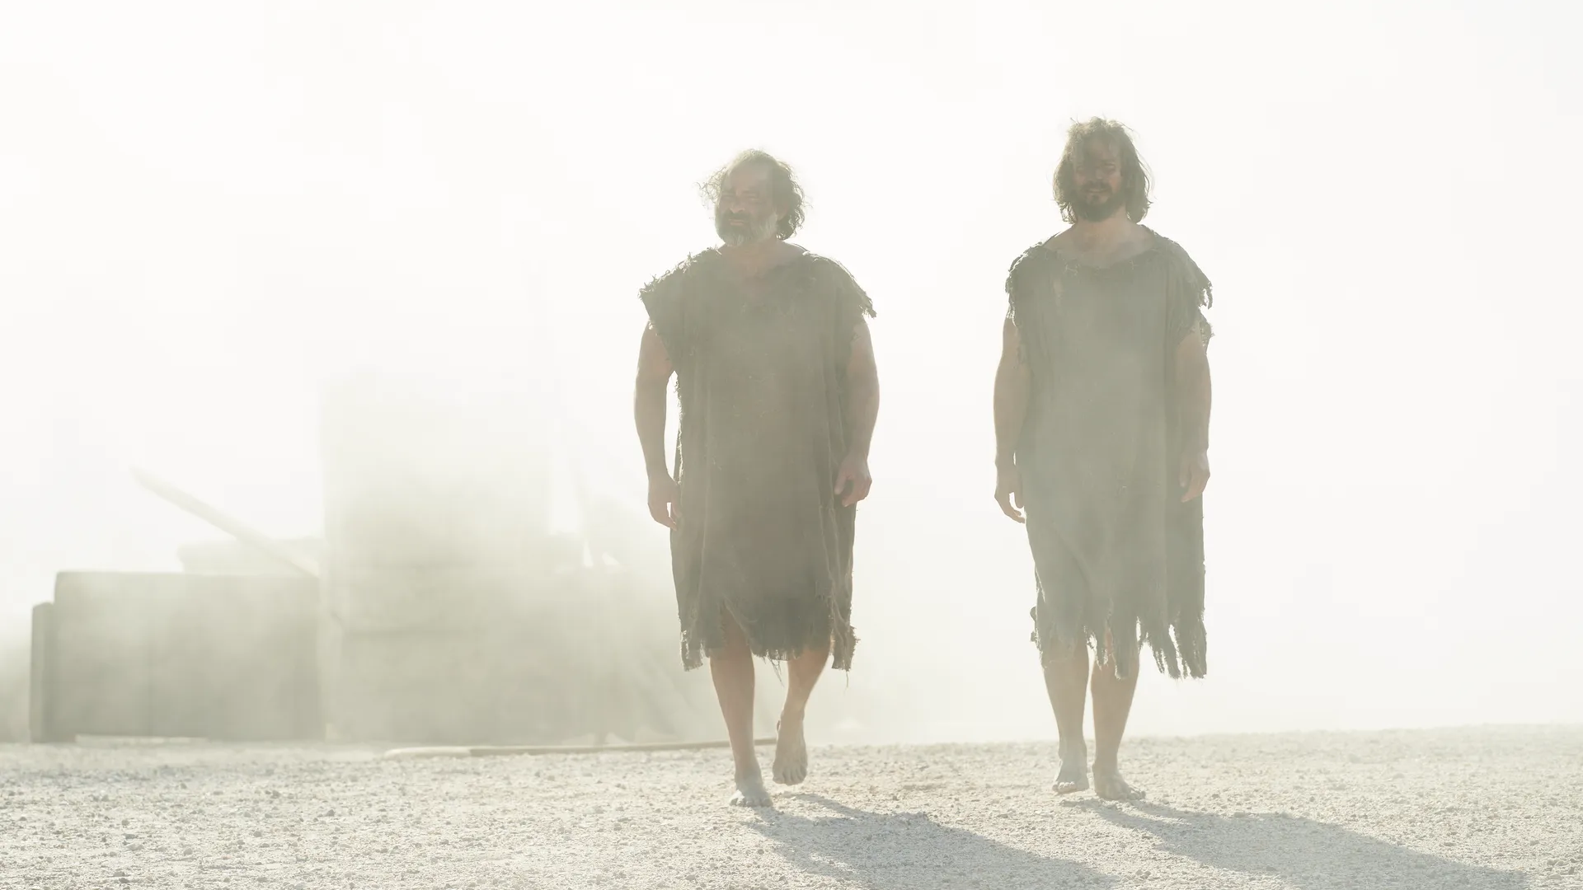
Notes:
https://churchofjesuschrist.org/imgs/ac116c0a357480ffedb2b45a97e17d2880822955/full/1920%2C/0/default

