Slide 1





Pick any one of these five cards
Don’t forget it!

Slide 2
And now, I will make your card disappear.
Concentrate on your card…

Slide 3





Your card has vanished!

Slide 4
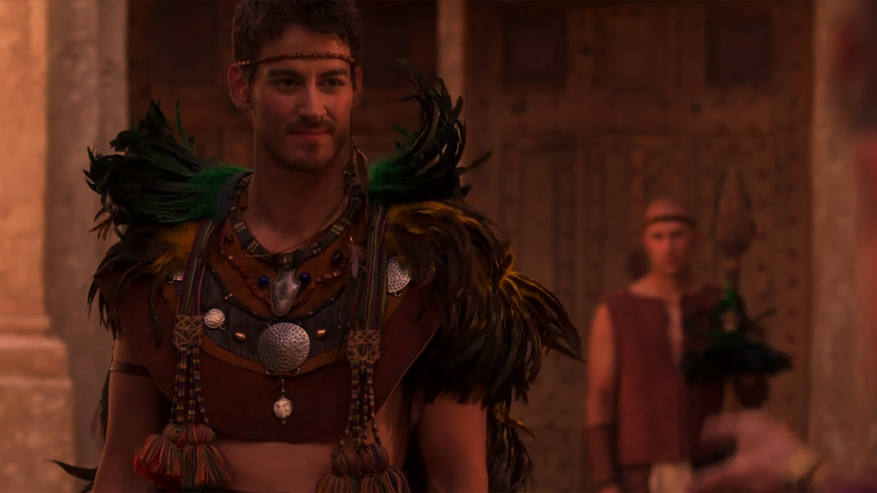

Notes:
https://en.wikipedia.org/wiki/File:Dun_dun_duuun!.ogg

Slide 5
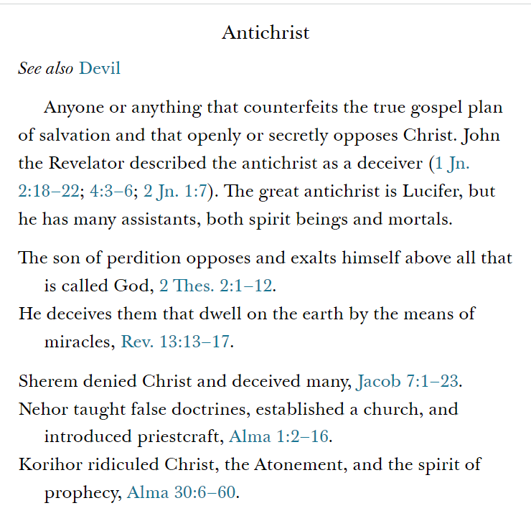
Notes:
More space is given to Korihor than there is to Nehor and Sherem combined. Korihor speaks more words than another of the other “bad boys” in the Book of Mormon, and he speaks more words than Alma the Elder. Mormon clearly wants us to learn from Korihor.
Guide to Scrip

Slide 6
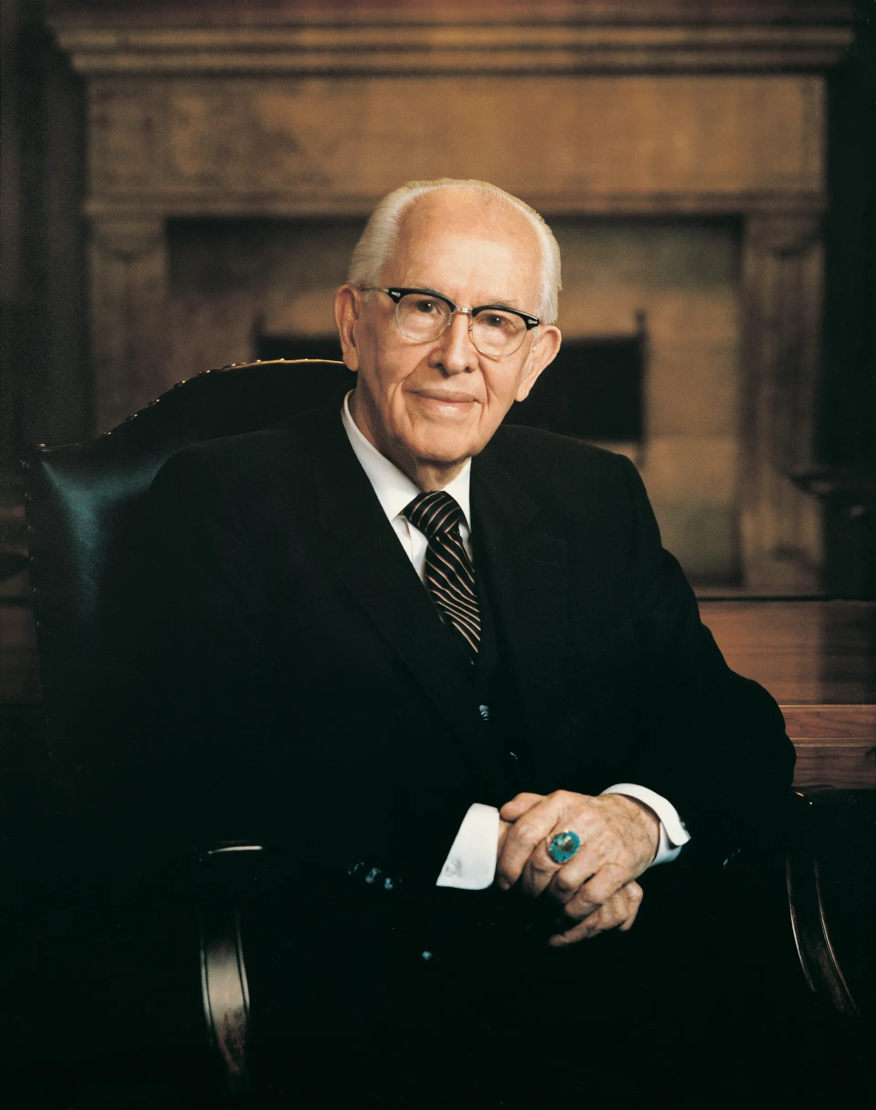
“The Book of Mormon exposes the enemies of Christ. It confounds false doctrines and lays down contention. It fortifies the humble followers of Christ against the evil designs, strategies, and doctrines of the devil in our day.
Notes:
https://www.churchofjesuschrist.org/imgs/a8a0daf57c187fb40437de5c14cbc3859e59b3b5/full/1920%2C/0/default

Slide 7
“The type of apostates in the Book of Mormon are similar to the type we have today. God, with his infinite foreknowledge, so molded the Book of Mormon that we might see the error and know how to combat false educational, political, religious, and philosophical concepts of our time.”
President Benson, Ensign,
Jan. 1988, 3.
Notes:
https://www.churchofjesuschrist.org/imgs/a8a0daf57c187fb40437de5c14cbc3859e59b3b5/full/1920%2C/0/default

Slide 8
“The articles of faithlessness”

Slide 9
“He began to preach unto the people against…the coming of Christ.” Alma 30:6
“[Korihor] began to preach unto the people that there should be no Christ.” Alma 30:12
“Why do ye look for a Christ?” Alma 30:13

Slide 10
“He began to preach unto the people against…the coming of Christ.” Alma 30:6
“[Korihor] began to preach unto the people that there should be no Christ.” Alma 30:12
“Why do ye look for a Christ?” Alma 30:13
“Ye cannot know that there shall be a Christ.” Alma 30:15

Slide 11
“He began to preach unto the people against…the coming of Christ.” Alma 30:6
“[Korihor] began to preach unto the people that there should be no Christ.” Alma 30:12
“Why do ye look for a Christ?” Alma 30:13
“Ye cannot know that there shall be a Christ.” Alma 30:15
“Ye…say that Christ shall come. I say that ye do not know that there shall be a Christ.” Alma 30:26

Slide 12
“He began to preach unto the people against…the coming of Christ.” Alma 30:6
“[Korihor] began to preach unto the people that there should be no Christ.” Alma 30:12
“Why do ye look for a Christ?” Alma 30:13
“Ye cannot know that there shall be a Christ.” Alma 30:15
“Ye…say that Christ shall come. I say that ye do not know that there shall be a Christ.” Alma 30:26
“I do not believe that there is a God.” Alma 30:48

Slide 13
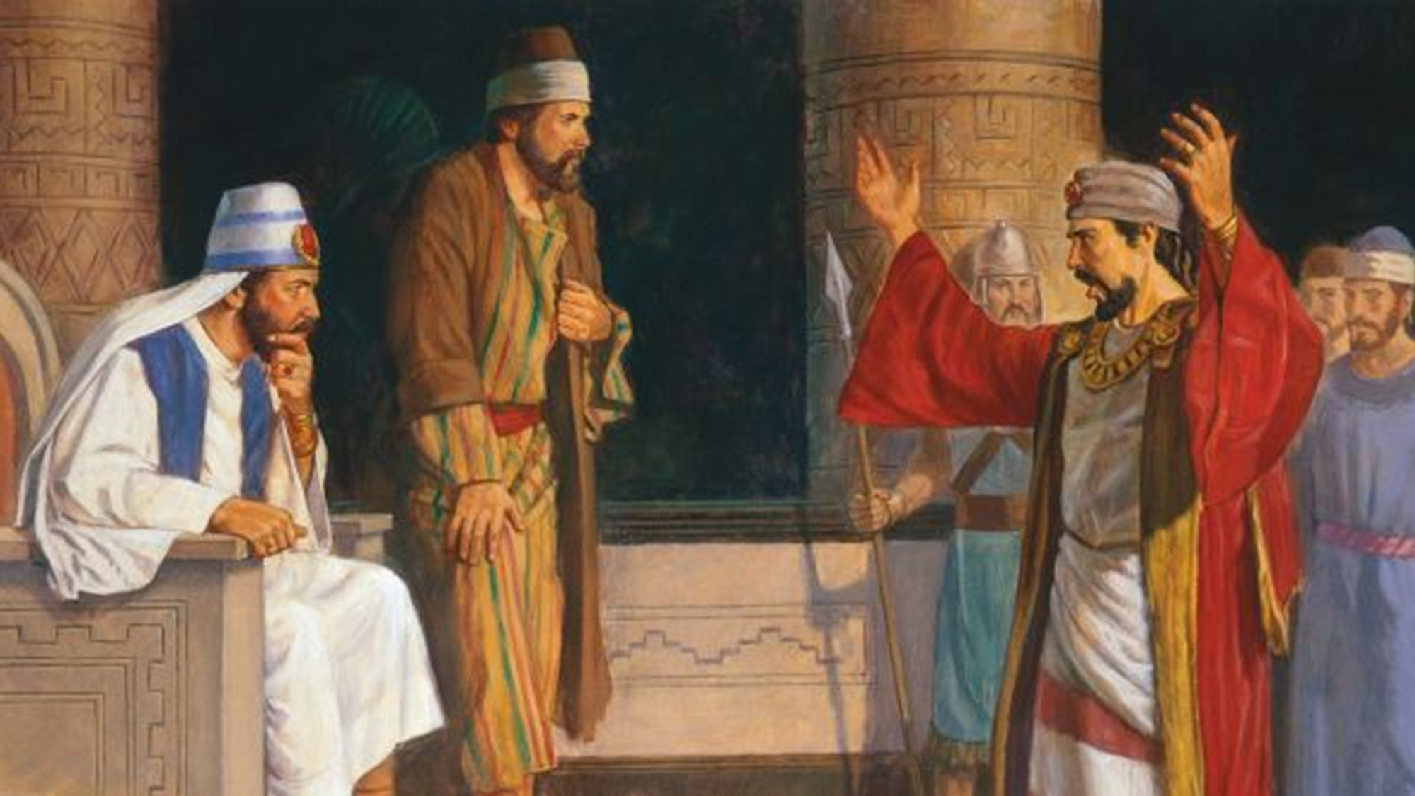
“Why do ye teach this people that there shall be no Christ, to interrupt their rejoicings?”
Alma 30:22
Robert Barrett
Notes:
https://bookofmormonartcatalog.org/catalog/korihor-confronts-alma/

Slide 14
“My soul will rejoice in…my God” (2 Nephi 4:30)
“I will rejoice in my God” (Alma 26:11)
“Rejoice in Jesus Christ” (Alma 37:9)

Slide 15
“Why do ye teach this people that there shall be no Christ, to interrupt their rejoicings?”
Alma 30:22
Robert Barrett
Notes:
https://bookofmormonartcatalog.org/catalog/korihor-confronts-alma/

Slide 16
Am I doing anything in my life that is interrupting my ability to rejoice in Jesus Christ?

Slide 17
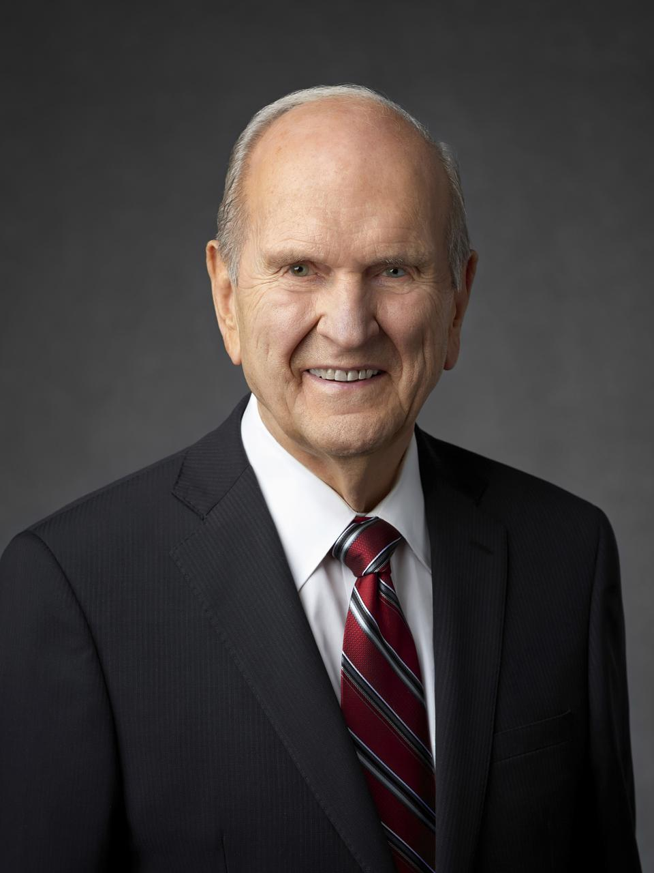
“Anything that opposes Christ or His doctrine will interrupt our joy…The world teaches that the purchase of things will bring joy. And if that doesn't work, buy more! It teaches that you can sin your way to joy. And if that doesn't work, sin more! It promises a pot of joy at the end of every hedonistic rainbow. But these philosophies are simply not true.
Notes:
https://newsroom.churchofjesuschrist.org/media/960x1280/President-Russell-M-Nelson-1-2018.jpg

Slide 18
“The unrighteous may experience any number of emotions and sensations, but they will never experience joy!...Joy is the gift that comes from intentionally trying to live a righteous life, as taught by Jesus Christ.”
President Nelson,
Heart of the Matter, 24
Notes:
https://newsroom.churchofjesuschrist.org/media/960x1280/President-Russell-M-Nelson-1-2018.jpg

Slide 19
“He began to preach unto the people against the prophecies which had been spoken by the prophets.” Alma 30:6
“These things which ye call prophecies, which ye say are handed down by holy prophets, behold, they are foolish traditions of your fathers.” Alma 30:15
“Ye say that those ancient prophecies are true. Behold, I say that ye do not know that they are true.” Alma 30:24

Slide 20
“He began to preach unto the people against the prophecies which had been spoken by the prophets.” Alma 30:6
“These things which ye call prophecies, which ye say are handed down by holy prophets, behold, they are foolish traditions of your fathers.” Alma 30:15
“Ye say that those ancient prophecies are true. Behold, I say that ye do not know that they are true.” Alma 30:24

Slide 21
“He began to preach unto the people against the prophecies which had been spoken by the prophets.” Alma 30:6
“These things which ye call prophecies, which ye say are handed down by holy prophets, behold, they are foolish traditions of your fathers.” Alma 30:15
“Ye say that those ancient prophecies are true. Behold, I say that ye do not know that they are true.” Alma 30:24

Slide 22
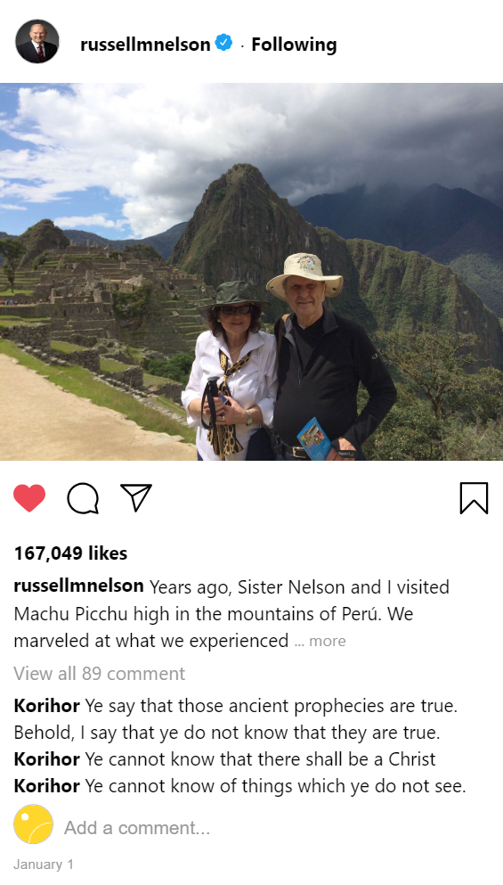
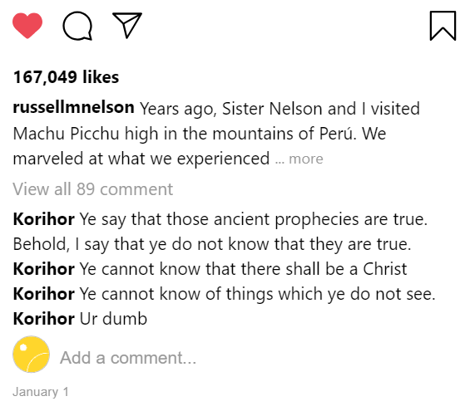

Slide 23
“Ancient priests…usurp power and authority over them, to keep them in ignorance.” Alma 30:23

Slide 24
“Ancient priests…usurp power and authority over them, to keep them in ignorance.” Alma 30:23
“Their priests…yoke them according to their desires, and have brought them to believe…that they should, if they did not do according to their words, offend some unknown being.” Alma 30:28

Slide 25
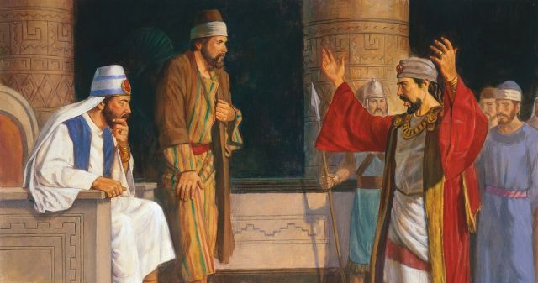
“Glutting on the labors of the people”
Alma 30:31
Robert Barrett
Notes:
https://bookofmormonartcatalog.org/catalog/korihor-confronts-alma/

Slide 26
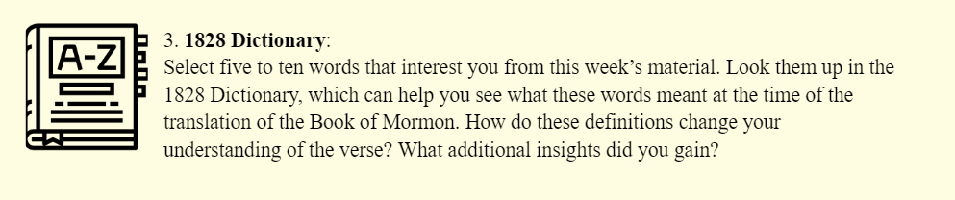
Glut: “To swallow greedily”

Slide 27
“Thou knowest that we do not glut ourselves upon the labors of this people; for behold I have labored even from the commencement of the reign of the judges until now, with mine own hands for my support.”
Alma 30:32
Robert Barrett
Notes:
https://bookofmormonartcatalog.org/catalog/korihor-confronts-alma/

Slide 28
“No [one] can know of anything which is to come.” (Alma 30:13)

Slide 29
“No [one] can know of anything which is to come.” (Alma 30:13)
“Ye cannot know of things which ye do not see.” (Alma 30:15)

Slide 30
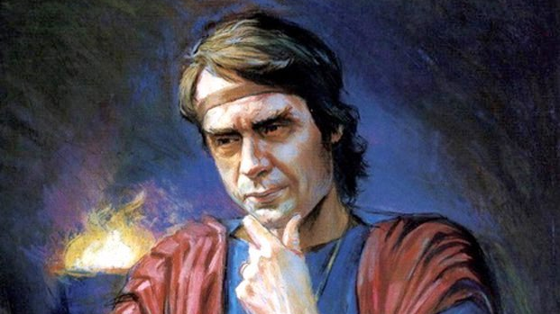
“It is the effect of a frenzied mind; and this derangement of your minds comes because of the traditions of your fathers, which lead you away into a belief of things which are not so.” Alma 30:16
Scott Snow
Notes:
https://bookofmormonartcatalog.org/catalog/korihor-2/

Slide 31
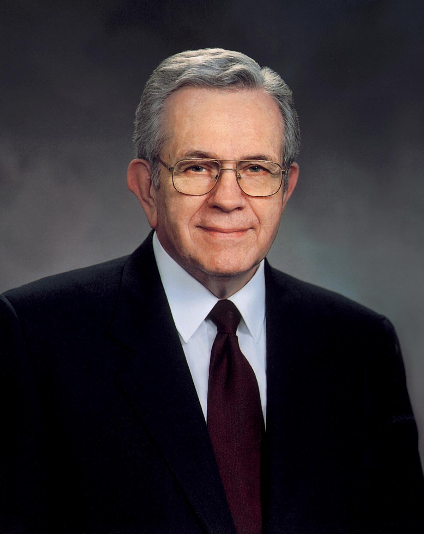
“If all you know is what you see with your natural eyes and hear with your natural ears, then you will not know very much.”
Elder Boyd K. Packer,
Mine Errand from the Lord, 339
Notes:
https://media.bizj.us/view/img/11662166/former-prestanner-byuh*750xx2563-3417-0-0.jpg

Slide 32
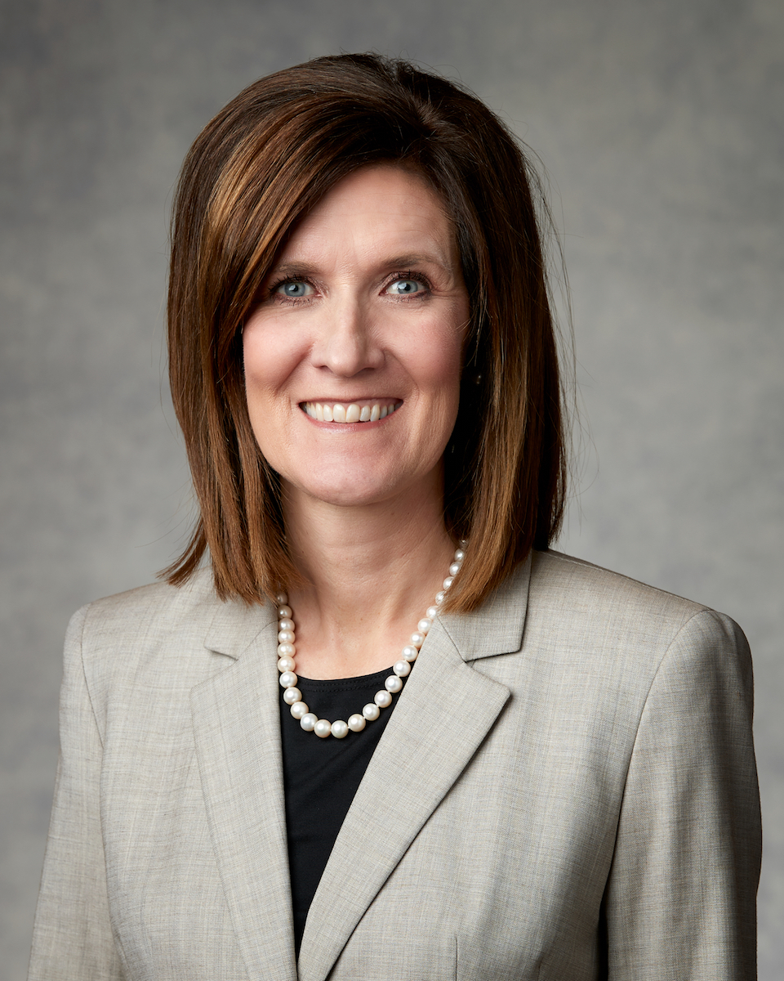
“[I was surprised when I received this impression:] ‘Stop looking at your phone when you are waiting in lines.’ Looking at my phone in lines had become almost automatic; I found it a good time to multitask, catch up on email, look at headlines, or scroll through a social media feed.
President Michelle D. Craig,
Ensign, November 2020
Notes:
https://media.bizj.us/view/img/11662166/former-prestanner-byuh*750xx2563-3417-0-0.jpg

Slide 33
“The next morning, I found myself waiting in a long line at the store. I pulled out my phone and then remembered the impression I had received. I put my phone away and looked around. I saw an elderly gentleman in line ahead of me. His cart was empty except for a few cans of cat food. I felt a little awkward but said something really clever like, “I can see you have a cat.”
President Michelle D. Craig,
Ensign, November 2020
Notes:
https://media.bizj.us/view/img/11662166/former-prestanner-byuh*750xx2563-3417-0-0.jpg

Slide 34
“He said that a storm was coming, and he did not want to be caught without cat food. We visited briefly, and then he turned to me and said, “You know, I haven’t told anyone this, but today is my birthday.” My heart melted. I wished him a happy birthday and offered a silent prayer of thanks that I had not been on my phone and missed an opportunity to truly see and connect with another person who needed it.”
President Michelle D. Craig,
Ensign, November 2020
Notes:
https://media.bizj.us/view/img/11662166/former-prestanner-byuh*750xx2563-3417-0-0.jpg

Slide 35
“Whatsoever a man did was no crime.” Alma 30:17
Notes:
https://www.flickr.com/photos/slgc/40964853051/in/photostream/

Slide 36
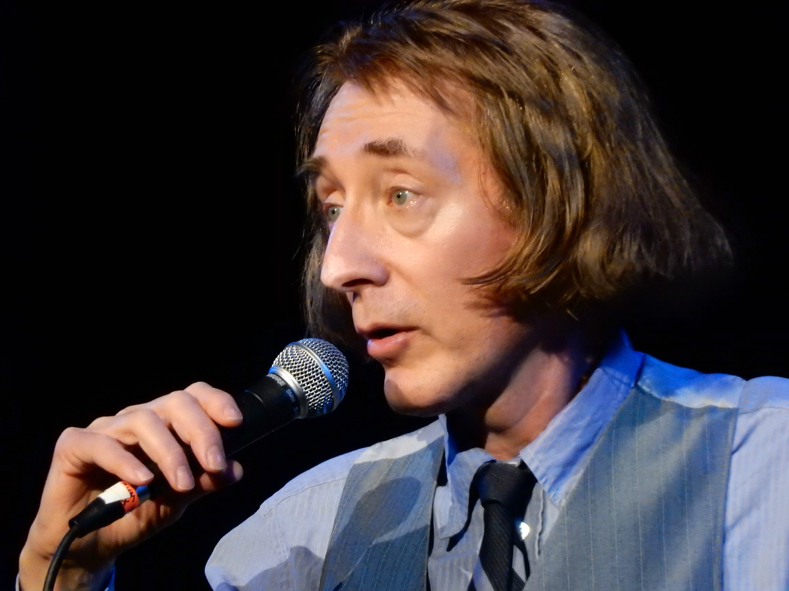
“Whatsoever a man did was no crime.” Alma 30:17
“When I was a kid I used to pray every night for a new bicycle. Then I realized that the Lord doesn't work that way, so I stole one and asked Him to forgive me.”
Emo Philips
Photo by slgckgc
Notes:
https://www.flickr.com/photos/slgc/40964853051/in/photostream/

Slide 37
“When a [person] was dead, that was the end thereof.”
Alma 30:18
Notes:
https://www.flickr.com/photos/my_public_domain_photos/35658481586

Slide 38
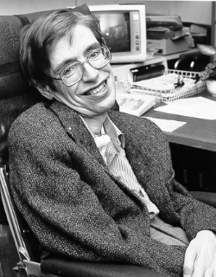
“When a [person] was dead, that was the end thereof.”
Alma 30:18
“I regard the brain as a computer which will stop working when its components fail. There is no heaven or afterlife for broken down computers; that is a fairy story for people afraid of the dark.”
Stephen Hawking
Notes:
https://www.flickr.com/photos/my_public_domain_photos/35658481586

Slide 39
“I do not teach this people to bind themselves down under…ordinances.”
Alma 30:23
Robert Barrett
Notes:
When we understand the WHY for what we do, we realize that covenants are blessings, not a restriction.
https://bookofmormonartcatalog.org/catalog/korihor-confronts-alma/

Slide 40
“Your garment is symbolic of the veil [of the temple]; the veil is symbolic of the Lord Jesus Christ. So when you put on your garment, you may feel that you are truly putting upon yourself the very sacred symbol of the Lord Jesus Christ—His life, His ministry and His mission, which was to atone for every daughter and son of God.”
President Nelson, “Enter into Thy Closet,” Seminar for new mission leaders,
June 2022
Notes:
Our covenants—and the temple garment don’t bind us down, they lift us up.
https://newsroom.churchofjesuschrist.org/media/960x1280/President-Russell-M-Nelson-1-2018.jpg

Slide 41
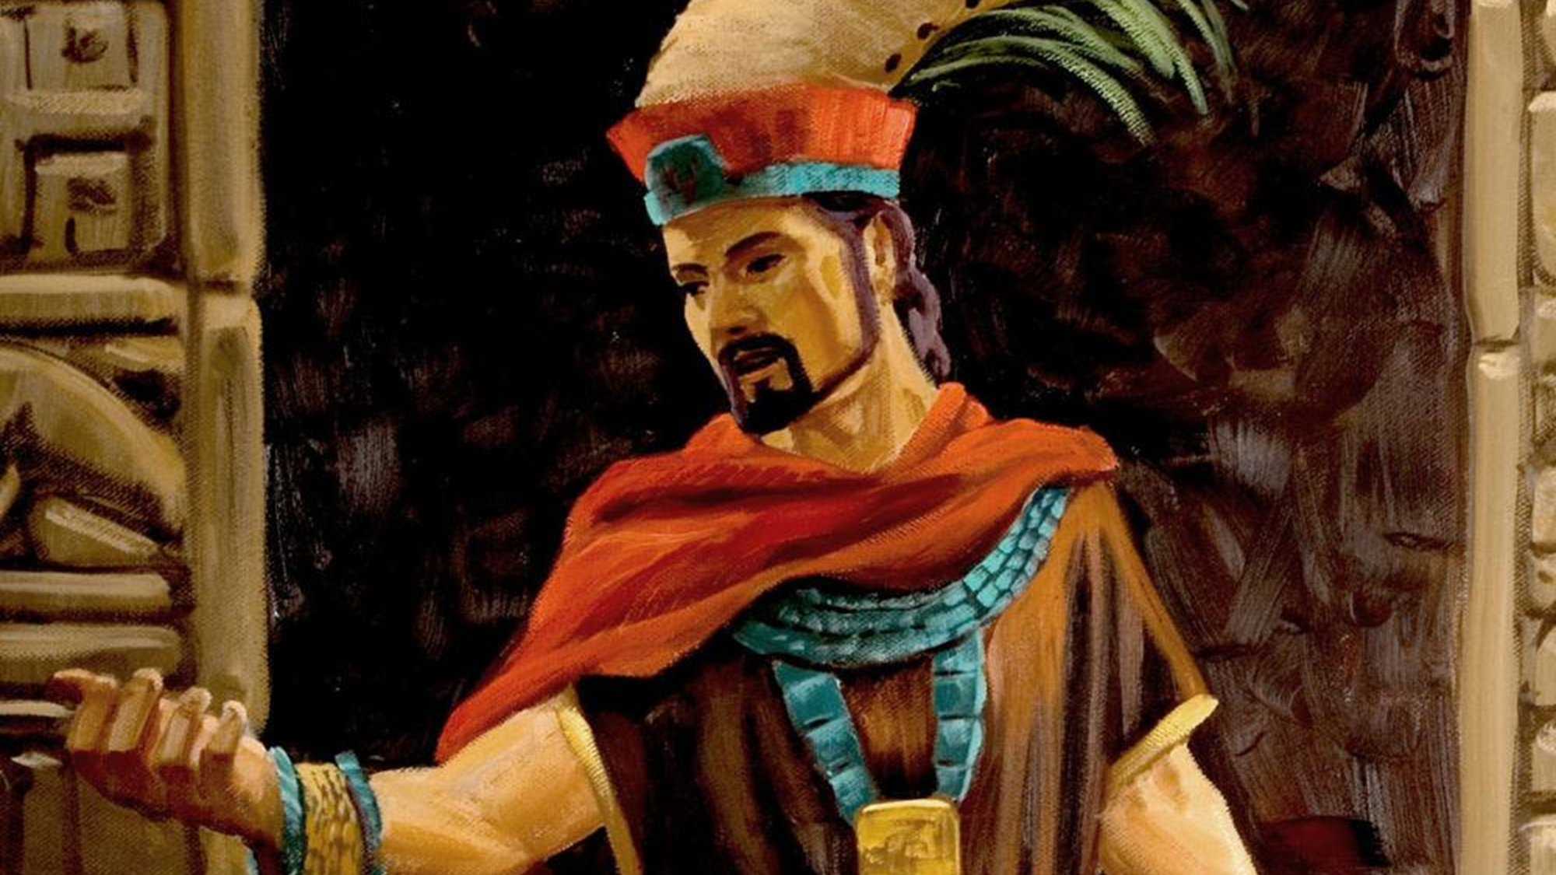
“Ye say that this people is a guilty and a fallen people, because of the transgression of a parent. Behold, I say that a child is not guilty because of its parents.”
Alma 30:25
James Fullmer
Notes:
https://bookofmormonartcatalog.org/catalog/korihor/

Slide 42
“Ye that are bound down under a foolish and a vain hope, why do ye yoke yourselves with such foolish things?” Alma 30:13
“Foolish traditions of your fathers.” Alma 30:15
“I do not teach the foolish traditions of your fathers.” Alma 30:23
“I do not teach this people to bind themselves down under…foolish ordinances.” Alma 30:23
“Ye lead away this people after the foolish traditions of your fathers.” Alma 30:27

Slide 43
Korihor “Accus[ed] [the priests] of leading away the people after the silly traditions of their fathers.”
Alma 30:31
Robert Barrett
Notes:
https://bookofmormonartcatalog.org/catalog/korihor-confronts-alma/

Slide 44

“Ye lead away this people after the foolish traditions of your fathers…”
Alma 30:27
Robert Barrett
Notes:
https://bookofmormonartcatalog.org/catalog/korihor-confronts-alma/

Slide 45
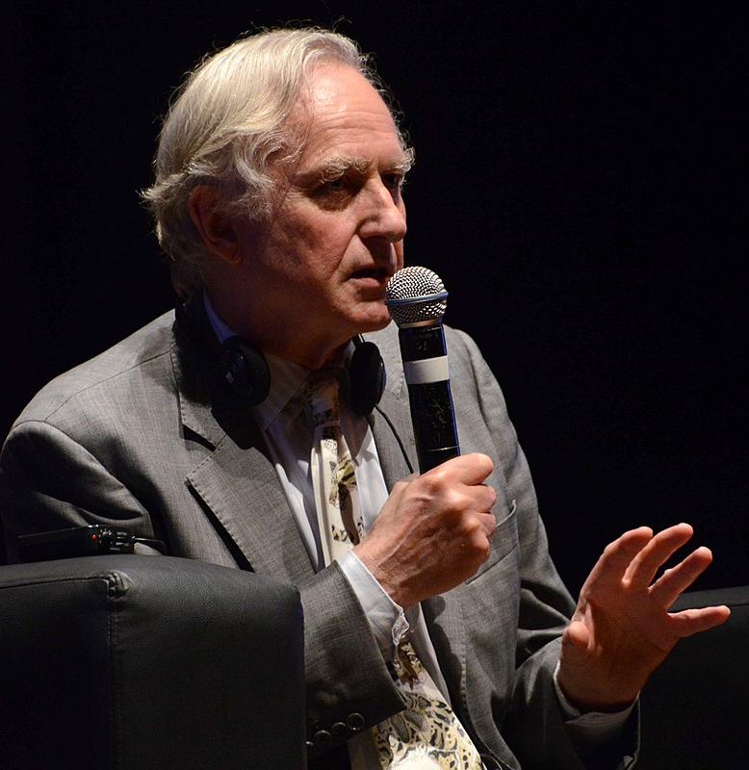
“If you are religious
at all it is overwhelmingly probable that your religion is that of your parents.”
Richard Dawkins
Fronteiras do Pensamento
Notes:
https://commons.wikimedia.org/wiki/File:Richard_Dawkins_no_Fronteiras_do_Pensamento_Porto_Alegre_%2818207784825%29.jpg

Slide 46
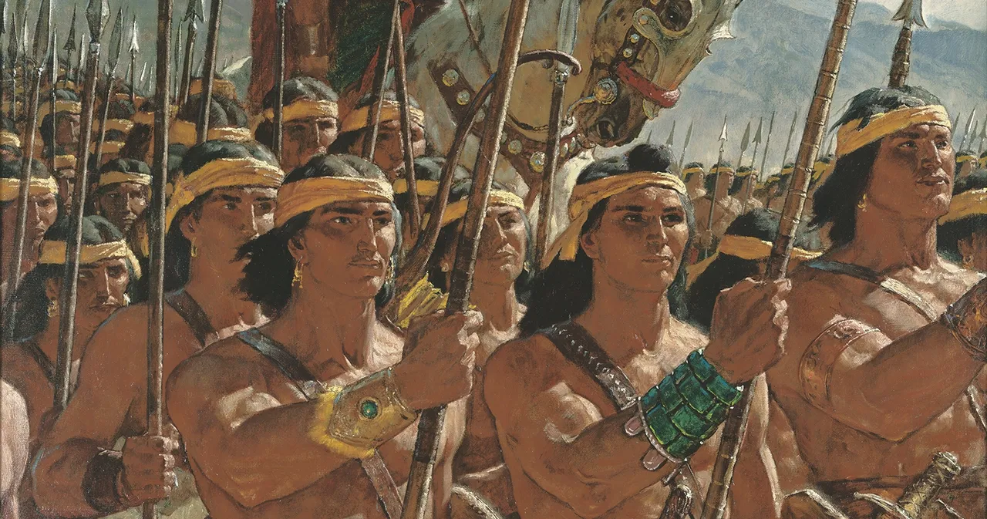
“We do not doubt
our mothers knew it.”
Alma 56:48

Slide 47
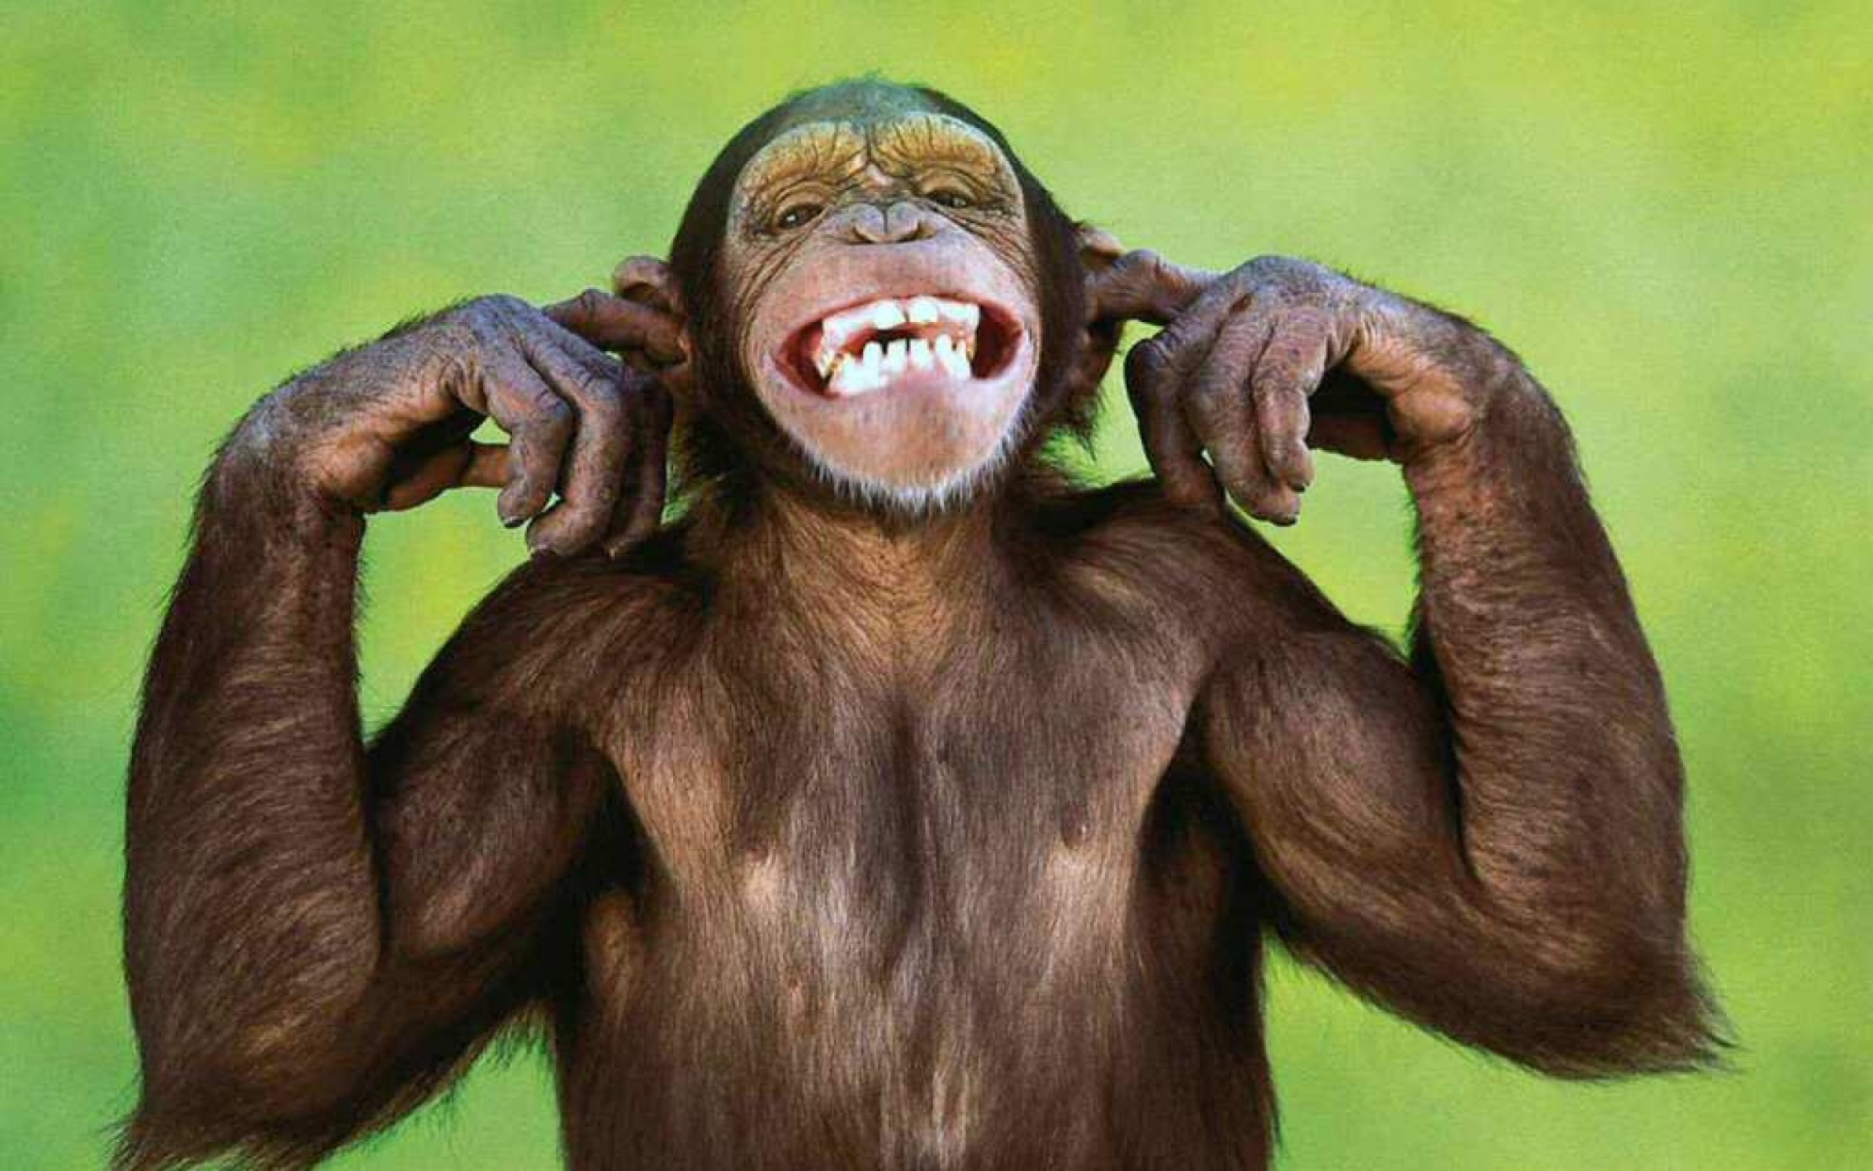
A. Ignore Korihor’s teachings and stay focused on your own work

Slide 48

A. Ignore Korihor’s teachings and stay focused on your own work
B. Get into a philosophical debate with Korihor
Geralt

Slide 49

A. Ignore Korihor’s teachings and stay focused on your own work
B. Get into a philosophical debate with Korihor
C. Talk to your friends who listened to Korihor and learn about him through your friends
Geralt
Geralt

Slide 50

A. Ignore Korihor’s teachings and stay focused on your own work
B. Get into a philosophical debate with Korihor
C. Talk to your friends who listened to Korihor and learn about him through your friends
D. Try to get Korihor to leave town
Geralt
Geralt

Slide 51

A. Ignore Korihor’s teachings and stay focused on your own work
B. Get into a philosophical debate with Korihor
C. Talk to your friends who listened to Korihor and learn about him through your friends
D. Try to get Korihor to leave town
E. Start following Korihor and convince others to do so also
Geralt
Geralt
IO-Images

Slide 52
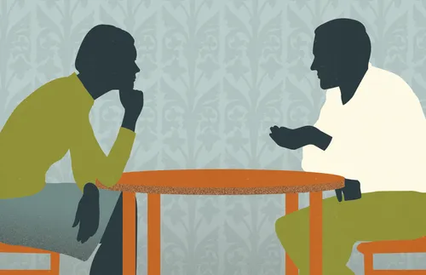
A. Ignore Korihor’s teachings and stay focused on your own work
B. Get into a philosophical debate with Korihor
C. Talk to your friends who listened to Korihor and learn about him through your friends
D. Try to get Korihor to leave town
E. Start following Korihor and convince others to do so also
F. Talk to Korihor and share your testimony of Jesus Christ with him
Geralt
Geralt
IO-Images

Slide 53
Place | Response to Korihor
Zarahemla | “Many people” followed Korihor’s teachings

Slide 54
Place | Response to Korihor
Zarahemla | “Many people” followed Korihor’s teachings
Jershon | Ammon “caused that [Korihor] should be carried out of the land.” Alma 30:21

Slide 55
Place | Response to Korihor
Zarahemla | “Many people” followed Korihor’s teachings
Jershon | Ammon “caused that [Korihor] should be carried out of the land.” Alma 30:21
Gideon | When they “saw the hardness of his heart, yea, when they saw that he would revile even against God, they would not make any reply to his words.” Alma 30:29

Slide 56
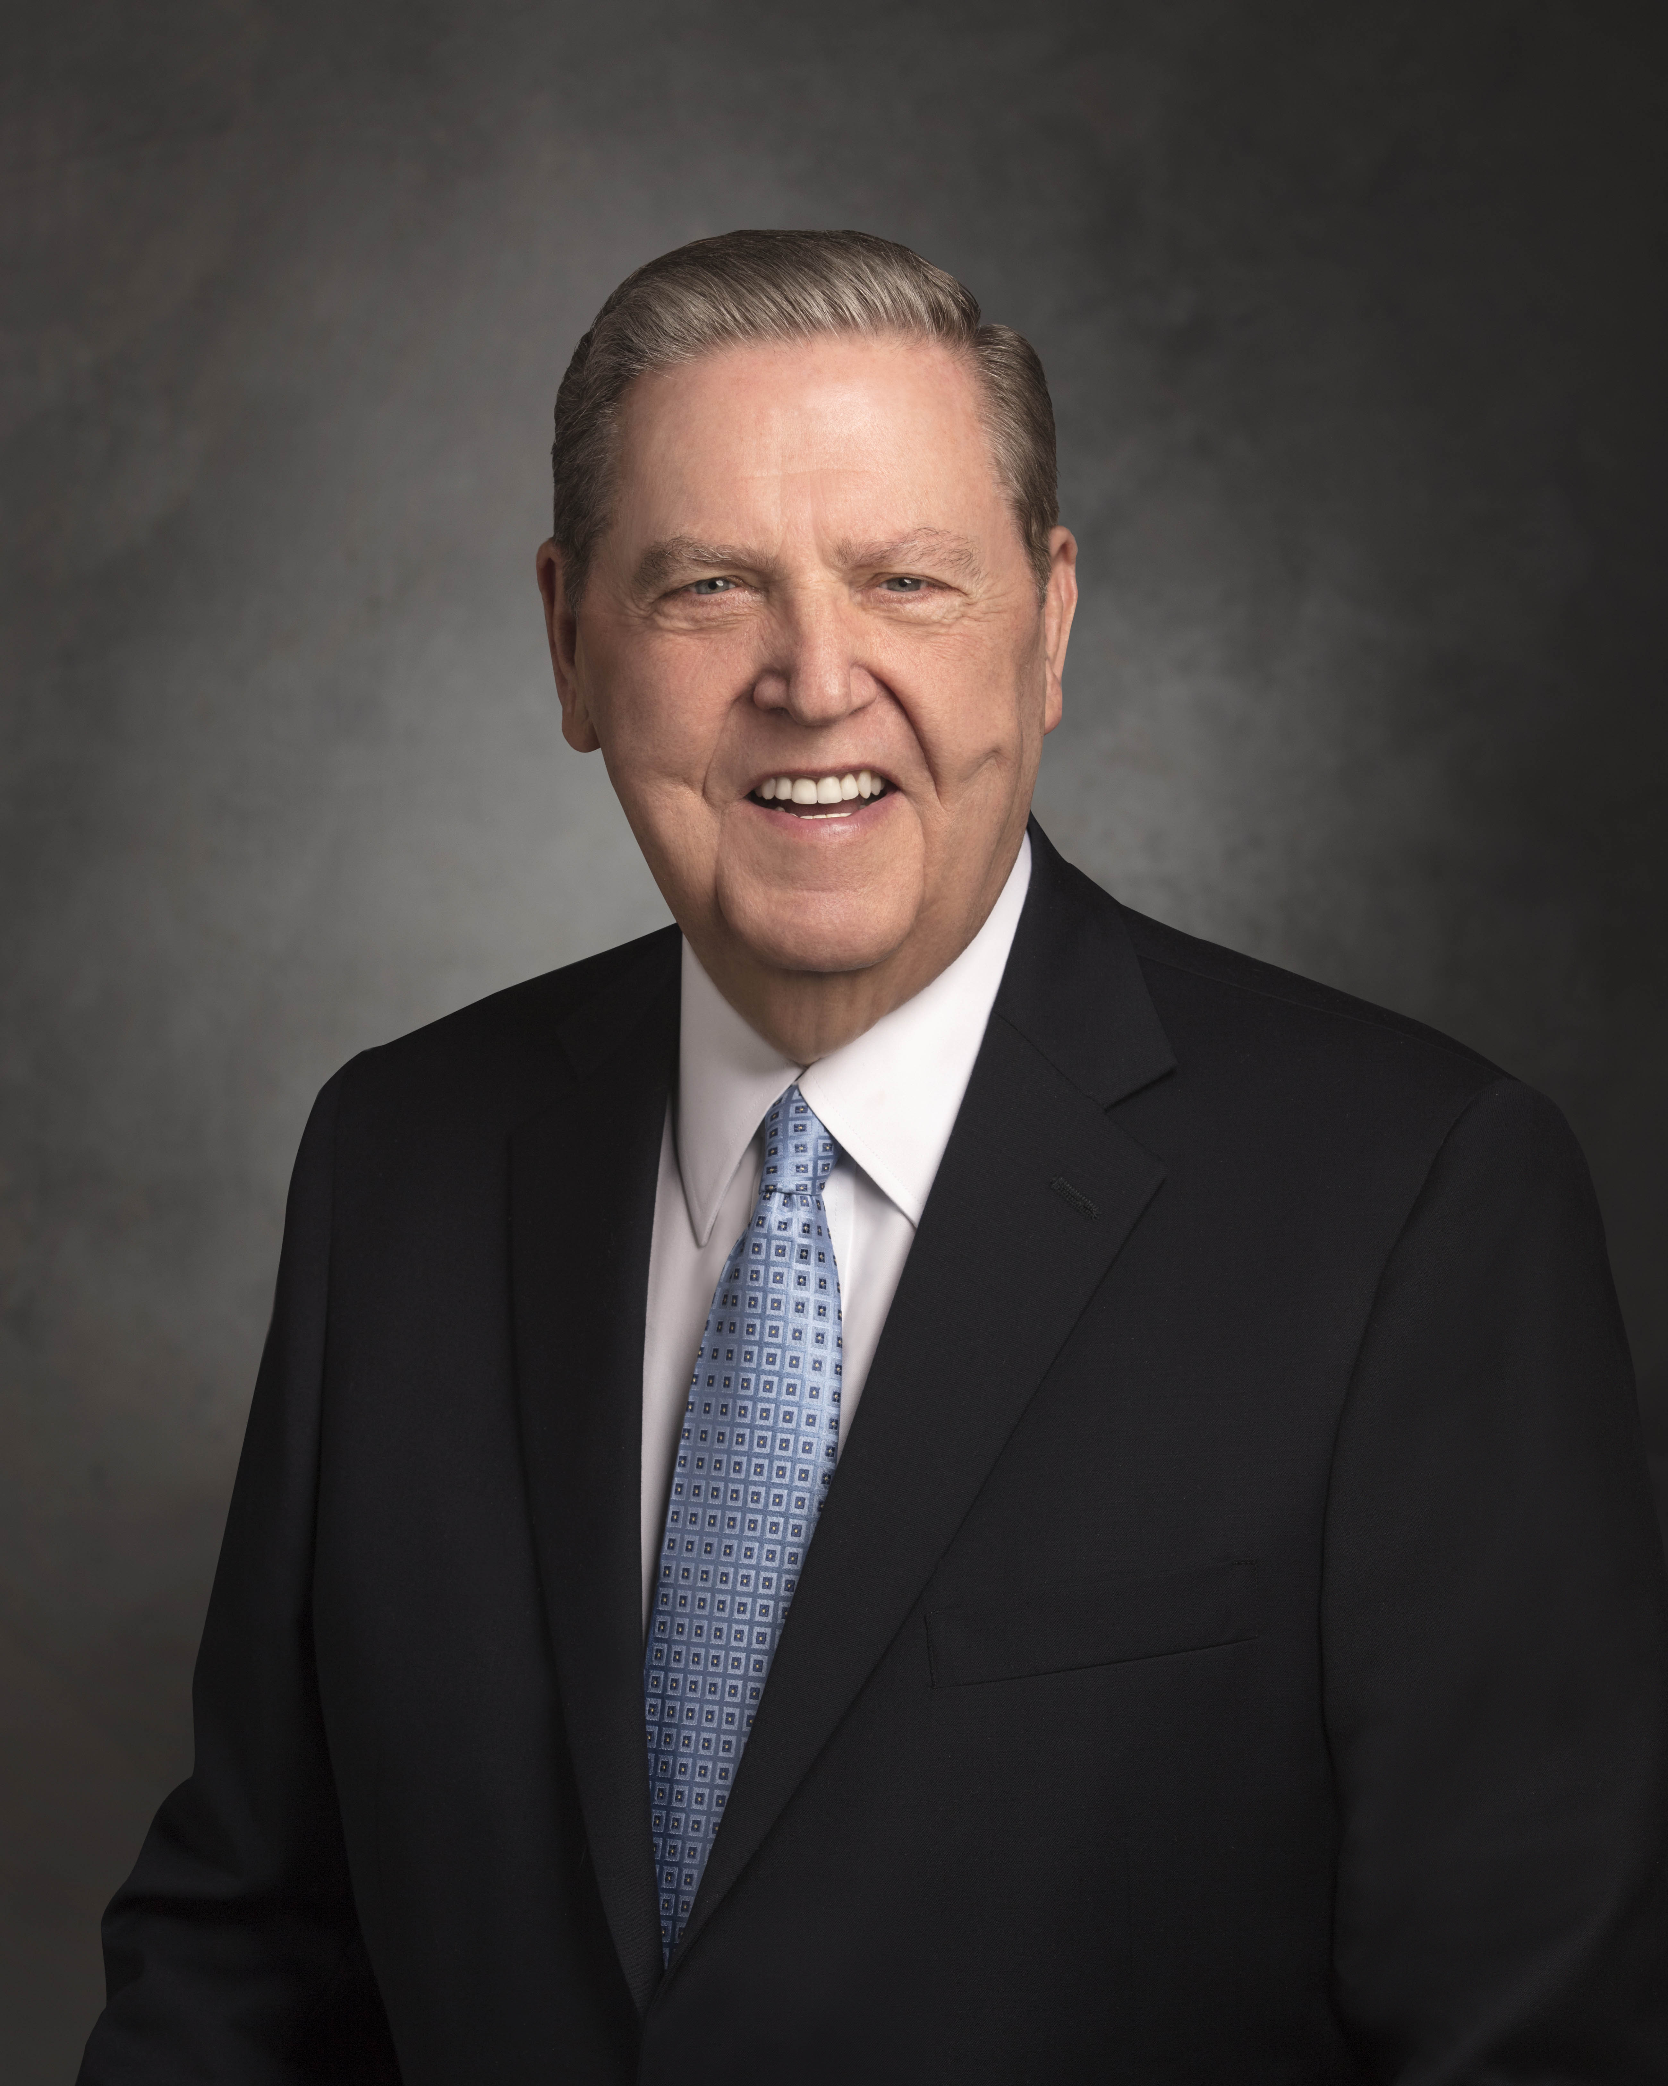
A sister missionary recently wrote to me: “My companion and I saw a man sitting on a bench in the town square eating his lunch. As we drew near, he looked up and saw our missionary name tags. With a terrible look in his eye, he jumped up and raised his hand to hit me. I ducked just in time, only to have him spit his food all over me and start swearing the most horrible things at us. We walked away saying nothing.
Notes:
https://newsroom.churchofjesuschrist.org/media/960x1280/President-Russell-M-Nelson-1-2018.jpg

Slide 57
I tried to wipe the food off of my face, only to feel a clump of mashed potato hit me in the back of the head. Sometimes it is hard being a missionary because right then I wanted to go back, grab that little man, and say, ‘EXCUSE ME!’ But I didn’t.”
Elder Jeffrey R. Holland, “The Cost—and Blessings—of Discipleship,” April 2014
Notes:
https://newsroom.churchofjesuschrist.org/media/960x1280/President-Russell-M-Nelson-1-2018.jpg

Slide 58

“How do ye know of their surety?”
Alma 30:15
Robert Barrett
Notes:
https://bookofmormonartcatalog.org/catalog/korihor-confronts-alma/

Slide 59

“What evidence have ye that there is no God, or that Christ cometh not? I say unto you that ye have none, save it be your word only.”
Alma 30:40
Robert Barrett
Notes:
https://bookofmormonartcatalog.org/catalog/korihor-confronts-alma/

Slide 60
“I know there is a God, and also that Christ shall come…I have all things as a testimony that these things are true… ye have the testimony of all these thy brethren, and also all the holy prophets…The scriptures are laid before thee, yea, and all things denote there is a God; yea, even the earth, and all things that are upon the face of it, yea, and its motion, yea, and also all the planets which move in their regular form do witness that there is a Supreme Creator.”
Alma 30:39, 41, 44
Notes:
https://assets.churchofjesuschrist.org/ba/75/ba75de5f47b5690944b3ab797a168c95a5b19f5b/jacob_with_wife.jpeg

Slide 61
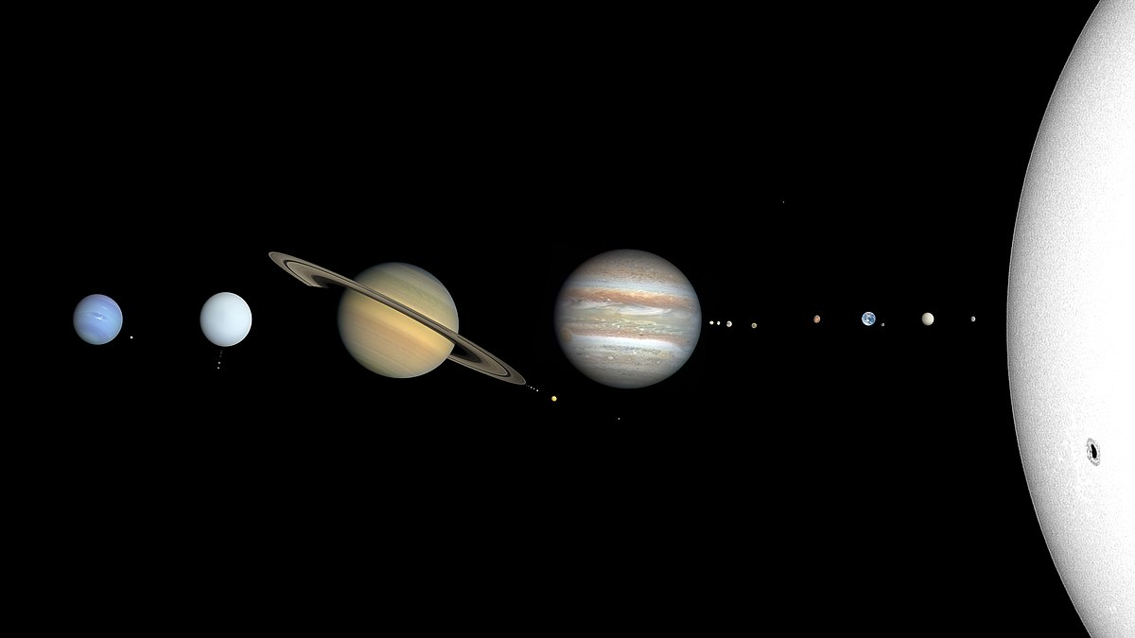
CactiStaccingCrane
Notes:
https://commons.wikimedia.org/wiki/File:Solar_System_true_color_%28planets_and_their_moons%29.jpg

Slide 62
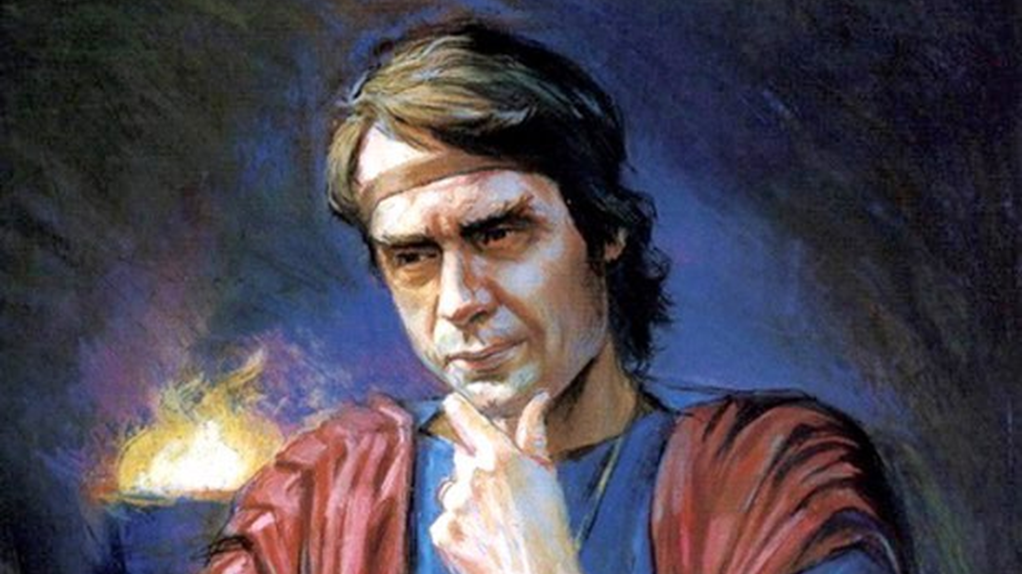
“I always knew that there was a God.”
Alma 30:52
Scott Snow
Notes:
https://bookofmormonartcatalog.org/catalog/korihor-2/

Slide 63

Korihor said God was “a being who never has been seen or known, who never was nor ever will be.”
Alma 30:28
Scott Snow
Notes:
https://bookofmormonartcatalog.org/catalog/korihor-2/

Slide 64
“The devil hath deceived me; for he appeared unto me in the form of an angel, and said unto me…There is no God; yea, and he taught me that which I should say. And I have taught his words; and I taught them because they were pleasing unto the carnal mind; and I taught them, even until I had much success, insomuch that I verily believed that they were true.”
Alma 30:53
Notes:
https://assets.churchofjesuschrist.org/ba/75/ba75de5f47b5690944b3ab797a168c95a5b19f5b/jacob_with_wife.jpeg

Slide 65
“The devil hath deceived me; for he appeared unto me in the form of an angel, and said unto me…There is no God; yea, and he taught me that which I should say. And I have taught his words; and I taught them because they were pleasing unto the carnal mind; and I taught them, even until I had much success, insomuch that I verily believed that they were true.”
Alma 30:53
Notes:
https://assets.churchofjesuschrist.org/ba/75/ba75de5f47b5690944b3ab797a168c95a5b19f5b/jacob_with_wife.jpeg

Slide 66
“Stop increasing your doubts by rehearsing them with other doubters.”
President Russell M. Nelson, Liahona, May 2021
Notes:
https://newsroom.churchofjesuschrist.org/media/960x1280/President-Russell-M-Nelson-1-2018.jpg

Slide 67
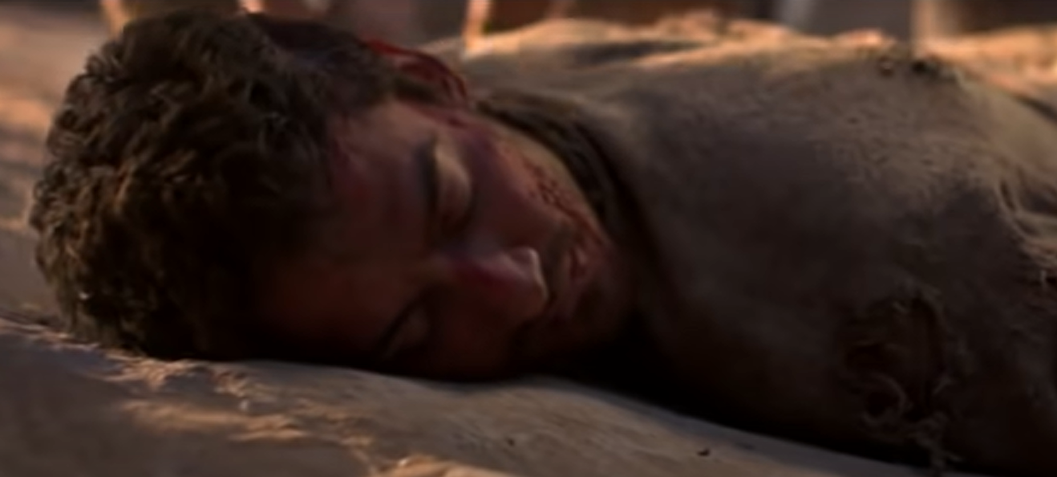
“He was run upon and trodden down, even until he was dead.” Alma 30:59

Slide 68
They believed that there would “be no Christ.” Alma 31:16

Slide 69
They believed that there would “be no Christ.” Alma 31:16
They rejected “foolish traditions” that came from “the childishness of their fathers.” Alma 31:16

Slide 70
They believed that there would “be no Christ.” Alma 31:16
They rejected “foolish traditions” that came from “the childishness of their fathers.” Alma 31:16
They thought that the teaching of Christ did “bind them down.” Alma 31:17

Slide 71
They believed that there would “be no Christ.” Alma 31:16
They rejected “foolish traditions” that came from “the childishness of their fathers.” Alma 31:16
They thought that the teaching of Christ did “bind them down.” Alma 31:17
They didn’t “believe in things to come.” Alma 31:22

Slide 72
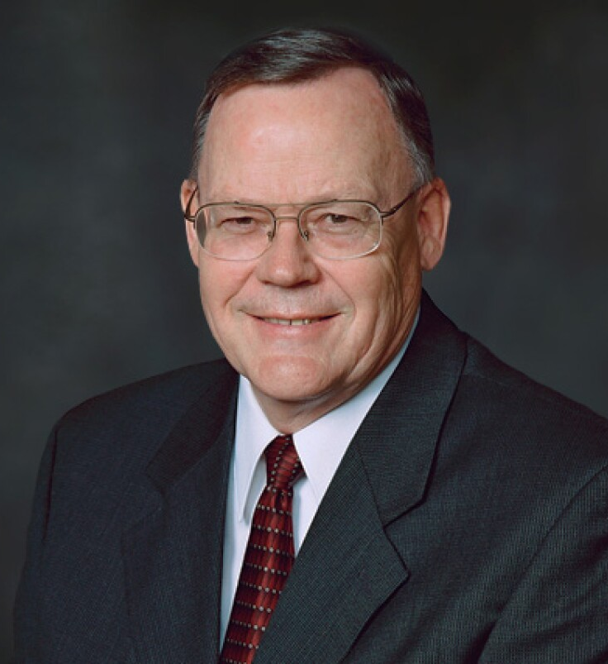
“How ironic that Korihor should meet his death at the hands of a people who practiced what he preached!”
Elder Gerald N. Lund,
Ensign, July 1992
Notes:
https://cms-b-assets.familysearch.org/dims4/default/930fda2/2147483647/strip/true/crop/659x427+0+0/resize/1240x803!/quality/90/?url=https%3A%2F%2Ffamilysearch-brightspot.s3.amazonaws.com%2Fb4%2F4b%2F0932368234a1123a4a4a118fa8d4%2Fgerald-n-lund.jpg

Slide 73
“And thus we see the end of him who perverteth the ways of the Lord; and thus we see that the devil will not support his children at the last day, but doth speedily drag them down to hell.”
Alma 30:60
Notes:
https://assets.churchofjesuschrist.org/ba/75/ba75de5f47b5690944b3ab797a168c95a5b19f5b/jacob_with_wife.jpeg

Slide 74
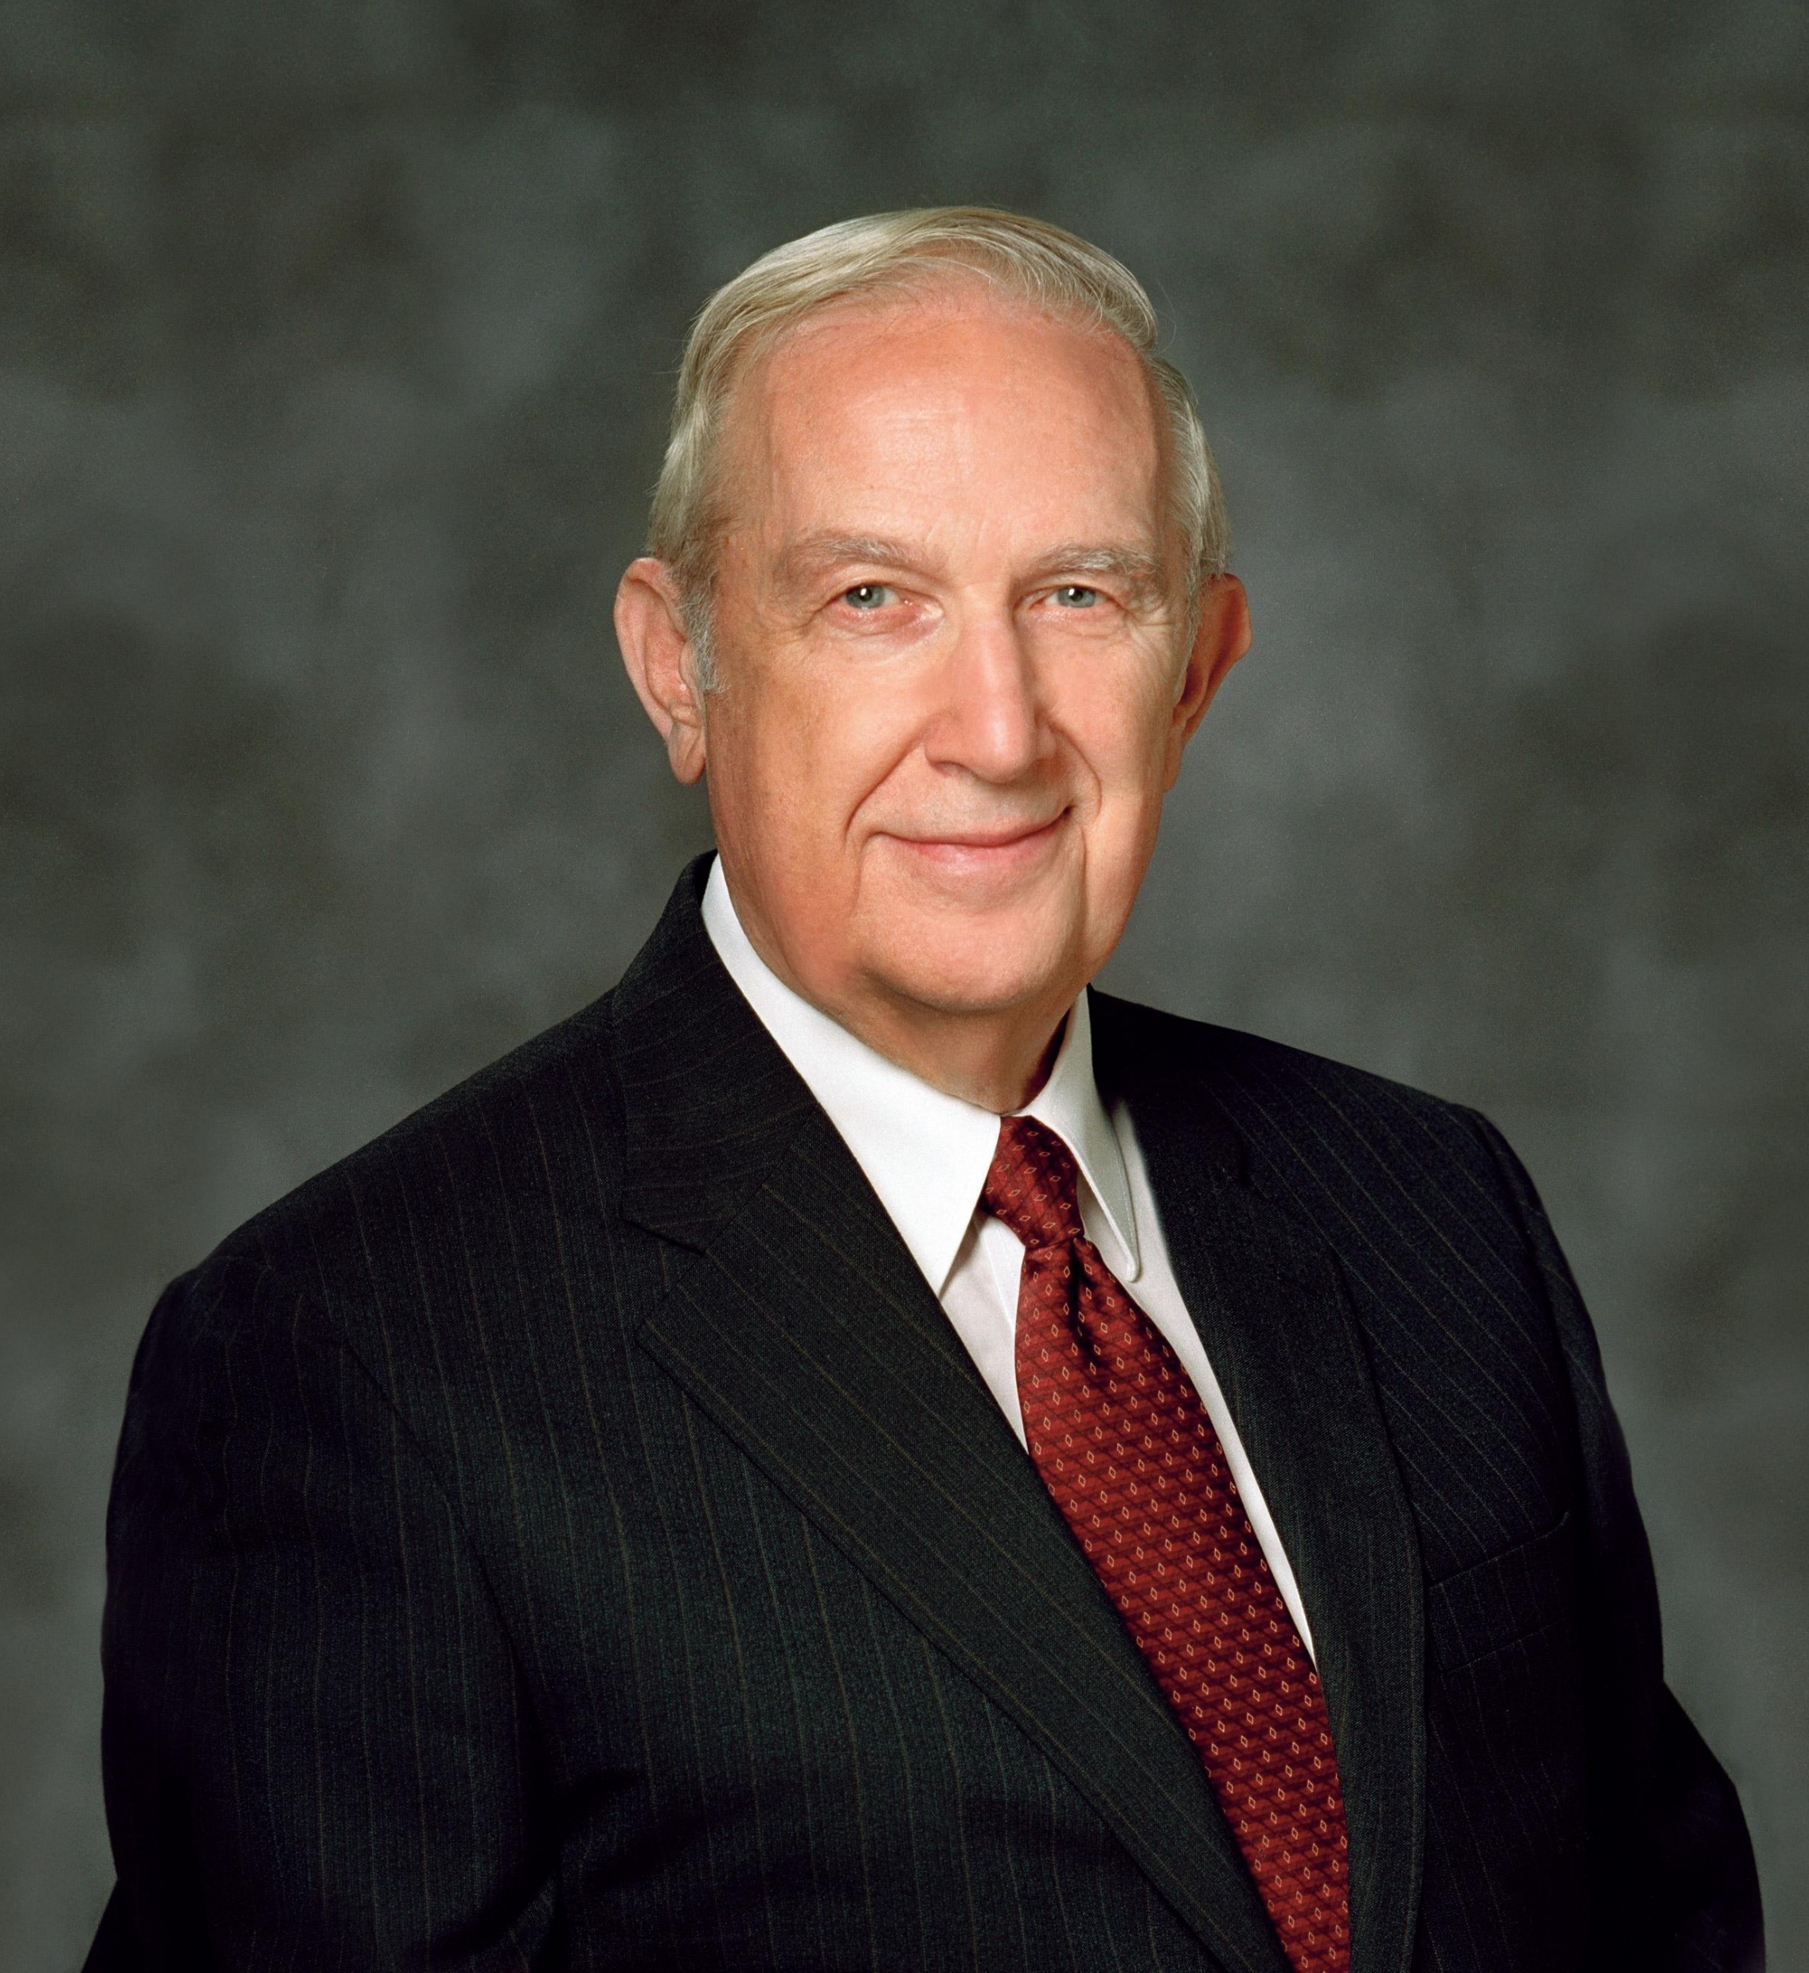
“Satan strives to convince one that sins can be hidden from others, yet it is he that causes them to be revealed in the most compromising circumstances.”
Elder Richard G. Scott
Ensign, Nov. 2002, 87
Notes:
As you connect to Alma 31 you could point out from Alma 31:9, 16, 22 how ironic it is that those with a similar belief system were the ones to trample him down.

Slide 75
“Your adversary the devil, as a roaring lion, walketh about, seeking whom he may devour.” (1 Peter 5:8)

Slide 76
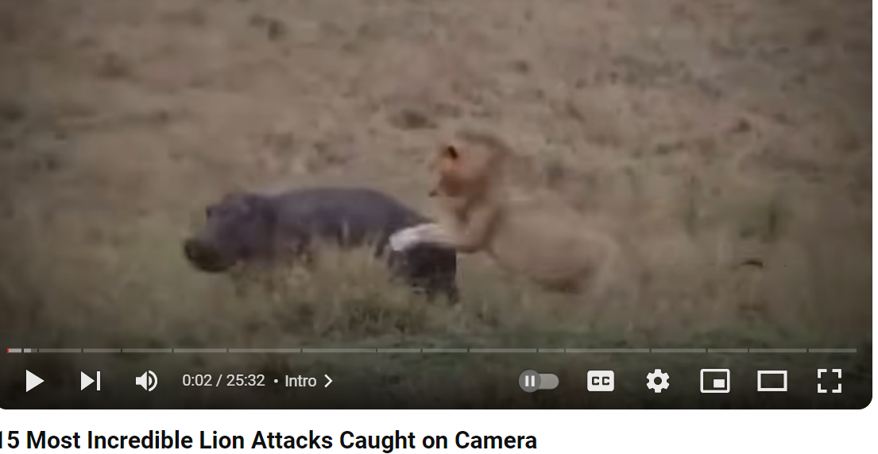
“Your adversary the devil, as a roaring lion, walketh about, seeking whom he may devour.” (1 Peter 5:8)

Slide 77
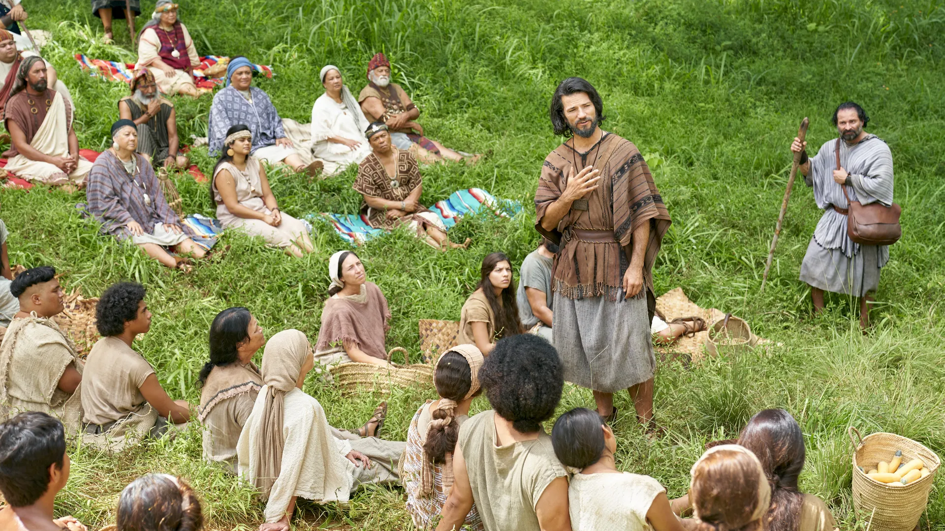
“The preaching of the word had a great tendency to lead the people to do that which was just—yea, it had had more powerful effect upon the minds of the people than the sword, or anything else, which had happened unto them—therefore Alma thought it was expedient that they should try the virtue of the word of God.” Alma 31:5
Notes:
https://www.churchofjesuschrist.org/media/image/speaking-to-the-poor-zoramites-45bd061?lang=eng&collectionId=5242dd9c608d42acbd564064138130c7

Slide 78
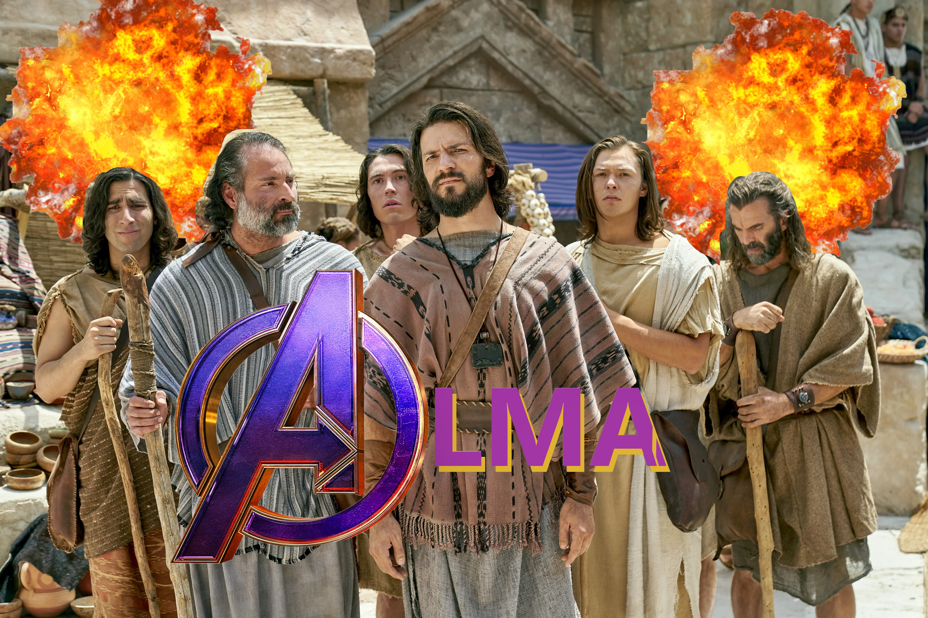

Slide 79
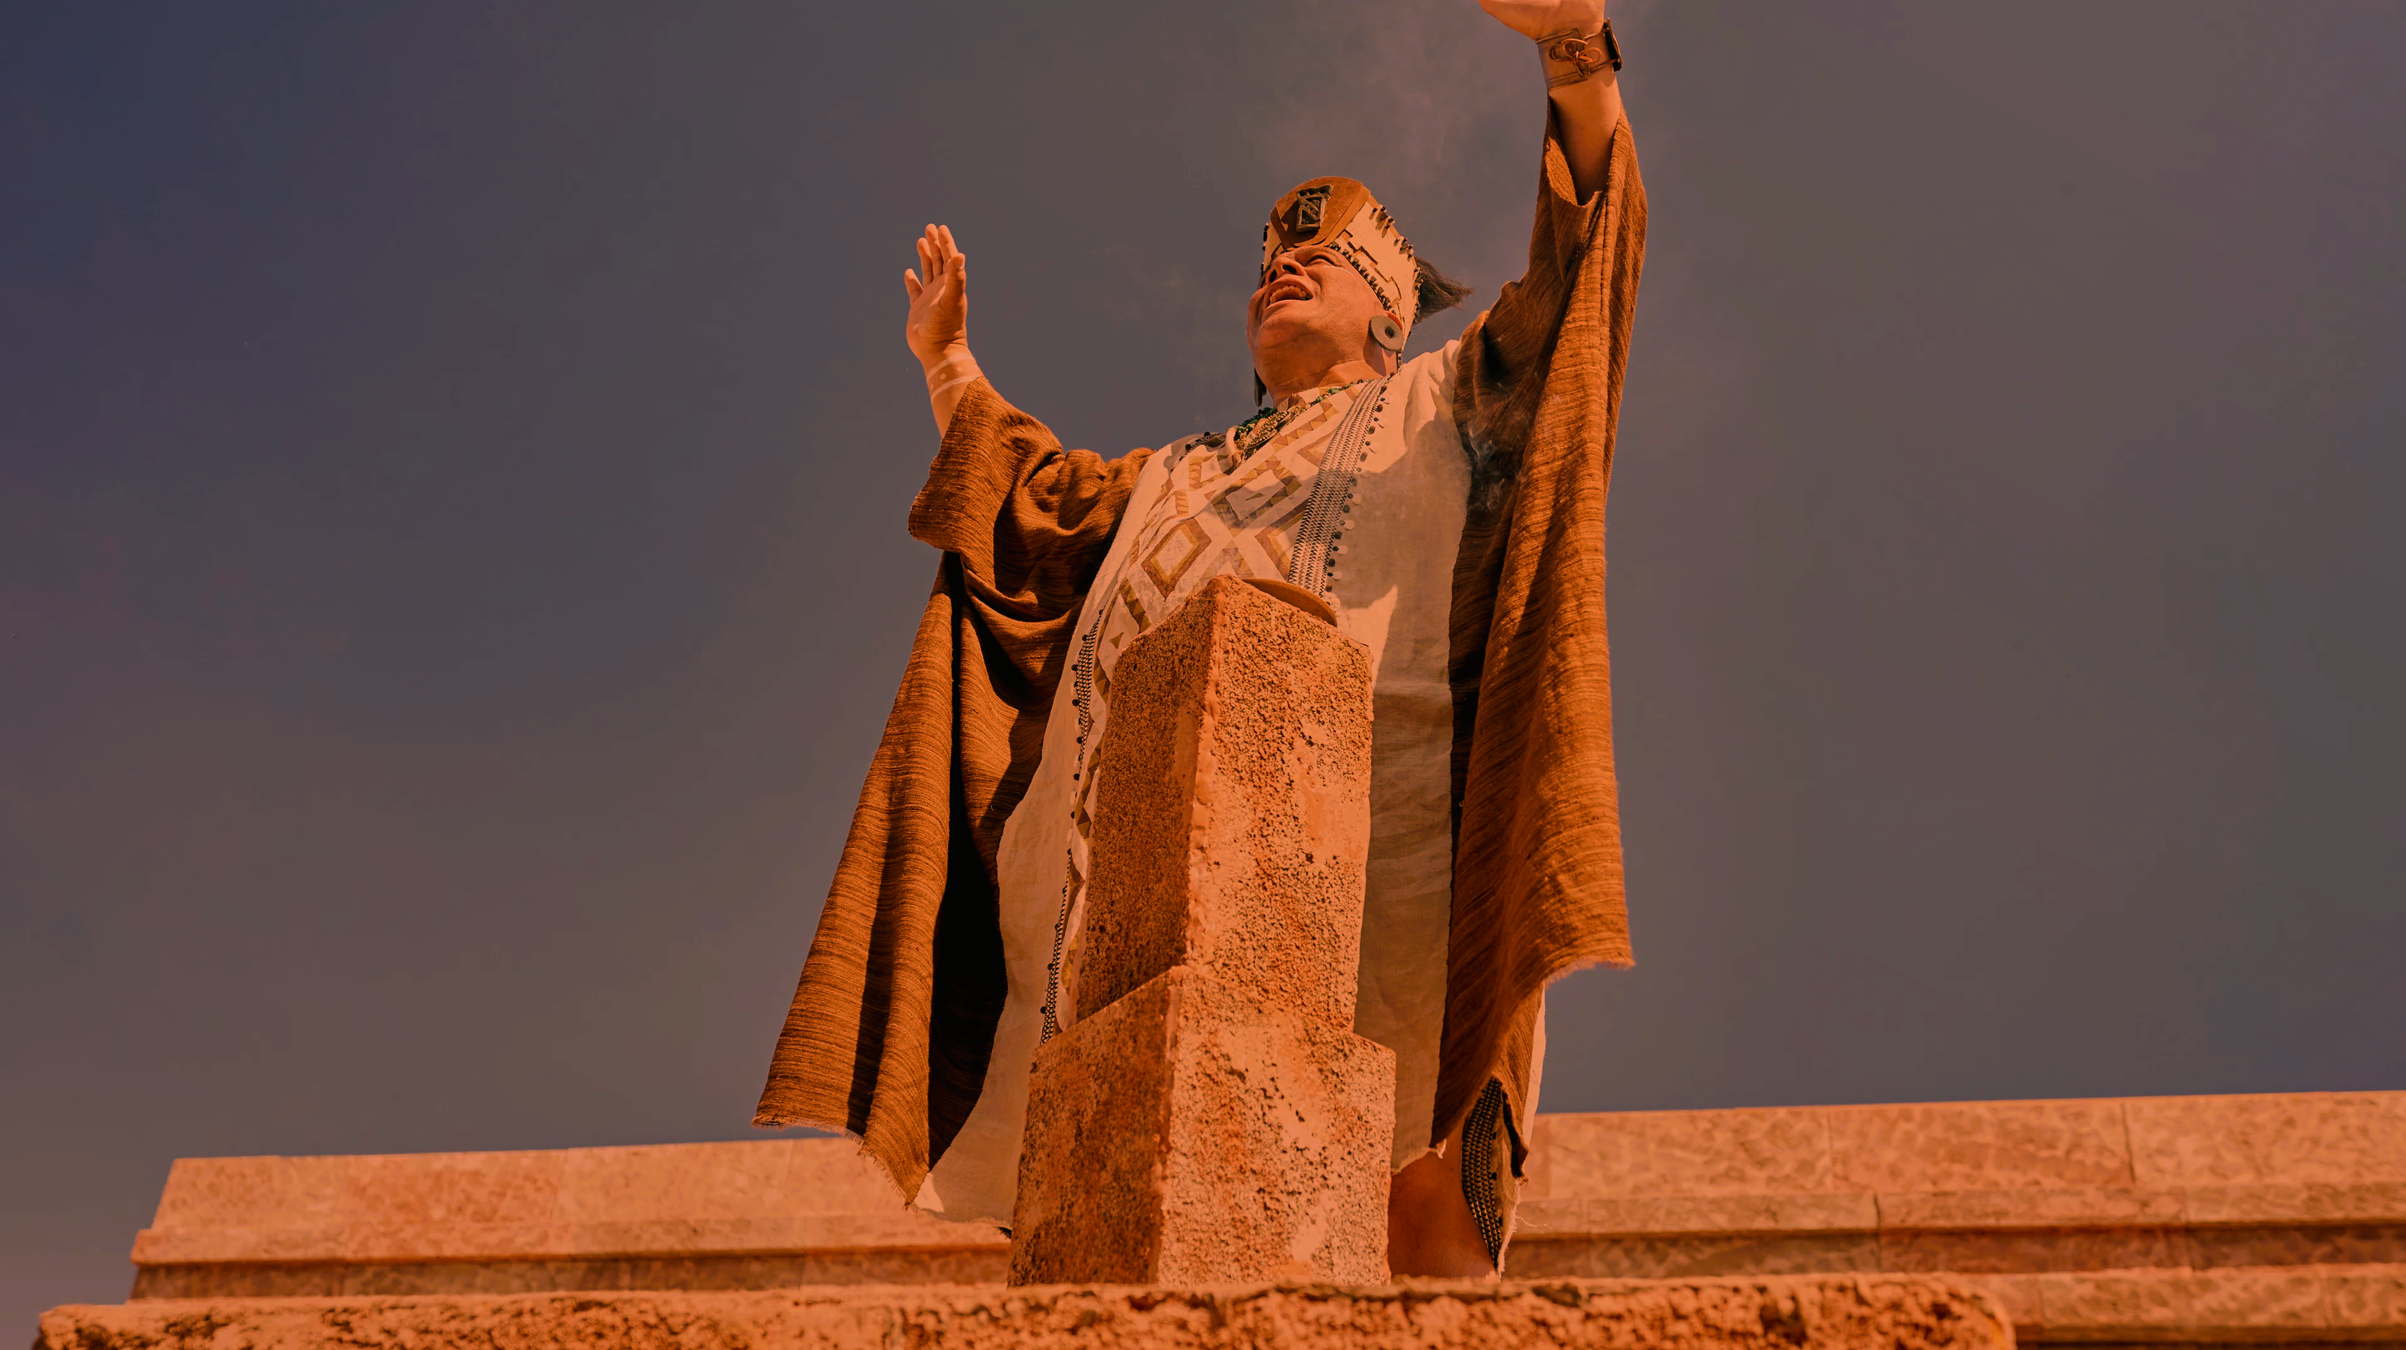

Slide 80
“Holy, holy God; we believe that thou art God, and we believe that thou art holy, and that thou wast a spirit, and that thou art a spirit, and that thou wilt be a spirit forever. Holy God, we believe that thou hast separated us from our brethren; and we do not believe in the tradition of our brethren, which was handed down to them by the childishness of their fathers; but we believe that thou hast elected us to be thy holy children; and also thou hast made it known unto us that there shall be no Christ.

Slide 81
“But thou art the same yesterday, today, and forever; and thou hast elected us that we shall be saved, whilst all around us are elected to be cast by thy wrath down to hell; for the which holiness, O God, we thank thee; and we also thank thee that thou hast elected us, that we may not be led away after the foolish traditions of our brethren, which doth bind them down to a belief of Christ, which doth lead their hearts to wander far from thee, our God. And again we thank thee, O God, that we are a chosen and a holy people. Amen.”
Alma 31:15–18

Slide 82
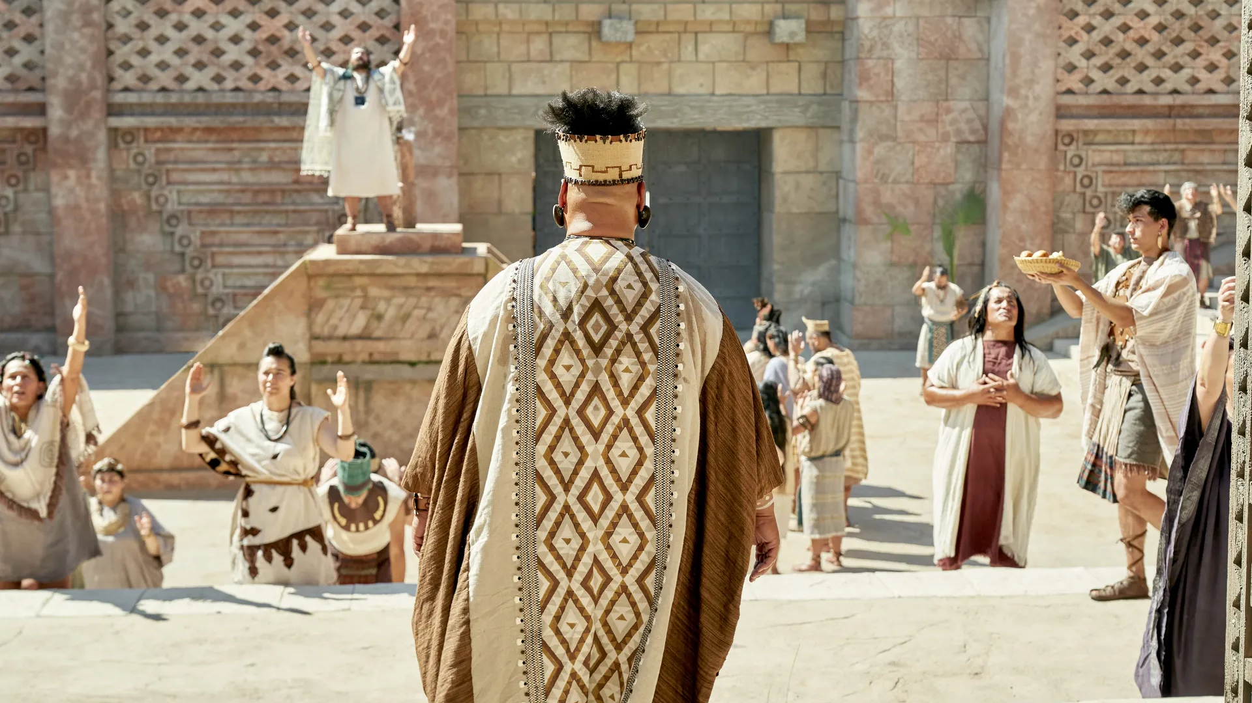
“Do not pray as the Zoramites do, for ye have seen that they pray to be heard of men, and to be praised for their wisdom. Do not say: O God, I thank thee that we are better than our brethren; but rather say: O Lord, forgive my unworthiness, and remember my brethren in mercy.” Alma 38:13–14
Notes:
https://www.churchofjesuschrist.org/media/image/zoram-and-the-rameumptom-266c1be?lang=eng&collectionId=5242dd9c608d42acbd564064138130c7

Slide 83
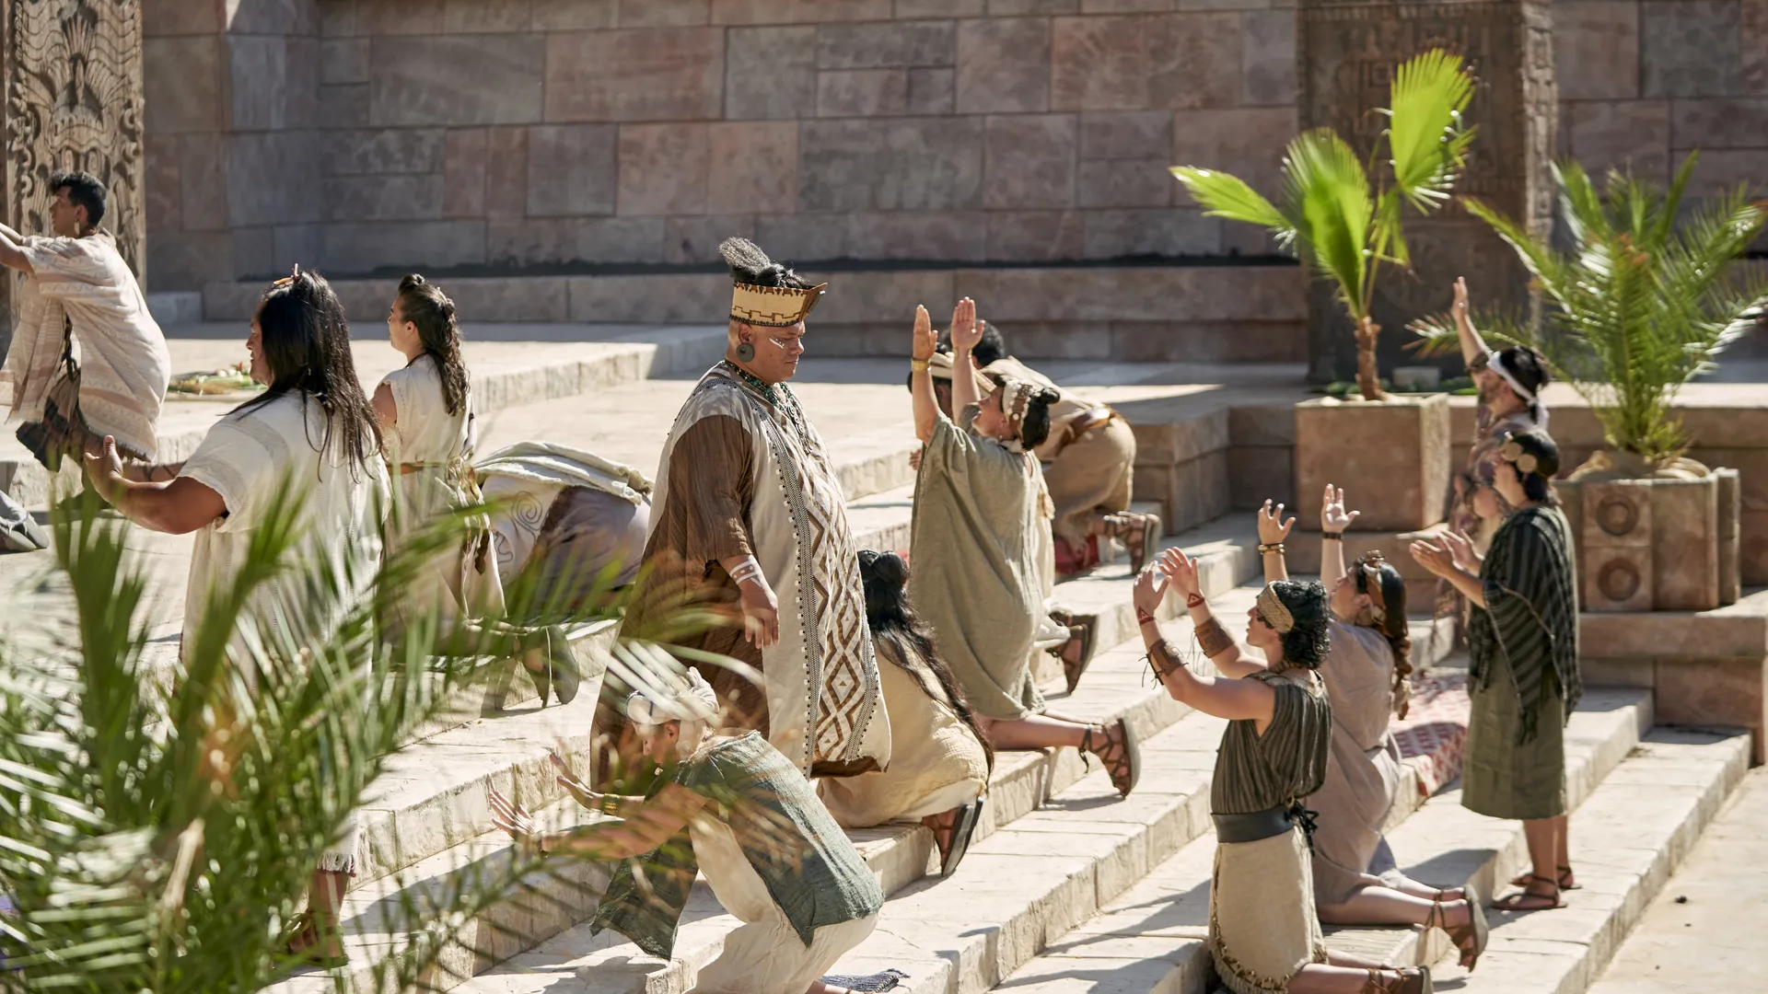
“After the people had all offered up thanks after this manner, they returned to their homes, never speaking of their God again until they had assembled themselves together again to the holy stand.”
Alma 31:23
Notes:
https://www.churchofjesuschrist.org/media/image/zoram-and-the-rameumptom-9e9b4a4?lang=eng&collectionId=5242dd9c608d42acbd564064138130c7

Slide 84
“I pray continually” 2 Nephi 33:3
“I cried unto [God] continually” Enos 1:15
“[Church members were] watching and praying continually” Alma 15:17
“They did pray unto the Lord their God continually” Alma 62:51

Slide 85
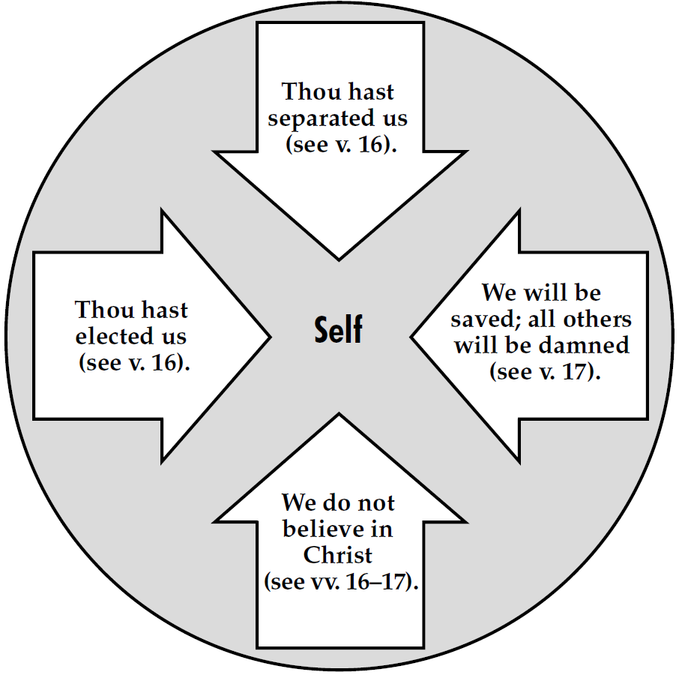

Slide 86
“O Lord, wilt thou comfort my soul, and give unto me success, and also my fellow laborers who are with me—yea, Ammon, and Aaron, and Omner, and also Amulek and Zeezrom, and also my two sons—yea, even all these wilt thou comfort, O Lord. Yea, wilt thou comfort their souls in Christ. Wilt thou grant unto them that they may have strength, that they may bear their afflictions which shall come upon them because of the iniquities of this people. O Lord, wilt thou grant unto us that we may have success in bringing them again unto thee in Christ. Behold, O Lord, their souls are precious, and many of them are our brethren; therefore, give unto us, O Lord, power and wisdom that we may bring these, our brethren, again unto thee.” Alma 31:32–35

Slide 87
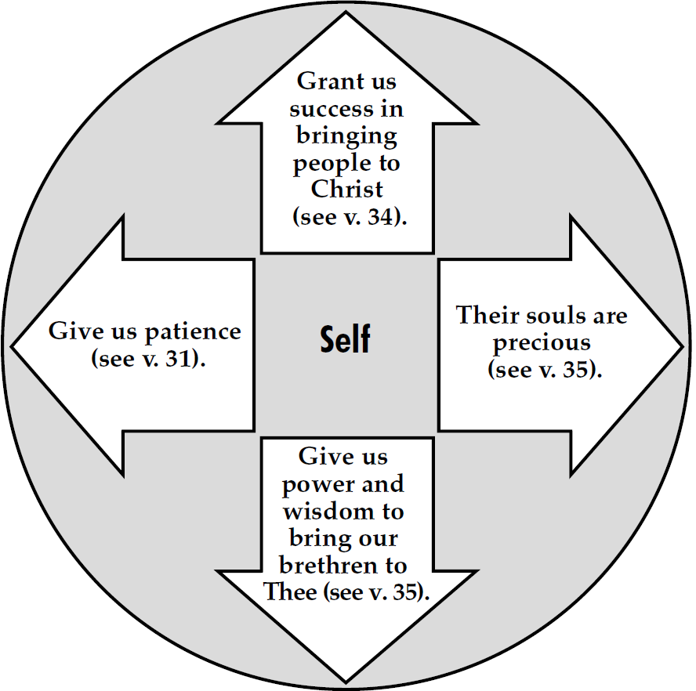

Slide 88
“O Lord, wilt thou comfort my soul, and give unto me success, and also my fellow laborers who are with me—yea, Ammon, and Aaron, and Omner, and also Amulek and Zeezrom, and also my two sons—yea, even all these wilt thou comfort, O Lord. Yea, wilt thou comfort their souls in Christ. Wilt thou grant unto them that they may have strength, that they may bear their afflictions which shall come upon them because of the iniquities of this people. O Lord, wilt thou grant unto us that we may have success in bringing them again unto thee in Christ. Behold, O Lord, their souls are precious, and many of them are our brethren; therefore, give unto us, O Lord, power and wisdom that we may bring these, our brethren, again unto thee.” Alma 31:32–35

Slide 89
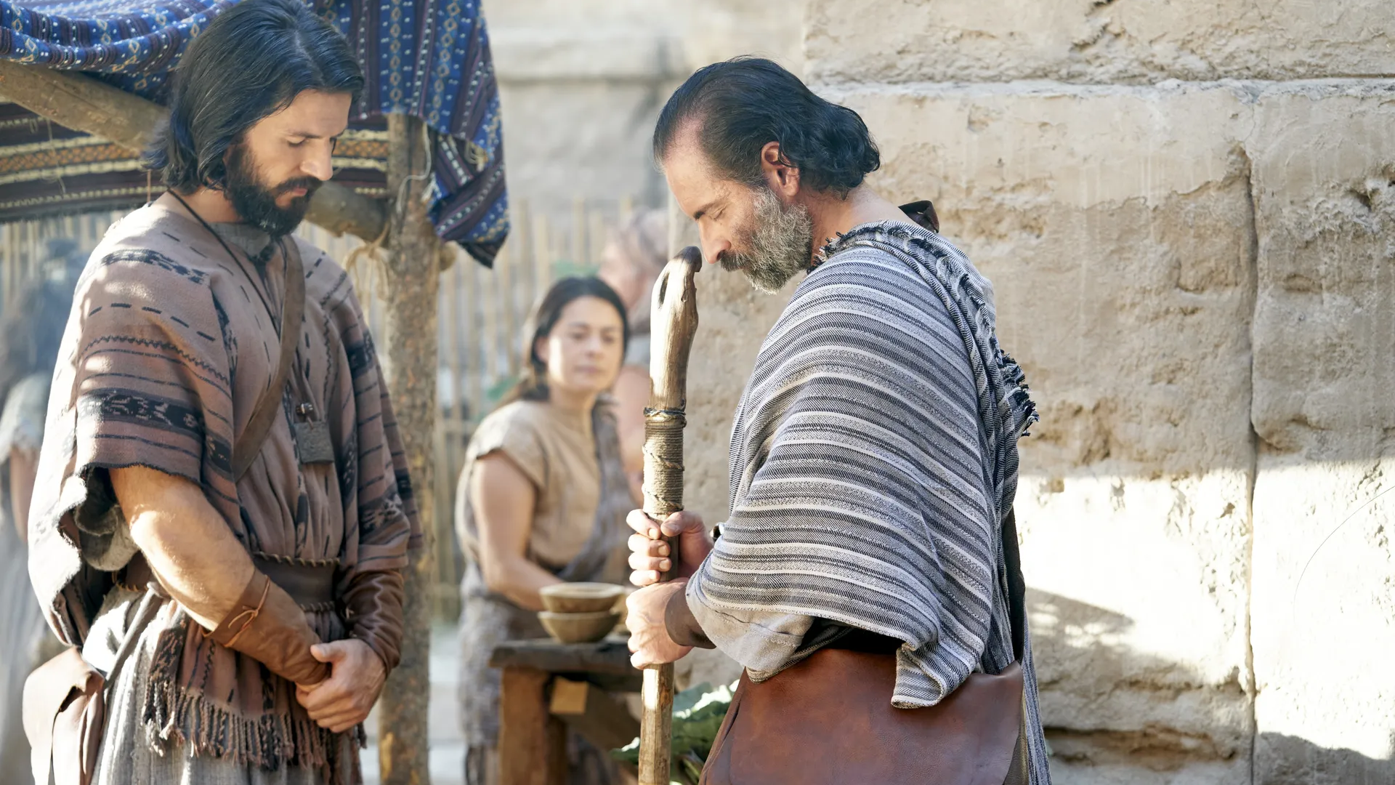
“The Lord…gave them strength.”
Alma 31:38
Notes:
https://www.churchofjesuschrist.org/media/image/alma-the-younger-amulek-praying-f3caa52?lang=eng&collectionId=5242dd9c608d42acbd564064138130c7

