Slide 1

Zoom, by Istvan Banyai

Slide 2


Slide 3
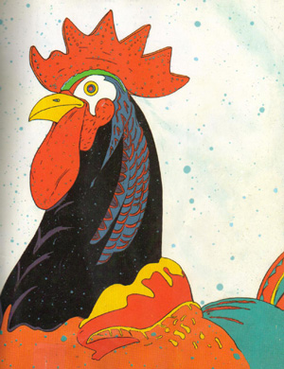

Slide 4


Slide 5


Slide 6
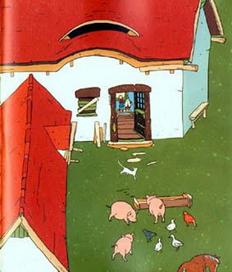

Slide 7
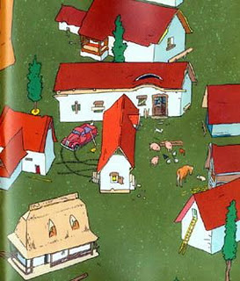

Slide 8
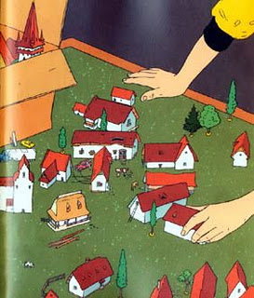

Slide 9
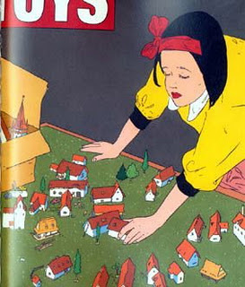

Slide 10


Slide 11
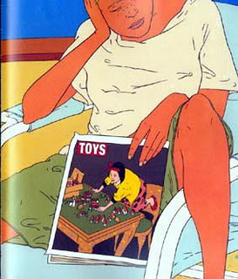

Slide 12

See the Big Picture

Slide 13
When Helaman begins, it’s the 40th year of the reign of the judges, about
52 BC…
Notes:
https://bookofmormonartcatalog.org/catalog/paanchi/

Slide 14
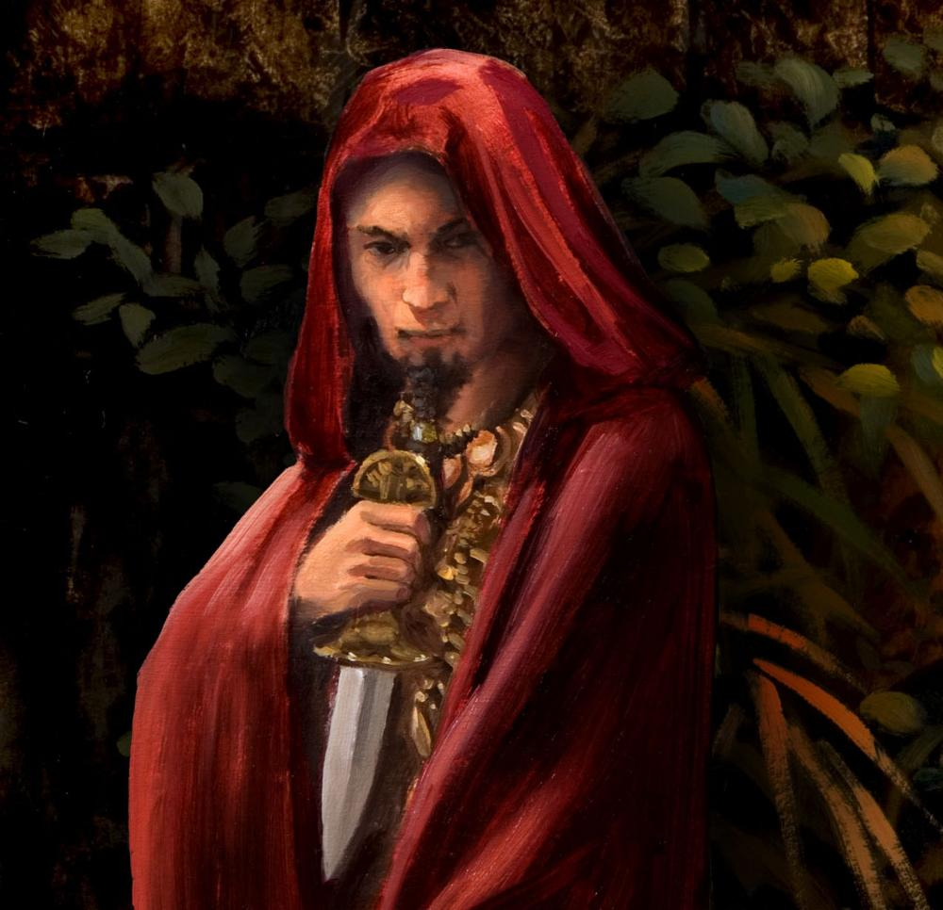
Kishkumen and the Gadianton robbers
James Fullmer
Notes:
https://bookofmormonartcatalog.org/catalog/gadianton/

Slide 15
Helaman 3-4:
20 years of Nephite history
(2 chapters covers as much time as Alma 43-63!)
Notes:
https://assets.churchofjesuschrist.org/ba/75/ba75de5f47b5690944b3ab797a168c95a5b19f5b/jacob_with_wife.jpeg

Slide 16
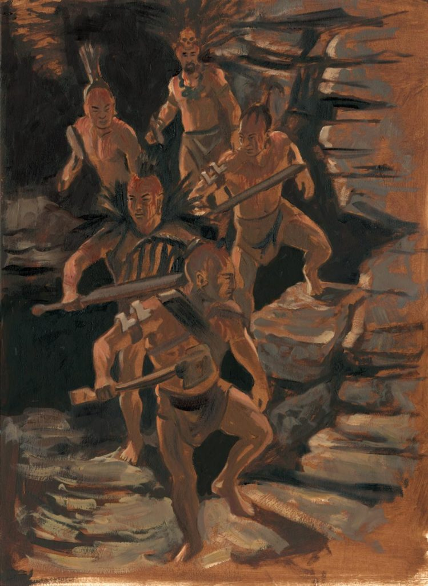
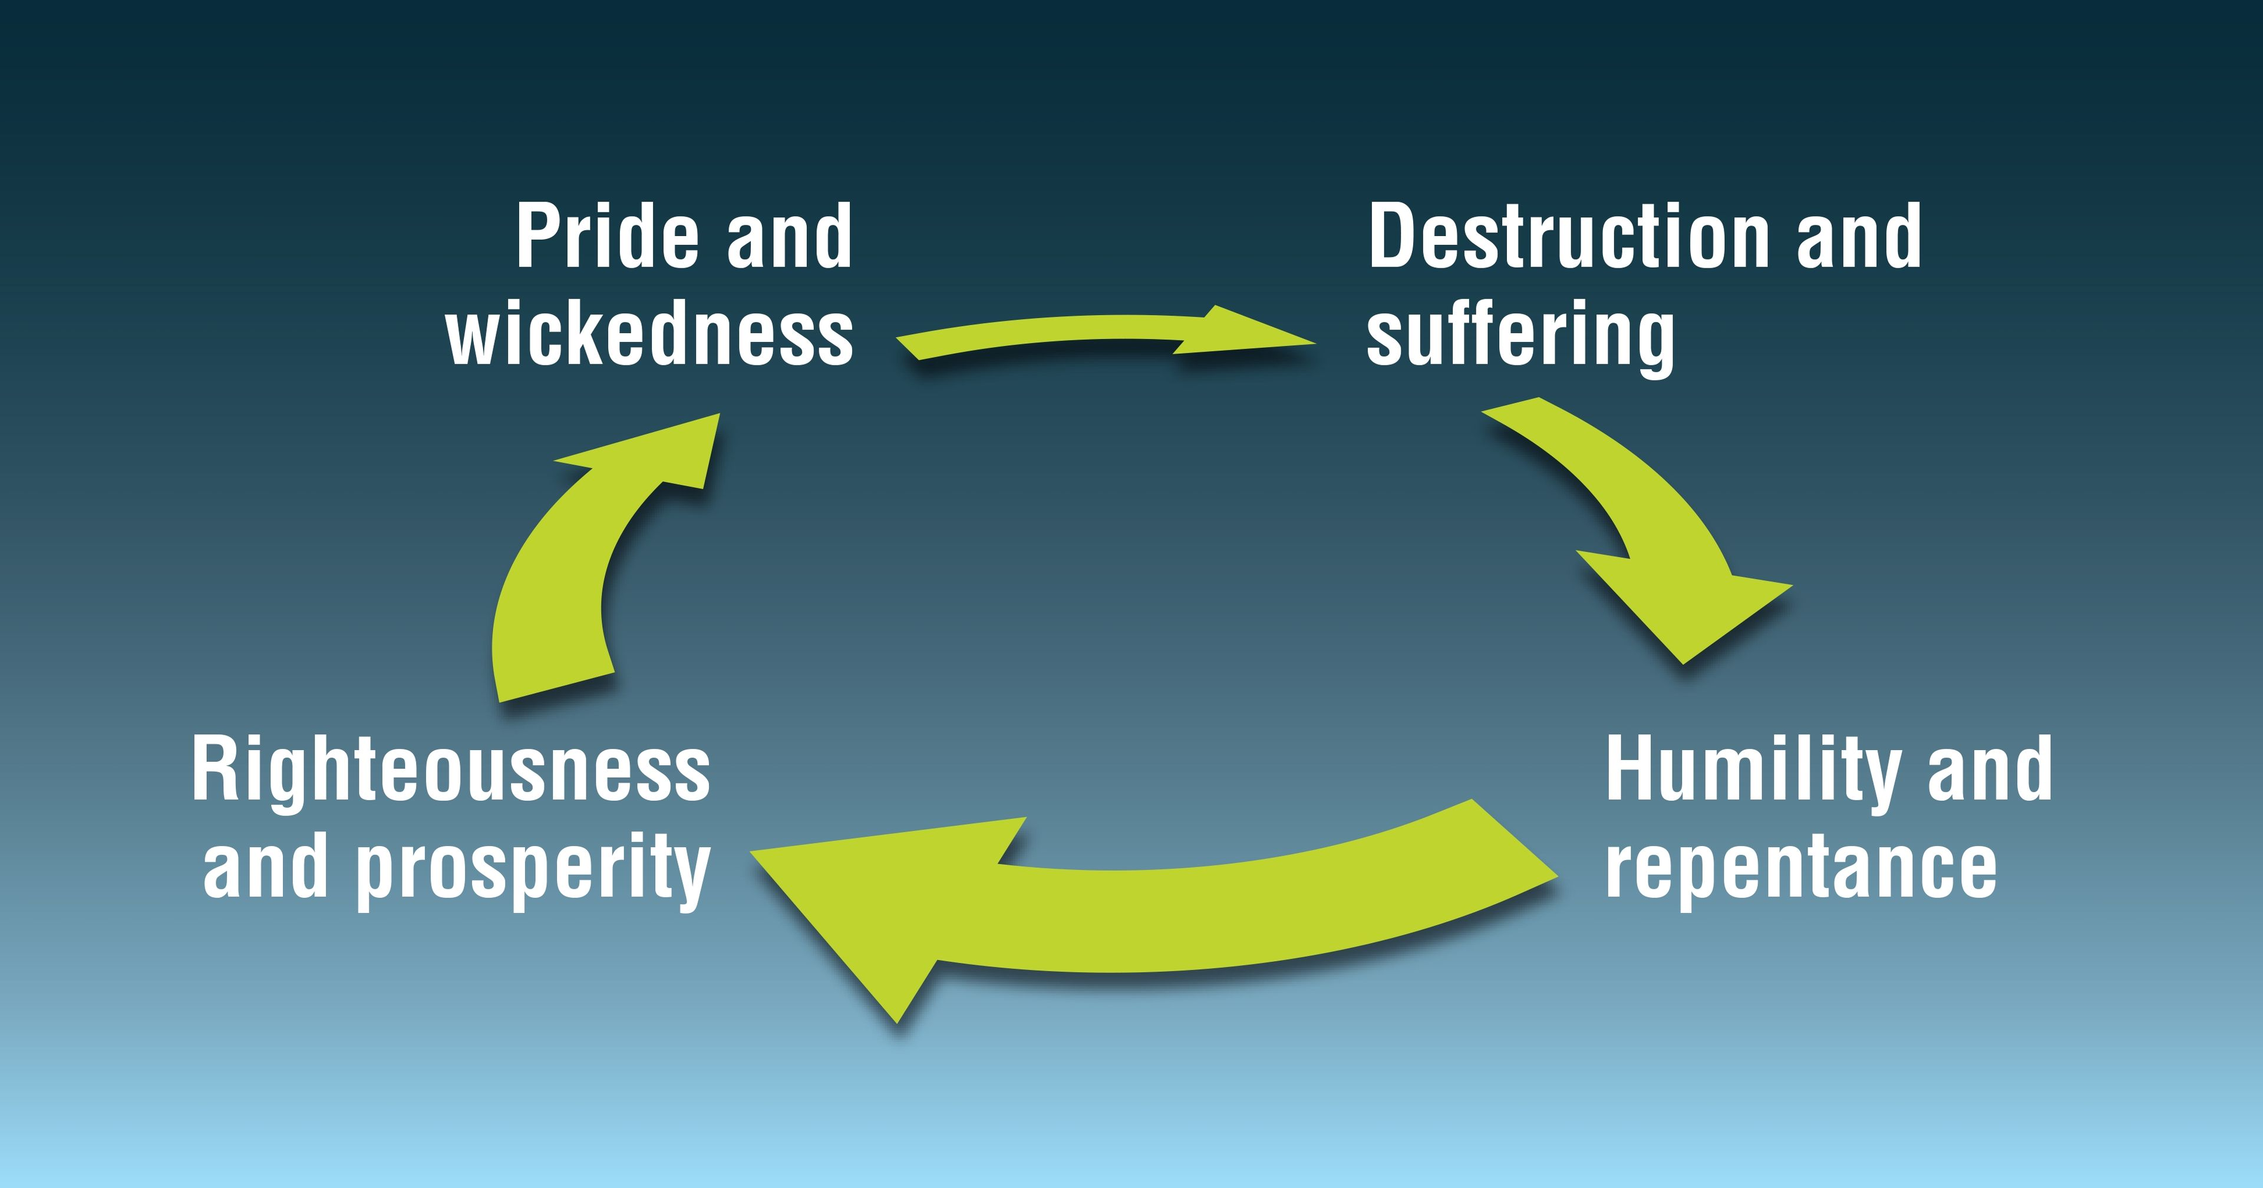
Helaman 6:
Prosperous society, but 2 problems
1. Gadianton robbers
2. Pride cycle
James Fullmer
Notes:
https://bookofmormonartcatalog.org/catalog/gadianton-robbers-come-down-from-the-mountains/
https://www.churchofjesuschrist.org/imgs/76fd0d1dba9b58e005af110d5ee7e9cb20e4ac67/full/3840%2C/0/default

Slide 17
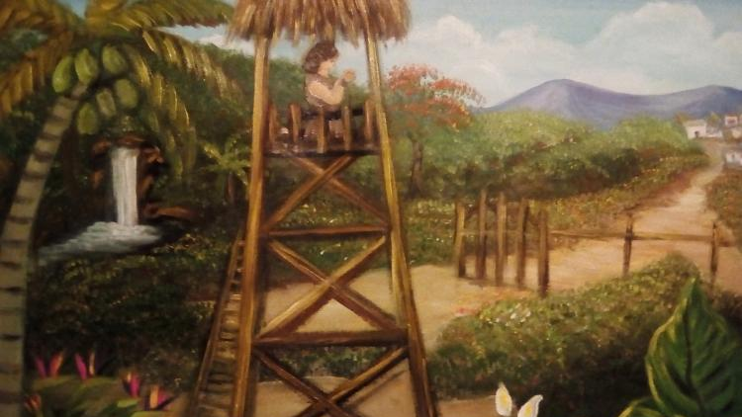
Helaman 7:
Nephi prays in public and prophetically declares the chief judge has been murdered
Lilia Vargas Mendez
Notes:
https://bookofmormonartcatalog.org/catalog/nefi-hijo-de-helaman-derrama-su-alma-a-dios-en-la-torre/

Slide 18
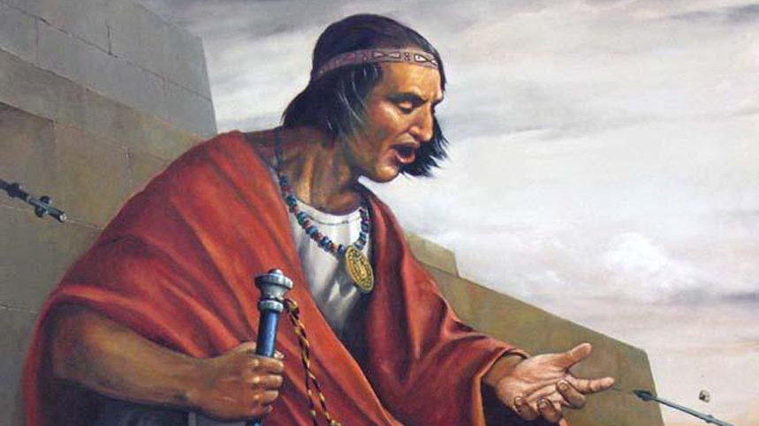
Samuel the Lamanite
Jorge Cocco Santángelo
Notes:
https://bookofmormonartcatalog.org/catalog/samuel-en-la-muralla-samuel-on-the-wall/

Slide 19
Pahoran’s sons who want to be the next chief judge:
Pahoran the Second
Pacumeni
Paanchi
Notes:
https://assets.churchofjesuschrist.org/ba/75/ba75de5f47b5690944b3ab797a168c95a5b19f5b/jacob_with_wife.jpeg

Slide 20
I asked
I gave AI the following request:
“Could you please draw me an image of three brothers, Pacumeni, Paanchi and Pahoran, they are Nephites.”

Slide 21
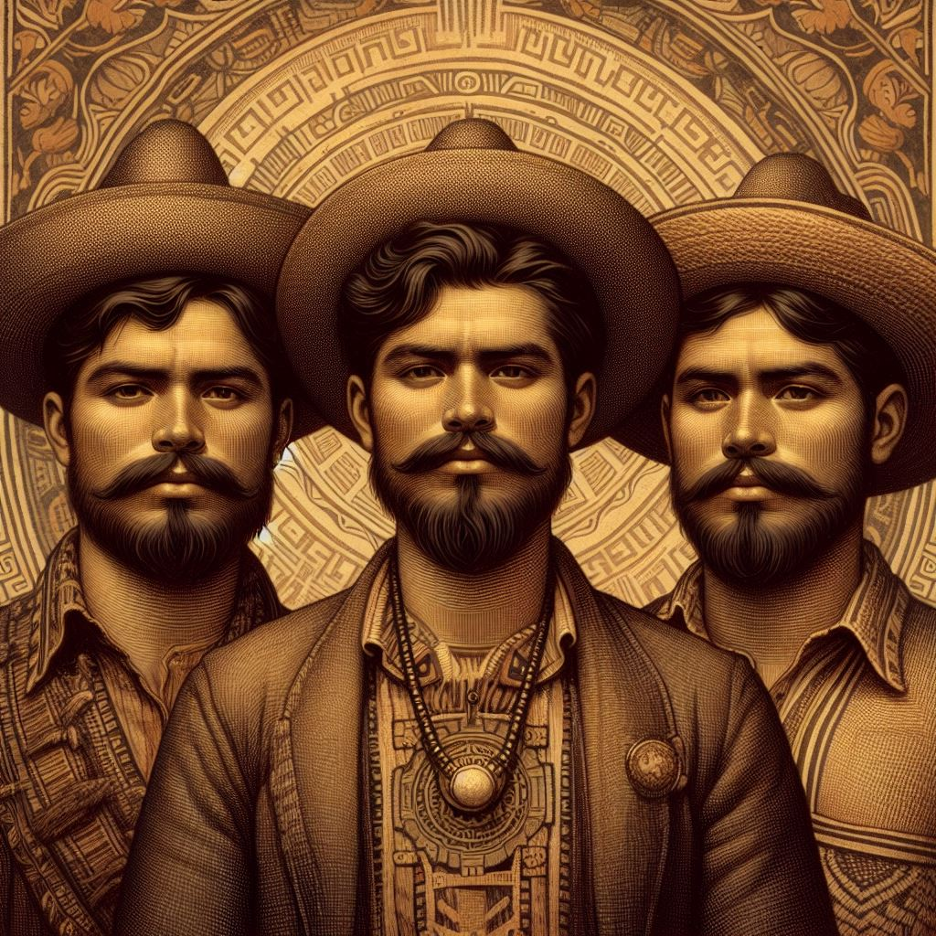

Slide 22
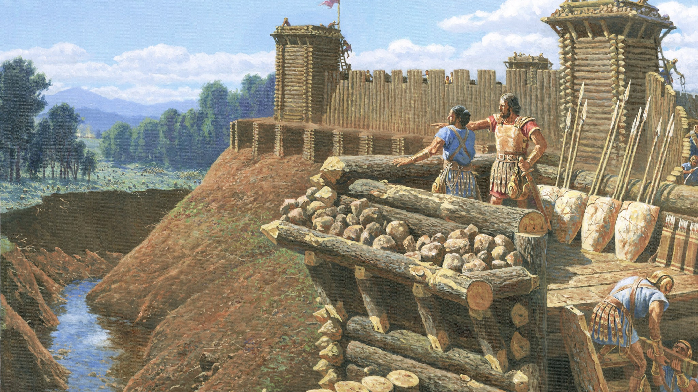
The Nephites “had supposed that the Lamanites durst not come into the heart of their lands to attack that great city Zarahemla.”
(Helaman 1:18)
Clark Kelley Price
Notes:
https://www.churchofjesuschrist.org/study/manual/book-of-mormon-seminary-teacher-manual-2024/33-alma-43-52/331-teacher?lang=eng

Slide 23

“Moronihah had supposed that the Lamanites durst not come into the center of the land.”
(Helaman 1:26)
Naw, probably just the borders.
Should we focus on the center?
Clark Kelley Price
Notes:
https://www.churchofjesuschrist.org/study/manual/book-of-mormon-seminary-teacher-manual-2024/33-alma-43-52/331-teacher?lang=eng

Slide 24
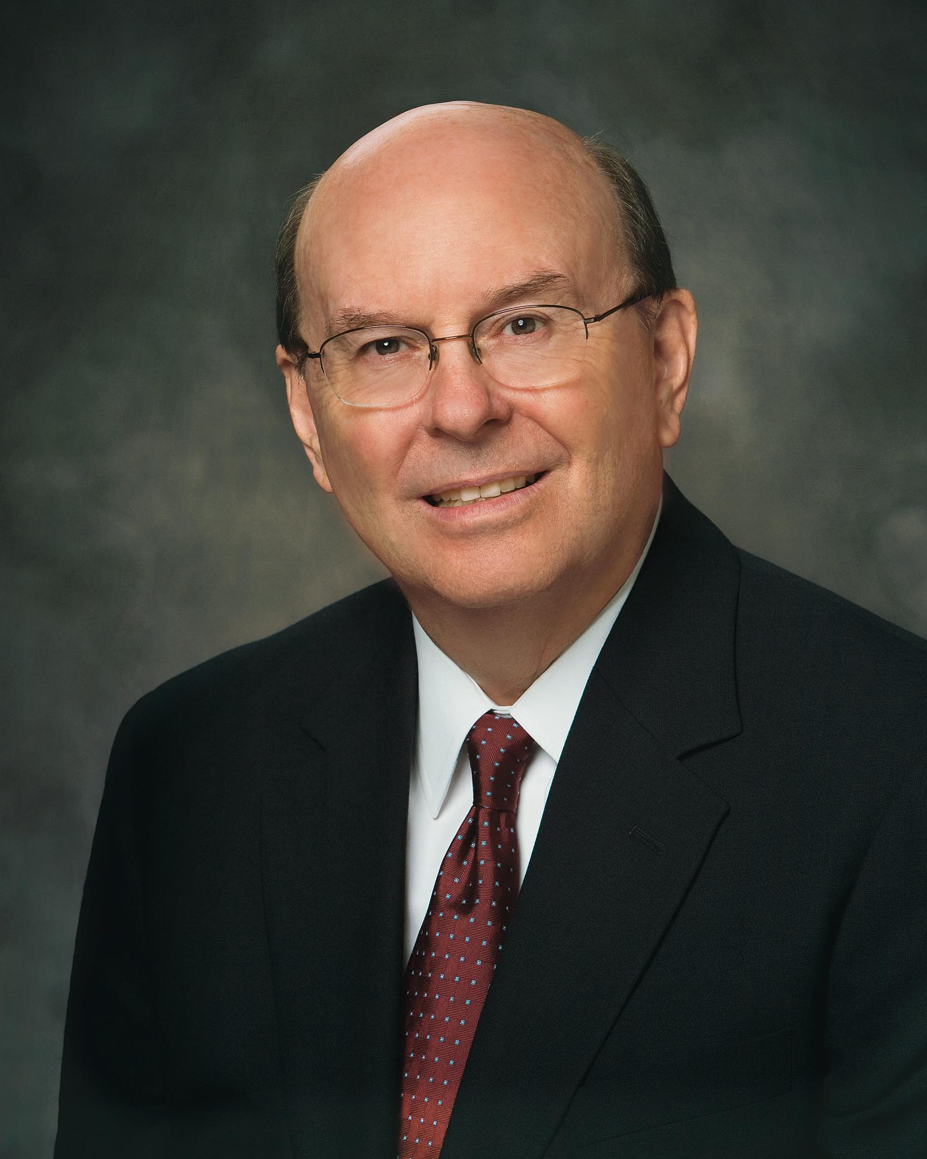
“[I was traveling with my two young sons] by car from San Francisco to Utah in June. The weather had been very good.
As we started our ascent [through] the Sierra Nevada Mountains, suddenly and without warning an enormous snowstorm hit us. None of the drivers were prepared. A semitruck in front of us had jackknifed and was spread across two lanes.
Notes:
https://news-ca.churchofjesuschrist.org/media/orig/CookQL_0710.jpg

Slide 25
“Other trucks and cars had slid off the freeway….All traffic then came to a halt. We were not prepared for this blizzard in June. We had no warm clothing, and our fuel was relatively low. I huddled with the two boys in an effort to keep us warm.
Notes:
https://news-ca.churchofjesuschrist.org/media/orig/CookQL_0710.jpg

Slide 26
“After many hours, safety vehicles, snowplows, and tow trucks began to clear up the massive logjam of vehicles… Part of the trauma I experienced crossing the Sierras in that blizzard many years ago occurred because I was not prepared for this sudden, unexpected event.
Notes:
https://news-ca.churchofjesuschrist.org/media/orig/CookQL_0710.jpg

Slide 27
“One of the great blessings of the scriptures is that they warn us of challenges that are unexpected but often occur. We would do well to be prepared for them. One form of preparation is to keep the commandments.”
Elder Quentin L. Cook,
Ensign, Nov. 2008
Notes:
https://news-ca.churchofjesuschrist.org/media/orig/CookQL_0710.jpg

Slide 28
The leader of the Lamanite army came “with such exceedingly great speed that there was no time for the Nephites to gather together their armies.”
(Helaman 1:19)
Clark Kelley Price
Notes:
https://www.churchofjesuschrist.org/study/manual/book-of-mormon-seminary-teacher-manual-2024/33-alma-43-52/331-teacher?lang=eng

Slide 29
The leader of the Lamanite army came “with such exceedingly great speed that there was no time for the Nephites to gather together their armies.”
(Helaman 1:19)
That's on us.
Oh shoot.
The leader of the Lamanites “did march forth, giving them no time.”
(Helaman 1:24)
Clark Kelley Price
Notes:
https://www.churchofjesuschrist.org/study/manual/book-of-mormon-seminary-teacher-manual-2024/33-alma-43-52/331-teacher?lang=eng

Slide 30
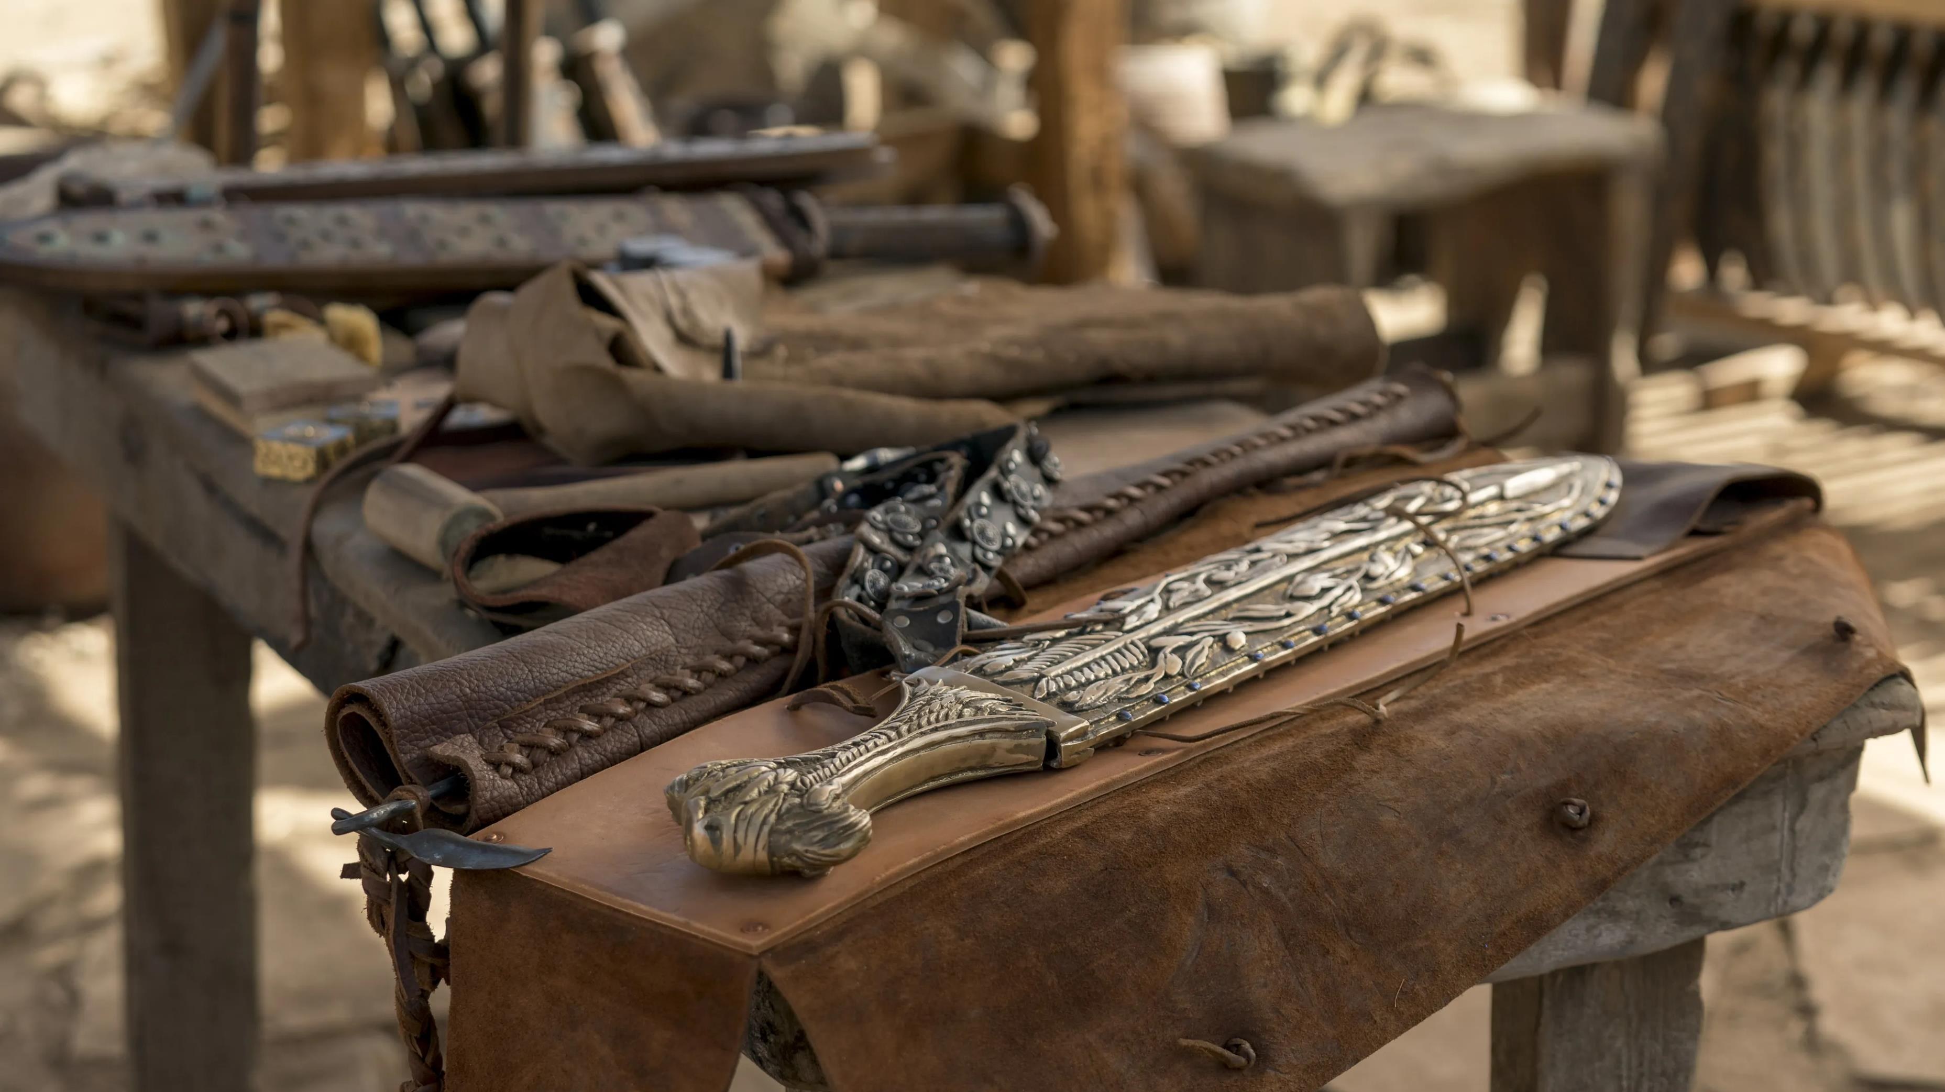
The time to prepare is before the attack
Notes:
https://www.churchofjesuschrist.org/imgs/f427cfadee05af00346efe2c4150a04bb6fa7ae2/full/3840%2C/0/default

Slide 31
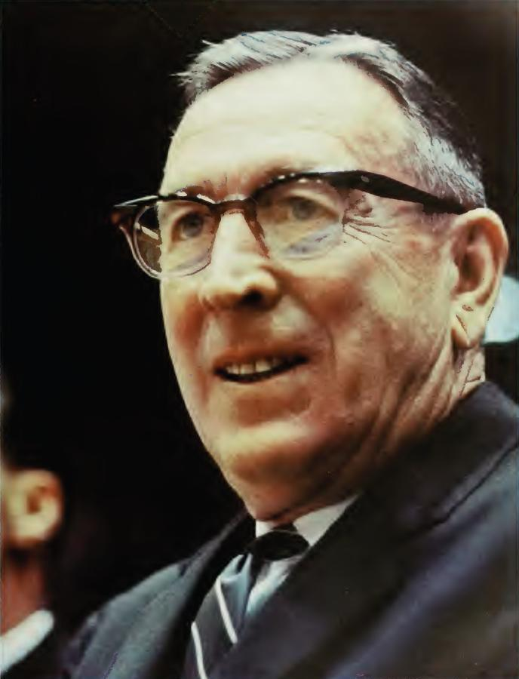
“The time to prepare isn’t after you have been given the opportunity. It’s long before that opportunity arises. Once the opportunity arrives, it’s too late to prepare…
Notes:
https://picryl.com/media/john-wooden-57db35

Slide 32
“When opportunity knocked 10 minutes into the 1964 national championship game against Duke University, [Doug McIntosh, a nonstarter] was prepared for his chance to show competitive greatness. UCLA’s starting center…got off to a slow start, and I signaled down the bench for Doug, who played the rest of the game and was an important reason UCLA won its first national championship in basketball…
Notes:
https://picryl.com/media/john-wooden-57db35

Slide 33
“Even though logic would have suggested that Doug McIntosh would have little impact in the championship game—probably not even play in it—he prepared as though he knew he would be called on, that his chance would come. When opportunity came knocking, Doug McIntosh was ready.”
John Wooden, https://www.thewoodeneffect.com/
Notes:
https://picryl.com/media/john-wooden-57db35

Slide 34
One day we might be called to be a missionary. What are we doing today to prepare for that call to serve?

Slide 35
One day we might be called to be a missionary. What are we doing today to prepare for that call to serve?
One day we might be called to be a challenging calling. What are we doing today to prepare to be an instrument in the Lord’s hand?

Slide 36
One day we might be called to be a missionary. What are we doing today to prepare for that call to serve?
One day we might be called to be a challenging calling. What are we doing today to prepare to be an instrument in the Lord’s hand?
One day we might have a new family role like spouse, parent, aunt, uncle or grandparent. What are we doing today to prepare for these wonderful opportunities?

Slide 37
Gadianton,
the leader of Kishkumen’s band
James Fullmer
Notes:
https://bookofmormonartcatalog.org/catalog/gadianton/

Slide 38
“More of this Gadianton shall be spoken hereafter. And thus ended the forty and second year of the reign of the judges over the people of Nephi. And behold, in the end of this book ye shall see that this Gadianton did prove the overthrow, yea, almost the entire destruction of the people of Nephi. Behold I do not mean the end of the book of Helaman, but I mean the end of the book of Nephi, from which I have taken all the account which I have written.”
(Helaman 2:12–14)

Slide 39
“[The people who moved northward]… became exceedingly expert in the working of cement; therefore they did build houses of cement, in the which they did dwell….The people who were in the land northward did dwell in tents, and in houses of cement…the people in the land northward [did] build many cities, both of wood and of cement.”
(Helaman 3:5–11)
Notes:
This is the only time “cement” appears in the Bible or the Book of Mormon.
https://assets.churchofjesuschrist.org/ba/75/ba75de5f47b5690944b3ab797a168c95a5b19f5b/jacob_with_wife.jpeg

Slide 40

Was there cement in ancient America?
Notes:
https://www.pexels.com/photo/full-frame-shot-of-abstract-pattern-247719/

Slide 41
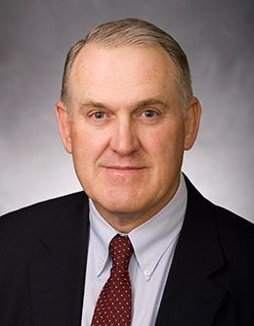
“Many items mentioned in the Book of Mormon have not been and may never be verified through archaeology, but many have been. Verification is a one-way street in this instance. Positive and negative evidence do not count the same…
Given current means of verification, positive items are here to stay, but negative items may prove to be positive ones in hiding.
Notes:
https://speeches.byu.edu/wp-content/uploads/jpg/Clark_John-Web-compressor.jpg

Slide 42
“‘Missing’ evidence focuses further research, but it lacks compelling logical force in arguments because it represents the absence of information rather than secure evidence.”
John E. Clark
Notes:
https://speeches.byu.edu/wp-content/uploads/jpg/Clark_John-Web-compressor.jpg

Slide 43
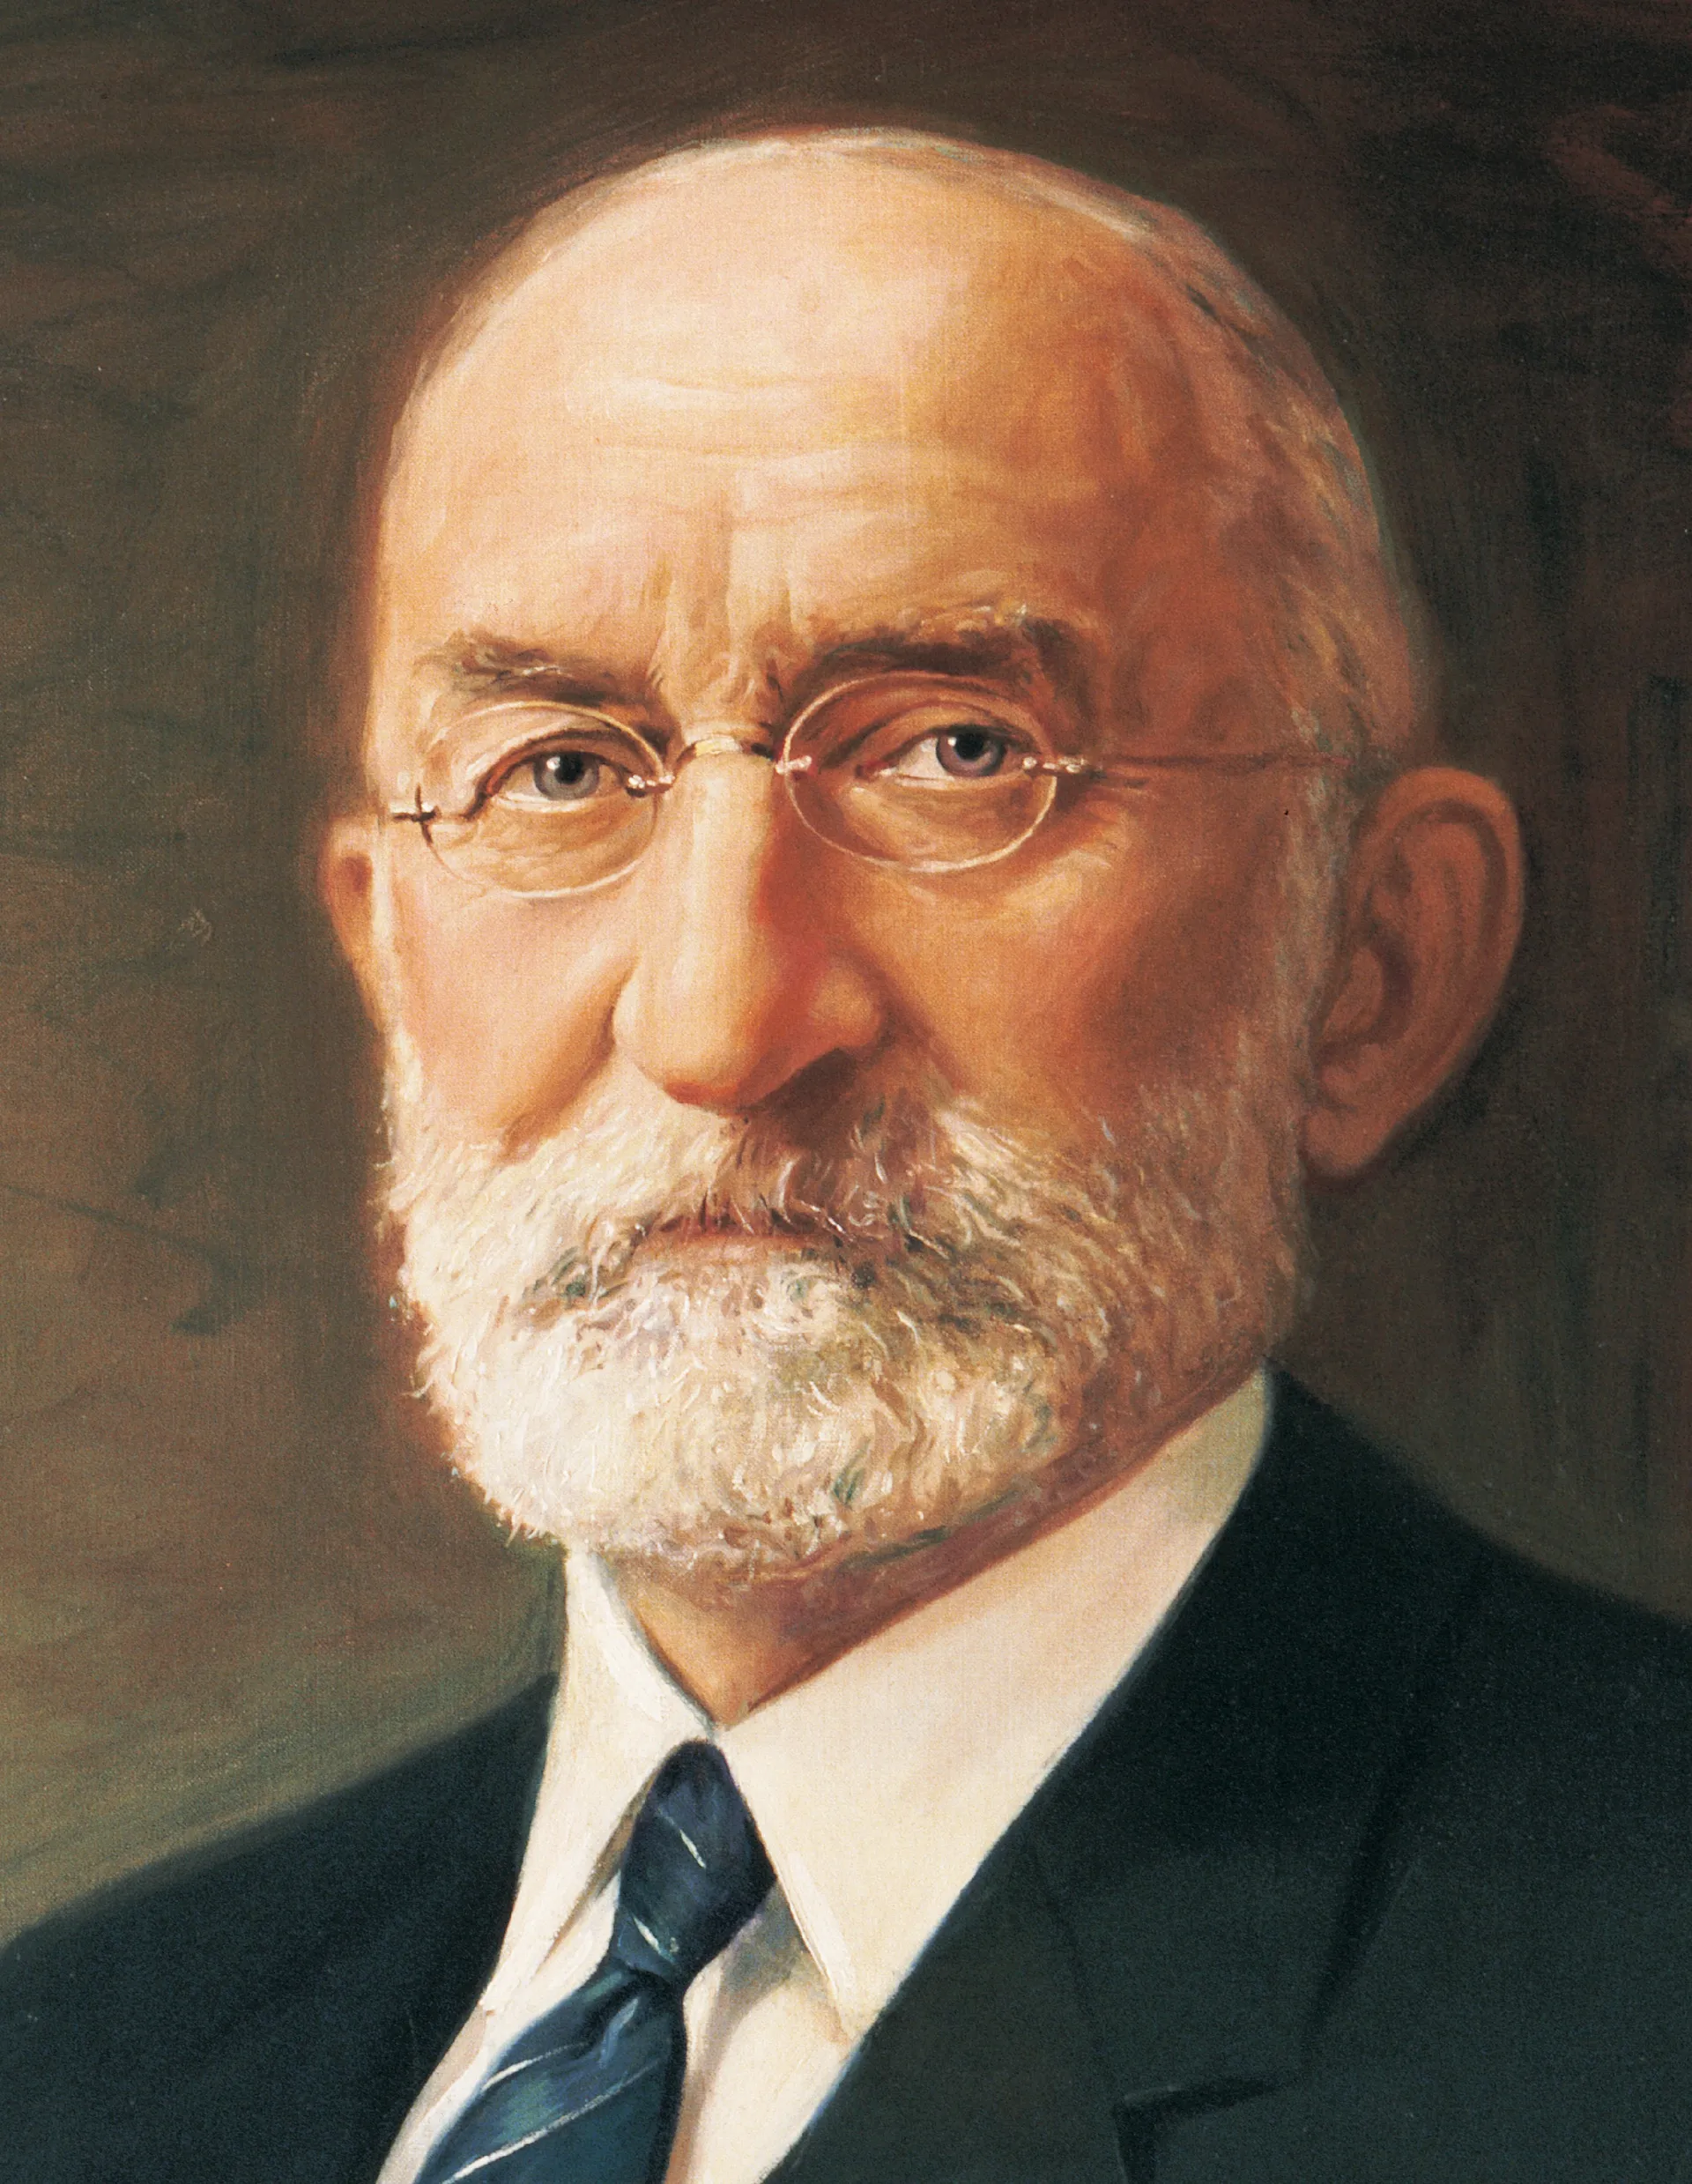
“When I was a young unmarried man, another young man who had received a doctor’s degree ridiculed me for believing in the Book of Mormon. He said that one lie in the Book of Mormon is that the people had built their homes out of cement and that they were very skillful in the use of cement. He said there had never been found, and never would be found, a house built of cement by the ancient inhabitants of this country, because the people in that early age knew nothing about cement.
Notes:
https://www.churchofjesuschrist.org/imgs/acfd585c5534c7b7f99797441f997573f38693ac/full/1920%2C/0/default

Slide 44
“He said that should be enough to make one disbelieve the book. I said: ‘That does not affect my faith one particle. I read the Book of Mormon prayerfully and supplicated God for a testimony in my heart and soul of the divinity of it, and I have accepted it and believe it with all my heart.’ I also said to him, ‘If my children do not find cement houses, I expect that my grandchildren will.’”
President Heber J. Grant,
in Conference Report,
Apr. 1929, 129.
Notes:
https://www.churchofjesuschrist.org/imgs/acfd585c5534c7b7f99797441f997573f38693ac/full/1920%2C/0/default

Slide 45
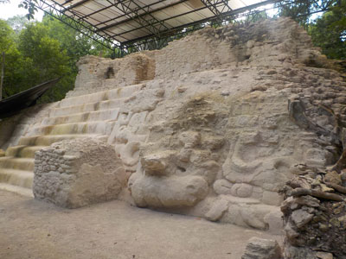
“According to [Non-LDS] Maya experts Michael D. Coe and Stephen Houston, it was not until the Late Preclassic period (300 BC–AD 250) that the Maya “quickly realized the structural value of a concrete-like fill made from limestone rubble” and lime-rich mud. This led to “an explosion of activity around 100 BC” in the Northern Petén.”
evidencecentral.org

Slide 46
Status of Book of Mormon Claims in 1842
Unconfirmed
Confirmed
Steel sword
Brass plates
Golden plates
Gold smelting
Silver smelting
Copper smelting
Brass
Iron
Precious ores
Molten stone [glass]
Cow
Oxen
Horse
Ass
Goat
Wild Goat
Sheep
Wild Beasts
Wheat
Barley
Barley-based monetary system
Solomon-like Temple
Stone monuments
Thrones
Palaces
Large cities
Fortifications
Cement
Highways
Military costumes
Swords
Spears
Scimitars
Javelins
Bows and arrows
Slings
Large armies
Human sacrifice
Submarine barges
Hebrew language
Reformed Egyptian script
Natives could read
Natives could write
BM place names
BM personal names
Two advanced civilizations
Older in north
Younger in south
Older disappeared
Younger spread north
Younger destroyed
200 year period of peace
3 culture sequence
Narrow neck
East and West seas
N-S large river
Southern highlands
Highland lake
Wide eastern sea coast
Narrow west coast
8 Confirmed (13.3%) 52 Unconfirmed (86.7%)
John Clark

Slide 47
Status of Book of Mormon Claims in 2005
Unconfirmed
Confirmed
Undetermined
Steel sword
Brass plates
Golden plates
Gold smelting
Silver smelting
Copper smelting
Brass
Iron
Precious ores
Molten stone [glass]
Cow
Oxen
Horse
Ass
Goat
Wild Goat
Sheep
Wild Beasts
Wheat
Barley
Barley-based monetary system
Solomon-like Temple
Stone monuments
Thrones
Palaces
Large cities
Fortifications
Cement
Highways
Military costumes
Swords
Spears
Scimitars
Javelins
Bows and arrows
Slings
Large armies
Human sacrifice
Submarine barges
Hebrew language
Reformed Egyptian script
Natives could read
Natives could write
BM place names
BM personal names
Two advanced civilizations
Older in north
Younger in south
Older disappeared
Younger spread north
Younger destroyed
200 year period of peace
3 culture sequence
Narrow neck
East and West seas
N-S large river
Southern highlands
Highland lake
Wide eastern sea coast
Narrow west coast
10 Undetermined (17%) 35 Confirmed (58%) 15 Unconfirmed (25%)
John Clark

Slide 48
Status of Book of Mormon Claims in 2021
Unconfirmed
Confirmed
Undetermined
Steel sword
Brass plates
Golden plates
Gold smelting
Silver smelting
Copper smelting
Brass
Iron
Precious ores
Molten stone [glass]
Cow
Oxen
Horse
Ass
Goat
Wild Goat
Sheep
Wild Beasts
Wheat
Barley
Barley-based monetary system
Solomon-like Temple
Stone monuments
Thrones
Palaces
Large cities
Fortifications
Cement
Highways
Military costumes
Swords
Spears
Scimitars
Javelins
Bows and arrows
Slings
Large armies
Human sacrifice
Submarine barges
Hebrew language
Reformed Egyptian script
Natives could read
Natives could write
BM place names
BM personal names
Two advanced civilizations
Older in north
Younger in south
Older disappeared
Younger spread north
Younger destroyed
200 year period of peace
3 culture sequence
Narrow neck
East and West seas
N-S large river
Southern highlands
Highland lake
Wide eastern sea coast
Narrow west coast
8 Undetermined (13%) 46 Confirmed (77%) 6 Unconfirmed (10%)
Lynne Hilton Wilson

Slide 49

“As seen by science, the Book of Mormon is stronger today than it was in 1830, 1844, 1950, or even 2000, so I expect it will continue to become stronger in the future.”
John Clark
Notes:
https://speeches.byu.edu/wp-content/uploads/jpg/Clark_John-Web-compressor.jpg

Slide 50
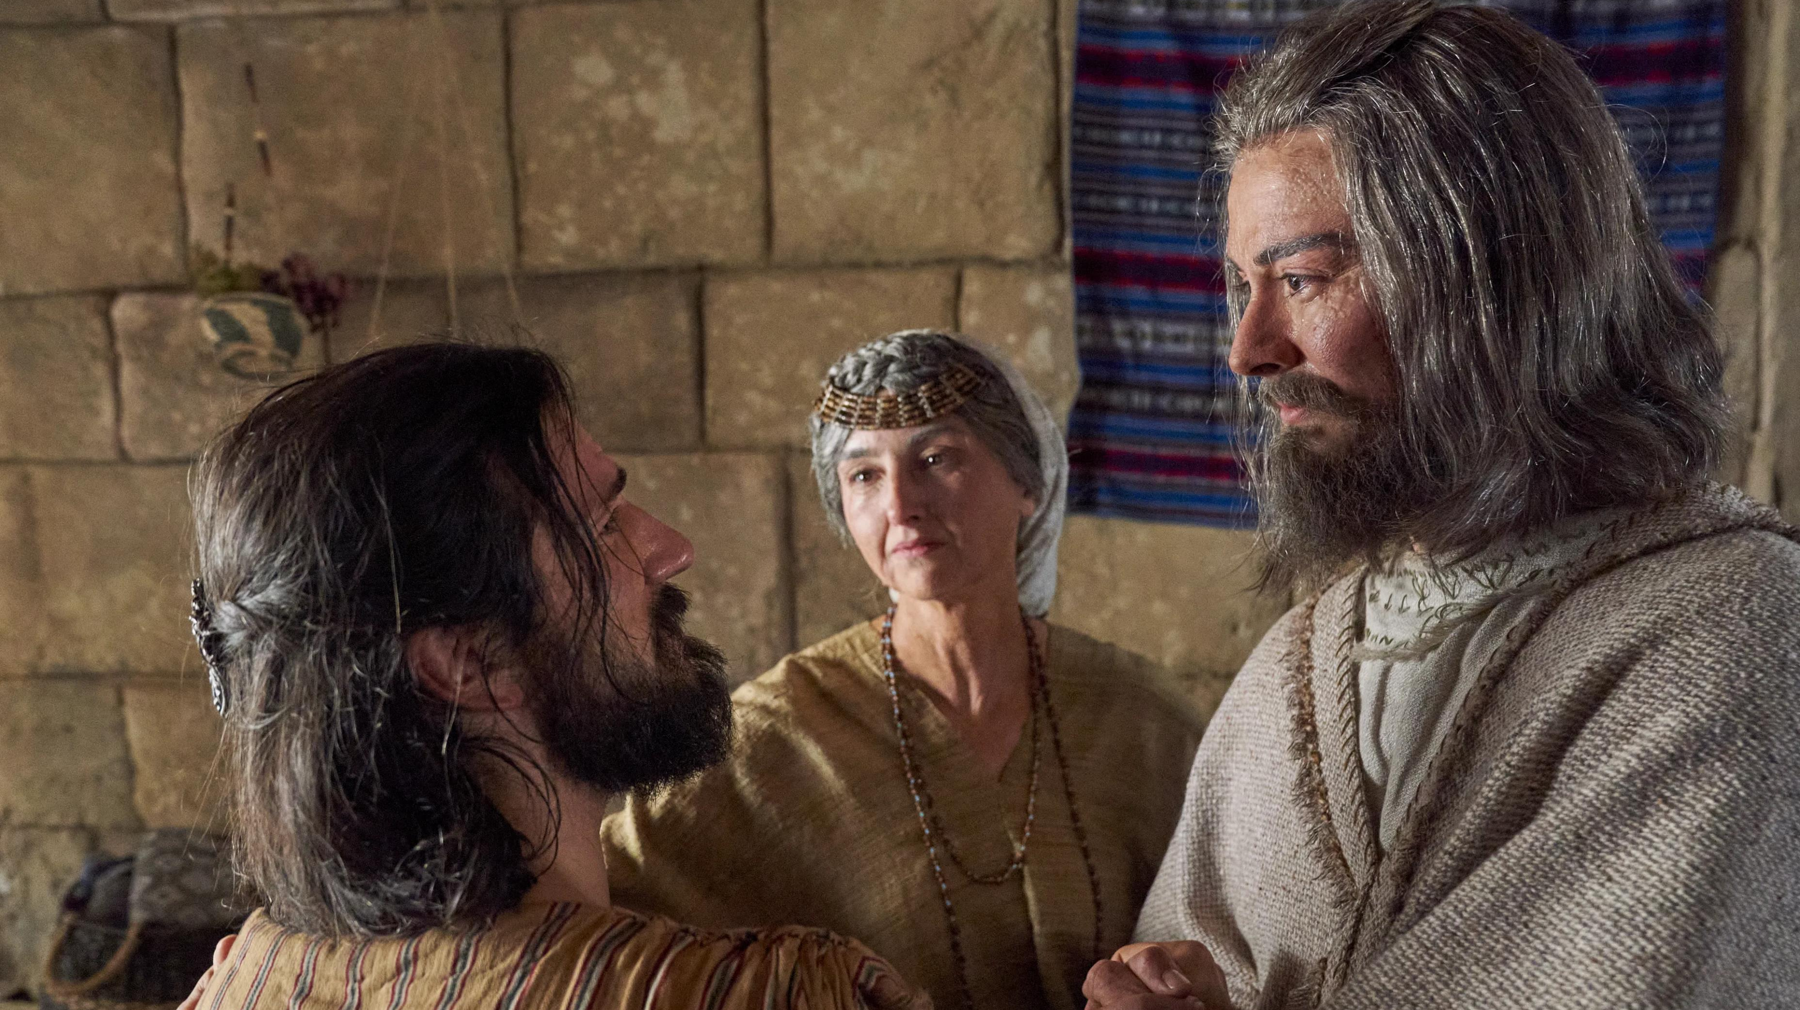
“Alma”
Notes:
https://churchofjesuschrist.org/imgs/579241da8c112462d28f5d09a58e44e0a9d89a76/full/3840%2C/0/default

Slide 51
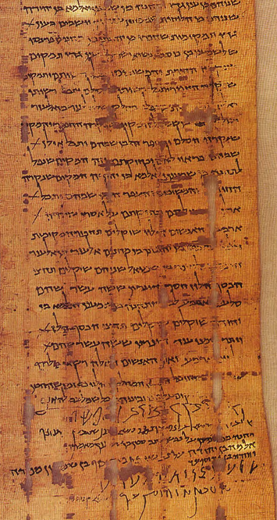
“The name Alma…is now attested in inscriptions from the ancient Near East discovered in the twentieth century.”
evidencecentral.org
Notes:
As first reported by Hugh Nibley, the name “Alma son of Judah” is attested twice on a land deed recovered from a cave near the Dead Sea dating to the Bar Kokhba Rebellion in the early second century AD. Terrence Szink has shown that the name is also attested more than eight times on cuneiform tablets at the archaeological site of Ebla in Syria as early as the late third millennium BC.

Slide 52
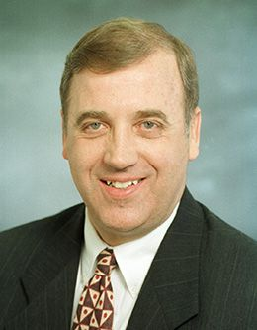
“While a book might conceivably be made to look authentic by matching the standard knowledge at the time of its production, it would gradually become less persuasive as more and more is learned about the times it claims to describe. On the other hand, truly authentic ancient documents would continue to look ancient, even in light of new discoveries and new expectations.”
Noel Reynolds,
Book of Mormon Authorship Revisited, 98-99
Notes:
https://speeches.byu.edu/speakers/noel-b-reynolds/

Slide 53
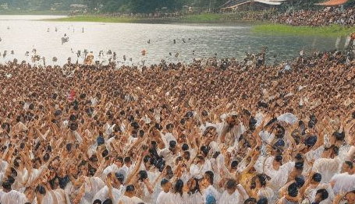
“There were thousands who did join themselves unto the church and were baptized unto repentance.
And so great was the prosperity of the church, and so many the blessings which were poured out upon the people, that even the high priests and the teachers were themselves astonished beyond measure.
(Helaman 3:24–25)
Notes:
AI generated image

Slide 54
“Because of their iniquity the church had begun to dwindle; and they began to disbelieve in the spirit of prophecy and in the spirit of revelation; and the judgments of God did stare them in the face…the Spirit of the Lord…had withdrawn from them because the Spirit of the Lord doth not dwell in unholy temples.”
(Helaman 4:23–24)
Notes:
https://assets.churchofjesuschrist.org/ba/75/ba75de5f47b5690944b3ab797a168c95a5b19f5b/jacob_with_wife.jpeg

Slide 55
“I have given unto you the names of our first parents who came out of the land of Jerusalem; and this I have done that when you remember your names ye may remember them; and when ye remember them ye may remember their works; and when ye remember their works ye may know how that it is said, and also written, that they were good. Therefore, my sons, I would that ye should do that which is good, that it may be said of you, and also written, even as it has been said and written of them.”
(Helaman 5:6–7)
Notes:
https://assets.churchofjesuschrist.org/ba/75/ba75de5f47b5690944b3ab797a168c95a5b19f5b/jacob_with_wife.jpeg

Slide 56
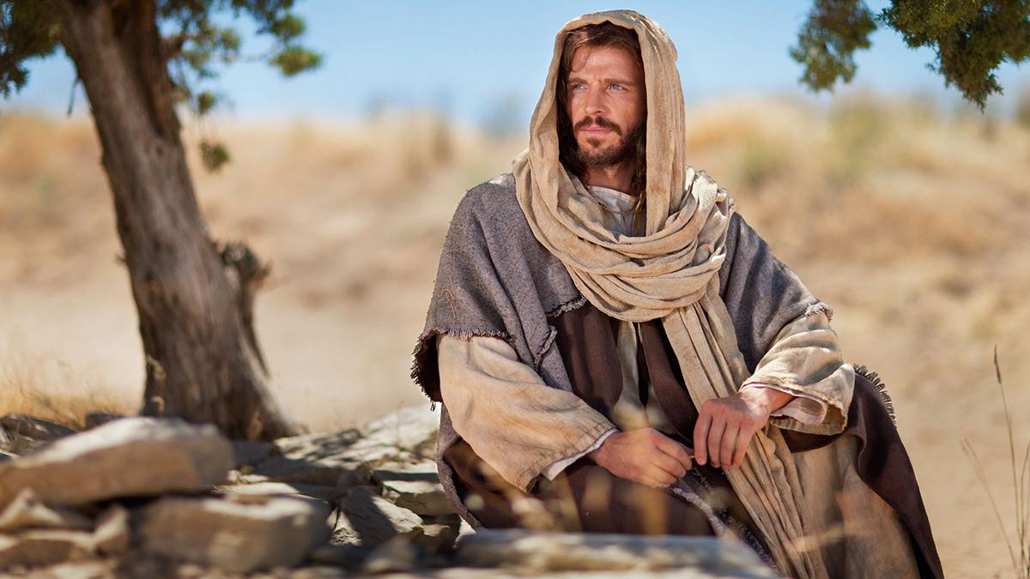
“O remember, remember…that there is no other way nor means whereby [people] can be saved, only through the atoning blood of Jesus Christ.”
(Helaman 5:9)
Notes:
https://content.churchofjesuschrist.org/acp/bc/cp/Canada/images2021/Keeping%20Christ%20at%20the%20Centre/1200x675/1-banner-jesus-at-the-well-medium.jpg

Slide 57
“And now, my sons, remember, remember that it is upon the rock of our Redeemer, who is Christ, the Son of God, that ye must build your foundation.”
(Helaman 5:12)
Notes:
https://content.churchofjesuschrist.org/acp/bc/cp/Canada/images2021/Keeping%20Christ%20at%20the%20Centre/1200x675/1-banner-jesus-at-the-well-medium.jpg

Slide 58
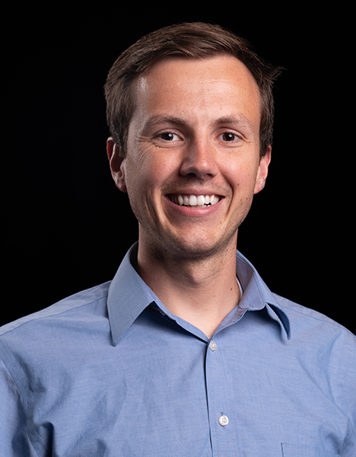
“In total, there are 221 references to remember and its derivatives in the Book of Mormon; 150 these are directly connected to Jesus Christ.”
Dr. Michael Ricks
Notes:
https://business-images.unl.edu/facStaffPhotos/MichaelRicks.jpg

Slide 59
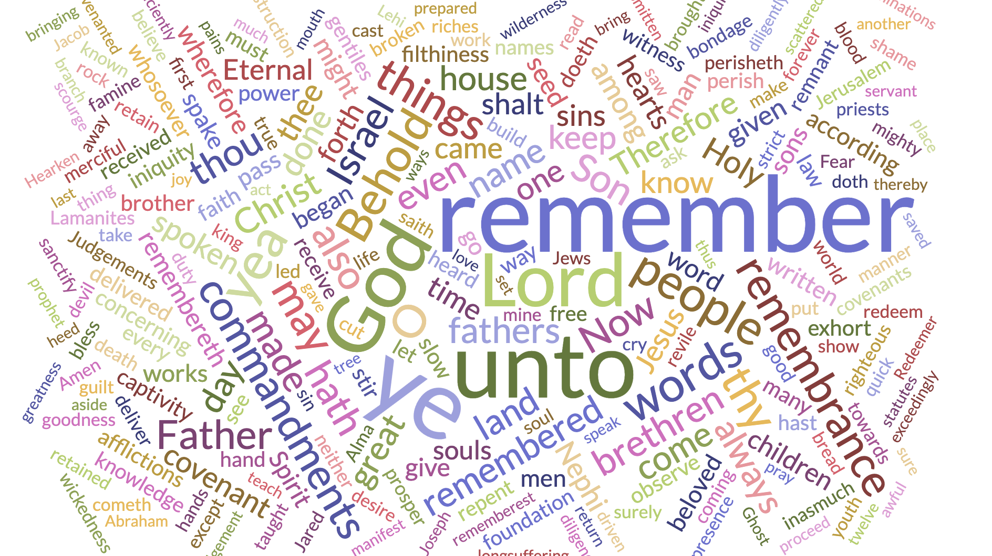
Notes:
Note this Word Cloud that visualizes the 250 most common words in the verses where remember is used. Larger and more central words occur with greater frequency.”
https://assets.churchofjesuschrist.org/ba/75/ba75de5f47b5690944b3ab797a168c95a5b19f5b/jacob_with_wife.jpeg

Slide 60
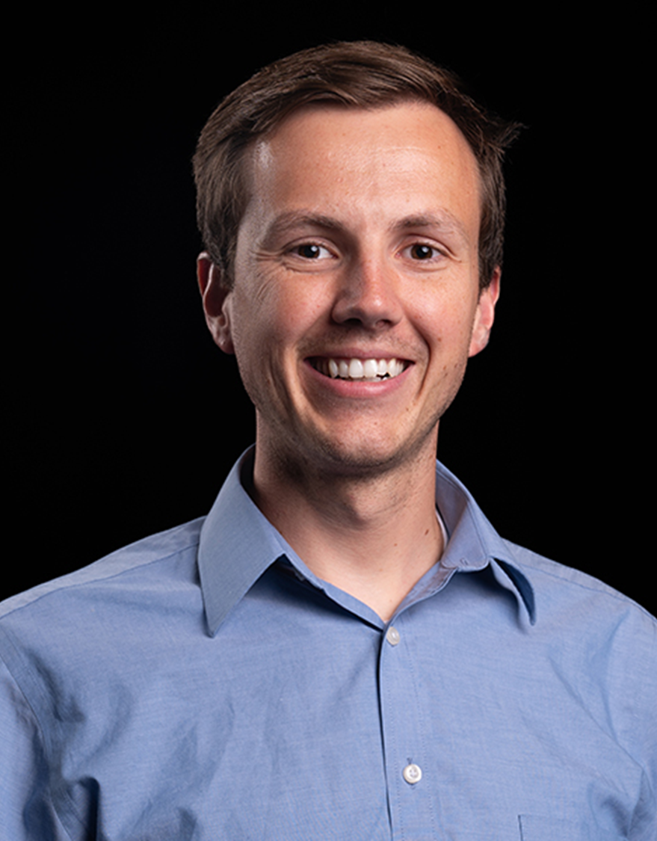
“At the heart of the themes of remembering in the Book of Mormon is remembering Jesus Christ. This theme is almost 50% larger than the next most common theme.”
Dr. Michael Ricks
Notes:
https://business-images.unl.edu/facStaffPhotos/MichaelRicks.jpg

Slide 61

“Remember, remember, that it is upon the rock of our Redeemer, who is Christ, the Son of God, that ye must build your foundation; that when the devil shall send forth his mighty winds, yea, his shafts in the whirlwind, yea, when all his hail and his mighty storm shall beat upon you, it shall have no power over you to drag you down to the gulf of misery and endless wo, because of the rock upon which ye are built, which is a sure foundation, a foundation whereon if men build they cannot fall.”
(Helaman 5:12)
Notes:
https://www.lds.org/bc/content/shared/content/images/magazines/new-era/2013/11/house-island_1168764_gly.jpg

Slide 62
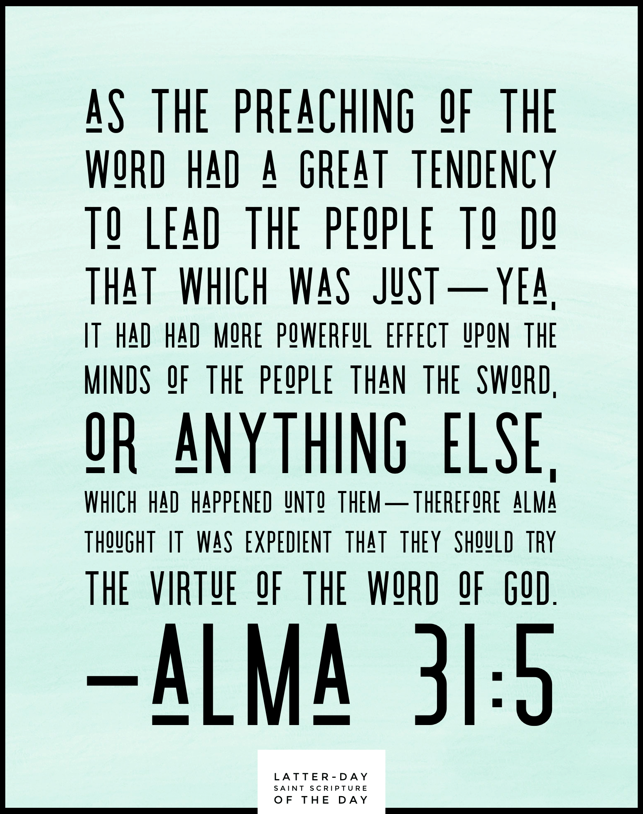
“There were about three hundred souls who saw and heard these things…they did go forth…declaring throughout all the regions round about all the things which they had heard and seen, insomuch that the more part of the Lamanites were convinced…And as many as were convinced did lay down their weapons of war, and also their hatred and the tradition of their fathers…they did yield up unto the Nephites the lands of their possession.” (Helaman 5:49–52)

Slide 63
Early Mentions of Secret Combinations In The Book of Mormon
2 Nephi 9:9- “[Satan] beguiled our first parents, [and] transformeth himself nigh unto an angel of light, and stirreth up the children of men unto secret combinations of murder and all manner of secret works of darkness.”
2 Nephi 26:22- “there are also secret combinations, even as in times of old, according to the combinations of the devil, for he is the founder of all these things.”

Slide 64
“[These] secret oaths and covenants…were put into the heart of Gadianton by that same being who did entice our first parents to partake of the forbidden fruit—Yea, that same being who did plot with Cain, that if he would murder his brother Abel it should not be known unto the world. And he did plot with Cain and his followers from that time forth.”
(Helaman 6:26–27)

Slide 65
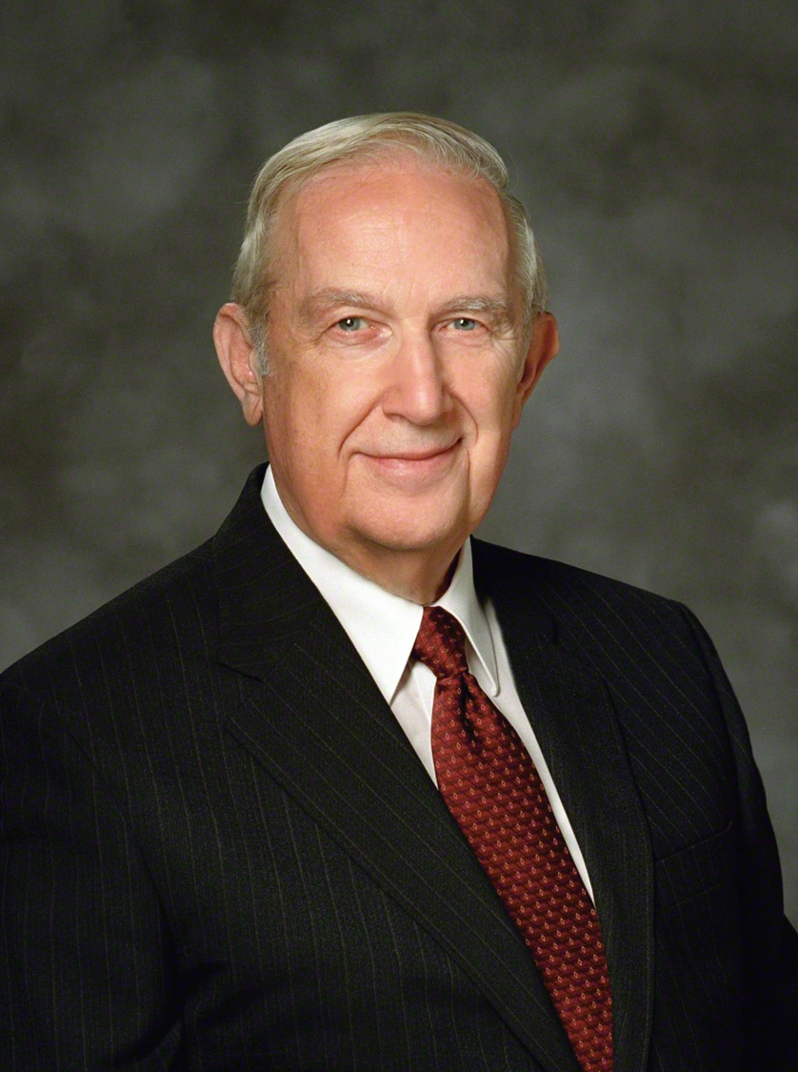
“Satan strives to convince one that sins can be hidden from others, yet it is he that causes them to be revealed in the most compromising circumstances.”
Elder Richard G. Scott
Ensign, Nov. 2002, 87

Slide 66
“Secret combinations…have caused the destruction of [the Jaredites], and also the destruction of the people of Nephi…it is wisdom in God that these things should be shown unto you, that thereby ye may repent of your sins, and suffer not that these murderous combinations shall get above you.”
(Ether 8:19, 21, 23)
Notes:
Use Helaman 6, Ether 9 and Ether 11

Slide 67
Historical Overview of Secret Combinations in Action Among the Nephites
Helaman 1:9-12
Helaman 2:3-14
Helaman 3:23
Helaman 6:18-24
Helaman 7:4-5, 25
Helaman 8:1-7, 10
Helaman 8:26-28
Helaman 11:1-2, 10
Helaman 11:24-33
3 Nephi 1:27-30
3 Ne. Ch. 2-Ch. 5:6
3 Ne. 6:21-Ch. 7:12
4 Ne. 38, 42, 45-46
Mormon 1:18-19

Slide 68
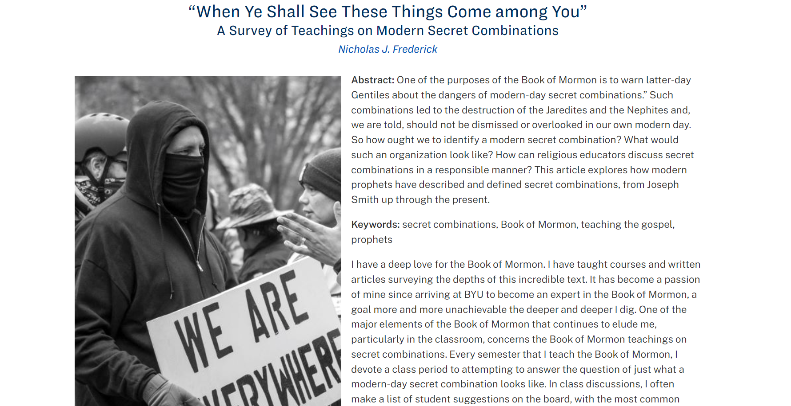
johnhiltoniii.com/thebookofmormon
Notes:
Use Helaman 6, Ether 9 and Ether 11

Slide 69
Secret combinations are secret (Helaman 1:9-12, Ether 8:14).
The purpose of secret combinations is to murder, rob, and gain wealth and power (Helaman. 2:8, 17, Ether 8:7, 16).
Secret combinations use secret words and secret signs (Helaman 6:22).
Secret combinations use covenants to do evil (Helaman. 1:9-12, Ether 8:13).
Secret combinations begin with the worst elements of society but they spread even to the righteous (Helaman 6:38-39, Ether 9:6).
Secret combinations lead the people to reject the truth (Helaman 8:1-5, Ether 11:22).
Secret combinations target women and children (Helaman 11:33).
Notes:
Use Helaman 6, Ether 9 and Ether 11

Slide 70
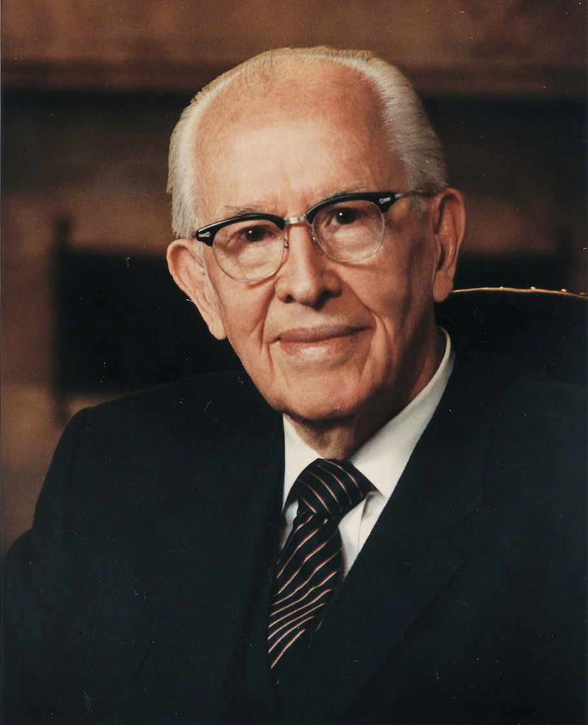
“I testify that wickedness is rapidly expanding in every segment of our society. It is more highly organized, more cleverly disguised, and more powerfully promoted than ever before. Secret combinations lusting for power, gain, and glory are flourishing.”
President Benson,
Ensign, Nov. 1988, 87

Slide 71
“A secret combination that seeks to overthrow the freedom of all lands, nations, and countries is increasing its evil influence and control over America and the entire world.”
President Benson,
Ensign, Nov. 1988, 87

Slide 72
“The Lamanites did hunt the band of robbers of Gadianton; and they did preach the word of God among the more wicked part of them, insomuch that this band of robbers was utterly destroyed from among the Lamanites.”
(Helaman 6:37)

Slide 73
“The people…repented and did humble themselves” (Helaman 11:9).
“It was because of their repentance and their humility that they had been delivered from an everlasting destruction.” (3 Nephi 4:33)
Notes:
Use Helaman 6, Ether 9 and Ether 11

Slide 74
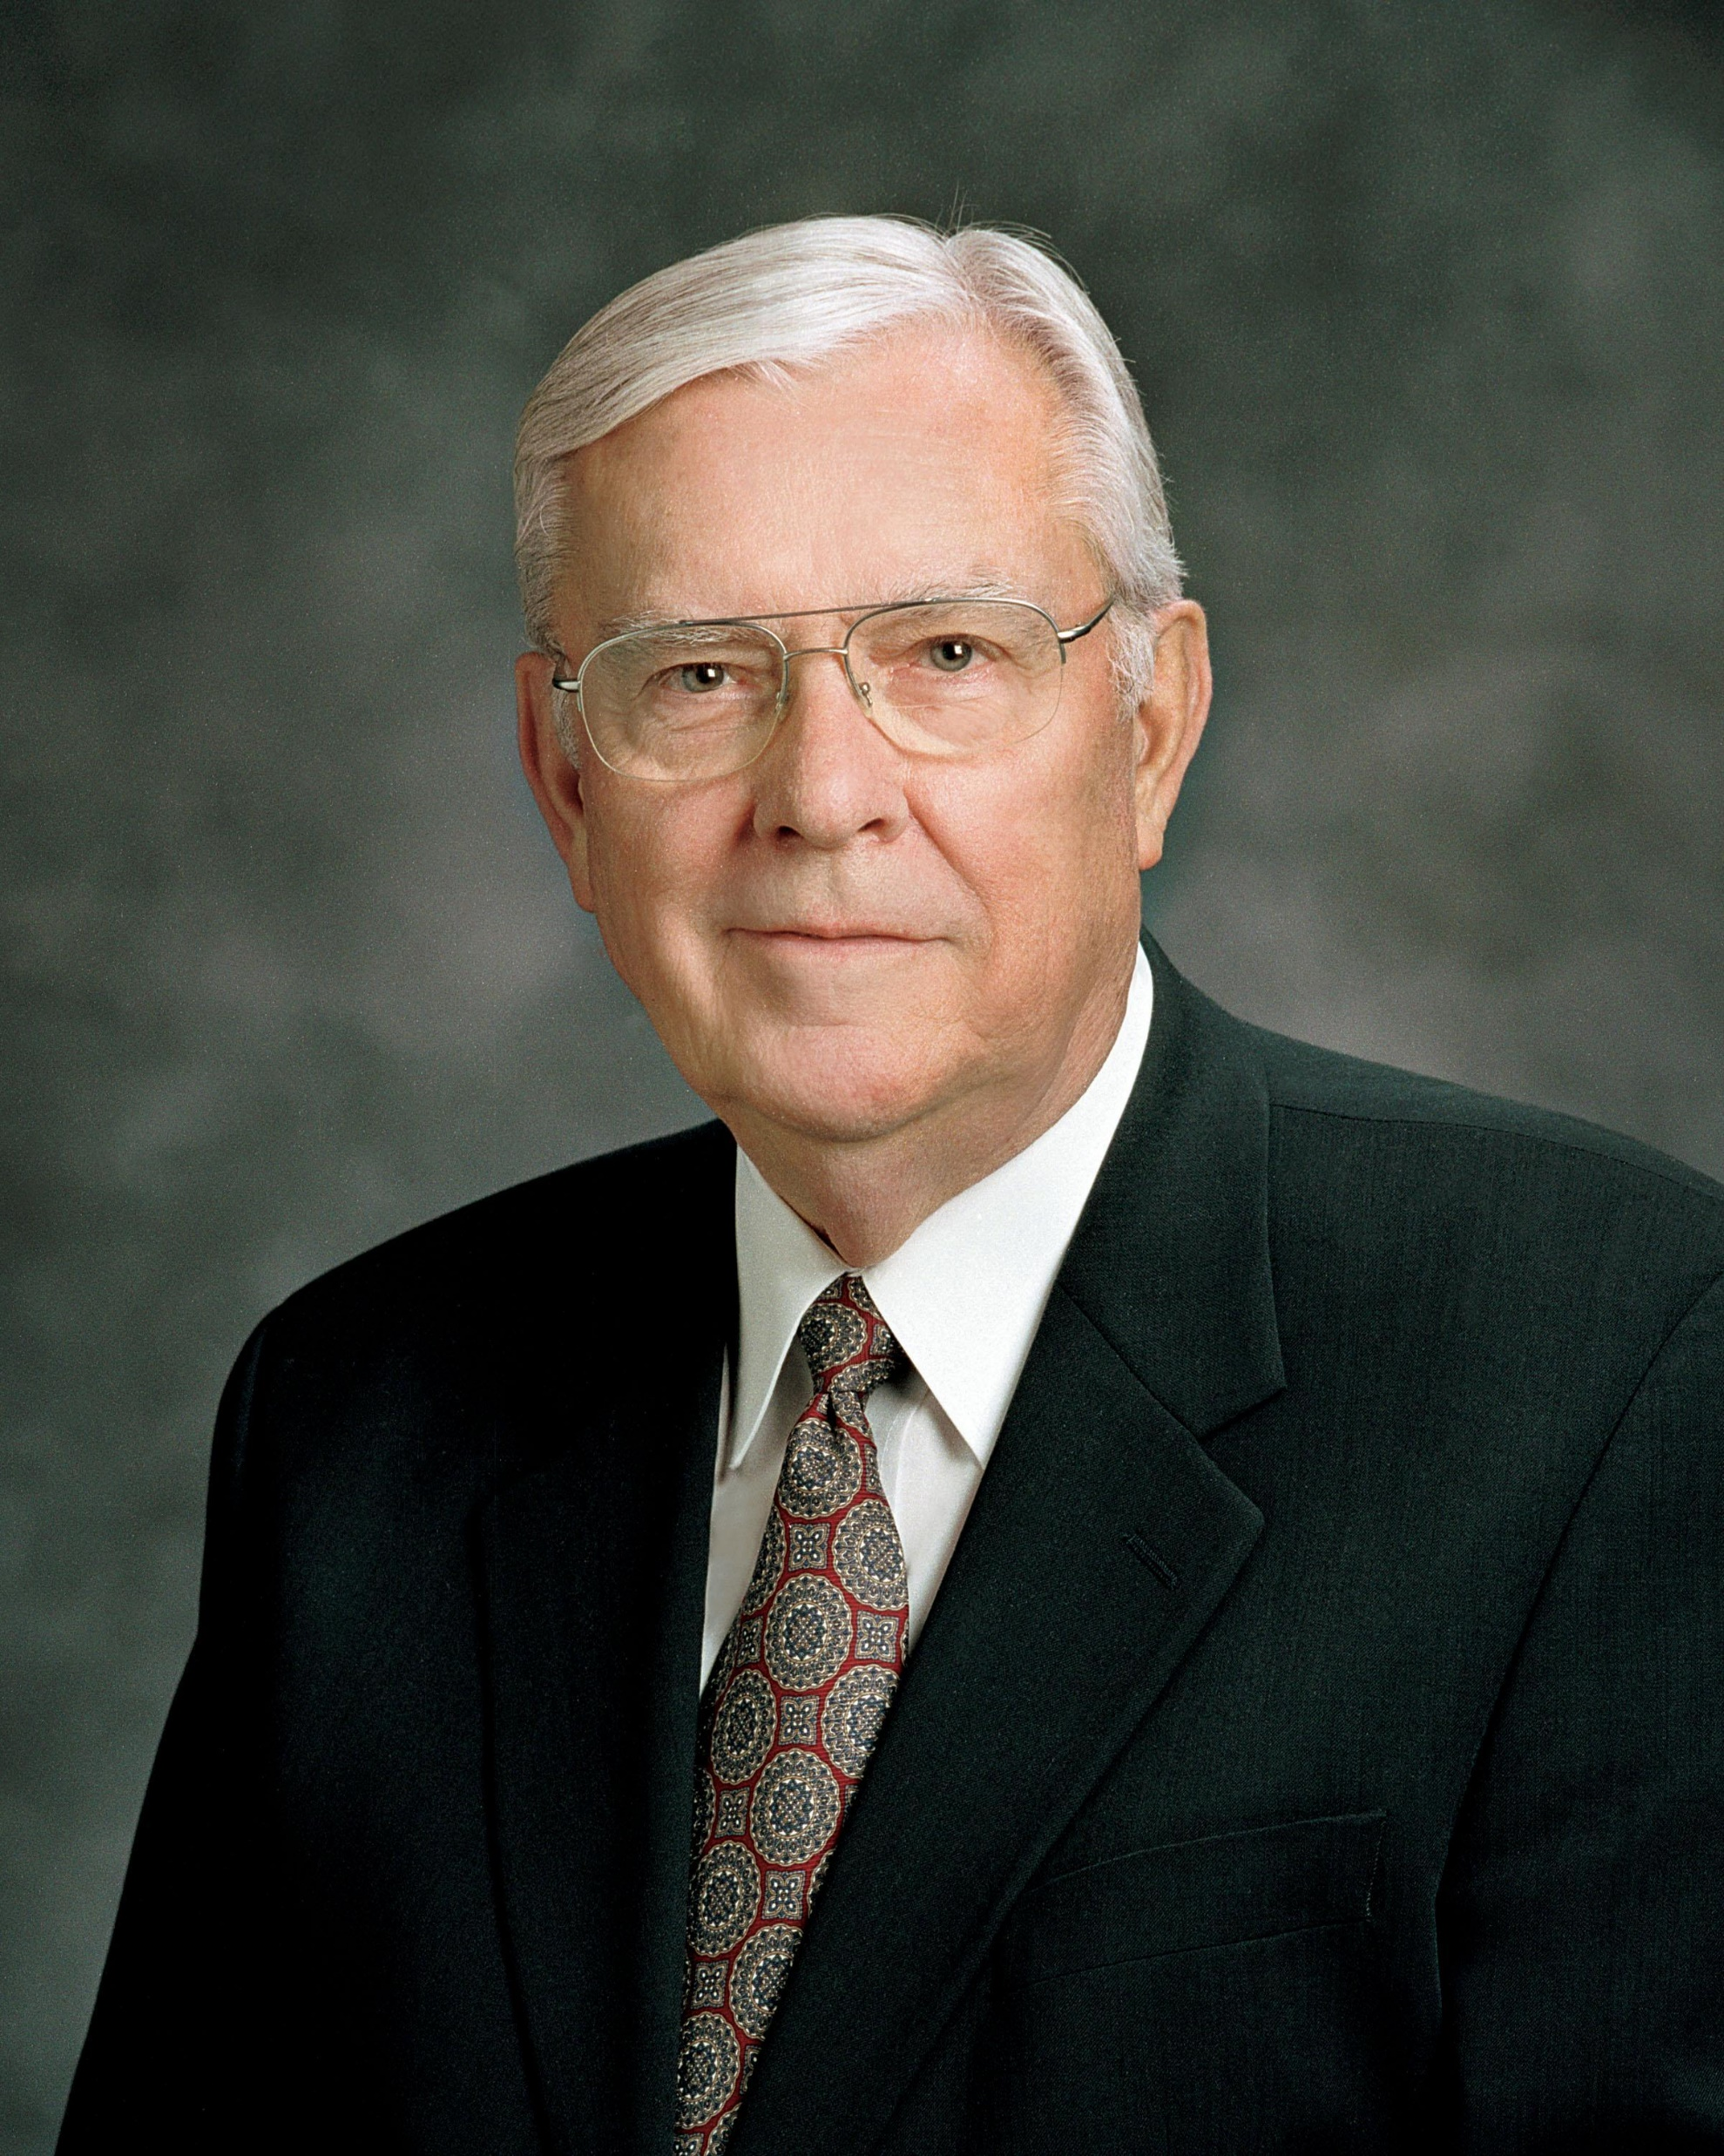
“Among today’s secret combinations are gangs, drug cartels, and organized crime families…We should work within our respective legal and judicial systems to enact and enforce laws that provide necessary protection against criminals while ensuring essential rights and freedoms. And we should volunteer to support and assist government leaders in promoting programs designed to protect and strengthen families and communities.”
Elder M. Russell Ballard,
Ensign, Nov. 1997
Notes:
https://www.churchofjesuschrist.org/bc/content/ldsorg/church/news/2017/11/14/elder-ballard-tackles-tough-topics-shares-timely-advice_1.jpg

Slide 75
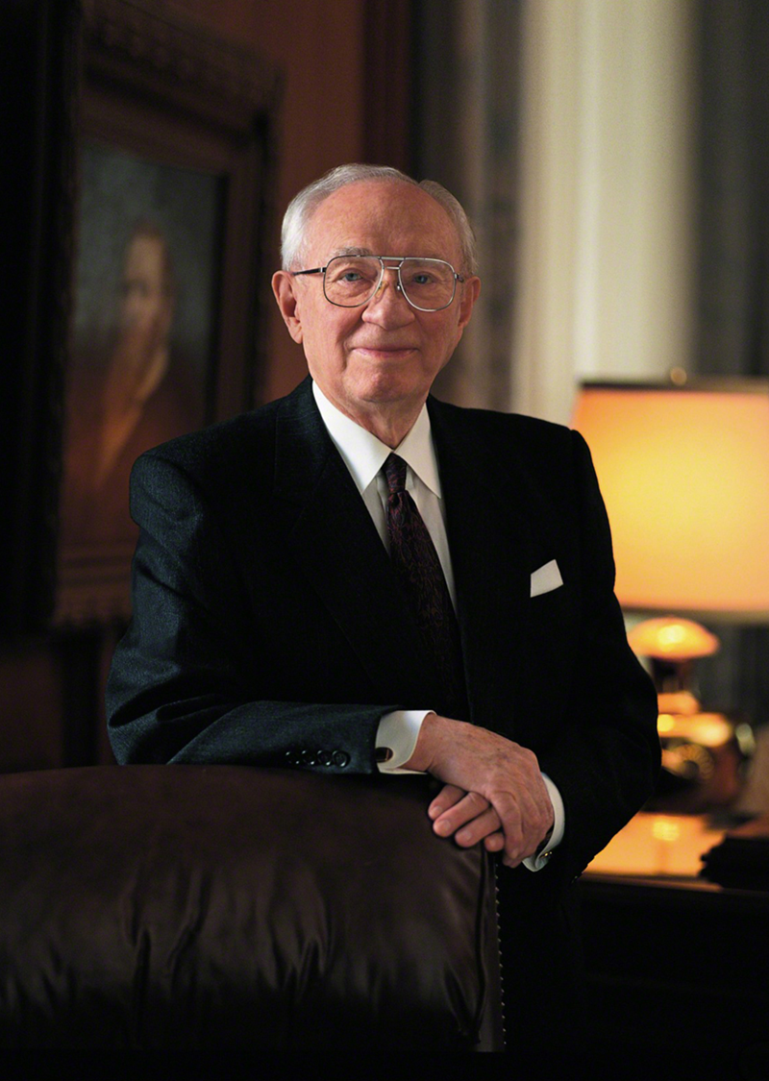
“The Book of Mormon speaks of the Gadianton robbers, a vicious, oath-bound, and secret organization bent on evil and destruction. In their day they did all in their power, by whatever means available, to bring down the Church, to woo the people with sophistry, and to take control of the society. We see the same thing in the present situation.”
President Hinckley
Ensign, Nov. 2001, 72

Slide 76
“Our safety lies in repentance. Our strength comes of obedience to the commandments of God.”
President Hinckley
Ensign, Nov. 2001, 72
Notes:
In the same talk quoted earlier from President Hinckley, shortly after the Sept. 11th attack President Hinckley said:

Slide 77
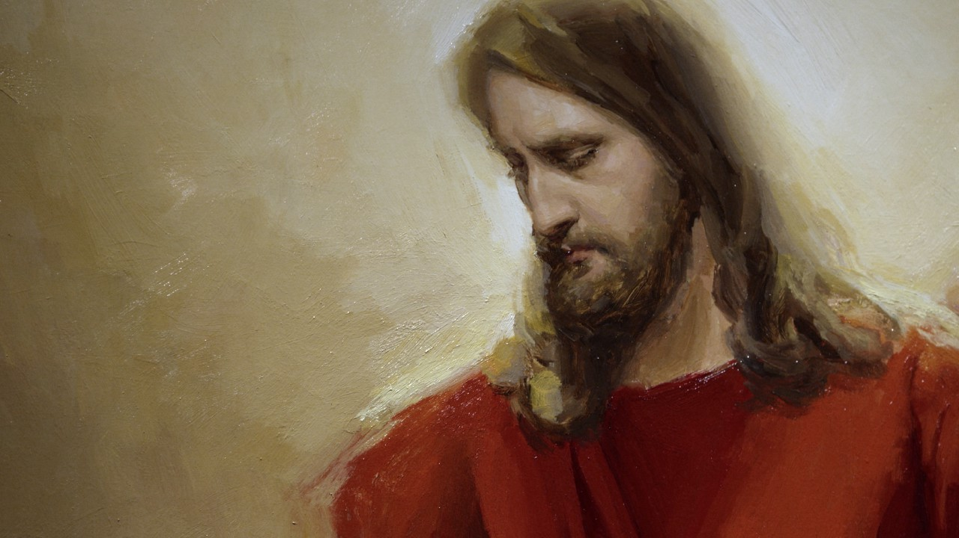
“[The righteous Nephites, even in their difficult circumstances], did fast and pray oft, and did wax stronger and stronger in their humility, and firmer and firmer in the faith of Christ, unto the filling their souls with joy and consolation, yea, even to the purifying and the sanctification of their hearts, which sanctification cometh because of their yielding their hearts unto God.”
(Helaman 3:35)
Notes:
https://assets.churchofjesuschrist.org/ba/75/ba75de5f47b5690944b3ab797a168c95a5b19f5b/jacob_with_wife.jpeg

Slide 78


For free resources related to this video, please visit https://johnhiltoniii.com/TheBookofMormon
Join our course discussions on social media
@johnhiltoniii

Slide 79
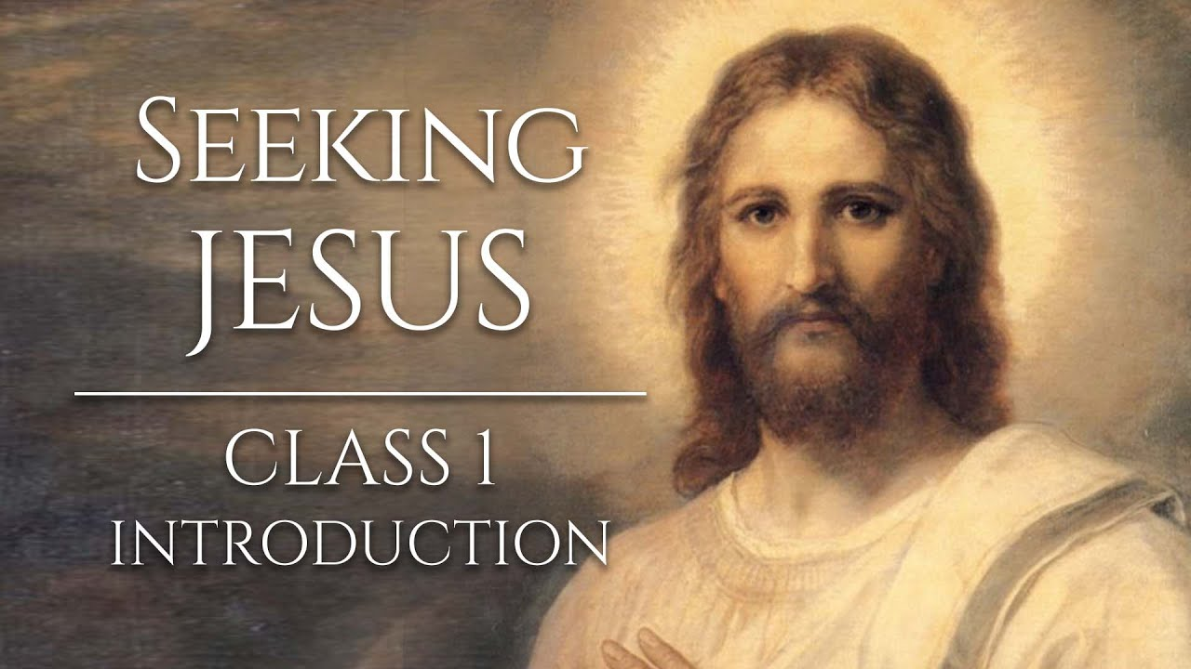
https://johnhiltoniii.com/SeekingJesus
You may also be interested in this
free video course…

Slide 80
This video is not produced or endorsed by Brigham Young University or the Church of Jesus Christ of Latter-day Saints.
John Hilton III is solely responsible for its contents
Insights from, discussions with, and resources authored by
Istvan Banyai, John Clark, Kerry Hull, Noel Reynolds, Mike Ricks, and John Wooden were used in the creation of this video. See further acknowledgements at https://johnhiltoniii.com/thebookofmormon

