Slide 1
“Ye may be privileged that ye may show the plates unto those who shall assist to bring forth this work; And unto three shall they be shown by the power of God; wherefore they shall know of a surety that these things are true.”
(Ether 5:2–3)

Slide 2
“In the mouth of three witnesses shall these things be established; and the testimony of three…shall stand as a testimony against the world at the last day.”
(Ether 5:4)

Slide 3
“I beheld with my eyes and handled with my hands the gold plates from which it was translated.
I also saw with my eyes and handled with my hands the ‘holy interpreters.’ That book is true.”
Oliver Cowdery
(“Testimonies of Oliver Cowdery and Martin Harris,” Millennial Star, Aug. 20, 1859, 544)
Notes:
https://history.churchofjesuschrist.org/content/joseph-smith-translates-the-gold-plates?lang=eng

Slide 4
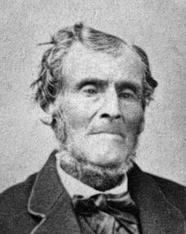
“Do you see that hand? Are you sure you see it? Are your eyes playing you a trick or something? No. Well, as sure as you see my hand so sure did I see the angel and the plates.”
Martin Harris
(Deseret News, Oct. 2, 1943; see also Investigating the Book of Mormon Witnesses, p.116)
Notes:
https://history.churchofjesuschrist.org/content/joseph-smith-translates-the-gold-plates?lang=eng

Slide 5
“Well, just as plain as you see that chopping block, I saw the plates;
and sooner than I would deny it, I would lay my head upon that chopping block and let you chop it off.”
Martin Harris
(Assorted Gems of Priceless Value (SLC, 1944), p. 351; see also Anderson, Investigating the Book of Mormon Witnesses, p.116)
Notes:
https://history.churchofjesuschrist.org/content/joseph-smith-translates-the-gold-plates?lang=eng

Slide 6
“I saw them just as plain as I see this bed
(striking the bed beside him with his hand),
and I heard the voice of the Lord,
as distinctly as I ever heard anything in my life, declaring that the records of the plates of the Book of Mormon were translated by the gift and power of God....”
David Whitmer
(Oral Interview, Published in the Deseret News (16 November 1878)

Slide 7
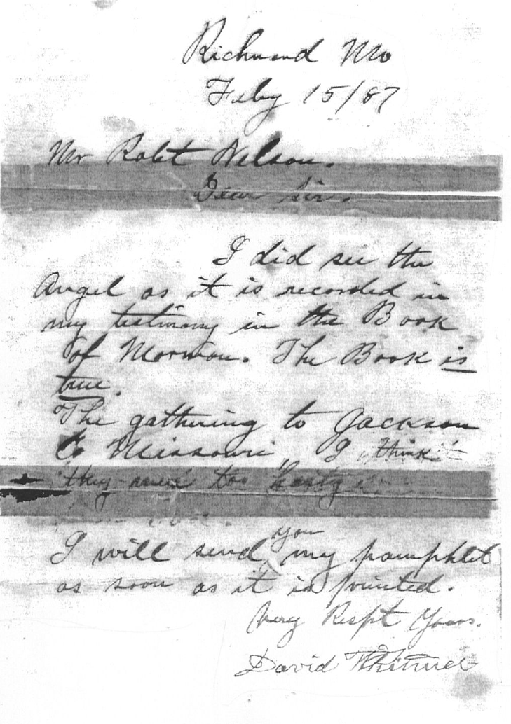
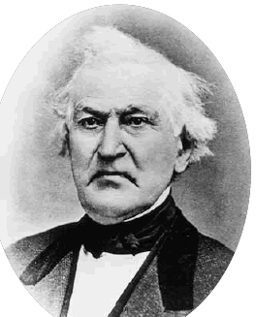
David Whitmer

Slide 8
David Whitmer
David Whitmer

Slide 9
David Whitmer
David Whitmer

Slide 10
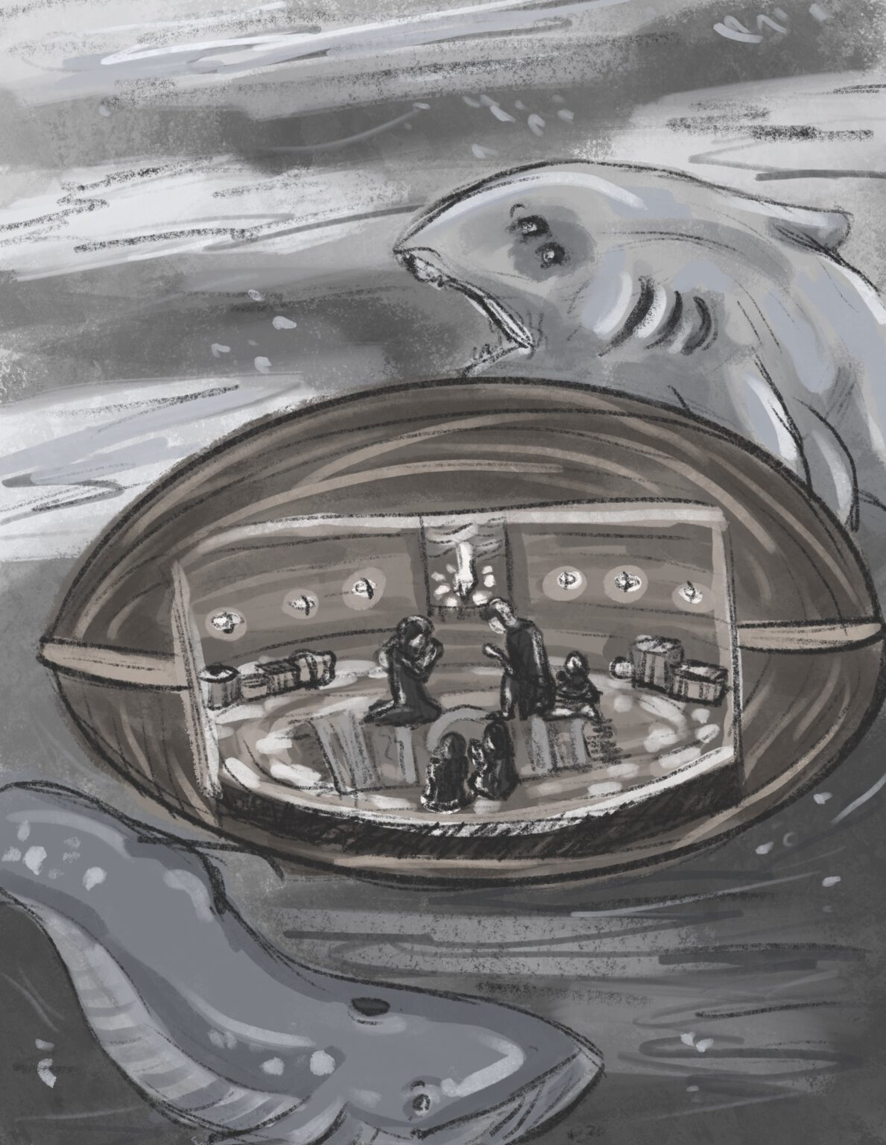
“They did sing praises unto the Lord; yea, the brother of Jared did sing praises unto the Lord, and he did thank and praise the Lord all the day long; and when the night came, they did not cease to praise the Lord.”
(Ether 6:9)
Anastasia Bolinder
Notes:
https://bookofmormonartcatalog.org/catalog/no-monster-of-the-sea-could-break-them/

Slide 11
“The people desired of them that they should anoint one of their sons to be a king over them. And now behold, this was grievous unto them. And the brother of Jared said unto them: Surely this thing leadeth into captivity. But Jared said unto his brother: Suffer them that they may have a king. And therefore he said unto them: Choose ye out from among our sons a king, even whom ye will.”
(Ether 6:22–24)

Slide 12
“And when he had gathered together an army he came up unto the land of Moron where the king dwelt, and took him captive, which brought to pass the saying of the brother of Jared that they would be brought into captivity.”
(Ether 7:5)

Slide 13
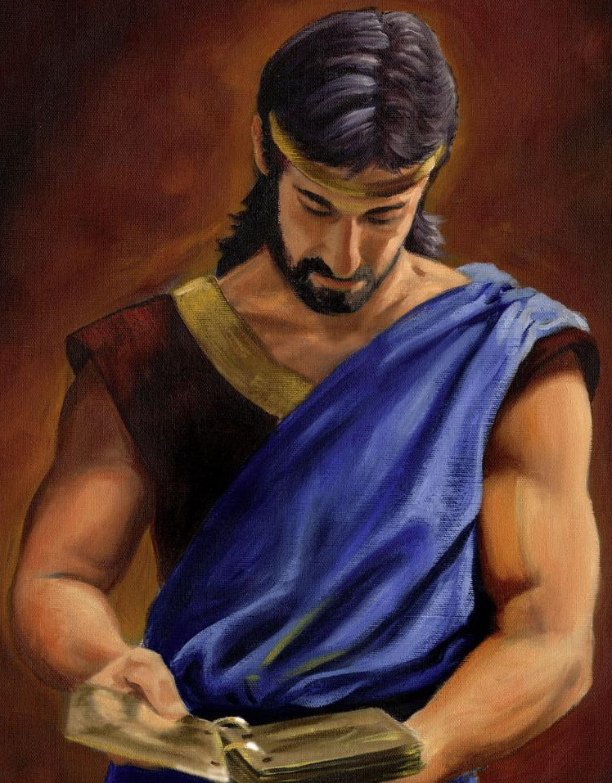
“Mosiah finished translating these [Jaredite] records… Now this account [of the Jaredites] did cause the people of Mosiah to mourn exceedingly, yea, they were filled with sorrow.”
(Mosiah 28:17–18)
James Fullmer
Notes:
https://bookofmormonartcatalog.org/catalog/mosiah-son-of-king-benjamin/

Slide 14
“And it came to pass that Orihah did walk humbly before the Lord, and did remember how great things the Lord had done for his father, and also taught his people how great things the Lord had done for their fathers.”
(Ether 6:30)

Slide 15
“Orihah did walk humbly before the Lord, and did remember how great things the Lord had done for his father, and also taught his people how great things the Lord had done for their fathers.”
(Ether 6:30)
“And there were no more wars in the days of Shule; and he remembered the great things that the Lord had done for his fathers in bringing them across the great deep into the promised land; wherefore he did execute judgment in righteousness all his days.”
(Ether 7:27)

Slide 16
“Shez…did build up a righteous kingdom; for he remembered what the Lord had done in bringing Jared and his brother across the deep; and he did walk in the ways of the Lord; and he begat sons and daughters.”
(Ether 10:2)

Slide 17
What are some things that God has done for you? Take a moment to think back on what God has done for you personally.

Slide 18
What has God done for your family members and/or ancestors?
Take a moment to think about what
God has done for them.

Slide 19
Take a moment right now and spend some time in prayer—praise God for the great things he has done for you, your family, and your ancestors.

Slide 20
“Orihah…did remember how great things the Lord had done for his father…”
(Ether 6:30)
“Shule remembered the great things that the Lord had done for his fathers.”
(Ether 7:27)
“Shez…remembered what the Lord had done in bringing Jared and his brother across the deep…”
(Ether 10:2)

Slide 21
Omer
Jared
Esrom
Coriantumr
Exceedingly fair daughter of Jared
Akish

Slide 22
“Jared became exceedingly sorrowful because of the loss of the kingdom, for he had set his heart upon the kingdom and upon the glory of the world.”
(Ether 8:7)

Slide 23
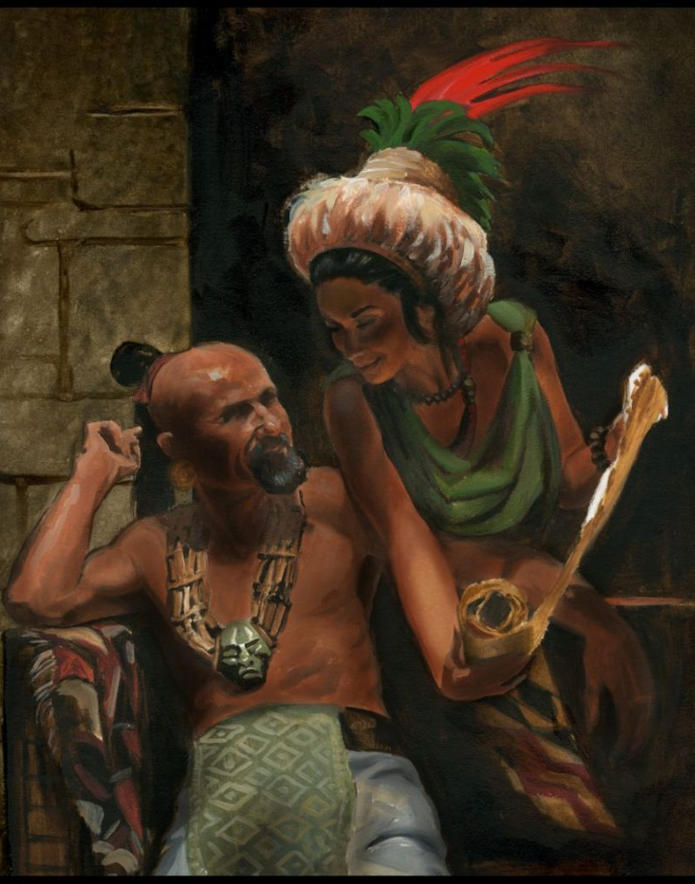
“Now the daughter of Jared being exceedingly expert, and seeing the sorrows of her father, thought to devise a plan whereby she could redeem the kingdom unto her father….She said unto [Jared]: Whereby hath my father so much sorrow? Hath he not read the record which our fathers brought across the great deep? Behold, is there not an account concerning them of old, that they by their secret plans did obtain kingdoms and great glory?” (Ether 8:9)
James Fullmer

Slide 24
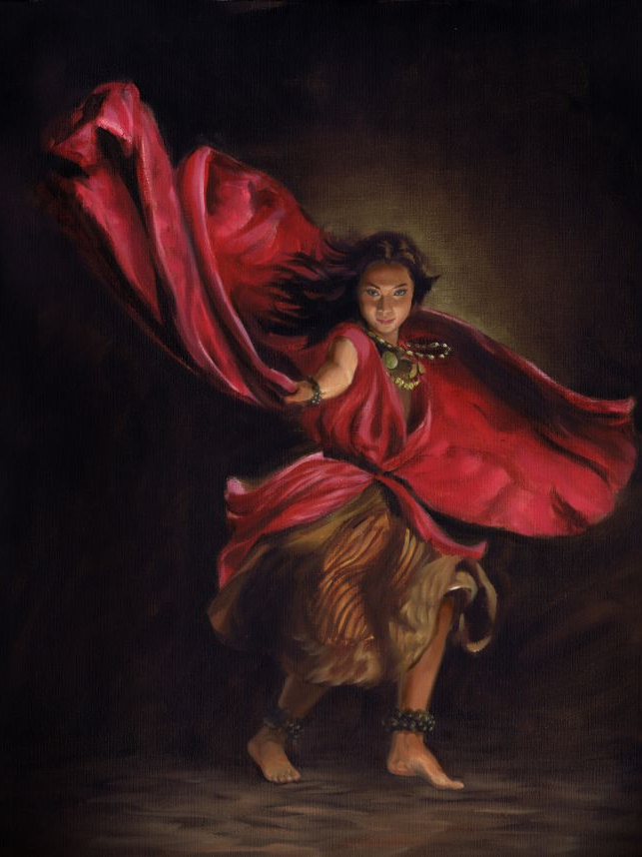
“Let my father send for Akish, the son of Kimnor; and behold, I am fair, and I will dance before him, and I will please him, that he will desire me to wife; wherefore if he shall desire of thee that ye shall give unto him me to wife, then shall ye say: I will give her if ye will bring unto me the head of my father, the king. And now Omer was a friend to Akish… ”
(Ether 8:10)
James Fullmer

Slide 25
“When Jared had sent for Akish, the daughter of Jared danced before him that she pleased him, insomuch that he desired her to wife. And it came to pass that he said unto Jared: Give her unto me to wife. And Jared said unto him: I will give her unto you, if ye will bring unto me the head of my father, the king. ”
(Ether 8:11–12)
James Fullmer

Slide 26
More Study Tools at
johnhiltoniii.com/thebookofmormon/resources

Slide 27
Am I proactive in working to prevent evil?

Slide 28
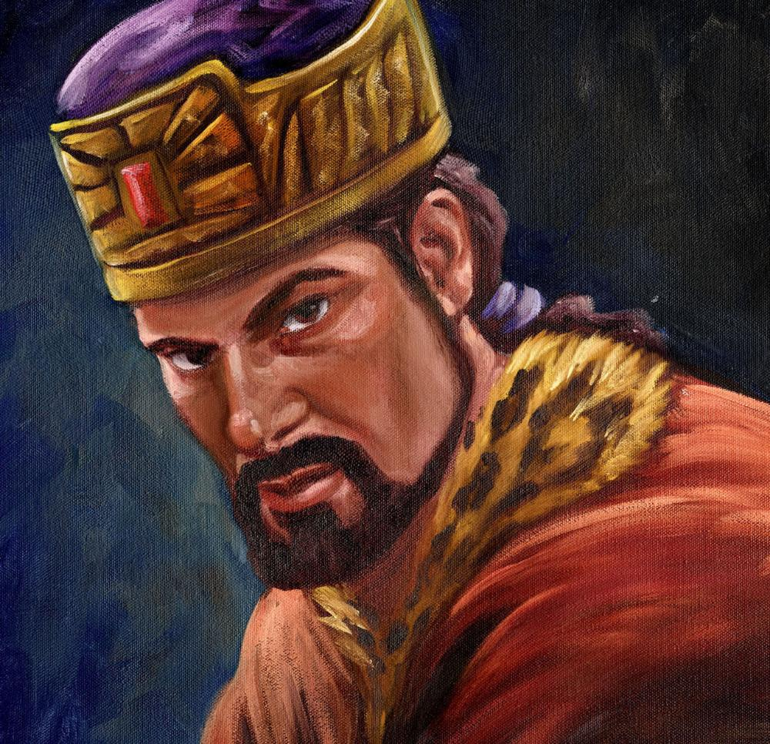
James Fullmer
Notes:
https://bookofmormonartcatalog.org/catalog/akish/

Slide 29
“And now, therefore, let my father send for Akish, the son of Kimnor; and behold, I am fair, and I will dance before him, and I will please him, that he will desire me to wife; wherefore if he shall desire of thee that ye shall give unto him me to wife, then shall ye say: I will give her if ye will bring unto me the head of my father, the king.”
(Ether 8:10)
“Akish sought the life of his father-in-law; and he applied unto those whom he had sworn by the oath of the ancients, and they obtained the head of his father-in-law, as he sat upon his throne, giving audience to his people.”
(Ether 9:5)

Slide 30
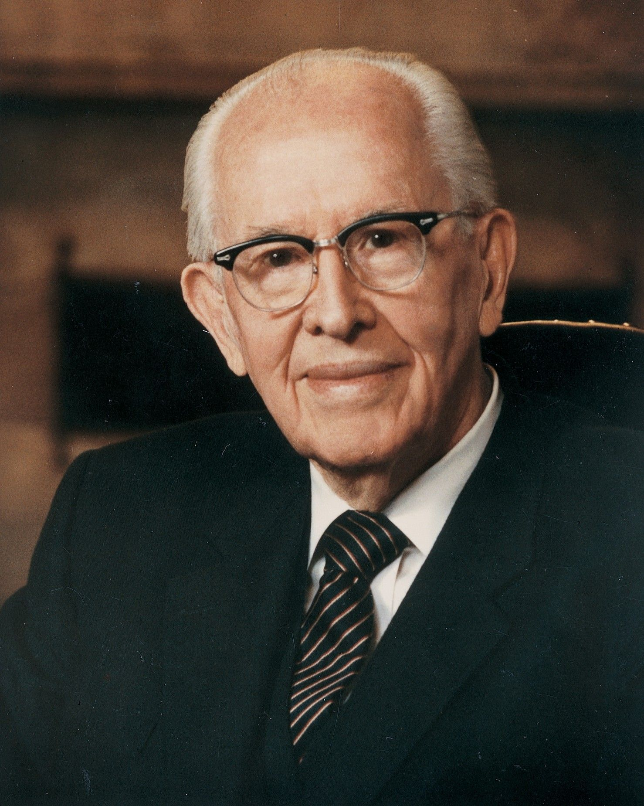
“Satan often lures people into [sin] by playing on their basic needs. He promises pleasure, happiness, and fulfillment. But this is, of course, a deception...”
Ezra Taft Benson, BYU Devotional, October 13, 1987
Notes:
https://assets.churchofjesuschrist.org/73/1d/731dba7762afb2310cb0c39571d9582d7bec335c/portrait_ezra_taft_benson_1986.jpeg

Slide 31
“[Secret combinations] have caused the destruction of [the Jaredites], and also the destruction of the people of Nephi. And whatsoever nation shall uphold such secret combinations, to get power and gain, until they shall spread over the nation, behold, they shall be destroyed…

Slide 32
“Wherefore, O ye Gentiles, it is wisdom in God that these things should be shown unto you, that thereby ye may repent of your sins, and suffer not that these murderous combinations shall get above you, which are built up to get power and gain…yea, even the sword of the justice of the Eternal God shall fall upon you, to your overthrow and destruction if ye shall suffer these things to be.”
(Ether 8:21–23)

Slide 33
“[The Jaredites had] all manner of cattle, of oxen, and cows, and of sheep, and of swine, and of goats, and also many other kinds of animals which were useful for the food of man. And they also had horses, and asses, and there were elephants and cureloms and cumoms; all of which were useful unto man, and more especially the elephants and cureloms and cumoms.”
(Ether 9:18–19)

Slide 34
Was there cement in ancient America?
Notes:
https://www.pexels.com/photo/full-frame-shot-of-abstract-pattern-247719/

Slide 35
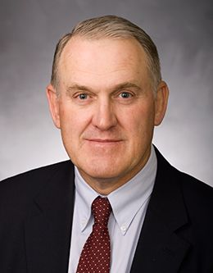
“Many items mentioned in the Book of Mormon have not been and may never be verified through archaeology, but many have been. Verification is a one-way street in this instance. Positive and negative evidence do not count the same…
Given current means of verification, positive items are here to stay, but negative items may prove to be positive ones in hiding.
Notes:
https://speeches.byu.edu/wp-content/uploads/jpg/Clark_John-Web-compressor.jpg

Slide 36
“‘Missing’ evidence focuses further research, but it lacks compelling logical force in arguments because it represents the absence of information rather than secure evidence.”
John E. Clark
Notes:
https://speeches.byu.edu/wp-content/uploads/jpg/Clark_John-Web-compressor.jpg

Slide 37
Status of Book of Mormon Claims in 1842
Unconfirmed
Confirmed
Steel sword
Brass plates
Golden plates
Gold smelting
Silver smelting
Copper smelting
Brass
Iron
Precious ores
Molten stone [glass]
Cow
Oxen
Horse
Ass
Goat
Wild Goat
Sheep
Wild Beasts
Wheat
Barley
Barley-based monetary system
Solomon-like Temple
Stone monuments
Thrones
Palaces
Large cities
Fortifications
Cement
Highways
Military costumes
Swords
Spears
Scimitars
Javelins
Bows and arrows
Slings
Large armies
Human sacrifice
Submarine barges
Hebrew language
Reformed Egyptian script
Natives could read
Natives could write
BM place names
BM personal names
Two advanced civilizations
Older in north
Younger in south
Older disappeared
Younger spread north
Younger destroyed
200 year period of peace
3 culture sequence
Narrow neck
East and West seas
N-S large river
Southern highlands
Highland lake
Wide eastern sea coast
Narrow west coast
8 Confirmed (13.3%) 52 Unconfirmed (86.7%)
John Clark

Slide 38
Status of Book of Mormon Claims in 2005
Unconfirmed
Confirmed
Undetermined
Steel sword
Brass plates
Golden plates
Gold smelting
Silver smelting
Copper smelting
Brass
Iron
Precious ores
Molten stone [glass]
Cow
Oxen
Horse
Ass
Goat
Wild Goat
Sheep
Wild Beasts
Wheat
Barley
Barley-based monetary system
Solomon-like Temple
Stone monuments
Thrones
Palaces
Large cities
Fortifications
Cement
Highways
Military costumes
Swords
Spears
Scimitars
Javelins
Bows and arrows
Slings
Large armies
Human sacrifice
Submarine barges
Hebrew language
Reformed Egyptian script
Natives could read
Natives could write
BM place names
BM personal names
Two advanced civilizations
Older in north
Younger in south
Older disappeared
Younger spread north
Younger destroyed
200 year period of peace
3 culture sequence
Narrow neck
East and West seas
N-S large river
Southern highlands
Highland lake
Wide eastern sea coast
Narrow west coast
10 Undetermined (17%) 35 Confirmed (58%) 15 Unconfirmed (25%)
John Clark

Slide 39
Status of Book of Mormon Claims in 2021
Unconfirmed
Confirmed
Undetermined
Steel sword
Brass plates
Golden plates
Gold smelting
Silver smelting
Copper smelting
Brass
Iron
Precious ores
Molten stone [glass]
Cow
Oxen
Horse
Ass
Goat
Wild Goat
Sheep
Wild Beasts
Wheat
Barley
Barley-based monetary system
Solomon-like Temple
Stone monuments
Thrones
Palaces
Large cities
Fortifications
Cement
Highways
Military costumes
Swords
Spears
Scimitars
Javelins
Bows and arrows
Slings
Large armies
Human sacrifice
Submarine barges
Hebrew language
Reformed Egyptian script
Natives could read
Natives could write
BM place names
BM personal names
Two advanced civilizations
Older in north
Younger in south
Older disappeared
Younger spread north
Younger destroyed
200 year period of peace
3 culture sequence
Narrow neck
East and West seas
N-S large river
Southern highlands
Highland lake
Wide eastern sea coast
Narrow west coast
8 Undetermined (13%) 46 Confirmed (77%) 6 Unconfirmed (10%)
Lynne Hilton Wilson

Slide 40
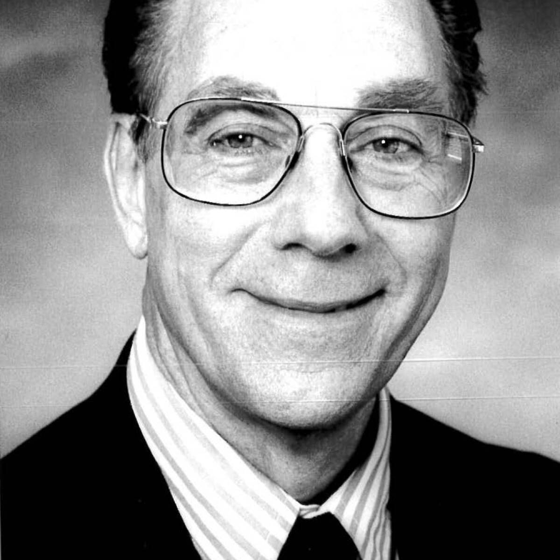
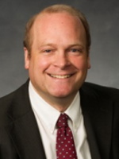
“When the Book of Mormon first appeared, skeptics said that references to horses, asses, elephants, and other animals…were out of place. During the first century after its publication, Book of Mormon critics argued that such animals never existed anywhere in the Americas before the arrival of Columbus and western Europeans in the late fifteenth century. In time, however scientific discoveries showed that species of horses,
asses, elephants, and other animals had once been present in North America, although dating to an earlier period than that covered in the Book of Mormon…”
(Wade E. Miller & Matthew Roper, “Animals in the Book of Mormon:
Challenges and Perspectives”)
Notes:
https://byustudies.byu.edu/article/animals-in-the-book-of-mormon-challenges-and-perspectives/

Slide 41
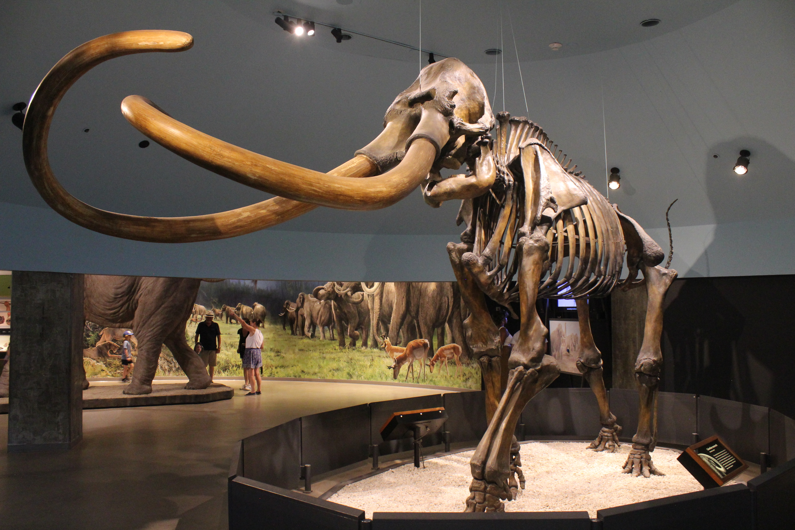
These remains were found near Los Angeles, CA
Jonathan Chen
Notes:
these remains were found near Los Angeles, CA
By Jonathan Chen - Own work, CC BY-SA 4.0, https://commons.wikimedia.org/w/index.php?curid=122327156

Slide 42
“It can no longer be argued that there were no horses, asses, or elephants in the Americas. The issue has shifted to when such animals became extinct…”
(Wade E. Miller & Matthew Roper, “Animals in the Book of Mormon: Challenges and Perspectives”)
Notes:
https://byustudies.byu.edu/article/animals-in-the-book-of-mormon-challenges-and-perspectives/

Slide 43
“Indigenous people along the northern coast of the Gulf of Mexico have traditions of giant beasts with long noses that could trample people and uproot trees…[and dating of mammoth remains] are recent enough to place the elephant in the time of the Jaredites.”
(Wade E. Miller & Matthew Roper, “Animals in the Book of Mormon: Challenges and Perspectives”)
Notes:
https://byustudies.byu.edu/article/animals-in-the-book-of-mormon-challenges-and-perspectives/

Slide 44
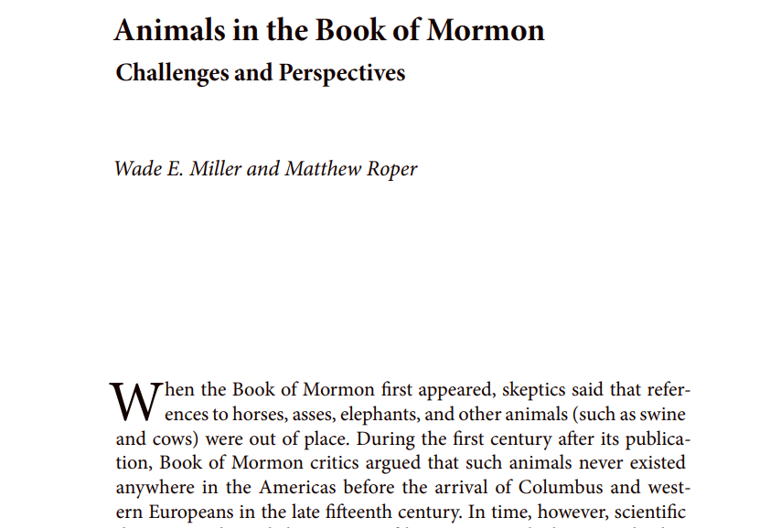

Slide 45
Emer
Father was Omer (lived in captivity)

Slide 46
Emer
Father was Omer (lived in captivity)
Older brother was Jared

Slide 47
Emer
Father was Omer (lived in captivity)
Older brother was Jared
The daughter of Jared was his niece

Slide 48
Emer
Father was Omer (lived in captivity)
Older brother was Jared
The daughter of Jared was his niece
Akish was his nephew

Slide 49
Emer
“After he had anointed Coriantum to reign in his stead he lived four years, and he saw peace in the land; yea, and he even saw the Son of Righteousness, and did rejoice and glory in his day; and he died in peace.”
(Ether 9:22)

Slide 50
“Morianton…is a little tricky to categorize. If he were alive today, he would have many followers on social media. First, he became king by gathering “together an army of outcasts” (Ether 10:9). For some reason, we love the idea of outcasts defeating the establishment. Ultimately, our favorite leaders are those who make things happen:

Slide 51
““Morianton built up many cities, and the people became exceedingly rich under his reign, both in buildings, and in gold, and silver, and in raising grain, and in flocks, and herds” (Ether 10:12). If Morianton ran for office today, I think he would be elected. However, Morianton is actually a complicated character.

Slide 52
“He “did do justice unto the people, but not unto himself because of his many whoredoms; wherefore he was cut off from the presence of the Lord” (Ether 10:11). It isn’t surprising that Morianton is a mixture of good and bad. Most of us are a kaleidoscope of moods, history, logic, strengths, and weaknesses….

Slide 53
“Even in the scriptures, we often see the human side of prophets. Lehi murmured against God, Nephi struggled with self-doubt, Ammon had a complicated past, and the Brother of Jared hung out on the beach for four years before going to the promised land. Human beings cannot be painted with one color.

Slide 54
“But there is something about this truth that is dangerous. Since people are complicated and make mistakes, many believe that this is what it means to be authentic. There is a feeling that if people are sinning then they are “being real.”
For example, two teenagers skip Sunday School, and one says, “I have to be honest. I really really don’t like that class.”

Slide 55
“Or, an eighteen-year-old at general conference looks around at all the happy, beautiful, righteous humans, and thinks, I must be honest with myself. I could never be like these people…”

Slide 56
“Or, an eighteen-year-old at general conference looks around at all the happy, beautiful, righteous humans, and thinks, I must be honest with myself. I could never be like these people…”

Slide 57
“My old self has been crucified with Christ. It is no longer I who live, but Christ lives in me. So I live in this earthly body by trusting in the Son of God, who loved me and gave himself for me.”
Galatians 2:20, New Living Translation

Slide 58
“In the days of Com there began to be robbers in the land; and they adopted the old plans, and administered oaths after the manner of the ancients, and sought again to destroy the kingdom. Now Com did fight against them much; nevertheless,
he did not prevail against them.”
(Ether 10:33–34)

Slide 59
“There came also in the days of Com many prophets, and prophesied of the destruction of that great people except they should repent, and turn unto the Lord, and forsake their murders and wickedness…the prophets were rejected by the people, and they fled unto Com for protection, for the people sought to destroy them. And they prophesied unto Com many things; and he was blessed in all the remainder of his days.”
(Ether 11:1–3)

Slide 60
Ether

Slide 61
Ether
Born into a line of kings, but by the time he’s born, that line of kings is in prison, and there is a different king on the throne.

Slide 62
Ether
Born into a line of kings, but by the time he’s born, that line of kings is in prison, and there is a different king on the throne.
His dad lived in captivity all his life.

Slide 63
Ether
Born into a line of kings, but by the time he’s born, that line of kings is in prison, and there is a different king on the throne.
His dad lived in captivity all his life.
His grandfather, Moron, “did that which was wicked before the Lord.” (Ether 11:14)

Slide 64
Ether
Born into a line of kings, but by the time he’s born, that line of kings is in prison, and there is a different king on the throne.
His dad lived in captivity all his life.
His grandfather, Moron, “did that which was wicked before the Lord.” (Ether 11:14)
His great-grandfather, Ethem, “did execute judgment and wickedness all his days.” (Ether 11:14)

Slide 65
“[Ether…] did cry from the morning, even until the going down of the sun, exhorting the people to believe in God…Great and marvelous were the prophecies of Ether…”
(Ether 12:3, 13:13)

Slide 66
What do these passages teach us about
the God of Ether?

Slide 67
“I received…an admonition to return to my ministry with more urgency, more consecration, more focus on the Savior, more faith in His word.”
Notes:
https://speeches.byu.edu/wp-content/uploads/jpg/Clark_John-Web-compressor.jpg

Slide 68
For free resources related to this video, please visit https://johnhiltoniii.com/TheBookofMormon
Join our course discussions on social media
@johnhiltoniii

Slide 69
https://johnhiltoniii.com/SeekingJesus
You may also be interested in this
free video course…

Slide 70
This video is not produced or endorsed by Brigham Young University or the Church of Jesus Christ of Latter-day Saints. John Hilton III is solely responsible for its contents
Insights from, discussions with, and resources authored by
John Clark, Wade Miller, Matthew Roper, Stephan Taeger and Scott Woodward were used in the creation of this video. See further acknowledgements at https://johnhiltoniii.com/thebookofmormon

