Slide 1
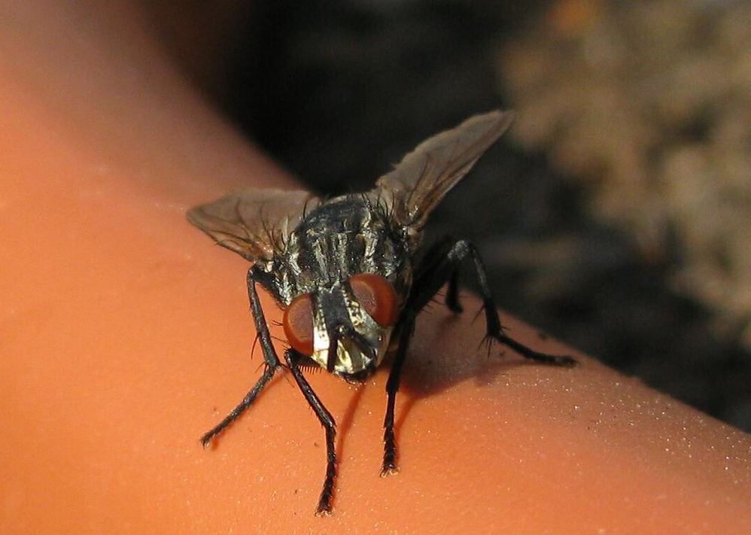
Gramurspelfried
Notes:
Maggots: https://unsplash.com/s/photos/maggots
Hail: https://www.youtube.com/watch?v=UfQy5OIByac
Fly: https://www.flickr.com/photos/69283568@N03/6603536101
Cricket: https://commons.wikimedia.org/wiki/File:Stenopelmatus_fuscus_(Jerusalem_Cricket).jpg

Slide 2
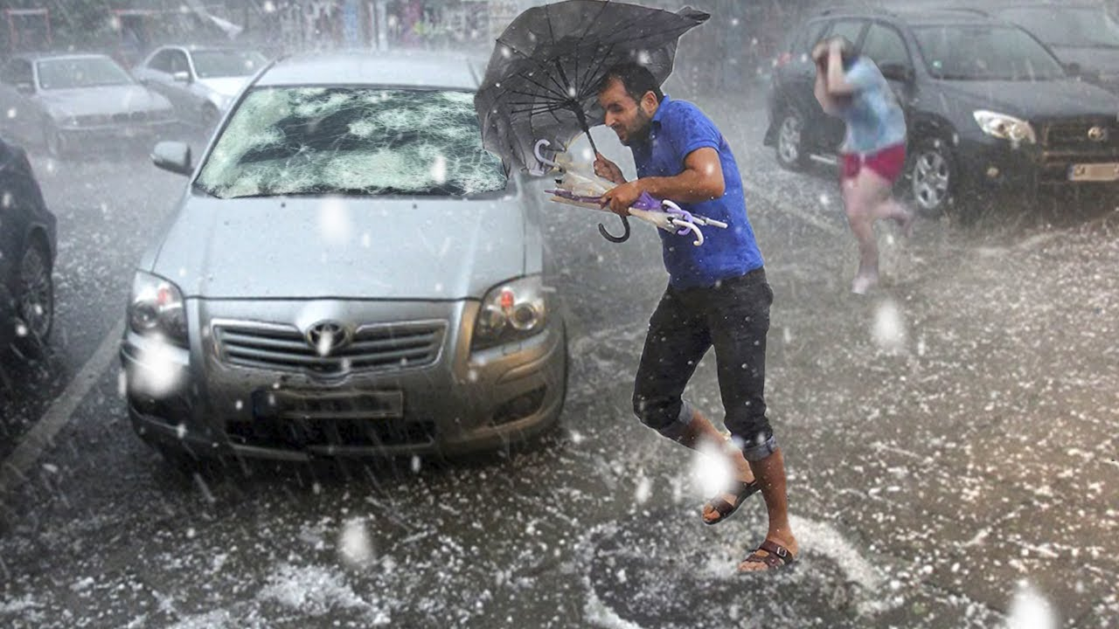
Wild WeatherUS
Gramurspelfried
Notes:
Maggots: https://unsplash.com/s/photos/maggots
Hail: https://www.youtube.com/watch?v=UfQy5OIByac
Fly: https://www.flickr.com/photos/69283568@N03/6603536101
Cricket: https://commons.wikimedia.org/wiki/File:Stenopelmatus_fuscus_(Jerusalem_Cricket).jpg

Slide 3
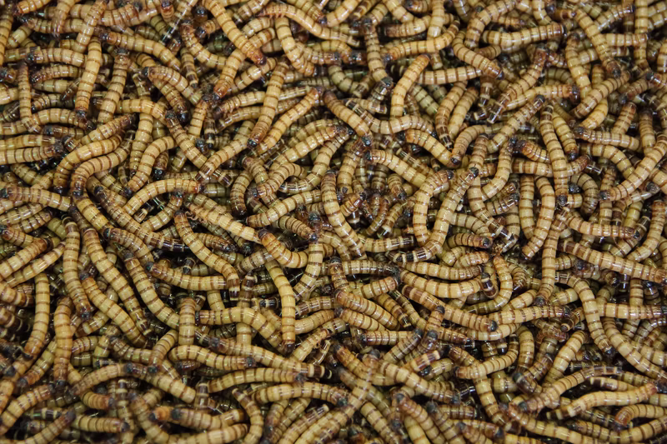
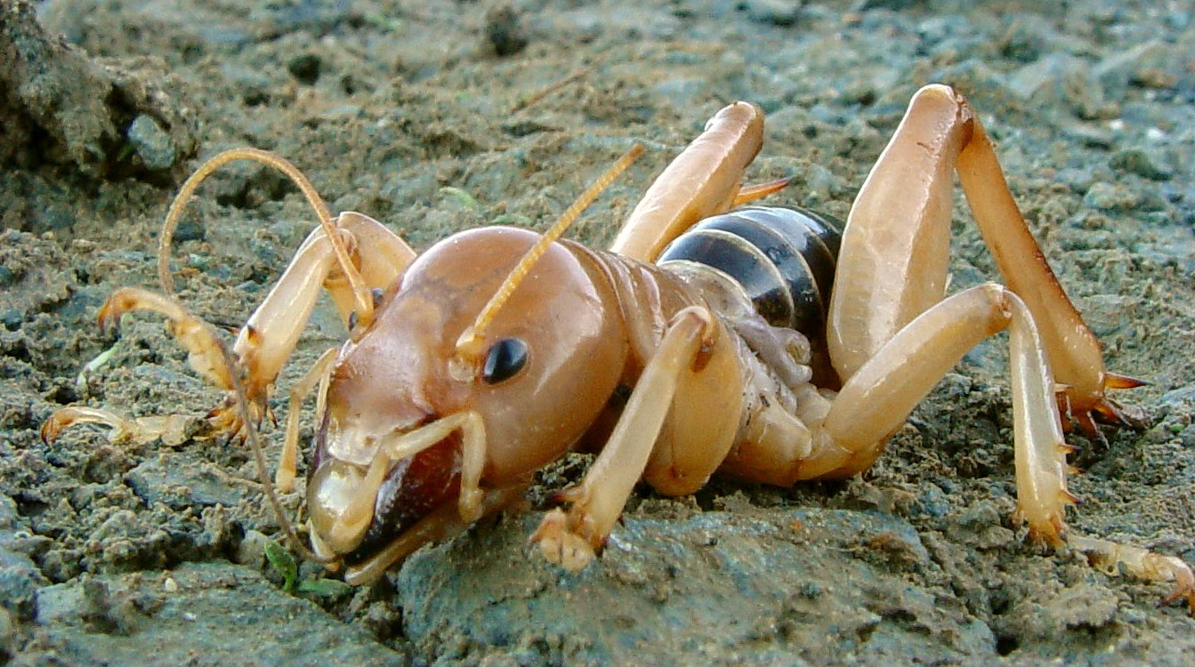
Robert Gunnarsson
Wild WeatherUS
Gramurspelfried
Franco Folini
Notes:
Maggots: https://unsplash.com/s/photos/maggots
Hail: https://www.youtube.com/watch?v=UfQy5OIByac
Fly: https://www.flickr.com/photos/69283568@N03/6603536101
Cricket: https://commons.wikimedia.org/wiki/File:Stenopelmatus_fuscus_(Jerusalem_Cricket).jpg

Slide 4

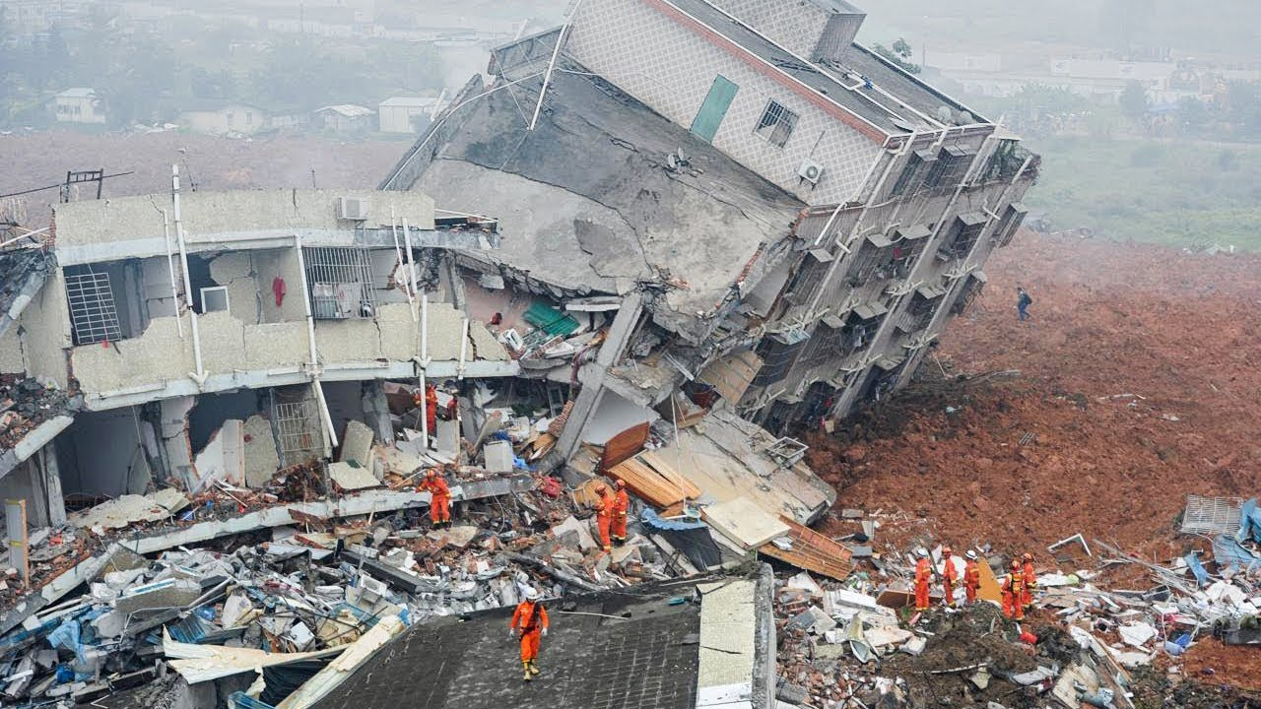
“The love of men shall wax cold, and iniquity shall abound…There shall be [people] standing in that generation, that shall not pass until they shall see an overflowing scourge; for a desolating sickness shall cover the land…. among the wicked, men shall lift up their voices and curse God and die. And there shall be earthquakes also in divers places, and many desolations; yet men will harden their hearts against me, and they will take up the sword, one against another, and they will kill one another.”
TheRoyal TV
Doctrine and Covenants 45:27, 31-33
Notes:
https://pixabay.com/illustrations/girl-sick-virus-coronavirus-5651622/
Earthquake: https://www.youtube.com/watch?v=vm4xx6P56H4

Slide 5
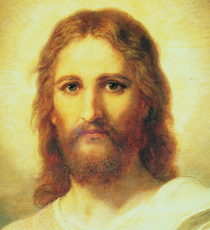
“Be not troubled, for, when all these things shall come to pass, ye may know that the promises which have been made unto you shall be fulfilled.”
(Doctrine and Covenants 45:35)
Heinrich Hofmann
Notes:
Image: https://www.churchofjesuschrist.org/study/manual/gospel-art-book/old-testament?lang=eng

Slide 6
“Be not troubled…the promises which have been made unto you shall be fulfilled.”
(Doctrine and Covenants 45:35)
Heinrich Hofmann
Notes:
Image: https://www.churchofjesuschrist.org/study/manual/gospel-art-book/old-testament?lang=eng

Slide 7
The Savior’s Second Coming
Be not troubled
Life before the Second Coming
Be not deceived
Three parables of preparation
The last battle
After the Second Coming

Slide 8
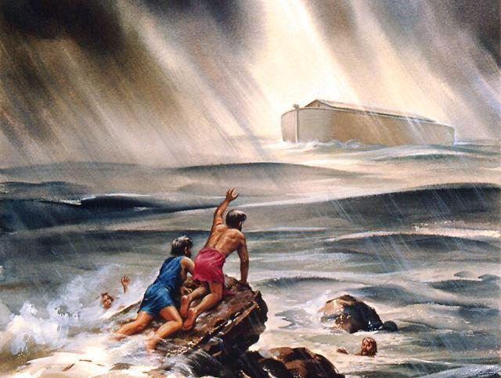
“But as it was in the days of Noah, so it shall be also at the coming of the Son of Man…for until that day that Noah entered into the ark they were eating and drinking, marrying and giving in marriage; And knew not until the flood came, and took them all away; so shall also the coming of the Son of Man be.” (Joseph Smith-Matthew 1:41-43)
Pacific Press/Goodsalt
Notes:
https://www.ucg.org/the-good-news/noah-the-rest-of-the-story

Slide 9

“The day of the Lord will come like a thief in the night.”
(1 Thessalonians 5:2, NRSV)
Shutterstock
Notes:
https://www.thelist.com/259207/what-it-really-means-when-you-dream-about-someone-breaking-into-your-house/

Slide 10
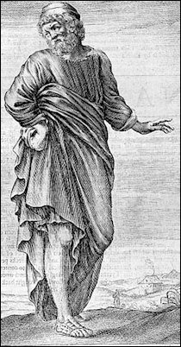
“There shall come in the last days scoffers, walking after their own lusts, And saying, ‘Where is the promise of his coming?’”
(2 Peter 3:3–4)
Notes:
https://commons.wikimedia.org/wiki/File:Pyrrho_in_Thomas_Stanley_History_of_Philosophy.jpg

Slide 11
The Savior’s Second Coming
Be not troubled
Life before the Second Coming
Be not deceived
Three parables of preparation
The last battle
After the Second Coming

Slide 12
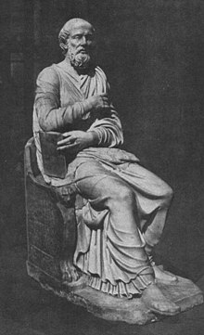
Second Coming Predictions
Hippolytus of Rome predicted
500 AD
Notes:
https://commons.wikimedia.org/wiki/File:HippolytusStatue.JPG
Unknown artist

Slide 13
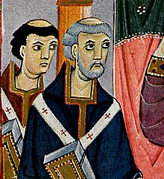
Second Coming Predictions
Pope Sylvester II predicted
1,000 AD
Meister der Reichenauer Schule
Notes:
https://commons.wikimedia.org/wiki/File:Meister_der_Reichenauer_Schule_002_(cropped).jpg

Slide 14
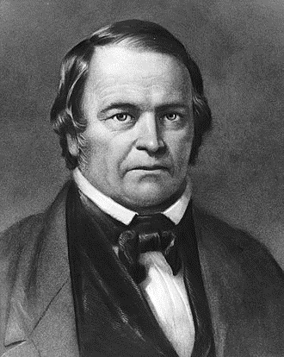
Second Coming Predictions
William Miller predicted
sometime between March 21, 1843, and March 21, 1844
Notes:
https://commons.wikimedia.org/wiki/File:William_Miller.jpg
Unknown artist

Slide 15
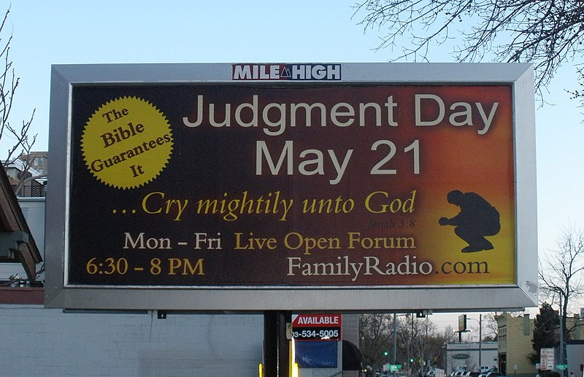
© O'Dea at Wikimedia Commons, CC BY-SA 4.0
Notes:
Prediction by American Christian radio host Harold Camping did not come to pass.
https://commons.wikimedia.org/wiki/File:Judgment_Day_21_May_2011_(English).jpg

Slide 16
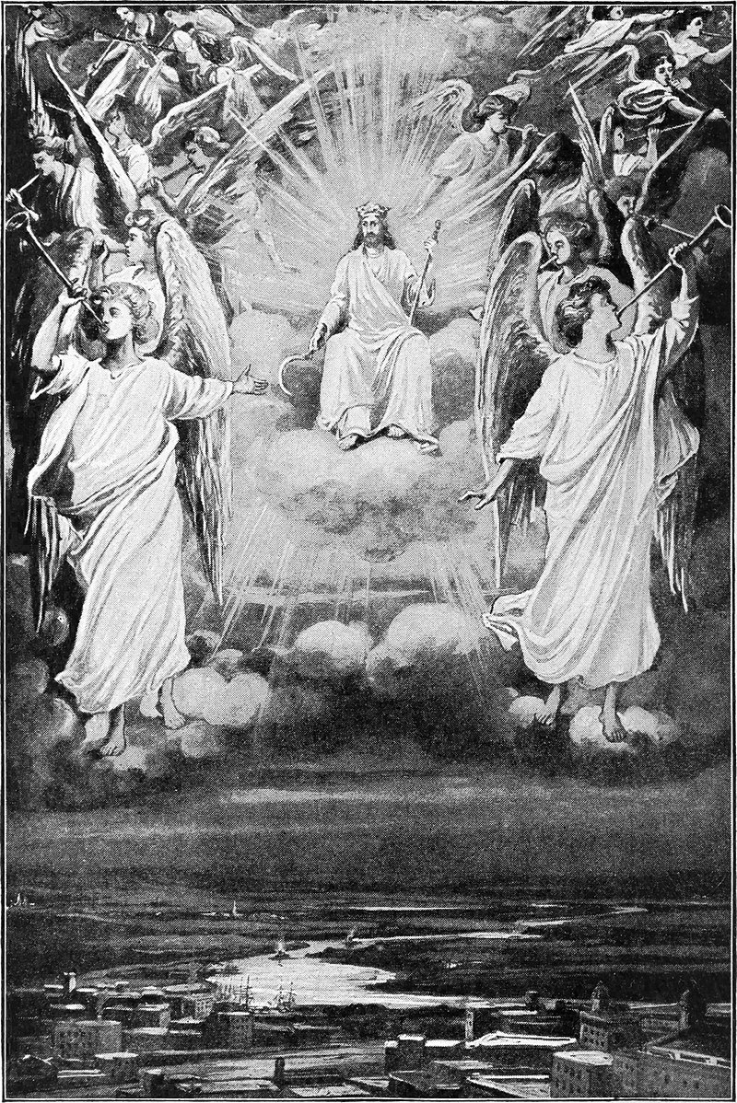
When Will the Second Coming Occur?
“Of that day, and hour, no one knoweth; no, not the angels of God in heaven, but my Father only.”
(Joseph Smith—Matthew 1:40)
William A. Spicer
Notes:
https://commons.wikimedia.org/wiki/File:Our_day_in_the_light_of_prophecy_and_providence_-_Christ_coming_in_glory.jpg

Slide 17
“There shall also arise false Christs, and false prophets, and shall show great signs and wonders, insomuch, that, if possible, they shall deceive the very elect, who are the elect according to the covenant.”
(Joseph Smith—Matthew 1:22)

Slide 18
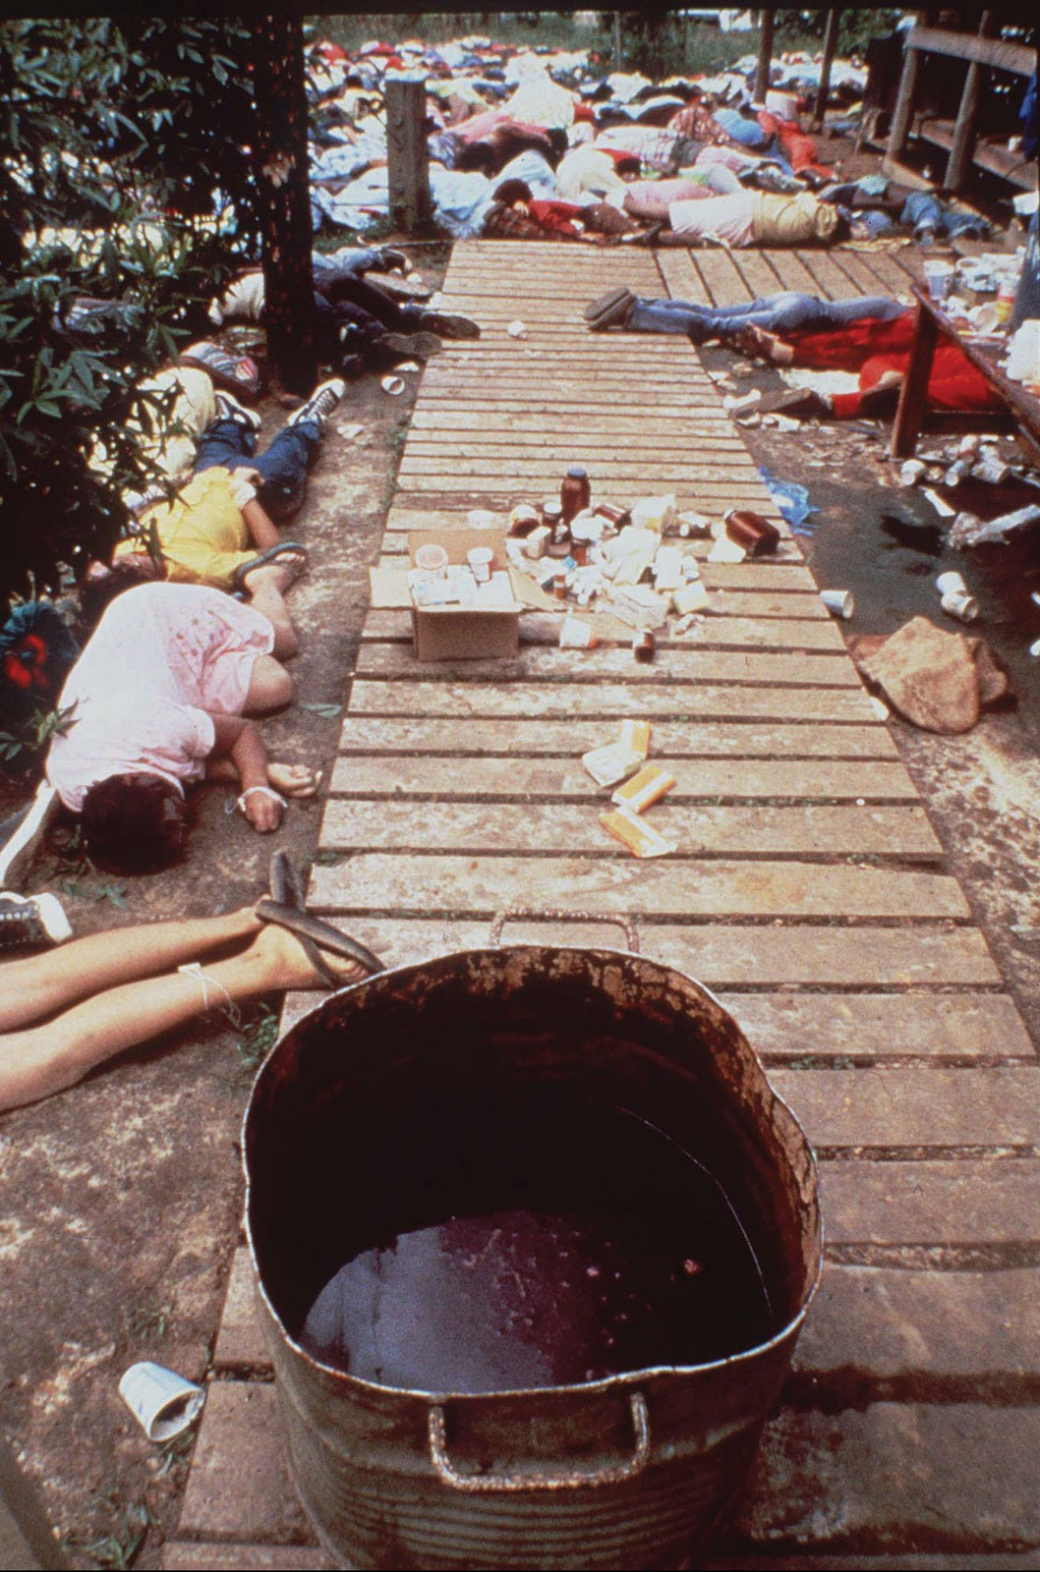
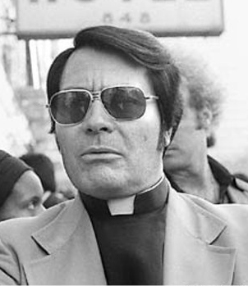
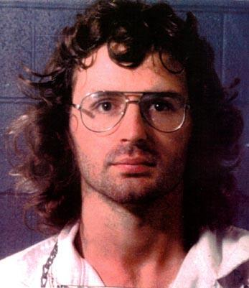
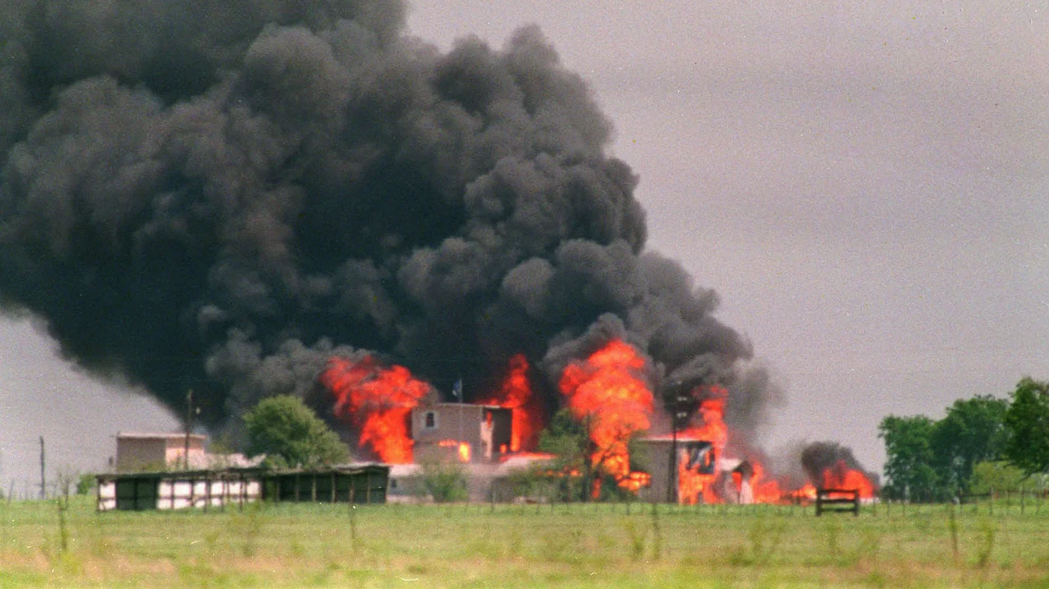
“There shall also arise false Christs, and false prophets, and shall show great signs and wonders, insomuch, that, if possible, they shall deceive the very elect, who are the elect according to the covenant.”
(Joseph Smith—Matthew 1:22)
Jim Jones and the
People’s Temple
David Koresh
and Waco
Notes:
Jim jones: https://commons.wikimedia.org/wiki/File:Jim_Jones_in_1977.jpg
By Nancy Wong
Massacre: https://www.britannica.com/topic/Peoples-Temple
By Frank Johnston/AP Images
Waco: https://www.npr.org/2013/04/20/178063471/two-decades-later-some-branch-davidians-still-believe
Susan Weems/AP Images
David koresh: https://commons.wikimedia.org/wiki/File:David_koresh.jpg
McLennan County Sheriff's Office.

Slide 19

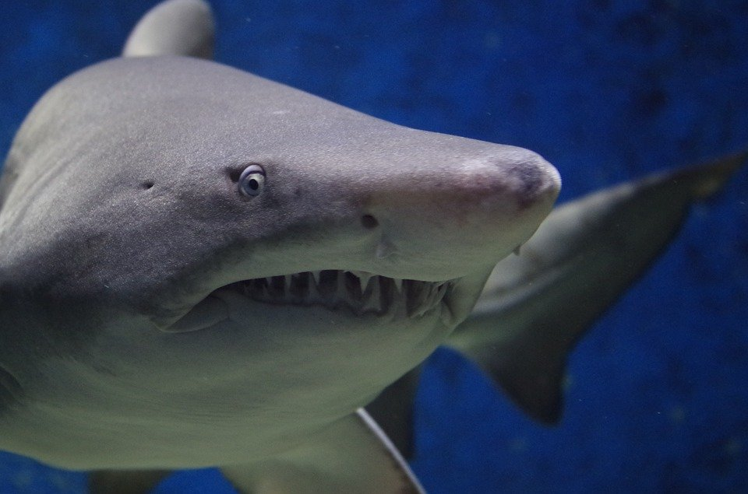
Notes:
https://pixabay.com/photos/deer-fawn-whitetail-5373523/
https://pixabay.com/photos/shark-animal-danger-teeth-fish-674867/

Slide 20
“There shall also arise false Christs, and false prophets, and shall show great signs and wonders, insomuch, that, if possible, they shall deceive the very elect, who are the elect according to the covenant.”
(Joseph Smith—Matthew 1:22)
Notes:
With all these warnings of deception, WHAT DO WE DO?

Slide 21

“There shall also arise false Christs, and false prophets, and shall show great signs and wonders, insomuch, that, if possible, they shall deceive the very elect, who are the elect according to the covenant.”
(Joseph Smith—Matthew 1:22)
Notes:
With all these warnings of deception, WHAT DO WE DO?

Slide 22
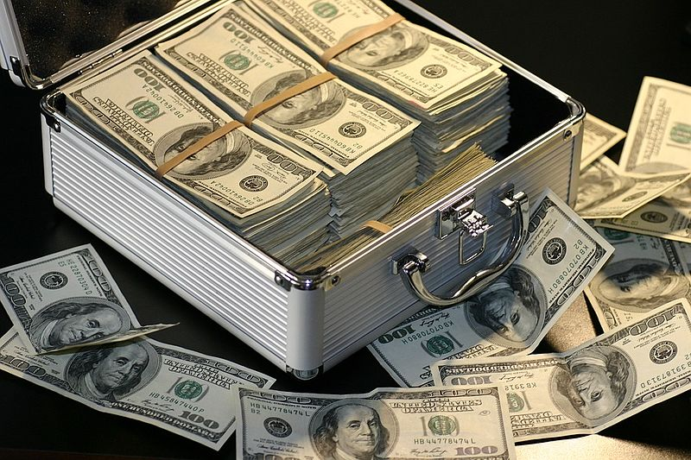
“There shall also arise false Christs, and false prophets, and shall show great signs and wonders, insomuch, that, if possible, they shall deceive the very elect, who are the elect according to the covenant.”
(Joseph Smith—Matthew 1:22)
Notes:
With all these warnings of deception, WHAT DO WE DO?

Slide 23

“There shall also arise false Christs, and false prophets, and shall show great signs and wonders, insomuch, that, if possible, they shall deceive the very elect, who are the elect according to the covenant.”
(Joseph Smith—Matthew 1:22)
Notes:
With all these warnings of deception, WHAT DO WE DO?

Slide 24

“Whoso treasureth up my word, shall not be deceived.”
(Joseph Smith—Matthew 1:37)
NiseriN
Notes:
https://www.istockphoto.com/photo/woman-holding-an-open-book-bursting-with-light-gm921871490-253127410

Slide 25
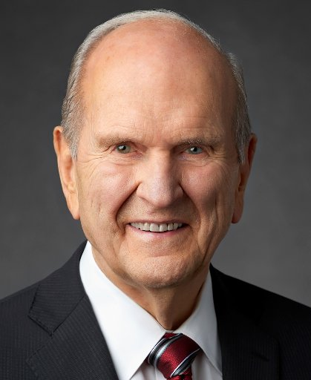
“It is now time that we each implement extraordinary measures—perhaps measures we have never taken before—to strengthen our personal spiritual foundations. Unprecedented times call for unprecedented measures…these are the latter days. If you and I are to withstand the forthcoming perils and pressures, it is imperative that we each have a firm spiritual foundation built upon the rock of our Redeemer, Jesus Christ.”
President Russell M. Nelson,
Liahona, Nov. 2021
Notes:
Jesus told us one way to strengthen our personal foundations: “Whoso treasureth up my word, shall not be deceived.”
(Joseph Smith—Matthew 1:37)

Slide 26
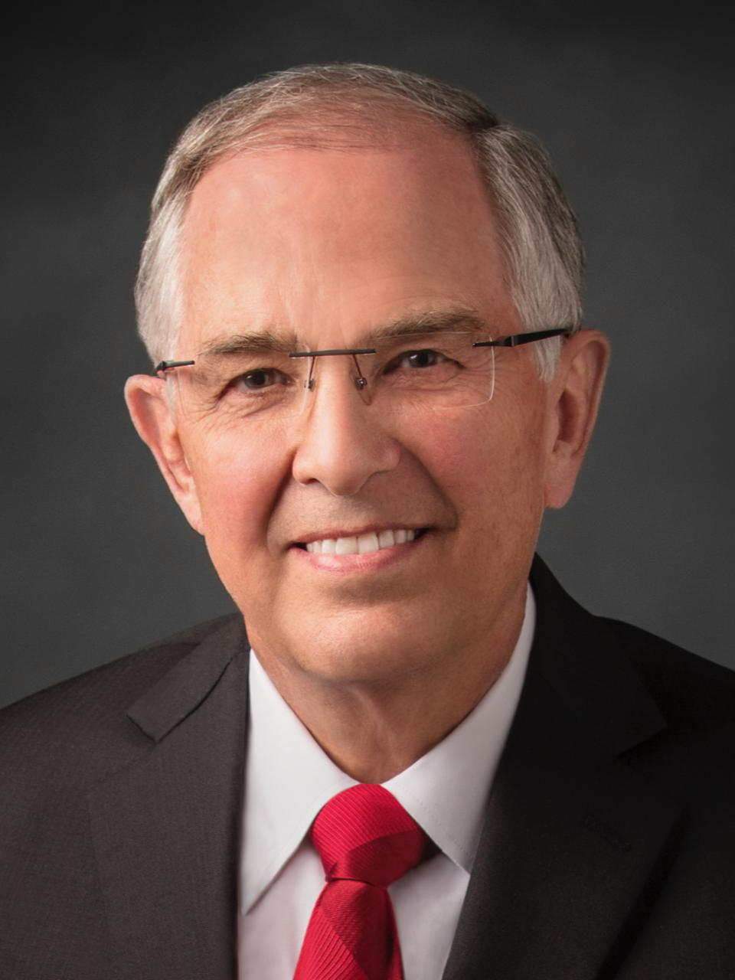
“I think it is very helpful if you begin today to learn a few of the teachings of Jesus Christ and have them in your memory….choose your own [passages to memorize]—find some things that Jesus has said and let them penetrate who you are. You won’t only remember them during your mission, but you will have them for all your life.”
Elder Neil L. Andersen,
Church News, 9 Mar. 2022
Notes:
Image: https://newsroom.churchofjesuschrist.org/ldsnewsroom/eng/background-information/leader-biographies/elder-neil-l-andersen
https://www.thechurchnews.com/leaders-and-ministry/2022-03-09/elder-andersen-mtc-shares-lists-scriptures-parables-testimonies-asks-missionaries-to-create-own-245573

Slide 27
The Savior’s Second Coming
Be not troubled
Life before the Second Coming
Be not deceived
Three parables of preparation
The last battle
After the Second Coming

Slide 28
“And as he sat upon the mount of Olives, the disciples came unto him privately, saying, Tell us, when shall these things be? and what shall be the sign of thy coming, and of the end of the world?” (Matthew 24:3)
Notice that Christ starts speaking to answer these questions in Matthew 24:4 and doesn’t stop talking until Matthew 26:1.
Matthew 24-25 is one continuous discourse from the Savior about the Second Coming.

Slide 29
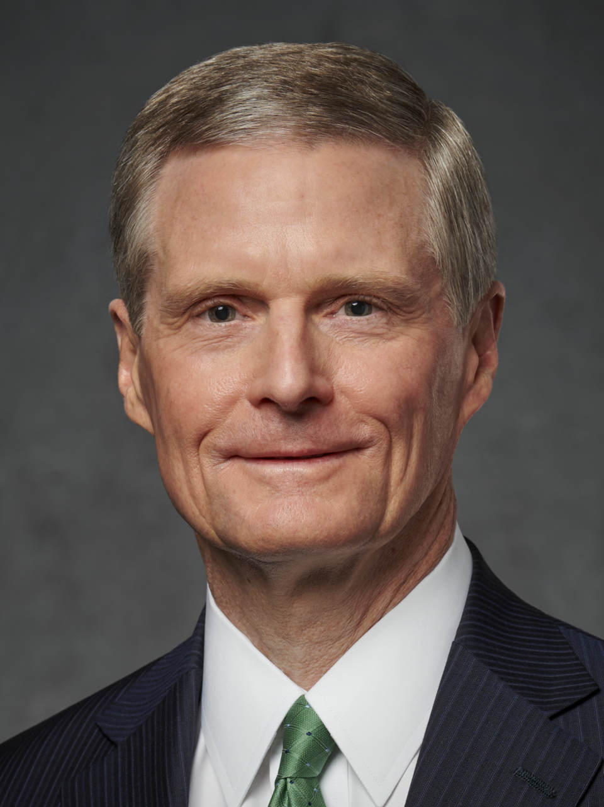
“Were the five wise virgins selfish and unwilling to share, or were they indicating correctly that the oil of conversion cannot be borrowed? Can the spiritual strength that results from consistent obedience to the commandments be given to another person? Can the knowledge obtained through diligent study and pondering of the scriptures be conveyed to one who is in need? Can the peace the gospel brings to a faithful Latter-day Saint be transferred to an individual experiencing adversity or great challenge? The clear answer to each of these questions is no.
Elder David A. Bednar
Ensign, November 2012

Slide 30
“As the wise virgins emphasized properly, each of us must “buy for ourselves.” These inspired women were not describing a business transaction; rather, they were emphasizing our individual responsibility to keep our lamp of testimony burning and to obtain an ample supply of the oil of conversion. This precious oil is acquired one drop at a time…No shortcut is available; no last-minute flurry of preparation is possible.
Elder David A. Bednar
Ensign, November 2012

Slide 31
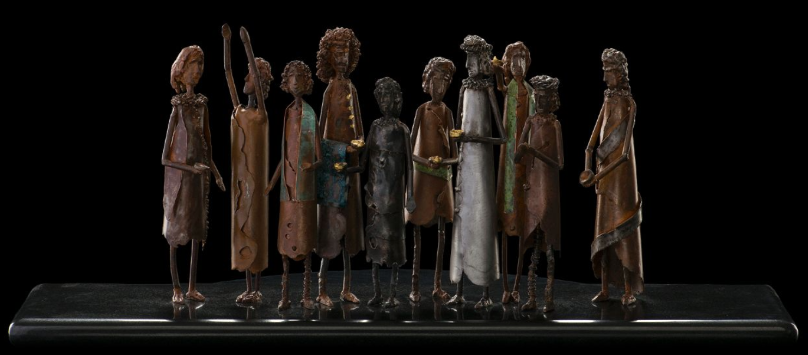
“When I shall come in my glory, shall the parable be fulfilled which I spoke concerning the ten virgins. For they that are wise and have received the truth, and have taken the Holy Spirit for their guide, and have not been deceived….shall abide the day.” (D&C 45:56-57)
Clayton Michael Lefler
Notes:
https://history.churchofjesuschrist.org/exhibit/iac-2015-tell-me-the-stories-of-jesus?lang=eng#mv51

Slide 32

As with the Parable of the Ten Virgins, the Lord refers to this parable in the Doctrine and Covenants. In section 60:2–3 he says, “But with some I am not well pleased, for they will not open their mouths, but they hide the talent which I have given unto them, because of the fear of man. Wo unto such, for mine anger is kindled against them. And it shall come to pass, if they are not more faithful unto me, it shall be taken away, even that which they have.”
Marcel Strauß
Notes:
https://unsplash.com/photos/5gJZZe48BS4

Slide 33
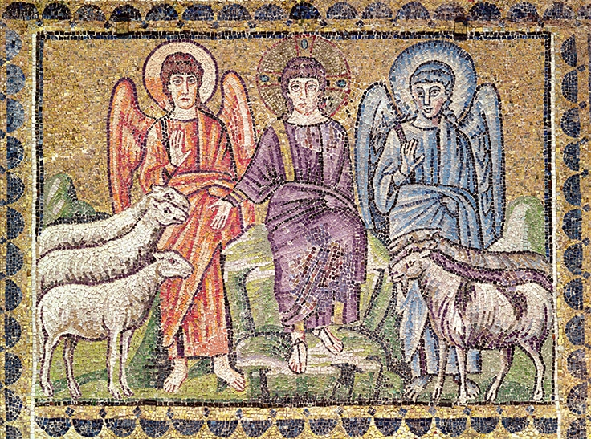
Parable of the Sheep and the Goats
Matthew 25:31-46
In Matthew, this is Jesus’ final message to His disciples before the Last Supper.
Notes:
https://commons.wikimedia.org/wiki/File:Separation_of_Sheep_and_Goats_MET_cdi24-144-4s1.jpg
From metropolitan museum of art, unknown artist

Slide 34
Matthew 25:31-46 (NRSV)
“When the Son of Man comes in his glory, and all the angels with him, then he will sit on the throne of his glory. All the nations will be gathered before him, and he will separate people one from another as a shepherd separates the sheep from the goats, and he will put the sheep at his right hand and the goats at the left. Then the king will say to those at his right hand, ‘Come, you that are blessed by my Father, inherit the kingdom prepared for you from the foundation of the world;

Slide 35
Matthew 25:31-46 (NRSV)
for I was hungry and you gave me food, I was thirsty and you gave me something to drink, I was a stranger and you welcomed me, I was naked and you gave me clothing, I was sick and you took care of me, I was in prison and you visited me.’ Then the righteous will answer him, ‘Lord, when was it that we saw you hungry and gave you food, or thirsty and gave you something to drink? And when was it that we saw you a stranger and welcomed you, or naked and gave you clothing?

Slide 36
Matthew 25:31-46 (NRSV)
And when was it that we saw you sick or in prison and visited you?’ And the king will answer them, ‘Truly I tell you, just as you did it to one of the least of these who are members of my family, you did it to me.’ Then he will say to those at his left hand, ‘You that are accursed, depart from me into the eternal fire prepared for the devil and his angels; for I was hungry and you gave me no food, I was thirsty and you gave me nothing to drink, I was a stranger and you did not welcome me,

Slide 37
Matthew 25:31-46 (NRSV)
naked and you did not give me clothing, sick and in prison and you did not visit me.’ Then they also will answer, ‘Lord, when was it that we saw you hungry or thirsty or a stranger or naked or sick or in prison, and did not take care of you?’ Then he will answer them, ‘Truly I tell you, just as you did not do it to one of the least of these, you did not do it to me.’ And these will go away into eternal punishment, but the righteous into eternal life.”

Slide 38

“Thou wilt remember the poor, and consecrate of thy properties for their support…And inasmuch as ye impart of your substance unto the poor, ye will do it unto me…For inasmuch as ye do it unto the least of these, ye do it unto me.”
(Doctrine and Covenants 42:30–31, 38)
Notes:
https://www.stockvault.net/photo/206936/humanitarian-aid CC BY 0 Author: Pixabay
Uploaded: August 12th 2016
License: Creative Commons - CC0
Dimentions: 1920 x 1393 px
File Size: 682.09 KB

Slide 39
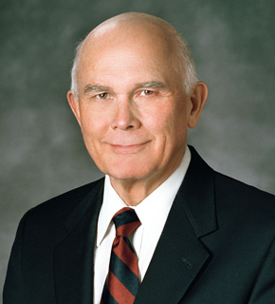

“What if the day of His coming were tomorrow? If we knew that we would meet the Lord tomorrow—through our premature death or through His unexpected coming—what would we do today? What confessions would we make? What practices would we discontinue? What accounts would we settle? What forgivenesses would we extend? What testimonies would we bear?
President Dallin H. Oaks, Ensign, May 2004, 7

Slide 40
President Dallin H. Oaks, Ensign, May 2004, 7
“If we would do those things then, why not now?”

Slide 41
The Savior’s Second Coming
Be not troubled
Life before the Second Coming
Be not deceived
Three parables of preparation
The last battle
After the Second Coming

Slide 42
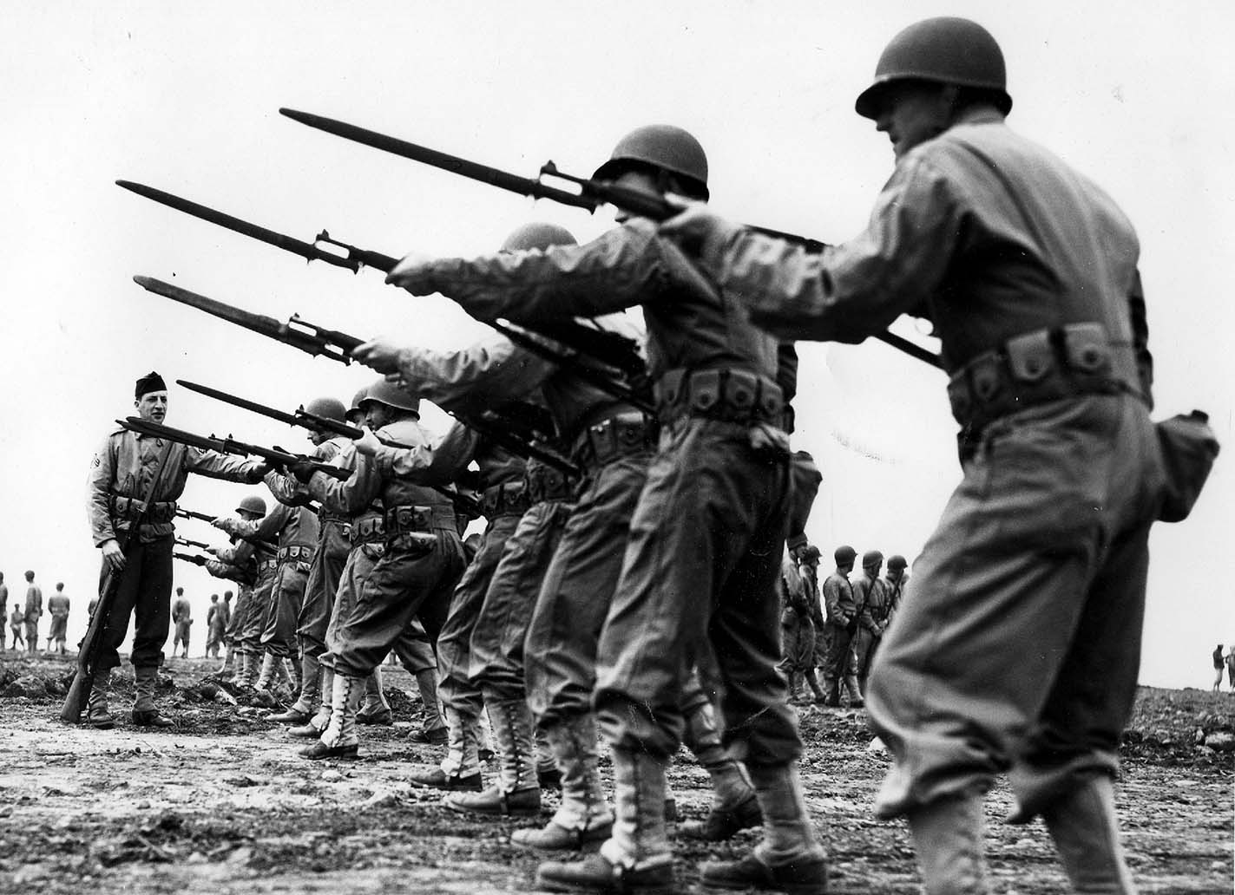

Jesus taught that as the Second Coming approaches, there “shall be heard of wars and rumors of wars, and the whole earth shall be in commotion, and men’s hearts shall fail them, and they shall say that Christ delayeth his coming until the end of the earth.”
(Doctrine and Covenants 45:26)
Naval photographer
WellGo USA
Notes:
Top: https://commons.wikimedia.org/wiki/File:Peary1943BayonetCrpd6996985447_054ffcd41d_k.jpg
By Navy Seabee Museum-Naval photographer
Bottom: https://datebook.sfchronicle.com/movies-tv/review-battle-of-jangsari-shows-the-korean-war-from-the-korean-perspective

Slide 43
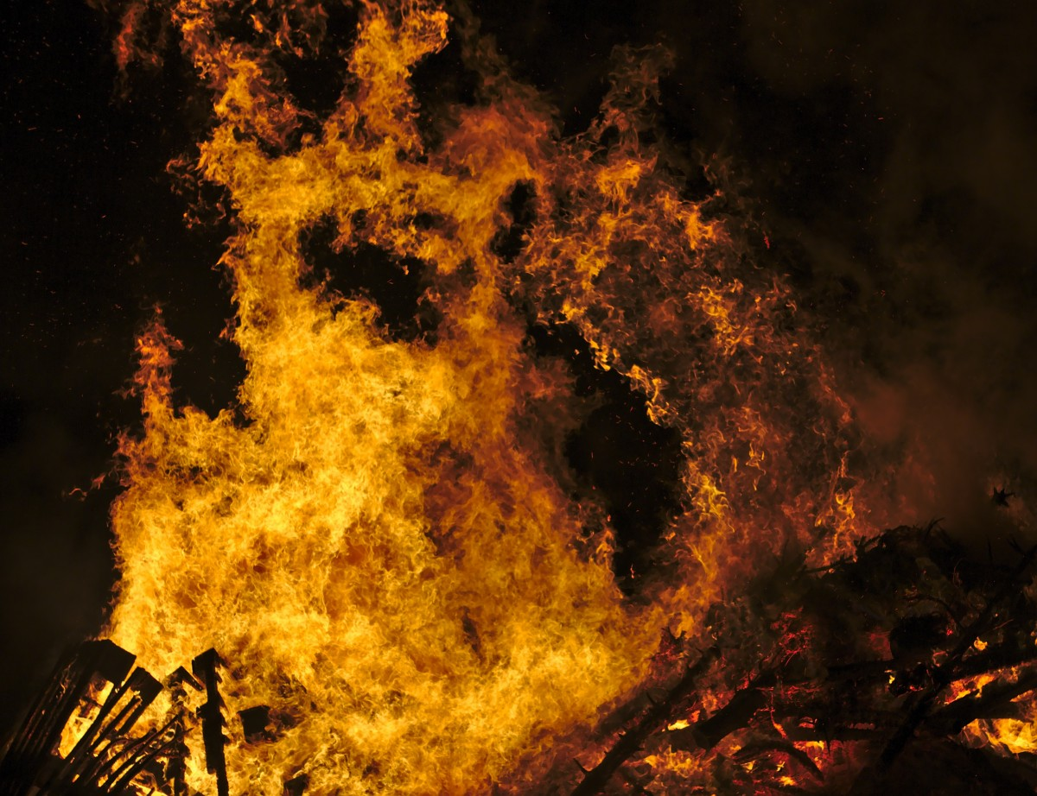
“He gathered them together into a place called in the Hebrew tongue Armageddon.”
(Revelation 16:16)
Notes:
https://pxhere.com/en/photo/766812

Slide 44
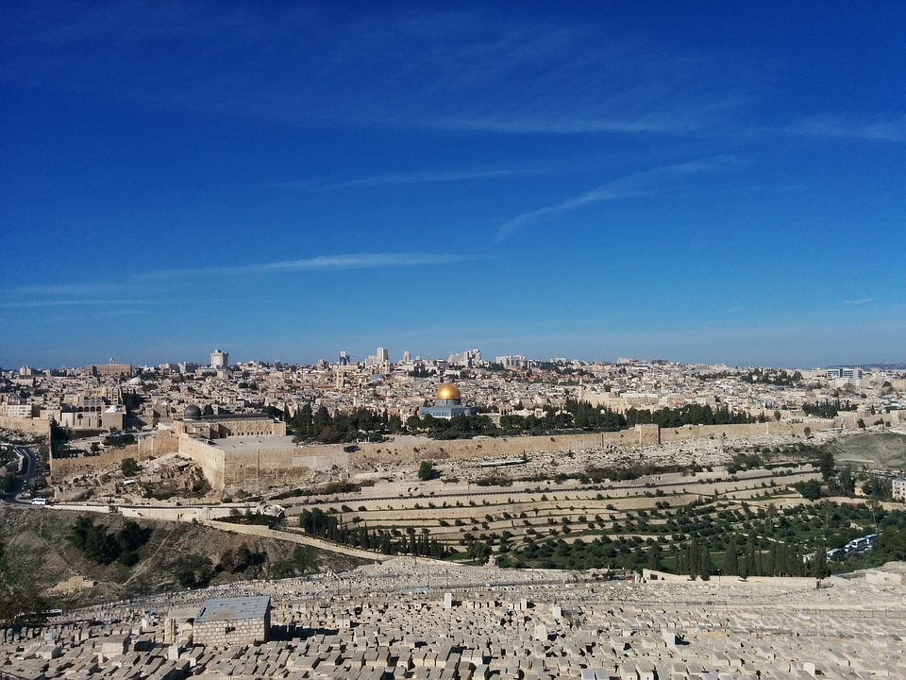
Christ Will be Triumphant in his Return
“Then shall the Lord go forth, and fight against those nations, as when he fought in the day of battle. And his feet shall stand in that day upon the mount of Olives…And the Lord shall be king over all the earth.”
(Zechariah 14:3–4, 9)
Notes:
https://pixabay.com/photos/jerusalem-the-mount-of-olives-2262550/

Slide 45
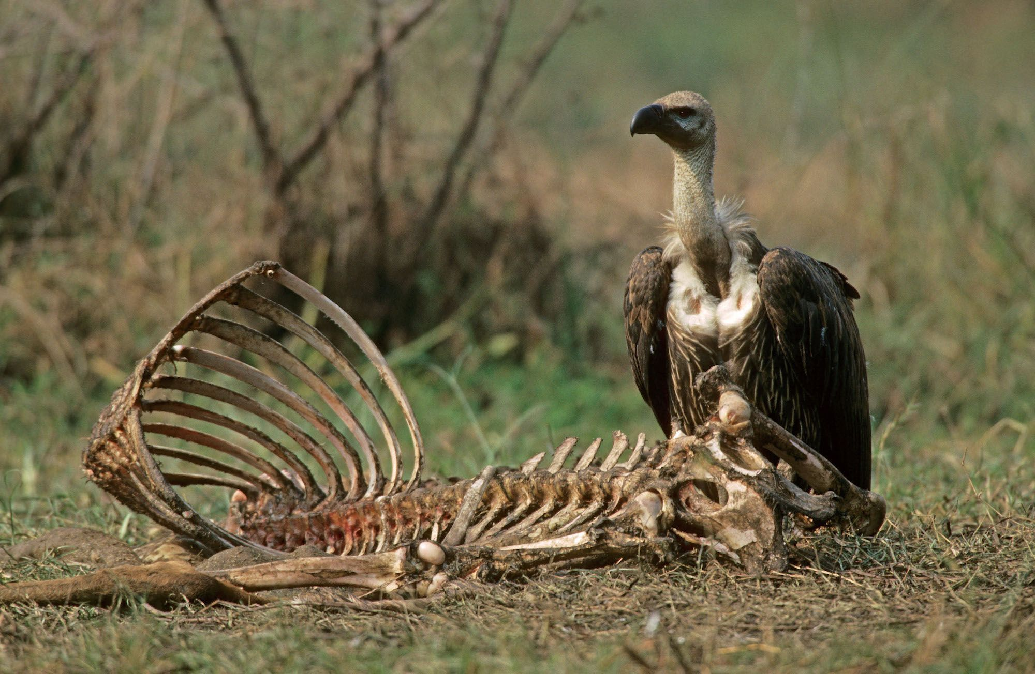
Christ Will be Triumphant in his Return
“I will smite thy bow out of thy left hand, and will cause thine arrows to fall out of thy right hand…I will give thee unto the ravenous birds of every sort, and to the beasts of the field to be devoured….So will I make my holy name known in the midst of my people Israel.” (Ezekiel 39:3–4, 7)
FLPA
Notes:
https://www.nationalgeographic.org/article/role-scavengers-carcass-crunching/

Slide 46
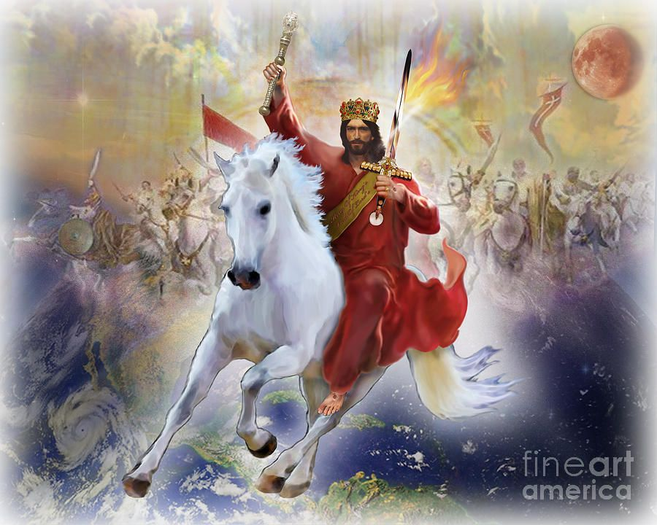
Christ Will be Triumphant in his Return
“I saw heaven opened, and behold a white horse; and he that sat upon him was called Faithful and True, and in righteousness he doth judge and make war. His eyes were as a flame of fire, and on his head were many crowns…he was clothed with a vesture dipped in blood: and his name is called The Word of God.” (Revelation 19:11-13)
Todd L Thomas
Notes:
https://fineartamerica.com/featured/the-returning-king-todd-l-thomas.html

Slide 47
Christ Will be Triumphant in his Return
“And the armies which were in heaven followed him upon white horses, clothed in fine linen, white and clean. And out of his mouth goeth a sharp sword, that with it he should smite the nations: and he shall rule them with a rod of iron.” (Revelation 19:14-16).
Todd L Thomas
Notes:
https://fineartamerica.com/featured/the-returning-king-todd-l-thomas.html

Slide 48
Christ Will be Triumphant in his Return
“I saw the beast, and the kings of the earth, and their armies, gathered together to make war against him that sat on the horse, and against his army. And the beast was taken, and with him the false prophet that wrought miracles before him, with which he deceived them that had received the mark of the beast, and them that worshipped his image.
Todd L Thomas
Notes:
https://fineartamerica.com/featured/the-returning-king-todd-l-thomas.html

Slide 49
Christ Will be Triumphant in his Return
“These both were cast alive into a lake of fire burning with brimstone. And the remnant were slain with the sword of him that sat upon the horse, which sword proceeded out of his mouth.”
(Revelation 19:19–21)
Todd L Thomas
Notes:
https://fineartamerica.com/featured/the-returning-king-todd-l-thomas.html

Slide 50
The Savior’s Second Coming
Be not troubled
Life before the Second Coming
Be not deceived
Three parables of preparation
The last battle
After the Second Coming

Slide 51
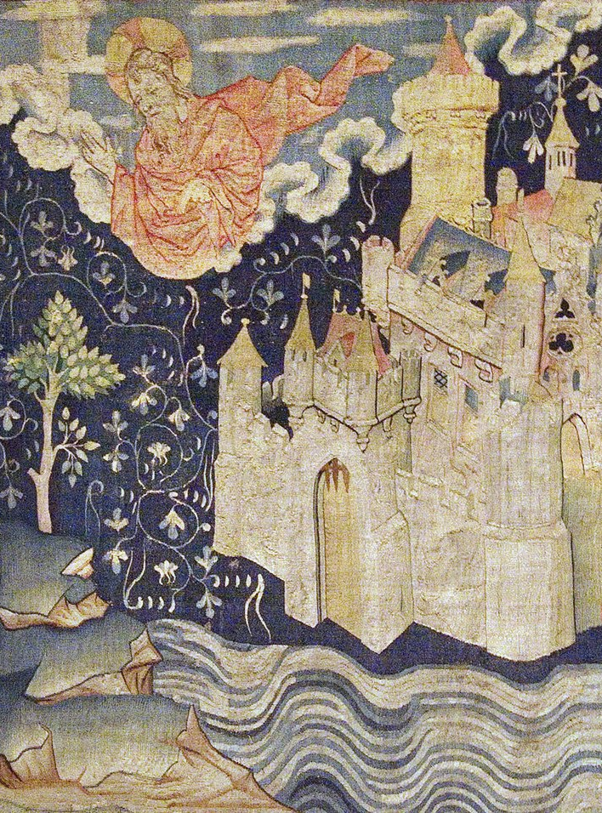
“I…saw the holy city, new Jerusalem, coming down from God out of heaven, prepared as a bride adorned for her husband. And I heard a great voice out of heaven saying, Behold, the tabernacle of God is with men, and he will dwell with them, and they shall be his people, and God himself shall be with them, and be their God. And God shall wipe away all tears from their eyes;
Notes:
Note the intimacy of wiping away a tear.
https://commons.wikimedia.org/wiki/File:La_J%C3%A9rusalem_c%C3%A9leste_(2).jpg
Image by Octave 444
Unknown artist

Slide 52
“And there shall be no more death, neither sorrow, nor crying, neither shall there be any more pain: for the former things are passed away. And he that sat upon the throne said, Behold, I make all things new.” (Revelation 21:2–5)
Notes:
https://commons.wikimedia.org/wiki/File:La_J%C3%A9rusalem_c%C3%A9leste_(2).jpg
Image by Octave 444
Unknown artsit

Slide 53
Galilean Villages | Elite Roman Cities | The New Jerusalem
No city walls

Slide 54
Galilean Villages | Elite Roman Cities | The New Jerusalem
No city walls | Large city walls (Ephesus = 5.5 miles, Rome = 7 mile perimeter, 33 feet tall)

Slide 55
Galilean Villages | Elite Roman Cities | The New Jerusalem
No city walls | Large city walls (Ephesus = 5.5 miles, Rome = 7 mile perimeter, 33 feet tall) | City walls have a perimeter of 6,000 miles and are 1,500 miles high (Rev. 21:16)

Slide 56
Galilean Villages | Elite Roman Cities | The New Jerusalem
No city walls | Large city walls (Ephesus = 5.5 miles, Rome = 7 mile perimeter, 33 feet tall) | City walls have a perimeter of 6,000 miles and are 1,500 miles high (Rev. 21:16)
Dirt roads

Slide 57
Galilean Villages | Elite Roman Cities | The New Jerusalem
No city walls | Large city walls (Ephesus = 5.5 miles, Rome = 7 mile perimeter, 33 feet tall) | City walls have a perimeter of 6,000 miles and are 1,500 miles high (Rev. 21:16)
Dirt roads | Stone roads

Slide 58
Galilean Villages | Elite Roman Cities | The New Jerusalem
No city walls | Large city walls (Ephesus = 5.5 miles, Rome = 7 mile perimeter, 33 feet tall) | City walls have a perimeter of 6,000 miles and are 1,500 miles high (Rev. 21:16)
Dirt roads | Stone roads | Streets of pure gold (Rev. 21:21)

Slide 59
Galilean Villages | Elite Roman Cities | The New Jerusalem
No city walls | Large city walls (Ephesus = 5.5 miles, Rome = 7 mile perimeter, 33 feet tall) | City walls have a perimeter of 6,000 miles and are 1,500 miles high (Rev. 21:16)
Dirt roads | Stone roads | Streets of pure gold (Rev. 21:21)
No running water

Slide 60
Galilean Villages | Elite Roman Cities | The New Jerusalem
No city walls | Large city walls (Ephesus = 5.5 miles, Rome = 7 mile perimeter, 33 feet tall) | City walls have a perimeter of 6,000 miles and are 1,500 miles high (Rev. 21:16)
Dirt roads | Stone roads | Streets of pure gold (Rev. 21:21)
No running water | Aqueducts

Slide 61
Galilean Villages | Elite Roman Cities | The New Jerusalem
No city walls | Large city walls (Ephesus = 5.5 miles, Rome = 7 mile perimeter, 33 feet tall) | City walls have a perimeter of 6,000 miles and are 1,500 miles high (Rev. 21:16)
Dirt roads | Stone roads | Streets of pure gold (Rev. 21:21)
No running water | Aqueducts | A fountain of living water flowing through the city (Rev. 21:6)

Slide 62
Galilean Villages | Elite Roman Cities | The New Jerusalem
No city walls | Large city walls (Ephesus = 5.5 miles, Rome = 7 mile perimeter, 33 feet tall) | City walls have a perimeter of 6,000 miles and are 1,500 miles high (Rev. 21:16)
Dirt roads | Stone roads | Streets of pure gold (Rev. 21:21)
No running water | Aqueducts | A fountain of living water flowing through the city (Rev. 21:6)
No temple | Temples to represent the houses of various gods

Slide 63
Galilean Villages | Elite Roman Cities | The New Jerusalem
No city walls | Large city walls (Ephesus = 5.5 miles, Rome = 7 mile perimeter, 33 feet tall) | City walls have a perimeter of 6,000 miles and are 1,500 miles high (Rev. 21:16)
Dirt roads | Stone roads | Streets of pure gold (Rev. 21:21)
No running water | Aqueducts | A fountain of living water flowing through the city (Rev. 21:6)
No temple | Temples to represent the houses of various gods | There is no temple because Jesus himself lives there (Rev. 21:22)

Slide 64
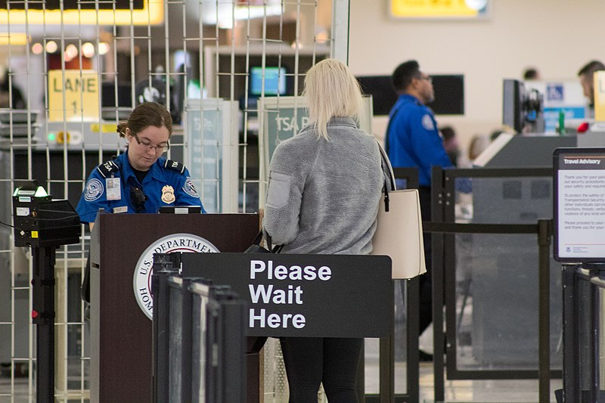
Notes:
https://commons.wikimedia.org/wiki/File:Transportation_Security_Administration_Checkpoint_at_John_Glenn_Columbus_International_Airport.jpg

Slide 65
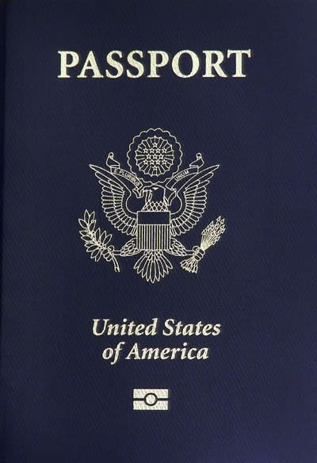
Notes:
https://commons.wikimedia.org/wiki/File:Us-passport.jpg

Slide 66
Notes:
https://commons.wikimedia.org/wiki/File:Us-passport.jpg

Slide 67
“The gates of [the New Jerusalem] shall not be shut…And there shall in no wise enter into it any thing that defileth, neither whatsoever worketh abomination, or maketh a lie: but they which are written in the Lamb’s book of life.” (Revelation 21:25)
Notes:
https://commons.wikimedia.org/wiki/File:La_J%C3%A9rusalem_c%C3%A9leste_(2).jpg
Image by Octave 444

Slide 68
Those who “do [Christ’s] commandments… have right to the tree of life, and may enter in through the gates into the city.”
(Revelation 22:14)
Notes:
https://commons.wikimedia.org/wiki/File:La_J%C3%A9rusalem_c%C3%A9leste_(2).jpg
Image by Octave 444

Slide 69

LRW2020
“In the midst of the street of [the New Jerusalem]…was… the tree of life, which bare twelve manner of fruits, and yielded her fruit every month: and the leaves of the tree were for the healing of the nations.” (Revelation 22:2)
Notes:
https://commons.wikimedia.org/wiki/File:Crystal_Tree_of_Life.png

Slide 70
Acknowledgements
Insights from, discussions with, and resources authored by Dr. Craig Koester, Dr. Nick Frederick, Dr. Mark Ellison, Dr. Stephan Taeger, and Dr. Frank Judd were used in the creation of this video.

